Slide 1
Future Research Infrastructures: Challenges and Opportunities
Status and perspectives
of bio-medical and medical research
with accelerators
Alberto Bravin
ID17 biomedical beamline
European Synchrotron Radiation Facility Grenoble
Varenna, Villa Monastero 10 July 2015

Slide 2
The accelerator tree
Particle accelerators have a large impact on society: the most directly impacting the people life are the diagnosis of various diseases and radiation therapy
Accelerators
Proton therapy
Ion therapy
Neutron therapy
Medical applications of synchrotrons
Proton imaging
Accelerator-based neutron sources
glasses
ceramics
Imaging & therapy
Cultural
heritage
material science
Ionic implantation
Synchrotron radiation sources (X-rays)
Semiconductor doping
crystallography
spectroscopy
X-ray therapy
X-ray imaging
Radio-isotopes
Electron accelerators
Cyclotrons
Electron therapy

Slide 3
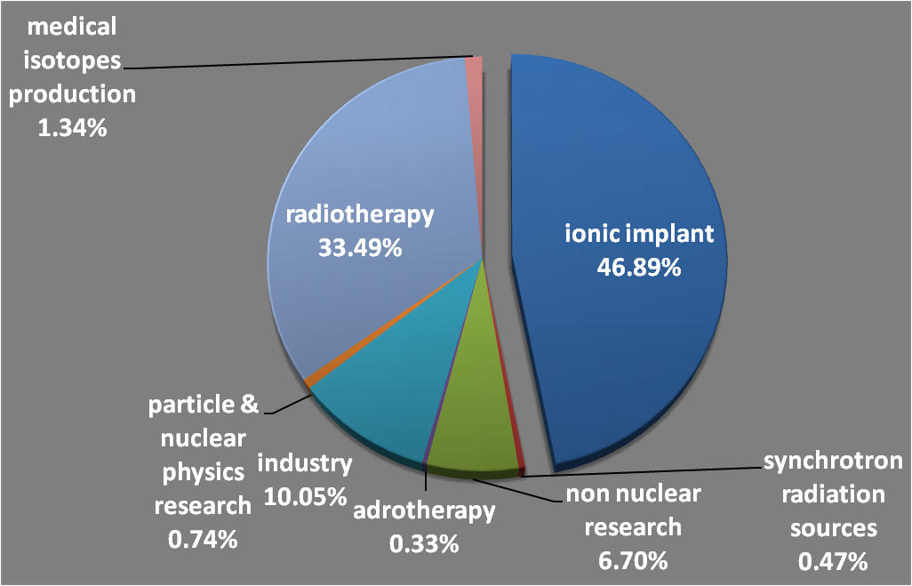
Accelerators in the world
About 15000 active accelerators
Medically dedicated or related applications: ~ 40% of the total

Slide 4
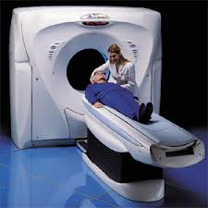
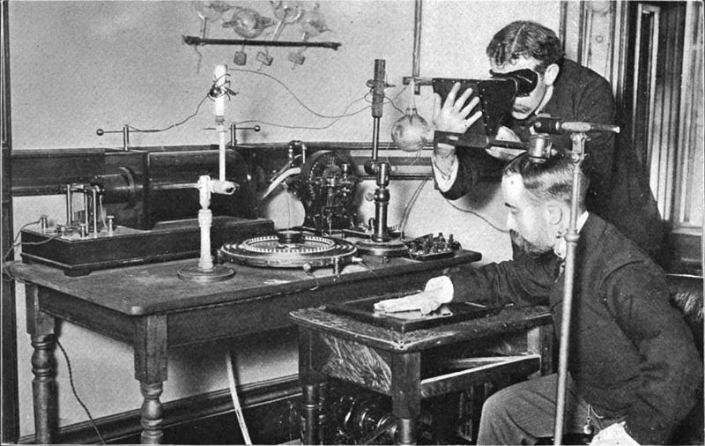
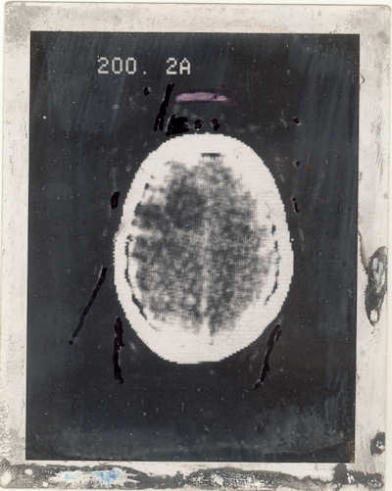
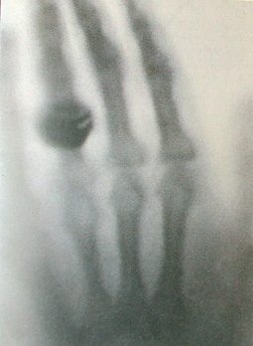
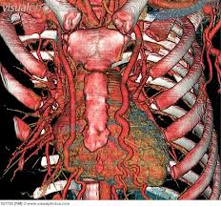
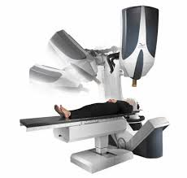
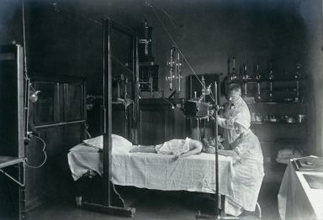
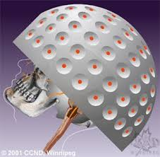
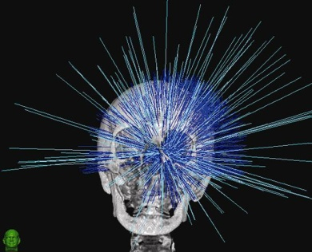
diagnostics and therapy
Imaging….
CT Hounsfield
Spiral CT
1895?
1949
1971
today
1896
… and therapy
Radiotherapy at Children hospital, Vienna, 1921
Stereotaxic radiosurgery
Leksell
Cyberknife

Slide 5
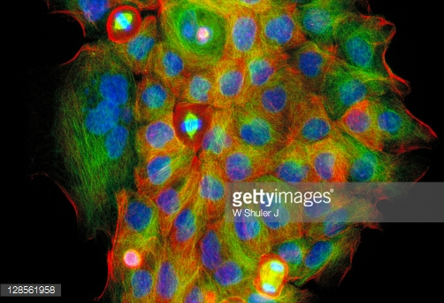
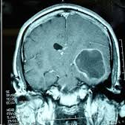
Cancer treatment
Management of cancer is done by:
- surgery
chemotherapy
- radiotherapy
About 50% of all cancer patients will undergo radiation therapy often in conjunction with other treatments.
The most common form of radiation therapy is external beam radiotherapy where a beam of radiation is fired into the body by a particle accelerator.
Human cancer cells. Source: W. Shuler
Which dose in radiation therapy?
Highest possible dose to the tumor up to the tolerable side effects on normal tissues
Concentrate as much as possible the dose in the tumor
MRI image with brain cancer signature

Slide 6
The accelerator tree
Particle accelerators have a large impact on society: the most directly impacting the people life are the diagnosis of various diseases and radiation therapy
Accelerators
Proton therapy
Ion therapy
Neutron therapy
Medical applications of synchrotrons
Proton imaging
Accelerator-based neutron sources
glasses
ceramics
Imaging & therapy
Cultural
heritage
material science
Ionic implantation
Synchrotron radiation sources (X-rays)
Semiconductor doping
crystallography
spectroscopy
X-ray therapy
X-ray imaging
Radio-isotopes
Electron accelerators
Cyclotrons
Electron therapy

Slide 7
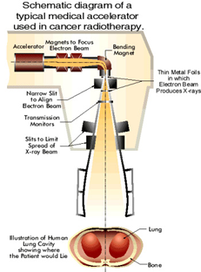
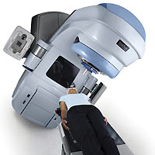
Conventional X-ray radiation therapy by linac accelerators
X-rays and electrons
Energy range: 4 MeV - 25 MeV
X-ray by Bremsstrahlung
World leader: Varian Medical Systems

Slide 8
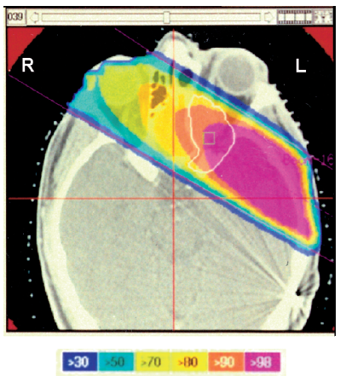
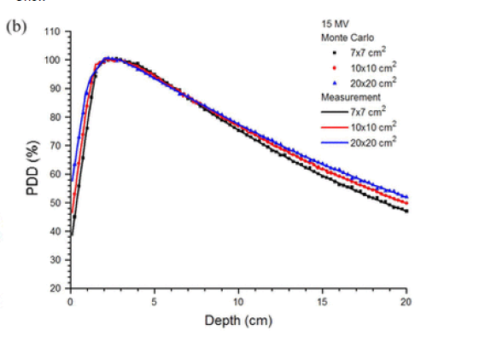
Dose prescription and distribution in x-ray therapy
20-80 Grays over 2-3 weeks; range depends on:
                - tumor location
                - age
                - tumor type
                - volume
Energy deposition:
% dose deposition with depth
Treatment planning and dose deposition
Chow et al. J.Appl. Cl. Med Phys, Vol 12, No 1 (2011)

Slide 9
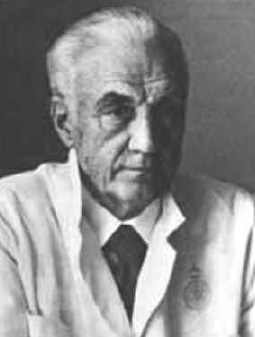
Stereotactic radiation: Gamma knife and cyber knife
to provide higher treatment accuracy (0.3 mm)
more dose to the tumor, less to the surrounding tissues
Leksell (1951): 250 kV X-ray tube source.
(1968): the Gamma knife was available
Leksell, Karolinska Inst.
Stockholm
  Collimator helmets + 201 Co⁶⁰ sources
Dose Rate 300 cGy/min
NO ACCELERATOR

Slide 10
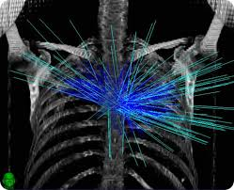
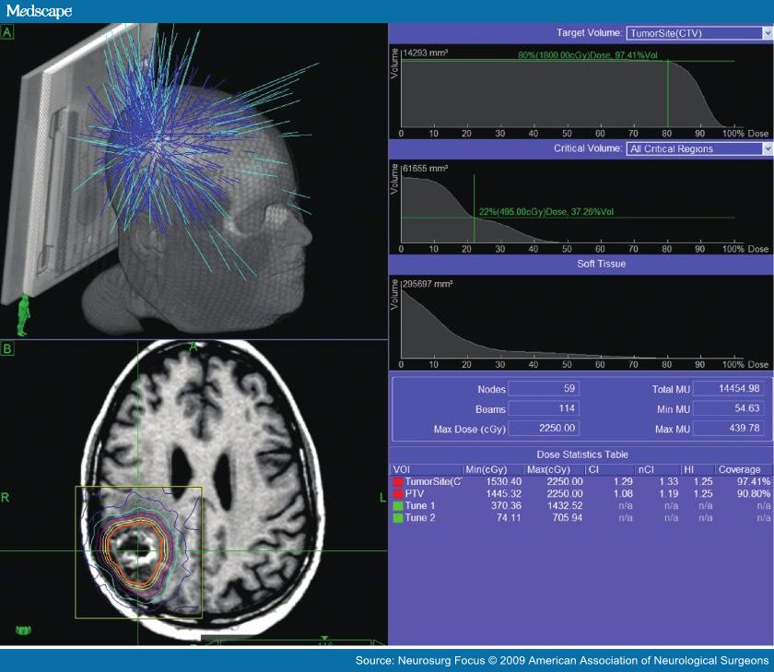
Cyber knife
- Cyber knife: evolution of the gamma knife
State of the art machine (<< 100 in Europe nowadays)
6 MeV accelerator
Heart beat and respiration gated

Slide 11
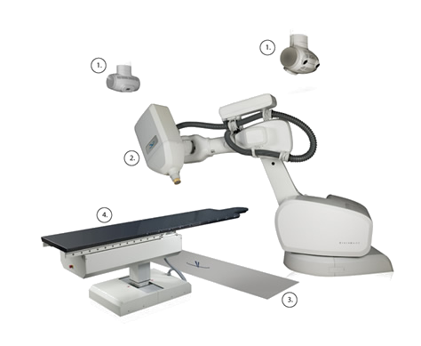
Cyber knife
Roof mounted KV X-ray
Robotic arm with 6 degrees of freedon
6 MV LINAC
Circular Collimator attached to head
Frameless patient immobilization couch
Floor mounted Amorphous silicon detectors

Slide 12
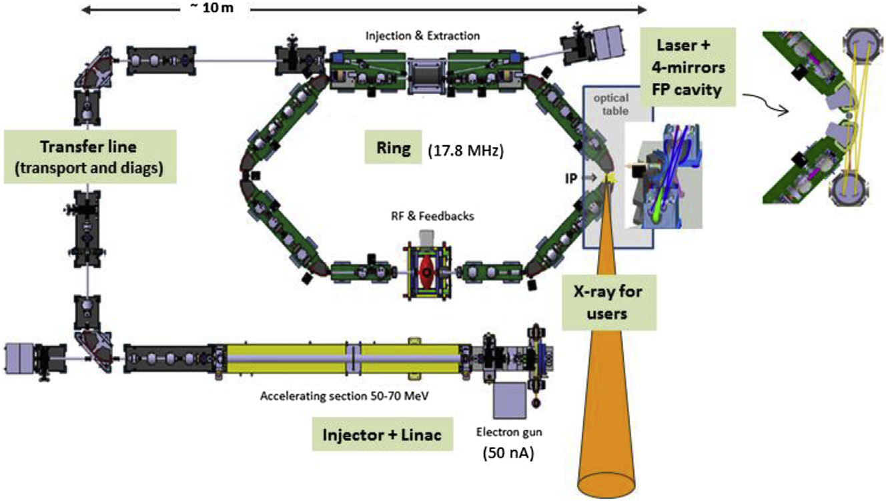
Compton scattering based sources
See presentation by L. Serafini (yesterday)
Why interesting in medicine?
- Energy tuneability
- Quasi monochromaticity
- Imaging-Therapy
- Link between present imaging techniques and therapies those under development at Synchrotron Radiation Sources
M. Jacquet and P. Suortti, Physica Medica, 2015

Slide 13
The accelerator tree
Particle accelerators have a large impact on society: the most directly impacting the people life are the diagnosis of various diseases and radiation therapy
Accelerators
Proton therapy
Ion therapy
Neutron therapy
Medical applications of synchrotrons
Proton imaging
Accelerator-based neutron sources
glasses
ceramics
Imaging & therapy
Cultural
heritage
material science
Ionic implantation
Synchrotron radiation sources (X-rays)
Semiconductor doping
crystallography
spectroscopy
X-ray therapy
X-ray imaging
Radio-isotopes
Electron accelerators
Cyclotrons
Electron therapy

Slide 14
Particle therapy (hadrontherapy)
Particle therapy is a form of external beam radiotherapy using beams of energetic protons, neutrons (hadrontherapy) or positive ions for cancer treatment .
neutrons produced by neutron generators and cyclotrons
- protons produced by cyclotrons and synchrotrons
heavy ions (He, C, N, Ar, Ne) produced by synchro -cyclotrons and synchrotrons
pi meson beams (Los Alamos, PSI, TRIUMF, all terminated in the ’90ies)
Which dose in radiation therapy?
Highest possible dose to the tumor up to the tolerable side effects on normal tissues
Concentrate as much as possible the dose in the tumor
1938 Neutron therapy by John Lawrence and R.S. Stone (Berkeley)
1946 R. Wilson (Harvard) suggests protons*; first patient (1954) in Berkeley
1988 Proton therapy approved by FDA
* Wilson, R.R. “Radiological use of fast protons,” Radiology 47, 487

Slide 15
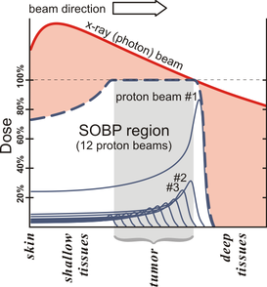
hadrontherapy
- The energy loss (dose deposition) increases while the particle slows down, up to a maximum over the last few millimeters of the particle’s range (the Bragg peak), and it then drops to (almost) zero.
Biological effect of a radiation (its relative biological effectiveness, RBE) depends on its average Linear Energy Transfer which is much higher for hadrons than X-rays
To treat tumors, proton energy is tuned typically in the range of 70 to 250 MeV to move the depth of the Bragg peak
Protons LET < Ions LET
Ions: larger biological effect

Slide 16
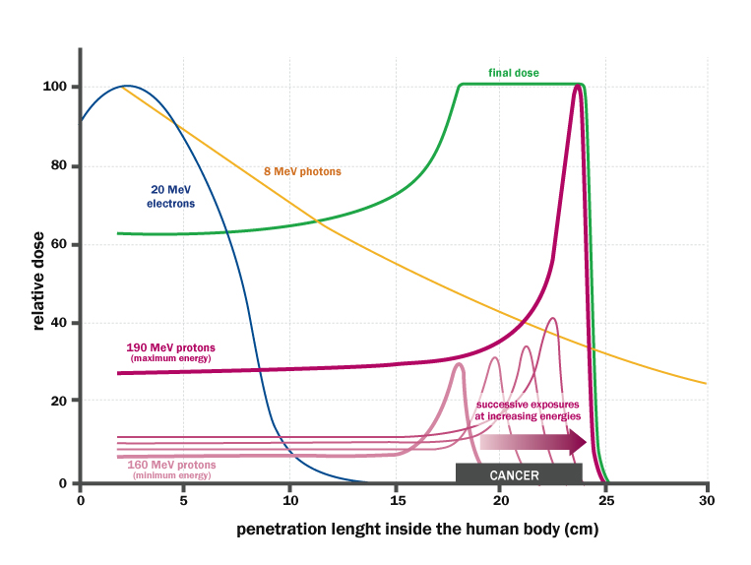
Comparison of different radiation types for therapy
Comparison of relative dose deposition by different radiation types

Slide 17
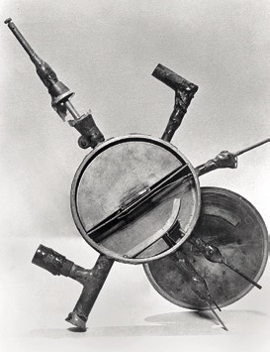
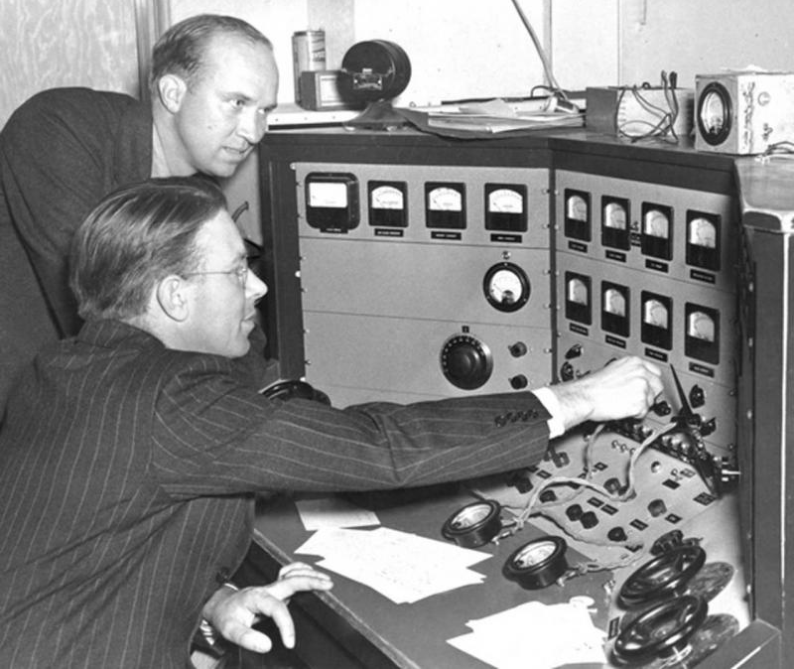
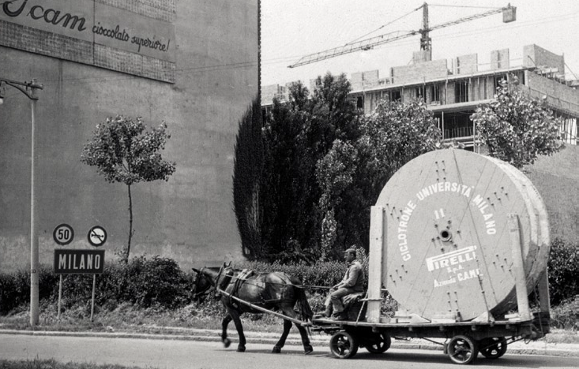
Cyclotrons for proton therapy
John & Ernest Lawrence first used protons from cyclotron to treat cancer(Lawrence Berkeley National Laboratory, 1954)
First cyclotron constructed in 1931
by E. Lawrence
Transport of the cables for the first cyclotron in Milan
(18 – 45 MeV)

Slide 18
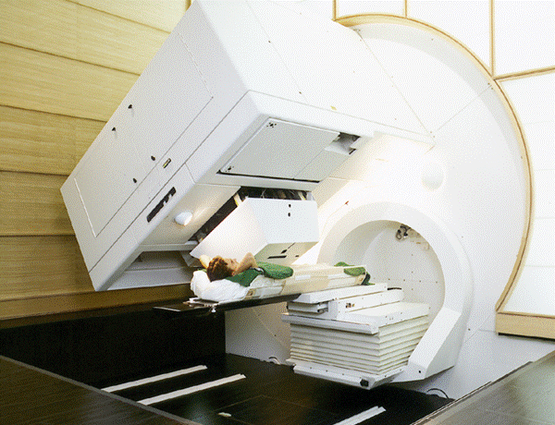
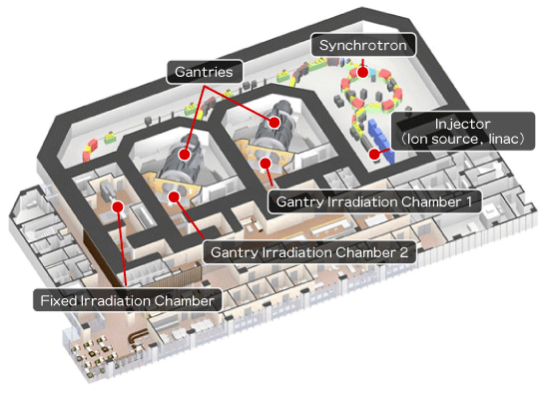
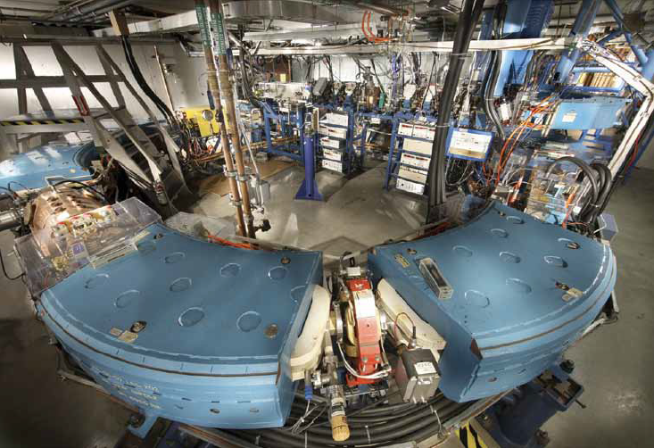
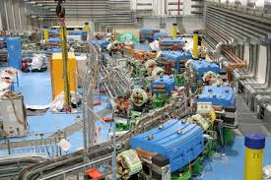
Proton therapy centers
Proton beam gantry, Paul Scherrer Institute (PSI) in Switzerland.
Nagoya proton therapy center, Japan
CNAO Center, Pavia
The Loma Linda Medical Center proton accelerator: > 17,000 patients treated since 1990.

Slide 19
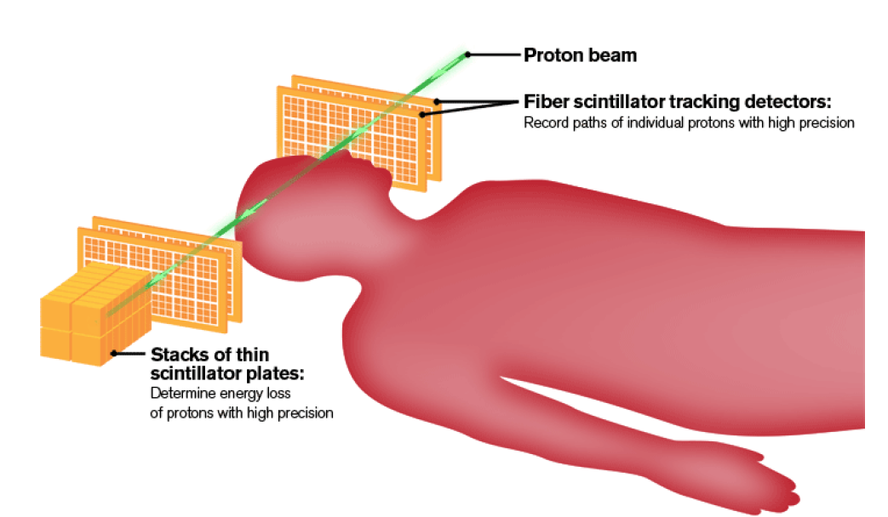
Proton computerized tomography (pCT)
Statements (to be further proved) that pCT can reduce the dose delivered for one image vs X-rays
Increase the precision of the therapy: proton therapy delivered without moving and repositioning the patient! Gain up to millimeters in precision!
---> smaller irradiated target
---> higher doses can be delivered
---->better tumor control

Slide 20
The accelerator tree
Particle accelerators have a large impact on society: the most directly impacting the people life are the diagnosis of various diseases and radiation therapy
Accelerators
Proton therapy
Ion therapy
Neutron therapy
Medical applications of synchrotrons
Accelerator-based neutron sources
Proton imaging
glasses
ceramics
Imaging & therapy
Cultural
heritage
material science
Ionic implantation
Synchrotron radiation sources (X-rays)
Semiconductor doping
crystallography
spectroscopy
X-ray therapy
X-ray imaging
Radio-isotopes
Electron accelerators
Cyclotrons
Electron therapy

Slide 21
Neutron therapy
Neutrons can be produced in a cyclotron by accelerating deuterons or protons and impinging them on a beryllium target.
Protons or deuterons must be accelerated to ≥50 MeV to produce neutron beams with penetration comparable to megavoltage x-rays. Neutrons are high LET therapy
⁹₄Be
¹⁰₅B
body
p
n
n
Why neutrons? Effective on some radioresistant tumors, hypoxic (dose deposition by neutron less influenced by Oxygen presence)
Prescription for limited number of tumors

Slide 22
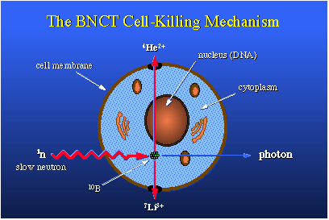
Boron neutron capture therapy
Patients are given an intravenous injection of a ¹⁰B tagged chemical that preferentially binds to tumor cells.
Irradiation of the target by thermal – epithermal neutrons (0.004-10 keV).
α and Li⁺ (slow, high LET) create the damage to the DNA.
Credits: http://jittdl.physics.iupui.edu

Slide 23
Accelerator based neutron sources
All BNCT clinical trials have used fission reactor neutron sources
Several accelerator based neutron sources are under development
- More compact and less expensive
- Better perceived by society
Cons:
- Smaller fluxed than reactor
First for clinical accelerator-based BNCT: Sumitomo Heavy Industries, approved by Japanese Ministry of Health, Labour, and Welfare (8 MeV, 10 mA Linac system)
Barth et al. Radiation Oncology 2012, 7:146

Slide 24
The accelerator tree
Particle accelerators have a large impact on society: the most directly impacting the people life are the diagnosis of various diseases and radiation therapy
Accelerators
Proton therapy
Ion therapy
Neutron therapy
Medical applications of synchrotrons
Accelerator-based neutron sources
Proton imaging
glasses
ceramics
Imaging & therapy
Cultural
heritage
material science
Ionic implantation
Synchrotron radiation sources (X-rays)
Semiconductor doping
crystallography
spectroscopy
X-ray therapy
X-ray imaging
Radio-isotopes
Electron accelerators
Cyclotrons
Electron therapy

Slide 25
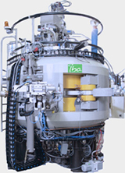
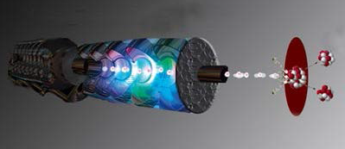
Cyclotrons for isotope production
Radiopharmaceuticals are radioisotopes (gamma ray(s) and/or alpha or beta particles emitters) used mainly in diagnostics
Use:
SPECT (Single Photon Emission Computed Tomography)
PET (Positron Emission Tomography)
Two largely produced/used radiopharmaceuticals (>90 %) are:
¹⁸F positron emitter with a half life of 109 minutes, produced from ¹⁸O
^{99m}Tc gamma emitter, with a half-life of only 6 hours
World leader: IBA – radiopharma

Slide 26
The accelerator tree
Particle accelerators have a large impact on society: the most directly impacting the people life are the diagnosis of various diseases and radiation therapy
Accelerators
Proton therapy
Ion therapy
Neutron therapy
Medical applications of synchrotrons
Accelerator-based neutron sources
Proton imaging
glasses
ceramics
Imaging & therapy
Cultural
heritage
material science
Ionic implantation
Synchrotron radiation sources (X-rays)
Semiconductor doping
crystallography
spectroscopy
X-ray therapy
X-ray imaging
Radio-isotopes
Electron accelerators
Cyclotrons
Electron therapy

Slide 27
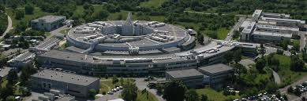
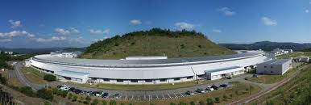
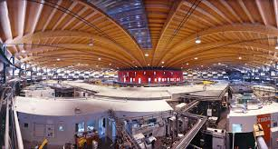
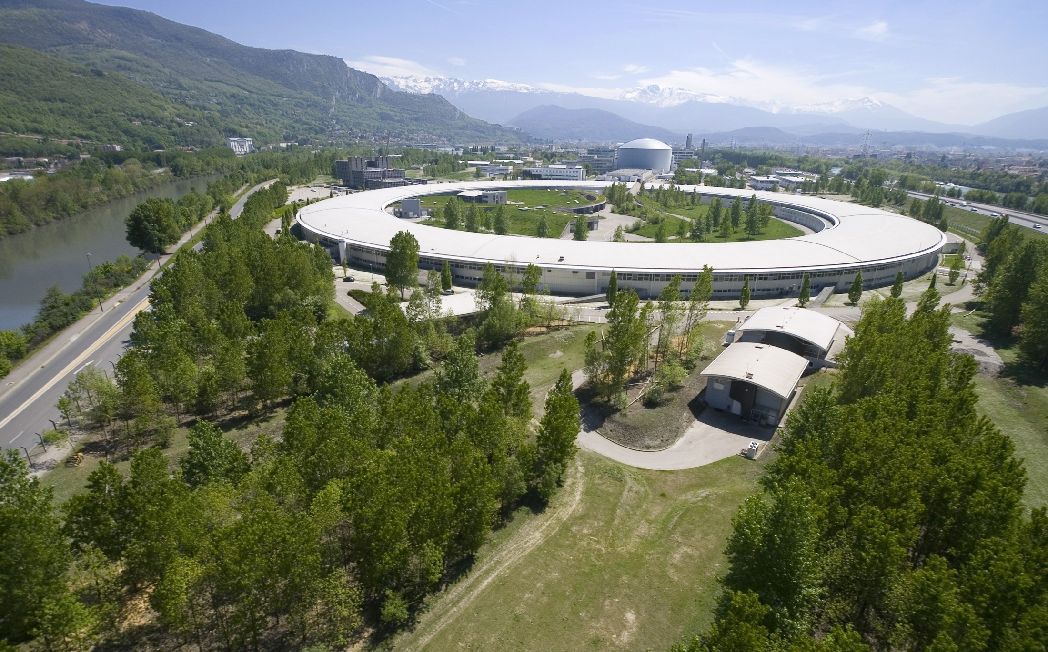
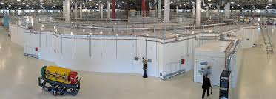
SR sources with BioMedical programs
Spring 8- Japan
SYRMEP @ Elettra, Trieste
TOMCAT @PSI Villigen
ID17 BioMedical beamline
@ESRF Grenoble
IMBL @ Australian L.S. Melbourne

Slide 28
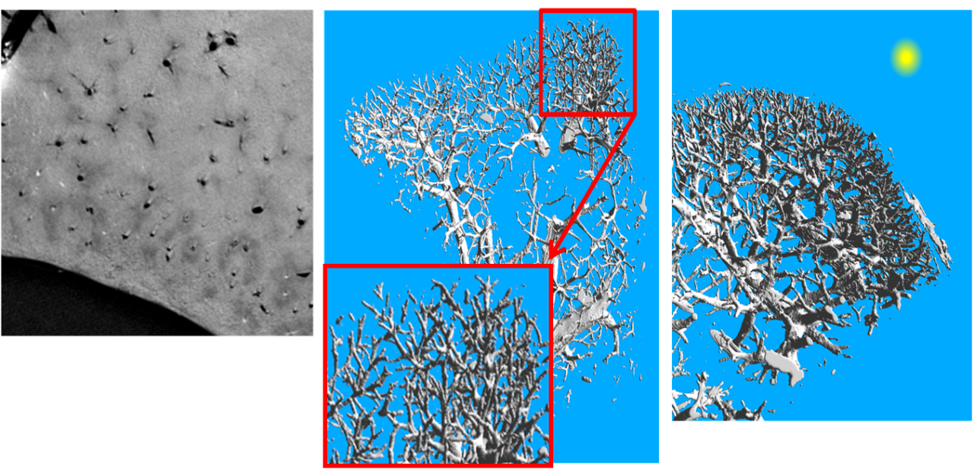
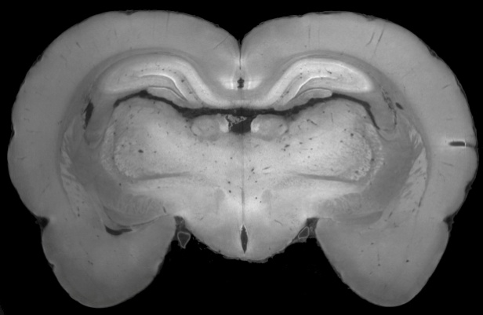
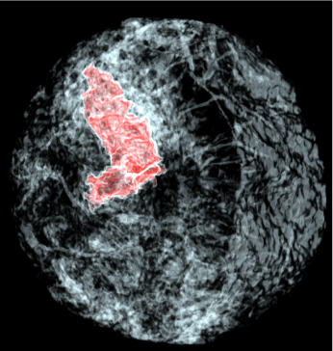
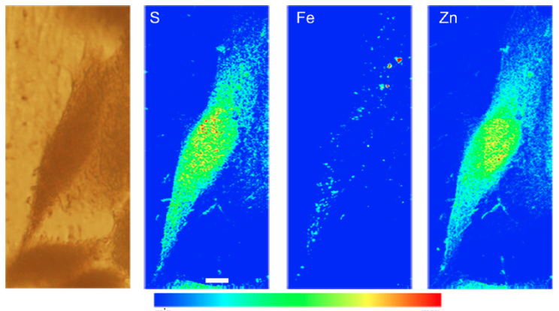
Synchrotron imaging over four length scales
Liver vascular network
Rat brain imaging
Full human breast
Iron accumulation
in neurons
Ortega et al . Mol Neurobiol. 2015 Apr
nanofluo
S. McDonald, et al., JSR 2009
Talbot interferometry
Coan, Bravin et al.
PBI phase contrast
Zhao, Brun et al. PNAS 2012
ABI phase contrast
0.01 micron
1 micron
10 microns
100 microns
cells
humans
cells
small animals
humans
small animals

Slide 29
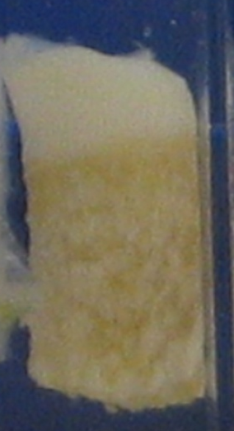
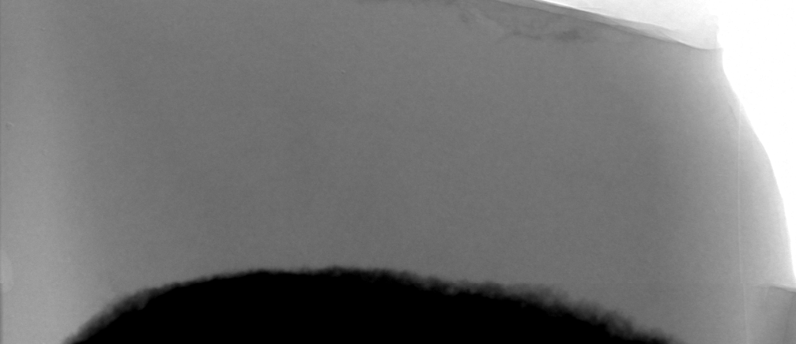
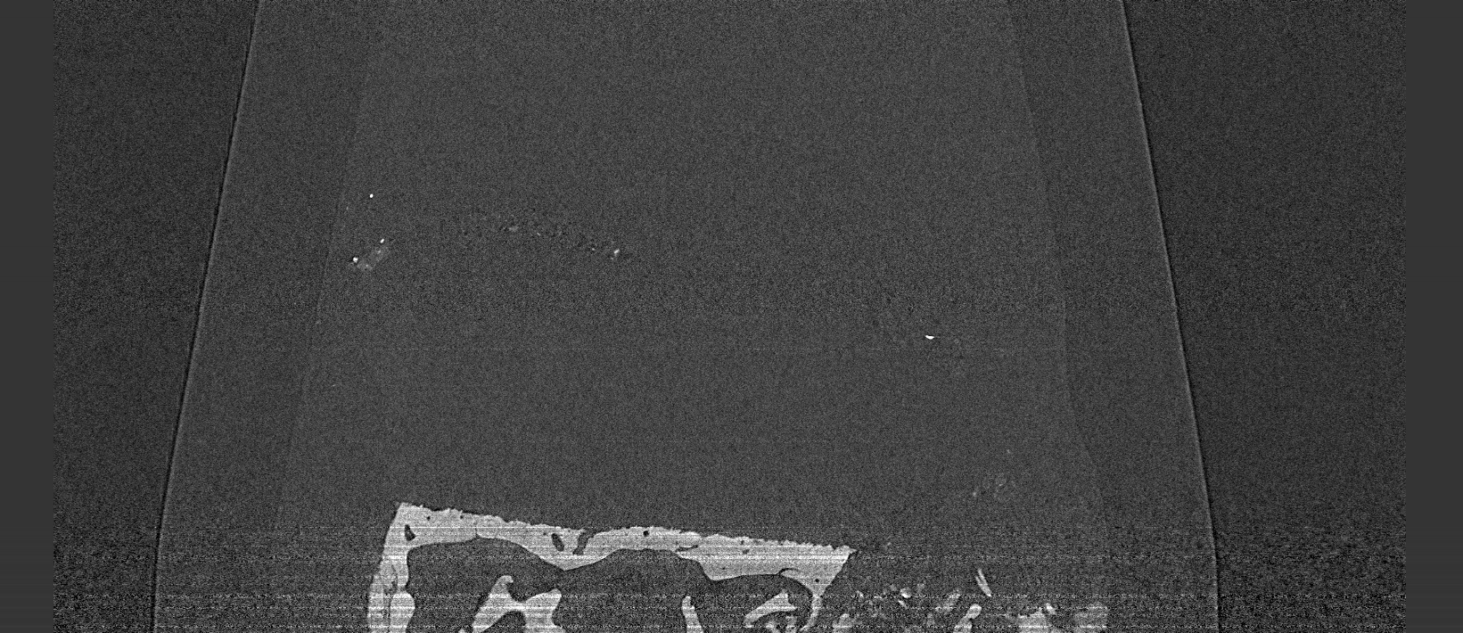
ABSORPTION BASED IMAGING ON NORMAL HUMAN CARTILAGE
The power of phase contrast imaging (coherence of source):
See also C.Jacobsen’s talk, yesterday
25 keV,
8 µm pixel size
Projection
Tomography
Coan et al. Inv. Radiology 2010

Slide 30
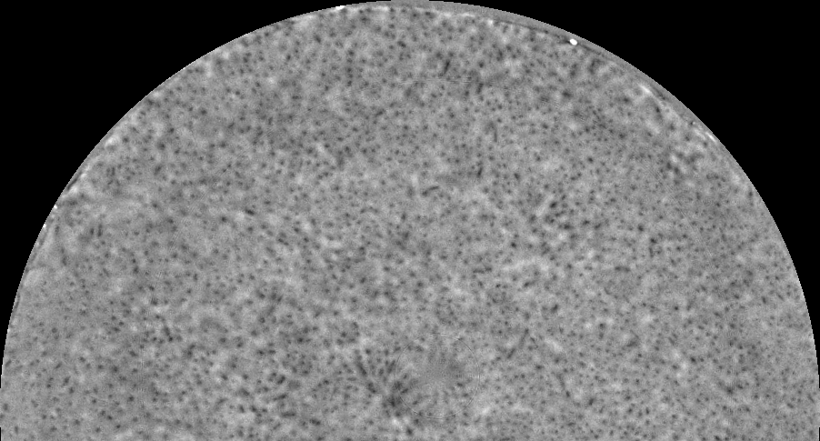

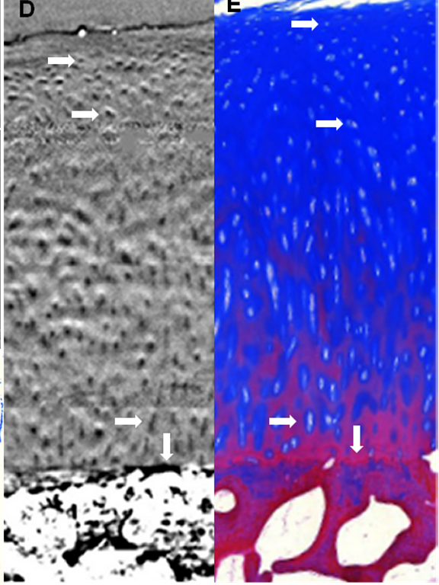
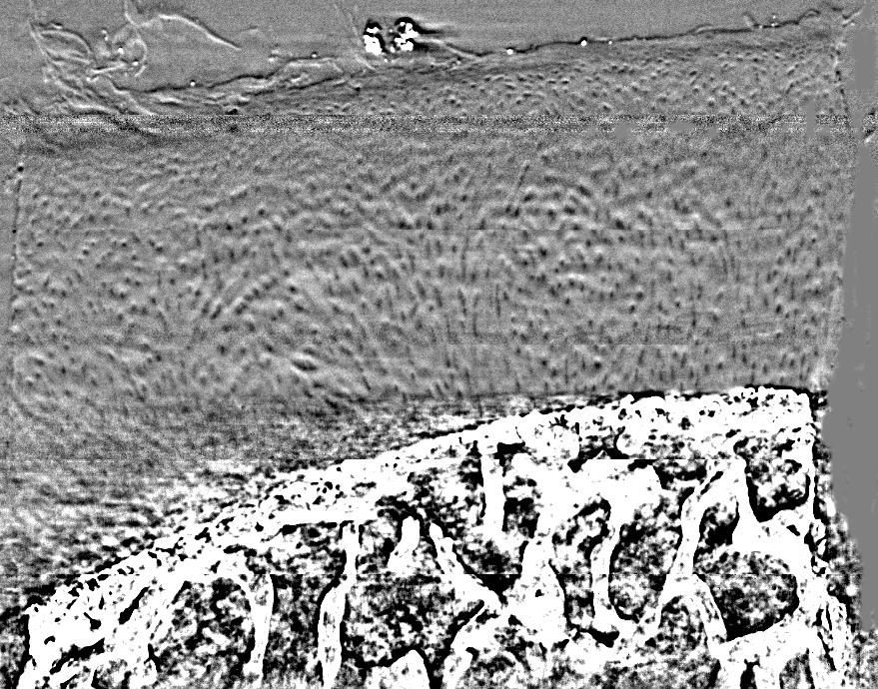
PHASE CONTRAST IMAGING OF NORMAL CARTILAGE
26 keV
Si (333)
8 µm pxl size
Axial ABI slice
Absorption
Correlation with histology
(i.e. the truth)
Frontal ABI slice
Coan et al. Inv. Radiology 2010

Slide 31
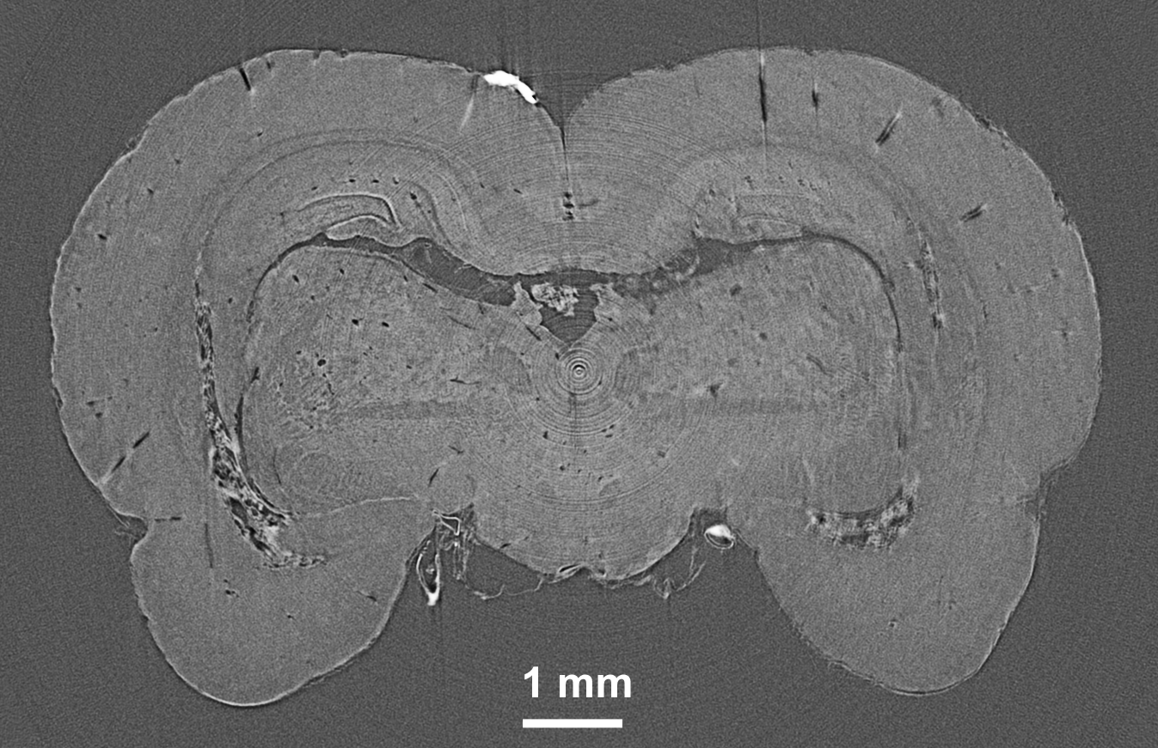

Improved soft tissue contrast
Phase
Absorption
Same dose
Courtesy of M. Stampanoni, PSI

Slide 32




Pathogenesis of Alzheimer’s plaques
5x FAD Mouse Model
2 mm
Phase contrast CT
Two-photon microscopy
19 weeks 39 weeks 70 weeks
Courtesy of M. Stampanoni, PSI
B. R. Pinzer et al., Neuroimage 2012

Slide 33





Slide 34




A1
E = 24 keV
PHC dist. = 80 cm
Num. projections = 720
Ccd pixel size = 14μm
A2
3D rendering of a 4 mm thick volume.
A1 and A2:
Tumor without colloidal gold
B1 and B2:
Tumor developed after implantation of 300,000 gold-loaded cells
In the skull segments (A2 and B2), the hole created for cell implantation is well visible (diameter 0.6 mm).
B1
B2
E.Schultke et al., Eur. J. Radiol.,Vol. 68, 2008
Courtesy of G. Tromba, ELETTRA

Slide 35




Layout of the patient facility
Courtesy of G. Tromba, ELETTRA

Slide 36




FFDM
SRM
CONVENTIONAL unit
Synchrotron Radiation
Courtesy of G. Tromba, ELETTRA

Slide 37
X-RAY RADIATION THERAPY: DOSE VOLUME EFFECT
Mouse brain, visual cortex
1mm
25µm
140Gy
4000Gy
Zeman et al, Radiat Res 15, 496,1961

Slide 38

APPLICATION TO RADIATION THERAPY: RAT CEREBELLUM AFTER MRt
Entrance dose: 2000 Gy
25 μm-wide microplane
12 h after irradiation
„valley“
DOSE: „PEAK“
„valley“
Dose volume effect: used also in conventional radiotherapy: with cyberknife
deliver 150 Gy on a spot of 5 mm!

Slide 39

MRT= HIGH DOSES DELIVERED IN SPATIALLY FRACTIONATED MICROPLANS
Tissue tolerance threshold dose for healthy tissue homogeneous irradiation
The dose in the valleys that creates a dose offset in the tissues, has to be below the tolerance threshold dose

Slide 40
MRT BEAM REQUIREMENTS: ESRF ID17 SOURCE
High intense, collimated, hard X-ray beam (~150 keV)
Wiggler: 21 poles, 1.6 T
Filters: 2.4 mm Al, 1.4 mm Cu
Dose rate: 14300 Gy/s @ 200 mA from source

Slide 41



MRT BEAM COLLIMATION IN DEPTH: PH2X ANALYSIS (DNA STRAND BREAKS)
50 µm /200 µm c-t-c
100 µm /200 µm c-t-c
homogeneous
High collimation is maintained in depth:
----- > microbeam structure conserved through the full sample
----- > tissue sparing in depth!
Credits R. Serduc et al. 2010

Slide 42


TISSUE SPARING BY MRT OF PIGLET CEREBELLUM
300 (625) Gy
25/200 μm ctc
5mm
MRT +15 months
No tissue destruction. Normal appearance of brain and cerebellum
Animals (20 pigs) were kept alive for ~2 years.
No one animal showed CNS damage clinical signs
J. Laissue et al. Dev. Med. & Child Neur. 2007, 49: 577–581
42

Slide 43

MRT + GENE MEDIATED IMMUNOPROPHILAXYS
Tumour bearing 9L gliosarcoma rats (MRT treatment at day 14)
625 Gy- Unidir
H. Smilowitz et al. J. Neurooncology, 78: 135-143, 2006

Slide 44
summary
X-ray LINAC Therapy, Cyber knife, Gamma knife, protons, ions, neutron therapy, X-ray MRT…
All have some PROS
Easy access, low cost, easy repeatability, better tumor control, smaller side effects, adapted for hypoxic tumors, etc..
…. and CONS
dose limit, location, tumor size, organ movement, repositioning, Boron concentration, accessibility, costs)
Optimal therapy and its prescription depends on all these factors (and perhaps many more); the choice for each patient has to be found as the best balance among the various options

Slide 45
FUTURE: Compton scattering based sources
Exporting imaging and therapy techniques from synchrotrons
M. Jacquet and P. Suortti, Physica Medica, 2015

Slide 46

What do we need?
For exporting MRT to clinical environment:
Laminar low diverging beam of 200-500 keV: high intensity
Cheap, easy to use, to be lately installed at hospitals
Cocktail Party, Thursday July 9th, Varenna 2015:
Alessandro Variola and Luigi Palumbo: “We can doit!”
Thank you for your attention!

