Slide 1





Extreme Light Infrastructure –
Nuclear Physics
ELI–NP
EUROPEAN UNION
GOVERNMENT OF ROMANIA
Structural Instruments
2007-2013
“Future Research Infrastructures: Challenges and Opportunities”
July 9 – 11, 2015, Varenna, Italy
Călin A. Ur
for the ELI–NP Team

Slide 2

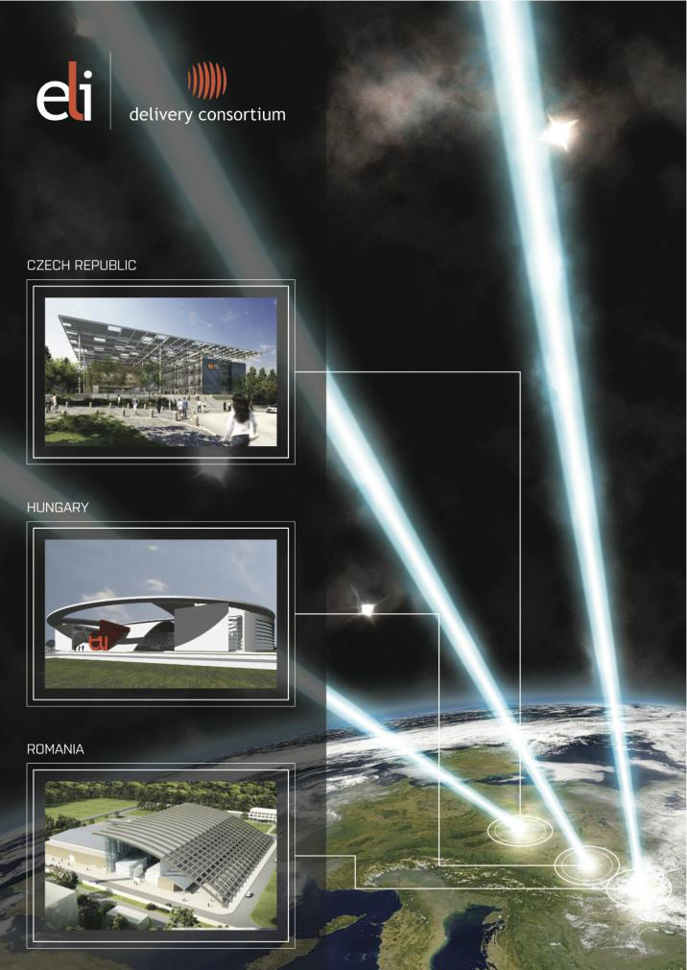
ELI in a Nutshell
Extreme Light Infrastructure
Pan–European Research Center
Target: implement the world’s largest laser research infrastructure
Infrastructure: distributed over three complementary pillars (CZ, HU, RO) – user facilities
Strategy: first ESFRI project to be fully implemented in newer EU member states
Funding: novel model combining ERDF funds for the implementation and contributions to an ERIC for the operation

Slide 3
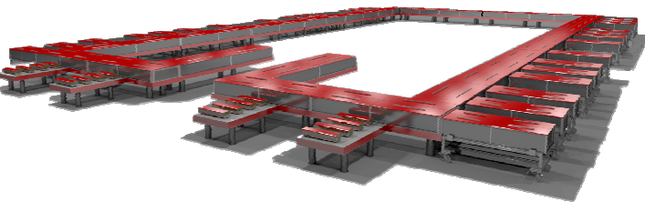
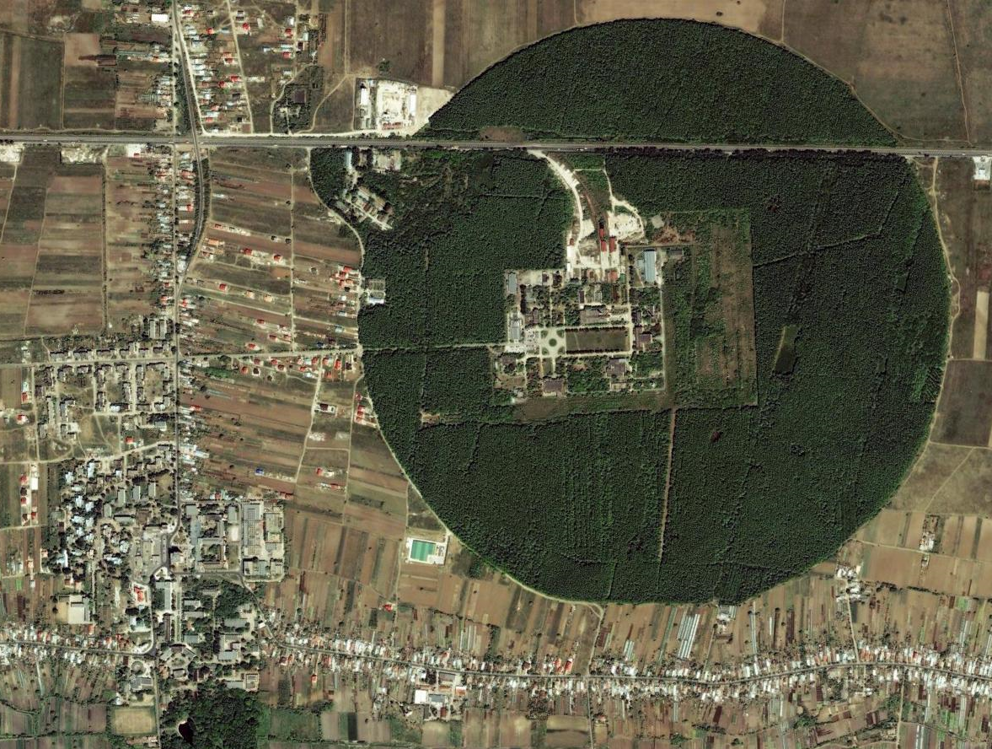
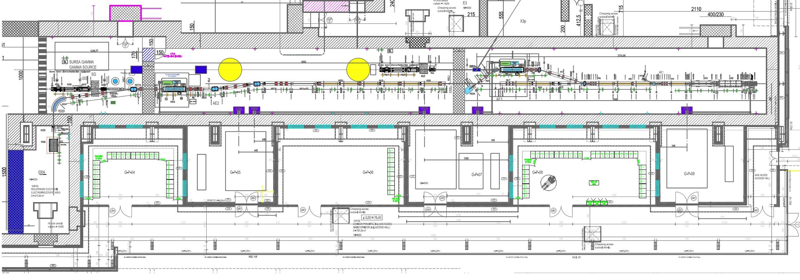
Extreme Light Infrastructure – Nuclear Physics
Nuclear Physics research with extreme electromagnetic fields
Two major systems
Based on the National Physics 2 x 10 PW High–Power Lasers System
Platform in Magurele (Bucharest)
High Brilliance Gamma Beam System
Thales Optronique
IFIN–HH @ Magurele
EuroGammaS

Slide 4
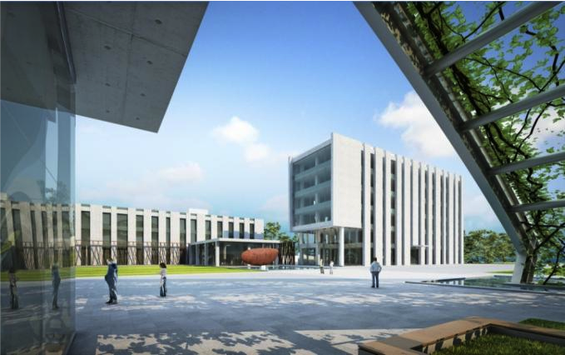
ELI–NP Implementation Timeline
2010 2011 2012 2013 2014 2015 2016 2017 2018
ELI–NP White Book
Feasibility Study
Cost estimate 293M€
Preparation of the Application
E.C. Eval. & Funding Approval
Procurement Laser System
Laser System – installation
Procurement Gamma Beam
Gamma Beam – installation
Experimental Areas TDR
Recruitment

Slide 5
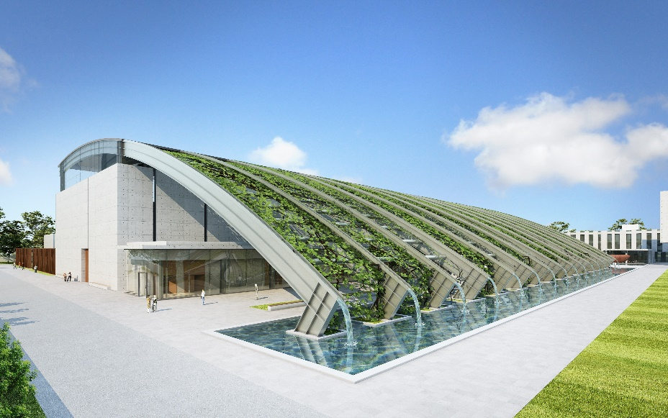
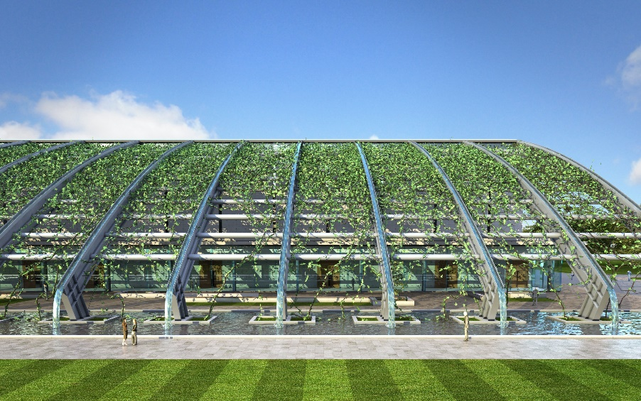
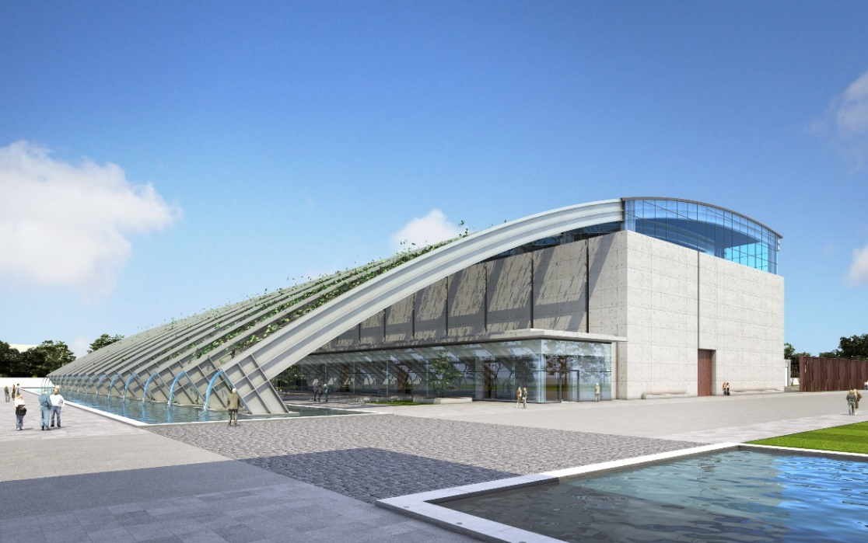
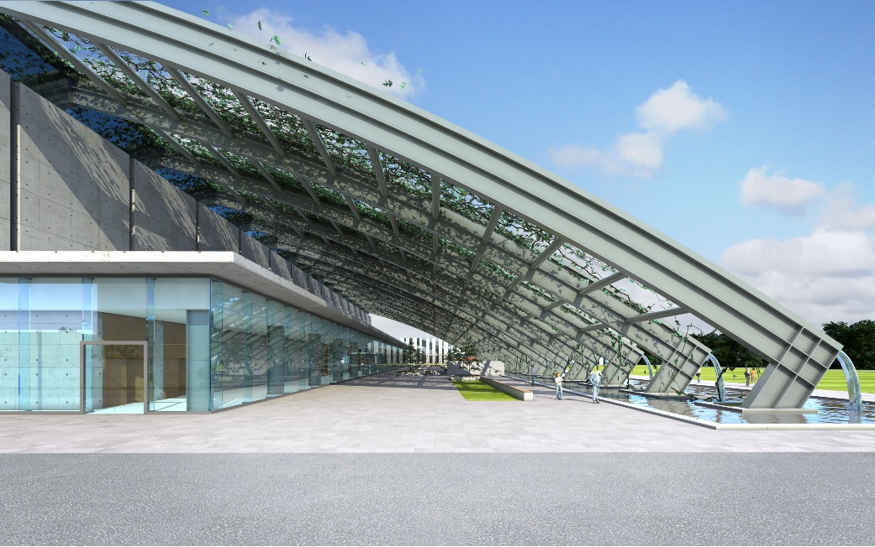
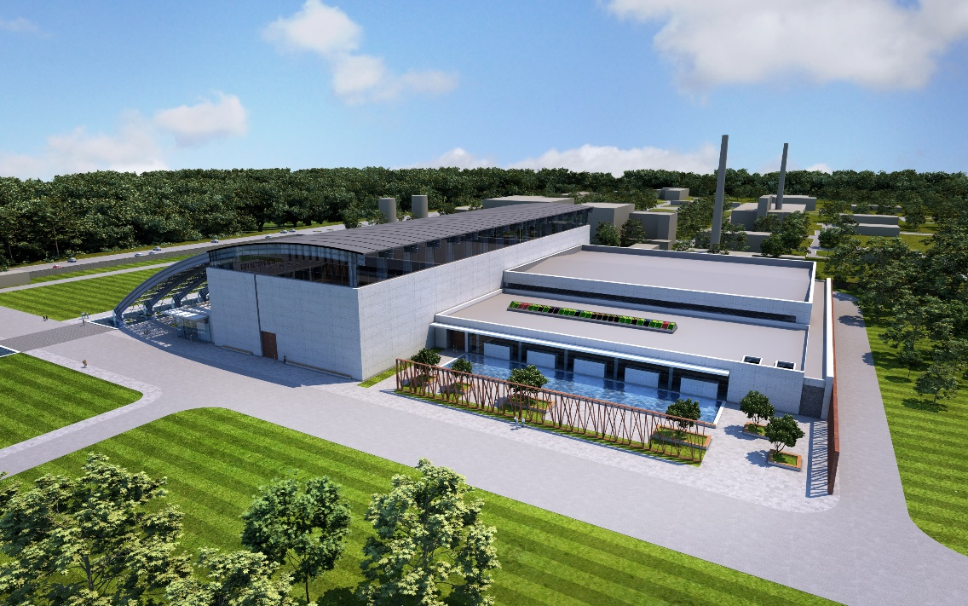
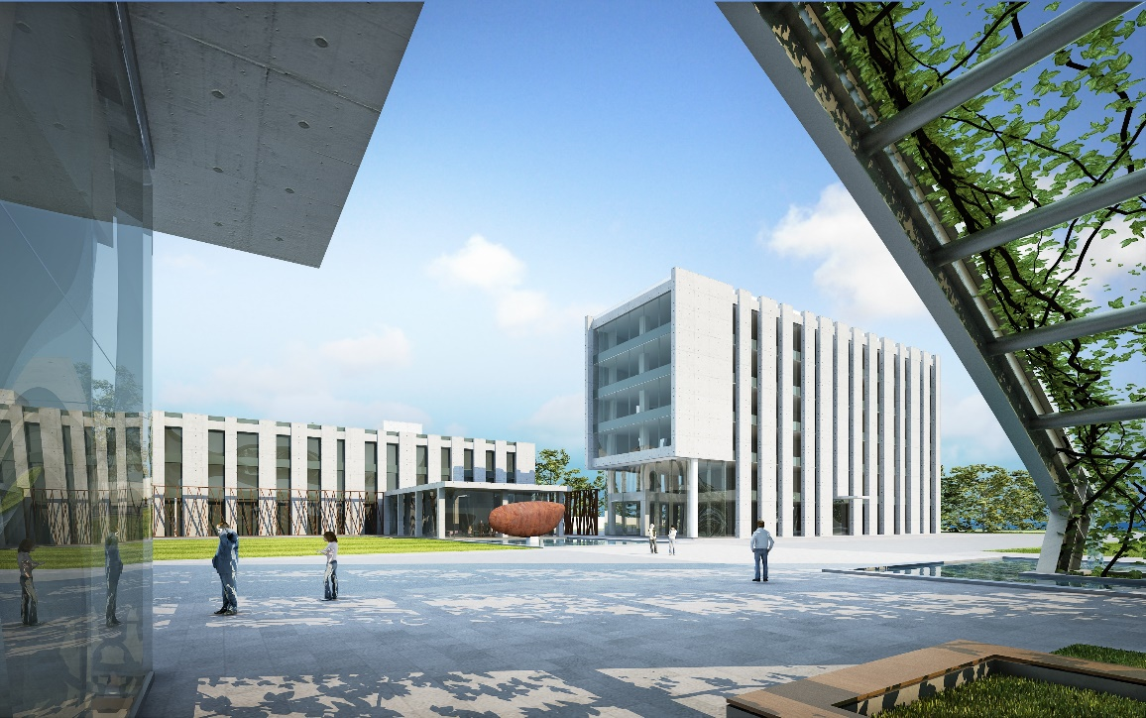
ELI–NP Artistic View (2013)

Slide 6
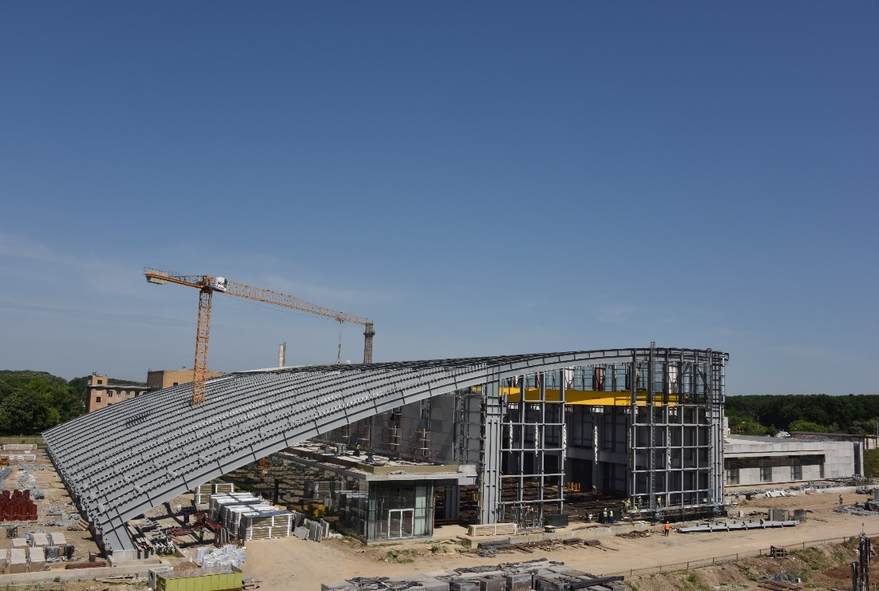

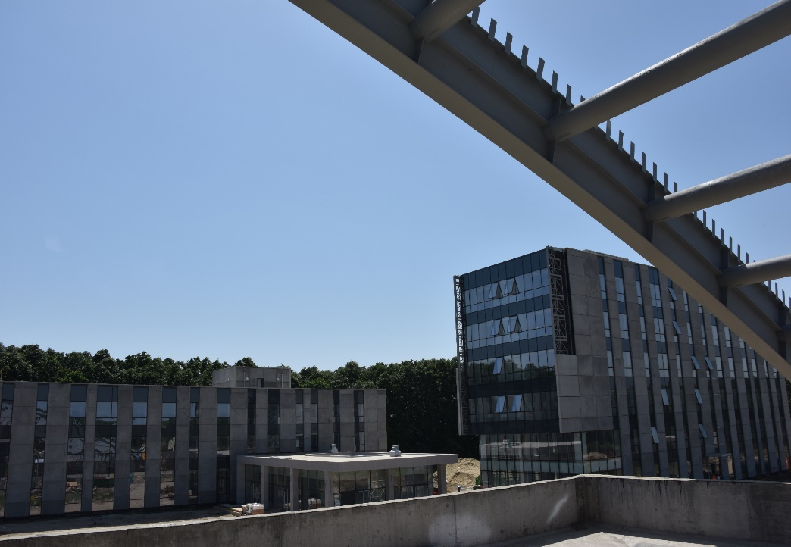
ELI–NP Real Life (2015)

Slide 7
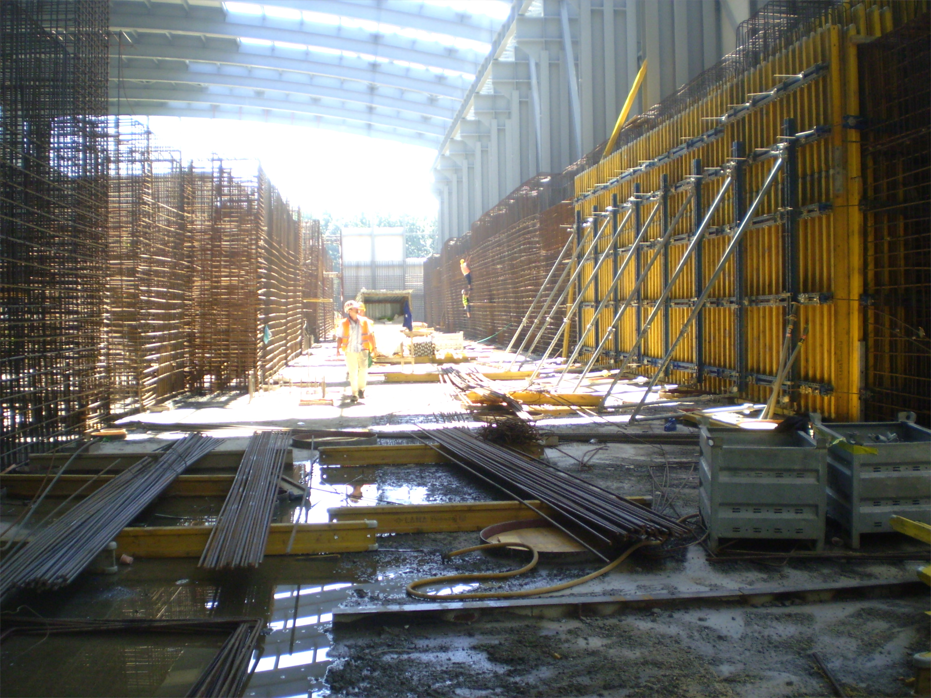
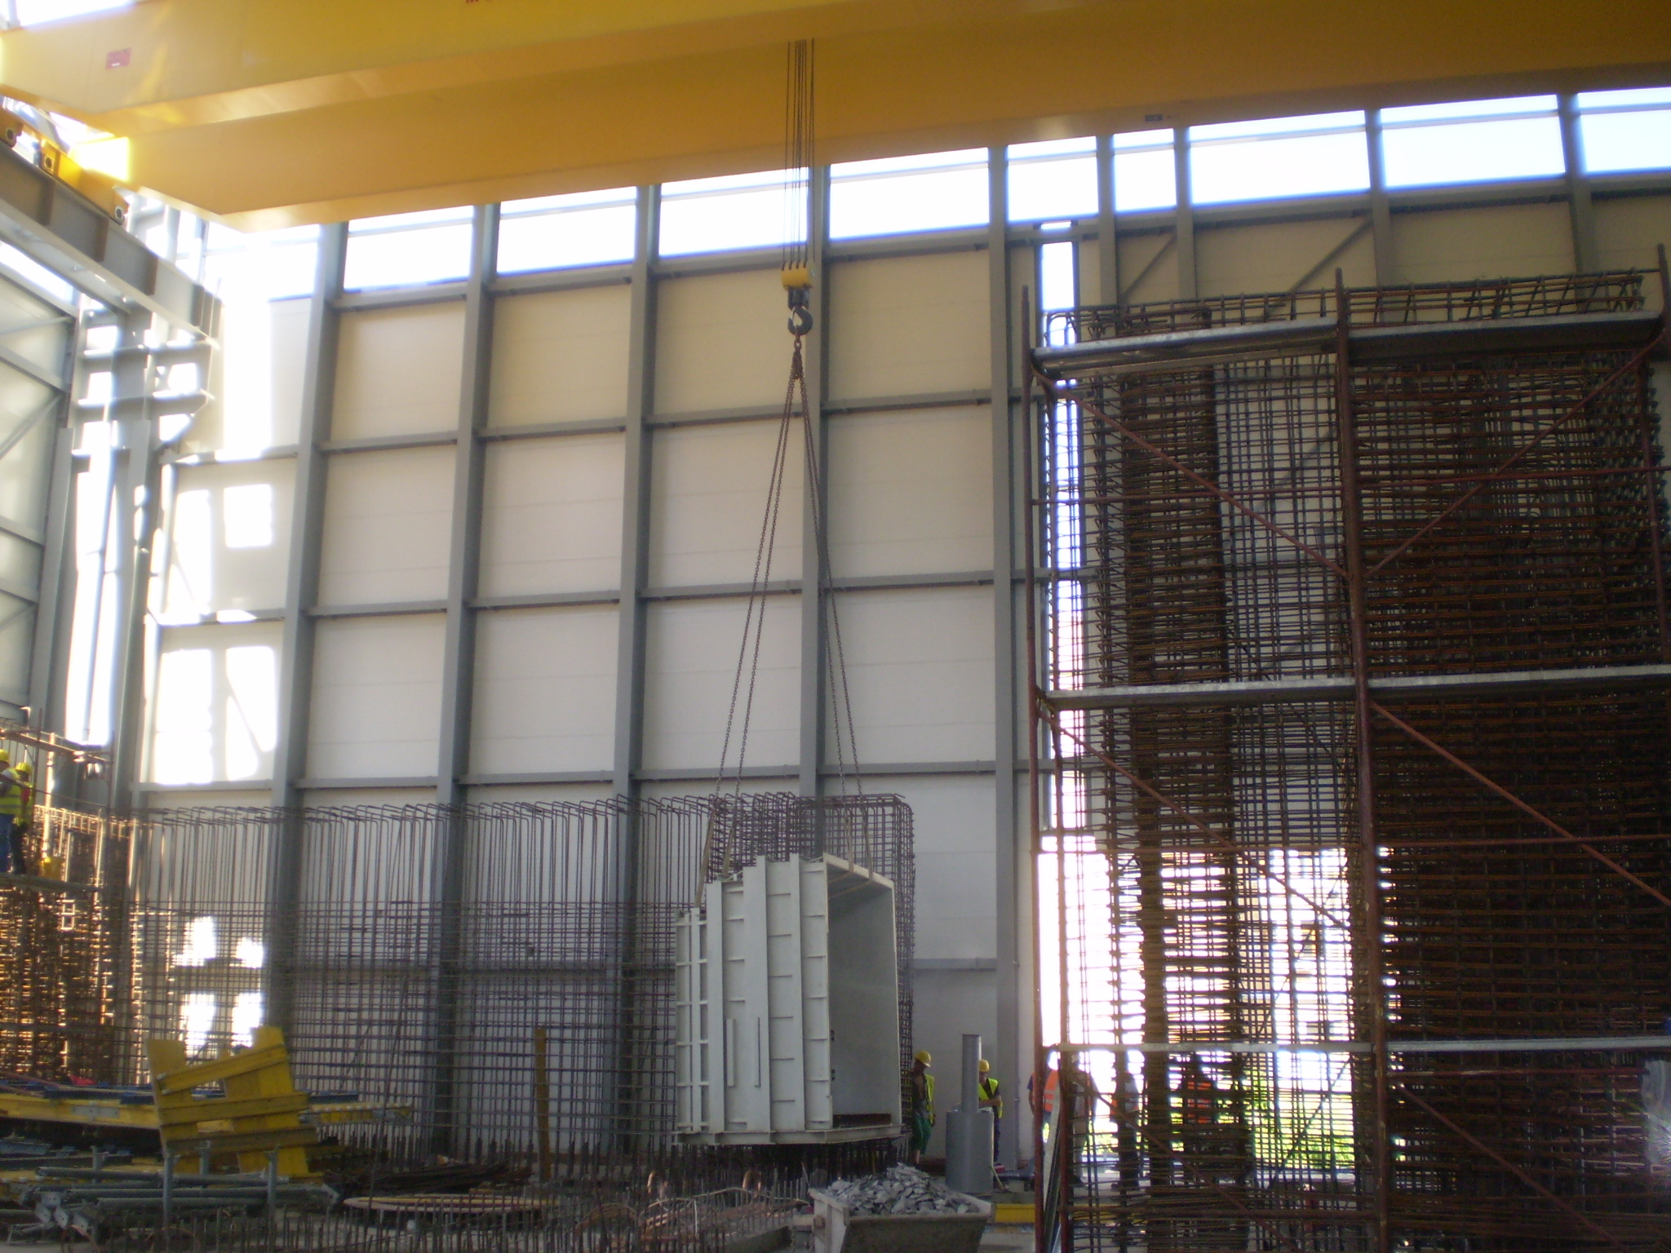
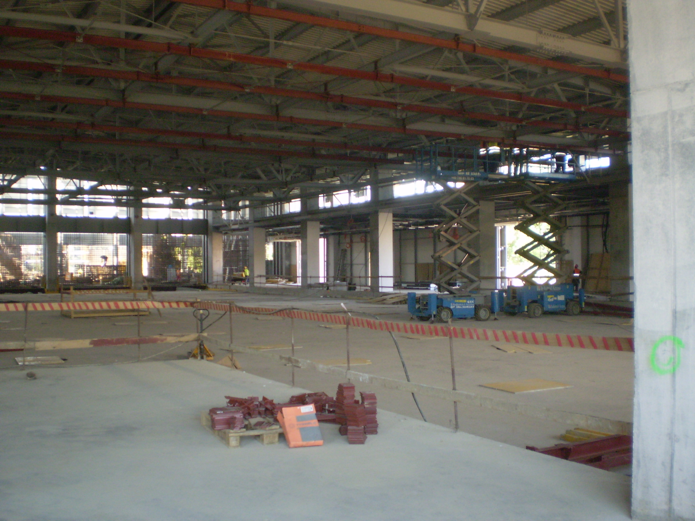
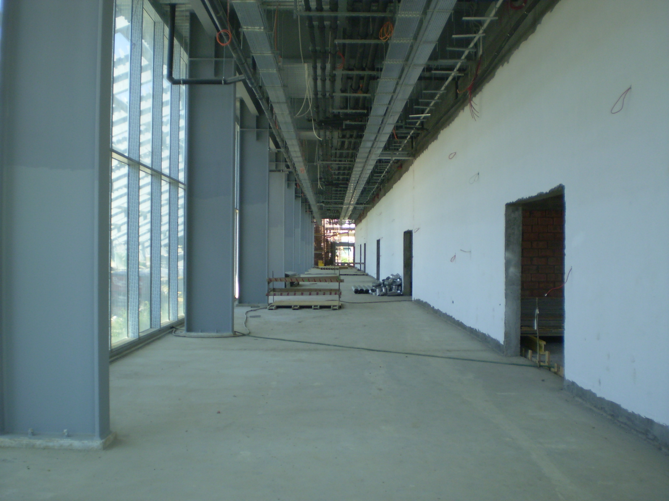
ELI–NP Real Life (2015)

Slide 8
ELI–NP Experiments
White Book ⟹ Day–1 Experiments
Towards TDR of experiments with intense laser beams at ELI-NP
June 27-28, 2013 – Bucharest-Magurele (Romania)
Towards TDR of experiments with brilliant gamma-ray beams at ELI-NP
July 25-26, 2013 – Bucharest-Magurele (Romania)
building the main working groups
conveners and local liaisons
ELI-NP TDRs at Midway – High Power Laser March 16-17, 2014 – Bucharest-Magurele (Romania)
ELI-NP TDRs at Midway – SystemGamma Beam System
March 16-17, 2014 – Bucharest-Magurele (Romania)
added new working groups
applied physics
ELI-NP Science Program and Instruments: Technical Design Reports
February 18-20, 2015 – Bucharest-Magurele (Romania)
final TDRs
definition of the experimental setups
Scientific evaluation of the TDRs by ISAB

Slide 9
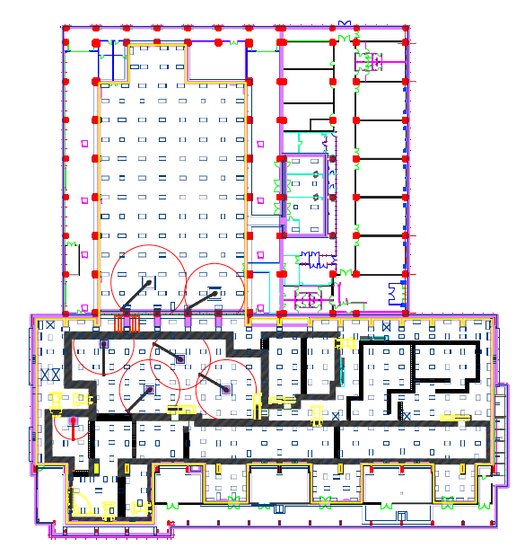
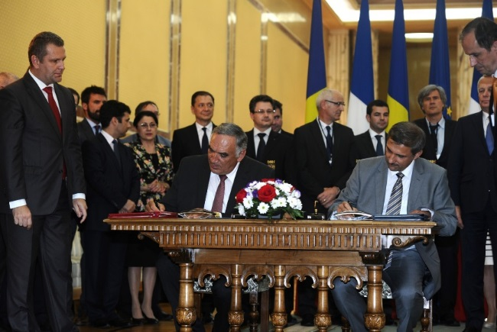
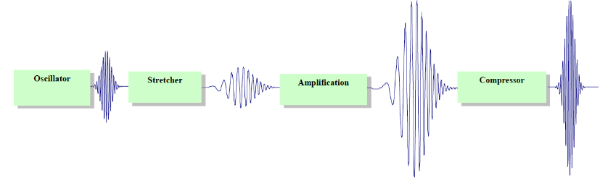
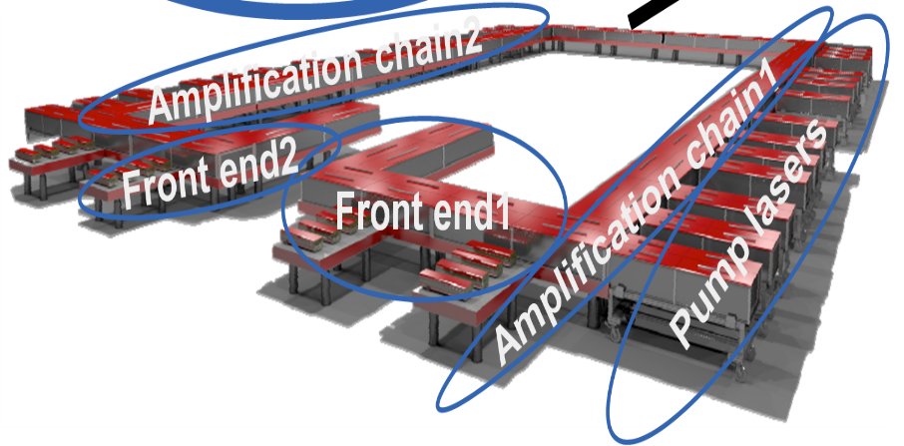
The High–Power Lasers System 2 x 10 PW
Provided by THALES Optronique & Thales Romania
HPLS
Based on OPCPA
Experiments
July 12th, 2013

Slide 10
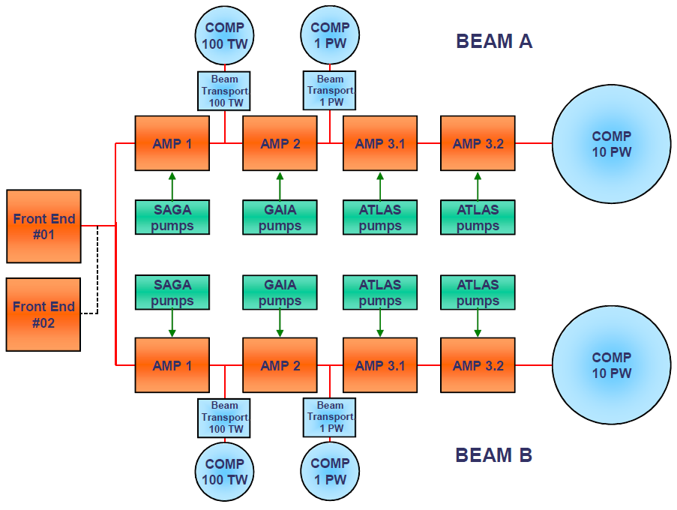
ELI–NP HPLS schemaric layout
2 HPLS up to 10 PW – 6 outputs
2 x 0.1 PW 10Hz
2 x 1 PW 1Hz
2 x 10 PW 0.1Hz

Slide 11
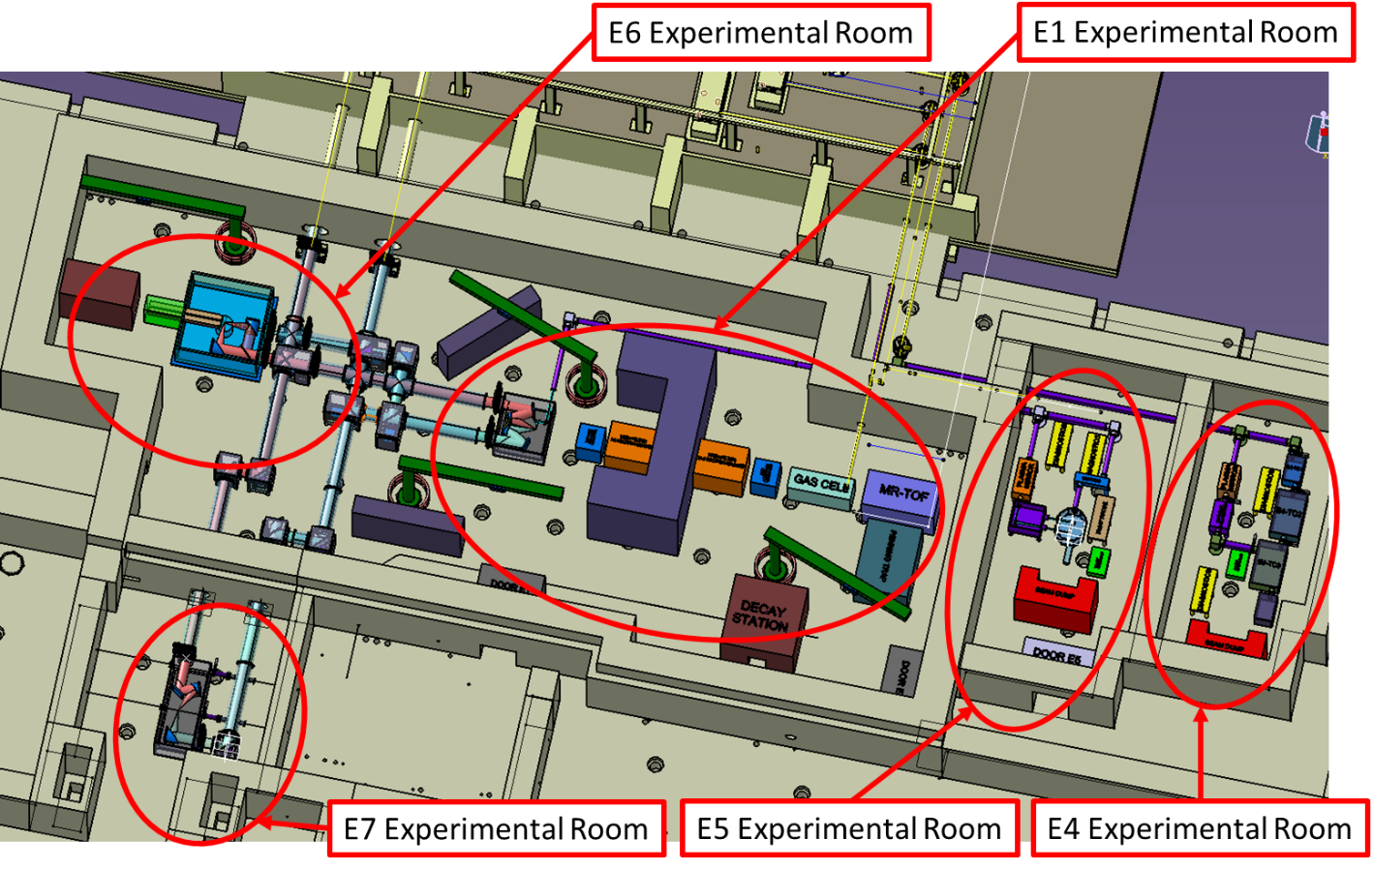
HPLS Experimental Areas

Slide 12
Laser Driven Nuclear Physics
Convener: M. Roth (TUD) ELI-NP Liaison: F. Negoita (IFIN-HH)
1. Nuclear fusion reactions from laser-accelerated fissile ion beams P. Thirolf (LMU)
Goal: Production of nuclei around rich N~126 waiting point et al.
2. Nuclear (de-)excitations induced by lasers F. Hannachi (CENBG/IN2P3) et al.
Goal: Observation of NEET/NEEC/BIC processes in plasma. Changes in nuclear T_{1/2}
3. Nuclear reactions in laser plasma S. Tudisco (LNS/INFN) et al.
Goal: Understanding screening effect in plasma conditions
4. Neutron production and other applications
4.1 Hot plasma confinement for
high flux neutron generation
S. Moustaizis (TU.Crete) et al.
4.2 Neutron production in light ion reactions
S. Kar (QUB), J.Fuchs (LULI) et al.
4.3 Muon-source and muon catalysed fusion
S.R.Mirfayzi, S.Kar (QUB)
Topic Stellar photoreaction
GBS
MeV γ
e + γ + A in E7
Production and
photoexcitation of isomers
LPA
~MeV e-

Slide 13
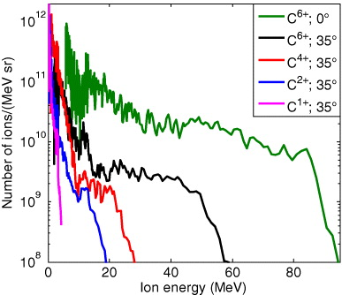
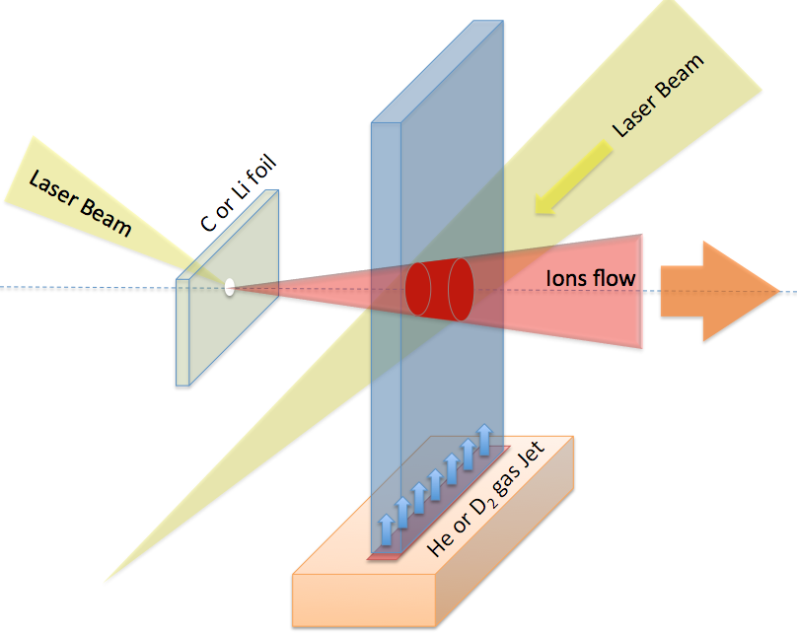
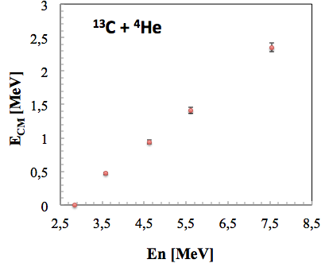
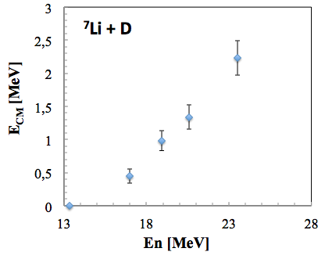
Laser Driven Nuclear Physics
Study of screening factor – The method and cases
Peta-Watts
6×10²⁰ W/cm²
10¹⁸ Atoms/cm³
D.C. Carrol et al., New J. of Phys. 12 (2010) 045020
The method requires
measuring high energy neutrons

Slide 14
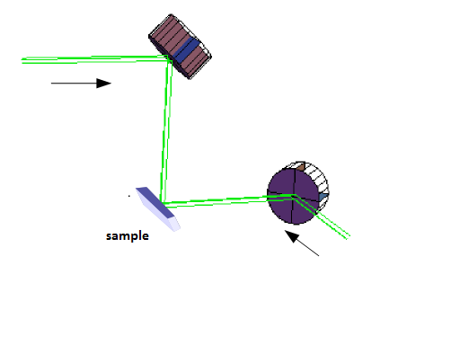
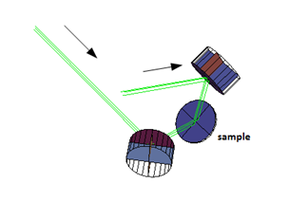
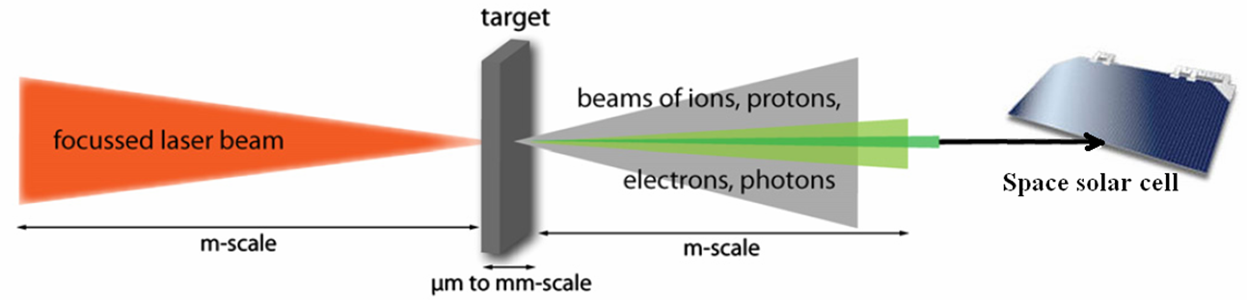
Materials in Extreme Environments
Convener: Marilena Tomut (GSI) ELI-NP Liaison T. Azavei
* Testing of new materials for accelerator components
- materials at fast energy deposition & mixed radiation fields
- laser induced shock waves
- laser modification of materials
* Evaluation of high energy ionizing radiation effects in materials
* Biological science research
  - radiation effects on bio-molecules & cells
* Testing and developments of detectors
* Irradiated optical components testing, Materials for fusion energy systems
Irradiation of components for space radiation studies

Slide 15
ELI–NP Gamma Beam System
System with outstanding key features:
high brilliance, high spectral density, tunable energy, small relative bandwidth, high degree of linear polarization
GBS
GBS

Slide 16
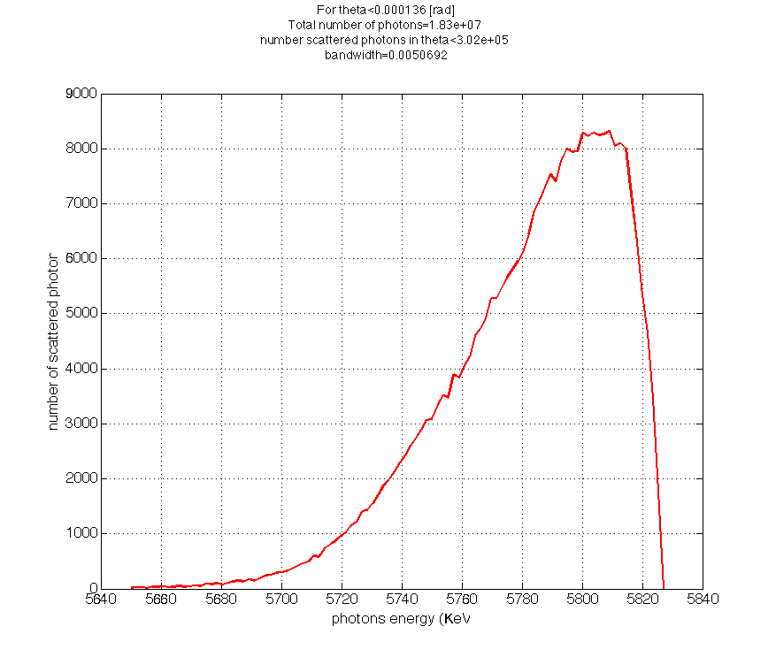
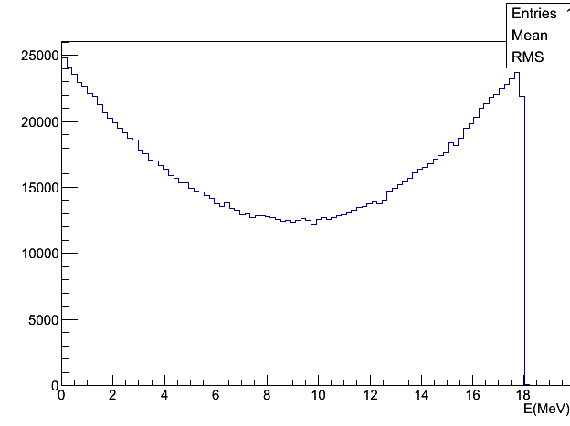
ELI–NP Gamma Beam System
10²¹
Brilliance
E_{L} = 2.3 eV
MEGA-ray
ELI–NP
laser
10¹⁹
E_{e–}
θ_{L} = 7.5º
ph/(mm²・mrad²・s・0.1%bw)
T-REX
10¹⁷
e–
γ–ray beam
E_{γ} < 19.5 MeV
10¹⁵
PLEIADES
LNBL
HIGS
10¹³
1995 2000 2005 2010 2015 2020
year
Inverse Compton Scattering of laser pulses on relativistic electron pulses
  high intensity / small emittance e– beam from a warm LINAC
  very brillant high rep./rate int. laser
  small collision volume
dN/dE

Slide 17
ELI–NP Gamma Beam System
10²¹
Brilliance
E_{L} = 2.3 eV
MEGA-ray
ELI–NP
laser
10¹⁹
E_{e–}
θ_{L} = 7.5º
ph/(mm²・mrad²・s・0.1%bw)
T-REX
10¹⁷
e–
γ–ray beam
E_{γ} < 19.5 MeV
10¹⁵
PLEIADES
LNBL
HIGS
10¹³
Collimated γ beam
1995 2000 2005 2010 2015 2020
year
Inverse Compton Scattering of laser pulses on relativistic electron pulses
  high intensity / small emittance e– beam from a warm LINAC
  very brillant high rep./rate int. laser
  small collision volume
dN/dE

Slide 18

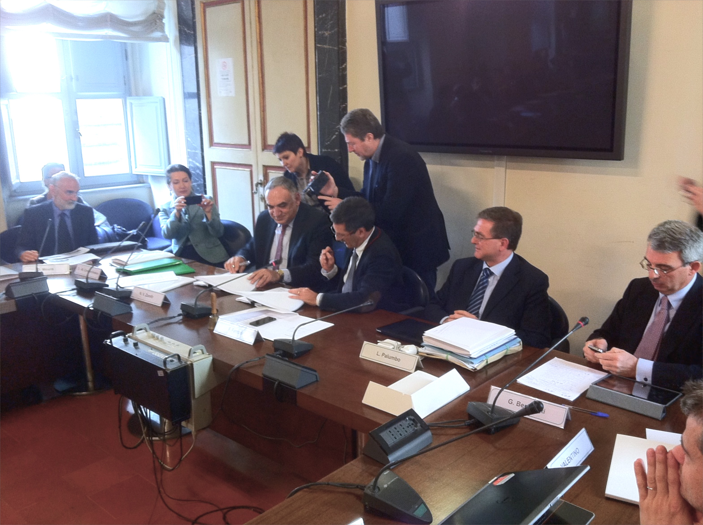
ELI–NP Gamma Beam System
Provider – EuroGammaS Association
Academic Institutions
INFN (Italy), Sapienza University (Italy), CNRS (France)
Industrial Partners
ACP Systems (France), ALSYOM(France),
COMEB (Italy), ScandiNova Systems (Sweden)
19/03/2014
March 19, 2014
… and sub – contractors
Academic Institutions
STFC (UK), ALBA Cell (Spain)
Industrial Partners
Amplitude Systems (France), Amplitude Technologies (France), Cosylab (Slovenia),
Danfysik (Denmark), Instrumentation Technologies (Slovenia), M&W Group (Italy),
Research Instruments (Germany), Toshiba (Japan)

Slide 19
ELI–NP Gamma Beam System
Provider – EuroGammaS Association
Academic Institutions
INFN (Italy), Sapienza University (Italy), CNRS (France)
Industrial Partners
ACP Systems (France), ALSYOM(France),
COMEB (Italy), ScandiNova Systems (Sweden)
Powerful consortium of
well–established academic and research institutions
and highly reliable industrial partners
⬇︎
to ensure the success of the project
19/03/2014
March 19, 2014
… and sub – contractors
Academic Institutions
STFC (UK), ALBA Cell (Spain)
Industrial Partners
Amplitude Systems (France), Amplitude Technologies (France), Cosylab (Slovenia),
Danfysik (Denmark), Instrumentation Technologies (Slovenia), M&W Group (Italy),
Research Instruments (Germany), Toshiba (Japan)

Slide 20
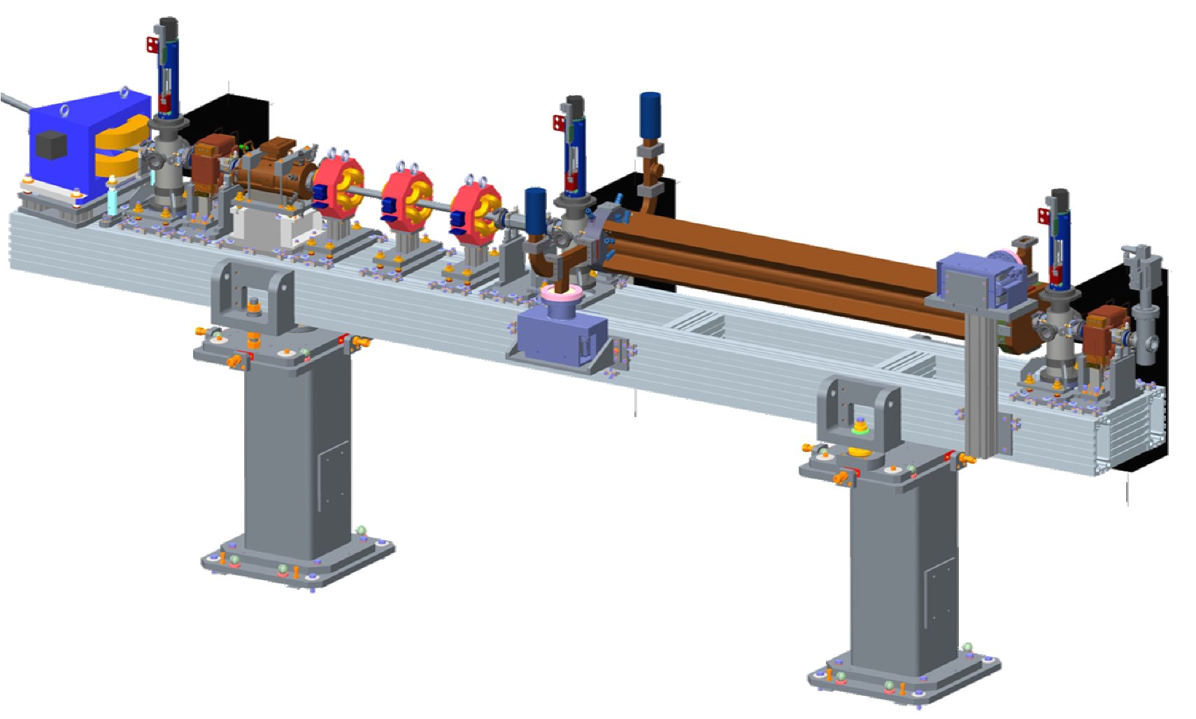
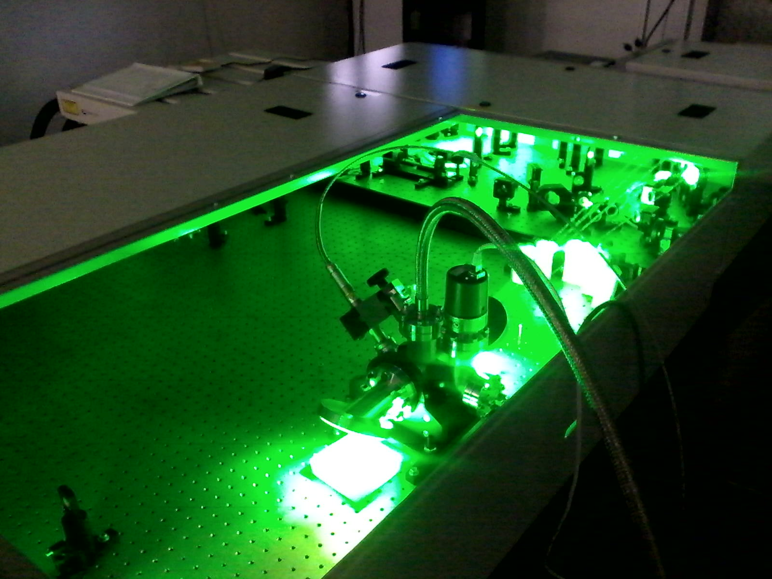
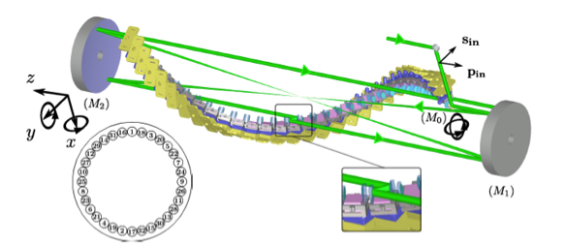
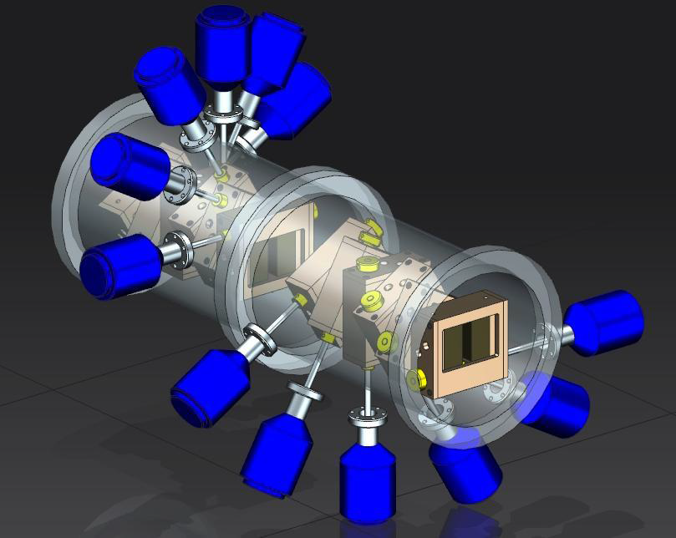
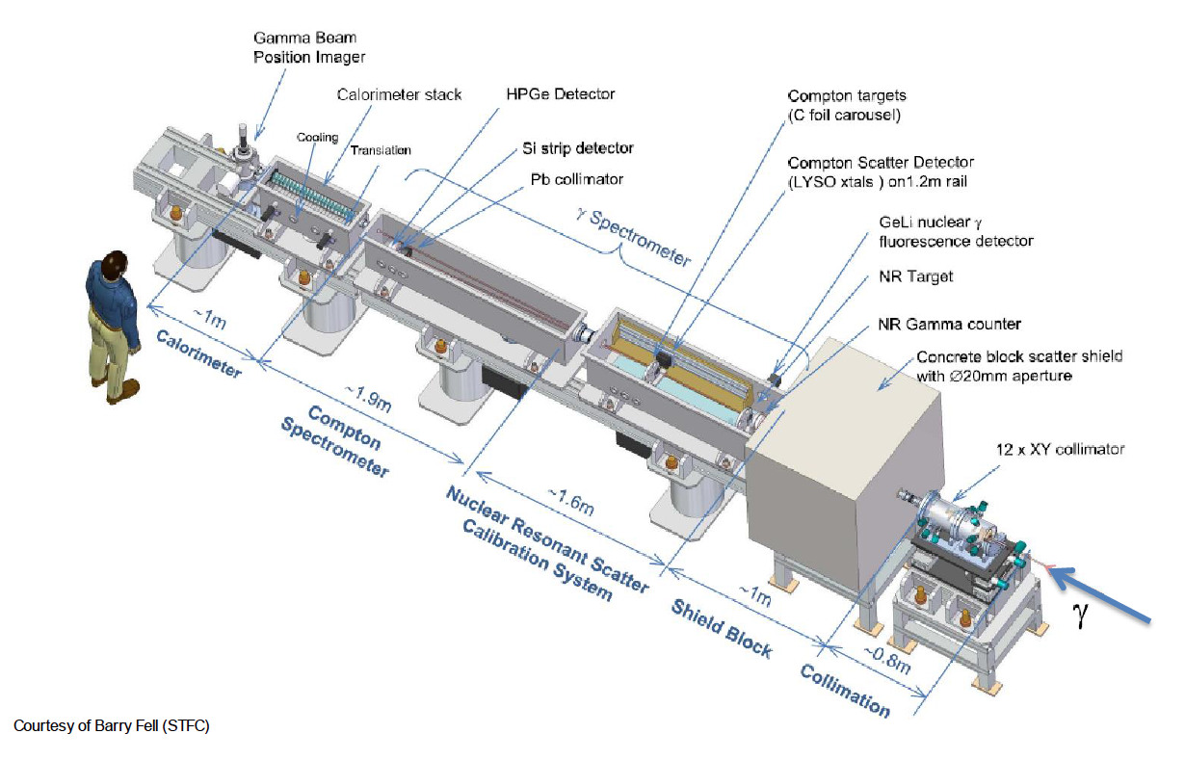
Main Components of the Gamma Beam System
Warm electron RF Linac
  two acceleration stages (300 MeV and 720 MeV)
High average power, high quality J–class 100 Hz ps Collision Laser
  two lasers (one for low–Eγ and both for high–Eγ)
Laser circulation with μm and μrad and sub–ps alignment/synchronization
  two interaction points: Eγ < 3.5 MeV & Eγ < 19.5 MeV
Gamma beam collimation system
  to obtain bandwidths < 5 x 10^{–3}
Gamma beam diagnostic system
  beam optimization and characterization: energy, intensity, profile

Slide 21
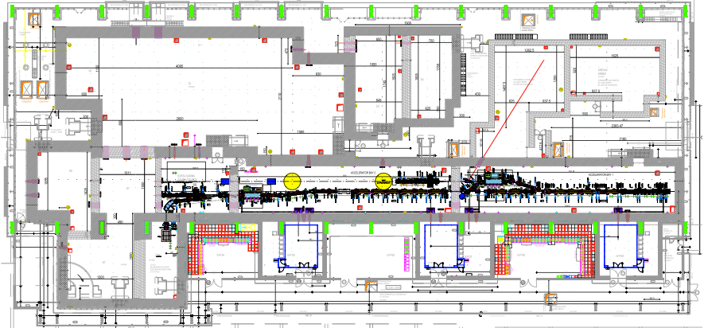
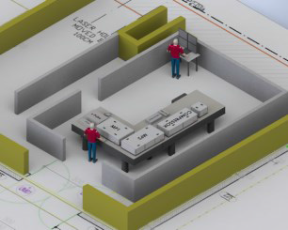
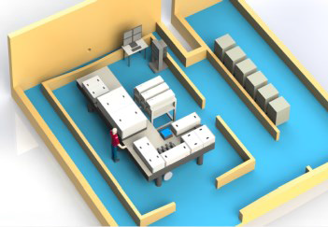
Gamma Beam System Layout
Photo–gun
e– source
Interaction Laser
High Energy
e– RF LINAC
High Energy
720 MeV
Interaction Laser
Low Energy
e– RF LINAC
Low Energy
300 MeV
Photo–gun
Laser

Slide 22
Gamma Beam System Layout
Low Energy
Gamma Beam
< 3.5 MeV
Photo–gun
e– source
Interaction Laser
High Energy
e– RF LINAC
High Energy
720 MeV
Interaction Laser
Low Energy
e– RF LINAC
Low Energy
300 MeV
Photo–gun
Laser

Slide 23
Gamma Beam System Layout
High Energy
Gamma Beam
< 19.5 MeV
Photo–gun
e– source
Interaction Laser
High Energy
e– RF LINAC
High Energy
720 MeV
Interaction Laser
Low Energy
e– RF LINAC
Low Energy
300 MeV
Photo–gun
Laser

Slide 24
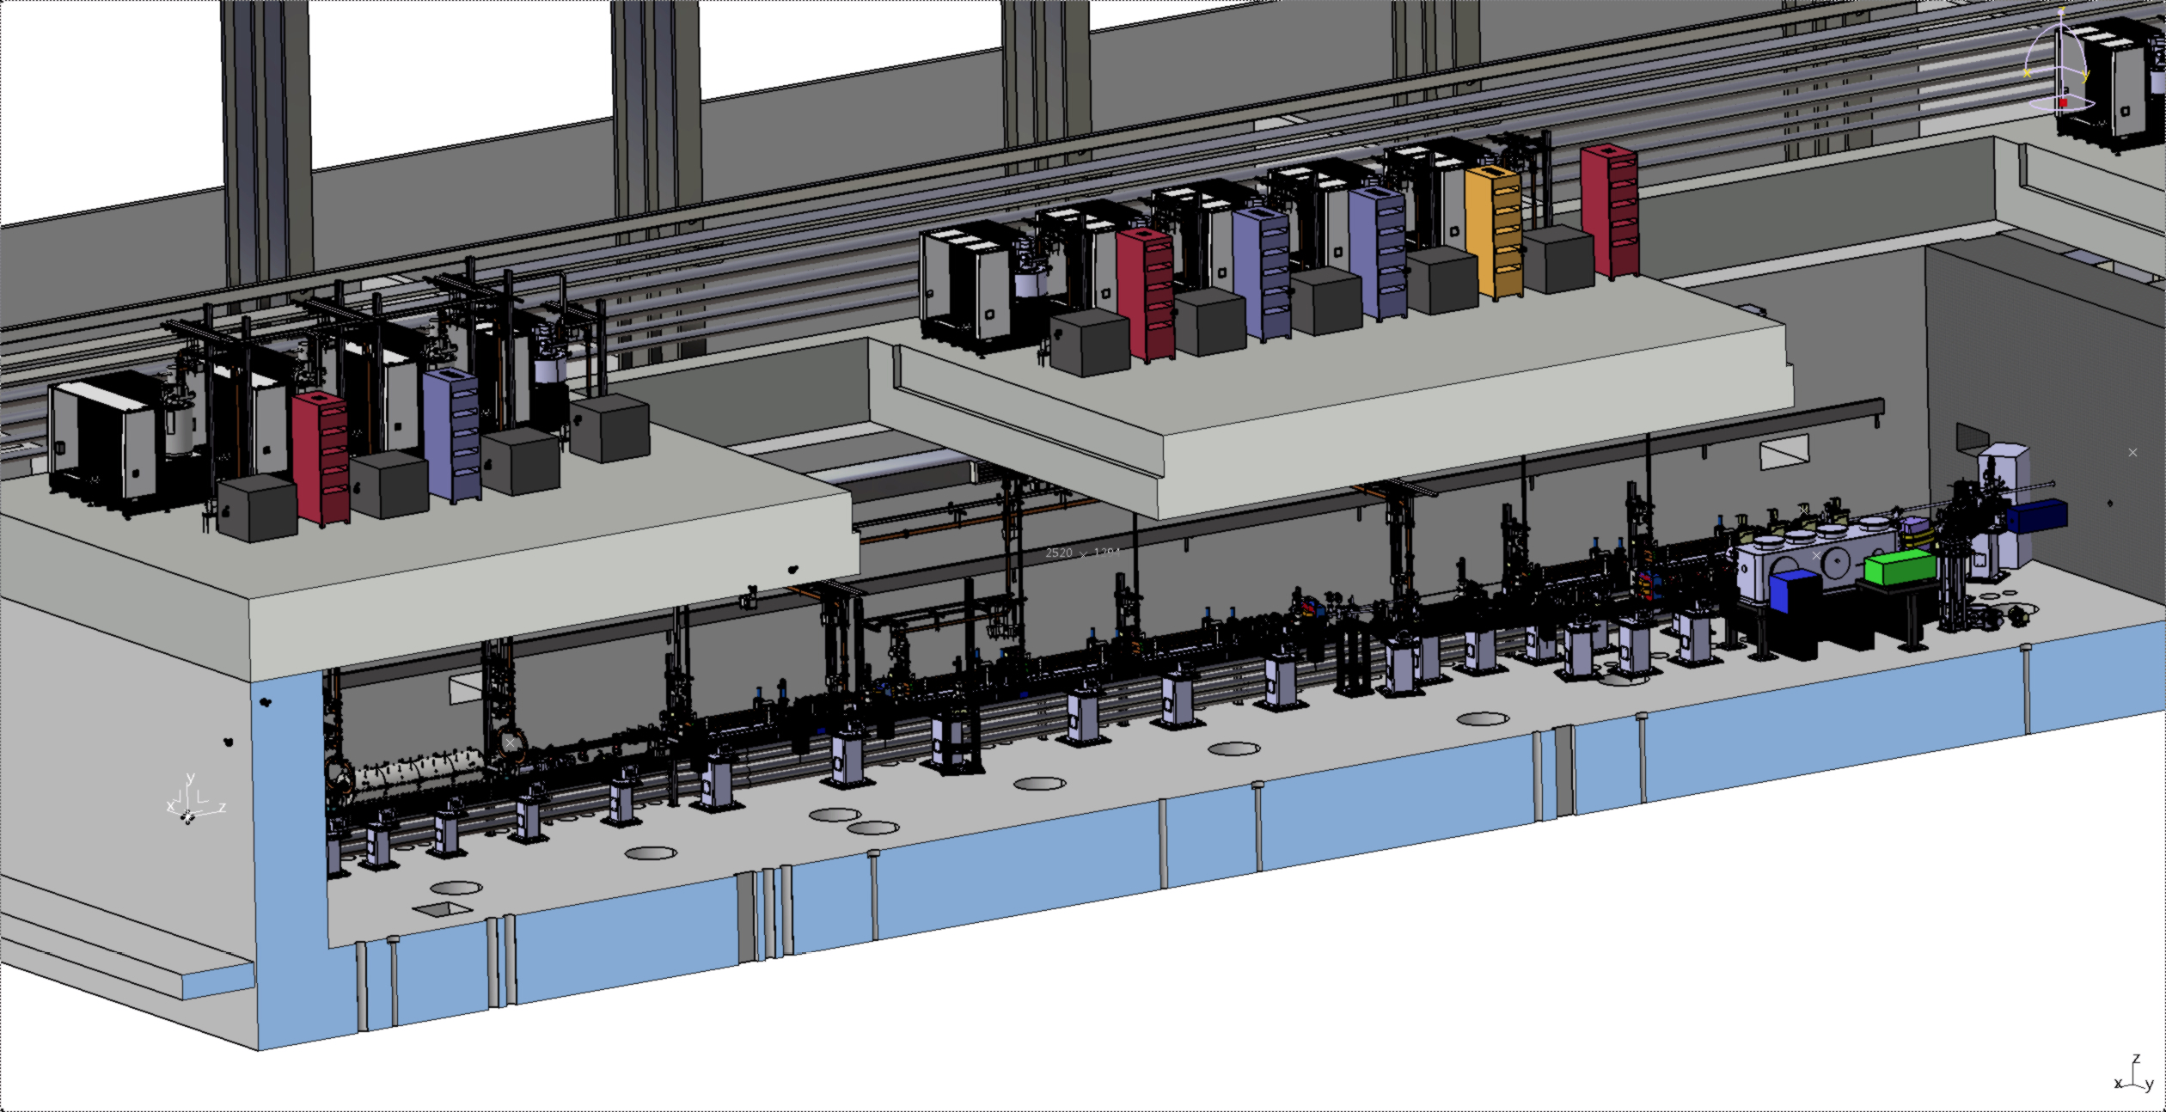
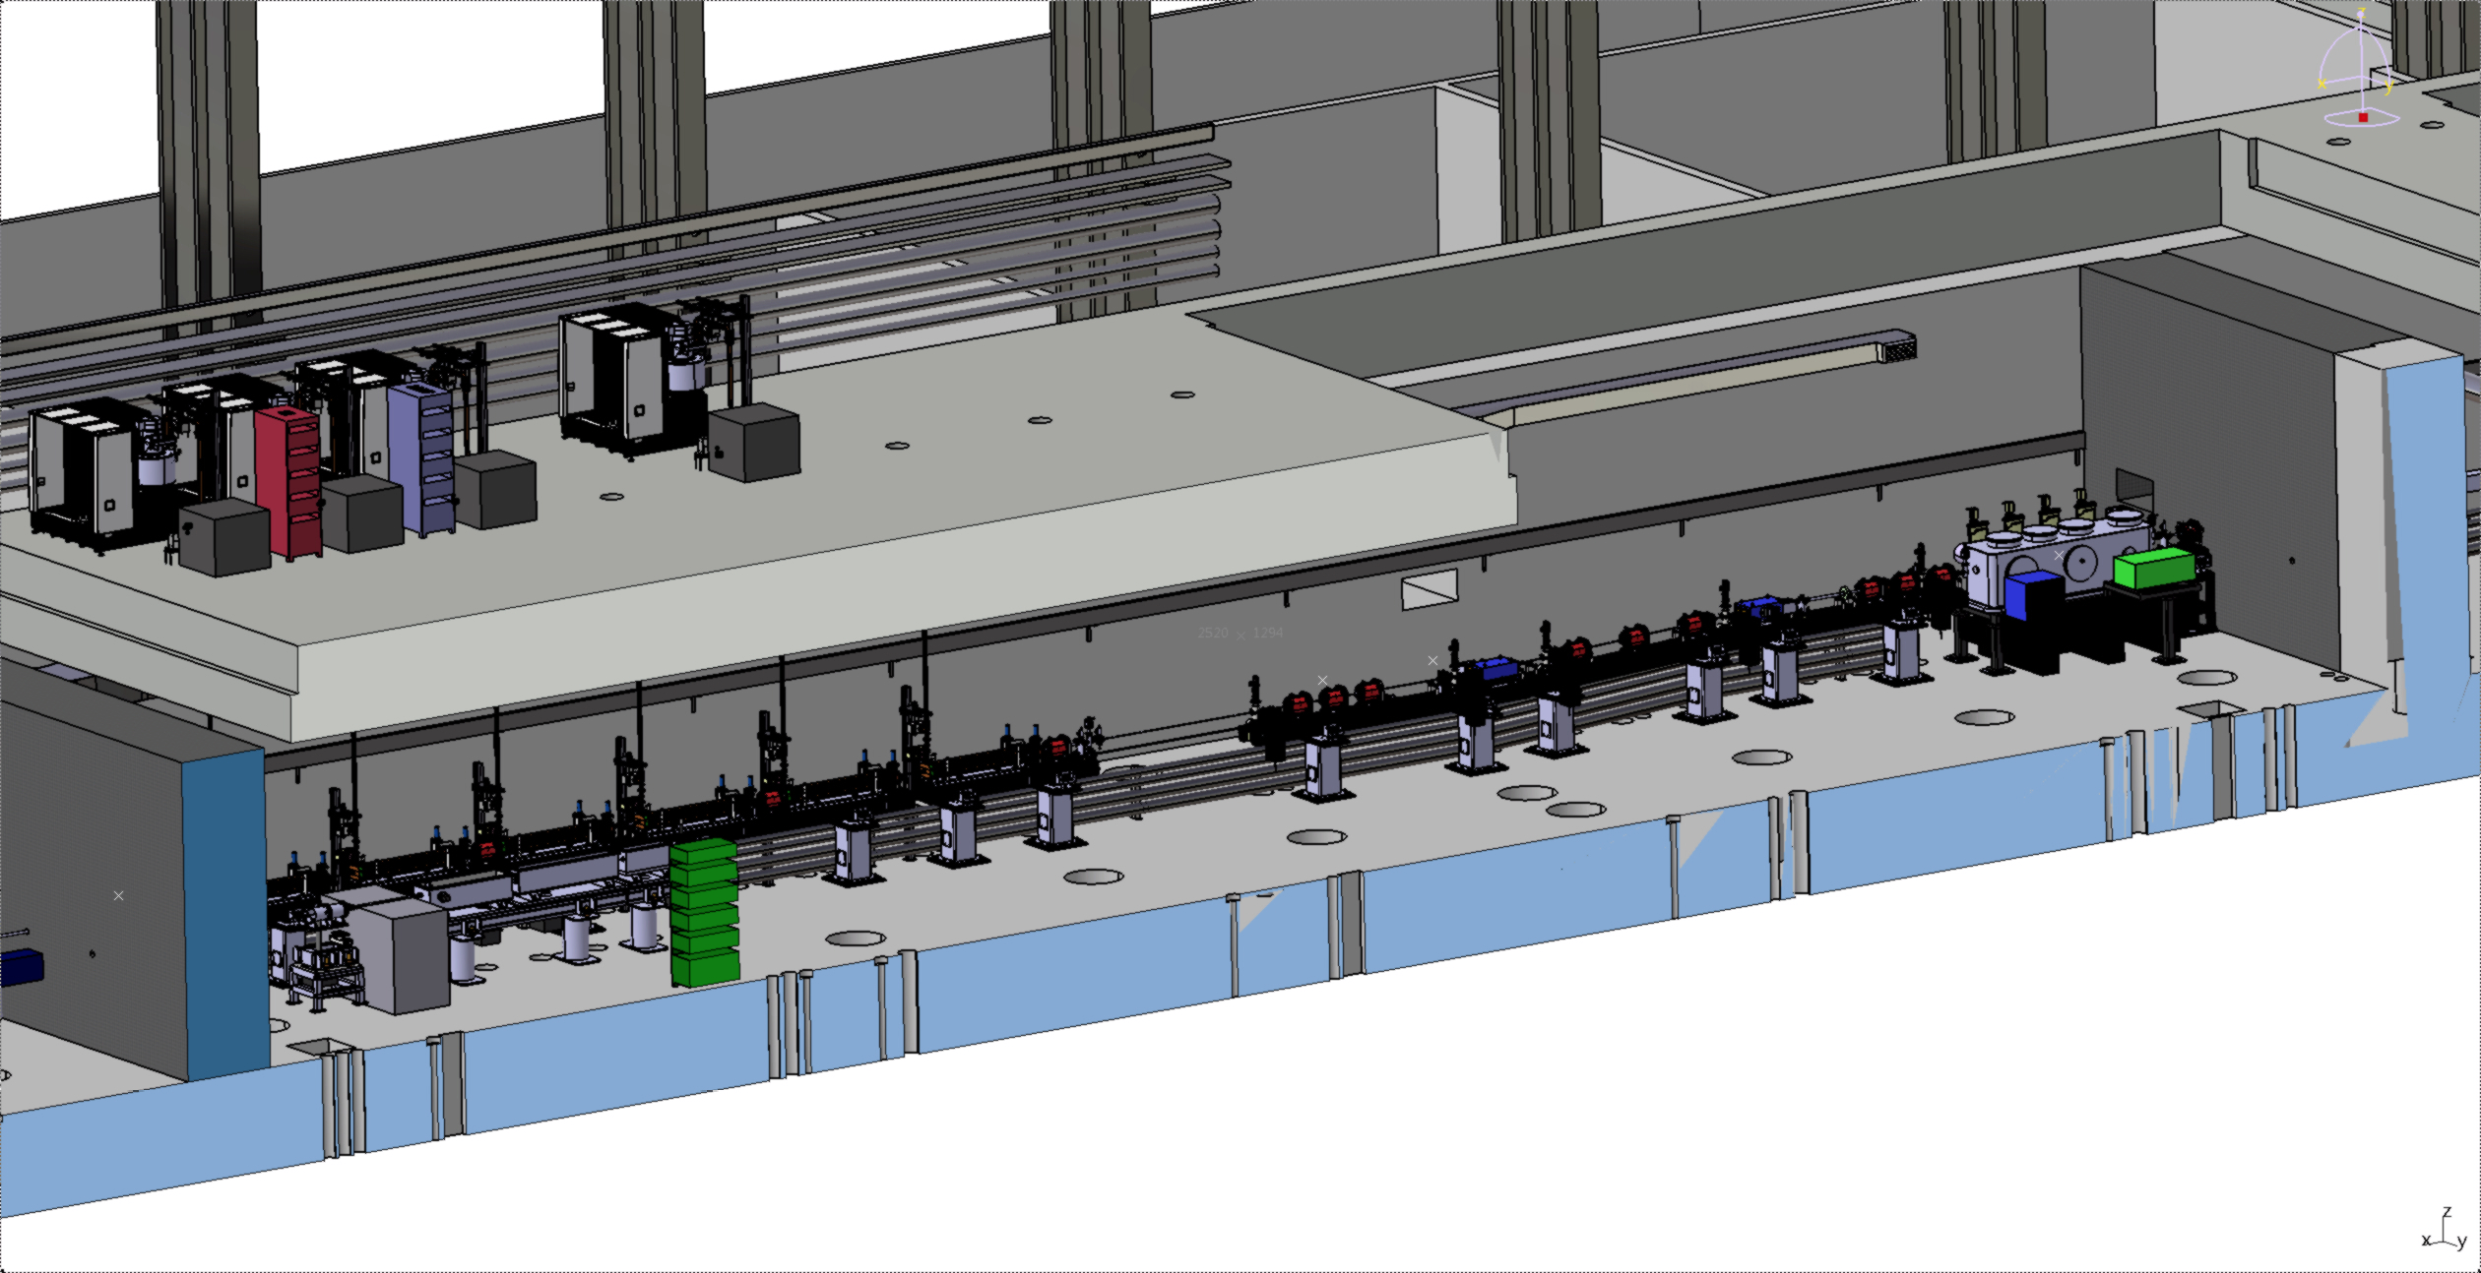
Gamma Beam System CAD 3D
Accelerator Bay 1
e– RF LINAC
Low Energy
300 MeV
Accelerator Bay 2
e– RF LINAC
High Energy
720 MeV
Courtesy of A.Fallone, V.Pettinacci

Slide 25
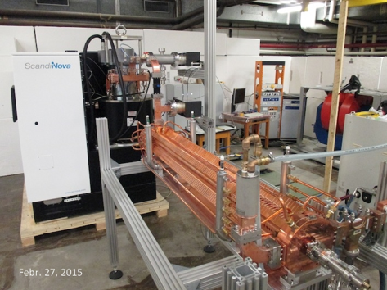
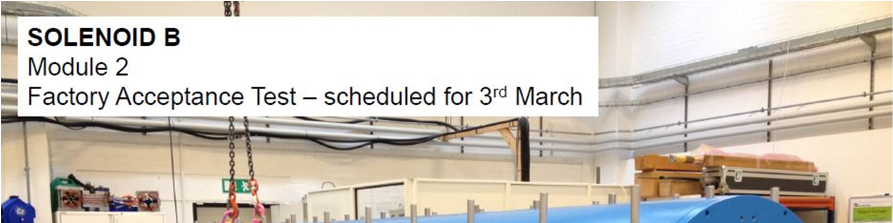
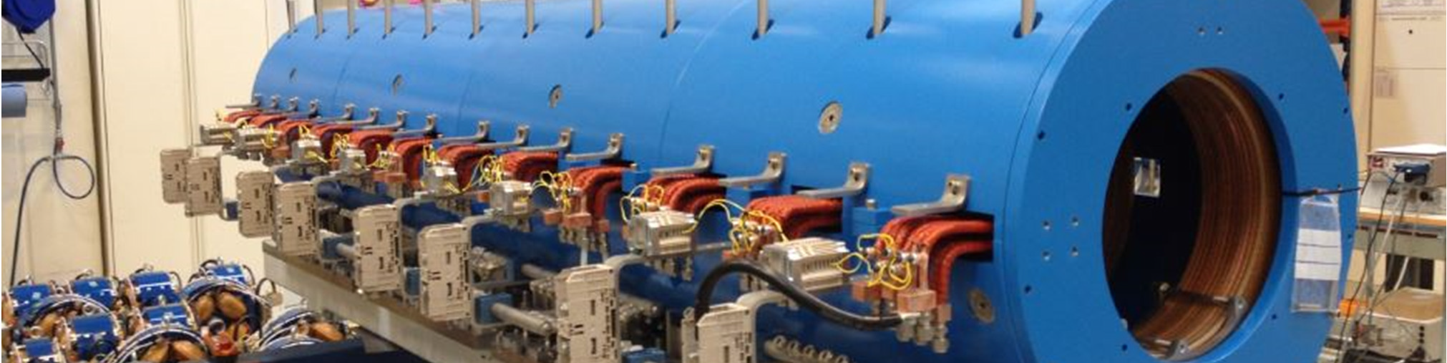
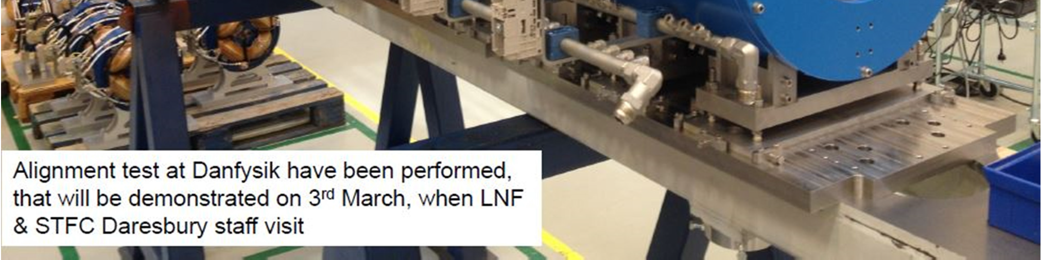
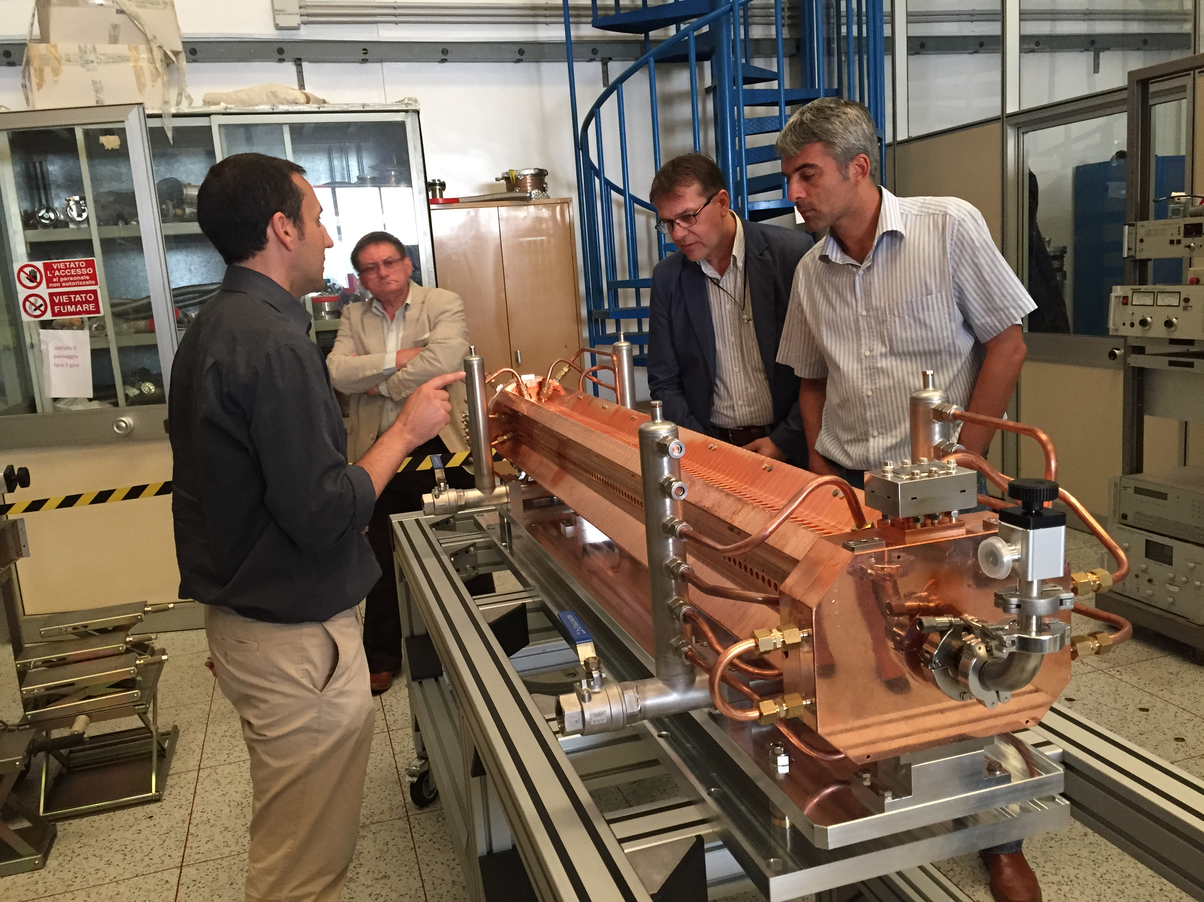
Factory Acceptance Tests
C–Band structure #0 + Modulator
Solenoid B
C–Band structure #1
ELI–NP visit to Frascati
June 25, 2015

Slide 26
ELI–NP Gamma Beam Features
Two stage system:
Low–energy stage: Eγ < 3.5 MeV
  March 2017
High–energy stage: Eγ < 19.5 MeV
September 2018
Energy (MeV) | 0.2 – 19.5
Spectral Density (ph/s∙eV) | > 0.5∙10⁴
Bandwidth rms (%) | ≤ 0.5
# photons per pulse within FWHM bdw. | ≤ 2.6∙10⁵
# photons/s within FWHM bdw. | ≤ 8.3∙10⁸
Source rms size (μm) | 10 – 30
Source rms divergence (μrad) | 25 – 200
Peak brilliance (N_{ph}/sec∙mm²∙mrad²∙0.1%) | 10²⁰ – 10²³
Radiation pulse length rms (ps) | 0.7 – 1.5
Linear polarization (%) | > 95
Macro repetition rate (Hz) | 100
# pulses per macropulse | 32
Pulse–to–pulse separation (nsec) | 16

Slide 27
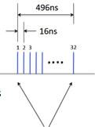

ELI–NP Gamma Beam Features
Two stage system:
Low–energy stage: Eγ < 3.5 MeV
  March 2017
High–energy stage: Eγ < 19.5 MeV
September 2018
Energy (MeV) | 0.2 – 19.5
Spectral Density (ph/s∙eV) | > 0.5∙10⁴
Bandwidth rms (%) | ≤ 0.5
# photons per pulse within FWHM bdw. | ≤ 2.6∙10⁵
# photons/s within FWHM bdw. | ≤ 8.3∙10⁸
Source rms size (μm) | 10 – 30
Source rms divergence (μrad) | 25 – 200
Peak brilliance (N_{ph}/sec∙mm²∙mrad²∙0.1%) | 10²⁰ – 10²³
Radiation pulse length rms (ps) | 0.7 – 1.5
Linear polarization (%) | > 95
Macro repetition rate (Hz) | 100
# pulses per macropulse | 32
Pulse–to–pulse separation (nsec) | 16
One pulse
~ 1 ps
~ 10⁵ photons

Slide 28
Photonuclear Reactions
Separation
threshold
~ 8 MeV
Absorption
γ
γ´
γ´
β
^{A´}Y
β
gs
^{A}X
Nuclear Resonance Fluorescence (NRF)
Photoactivation
Photodesintegration
Photofission
(-activation)

Slide 29
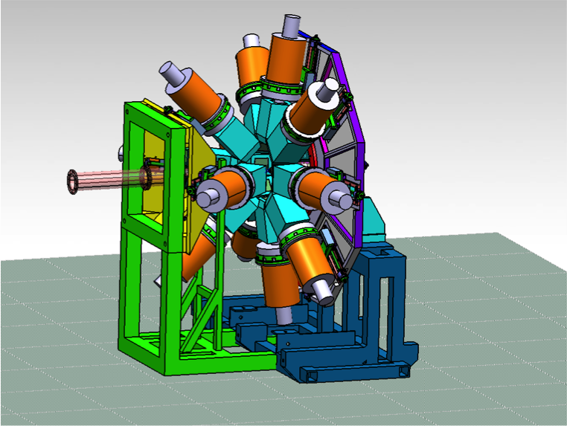








Gamma Beam Experiments
NRF
γANT
PhF
CPWG
γ Diagnostics
IndAppl
PHYSICAL & CHEMICAL TESTS
Radioisotopes
Positrons

Slide 30

Gamma Beam Experiments
Fundamental Research
  Nuclear Resonance Fluorescence (A.Zilges, C.A.Ur)
  Nuclear Astrophysics (γ,p) (γ,α) (M.Gai, O.Tesileanu)
  Photonuclear Reactions (γ,n) (H.Utsunomiya, F.Camera, D.Filipescu)
  Photofission&Studies of Exotic Nuclei (A.Krasznahorkay, F.Ibrahim, D.L.Balabanski)
Applications
  Gamma Imaging (H.Ohgaki, V.Iancu)
  Material Science with Positrons (C.Hugenschmidt, N.Djourelov)
  Medical Radioisotopes (D.Niculae, M.Bobeica)
R&D Diagnostics Detectors
  Gamma Beam Delivery and Diagnostics (H.Weller, C.A.Ur)
  Broad International Collaboration
  Germany, USA, Japan, Italy, Hungary, France,
  Poland, Vietnam, Switzerland, UK, Russia, …

Slide 31





Discovery Frontiers for NRF at ELI–NP
Availability frontier
access to rare isotopes
photoresponse of weakly abundant p–nuclei
and actinides
Sensitivity frontier
weak channels
rotational 2+ states of the nuclear
scissor modes
Precision frontier
high statistics
Γ₀ and Γ/Γ₀ measurements

Slide 32




Nuclear Resonance Fluorescence
Observables:
Excitation Energy E_{r}
Spin and parity J, π
Decay Energies E_{γ}
Partial Widths Γ_{i}/Γ₀
Multipole Mixing δ
Decay Strengths B(πλ)
Level Width Γ (eV)
Lifetime τ (ps – as)
ELI–NP
/ 1000
HIγS @ Duke U.
¹³⁸Ba (pol γ,γ‘)
Instrumentation:
Courtesy of N.Pietralla
ELIADE = ELI–NP Array of DEtectors
8 x TIGRESS – type Clover detector (segmented) with back–catcher (ε_{ph} ~ 6%)
4 x 3”x3” LaBr₃(Ce) detectors

Slide 33


The ELIADE Array
Background radiation in the detectors
Compton scattering of the beam
511 keV from positrons annihilation
Segmented Clover detectors + digital DAQ
Reduce the 511 keV background
Distinguish events from different pulses of gamma beam
Eliminate pile-up events

Slide 34

The ELIADE Array in E2 Experimental Area

Slide 35


Gamma Above n Threshold
Studies of GDR and PDR decay
Studies of spin–flip M1 resonances
(γ,n) cross section measurements, e.g. p–process related measurements:
  the ¹³⁸La(γ,n) ¹³⁷La reaction
  the ¹⁸¹Ta(γ,n)¹⁸⁰Ta reaction
  the ¹⁸⁰Ta^{m}(γ,n)¹⁷⁹Ta reaction
Instrumentation:
³He neutron counter array
LaBr₃(Ce) / CeBr₃ array – gamma rays
NE213 liquid scintillator array – neutrons

Slide 36



Nuclear Astrophysics
Molecular states and symmetries in light nuclei
The ¹⁶O(γ,α)¹²C reaction
The ²⁴Mg(γ,α)²⁰Ne reaction
The ²²Ne(γ,α)¹⁸O reaction
The ¹⁹F(γ,α)¹⁸O reaction
The ²¹Ne(γ,α)¹⁷O reaction
Instrumentation:
Large–area Si DSSD array
eTPC

Slide 37

Nuclear Astrophysics
Molecular states and symmetries in light nuclei
The ¹⁶O(γ,α)¹²C reaction
The ²⁴Mg(γ,α)²⁰Ne reaction
The ²²Ne(γ,α)¹⁸O reaction
The ¹⁹F(γ,α)¹⁸O reaction
The ²¹Ne(γ,α)¹⁷O reaction
Instrumentation:
Large–area Si DSSD array
eTPC
Day One experiment:
The ⁷Li cosmological problem
ELI-NP will be the ideal cite to study the
⁷Li(γ,α)³H reaction

Slide 38



Photofission
Studies in the 2nd and 3rd minimum of the fission barrier: transmission resonances
Rare fission modes: ternary fission
Structure of neutron–rich nuclei: the rare–earth neutron–rich deformed region
Instrumentation:
System of multi–target Frisch–gridded twin ionization chambers and DSSD detectors
Array of 12 x THGEM detectors

Slide 39

Photofission and Exotic Nuclei
ALTO, ARIEL, etc.
Photofission cross section for ²³⁸U
Caldwell et al., Phys. Rev. C 21 (1980) 1215

Slide 40
Photofission and Exotic Nuclei
ALTO, ARIEL, etc.
ELI-NP
Inverse Compton Scattering
Photofission cross section for ²³⁸U
Caldwell et al., Phys. Rev. C 21 (1980) 1215
5 x 10¹⁰ photons/s

Slide 41

Gamma Beam Industrial Applications
Non–destructive Inspection
Active interrogation – Nuclear resonance fluorescence
Nuclear waste management
Cargo screening/Material identification
Origin of objects
Metal count in food and in plants
Density screening in ill tissue
High resolution imaging – Radiography and Tomography
Test quality of industrial objects (engines faults, steel quality)
Test strength of sinterization/welding
Phase distribution
Diffusion
2θ
NRF + CT: Elemental/isotopic maps

Slide 42



Summary
a new research facility is being under construction at Bucharest
  beyond state–of–the–art systems : HPLS and GBS
many new research opportunities
  nuclear physics
    Laser Driven Nuclear Physics, QED, combined laser–gamma
    NRF, photofission, photodissociation
  applications
    materials in extreme environments
    non–destructive inspection
      tomography and radiography with high energy gamma rays
      active interrogation with NRF

Slide 43





Slide 44

Gamma Beam Industrial Applications
Active interrogation of objects using Nuclear Resonance Fluorescence (NRF)
High intensity gamma beam and small bandwidth
Tunable energy
High efficiency detector array – ELIADE
Witness foil (sample)
Object
Object
ELI-NP
γ beam
ELI-NP
γ beam
Two experimental methods will be carried out:
  Scattering NRF – Standard Method in Nuclear Physics Study
  Self-absorption/Transmission NRF (proposed by Bertozzi in 2005)
    Main interest in SNM control management

Slide 45




Gamma Beam Industrial Applications
Radiography and tomography: Imaging large and/or complex objects with high resolution
Performance estimated based on analytical model and GEANT4 simulations
2θ
Grid pattern
Phantom
Analytical model: estimate measurement time, count rates, expected resolution
Measurement time scales with 1/a⁴
Measurement time scales with S²
S – significance factor; a – thickness/width of the grid; d – distance source-grid;

