Slide 1
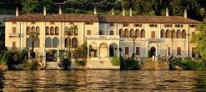
Varenna Workshop on Future Research Infrastructure; Challenges and Opportunities
Lucio Rossi
CERN
High Luminosity LHC Project Leader
Villa Monastero, 9 July 2015

Slide 2
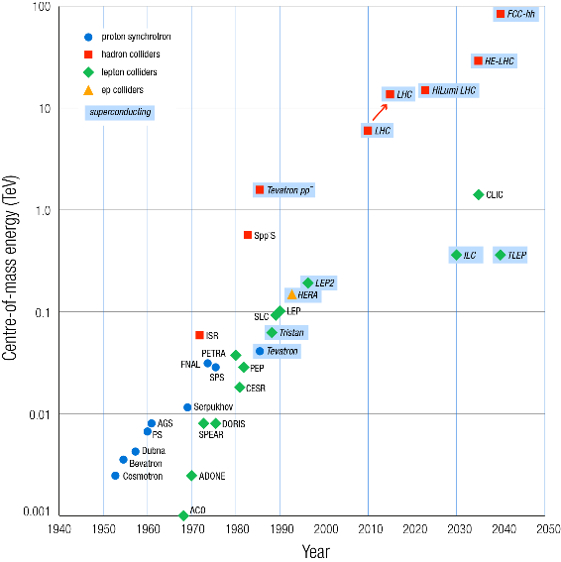
Accelerators progress: SC domination

Slide 3
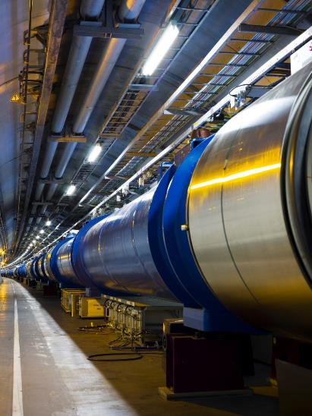
LHC; the largest instrument
27 km, p-p at 7+7 TeV
3.5+3.5 start, 4+4 in 2012
6.5+6.5 TeV in 2015!
1232 x 15 m Twin Dipoles
Operational field 8.3 T @11.85 kA
(9 T design)
HEII cooling, 1.9 K with 3 km circuits (130 tonnes He inventory).
Field homogeneity of 10⁻⁴, bending strength uniformity better then 10⁻³. Field quality control (geometric and SC effects) at 10⁻⁵.

Slide 4
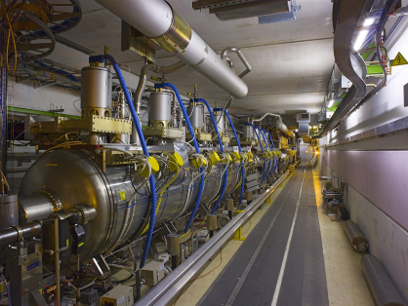
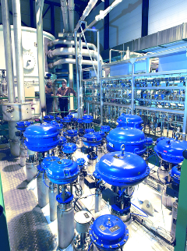
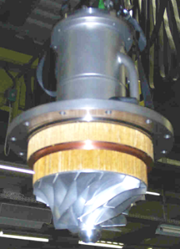
SCRF, Cryo…
400 MHz Standing wave RF
4 single cell cavities in cryomodule, 2 crym per beam. Total 16 cavities.
Sputtered niobium design (as LEP)
Gradient 5.5 MV/m nominal (8 MV/m available)
Nominal 2MV, up to 3 MV at 8 MV/m
Cryo : 8 x 18 kW@4.5K

Slide 5
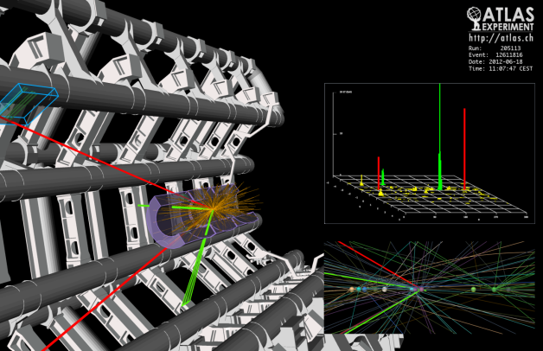
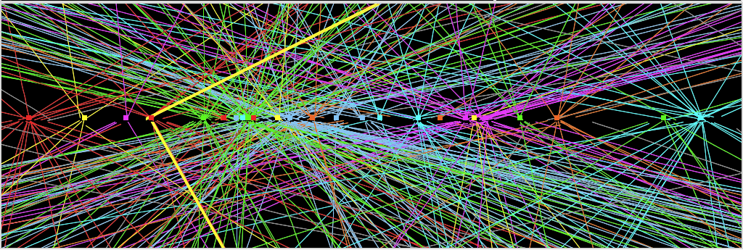
The Higgs: the needle in a haystack
Z→ μμ
Z→ μμ event from 2012 data with 25 reconstructed vertices

Slide 6

Luminosity ∝ collision rate

Slide 7
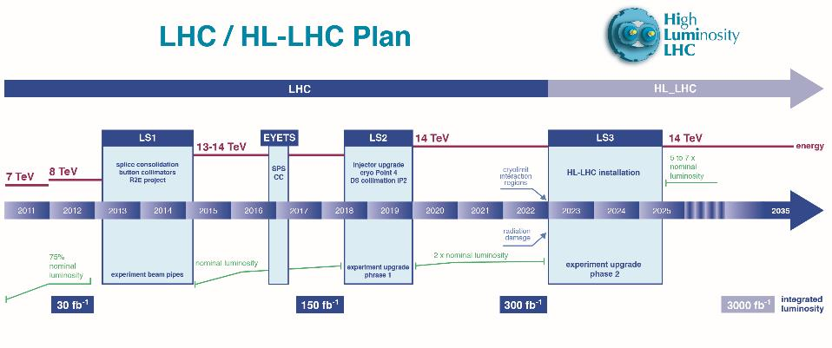
Run I
Run II
Run III
Run IV, V…
0.75 10³⁴ cm⁻²s⁻¹
50 ns bunch
high pile up ∼40
1.5 10³⁴ cm⁻²s⁻¹
25 ns bunch
pile up ∼40
1.7-2.2 10³⁴ cm⁻²s⁻¹
25 ns bunch
pile up ∼60
Technical limits to lumi increase (Machine & Experiments)
50 ⇒ 25 ns

Slide 8
Run I
Run II
Run III
Run IV, V…
Lay-out, permits, tenders, preparation
Excavation period
Surface buildings and services
Civil engineer works for HL-LHC
Problem of vibrations makes difficult/impossible to excavate during Run III

Slide 9
Goal of High Luminosity LHC (HL-LHC) as fixed in November 2010
The main objective of HiLumi LHC Design Study is to determine a hardware configuration and a set of beam parameters that will allow the LHC to reach the following targets:
A peak luminosity of 5×10³⁴ cm⁻²s⁻¹ with levelling, allowing:
An integrated luminosity of 250 fb⁻¹ per year, enabling the goal of 3000 fb⁻¹.
This luminosity is more than ten times the luminosity reach of the first 10 years of the LHC lifetime.
Concept of ultimate performance (Oct.2013, ECFA & RLIUP) under study:
L_{peak} ≅ 7.5 10³⁴ cm⁻²s⁻¹ and Int. L ∼ 4000 fb⁻¹
LHC should not be the limit, would Physics require more…

Slide 10
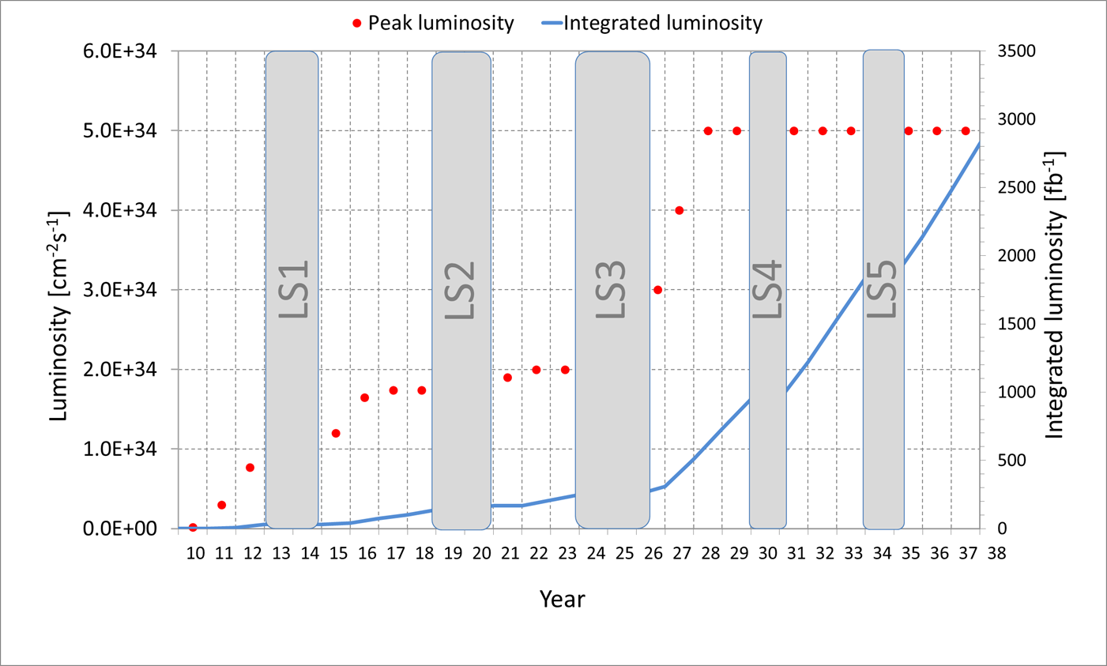
Nominal upgrade parameters
3000 fb⁻¹ would be reached in 2038
Nominal lumi paramters
L = 5 10³⁴ cm⁻²s⁻¹
Int. L = 3000 fb⁻¹
Pile up μ ∼ 140

Slide 11
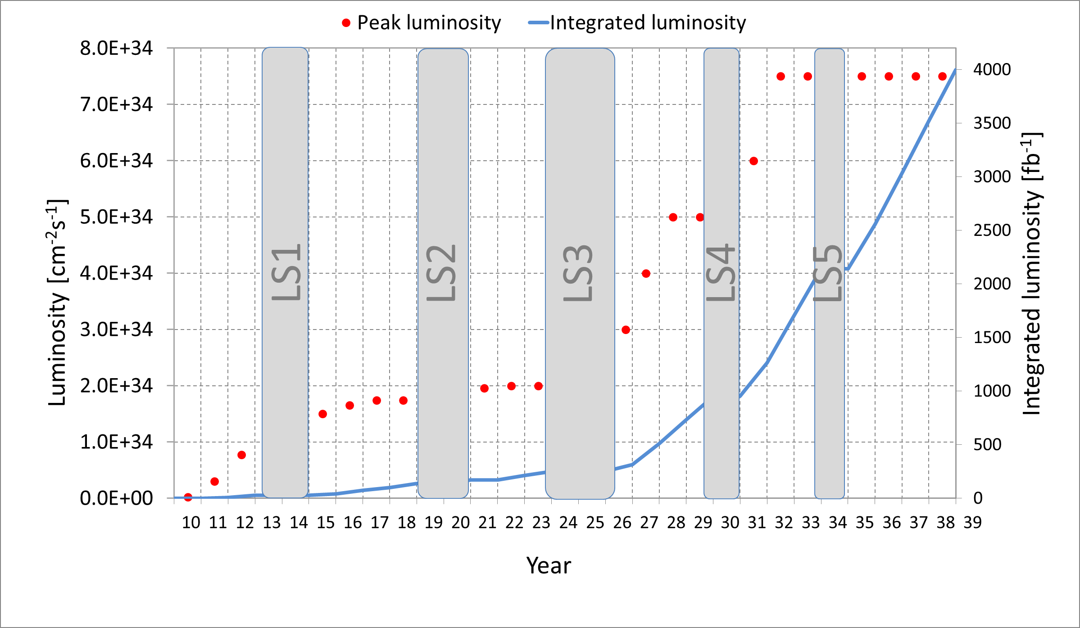
Ultimate performance: 4000+ fb⁻¹ by 2038
Ultimate lumi (not yet studied in details)
L = 5 → 7-7.5 10³⁴ cm⁻²s⁻¹
Int. L = 3000 → 4000 fb⁻¹
Pile up μ ∼ 200

Slide 12


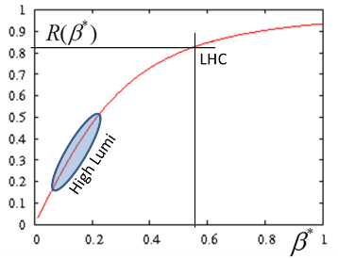

Luminosity the main ingredients
L_{int}
Beam current
energy
Beam size
Beam current and emittance: involve injection chain and whole ring
β∗ involves «only» 2 IRs, 2x600 m
Unit of lumi through the talk
LHC has been designed for L₀ with margin
All systems have ∼ designed to withstand 2L₀ (to be achieved by increasing N_{b} x 1.5)

Slide 13
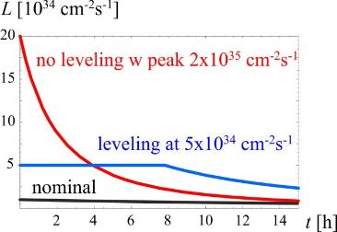
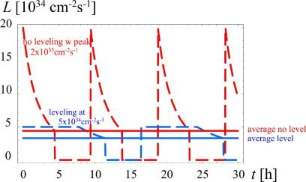
Luminosity and levelling - 2
Levelling: F. Zimmermann, JP Koutchouk and G. Sterbini
It reduces the pile up in the detector : data quality!
    It reduces the collision debris:
        Acceptable level of heat deposition in the triplets and other magnets
        Less radiation effect du to peak radiation

Slide 14

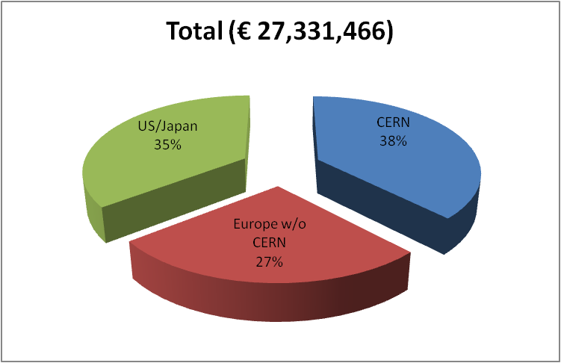
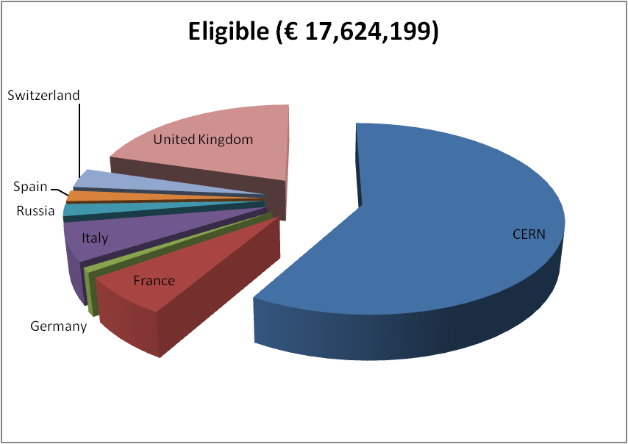
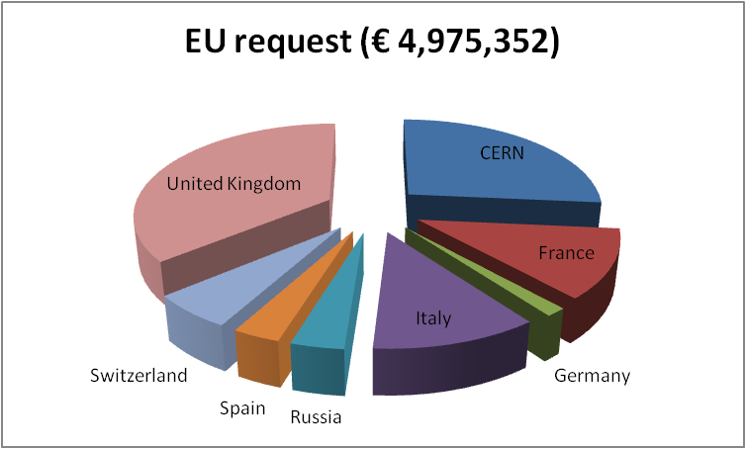
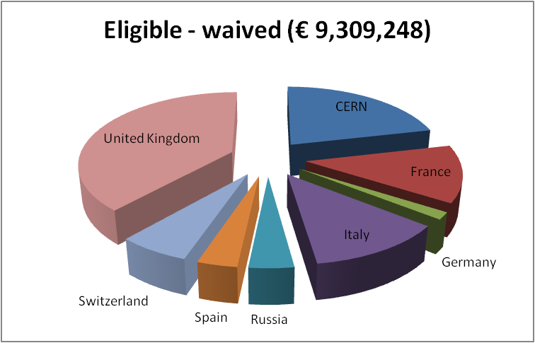
Budget FP7 HiLumi DS
CERN waives all technical works:
LHC is core program.
Only kept the CERN cost for managem.
Only EU research area
Perfect score 15/15, 100% budget
Waiving effect
50%
85% of CERN gen. mngt

Slide 15
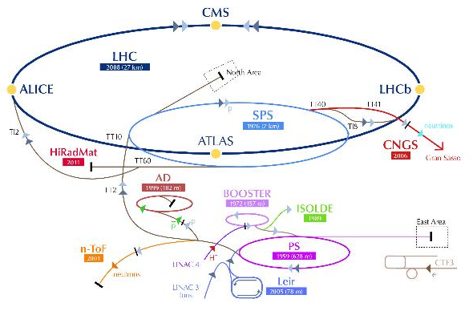
LIU Project Definition
Mandate (December 2010)
“The LHC Injectors Upgrade should plan for delivering reliably to the LHC the beams required for reaching the goals of the HL-LHC. This includes LINAC4, the PS booster, the PS, the SPS, as well as the heavy ion chain.”
Implementation
The LIU Project will:
  Analyze the status of the injectors and the HL-LHC requirements,
  Propose an upgrade path for the injectors, exploiting the work done by the Task Forces on the „PSB energy upgrade“ and „SPS upgrade“ and by the Working Group on the SPS upgrade,
  Organize the upgrades (WBS with resources and planning) and take care of their implementation,
  Take care of hardware and beam commissioning.

Slide 16
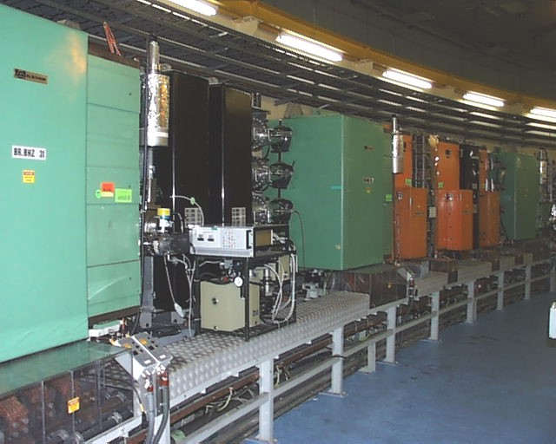
PSB upgrade
Beam Dynamics
Magnets
RF Systems
Power Converters
Beam Instrumentation
Beam Intercepting Devices
Vacuum System
LINAC4 to PSB transfer line and PSB injection systems
PSB Extraction system and PSB-PS transfer line
Controls
Electrical Systems
Cooling and Ventilation
Installation, Transport and Handling
Civil Engineering
Radiation Protection
Interlock Systems
Survey
Commissioning and Operation
Half-Sector Test Project + Stripping Foil Test
Increased intensity and brightness
160 MeV H⁻ injection
2 GeV upgrade
All details are available at: https://espace.cern.ch/liu-project/liu-psb/default.aspx

Slide 17
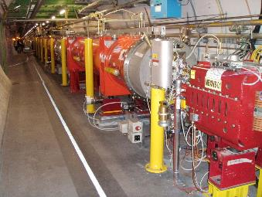
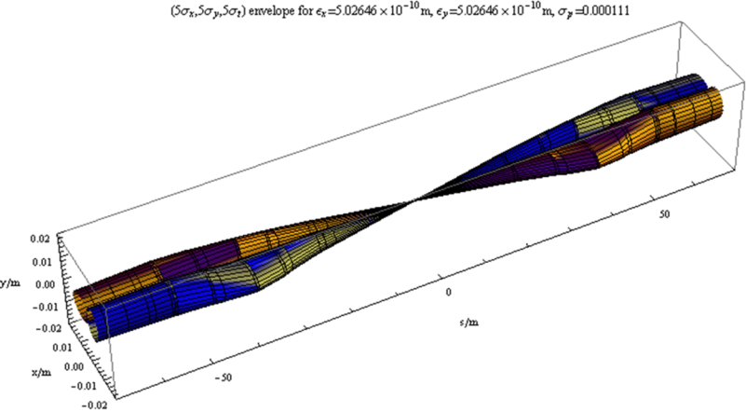
Increasing luminosity by reducing beam size with a «local» action
Quadrupole triplet and D1
Smaller β∗ ⇒ larger IT aperture
LHC has better aperture than anticipated: now all margin can be used; however is not possible to have β∗ < 40 cm (55 cm being the nominal)

Slide 18
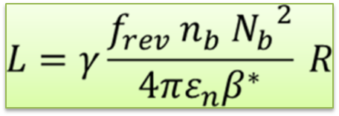
Parameters LHC and HL-LHC (PLC)
Parameter | Nominal LHC | HL-LHC 25ns​ (standard) | HL-LHC 25ns (BCMS) ⁹ | HL-LHC 50ns
Beam energy in collision [TeV] | 7 | 7 | 7 | 7
N_{b} | 1.15E+11 | ​2.2E+11 | ​2.2E+11 | ​3.5E+11
n_{b} | ​2808 | 2748 | 2604 | 1374
Number of collisions in IP1 and IP5 ¹ | 2808 | 2736 | 2592 | 1368
N_{tot} | 3.2E+14 | 6.0E+14 | 5.7E+14 | 4.9E+14
beam current [A] | ​0.58 | 1.09 | 1.03 | 0.89
x-ing angle [μrad]​ | 285 | 590 | 590 | 590
beam separation [σ] | 9.4 | 12.5 | 12.5 | 11.4
β* [m] | 0.55 | ​0.15 | ​0.15 | ​0.15
ε_{n} [μm]​ | 3.75 | ​2.50 | ​2.50 | 3
IBS horizontal [h] | ​80 -> 106 | 18.5 | 18.5 | 17.2
IBS longitudinal [h] | 61 -> 60 | 20.4 | 20.4 | 16.1
Total loss factor R0 without crab-cavity | ​0.836 | 0.305 | 0.305 | 0.331
Total loss factor R1 with crab-cavity | (0.981) | 0.829 | 0.829 | 0.838
beam-beam / IP without Crab Cavity | 3.1E-03 | ​3.3E-03 | ​3.3E-03 | 4.7E-03
beam-beam / IP with Crab cavity | 3.8E-03 | 1.1E-02 | 1.1E-02 | 1.4E-02
Peak Luminosity without crab-cavity [cm⁻² s⁻¹] | 1.00E+34 | 7.18E+34 | 6.80E+34 | 8.44E+34
Virtual Luminosity with crab-cavity: Lpeak*R1/R0 [cm⁻² s⁻¹] | (1.18E+34) | 19.54E+34 | 18.52E+34 | 21.38E+34
Events / crossing without levelling and without crab-cavity | 27 | 198 | 198 | 454
Levelled Luminosity [cm⁻² s⁻¹] | - | ​5.00E+34 ⁵ | ​5.00E+34 | 2.50E+34
Events / crossing (with leveling and crab-cavities for HL-LHC) ⁸ | 27 | 138 | 146 | 135
Peak line density of pile up event [event/mm] (max) | 0.21 | 1.25 | 1.31 | 1.20
Leveling time [h] (assuming no emittance growth) ⁸ | - | 8.3 | 7.6 | 18.0

Slide 19
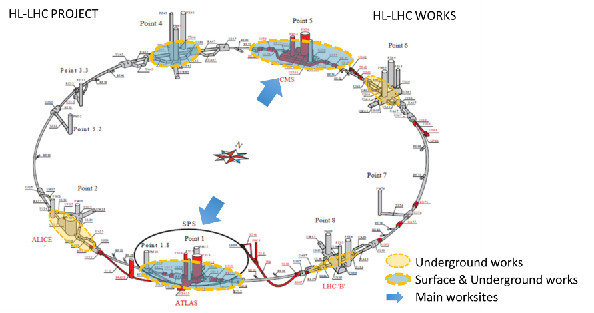
Works in various part of the ring

Slide 20
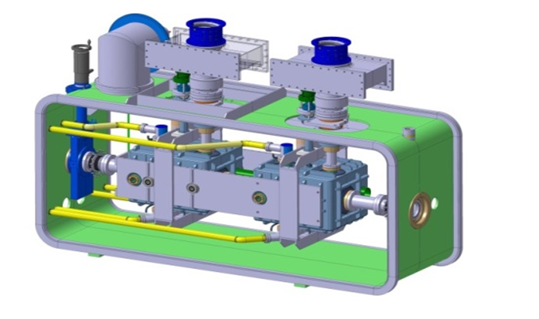
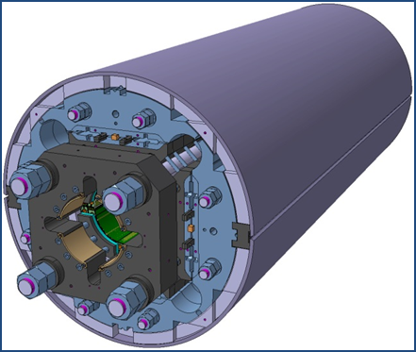
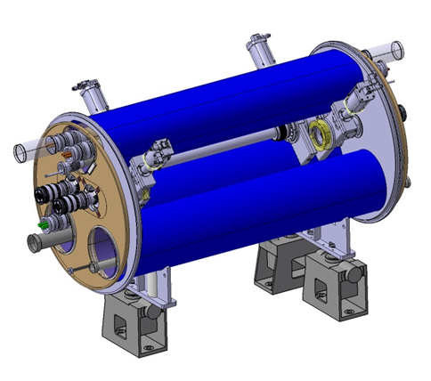
The largest HEP accelerator in construction
ATLAS
CMS
Dispersion Suppressor (DS)
Matching Section (MS)
Interaction Region (ITR)
Modifications
In IP2: new DS collimation with 11 T
In IP7 new DS collimation with 11 T
Complete change and new lay-out
TAN
D2
CC
Q4
All correctors
Q5 (Q6 @1.9 K?)
New MQ in P6
New collimators
Complete change and new lay-out
TAS
Q1-Q2-Q3
D1
All correctors
Heavy shielding (W)
Cryogenics, Protection, Interface, Vacuum, Diagnostics, Inj/Extr… extension of infrastr.
> 1.2 km of LHC !!
Notes:
Inner Triplet Magnets: Actual radiation damage on the Inner Triplets Magnets is expected already at the level of integrated dose of LHC. The replacement of the triplet must be anticipated before damage occurs, because of the serious and long intervention (requiring one to two years shutdown)
Collimation: The present collimation system will need an upgrade that takes in account the increased beam intensities and the need to protect the new triplets in IR1 and IR5. This would require the replacement of some of the LHC main dipoles with dipoles of equal bending strength (∼120 T⋅m), but obtained by a higher field (11 T) and shorter length (11 m) than those of the LHC dipoles (8.3 T and 14.2 m), gaining in this way enough room for installing the new special collimators.

Slide 21
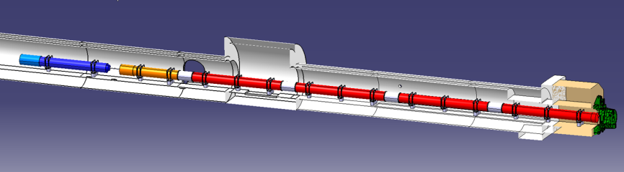
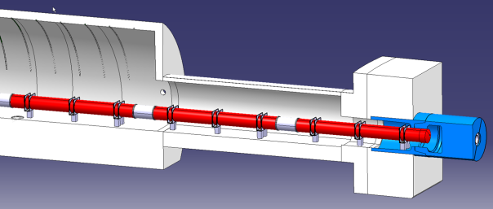
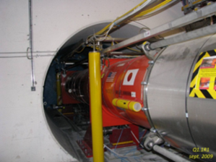
Integration view of IT zone
(InTeraction Region, ITR)
ATLAS
CMS
P. Fessia
JP. Corso and EN-MEF int. team

Slide 22
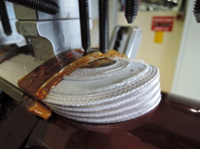
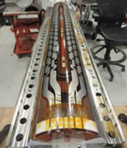
Progress for MQXF – Nb₃Sn
(low-β quads, or Inner Triplet IT quads)
First paper: INFN/TC-95/25, 13 Sept ‘95, «Preliminary proposal of Nb₃Sn Quadrupole for the LHC Low-β»
CERN study in 2001-02 (F. Ruggiero WG, LHC report 626, Dec 2002)
CERN & USA study (J. Strait et al., PAC03; F. Ruggiero et al., EPAC04)
12 y of LARP R&D for Nb₃Sn quad from 2004
USA-DOE Nb3Sn conductor R&D from 1998!
NbTi upgrade (Phase I project, stopped in 2010.
It is the cornerstone of the HL-LHC
  Performance! (∅=150 mm, B_{op}=12.1 T! B_{des}=13.5 T)
  New technology, Nb₃Sn, J_{c} 3 times ITER)
  We cannot miss it
  ⇒ It is the item more studied
CERN short coil n.4 with NbSn cable
LARP short coil n.6
with Nb₃Sn cable

Slide 23
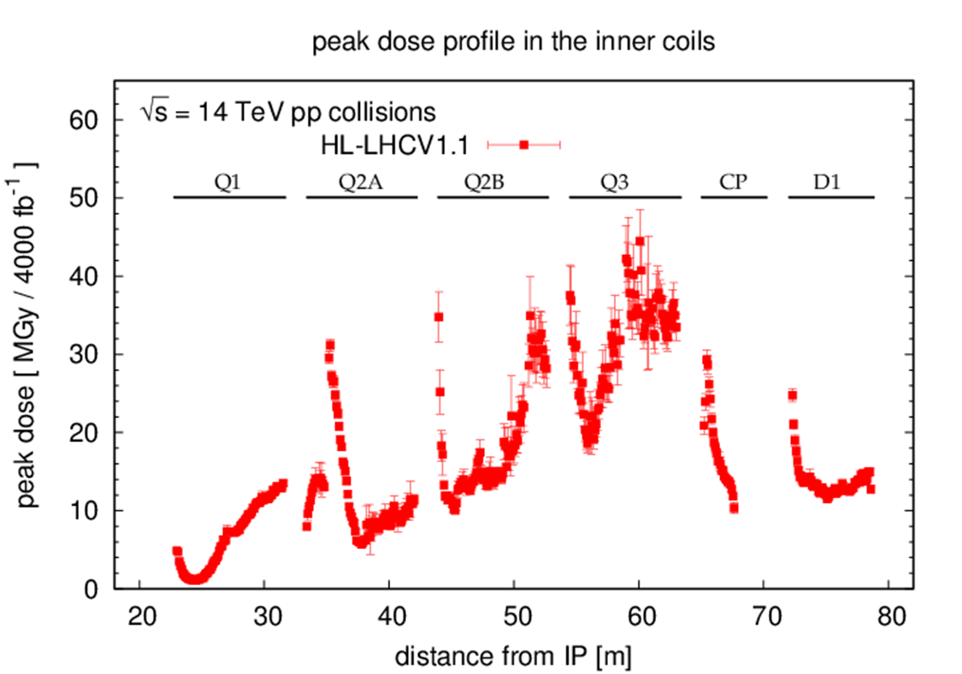
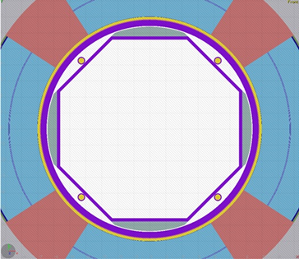
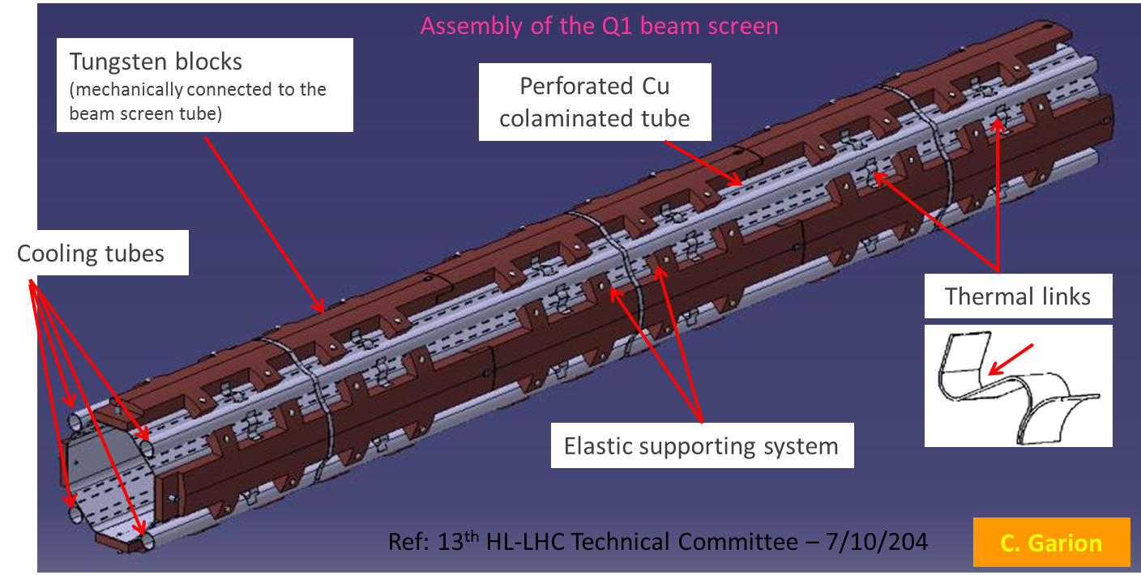
Thanks to better shielding the new triplet will survive 4000 fb⁻¹
Optimisation ongoing,
should reduce 10-20%
Peak dose @ 3000 fb⁻¹
W-shielded beam screen is a cornestone of the project

Slide 24
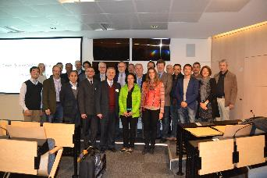
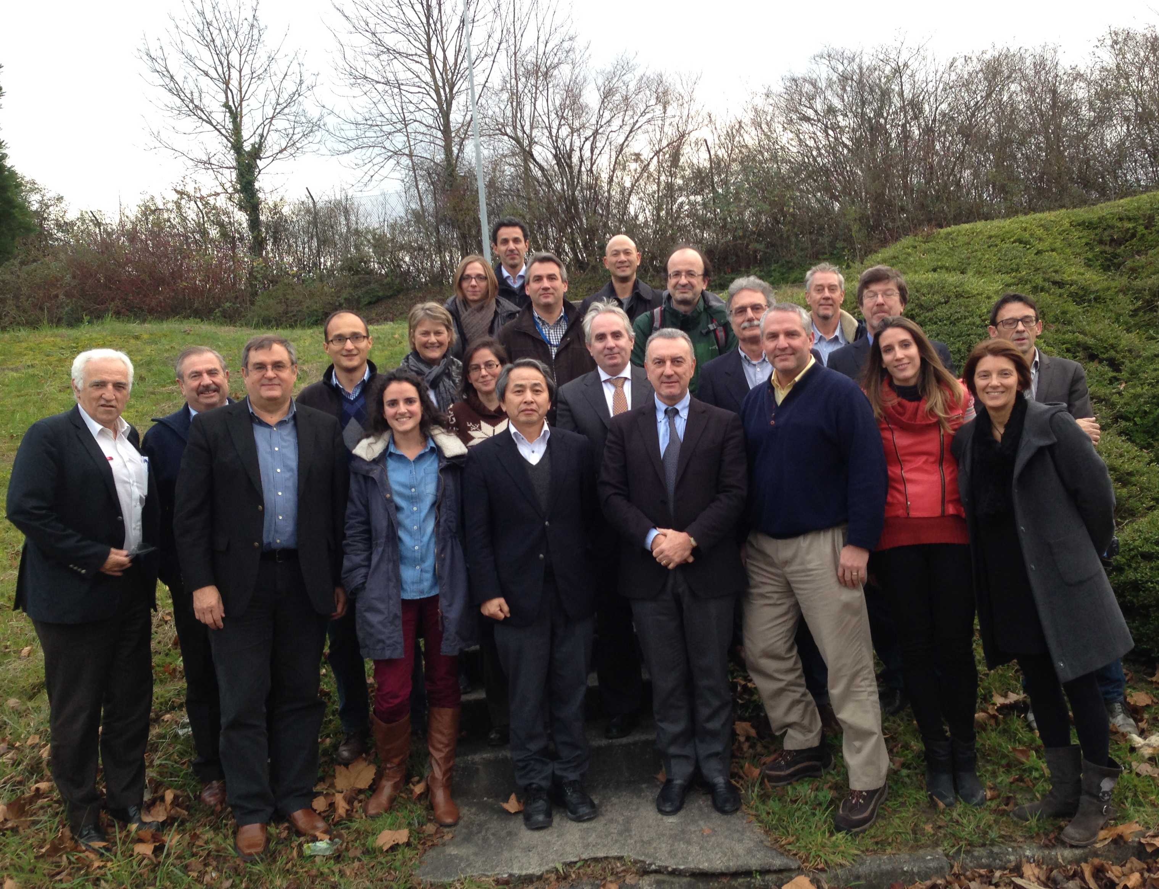
Two International Reviews
Nov. 2015:Review of MQXF (triplet quadrupoles) Conductors (Nb₃Sn)
  Increase margins by 5%
  Support development at second producer (PIT)
  Support for low keystone cable (for PIT)
Dec. 2015: Review of the MQXF Design
  Design very well advanced: 150 mm fine!
  Decrease operating current (by 5%) with longer magnets
  Low keystone cable for both PIT & RRP
  Excellent teamwork CERN-LARP

Slide 25
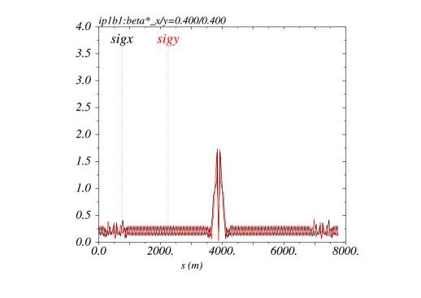
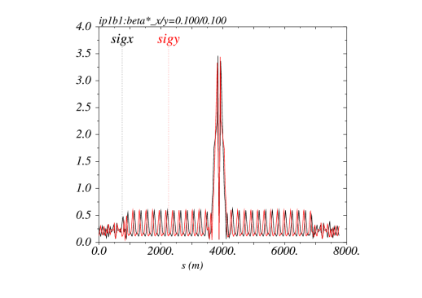
The Achromatic Telescopic Squeezing (ATS) scheme
Small β* is limited by aperture but not only: optics matching & flexibility (round and flat optics), chromatic effects (not only Q’), spurious dispersion from X-angle,..
A novel optics scheme was developed to reach un-precedent β* w/o chromatic limit based on a kind of generalized squeeze involving 50% of the ring
(S. Fartoukh)
β*= 40 cm
β*= 10 cm
The new IR is sort of 8 km long !
Beam sizes [mm] @ 7 TeV from IR8 to IR2 for typical ATS
“pre-squeezed” optics (left) and “telescopic” collision optics (right)

Slide 26
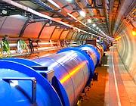
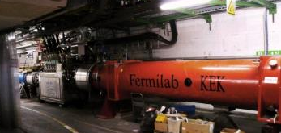
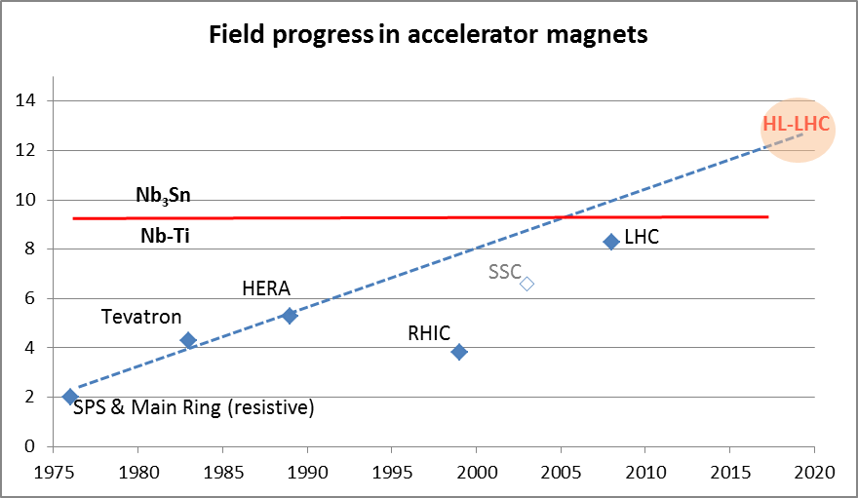
Magnet the progress
LHC dipoles features 8.3 T in 56 mm (designed for 9.3 peak field)
LHC IT Quads features 205 T/m in 70 mm with 8 T peak field
HL-LHC
  11 T dipole (designed for 12.3 T peak field, 60 mm)
  New IT Quads features 140 T/m in 150 mm > 12 T operational field, designed for 13.5 T).

Slide 27
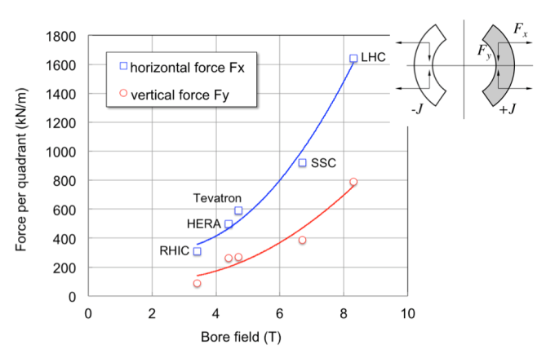
Going up to 11 or 12 T : forces doubles
HiLumi magnets!

Slide 28
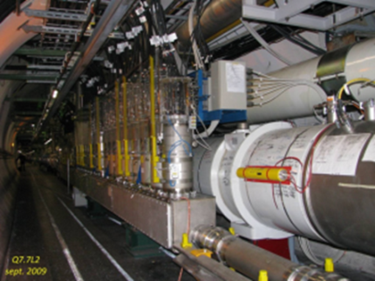
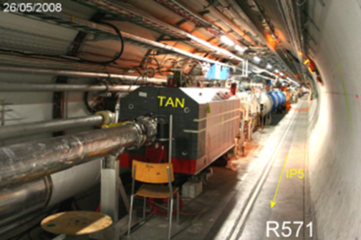
MS magnets have to upgraded
But also cryogenic separation from arc
The cryoline is continous between the continuous cryostat (Regular lattice Arc and DS Arc) and the MS-IT zones. This connections have consequences:
Makes a limitation in cryopower since the IT zone will increase the power deposited with the lumi increase
A stop in the MS or IT zone would entail a thermal cycle on the entire Sector

Slide 29
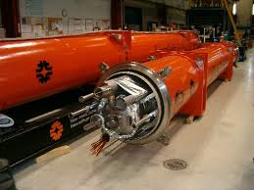
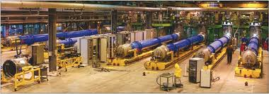
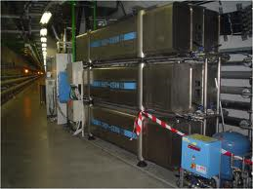
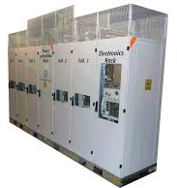
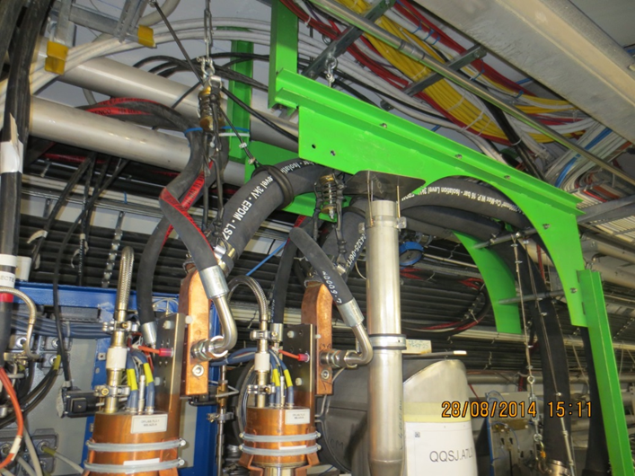

Magnets must be cryostated, tested, cooled, protected, powered, aligned, …
Cryostats
Testing
Protection
EPC,Cables, DFB:
Alignment

Slide 30




IT cryoplants and new LSS QRL
Availability: separation New Inner Triplets (and IPM in MS) from the arc cryogenics.
Keeping redundancy for nearby arc cryoplant
Redundancy with nearby Detector SC Magnets cryoplant

Slide 31


Beating the Reduction Factor:
Crab Cavities
RF crab cavity deflects head and tail in opposite direction so that collision is effectively “head on” and then luminosity is maximized
Crab cavity maximizes the lumi and can be used also for luminosity levelling: if the lumi is too high, initially you don’t use it, so lumi is reduced by the geometrical factor. Then they are slowly turned on to compensate the proton burning
F. Zimmermann LHC promoter!

Slide 32


Crab Cavity, for p-beam rotation at tens fs level precision !
And compact!
Elliptical type CC has been tested first in KEK 2008

Slide 33
Situation: from drawings to reality…
LARP-BNL
LARP-ODU-JLAB
Uni.Lancaster-CI-CERN

Slide 34



And excellent results: RF dipole > 5 MV
¼ w and 4-rods also tested (1.5 MV) cleaning & vacuum issues: new test under way
2 K result
4.2 K result
Quench
Goal is 3.3 MV
ΔV > 5 MV would be an asset
J. Delayen
5

Slide 35


CC: for preparing LHC we need a test in SPS
Present baseline: 4 cavity/beam-IP side
TEST in SPS under preparation (A. MacPherson)

Slide 36



Downselection and accelerator cavity designs: test by 2015
RF Dipole: Waveguide or
waveguide-coax couplers
International Review Committee to assess CC downselection, BNL, May 2014
Double ¼-wave: Coaxial couplers with
hook-type antenna
E. Jensen (CERN)
G. Burt (Uni.Lancaster, CI)
R. Calaga (CERN, former LARP)
A. Ratti (LBNL, LARP)

Slide 37

Increased beam intensity and Lumi: collimation upgrade, new materials
OPTIONS under investigation

Slide 38




IP2 - DS collimators ions – 11 T (LS2 -2018)
IP7 – DS collimators in the betatron cleaning(LS3)
Recommended by the Collimation Review
11 T Nb₃Sn
F. Savary (11 T)
S. Redaelli (collimation)

Slide 39

CERN 11 T dipole (1.8 m long model)

Slide 40



Low impedence collimators(LS2 & LS3)
New material: MoGr
S. Redaelli
A. Bertarelli

Slide 41
Preparing the fututre ...
Future Circular Collider
HE-LHC :33 TeV
with 20T magnets
First studies on a new 80-100 km tunnel in the Geneva area
  42 TeV with 8.3 T using
  present LHC dipoles
  80 TeV with 16 T based
  on Nb₃Sn dipoles
  100 TeV with 20 T based
  on HTS dipoles

Slide 42

Is it really possibile to go so high?
Looking at performance offered by practical SC, considering tunnel size and basic engineering (forces, stresses, energy) the practical limits is around 20 T. Such a challenge is similar to a 40 T solenoid (μ-C)
Nb-Ti operating dipoles;
Nb3Sn cosϑ test dipoles
Nb3Sn block test dipoles
Nb3Sn cosϑ LARP QUADs

Slide 43



SC link to remove PC from Rad environment: High current- High temp.
Tested March 2014
I = 20 kA
T = 24 K
Bpeak = 1 T
Length = 2×20 m
Φext ∼ 65 mm
A. Ballarino, CERN

Slide 44

L = 20 m
(25×2) 1 kA @ 25 K, LHC Link P7

Slide 45

Next challenge: Civil Engineering (P5)

Slide 46

Underground Civil Engineering (P5)

Slide 47

Underground facilities P1
SC link & PC ZONE
UA 13
UA 17
UL 13
UL 17
RF ZONE

Slide 48
Project: the way to day
Jul-10 |  | Mandate to L. Rossi by D.A.T. to set up FP7-Design Study
Nov-10 |  | Application FP7-HiLumi LHC Design Study
Dec-10 |  | Institution of the HL-LHC as a project inside D.A.T.
Mar-11 |  | Approval FP7-HiLumi LHC Design Study
Apr-11 |  | CERN kick-off meeting of DS
Nov-11 |  | Start of FP7 DS and 1st General Meetign @ CERN
Jul-12 |  | Document CERN-ATS-2012-236 describing HL-LHC for EU strategy
Jul-12 |  | Decision MQXF (IT quad) aperture 150 mm
Nov-12 |  | 2nd General Meeting @ Frascati
May-13 |  | HL-LHC 1st Priority in EU strategy update(Council @ Brussels)
May-13 |  | International Review on Collimation
Jun-13 |  | First partial insertion iof HL-LHC in the MTP
Oct-13 |  | RLIUP (Review of LHC and Inj Upgrade Plans by CMAC)
Oct-13 |  | First HL-LHC detector ECFA workshop
Nov-13 |  | HL-LHC Project kick-off and 3rd General meeting @ Daresbury
May-14 |  | International Review on CC @BNL
Jun-14 |  | MTP CERN incorporate HL-LHC budget
Oct-14 |  | International Review on MQXF NbSn Conductor @ CERN
Nov-14 |  | 4th General Meeting @ KEK
Nov-14 |  | Preliminary Design Report (PDR)
Dec-14 |  | International Reviews on MQXF and MBH design @CERN
Mar-15 |  | Cost & Schedule Review @ CERN by CMAC

Slide 49
Cost & Schedule Review

Slide 50

Cost & Schedule review: main outcome
“The committee has given the project a clean bill of health, along with issuing a number of recommendations…”
DG Heuer, CERN Bulletin 16.03.15
950 MCHF material cost (+ consolidation) including 1000 FTE-y of associate personnel
1600 FTE-year of CERN staff
Recommendations:
  The main issue is Civil Engineering: cost & timing
  Plan of the SC magnets: test and back-up plan
  Stage the Crab Cavities installation.
  Secure in-kind contribution: USA is almost done for 200 M$ (DOE accounting) and Japan for 15-25 MCHF.

Slide 51


Slide 52
International Reviews and Communications
1 Referees Process by EC-FP7 (blind)
1 CC
2 LHC Collimators Upgrade and 11 T
2 Low-β Quads
1 RLIUP/C-MAC
1 Chamonix 2014/C-MAC
1 C&S Review/C-MAC
TOTAL: 9 International reviews (in 4 years!)
26 FP7 Deliverable reports and 52 Milestone reports (> 1500 pages)
HiLumi LHC Book (World Sci. Publisher) coming out in June 2015 (300 pages)
> 400 publications of which > 200 for HiLumi LHC

Slide 53



Collaboration: the long way
DOE Nb3Sn R&D
2000
LARP
generic
FP6
CARE
Nb3Sn
The HL-LHC project formally started in 2010; however it is the focal point of 20 years of converging International Collaboration
2005
CERN-KEK R&D
LARP
HiField quads
FP7
sLHC PP
(INJ)
FP7
EuCARD
HiField Dip
2010
CERN-KEK D1 design
LARP
Demo
sLHC INJ implem.
FP7 DS
Hi-Lumi LHC
today
M
2015
Construction
Injector
upgrade
HL-LHC commissioning
2023

Slide 54



















High Luminosity LHC Participants

Slide 55

Implementation plan (FP7-Nov. 2010)
today
All WPs are active, from diagnostics to Machine Protection (except HWC);
Integration started with vigour as well as QA
Pivotal decision: CERN MTP of September 2015 with full HL_LHC CtC (40% MTP + 60% LTP)
Cryo, Collimators, Diagnostics, etc. starts in LS2 (2019-20)
Proof of main hardware by 2016; Prototypes by 2017
Start construction 2017/18 from IT, CC, other main hardware
IT String test (integration) in 2021-22; Main Installation 2024-26
Though but – based on LHC experience – feasible (C.E. and cash flow are main uncertainties)

