Slide 1
Polarization and test of 1 mm² Hamamatsu MPPC Laboratory course: Day 2
Calorimetry Laboratory

Slide 2
Experience Description
The 6 students will be separated in three groups.
The experience is composed by three parts:
Build a polarization circuit for a 1 mm² Hamamatsu MPPC;
Measure the response of the MPPC to a blue led/laser changing the light on the detector with a graduated polaroid;
Study the MPPC linearity and the gain.

Slide 3
APD
1) A photon absorbed in the depletion region produces a new electron-hole pair;
2) The electron-hole pair is accelerated by the high electric field generating further electron-hole pairs;
3) An Avalanche multiplication happens with a Gain proportional to the applied reverse bias voltage (G ~100-500).

Slide 4
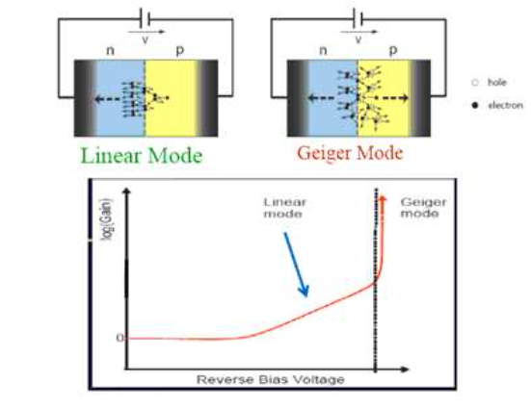
I-V curve
A photodiode working in Geiger mode is polarized with a reverse bias voltage greater than the Breakdown.
In this way, there is a very high electric field in the depletion region, such that one photon interacting will produce the avalanche.

Slide 5
MPPC
When the reverse voltage applied to an APD is set higher than the breakdown voltage, the electric field in the APD becomes high enough to cause a discharge (Geiger discharge) even by input of one single photon.
The Geiger mode allows obtaining a large output by way of the discharge even when detecting a single photon. Once the Geiger discharge begins, it continues as long as the electric field in the APD is maintained.

Slide 6
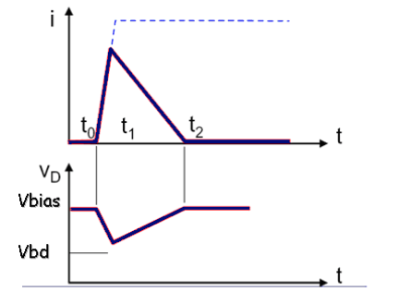
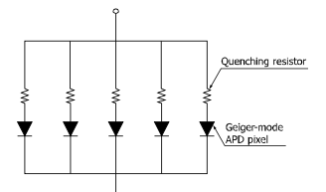
Quenching resistor
One specific example to stop the Geiger discharge is a technique using a so-called quenching resistor connected in series with the APD. This quickly stops avalanche multiplication in the APD because a drop in the operating voltage occurs when the output current, caused by the Geiger discharge, flows.
w/o the quencing
MPPC Structure
with the quencing

Slide 7
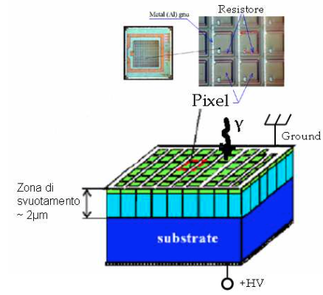
Basic operation
The basic element (pixel) of an MPPC is a combination of the Geiger mode APD and quenching resistor, and a large number of these pixels are electrically connected and arranged in two dimensions;
Each pixel in the MPPC generates a pulse o the same amplitude when it detects a photon. The pulses generated by multiple pixels create the output signal as a superimposition of the single pixel pulses.
depletion area
2 um

Slide 8
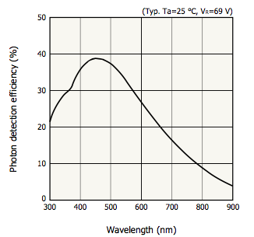
PDE
The photon detection efficiency is the product of 3 components:
1) The quantum efficiency @ the silicon surface
2)The “filling factor” of active area with respect to the total area of the MPPC
3)The avalanche probability (that is function of Vbias)

Slide 9
Phototube vs SiPm
Vbias ~ kV
Gain ~10⁶
QE ~ 30%
No able to work in high magnetic field
Proportional response
Vbias ~ 30-70 V
Gain ~10⁶
PDE ~ 40%
Able to work in high magnetic field
Digital devices, saturation problem

Slide 10
First part of the experience
Due to their high gain (~10⁶), it is simple to polarize the MPPC and readout its signal also without a amplifier;
In the first part of the experience you will build the polarization scheme and you will measure the response of your polarized MPPC to a blue led.
Polarization scheme

Slide 11
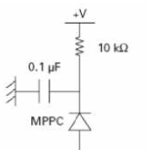
Polarization Scheme
We will use a simple RC filter and we will connect the output directly to the 50 Ohm of the DAQ.
DAQ

Slide 12
MPPC Dynamic Range
The MPPC is by construction a “digital” device. We can count single “photons” with a good amplifier but if two photons impinge in the same pixel the response is proportional to one (inside the so called “recovery time”)
The Hamamatsu devices that we will use have ~400 pixel…
What do you expect to see as response when is fired by 500 photons?

Slide 13
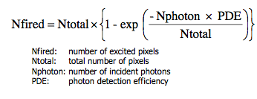
Second part of the experience
In the second part of the experience you will measure the MPPC linearity by changing the light using a graduated polaroid and acquiring a signal with a Caen Flash ADC.
[0]*(1-exp(-([1]*x+[2])/[3]))

Slide 14
How to run/analyze
1. data taking
create sub-directory where data will be stored:
> godata
> mkdir "namedir”
> godaq2
> RUNDAQ3 start the DAQ program
answer questions: "namedir", number of events, number of positions/runs
shift+W to write on disk
S to start/stop
return to move to next position/next run
2. how to start root
> root -l
3. how to create roottoples (FOR LED/LASER with 0-400 ns integration)
> goroot
> source doroot_edit.csh "namedir" "Nfiles (i.e. readout channels)"

