Slide 1
Introduction to
Data Acquisition
EDIT school 2015
Niko Neufeld, CERN-PH

Slide 2
Contents
This is the story of the physics signal from the detector to tape
The level is undergraduate and targeted at non-specialist students (originally developed for physicists)
The aim is to explain important concepts and terminology
Trigger & DAQ do not live in isolation: context and more details for example in
  The ISOTDAQ school: http://isotdaq.web.cern.ch/isotdaq/isotdaq/Home.html
  The CERN summer-student lecture programme: http://summer-timetable.web.cern.ch/summer-timetable/

Slide 3
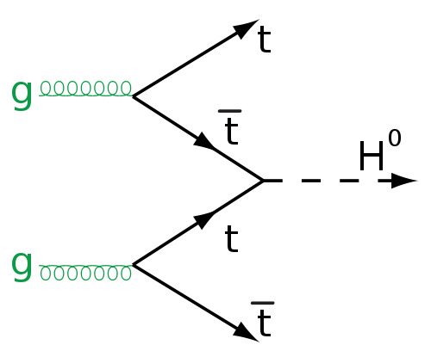
Physics, Detectors, Electronics Trigger & DAQ
High rate collider
Fast electronics
rare, need many collisions
Big data acquisition
trigger

Slide 4
Disclaimer
DAQ is a wide topic covering quite some engineering and computing
Based entirely on personal bias ☺ and to prepare you for the labs I have selected a few topics
Some things will be only touched upon or left out altogether – information on those you will find in the references at the end
  Management of large networks and farms
  Networking beyond TCP/IP
  High-speed mass storage
  etc…

Slide 5
Thanks
Some material and lots of inspiration for this lecture was taken from lectures by: P. Mato, P. Sphicas, J. Christiansen, E. Pasqualucci, W. Vandelli
Many thanks to S. Suman for his help with the animations

Slide 6
Where do we come from?
The front-end electronics

Slide 7
The read-out chain
Detector / Sensor
Amplifier
Filter
Shaper
Range compression
clock (TTC)
Sampling
Digital filter
Zero suppression
Buffer
Feature extraction
Buffer
Format & Readout
to Data Acquisition System

Slide 8
The “front-end” electronics`
Front-end electronics is the electronics directly connected to the detector (sensitive element)
Its purpose is to
  acquire an electrical signal from the detector (usually a short, small current pulse)
  tailor the response of the system to optimize
    the minimum detectable signal
    energy measurement (charge deposit)
    event rate
    time of arrival
    insensitivity to sensor pulse shape
  digitize the signal and store it for further treatment
incident radiation
Digitization
Amplifier
digitization
pre-amplifier
Detector
detector
DSP
DSP
DAQ
Buffering
DAQ
Shaping
buffering
shaping
Interface
Triggering
Interface
triggering
Multiplexing
multiplexing
ETC.
etc.

Slide 9
A simple DAQ
Introducing buffering, triggering and dead-time

Slide 10
Trivial DAQ
External View
sensor
Physical View
sensor
CPU
ADC Card
disk
Logical View
Proces-
sing
ADC
storage

Slide 11
What’s wrong with trivial?
Constant readout frequency (also called “sample rate”) (loop delay) leads to
  (bad) Useless readings if signal has not changed or occurs randomly or consists of short pulses
  (worse ☹) missed readings if signal frequency is larger than readout frequency or not within “sampling window”
No protection if signal come faster than ADC can process (worst ☹) → risk of reading junk

Slide 12
Trivial DAQ with a real trigger
Sensor
Trigger
Delay
Discriminator
ADC
Start
Proces-
sing
Interrupt
storage
What if a trigger is produced when the ADC or
processing is busy?
Notes:
Delay important to give the trigger time to “decide” → will be short for a discriminator, but real sensors can deliver data at very high rate potentially; at the very least the signal propagation time is finite (think 5 ns / m).
Unnecessary readings are removed. Missed readings are partially fixed, if the time between consecutive incoming signals is larger than the Delay.

Slide 13
Trivial DAQ with a real trigger 2
Sensor
Trigger
Delay
Discriminator
Start
Busy Logic
ADC
and
not
Proces-
sing
Interrupt
Set
Q
Clear
Ready
storage
Deadtime is the time during which the system is busy and
cannot accept incoming data
Notes:
For random arrival times, Poisson statistics, th deadtime can never be exactly 0, because no processing is infinitely fast.

Slide 14
Deadtime
It seems the best is (obviously) to be dead-time free
  But this requires processing at least as fast as your data come (think 40 MHz at the LHC for example)
  And for random arrival times it can be impossible ( or very costly) to go to 0 dead-time
If you are looking for very rare events, it can be perfectly fine to have dead-time (ATLAS, CMS)

Slide 15
Trivial DAQ with a real trigger 3
Sensor
Trigger
Discriminator
Delay
Start
Busy Logic
ADC
and
Full
FIFO
DataReady
Proces-
sing
storage
Buffers are introduced to de-randomize data,
to decouple the data production from the data
consumption. Better performance.

Slide 16
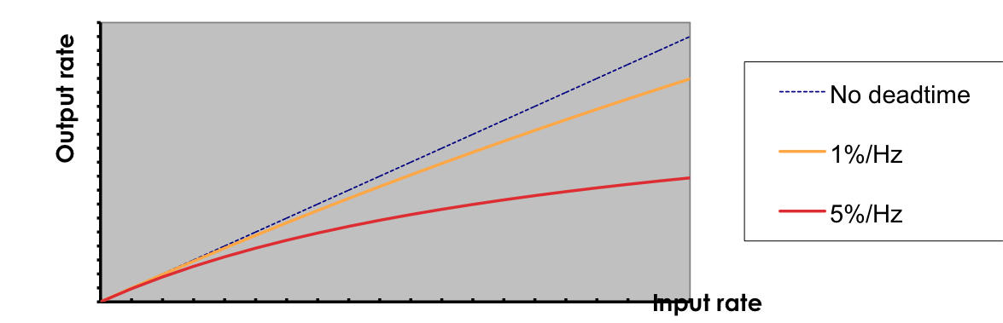
Effect of de-randomizing
Sensor
Sensor
Trigger
Trigger
Delay
Discriminator
Delay
Discriminator
Busy Logic
ADC
Start
and
Busy Logic
ADC
Start
Full
and
not
FIFO
Proces-
sing
Interrupt
Set
Proces-
sing
DataReady
Ready
Clear
Q
storage
storage
The system is busy during the ADC conversion time + processing time until the data is written to the storage
The system is busy during the ADC conversion time if the FIFO is not full (assuming the storage can always follow!)

Slide 17
Deadtime, buffers for grown-ups
A look at the LHC experiments

Slide 18
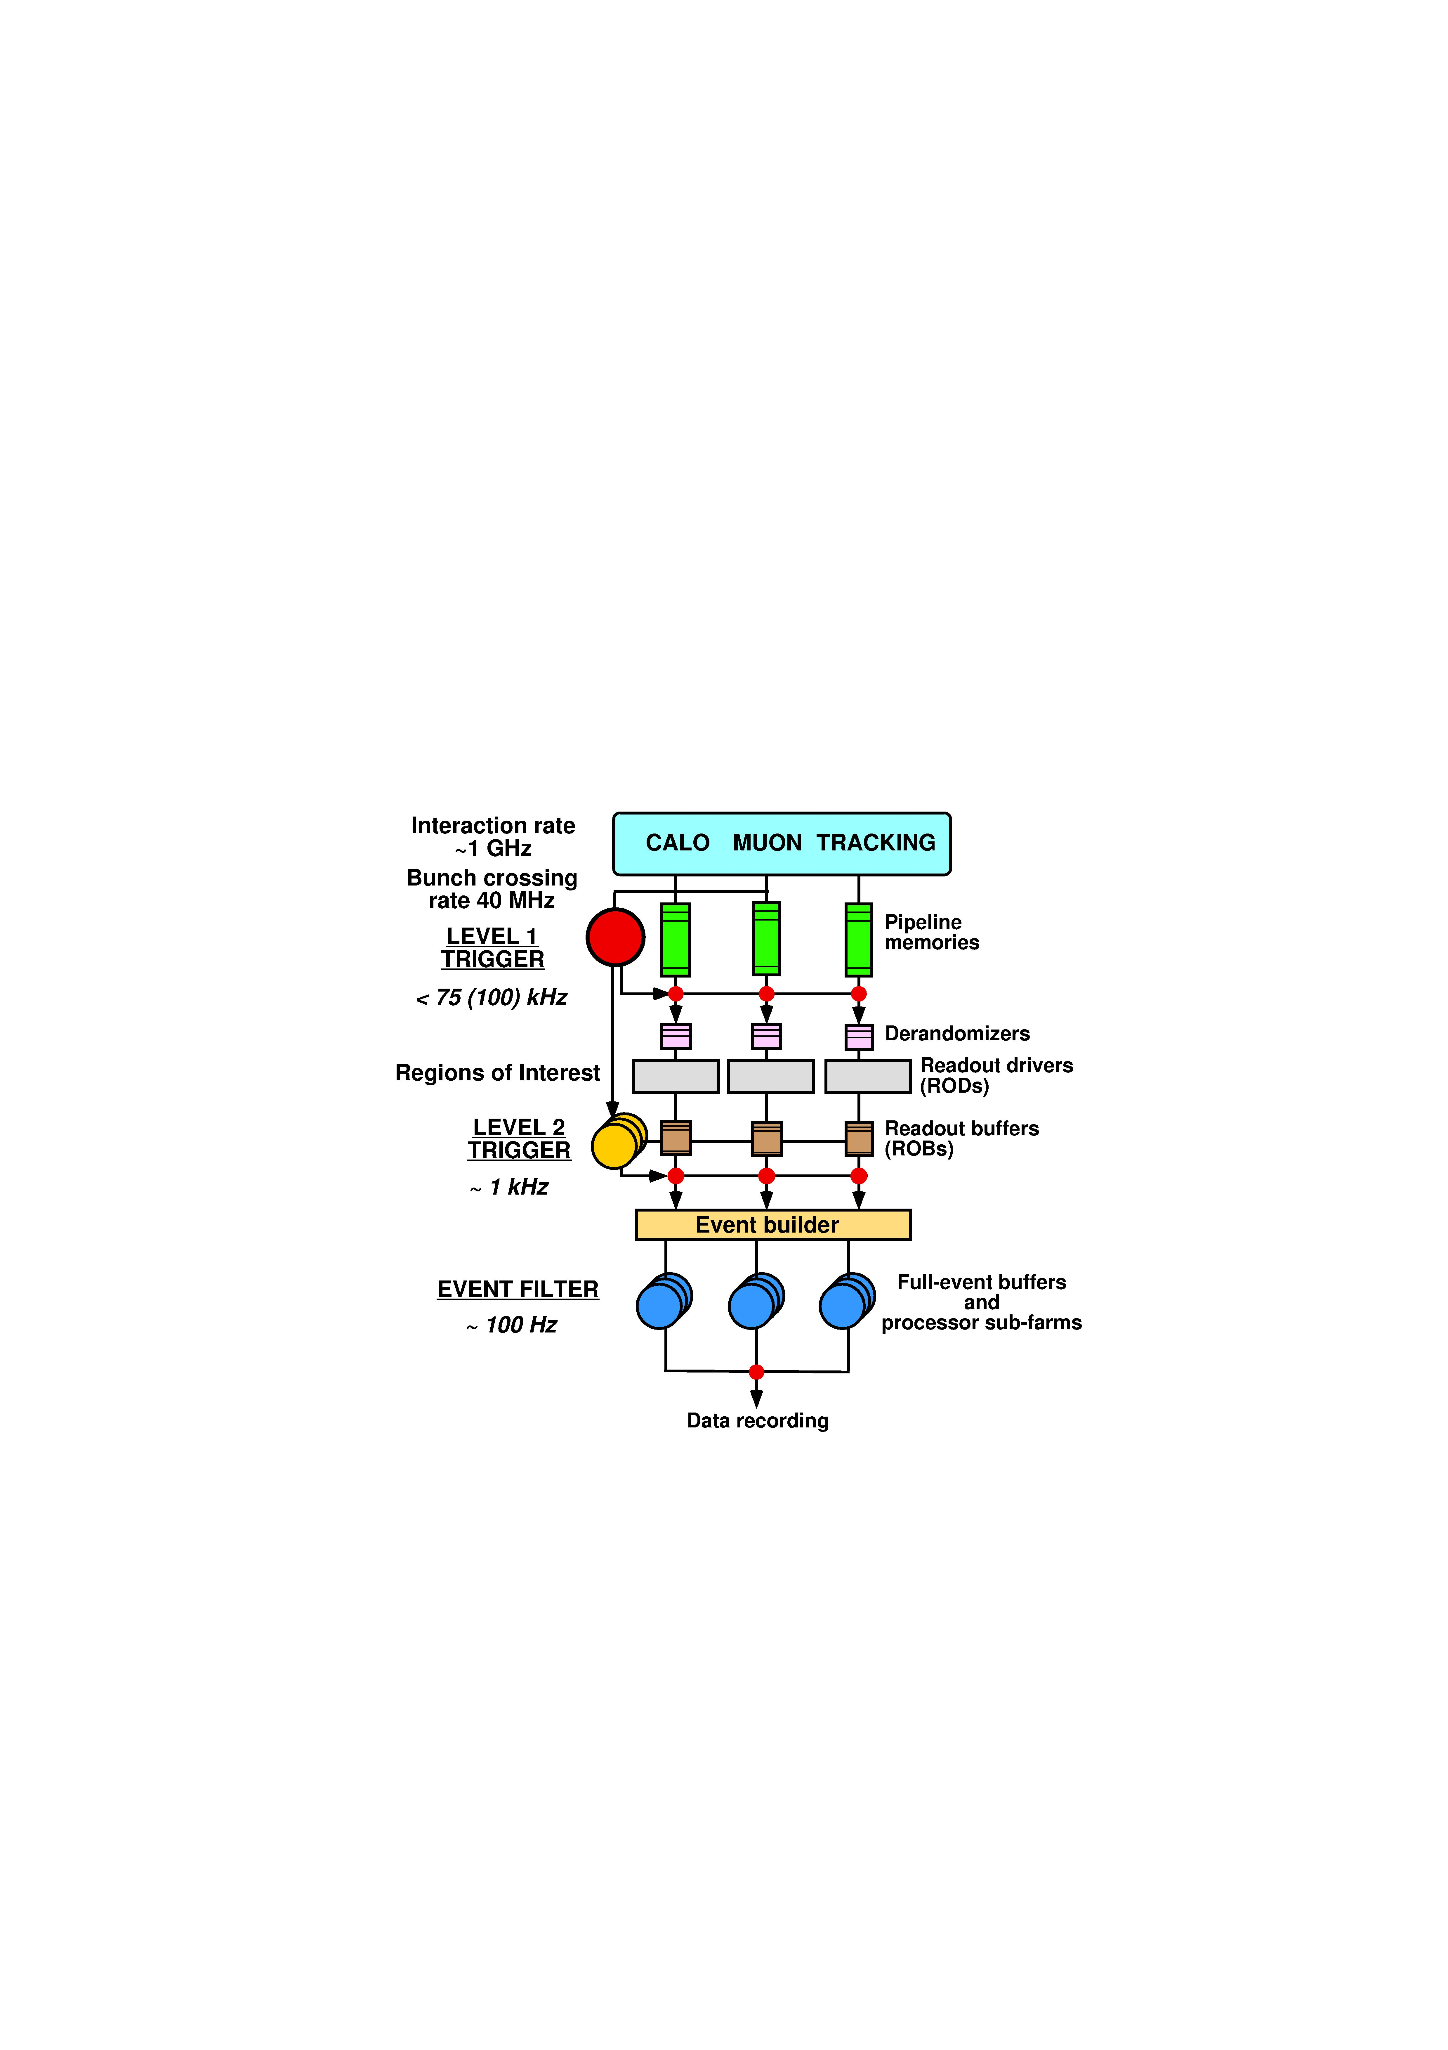
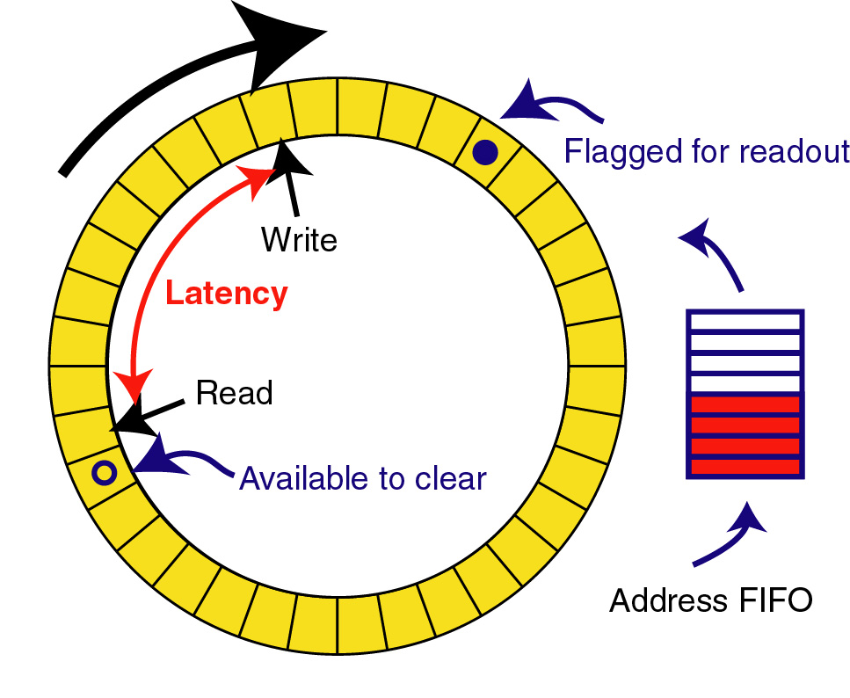
Triggered read-out
Trigger processing requires some data transmission and processing time to make decision so front-ends must buffer data during this time. This is called the trigger latency
For constant high rate experiments a “pipeline” buffer is needed in all front-end detector channels: (analog or digital)
  Real clocked pipeline (high power, large area, bad for analog)
  Circular buffer
  Time tagged (zero suppressed latency buffer based on time information)
Shaping
Constant writing
Channel mux.
ADC
DAQ
Trigger

Slide 19
Trigger rate control
Trigger rate determined by physics parameters used in trigger system:
1 kHz – 1MHz for LHC experiments
  The lower rate after the trigger allows sharing resources across channels (e.g. ADC and readout links)
Triggers will be of random nature i.e. follow a Poisson distribution → a burst of triggers can occur within a short time window so some kind of rate control/spacing is needed
  Minimum spacing between trigger accepts → dead-time
  Maximum number of triggers within a given time window
Derandomizer buffers needed in front-ends to handle this
  Size and readout speed of this determines effective trigger rate

Slide 20
System optimisation: LHCb front-end buffer
Trigger latency
Fixed to 4 us in LHCb
Working point for LHCb
Max readout time: 900 ns
Derandomzier depth:
16 events
➔ 1 MHz maximum trigger accept rate

Slide 21
Data Acquisition for a Large Experiment

Slide 22
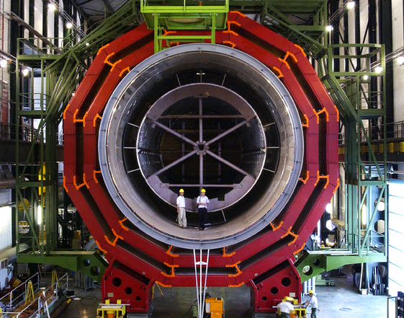
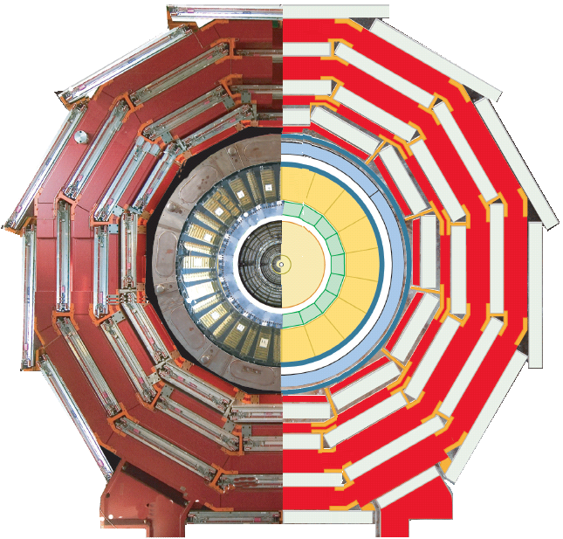
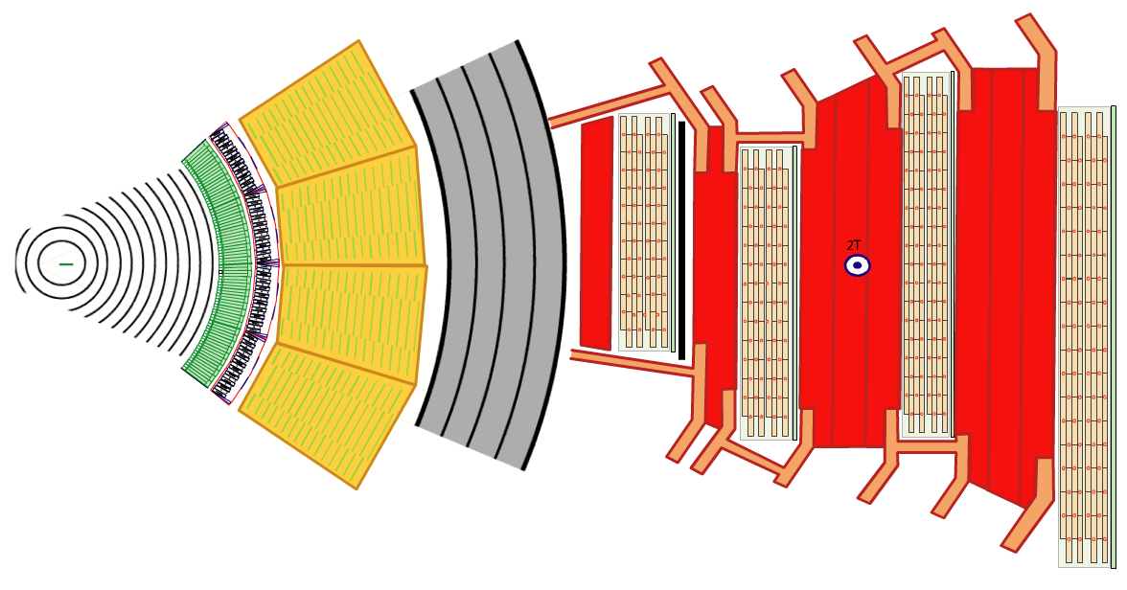
Moving on to Bigger Things…
The CMS Detector

Slide 23
Moving on to Bigger Things…
15 million detector channels
@ 40 MHz
= ~15 * 1,000,000 * 40 * 1,000,000 bytes
= ~ 600 TB/sec
?

Slide 24

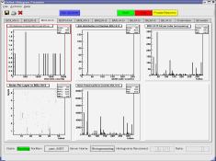


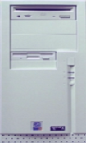
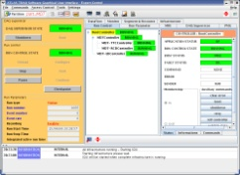
A multi-crate system
Trigger
Detector 1
Trigger
Detector N
C
P
U
Configuration
Trigger
A
D
C
A
D
C
T
D
C
T
D
C
C
P
U
Configuration
Trigger
A
D
C
A
D
C
T
D
C
T
D
C
. . .
Online monitoring
Trigger
Trigger
Readout
Readout
Run Control
Event Flow Manager
E
B
(1)
. . .
E
B
(M)

Slide 25
Software components
Trigger management
Data read-out
Event framing and buffering
Data transmission
Event building and data storage
System control and monitoring
Data sampling and monitoring

Slide 26
Data readout (a simple example)
Trigger
Detector
C
P
U
Trigger
A
D
C
A
D
C
T
D
C
T
D
C
Configuration
Trigger
Readout
Data digitized by VME modules (ADC and TDC)
Trigger signal received by a trigger module
  I/O register or interrupt generator
Data read-out by a Single Board Computer (SBC)

Slide 27
Data readout
19”
Electronics for many sensors integrated on an electronics board (PCB)
Several of these boards are put together in a common chassis or crate
The boards (also called “modules”) need
  Mechanical support
  Power
  A standardized way to access their data (our measurement values)
All this is provided by standards for (readout) electronics such as VME (IEEE 1014) or xTCA
7U VME Crate
(a.k.a. “Subrack”)
7U
Backplane Connectors
(for power and data)
VME Board
Plugs into Backplane

Slide 28
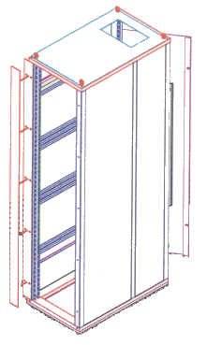

A Word on Mechanics and Pizzas
The width and height of racks and crates are measured in US (“imperial”) units: inches (in, '') and U
  1 in = 25.4 mm
  1 U = 1.75 in = 44.45 mm
The width of a "standard" rack-item (crate) is 19 in.
The height of a crate (also sub-rack) is measured in Us
Rack-mountable things, in particular computers, which are 1 U high are often called pizza-boxes
At least in Europe, the depth is measured in mm
Gory details can be found in IEEE 1101.x (VME mechanics standard) and similar sophoriphic documents
19 in
49 U
1 U

Slide 29
Communication in a Crate: Buses
A bus connects two or more devices and allows the to communicate
The bus is shared between all devices on the bus → arbitration is required
Devices can be masters or slaves (some can be both)
Devices can be uniquely identified ("addressed") on the bus
Master
Slave
Slave
Master
Device 1
Device 2
Device 3
Device 4
Device 1
Device 2
Device 3
Device 4
Data Lines
Data Lines
Select Line
Select Line
Notes:
Address and data signals can be on separate electrical lines or share the same lines (multiplexed)

Slide 30
Buses pros & cons
Relatively simple to implement
Easy to add new devices
  topological information of the bus can be used for automagically assigning addresses for bus devices: this is what plug and play is all about (no evil jumpers, DIP-switches and other such horrors)
A bus is shared between all devices (each new active device slows everybody down)
Number of devices and physical bus-length is limited (scalability!)
  For synchronous high-speed buses, physical length is correlated with the number of devices (e.g. PCI)
  Traditional parallel buses have a lot of control, data and address lines (look at a SCSI or ATA cable)
Buses are typically useful for systems << 1 GB/s
Notes:
Bus-width can only be increased up to a certain point (128 bit for PC-system bus)
Bus-frequency (number of elementary operations per second) can be increased, but only to a point. Modern “buses” use multiple differential serial lines (“lanes”)

Slide 31
Trigger management
How to know that new data is available?
  Interrupt
    An interrupt is sent by an hardware device
    The interrupt is
      Transformed into a software signal
      Caught by a data acquisition program
        Undetermined latency is a potential problem!
        Data readout starts
  Polling
    Some register in a module is continuously read out
    Data readout happens when register “signals” new data
In a synchronous system (the simplest one…)
  Trigger must also set a busy
  The reader must reset the busy after read-out completion

Slide 32
Managing interrupts
irq_list.list_of_items[i].vector = 0x77;
irq_list.list_of_items[i].level = 5;
irq_list.list_of_items[i].type = VME_INT_ROAK;
signum = 42;
ret = VME_InterruptLink(&irq_list, &int_handle);
ret = VME_InterruptWait(int_handle, timeout, &ir_info);
ret = VME_InterruptRegisterSignal(int_handle, signum);
ret = VME_InterruptUnlink(int_handle);

Slide 33
Real time programming
Has to meet operational deadlines from events to system response
  Implies taking control of typical OS tasks
    For instance, task scheduling
  Real time OS offer these features
Most important feature is predictability
  Performance is traded for predictability
It typically applies when requirements are
  Reaction time to an interrupt within a certain time interval
  Complete control of the interplay between applications

Slide 34
Real-time ≠ Real-time
Typically “real-time” means “fast” – often relative to human perception or reaction: real-time video, real-time streaming etc… This is sometimes called “soft” real-time to distinguish it from:
systems which guarantee a maximum delay on any stimulus-response time. This is called “hard” real-time.

Slide 35
Is real-time needed in DAQ?
Can be essential in some cases
  It is critical for accelerator control or plasma control
    Wherever event reaction times are critical
    And possibly complex calculation is needed
Not commonly used for data acquisition now
  Large systems are normally asynchronous
    Either events are buffered or de-randomized in the HW
    Or the main dataflow does not pass through the bus
  In a small system dead time is normally small
Drawbacks
  We loose complete dead time control
    Event reaction time and process scheduling are left to the OS
  Increase of latency due to event buffering
    Affects the buffer size at event building level
  Normally not a problem in modern DAQ systems

Slide 36
Polling modules
Loop reading a register containing the latched trigger
while (end_loop == 0) {
uint16_t *pointer;
volatile uint16_t trigger;
pointer = (uint16_t *) (base + 0x80);
trigger = *pointer;
if (trigger & 0x200) {
// look for a bit in the trigger mask
... Read event ...
... Remove busy ...
} else
sched_yield (); // if in a multi-process/thread environment
}

Slide 37
Polling or interrupt?
Which method is convenient?
It depends on the event rate
  Interrupt
    Is expensive in terms of response time and CPU
      Typically (O (1 μs))
    Convenient for events at low rate
      Avoid continuous checks
      A board can signal internal errors via interrupts
  Polling
    Convenient for events at high rate
      When the probability of finding an event ready is high
    Does not affect others if scheduler is properly released
    Can be “calibrated” dynamically with event rate
      If the input is de-randomized…

Slide 38
The simplest DAQ
Synchronous readout:
  The trigger is
    Auto-vetoed (a busy is asserted by trigger itself)
    Explicitly re-enabled after data readout
Additional dead time is generated by the output
// VME interrupt is mapped to SYSUSR1
static int event = FALSE;
const int event_available = SIGUSR1;
// Signal Handler
void sig_handler (int s)
{
if (s == event_available)
event = TRUE;
}
event_loop ()
{
while (end_loop == 0) {
if (event) {
size += read_data (*p);
write (fd, ptr, size);
busy_reset ();
event = FALSE;
}
}
}

Slide 39
Fragment buffering
Why buffering?
  Triggers are uncorrelated
  Create internal de-randomizers
    Minimize dead time
    Optimize the usage of output channels
      Disk
      Network
    Avoid back-pressure due to peaks in data rate
Attention
  Try to avoid actually (mem-)copying the data
      Copying memory chunks is an expensive operation
      Only move pointers!

Slide 40
A simple example…
Ring buffers emulate FIFO
  A buffer is created in memory
    Shared memory is requested from the operating system
    A “master” creates/destroys the memory and a lock (“mutex”, “semaphore”)
    A “slave” attaches/detaches the memory
  Packets (“events”) are
    Written to the buffer by a writer
    Read-out by a reader
  Works in multi-process and multi-thread environment
  Efficiency
    Avoid multiple copies!
    If possible, build events directly in buffer memory

Slide 41
Ring buffer
ceiling
tail
ceiling
tail
head
head
head
head
head
head
Writer:
Reserve a chunk of memory:
Build event frame and calculate (max) size
Protect pointers
Move the head
Write the packet header
Set the packet as FILLING
Unprotect pointers
Reader:
Release
Protect pointers
Move tail
Unprotect pointers
Reader:
Work on data
Reader:
Locate next available buffer:
Protect pointers
Get oldest event (if any)
Set event status to EMPTYING
Unprotect pointers
Writer:
Validate the event:
Protect the buffer
Set the packet as READY
(Move the head to correct value)
Unprotect the buffer
Writer:
Build the event fragment in memory:
Prepare event header
Write data to the buffer
Complete the event frame
The two processes/threads can run concurrently
  Header protection is enough to insure event protection
  A library can take care of buffer management
    A simple API is important
  We introduced
    Shared memories provided by OS
    Buffer protection (semaphores or mutexes)
    Buffer and packed headers (managed by the library)
struct header
{
int head;
int tail;
int ceiling;
…
}

Slide 42
Event buffering example
Data collector
Data writer
int cid = CircOpen (NULL, Circ_key, size));
while (end_loop == 0) {
if (event) {
int maxsize = 512;
char *ptr; uint32_t *p; uint32_t *words;
int number = 0, size = 0;
while ((ptr = CircReserve (cid, number,
maxsize)) == (char *) -1)
sched_yield ();
p = (int *) ptr;
*p++ = crate_number; ++size;
*p++; words = p; ++size;
size += read_data (*p);
*words = size;
CircValidate (cid, number, ptr,
size * sizeof (uint32_t));
++number;
busy_reset ();
event = FALSE;
}
sched_yield ();
}
CircClose (cid);
int fd, cid;
fd = open (pathname, O_WRONLY | O_CREAT);
cid = CircOpen (NULL, key, 0));
while (end_loop == 0) {
char *ptr;
if ((ptr = CircLocate (cid, &number,
&evtsize)) > (char *) 0) {
write (fd, ptr, evtsize);
CircRelease (cid);
}
sched_yield ();
}
CircClose (cid);
close (fd);
Find next event
Write to the output and release the buffer
Open the buffer in master mode
Release the scheduler
Prepare the header
Set TRUE by a signal handler upon trigger arrival
Reserve the buffer (maximum event size)
Validate the buffer
Read data and put them directly into the buffer
Reset the busy
Release the scheduler
Close the buffer

Slide 43
Event framing
Fragment header/trailer
Identify fragments and characteristics
  Useful for subsequent DAQ processes
    Event builder and online monitoring tasks
  Fragment origin is easily identified
    Can help in identifying sources of problems
  Can (should) contain a trigger ID for event building
  Can (should) contain a status word
Global event frame
  Give global information on the event
Very important in networking

Slide 44
Framing example
typedef struct {
u_int startOfHeaderMarker;
u_int totalFragmentsize;
u_int headerSize;
u_int formatVersionNumber;
u_int sourceIdentifier;
u_int numberOfStatusElements;
} GenericHeader;
Event
Payload
Header
Status words

Slide 45
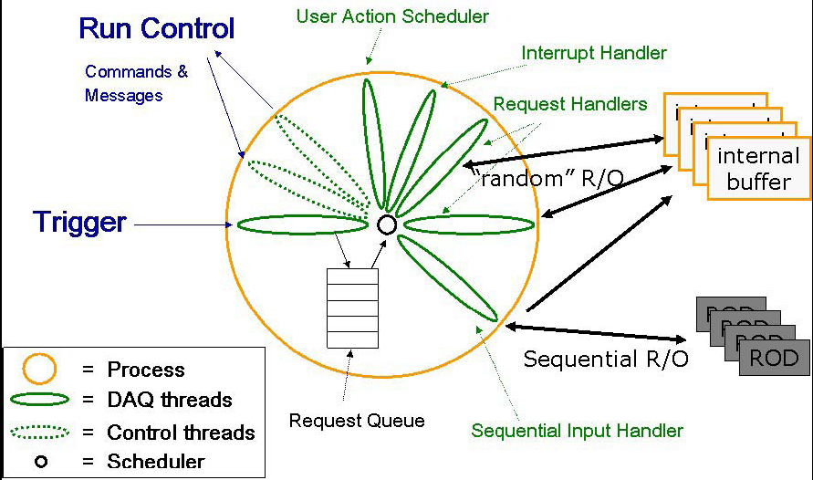
Generic readout application
Module
Input Handler

Slide 46
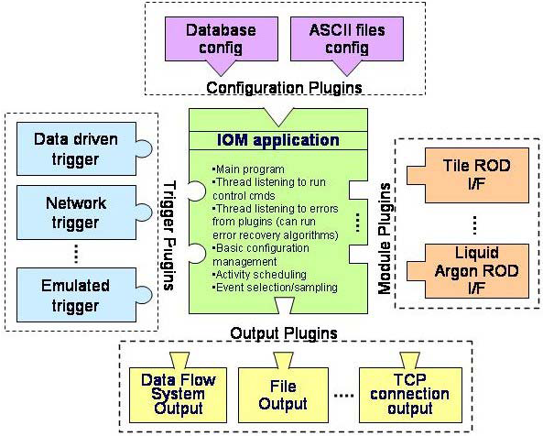
Configurable applications
Ambitious idea
  Support all the systems with a single application
    Through plug-in mechanism
    Requires a configuration mechanism
    You will (not) see an example in the exercise

Slide 47
Some basic components
We introduced basic elements of IPC…
  Signals and signal catching
  Shared memories
  Semaphores (or mutexes)
  Message queues
…and some standard DAQ concepts
  Trigger management, busy, back-pressure
  Synchronous vs asynchronous systems
  Polling vs interrupts
  Real time programming
  Event framing
  Memory management

Slide 48
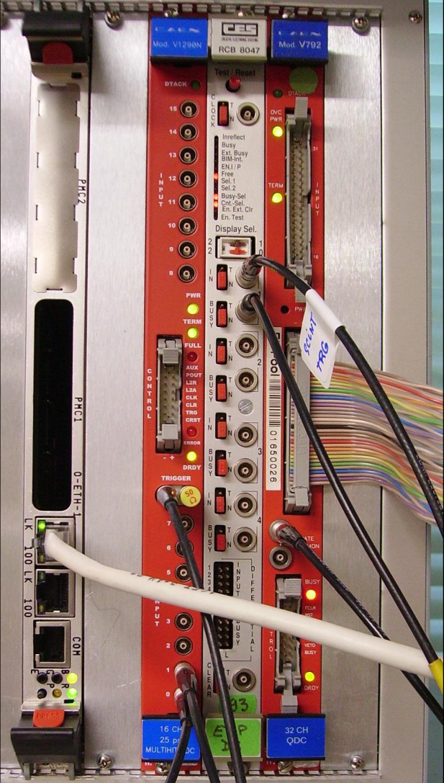
What will you find in the lab?
Theory at work…
Exercise
  Simple DAQ with
    VME crate controller
    CORBO module
      Upon trigger reception
        Sets busy
        Sends a VME interrupt
        Latch the trigger in a register
    QDC
    TDC

Slide 49
Network based DAQ
In large (HEP) experiments we typically have thousands of devices to read, which are sometimes very far from each other → buses can not do that
Network technology solves the scalability issues of buses
  In a network devices are equal ("peers")
  In a network devices communicate directly with each other

Slide 50
Large DAQ / Event-building
Large detectors
  Sub-detectors data are collected independently
    Readout network
    Fast data links
  Events assembled by event builders
    From corresponding fragments
  Custom devices used
    In FEE
    In low-level triggers
  COTS used
    In high-level triggers
    In event builder network
DAQ system
  data flow & control
  distributed & asynchronous
Detector Frontend
Level 1
Trigger
Readout
Systems
Event
Builder Networks
Controls
Manager
Filter
Systems
Computing Services

Slide 51
Data networks and protocols
Data transmission
  Fragments need to be sent to the event builders
    One or more…
  Usually done via switched networks
User-level protocols
  Provide an abstract layer for data transmission
    … so you can ignore the hardware you are using …
    … and the optimizations made in the OS (well, that’s not always true) …
Most commonly used
  TCP/IP suite
    UDP (User Datagram Protocol)
      Connection-less
    TCP (Transmission Control Protocol)
      Connection-based protocol
      Implements acknowledgment and re-transmission

Slide 52
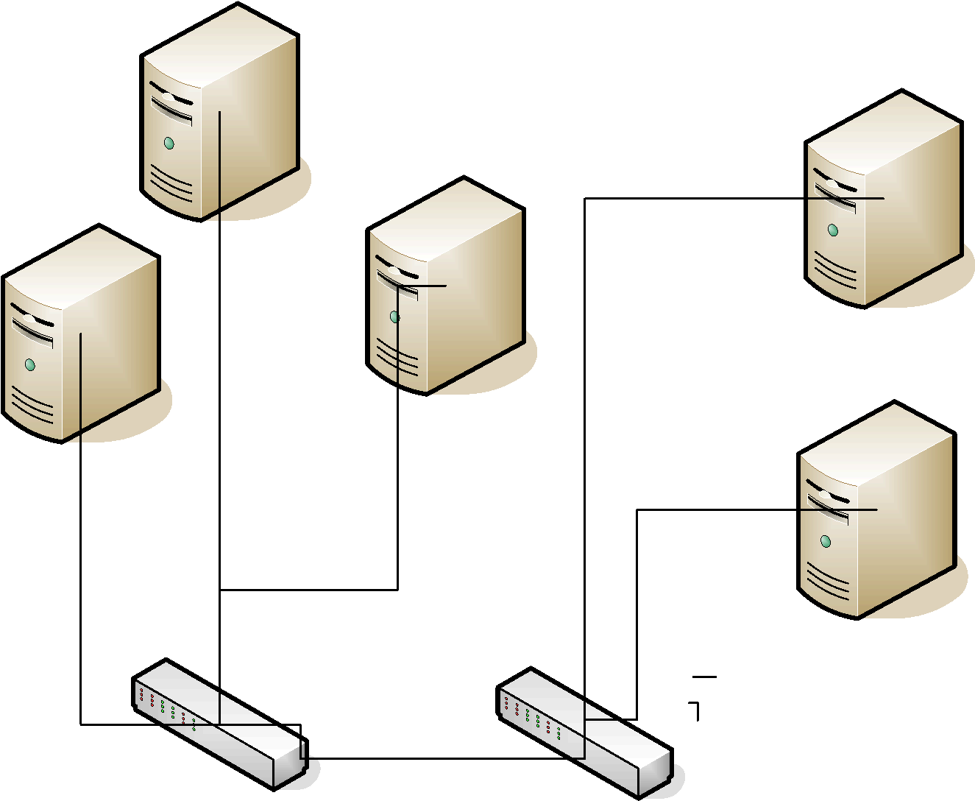
A Switched Network
While 2 can send data to 1 and 4, 3 can send at full speed to 5
2 can distribute the share the bandwidth between 1 and 4 as needed
3
4
1
2
5

Slide 53
Data transmission optimization
When you “send” data they are copied to a system buffer
  Data are sent in fixed-size chunks
At system level
  Each endpoint has a buffer to store data that is transmitted over the network
  TCP stops to send data when available buffer size is 0
    Back-pressure
  With UDP we get data loss
  If buffer space is too small:
    Increase system buffer (in general possible up to 8 MB)
  Too large buffers can lead to performance problems
In the lab you will have fun with
  Data transmission
  Network control

Slide 54
TCP client/server example
struct sockaddr_in sinhim;
sinhim.sin_family = AF_INET;
sinhim.sin_addr.s_addr = inet_addr (this_host);
sinhim.sin_port = htons (port);
if (fd = socket (AF_INET, SOCK_STREAM, 0) < 0)
{ ; // Error ! }
if (connect (fd, (struct sockaddr *)&sinhim,
sizeof (sinhim)) < 0)
{ ; // Error ! }
while (running) {
memcpy ((char *) &wait, (char *) &timeout,
sizeof (struct timeval));
if ((nsel = select (nfds, 0, &wfds,
0, &wait)) < 0)
{ ; // Error ! }
else if (nsel) {
if ((BIT_ISSET (destination, wfds))) {
count = write (destination, buf, buflen);
// test count…
// > 0 (has everything been sent ?)
// == 0 (error)
// < 0 we had an interrupt or
// peer closed connection
}
}
}
close (fd);
struct sockaddr_in sinme;
sinme.sin_family = AF_INET;
sinme.sin_addr.s_addr = INADDR_ANY;
sinme.sin_port = htons(ask_var->port);
fd = socket (AF_INET, SOCK_STREAM, 0);
bind (fd0, (struct sockaddr *) &sinme,
sizeof(sinme));
listen (fd0, 5);
while (n < ns) { // we expect ns connections
int val = sizeof(this->sinhim);
if ((fd = accept (fd0,
(struct sockaddr *) &sinhim, &val)) >0) {
FD_SET (fd, &fds);
++ns;
}
}
while (running) {
if ((nsel = select( nfds, (fd_set *) &fds,
0, 0, &wait)) [
count = read (fd, buf_ptr, buflen);
if (count == 0) {
close (fd);
// set FD bit to 0
}
}
}
close (fd0);

Slide 55
Controlling the data flow
Throughput optimization
Avoid dead-time due to back-pressure
  By avoiding fixed sequences of data destinations
  Requires knowledge of the EB input buffer state
EB architectures
  Push
    Events are sent as soon as data are available to the sender
      The sender knows where to send data
      The simplest algorithm for distribution is the round-robin
  Pull
    Events are required by a given destination processes
      Needs an event manager
        Though in principle we could build a pull system without manager

Slide 56
Switched Networks
In a switched network each node is connected either to another node or to a switch
Switches can be connected to other switches
A path from one node to another leads through 1 or more switches (this number is sometimes referred to as the number of "hops" )

Slide 57
Congestion
1
3
"Bang" translates into random, uncontrolled packet-loss
In Ethernet this is perfectly valid behavior and implemented by very cheap devices
Higher Level protocols are supposed to handle the packet loss due to lack of buffering
This problem comes from synchronized sources sending to the same destination at the same time
2
2
Bang
2

Slide 58




Event Building
To Trigger
Algorithms
Event Builder 3
Event Builder 3
Data Acquisition
Switch
Event Builder 3
1
2
3
4
Event fragments are received from detector front-end
Event fragments are read out over a network to an event builder
Event builder assembles fragments into a complete event
Complete events are processed by trigger algorithms

Slide 59
Push-Based Event Building
Switch Buffer
Event Builder 1
Event Builder 2
Data Acquisition
Switch
“Send next event to EB1”
Readout
Supervisor
“Send next event to EB2”
1
2
3
Readout Supervisor tells readout boards where events must be sent (round-robin)
Readout boards do not buffer, so switch must
No feedback from Event Builders to Readout system

Slide 60
Pull-Based Event Building
“Send me
an event!”
“Send me
an event!”
Event Builder 1
Event Builder 1
“Send me
an event!”
Event Builder 2
Data Acquisition
Switch
“Send me
an event!”
Event Builder 3
EB1:
EB2:
EB3:
0
0
0
1
1
1
0
1
1
0
0
1
1
0
1
“Send next event to EB1”
“Send next event to EB2”
“Send next event to EB3”
1
2
3
Event Builders notify Readout Supervisor of available capacity
Readout Supervisor ensures that data are sent only to nodes with available capacity
Readout system relies on feedback from Event Builders

Slide 61
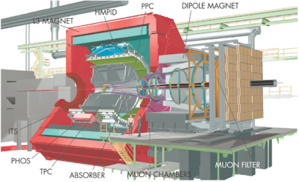
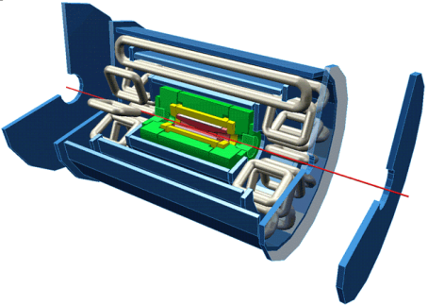
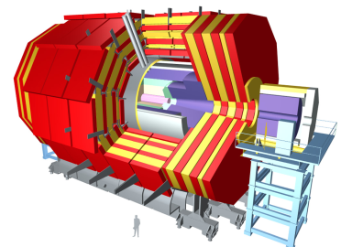
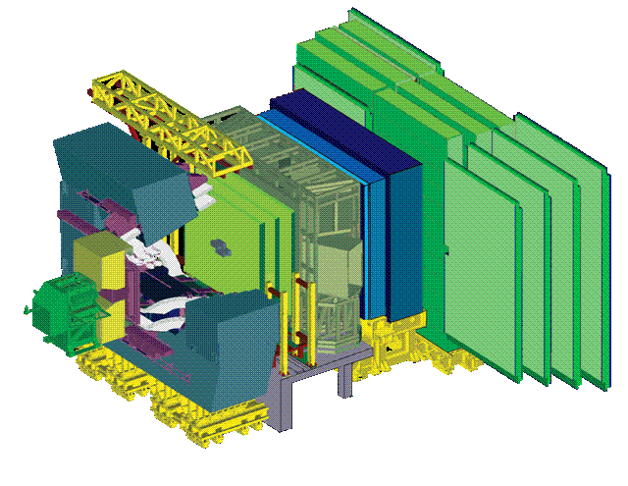
Trigger/DAQ parameters
No.Levels Level-0,1,2 Event Readout HLT Out
Trigger Rate (Hz) Size (Byte) Bandw.(GB/s) MB/s (Event/s)
4 Pb-Pb 500 5x10⁷ 25 1250 (10²)
p-p 10³ 2x10⁶ 200 (10²)
3 LV-1 10⁵ 1.5x10⁶ 4.5 300 (2x10²)
LV-2 3x10³
2 LV-1 10⁵ 10⁶ 100 ~1000 (10²)
2 LV-0 10⁶ 5x10⁴ 50 600 (1.2x10⁴)
ALICE
ATLAS
CMS
LHCb
Notes:
Trigger levels include HLT which is operating on entire events

Slide 62

Runcontrol
© Warner Bros.

Slide 63
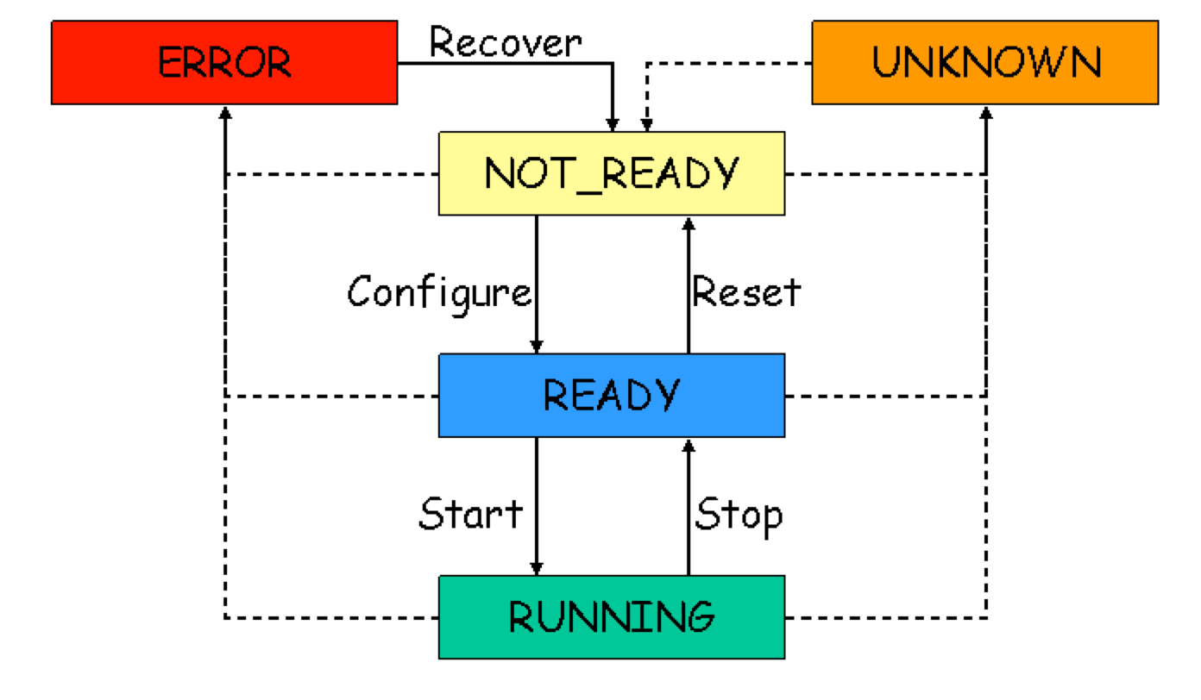
Run Control
The run controller provides the control of the trigger and data acquisition system. It is the application that interacts with the operator in charge of running the experiment.
The operator is not always an expert on T/DAQ. The user interface on the Run Controller plays an important role.
The complete system is modeled as a finite state machine. The commands that run controller offers to the operator are state transitions.
LHCb DAQ /Trigger Finite State Machine diagram (simplified)

Slide 64
Finite State Machine
Each component, sub-component of the system is modeled as a Finite State Machine. This abstraction facilitates the description of each component behavior without going into detail
The control of the system is realized by inducing transitions on remote components due to a transition on a local component
State A
State C
Component 1 can only
complete the transition to
State B if Component 2 is
in state D.
State B
State D
Component 1
Component 2
Each transition may have actions associated. The action consist of code which needs to be executed in order to bring the component to its new state
The functionality of the FSM and state propagation is available in special software packages such as SMI

Slide 65
Message system
Networked Inter Process Communication
Will not be described here
Many possible implementations
  From TCP based (DIM, ZeroMQ)
  … through (rather exotic) SNMP …
    (that’s the way many printers are configured…)
    Very convenient for “economic” implementation
      Used in the KLOE experiment
  … to Object Request Browsers (ORB)
    Used f.i. by ATLAS

Slide 66
Detector Control
The detector control system (DCS) (also Slow Control) provides the monitoring and control of the detector equipment and the experiment infrastructure.
Due to the scale of the current and future experiments is becoming more demanding: for the LHC Experiments: ≈ 100000 parameters
Control hierarchy
Experiment
Control
Run / DAQ
Control
Detector
Control

Slide 67
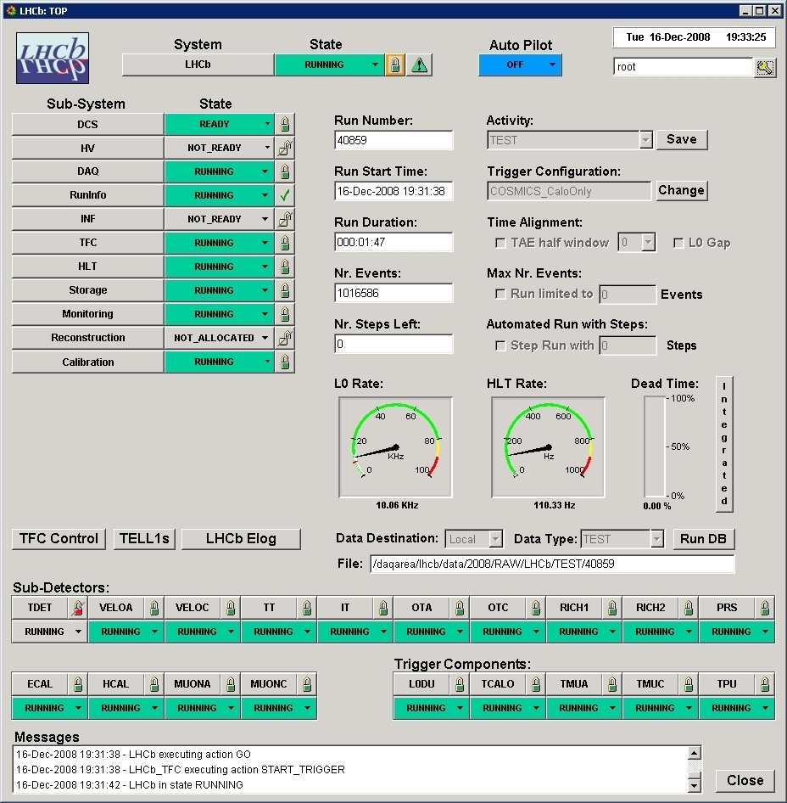
Run Control GUI
Main panel of the LHCb run-control
(PVSS II)

Slide 68
The end

Slide 69
Further Reading
Electronics
  Helmut Spielers web-site: http://www-physics.lbl.gov/~spieler/
Buses
  VME: http://www.vita.com/
  PCI
  http://www.pcisig.com/
Network and Protocols
  Ethernet
  “Ethernet: The Definitive Guide”, O’Reilly, C. Spurgeon
  TCP/IP
  “TCP/IP Illustrated”, W. R. Stevens
  Protocols: RFCs
  www.ietf.org
  in particular RFC1925 http://www.ietf.org/rfc/rfc1925.txt
  “The 12 networking truths” is required reading
Wikipedia (!!!) and references therein – for all computing related stuff this is usually excellent
Conferences
  IEEE Realtime
  ICALEPCS
  CHEP
  IEEE NSS-MIC
Journals
  IEEE Transactions on Nuclear Science, in particular the proceedings of the IEEE Realtime conferences
  IEEE Transactions on Communications

Slide 70
More Stuff
Data format, DIY DAQ, run-control

Slide 71
Controlling the system
Each DAQ component must have
  A set of well defined states
  A set of rules to pass from one state to another
  Finite State Machine
A central process controls the system
  Run control
    Implements the state machine
    Triggers state changes and takes track of components’ states
      Trees of controllers can be used to improve scalability
A GUI interfaces the user to the Run control
  …and various system services…

Slide 72
Languages & Wisdom
Which language?
  You need easy control of OS primitives → suggests C or a language with good C-bindings
Efficiency is good
  Avoid wasting CPU cycles or memory bandwidth where it is easy to do so
Readable, clear code is even more important
“As simple as possible but not simpler”
“Premature optimization is the root of all evil”

Slide 73
Connecting Devices in a Network
On an network a device is identifed by a network address
  eg: our phone-number, the MAC address of your computer
Devices communicate by sending messages (frames, packets) to each other
Some establish a connection lilke the telephone network, some simply send messages
Modern networks are switched with point-to-point links
  circuit switching, packet switching

Slide 74
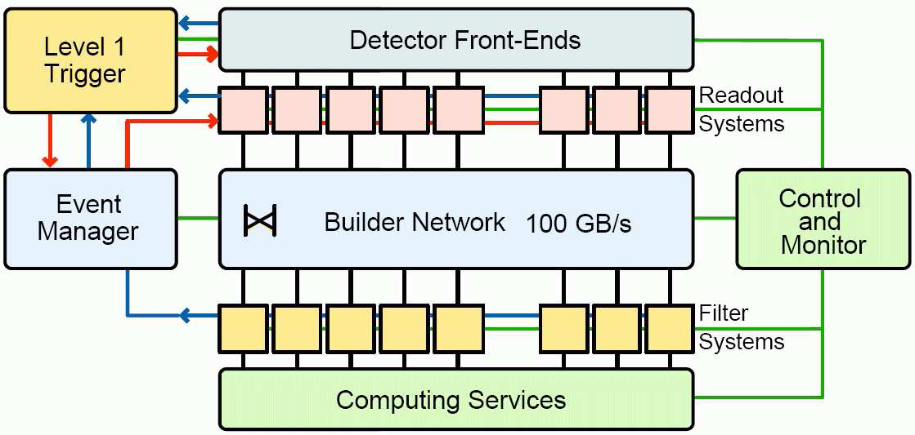
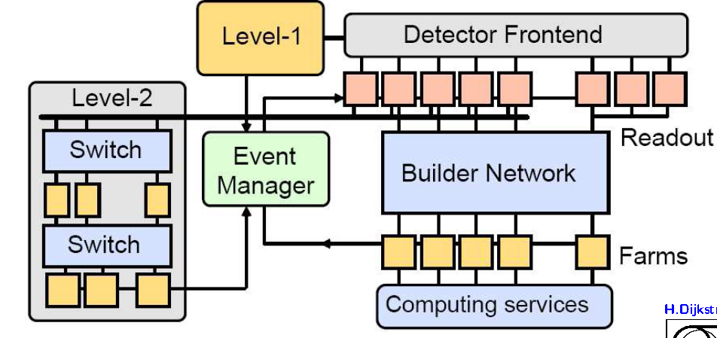
Two philosophies
Send everything, ask questions later (ALICE, CMS, LHCb)
Send a part first, get better question
Send everything only if interesting (ATLAS)

Slide 75
Network Technologies
Examples:
  The telephone network
  Ethernet (IEEE 802.3)
  ATM (the backbone for GSM cell-phones)
  Infiniband
  Myrinet
  many, many more
Note: some of these have "bus"-features as well (Ethernet, Infiniband)
Network technologies are sometimes functionally grouped
  Cluster interconnect (Myrinet, Infiniband) 15 m
  Local area network (Ethernet), 100 m to 10 km
  Wide area network (ATM, SONET) > 50 km

Slide 76
Overcoming Congestion:
Queuing at the Input
1
3
Two frames destined to the same destination arrive
While one is switched through the other is waiting at the input port
When the output port is free the queued packet is sent
2
2
2

Slide 77
Head of Line Blocking
1
3
The reason for this is the First in First Out (FIFO) structure of the input buffer
Queuing theory tells us* that for random traffic (and infinitely many switch ports) the throughput of the switch will go down to 58.6% → that means on 100 MBit/s network the nodes will "see" effectively only ~ 58 MBit/s
2
2
4
Packet to node 4 must wait
even though port to node 4 is free
2
4
*) "Input Versus Output Queueing on a Space-Division Packet Switch"; Karol, M. et al. ; IEEE Trans. Comm., 35/12

Slide 78
Output Queuing
In practice virtual output queueing is used: at each input there is a queue → for n ports O(n²) queues must be managed
Assuming the buffers are large enough(!) such a switch will sustain random traffic at 100% nominal link load
1
3
2
2
4
Packet to node 2 waits at output to
port 2. Way to node 4 is free
4
2

Slide 79
Binary vs Text
11010110 Pros:
  compact
  quick to write & read (no conversion)
Cons:
  opaque (humans need tool to read it)
  depends on the machine architecture (endinaness, floating point format)
  life-time bound to availability of software which can read it
<TEXT></TEXT> Pros:
  universally readable
  can be parsed and edited equally easily by humans and machines
  long-lived (ASCII has not changed over decades)
  machine independent
Cons:
  slow to read/write
  low information density (can be improved by compression)

Slide 80
A little checklist for your DAQ
Remember:
YMMV

Slide 81
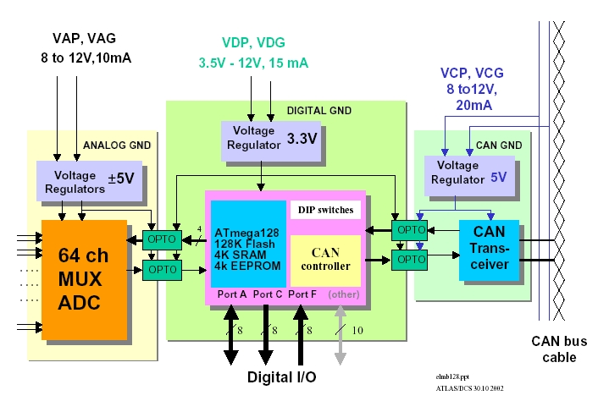
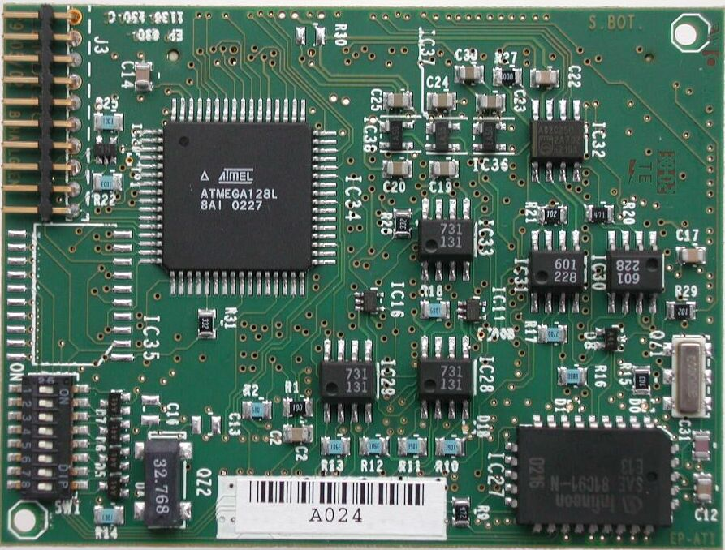
Control and monitoring
Access to setup registers (must have read-back)
Access to local monitoring functions
  Temperatures, power supply levels, errors, etc.
Bidirectional with addressing capability (module, chip, register)
Speed not critical and does not need to be synchronous
  Low speed serial bus: I²C, JTAG, SPI
Must be reasonably reliable (read-back to check correct download and re-write when needed)
SPECS
Example: ELMB

Slide 82
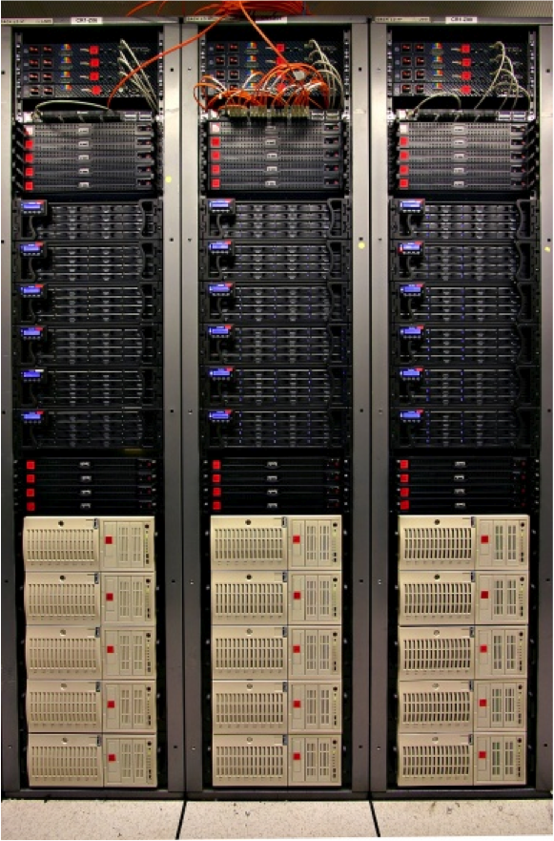
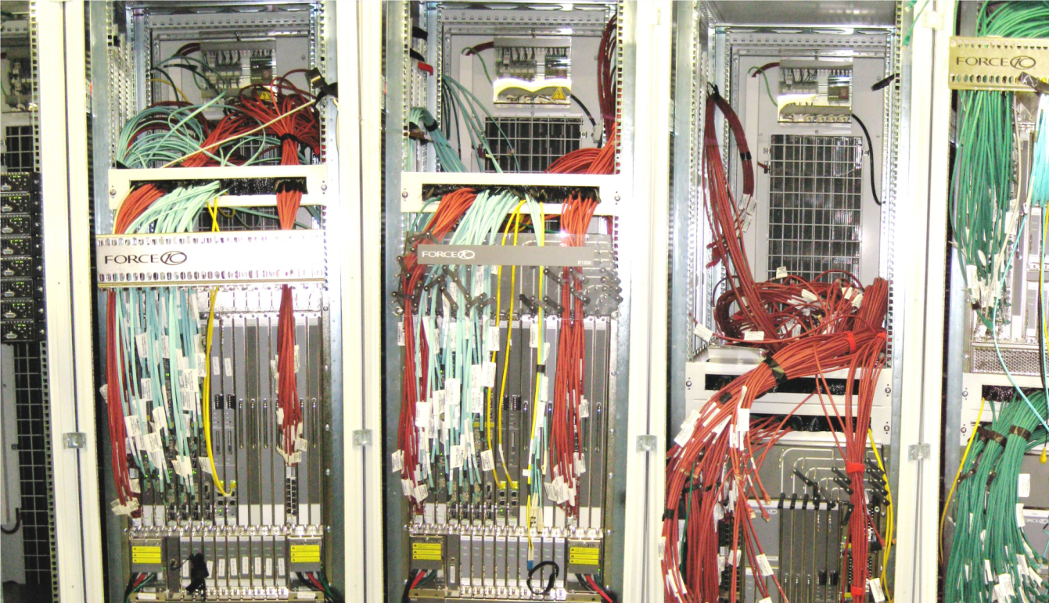
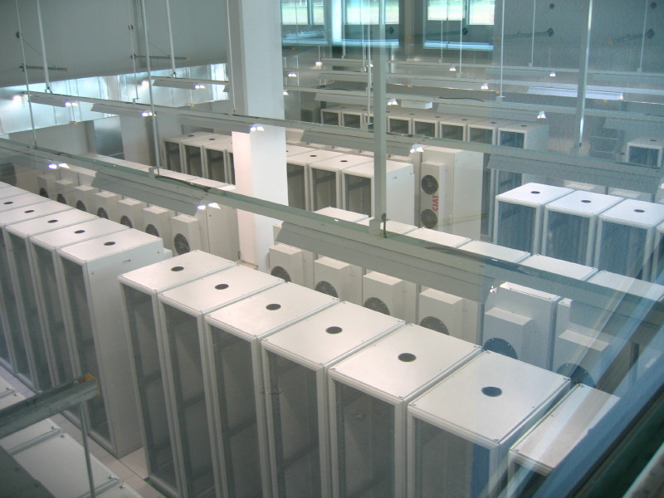

Gallery
ALICE Storage System
ATLAS Online Network Infrastructure
CMS on-line computing center

Slide 83
Even more stuff

Slide 84
Multilevel triggering
First level triggering.
  Hardwired trigger system to make trigger decision with short latency.
  Constant latency buffers in the front-ends
Second level triggering in DAQ interface
  Processor based (standard CPU’s or dedicated custom/DSP/FPGA processing)
  FIFO buffers with each event getting accept/reject in sequential order
  Circular buffer using event ID to extracted accepted events
    Non accepted events stays and gets overwritten by new events
High level triggering in the DAQ systems made with farms of CPU’s: hundreds – thousands.
(separate lectures on this)
DAQ interface
Front-end
MUX
DAQ
Data
formatting
Zero-
suppression
Trigger L2
Trigger L1

Slide 85
Excursion: zero-suppression
Why spend bandwidth sending data that is zero for the majority of the time ?
Perform zero-suppression and only send data with non-zero content
  Identify the data with a channel number and/or a time-stamp
  We do not want to loose information of interest so this must be done with great care taking into account pedestals, baseline variations, common mode, noise, etc.
  Not worth it for occupancies above ~10%
Alternative: data compression
  Huffman encoding and alike
TANSTAFL (There Aint No Such Thing As A Free Lunch)
  Data rates fluctuates all the time and we have to fit this into links with a given bandwidth
  Not any more event synchronous
  Complicated buffer handling (overflows)
  Before an experiment is built and running it is very difficult to give reliable estimates of data rates needed ( background, new physics, etc.)

Slide 86
Synchronous readout
All channels are doing the same “thing” at the same time
Synchronous to a global clock (bunch crossing clock)
Data-rate on each link is identical and depends only on trigger -rate
On-detector buffers (de-randomizers) are of same size and there occupancy (“how full they are”) depends only on the trigger-rate
☹ Lots of bandwidth wasted for zero’s
  Price of links determine if one can afford this
☺ No problems if occupancy of detectors or noise higher than expected
  But there are other problems related to this: spill over, saturation of detector, etc.
On-detector
Off-detector
MUX
DAQ
Data
formatting
Zero-
suppression
Data buffering during trigger
Derandomizer buffer
Trigger
Global clock

Slide 87
The read-out chain
Detector / Sensor
Amplifier
Filter
Shaper
Range compression
clock (TTC)
Sampling
Digital filter
Zero suppression
Buffer
Feature extraction
Buffer
Format & Readout
to Data Acquisition System

Slide 88
Two important concepts
The bandwidth BW of an amplifier is the frequency range for which the output is at least half of the nominal amplification
The rise-time t_{r} of a signal is the time in which a signal goes from 10% to 90% of its peak-value
For a linear RC element (amplifier):
BW * t_{r} = 0.35
For fast rising signals (t_{r} small) need high bandwidth, but this will increase the noise → shape the pulse to make it “flatter”

Slide 89
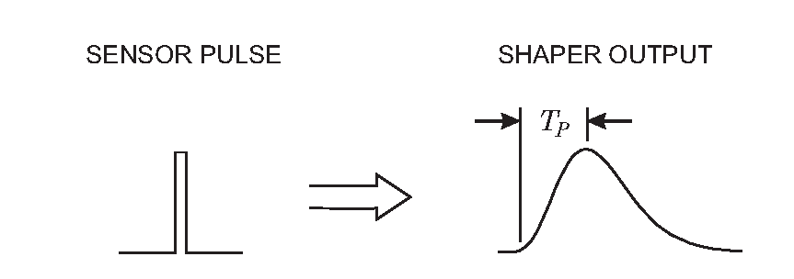
The pulse-shaper should “broaden”…
Sharp pulse is “broadened” – rounded around the peak
Reduces input bandwidth and hence noise

Slide 90
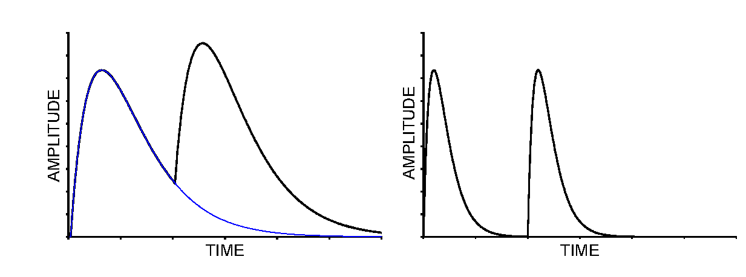
…but not too much
Broad pulses reduce the temporal spacing between consecutive pulses
Need to limit the effect of “pile-up” → pulses not too broad
As usual in life: a compromise, in this case made out of low-band and high-band filters

Slide 91
How good can we get?
Noise

Slide 92
Fluctuations and Noise
There are two limitations to the precision of signal magnitude measurements
  Fluctuations of the signal charge due to a an absorption event in the detector
  Baseline fluctuations in the electronics (“noise”)
Often one has both – they are independent from each other so their contributions add in quadrature:
Noise affects all measurements – must maximize signal to noise ration S/N ratio

Slide 93
Signal fluctuation
A signal consists of multiple elementary events (e.g. a charged particle creates one electron-hole pair in a Si-strip)
The number of elementary events fluctuates where F is the Fano factor (0.1 for Silicon), E_{i} the energy of an elementary event
r.m.s.

Slide 94
Electronics Noise
Thermal noise
  created by velocity fluctuations of charge carriers in a conductor
  Noise power density per unit bandwidth is constant: white noise ➔
  larger bandwidth → larger noise (see also next slide)
Shot noise
  created by fluctuations in the number of charge carriers (e.g. tunneling events in a semi-conductor diode)
  proportional to the total average current

Slide 95
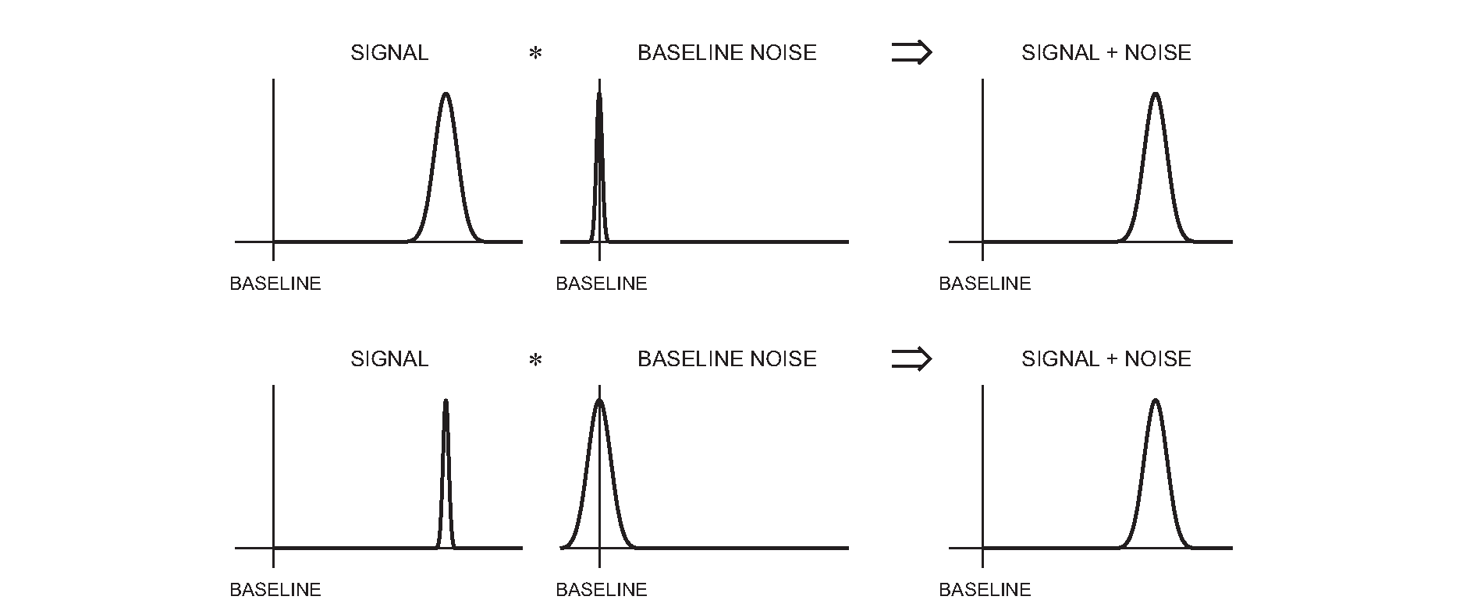
SNR / Signal over Noise
What do we actually care about?
Need to optimize Signal over Noise Ratio (SNR)

Slide 96
(Large) Systems

Slide 97
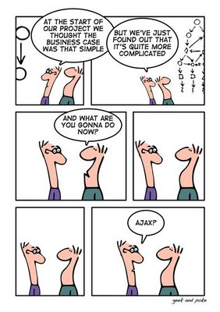
New problems
Going from single sensors to building detector read-out of the circuits we have seen, brings up a host of new problems:
  Power, Cooling
  Crosstalk
  Radiation (LHC)
Some can be tackled by (yet) more sophisticated technologies

Slide 98
(Non-) Scalability

Slide 99
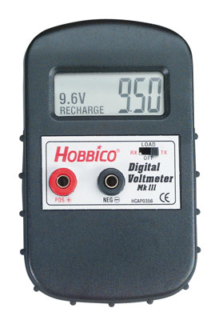
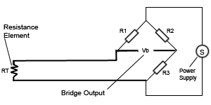
Measuring Temperature
Suppose you are given a Pt100 thermo-resistor
We read the temperature as a voltage with a digital voltmeter

Slide 100
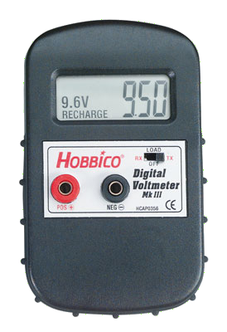
Reading Out Automatically
#include <libusb.h>
struct usb_bus *bus;
struct usb_device *dev;
usb_dev_handle *vmh = 0;
usb_find_busses(); usb_find_devices();
for (bus = usb_busses; bus; bus = bus->next)
for (dev = bus->devices; dev; dev = dev->next)
if (dev->descriptor.idVendor == HOBBICO) vmh = usb_open(dev);
usb_bulk_read(vmh ,3,&u,sizeof(float),500);
Note how small the sensor has become.
In DAQ we normally need not worry about the details of the things we readout
USB/RS232

Slide 101

Read-out 16 Sensors
Buy 4 x 4-port USB hub (very cheap) (+ 3 more voltmeters)
Adapt our little DAQ program
No fundamental (architectural) change to our DAQ

Slide 102
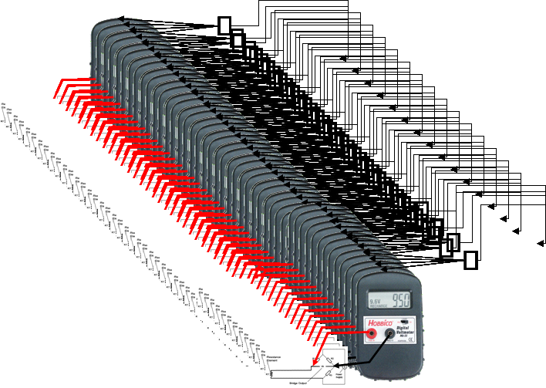
Read-out 160 Sensors
For a moment we (might) consider to buy 52 USB hubs, 160 Voltmeters
…but hopefully we abandon the idea very quickly, before we start cabling this!
Expensive, cumbersome, fragile →
our data acquisition system is not scalable

