Slide 1



Calibration of
Beam Position Monitors (BPMs)
Excellence in Detectors and Instrumentation Technologies
INFN - Laboratori Nazionali di Frascati, Italy
October 20-29, 2015
Yellow: Your Tasks T1 – T8

Slide 2


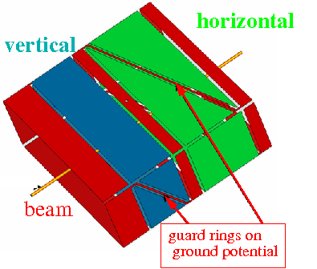
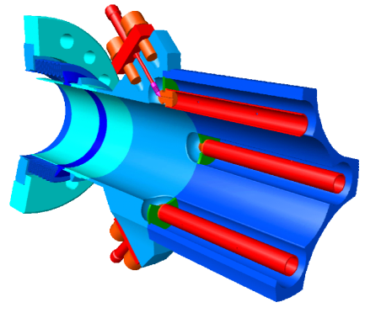
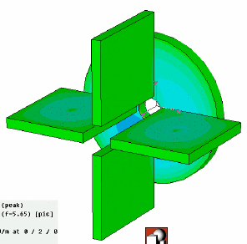
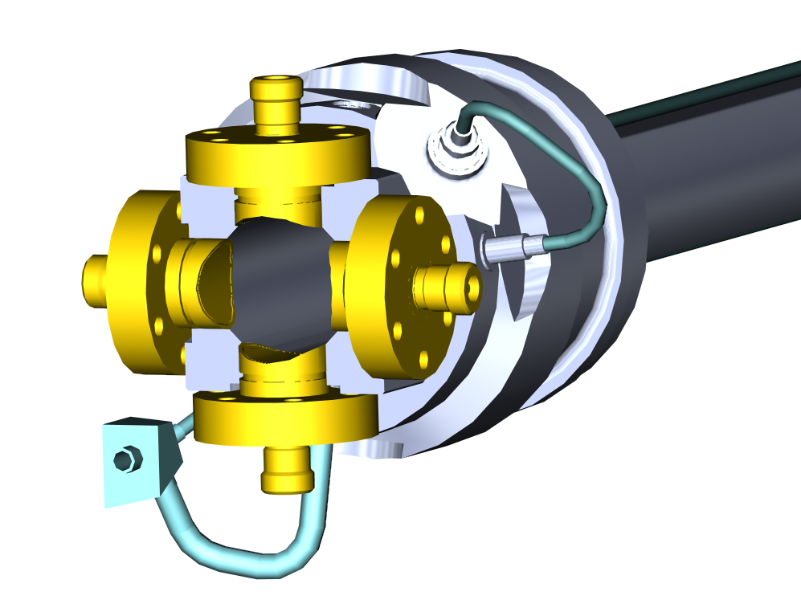
Comparison of BPM Types
BPM Type | Application | Precaution | Advantage | Disadvantage
Shoe-Box | p-synchrotrons heavy-ion accelerators | long bunches f_{RF} < 10 MHz | very linear no x-y coupling sensitive for broad beams | complex mechanics capacitive coupling between plates
Button | p-linacs all e-accelerators | f_{RF} > 10 MHz | simple mechanics | non-linear x-y coupling possible signal deformation
Stripline | colliders p-linacs all e-accelerators | best for β ≈ 1 short bunches | directivity „clean“ signal large signal | complex 50 Ω matching complex mechanics
Cavity | e-linacs (e.g. FELs) | short bunches, special applic. | very sensitive | very complex high frequency
P. Forck, “Lecture Notes on Beam Instrumentation and Diagnostics”, JUAS 2011
Gero Kube & Kay Wittenburg, DESY / MDI
EDIT 2015, Frascati (Italy), 23./27.October 2015

Slide 3
Beam Position Monitors
short version of E-XFEL BPM specification
 | Number | Beam Pipe | Length | Type | Single Bunch Resolution (RMS) | Train Averaged Resolution (RMS) | Optimum Resolution Range | Relaxed Resolution Range | x/y Crosstalk | Bunch to Bunch Crosstalk | Trans. Alignment Tolerance (RMS)
 |  | mm | mm |  | μm | µm | mm | mm | % | μm | μm
Standard BPM | 219 | 40.5 | 200/ 100 | Button | 50 | 10 | ± 3.0 | ± 10 | 1 | 10 | 200
Cold BPM | 102 | 78 | 170 | Button/ Re- entrant | 50 | 10 | ± 3.0 | ± 10 | 1 | 10 | 300
Cavity BPM Beam Transfer Line | 12 | 40.5 | 255 | Cavity | 10 | 1 | ± 1.0 | ± 2 | 1 | 1 | 200
Cavity BPM Undulator | 117 | 10 | 100 | Cavity | 1 | 0.1 | ± 0.5 | ± 2 | 1 | 0.1 | 50
IBFB | 4 | 40.5 | 255 | Cavity | 1 | 0.1 | ± 1.0 | ± 2 | 1 | 0.1 | 200
specified charge range: 0.1 – 1nC
different BPM types to meet different requirements
courtesy: D.Nölle (DESY)
Gero Kube & Kay Wittenburg, DESY / MDI
EDIT 2015, Frascati (Italy), 23./27.October 2015

Slide 4
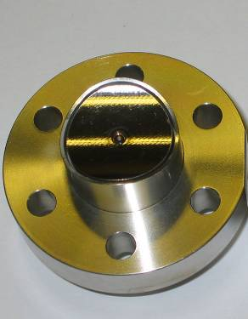
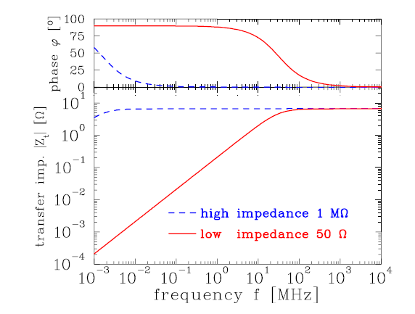
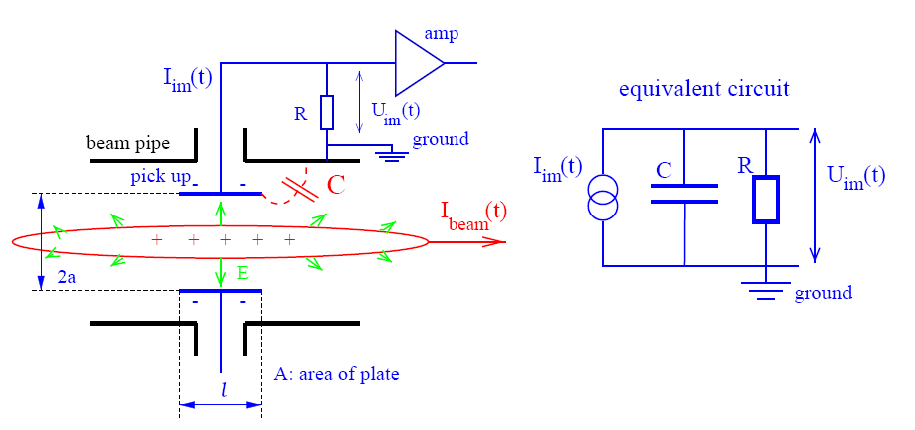
Beam Position Monitor
most common: capacitive pickups
signal generation via beam electric field
popular design: button-type pickup
→ simple, cheap, …
→ moderate resolution
LHC button pickup
courtesy: R.Jones (CERN)
operation principle
electric field induces image charge on pick-up
→ pick-up mounted isolated inside vacuum chamber
→ amount of induced charge depends on distance between beam and pick-up
button pickup: high pass characteristics
Z_{t}
not well suited for long bunches
→ especially: low energy hadron beams, i.e. heavy ion beams
→ small coupling between pickup and bunch
P. Forck, “Lecture Notes on Beam Instrumentation and Diagnostics”, JUAS 2011
Gero Kube & Kay Wittenburg, DESY / MDI
EDIT 2015, Frascati (Italy), 23./27.October 2015

Slide 5
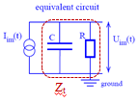
Electrostatic Beam Position Monitor
V
T1) How Q_{Beam}(t) looks like?
-
+
-
+
-
-
+
-
+
-
+
-
-
+
-
+
-
+
-
+
-
-
+
-
+
-
+
-
+
-
+
-
-
+
-
+
+
-
-
-
-
+
-
+
-
-
-
-
+
+
-
+
-
-
+
-
+
-
-
-
-
-
-
-
-
-
+
-
+
+
-
+
+
-
+
-
-
+
-
+
-
+
-
+
-
+
+
+
+
-
+
-
-
+
-
+
+
+
+
+
+
+
+
+
+
+
+
+
+
+
+
+
+
+
+
+
+
+
+
+
+
+
+
+
+
+
+
+
+
+
+
+
+
+
+
+
+
+
+
+
+
+
+
+
+
+
+
+
+
+
+
+
+
+
+
+
+
+
+
+
+
+
+
+
+
+
+
+
+
+
+
+
+
+
+
-
+
+
-
+
+
-
-
-
-
+
-
-
+
-
-
+
+
+
-
-
+
-
+
+
-
-
-
+
-
+
-
-
-
-
-
-
+
-
+
+
+
+
-
+
-
-
+
Rhodri Jones –CERN Beam Instrumentation Group

Slide 6
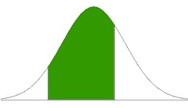
BPM Signal Generation
induced charge on BPM button
Q_{ind}(t)
BPM button
Q(t) = bunch length
E
bunch
z = c∙t
-a
0
+a
button voltage (distorted by Impedance)
image current
to be measured
signal behind cable
…
Gero Kube & Kay Wittenburg, DESY / MDI
EDIT 2015, Frascati (Italy), 23./27.October 2015

Slide 7
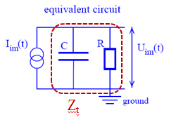
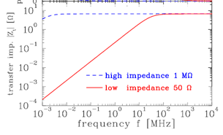
Transfer Impedance Z_{T}
A = (d/2)² π = π 5.4² mm²
r = Ø/2 = 30.16 mm
C_{e}= 3.07 pF
R₀= 50Ω
Beampipe: round: Ø = 60.325 mm
Button Diameter d=10.8 mm
Z_{T} ≈ 0.52 Ω
for round beam pipes
Area A
for ω>>ω_{L}
r
T2): for ω>>ω_{L}
Calculate Z_{T} and _{fL}
Let’s simulate: Beam.mat
Z_{t}(ω) = U_{BPM}(ω) / I_{Beam}(ω)
T3) Plot Z(ω) vs ω at f=1, 5, 10, 20 GHz
see simulation Beam.mat

Slide 8
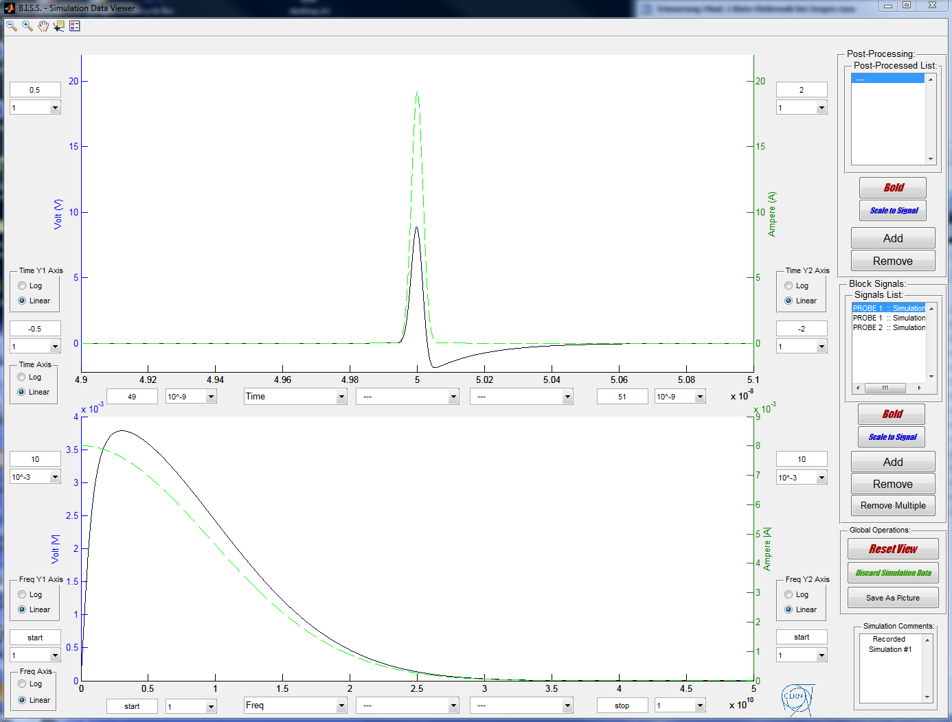
Beam.mat
Q_{Beam}(t)
U_{BPM}(t)
U_{BPM}(ω)
Q_{Beam}(ω)

Slide 9
Position Reconstruction
Two common monitor geometries
difference in position reconstruction
linac-type
storage ring-type
y
y
x = K_{x}
P₁ – P₃
x = K_{x}
(P₁+P₄) – (P₂+P₃)
P₁ + P₃
P₁+P₂+P₃+P₄
beam
x
beam
x
y = K_{y}
P₂ – P₄
y = K_{y}
(P₁+P₂) – (P₃+P₄)
P₂ + P₄
P₁+P₂+P₃+P₄
Beampipe: round: r = 30.17 mm
Button Diameter d =10.8 mm
Position Information
T4) Calculate K_{x,}
for both types
requires knowledge of monitor constant K_{x}, K_{y}
r
→ rule of thumb (circular duct)
α
sin(α) = 0.175
= 0.177
K_{x}=15.16 mm (linac)
K_{x} = 21.45 mm (ring)
linac-type
storage ring-type
Gero Kube & Kay Wittenburg, DESY / MDI
EDIT 2015, Frascati (Italy), 23./27.October 2015

Slide 10
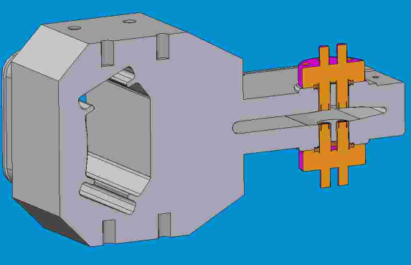
Electrostatic Pick-up – Button
Non-linear
  requires correction algorithm when beam is off-centre
  vacuum chamber not rotational symmetric (SR-source)
Area A
courtesy: A.Delfs (DESY)
r
beam
pump channel
button pickup (cut)
PETRA-III BPM close to ID
Rhodri Jones –CERN Beam Instrumentation Group

Slide 11

Monitor Constant Calculation
arbitrary geometries
→ no simple rule of thumb calculation
strategy for calculation
= K_{x} * Δ/Σ
start with position raster for point beam
for each beam position (x₀, y₀)
→ calculate induced charge onto buttons
e.g. via boundary element method:
T5) Calculate K_{x} from simulation Hybrid.mat
and compare with “rule of thumb”
build position map
→ for each (x₀, y₀) assign Δ_{x,y}/Σ values
sensitivity: slope at origin
sensitivity S_{x,y}
plot values along (x,y)-axes
monitor constant: K_{x,y} = S_{x,y}⁻¹
Gero Kube & Kay Wittenburg, DESY / MDI
EDIT 2015, Frascati (Italy), 23./27.October 2015

Slide 12
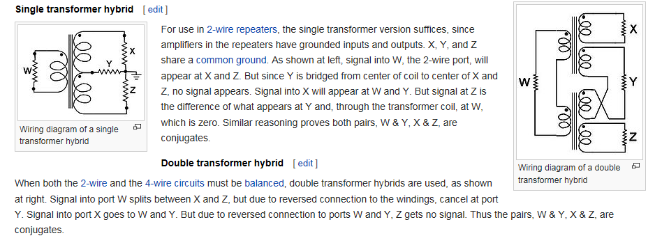
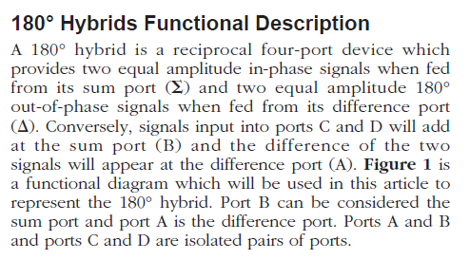
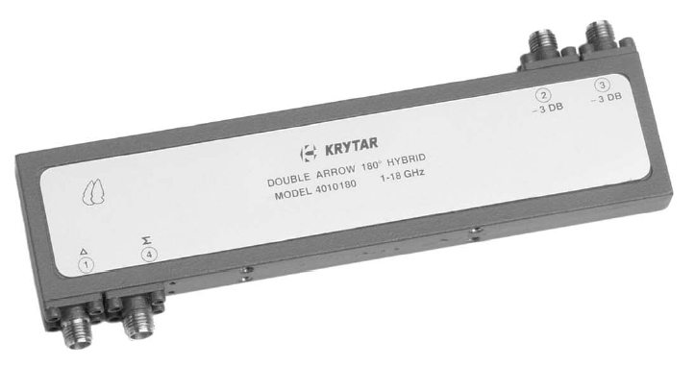
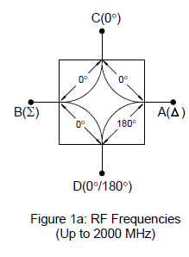
180 deg Hybrids
Input at x and z
out W = x+z, out Y = x-z

Slide 13
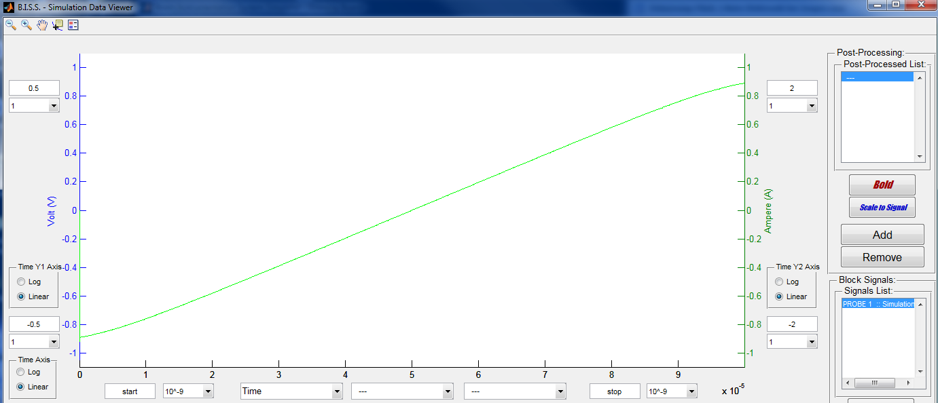
y=S*x, x_{full scale} = position variation, S=y/x
-100% to 100% means the ± radius => x=10 => x= 30.17 mm
K_{x} = 1/S = 2 * 3.017 / 0.4 = 15.085

Slide 14

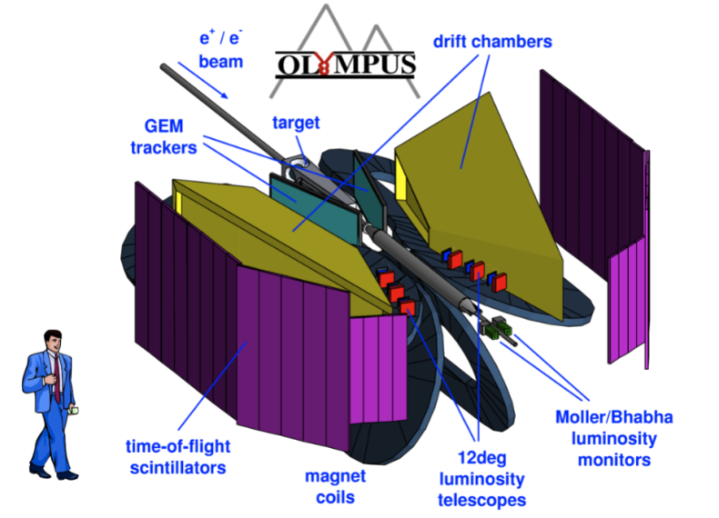
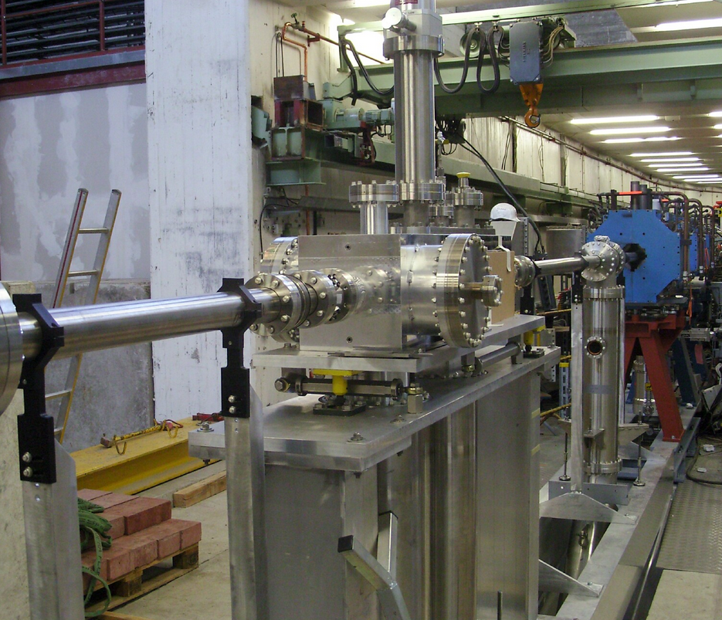
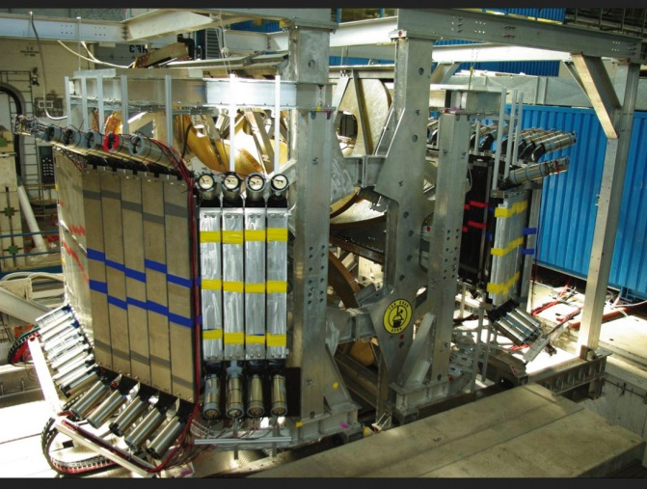
OLYMPUS @ DORIS (DESY)
two-photon exchange in lepton scattering
compare e⁺p and e⁻p elastic scattering
R. Milner et al., „The OLYMPUS experiment“, Nucl. Instrum. Methods A741 (2014) 1
OLYMPUS Target Chamber
BPM
BPM
Gero Kube & Kay Wittenburg, DESY / MDI
EDIT 2015, Frascati (Italy), 23./27.October 2015

Slide 15
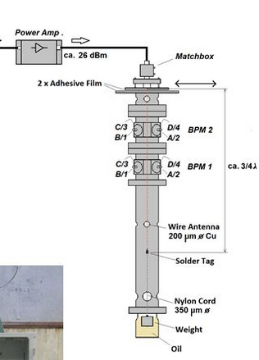
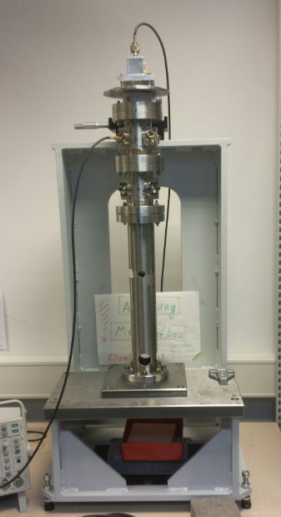
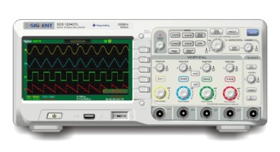
Monitor Constant Measurement
BPM test stand
U. Schneekloth et al., Proc. IBIC 2014, Monterey (Ca), USA, (2014) 324
RF generator
499.66 MHz
ca. 33 dBm
test stand
→ vertical scanning device
→ 2 precision movers (micro screws) on top
→ wire antenna (Ø 0.2mm) centered in BPMs,
stretched by weight, damped movement
OLYMPUS BPMs
electrical input signal
→ 500 MHz cw signal induced on wire
→ electrical wire length: ¾ λ of 500 MHz
(standing wave)
→ essential: solid ground connections
signal readout
Gero Kube & Kay Wittenburg, DESY / MDI
EDIT 2015, Frascati (Italy), 23./27.October 2015

Slide 16
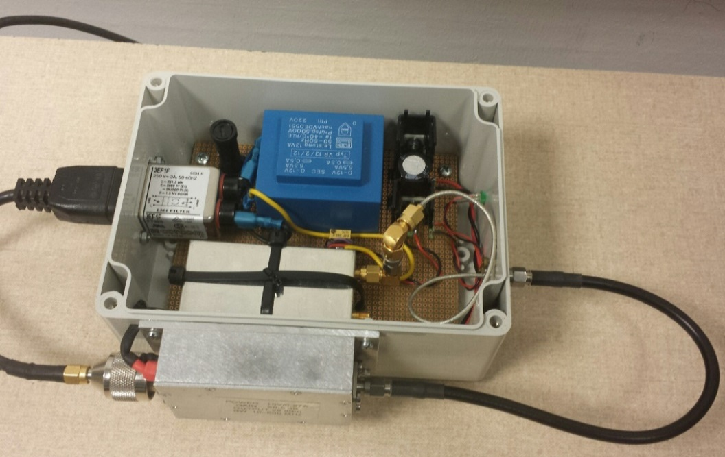
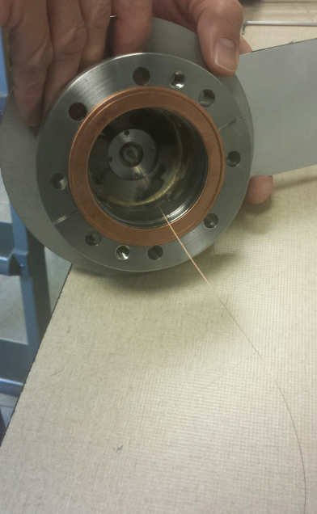
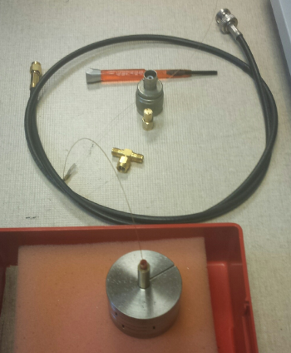
BPM Test Stand
wire antenna
RF generator
power amplifier
weight
nylon chord
solder tag
Gero Kube & Kay Wittenburg, DESY / MDI
EDIT 2015, Frascati (Italy), 23./27.October 2015

Slide 17
Tasks: BPMs
calculate BPM signals using the Simulation Tool
get a first impression about BPM signal forms
→ chamber geometry influence
→ non-linearities
→ output impedance
Done
calculate monitor constants for OLYMPUS BPMs
use rule-of-thumb formulae for both geometries
measure OLYMPUS BPM monitor constants (both geometries)
T6) define electrical center of both BPM bodies (origin) and calibrate movers
T7) perform 1-dim. scan along one axis → max. wire position: ± 15 mm (!!!)
→ 7a) measure signal amplitudes from each button
→ 7b) calculate Δ/Σ from measured signals
→ 7c) plot Δ/Σ versus wire position
T8) determine monitor constant from slope at origin and compare with simulation and rule-of-thumb
(measure 2-dim. position map)
Gero Kube & Kay Wittenburg, DESY / MDI
EDIT 2015, Frascati (Italy), 23./27.October 2015

Slide 18
OLYMPUS Target Chamber BPMs
target chamber BPMs:
round: Ø 60.325 mm button diameter 10.8 mm
Gero Kube & Kay Wittenburg, DESY / MDI
EDIT 2015, Frascati (Italy), 23./27.October 2015

Slide 19
Processing System Families
Automatic
Gain Control
on Σ
DIGITISER
Multiplexed
Heterodyne
Synchronous
Detection
POS = (A-B)
No turn by turn
Hybrid
Δ / Σ
Heterodyne
Homodyne
Detection
POS = Δ / Σ
Electrodes
A, B
Down
Conversion
Direct
Digitisation
POS = Δ / Σ
Individual
Treatment
Logarithmic
Amplifiers
Differential
Amplifier
POS = [log(A/B)]
= [log(A)-log(B)]
Legend:
/ = Single channel
Wide Band
Narrow band
Passive
Normalisation
Amplitude
to Time
Limiter,
Δt to Ampl.
POS = [A/B]
Normaliser
Processor
Amplitude
to Phase
.
Limiter,
φ to Ampl.
POS = [ATN(A/B)]
turn by turn
Active
Circuitry
Rhodri Jones –CERN Beam Instrumentation Group

Slide 20
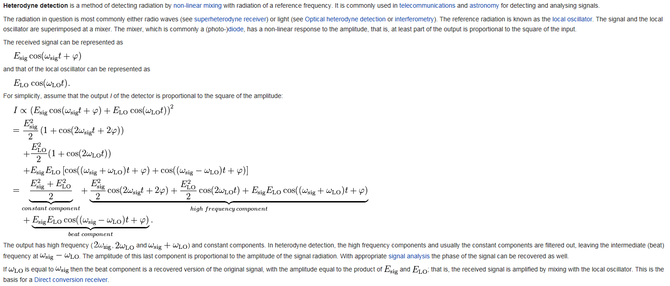

Slide 21
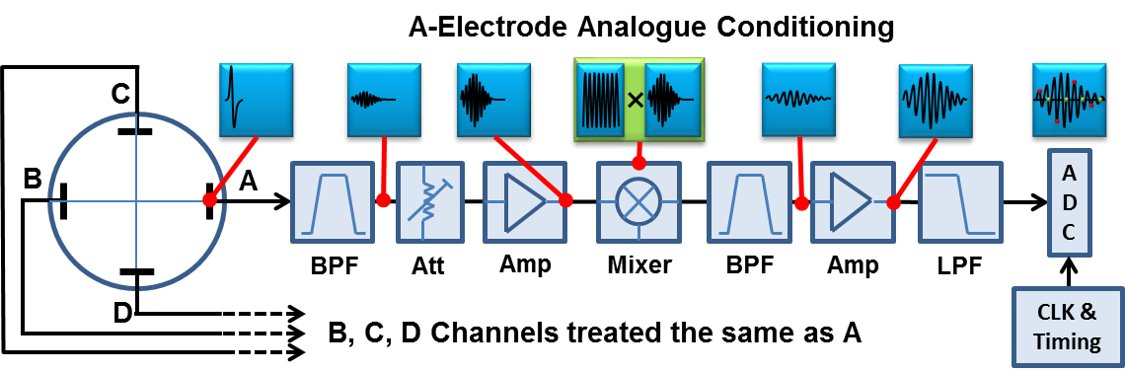
Modern BPM Read-out Electronics
Based on the individual treatment of the electrode signals
  Use of frequency domain signal processing techniques
    Developed for telecommunications market
  Rely on high frequency & high resolution analogue to digital converters
    Minimising analogue circuitry
    Frequency down-conversion used if necessary to adapt to ADC sampling rate
    All further processing carried out in the subsequent digital electronics
Rhodri Jones –CERN Beam Instrumentation Group

Slide 22
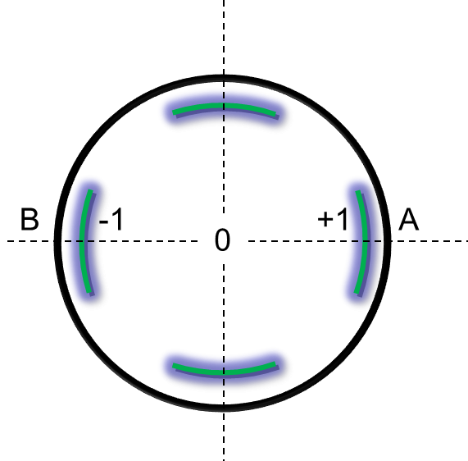
Normalising the Position Reading
To make it independent of intensity
3 main methods:
  Difference/Sum : (V_{A} – V_{B}) / (V_{A} + V_{B}) = Δ / Σ
  Phase : Arctan(V_{A} / V_{B})
  Logarithm : Log(V_{A}) – Log(V_{B})
Rhodri Jones –CERN Beam Instrumentation Group

Slide 23
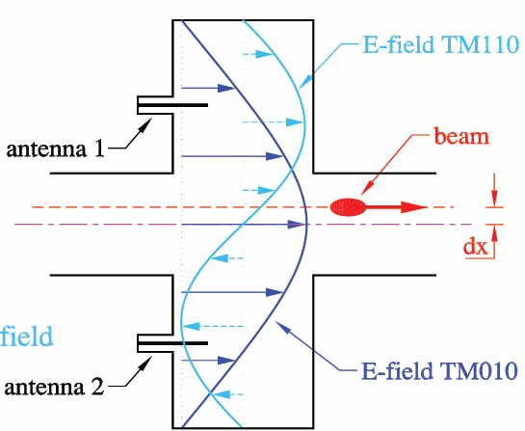
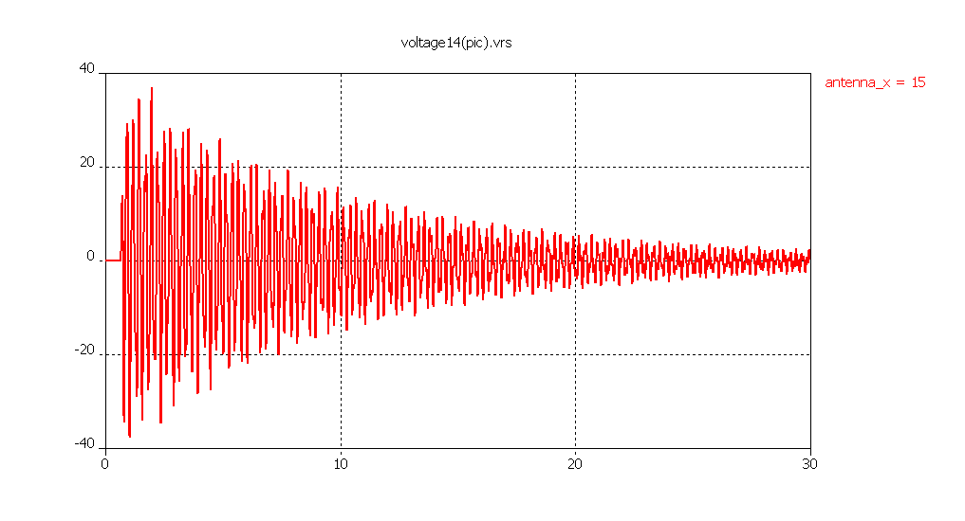
Narrowband Signals: Cavity BPM
Linac: high resolution BPM for short bunches and single pulses
requirement: increase in BPM signal strength
standard BPMs: intensity signals which have to be subtracted to
obtain position information
→ difficult to do electronically without some of the intensity
information leaking through
cavity BPM: collect directly position information
bunch excites several resonating modes while passing a
pillbox-like cavity
→ short bunches deliver wide spectrum of frequencies
monopole mode TM₀₁₍₀₎: beam intensity
→ maximum at center
→ strong excitation
dipole mode TM₁₁₍₀₎: beam position
→ minimum at center
→ excitation by beam offset
→ slightly shifted in frequency wrt. monopole mode
antenna signal: time domain
U / V
task: antenna design to couple out dipole mode
amplitude: position information → only absolute value !
phase (wrt. monopole mode): sign information → simultaneous measurement required !
t / ns
Gero Kube & Kay Wittenburg, DESY / MDI
EDIT 2015, Frascati (Italy), 23./27.October 2015

Slide 24
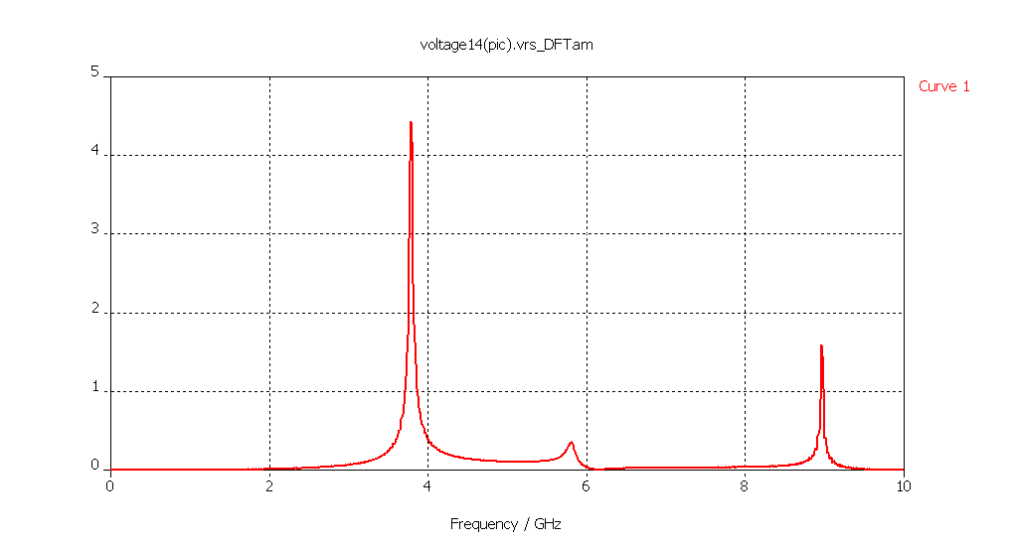
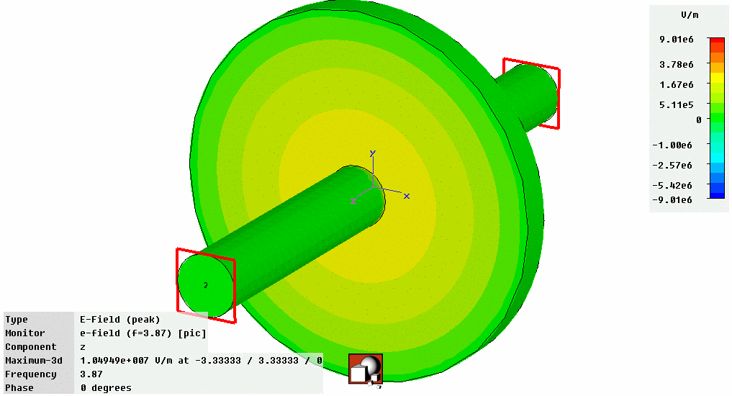
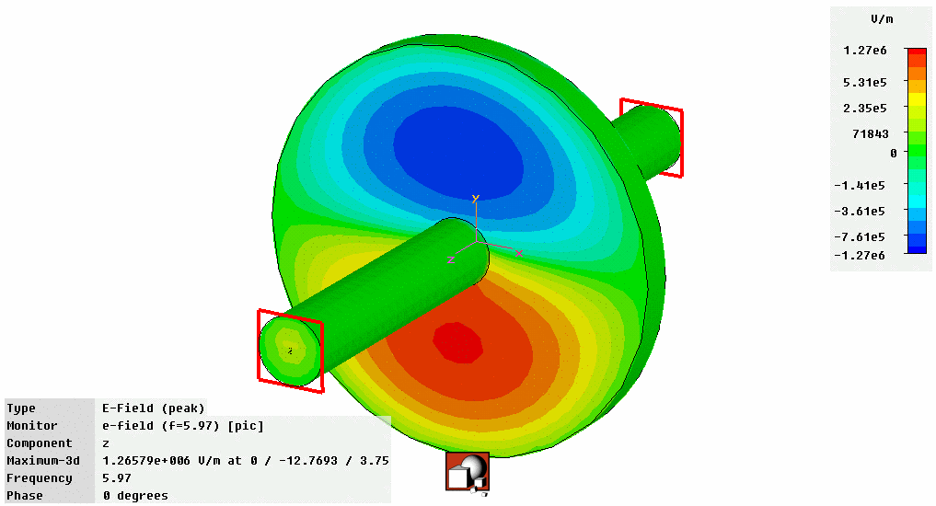
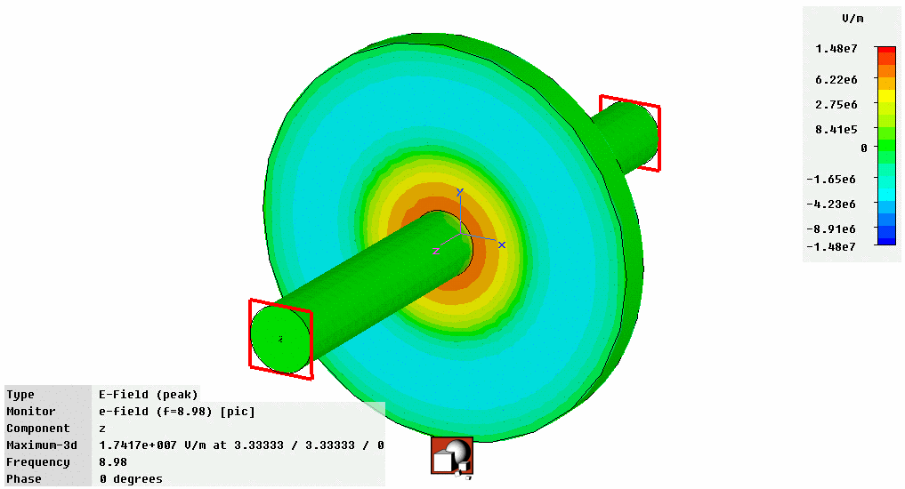
Cavity BPM
cavity frequency spectrum
U / V
TM₀₁
TM₀₂
TM₁₁
U~q
U~q∙|r|
U~q
f / GHz
q: beam charge, r: beam offset
problem: monopole mode (TM₀₁) leakage into dipole mode (TM₁₁)
→ suppression of monopole mode required
courtesy: D.Lipka (DESY)
Gero Kube & Kay Wittenburg, DESY / MDI
EDIT 2015, Frascati (Italy), 23./27.October 2015

Slide 25
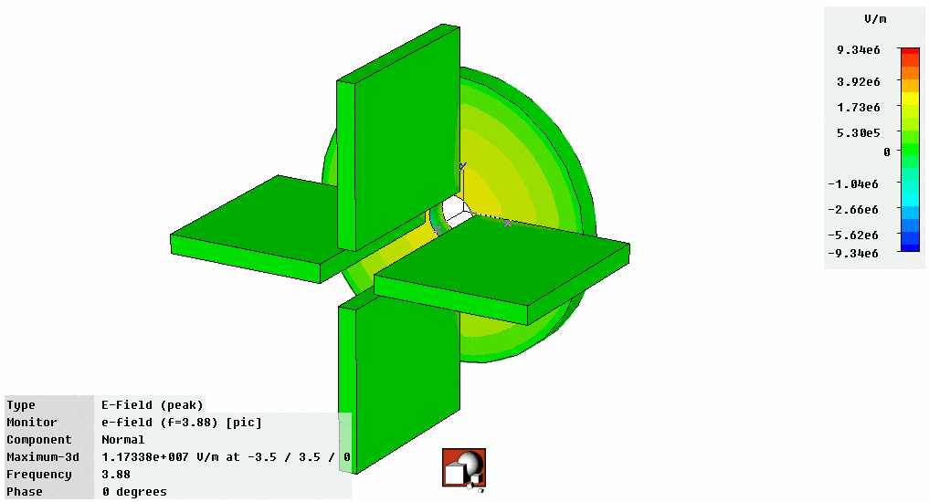
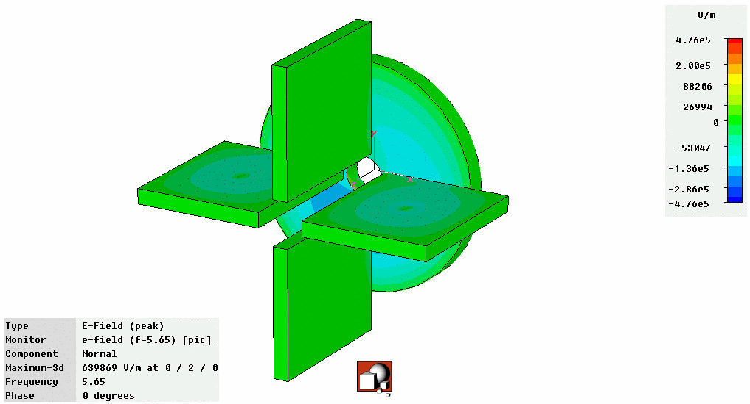
Cavity BPM
suppresion of monopole mode
dipole mode (TM₁₁) signal coupled out via waveguide
→ choose outcoupling at position of large TM₁₁ electric field amplitude
design waveguide with cutoff frequency above f₀₁ (monopole mode) resonance
influence of outcoupling waveguide
Monopole Mode
Dipole Mode
courtesy: D.Lipka (DESY)
narrow-band electronics for signal processing
→ B.Keil, Proc. DIPAC’09, Basel (Switzerland) 2009, TUOC01, p.275
→ D.Lipka, Proc. DIPAC’09, Basel (Switzerland) 2009, TUOC02, p.260
Gero Kube & Kay Wittenburg, DESY / MDI
EDIT 2015, Frascati (Italy), 23./27.October 2015

Slide 26
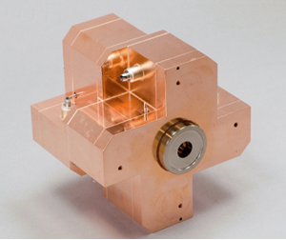
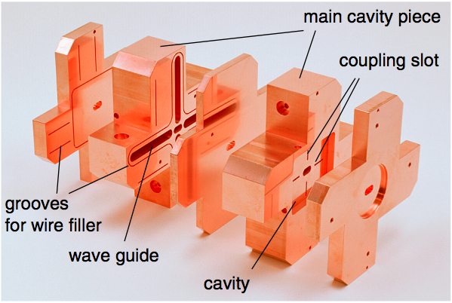
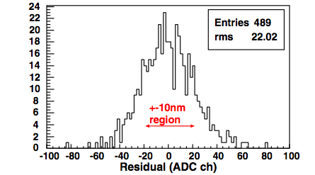
Today’s State of the Art BPMs
Prototype BPM for ILC Final Focus
  Required resolution of 2nm (yes nano!) in a 6×12mm diameter beam pipe
  Achieved World Record (so far!) resolution of 8.7nm at ATF2 (KEK, Japan)
Courtesy of D. Lipka & Y. Honda
Courtesy of D. Lipka,
DESY, Hamburg
Rhodri Jones –CERN Beam Instrumentation Group

Slide 27
Reserve

Slide 28
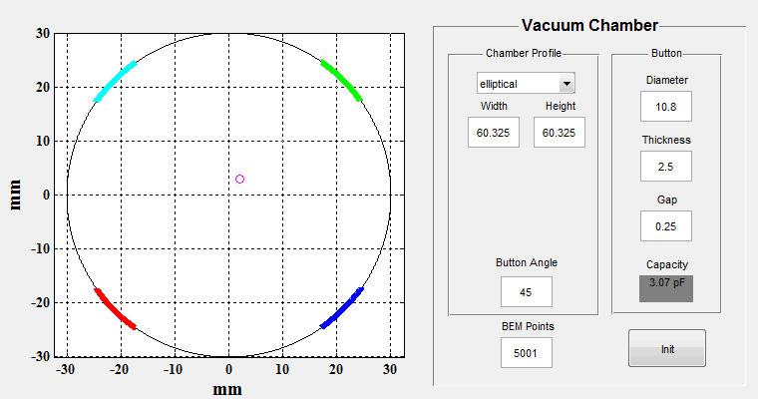
BPM Signal Generation
induced charge on BPM button
Q_{ind}(t)
BPM button, Ø2a
E
e-bunch
chamber geometry
beam charge & bunch length
z = c∙t
-a
0
+a
button voltage
image current
signal behind cable
…
Gero Kube & Kay Wittenburg, DESY / MDI
EDIT 2015, Frascati (Italy), 23./27.October 2015

Slide 29
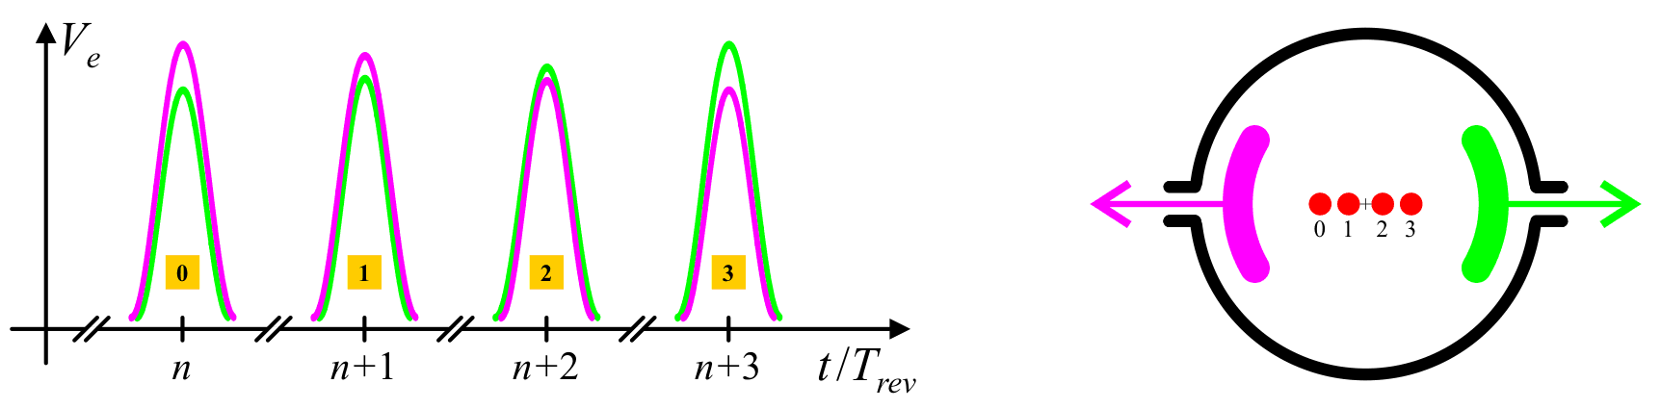
BPM Signals
observation (1): signals are short with small modulation
single bunch response → nsec or sub-nsec pulse signals
beam position information → amplitude modulated on large (common mode) beam intensity signal!
courtesy: M. Gasior (CERN)
BPM building blocks
feedback bus
(if applicable)
control
system
(LAN)
position
data
BPM Pickup
RF device, EM field
detection, center of
charge
symmetrically
arranged electrodes
or resonant structure
CAL
Analog Signal Conditioning
ADC
Digital Signal Processing
Data Acquisition
CLK
Power Supply & Misc.
Trigger & Timing
Control
Read-out Electronics
analog signal conditioning
signal sampling (ADC)
digital signal processing
data acquisition and control system interface
trigger, CLK & timing signals
provides calibration signals or
other drift compensation methods
courtesy: M. Wendt (CERN)
timing, trigger signals
Gero Kube & Kay Wittenburg, DESY / MDI
EDIT 2015, Frascati (Italy), 23./27.October 2015

Slide 30
BPM Signals
observation (2): nonlinearities
especially BPMs for circular e-accelerators
synchrotron radiation emission
→ pickups mounted out of orbit plane
vacuum chamber not rotational symmetric
→ ε_{hor} >> ε_{vert} (SR emission in hor. plane)
→ injection oscillations due to off-axis injection
(allows intensity accumulation)
courtesy: A.Delfs (DESY)
beam
pump channel
button pickup (cut)
PETRA-III BPM close to ID
correction of strong non-linearities in beam position required
Gero Kube & Kay Wittenburg, DESY / MDI
EDIT 2015, Frascati (Italy), 23./27.October 2015

Slide 31
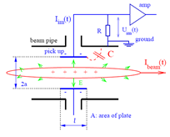
Electrostatic Monitor – Beam Response
Area A
r
For Button with
Capacitance C_{e} & Characteristic Impedance R₀
Transfer Impedance:
Lower Corner Frequency:
Rhodri Jones –CERN Beam Instrumentation Group

Slide 32
Electrostatic Monitor – Beam Response
C
Response U_{BPM} (V)
V_{B}
0
0
Frequency (Hz)
R
V
+
+
+
+
+
+
+
+
+
+
+
+
+
+
+
+
+
+
+
+
+
+
+
+
+
+
+
+
+
+
+
+
+
+
+
+
+
+
+
+
+
+
+
+
+
+
+
+
+
+
+
+
+
+
+
+
+
+
+
+
+
+
+
+
+
+
+
+
+
+
+
+
+
+
+
+
+
Rhodri Jones –CERN Beam Instrumentation Group

