Slide 1
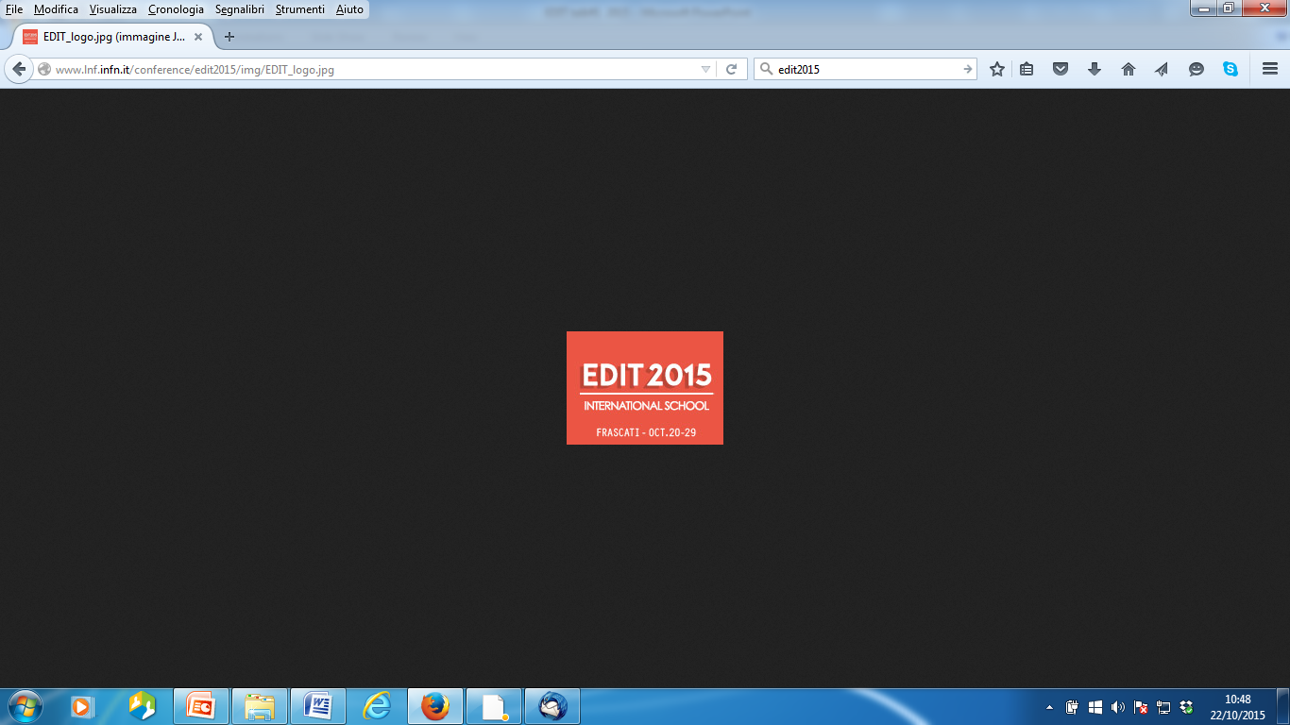

Excellence in Detectors and Instrumentation Technologies
INFN - Laboratori Nazionali di Frascati, Italy October 20-29, 2015
Application to Medicine & Hadrontheraphy
Lecture#2 - The current status and challenges of detection and imaging in radiation therapy
Alberto Del Guerra
Functional Imaging and Instrumentation Group
Dipartimento di Fisica “E. Fermi”
Universita’ di Pisa and INFN, Sezione di Pisa
http://www.df.unipi.it/~fiig/
Email:alberto.delguerra@df.unipi.it

Slide 2
Contents
  Rationale for imaging in hadrontherapy
  First attempts in the late ‘70s
  Proton radiography and proton tomography
  Taking advantage of nuclear interactions:
    Modelling
    Positron emitters and PET imaging
    Prompt neutral particles ➔gammas
    Prompt charged particles ➔protons
    Combined systems (INSIDE project)
  A novel technique: PET Cherenkov Imaging
  Conclusions

Slide 3
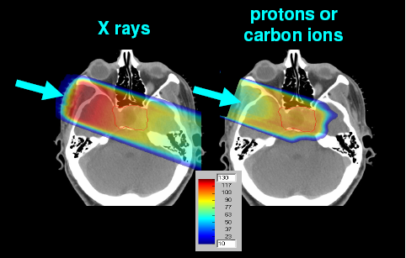
Advantages of Hadrontherapy
More dose delivered in depth
Better dose conformation for the same total dose
120
60
Co
100
Protons, 200 MeV
80
Ionizaton percentage
60
40
,
8 MeV
20
-
e
0
0
5
10
15
20
25
30
Depth in water (cm)

Slide 4
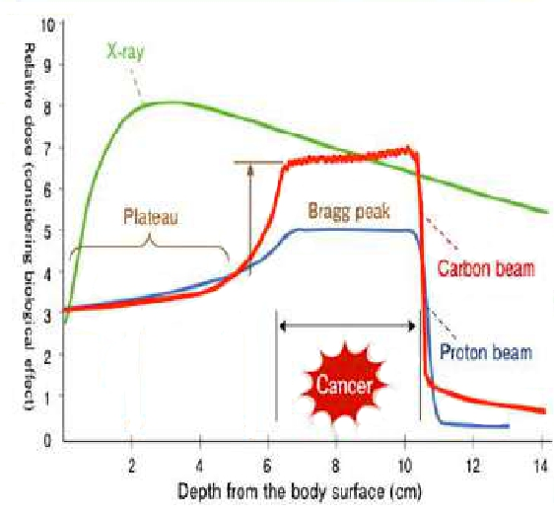
Advantage of Hadron-Therapy
Extended Tumor
Sharp dose fall-off after the Brag Peak
Higher Relative Biological Effectiveness
Highly conformal
More focused on tumor
Max dose at last mm particle’s range (BP)
Proper spatial superimposition of several Bragg-peaks of different depths and amplitudes,
enables optimal conformation of the delivered dose to the tumor volume.
The depth of the Bragg Peak depends on the initial energy of the ions, while its width on the straggling and on the energy spread of the beam has to be small.

Slide 5
  Rationale for imaging in hadrontherapy: critical issues
Physics related
    CT HU (e.g.calibration apparatus)
    conversion to proton stopping power
    dose calculation uncertainties
    daily positioning on the couch
    internal organ motion
    changes in air cavities
    tumour regression
    weight loss
Patient related
  RBE values
  Tumor heterogeneity
  Contouring uncertainties
  Reconstruction artifacts in CT
  Machine related
Other sources
Dose/Bragg Peak
Monitoring is advisable!
Notes:
5

Slide 6
➔Dose/Bragg Peak monitoring➔ 2 major techniques
  Rationale for imaging in hadrontherapy
Planned .. but there was a tissues variation !!
1 - Based on X-ray CT- analogous: pCT (only for Protons)
2 - Based on Nuclear Reactions of Hadrons in Tissue
  Off-line & On-line PET
  Prompt gamma’s and neutrons
  Prompt charged particles (only for Ions)

Slide 7
The BEVALAC experience @Berkeley
with radioactive beams (late‘70s)
“Physical Measurements with High-Energy Radioactive Beams”
A. Chatterjee, W. Saunders, E. L. Alpen, J. Alonso, J. Scherer and J. Llacer Radiation Research, Vol. 92, No. 2 (Nov 1982), pp. 230-244
Abstract
“Physical measurements were made with high-energy radioactive beams (positron emitters) produced as secondary particles from a heavy-particle accelerator. Data are presented for water-equivalent thickness of a silicon diode,a comparison of Bragg peak ionization depth vs stopping depth,and differential stopping depths when a beam is intercepted by heterogeneous materials in the orthogonal direction. A special positron-emitting beam analyzing (PEBA) system was used to form images of the stopped radioactive beam. These measurements will have direct impact on charged-particle radiotherapy,since the precise range of beams of charged particles to targets within patients can be measured and used for treatment planning. Also, during the treatments the stopping point of the beam can be monitored to verify that the treatment is being delivered as planned.

Slide 8
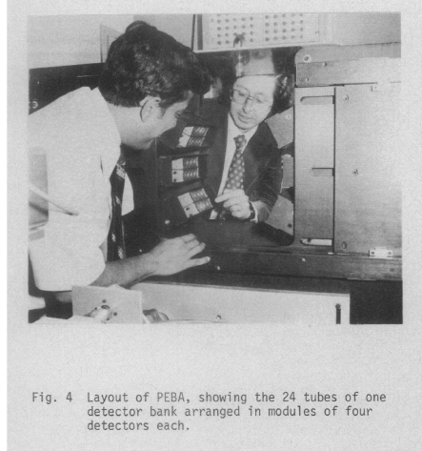
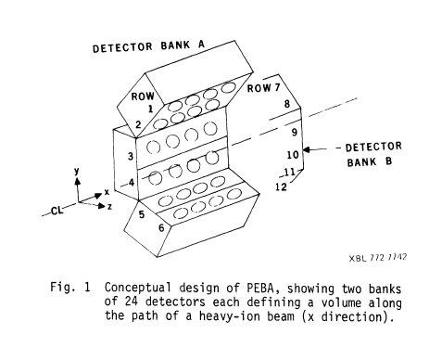
The PEBA detector
IEEE Transactions on Nuclear Science, Vol. NS-26,
No. 1, February 1979, Jorge Llacer, et al.
NaI(Tl) 3” long for the inner; 2” for the outer ones.
In-house electronics+ CAMAC+ and microprocessors
Results: 1 mm resolution – Limited 3-D reconstruction

Slide 9
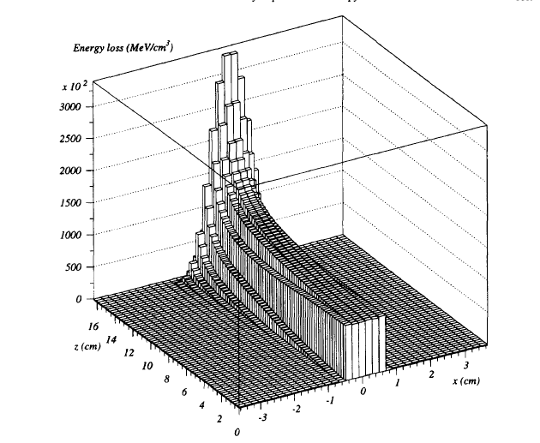
Energy loss distribution with a proton beam of 140.5 MeV in water, using the code PTRAN (one-dimensional/pencil beam) [1997]
A.Del Guerra et al., “PET Dosimetry in Proton Radiotherapy:a Monte Carlo Study”, Appl. Radiat. lsot. Vol. 48, No. 10-12, pp. 1617-1624, 1997

Slide 10
  Proton radiography and proton tomography (*)
Using the same particles (i.e. protons) but with a higher energy, so that they pass through the target:
- Measure the position with a tracker before (upstream) and after the target (downstream)
Measure the residual enery with an energy detector (calorimeter) downstream
Make one planar view to obtain a proton-radiography (pR)
Make many projections to obtain a proton-CT (pCT)
(*)The idea was originally proposed by Allan Cormack in 1963
( J.Appl. Phys.1963,34, p.2722)

Slide 11
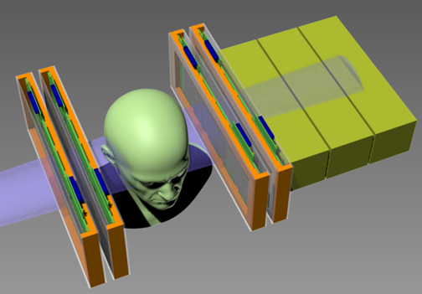
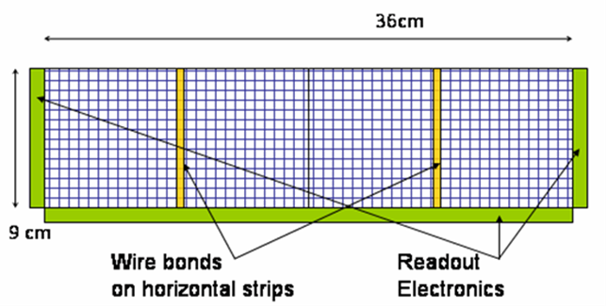
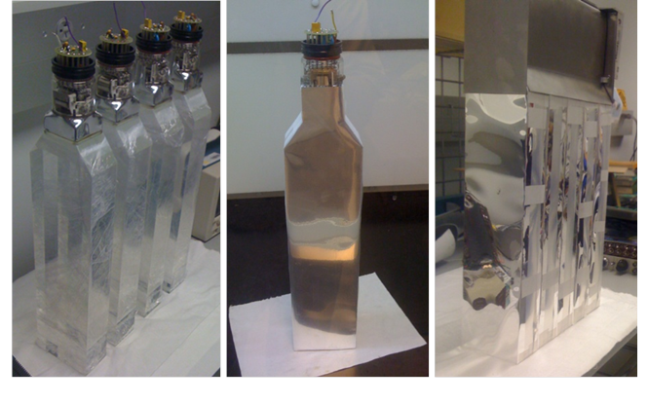
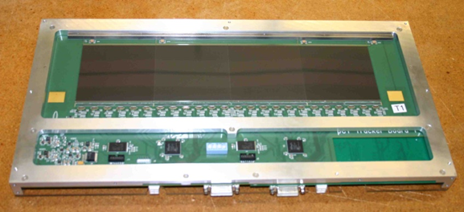
Status of the pCT Project
UC Santa Cruz, Loma Linda U., Baylor U., Wollongong U.
Tracker:
Extrapolates protons into the phantom.
4 x-y planes of Silicon strip detectors with “slim edges” to avoid image artifacts.
Energy Detector:
Provides measurement of the Water Equivalent Path Length (WEPL) of the phantom.
5-stage scintillator with PMT readout.
http://dx.doi.org/10.1016/j.nima.2015.07.066
(Courtesy of H.Sadrozinski, 2015)

Slide 12
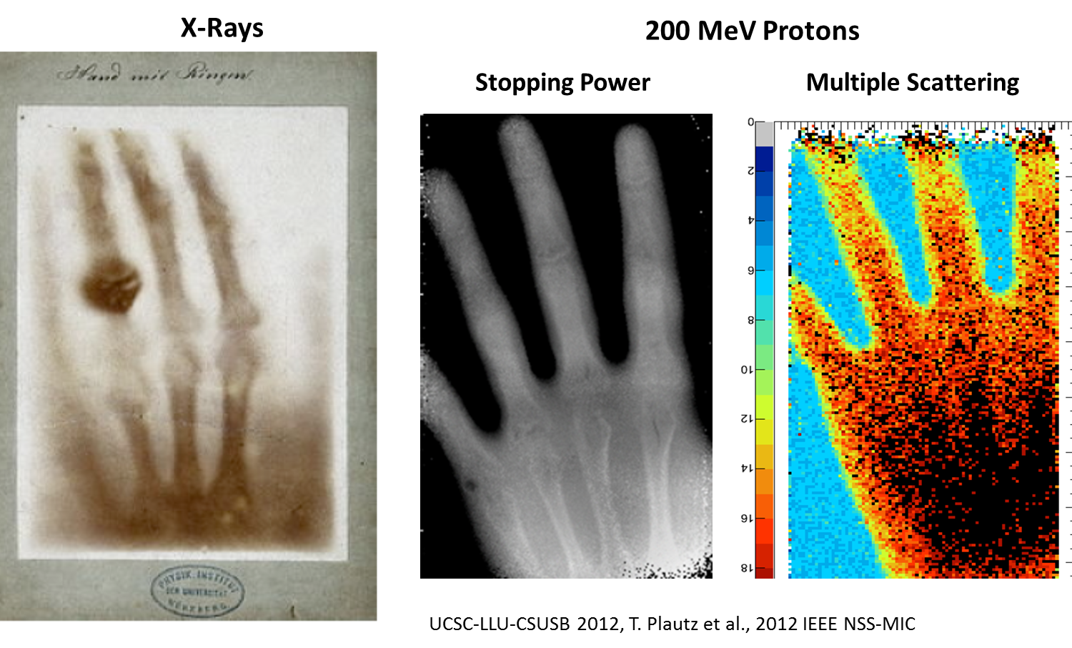
Radiography with pCT Scanner
Wilhelm Roentgen,
Laboratory Radiology (1895)
N.B . Berta’s hand, Hand Phantom!

Slide 13
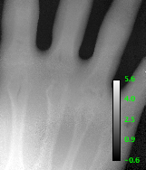
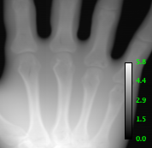
Radiography Relative Stopping Power from X-rays & Protons
X-ray radiograph transformed from Hounsfield Units to RSP
Proton Radiograph (directly in RSP) with 0.5x0.5 mm pixels
About 3%-7% difference between X-ray R and pR
ROI | RSP_{xray} (cm) | RSP_{proton} (cm) | % difference (2*diff/sum) | Relative Error
a. | 3.618±0.130 | 3.527±0.125 | 2.55% | 0.505σ
b. | 2.892±0.070 | 3.015±0.076 | 4.16% | 1.190σ
c. | 4.236±0.119 | 4.561±0.153 | 7.39% | 1.677σ
d. | 2.548±0.082 | 2.539±0.041 | 3.54% | 0.0981σ

Slide 14
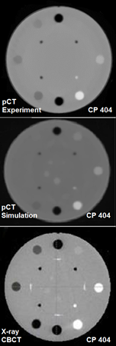
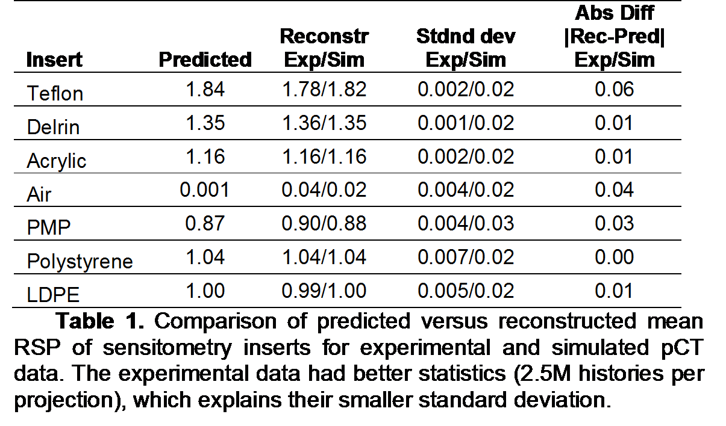
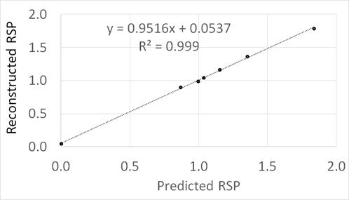
Testing the RSP Resolution & Dose: CTP 404
The Catphan CTP 404
contains inserts of relative
stopping power varying
from 0.001 to 1.85.
This permits a comparison of a proton scan with Geant4 simulation and
X-ray scan.
pCT Collaboration (UC Santa Cruz, Loma Linda, Baylor, Wollongon)
The reconstructed map of the relative stopping power RSP in the CTP 404 phantom
reproduces RSP values of all inserts with accuracy required
by clinical specifications.
Dose comparison of proton vs. X-ray CT scans:
Using weighted CT Dose Index (CTDI)
Proton CT (2 M histories): CTDI = 0.61 mGy X-ray eq CBCT: CTDI = 2.53 mGy

Slide 15
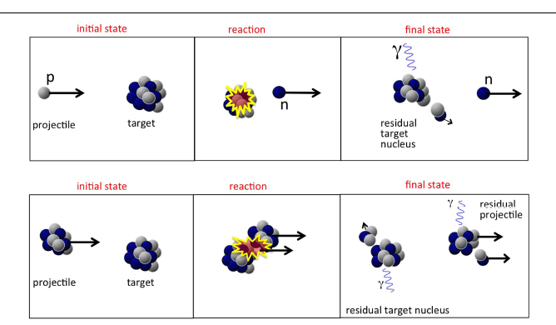
Taking advantage of
nuclear interactions
Top: proton-nucleus interaction;Bottom:nucleus-nucleus interaction
Ref.: Aafke Kraan, Frontiers in Oncology, 07 July 2015 doi: 10.3389

Slide 16
Modelling
A “pletora” of Monte Carlo Codes(*)
FLUKA - <www.fluka.org>
GEANT4 – S.Agostinelli et al. NIM-A, 2003,506(6),250-303
MCNPX/6 -T.Gorley et al. Nucl Techol,2012,180(3),298-315
PHITS -T.Sato et al. Nucl Sci.Techol,2013,50(9),913-923
HIBRAC - L.Silver et al.,Radiat. Meas, 2009,44(1),38-46
SHIELD-HIT – DC Hansen et al.Phys. Med. Biol 2012,57, 2393-409
VMCpro – M.Fippel et al. Med. Phys. 2004,31(8),2263-73
PENELOPE➔PENH – E.Sterpin et al. Med.Phys. 2013,40.
... and more
(*) - For a thorough discussion see Ref.: Aafke Kraan, “Range verification methods in particle therapy: underlying physics and Monte Carlo modeling “, Frontiers in Oncology, 7 July 2015, open access; doi: 10.3389/fonc.2015.00150

Slide 17
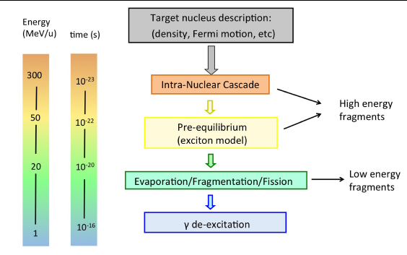
Display of stages in nucleon-nucleus interaction relevant for radiotherapy
Ref.: Aafke Kraan, Frontiers in Oncology, 7 July 2015 doi: 10.3389

Slide 18
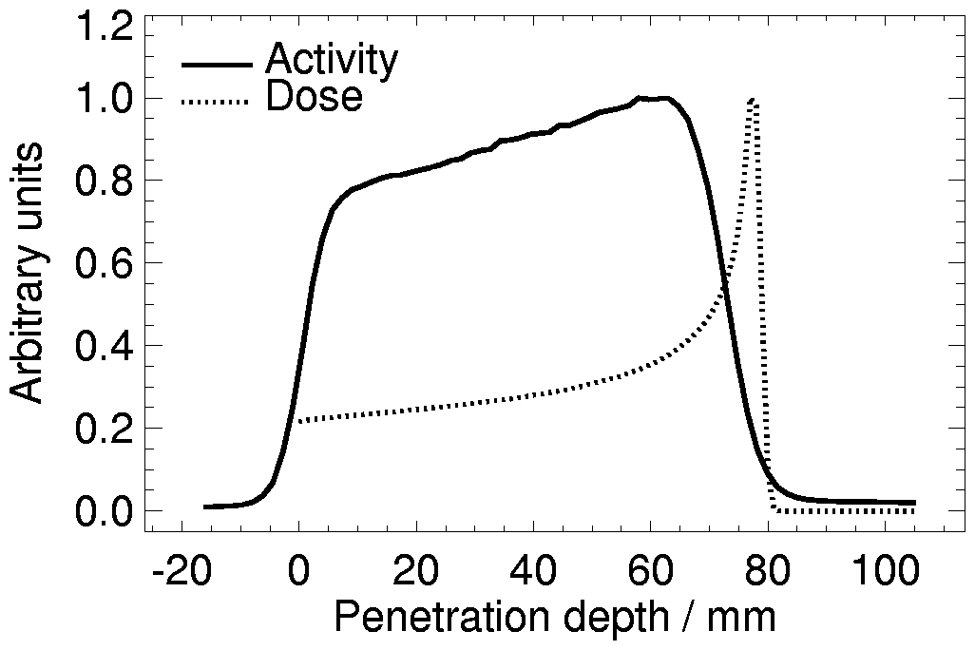
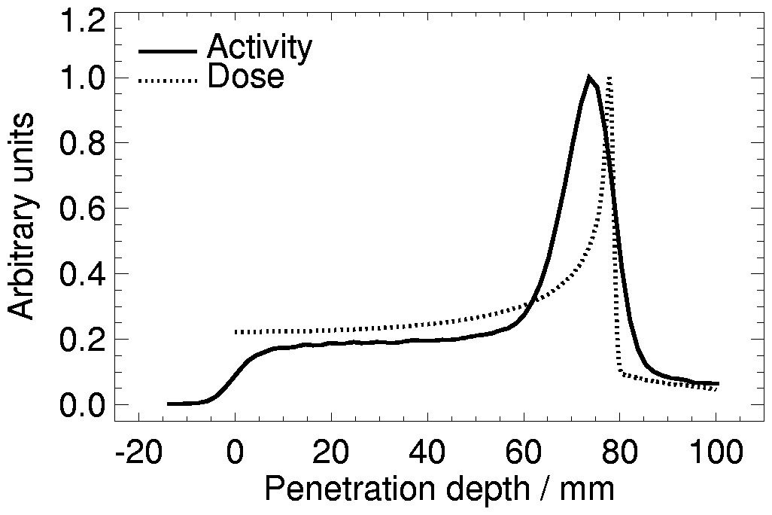
Positron Emitters and PET imaging
p
p
p
¹²C
¹¹C
n
n
¹²C
¹⁶O
¹⁶O
¹⁵O
¹⁶O
¹⁶O
¹⁵O
n
A possible method for the control of the geometrical accuracy of the treatment (TPS) is PET imaging of the activity generated in the nuclear interactions in tissue
¹¹C
¹⁰C
¹H: E = 110 MeV
Target: PMMA
¹²C: E = 212 AMeV
Target: PMMA
¹⁵O, ¹¹C, ¹³N ...
¹⁵O, ¹¹C, ¹³N ...
Small amounts of β⁺ emitting radioisotopes are produced with short half-lives
  ¹¹C (20.3 min)
  ¹³N (9.97 min)
  ¹⁵0 (2.03 min)
18
Notes:
E’ dunque chiaro ce c’entra di nuovo l’imaging.
Infatti sia usando p che 12C si hanno reazioni…
Distribuzione di attività di emettitori b+ - PET
Per via del fatto che si ha una breve emivita … in-beam PET

Slide 19
TERMINOLOGY
(Both for Protons and Carbon)
First pioneer work by W. Enghardt et al. in the ’90 with Carbon Ions (GSI/Bastei tomograph)
Off-line PET (e.g.) (MGH/Heidelberg/CHIBA)
However➔In-beam/In-room dedicated instruments are needed to:
1- Avoid patient re-positioning
2- Avoid data loss of very short living isotopes (e.g. ¹⁵O )
3- Avoid radioisotope wash-out
On-line PET (only on phantoms up until now)
➔In Room-PET, but off-Beam
(GSI/PISA-CNAO/CHIBA/MGH/HEIDELBERG)
➔In Beam-PET, but with beam-on
(PISA-CNAO/CHIBA-openPET)

Slide 20
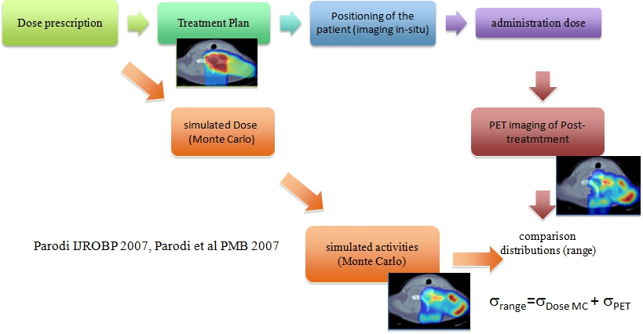
Rationale for “
PET monitoring (Dose ➔ Activity: Standard Approach)
Comparison between simulated and measured activity with PET

Slide 21
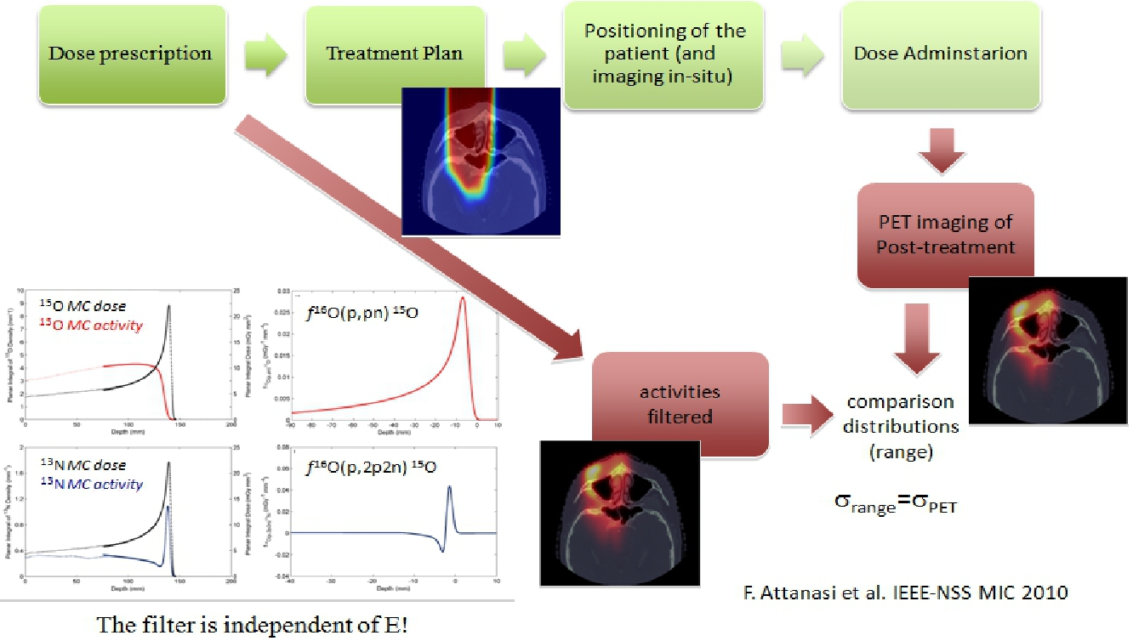
Rationale
PET monitoring (Dose ➔Activity: The “Filtering”)
From the planned dose the simulated activity profile is obtained by using the filter approach (ref.:F.Attanasi, et al. Phys. Med. Biol, 2011, 56, 5079-5098).

Slide 22
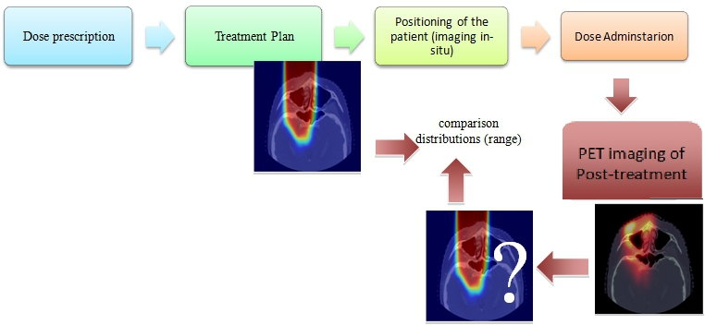
PET monitoring : The dream
The delivered dose is measured from the measured activity of PET by using an inverse filtering .The planned dose can then be compared with the measured dose

Slide 23

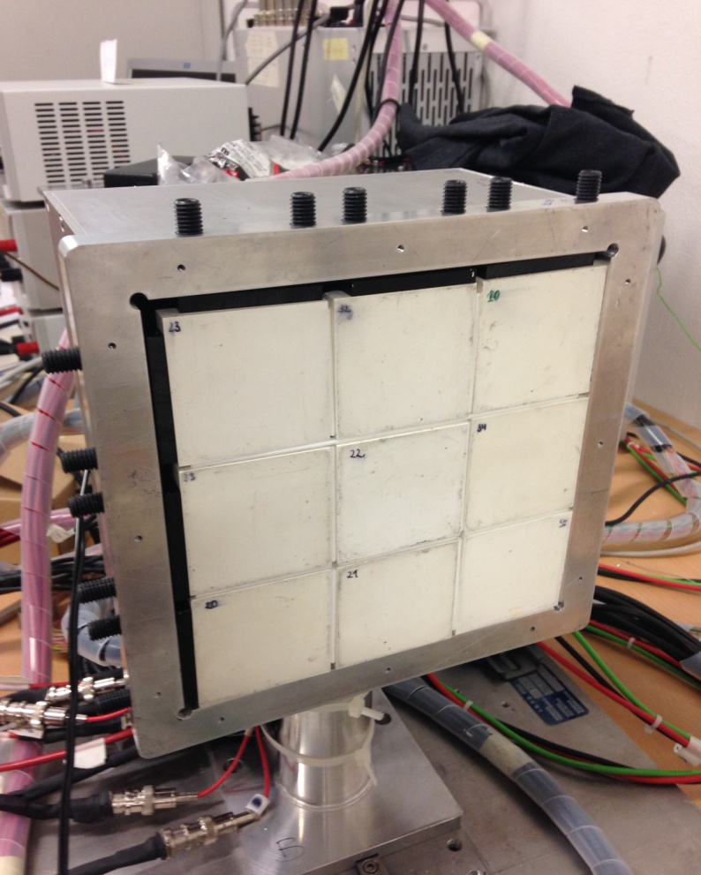
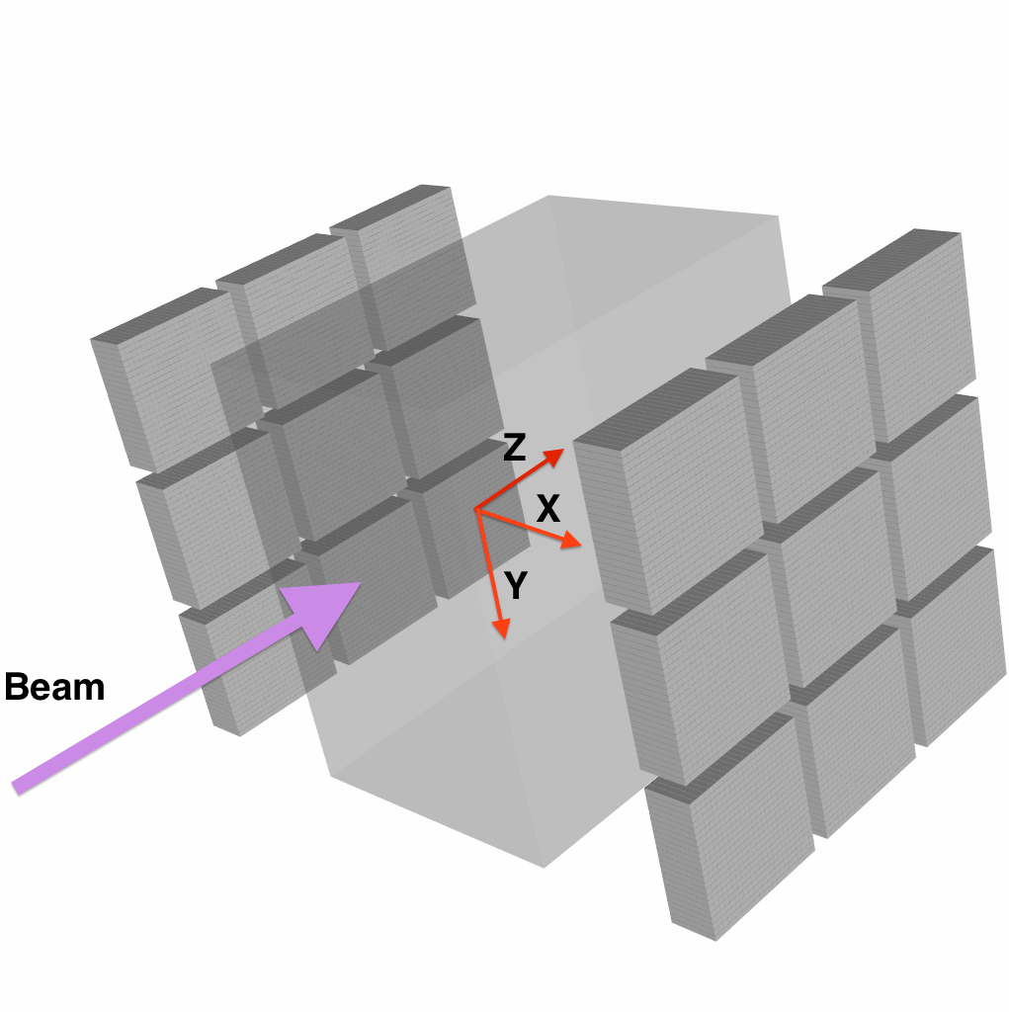
DoPET(University of PISA & INFN)
DoPET is a stationary 2 heads tomograph
gantry compatibility
in-beam acquisition
15x15 cm²
9 modules
per head
15x15 cm²

Slide 24

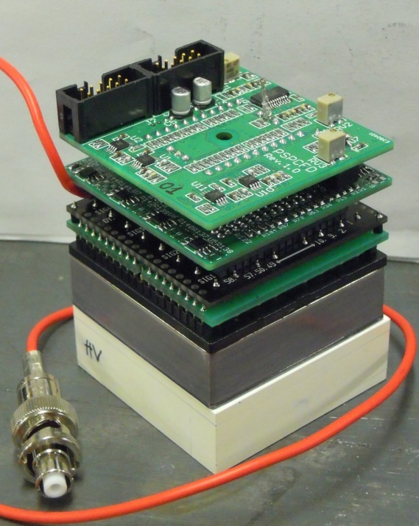
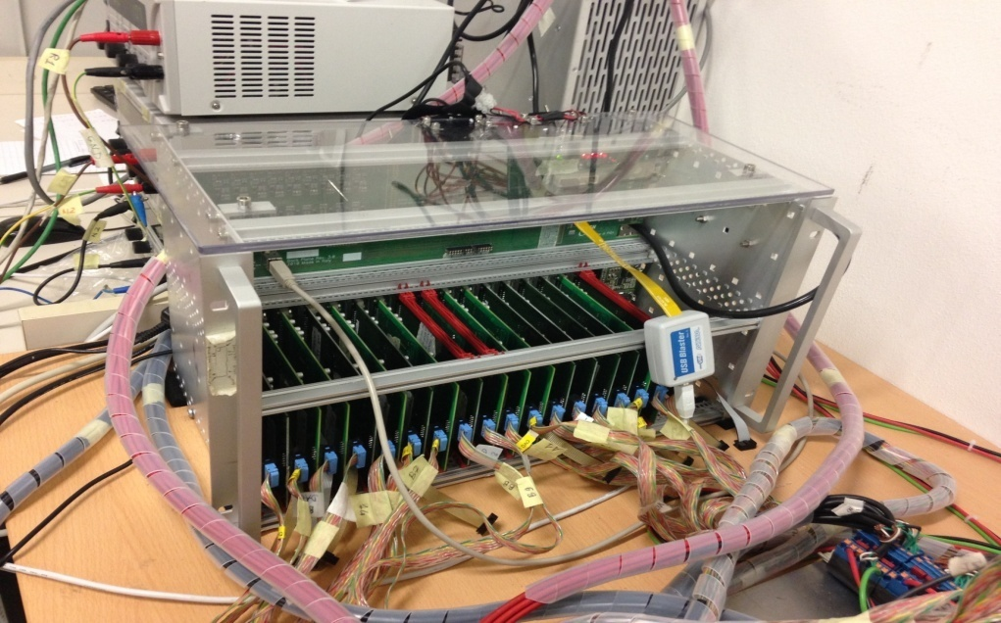
DoPET (9 vs 9 modules)
The current prototype is an upgrade of a previous 4x4 system
S,Vecchio, IEEE Trans. Nucl. Science, 56 (1), (2009)
G.Sportelli, IEEE Trans. Nucl. Science 58 (3) (2011)
Hardware (9x9 modules)
- Each detecting module made of
one LYSO matrix (23 x 23 crystals, 2mm pitch)
one PS-PMT 8500 Hamamatsu
Dedicated front-end electronics
- FPGA based acquisition and coincidence processing (Coincidence time window ~5 ns).
Software: Activity reconstruction algorithm:
- Maximum Likelihood Estimation Maximization (MLEM)
- The reconstruction is performed in few minutes➔
We are working on implementing GPU for bringing
down the time to 30s

Slide 25
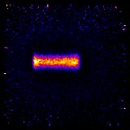
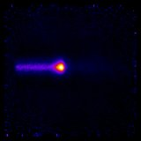
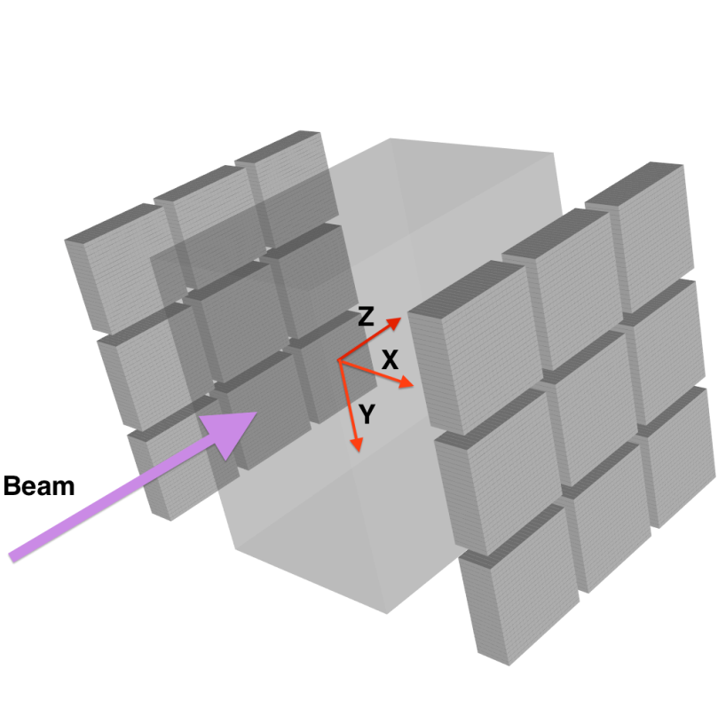
Protons and Carbon ions onto PMMA phantoms:
Imaging of the produced activity
Proton beam
98 MeV
 | ρ(g/cm**3) | H(%) | C (%) | O (%)
PMMA | 1.18 | 8 | 60 | 32
H2O | 1.0 | 11.19 |  | 88.81
Carbon beam
178 MeV/u
z
z
z
heads
distance 30cm
y
y
y
FLUKA MC
z
FLUKA MC
z

Slide 26
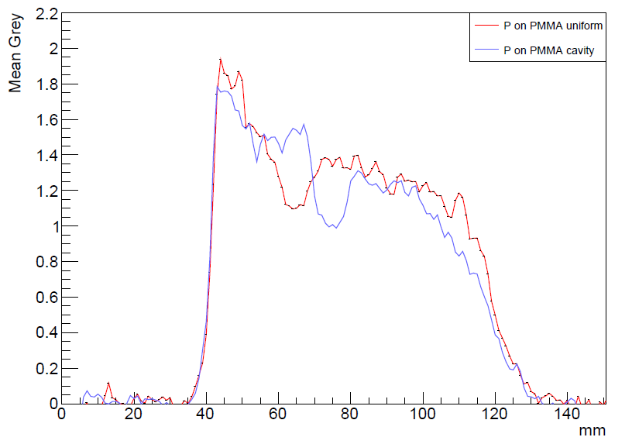
Protons 2Gy
(TPS-Single fraction)
Two cavities z-profiles
Acquisition time:0-600 s
Difference: full vs. void
exp ~ 4 mm
MC ~ 3mm
10mm
cavity
140 mm
phantom
entrance surface
Reproducibility: void vs. void
z
z

Slide 27
Prompt gamma’s w/protons
Measurements with collimated detectors
Energy spectrum 160 MeV protons in PMMA, NaI(Tl) detector
moving target
beam
collimator
detector
Energy: <1 MeV to 10 MeV
A small fraction is measured as discrete lines
Low energy gammas: larger scattered fraction
Synchronization with accelerator RF or monitor and Time of Flight
Smeets PMB 2012

Slide 28
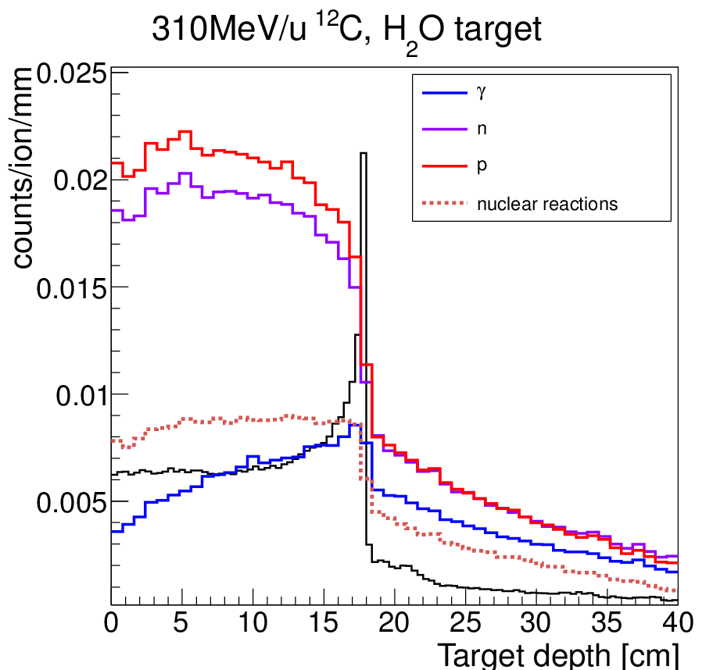
Nuclear fragmentation w/C-12 Ions
Dose deposition during radiotherapy:
  Ionization (in black on the plot)
Hadrontherapy:
  Nuclear fragmentation
    High probability
    Influence on dose deposition
    Secondary particles
      γ, n, p, fragments
      Radioactive Isotopes (β⁺)
  Range control by means of
  nuclear reaction products:
      Prompt gamma’s
        ≤ 1 per nuclear reaction
        ~ isotropic emission
        Massive particle background (p,n)
GEANT4

Slide 29
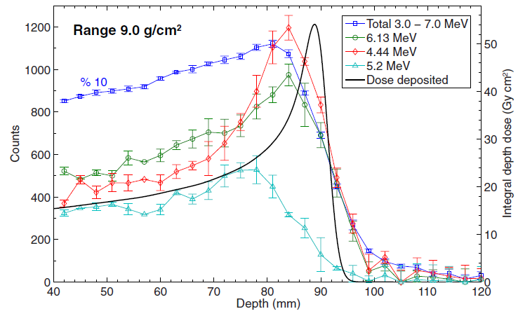
Prompt gamma’s measurements
110 MeV protons in water
95 MeV/u carbon ions in PMMA
J.Verburg, PMB 2013
M. Pinto et al, Med Phys 2015
PG yield above 1 MeV
~ 0.3% /cm per proton
~ 2% /cm per carbon
High resolution profiles: influence
of heterogeneities close to the
Bragg peak

Slide 30
Detectors for Prompt gamma’s
Collimated cameras
Multi-slit cameras
  Seoul
  Lyon ~1mm at pencil beam scale (10⁸ protons)
  Delft - Multislit with TOF (project)
  MGH: TOPAS Simulation of collimated camera for passive delivery: Synchronization with range modulator wheel (M. Testa, PMB 2014, J. Verburg, PMB 2015)
Knife edge
  Seoul (D. Kim, JKPS 2009)
  Delft : Simulation (Bom, PMB 2012, Cambraia Lopes, PMB 2015)
  IBA : Operational prototype (Perali, PMB 2014, Preignitz, PMB 2015)
Compton cameras
  No collimation: potentially higher efficiency
  Potentially better spatial resolution (< 1cm PSF)
  If beam position known → simplified reconstruction
  3D-potential imaging (several cameras)

Slide 31
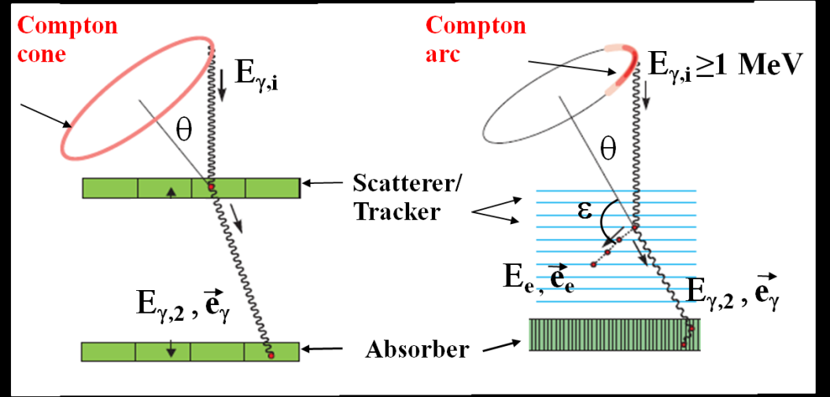
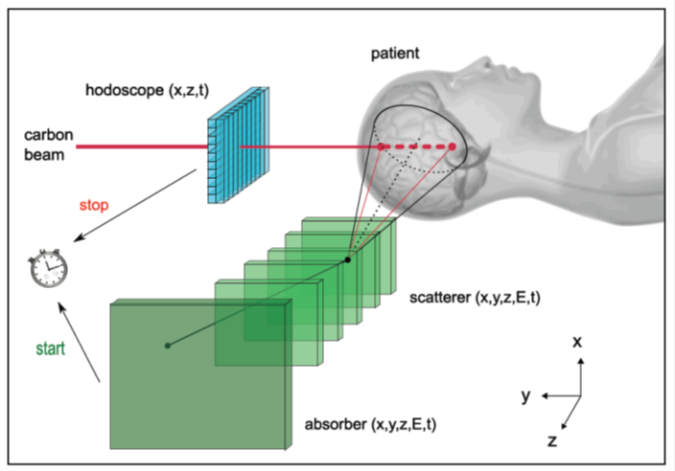
Compton camera
Lyon project: TOF and beam position with hodoscope
Count rate issue
Simulation: line-cone reconstruction for Lyon prototype
1 distal spot (10⁸ incident protons) incident on PMMA target, 160 MeV
Continuous beam (IBA C230)
Clinical intensity: 200 protons/bunch ➔S/N=1/10
Reduced intensity: 1 proton/bunch ➔S/N=5/1
(J.Krimmer, NIMA 2015)

Slide 32

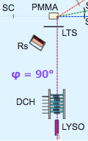
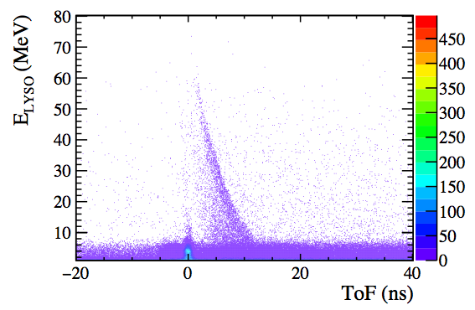
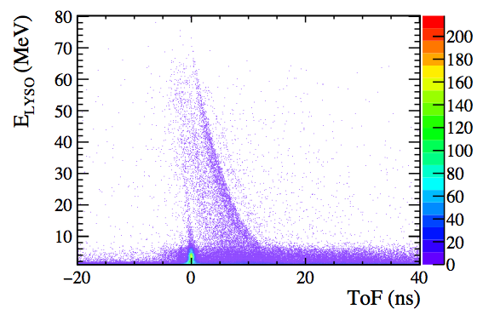
Prompt protons
Charged fragments - large angles
Tracks reconstructed by the Dose CHarged particle profile (DCH)
  Detector alignment done with aluminum table fixed positions (± 1mm)
  DCH center aligned with fixed BP positions (xPMMA = 0, ~1.5 cm before exit window)
  Ω ~ 6⋅10⁻⁵ sr, εdet > 90%
  DCH trk resolution @ emission point ~ 1mm
beam direction
φ = 60°
He beam
¹²C beam
@90°
data
preliminary
preliminary
@90°
Mostly p,d,t
Mostly p,d,t
data
data

Slide 33
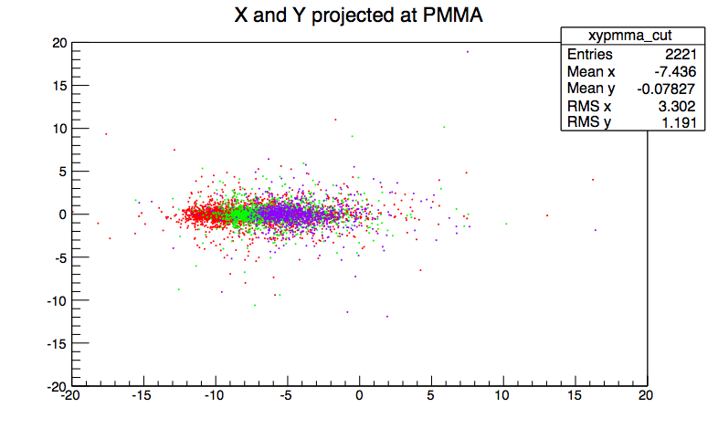
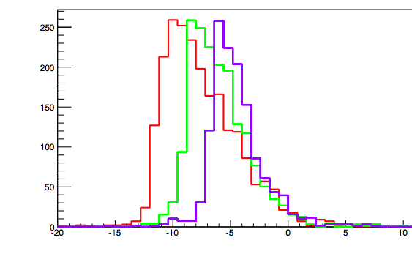
Bragg Peak monitoring on He beams
A non negligible production of charged particles at large angles is observed for all beam types
The emission shape is correlated to the beam entrance window and BP position as already measured with ¹²C
φ = dNall/(Nions dΩ)
Y (cm)
data
He 145
BP
He 125
He 102
preliminary
Beam type/E | φ 90° (10⁻³)
He 102 | 0.6
He 125 | 0.7
He 145 | 1
C 160 | 1
C 180 | 2
C 220 | 3
O 210 | 3
O 260 | 5
O 300 | 10
Z proj.
Z (cm)
data
BP
He 145
# of tracks/0.4 cm
He 125
He 102
preliminary
preliminary
different PMMA thickness !!
Z (cm)
(Courtesy of V.Patera, 2015)

Slide 34
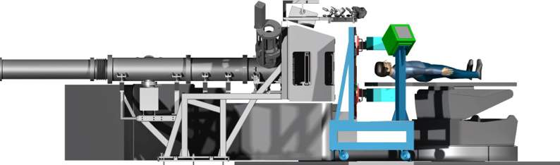







INnovative Solutions for In-beam DosimEtry in Hadrontherapy
Pisa,Torino,Roma”La Sapienza”,Bari,INFN
INSIDE coordinator: M. G. Bisogni (Pisa)
This project has been supported by Italian MIUR under the program PRIN 2010-2011 project nr. 2010P98A75 and by EU FP7 for research, technological development and demonstration under grant agreement no 317446 (INFIERI)
N. Belcari
N. Camarlinghi
A. Del Guerra
S. Ferretti
E. Kostara
A. Kraan
B. Liu
N. Marino
M. Morrocchi
M.A. Piliero
G. Pirrone
V. Rosso
G. Sportelli
P. Cerello
S. Coli
E. Fiorina
G. Giraudo
F. Pennazio
C. Peroni
A. Rivetti
R. Wheadon
A. Attili,
S. Giordanengo
E. De Lucia
R. Faccini
P.M. Frallicciardi
M. Marafini
C. Morone
V. Patera
L. Piersanti
A. Sarti
A. Sciubba
C. Voena
F. Ciciriello
F. Corsi
F. Licciulli
C. Marzocca
G. Matarrese
G. Battistoni
M. Cecchetti
F. Cappucci
S. Muraro
P. Sala
partners:

Slide 35
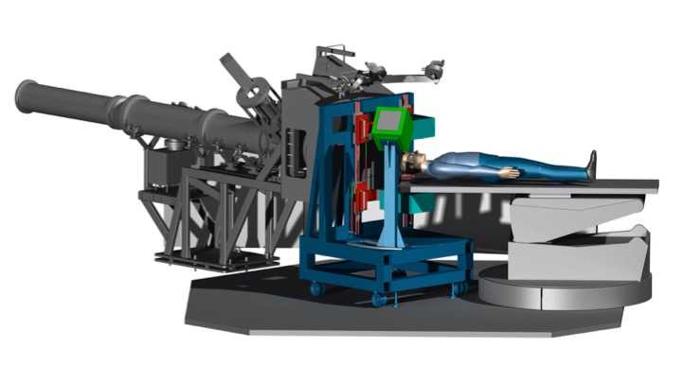
The Project
Prompt secondary particles emission
DOSE PROFILER
Tracker +
Calorimeter =
β⁺ activity distribution
IN-BEAM PET HEADS
BI-MODAL MONITORING
SYSTEM
Goals:
To be integrated in the gantry
To be operated in-beam
To provide an IMMEDIATE feedback on the particle range
@
Notes:
based on the combination of a in-beam PET scanner and a tracking system

Slide 36
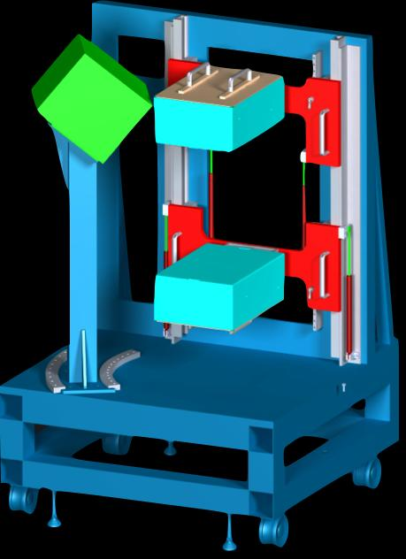
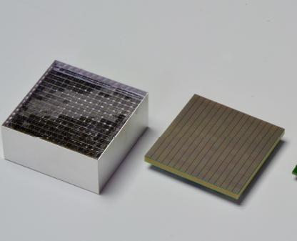
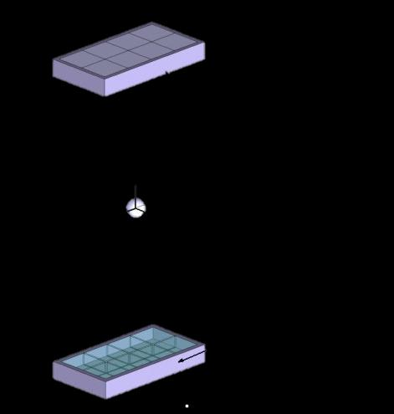
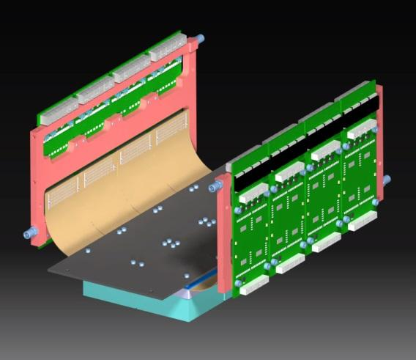
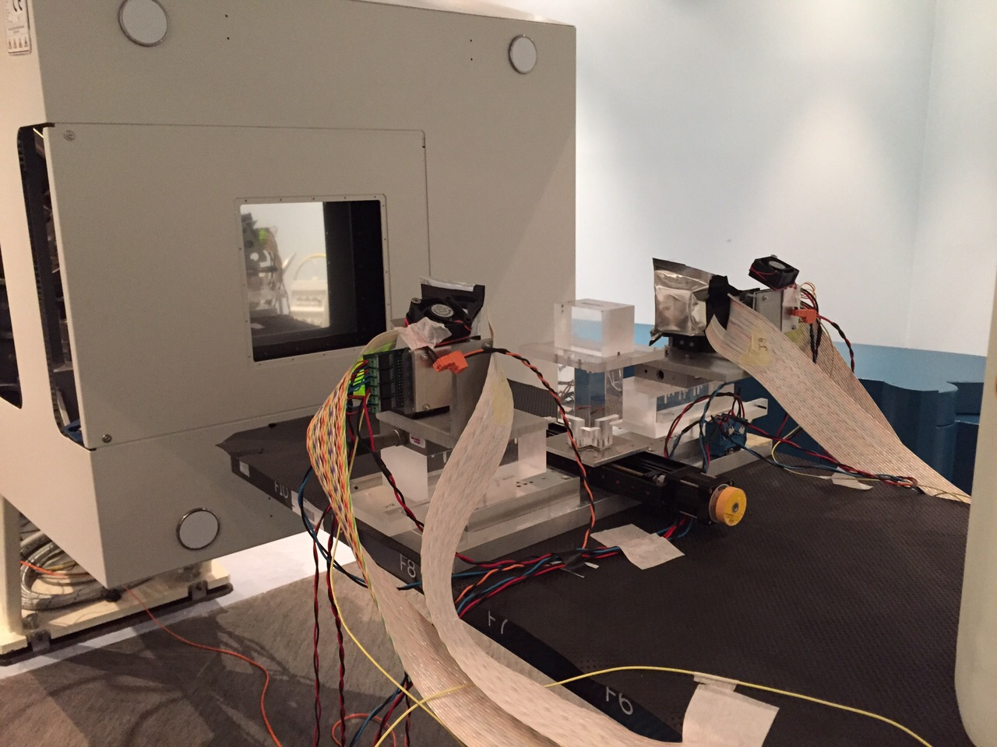
In-beam PET heads
10x 20 x 5 cm³
Distance from the
isocenter=25 cm
256 LFS pixel crystals (3x3x20mm³) coupled one to one to MPPCs (Multi Pixel Photon Counters, SiPMs).
phantom
Demonstrator
1 vs 1 module
Tested at CNAO
On May 5 2015
Solid model
Of the PET head
Work partly supportedd by the European Union EndoTOFPET-US project and by a Marie Curie Early Initial Training Network Fellowship of the European Union 7th Framework Program (PITN-GA-2011-289355-PicoSEC-MCNet).
PET modules
Notes:
The INSIDE system is mounted on a cart to be fully compatible with clinics

Slide 37

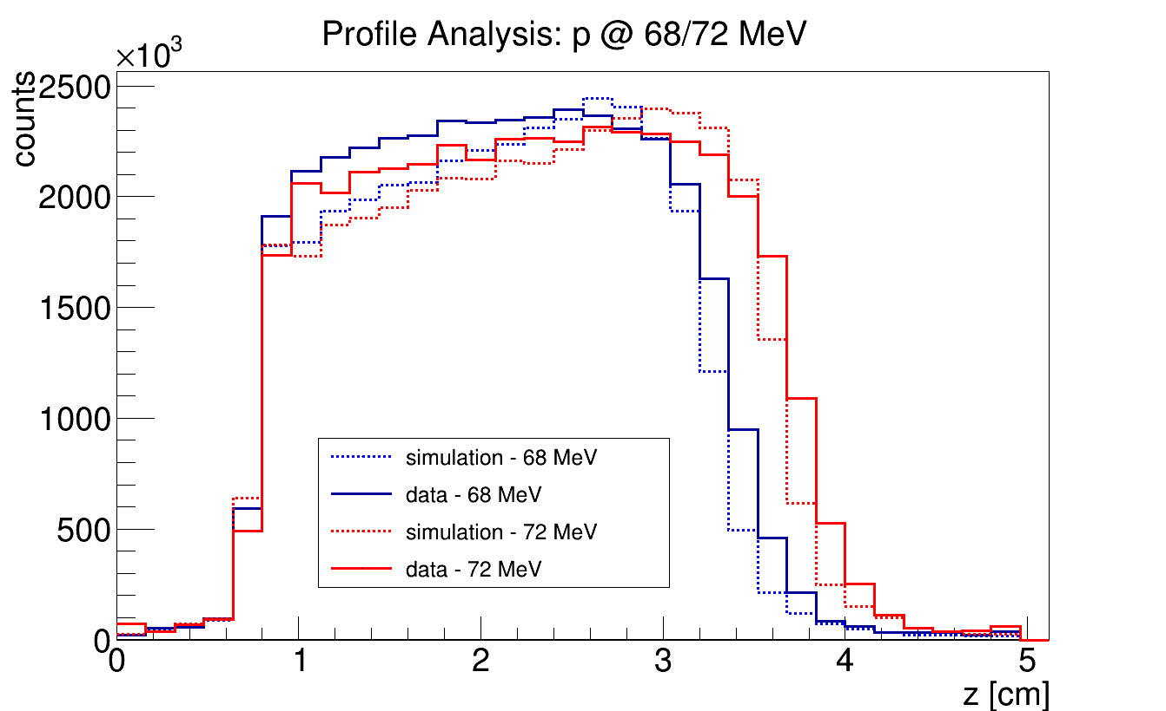
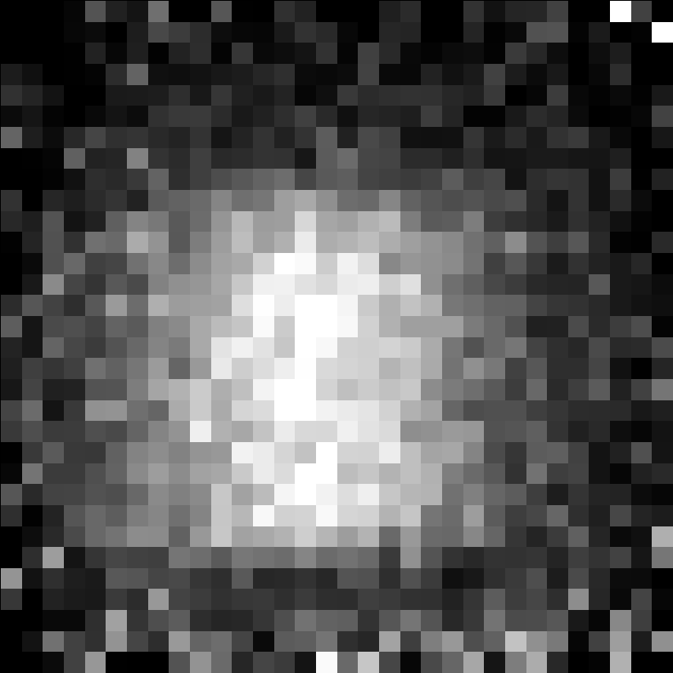
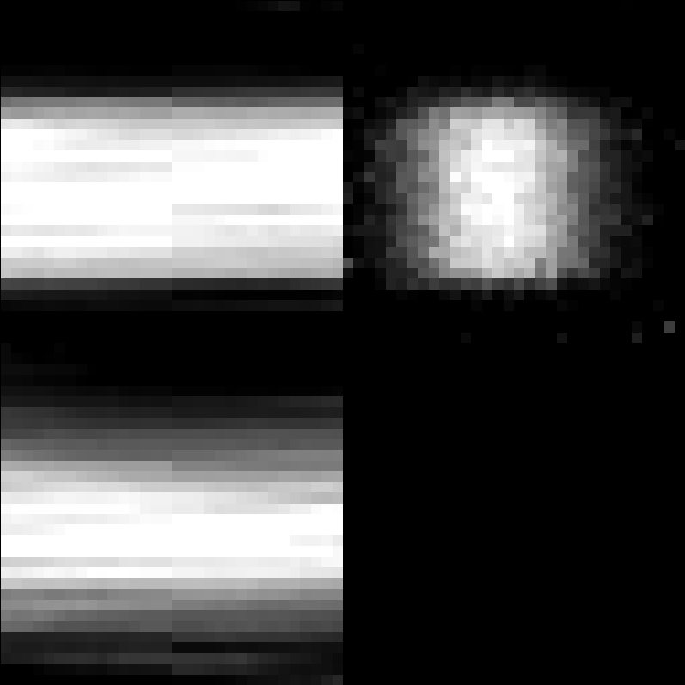

Mono-energetic proton beams
PET reconstructed activity
in-spill
inter-spill
preliminary
preliminary
p beam
p beam
after treatment
The MC simulation is a reliable tool to evaluate the performance of the full in-beam PET system.
β⁺ activity distribution
can be determined both in-spill,
Inter-spill and after few minutes of
Irradiation
preliminary
p beam
Notes:
Disegnato per lavorare ad alto rate

Slide 38



Dose Profiler
Elettronics: BASIC32, FPGA
water cooling
28 x 28 x 35 cm³
6 planes of orthogonal squared scintillating fibers coupled to SiPMs
an electromagnetic calorimeter coupled to Position Sensitive PMTs.
6 fibre planes
X,Y (500 μm) fibers
plastic scintillator
multi anode PMTs
calorimeter
Notes:
plastic scintillator: to avoid electron back scattering
Calorimeter: LYSO crystals
2 layers of 192 fibers (0.5x0.5 mm^2)
1mm ^3 sipm

Slide 39


INSIDE: a combined system x protons and x Ions
:
    β⁺ activity detection: IN-BEAM PET HEADS
    secondary particle tracking: DOSE PROFILER
to provide 3D real-time monitoring in hadrontherapy
MC simulation is essential for system design, development and operation
In-beam PET: two-steps technique reduces the simulation time (70x), validated on real data
Dose Profiler: secondary particle signal quantification with ¹²C beam
In-beam PET first modules (tested at CNAO, May 2015):
        very satisfactory results
        both in-spill and inter-spill and off beam. PET imaes
        adequate coincidence time resolution
The commissioning of the INSIDE system
at CNAO is planned by early 2016.
Contacts: Maria Giuseppina Bisogni giuseppina.bisogni@pi.infn.it

Slide 40
A novel technique :
PET Cherenkov Imaging

Slide 41



Čerenkov Effect (1934)
Emission of bluish-white light when a charged particle travels in a dielectric medium with a velocity greater than the speed of light in that medium ⇒ threshold process
Instantaneous emission (no delay like scintillation)
Emission dependent on medium refractive index (the higher the better, but everything with n > 1 can shine!)
Continuous spectrum (∝ 1/λ²) limited by medium window of transparency

Slide 42


Čerenkov Luminescence Imaging (CLI)
Beta decay products in tissue are charged particles in dielectric medium ⇒ Čerenkov emission associated with beta decay
Beta spectrum determines light production:
  ¹⁸F → 2 Č/decay, ⁹⁰Y → 70 Č/decay (Mitchell 2011)
Faint signal, strong absorption and scattering (max path 1-2 cm)
β⁻ imaging, ease of use, $$$$

Slide 43



Small animal CLI: state of the art
Spinelli et al. 2010, San Raffaele and University of Verona - ¹⁸F-FDG uptake
(a) CLI image 1 h after ¹⁸F-FDG injection
(b) ¹⁸F-FDG average radiance from heart, bladder and background regions in the animal during the first hour after 18F-FDG injection.
Li et al, 2010 UC Davis – Čerenkov luminescence tomography (CLT) using spectral acquisitions and multiple views acquired with mirrors

Slide 44


Small animal CLI: state of the art
Holland et al, 2011 MSKCC - Intraoperative CLI during surgical resection
Thorek et al, 2013 MSKCC - Excitation of fluorofores with Čerenkov radiation (SCIFI)

Slide 45

Can CLI be quantitative?
Liu et al, 2012 Stanford – cross-calibration with PET
(A) In vivo CLI and PET images of mice bearing tumour.
(B) Corresponding relative quantitative analysis of CLI and PET results and their correlation.

Slide 46


Cerenkov (Based) PET imaging
20-25 cm axial ➔ Patient bed motion
Step and shoot or continuous motion for a full body image
Snap-shot for a full body
The annihilation quanta (511 keV) interact via Compton scattering or photoelectric effect in the detector material. Materials with high density and high atomic number are advantageous, because the chance for interaction is higher, with a large fraction being photoelectric absorption. In either case,
energy is transferred to an electron. If energy transfer is sufficiently high, Cherenkov light is emitted while the electron is travelling through the material. By measuring Cherenkov light, the gamma ray interaction is detected.

Slide 47
Cerenkov (Based) PET imaging
Develop a PET-detector based on a Cherenkov radiator with spatial resolution of about 4 mm and 100 ps coincidence timing resolution. This includes radiator material and light sensor.
Develop a scalable, fast readout electronics enabling parallel
acquisition of more than 100,000 individual detection channels.
Develop data processing and image reconstruction methods which
make use of the unique features of Cherenkov-PET, such as
intrinsic gamma energy selection, 100 ps TOF, and individual
readout of detection elements.
Optimize system parameters aiming at a full-body
Cherenkov-PET tomograph.

Slide 48
CONCLUSIONS

Slide 49
Take Home Message #1
MULTIMODALITY is the PRESENT:
  PET/CT
  PET/MR
  PET/OPT,Cherenkov
  and more…
PET organ/application specific is the FUTURE:
  Brain
  Breast
  Prostate
  Hadrontherapy
  and more…

Slide 50
Take home message #2
years
Consumer cycle: 3 y
Medical device cycle 15-20 y
  Technology Transfer in the medical field needs long term investment
  Industry can withdraw half-way through, if not profitable,e.g. Siemens for proton therapy
Ref: From the keynote talk by Dr. Jaemoon Jo
(SamsungSenior Vice-President) at MIC_2013, Seoul

Slide 51
Suggested Further Readings
“Ionizing Radiation Detectors for medical imaging”, World Scientific , 2004. Alberto Del Guerra.“ ISBN 981-238-674-2
“Positron Emission Tomography- Basic Science and Clinical Practice”, Springer,2003, P. Valk, D.L:Bailey,D.W.Townsend, M.N.Maisey, ISBN: 1-85233-485-1
“Medical Imaging-Technology and Applications”, CRC Press, 2014.Edited by Troy Farncombe and Krzysztof Iniewski, ISBN 978-1-4665-8262
“Webbs’s Physics of Medical Imaging,” Second edition, CRC Press, 2012, Edited by M A Flower, ISBN: 978-0-7503-0573-0

Slide 52
Ackowledged contributions from:
Harmut Sadrozinski (UC Santa Cruz, USA)
Denis Dauvergne (in2p3, France )
Vincenzo Patera (University of Roma “La Sapienza”)
... and more
... and the members of the Fiig Group (Pisa University),
in particular:
Valeria Rosso
Maria Giuseppina Bisogni
THANK YOU!
Questions?

