Slide 1
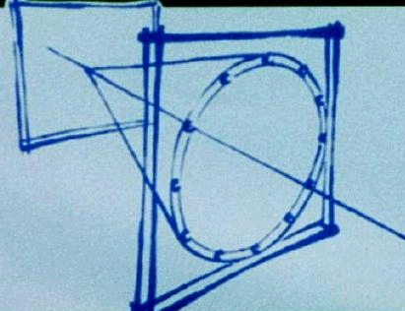
Particle ID with emphasis on
Cherenkov detectors

Slide 2
OUTLINE
Introduction
    PID (Particle IDentification)
    The Cherenkov effect in brief
Cherenkov Counters
    Historical background
    The role of the radiator
    Different Cherenkov Conter types:
      Threshold
      Differentail
      RICH
The photondetectors
Cherenkov counter optics, an example
The RICH family
    A (non exhaustive ) gallery
    The most recent approaches
RICHes & Physics

Slide 3
PID

Slide 4
PID: how ?
PID, 2 ways:
  Based on the specific features of particle interactions, examples
    High energy muons, penetration
    Intermediate energy muons, range
    Low energy p, range
    E.m. particles vs hadrons: calorimetry (shower development)
    …
  Measurement of the particle mass
    Direct measurement from decay products
    m from the equation
  E² = (mc²)² + (pc)²
    2 measurements have to be combined
    p (deflection in magnetic field) v (TOF, Cherenkov)
    E (range) v (TOF)
      p (deflection in magnetic field) dE/dx (for instance TPC)
      p (deflection in magnetic field) E/m (transition radiation→ e)
      p (deflection in magnetic field) E (range)

Slide 5
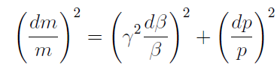
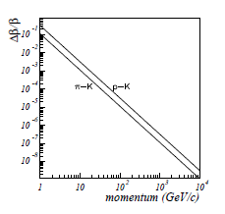

PID by measuring p & v
Resolution:
Assuming p is measured with fine resolution, the resolution in Δm/m becomes a specific request concerning the resolution of the β measurement:

Slide 6
THE CHERENKOV EFFECT

Slide 7
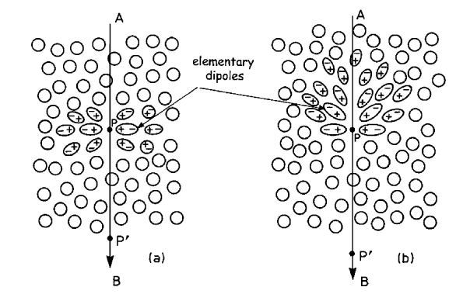
INTUITIVELY
phase velocity of the light in the medium :
1/n ∙ c
β_{part}∙c < phase velocity of the light in the medium
Symmetric configuration →
Destructive interference
β_{part}∙c > phase velocity of the light in the medium
No longer a Symmetric configuration →a coherent interference front is created

Slide 8
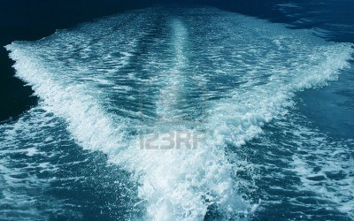
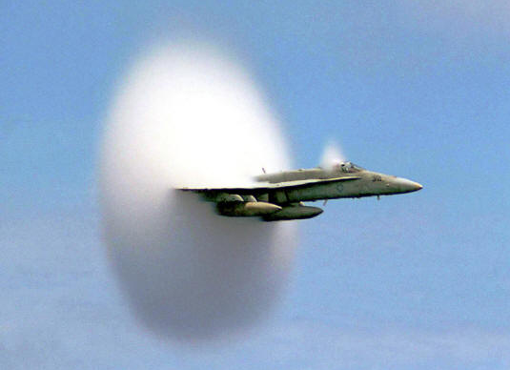
CHOC WAVE
Analogous phenomena (mechanical waves):
  Boat wake
  Supersonic plane
Phenomena taking place above a given threshold

Slide 9
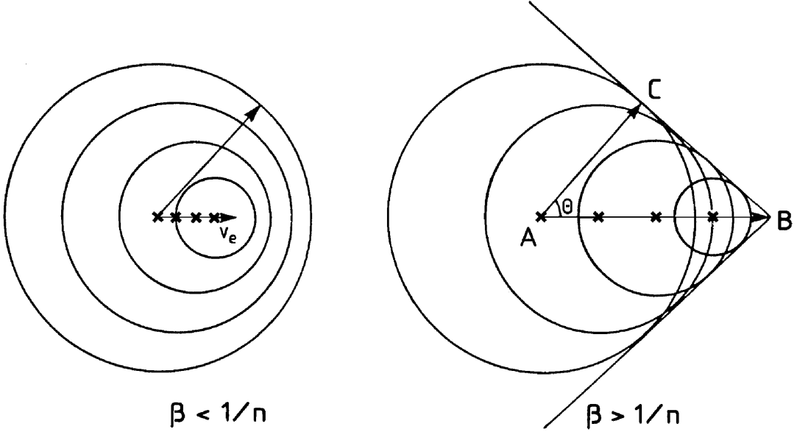
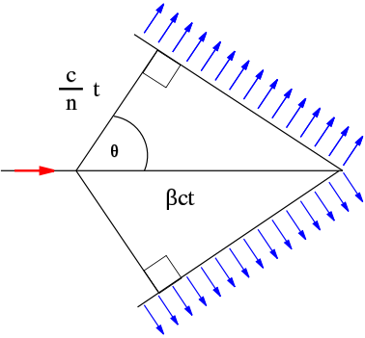
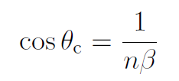
The coherent interference
threshold: nβ = 1
saturation: β → 1
The Cherenkov photons are linearly polarized:
E vector is orthogonal to the cone surface
H vector is tangent to the cone surface

Slide 10


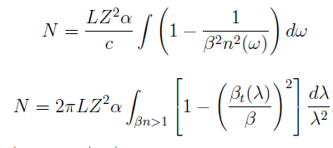

A FEW EQUATIONS
Frank e Tamm, photon spectrum:
  Photons are in the infrared, visible
  and UV range
Fixing the radiator length L:
Integrating the spectrum:
  1 - 1/(β²n²) = 1 - cos²θ_{C} = sen²θ_{C}
When β = 1, L = 1 and ΔE = 1 :
Always:
  N is a mean value: Poisson statistics → v from a direct measurement of θ_{C} , not from N !!!
N ≈ 1-1/(βn)² = sin²θ_{C}

Slide 11


EQUATIONS OF PRACTICAL INTEREST
In detectors photon losses, QE and photoelectron detection efficiency have to be accounted for
N₀ – FIGURE OF MERIT of a Cherenkov Counter
  ε – photoelectron detection efficiency
  QE – quantum efficiency
  T – transparency
  R - reflectance
N_{PE} – mean value of detected photoelectrons (here assuming Z=1)

Slide 12
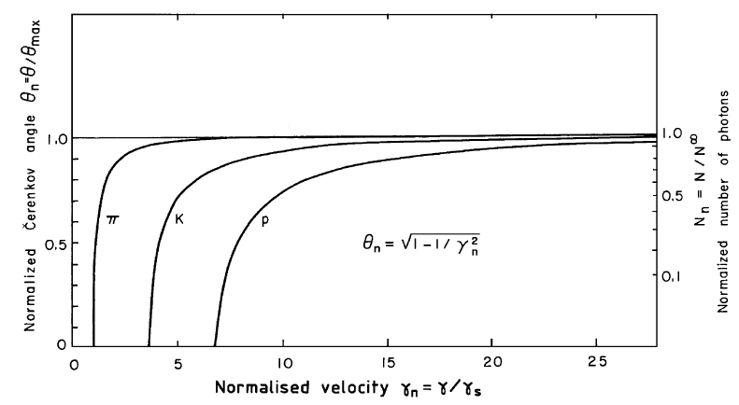
THRESHOLD & SATURATION
Near threshold:
A moderate angular resulution is enoght
Limited number of photons
Towards saturation:
Very fine angular resolution needed
More photons
th

Slide 13
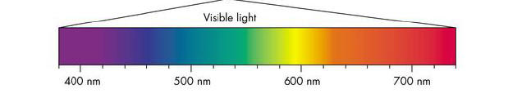
REMINDER
Photons, E vs λ
[ E= hc/λ →λ (nm) = 1240 / E(eV) ]
N-photons vs λ
visible light
n = 1.333
n = 1.000297

Slide 14
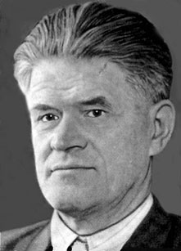
THE CHERENKOV EFFECT, A BIT OF HISTORY
1892: Oliver Heaviside – prediction based on the e.m.: particle with velocity > light velocity in the medium emit e.m. radiation con with propagation front at fix angle respect to the particle trajectory
1919: Marie Curie – feeble blue light observed from water radium solutions
1934: Pavel Cherenkov – experimental proof that the observed light is produced by the movement the Compton electrons; the equation linking the Cherekov angle and the refractive index of the medium is formulated [PMT not yet invented !!!]
1937: Frank and Tamm - classical theory of the Cherenkov effect and shape of the photon spectrum
1940: Ginsburg - quantistic theory of the Cherenkov effect
1958: Nobel award to Cherenkov, Frank and Tamm
Pavel Cherenkov

Slide 15
CHERENKOV COUNTER, GENERAL ELEMENTS

Slide 16
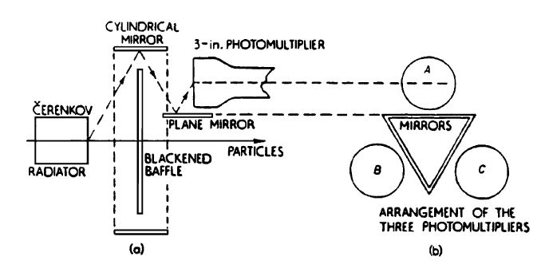
CHERENKOV COUNTERS, A BIT OF HISTORY
1937: Pavel Cherenkov mentioned the possibility of using the Cherenkov radiotion for PID
early 1940 years: PMTs are there !
1951: J.V.Jelly builts the first Cherenkov Counter
1955: a Cherenkov counter in the setup of the experiment that discovred the anti-p
1960: A. Roberts – the measurement of θ_{C} to perform PID – first RICH(*) scheme
1977: T. Ypsilantis e J. Seguinot first working RICH
1982: first RICH used in an experiment, E605 at Fermilab
(*) RICH - Ring Imaging CHerenkov
Setup sperimentale dell’esperimento che scoprì l’anti-p
O. Chamberlain et al., Phys. Rev. 100 (1955) 947

Slide 17
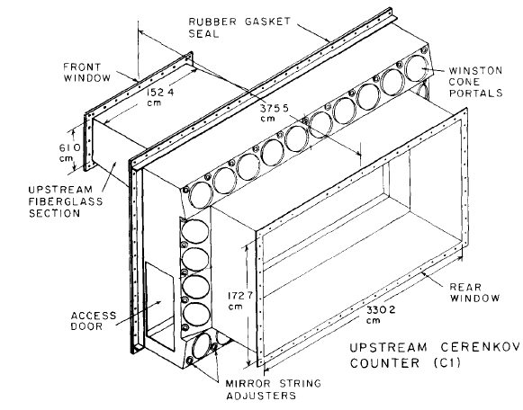
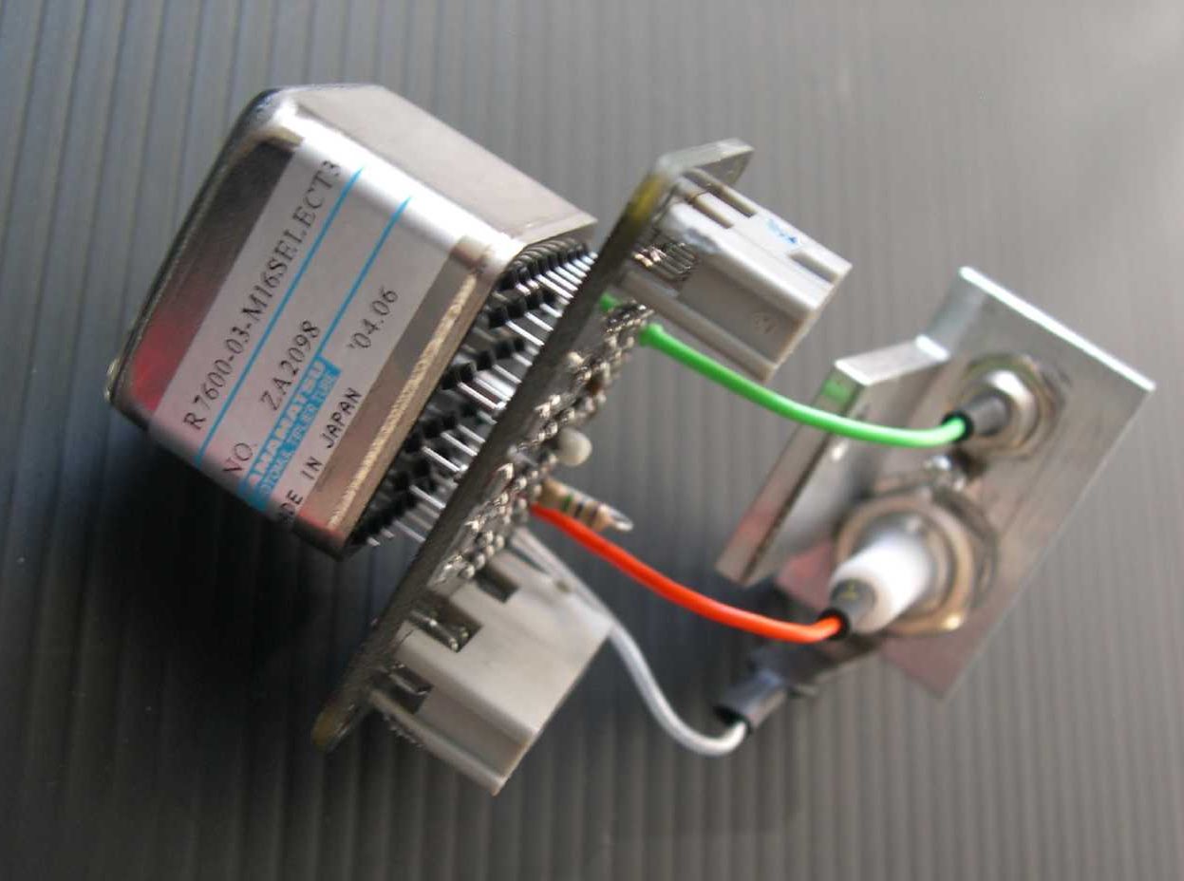
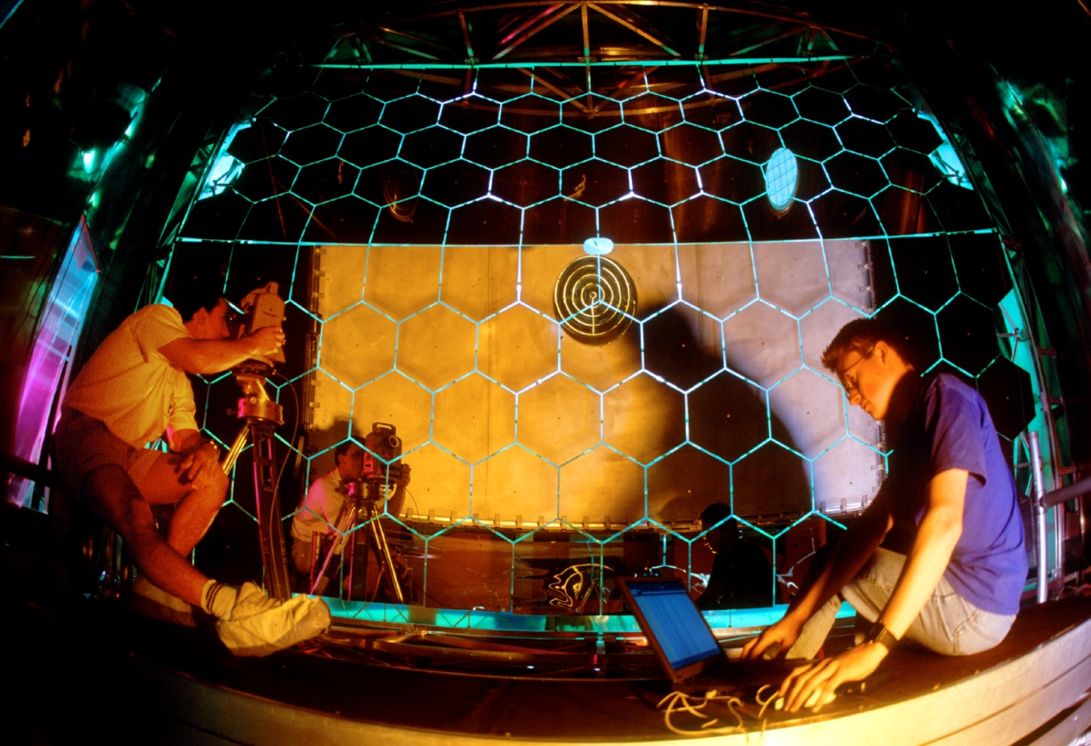
CHERENKOV COUNTERS, THE COMPONENTS
RADIATOR
  The Cherenkov light is produced and
  transmitted here
  The detector design originates from the choice of
  the radiator
PHOTODETECTORS
  The ranges of transparency in the radiator and
  efficiency in the photodetector must match
  Provide position information when needed
( FOCALIZATION OPTICS )
  when NEEDED
E-691 C1
D.Barlett et al.,
NIMA 260 (1987) 55
MAPMT
Hamamatsu R7600-03-M16
COMPASS RICH-1
Photo CERN

Slide 18
  THE DETECTOR DESIGN ORIGINATES FROM THE CHOICE OF THE RADIATIOR

Slide 19
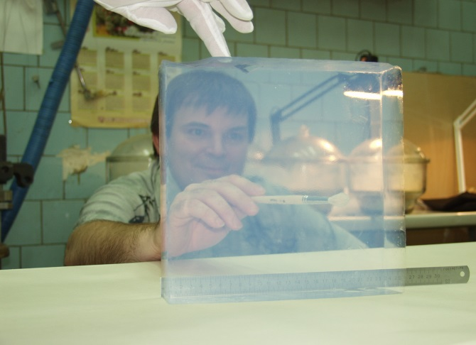
RADIATORs
Choice based on:
  Threshold γ (γ_{th}), namely the p-range of interest
  Transparency range
  Chromatic dispersion (intrinsic limit of the resolution in imaging counters)
Radiator families
  1 < n < 1. 12 (γ_{th} >2.15)
    Gas
    Cryogenic liquids (He, Ne)
    Silica aerogel (only visible light)
  1.12 < n < 1.35 (1.49 < γ_{th} < 2.15)
    Liquid fluorocarbons
      CF₄, C₂F₆, C₄F₁₀ at low temperature
      C₅F₁₂, C₆F₁₄ at room temperature
  n > 1.33 (γ_{th} < 1.52)
    Transparent liquids (water, alcohol, glycerin, hydrocarbons)
  n > 1.46 (γ_{th} < 1.37)
    Solids with transparence in the visible range (glass, plastics)
    Solids with transparence in the UV range (fused silica, namely quartz, NaF, CaF2, LiF)
E. KRAVCHENKO
@ RICH2007

Slide 20
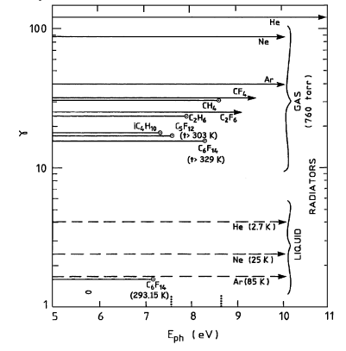
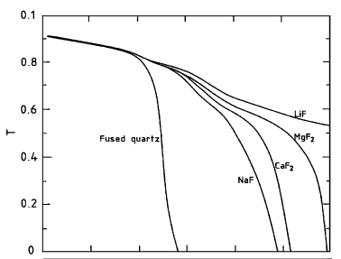

TRASMISSION
RADIATORS
WINDOWS

Slide 21



THE CHROMATIC DISPERSION
dn / dE:
Lorentz-Lorenz equation
f(E) - molar reflectivity, in general well reproduced by a 2-pole fit (Sellmeier):
In a gas ( n-1 << 1 ): n-1 ≈ P / T

Slide 22
CHROMATIC DISPERSION & No OF PHOTONS
At 5 eV
quartz
quartz

Slide 23
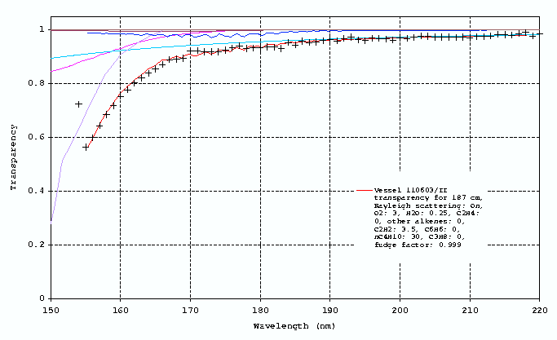
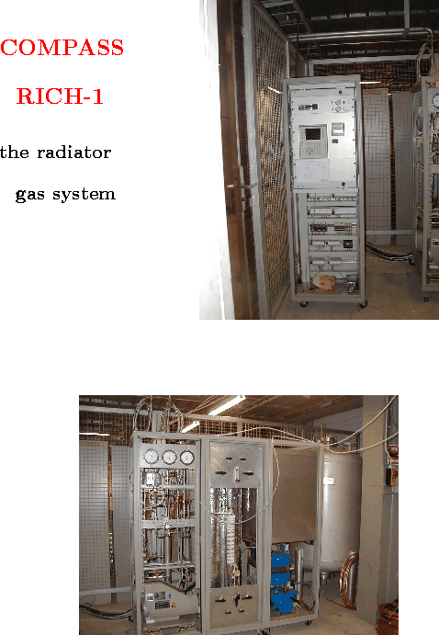
To work in the VUV range
COMPASS RICH-1, typical
transmission
through 1,87 m,
corresponding to:
H₂O: ~1 ppm,
O_{2:} ~3 ppm
liquid
storage
tank
transmission
filters
liquifier
PLC and
electrical
installation
wavelength (nm)
compressors

Slide 24
CHERENKOV COUNTER TYPES

Slide 25
CHERENKOV COUNTER TYPES
THRESHOLD CHERENKOV COUNTERS
  nβ > 1
DIFFERENCIAL
  p is given, an n ∙ Δβ – range is selected (by selecting a Δθ_{c} range)
  Cherenkov IMAGING counter (RICH) - θ_{c} is measured
  With focalization
  Proximity focusing
  DIRC

Slide 26
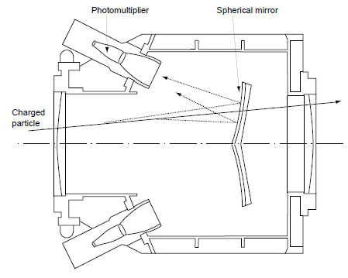

THRESHOLD CHERENKOV COUNTERS
Typical scheme
efficiency
  Poisson statistics
  Inefficiency
  Efficiency

Slide 27
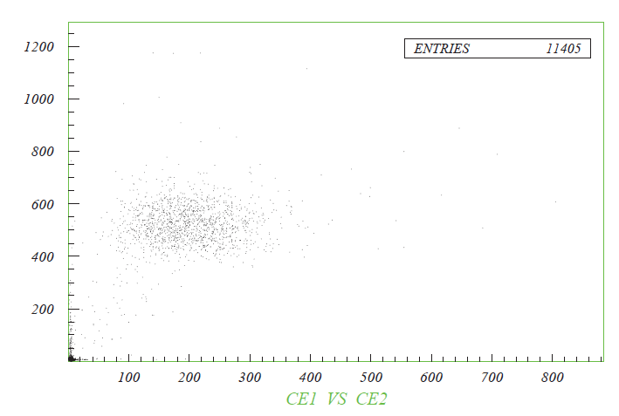
THRESHOLD CHERENKOV COUNTERS
Experimental Setup of the experiment that discovered the anti-p
O. Chamberlain et al., Phys. Rev. 100 (1955) 947
Secondary beam of
negative particles
at 1 GeV/c
Radiator:
quartz, 96.4 cm
Counters with gas radiator to tag
particles species in secondary
beams
  By P regulation, γ_{th} is modified
  to tag different particles spieces
  A couple of counters is often
  used to suppress
  the background due δ−rays
I contatori CE1 e CE2 counters, PS Est Hall at CERN – in this example e⁻ are tagged for rejection

Slide 28
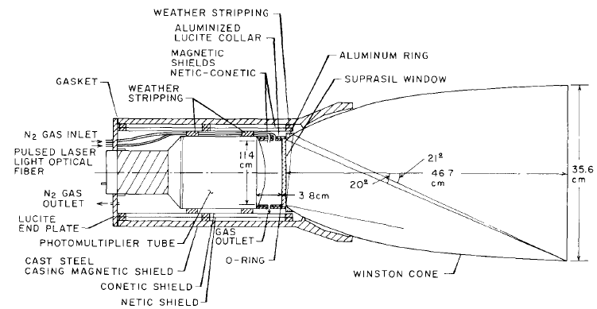
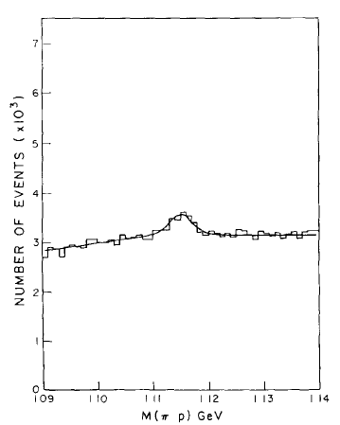
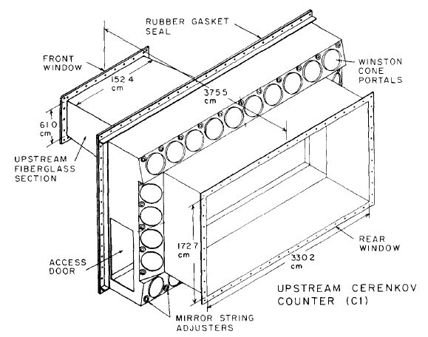
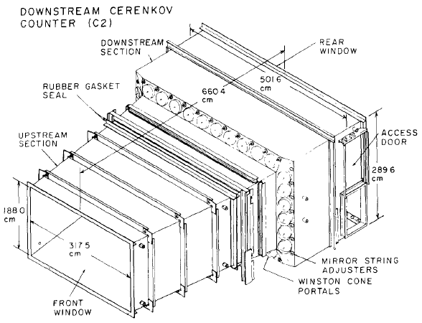
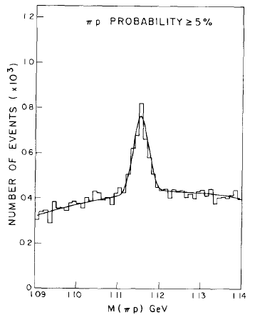
THRESHOLD CHERENKOV COUNTERS
E-691 at Fermilab ( studies of the photoproduction of charmed particles)
2 hugh threshold Cerenkov counters
at atmospheric P → K/π, K/p sep. 5-35 GeV/c
PMT coupled to Winston cones
Average number of collected photons:
  ~ 2-3 in C1, inefficienza P(2.5) = 8%
  ~ 3-4 in C2, inefficienza P(3.5) = 3%
Winston cone
PMT
Radiator - N₂ : He =20:80
L = 6604 cm
w/o C1, C2
Λ → p π
with C1, C2
Radiator - N₂
L = 3755 cm

Slide 29
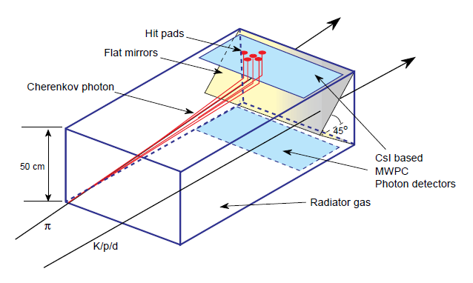
THRESHOLD CHERENKOV COUNTERS
A more recent counter: TIC, CERN-NA44 (heavy ions at CERN SPS)
hadron identification in the 3-8 GeV/c momentum range by the TIC (Threshold Imaging Cherenkov)
Localization of the photon blob: correlation of the blob to the specific particle in multiparticle events

Slide 30


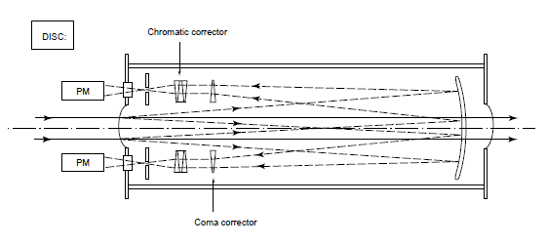
DIFFERENCIAL CHERENKOV COUNTERS
Charged particle discrimination in secondary beams
DISC - Differential Isochronous Self Collimating
The useful phase space is very narrow (it can be used only along beam lines)
World record in beta-resolution
efficiency (coincident of k PMT) < 90%
J. Litt and R. Meunier, Ann. Rev. Nucl. Sci. 23 (1973)

Slide 31
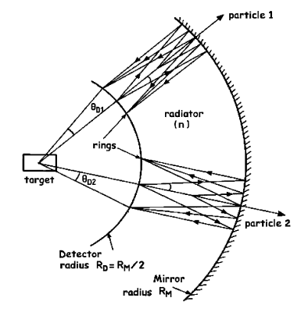
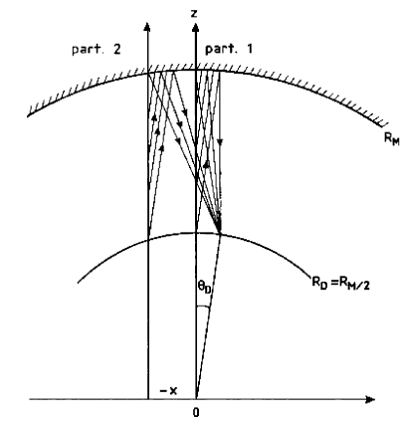
RICH, THE PRINCIPLE
Proposed by Roberts, 1960 [ A. Roberts, Nucl. Instr. and Meth. 9 (1960) 55 ]
Ideal geometry:
  Spherical mirrors and detectors, detectors at the focal surface, particle source (target) at the sphere centre
2 options:
  The particle trajectory is MEASURED, a θ_{C} measurement by each ph.
  Image centre is NOT KNOWN, the ring pattern must be recognized
Photon detectors with good space resolution
// trajectories & same p →
Identical image

Slide 32
PHOTODETECTORS

Slide 33
PHOTODETECTORS
single photon detectors :
the CENTRAL QUESTION since the beginning of the RICH era
3 groups (with examples, not exhaustive lists)
Vacuum based PDs
PMTS (SELEX, Hermes, BaBar DIRC)
MAPMTs (HeraB, COMPASS RICH-1 upgrade)
  Flat pannels (various test beams, proposed for CBM)
Hybride PMTs (LHCb)
MCP-PMT (all the studies for the high time resolution applications)
Gaseous PDs
Organic vapours - in practice only TMAE and TEA (Delphi, OMEGA, SLD CRID, CLEO III)
Solid photocathodes and open geometry (HADES, COMPASS, ALICE, JLAB-HALL A)
Solid photocathodes and closed geometries (FENIX HBD, even if w/o imaging, COMPASS second upgrade)
Si PDs
Silicon PMs (only tests)
USED SO FAR IN EXPERIMENTS

Slide 34
PMTs

Slide 35
PMT
For a long while only single channel devices (limited space resolution)
To equip large surfaces: costs!

Slide 36
PMT – THE PHOTOCATHODES
STANDARD:
peak QE ~ 25%
The LHCb-production example:
  The necessity of deeper contacts and positive feedback loops with industry
- recent HAMAMATSU photocathodes with peak-values above 40% !
  LHCb HPD
  production by
  DEP
<QE> per delivery batch
QE [%]
RMS of
batch spread
  <QE @ 270nm> = 30.8%
Batch number
UBA
BIALKALI
40
SBA
HAMAMATSU
QE (%)
0 20 40
20
0
400 600
wavelength (nm)

Slide 37
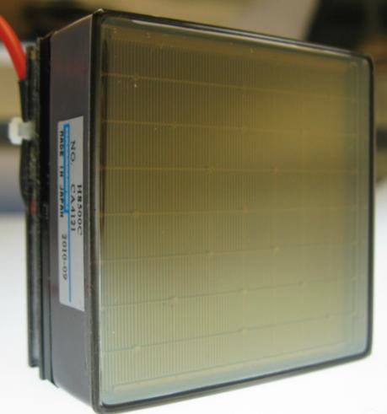
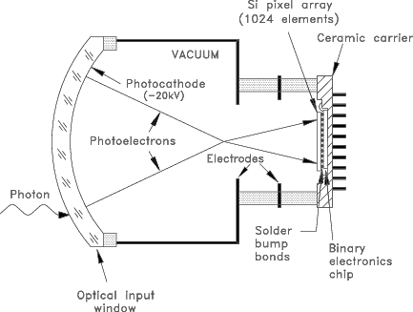
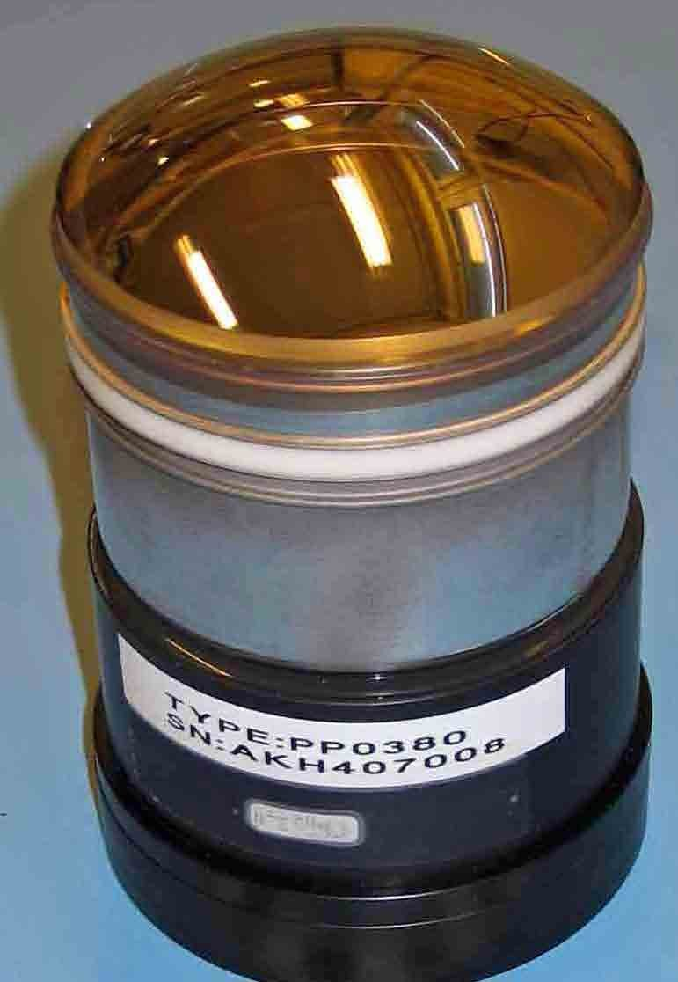
PMT – the architectures
STANDARD
MULTIANODE
- HYBRID
MAPMT
HAMAMATSU R7600-M16
16 anodes
time resolution << 1 ns
Flat PANNEL
HAMAMATSU H8500
64 anodes
(256 ch.s also available)
HPM, LHCb custom
1024 anods

Slide 38
MCP – PMT

Slide 39
MCP - PMT

Slide 40
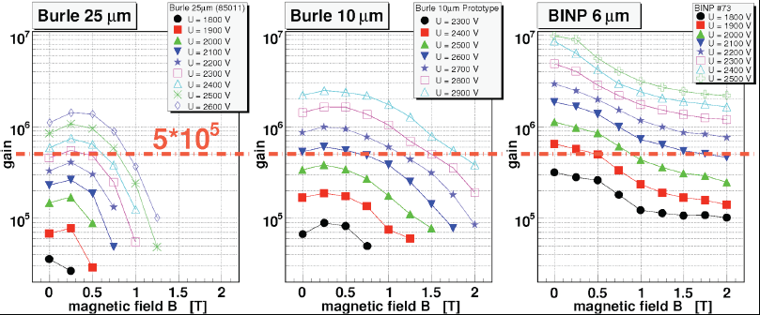
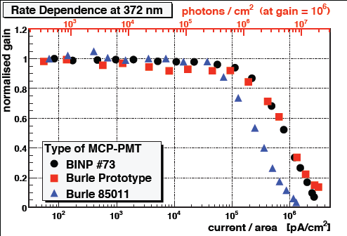
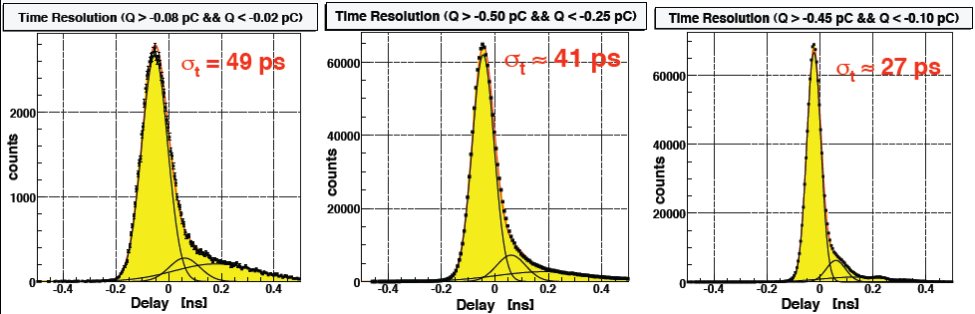
MCP-PMTs 1/3
good
response
in magnetic
field
good
time
resolution
B. Seitz @ TIPP09
the rate response
is still a concern
[… another serious concern is life time … ]

Slide 41
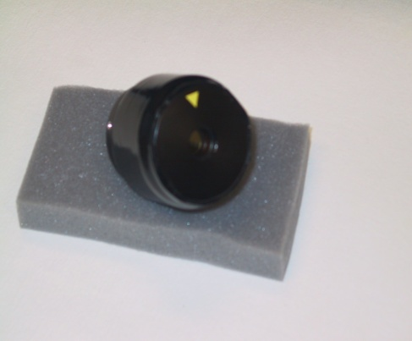
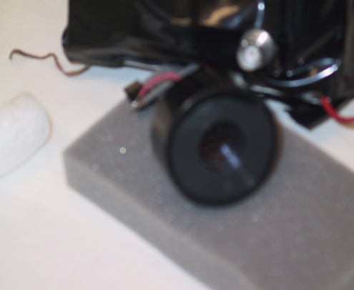
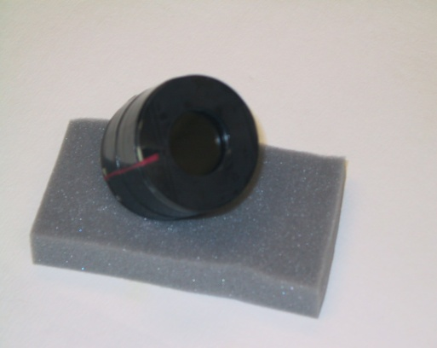
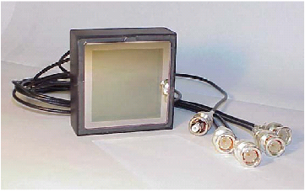
MCP-PMTs 2/3
K. INAMI @ TIPP09
Diameter: 6μm
Diameter: 8μm
Diameter: 10μm
Diameter: 25μm
HPK6 BINP8 HPK10 Burle25
Gain vs B TTS vs B TTS vs Gain

Slide 42
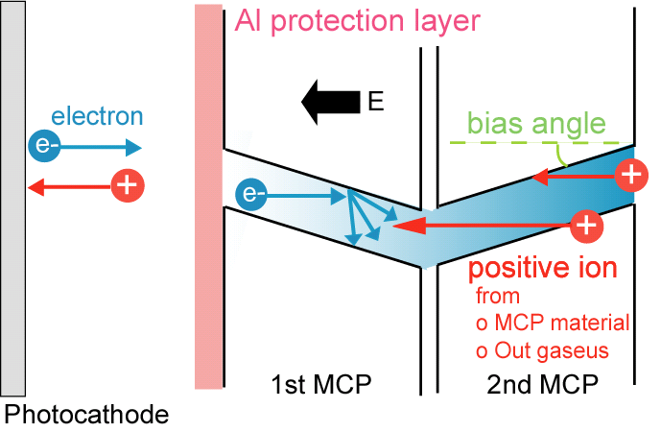
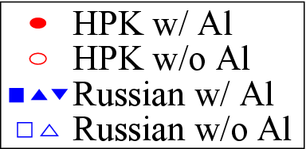
MCP-PMTs 3/3
Enough life-time?
K. INAMI @ TIPP09

Slide 43
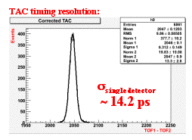
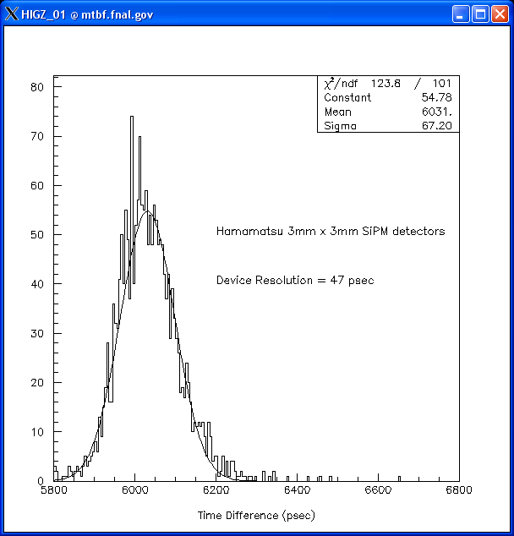
HUNTING THE ps
PSEC Timing – T979
Erik Ramberg @ TIPP09
MCP: 10 μm Photonis Planacon,
with 10+3 mm radiator
SiPM: Hamamatsu MPPC 3 x 3 mm² with 6 x 6 x 16 mm³ poly radiator
resolution: 47 ps
the need of adequate electronics
the synergies with PET
for MCP detectors : the intrinsic resolution
limit due to TTS from the photocathode

Slide 44
Si PM

Slide 45
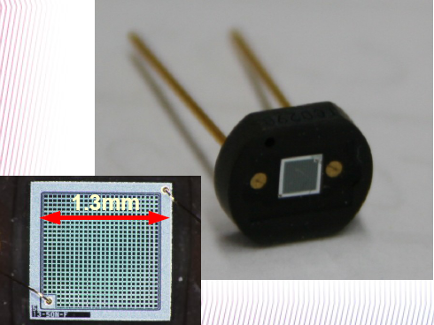
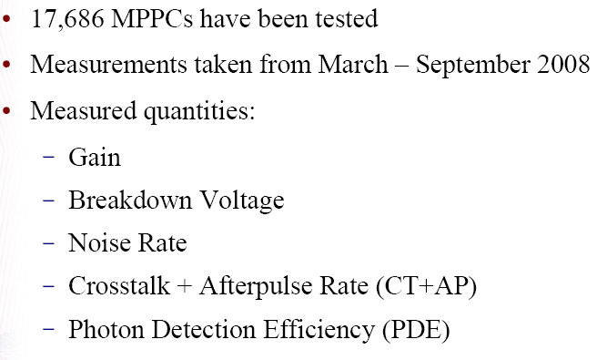
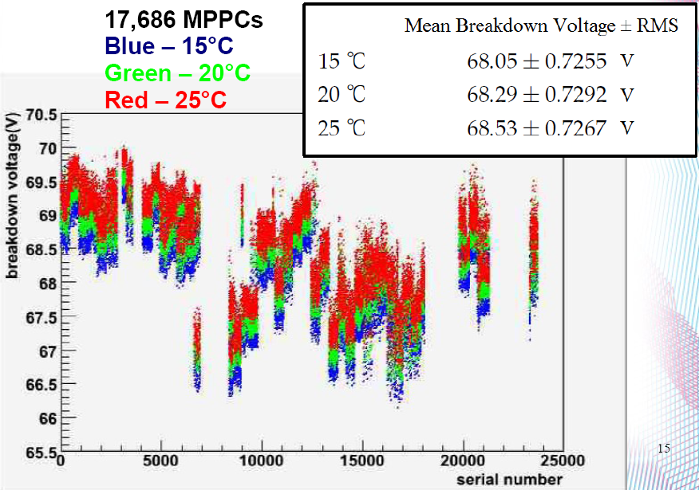




Si-PM, GENERAL COMMENTS
D. ORME @ TIPP09
First large-scale use of SiPMs in
a physics experiment : T2K

Slide 46

Si-PM FOR Cherenkov imaging counters
Afterpulsing and cross talk
should be taken into account.
(H. Haba, RICH2007)
ISSUES:
Low V operation (10-100 V)
Peak PDE (QE x ε_geiger x ε_geo ) up to 65% (@400nm Hamamatsu data sheet), but …
Gain ~ 10⁶
time resolution ~/<100 ps
Works in magnetic field
Small size → light guides
High noise rate ~ 100 kHz/mm² (noise pulse = pe pulse) +
Noise rates varying with environmental conditions (T) and aging
Radiation damage (p,n)
Cross-talk
Measured with
photocurrent.
From HPK
catalogue:
HC100
HC050
HC025
Otono @PD07

Slide 47







Si-PM in an AEROGEL RICH
S. KORPAR @ TIPP09
TEST BEAM
test w/o and w/ light guides:
Noise rate: 2.4 MHz/ch.
Noise & signal (5 ns time window)
N_ph, meas. / exp.~ 50-60%
background
Module:
8 x 8 MPPC HC100
Pad size: 5.08 mm
4 mm² active (15.5% w/o LG)

Slide 48
GASEOUS PHOTODETECTORS

Slide 49
WHY GASEOUS PHOTDETECTOR?
In spite of critical aspects and technical challenges,
gaseous photon detectors offer:
operation in magnetic field
the most effective solution for what concerns the cost of large detector area application
minimum material budget when the photon detectors have to seat in the experiment acceptance
third generation of gaseous photon detectors

Slide 50
GASEOUS PHOTODETECTORS, WHERE ARE WE?
photoconverting vapours are no longer in use, last example: CLEO III
(rates ! time resolution !)
the present is represented by MWPC (open geometry!) with CsI
  the first prove (in experiments !) that coupling solid photocathodes and gaseous detectors works
  Severe recovery time (~ 1 d) after detector trips ion feedback →
  Aging after integrating a few mC / cm² CsI ion
  Moderate gain: < 10⁵ (effective gain: <1/2) bombardment
The way to the future: photon & ion blocking architectures
  GEM/THGEM allow for multistage detectors
    With THGEMs: High overall gain ↔ pe det. efficiency!
    Good ion blocking (up to IFB at a few % level)
  IBF control by Micromegas

Slide 51




GASEOUS PDs, THE PAST
Gaseous photon detectors, the first generation: converting vapours
OMEGA
E605
SLD - CRID
DELPHI
TMAE
(Tetrakis-Dimethylamine-Ethylene)
CLEO III
TEA (Tri-Ethyl-Amine)

Slide 52


GASEOUS PDs, THE PAST
TMAE
TMAE
DELPHI barrel RICH
Photosensitive volume:
5 cm thick
QE,
NIMA 323 (1992) 351
thick photosensitive volume (slow photon
detectors, parallax error)
heating and temperature control
(T _bubbling <T_operation)
photon feed-back from amplification region
(protections)
chemically extremely reactive
cloisons
Anode wire
DELPHI barrel RICH, NIMA 273 (1988) 247

Slide 53


GASEOUS PDs, THE PAST
TEA
NIMA 554 (2005) 147
CLEO III, NIMA 441 (2000) 374
technical challenges of the far UV domain
large chromatic dispersion in far UV region:
  Proximity focusing (the Chromatic dispersion is not the major resolution limitation)
  He, a radiator gas with extremely reduced chromatic dispersion

Slide 54






GASEOUS PDs, THE PRESENT
MWPCs with solid state photocathode (the RD26 effort)
ALICE-HMPID
CsI area > 10 m²
TIC, NA44
JLAB-HALL A
A solid state photocathode exposed to
a gaseous atmosphere in an effective PD:
a success !
COMPASS,
RICH-1
CsI area > 5 m²
STAR
HADES

Slide 55


GASEOUS PDs, THE PAST
Structure of the PDs
@ 2 kV (typical):
E (CsI surface) ~ 7 kV/cm
Photocathode - the most robust
one in gaseous atmosphere: CsI
COMPASS,
RICH-1 PDs
The best quartz cuts here
P. Abbon et al, NIM A 577 (2007) 455.
A. Di Mauro, NIM A 525 (2004) 173.

Slide 56
GASEOUS PDs, THE PRESENT
Reflective versus semi-transparent photocathodes
REFLECTIVE - larger photoelectron collection :
  Semitransparent photocathode - the application of a thin metallic film, which absorbs photons, on the entrance window is required
  the probability of photoelectron absorption is lower in a reflective photocathode than in a semitransparent one as the conversion probability is the highest at the entrance surface of the photo-converter
the thickness of the photo-converter layer is non critical in the reflective configuration, contrary to the semitransparent one:
this aspects is very relevant for large area detectors

Slide 57



GASEOUS PDs, THE PRESENT
Photoelectron extraction from a CsI film, the role of gas and E
VACUUM
Breskin et al.,
NIM A 367 (1995) 342
M. Alexeev et al., NIM A 617 (2010) 396
C. D. R. Azevedo et al., 2010 JINST 5 P01002

Slide 58
Large surface photocathodes, the technology
coating

Slide 59





Large surface photocathodes, the technology
CsI: hygroscopic,
water degrades QE
never
exposed
to air
(max
50 ppm O_{2 ,}
routinely:
10 ppm)
glove box for
photocathode
mounting
photocathode
storing
PDs CH4 gas
system,
semiclosed
loop with O₂
and H₂O
filters
photocathode
transportation
system

Slide 60

GASEOUS PDs, THE PRESENT
MWPCs with CsI photocathode, the limits
Severe recovery time (~ 1 d) after detector trips
  Ion accumulation at the photocathode moderate gain: ≈ a few times 10⁴
Feedback pulses (effective gain: <1/2)
  Ion and photopns feedback from the multiplication process not fast
Aging after integrating a few mC / cm²
  Ion bombardment of the photocathode
0.2 mC/cm²
MWPCs → slow signal formation
  + low gain → “slow” electronics (signal
  integration, low noise level)
  Gassiplex FE : integration time ~ 0.5 μs, time res> 1 μs
  APV (COMPASS RICH-1 upgrade) : resolution ~ 400 ns
  → Detector memory, i.e. not adequate for high rates
1 mC/cm²
H. Hoedlmoser et al., NIM A 574 (2007) 28.

Slide 61
GASEOUS PDs, THE FUTURE
TWO REQUESTS
Reduced photon and Ion BackFlow (IBF)
  Reduced aging
  High gain → high photoelectron detection efficiency
Intrinsically fast gaseous detectors (signal due to electron motion)
  Short integration time
  High rate environments
MICROPATTERN GASEOUS DETECTORS

Slide 62



PD A GAS, IL FUTURO
First developments …
GEM-based PDs
No photon feedback!
Semi-transparent PC
ion avalanche
Reflective PC
e⁻ avalanche
A. Breskin and R. Chechwik, NIM A 595 (2008) 116

Slide 63






GASEOUS PDs, THE FUTURE
Ions
I⁺
foglio di poliimmide metalizzato,
foratura con attacco chimico
e⁻
40 %
Induction gap
e⁻
70 µm
60 %
55 µm
5 µm
50 µm
Electrons
S. Bachmann et al., NIMA A479(2002)294

Slide 64


GASEOUS PDs, THE FUTURE
B≈0
… and applications:
PHENIX HBD,
a threshold Cherenkov counter
(window-less)
Central message for any similar application
Reversed bias cuts the MIP signal !
Aspects non exportable to imaging devices:
detection of >> 1 photon per pad: low gain (5000)
non negligible noise level (~20% single photon signal)
detect photons with λ down to ~110 nm: chromaticity !
Cherenkov
blobs
Transparent mesh 90%
e⁻
e⁺
HV
CsI
~ 1 m
MIP
A. Milov et al. J. Phys. G34, S701 2007
Standard Bias
Reverse Bias
I. Tserruya, RICH2010

Slide 65

GASEOUS PDs, THE FUTURE
Thick GEM – THGEM
PCB technology, thus:
robust
mechanically self supporting
industrial production of large size
boards
economic
Comparing to GEMs
Geometrical dimensions X ~10
  But e⁻ motion/multiplic. properties do not!
  Larger holes: dipole fields and
  external fields are strongly coupled
About gain:
Large gains are easily obtained (rim !)
About PCB geometrical dimensions:
Hole diameter : 0.2 – 1 mm
Pitch : 0.5 – 5 mm
Thickness : 0.4 – 3 mm
RIM
introduced in // by different groups:
L. Periale et al., NIM A478 (2002) 377.
P. Jeanneret, PhD thesis, Neuchatel U., 2001.
P.S. Barbeau et al, IEEE NS50 (2003) 1285
R. Chechik et al, .NIMA 535 (2004) 303

Slide 66






GASEOUS PDs, THE FUTURE
THGEM
The first phase of the
systematic studies is entirely
due to the Weizmann group
R. Chechik et al., NIMA 553 (2005) 35
M. Alexeev et al.,
NIMA 617 (2010) 396
Gain vs time
0.1 mm rim
no rim
Tripple THGEM: Ion Back Flow
by staggering plates
M. Alexeev et al., JINST 7
(2012) C002014

Slide 67



GASEOUS PDs, THE FUTURE
THGEM-PD & Cherenkov
photons
THGEMs
Dim: 0.4 mm
Pitch: 0.8 mm
Thickn.: 0.4mm

Slide 68





GASEOUS PDs, THE FUTURE
MICROMEGAS has intrinsic IBF blocking properties
mesh
(catodo)
↑ E_{d}
Ionizzazione e drift
(gap ~ 3-5 mm)
↑ E_{a}
Parallel Plate
(gap ~ 100 μm)
R-O strip
(anodo)
IBF ~ 1% e meno !
S. Mukhopadhyay, N. Majumdar
12th RD51 Collaboration meeting
e⁻
ξ = E_{a}/E_{d} ~ 50 →
trasparenza per gli e⁻
soppressione del
ritorno degli ioni +
transmission (%)
ioni +
ξ = E_{a}/E_{d}
Y. Giomataris et al, NIMA A376 (1996) 29

Slide 69



GASEOUS PDs, FUTURE is here
Staggered THGEMs
Hybrid approach:
THGEM + MICROMEGAS
On the floor in 2016
3 m
6 m
MWPC’s + CsI
THGEMs + CsI
5 m
PMTs
UV mirror
wall
COMPASS RICH-1
beam pipe
radiator:
C₄F₁₀
radiator gas: C₄F₁₀

Slide 70
A FEW WORDS ABOUT OPTICS

Slide 71


COMPASS RICH-1, THE MIRROR SYSTEM 1/2
average on 126 mirror
units at production
‘VUV mirror wall’,
21 m²,116 mirrors
radius: 6.6 m
reflectance stable in time
2000 = @ COATING
2000
reflectance
2001
2002

Slide 72




COMPASS RICH-1, THE MIRROR SYSTEM 2/2
the elements of this
modular structure
THICKNESS
mechanics: 2.5 % X₀
mirrors ~5.5 % X₀
STABILITY:
after an initial deformation ~1 mrad, stable: 0.1 mrad over ~ 3.5 y
assembly jig
individual
mirror support
mirror wall
mechanics,
assembling
mirror rear side
regulation
for angular
alignment,
2 orthog.
movements
mirror wall mechanics,
assembled

Slide 73
THE RICH FAMILY

Slide 74
THE RICH FAMILY
Proximity focusing
thin radiator
(liquid, solid)
Effective
at low momenta
(p < 5-6 GeV/c)
EXAMPLES: STAR,
ALICE HMPID, HERMES, CLEO III
With focalization
Extended radiator
(gas)
the only approach
at high momenta
(p > 5-6 GeV/c)
EXAMPLES: SELEX,
OMEGA, DELPHI, SLD-CRID, HeraB, HERMES, COMPASS, LHCb
DIRC
Quartz as radiator and as light guide
Effective at low momenta
(p < 5-6 GeV/c)
The only existing DIRC (so far) was in operation at BABAR

Slide 75
RICHes WITH FOCALIZATION: HISTORICAL EXAMPLES

Slide 76

SELEX
SELEX (E 781) at Fermilab
Studies of charmed baryons
RICH
10 m He
n_ph (β=1) : 13.6

Slide 77
OMEGA
OMEGA
Multipurpose spectrometer at SPS, CERN
(exp.s WA 69, 82, 89, 94)
H spectroscopy (s,c)
Heavy ions
OMEGA RICH
radiator: N2; N2 + C2 F6
Spherical mirrors, f = 5 m
TPC a 40 ºC
  CH4 + C4H10 + TMAE (15 ºC)
  C2H6 + TMAE (30 ºC)
π-K separation 15-100 (150) GeV/c
<n_ring> = 16 - 20

Slide 78
RICHES WITH FOCALIZATION: A RUNNING DETECTOR

Slide 79

COMPASS RICH-1
3 m
6 m
vessel
π
in operation
at COMPASS
since 2001
PERFORMANCES:
photons / ring (b ≈ 1, complete ring in
acceptance) : 14
s_{q-ph} (b ≈ 1) : 1.2 mrad
s_{ring} (b ≈ 1) : 0.6 mrad
2σ p/K separation @ 43 GeV/c
PID efficiency > 95% (q _{particLe} > 30 mrad)
K
mirror
wall
photon
detectors:
CsI MWPC
5 m
p
radiator:
C₄F₁₀

Slide 80

COMPASS RICH-1 – UPGRADE 1/2
Large uncorrelated background
in the forward direction
(μ beam halo)
UPGRADE
overlap
of event
images

Slide 81


COMPASS RICH-1 – UPGRADE 2/2
photons
field lens
Technical data
Hamamatsu 16 anode PMTs
(R7600 – UV extended glass)
quartz optics
surface ratio 1:7 ($ !)
wide angular acc. (± 9.5 degrees)
high sensitivity pre-amplifier
fast, high time resolution digital electronics
dead zone: 2% even with 46 mm pitch
About performance
photons / ring (β ≈ 1, complete ring in
acceptance) : 56
time resolution better than 1 ns
σ_{θ-ph} (β ≈ 1) : 2 mrad
σ_{ring} (β ≈ 1) : 0.3 mrad
2σ π/K separation @ 55 GeV/c
PID efficiency > 95% (also < 30 mrad)
concentrator
MAPMT
online event
display

Slide 82
COMPASS RICH-1 UPGRADE, EVENTS (ON-LINE IMAGES)
The same event, two different time windows
100 ns 10 ns
n_ph ~ 60 PHOTONS / RING

Slide 83

COMPASS RICH-1 UPGRADE, a typical event

Slide 84
PROXIMITY FOCUSING RICHes

Slide 85
THE DEVELOPMENT OF THE TEA-BASED FAST RICH
Proposed and developed for a (never built) B-factory at PSI (Switzerland)
Basic ingredients:
  TEA: a 20 ºC, absorption length: 0.56 mm → very short electron drift → fast with good time resolution
  PAD read-out → fast
prototype
  scheme: proximity focusing
  π-K separation (3σ) up to
  3.5-4 GeV/c
  radiatore: LiF, CaF2
  Dedicated read-out electronics

Slide 86
CLEO III
Upgrade of CLEO II
at CESR – asymmetric B-factory
  Matrix CKM
  CP violation
  Rare B decays
π-K separation at 4 σ level up to 2.65 GeV/c
Proximity focusing
  LiF saw-shaped to let the light by normal incident particles getting out
CH4 + TEA at 18 ºC

Slide 87
CLEO III, events
Saw-shaped
radiator
Plane radiator

Slide 88



ALICE HMPID
EXPECTED PID:
K/π up to 3 GeV/c
p/π up to 5 GeV/c
Confirmed by STAR RICH :
an HMPID prototype

Slide 89



ALICE HMPID
.5<p<.75 GeV/c
12% occupancy
1.5<p<1.75 GeV/c
π

Slide 90
DIRC
A single one developed, built and used in the experiment
BABAR (ended)

Slide 91


WHAT IS A DIRC ?
A fraction of the produced light is guided to the PMT system at one of the bar ends
Thanks to the very fine mrchanical accuracy of the bar, the light direction is preserved (left/right ambiguity)
Reconstruction is based on the PMT coordinates and the signal time

Slide 92
BABAR DIRC
BABAR
At PEP-II B-factory, SLAC
Study of CP violation in the B sector
DIRC
144 bars, 4.9 m long (4 parts glued together), kept in constant N2 flux
purified water at an end to let the photons out
n_ph (β = 1) = 23
Algebraic reconstruction of the image (it is not a ring !)
separation π/K at 2 σ level up to 4 GeV/c

Slide 93


BABAR DIRC
The only DIRC ever built and operated !
π/K separation power
K ID efficiency
π miss- Id as K

Slide 94
RICHes with MULTIPLE RADIATORS

Slide 95
DELPHI (prototype, barrel, forward)
DELPHI at LEP (e+ e- circular collider), CERN
Systematic study of the weak force vector bosons
+ much more in physics
in particular, RICHes used for the study of the heavy quark spectroscopy
separation π,K,p in the range 0.3-40 GeV/c → dual radiator
Long drift path of the pe (=photoelectrons) : up to a 1.6 m
  Crucial calibration and monitoring : drift velocity, alignments
  Slow response
Photoconversion, drift and multiplication in CH4 +TMAE
  Crucial calibration and monitoring : refractive indexes, transparency, temperature, pressure
In the following, DELPHI BARREL RICH

Slide 96

DELPHI _ BARREL RICH
Liquid radiator: 1 cm, C6F14
Gaseous radiator: C5F12 (@ 40 ºC)
E_drift = 0.6 kV/cm (100 kV in total !)
Max drift time: 25 μs
Multiplication and detection: camera multifili a elettrodi ciechi

Slide 97
DELPHI _ BARREL RICH, events

Slide 98

DELPHI RICH BARREL, θ vs p
Liquid radiator
Gaseous radiator

Slide 99
RICHes WITH DUAL RADIATOR:
THE RICHes of HERMES
First RICHes using aerogel
HERMES: 2 identical RICH counters

Slide 100


RICHes WITH DUAL RADIATOR:
THE RICHes of HERMES
DATA
at saturation:
<n.ph.s_aerogel>: ~8
Calculation:
effective range
of separation
Κ ID efficiency
Κ missID efficiency
DATA
π missID efficiency
π: no ID efficiency

Slide 101

MULTIPLE RADIATORS
Another example:
LHCb RICHes
Aerogel
(RICH1)
C4F10
(RICH1)
CF4 (RICH2)

Slide 102

LHCb
B-PHYSICS at LHC
2 RICH
radiators
  aerogel + C4F10
  CF4
Double reflection to limit the spherical abberation
photodetectors
  HPD
RICH 1
RICH 2

Slide 103



MULTIPLE RADIATORS
LHCb - RICHes

Slide 104
“FLYING” RICHes
Experiments:
CAPRICE stratospheric balloons (ended)
AMS, on the Shuttle (active)

Slide 105

CAPRICE, AMS
CAPRICE
Cosmic radiation
Separation of pbar, e-, μ−, π− 1-5 GeV/c
Radiator
  NaF
  C4F10
Photodetector:
  MWPC at 45 ºC: C2H6 + TMAE (38 ºC)
  MWPC with CsI
AMS
Cosmic radiation
Separation of relativistic ions (A≤15), 1< p/A<10 GeV/c
Radiator
  NaF + aerogel
  C4F10
photodetector:
  MAPMT
Radiator(s)
Conical mirror
Photodetector
plane (680 MAPMTs)

Slide 106
RICHes TO IDENTIFY RELATIVISTIC HEAVY IONS
EXPERIMENTS:
CAPRICE stratospheric balloons (ended)
AMS 2, on the Shuttle (active)
HIRICH at GSI (ended)

Slide 107





RELATIVISTIC HEAVY IONS
N_photon proportional to Z² !
→ Here photon counting pays !
C
Li
Si-P ?
AMS test beam (at CERN, heavy ion beam):
20 GeV/N
Cherenkov
rings
He
6
~Fe ?
3
>~16
2
Z
>16

Slide 108
NOVEL ARCHITECTURES AND APPROACHES

Slide 109
A breakthrough
in the next future?
For future applications
  The new concepts of DIRC family
  COMPLEMENTING or ALTERNATIVE possibilities with TOF
  Multiple refractive index Aerogel for proximity focusing RICH (FARICH, BELLE upgrade)
t resolution
required ~ 10 ps

Slide 110





FOCUSING DIRC
J. Schwiening @ RICH2007
A general upgrade of the DIRC concept:
Future DIRC needs to be smaller and faster
Focusing (to remove the bar thickness
dependence) and smaller pixels can reduce the
expansion volume by a factor of 7-10
Faster PMTs to remove chromatic dependence
and reduce sensitivity to background.
Photon detectors
Hamamatsu H-9500 MaPMTs
Burle-Photonis MCP-PMT
mineral oil
Correction off:
Correction on:
Correction off:
Correction on:
σ=10.4mrad
σ=6.9mrad
σ=7.5mrad
σ=5.5mrad
Αll pixels:
Position 1
Lpath≈10m
3mm pixels only:
θ_{c} (mrad)
θ_{c} (mrad)
θ_{c} (mrad)
θ_{c} (mrad)

Slide 111

THE TOP CONCEPT
DIRC: large screen !
TOP
K. Inami @ RICH2007
test beam
Second coordinate from time measurement:
due to the different Cherenkov angle
the light path has a different length
simulation

Slide 112
TOF vs CHERENKOV IMAGING
Key points:
fast Cherenkov light
rather than a scintillation
new detectors able to provide
σ ~/< 10 ps
Fast electronics
Adequate for low momenta
TOF, 20 ps
TOF, 15 ps
TOF, 10 ps
TOF, 5 ps
Aerogel
(Novosibirsk)
MC
Babar
DIRC
Aerogel
(Japan)
Test beam
TOF, 1 ps
dE/dx, 100 meas.s
J. Va’vra
@ RICH2007

Slide 113



AREOGEL WITH MULTIPLE REFRACTIVE INDEX
  (Recall: p^{max}_{nσ} ~ 1/√σ_{ring} )
π/K separation with focusing configuration
~ 4.8σ @4GeV/c
σ_{c}=22.1mrad
N_{pe}=10.7
Conventional
4cm thick aerogel
n=1.047
Multiple Radiators
σ_{c}=14.4mrad
N_{pe}=9.6
2 layers of 2cm thick
n₁=1.047, n₂=1.057
T. Iijima @ RICH2007

Slide 114
RICHes & PHYSICS

Slide 115
RICHes FOR PARTICLE AND NUCLEAR PHYSICS

Slide 116
CHERENKOV COUNTERS IN ASTROPARTICLE PHYSICS
Flying spectrometers to study CR composition
  Caprice, AMS, CREAM
(Solar and) cosmic ν telescopes
  Super-K , Tunka, Amanda, Antares,
  Nemo, KM3Net
High energy gamma-ray astonomy
  Auger, HESS, MAGIC,
  VERITAS observatory, CANGAROO-III
These experiments are totally based on
the detection of the Cherenkov radiation!

Slide 117
THANK YOU !

