Slide 1

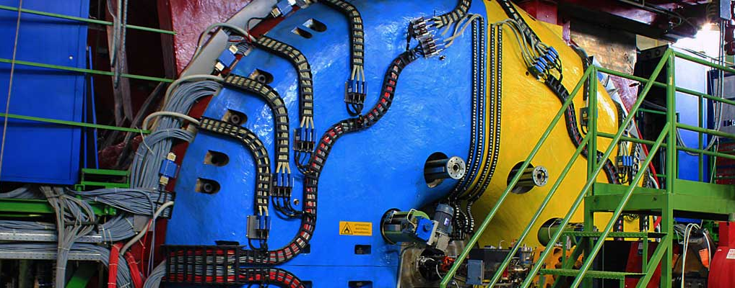

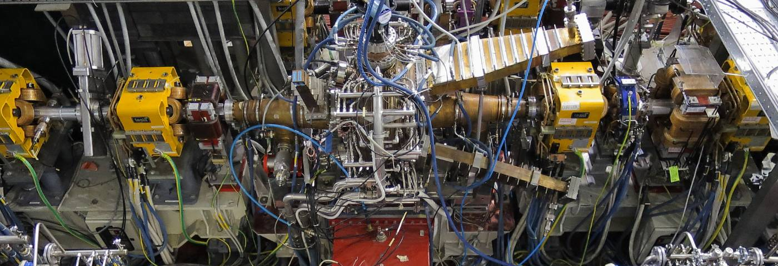



Accelerator Laboratory
OPTICS BASICS
S. Guiducci

Slide 2
Bibliography
S. Y. Lee, Accelerator Physics, 2nd Ed., (World Scientific, 2004)
CERN Accelerator School, 5th General Accelerator Physics Course, CERN 94-01, 1994 http://cdsweb.cern.ch/record/235242/files/full_document_V1.pdf
K. Wille, The Physics of Particle Accelerators – an introduction, translated by J. McFall, (Oxford University Press, 2000)
Susanna Guiducci
Optics Basics

Slide 3
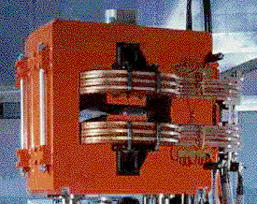
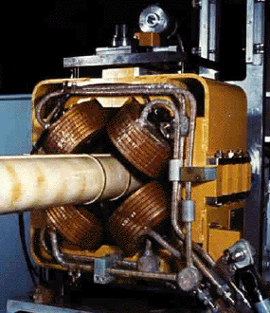
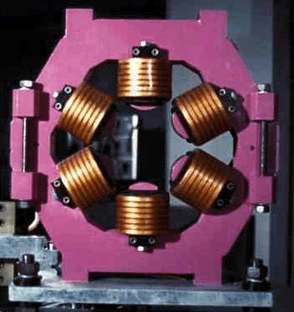
Magnetic components of a storage ring
DIPOLE
QUADRUPOLE
SEXTUPOLE
Susanna Guiducci
Optics Basics

Slide 4
Components of a storage ring
Magnets with different characteristics are used to keep confined a beam of charged particles in a storage ring:
  Dipoles: to guide the beam along a circular trajectory and to correct deviations from the ideal orbit
  Quadrupoles: to focuse the beam around the reference orbit and achieve small beam sizes at some positions
  Sextupoles, octupoles, etc: magnets with non linear fields used to correct unwanted effects (chromaticity, etc…)
  Wigglers and undulators: magnets with many poles with alternating polarity used to achieve synchrotron light beams with various wavelengths in the synchrotron light sources storage rings
Charged particles bent on a circular trajectory in dipoles loose energy for synchrotron radiation. A Radio Frequency (RF) cavity, with a longitudinal electromagnetic field varying at high frequency, is used to restore the particle energy
Susanna Guiducci
Optics Basics
Notes:
Da rivedere!

Slide 5
Components of a storage ring 2
The beam travels in a vacuum chamber where a very low pressure is achieved by means of different pumping systems in order to minimize the interactions with the particles of the residual gas
A cooling system is necessary for the magnets and RF
A series of diagnostic systems is used to monitor the beam characteristics (current, beam position monitors, beam size monitor, luminosity monitor,…) and the accelerator performance
To inject the beam special pulsed magnets are used
Collimators and masks are used to intercept the large amplitude particles and avoid damage of the accelerator sytems and of the detector’s components and performance
A control system is managing the operation of the accelerator
An injector system is used to produce, accelerate and transport the beam inside the accelerator
Susanna Guiducci
Optics Basics
Notes:
Da rivedere!

Slide 6
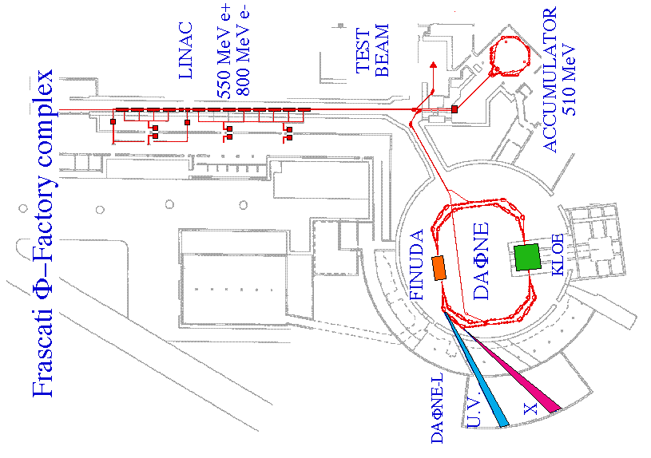
Schematic layout of DAFNE accelerator complex
Susanna Guiducci
Optics Basics

Slide 7
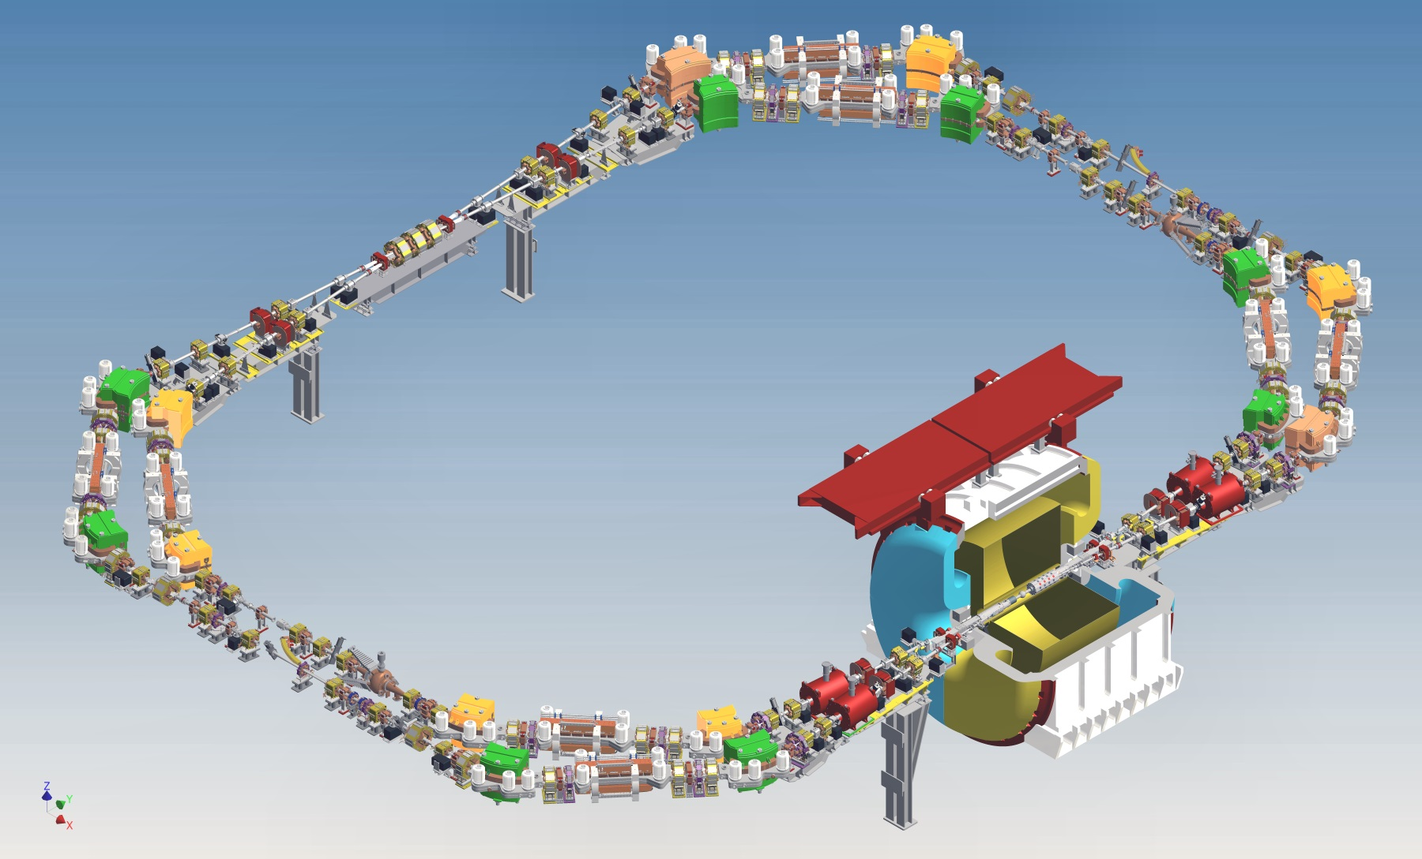
The DAΦNE main rings with KLOE-2
E_{CM} = 1020 MeV
Crab-Waist collision scheme implemented for the first time
Max Luminosity achieved at DAΦNE 4 10³² cm⁻²s⁻¹ is by far the highest achieved at this energy
Susanna Guiducci
Optics Basics

Slide 8
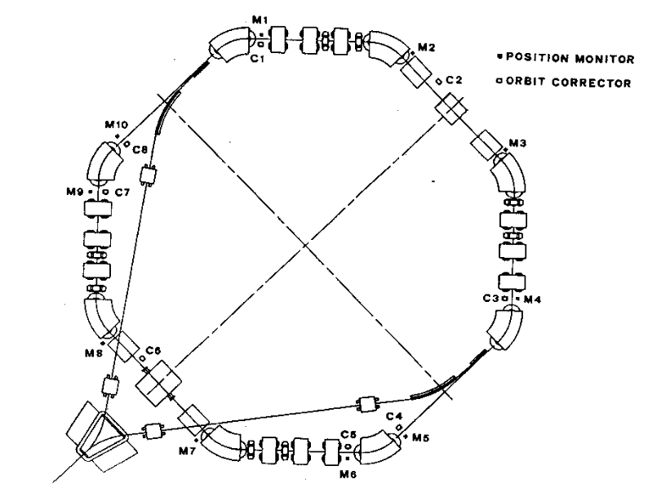
The DAΦNE accumulator ring
e⁻ extraction
Dipoles
e⁻
Quadrupoles
e⁻
e⁻ injection
e⁺ rotate in the opposite direction
Susanna Guiducci
Optics Basics

Slide 9
Lorentz force
The magnetic force F_{B} = qvB is perpendicular to the particle velocity and bends the trajectory with a radius of curvature ρ
The centrifugal force balances the magnetic force:
For relativistic particles the strength of a 1 Tesla bending magnet is equivalent to an electric field of
da 3x10⁸ V/m (far beyond technical limits)
Susanna Guiducci
Optics Basics

Slide 10
Dipole magnets
Magnets with 2 poles separated by a gap
The dipole field is uniform and perpendicular to the orbit plane
The particle is bent by an angle θ with a radius of curvature ρ
Given the length L and the field B the angle is:
For small θ : θ=LB/(Bρ)
Bρ = p/e is the magnetic rigidity
of a particle with charge e
Bρ [T·m] = 3.3356·p [GeV/c]
10
Susanna Guiducci
Optics Basics
Notes:
Da rivedere!

Slide 11
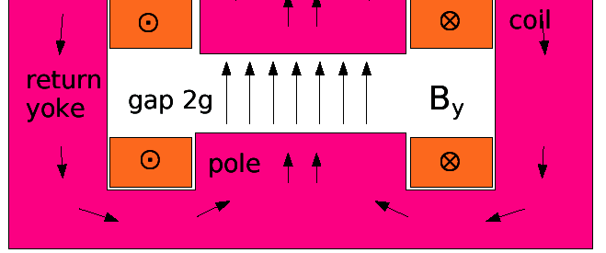
“C” and “H” Dipole magnets
Room temperature electromagnetic dipole have a maximum field of ~2 Tesla
To increase the field Super Conducting (SC) dipoles are needed as the LHC dipoles with B = 8 T
Future colliders aim at SC dipoles with very high fields: B = 16 T or more
11
Susanna Guiducci
Optics Basics
Notes:
Da rivedere!

Slide 12
Quadrupole focusing
The quadrupole is a magnet with 4 poles. The field is zero in the center and varies linearly both in the horizontal and vertical direction
The quadrupole has a focusing effect, similar to a lens
Depending on the field sign it is focusing in the horizontal, called QF, or in the vertical plane called QD, and defocusing in the other direction
S
N
Defocusing in vertical
“QD”
Horizontal oscillation
N
S
“QF”
Focusing in horizontal
Vertical
oscillation
Doublet
Susanna Guiducci
Optics Basics

Slide 13
Quadrupole magnet
Field lines
4 poles with hiperbolic contour
Poles are symmetric with respect to x and y axes
The field is zero at the center and varies linearly both in the x and y direction
Hyperbolic pole shape
13
13
Susanna Guiducci
Optics Basics
Notes:
Da rivedere!

Slide 14
Quadrupole field
On the X (horizontal) axis the field is vertical:
On the Y (vertical) axis the field is horizontal:
The gradient G is defined as:
The ‘normalized’ gradient K is:
The focal length is:
Magnetic field
B_{y} = G x
Force on the particles
B_{x} = G y
QF: Focusing in x,
defocusing in y
14
14
14
Susanna Guiducci
Optics Basics
Notes:
Da rivedere!

Slide 15
Quadrupole kick
campo magnetico
The focal length is:
The angular “kick” given to the particles is linear
Polo di forma iperbolica
x · y = costante
15
15
Susanna Guiducci
Optics Basics
Notes:
Da rivedere!

Slide 16
Chromatic effects
A quadrupole acts as a focusing lens with focal length:
The focal length depends on the particle momentum
Since the beam has an energy spread, the high energy particles will be under-focused and the low energy particles will be over-focused (chromaticity)
Solution: introduce sestupole magnets
16
16
16
Susanna Guiducci
Optics Basics
Notes:
Da rivedere!

Slide 17
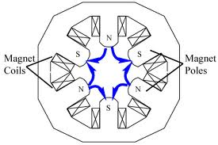
Sextupole magnets
6 poles with hyperbolic shape
The field is zero at the center and varies quadratically with the transverse coordinate:
Normalized gradient:
Kick:
A sextupole is like a quadrupole with a gradient proportional to the transverse diplacement
17
17
Susanna Guiducci
Optics Basics
Notes:
Da rivedere!

Slide 18
Magnetic Field Multipole Expansion
Magnetic elements with 2-dimensional fields of the form
can be expanded in a complex multipole expansion:
In this form, we can normalize to the main guide field strength, -Bŷ, by setting b₀=1 to yield:
18
18
18
Susanna Guiducci
Optics Basics
Notes:
Da rivedere!

Slide 19
Multipole Moments
Upright Fields
Dipole:
Quadrupole:
Sextupole:
Octupole:
Skew Fields
Dipole (θ = 90°):
Quadrupole (θ = 45°):
Sextupole (θ = 30°):
Octupole (θ = 22.5°):
19
19
19
Susanna Guiducci
Optics Basics
Notes:
C e’ un meno su quad By?

Slide 20
Coordinate system
y
For circular machines, it is convenient to convert to a curvilinear coordinate system (Frenet-Serret) and change the independent variable from time to the longitudinal abscissa “s”, which is the reference orbit given by the bending magnets and is moving with the beam
The local radius of curvature is denoted by ρ
x
z
s
The unit vectors
are the basis for the coordinate system

Slide 21
Motion in a circular accelerator
x and y are the betatron coordinates representing small amplitude motion around the reference orbit
In each plane (x,s) and (y,s) the motion of a particle in a transverse magnetic field is described by two variables:
  Position x(s), displacement perpendicular to the reference orbit
  Angle x’(s)= dx/ds with respect to the reference orbit
The motion is similar to an harmonic oscillator
x’
x
x
s
ds
dx

Slide 22
Equations of motion
Particle motion in electromagnetic fields is governed by the Lorentz force:
with the corresponding Hamiltonian in Cartesian coordinates:
Φ = scalar potential
A = vector potential
22
Susanna Guiducci
Optics Basics
Notes:
Da rivedere!

Slide 23
Hamiltonian in the curvilinear coordinate system
Using a canonical transformation we get a new Hamiltonian in the reference orbit coordinate system (x, s, y)
Because the reference orbit is a closed curve the new Hamiltonian on s is periodic
Using the relations:
and expanding to 2nd order in p_{x} and p_{y} yields:
23
Susanna Guiducci
Optics Basics
Notes:
Da rivedere!

Slide 24
Equations of motion (2)
In the absence of synchrotron motion, we can generate the equations of motion with:
Which yields (top/bottom sign for +/- charge):
24
Susanna Guiducci
Optics Basics
Notes:
Da rivedere!

Slide 25
Equations of motion (Hill’s Equation)
We next want to consider the equations of motion for a ring with only guide (dipole) and focusing (quadrupole) elements:
K_{x} and K_{y} are periodic functions of s
The period length Lp is the circumference or a fraction of it, in case the lattice, i.e. the layout of dipole and quadrupoles, has a periodic structure
A horizontal bending dipole has K_{x} = 1/ρ² and K_{y} =0
In a quadrupole 1/ρ = 0 and K_{x} = - K_{y} is the focusing strength
  A horizontally focusing quadrupole is vertically defocusing
also commonly
denoted as k₁
25
Susanna Guiducci
Optics Basics

Slide 26
General Solution to Hill’s Equation
The general solution to Hill’s equation can now be written as:
with β_{x}(s) a periodic function of s: β_{x}(s+L_{P}) = β_{x}(s)
The linear betatron motion is like an harmonic oscillation with amplitude and phase varying along the ring as a function of s
We can now define the betatron tune for a ring as:
26
Susanna Guiducci
Optics Basics
Notes:
Da rivedere!

Slide 27

Betatron oscillations
The periodic function β(s) describes the envelope of the betatron oscillations that the particles perform with respect to the reference orbit given by guide field of the dipoles
The oscillations are in both planes, x and y
The number of betatron oscillations per turn, “betatron tune”, or “phase advance”, is an important ring parameter
With C ring circumference
R ring radius
Susanna Guiducci
Optics Basics
Notes:
Da rivedere!

Slide 28
Comments about the solutions to Hill’s equations
  The solutions to Hill’s equation describe the particle motion around a reference orbit, the closed orbit. This motion is known as betatron motion. We are generally interested in small amplitude motions around the closed orbit
  Accelerators are generally designed with discrete components which have locally uniform magnetic fields and the focusing functions, K(s), can be represented in a piecewise constant manner
  This allows us to locally solve for the characteristics of the motion and implement the solution in terms of a transfer matrix M
  For each segment for which we have a solution, we can then take a particle’s initial conditions at the entrance to the segment and transform it to the final conditions at the exit
Susanna Guiducci
Optics Basics
Notes:
Da rivedere!

Slide 29
Transfer Matrices
We now write the solutions of the Hill’s equations in transfer matrix form:
where
Focusing
Quadrupole
Drift Region
Defocusing
Quadrupole
All Matrices have Det = 1
Susanna Guiducci
Optics Basics
29
Notes:
Da rivedere!

Slide 30
Transfer Matrices
Examples:
  Quadrupole in thin lens approximation:
  Sector dipole (entrance and exit faces ┴ to closed orbit):
All Matrices have Det = 1
c.o.
Susanna Guiducci
Optics Basics
30
Notes:
Da rivedere!

Slide 31
Twiss Parameters
The generalized one turn matrix can be written as:
This is the most general form of the matrix. α, β, and γ are known as either the Courant-Snyder or Twiss parameters (note: they have nothing to do with the familiar relativistic parameters) and Φ is the betatron phase advance. The matrix J has the properties:
The n-turn matrix can be expressed as:
which leads to the stability requirement for betatron motion:
Identity matrix
Susanna Guiducci
Optics Basics
31
Notes:
Da rivedere!

Slide 32
Example of a lattice: the FODO cell
Lattice is the sequence of dipole, quadrupoles and other magnets which constitutes the accelerator
The FODO cell is a series of focusing and defocusing quadrupoles
Susanna Guiducci
Optics Basics
Notes:
Da rivedere!

Slide 33
Thin Lens FODO Cell
In thin lens approximation the matrix of a sequence QF-Drift-QD-Drift-QF (FODO cell) in the horizontal plane can be written as (we start from the center of QF, then its focal length is half and the sign is opposite with respect to QD):
For the vertical plane change f in –f
The total effect is focusing in both planes
Susanna Guiducci
Optics Basics
Notes:
Da rivedere!

Slide 34
Exercise on FODO cell
Comparing the FODO cell matrix with the matrix of a periodic structure evaluate the betatron phase advance φ and the Twiss functions β and α at the center of QF and QD
Since the cell is periodic we have α₁ = α₂ = α_{F} and β₁ = β₂ = β_{F} and the transport matrix is
or
α_{F} = α_{D} = 0
Susanna Guiducci
Optics Basics
Notes:
Da rivedere!

Slide 35
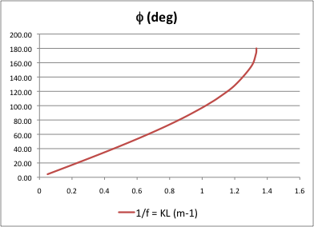
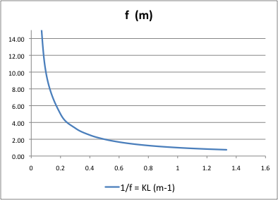
β_{F} and β_{D} vs phase advance for FODO cell
For φ=180º
β_{F}→∞
β_{D}→0
The motion is unstable
L=1.5 m
β_{F}
β_{D}
The minimum
f = L/2 = 0.75m
Susanna Guiducci
Optics Basics
Notes:
Da rivedere!

Slide 36
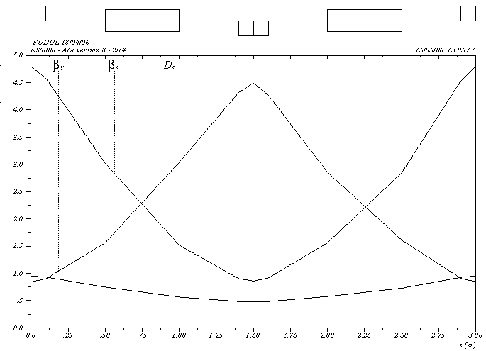
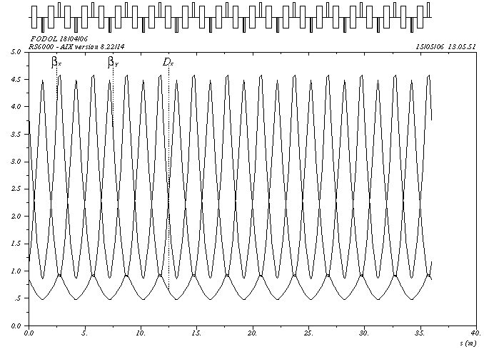
An example of ring based on FODO cell
12 FODO cells
Q_{x} = 3.15, Q_{z} = 3.15
Single FODO cell
ψ_{x}= ψ_{y}= 94.5º
Susanna Guiducci
Optics Basics
Notes:
Da rivedere!

Slide 37
Thank you for the attention

