Slide 1
NA62 Riunione di Gruppo I Napoli 07/01/2015 F.Ambrosino, M.B. Brunetti, T. Capussela, D.Di Filippo, P. Massarotti, M. Mirra, M. Napolitano, G. Saracino

Slide 2
Outline
NA62 postcard
Attività napoletane 2014
Run 2014
Prospettive 2015
Uno sguardo al futuro

Slide 3
Outline
NA62 postcard
Attività napoletane 2014
Run 2014
Prospettive 2015
Uno sguardo al futuro

Slide 4
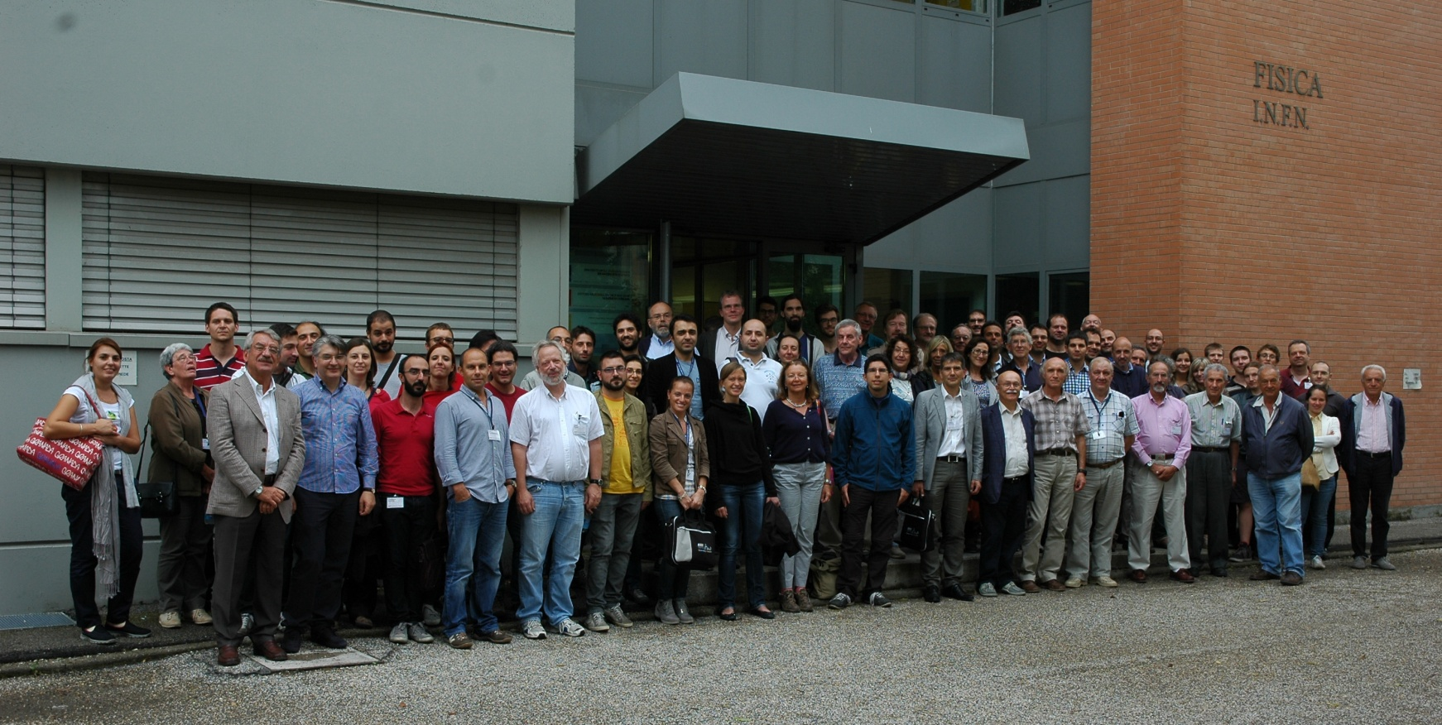
NA62
Birmingham
Bristol
Glasgow
Liverpool
IHEP
INR
JINR
Mainz
Prague
UC Louvain
Bratislava
CERN
Bucharest
George Mason
SLAC
UC Merced
BU(*)
Ferrara
Florence
LNF
Naples
Perugia
Pisa
Rome I
Rome II
Turin
Sofia
San Luis Potosi
*CERN-BU KR2109
Ferrara, Italy, 4/9/2014
28 Institutes, 206 Collaborators
Contacts with Indian, Canadian, and other US Institutions

Slide 5
NA62 Goal
We aim to measure precisely
with in-flight kaon decays
State of the art:
[1] J. Brod, M. Gorbahn, PRD78, arXiv:0805.4119
[2] AGS-E787/E949 PRL101 (2008) 191802, arXiv:0808.2459
[3] M. Gorbahn arXiv:0909.2221
[4] KEK-E391a, arXiv:0911.4789v1
[5] A.J. Buras et al., EPJ C72, arXiv:1208.0934
[6]CMS-LHCb, CKM2014

Slide 6
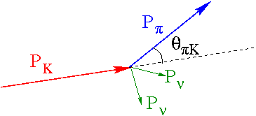
NA62 In-flight Technique
Calorimetry to veto extra particles
Very light trackers to reconstruct the K⁺ and the π⁺ momenta
Full particle identification

Slide 7
NA62 LAyout
CHANTI

Slide 8
Outline
NA62 postcard
Attività napoletane 2014
Run 2014
Prospettive 2015
Uno sguardo al futuro

Slide 9
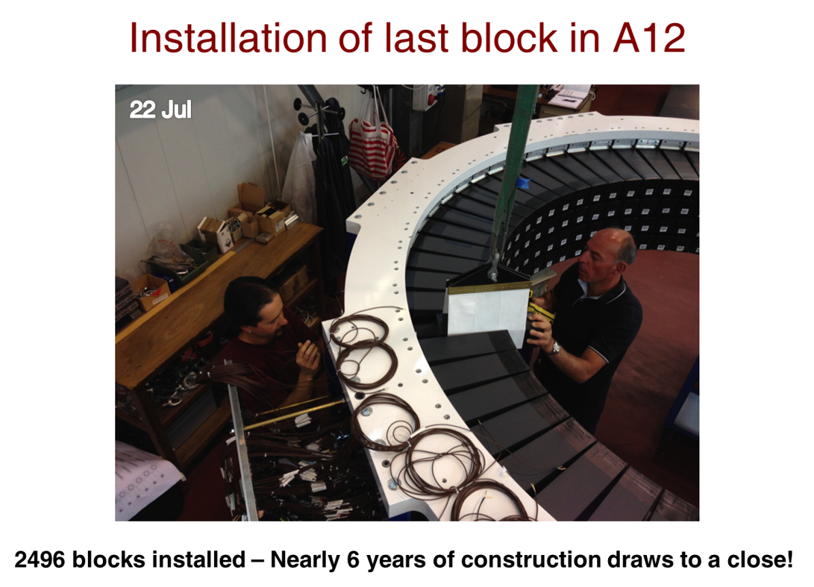
Attività 2014: LAV
Nel 2014 abbiamo completato la costruzione a LNF e l’istallazione al CERN dei Large Angle Vetoes
Una «grande impresa» durata quasi 6 anni, coronata da successo.
Fondamentale l’apporto dei servizi (OM-PM)

Slide 10
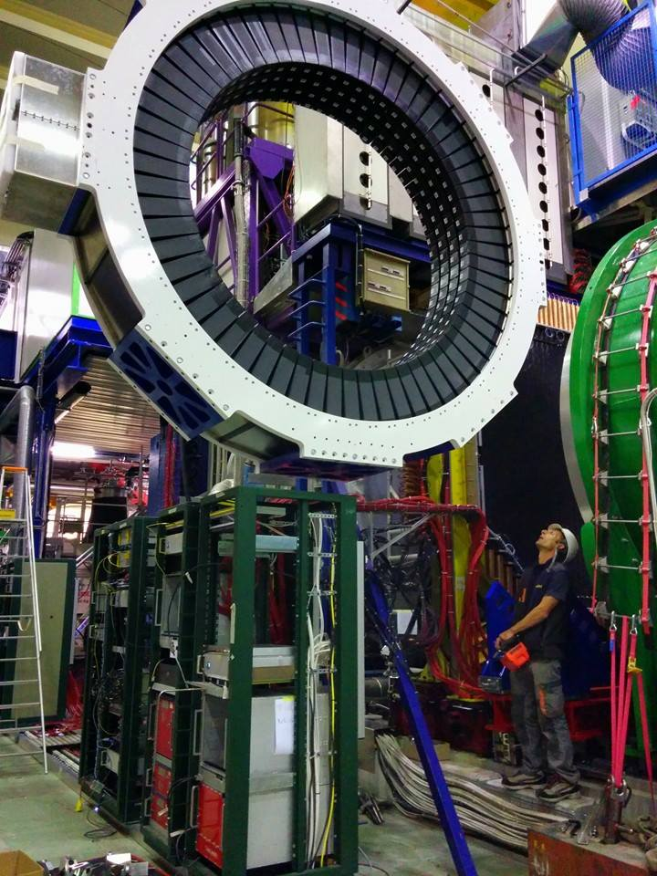
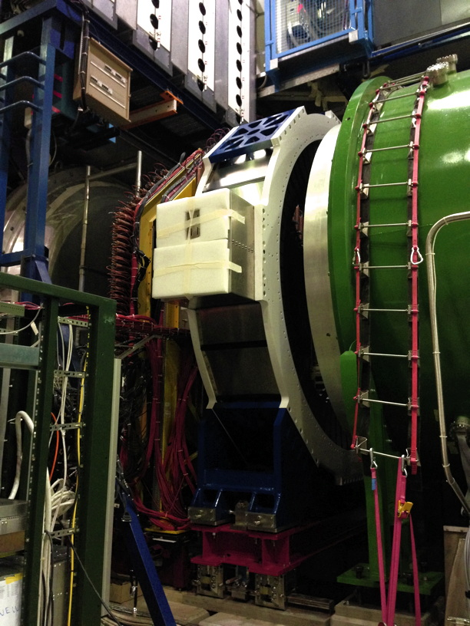
LAV12 @ CERN

Slide 11
Attività 2014: CHANTI
Rivelatore 100% napoletano fin dalla proposta e dal progetto. Nel 2014:
Completati costruzione e test del detector
Acquistata, testata e calibrata l’elettronica di front-end (600 canali)
Completata la camera vuoto e istallato il tutto con successo al CERN
Raffinata la simulazione MC
Fondamentale l’apporto dei servizi (OM-PM-SER)

Slide 12
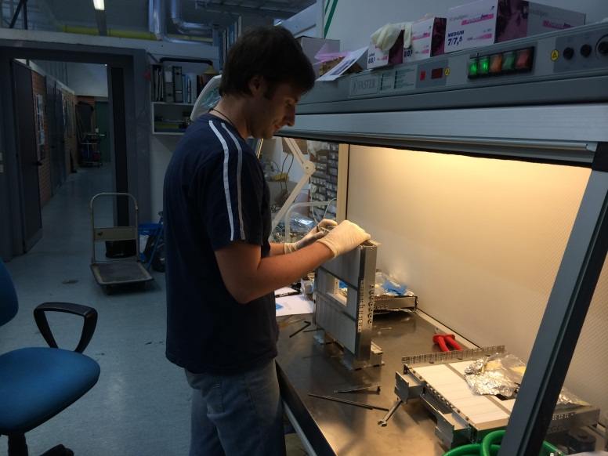
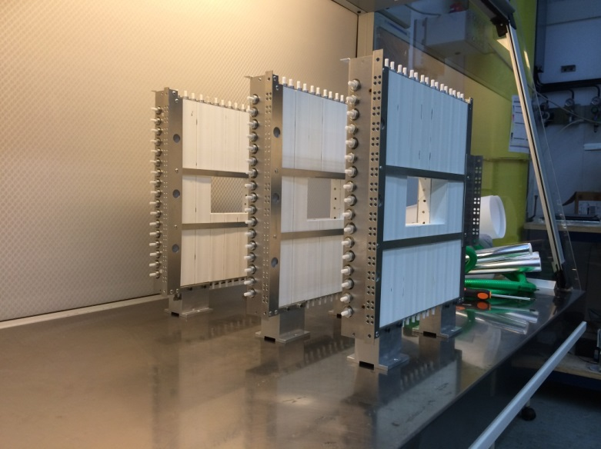
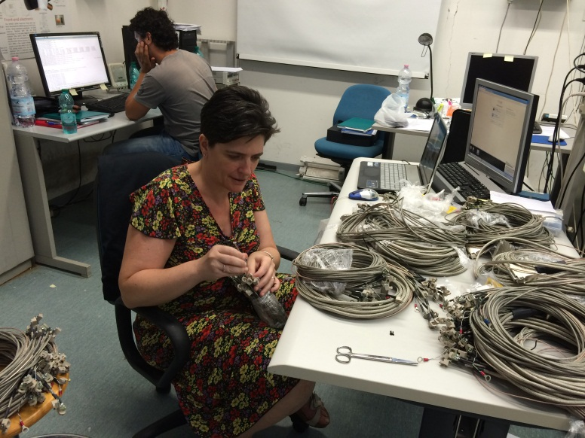
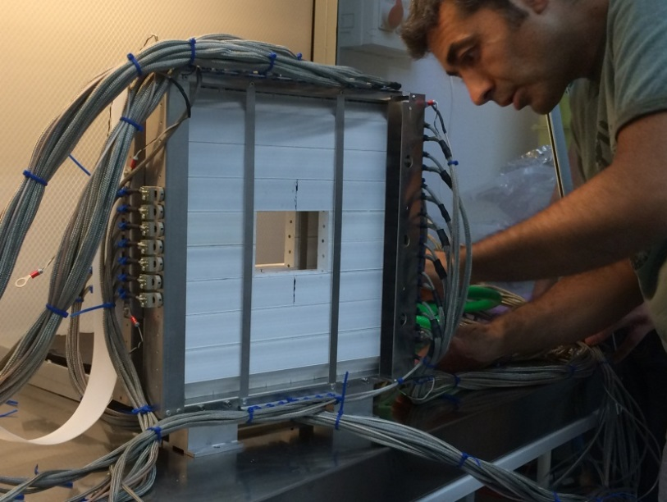
CHANTI: costruzione

Slide 13
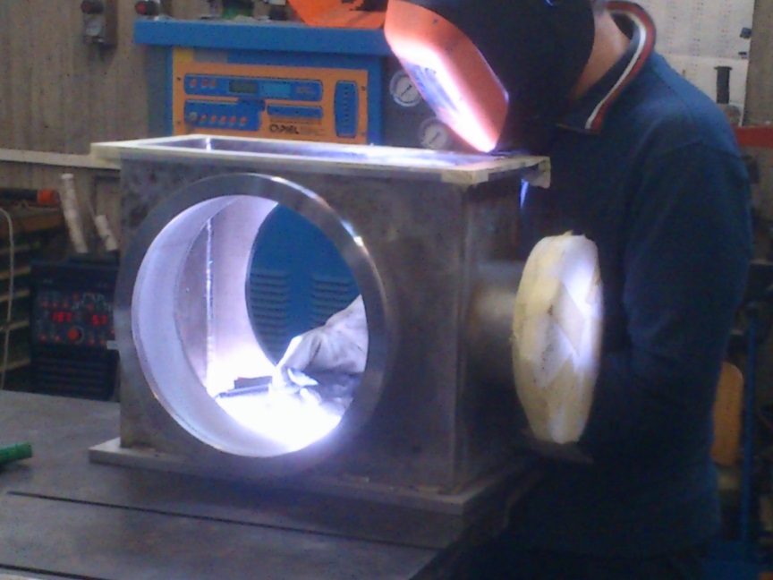
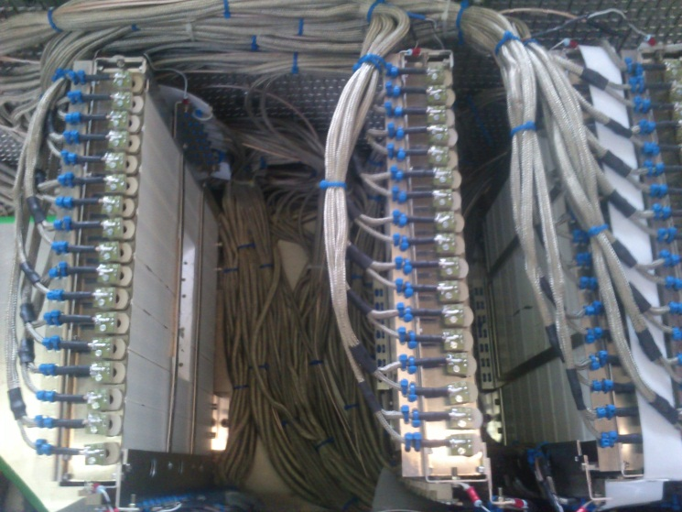
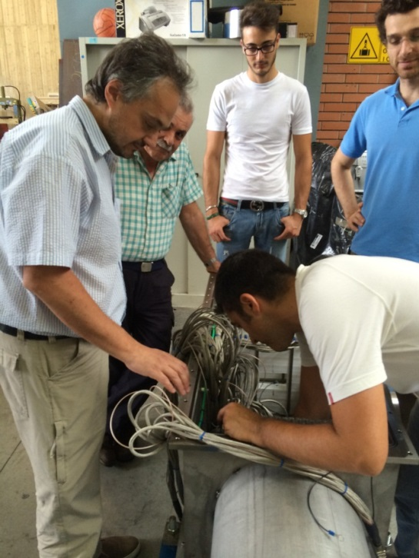
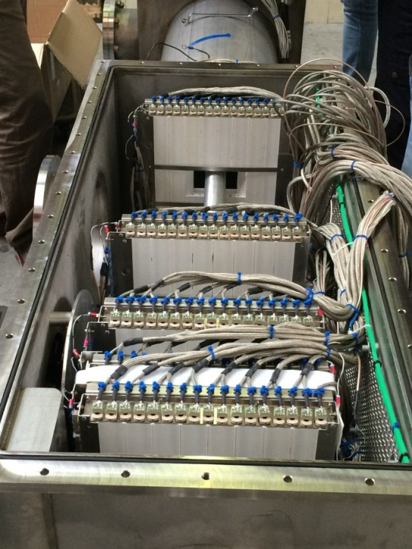
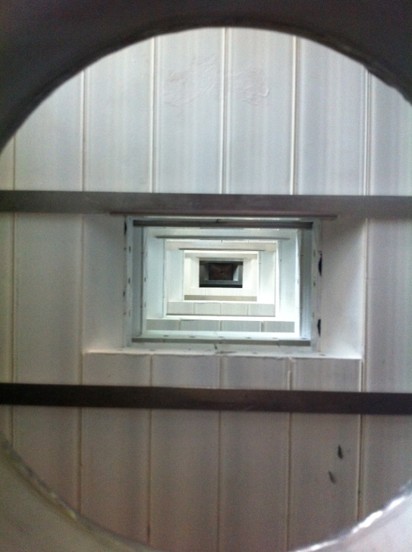
CHANTI: costruzione

Slide 14
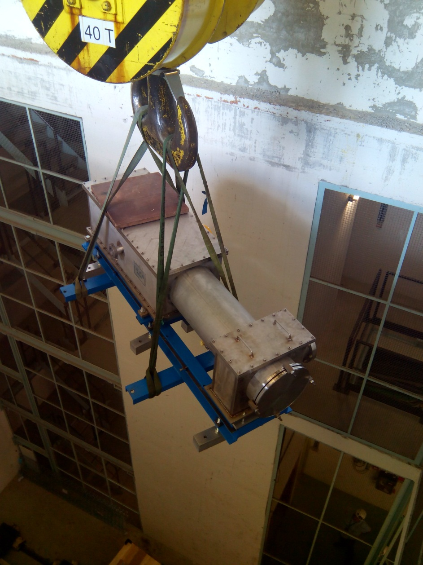
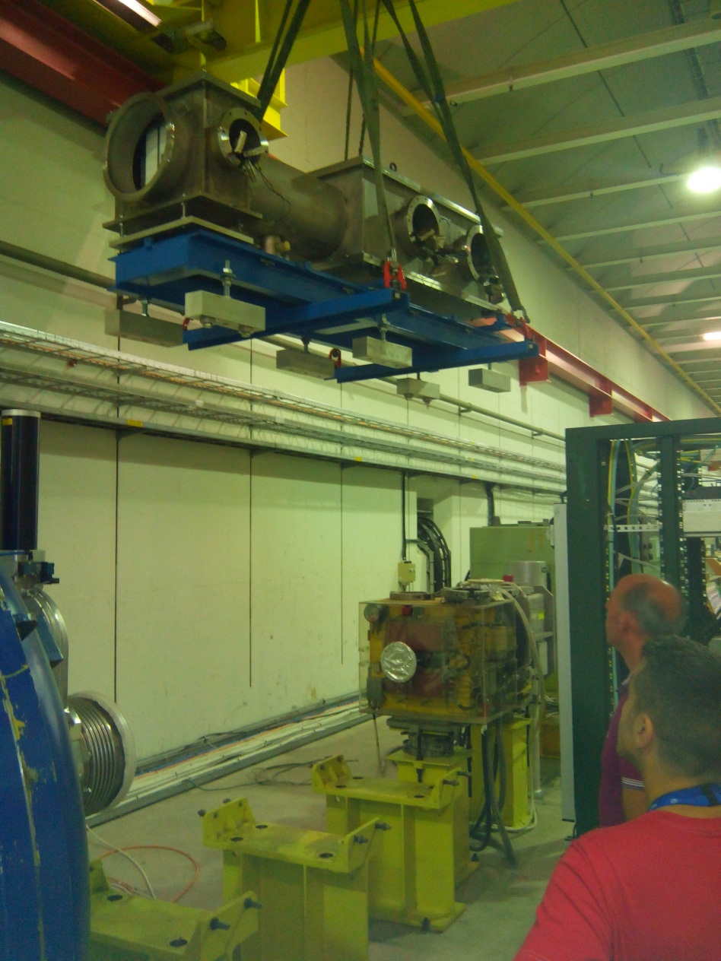
CHANTI: ISTALLAzione

Slide 15
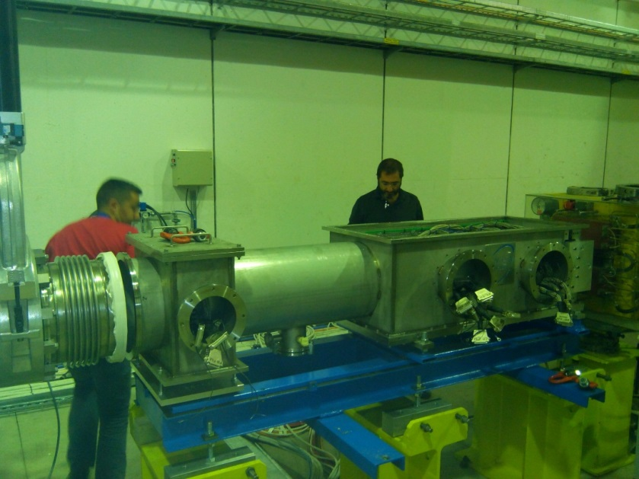
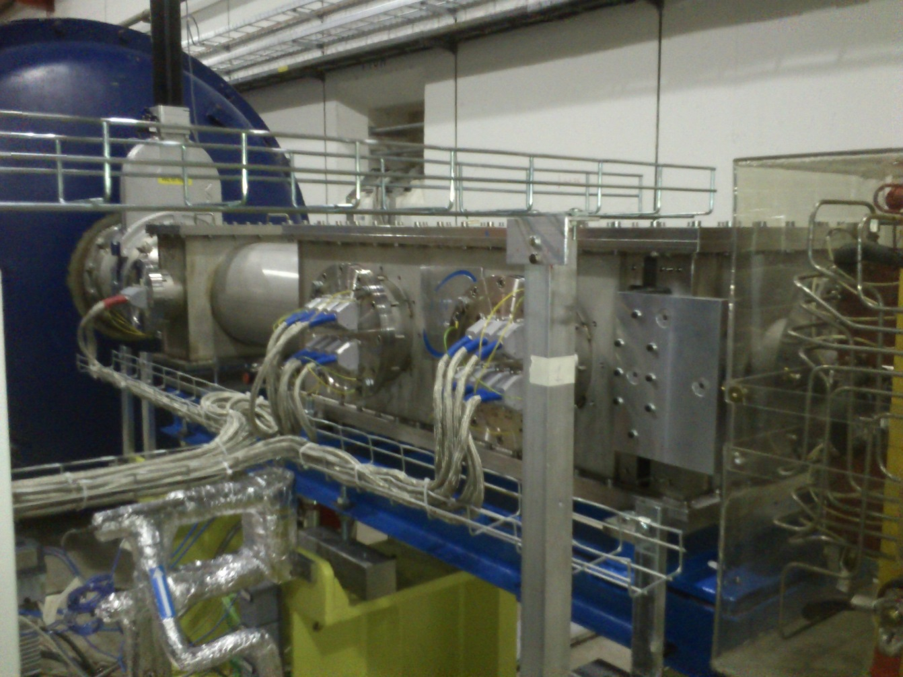
CHANTI: ISTALLAzione

Slide 16
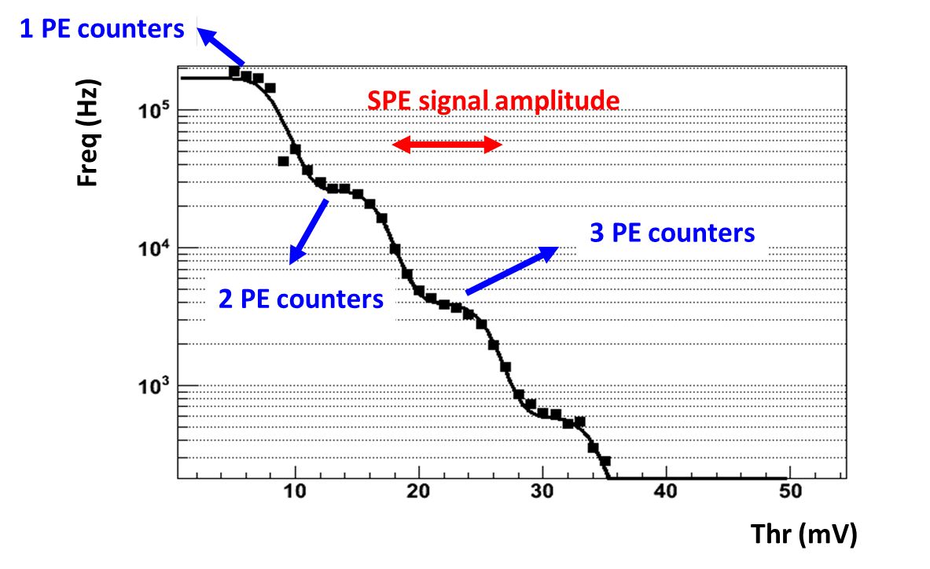
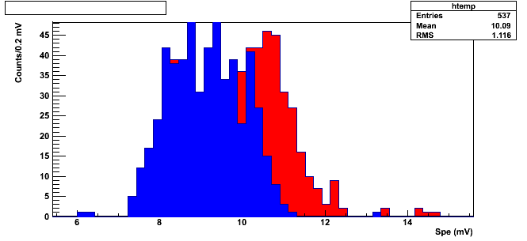
CHANTI: FEE calibration
Check dell’intera catena di FEE, e della calibrazione relativa fra i canali fatto misurando l’ampiezza di singolo fotoelettrone.
SPE value for nominal bias voltage
Counts/0.2mV
SPE value for nominal bias voltage + 0.25mV
SPE (mV)

Slide 17
Outline
NA62 postcard
Attività napoletane 2014
Run 2014
Prospettive 2015
Uno sguardo al futuro

Slide 18
Installation and Start up
The picture shows the last large element being installed (STRAW4)
Beam time 2014: October 6 – December 15
Somewhat “cold start”, with many beam instabilities in the first period: it was the very first SPS start after a long shutdown.

Slide 19
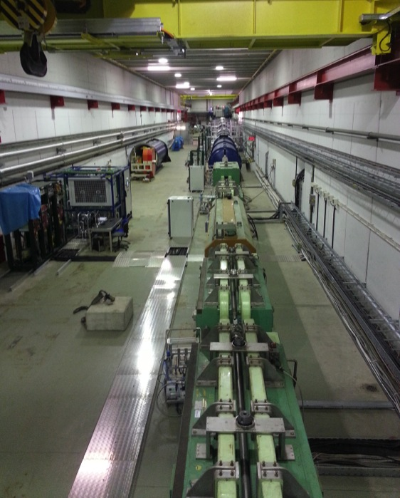
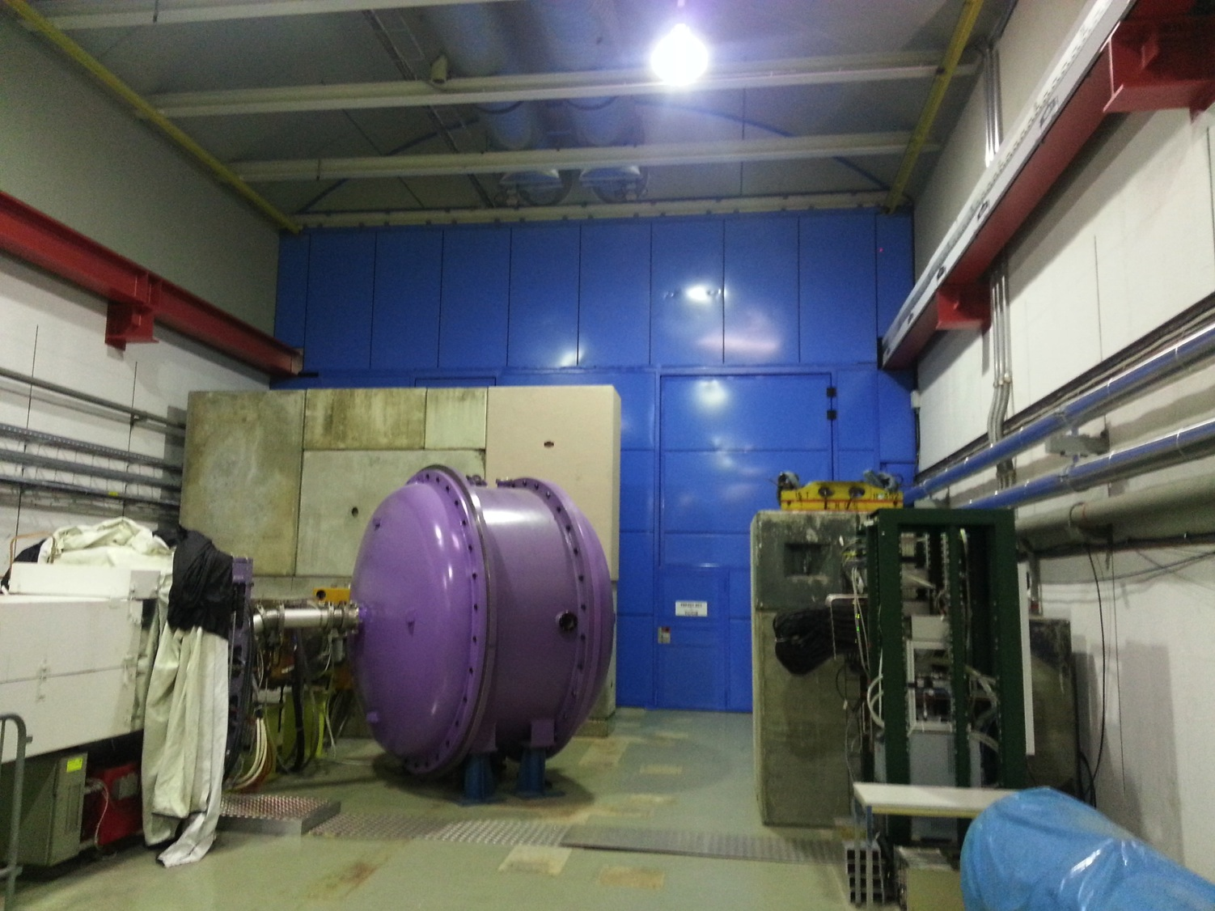
BEAM LINE STATUS
The K12 beam line was commissioned partly in the 2012 Technical Run, but: - loss of kaon flux - asymmetric horizontal profiles around KTAG.
Detailed studies were done, including - realignment of the front end of the beam - consolidation of T10 target - various optimisations made (e.g. installation of fast vacuum valve in new position)
Now nominal K12 beam performance. Still low P42 flux requested
The vacuum system works fine.
Double wall to separate TCC8 and ECN3 air volumes operational.

Slide 20
NA62 BEAM LINE status
Beam profile at the end of the dump tunnel. Spot size as calculated.
SM
Horizontal profiles before and after the KTAG counters. These were very asymmetric and cut in the 2012 run. Now the beam transmission is as expected.
SM

Slide 21
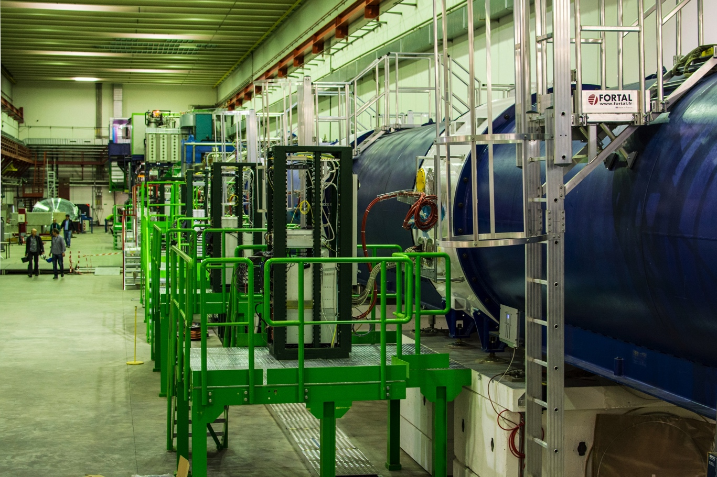
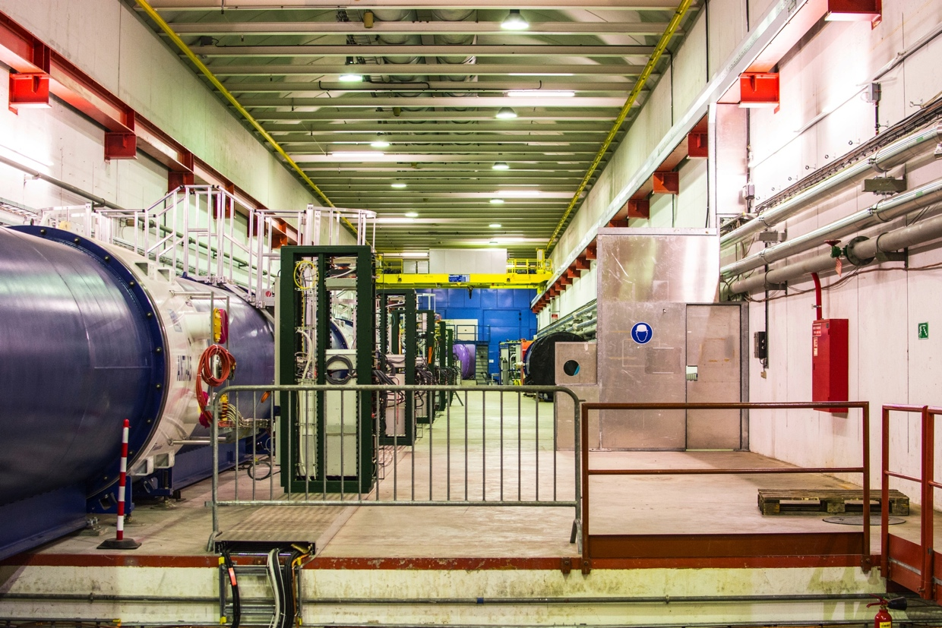
NA62 detector status
LAV 1-5 in TTC8
SM
View of ECN3
SM

Slide 22
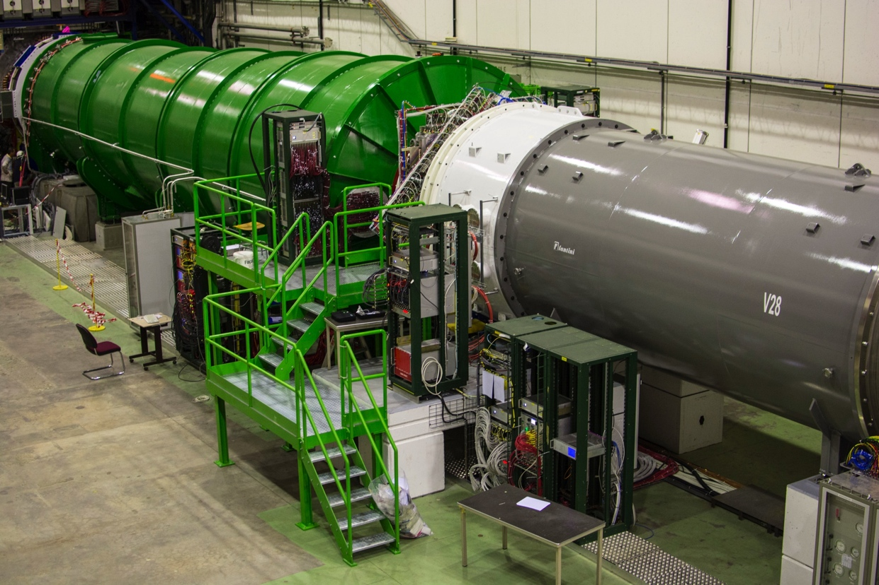
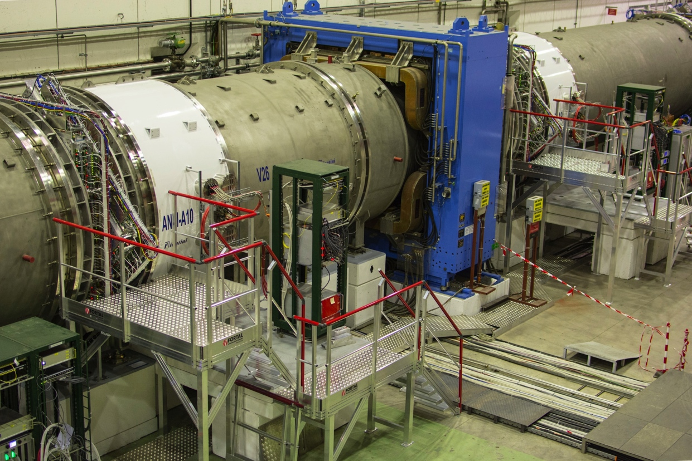
NA62 detector status
Straw3 - LAV10 - MNP33 -
Straw2 - LAV9
SM
RICH Straw 4 and LAV11
SM

Slide 23
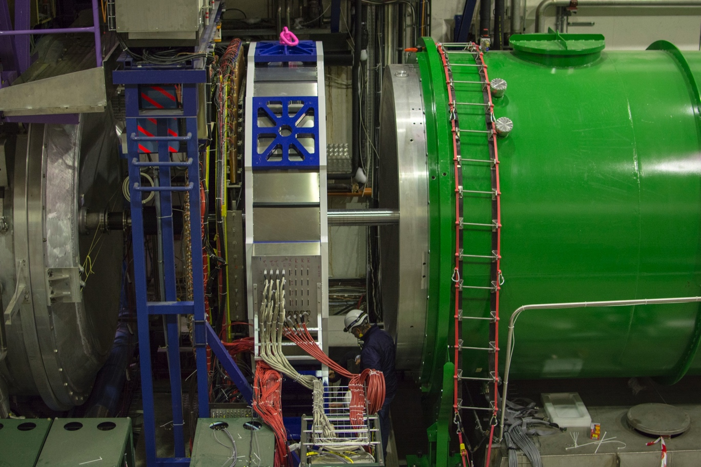
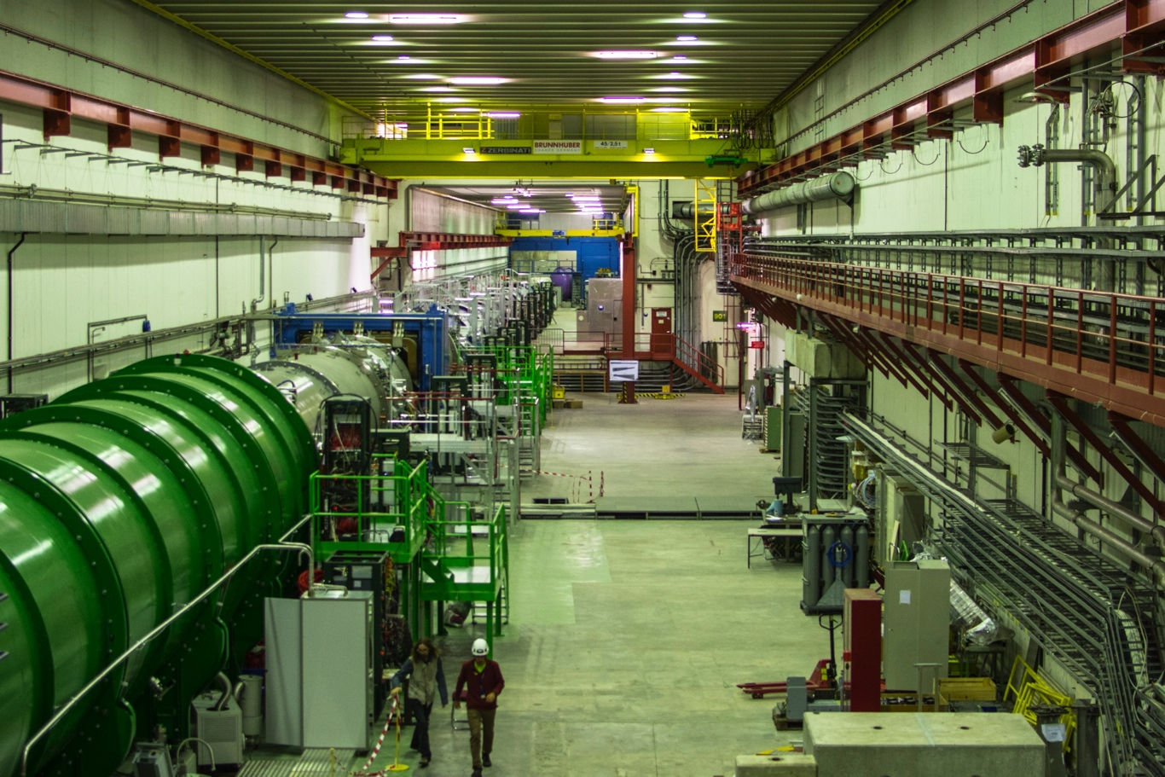
NA62 detector status
NA62 view from LKr
SM
LKr - CHOD LAV12 and RICH
SM

Slide 24
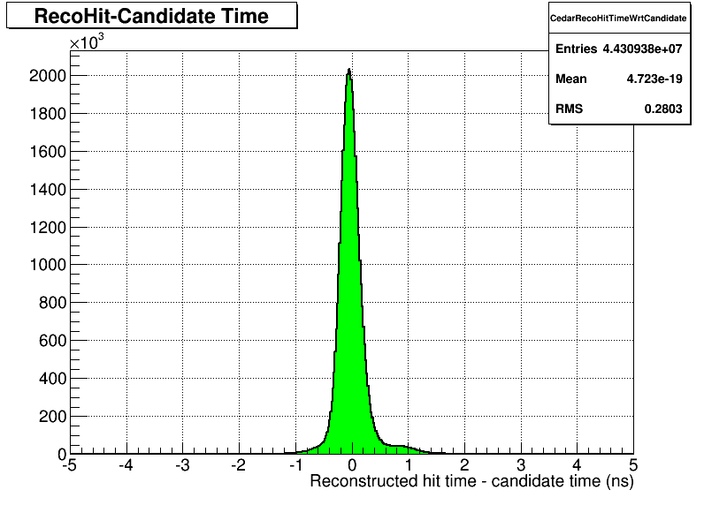
KTAG
Birmingham, Bristol, Liverpool
Online display
Nominal N₂ pressure for Kaons
Preliminary: single hit time resolution (~280 ps)

Slide 25
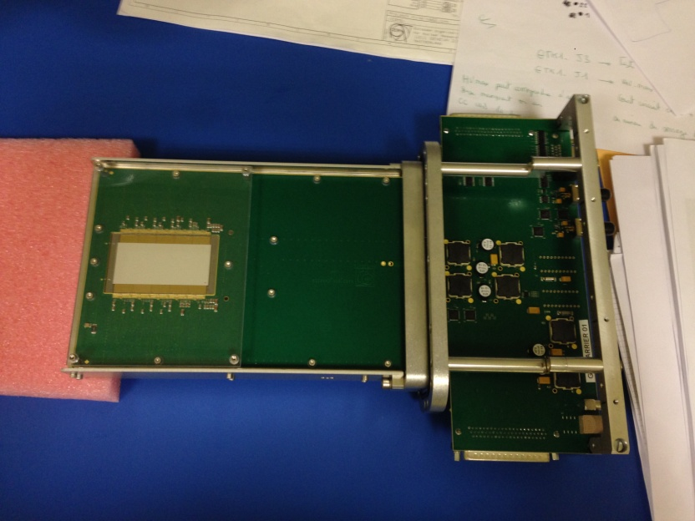
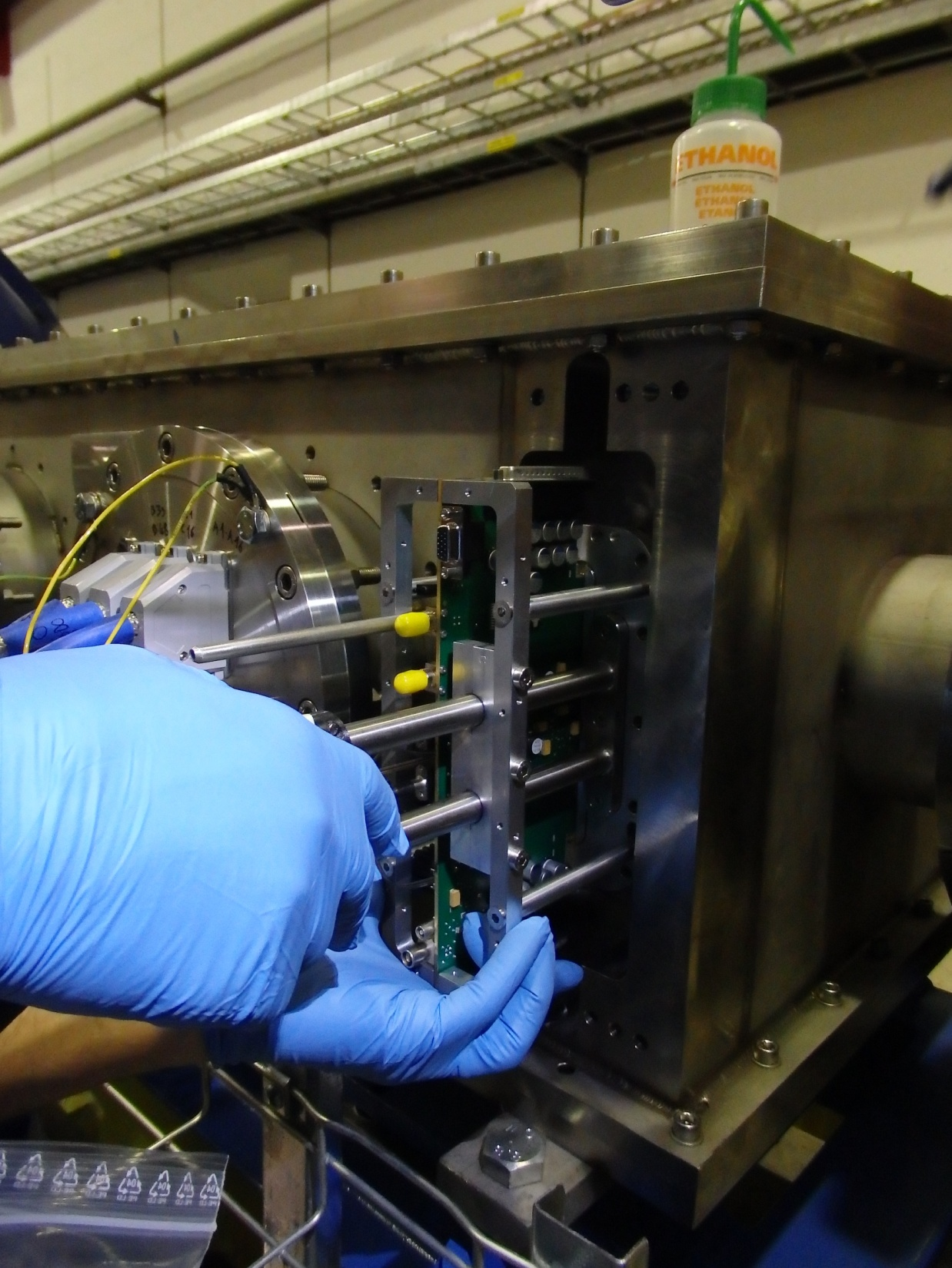
GIGATRACKER (GTK)
CERN, Ferrara, Louvain-la-Neuve, Torino
GTK3
Installed in K12 beam on November 6

Slide 26
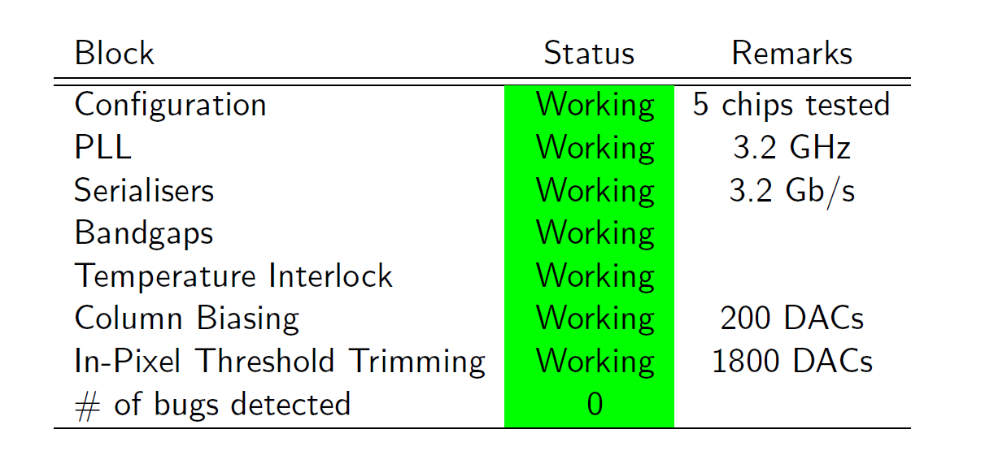
GTK Read OUT CHIP
TDCPix
130 nm CMOS IBM
CERN
PH-ESE Design
Excellent performance
Major breakthrough for NA62
“Whole Chip” Resolution ~ 72 ps RMS

Slide 27
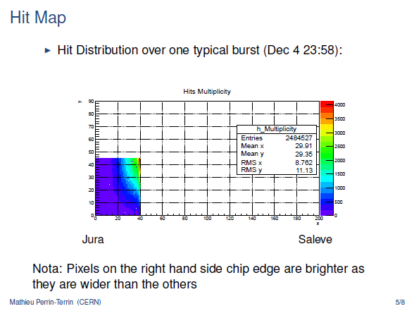
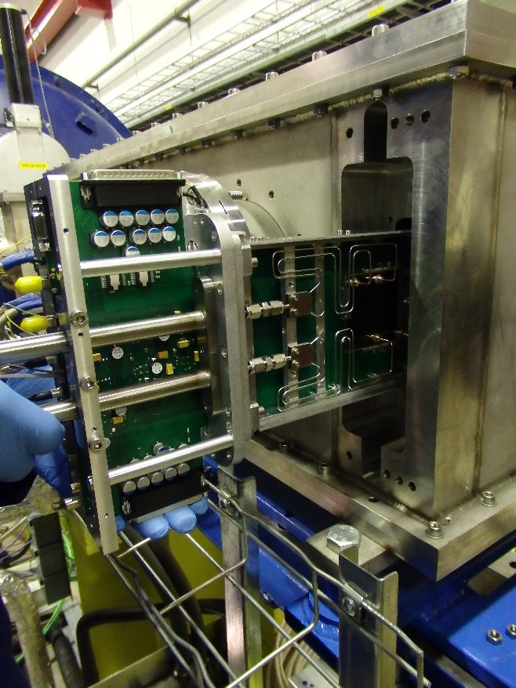
GTK Status
First station has been installed in GTK3-CHANTI (Nov.6):
chip thickness: 450 μm, total thickness: 800 μm.
Only chip #5 connected to DAQ
Second station:
chip thickness: 450 μm, total thickness: 800 μm.
Installed Nov 35th.
Removed after temperature problems and re-Installed Dec 5°
Third station: chip thickness: 100 μm,
total thickness: 450 μm.

Slide 28
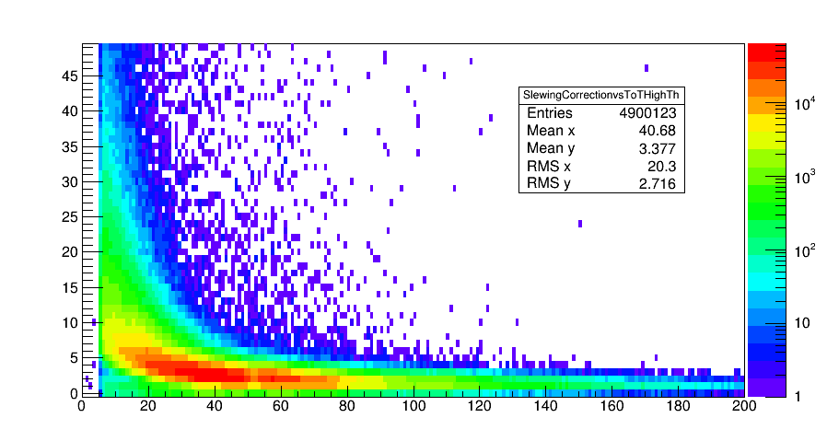
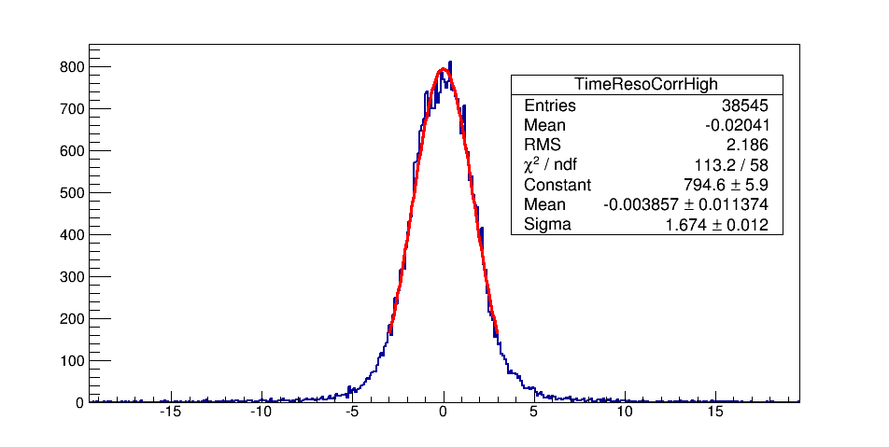
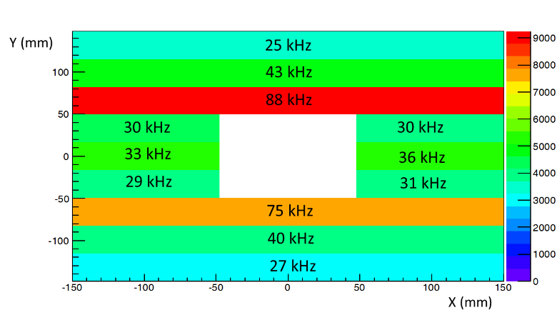
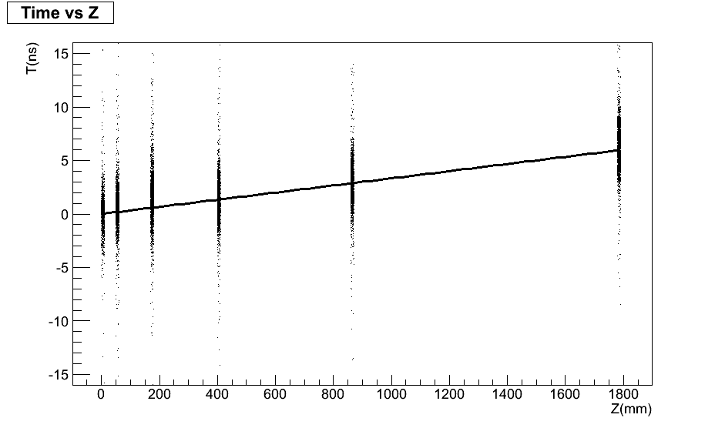
CHANTI: performance
Corr (ns)
Time slewing correction
σ=1.2ns
ToT (ns)
Single hit resolution
Muon halo in CHANTI

Slide 29
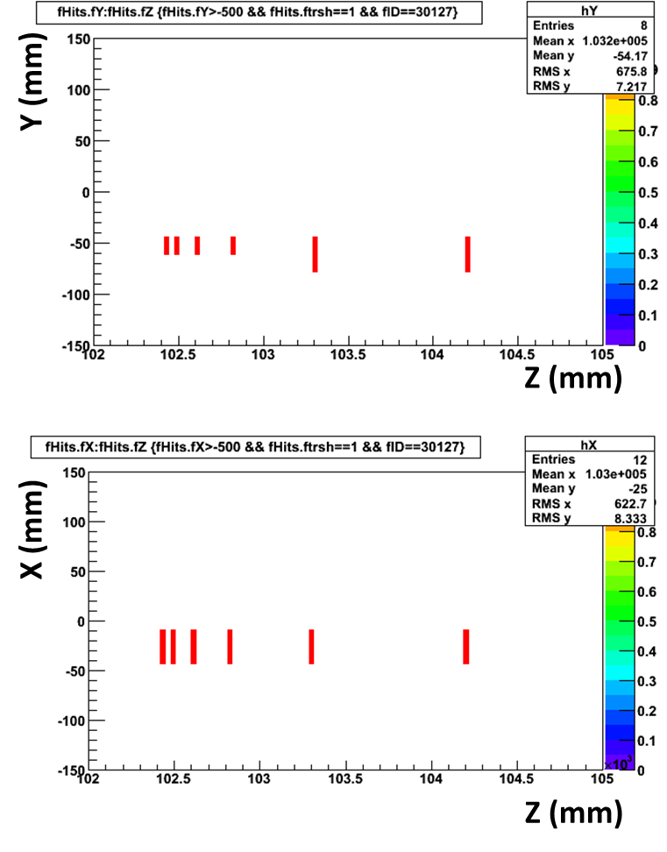
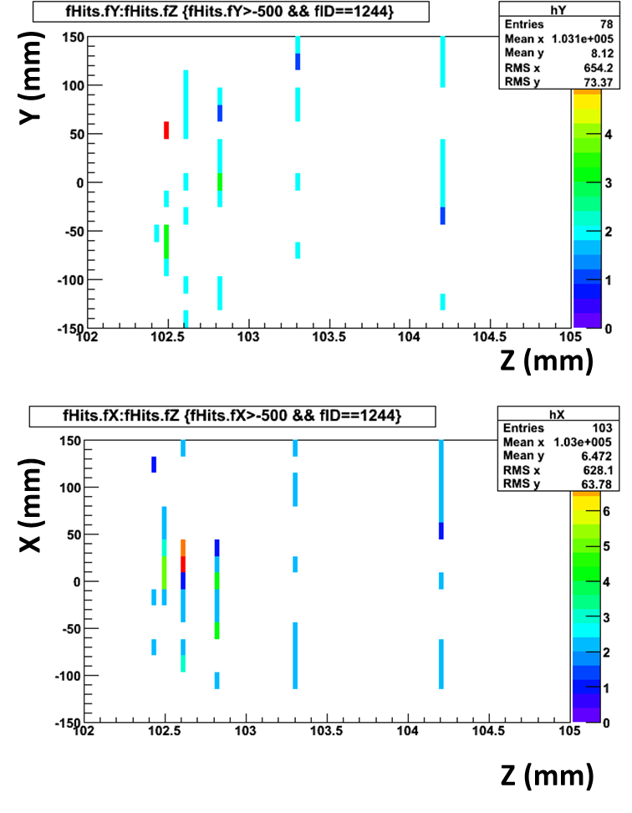
CHANTI performance
SINGLE MUON in CHANTI
Inelastic event in CHANTI

Slide 30
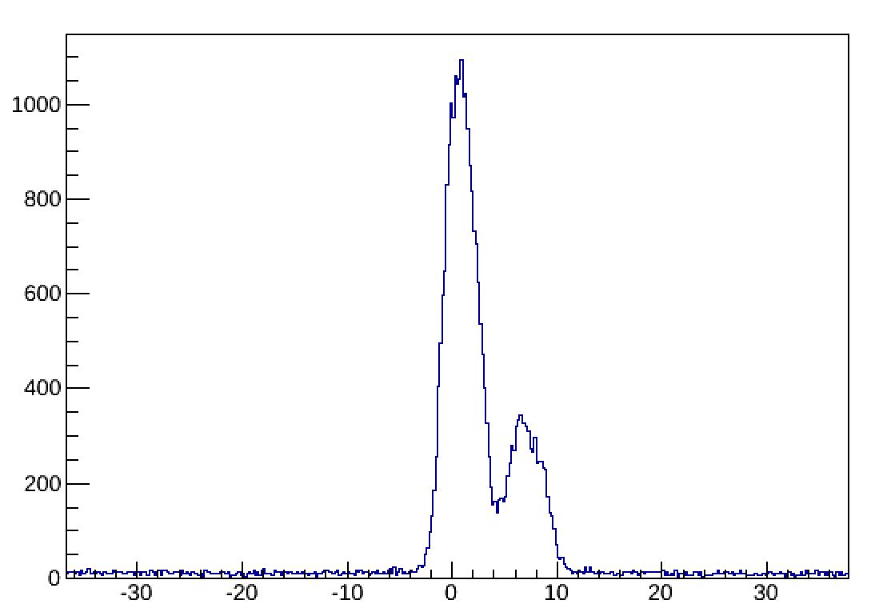
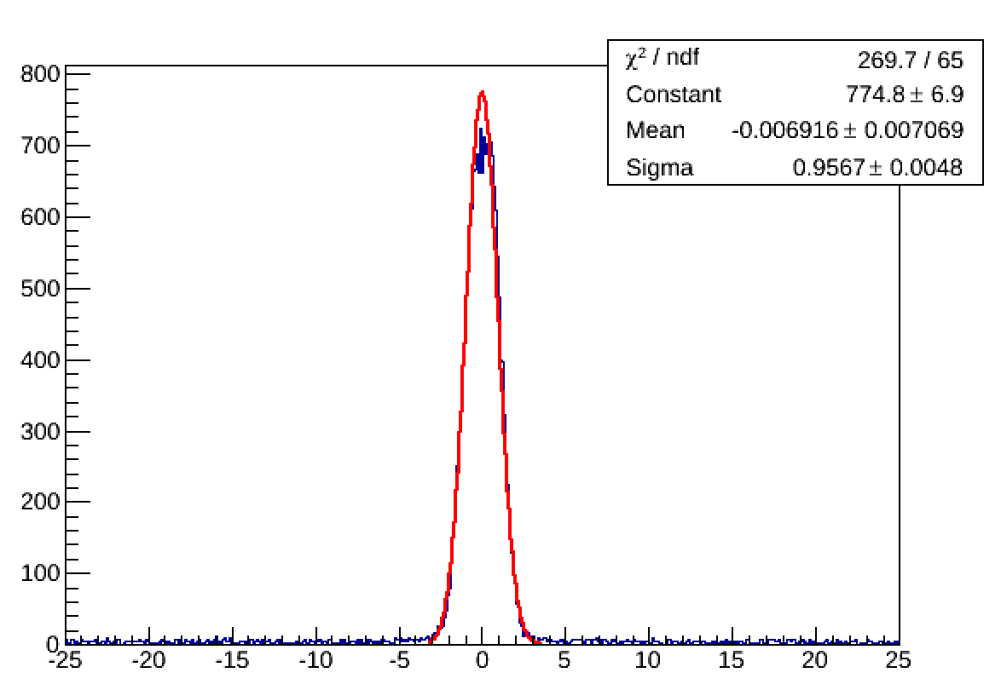
LAV Time resolution studies
T_{LAV}-T_{CEDAR} (ns)
Channel
Second peak induced by different cable length. Disappears after T₀ correction
T_{LAV}-T_{CEDAR} (ns)
Already achieved ~1ns time resolution per single block and a perfect time alignment with respect to the KTAG
T_{LAV}-T_{CEDAR} (ns)

Slide 31
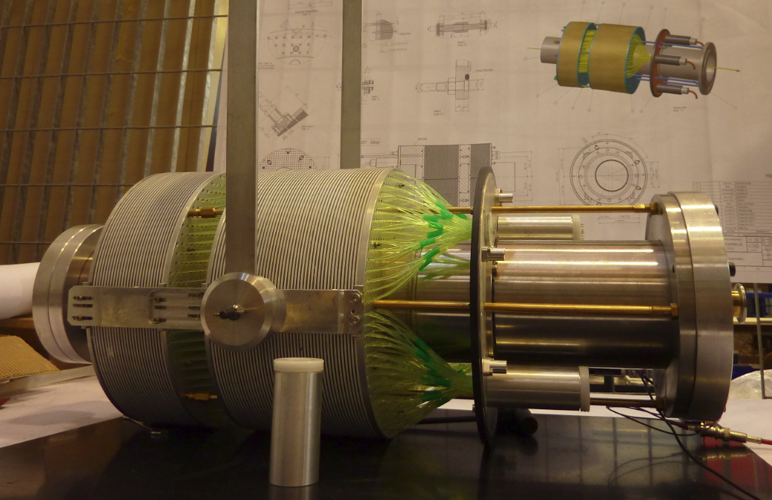
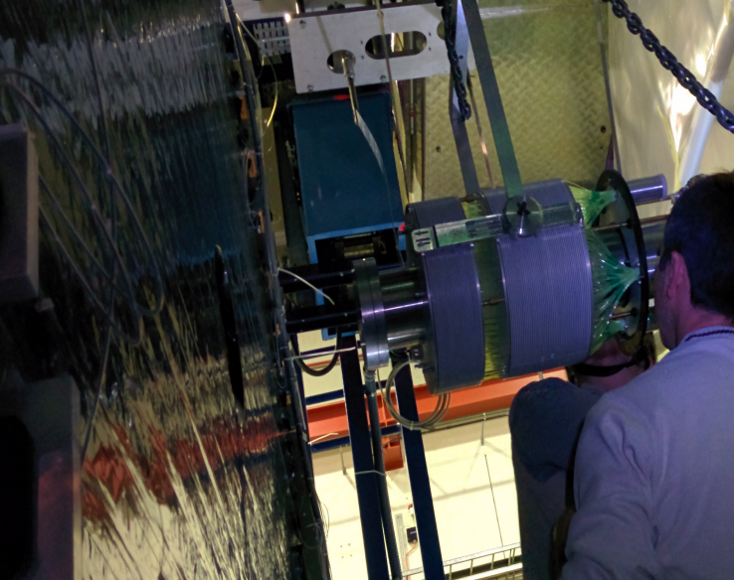
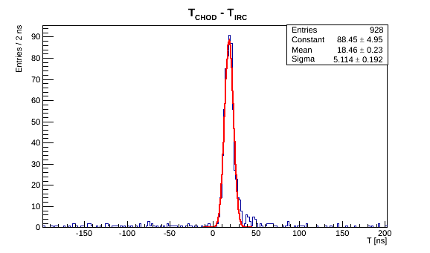
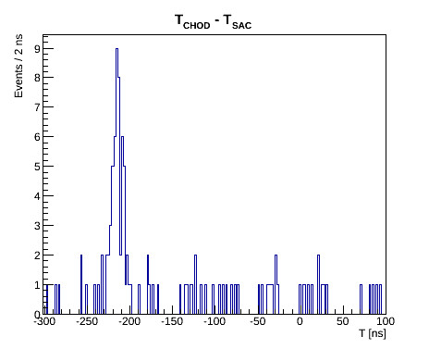
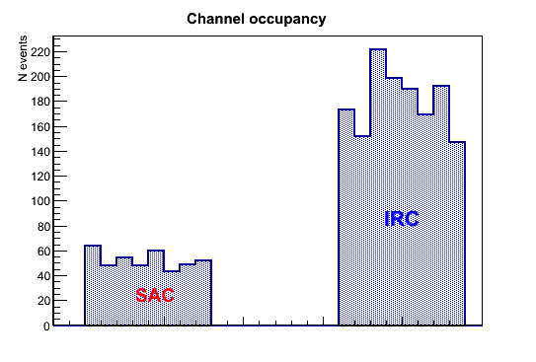
Small Angle Vetos
IRC
IRC constructed at LNF
SAC upgraded and tested
at LNF BTF
2014 run:
LAV FEE + TDC/TEL62 based readout
RAW data, no calibration or correction!

Slide 32
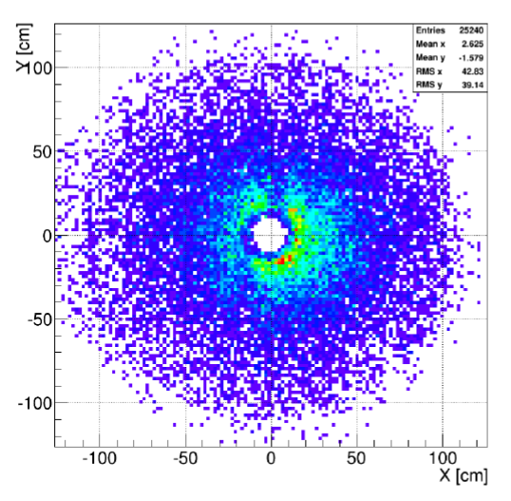
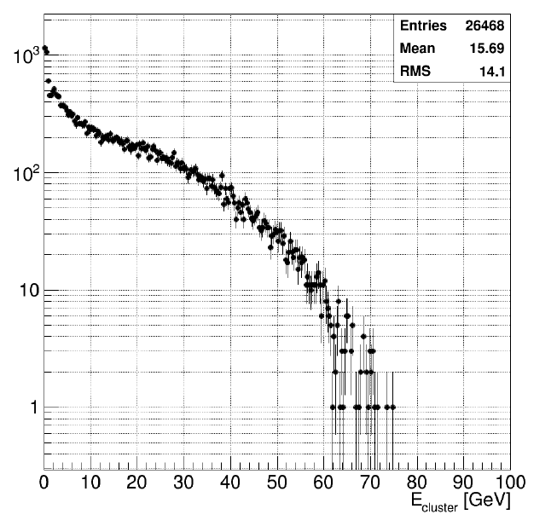
Liquid KRYPTON READ OUT
Commissioned & Readout!!
14 bit FADC, 40 Ms, 32 ch / module 432 modules, 28 VME crates
Specifications/Tender : CERN PH-ESE,PH-SME Manufacturer: CAEN (ITALY)

Slide 33
First Look at the 2014 LKR DATA…
Squared missing mass spectrum
M²_{miss} = (P_{K+} –P_{π0})²
Not even Preliminary

Slide 34
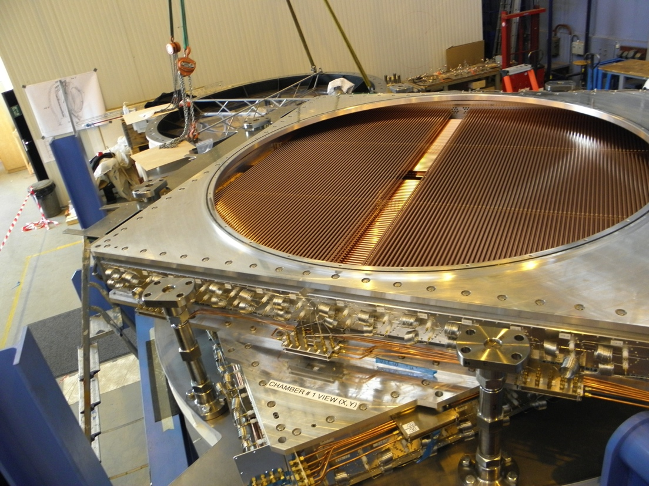
NA62 STRAW TRACKER
CERN – JINR

Slide 35
Completion of THE STRAWS
Number (Ch/Mod/ Coordinates) | Start of assembling | End of assembling | End of testing | Delivered to CERN | Assembling and testing time (months)
CH2 M1 U-V | 09.2012 | 04.2013 | 10.2013 | 11.2013 | 14
CH2 M2 X-Y | 07.2013 | 01.2014 | 02.2014 | 04.2014 | 8
CH4 M1 U-V | 12.2013 | 02.2014 | 03.2014 | 04.2014 | 4
CH4 M2 X-Y | 02.2014 | 05.2014 | 06.2014 | 07.2014 | 5

Slide 36
STRAW Commissioning
Full Straw Spectrometer installed
Low Voltage and High Voltage powered
Straws 1, 2 and 4 read out
1 out of 7168 straw shows a leak
Ar 70% CO₂ 30%
HV = 1750 V
Raw Leading times (ns)

Slide 37
NA62 RICH
CERN, Firenze, Perugia
Beam pipe
Mirror mosaic
F/E Electronics
Vessel
Radiator: Neon 1 bar

Slide 38
RICH Commissioning
RUN 1068 (Q1×MUV3)
1170 bursts
7 missing or masked channels:
1 dead PMT or missing connection at HV divider
2 missing connections to readout
1 masked on Jura side
3 masked on Saleve side

Slide 39
RICH RINGS

Slide 40
MUV1: Construction
First layer (Apr 2014)
Last layer (Sep 2014)
Some delays because of very late scintillator delivery.
MUV1 detector now just being closed and finished.
Transport to CERN foreseen for early 2015.

Slide 41
MUV2
CREAM
readout
MUV2 already running in technical run 2012.
For 2014 new read-out implemented: CREAM boards as for LKr, with prior signal shaping. ➜ Working perfectly.
Cluster Energy

Slide 42
MUV3
MUV3 already running in technical run 2012.
Now: all scintillator tiles equipped with PMTs.
Still old NA48-AKL CFD read-out ➜ Will be renewed for 2015 run.

Slide 43
Trigger and Data
Acquisition (TDAQ)
Key element for high-rate rare decay search
Several innovative solutions
Full-digital integrated L0 hardware trigger on 10 MHz main data to 1 MHz readout
First test of real
time use of GPUs in
hardware trigger

Slide 44
TDAQ STATUS
TEL62 systems (KTAG, CHANTI, LAV, CHOD, RICH, MUV3): production completed, all detectors equipped High-rate firmware debugging Full integration in run control system Stable in current reduced-rate data-taking
LKr: fully deployed, incremental firmware developments, also used for MUV2 Straws: Read out in zero-bias mode GTK: in deployment and testing on beam SAC/IRC: temporarily using TEL62, FADC system in preparation
L0 trigger: L0 Processor active with basic functionality, currently running with analogue trigger inputs Digital single-board L0 primitives LAV, CHOD, RICH, MUV3:
ready for testing, multiple-board connection being implemented Partial deployment of LKr/L0 trigger L1/L2 Farm: stably working at low rates

Slide 45
NA62 RUN 2014: Summary
The baseline (TD) detector (except MUV1) has been commissioned with beam
Detector is in good shape. We will analize our first data to fully understand the detector itself and get ready for 2015 beam
With NA62 starting, CERN is again exploring the Standard Model using high intensity Kaon beams. This newly built apparatus is an attractive long-term facility to search for new physics

Slide 46
Outline
NA62 postcard
Attività napoletane 2014
Run 2014
Prospettive 2015
Uno sguardo al futuro

Slide 47
OUTLOOK 2015 NA62
Operate the experiment safely and efficiency
Data reduction and analysis preparations
Beam Request 2015:
We request as much as possible proton time in 2015. We understand that the start date is related to the completion of the ventilation system in ECN3 (June 30). Should the ventilation system be ready before, NA62 would like to profit from the early SPS start up. We are very interested to continue to take data with protons until the End of Physics (December 14, 2015).
Likely beam time for NA62 in 2015:
July 1st – November 15th

Slide 48
OUTLOOK 2015 NA62-NA
Mantenere responsabilità CHANTI (nel 2014 detector experts on call : D. Di Filippo-P.Massarotti-M.Mirra)
Integrazione CHANTI DCS (attualmente standalone)
CHANTI Dedicated firmware (trigger?)
Completamento MC CHANTI
Preparazione all’analisi dati
….

Slide 49
Outline
NA62 postcard
Attività napoletane 2014
Run 2014
Prospettive 2015
Uno sguardo al futuro

Slide 50
Il PRIN e il futuro di NA62
Finanziato un PRIN 2010-2012 per studiare le potenzialità di upgrade di NA62 su fascio neutro
Target dichiarato: KL->p0 nu nubar
Necessità di un sostanziale rifacimento del detector (e.g.> 20 LAV)
Napoli ha proposto lo studio di KL->pi0 l+l-
Meno “pulito” dal punto di vista teorico
Si può fare (?) con NA62 “as is” (+ o -)
Tesi magistrale M.B. Brunetti

Slide 51
Motivazioni

Slide 52
NA62 : strategie
e+
Decay Volume
MNP33
e-
S1
S2
S3
S4
LKr
Approx. 105 m
Approx. 183 m
Approx. 219 m
Approx. 242 m
mu+
Blue tube:
Decay Volume
MNP33
S1
S2
S3
S4
LKr
mu-
MUV1-3
Approx. 183 m
Approx. 219 m
Approx. 242 m
Approx. 244 m

Slide 53
Yield atteso
Geometrical acceptance efficiency:
K_{L}→π⁰e⁺e⁻: (6.5 ± 0.9) x 10⁻²
K_{L}→π⁰μ⁺μ⁻: (14.1 ± 1.3) x 10⁻²
0.9 × 10¹² K_{L}/year (Extrapolated from studies for NA48)
Using SM BR:
K_{L}→π⁰e⁺e⁻ : 1.7 ev/year
K_{L}→π⁰μ⁺μ⁻: 0.5-1.3 ev/year

Slide 54
UN PossibilE Upgrade: MAGNETO

Slide 55
Conclusioni
Il 2014 è stato un anno cruciale per NA62
Siamo estremamente soddisfatti delle prestazioni del CHANTI, il rivelatore ha funzionato fin dal primo momento secondo le attese ( o meglio…)
Il 2015 ci farà capire le prospettive di realizzare il goal di NA62 prima di LS2
Si comincia a pensare al futuro di medio e lungo termine, vedendo NA62 come una facility CERN per la fisica dei K.

