Slide 1
CMS: Physics
Luca Lista INFN Napoli
1

Slide 2
Electroweak physics and proton PDF
Proton PDF is part of the
Higgs-boson precision campaign

Slide 3
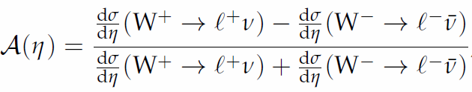
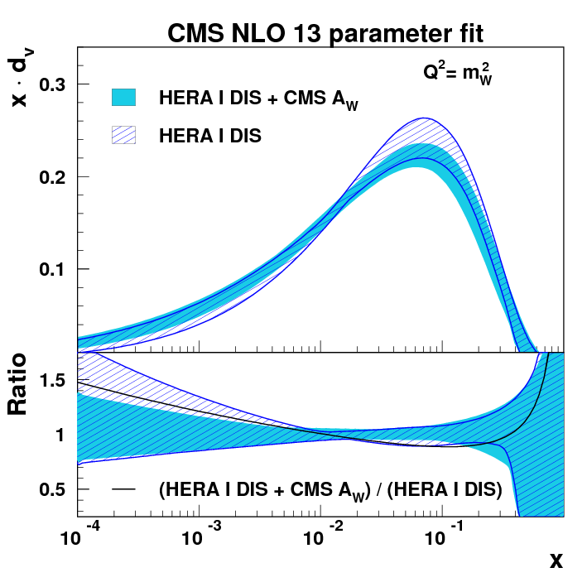
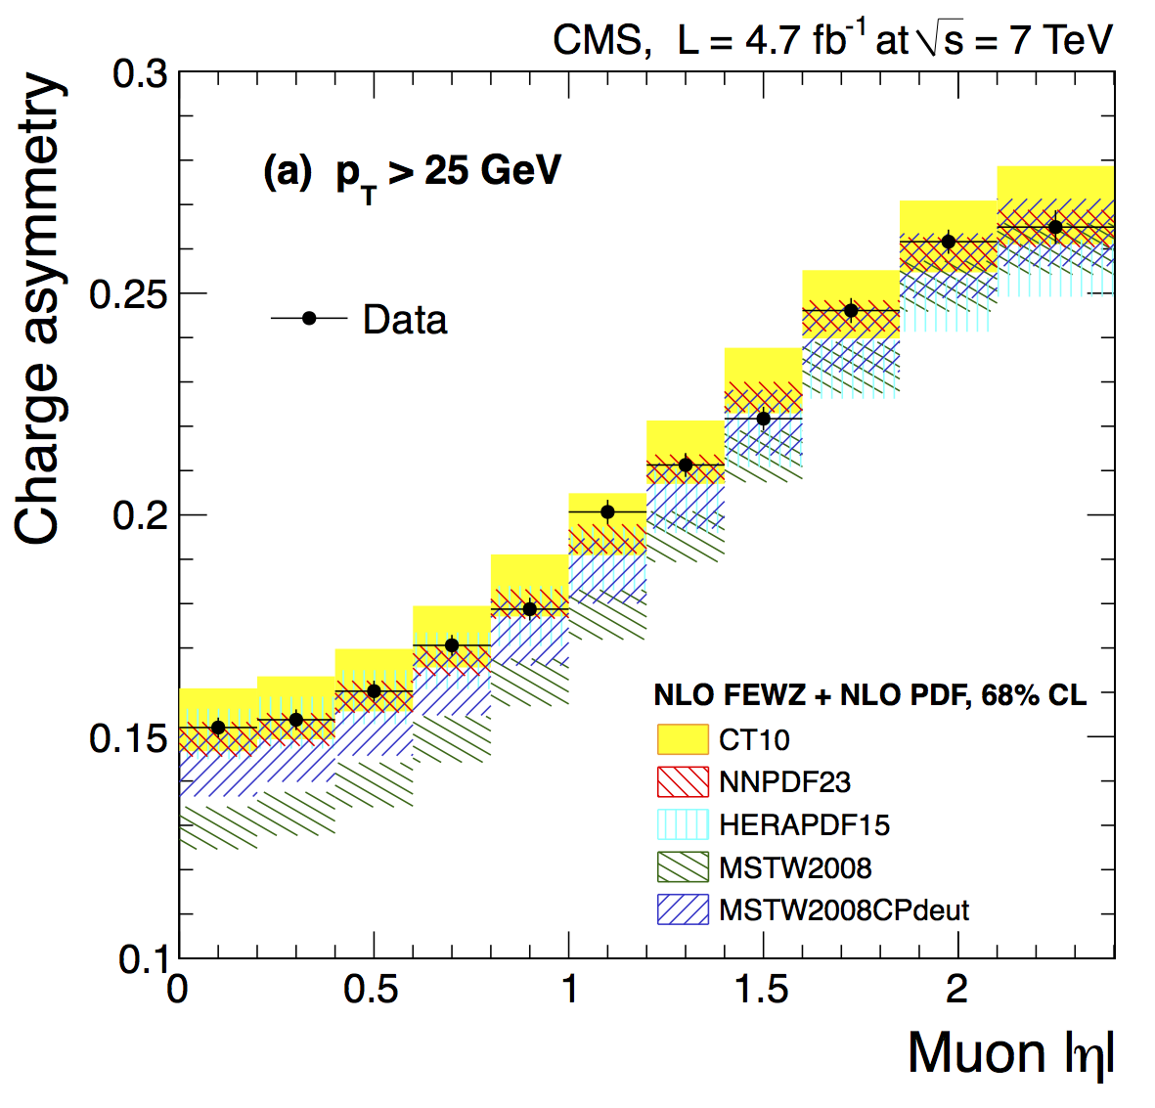
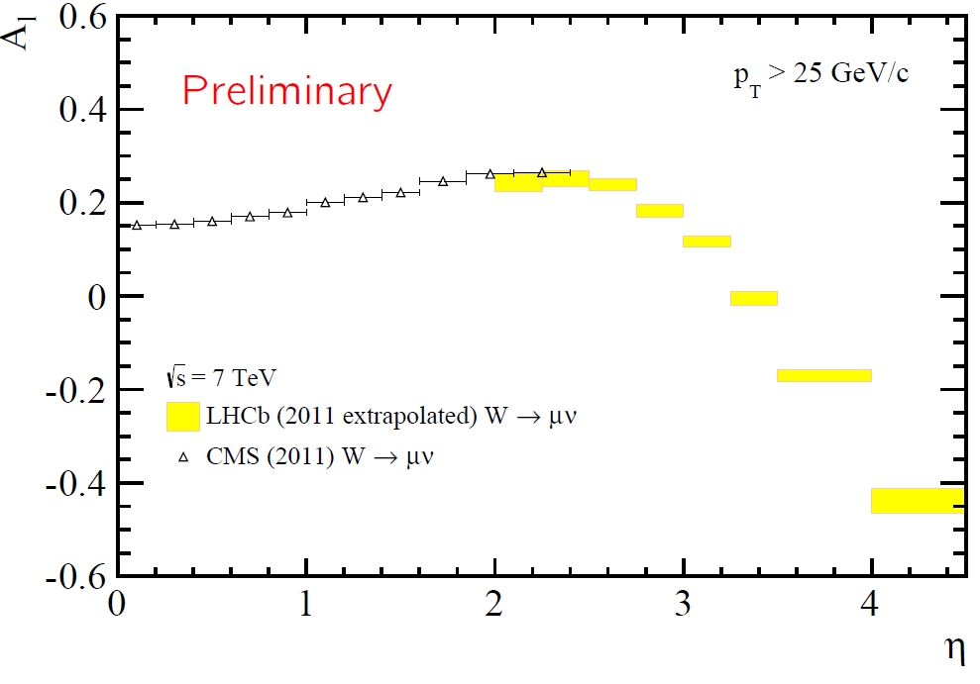
W charge asymmetry
PRD90(2014)032004
At 7 TeV, ~4×10⁶ W→μν candidates produced per fb⁻¹
Differential W charge asymmetry precisely probes u/d ratio vs. x
Asymmetry measured to 0.1% absolute per bin
Constrains all PDF families

Slide 4
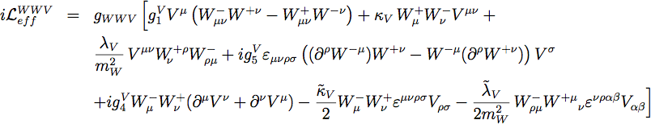
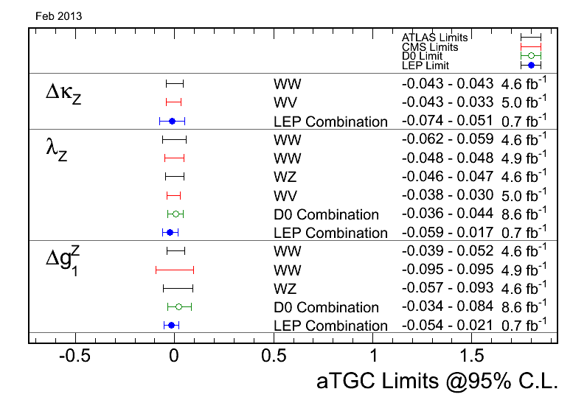
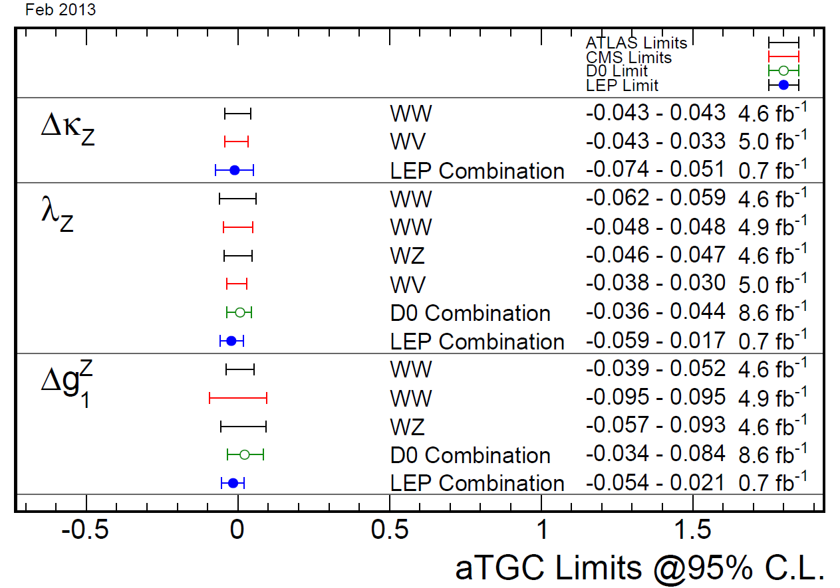
Charged aTGCs: World Summary
Best single LHC 7 TeV measurements equal LEP2 or Tevatron combinations
Semileptonic WW gives
the best information on
κ and λ, leptonic WW and WZ better for g.
LHC 8 TeV will provide 2-3× better constraints, eclipsing LEP2
ZZγ, Zγγ
WWZ

Slide 5
Heavy flavor physics
Includes search for new
physics in rare decays

Slide 6
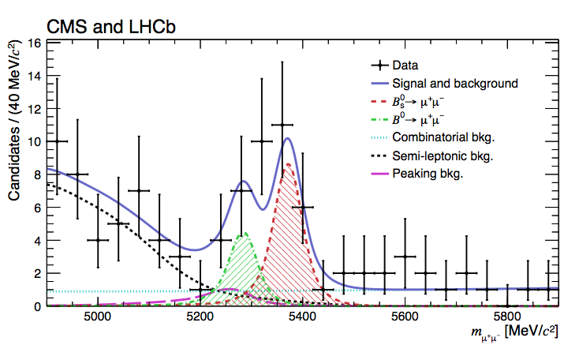
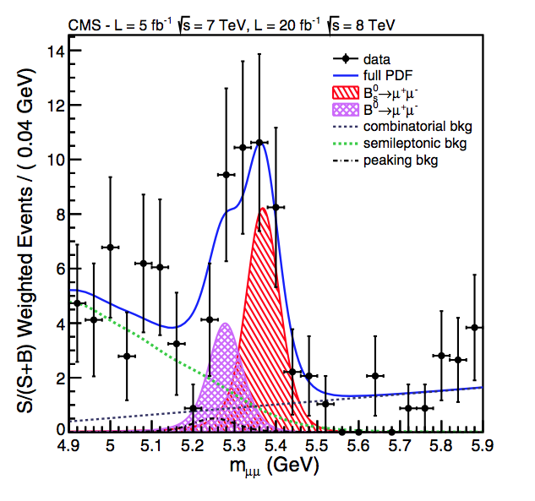
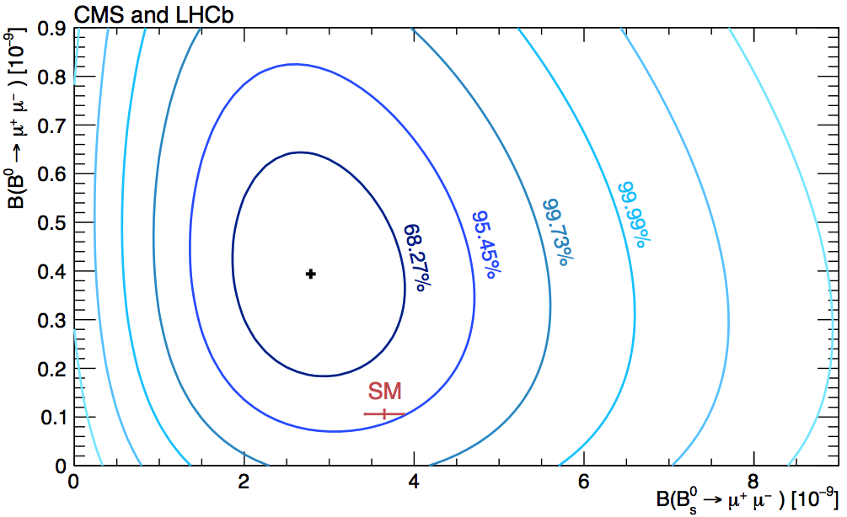
B⁰_{s/d}→μ⁺μ⁻
CMS PAS BPH-13-007 & LHCb-CONF-2013-012
PRL111(2013)101804 → Nature!
Stringent test of new physics in penguin diagrams
Challenging analysis, all muon information exploited by a BDT used to separate genuine muons from misidentified charged hadrons
Final combination with LHCb performed using fill combined fit
6.2σ for the B⁰_{s}→μ⁺μ– (exp. SM 7.6σ); 4.3σ CMS alone
  First observation
3.2σ for the B⁰_{d}→μ⁺μ– (exp. SM 0.8σ)

Slide 7
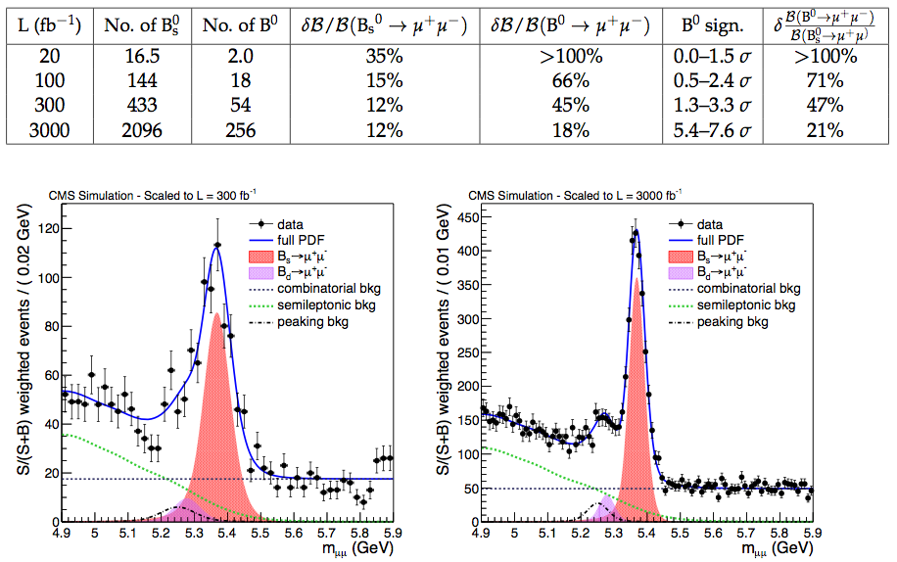
B⁰_{s/d}→μ⁺μ⁻: prospects for run II and beyond
CMS PAS FTR-13-022
Assuming SM BR and planned detector upgrades
  Hi-Lumi: improve inner tracking granularity and muon detector coverage
today
~2018
~2021
~2023

Slide 8
Top-quark physics
Stop hints may arrive from
the first top measurements

Slide 9
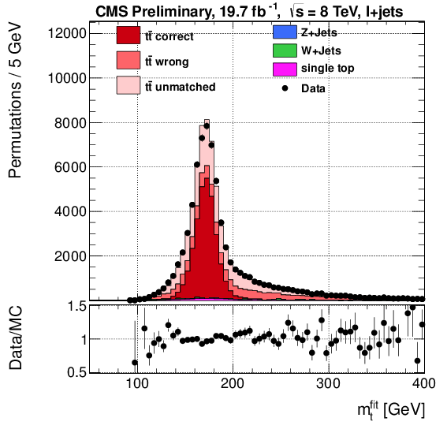
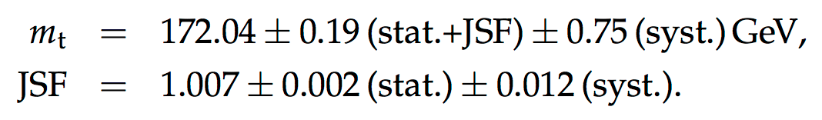
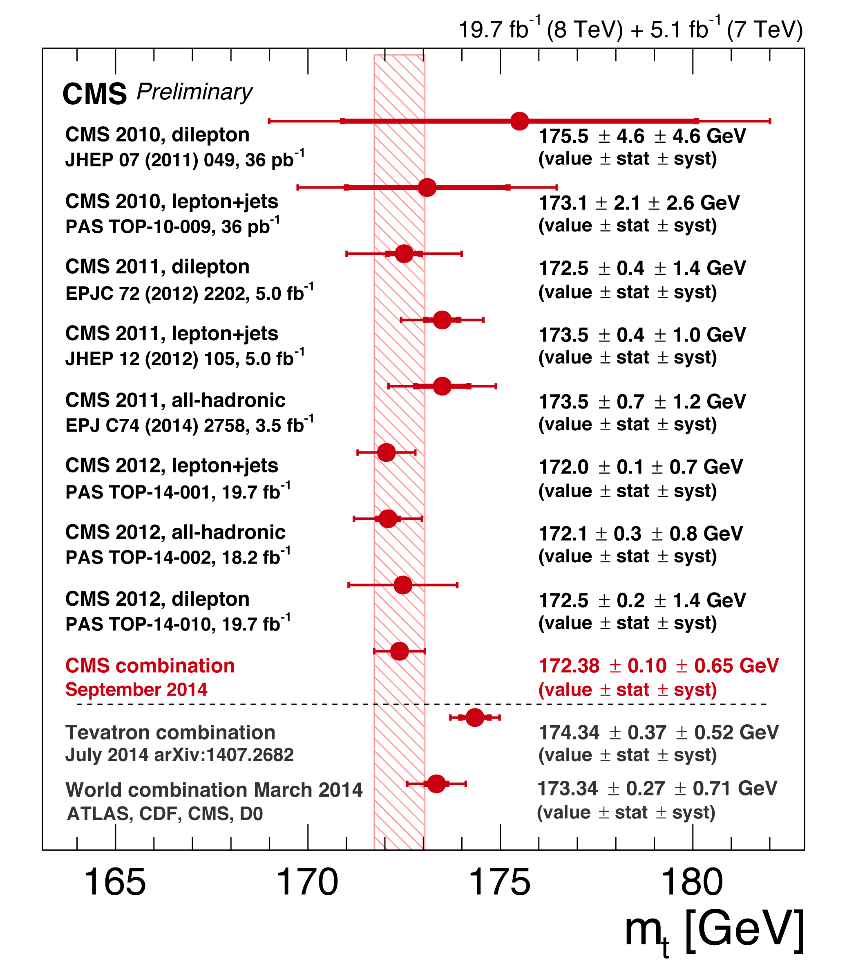
Top-quark mass m_{t}
CMS PAS TOP-14-001
CMS PAS TOP-14-015
Recently improved CMS improved the top-mass measurement from l + jets:
  Reached ultimate Tevatron precision, Most precise measurement by D0:
  m_{t} = 174.98 ± 0.76 GeV
  (arXiv:1405.1756, l+jets)
LHC and world combination to be updated
ALTAS measured m_{t} in single top:
m_{t} =172.2 ± 0.7(stat.) ± 2.0(syst.)GeV
(ATLAS-CONF-2014-055)

Slide 10
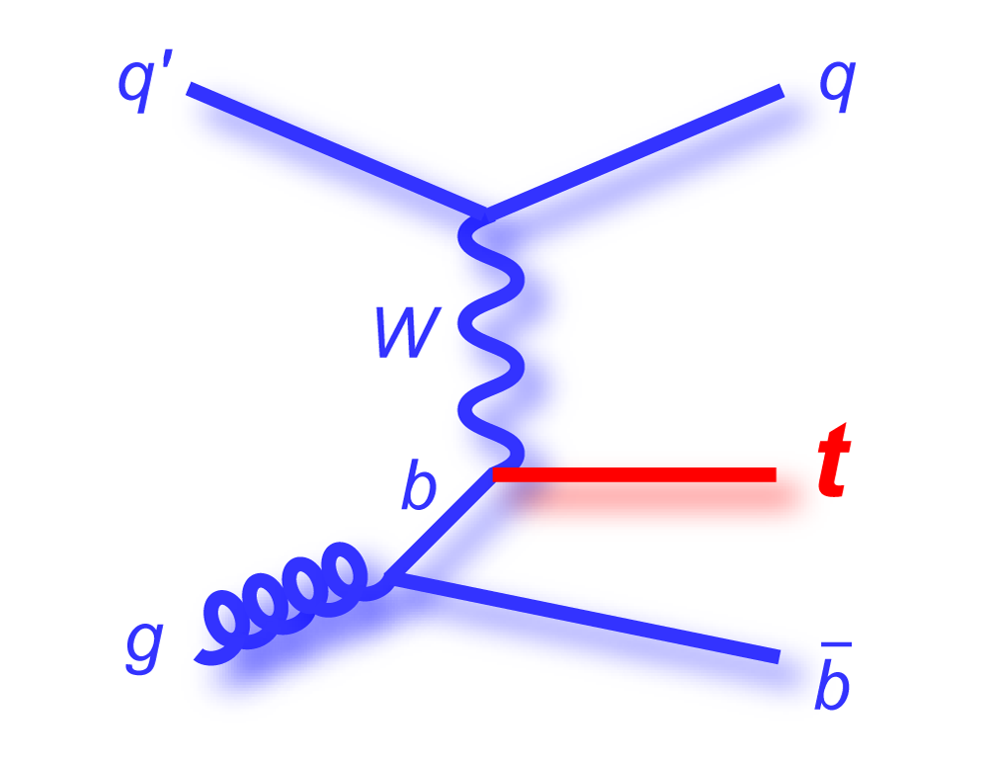
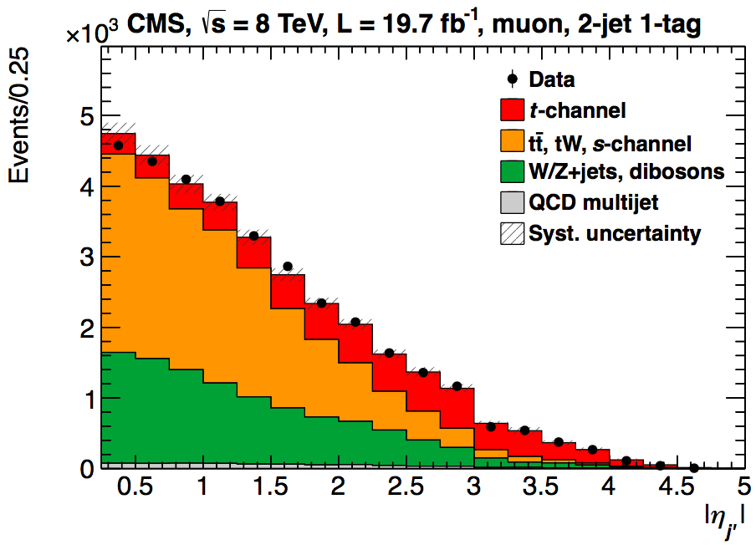
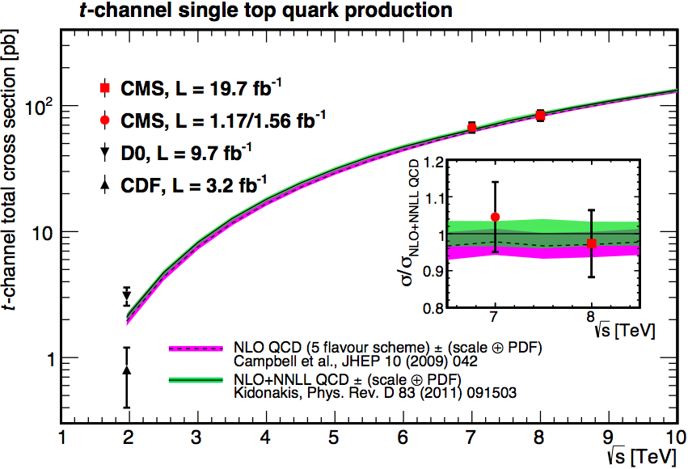
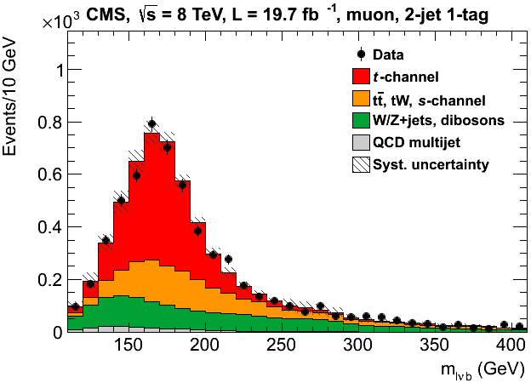
Single top, t channel
Signal region: one e or μ, 2jets-1tag events
Signal, W+jets, tt^{ˉ} yields determined from a fit to the |η_{j’}| distribution
Shapes for W+jets and tt^{ˉ} are determined from control regions in data
  σ_{t-ch.} = 83.6 ± 2.3(stat) ± 7.4(syst) pb
  R_{8/7} = 1.24 ± 0.08(stat) ± 0.12(syst)
Largest uncertainty: signal modeling (POWHEG vs COMPHEP), jet energy scale
LHC Combination: (TOPLHCWG, using BLUE), using preliminary result (CMS PAS TOP-12-011, ATLAS-CONF-2012-132) :
  σ_{t-ch.} = 85 ± 4(stat) ± 11(syst) ± 3(lumi) pb
  = 85 ± 12 pb
To be updated with latest results!
JHEP06(2014)090
CMS PAS TOP-12-002/ATLAS-COM-CONF-2013-061
|η_{j’}| >2.5

Slide 11
t-channel: distributions
The t-channel data sample is large enough to study distributions
  → differential cross sections
Signal can be enhanced by requiring e.g.: large forward jet pseudorapidity: |ηj’| > 2.0
lepton charge
cosθ*_{l}[†]
Top/antitop σ ratio,
JHEP06(2014)090
  Top polarization, CMS-PAS-TOP-13-001
W helicity, CMS PAS TOP-12-020
  R_{t} = σ_{t}(t)/σ_{t}(tˉ) =
  1.95 ± 0.10(stat) ± 0.19(syst)
P_{l} = 0.82 ± 0.12(stat) ± 0.32(syst)
[†]θ*_{l} = angle between lepton in W rest frame and the W in top rest frame.

Slide 12
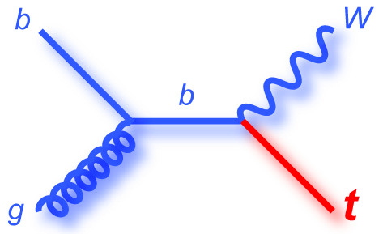
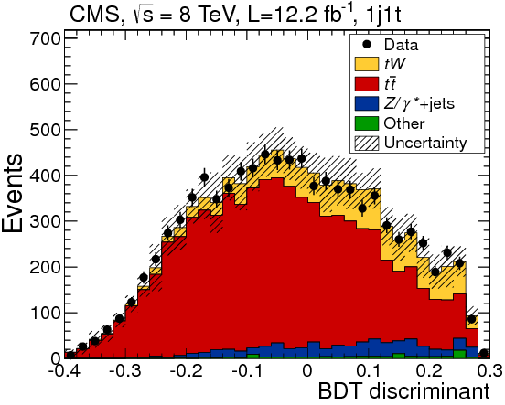
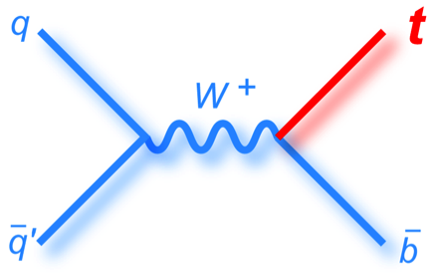
tW, s-ch. production
7 TeV: Phys.Rev.Lett 110, 022003 (2013)
8 TeV: Phys. Rev. Lett. 112 (2014) 231802
tW, 8TeV (12.2fb⁻¹):
σ_{tW} = 23.4^{+5.5}_{-5.4} pb
6.1σ obs. (5.4^{+1.5}_{-1.4}σ exp.)
Main systematics: ME/PS matching, ren./fact. scale
s-ch.: 8 TeV upper limit:
σ_{s-ch.} < 11.5 pb = 2.1×σSM, 95%CL
Assuming SM signal:
σ_{s-ch.} = 6.2^{+8.0}_{-5.1} pb (68% FC int.)
  BDT analysis, sensitivity still limited (0.9σ exp, 0.7σ obs), mainly by theory systematics
CMS-PAS-TOP-13-009

Slide 13
Single top cross sect. summary
All measurements are in agreement with the most precise theory predictions
arXiv:1410.1154 → JHEP
JHEP 06 (2014) 090
PRL 112 (2014) 231802
JHEP 12 (2012) 035
PRL 110 (2013) 022003
CMS PAS TOP-14-009
CMS PAS TOP-12-002

Slide 14
Higgs boson
Longer-term program
in order to achieve the
best precision

Slide 15
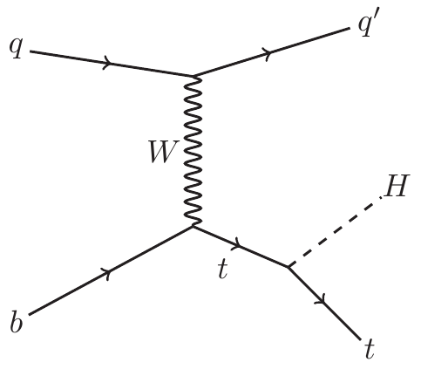
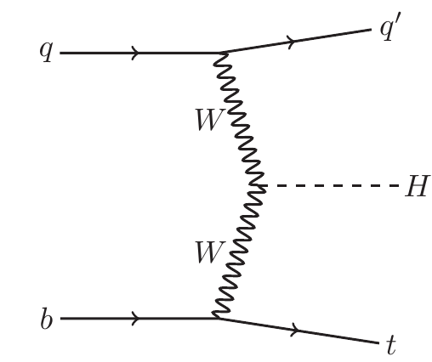
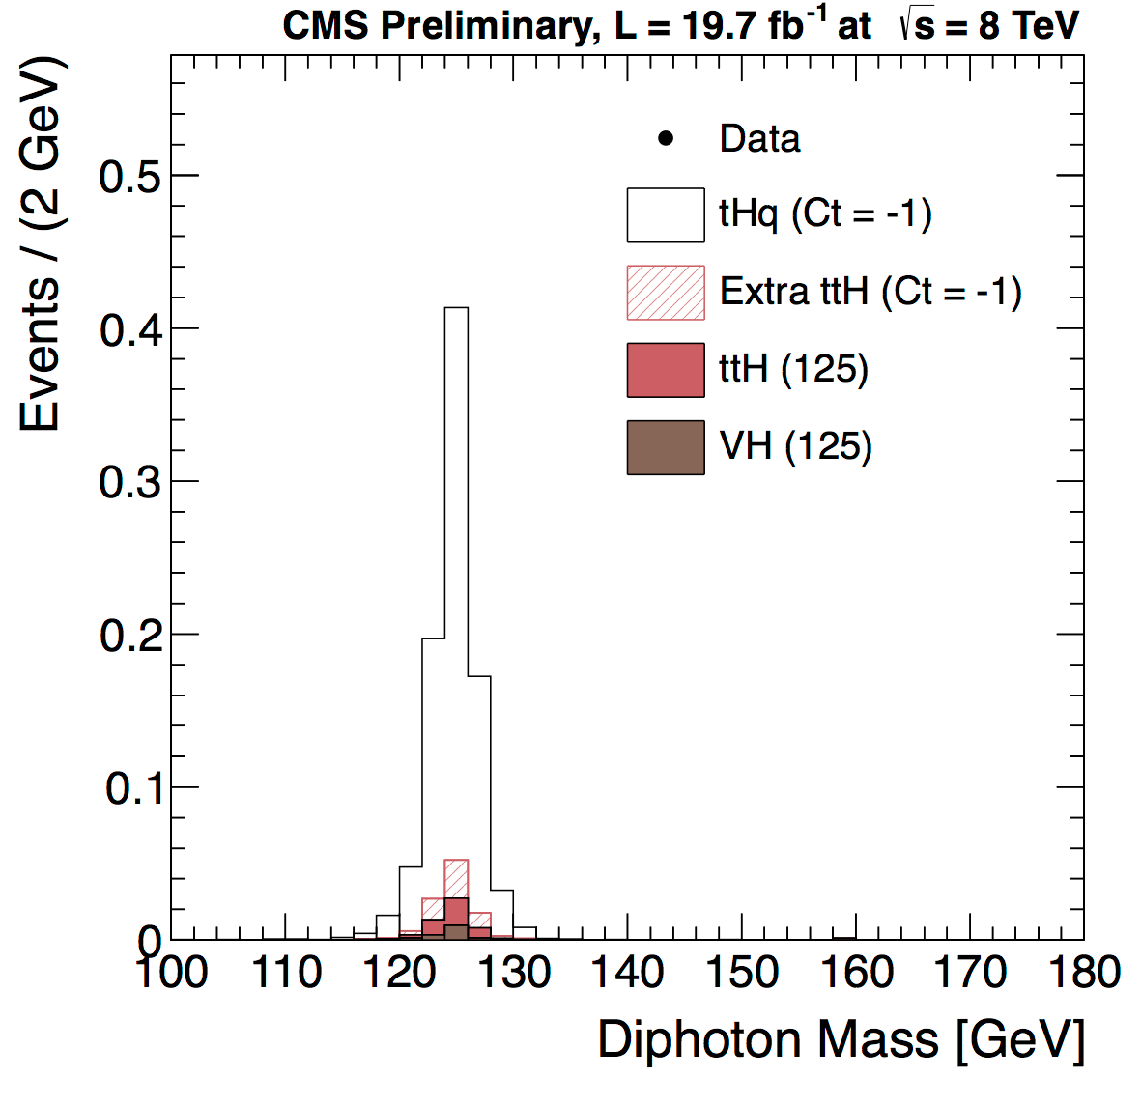
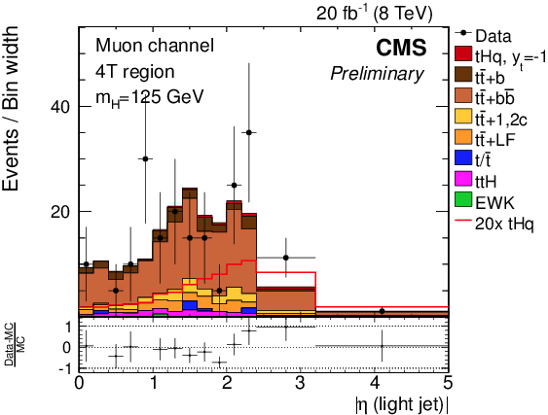
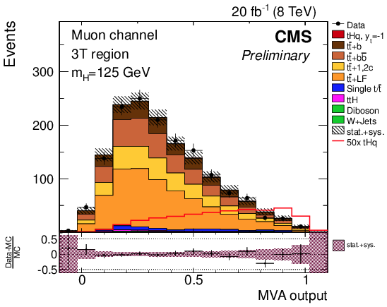
Search for tHq
CMS PAS HIG-14-015
Main interest with present luminosity: probe Higgs anomalous coupling to top quark (y_{t} = −1), due to interference of ttH and WWH diagrams
H→bb recently approved, γγ in march
Limits reached
  σ(tHq, H→bb) < 7.6×σ(y_{t}=−1), 5.1 exp., 95%CLs
  σ(tHq, H→γγ) < 4.1×σ(y_{t}=−1), 4.1 exp., 95%CLs

Slide 16
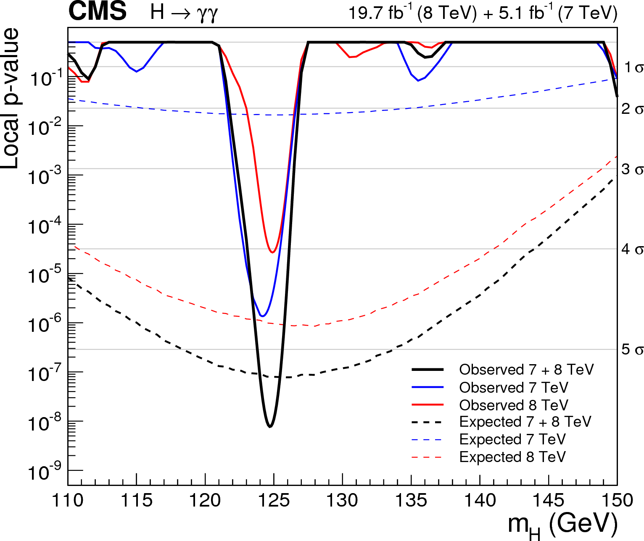
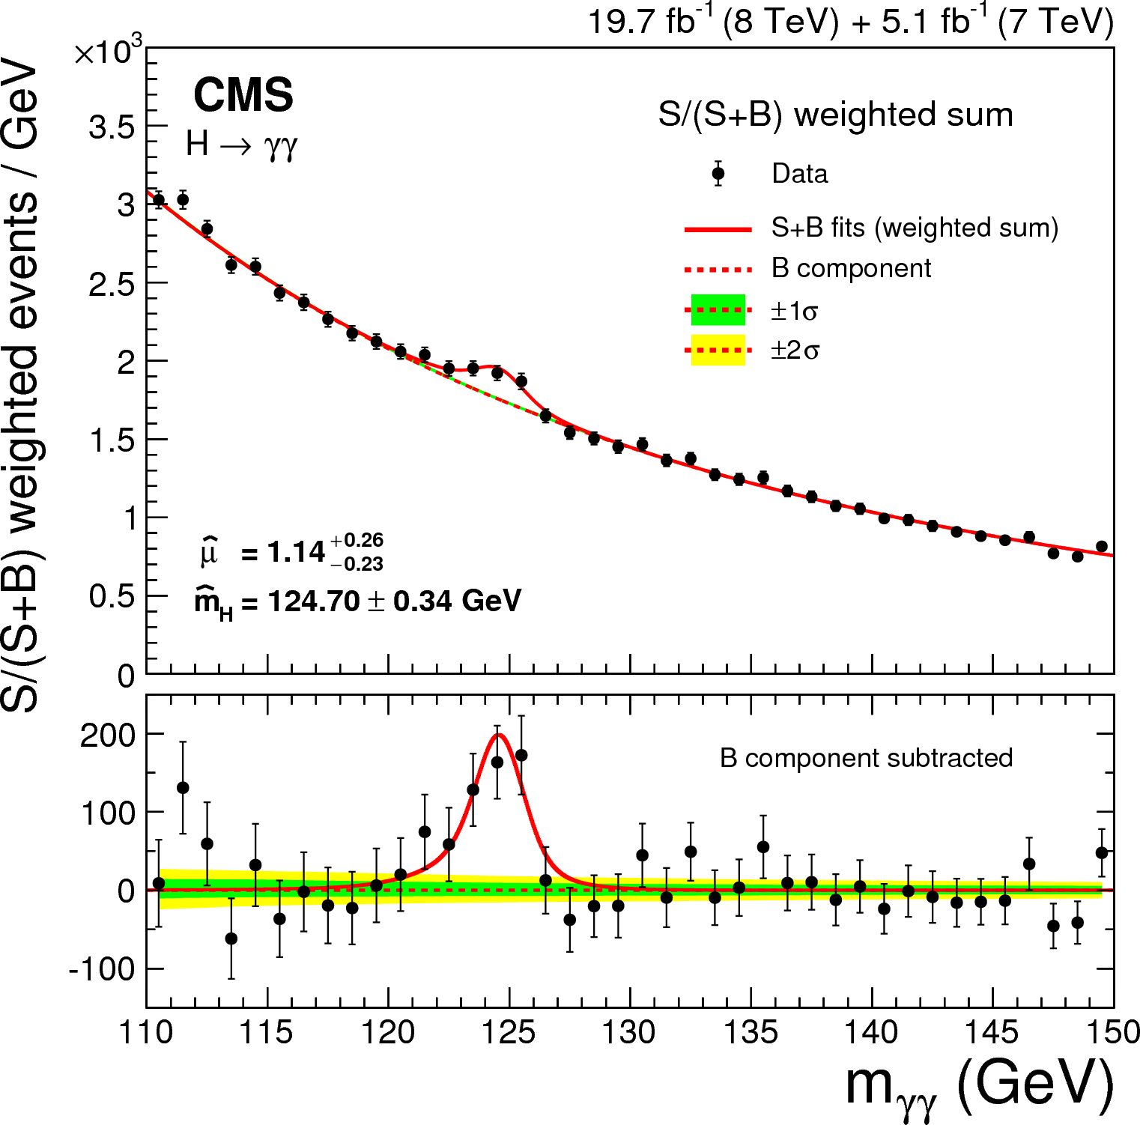
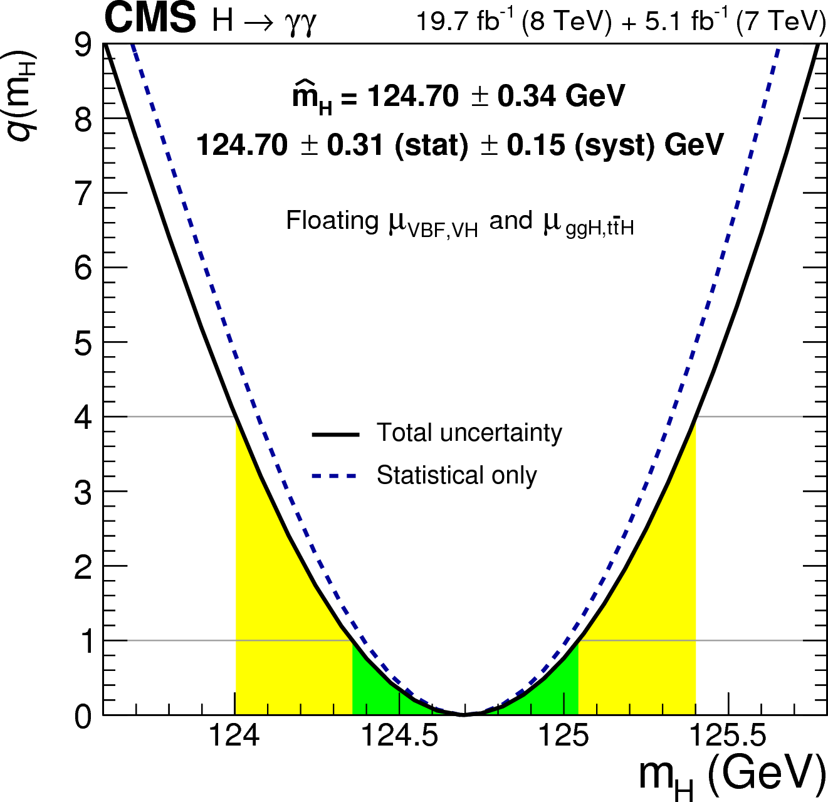
H → γγ
EPJC74(2014)3076
New analysis of the entire data sample
  5.7σ obs. (5.2σexp.)
Updated Higgs mass measurement in γγ:
Combined with ZZ*:
best individual Higgs-mass measurement, and the best single-experiment combination

Slide 17
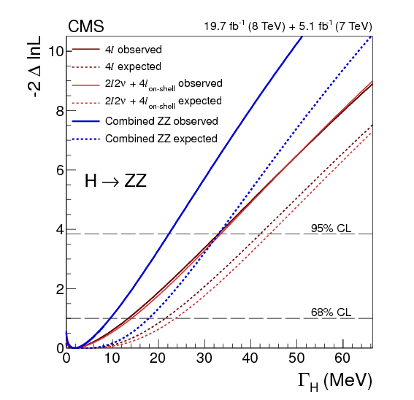
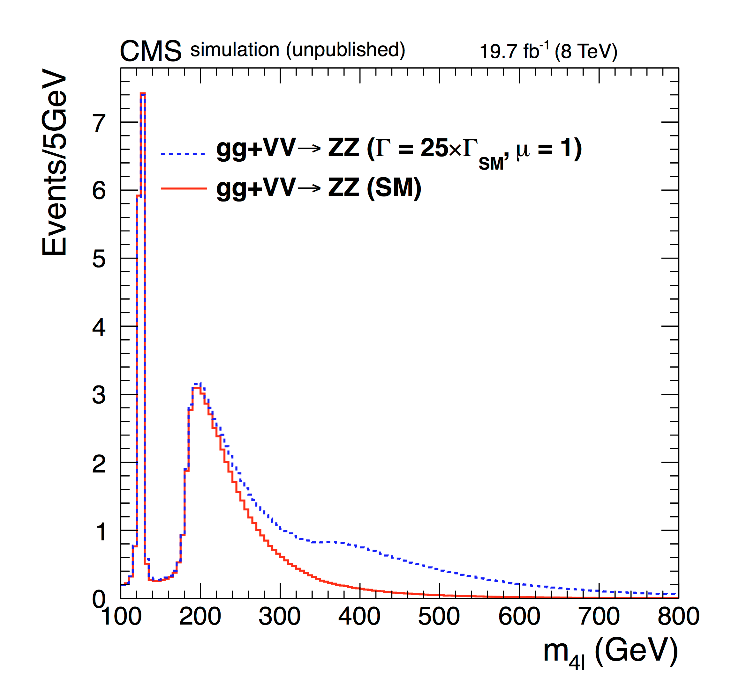
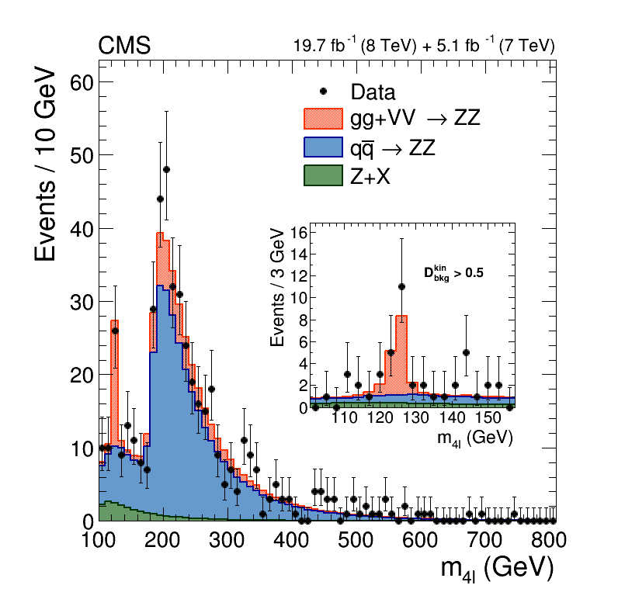
Higgs boson width
ZZ→4l (2D: m4l, gg vs qq discr.), ZZ→2l2ν (jet-incl. m_{T} shape)
Γ/Γ_{SM} < 8.0 (10.1) 4l, <8.1(106) 2l2ν
Γ/Γ_{SM} < 5.4 (8.0) combined
(Γ_{SM} = 4.15 MeV @ m_{H} = 125.6 GeV)
PLB 736 (2014) 64

Slide 18
Physics Beyond the
Standard Model
Will be the mayor
focus of the first 2015 data
→ Dedicated session on Wednesday

Slide 19
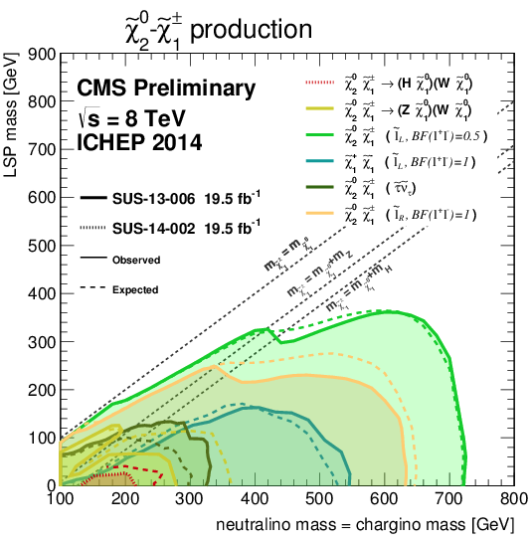
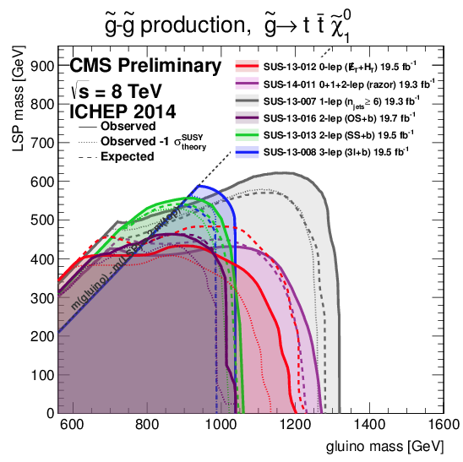
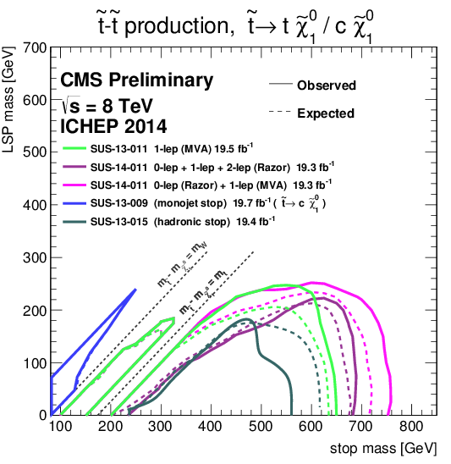
Supersymmetry
No hint in all explored channels
Will be the main player of run II at higher energy

Slide 20
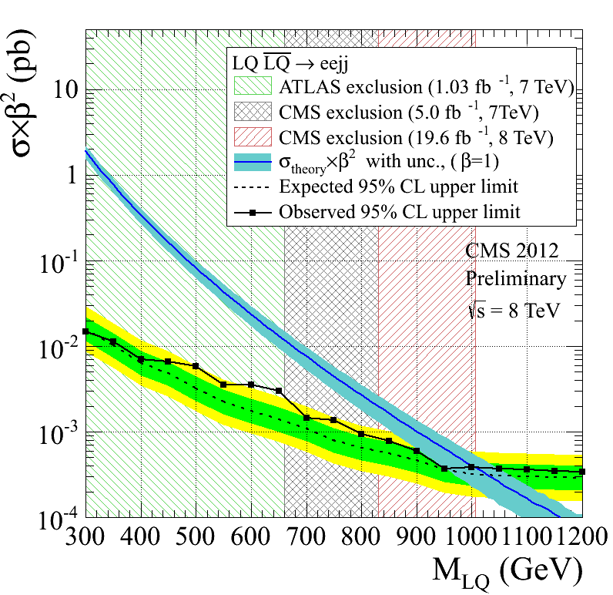
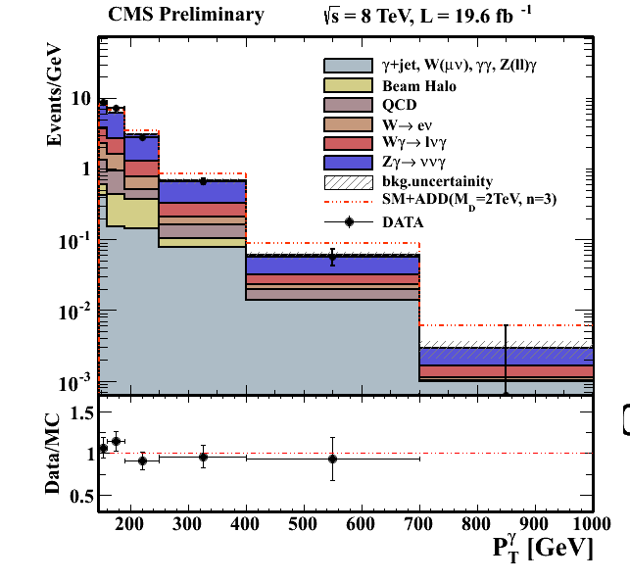
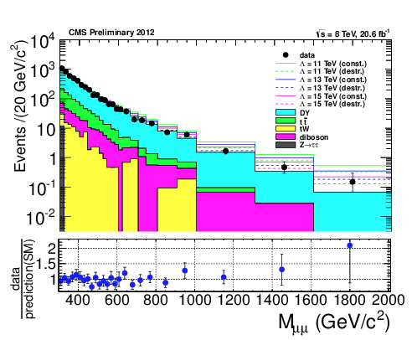
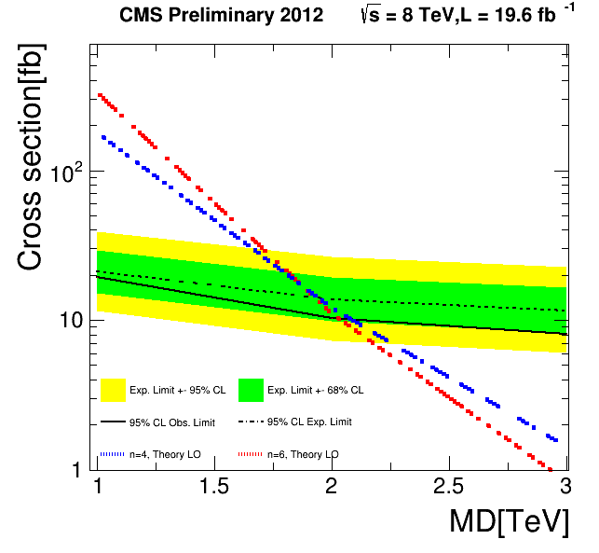
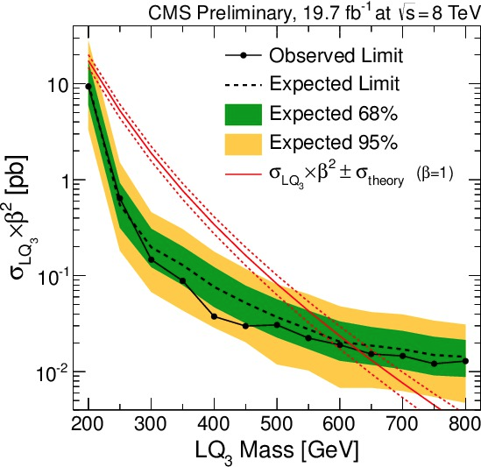
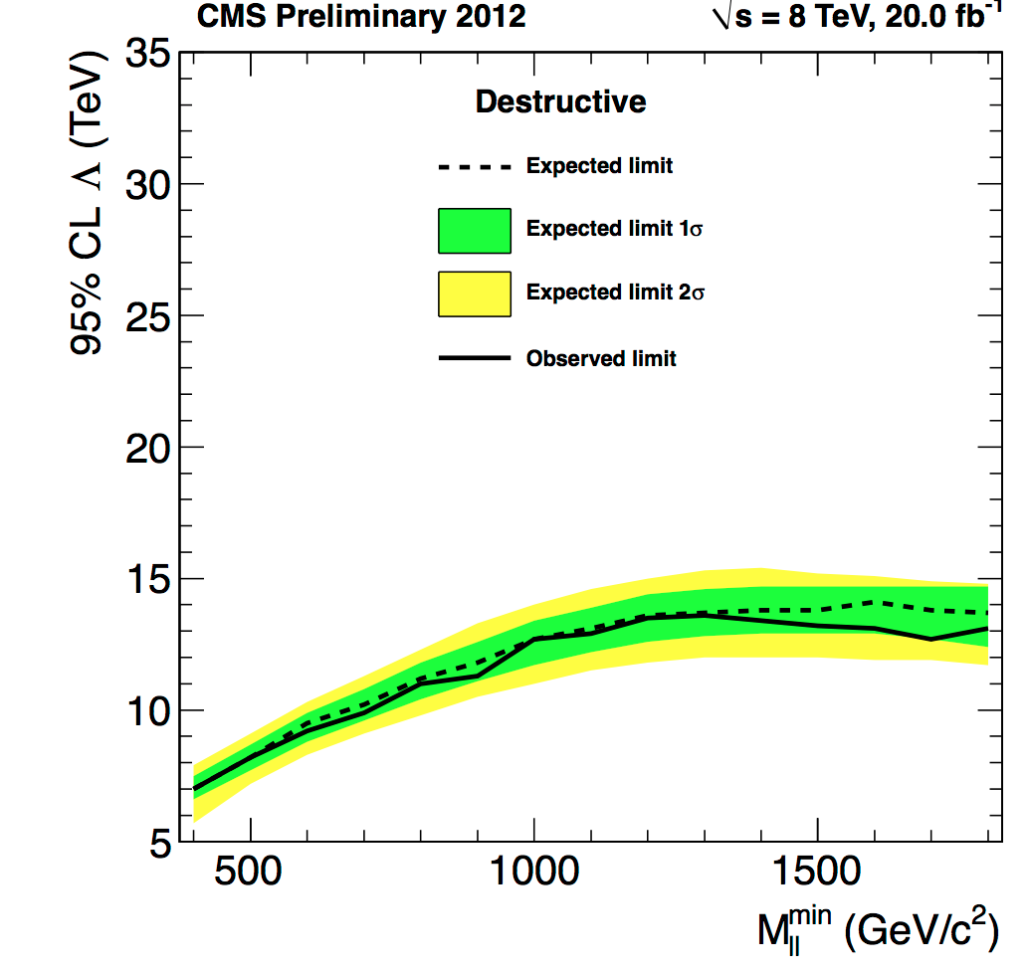
Latest results on exotic searches
EXO-12-041, 13-010
1st & 3rd gen. scalar Lepto-Quark
EXO-12-047
Dark Matter &Large Extra Dim in γ+ME_{T}
EXO-12-020
Contact int. in ll
destr. interf.

Slide 21
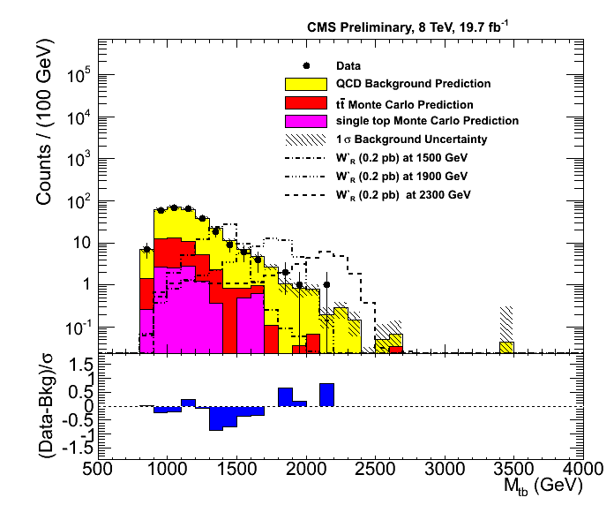
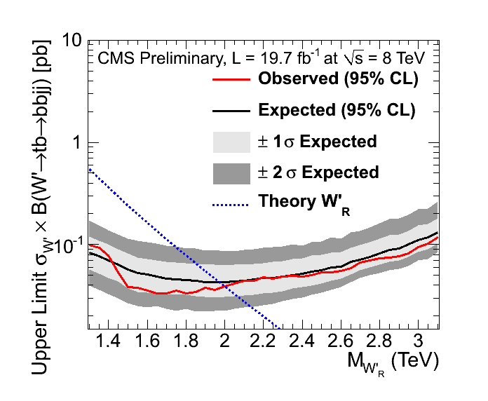
New physics with top quark
Boosted topologies (t, W, Z, H, …) will be more and more important at 13-14 TeV
B2G-12-009: W’ →tb (boosted)

Slide 22
Summary
Top quark
Higgs
W and Z

Slide 23
Naples main contributions
Top-quark physics: O. Dogangun, F. Fabozzi, O. Iorio (single-top convener) L. Lista (TOPLHCWG CMS single-top), M. Merola
Higgs properties: S. Meola
Dark matter search (associated top production): O. Iorio, L. Lista
Physics performance and datasets: F. Fabozzi (physics-validation convener)
Students (laurea triennale): A. De Iorio, S. Fusco, C. Giugliano, L. Vigilante

Slide 24
Conclusions
Fantastic results achieved with present dataset ranging from precision physics, Higgs boson post-discovery measurements, to extensive range of searches for new physics
Getting ready for run II, where an unexplored landscape will be disclosed, and possibly new physics signals will show up

