Slide 1
CMS Muon detector from LHC to HL-LHC
Pigi Paolucci
INFN Napoli

Slide 2
Gruppo di Napoli
S. Buontempo (DR)
N. Cavallo (PO)
F. Fabozzi (PA)
O. Iorio (AR)
L. Lista (PR)
S. Meola (PA)
M. Merola (AR)
P. Paolucci (PR)
F. Tyssen (Post-doc)
Project Manager (Pigi)
Technical Coordinator (Salvatore)
Rapr. Nazionale della fisica (Luca)
Single Top Convener (Orso)
Attività Hardware
Sistema presente
Rivelatori ad RPC
DAQ – realizzato a Napoli
Software Trigger/DAQ
Sistema di potenza
Upgrade Phase II
Rivelatori iRPC: bakelite
Rivelatori iRPC: design
Meccanica GEM/RPC
Sistema di potenza
GIF++ construction
L. Parascandolo
A. Vanzanella
F. Cassese
L. Roscilli
G. Passeggio
Servizi

Slide 3
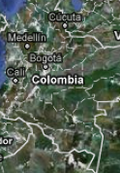
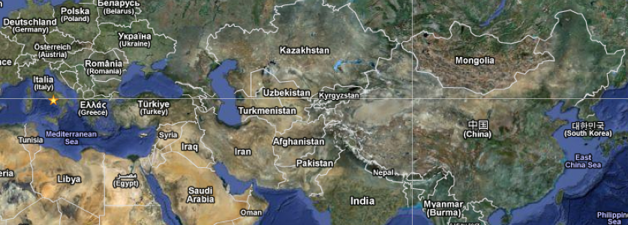
RPC project
Authors
CHINA | 2
KOREA | 16
INDIA | 4
BELGIUM | 10
COLOMBIA | 2
N. Puebla | 3
PAKISTAN | 6
EGYPT | 3
CERN | 4
ITALY | 28
BULGARIA | 12
Georgia | 2
TOTAL | 90
Nueva
Puebla
RE4 | Italy | Pakistan | India | Colombia | CERN
 | Korea | China | Belgium | Finland | Egypt
 | Mexico |  | Georgia
R&D phase II | Italy, CERN, Korea, Belgium, Pakistan, Mexico |  | Georgia Egypt | Colombia India
Uniandes
Belgium
Georgia
CERN
Bulgaria
Italy
Notes:
Very good control of the dominant ZZ background
Cntrolla sia ultimo plot …

Slide 4
Organization Chart 2014
Conference Committee
B. Pavlov
Institution Board
L. Litov
Editorial board
S. Qian, D. Piccolo,
M. Abbrescia
Project Manager
P. Paolucci
G. Pugliese – M. Tytgat
Steering committee
W. Van Doninck, M. Maggi
H. Hoorani, A. Colaleo,
A. Sharma
(PM+DPM+RC+TC+DPG+UP)
Resource manager H. Hoorani
DPG
A. Ocampo
P. Verwilligen
Run Coordinator
M. Maggi
A. Cimmino
Technical Coordination
S. Buontempo
A.Dimitrov
Upgrade
Coordinator
M. Abbrescia
A. Sharma

Slide 5
Attività 2013-2014 Manutenzione

Slide 6
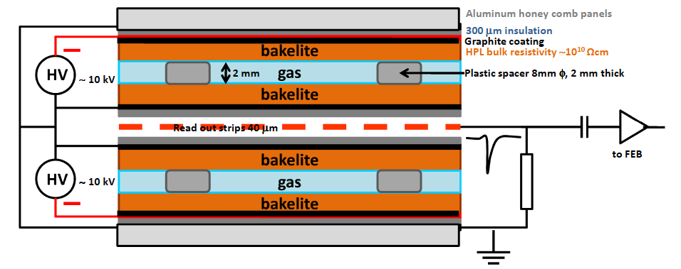
RPC present system
CMS muon upgrade
Completion of the 4th station in 2013-14:
144 chambers
RPC present system
Covers 0 < |η | < 1.6
1056 chambers
110,000 electronic channels and 3500 m² of active area
Double gaps gas chamber: 2 mm gas width
Bakelite bulk resistivity: ρ = 2 - 5 x 10¹⁰ Ωcm
Strip width: 1 − 4 cm.
Gas mixture: C₂H₂F₄ + isoC₄H₁₀ + SF₆ (40% of H)
95.2% 4.5% 0.3%
Operated in avalanche mode

Slide 7
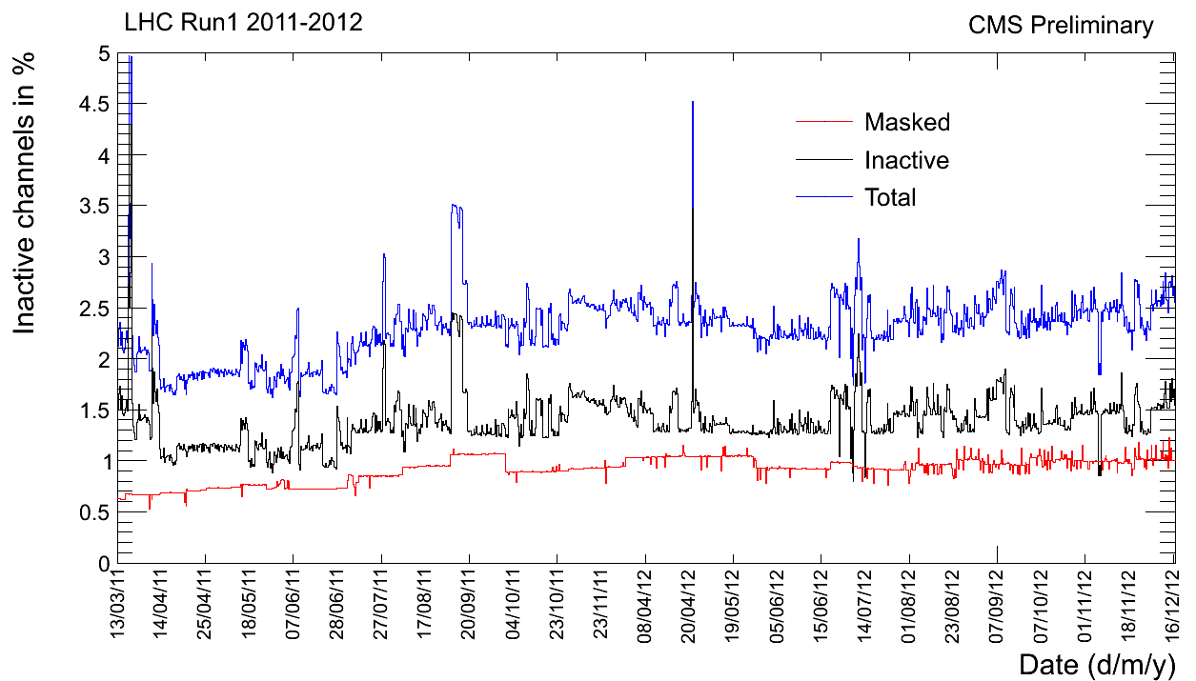
2013-2014 actvities
RPC Maintenance 2013-2014
Power system
DAQ
Front-end
Gas leak
Fully recovered now
Area 4000 m²
8.000 m² di gap
18.540 Gas connections
840 HV channels
20 km HV cable
8.000 HV connectors
120.000 strips
6.448 front-end boards
934 Distribution boards
2011
2012

Slide 10
Attività 2013-2014 Upgrade RE4

Slide 11
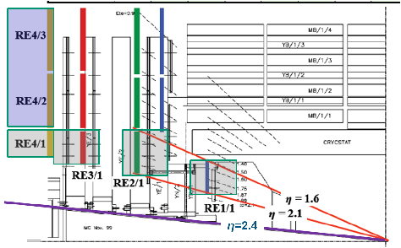
Muon system

Slide 12
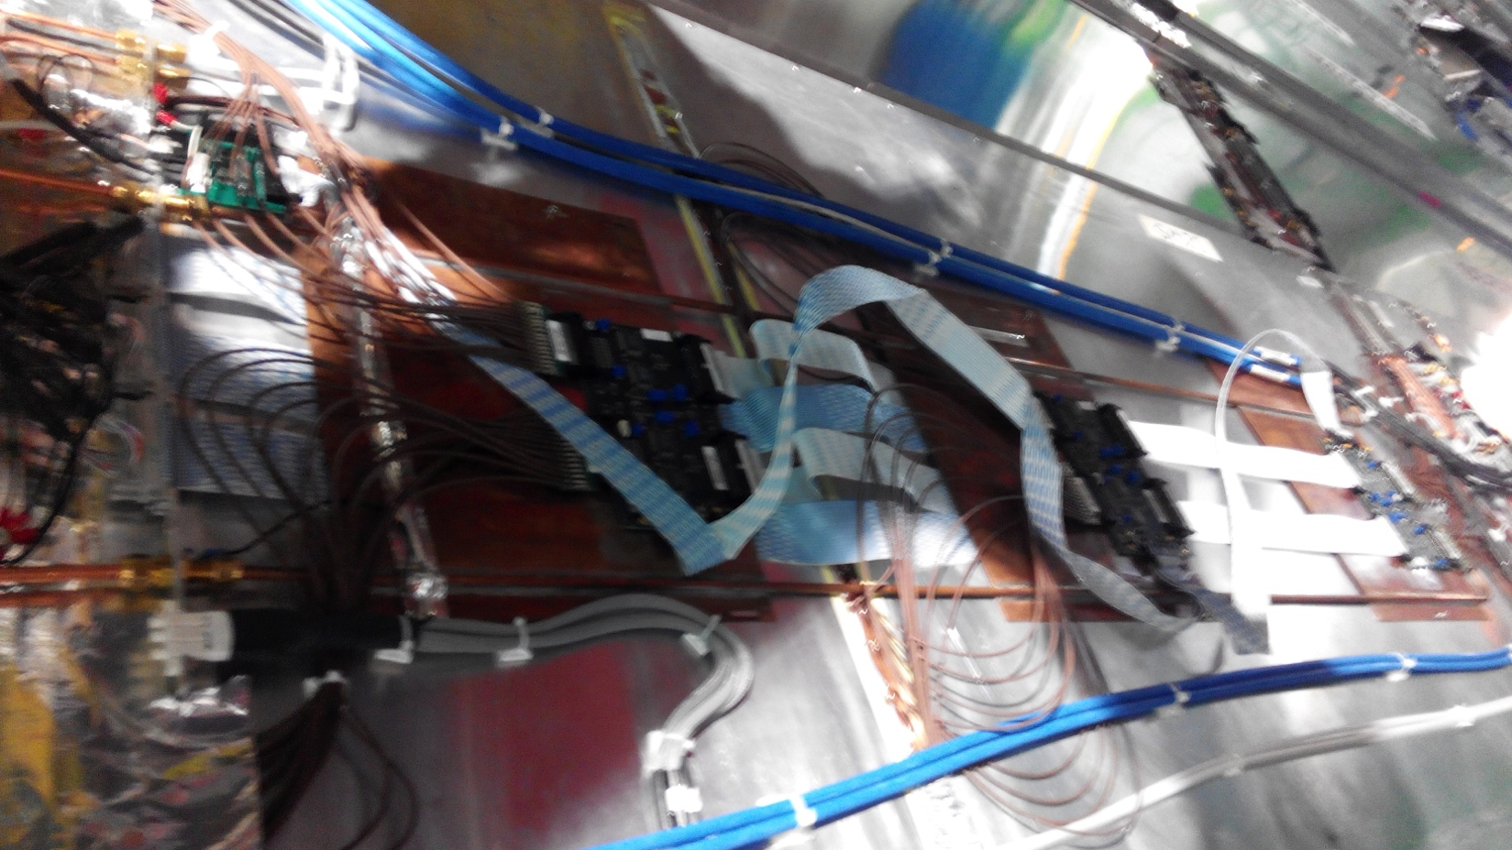
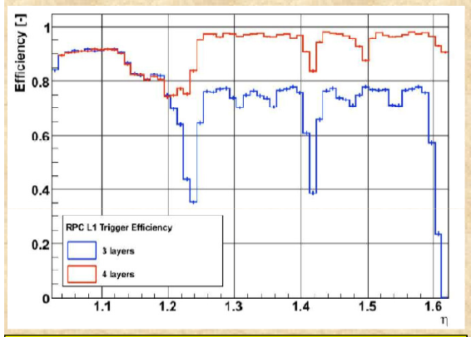
Upgrade phase I - RE4
RE4 installation 2013-2014
144 new chambers
DAQ-Trigger
Commissioning
4.2 millions CHF
20 institutions
100 people

Slide 14
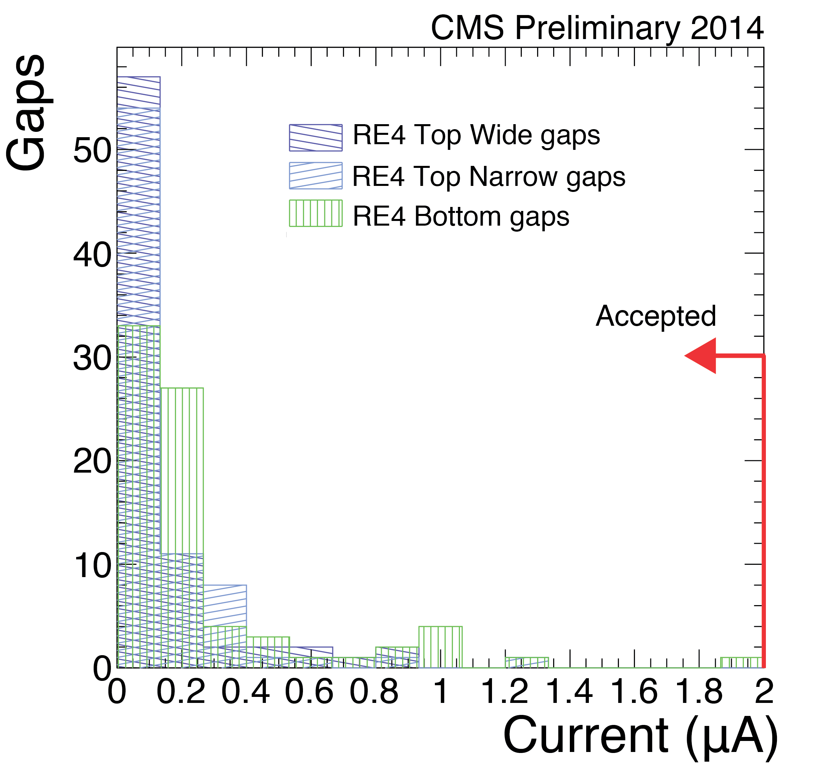
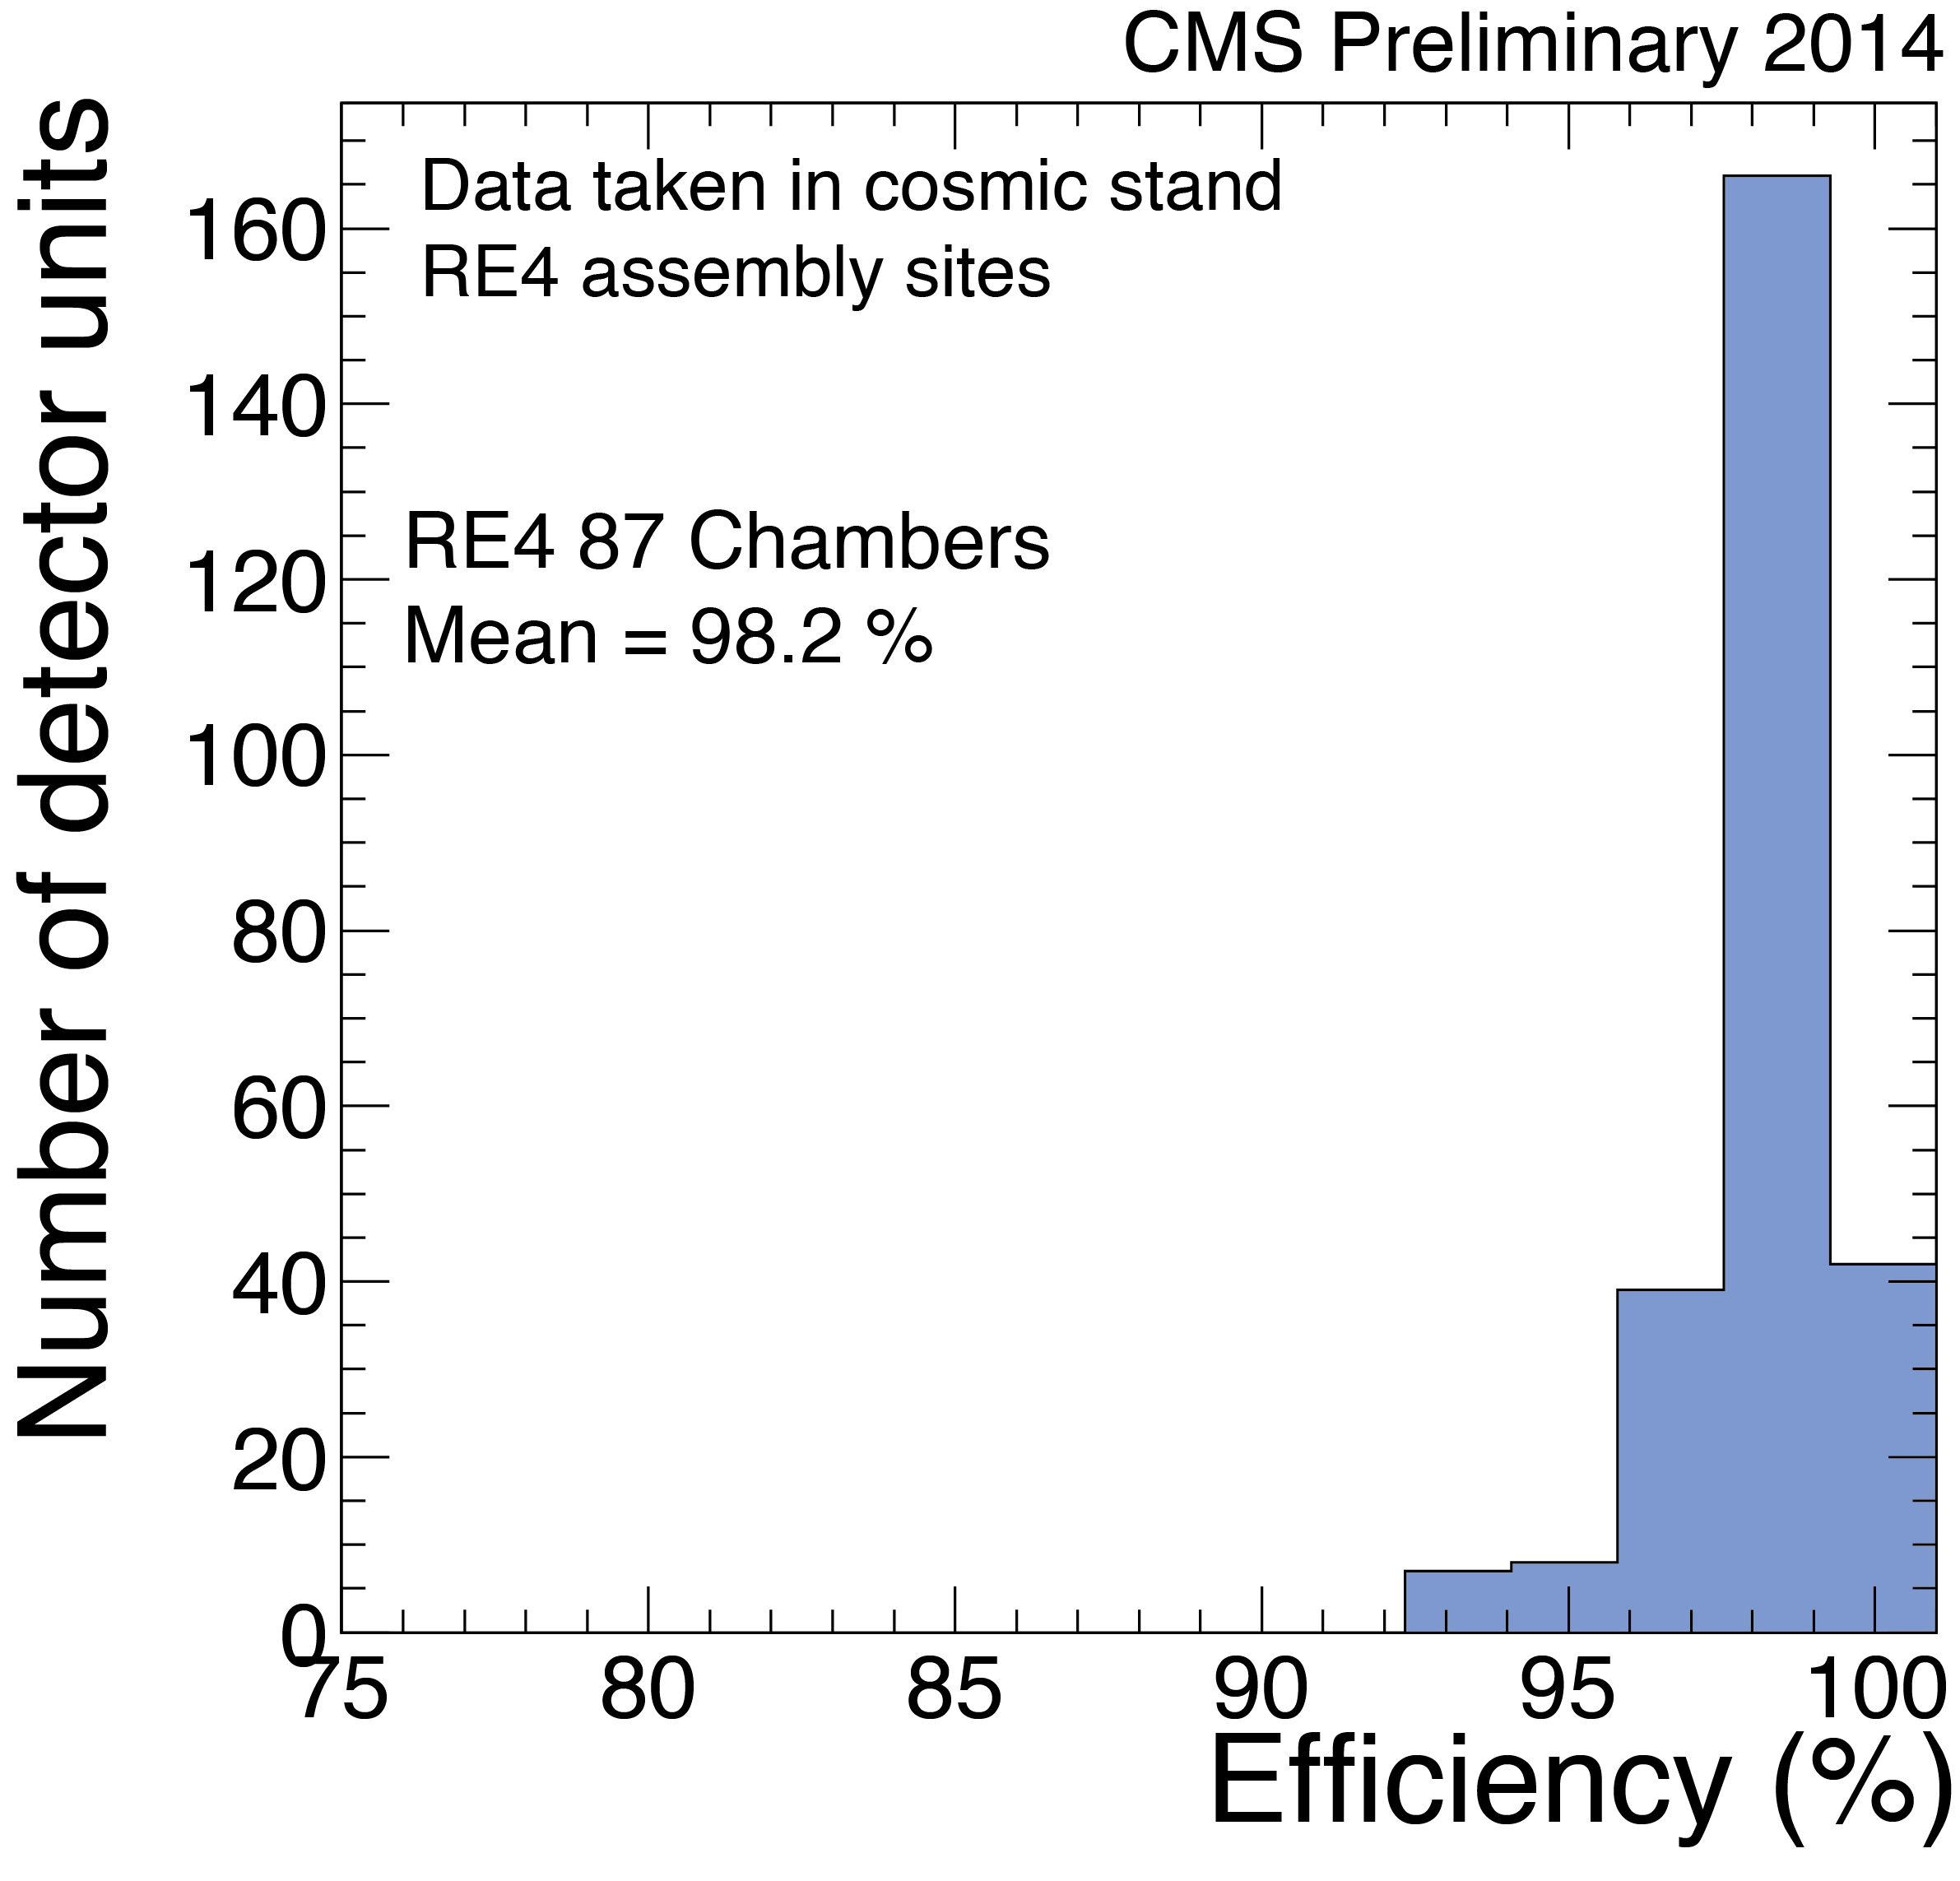
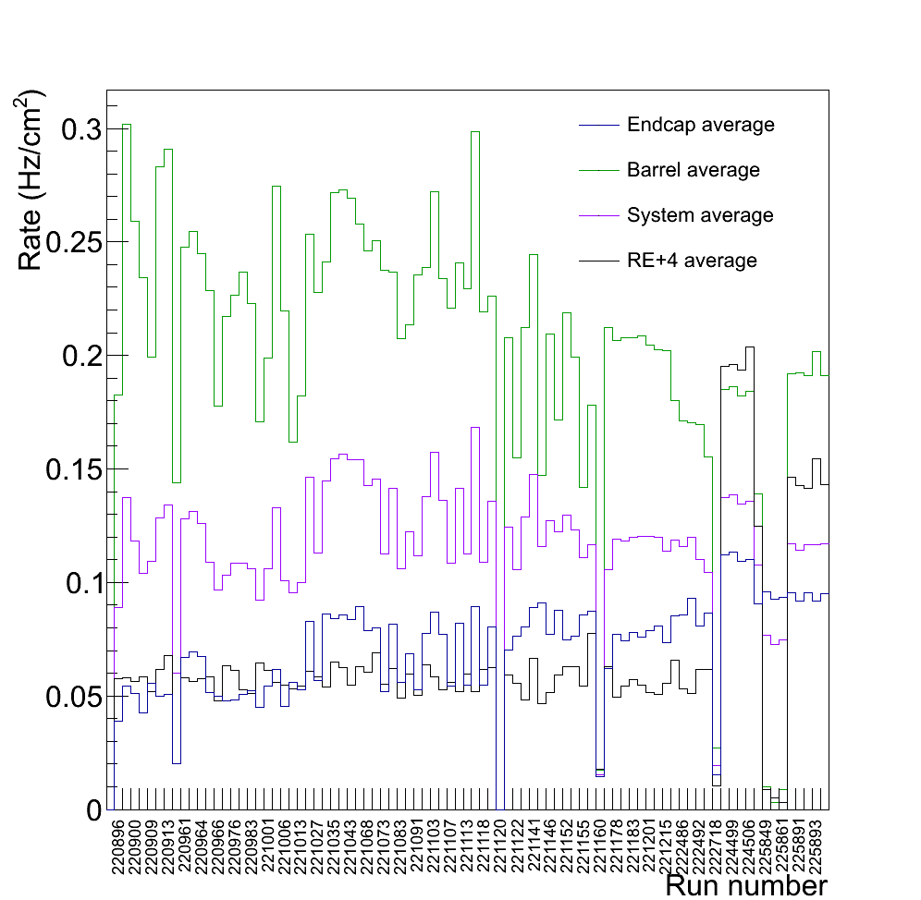
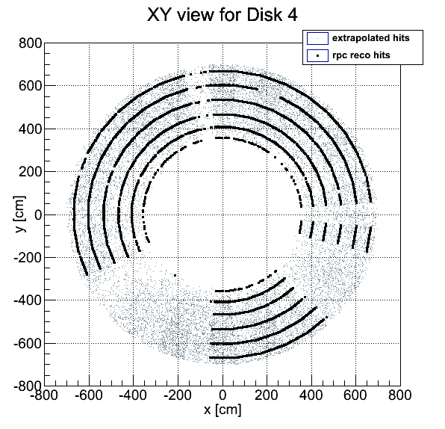
RE4 – chamber construction
Construction
Very low current
High efficiency
Commissioning

Slide 15
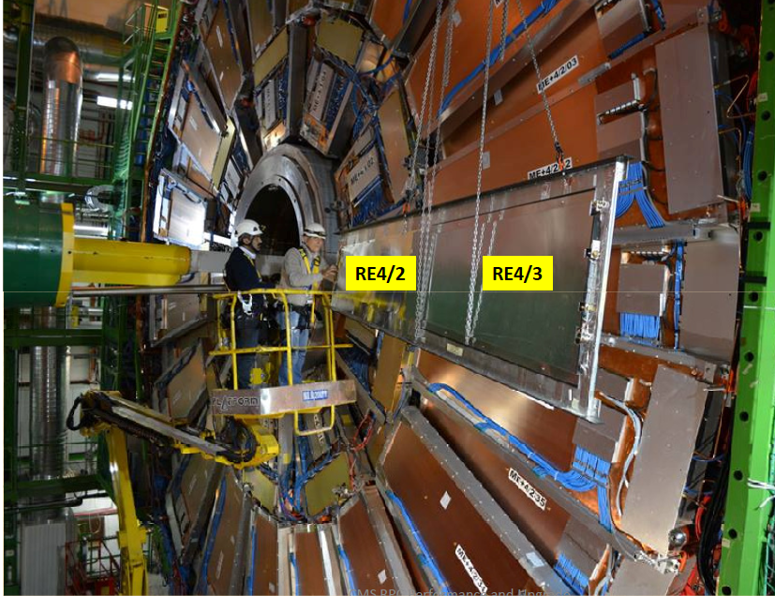

Slide 16
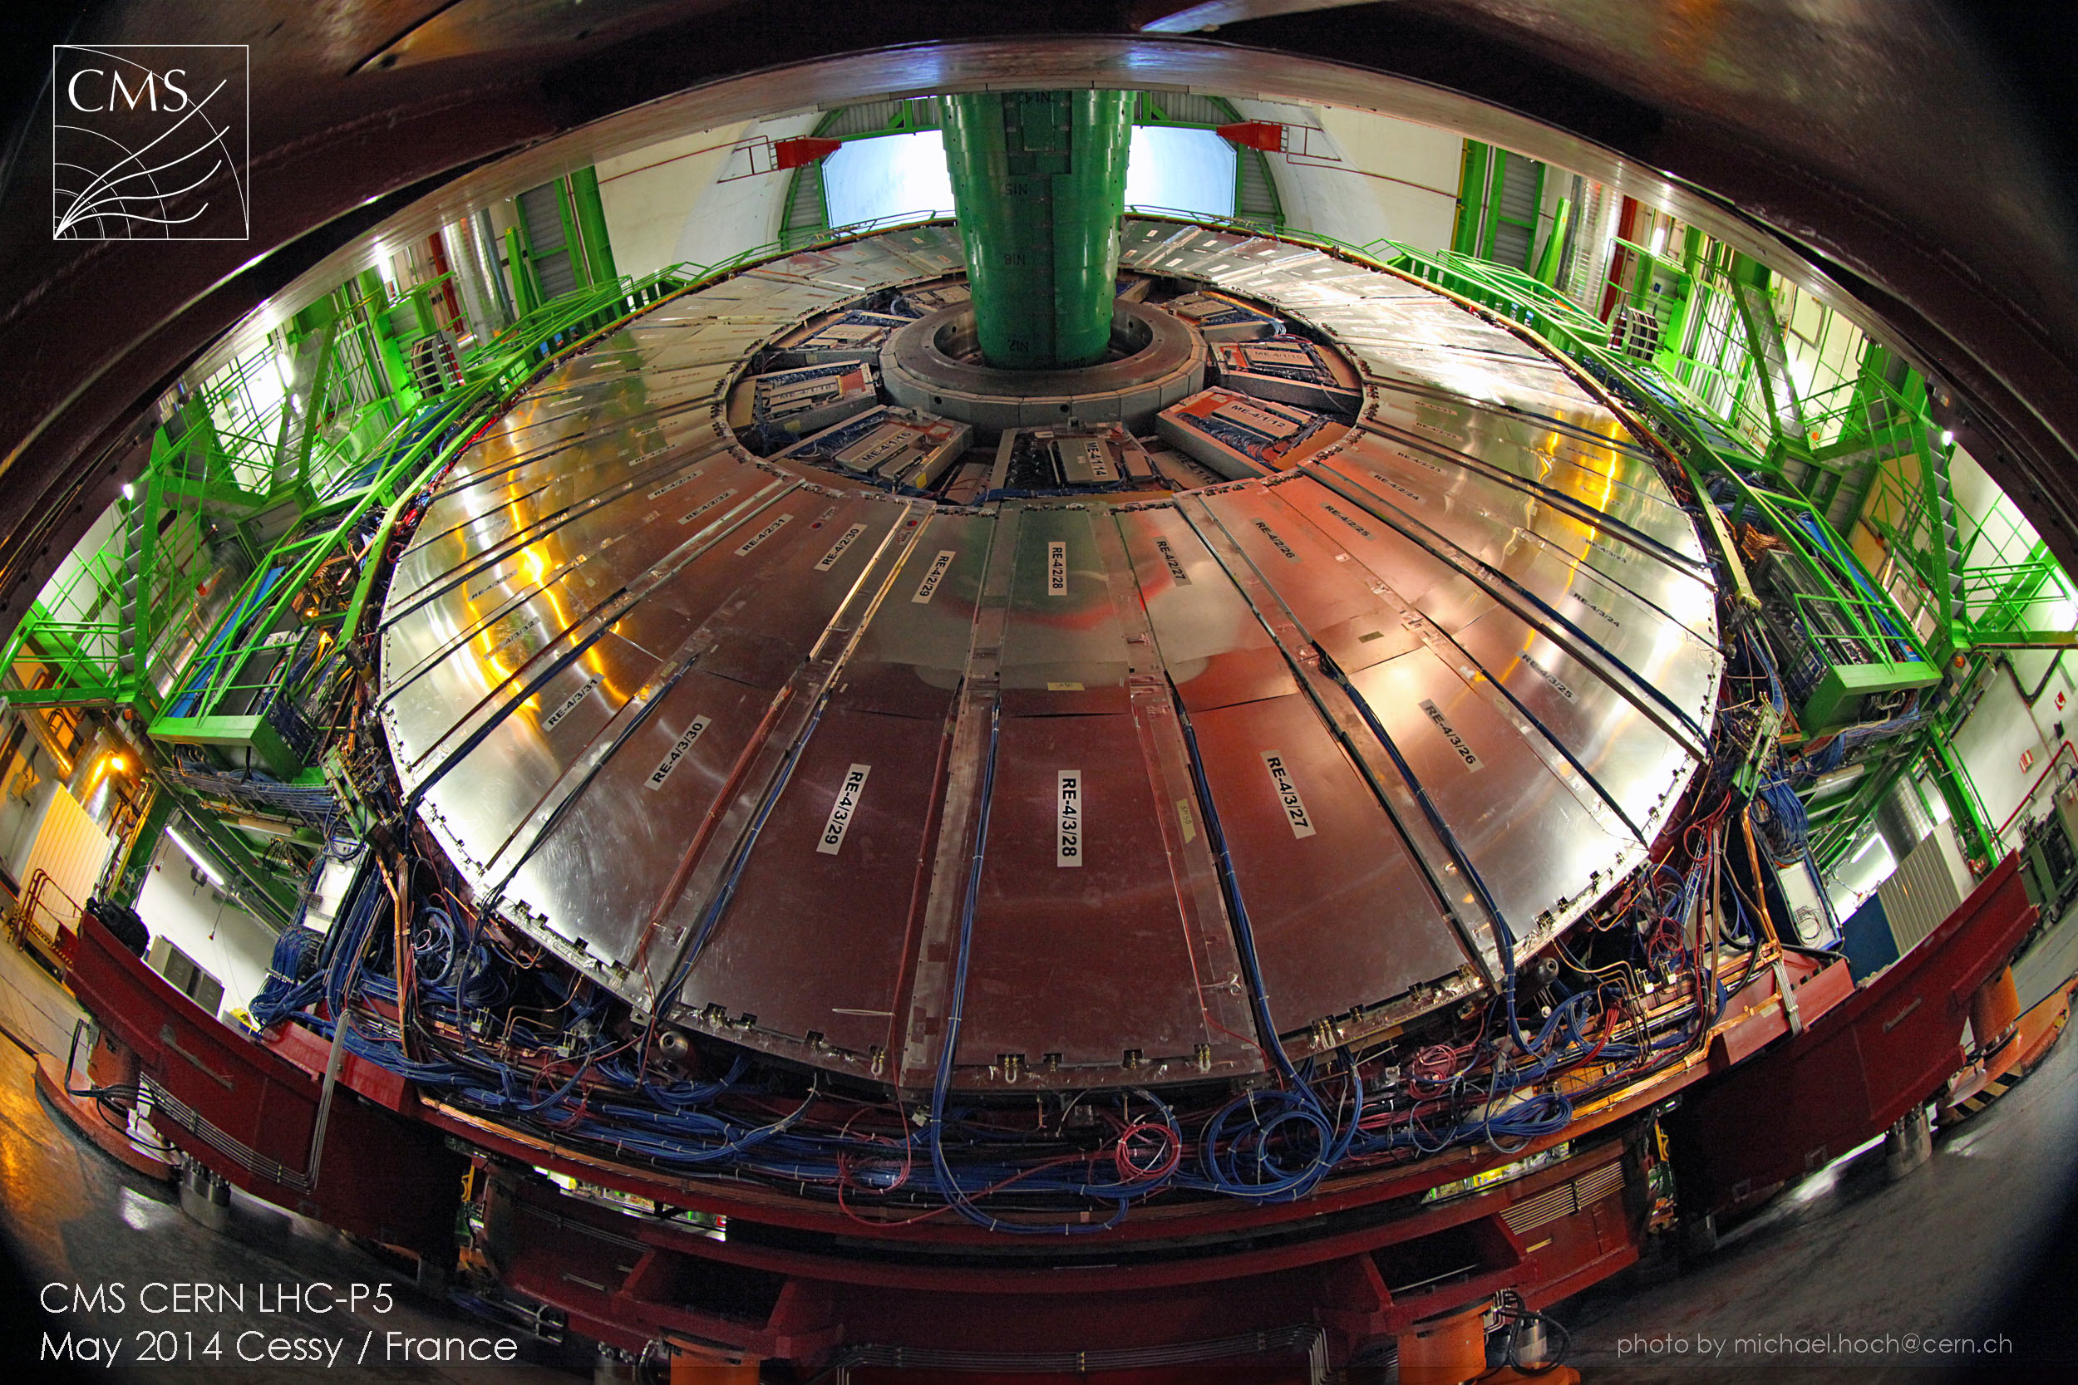
The only phase-I project
completed on schedule and within the budget

Slide 17
Upgrade Phase II GEM and iRPC

Slide 18
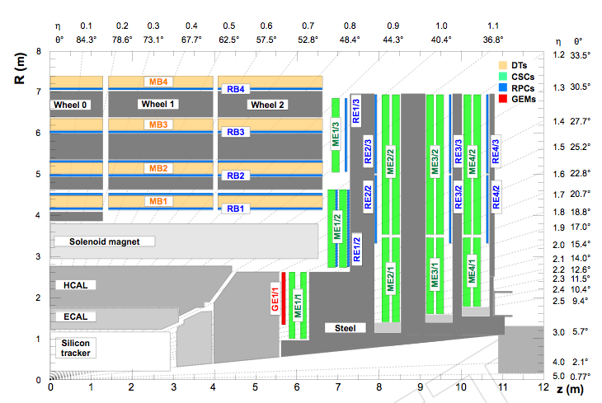
Muon system

Slide 19
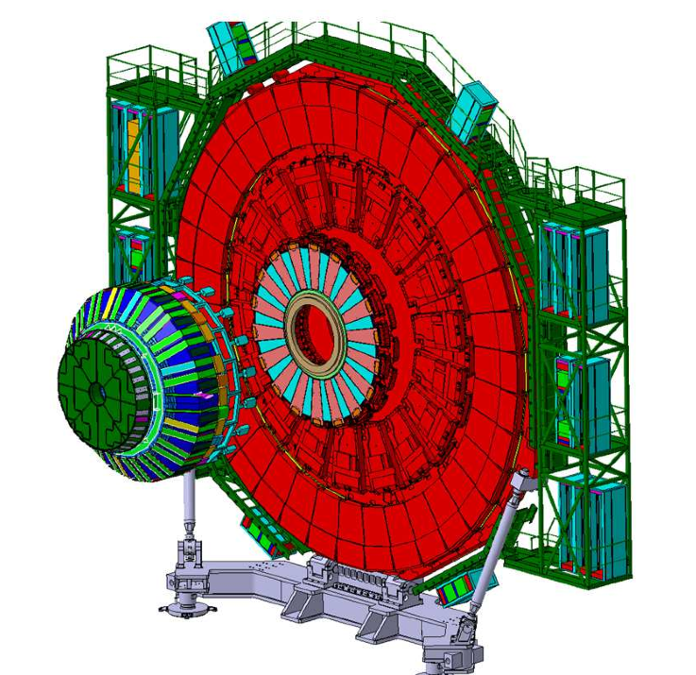
High eta region

Slide 20
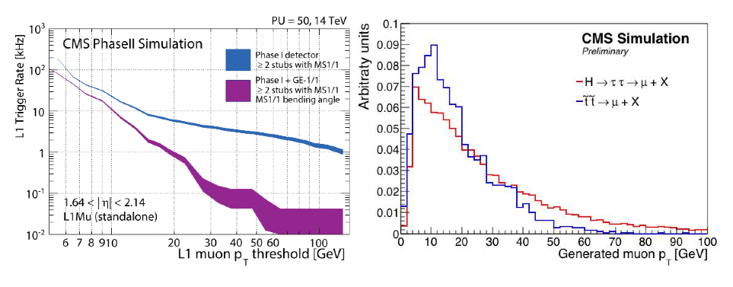
Muon system Upgrade

Slide 21
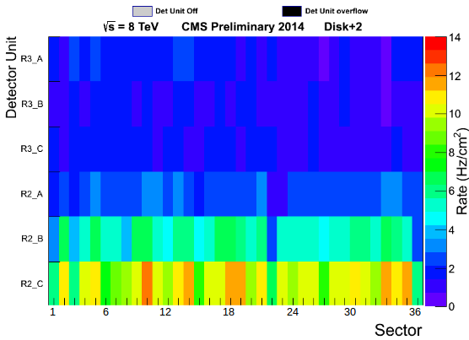
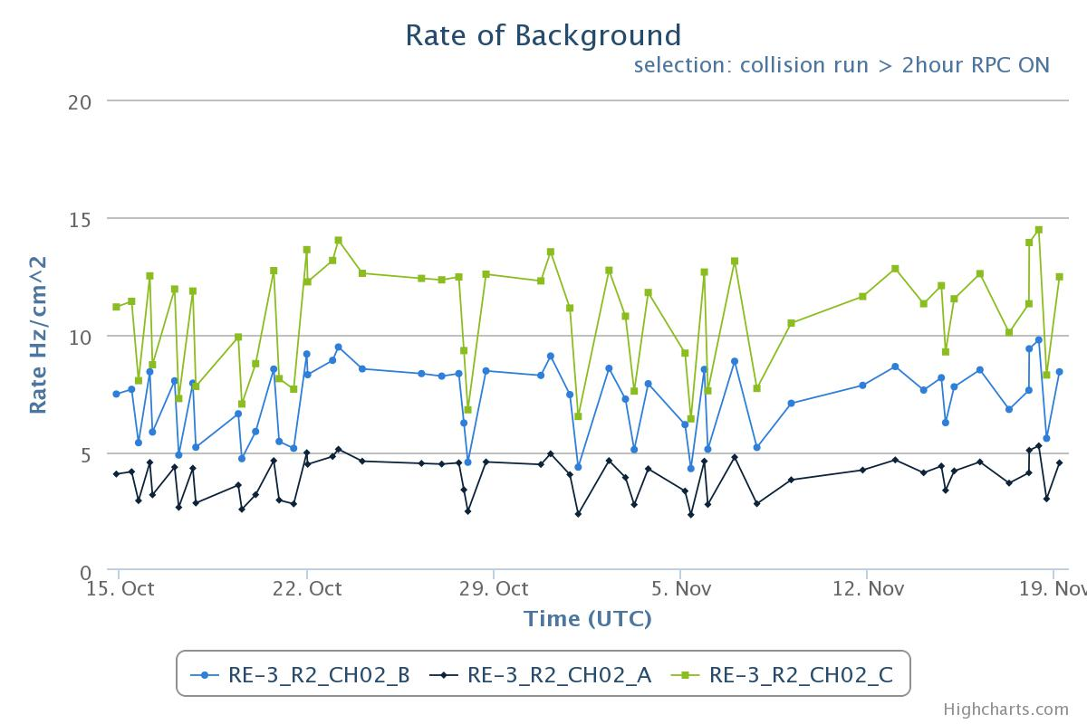
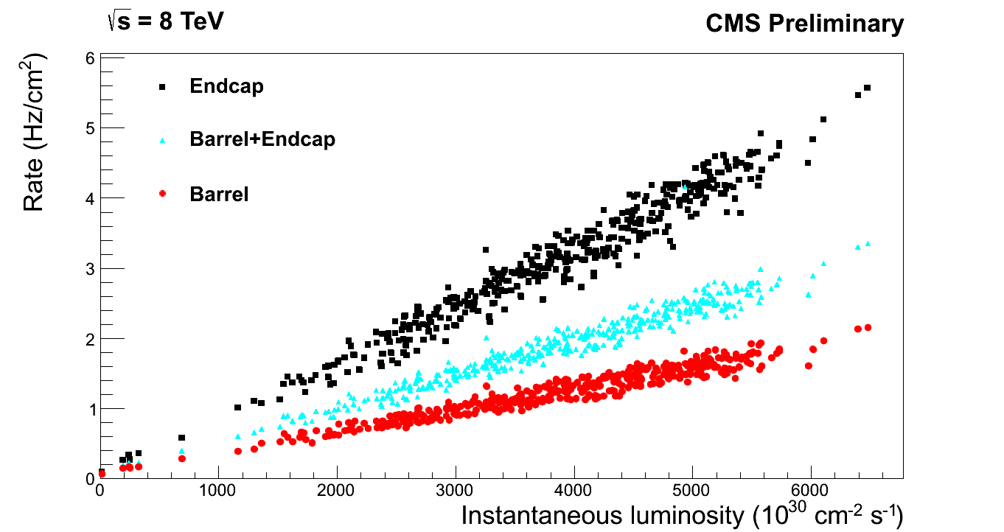
Where we arrived in the 2013
RPC certified by CMS at
Endcap rate Map
Maximum rate capability 1 kHz/cm²
10 years of LHC at 200 Hz/cm²
Total integrated charge = 100 mC/cm²
(ATLAS up to 300 mC/cm² )
Max rate vs time
Present CMS results
Maximum rate (Barrel) = 7 Hz/ cm²
Maximum rate (Endcap) = 14 Hz/cm²
Average rate (Barrel) = 2 Hz/cm²
Average rate (Endcap) = 5 Hz/cm²
Q = rate T_{eff} <q> = 3 mC/cm²
rate vs lumi

Slide 22
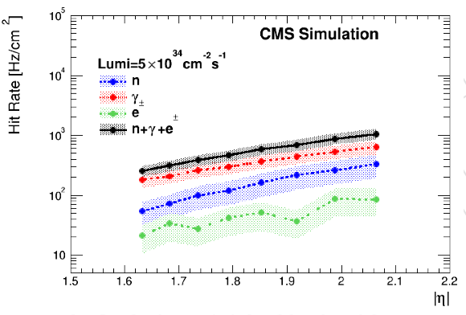
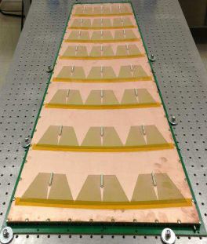
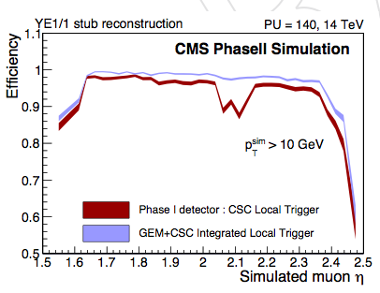
GEM upgrade
Two GEM station will be installed in the inner disk to improve the P_{T} assignment and reduce the trigger rate.

Slide 23
Extrapolation to HL-LHC
For 10 years of HL-LHC – 3000 fb⁻¹
 | Max (Hz/cm²) | Average ( Hz/cm²) | Q_{max} (C/cm²)
Barrel | 125 | 25 | 0.15
Endcap | 250 | 60 | 0.30
RE3/1 & RE4/1 | 500 (CSC & Fluka) see backup slide | < 250-300 (CSC & Fluka) | 1.2
The main requirements for the high eta region of the disk 3 and 4 can be summarized as follow:
Maximum rate of 1 kHz/cm² (safety factor included)
Integrated charge of about 1 C/cm²
Eco-gas (C2H2F4 and SF6 to be replaced)
Fitting the space available (up to η 2.4) similar to RE4 space

Slide 24
RPC history
1992 1996 2003 2013 2019
LEP/L3 | BaBar | CMS/ATLAS | RE4 | Phase II
10 years | 5 years* | 10 years
10¹¹⁻¹² Ωcm | 10¹¹⁻¹² Ωcm | 2-5 10¹⁰ Ωcm | 1-2 10¹⁰ Ωcm | 7-8 10⁰⁹ Ωcm
300 m² | 2000 m² | 7000 m² | 300 m² | 200 m²
streamer | streamer | avalanche | avalanche | avalanche
Heavy mechanic | Gap Industrial prod. (Italy) | 2nd Gap company (Korea) | improved HPL prod. (Italy) | Light detector
Few leaks | eco gas mix | Oiling procedure improved a lot |  | new eco gas mix
FE chip Napoli | FE chip Napoli | FE chip Bari | FE chip Bari | New FE chip
0.3 Hz/cm² | < 3 Hz/cm² | < 15 Hz/cm² | 150 Hz/cm² | 1000 Hz/cm²**
* First batch failed for high temperature (27-30 ºC). Then oiling procedure was improved a lot
** very maximum rate (safety and energy factor included)
Collaboration with ATLAS is going on

Slide 25
From phase I (RE4) to phase II
To go up to 1 kHz/cm² for 10 HL-LHC years at 5 10³⁴ cm⁻²s⁻¹
We need to optimize: the bulk resistivity of the Bakelite electrodes and, eventually, the average charge generated by the avalanche.
The role of these parameters can be explained looking at the three following equations, obtained using simple electrostatic model:
The time constant of an elementary cell involved in the avalanche process:
τ = e₀ (e_{r} + 2) ρ
The area of the “cell” concerned in the discharge
S = 2<q>/e₀E = 2<q>d/e₀V_{d}
The rate capability of the single cell
r = 1/Sτ
Where <q> is the average charge per avalanche (C), r is the rate (Hz/cm²), ρ is bulk resistivity (Ωcm), E is the electric field inside the gas, V_{d} is the voltage drop that stop the avalanche in the cell and d is the gas gap width.
τ can be reduced of a factor 2-3 (ρ= 9-10 × 10⁹ Ωcm)
Rate can increase of 3-5 times

Slide 26
From Phase I (RE4) to phase II
To increase the rate capability and reach the kHz/cm²* needed need to decrease the resistivity of the Bakelite electrode and reduce the average charge <q> associated to the avalanche. A resistivity of 9-10×10⁹ Ωcm (factor 2-3 in the rate) can be easily produced taking into account that for the RE4 region we were already able to reach the 1-2×10¹⁰ Ωcm.
A thinner gap/bakelite (from 2 mm to 1.5-1.0 mm), a more performing front-end chip and new gas is a possible aspect to be investigated to reduce the average charge produced in an avalanche and at same time the power consumption of the detector.
 | RE4 | RE4/1 & RE3/1
Electrode | ρ= 1-2 × 10¹⁰ Ωcm | ρ= 6-7 × 10⁹ Ωcm
Gap | 2 mm | 1 or 1.5 mm
Power system | < 1% fault | New connectors
Gas system | some leaks | New distribution

Slide 27
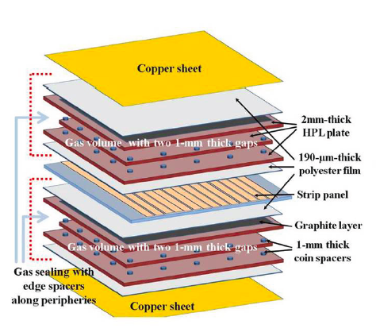
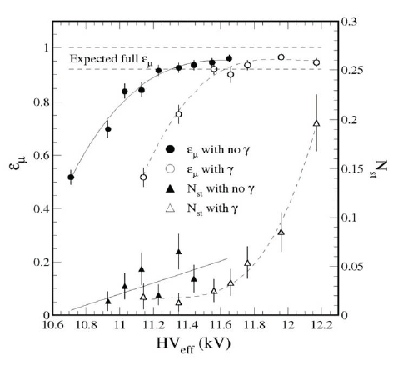
Multigap bakelite (Korea)
The standard double gap configuration used in CMS has been modified by adding an additional thin gap, with a thickness reduced to 1 mm, on both sides of the read out strips. Standard HPL and front-end electronics
Plateau for cosmic rays muon with and without irradiation (γ-ray at 3 kHz/cm² on the whole chamber). The chamber reaches full efficiency and has a streamer-free plateau of several hundreds Volts.

Slide 28
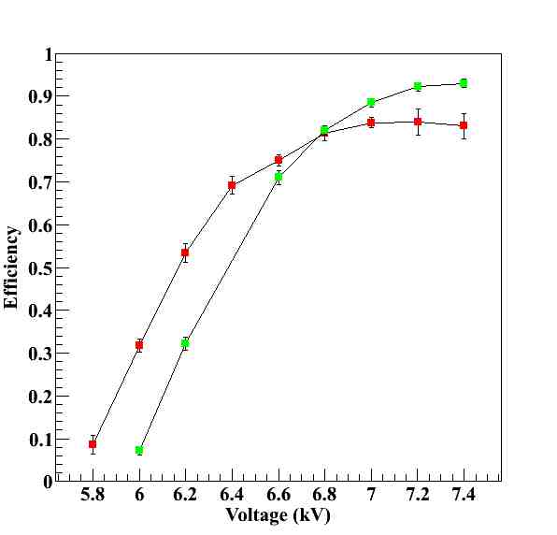
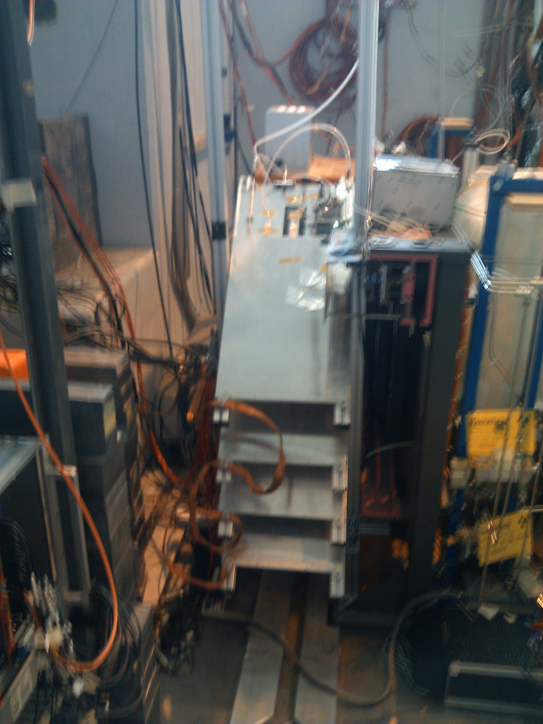
Glass RPC
Resistivity few 10⁹ Ωcm
Thin plates could be used (< 1mm) .
Small gas gaps (≤1 mm) and with standard gas mixture Charge/mip ≤ few pC.
This explains why one can achieve higher rate capabilities with respect to other materials 10 kHz/cm² (to be verified)
Timing performance ≈ 1 ns for single gap and less than few tens of ps in case of multi-gap.
Constraint : Size of low-resistivity glass is limited. Largest surface is 30X30 cm²
Test at GIF++ will be performed by the Lyon group with the help of the RPC collaboration.
Standard radiation tests to be performed at GIF++.
After 8 months of exposure
Source OFF
(CO₂)
Preliminary
Source ON
(Isobutane)

Slide 29
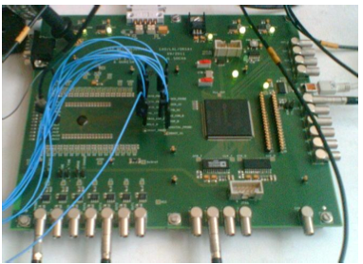
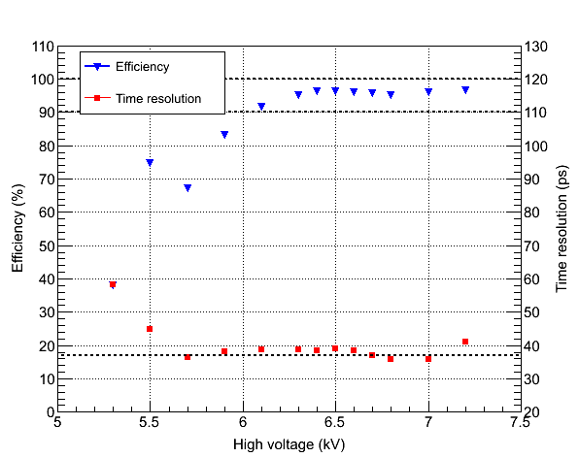
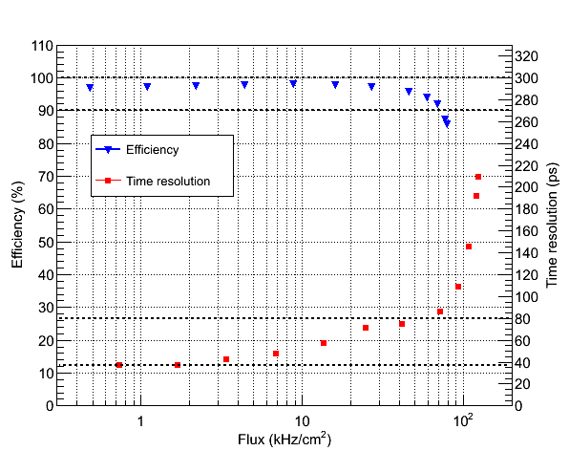
Glass RPC test beam
Beam Test@HZDR June, 2012
Time Resolution < 40ps
HV scan
Rate scan

Slide 30
Eco-gas studies
The European Community has limited the industrial production and use of gas mixtures with Global Warming Power
This is valid mainly for industrial (refrigerator plants) applications
C₂H₂F₄ is the main component of the present RPC gas mixture:
C₂H₂F₄ and SF₆ Crucial to ensure a stable working point in avalanche
On the physical and chemical properties of this components we:
Designed FE electronics and chambers
Did all performance, ageing and calibration tests
Gas mixture was already modified during the LEP time for a similar European request. No problem in the change at all

Slide 31
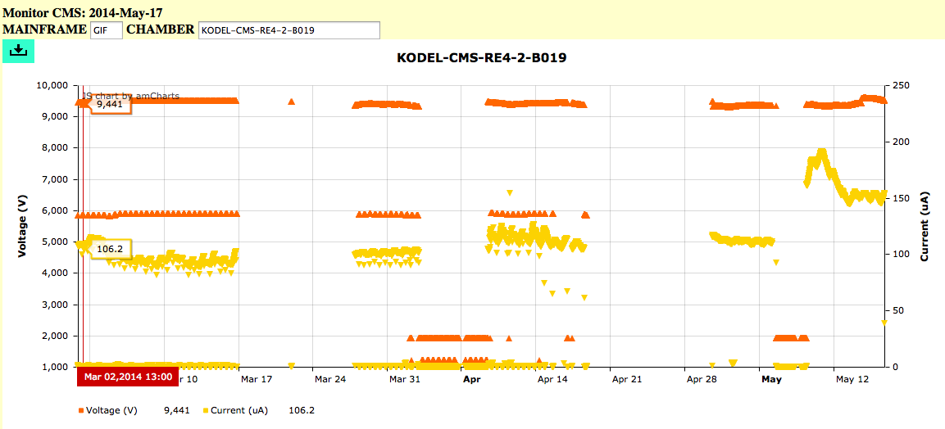
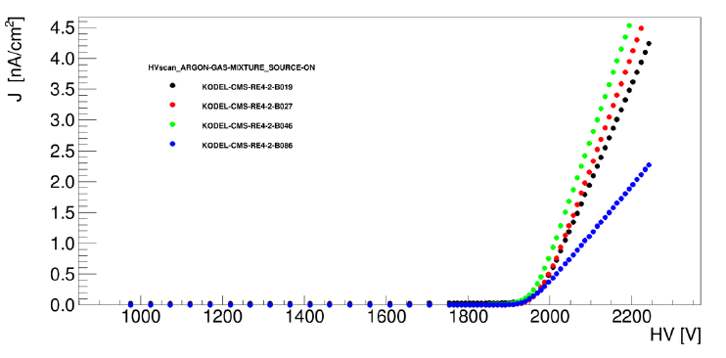
RE4 test at GIF & GIF++
Current monitoring vs. integrated charge
Integrated charge up now: ≈ 0.05 C/cm² gap with current stable
Plan to integrate 10 years LHC and then HL-LHC at GIF++ in about 1 year.
Bakelite resistivity monitoring vs. integrated charge
HV scan with argon and source ON every month.
Resistance gap (not only Bakelite) ≈ 1-2 10¹¹ Ω cm to be used for stability.
Stable in time
31

Slide 32
Conclusioni
I goal principali dei prossimi anni sono:
Running del sistema presente 2015-2018
Sviluppo del rivelatore a GEM per il 2018-2019
Sistema di potenza
Meccanica del rivelatore
Progettazione di un “futuro” rivelatore ad RPC 2022-2023
Leggero, sottile e che possa lavorare a tensioni inferiori
Pronto per il 2019 (dimostratore)
Test in laboratorio a Napoli per rivelatori con piccole gap e a bassa resistività
Grazie a tutti per il lavoro originale e professionale svolto nel 2014

