Slide 1
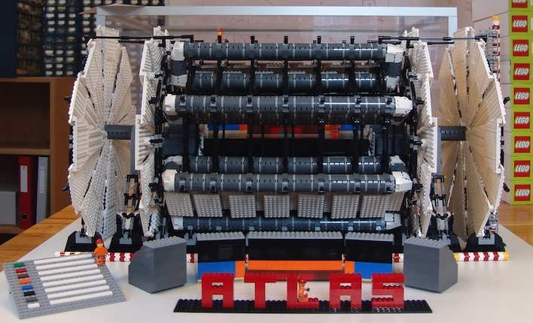
Atlas: Upgrade Phase I
Massimo Della Pietra

Slide 2
Summary
NSW Micromegas Construction
MM Test Beam and performances
MM Activity @ Naples
TDAQ Activity for NSW
LHC & ATLAS are coming back….

Slide 3
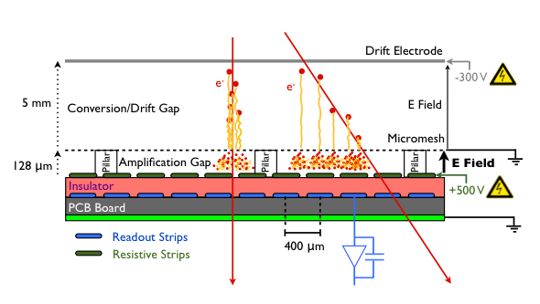
MM detector

Slide 4
ATLAS New Small Wheel
8 layer of precision measurement (MM) + 8 layer of trigger (sTGC chambers)
  Complementary detectors both capable to do tracking and trigger
MM Stereo strips (~400 μm pitch) for 2nd coordinate measurement
Back to back configuration of two MM unit to minimize B field (Lorentz angle) bias in reconstruction and μTPC bias at small angle.

Slide 5
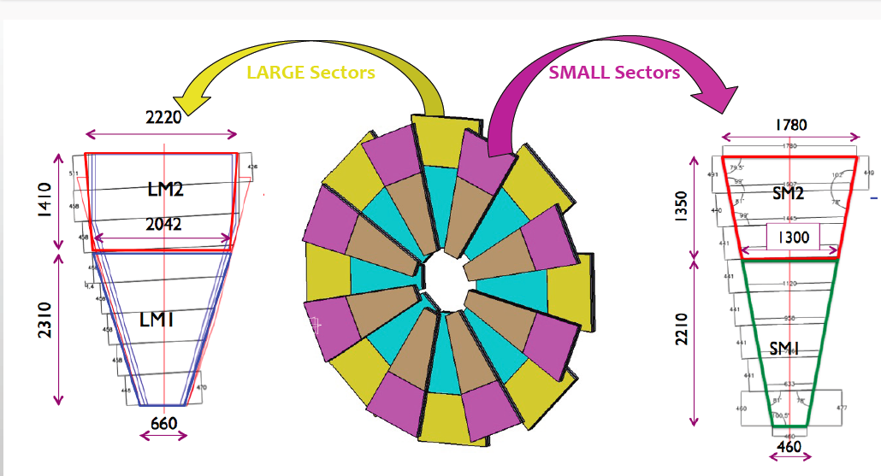
ATLAS New Small Wheel
Tessaloniki,
Dubna
Germany
Italy-INFN
Saclay
Italy-INFN: Cosenza, Frascati, Lecce, Napoli, Pavia, Roma 1, Roma 3,

Slide 6
MM construction
Mechanical prototype built up from scratch going from single MM panel to a quadruplet to a full wedge of the wheel.
Many construction details have been fixed using the experience of two full size working prototypes (CERN).
Naples group is involved with Givi (@CERN) and with a mechanical workshop support to Pavia and Frascati activities (L. Rocco)
Module 0 detector, foreseen at the end of 2014, has been postponed of 6 months.
In 2015 Naples will support quadruplet integration in Frascati with physicists and technicians.

Slide 7
MM construction schedule

Slide 8
MM construction schedule

Slide 9
MMSW Full size prototype

Slide 10
MM @ TestBeams
Intense activity in 2014:
  Three test beams campaigns:
    August @T9
    September @T10
    October @ H6
    November – December @ H4 (B Field)
  Two full size prototypes MSW1 and MSW2
  Two different readout electronics
  MM hodoscope for tracking reference
  Naples involved both to data taking and analysis
    (Givi, C. Di Donato, V. Canale, R. Del Burgo)

Slide 11
MM @ Test Beams: Spatial Resolution
Precision coordinate resolution of ~ 74 μm as expected from small prototypes with a pitch of 415 μm
Second coordinate measurement obtained from stereo-strip ~ 2.2 mm compatible with simulation σ_{φ} ≈ 27 σ_{η}

Slide 12
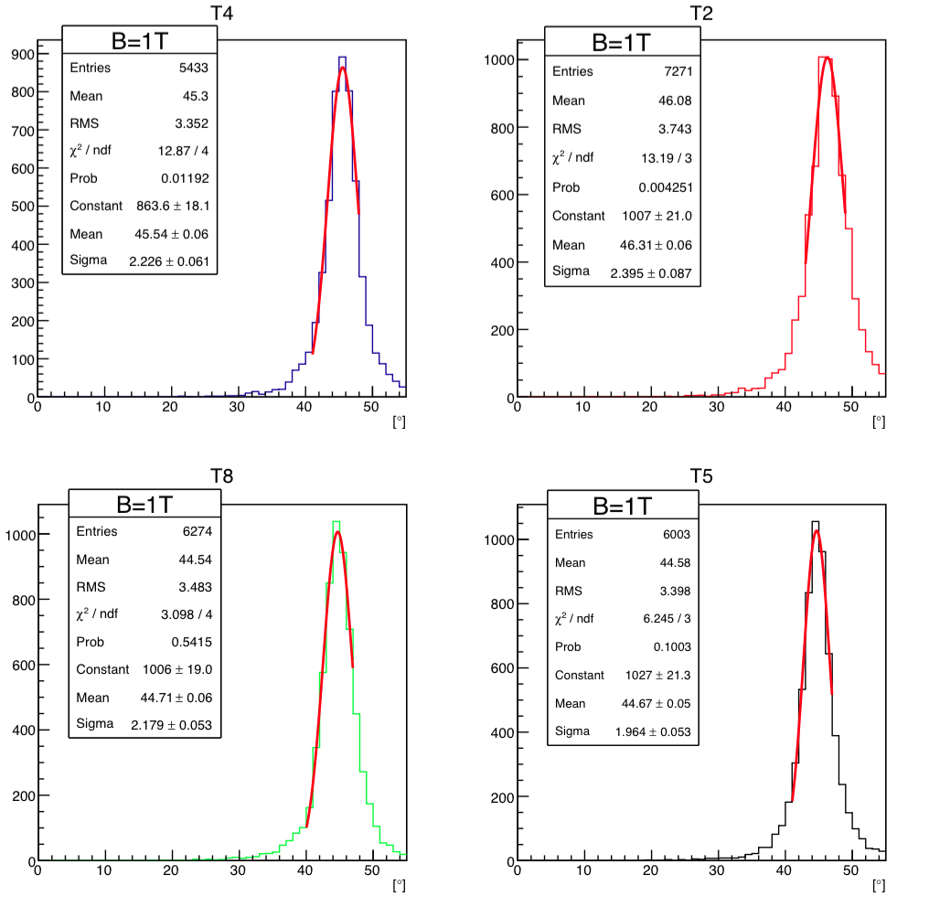
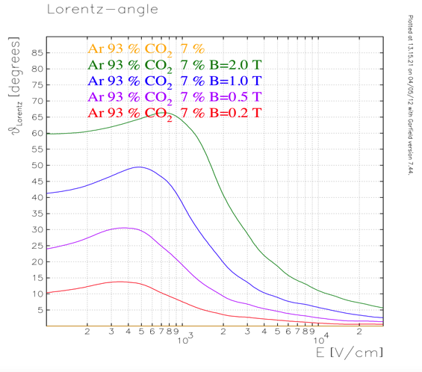
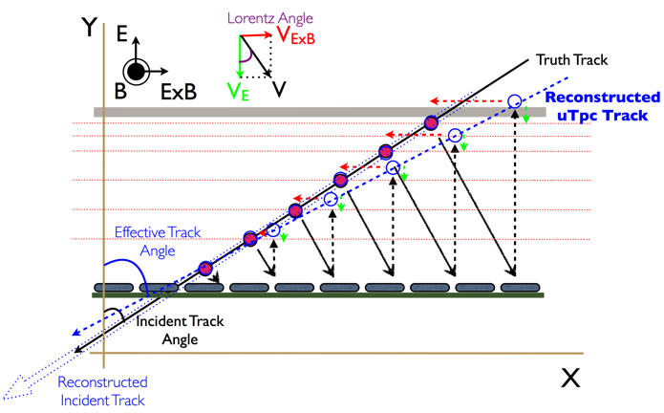
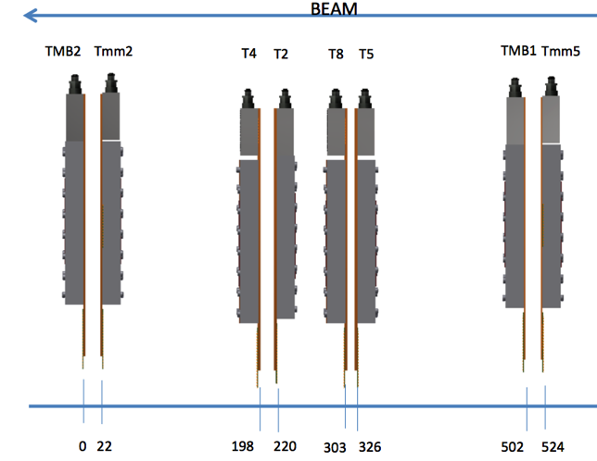
MM @Test Beams: B Field – Lorentz angle
Good agreement between data and simulation
B
e⁻

Slide 13
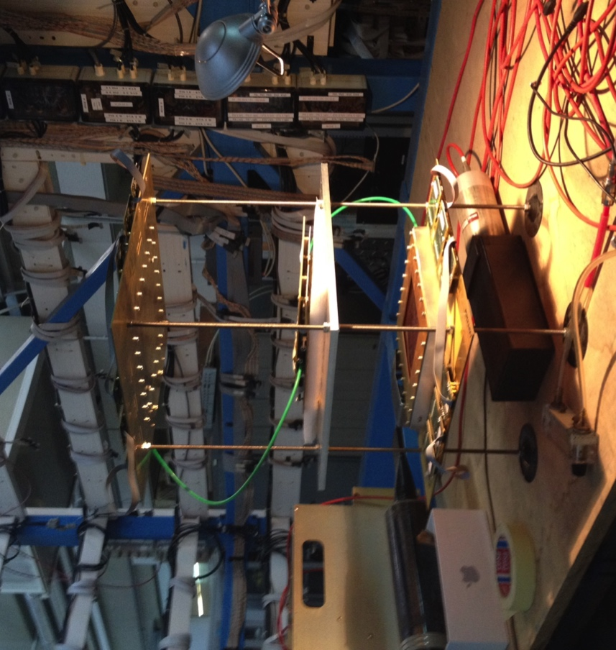
MM R&D Activity @Naples (RD51)
Study of many MM performances with different gas mixtures also varying pressure:
  Transparency
  Gain
  Drift velocity
  Spatial resolution
Study of a first prototype of a MM with resistive pixels for high rate applications
  Prototype ordered @ CERN workshop
  dimension of pixels
  signals routing
  resistive pattern
MM2D chambers: X Y
  (10x10 cm², strip pitch 250 υm, # channels 360 for each view)
MBT0 chamber: double gap, XV (60⁰)
  (strip pitch/width 500/250 υm in x,
  1.5/0.9 mm in V, # channels 190 X/ 66 V
SRS (APV) readout

Slide 14
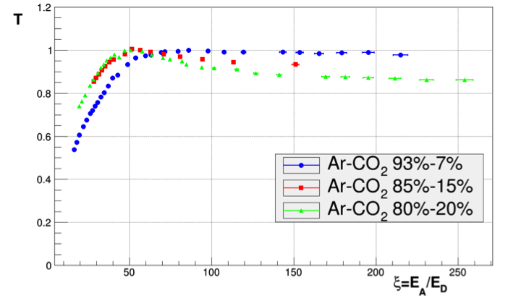
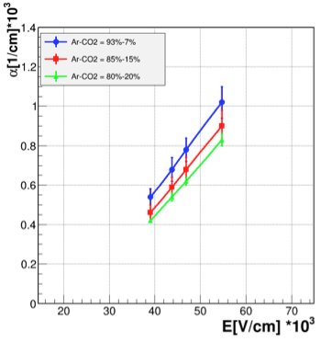
MM R&D Activity @Naples (RD51)
Electron transparency Fe55 source
Drift Velocity in ArCO₂
Townsend coefficient in ArCO₂
M. Alviggi
C. Di Donato

Slide 15
MM deformation monitoring with FBG
Fiber Bragg Grating (FBG) sensor used to measure superficial strain of a bent surface.
Used to measure deformation of MM mechanical prototype in Pavia
Work under submission to JINST (M. Alviggi, V. Canale, A. Iadicicco, S. Campopiano, MDP)

Slide 16
MM deformation monitoring with FBG
Superficial Strain
Weight on a panel
Deflection
Deflection can be obtained from superficial strain profile integrating twice and using boundary condition.
Using another sensor on the other side of the surface bending and compression can be disentangled.
Deflection measured
both with FBG (line)
and with direct laser measurement (dots)
Resolution of the method is of the order of few tens of microns
Mesh forces and torque
Chamber gas filling

Slide 17
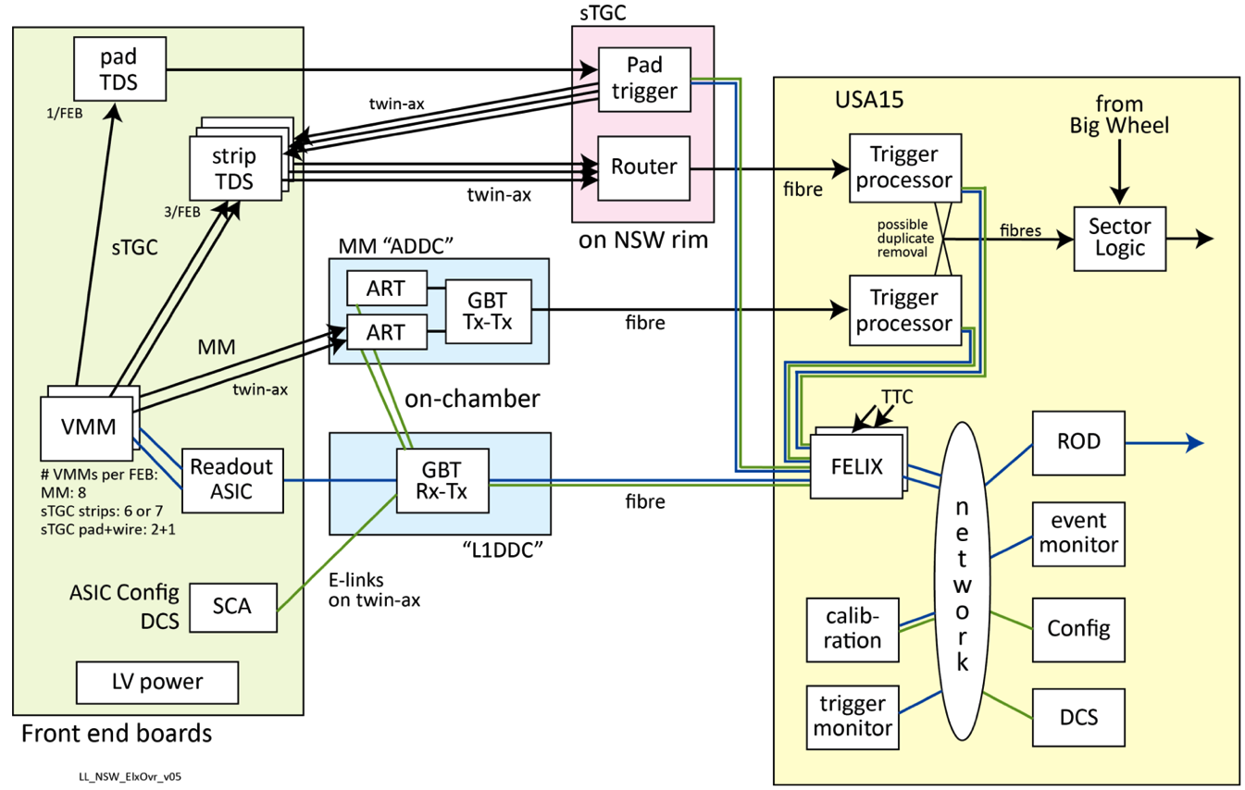
Naples TDAQ Activity for NSW
High speed FPGA based serial link development for MM DAQ and NSW Trigger (V. Izzo, S. Perrella)
sTGC PAD Trigger board hardware and firmware development (V. Izzo, S. Perrella)
2015 Activity

Slide 18
Naples TDAQ Activity for RUNII
Maintenance of LVL1 Muon Barrel Trigger (V. Izzo, S. Perrella, MDP):
  New software for LVL1 Trigger DAQ developed.
  Maintenance of ROD and full TDAQ system.
  Online monitoring and Data Quality.
TDAQ related installation and commissioning for RPC in feet and elevator regions.
Commissioning, production and test for a new MuCTPI board with optical data transfer. (V. Izzo, S. Perrella, MDP, R. Giordano)
2015 Activity

Slide 19
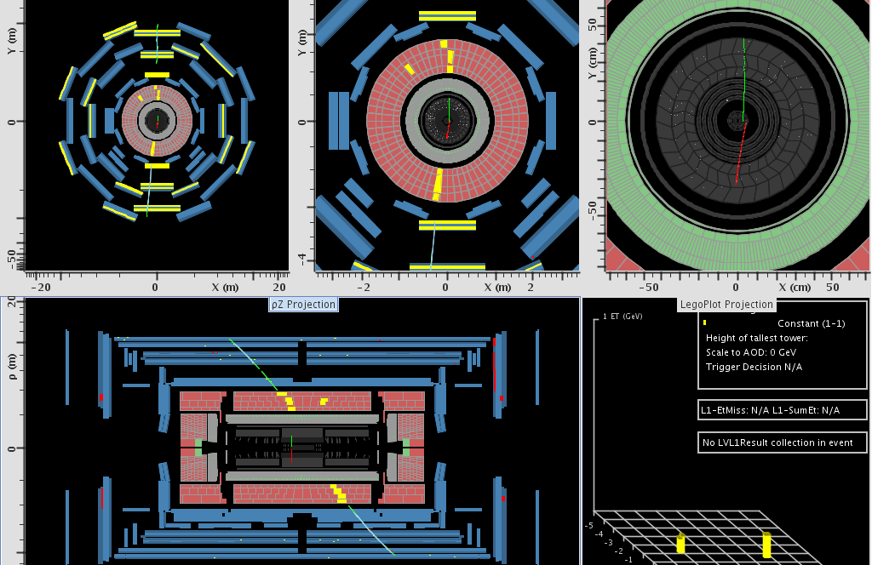
…ATLAS is coming back!
Cosmic muon triggered during M7
All RPC sector running except of feet region
L1 trigger rate ~600 Hz

