Slide 1
Preliminary data analysis on 16x16 modules
Francesco Pennazio on behalf of the Torino INSIDE group
INSIDE meeting, Roma, December 18th 2014

Slide 2
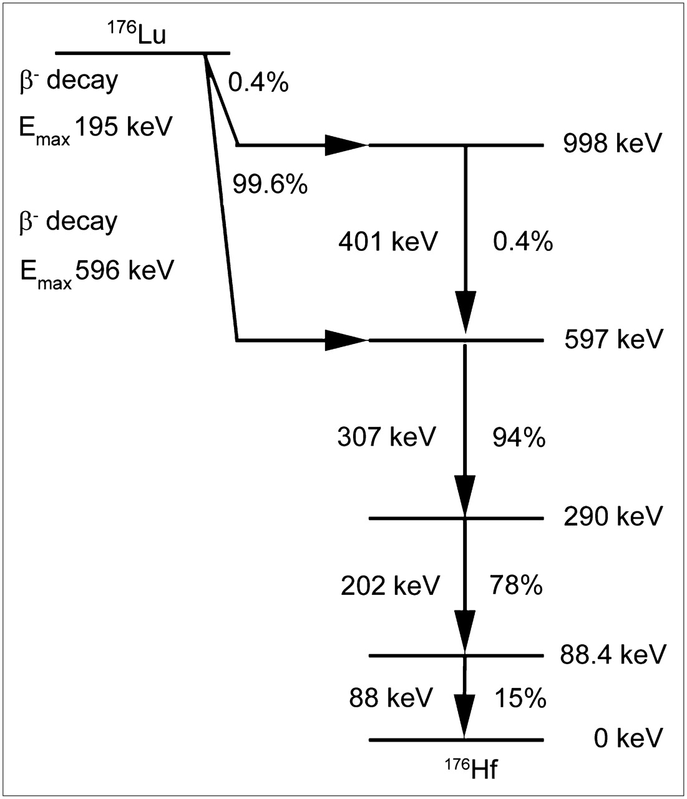
Lutetium 176 decay scheme
Conversion into 55 keV
INSIDE meeting, Roma, December 18th 2014

Slide 3
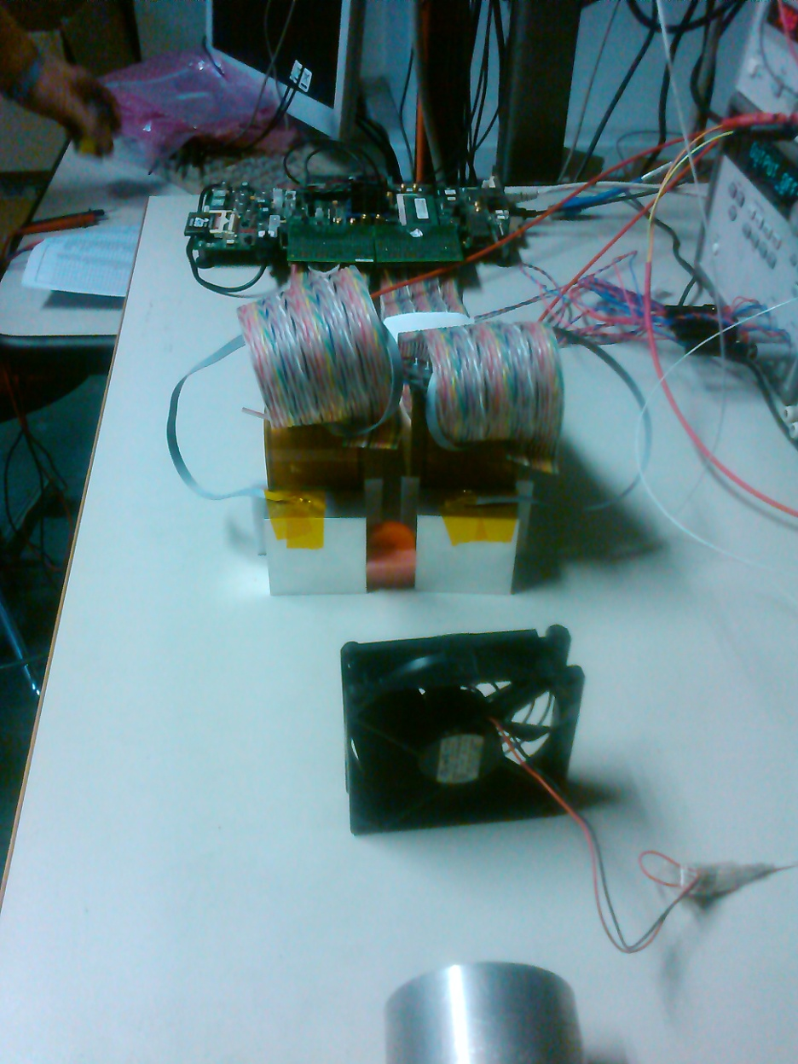
Experimental setup
Matrices
Temperature control (50°C)
(15 years old) Na22 source
fan
INSIDE meeting, Roma, December 18th 2014

Slide 4
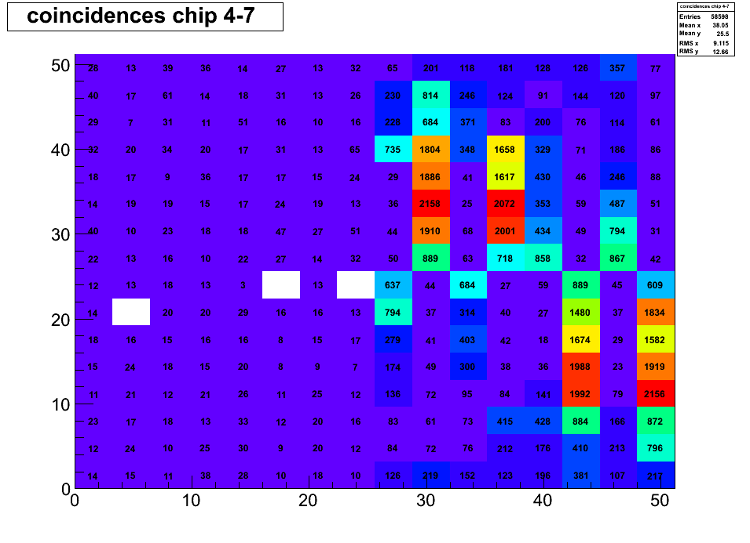
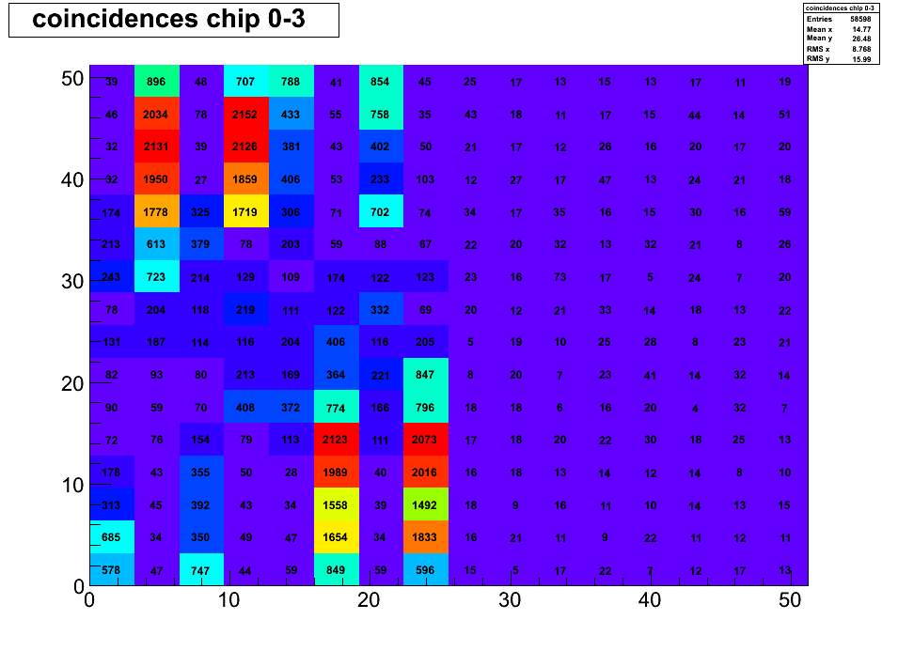
Coincidences map
… channel map?
We then can analyze just few channel – channel coincidences
INSIDE meeting, Roma, December 18th 2014

Slide 5
Energy spectrum
TOFPET ASIC measures energy with TOT technique (∼ log(E))
TOT detailed MC and Simulink model, Marco Boretto master thesis, Apr. 2014
Acquisition system has already implemented a conversion system to try to linearize the TOT (TOTraw->TOTcorr)
INSIDE meeting, Roma, December 18th 2014

Slide 6
Energy spectrum
Chip 0 channel 11 TOT spectrum
Background
¹⁷⁶Lu 202 keV
¹⁷⁶Lu 307 keV
²²Na 511 keV
TOT raw
TOT corrected
INSIDE meeting, Roma, December 18th 2014

Slide 7
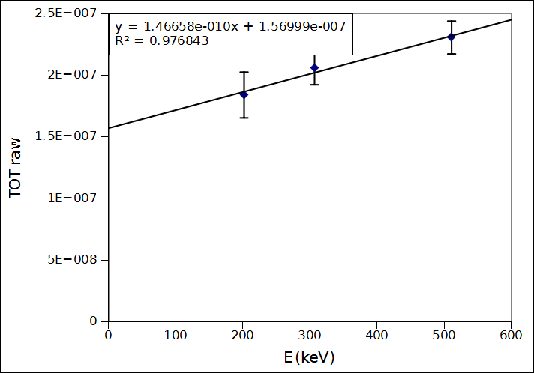
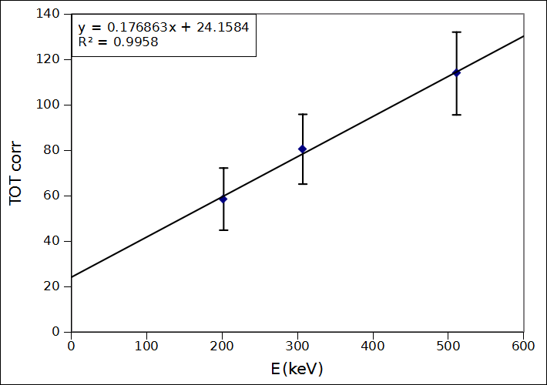
Energy resolution
Chip 0 channel 11 TOT spectrum
TOT raw
TOT corrected
INSIDE meeting, Roma, December 18th 2014

Slide 8
Coincidence energy spectrum
Chip 0 channel 11 TOT spectrum
Background
¹⁷⁶Lu 202 keV 18% ∆E/E*
¹⁷⁶Lu 307 keV 14% ∆E/E
²²Na 511 keV 11% ∆E/E
* ∆E/E with gaussian fit sigma
TOT raw
TOT corrected
INSIDE meeting, Roma, December 18th 2014

Slide 9
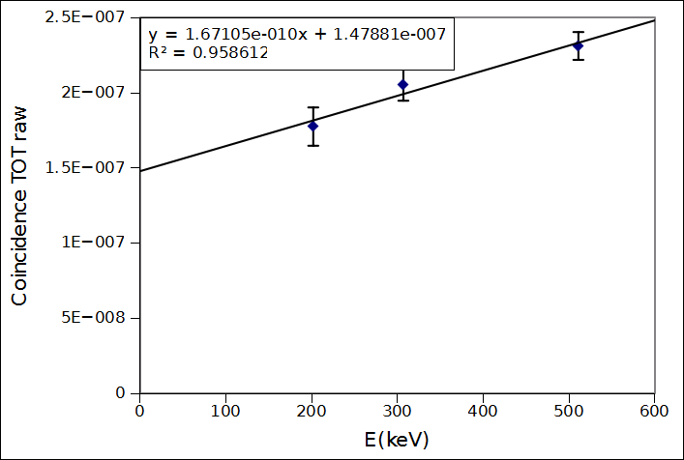
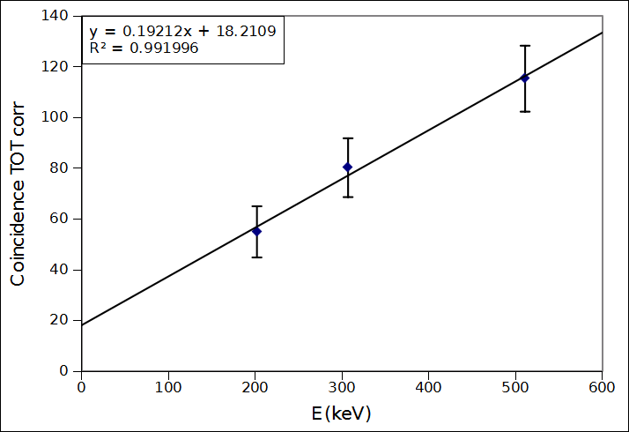
Coincidence energy spectrum
Chip 0 channel 11 TOT spectrum
TOT raw
TOT corrected
INSIDE meeting, Roma, December 18th 2014

Slide 10
Coincidence time resolution
Lu-176 decays emitting β and 3γ (2 detectable) -> CTR can be studied with different energy selection windows, since the 401 keV β spectrum overlies the γ photopeaks
Analysis procedure -> 2 channels selection
Energy window on single acquired data around selected photopeak
8 ns time window to find coincidences
Data with TOFPET shaping ON
¹⁷⁶Lu 307 1.05 ns σ
²²Na 511 keV 0.35 ns σ
INSIDE meeting, Roma, December 18th 2014

Slide 11
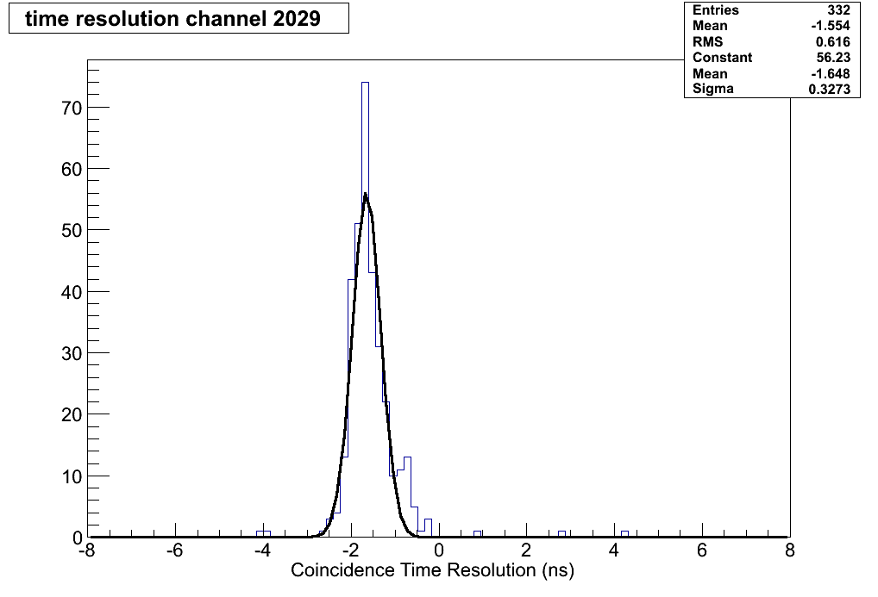
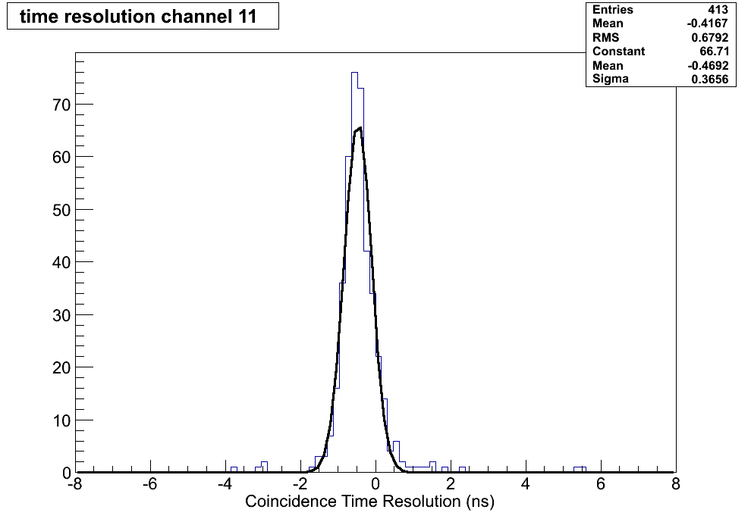
511 keV coincidence time resolution
chip 2 channel 29 vs chip 5 channel 41
Coincidence Time Resolution 330 ps σ
chip 0 channel 11 vs chip 5 channel 51
Coincidence Time Resolution 370 ps σ
INSIDE meeting, Roma, December 18th 2014

Slide 12
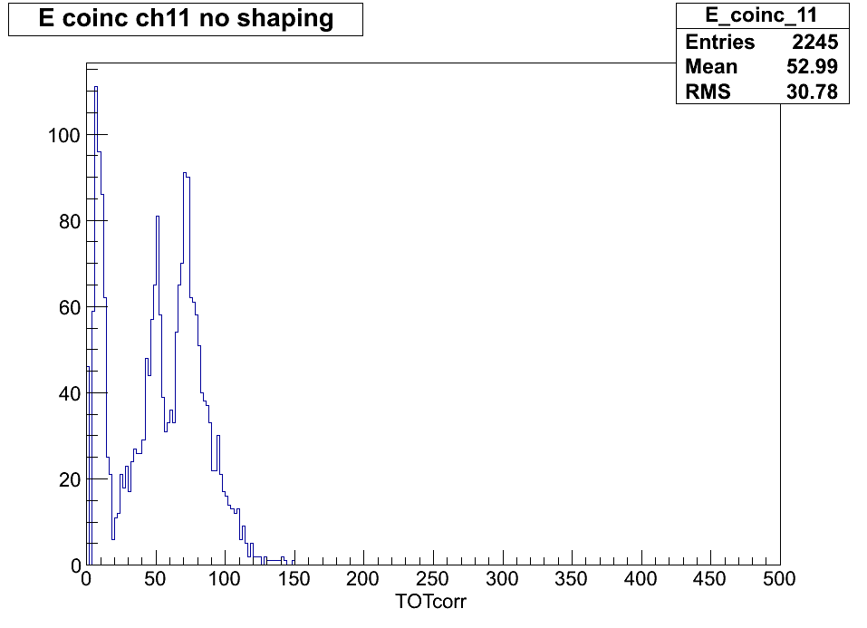
¹⁷⁶Lu-only coincidence time resolution
Lu-176 decays emitting β and 3γ (2 detectable) -> CTR can be studied with different energy selection windows, since the 401 keV β spectrum overlies the γ photopeaks
Analysis procedure -> 2 channels selection
Energy window on single acquired data around selected photopeak
8 ns time window to find coincidences
¹⁷⁶Lu 307 keV 0.66 ns σ
Data with TOFPET shaping OFF
No ²²Na source available for this dataset
²²Na 511 keV ?
INSIDE meeting, Roma, December 18th 2014

Slide 13
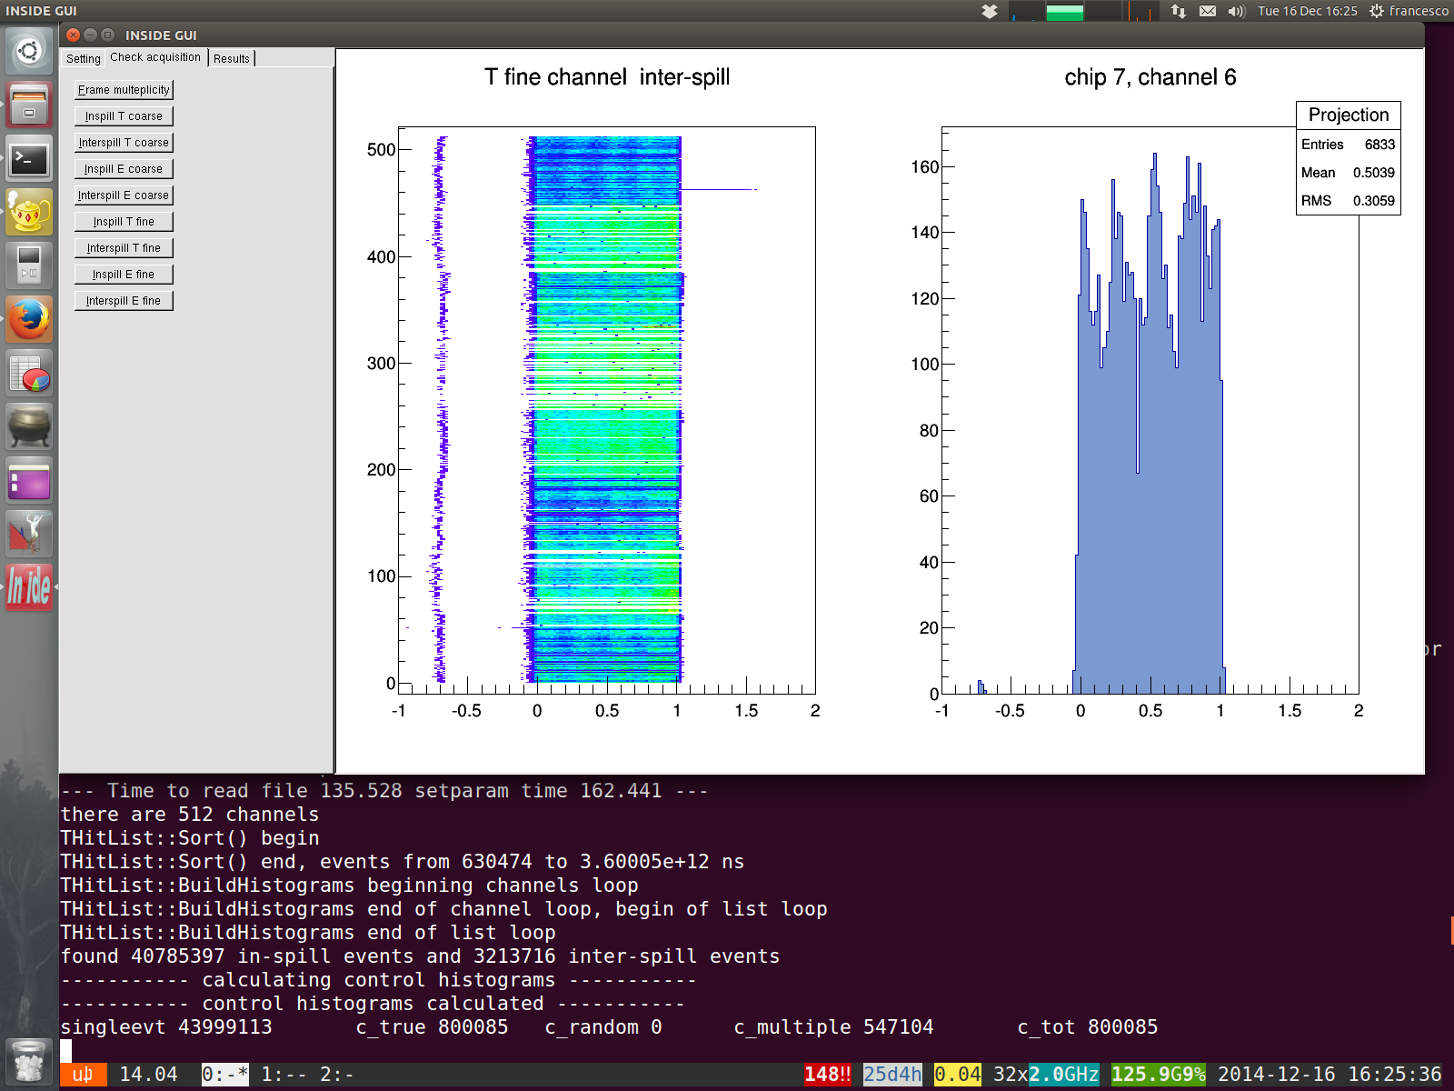
Software development
As the INSIDE PET detector size increases, number of histograms needed is becoming huge: an interface is being developed to increase data analysis efficiency and to evaluate overall chip and detector behavior.
In- and inter-spill values
Chip “health” analysis (Tcoarse, Ecoarse, Tfine, Efine)
Overall system (512 channels)
Single-channel interactive selection
INSIDE meeting, Roma, December 18th 2014

Slide 14
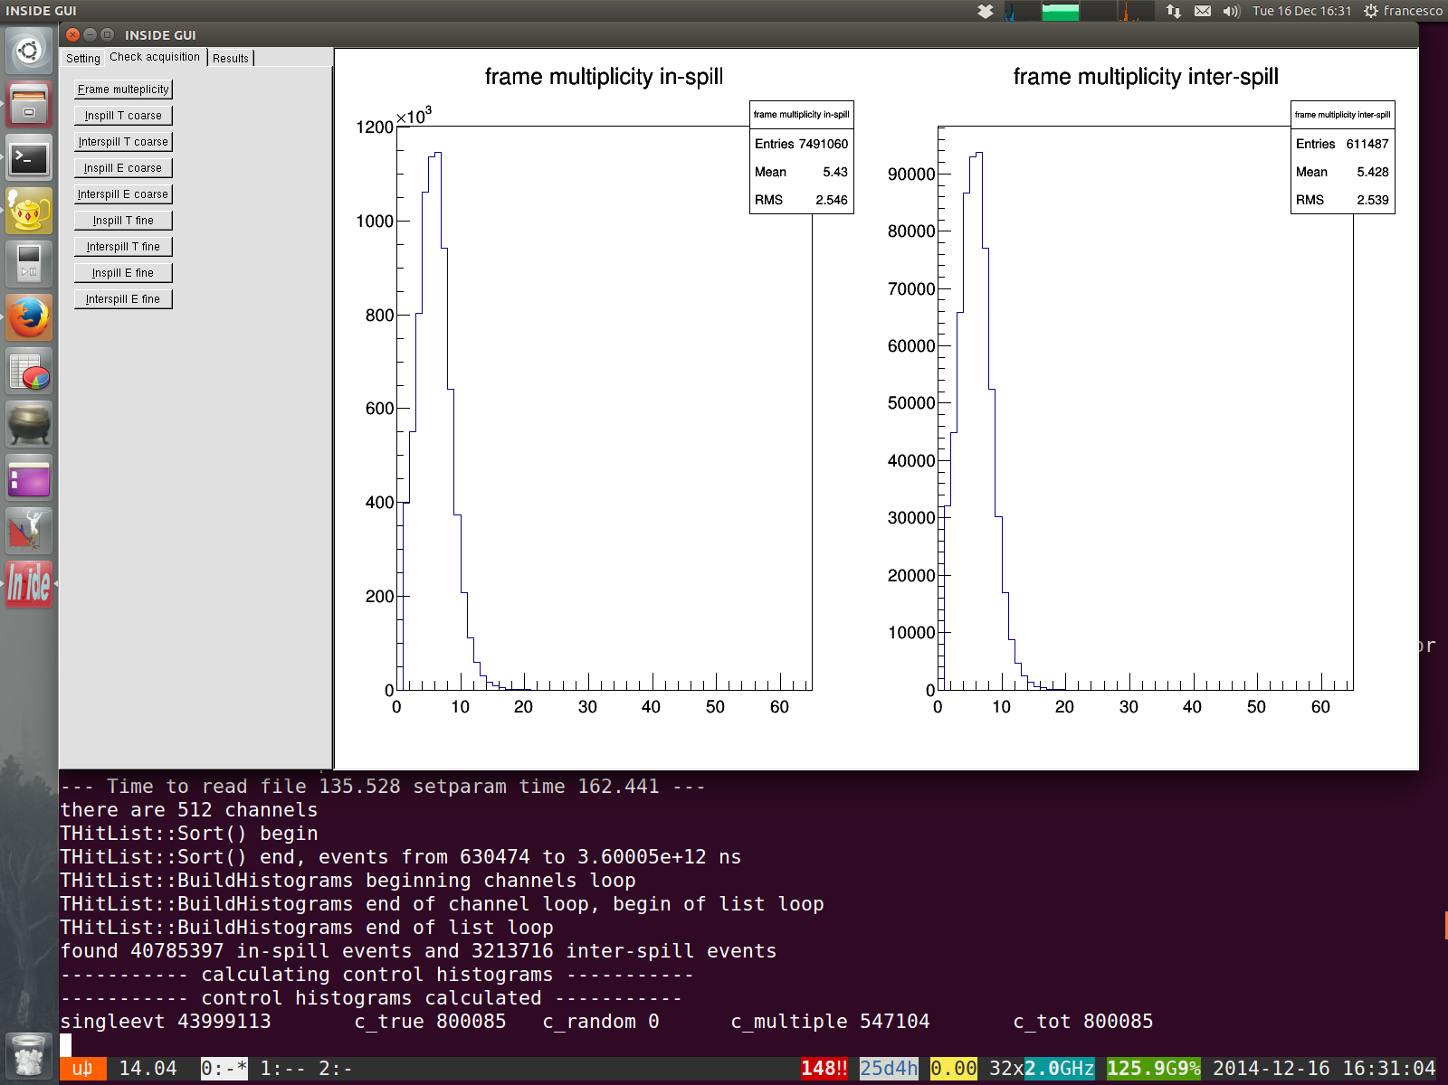
Software development
As the INSIDE PET detector size increases, number of histograms needed is becoming huge: an interface is being developed to increase data analysis efficiency and to evaluate overall chip and detector behavior.
In- and inter-spill values
Number of events per frame
INSIDE meeting, Roma, December 18th 2014

Slide 15
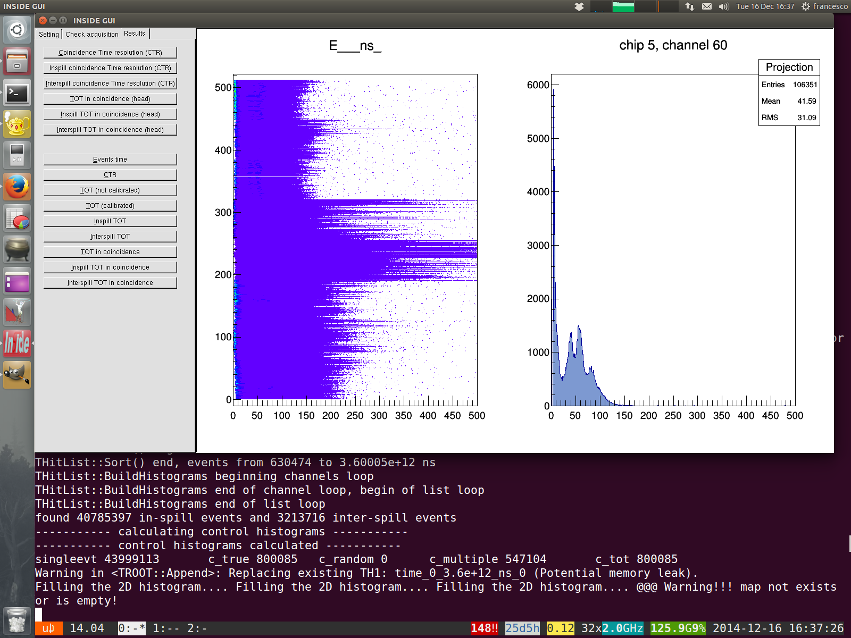
Software development
As the INSIDE PET detector size increases, number of histograms needed is becoming huge: an interface is being developed to increase data analysis efficiency and to evaluate overall chip and detector behavior.
Single-channel figures of merit
TOT and CTR behavior of channels of the same chip are about uniform, chip by chip calibration and channel-by-channel fine calibration is needed, feasible off-line via software
INSIDE meeting, Roma, December 18th 2014

Slide 16
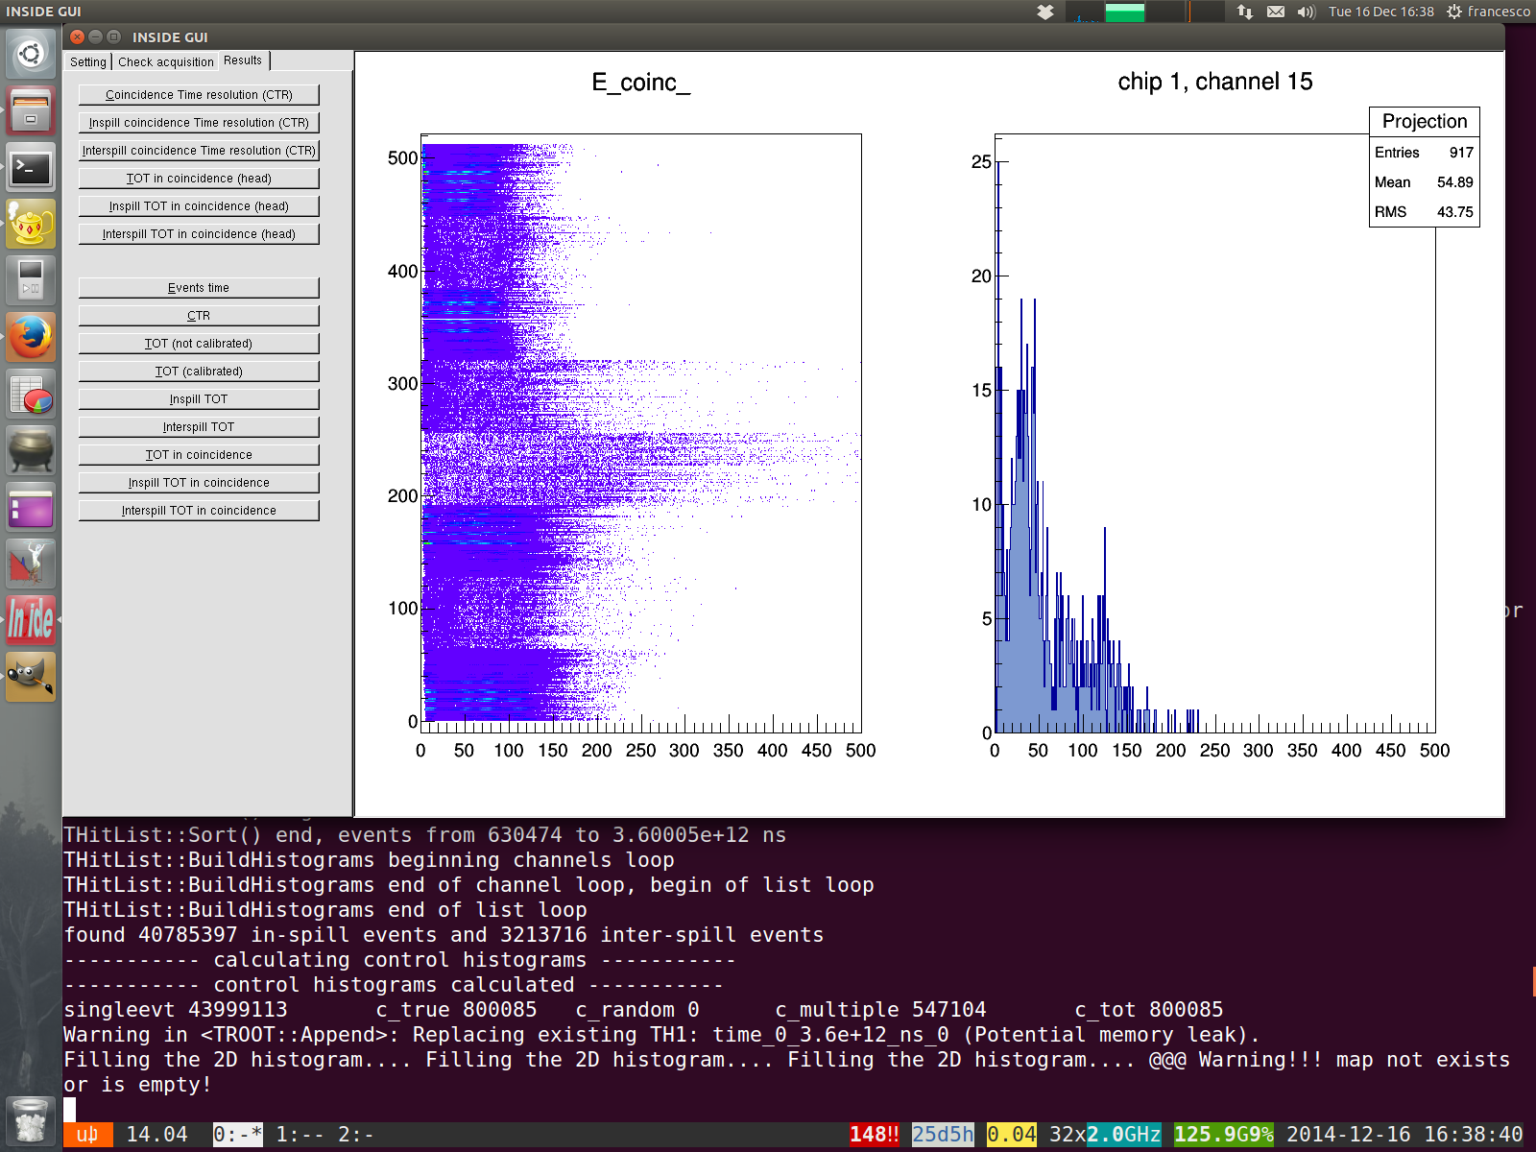
Software development
As the INSIDE PET detector size increases, number of histograms needed is becoming huge: an interface is being developed to increase data analysis efficiency and to evaluate overall chip and detector behavior.
Coincidences figures of merit
INSIDE meeting, Roma, December 18th 2014

Slide 17
Conclusions and outlook
Preliminary data shows that the modules fully meet the project requirements in terms of time and energy resolution.
Analysis software is stable and flexible (it analyses both simulated and acquired data).
Data analysis graphical interface is available.
Future work:
Channel-by-channel equalization to extend the single channel vs channel results to module vs module
Energy calibration
Data analysis optimization:
Analysis of binary data
Extension of GUI functionalities
INSIDE meeting, Roma, December 18th 2014

