Slide 1
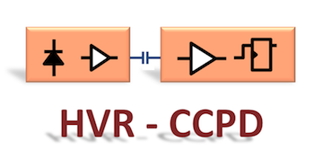
Hybridization Studies:
SU8, Assembly
HV/HR-CMOS Genova Meeting
5 December 2014
Alessandro, Andrea, Ettore, Giuseppe, Michele, Nanni, Valentina
Indico:
https://agenda.infn.it/conferenceDisplay.py?confId=8981

Slide 2
Brief Summary Since Last Time
Many progresses made since last meeting (6.10.2014)
  Deposition of columns on FE-I4
  Gluing test with large/small chips (ATLAS DORIC)
  Real assembly of HV2FEI4 from Geneva University: G1 and G2.
You can find detailed information at:
  https://espace.cern.ch/project-INFN-HVR-CCPD/Hybridization/Shared%20Documents/SU8%20on%20FE-I4/14-12-04_Gluing%20QA_V4.pptx
  We report here only last achievements on G1 and G2

Slide 3
G1
Assembly of a HV2FEI4 (G1) with a FE-I4 (VTBA96H : 43)

Slide 4
Procedure
Glued kapton tape (measured 60 µm thickness) to G1 back side
  Tape exceeding G1 by 2 mm on each side
  Chip with tape vacuum hold by Fineplace head.
  To permit better alignment chip decentred (see figure)
FE-I4 has deposited pillars of 40x40 µm size
  Pillar height about 3 µm (same recipe as used on Siegert
  wafers that was tuned for 5 µm. Effect due to different surface of FE-I4 from polished wafer.
  Glue (EpoTEC 301-2) deposited on FE-I4 by syringe needle. Quantity evaluated form “experience”.
  Flip chipped on Friday 7/11. Weight put to minimum (3 kg).
  Cured at 100ºC for 99 min (max settable timer) then temperature dropped to 70ºC until Saturday, left untouched until Monday for glue curing.
Remove kapton tape (Monday 8/11).
  Checked position XY of chip respect FE-I4 structures before and after removing tape (worries that glue isn’t strong enough) – see next slide photo
  Removed 4-corners of kapton tape (about 1 mm each) – measured step from G1 back to FE-I4 passivation layer. Peel-off rest of kapton in stripes. Re-measured 4-corners heights: no change!
Pickup head
Vacuum hole
G1 chip
Kapton

Slide 5
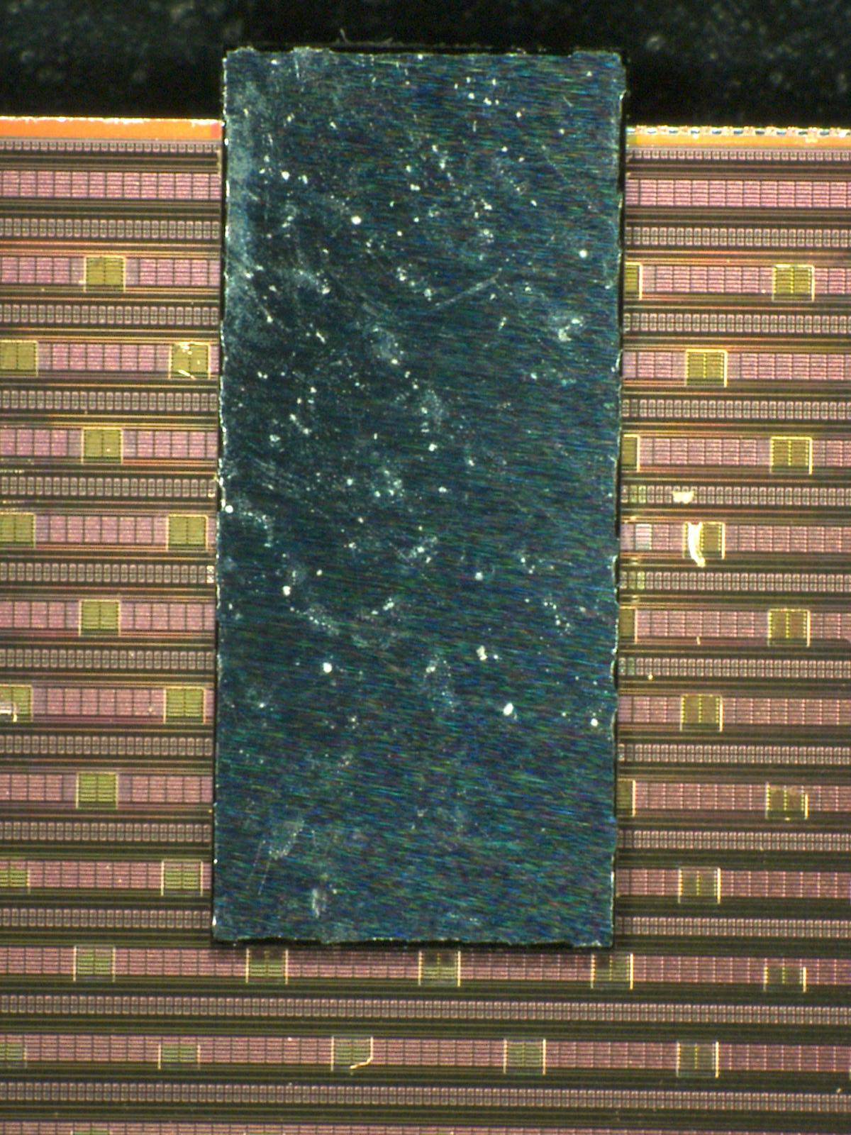
Measurements
The 4 corners of the chip have been measured for step height:
  Up to 10.5 µm difference on two diagonally opposed corners
Result is unsatisfactory!
  What the issues and how to improve?
Issues:
  The pick up head was decentred respect to chip position – this to have full view of all G1 pads.
  The small column are probably to thin to respond to a skewed force application.
topRight
256.0 µm
bottomRight
264.3 µm
topLeft
253.7 µm
bottomLeft
258.1 µm
2.32 mm
Position of
vacuum sucking
DORIC chip
5.20 mm
4.75mm
 | Left [µm] | Right [µm]
top | 253.7 | 256.0
bottom | 258.1 | 264.3

Slide 6
G2
Assembly of a HV2FEI4 (G2) with a FE-I4 (VTBA96H : 44)

Slide 7
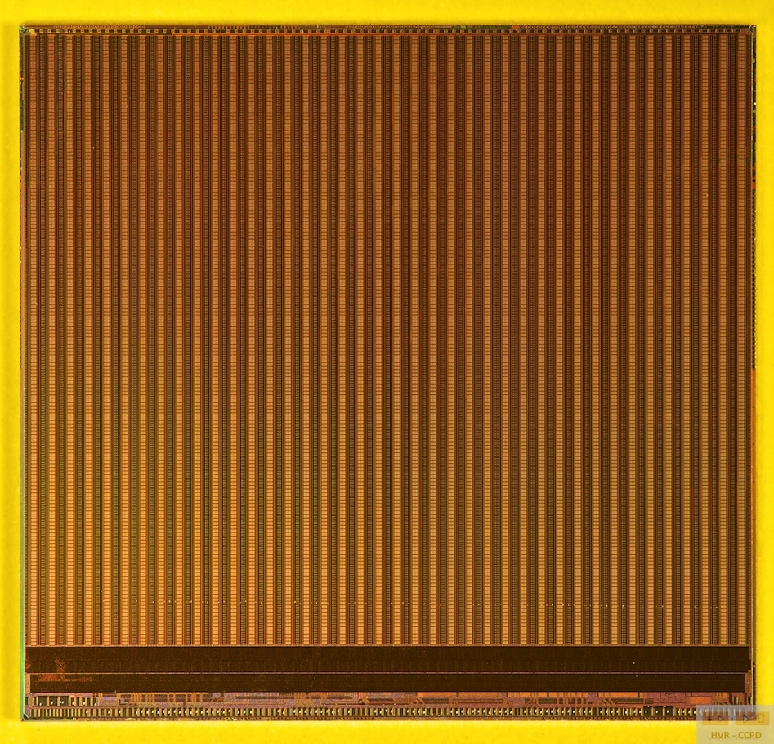
SU8 Columns
FE-I4B
  Wafer: VTBA96H
  Chip: 44
Column no.1 (typical)
  Left peak: 4.47 µm
  Center: 3.63 µm
  Right peak: 4.00 µm
  Average: 3.9 µm
Colum heights averaged on 200 µm top
3.90 µm
3.82 µm
3.77 µm
3.79 µm
3.76 µm
3.85 µm
4.01 µm
Zoom
3.63 µm
4.47 µm
4.00 µm
Scan direction – 2 cm
Average 3.9 µm

Slide 8
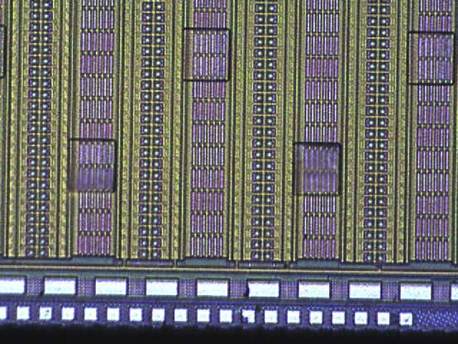
Edge Bead Removal
First column row is too high because of bead effects:
  Edge bead remover: chemical solution ( 0.6 ml acetone, in our case) at the end of the spinning
    Easy solution to remove the problem of
    the beads
    PROBLEMS:
      Non reproducible activity because of the
      set up
      Squared sample: also su8 at the corners
      are removed
EBR used in 2 samples (44 and 43)
  Good results in terms of uniformity of the
  columns
  Problem in the “flatness” of the
  columns because
  of the non-flatness
  of the substrate!
Last row of spacers:
Position bottom right
Resist removed
Resist not removed

Slide 9
Bump Pad Alignment
We have modified the head of the “Fineplace-96” flip-chip machine to have the small chips well visible under microscope
  Modification consists in adding a small plate that moves the vacuum hole by 3 mm (see next slide).
  Plate made of brass (too high CTE); we cannot heat up too much for curing the glue: experienced ~25 µm displacement at 150ºC – decided to cure at 50ºC.
Qualify the modification with a glass chip of the size of the HV2FEI4 having bump pattern as in the FE-I3: only some bump pads columns can be aligned with FE-I4 pads
  Glass with indium bumps attached to a kapton (60 µm thick) 2 mm larger than the chip to protect the backside from being glued onto the flip-chip head. It also compensate pressure on entire chip coming from not perfect parallelism between facing surfaces to be glued.
  Glass-chip bumps aligned with FE-I4 (VTBA96H – 51) bump-pads
  Cured at 50ºC for 2 days.
  Kapton removed and bump alignment checked with microscope (see next slides) – alignment is good!
  Measured steps between back-of-chip and FE-I4 (reference is top of passivation of top metal – MA)

Slide 10
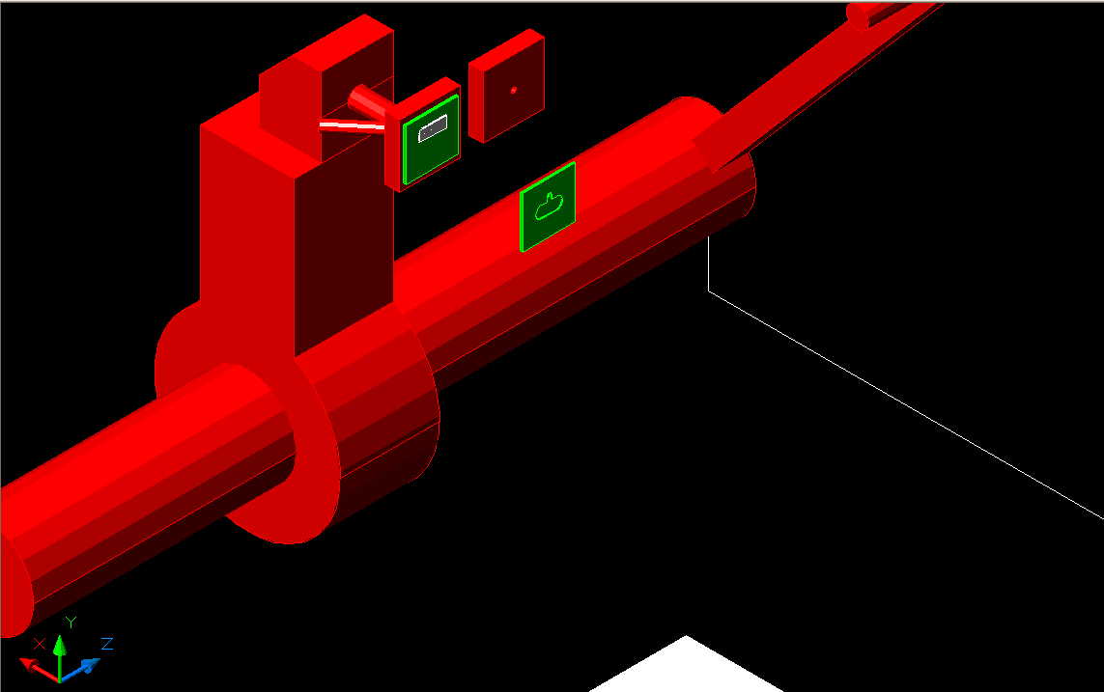
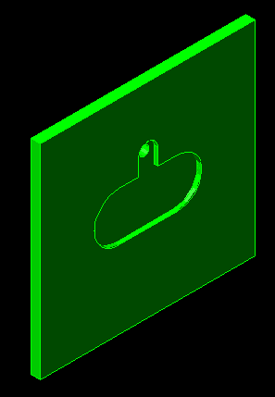
Fineplace 96 Head Adapter
as
Head
Head + plate.
Plate seen from back side
Added plate (zoom in).
Total thickness 0.5 mm
Hole (φ = 0.5mm) for vacuum
aspiration of HV2FEI4 chip
In machining using invar

Slide 11
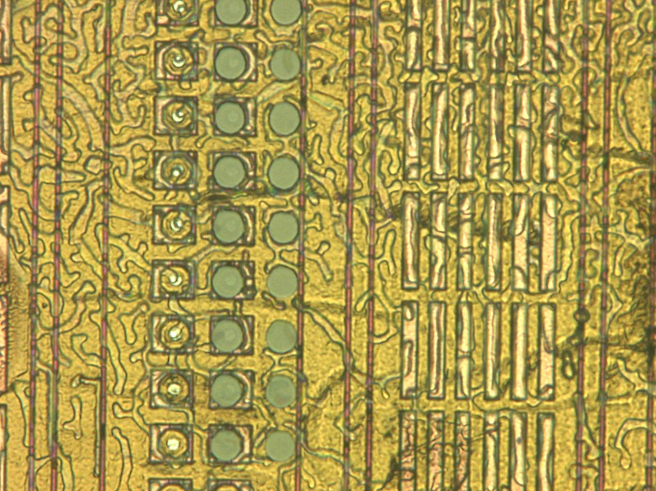
Bump Pad Alignment
Steps: glass to FEI-4 | Left [µm] | Right [µm]
Top | 310.50 | 309.06
Bottom | 310.06 | 309.16
Very good alignment over the whole chip area
Note on “bubble-structures”
Probably some contamination of the EpoTEK 301-2 with alcohol isopropyl used for cleaning before gluing
Tested again, better drying, with another glass on same FE-I4 chip: no issues - see next slide

Slide 12
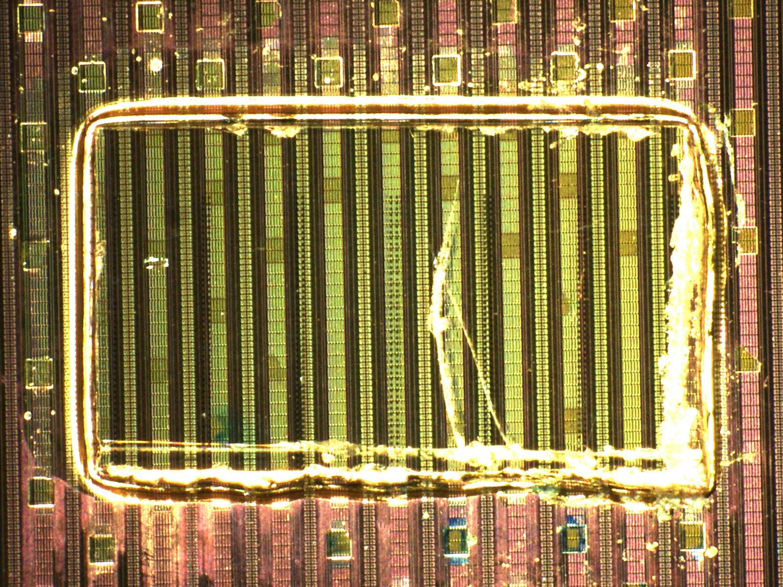
ds

Slide 13
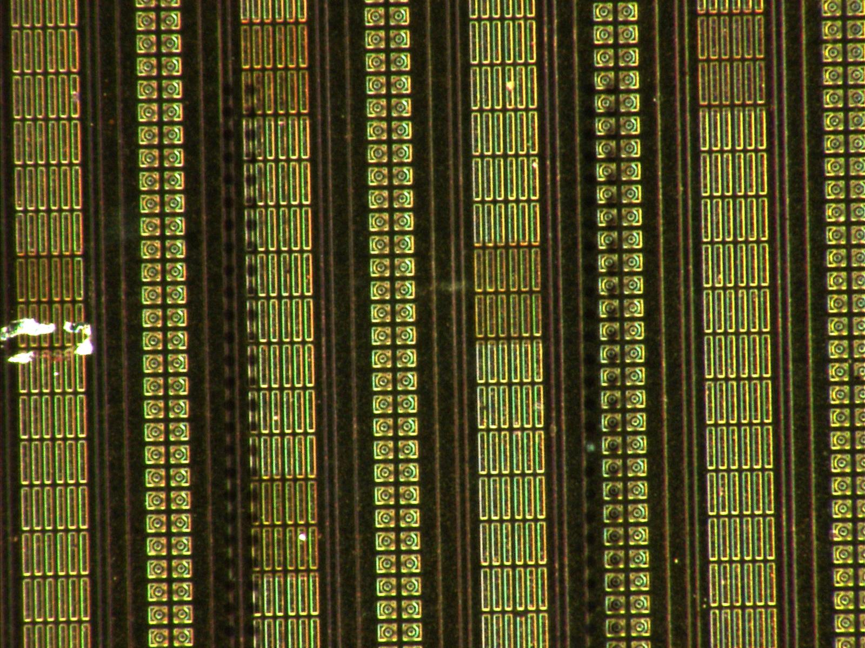
d
SU-8 columns
Glue on top of the glass
Note
Glass applied without additional pressure than weight.
Cured at 50ºC in the owen
No bubbles visible between glass and FE-I4.

Slide 14
Gluing and Aligning Process of G2
Process steps:
  Kapton tape attached on the back side of G2 (about 1 mm side extending chip dimension)
  G2 aligned to FE-I4 using the added brass plate
  0.4 µl of EpoTEK 301-2 applied with micropipette to FE-I4
  Applied pressure (2kg) and 50ºC for the whole weekend (Fri 27/11 to Mon 1/12)
  Kapton removed from 4 corners (<< 1 mm² per corner) and step height to FE-I4 measured
  Kapton fully removed and step height in the same corners measured again. Measurements match within 250 nm.
Comments:
  We consider that the chip is aligned in XY, since the same process was done with several glasses with bumps providing repetitive results
  Column heights we measured in a range of 250 nm (between tallest and shortest)
  Next slides we bring measures of the step between G1 back to FE-I4…

Slide 15
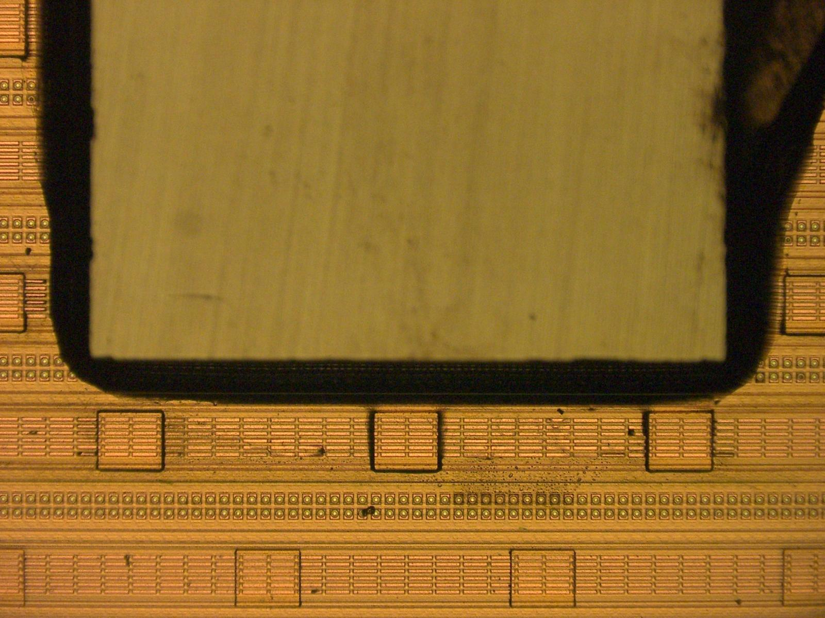
HV2FEI4 (G2) chip
sa
SU8 Column: 225 (➔) x 200 (⬆) µm²
FE-I4B
Wafer: VTBA96H
Die: 44

Slide 16
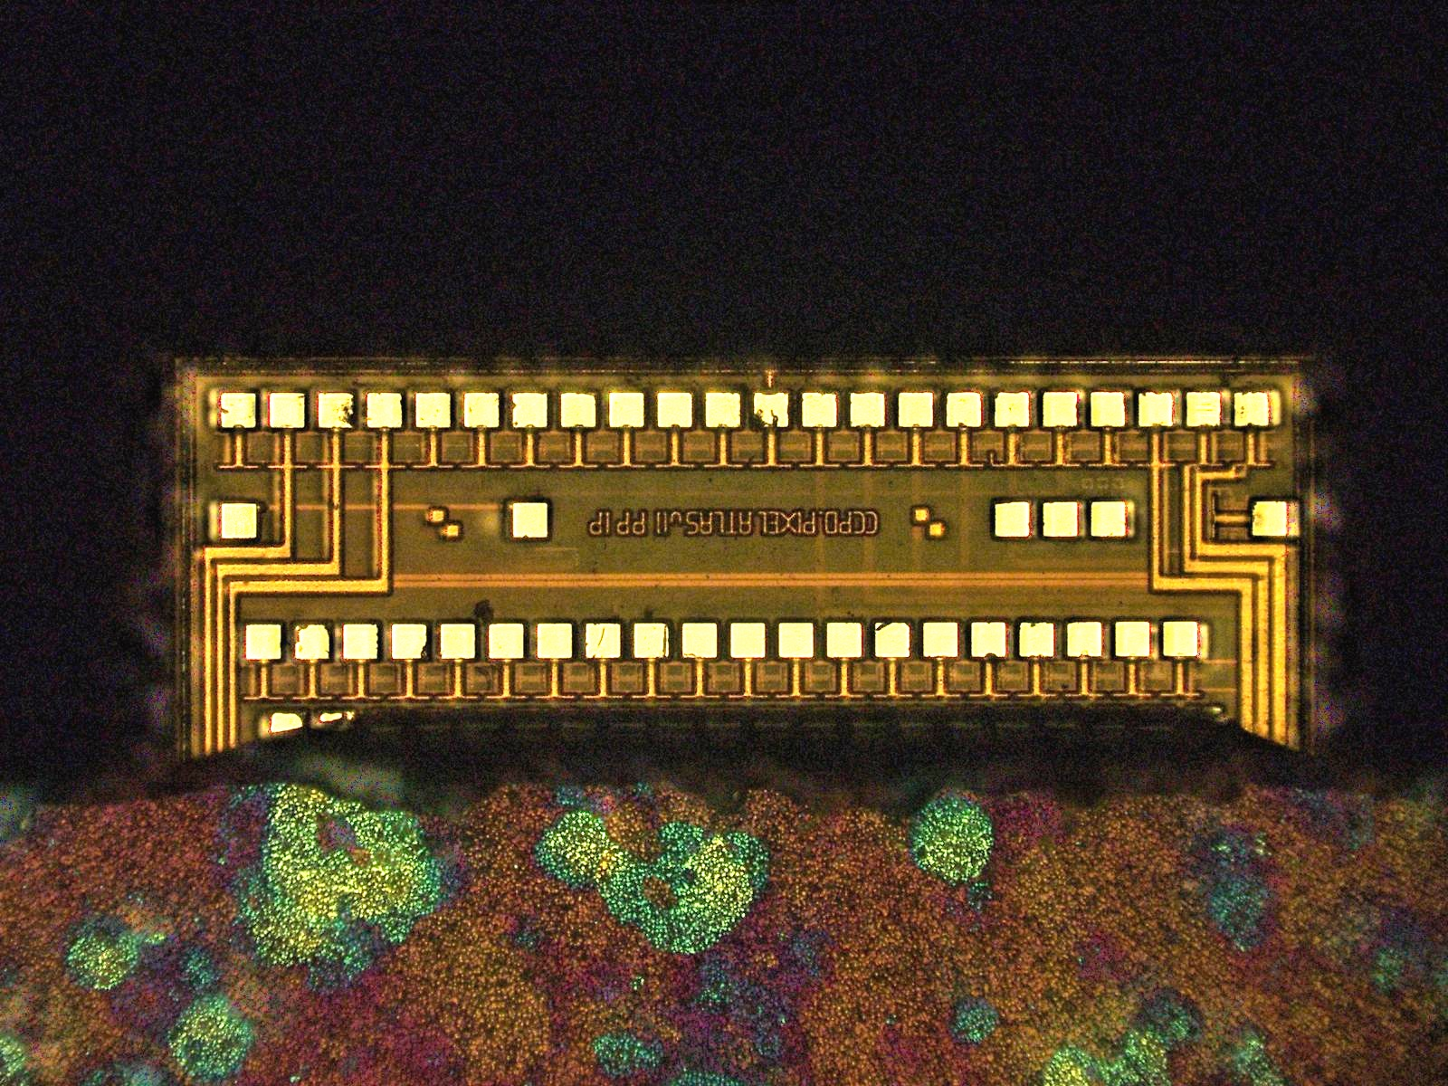
FE-I4B – back side
sd
G2 pads are clean from glue

Slide 17
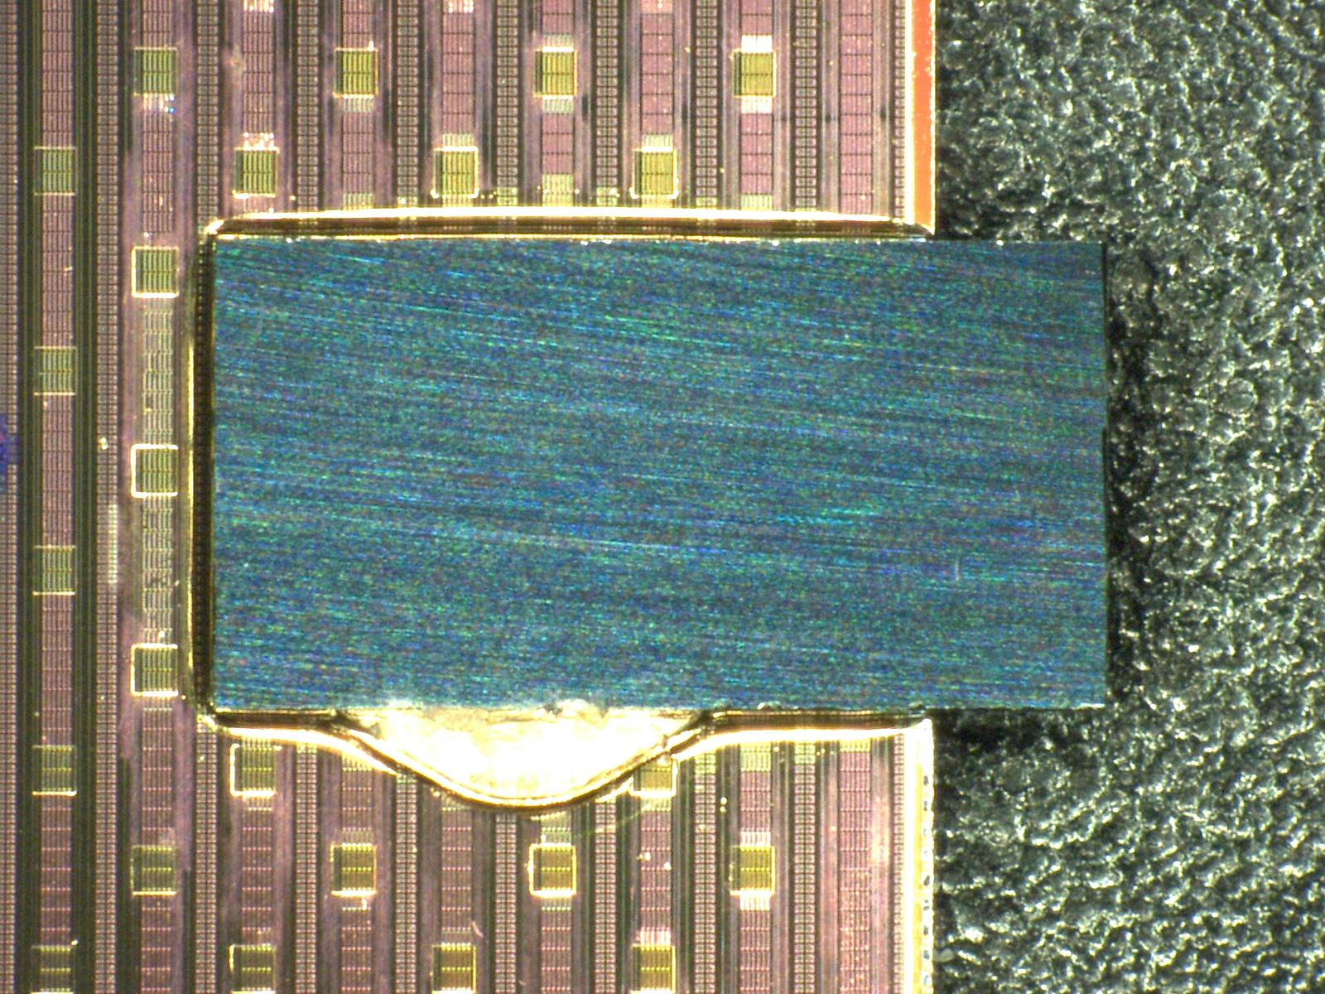
sd
 | Side A [µm] | Side B [µm]
Scan 1 | 254.40 | 257.04
Scan 2 | 257.31 | 257.91
Scan 3 | 256.77 | 257.83
Scan 4 | 256.55 | 257.55
Scan 5 | 255.97 | 257.23
Side A
Scan 5
Scan 4
Scan 3
Scan 2
Scan 1
Side B

Slide 18
G2 Backside
Scan 1
G2 backside has some bowing
Non known if it is thickness variation or chip bow.
1st scan corresponds to where the minimum in step high is seen
Suspect that there is some waviness on the backside of the G2 chip coming from wafer thinning (see profiles and photo) – probably better uniformity on front side.
  Next assembly study both surfaces before gluing and see, if any correlation exists after gluing
Scan 2
 | Side A [µm] | Side B [µm]
Scan 1 | 254.40 | 257.04
Scan 2 | 257.31 | 257.91
Scan 3 | 256.77 | 257.83
Scan 4 | 256.55 | 257.55
Scan 5 | 255.97 | 257.23
Scan 3
Scan 4
Scan 5
Probably EpoTEK glue on the chip edge
Step measured after the bump

Slide 19
G2 – IV Measurements
IV curve has been measured before and after gluing by contacting:
  GNDA -> GND
  VDDA -> GND
  SUB -> -V_{bias}
Current < 20÷30 nA before breakdown
  V_{BD} = 94 V before and fatre gluing
  Small current increase (by 10 nA) after G2 is
  glued. Probably due to mechanical stress
  (or glue?)

Slide 20
Conclusions
G2 gluing indicate that the results are consistently better than G1 (gaining experience) – we have “good reasons” to believe that:
  The XY alignment is in the range of 2÷3 µm
  The distance between the G2 and the FE-I4 is:
    4 µm of the columns + 2 µm of the FE-I4 passivation + ?? of the G2 passivation (Al-pad to Al-pad). We have not measured the G2 topography
    Variation in the step heights is probably due to rough lapping of the back surface and not to real variation of the distance between G2/FE-I4
Next steps
  Assemble the chip and test the behaviour: try to verify uniformity of the signal from G2 to FE-I4
  Assemble others HV2FEI4 and progress in the understanding of the hybridization process.

Slide 21
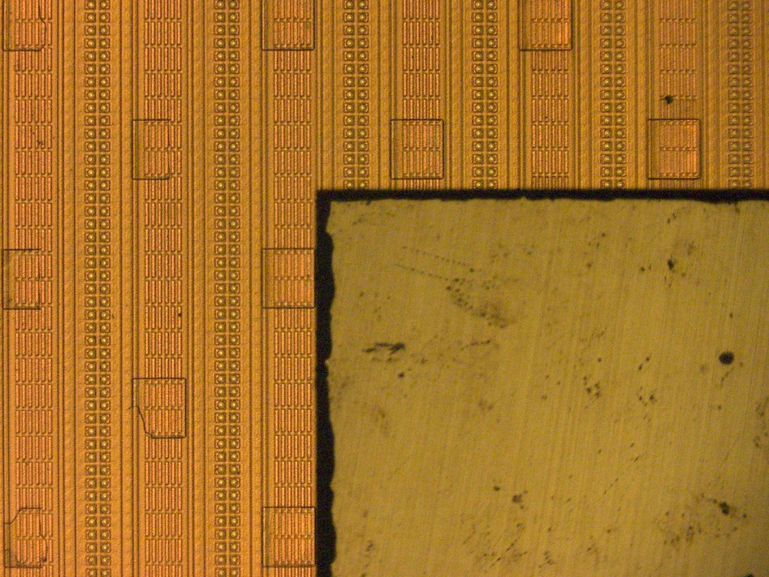
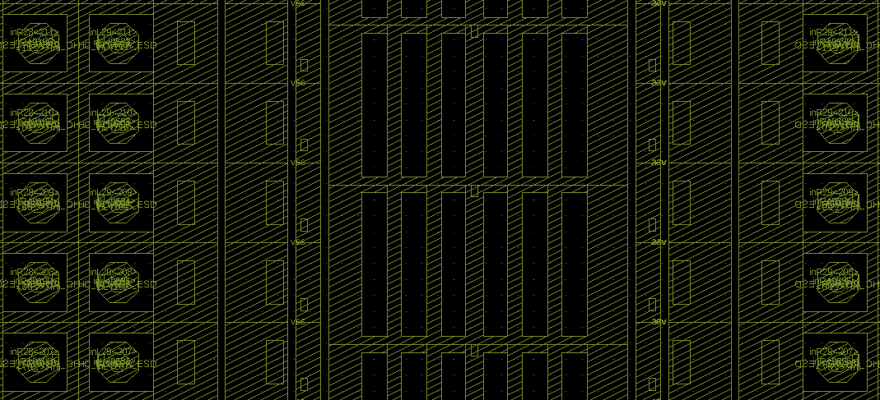
Reference Surface for Step Measurement
from here
to here
Measurements made from chip back to top FE-I4 metal (MA). MA layout is show below. Levelling and roughness filtering is applied to obtain accurate value.

