Slide 1
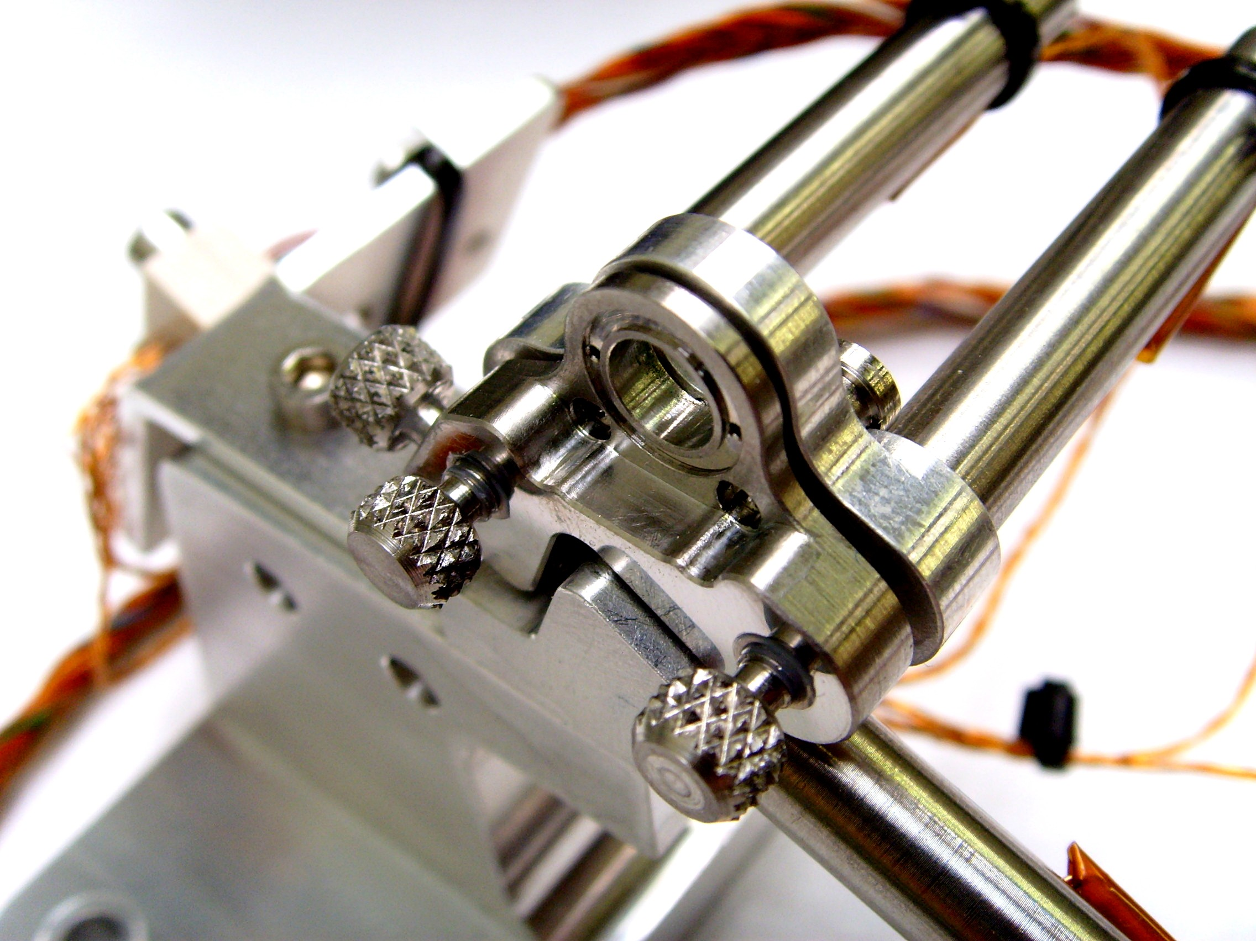
Testing the quantum superposition principle
Hendrik Ulbricht
School of Physics and Astronomy
University of Southampton
United Kingdom

Slide 2
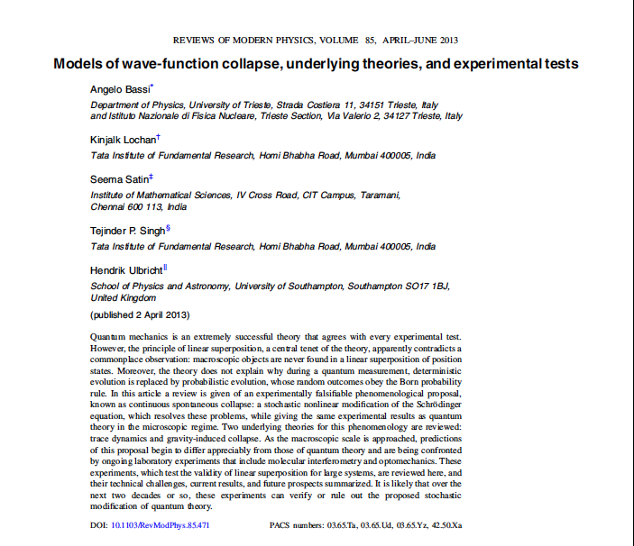
One motivation: Test Collapse models
Collapse models:
CSL, GRW,
Diosi-Penrose, …
Also non-collapse
Models:
Schroedinger-Newton

Slide 3
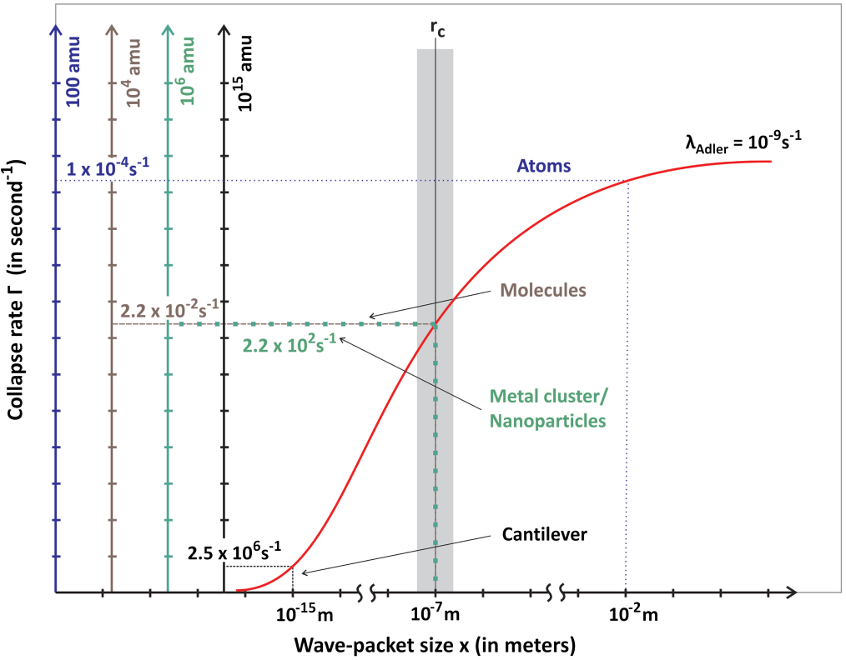
What system parameters do we need to generate macroscopic Quantumness?
Large mass
Larger spatial separation/ size of superposition state
Large time for the superposition state to exist

Slide 4
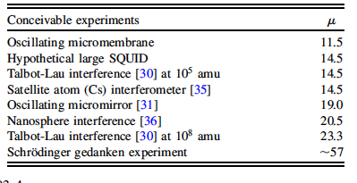
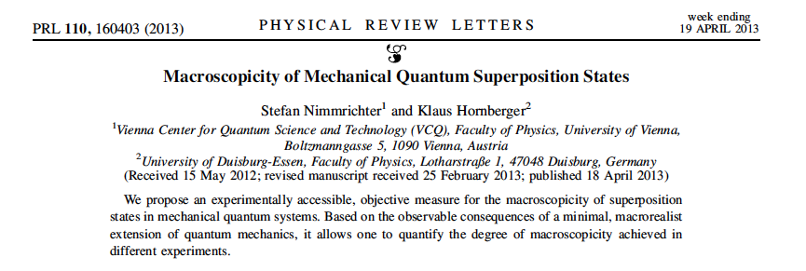
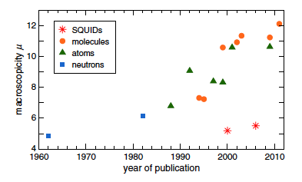
Macroscopicity measure: to compare different experiments and to check if they test the superposition principle and CSL models

Slide 5
Molecule interfrometry
Scaling mass in matter-wave interferometry …

Slide 6
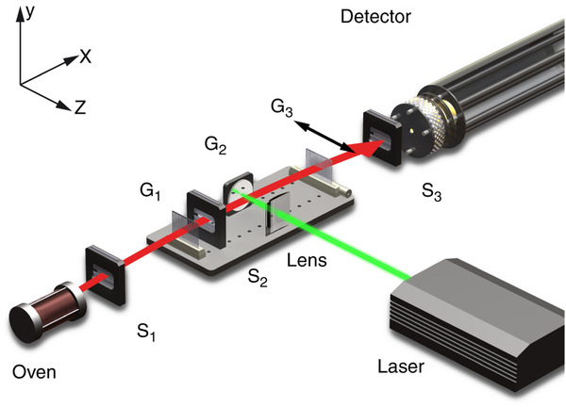
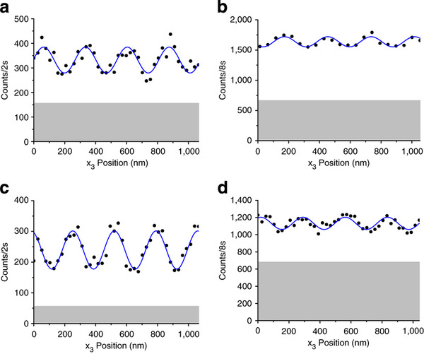
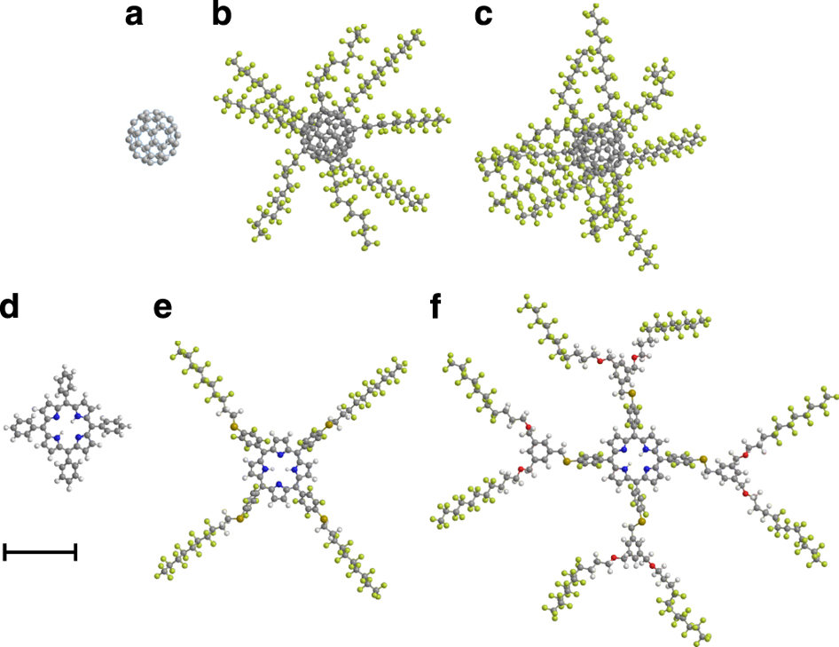
Mass record in matter-wave interferometry, 2013, Vienna: 10,000amu
Kapitza-Dirac Talbot-Lau Interferometer

Slide 7
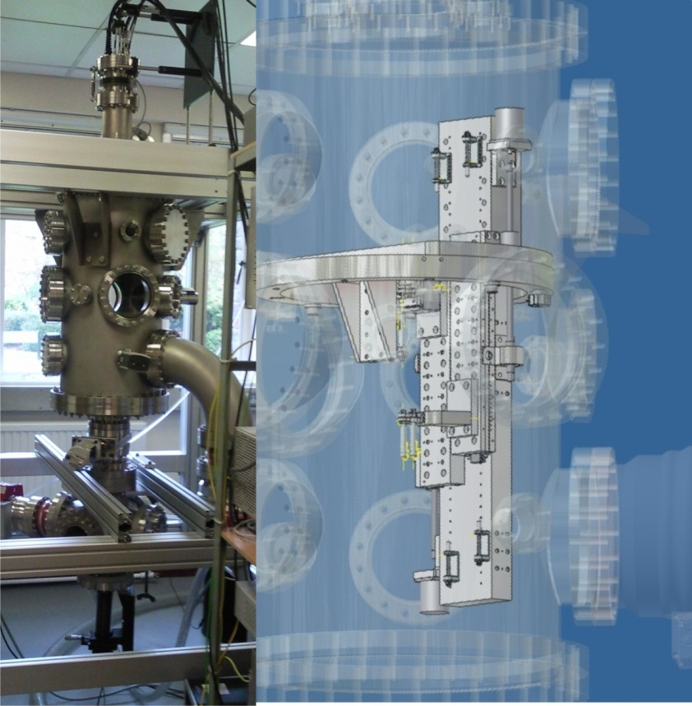
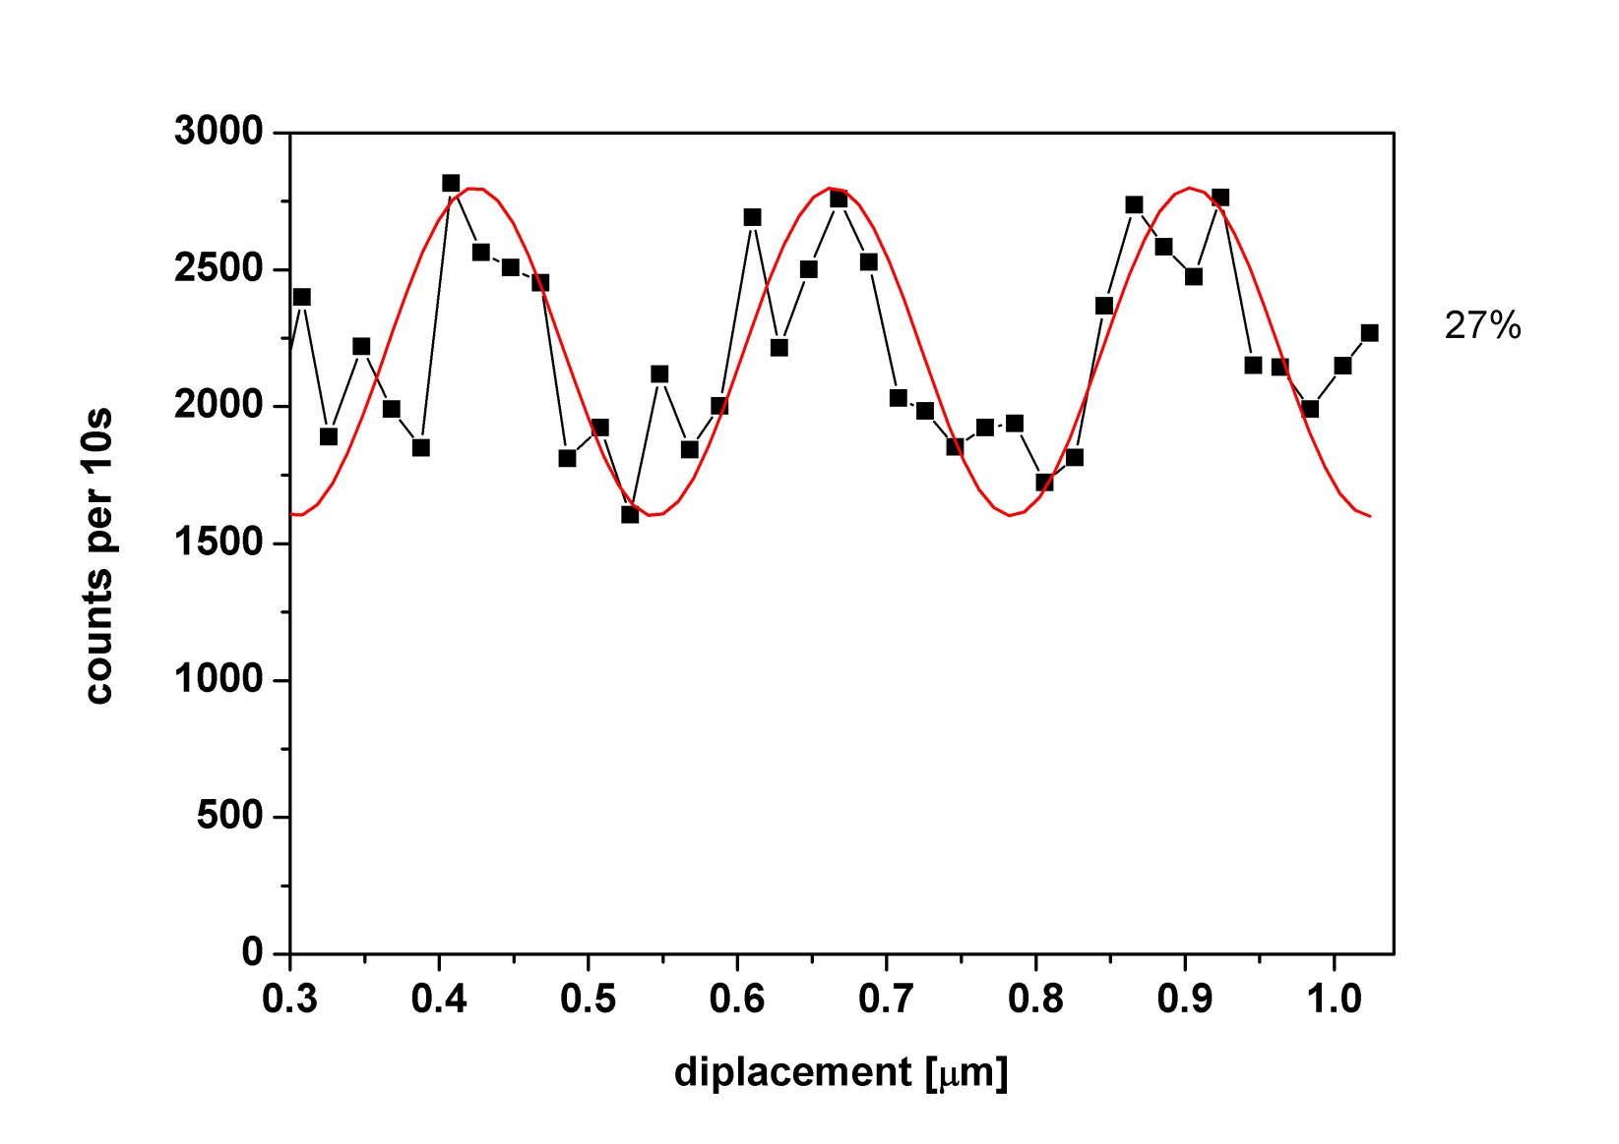
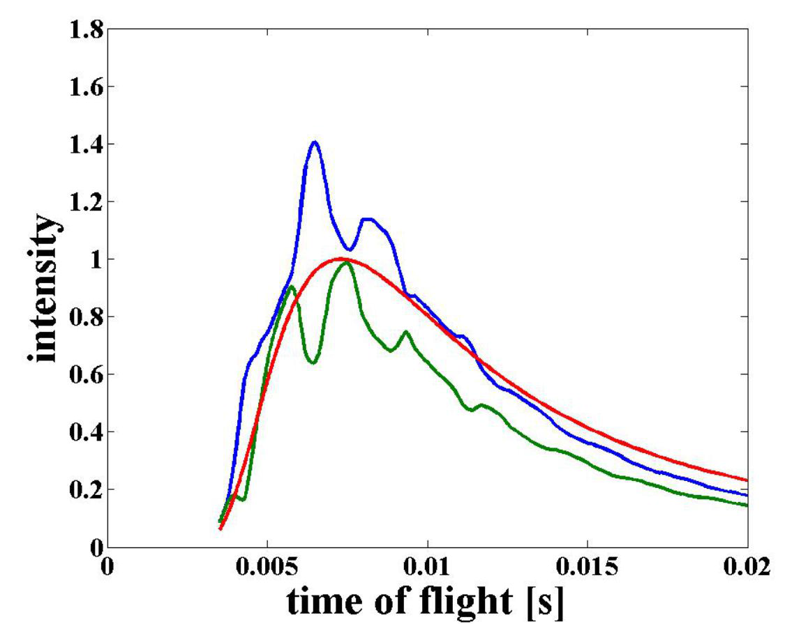
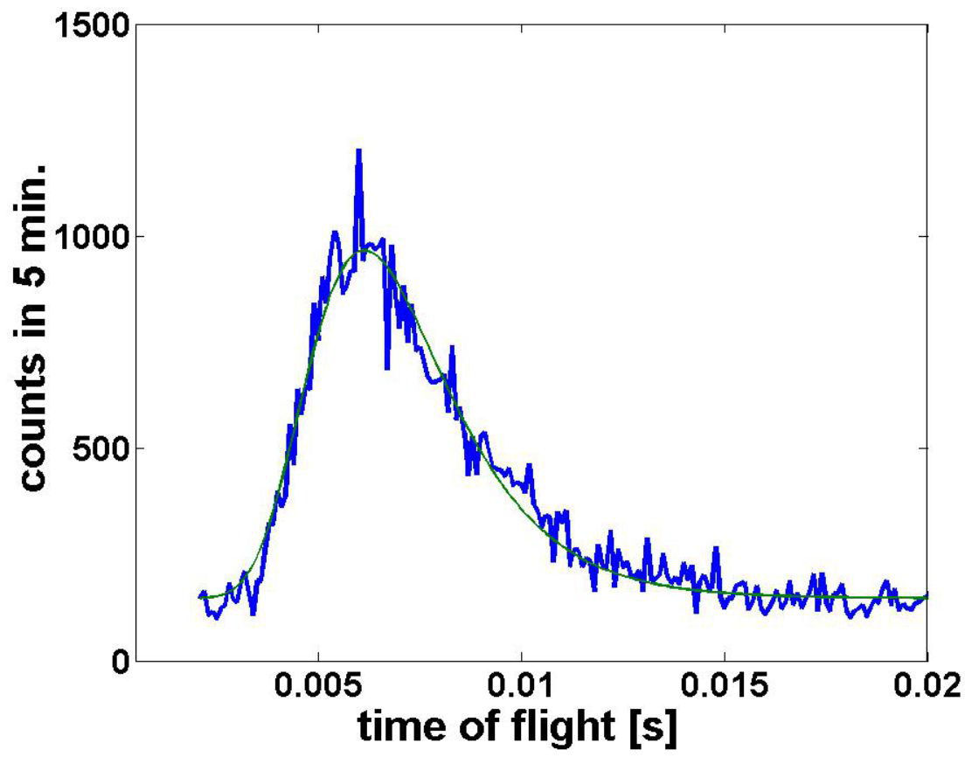
Talbot-Lau Interferometer
Set up of vertical interferometer
in Southampton:
Van der Waals/Casimir Polder interactions
Wigner function reconstruction
Spin effects
WORK IN PROGRESS
Settings:
10⁻⁸ mbar base pressure
Water cooled Knudsen source
In-situ grating alignment & positioning
TOF scheme
Time-of Flight modification
Count rate (cps)
First signs of life!
3rd grating position (µm)
7

Slide 8
Nanoparticle interferometry
Scaling mass even further … good for gravity sensing (decoherence and dephasing) … technologies much simpler than for molecules

Slide 9
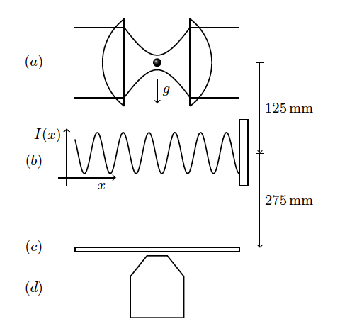
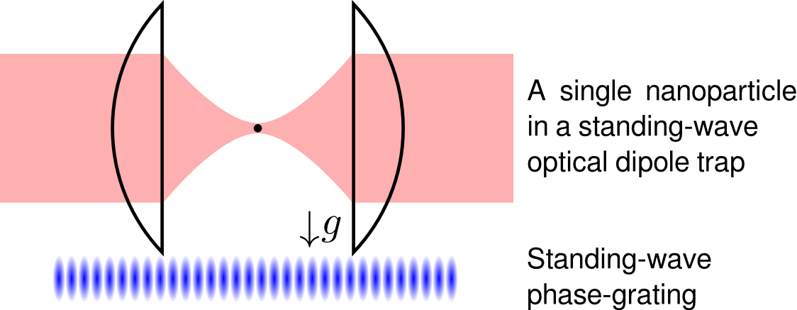
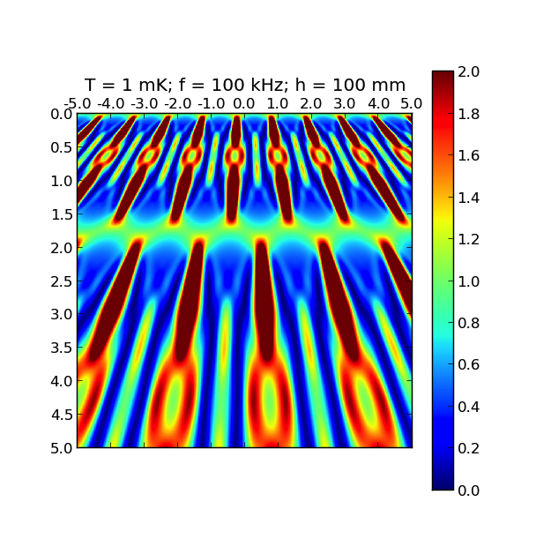
Our Scheme: Matter-wave interferometry of 10 nm sphere
Talbot interference of mass: 10⁶ amu
Setup:
Quantum carpet:
Wigner function model of interference pattern with all known dephasing and decoherence effects.
Dominating decoherence effect: Thermal photo-emission.
Mass of particle is limited by Earth’s gravity … future experiment in space?
Based on existing techniques!
Bateman, J., S. Nimmrichter, K. Hornberger, and H. Ulbricht
Near-field interferometry of a free-falling nanoparticle from a point-like source
Nature Communications 4, 4788 (2014).

Slide 10
The matter-wave to opto-mechanics interface
To scale mass even further …. (10¹³ amu)

Slide 11
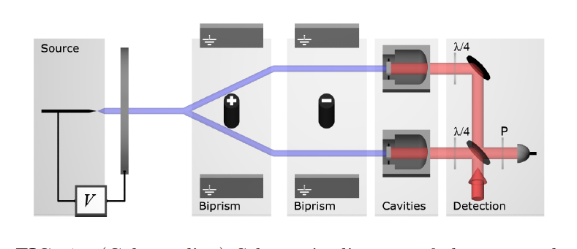
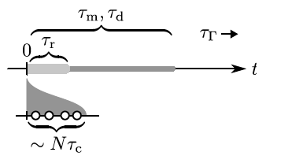
How to go bigger?: Transfer superposition state!
Scheme for experiment (matter-wave->mechanics->optics):
Spatial superposition state of atomic He⁺ is incident to a pair of mirrors
Mirrors are coupled to light in cavity
Read-out of light field by state tomography by pulsed opto-mechanics scheme
Optics is coupling the motional state of the two ‘initially’ independent opto-mechanical
systems., generating a joint motional state. All individual (solid-state) effects in each optomechanical
System is erased – and the spatial information about them is lost,
Then the particle hit ….
Time- scales involved:
Faster than decoherence!
All parts of this proposal are based on existing, demonstrated technology
Macroscopicity of 30 (Nimmrichter macroscopicity)
Xuereb, A., H. Ulbricht, and M. Paternostro, Optomechanical interface for matter-wave interferometry, Scientific Reports 3, 3378 (2013).

Slide 12
Theoretical analysis:
Number state for incoming particle in superposition
Thermal state for both opto-mechanical systems (no ground state needed!, state can be different for both)
Definition of joint motional state of opto-mechanics
Negativity of Wigner function of the joint mechanical state by state tomography (as by pulsed optomechanics)
Result: Superposition state survives transfer!
Xuereb, A., H. Ulbricht, and M. Paternostro, Optomechanical interface for matter-wave interferometry, Scientific Reports 3, 3378 (2013).

Slide 13
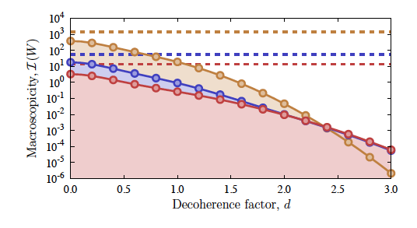
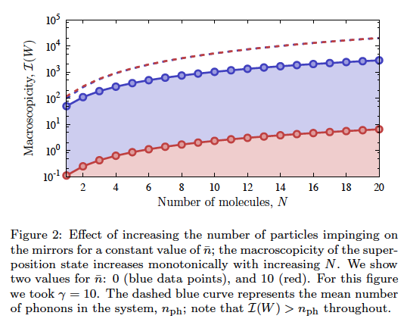
Study the system: Look into a definition of macroscopicity of this specific system, treatment of decoherence …
Macroscopicity of our
system
Macroscopicity depending on
generic decoherence
A. Xuereb, H. U., M. Paternostro, Macroscopicity in an optomechanical matter-wave interfrometer, Octics Comm. (2014).

Slide 14
Different approach: Frequency domain tests

Slide 15
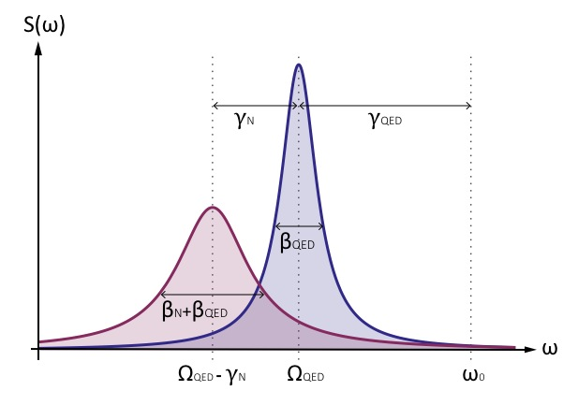
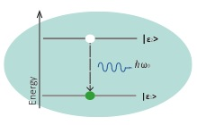
Generic broadening of spectral linewidth from collapse (noise):
Bahrami, M., A. Bassi, and H. Ulbricht
Testing the quantum superposition principle in the frequency domain
Phys. Rev. A 89, 032127 (2014)]

Slide 16
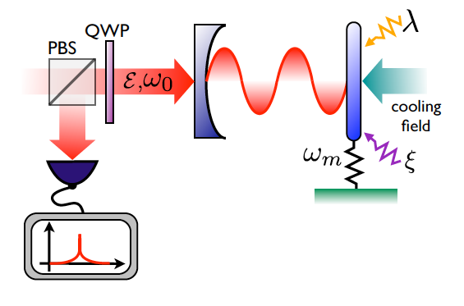
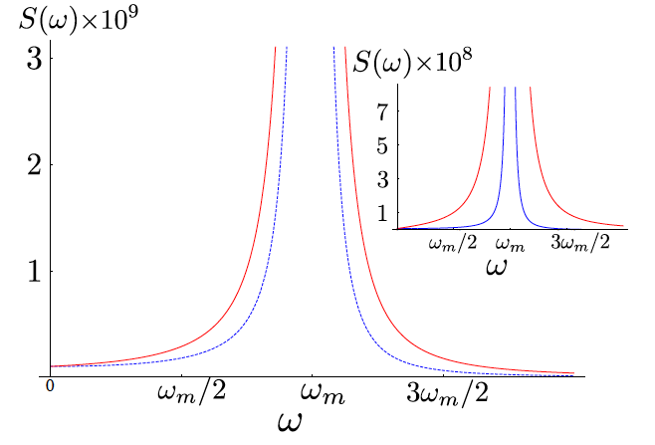
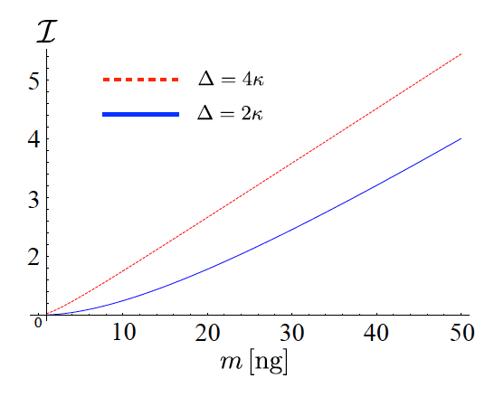
Applied to opto-mechanical system
Collapse noise affects mechanical motion of
opto-mechanical system, read out by optics
Broadening effect modeled by input/output theory
of opto-mechanics.
Factor of 5 effect for cooled mechanics predicted for
realistic experimental conditions to test Adler CSL.
Can also be applied to levitated opto-mechanics
M. Bahrami, M. Paternostro, A. Bassi and H. Ulbricht
Proposal for Non-interferometric Test of Collapse Models in Optomechanical Systems, PRL 112, 210404 (2014).

Slide 17
Thanks to ….
Group at Southampton: James Bateman, Nathan Cooper, Muddassar Rashid, David Hempston, Jamie Vovrosh.
Quantum Optics theory: Mauro Paternostro, Andre Xuereb.
Matter-wave interferometry and experiments: Markus Arndt, Klaus Hornberger, Stefan Nimmrichter,
Foundations of Physics: Angelo Bassi, Mohammad Bahrami, Tejinder P Singh

