Slide 1

SPES status
BOZZA
2° Meeting of the SPES Technical Advisory Committee
Gianfranco Prete
Project leader
LNL, December 4th 2014

Slide 2
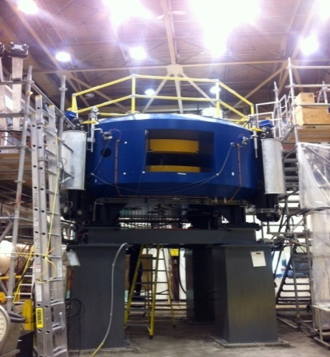

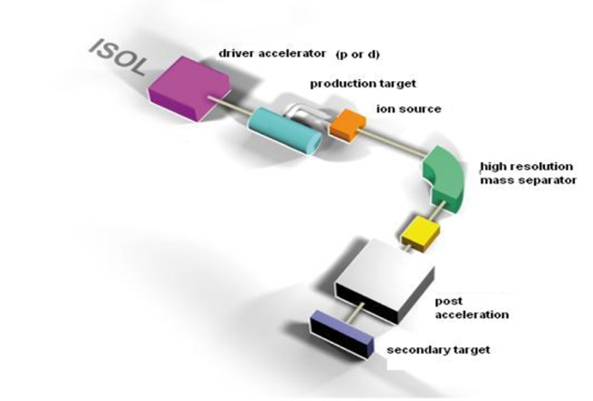
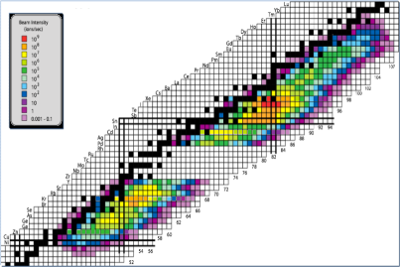

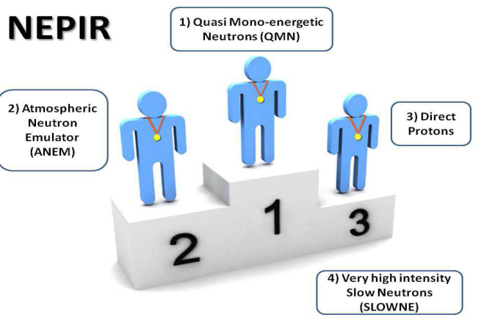
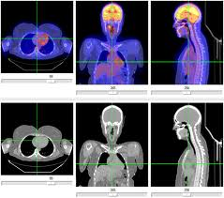
SPES Strategy
Second generation ISOL facility
Toward
BEST Cyclotron installation & commissioning:
70 MeV proton beam
750 μA
Production & re-acceleration of exotic beams, especially neutron–rich from p-induced Fission on UCx
α
β
LARAMED
γ
δ
Research and Production of Radio-Isotopes for Nuclear Medicine
Accelerator based neutron source (Proton and Neutron Facility for Applied Physics)
Notes:
The SPES strategy was already presented many times: it is related to the division of the project in phases which are independently financed.
The alpha phase which is gonna to be quickly completed refers to the construction of a new building for the installation and commissioning of a newly developed commercial Cyclotron from the BEST company characterized by a variable energy (30-70 MeV) and a very intense proton beam (up to 750 microA) .
The beta phase is related to the production and post-acceleration of exotic beams produced mainly through the fission induced by the intense protion beam on a sliced UCx target.
Phase gamma concerns with th research and production of radio-isotopes fro Nuclear medicine (the so-called LARAMED project)
Finally phase delta is related to the use of p or n beams for applications for material studies or electronics damage study etc.

Slide 3
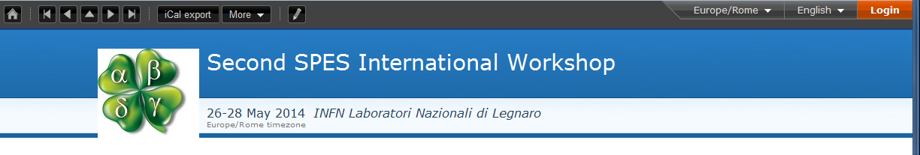
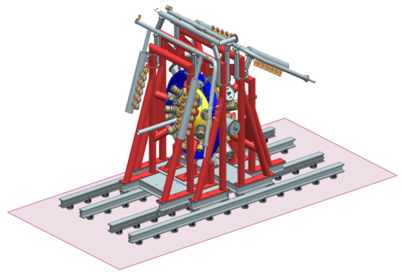

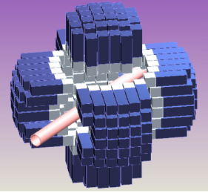
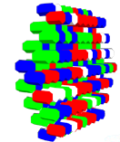
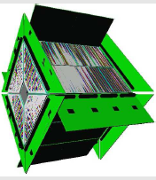
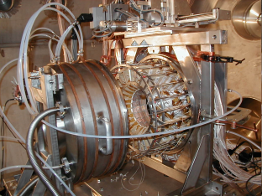
Presented 37 Letters of Intents
PRISMA
GALILEO
*AGATA
*PARIS
*NEDA
RIPEN
*Fazia
**CHIMERA
TRACE
GARFIELD

Slide 4
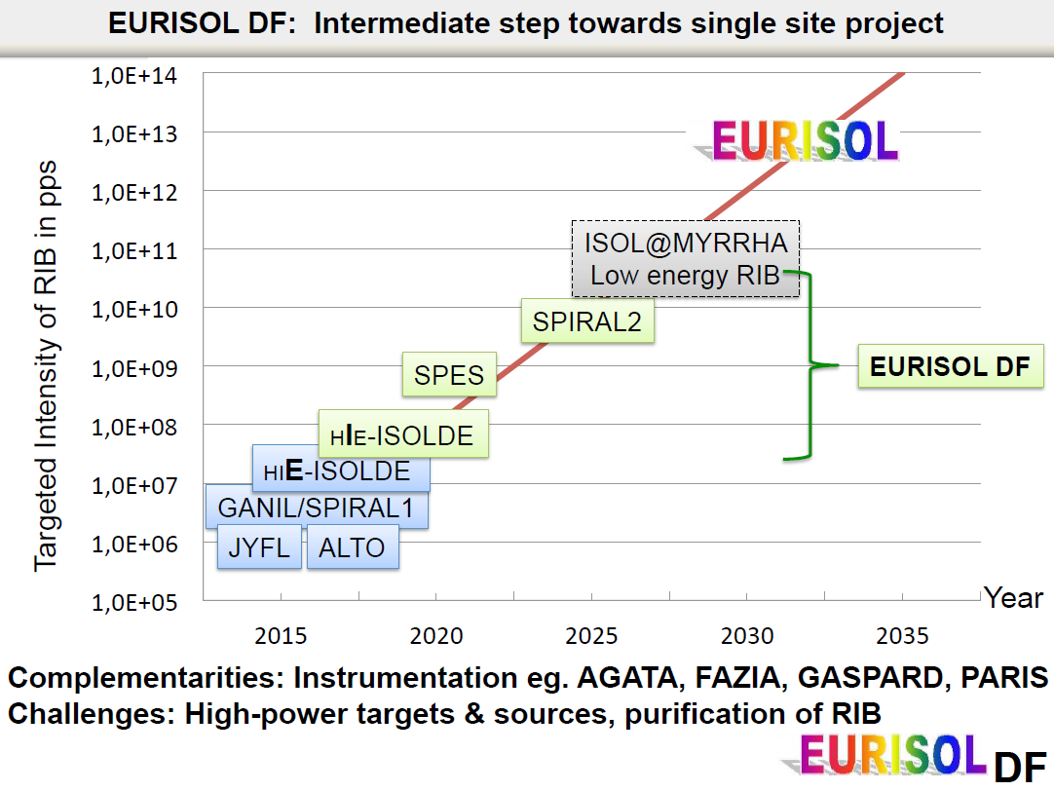
SPES up-grade:
High level «European» instrumentation
Second ISOL bunker and High intensity
High resolution mass separation at 1/40000
Reaccelerated beam energy upgrade
  New cavities for ALPI
  New EBIS Charge Breeder with up to date performances
Curtesy M.Lewitowicz

Slide 5
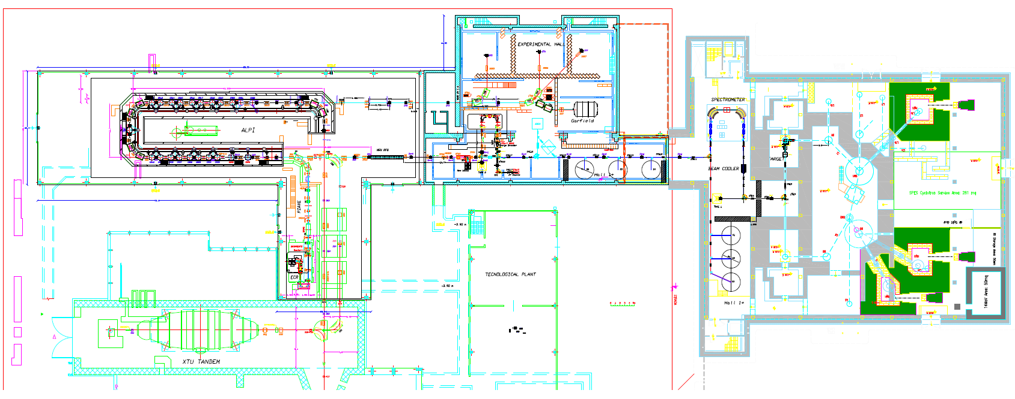
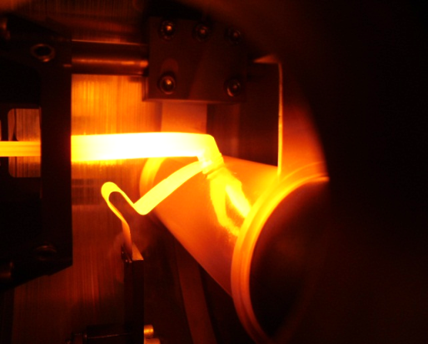
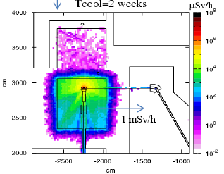

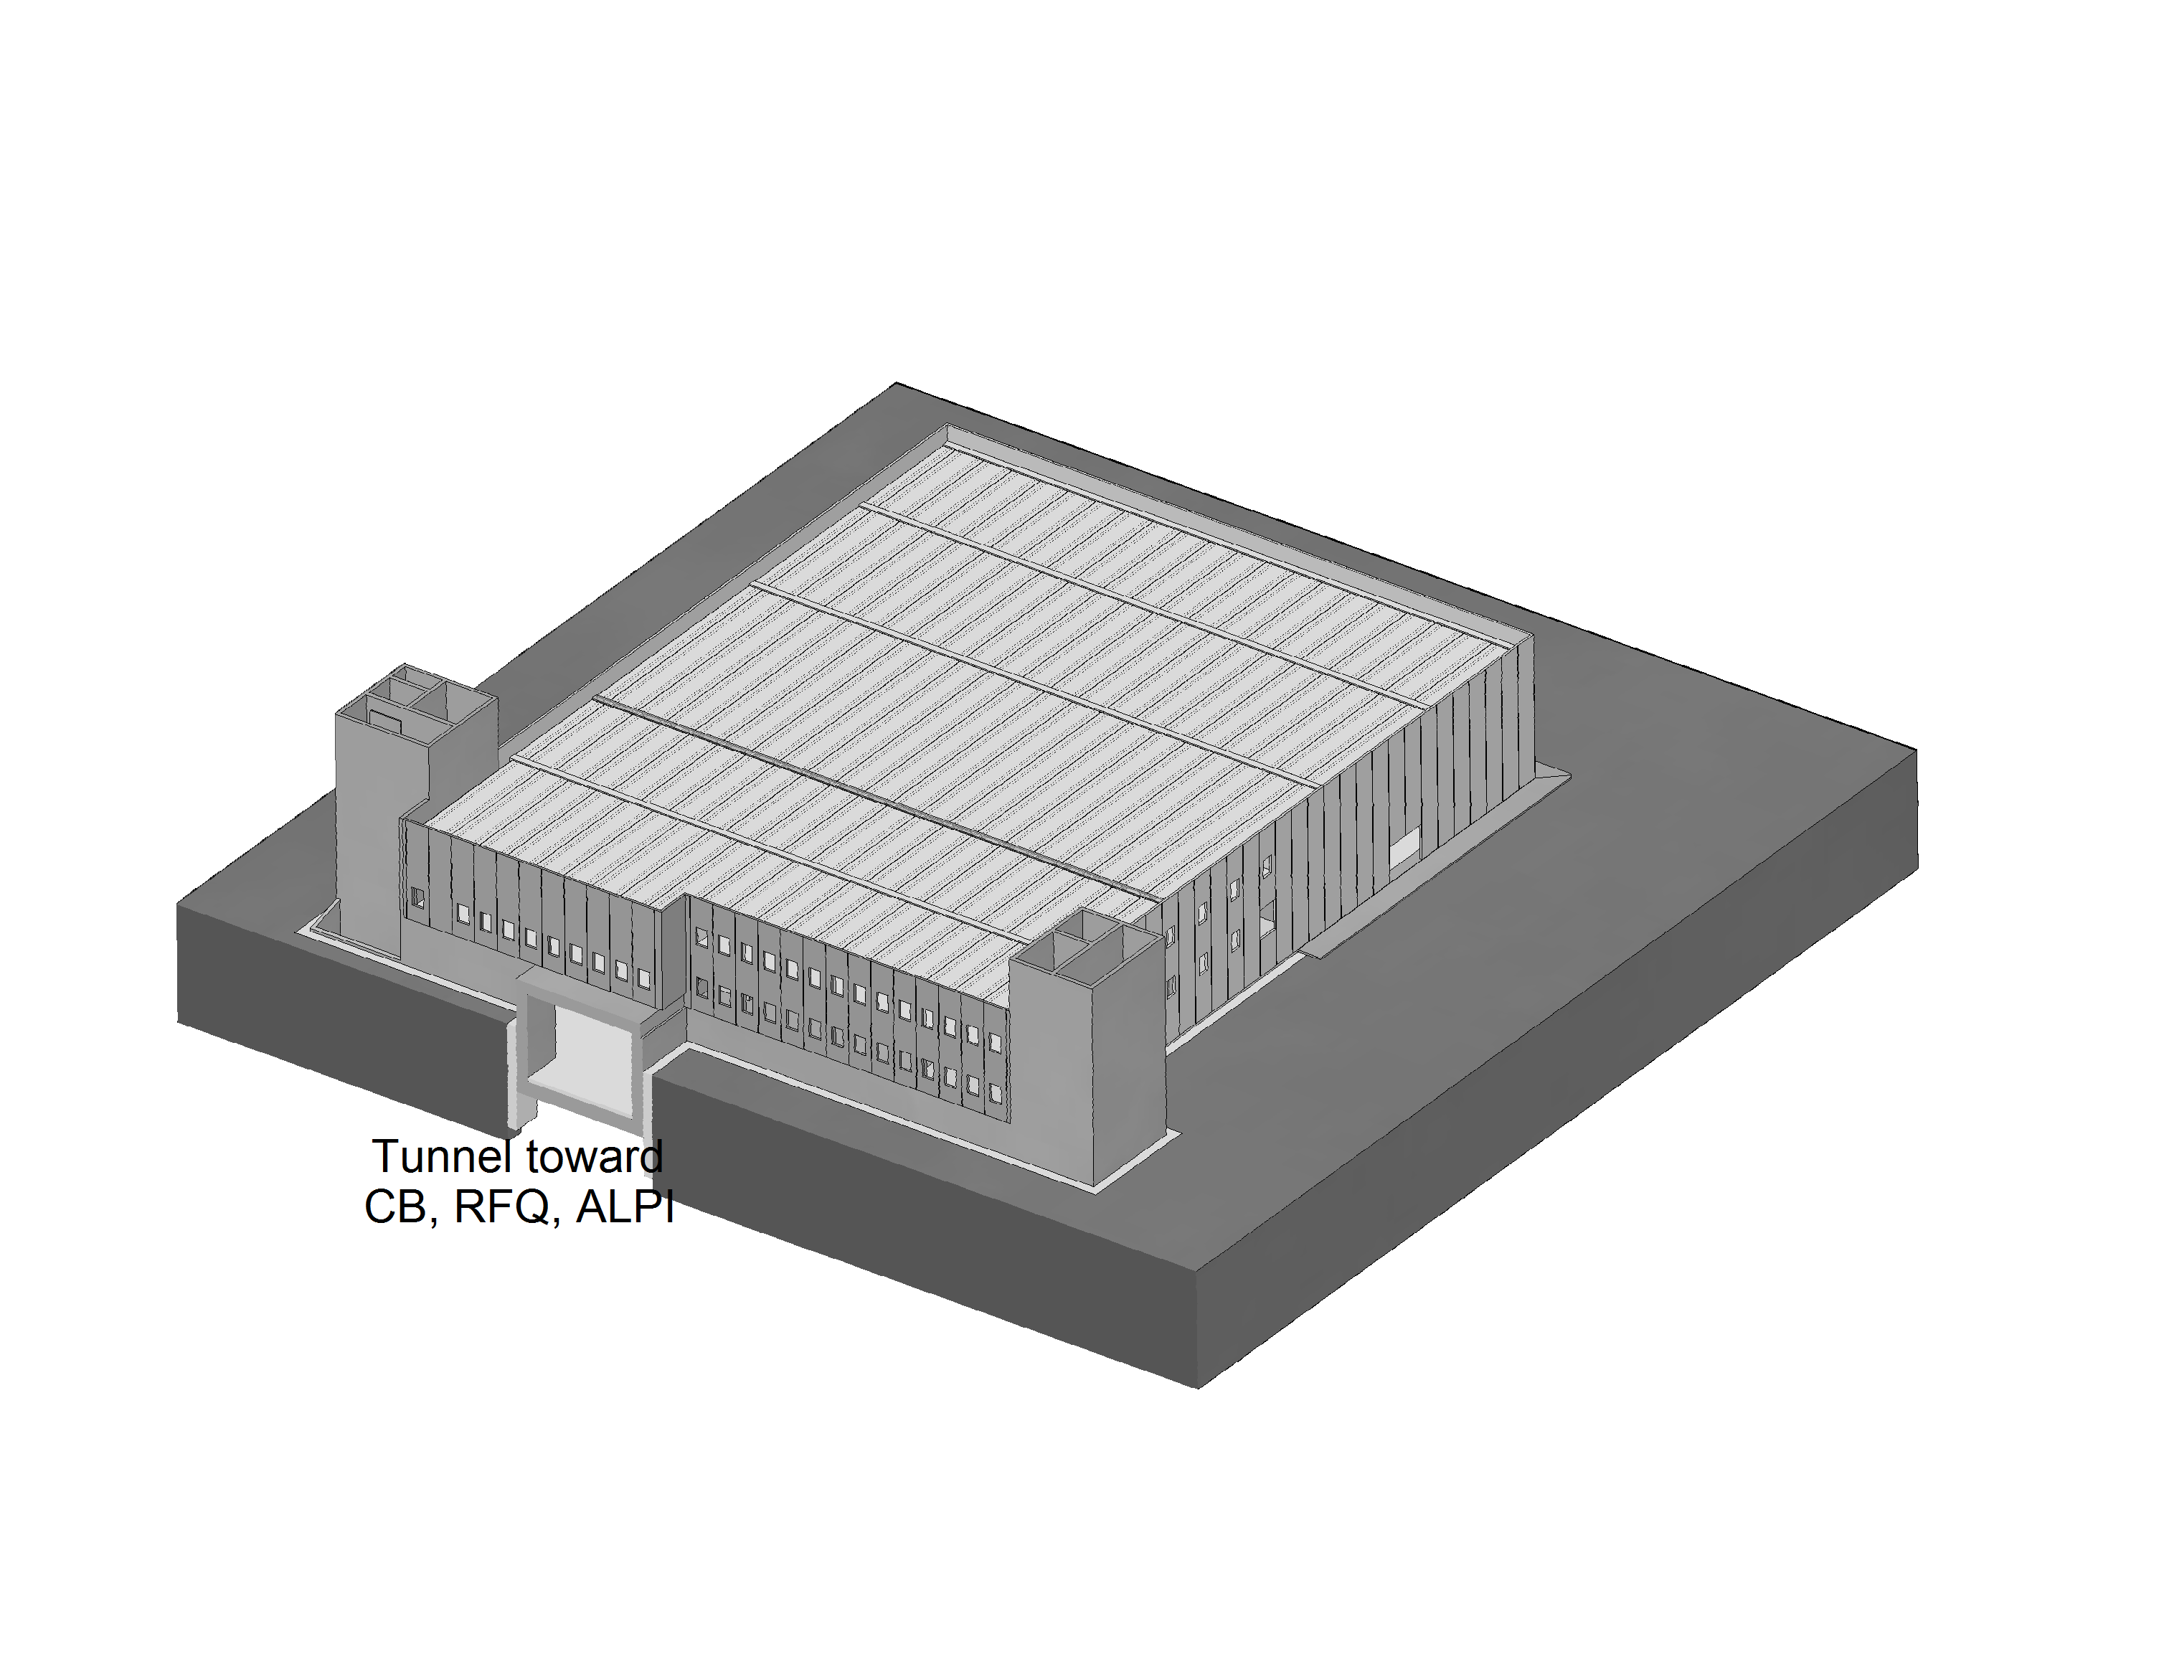
SPES Facility Layout
Existing facility
3° Exp.Hall
3
ALPI
5
4
3
2
Control system
Tandem
6
Target under operation at 2000ºC
70 MeV 0,75 mA
Proton cyclotron
 | SPES sub-systems
1 | Building and infrastructures with 2 ISOL bunkers for radioactive beam and application area for radioisotopes and neutrons
2 | Cyclotron 70 MeV protons with 2 independent exits
3 | ISOL UCx target designed for 10¹³ f/s
4 | Beam transport with High Resolution Mass Separation
5 | Reacceleration with ALPI superconducting linac (10A MeV A=130)
6 | Radioprotection, safety & controls
1

Slide 6
Infrastructures
Existing facility
3° Exp.Hall
3
ALPI
5
4
3
2
Control system
Tandem
6
1
Target under operation at 2000ºC
 | SPES sub-systems
1 | Building and infrastructures with 2 ISOL bunkers for radioactive beam and application area for radioisotopes and neutrons
2 | Cyclotron 70 MeV protons with 2 independent exits
3 | ISOL UCx target designed for 10¹³ f/s
4 | Beam transport with High Resolution Mass Separation
5 | Reacceleration with ALPI superconducting linac (10A MeV A=130)
6 | Radioprotection, safety & controls

Slide 7
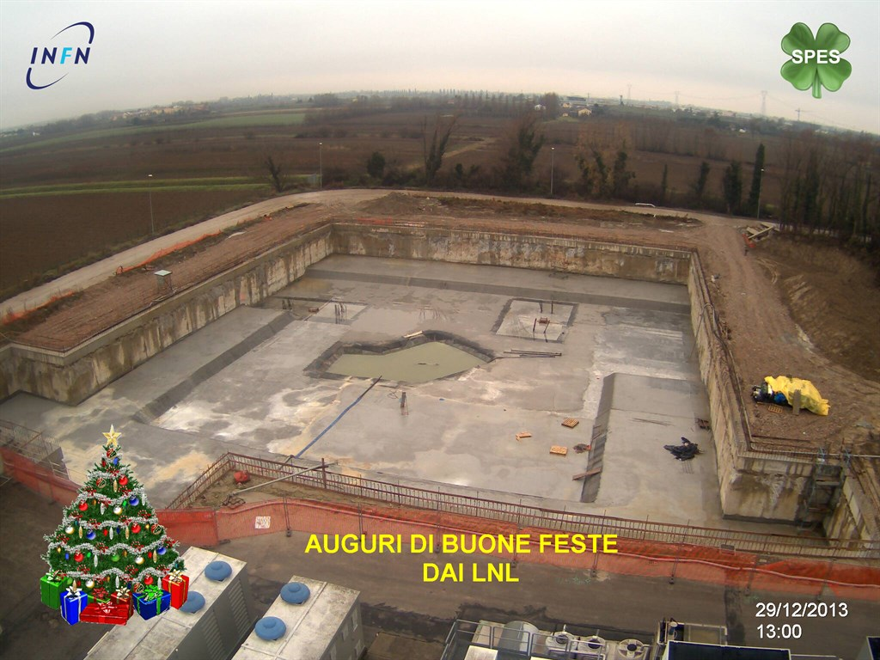
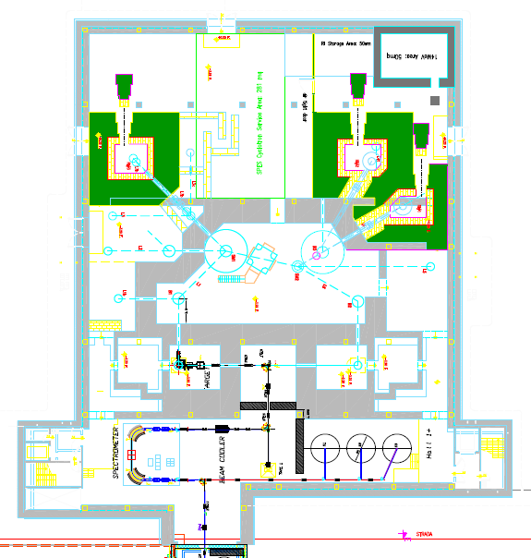
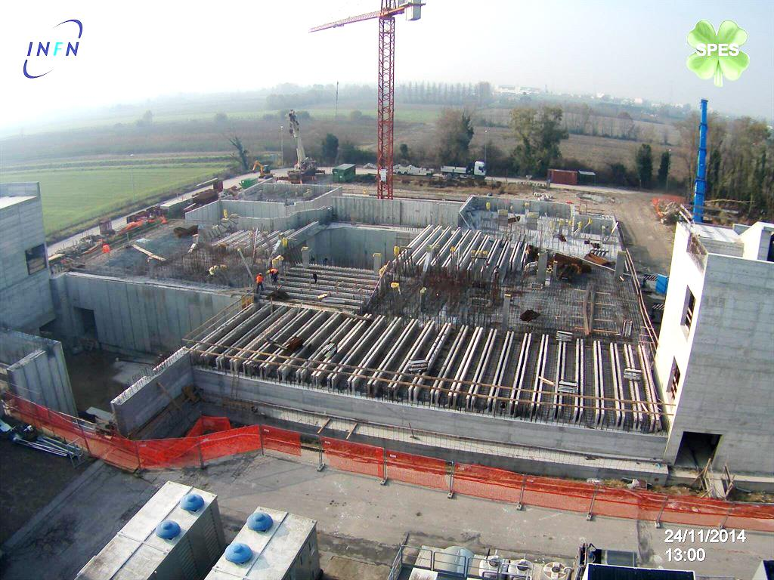
WORK in progress
SPES building construction
One year ago
LARAMED Radioisotope production area
NEPIR
Neutron area
cyclotron
ISOL facility
Today
Milestones to accept cyclotron :
1. Delivery of building Feb 28, 2015
2. Delivery of infrastructures Apr 30, 2015
Notes:
Date indicate valide per posa ciclotrone e infrastrutture ciclotrone. Consegna edificio e chiusura cantiere fine settembre (v. Calderolla)

Slide 8
LARAMED Project
Funded with 6.8 Meuro
Joint Research lab of INFN, CNR, Universities and external companies:
Measurement of cross section through targets activation
High power targets tests
Radioisotopes/radiopharmaceuticals Production test facility (^{99m}Tc, ⁶⁴Cu, ⁶⁷Cu, ⁸²Sr, ...)
Production laboratory in conjunction with external companies:
Selected isotopes of medical interest
STATUS:
Building and infrastructures development
Design of radiochemistry labs
Design of beam line and target management
Contract with company for radioisotopes production to be finalized

Slide 9
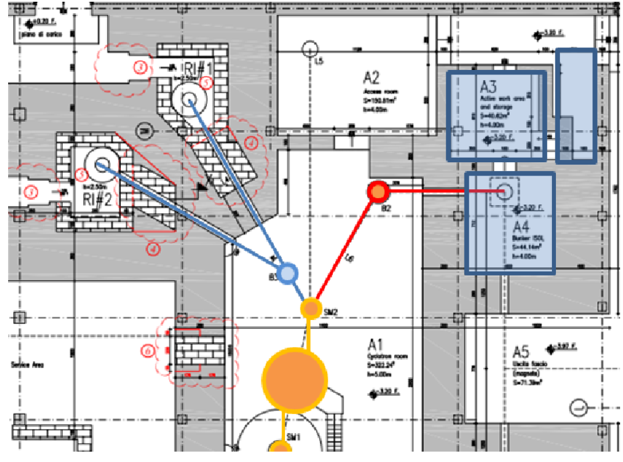
Temporary A3-A4 installation
Operation allowed by SPES alpha authorization (500μA, 70MeV in the limit of rad.prot. rules)

Slide 10
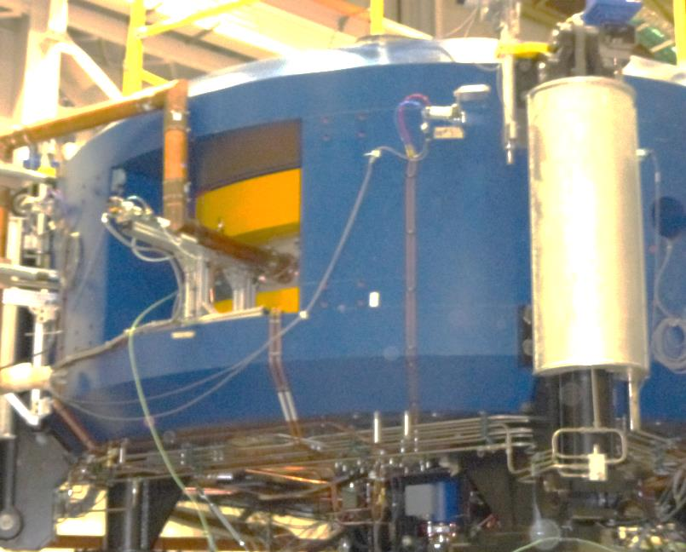
Cyclotron
Existing facility
3° Exp.Hall
ALPI
5
3
4
3
2
Control system
Tandem
6
Target under operation at 2000ºC
70 MeV 0,75 mA
Proton cyclotron
 | SPES sub-systems
1 | Building and infrastructures with 2 ISOL bunkers for radioactive beam and application area for radioisotopes and neutrons
2 | Cyclotron 70 MeV protons with 2 independent exits
3 | ISOL UCx target designed for 10¹³ f/s
4 | Beam transport with High Resolution Mass Separation
5 | Reacceleration with ALPI superconducting linac (10A MeV A=130)
6 | Radioprotection, safety & controls
1

Slide 11
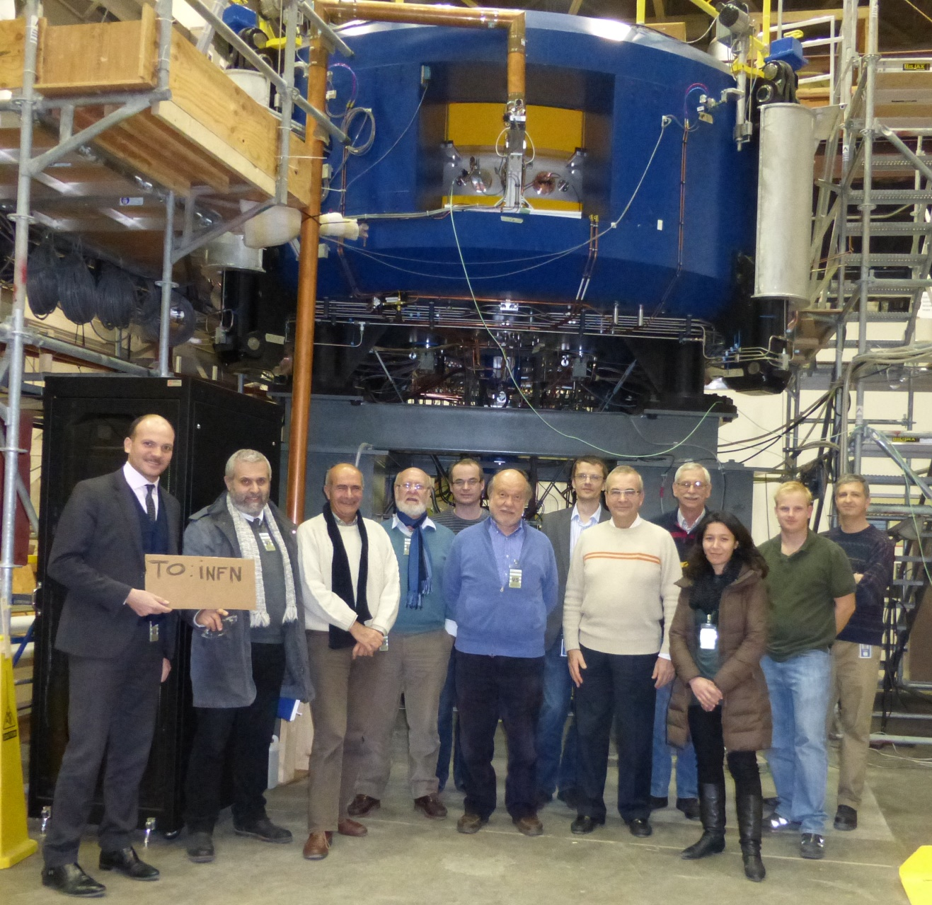
Cyclotron test at BEST Company site (Ottawa)
Main Parameters
Accelerator Type | Cyclotron AVF 4 sectors
Particle | Protons (H⁻ accelerated)
Energy | Variable within 30-70 MeV
Max Current Accelerated | 750 µA (52 kW max beam power)
Available Beams | 2 beams at the same energy (upgrade to different energies)
Max Magnetic Field | 1.6 Tesla
RF frequency | 56 MHz, 4th harmonic mode
Ion Source | Multicusp H⁻ I=15 mA, Axial Injection
Dimensions | Ф=4.5 m, h=1.5 m
Weight | 150 tons
Cyclotron assembled and operated with 700 μA at 1MeV
In the factory at Ottawa, the construction and the assembly of the Cyclotron is completed. The assembly of the RF resonators is over and the injection and acceleration phase started according to the schedule (1 MeV at full current).
FAT partially approved on November 29th
Notes:
In particular on last May some tests have been performed on the source. Some of our engineers have been participating to the test at BEST in Vancouver and they could certify the succesfull results. Meanwhile in Ottawa the assembling of the Cyclotron was going on: the RF resonators have been assembled and they are now under conditioning. The first checks on the resonance frequency and on the tuning range are according to the specifications. The schedule now foresees the FACTORY ACCEPTANCE TEST during these months after which the shipment will be programmed in the coming Fall.

Slide 12
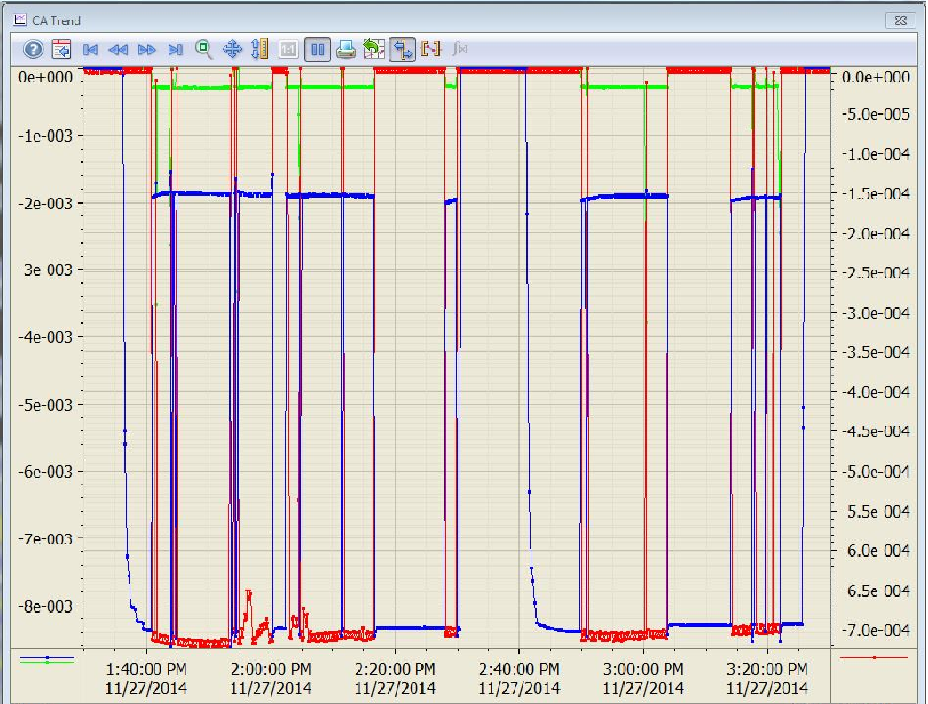
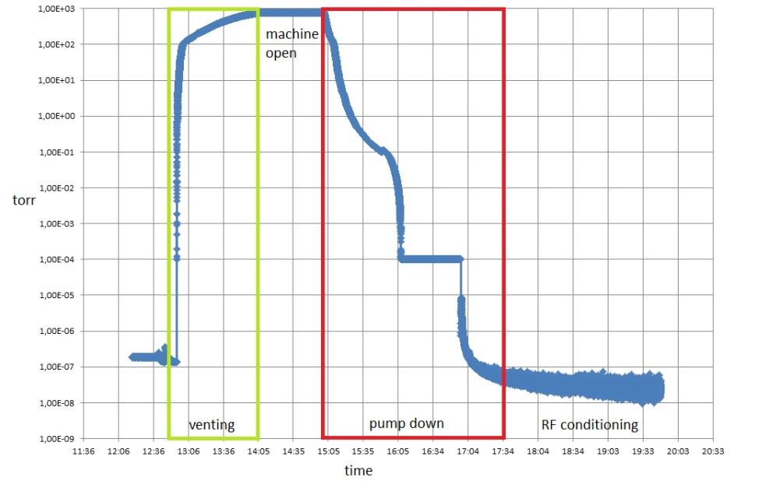
Final Fatory Acceptance Test
in Ottawa next week
Succesful vacuum test: below 10⁻⁷ Torr after 2hours pumping
700 μA
See Augusto presentation
current measured at inflector collimator (green), beam stop (blue) and 1MeV probe (red).
Test was not completely succesfull, under discussion the following steps (more exaustive test in Ottawa or cyclotron dismounting and transfer to Italy)
Notes:
The Figure shows how the current measured at inflector collimator (green curve), beam stop (blue
curve) and 1MeV probe (red curve) are displayed.

Slide 13
ISOL production
Existing facility
3° Exp.Hall
ALPI
5
4
3
2
Control system
Tandem
6
 | SPES sub-systems
1 | Building and infrastructures with 2 ISOL bunkers for radioactive beam and application area for radioisotopes and neutrons
2 | Cyclotron 70 MeV protons with 2 independent exits
3 | ISOL UCx target designed for 10¹³ f/s
4 | Beam transport with High Resolution Mass Separation
5 | Reacceleration with ALPI superconducting linac (10A MeV A=130)
6 | Radioprotection, safety & controls
Target under operation at 2000ºC
1

Slide 14
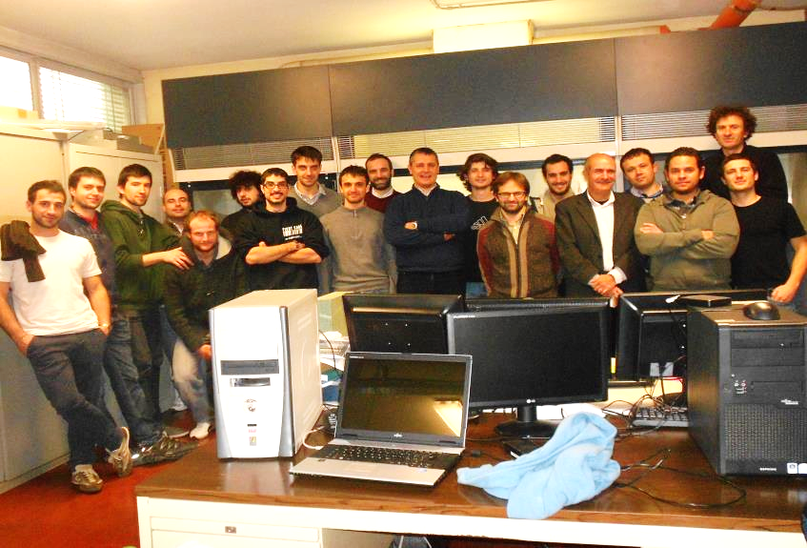

Technical highlights: the production target
SPES DIRECT TARGET CONCEPT to operate with 8 kW proton beam
Direct Target carefully designed to reach 10¹³ fissions/s with 8 kW proton beam (thermo-mechanical considerations);
In beam test performed at iThemba lab (South Africa) on May 2014;
Prototype under operation.
Fully developed front-end following ISOLDE design;
(A. Andrighetto et al.)
UCx target completely developed
Target under operation at 2000ºC

Slide 15
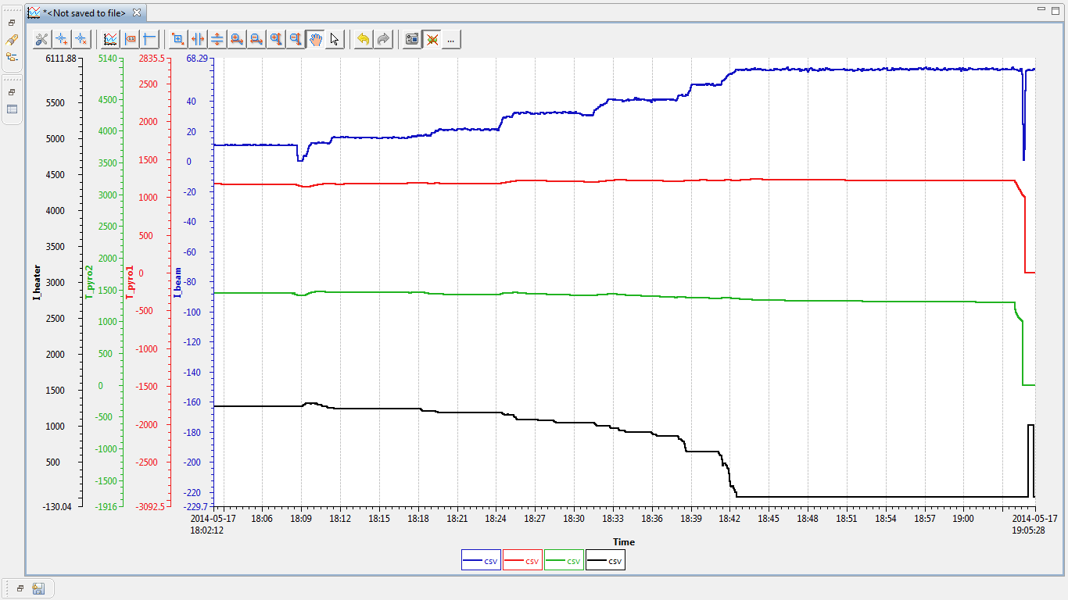
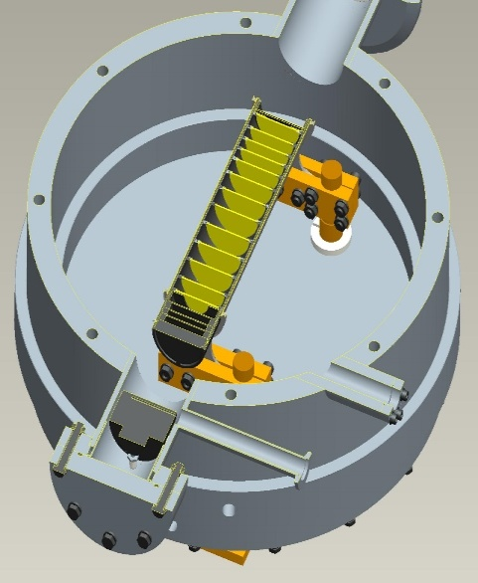
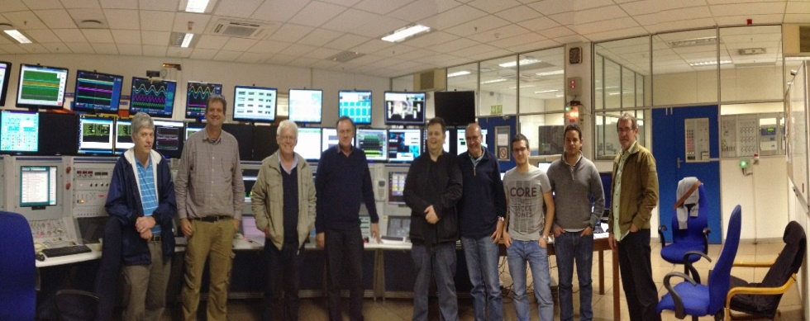
Target Power test @ iThemba Labs
SPES target in-beam power test (SiC target, operating temperature 1450ºC)
Heater power compensated by proton beam.
Up to 4 kW proton beam in target.
Stable temperatures
Stable vacuum
(3 10⁻⁵ mbar)
Proton beam
66MeV 60 μA
T_{disk}
Proton current
T_{box} 1200ºC
heater
T_{box}
T_{disk} 1450ºC
Thanks to Rob, Lowry and all the iThemba_Labs Cyclotron staff
Heater power
iThemba_Labs, May 17th, 2014
A.Monetti, J.Vasquez
Notes:
The test was performed few months ago at iThemba, within the collaboration between Italy and South Africa on a complete SPES configurated target, bringing up to 4KW on target. Check on the stability of Vacuum and temperature were performed and the test was completely satisfactory. Some more test are planned in the next future.

Slide 16
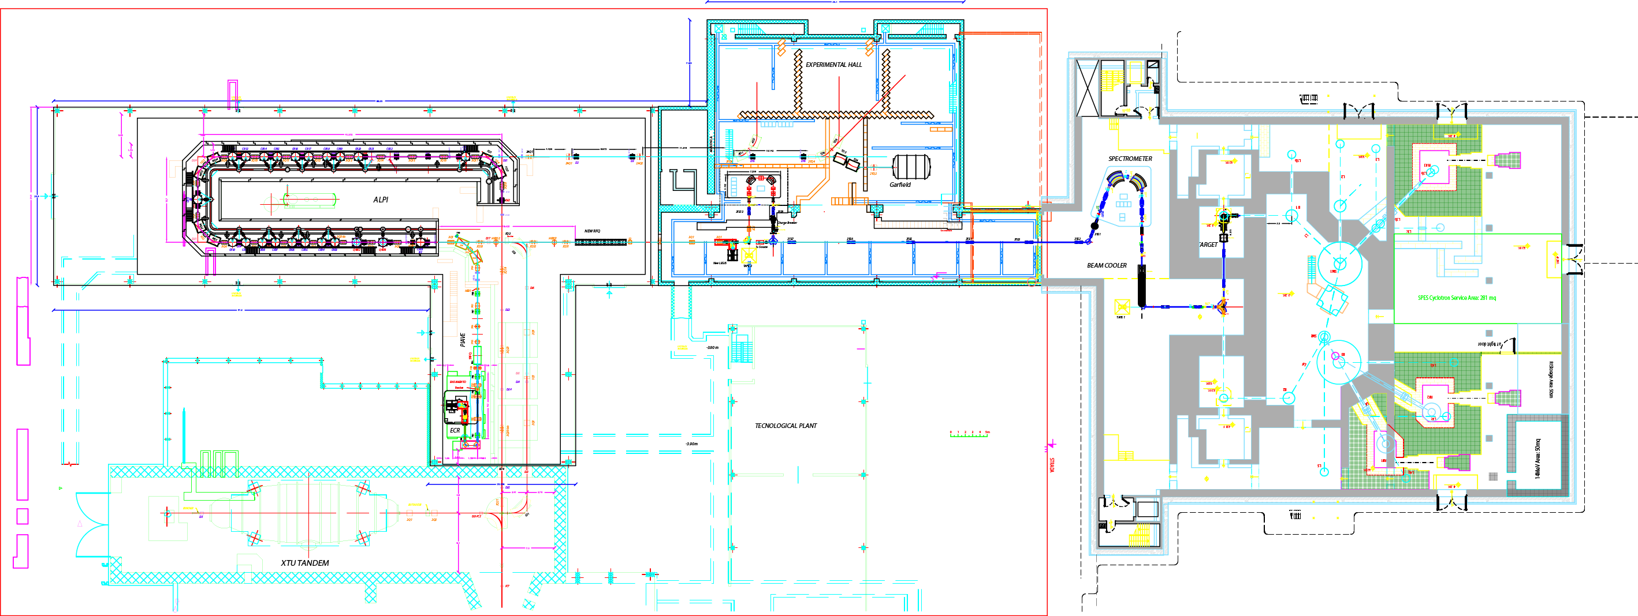
Beam transport and reacceleration
Existing facility
3° Exp.Hall
ALPI
5
3
5
4
2
Control system
Tandem
6
 | SPES sub-systems
1 | Building and infrastructures with 2 ISOL bunkers for radioactive beam and application area for radioisotopes and neutrons
2 | Cyclotron 70 MeV protons with 2 independent exits
3 | ISOL UCx target designed for 10¹³ f/s
4 | Beam transport with High Resolution Mass Separation
5 | Reacceleration with ALPI superconducting linac (10A MeV A=130)
6 | Radioprotection, safety & controls
1
Notes:
Nuovo layout

Slide 17
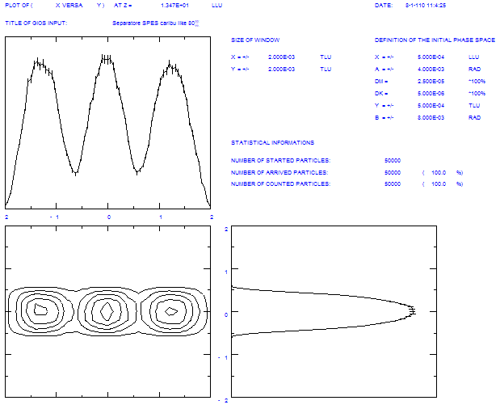
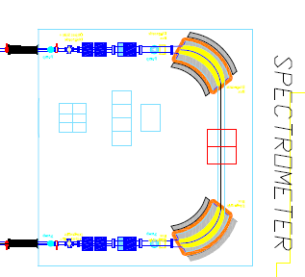
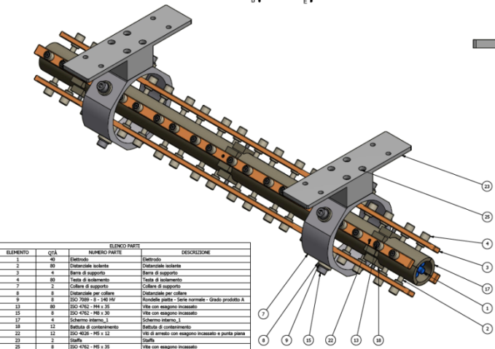
High Resolution Mass Separator & Beam Cooler
Collaboration SPES – CENBG Bordeaux (SPIRAL2)
High Resolution Mass Separator
Scaled-up version of the separator designed by Cary Davids for CARIBU, Argonne
Mass resolution: 1/40000 (eng. design: 1/25000)
ΔM=2.5 10⁻⁵
Beam Cooler to match the HRMS input requirements
Physics Design stage
COOLBEAM experiment financed by INFN-CSN5, 2012→2015
Collaboration: LNL-LNS, Mi bicocca
1.3 mm
M.Maggiore
Electrostatic Plates to correct the voltage ripple of the H.V. platform
Typical voltage fluctuation frequency 200-300 Hz, <<10kHz
20 cm
10 cm
Plates gap 6 cm,
± 750 V to correct
± 5 V platform ripple
L.Calabretta, M.Comunian, A.Russo, L.Bellan
Notes:
For what it concerns the high resolution mass spectrometer the design of the spectrometer is being studied as an upgraded version of the CARIBU design by Davids in Argonne. However a collaboration with people working on Spectrometers for DESIR is under discussion within the LEA agreement between France and Italy. In order to reach the required selection parameters of 1/20000 engineering design a cooler stage is under study so to reduce the input emittance before the spectrometer as displayed in the slide.
5-6 pi mm mrad da SIS; 30 pi con la PIS; con BC che la fa diventare 3; Delta E è dal Jitter della piattaforma, che non è possibile e quindi si sincronizza il ripple della piattaforma con un campo sul fascio di deflessione in feedback

Slide 18
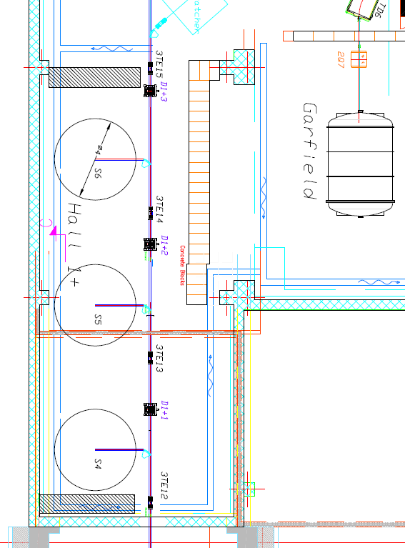
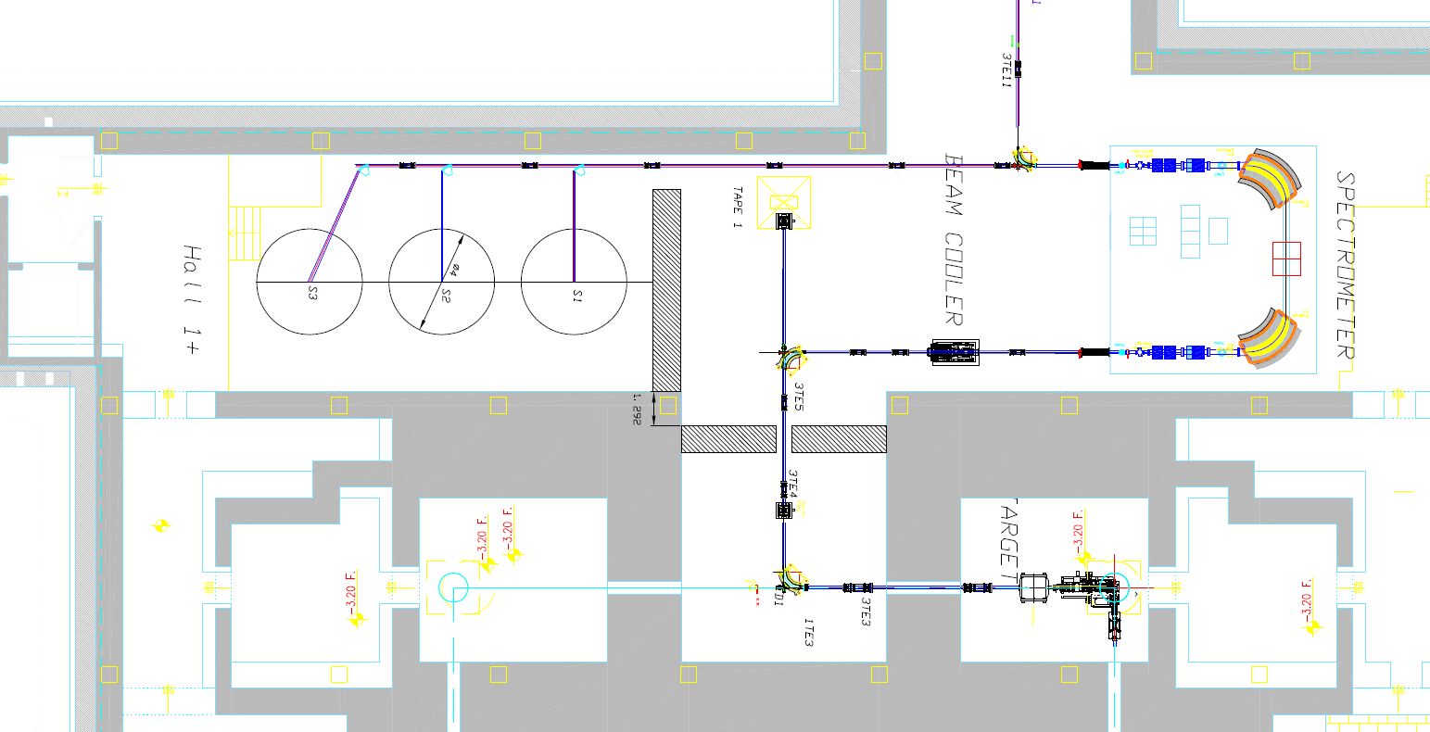
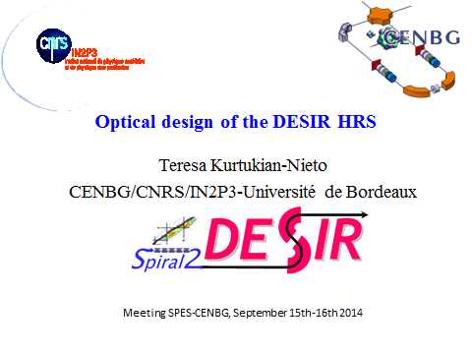
HRMS 1+beam line and sinergies with LNS
Possible use of EXCYT components to improve SPES
(items to be discussed)
dipoles for mass selction
High Voltage plateform parts
HV power supply
development of gas recovery system
Collaboration with SPIRAL2 for High Resolution Mass Separator design.
Feasability study for 1+ beam line
Notes:
Nuovo layout

Slide 19
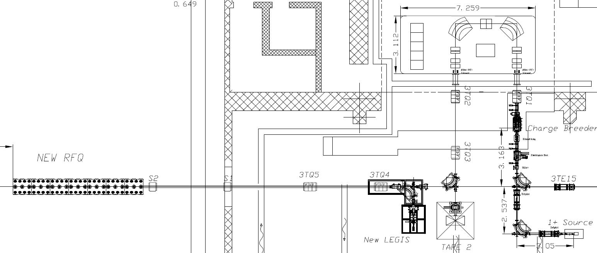


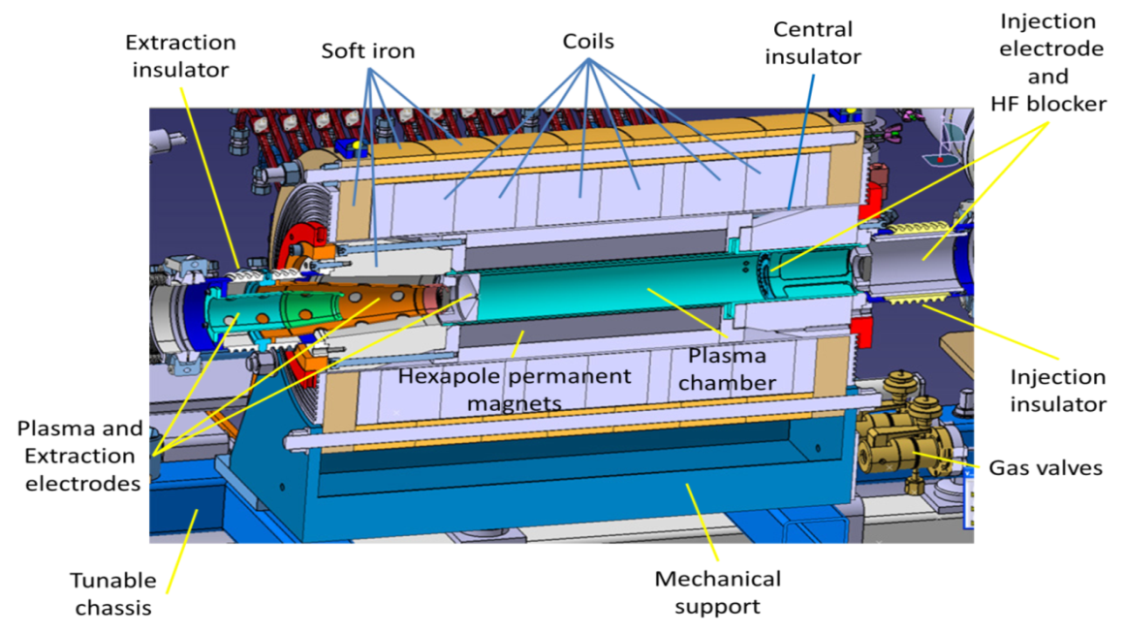
Collaboration agreement with LPSC (Grenoble) for the SPES Charge Breeder
Charge Breeder development and medium resolution mass separator
The development of an Upgraded PHOENIX booster is Part of a MoU in the frame of the European Associated Laboratories (LEA-Colliga) with GANIL.
(In exchange: development of SPIRAL2 n-converter by INFN)
Project and construction by LPSC_Grenoble
2010 Preliminary measurements
2011 Conceptual design and schedule definition
2012 Design
2013 Agreement definition
2014 Construction
2015 Commissioning
Mass Separator
CB
Tape System
1+ Stable Source
T. Lamy (LPSC), A. Galatà (INFN), et al.
Notes:
Mettere IN2P3 e LPSC, verifica con Galatà!

Slide 20
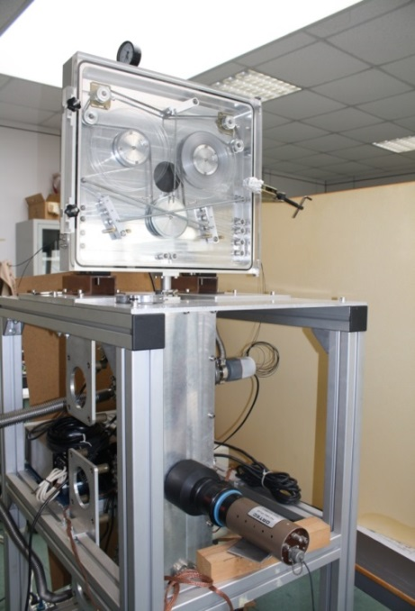
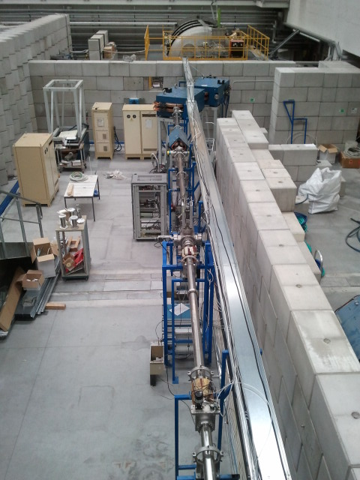
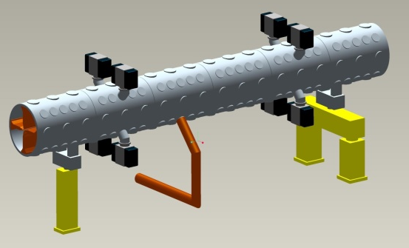
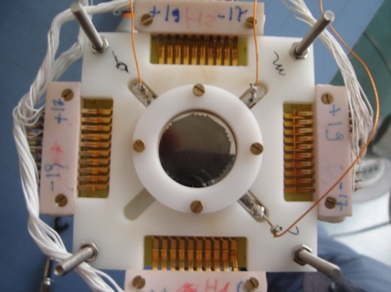
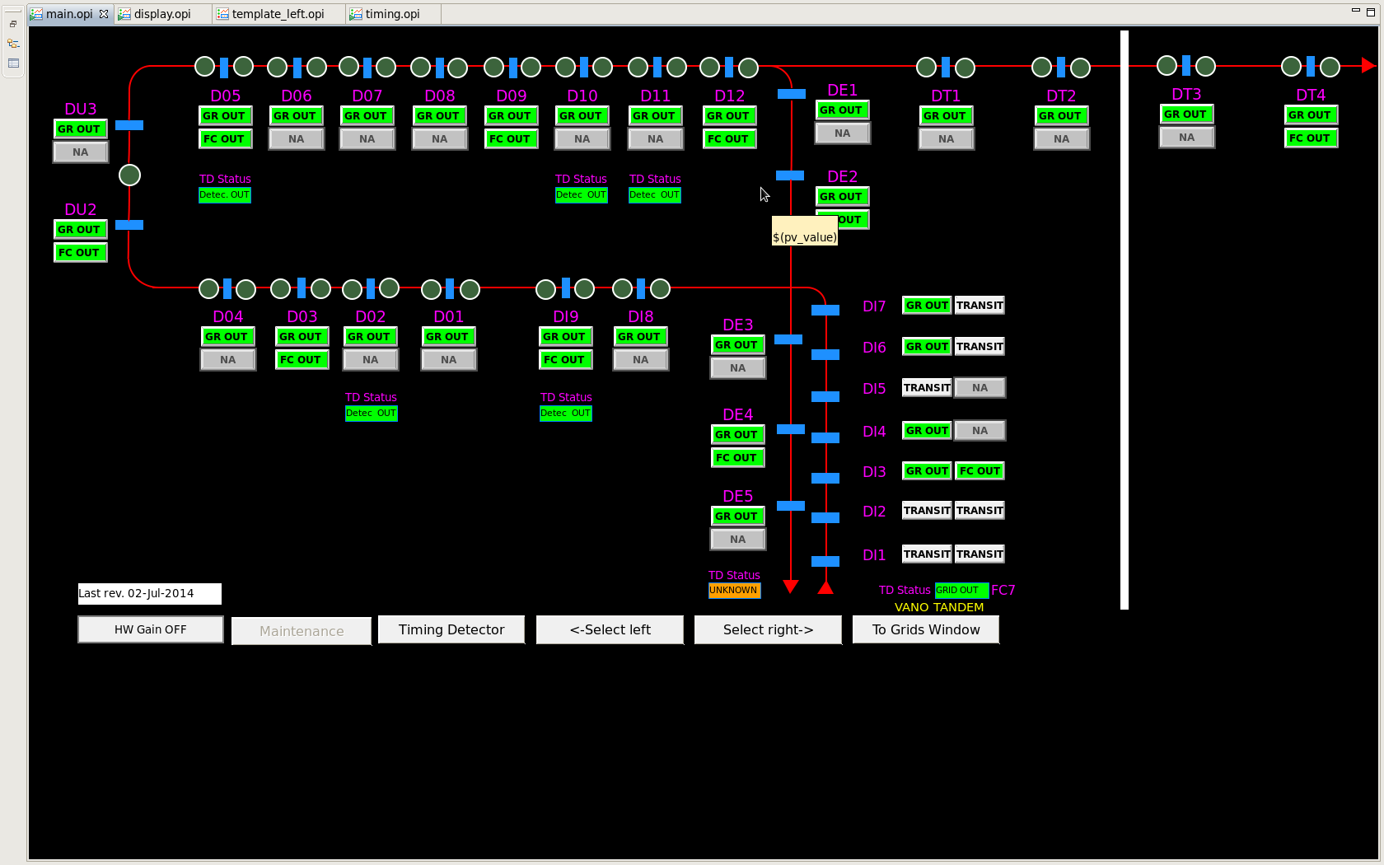
Exotic Beam reacceleration and diagnostics
Room temperature RFQ
Mechanical layout of the RFQ
Installation of new High Energy beam line.
(Today under commissioning)
Tape system
MCP based Low intensity beam monitor
New EPICS control system for diagnostic and magnets
A. Pisent, M.Poggi, T.Marchi
Notes:
Fare 1 sola slide con diagnostica + rfq

Slide 21


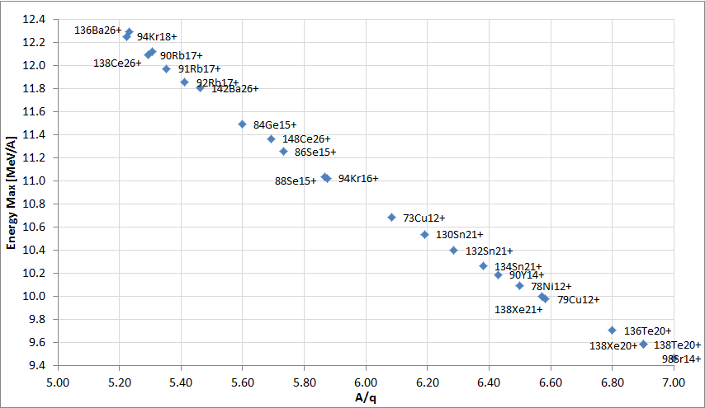
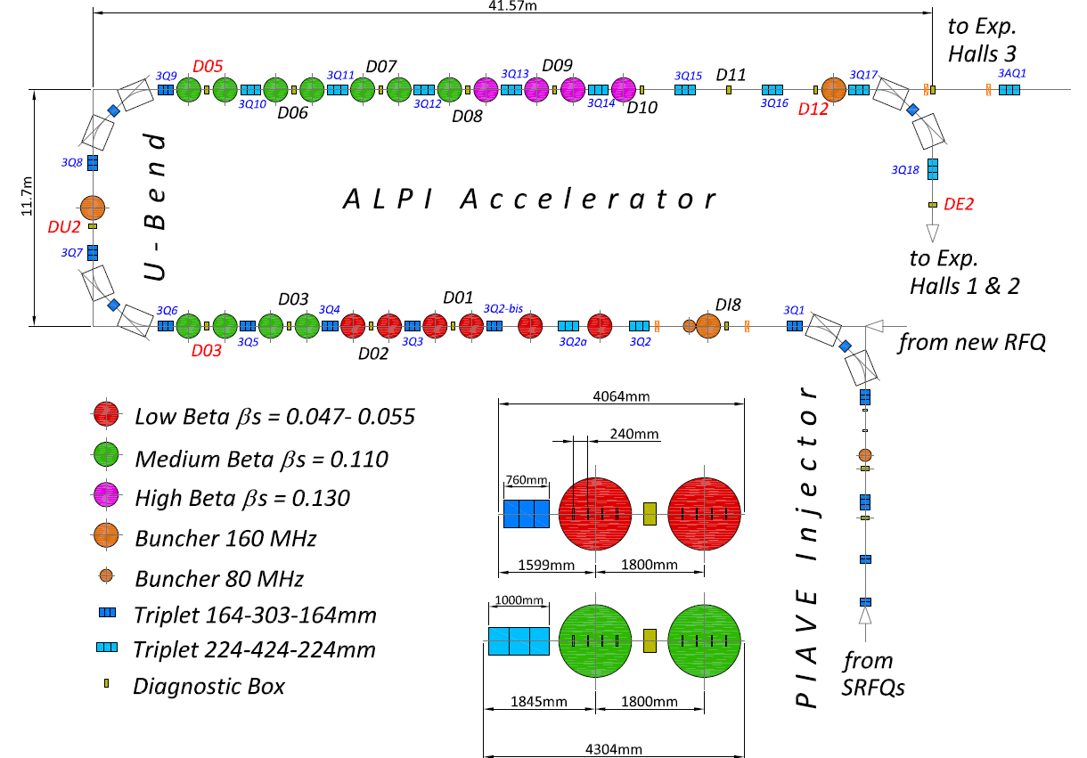
The Upgraded Alpi post-accelerator
For stable beams
For exotic beams
Low Beta=5 MV/m, Medium Beta=4.3 MV/m, High Beta=5.5 MV/m
Conservative value: 2 cavities off in the calculation.
M. Comunian
Reshape and improvement of low beta cavities.
Added high beta cryostats to improve the final energy.
Low beta

Slide 22
Rad.Prot, safety & controls
Existing facility
3° Exp.Hall
3
ALPI
5
4
Control system
3
2
6
Tandem
Target under operation at 2000ºC
 | SPES sub-systems
1 | Building and infrastructures with 2 ISOL bunkers for radioactive beam and application area for radioisotopes and neutrons
2 | Cyclotron 70 MeV protons with 2 independent exits
3 | ISOL UCx target designed for 10¹³ f/s
4 | Beam transport with High Resolution Mass Separation
5 | Reacceleration with ALPI superconducting linac (10A MeV A=130)
6 | Radiation protection, safety & controls
1

Slide 23
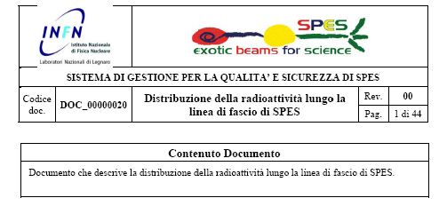
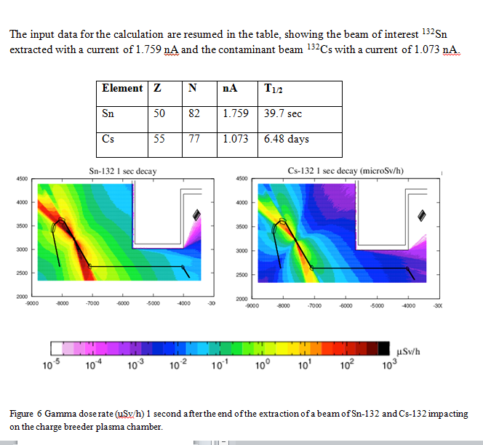
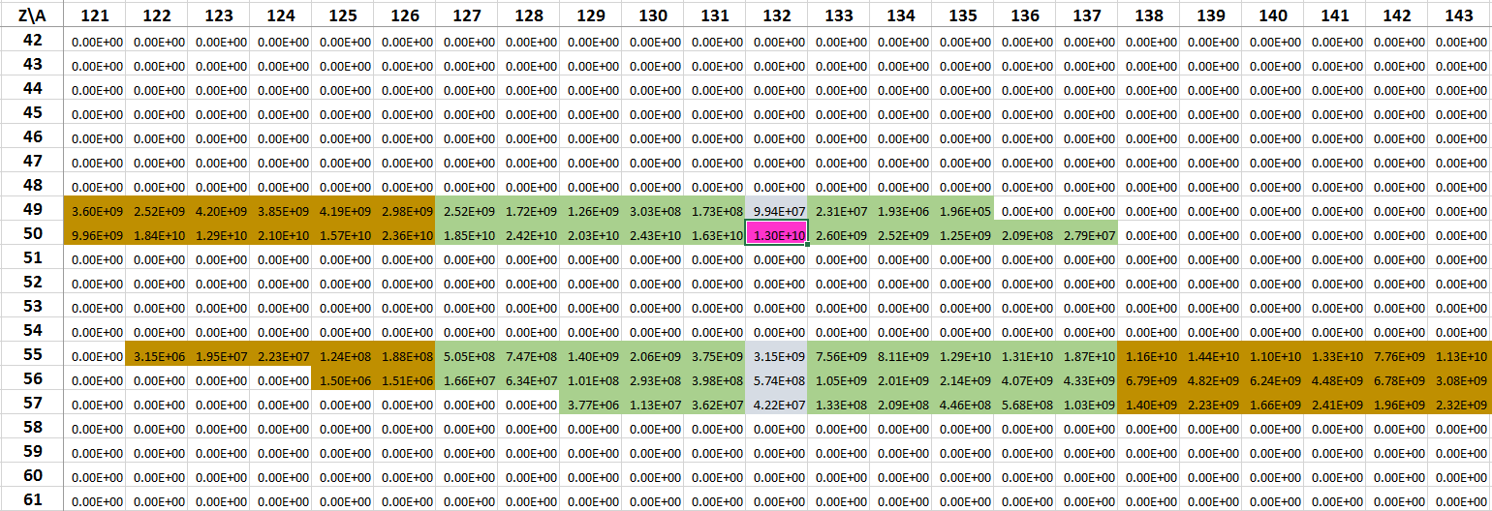
Radioactivity distribution inside SPES beam lines
Selective capability of the SPES mass separators
Figure 14: Z\A plane with the particle currents and the separation places, (brown) WF, (green) 90 deg dipole, (light blue) HRMS (beam cooler losses have been considered). Purple indicates the nominal species.

Slide 24
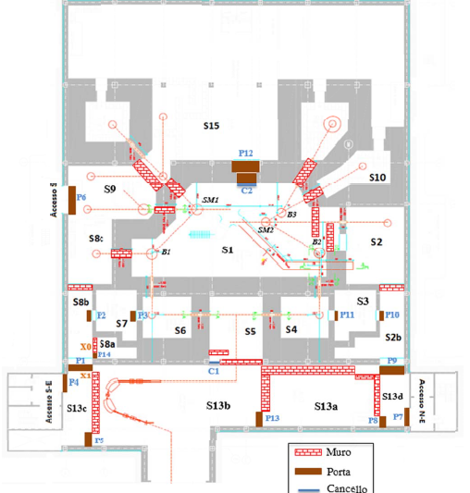
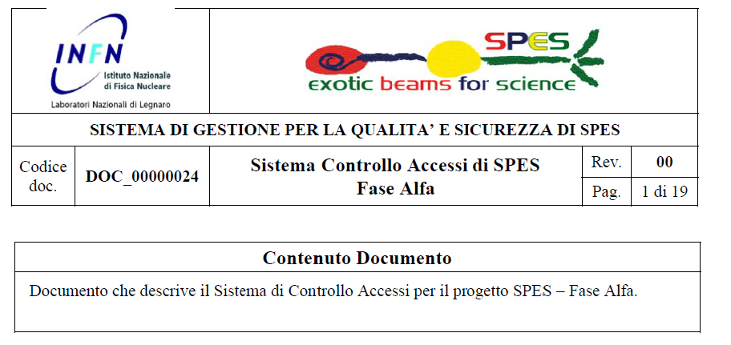
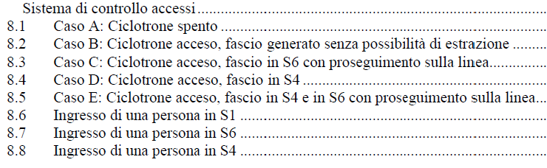
Access control description

Slide 25



Radiologic survey system
Gara sottomessa all’INFN
1.2 Meuro

Slide 26
SPES Safety TAC Nov 19-20, 2014
R. Catherall (chair) will report tomorrow about findings, comments and recommendations
(debriefing on-going…)
Prioritization of actions on safety and plants for:
Execution of cyclotron SAT tests (from and 2015, see Lombardi)
Exploitation of the cyclotron for Nulear Physics tests and radioisotope production (from 2016)
Explotation of SPES-beta (from 2018)
Notes:
Aggiungere una slides con le azioni di Duy

Slide 27
Planning for final SPES Safety System development
Risk analysis on the way, following the ISOLDE safety roadmap (based also on information on safety systems for similar projects /facilities (e.g. ISOLDE (CERN), ALBA (Spain), ELETTRA (Italy) )
Full design of Safety System with support of external companies
Preliminary contacts with some companies in the field (Siemens, Pilz, Schneider.....)
The goal is to have:
Bid for executive project of Safety System : January 2015
Bid for implemetation of Safety System : June 2015
Notes:
Chiarire che è il sistema di sicurezza per SPES-beta, preparato da noi con Safety engineer, sistematizzato a norma di legge con la ditta.

Slide 28
SPES general planning
 | 2012 | 2013 | 2014 | 2015 |  | 2016 | 2017 | 2018 | 2019
Authorization to operate and safety | UCx 5microA
ISOL Target-Ion Sources development
ISOL Targets construction and installation
ISOL on-line commissioning
Building Construction | Executive project | raw building construction
Cyclotron Construction & commissioning |  |  |  | Cyclotron at LNL
RFQ development and Alpi up-grade
Design of RIB transport & selection (HRMS, Charge Breeder, Beam Cooler)
Construction and Installation of RIBs transfer lines , CB and spectrometers
Stepwise commissioning and first exotic beam (2018), HRMS in 2019
Versus TAC1, stretched by 10 months for better planning (see next slide), and by 10 months
due to the addition of the BC+HRMS construction and commissioning
Notes:
Anticiperei questa, perché così contestualizzi meglio le spieghe successive dei soldi

Slide 29

Schedule updated in «Project»
(750 tasks)
Main commissioning milestones:
- End 2015: Cyclotron
End 2016: Charge Breeder to RFQ injection (and training on breeding and mass separation)
End 2017 – end 2018: first commissioning of SPES w/o BC and HRMS
End 2019: completion of commissioning w/BC and HRMS (and of the project).
Notes:
Verificare se e quanto il ritardato inizio (fondi 2014, 6 mesi dopo) impatta sulla scaletta qui sopra…
Giovanni: verifica planning e fornire a Gianfranco

Slide 30
SPES funding plan
SPES subsystems and construction cost for each subsystem
Values in Meuro | 2012 | 2013 | 2014 | 2015 | 2016 | 2017 | 2018 | Grand Total
Radiation prot, Safety &Controls |  | 0.1 | 1.6 | 3.3 | 0.8 | 0.3 |  | 6.1
INFRASTRUCTURES | 4.5 | 0.3 | 0.5 | 3.1 | 1.1 |  |  | 9.5
CYCLOTRON | 10.7 |  |  | 0.2 |  |  |  | 10.9
EXOTIC BEAMS | 0.9 | 0.8 | 0.5 | 0.9 | 0.8 | 0.1 |  | 4.0
BEAM TRANSPORT | 0.5 | 0.2 | 3.3 | 1.5 | 5.8 | 1.8 | 0.7 | 13.7
Re-ACCELERATOR | 1.9 | 0.4 | 0.9 | 3.0 | 0.7 | 0.2 |  | 7.2
 | 18.5 | 1.9 | 6.7 | 11.9 | 9.2 | 2.3 | 0.7 | 51.2
*HRMS (2,7M€) included, residue of bid for building (2M€) included

Slide 31
Economic planning for SPES construction 2013-2018
(kEuro) | 2013 | 2014 | 2015 | 2016 | 2017 | 2018
Total SPES 2013-2018 32.660 kEuro | 1.860 | 6.800 | 11.900 | 9.100 | 2.300 | 700
*HRMS (2,7M€) included, residue building (2M€) included

Slide 32
CORE SPES funding plan
As presented at TAC1
2014 Budget: 50% Available
(also subject to TAC evaluation)
Main differences: beyond the 4,5 M€ (?) of Prize Project

Slide 33
Main bids 2014
Existing facility
3° Exp.Hall
Beam transport
ALPI
Vacuum system
Main Bids 2014 | (k€)
Bid for radioprotection surveillance Bid for control system network Bid for beam transport components (CB to end of ALPI) Bid for cryogenics upgrade Bid for vacuum system (CB-Alpi injection) Bid for additional bunkers doors Bid for Laser source | 1100 400 1500 800 1200 700 500
Tandem
Shielding doors
Available funds 2014: 6.8 Meuro
(4.5 of them assigned at end of October)

Slide 34
Tentative schedule for the subsequent phases of cyclotron acceptance tests and operation
First phase of cyclotron installation and operation (beginning of SAT tests).
April 2015 expected Cyclotron at LNL
Building and infrastructures required for the cyclotron operation should be in place.
January-April 2015:
  Validation of the safety aspects of the technical specifications regarding the cooling and ventilation system that will be delivered in April 2015 (e.g. redundancy, interlocks, emergency procedure).
  Design of the high-power beam dump (35 kW) and preliminary risk analysis for tests execution at low and high power beam.
  Definition and set-up of the storage location for the beam dumps (low and high power) after acceptance test.
  April-September 2015:
    Cyclotron installation.
    Delivery of radiation protection surveillance system (consistent with ongoing order procedure).
    Construction of high power beam dump.
    Evaluation of ventilation system with doors installed.
Notes:
In April 2015 the building+infrastructures required for the cyclotron operation should be in place. As in the presentation to TAC2.
January-April 2015: Validation of the safety aspects of the technical specifications regarding the cooling and ventilation system that will be delivered in April 2015 (e.g. redundancy, interlocks, emergency procedure)
January-April 2015: final design of the low-power beam dumps (10-16 kW); preliminary risk analysis of the tests done on the low (and high) power beam dumps
RP simulations on radiation and air+water contamination will be carried out following the previous steps for the low-power beam dump, to be calculated to see if we can reach the SPES-beta specs (40 MeV, 200 uA)
January-April 2015: Definition of the storage location of the 2 beam dumps (low (and high) power) after acceptance test
About at the same time the cyclotron will be delivered (April 2015), so we can guess that we can assemble and hardwire it by September 2015
By September-October we should receive the system for radiation monitoring (consistent with ongoing order procedure).

Slide 35
Tentative schedule for the subsequent phases of cyclotron acceptance tests and operation
Expected situation in October 2015 for starting Cyclotron operation
ISOL bunker completed with shielding and air tight doors and ready to host the beam dump.
Absence of access control system will be managed by locked doors when the beam is on.
Production of contaminated air will be controlled by radiation density monitor on the outer chimney, with a feedback on the cyclotron on/off state if the threshold is reached (1Bq/gr).
    All the above allows us to carry out first tests with the proton beam from the cyclotron in very preliminary and temporary conditions.
Notes:
Situation expected in October 2015, if the above is carried out as planned:
All the above allows us to carry out first tests with the proton beam from the cyclotron in very preliminary and temporary conditions, anyway the tests will be interesting and useful. Conditions will be the following:
Absence of access control system will be managed by locked doors when the beam is on
Production of contaminated air will be controlled by radiation density monitor on the outer chimney, with a feedback on the cyclotron on/off state if the threshold is reached
Preliminary means that we can reach a power compatible with our need for nuclear physics experiments (40 MeV out of 70, and 200 uA out of 700 on SiC, with respect to cyclotron specs and what is to be done in the SAT – Site Acceptance Tests).
IMPORTANT: all the above assumes that we are able to limit the air intake to the “hot” bunker to 50 m3/h or less, otherwise the release into the chimney will be much higher and the proton current limit much lower. Feasibility of this conditions should be checked with similar practical examples anywhere else. BUT: With max intake of 50m3/h, on graphite, one can stay below 1 Bq/g by mixing 100 m3/h from other areas of the building directly into the chimney (allowed) and, according to radioactivity production calculations, even reach the SAT specs (70 MeV and 500 uA).

Slide 36
2015 Milestones and bids
Funds 11.900 kEuro
Milestones | Main Bids | (k€)
1- Building and plants completed 2- Cyclotron: delivery, installation and SAT 3- Commissioning of target remote handling system 4- Commissioning of diagnostic box prototype 5- Charge Breeder installed 5- RFQ engineering design completed 6- Installation of access control system 6- Commissioning of Radioprotection surveillance | Bid for ISOL laboratory and hot cell Bid for transport system (BC, 1+line, MRMS-platform, diagnostic) Bid for RFQ materials and RF System Bid for access control system Bid for Safety System Bid for control of RF, diag, transp Partial payment of building | 2900 1500 1900 600 1200 1500 1000
(index refers to SPES components)

Slide 37
SPES personnel plan
SPES personnel in 2014
Personnel involved: about 70 persons
46 FTE
It was 68 persons, 44 FTE in TAC1
45 (18 FTE) staff
8 (7 FTE) temporary contracts
21 (21 FTE) training

Slide 38
Personnel for cyclotron operation and management
Responsible (Tecnologo/Ricercatore II liv)
RF engineer (Tecnologo III liv)
Accelerator Physics (Ricercatore/Tecnologo III liv)
RF technician
Diagnostic and control technician
Vacuum/mechanics technician
N.6 Machine Operators
6 units in 2015 and 6 in 2016
Notes:
In English.

Slide 39
Management Challenges and Weaknesses
Decreasing lab personnel for government restrictions;
Overlap with projects with equivalent priority (IFMIF, then ESS, …) with critical people in critical positions in both;
Lacking people/competences:
  Effort to maintain strategic competences using turn over
  Lack on Management and administration (quality management, project management, project secretariat, project administation)
  Steep increase in everyone’s committments leaves too little room for: meetings (MB, project team, …); appropriate preparation of documents;
  (system integrator started, but at the moment with strong committment on IFMIF…) – TO BE FIXED ASAP
Notes:
Equivalent priority ==undefined priority; SPES schedule considers FTEs, taking into consideration such multiple committments, but various schedules are not yet harmonized

Slide 40
Additional slides

Slide 41
SPES workshop
Building
Cyclotron
ISOL power test
Safety strategy
Milestones
Funding
personnel
Notes:
Ho visto che è piuttosto efficace ciò che presenta Kester al FAIR MAC e ti propongo qualcosa di simile: prima metà del talk in cui passi in rassegna tutta la macchina con i principali achievements di tipo tecnico, risultati ottenuti, pezzi acquistati, pezzi montati. In questo senso potresti passare in rassegna la macchina tipo il talk che mi hai preparato per lunedì e che ho leggermente modificato.
Poi la seconda parte gestionale.

Slide 42




SPES layout
RFQ ----- MRMS – CB --- 1+ RIB line ----- HRMS -- BC ------ISOL-----Cyclotron
$\frac{∆M}{M}$=1/1000
$\frac{∆M}{M}$=1/20000
$\frac{∆M}{M}$=1/200
Notes:
O la 6 o la 7, nuovo layout!

Slide 43
Cyclotron criticalities
Factory Acceptant Test: Ottawa 24-28 Nov 2014
Delivery a LNL started : 5 Feb 2015
Delivery to LNL completed: 28 Feb 2015
Installation : 2 months
Site Acceptance Test: within Sep 2015
Critical points:
Synchronize delivery, installation and tests of cyclotron and beamline with building and plants for SPES-alpha phase
Personnel
Logistic support from LNL to BEST for installation
Technical support from LNL to BEST for hardware tests and commissioning (SAT)
Detailed agreement on SAT (updated agreed upon version), with particular concern for critical components as beam diagnostics and high-P beam dumps

Slide 44



Beam Diagnostics

Slide 45


Exotic Beam reacceleration: room temperature RFQ
Mechanical layout of the RFQ
Physics design
High power RF Coupler 200kW 100% duty cycle
Energy 5.7 → 727.3 [β=0.0395] KeV/A (A/q=7)
Frequency 80 MHz
Beam transmission >95%, low RMS longitudinal emittance at output: 0.15 ns*keV/u.
Length 695 cm (7 modules) intervane voltage 63.8 – 85.8 kV
RF power (four vanes) 100 kW.
Mechanical design and realization, taking advantage of IFMIF experience (LNL, INFN_Pd, Bo, To).
MRM Spectrometer
CB
RFQ
Magnetic Line with
Magnets and Solenoids
Tape System 2
E. Fagotti, A. Pisent
1⁺ Stable Source
Notes:
Fare 1 sola slide con diagnostica + rfq

Slide 46


SC Resonator Improvements on ALPI
LOW-BETA
UPGRADE

Slide 47


Slide 49
SPES Economic planning
Work Pakage | 2012 | 2013 | 2014 | 2015 | 2016 | 2017 | 2018 | Grand Total
WP-B1 – Scientific support | 0.0 | 0.0 | 0.0 | 0.3 | 0.2 | 0.0 | 0.0 | 0.5
WP-B2-Radiation Protection and Safety (1,9) | 0.0 | 0.0 | 1.3 | 1.3 | 0.0 | 0.0 | 0.0 | 2.6
WP-B3 - Infrastructures | 4.5 | 0.3 | 0.5 | 3.1 | 1.1 | 0.0 | 0.0 | 9.5
WP-B4-Controls | 0.0 | 0.1 | 0.3 | 2.0 | 0.8 | 0.3 | 0.0 | 3.5
WP-B5 - Cyclotron | 10.7 | 0.0 | 0.0 | 0.2 | 0.0 | 0.0 | 0.0 | 10.9
WP-B6- Exotic Beams | 0.9 | 0.8 | 0.5 | 0.9 | 0.8 | 0.1 | 0.0 | 4.0
WP-B7 - Beam Transport | 0.5 | 0.1 | 2.0 | 1.1 | 3.2 | 1.5 | 0.7 | 9.0
WP-B8 - RFQ | 0.0 | 0.0 | 0.0 | 1.9 | 0.3 | 0.1 | 0.0 | 2.3
WP-B9 - Re-Accelerator | 1.9 | 0.4 | 0.9 | 1.1 | 0.4 | 0.1 | 0.0 | 4.8
WP-B10 - Mechanics | 0.0 | 0.0 | 0.0 | 0.0 | 0.0 | 0.1 | 0.0 | 0.2
WP-B11 –Vacuum systems | 0.0 | 0.1 | 1.3 | 0.1 | 2.4 | 0.2 | 0.0 | 4.0
 | 18.5 | 1.9 | 6.7 | 11.9 | 9.2 | 2.3 | 0.7 | 51.2

Slide 50
Milestones and bids up to the end of the project
Year | INFN provision (k€) | Milestones (index referred to SPES components) | Main Bids (k€)
2016 | 8.300 | 2- Cyclotron in operation 3- Installation ISOL target and ion source system 3- Design of target storage system 4- Commissioning of Charge Breeder and MRMS 4- HRMS engineering design completed 6- Safety system for cyclotron operation available | Bid for tape station (500) Bid for second part of vacuum system and gas recovery system (2500) Bid for transport components (ISOL to CB) (1600) Bid for Diagnostic boxes (1+ beam line ISOL to CB) (700) Bid for low frequency bunchers (385) Bid for Beam Cooler (700) Partial payment building (1000)
2017 | 2.300 | 3- ISOL laboratory and hot cell completed 3- Commissioning of ISOL system and 1+ beam 5- Low frequency bunchers available 6- Machine Protection system completed 6- Authorization process for UCx operation completed | Bid for HRMS
2018 | 700 | 3- Commissioning of Laser laboratory 4- Commissioning of Beam Cooler 5- Commissioning of RFQ | Bid for HRMS platform
2019 |  | 4- Commissioning of HRMS SPES full operation with reacceleration of purified neutron rich beams

Slide 51
SPES main milestones
2014/2 | Cyclotron Factory Acceptance Test (FAT) completed
2014/2 | Start authorization request for UCx target irradiation
2015/1 | Building and plants completed
2015/2 | Commissioning of Radioprotection surveillance
2015/2 | Cyclotron Acceptance Test (SAT) completed
2015/2 | RFQ engineering design completed
2016/1 | Safety system for cyclotron operation available
2016/1 | Installation ISOL front end and ion source system
2016/1 | Commissioning of Charge Breeder and MRMS
2017/1 | HRMS engineering design completed
2017/2 | Commissioning of ISOL system and 1+ beam
2018/1 | Commissioning of RFQ
2018/1 | Commissioning of 1+ beam line
2018/1 | Authorization process for UCx operation completed
2018/2 | Commissioning of ALPI reacceleration for radioactive beams
2019/1 | Commissioning of HRMS

Slide 52
2014 Milestones and bids
Funds: 6.800 kEuro
Milestones | Main Bids | (k€)
1- Row building construction completed 2- Cyclotron Factory Acceptance Test (FAT) completed 3- Construction of target remote handling system 3- Online high power test of ISOL target (iThembaLabs) 4- Beam transport study with error analysis (CB to expTarget) 5- Upgrade cryogenic system (new controls) 6- Design of Cyclotron Control Access 6- Design of control system and EPICS implementation 6- Authorization request for UCx – Laramed operation (pending) | Bid for radioprotection surveillance Bid for control system network Bid for transport components (CB to end of ALPI) Bid for cryogenics upgrade Bid for vacuum system (CB-Alpi injection) Bid for additional bunkers doors Bid for Laser source | 1100 400 1500 800 1200 700 500
(index refers to SPES components)

Slide 53
2015 Milestones and bids
Funds 11.900 kEuro
Milestones | Main Bids | (k€)
1- Building and plants completed 2- Cyclotron: delivery, installation and SAT 3- Commissioning of target remote handling system 4- Commissioning of diagnostic box prototype 5- Charge Breeder installed 5- RFQ engineering design completed 6- Installation of access control system 6- Commissioning of Radioprotection surveillance | Bid for ISOL laboratory and hot cell Bid for transport system (BC, 1+line, MRMS-platform, diagnostic) Bid for RFQ materials and RF System Bid for access control system Bid for Safety System Bid for control of RF, diag, transp Partial payment of building | 2900 1500 1900 600 1200 1500 1000
(index refers to SPES components)

Slide 54

SPES organization
Scientific Advisory Committee
INFN nuclear physics community
Gilles de France (GANIL), B.Fornal (Kracow),
P.Van Duppen (Leuven-Rex-Isolde),
T. Motobayashi (RIKEN), K.Gelbke, (FRIB)
T.Aumann (Darmstadt),
A.Vittuti, A.Olmi
ex-officio:
G. deAngelis, G.Cuttone, G.Fiorentini, G.Prete
INFN
MAC
SAC
TAC
Steering Committee
SPES Project Leader
Technical Advisory Committee
Steering Committee:
Giovanni LaRana, (Sez. Napoli)
Mauro Bruno (Sez. Bologna)
Sara Pirrone (Sez. Catania)
Adriana Nannini (Sez. Firenze)
Franco Camera (Sez. Milano)
Dino Bazzacco (Sez. Padova)
Lorenzo Corradi (LNL)
Titti Agodi (LNS)
Luigi Cosentino (LNS)
Y. Blumenfeld (IPN-Orsay),
L.Miralles (CERN),
R. Ferdinand (GANIL),
D. Rifuggiato (LNS),
R. Catherall (ISOLDE),
M. Pelliccioni (INFN),
P. Fabbricatore (INFN-Ge)
Scientific coordinator
Management
Board (WP Leaders and Deputies)
Scientific working group
Project Work Packages and Work Units
˜ as in TAC1: MB better defined; 1 replacement in TAC

Slide 55
SPES Project Organization

Slide 56

Project Structure

Slide 57


Alignment between LNL structure and Project structure
The high level structure of the project and the WP structure bears some alignment
with the LNL structure, which is deemed to be more efficient than a pure matrix,
given the rather limited number of units involved.

Slide 58
Personale in formazione e a Tempo Determinato per la realizzazione del progetto
Personale in formazione (Borse e Assegni)
Fondi Direttore LNL
COSTI personale formazione (k€):
anno | keuro
2015 | 430
2016 | 252
2017 | 117
2018 | 138
 | compertenze | Formazione | TD
1 | Sicurezze e radioprotezione | 1 | 2
2 | Controlli EPICS e di sicurezza | 5 | 1
3 | Sviluppo bersagli UCx | 1
4 | Sorgente ISOL | 1 | 1
5 | LASER per ionizzazione |  | 1
6 | Charge Breeder e ECR | 1 | 1
7 | Beam Cooler e separazione in massa | 2
8 | Impianti vuoto e recupero gas |  | 1
9 | Handling bersaglio | 2
10 | Ciclotrone | 1 | 1
11 | Infrastrutture | 1
12 | Progettazione Meccanica | 3
13 | Meccanica | 2
 | Altri (TapeSystem) | 1
 |  | 21 | 8
Piano del direttore per il personale a Tempo Determinato da mantenere su fondi esterni fino al 2018

Slide 59
High Power SPES Target (70 MeV)
 | Proton Energy | Proton current | UCx target | Target power | In-target Fission/s
SPES | 40 MeV | 0.2 mA | 30 gr | 8 kW | 10E13 f/s
Up-grade under study | 70 MeV | 0.15 mA | 60 gr | 10 kW | 2x10E13 f/s
Up-grade to be evaluated | 70 MeV | 0.3 mA | 60 gr | 20 kW | 4x10E13 f/s
Disk: 0,9 mm
UCx density: 4,2 g/cm²
dump
target

Slide 60
Energy of SPES Post-Accelerator as function of A/q
Preliminary results for ALPI upgraded performances
Low Beta=5 MV/m, Medium Beta=5.5 MV/m, High Beta=5.5 MV/m
Low Beta=5 MV/m, Medium Beta=4.3 MV/m, High Beta=5.5 MV/m
132Sn 27+
EBIS charge state
Upgraded SPES
Actual SPES
(2 cavities as margin)
ECRIS charge state
132Sn 21+

Slide 61
LARAMED Products
Radioisotope | Half-life
Fe-52 | 8.3 h
Cu-64 | 12.7 h
Cu-67 | 2.58 d
Sr-82 | 25.4 d
Ge-68 | 270.8 d
I-124 | 4.18 d
Ac-225 | 10 d
Some radionuclides of interest for nuclear medicine. They can be produced by means of the cyclotron of the SPES-α phase

Slide 62

⁶⁴Cu and ⁶⁷Cu
In the last few years a new radiopharmaceutical has been developed, labelled with Cu‐64 e Cu‐67, that selectively concentrates in hypoxic cells
The new molecule ([64/67Cu]ATSM ) has proved to be particularly useful in diagnosys and therapy of prostatic neoplasies, where the tracer [¹⁸F]FDG cannot be used.
A cyclotron of medium-high energy is an effective tool to increase the production yields of Cu‐64 and, consequently, enhance the availability of [⁶⁴Cu]ATSM
Isotope | Cu-64 | Cu-67
τ _{1/2} | 12.7h | 2.5d
EC | 41% | -
β+ | 19% | -
β- | 39% | 100%
[^{64/67}Cu]ATSM

Slide 63
⁶⁸Ge/⁶⁸Ga
Together with F‐18 e C‐11, recently, the request of the β⁺ emitter radionuclide ⁶⁸Ga has grown exponentially.
This interest is based on the fact that Ga‐68 proved to be
Isotope | Ge-68 | Ga-68
τ _{1/2} | 271d | 68m
EC | - | -
β+ | - | 100%
β- | 100% in Ga-68 | -
very useful being stably labeled to small peptidic biomolecules , used in the diagnosys of many pathologies of peptide receptor tissues.
The production, by means of medium-high energy cyclotrons, will provide an effective solution to the problem of availability of the generator nuclide ⁶⁸Ge, whose production, with the methods used nowadays, is insufficient.

Slide 64
⁸²Sr/⁸²Rb
The ion Rb⁺ is a biologic analog of K⁺, fundamental in the heart cell operation.
Once administered by intravenous injection, Rb+ is assembled in the myocardium and, when sustituted with a γ emitter radioisotope, it can be use as tracer to study the cardiac operation.
Isotope | Sr-82 | Rb-82
τ _{1/2} | 25d | 1.27m
EC | 100% in Rb82 | -
β+ | - | 100%
β- | - | -
This radioisotope is actually produced in low energy cyclotrons, that do not allow high yields due to low energy and intensities .

