Slide 1
The International Linear Collider
  Benno List
  DESY –IPP–
  XVII Roma Tre Topical Seminar on Subnuclear Physics:
  The Higgs potential and physics at future colliders.
  Dec 10, 2014

Slide 2
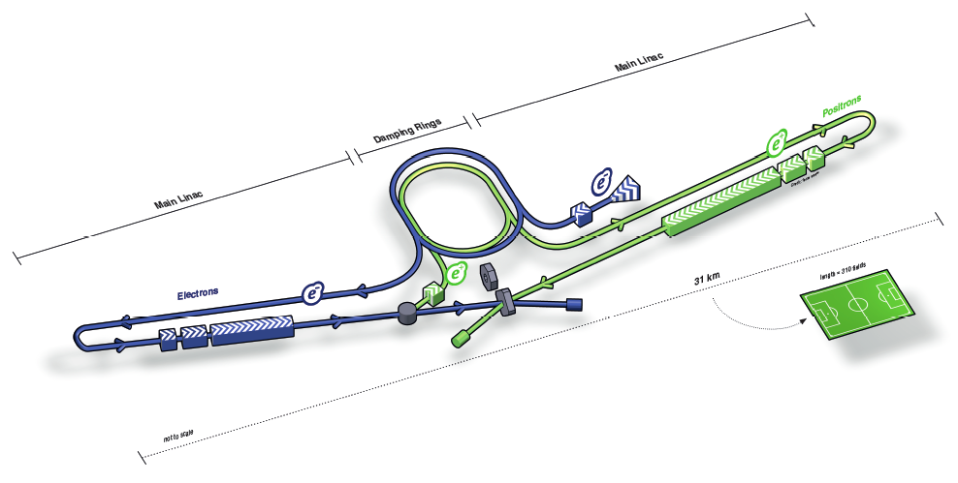
The International Linear Collider
A linear e⁺e⁻ collider with 500GeV CM energy, upgradeable to 1TeV
Acceleration with superconducting RF cavities
Polarized beams
Designed by a worldwide collaboration
About 31km long
For more information:
www.linearcollider.org

Slide 3
Running Scenarios
Joint Parameters WG (Physics/Detectors and Machine) studies many running scenarios
-> work in progress
Investigated time
evolution of physics
results
~25 years of running
before 1TeV upgrade,
incl. lumi upgrades
Baseline: Start with “500GeV” machine (no long 250GeV run)
Example: “D500” scenario:
0.5ab⁻¹ @250 and 300,
5.5ab⁻¹ @ 500GeV

Slide 4
Running Scenarios
Joint Parameters WG (Physics/Detectors and Machine) studies many running scenarios
-> work in progress
Investigated time
evolution of physics
results
~25 years of running
before 1TeV upgrade,
incl. lumi upgrades
Baseline: Start with “500GeV” machine (no long 250GeV run)
Example: “D500” scenario:
0.5ab⁻¹ @250 and 300,
5.5ab⁻¹ @ 500GeV

Slide 5
Three Questions
Why?
How?
When?

Slide 6
WHY
… international?
… linear?
… e⁺e⁻ collider?
→ physics case
… superconducting?
→ how?

Slide 7
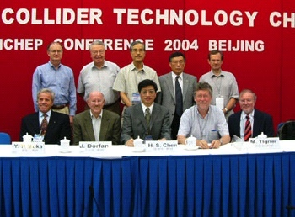
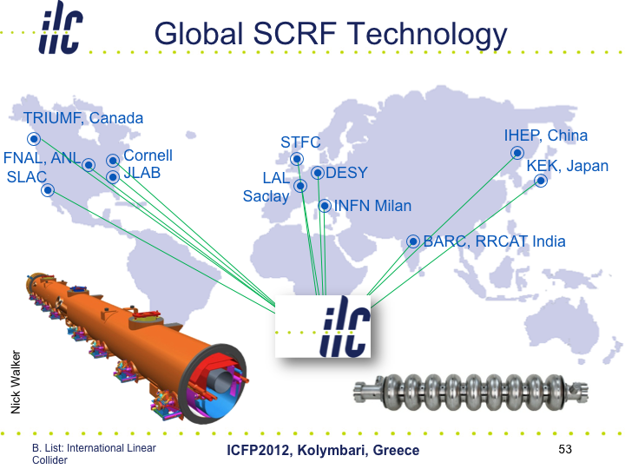
Why International?
ILC is too large for a single country, or even a
single region
New paradigm:
No central host lab
Truly global cooperation

Slide 8
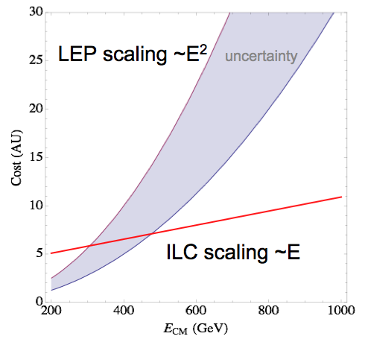
Why Linear?
Circular e⁺/e⁻ accelerator:
Limiting factor is energy loss by synchrotron radiation
Synchrotron radiation power: P ∝ E⁴ / R
if circumference ∝ E²
-> cost scales as ∝ E²
  For a linear accelerator: cost ∝ E
  Increasing the energy:
  Just make tunnel longer!
  Beyond the top pair threshold,
  there are only linear colliders!
N. Walker, ICHEP 2014, Valencia

Slide 9

Why an e⁺e⁻ Collider?
pp and e⁺e⁻ colliders are complementary, we need both:
  Energy reach and precision
  Strong and electroweak interactions
e⁺e⁻ strong points:
  Pointlike interaction
  No debris from witness quarks
  Known energy and
  polarization of initial state
  Flavour democracy:
  no bias towards up/down,
  i.e. proton constituent flavours

Slide 10
Why an e⁺e⁻ Collider?
To measure the Higgs properties
To measure the Top properties
To constrain SUSY / BSM by precision measurements
To look for new particles:
Discovery potential is complementary to LHC, not inferior

Slide 11
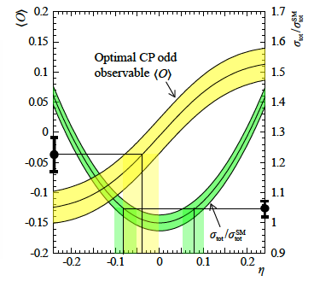
Why a Higgs Factory?
Establish the Higgs mechanism:
  Measure the branching ratios and absolute width model independently
  → recoil mass method: e⁺e⁻ → Zh → 𝓁⁺𝓁⁻ X → Includes invisible decays!
  Measure mass: input to branching ratio prediction
  Measure Top-Higgs coupling in e⁺e⁻ → tth
  Measure Higgs self-coupling: e⁺e⁻→ Zhh – needs energies >= 500 GeV
  Measure CP quantum numbers
Le Diberder et al, arXiv:1210.0202 (2012).

Slide 12
Why a Higgs Factory?
Establish the Higgs mechanism:
  Measure the branching ratios and absolute width model independently
  → recoil mass method: e⁺e⁻ → Zh → 𝓁⁺𝓁⁻ X → Includes invisible decays!
  Measure mass: input to branching ratio prediction
  Measure Top-Higgs coupling in e⁺e⁻ → tth
  Measure Higgs self-coupling: e⁺e⁻→ Zhh – needs energies >= 500 GeV
  Measure CP quantum numbers
Mass and
Zh coupling
Branching Ratios
Quantum
numbers
Le Diberder et al, arXiv:1210.0202 (2012).

Slide 13
Higgs Couplings: SM or other Higgs?
Measure couplings directly, model independent,
and separately!
ILC 250: Lumi 417 fb-1, sqrt(s) = 250 GeV
ILC 500: Lumi 833 fb-1, sqrt(s) = 500 GeV
ILC 250up: Lumi 1920 fb-1, sqrt(s) = 250 GeV
ILC 500up: Lumi 2670 fb-1, sqrt(s) = 500 GeV
ILC 1000up: Lumi 4170 fb-1, sqrt(s) = 1 TeV
Standard Model

Slide 14
Higgs Couplings: SM or other Higgs?
Measure couplings directly, model independent,
and separately!
Supersymmetry
(MSSM)
ILC 250: Lumi 417 fb-1, sqrt(s) = 250 GeV
ILC 500: Lumi 833 fb-1, sqrt(s) = 500 GeV
ILC 250up: Lumi 1920 fb-1, sqrt(s) = 250 GeV
ILC 500up: Lumi 2670 fb-1, sqrt(s) = 500 GeV
ILC 1000up: Lumi 4170 fb-1, sqrt(s) = 1 TeV
Standard Model

Slide 15
Higgs Couplings: SM or other Higgs?
Measure couplings directly, model independent,
and separately!
Composite Higgs
(MCHM5)
Supersymmetry
(MSSM)
ILC 250: Lumi 417 fb-1, sqrt(s) = 250 GeV
ILC 500: Lumi 833 fb-1, sqrt(s) = 500 GeV
ILC 250up: Lumi 1920 fb-1, sqrt(s) = 250 GeV
ILC 500up: Lumi 2670 fb-1, sqrt(s) = 500 GeV
ILC 1000up: Lumi 4170 fb-1, sqrt(s) = 1 TeV
Standard Model

Slide 16
Why top physics after LHC?
Top mass: Fundamental SM parameter,
leading contribution to radiative corrections
Threshold scan measures mass in a theoretically very clean way
→ gets rid of QCD uncertainties (~0.5 GeV)
Input for radiative correction measurements!
Top performance:
Mass*: 27MeV (0.019%)
Width: 22MeV (1.7%)
Seidel et al., EPJ C73(2013)2530

Slide 17
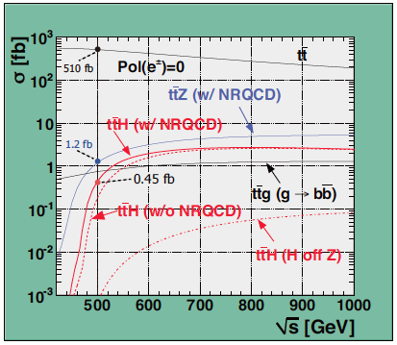
Interesting Energies
Higgs recoil: 250GeV
Higgs and tt threshold: 350 GeV
Htt coupling, Higgs self coupling:
≥ 500 GeV – 1000 GeV
⇒ Higgs + Top provide physics case for machine with
initial ~500 – 550GeV energy reach → the ILC!

Slide 18
Energy Reach
Htt coupling has a very sharp
threshold at 475GeV
Need to reach >=500GeV
with high confidence
A machine that delivers 500GeV at 95%CL can most probably reach 550GeV or more
(may require some funds though…)
Discussions about performance reserve are ongoing: stay tuned

Slide 19
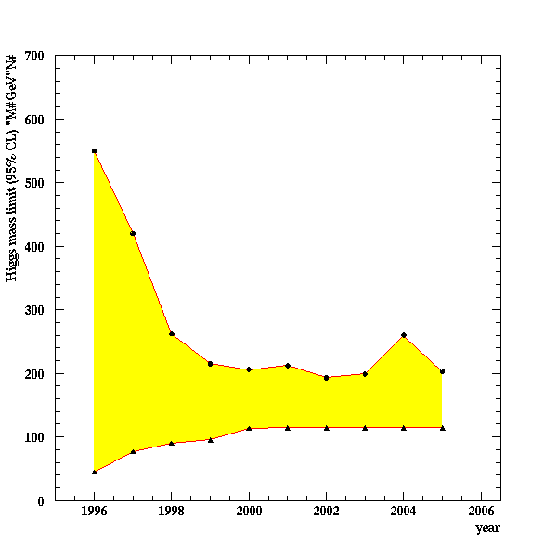
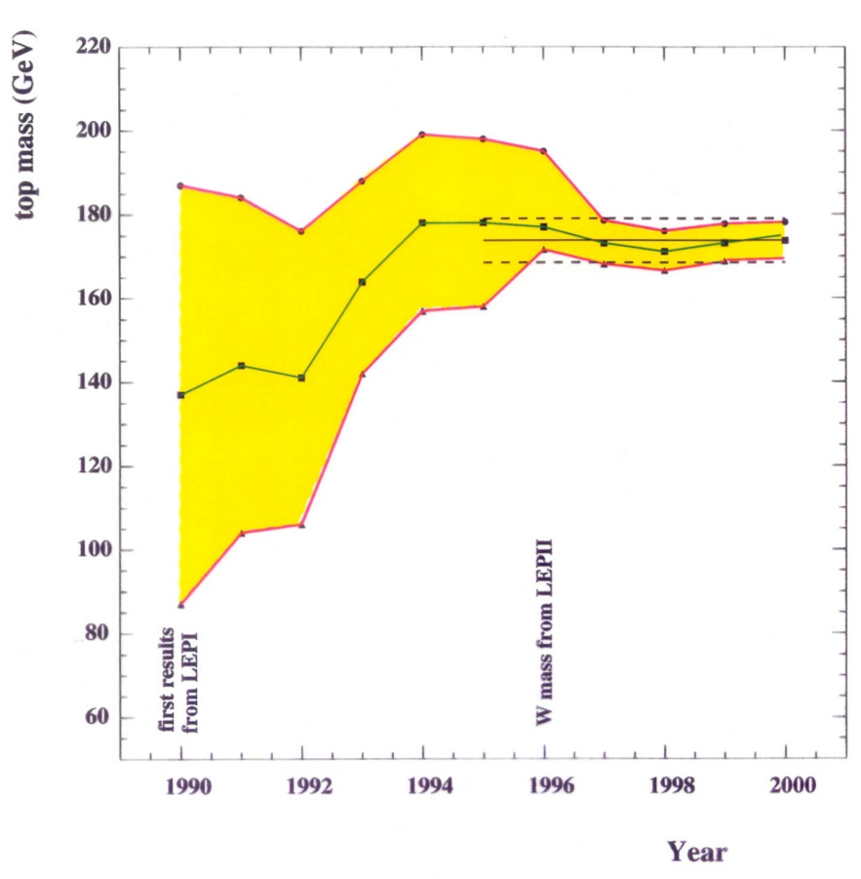
Why continue precision physics?
Radiative corrections gave us
  the Top mass before the Top discovery
  bounds for the Higgs mass before the Higgs discovery
With known Top and Higgs masses, we constrain whatever lies beyond the SM!

Slide 20
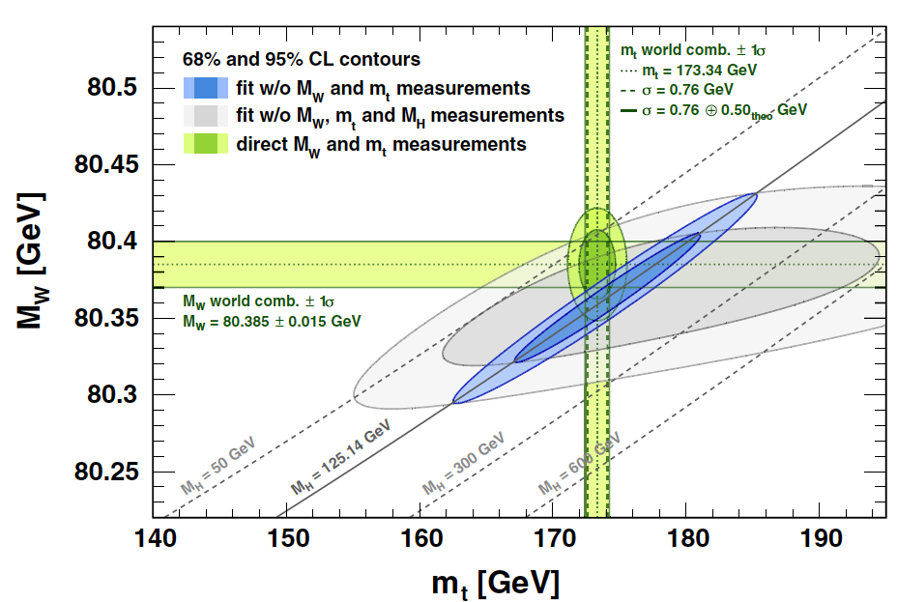
ILC Precision: Gfitter Projection
Gfitter group, EPJC 74(2014)9.

Slide 21
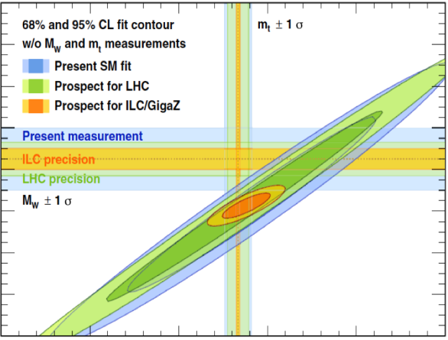
ILC Precision: Gfitter Projection
Gfitter group, EPJC 74(2014)9.

Slide 22
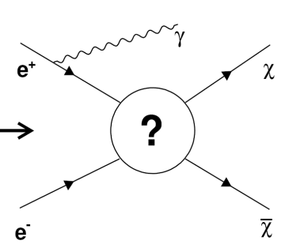
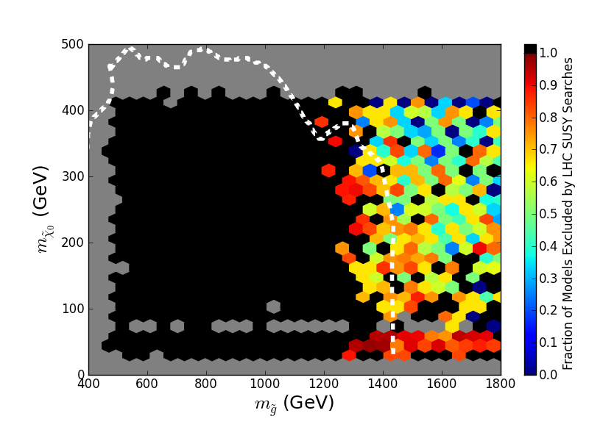
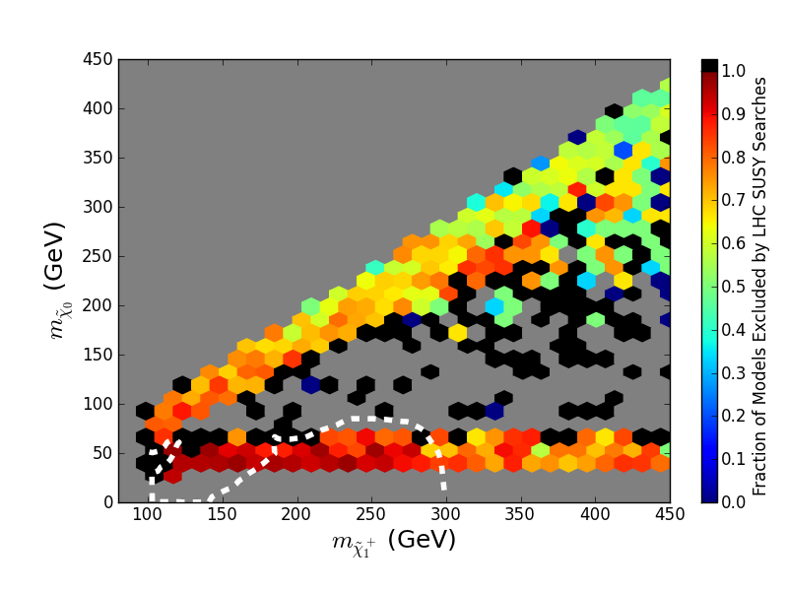
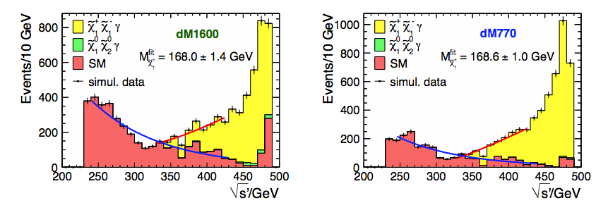
Beyond the Standard Model?
Dark Matter:
Wino / Higgsino-like
pMSSM with
low fine-tuning
Models with small
NLSP/LSP mass diff.
ILC 1 TeV
ILC 500 GeV
Cahill-Rowley, Hewett, Rizzo
Berggren et al., EPJ C73 (2013) 2660

Slide 23
Beyond the Standard Model?
Dark Matter:
Wino / Higgsino-like
pMSSM with
low fine-tuning
Models with small
NLSP/LSP mass diff.
Plenty to do, even after HL-LHC!
ILC 1 TeV
ILC 500 GeV
Cahill-Rowley, Hewett, Rizzo
Berggren et al., EPJ C73 (2013) 2660

Slide 24
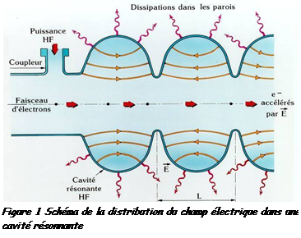
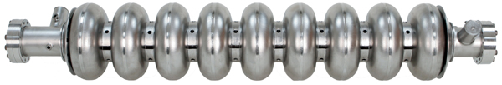
Why Superconducting?
Linear accelerator:
Accelerate electrons in a
long string of Rfcavities
Gradient: 31.5MV/m
→ need 15.8km for 500GeV!
For given total power
(electricity bill!), luminosity
proportional to efficiency
ILC: ~160MW @ 500GeV
Superconducting cavities
maximise RF-to-beam efficiency
http://www.supraconductivite.fr/media/
images/Applications/image037.png
RF efficiency
RF power

Slide 25
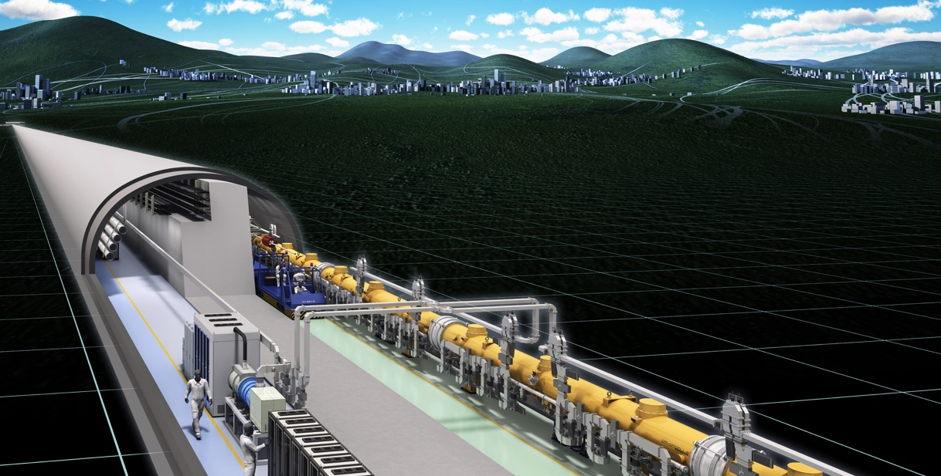
HOW
… will it look like?
… can one get the energy?
→ Superconducting RF technology
… can one get the luminosity?
→ low emittance beams, final focus
… can one do measurements?
→ the experiments
… much will it cost?

Slide 26
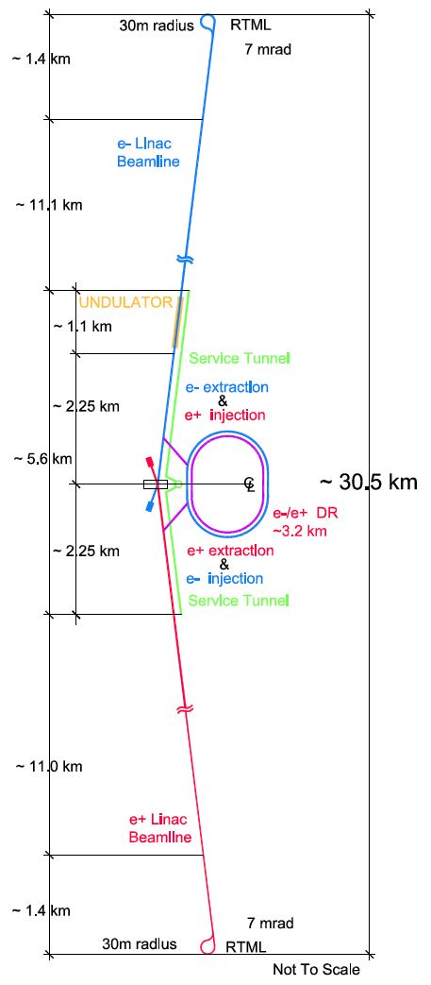
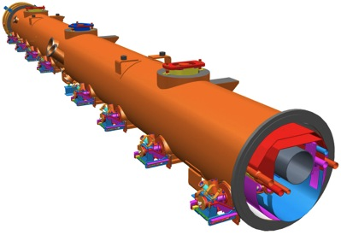
How will the ILC look like?
200-500 GeV E_{cm} e⁺e⁻ collider
L ~2×10³⁴ cm⁻²s⁻¹
Superconducting “TESLA” Technology
30km long main tunnel
  21km Main Linac
  4.5km interaction region
Positron production from undulator radiation (polarized source!)
3.2km central damping ring
14mrad crossing angle

Slide 27
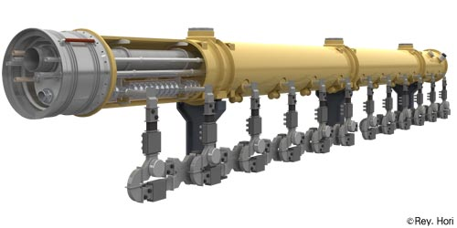
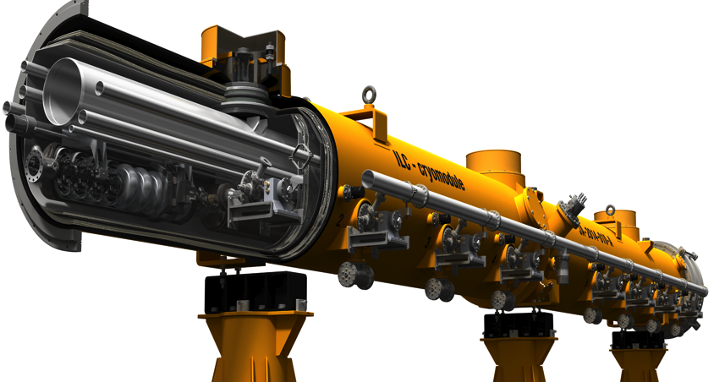
How to get the energy
1.3m
Superconducting “TESLA” Cavities
Parameter | Value
Av. field gradient | 31.5 MV/m
Length | 1.3026 m
Frequency | 1.3 GHz
Quality factor Q₀ | > 10¹⁰
# 9-cell cavities | 16024
# cryomodules | 1855

Slide 28
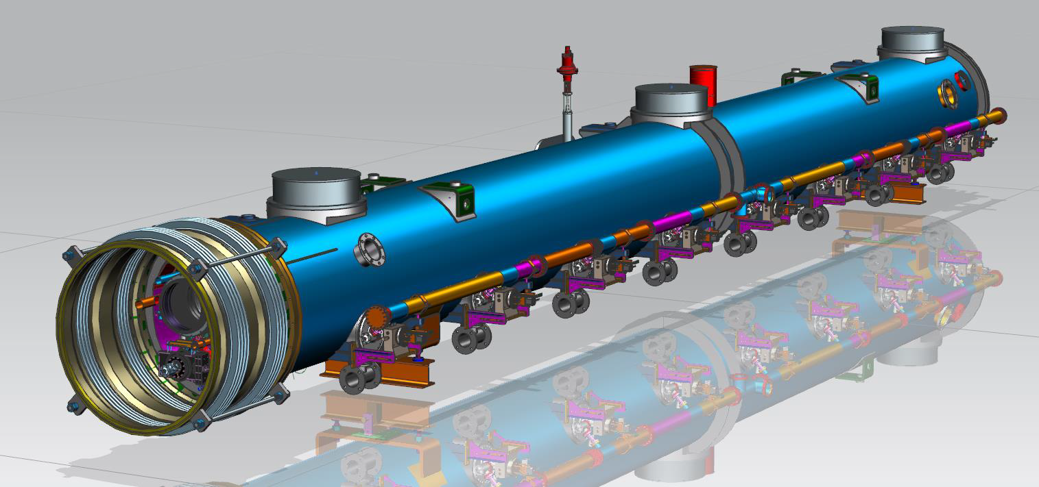
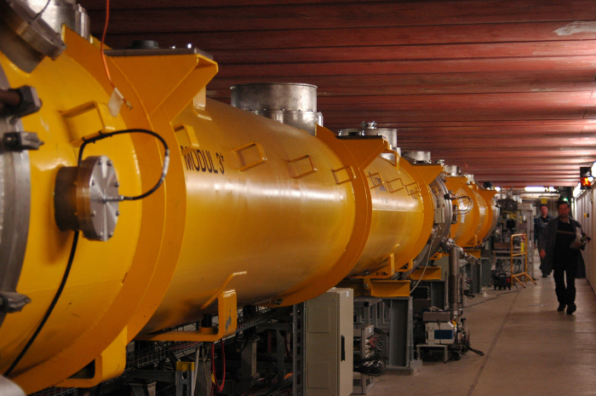
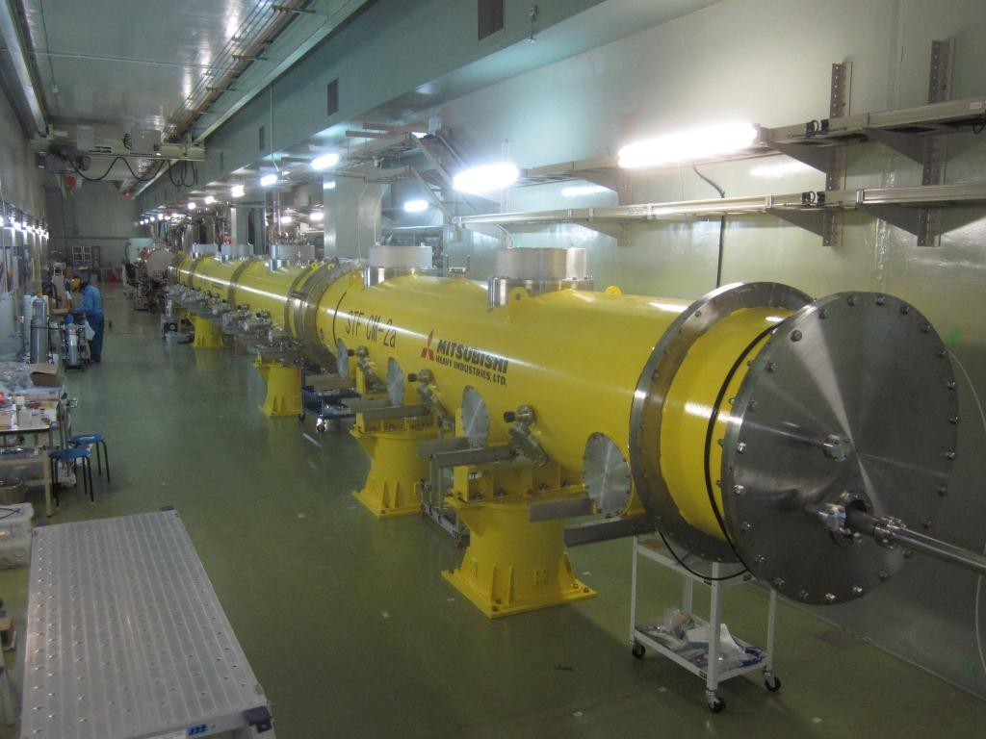
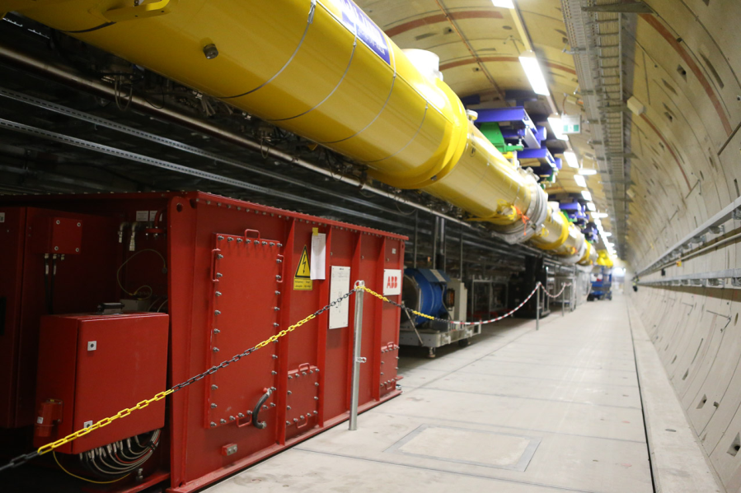
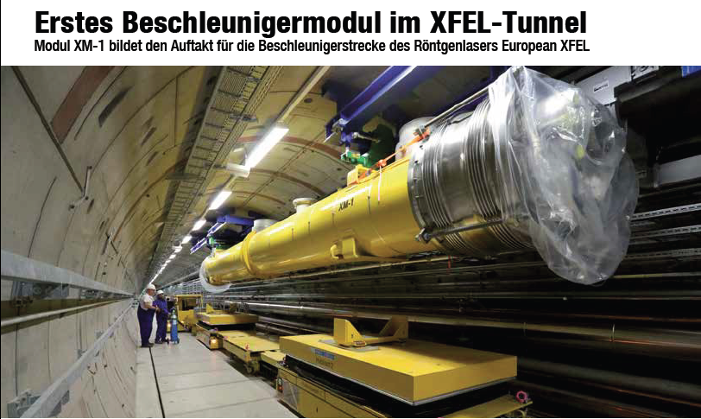
“ILC-Type” Cryomodules around the World
35 cryomodules for LCLS-II at SLAC
DESY FLASH: in operation for 15 years!
100 Cryomodules for European XFEL –
installation has started
STF2: Test Facility at KEK

Slide 29
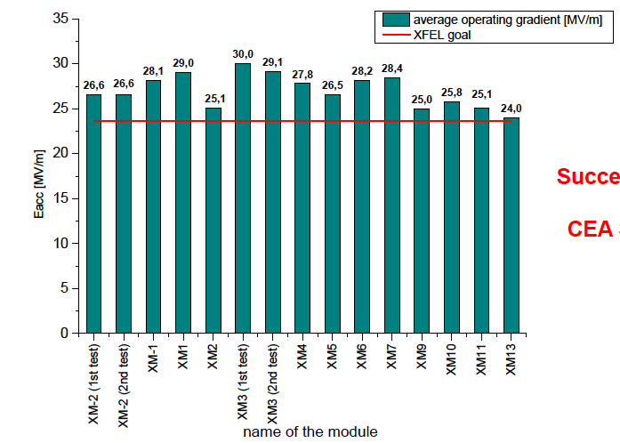
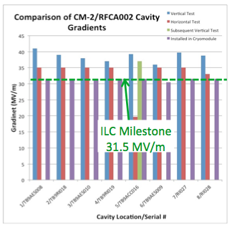
Module Performance: Recent Results
Module series production for E-XFEL
Reschke, TTC meeting KEK 2014
Cavities in Cryomodule CM-2 (FNAL)
Harms, TTC meeting, KEK 2014

Slide 30
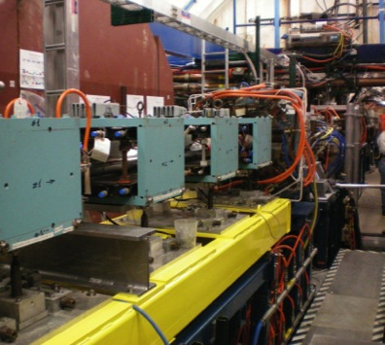
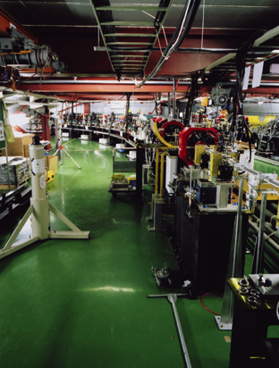
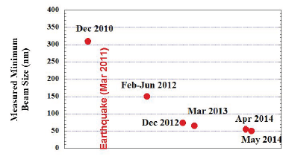
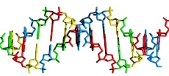
The Luminosity Challenge
Design: L=1.74･10³⁴ cm⁻²s⁻¹ requires a very small beamspot
ATF2: 50nm Beam Size at 1.3GeV!
K. Kubo, IPAC14 (WEZA01)
Small Emittance
CESR-TA Facility at Cornell:
Validate Damping Ring design
Sharp Focus
ATF2 Facility at KEK:
Validate Final Focus
ILC Beam Spot
12nm
DNA: 2.5 nm
1000nm

Slide 31
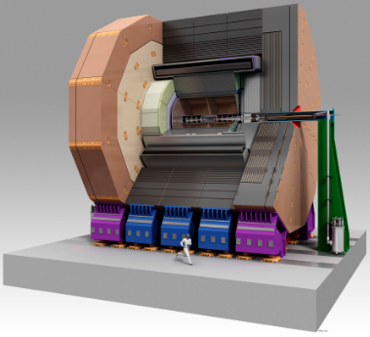
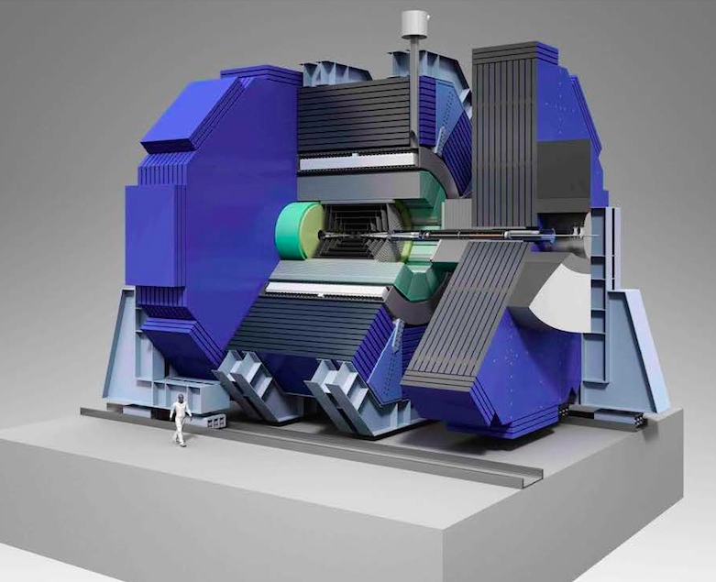
How to detect the particles?
Two Detectors: ILD and SiD, sharing one interaction region
Clean e⁺e⁻ environment permits low-mass, precision trackers → Excellent performance expected
ILD
SiD

Slide 32
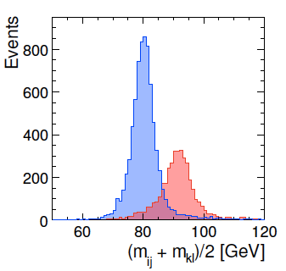
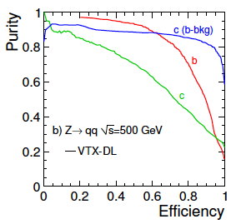
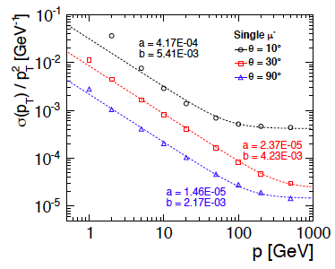
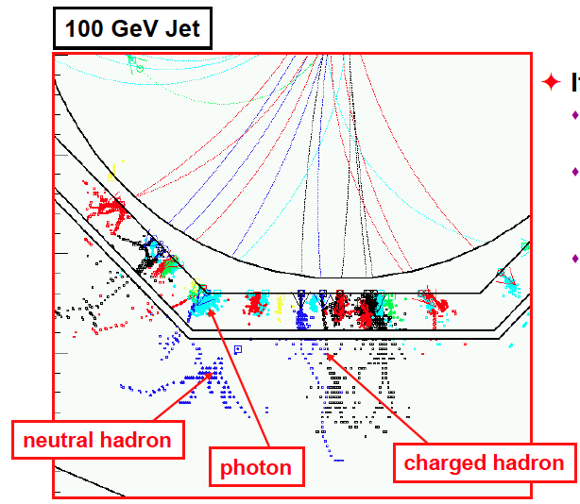
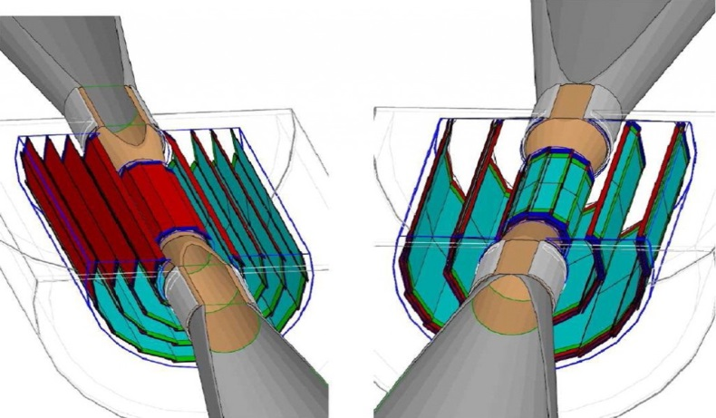
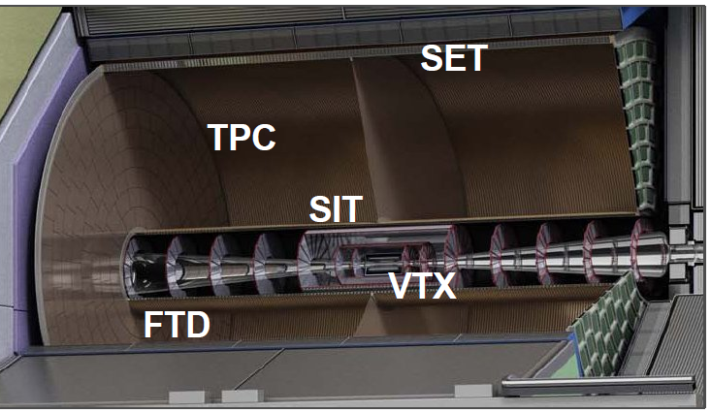
Detectors: Challenges and Opportunities
Jet energy resolution
-> particle flow calorimetry
Jet flavour tagging
-> super-thin pixel detectors
Extremely good tracking
-> TPC or thin silicon tracker
W⁺W⁻
→ 4 jets
Z⁰Z⁰
→ 4 jets
M. Thomson, Calor 2010

Slide 33

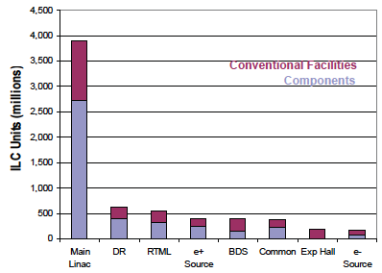
How much does it cost?
Estimate in 2013 Technical Design Report:
7.8 ･10⁹ $ + 14k years labor (7% increase)
Dominated by Main Linac
Also read the fine print:
This number does not include costs for accelerator, lab, site activation

Slide 34

WHEN
When can ILC be built?
… and Where?

Slide 35
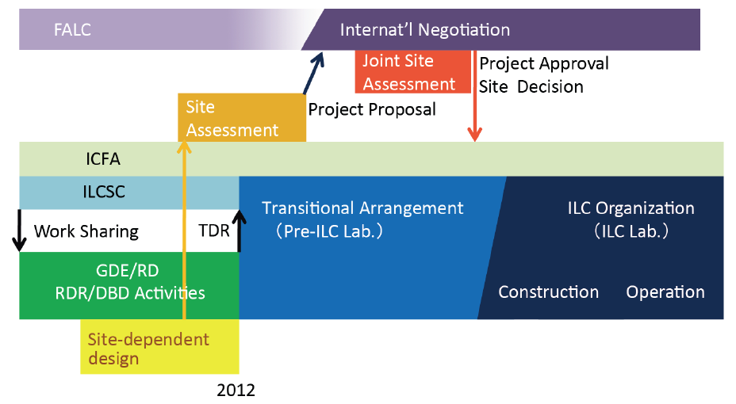

The ILC Timeline
Japan:
MEXT
Review
Apr
2016
Preparation Phase
Expecting ~ (2+ 4) year
Being re-studied
We are here, 2014

Slide 36






Candidate Sites in Japan
Preferred Site
http://ilc-str.jp/topics/2013/08281826/

Slide 37
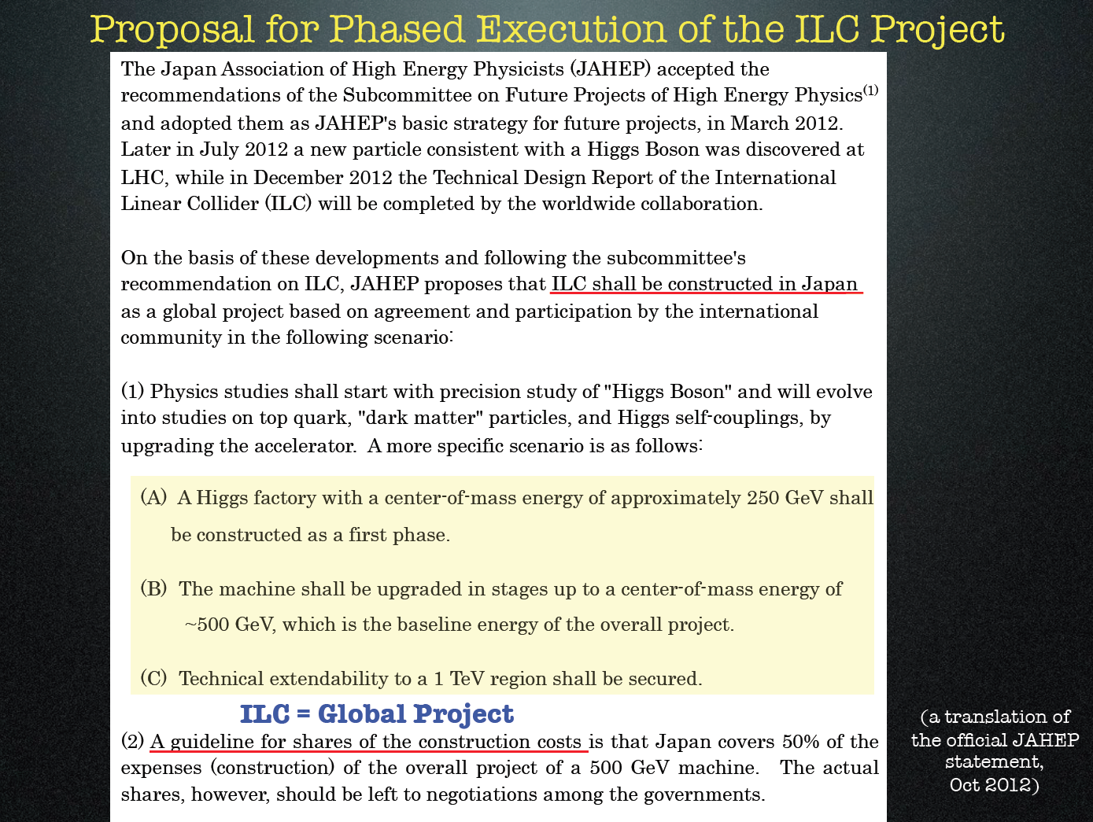
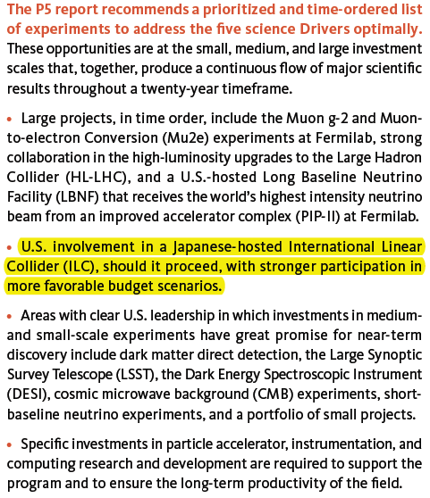
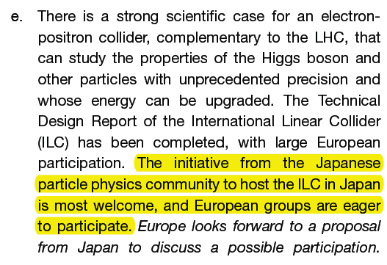
ILC on the World’s Roadmaps
Japan, Oct 2012
Statement by JAHEP panel
America:
Report of the Particle Physics
Project Prioritization Panel (P5)
European Strategy for Particle
Physics, Update 2013
http://cds.cern.ch/record/1551933/
http://www.usparticlephysics.org/p5/pdf/
BuildingForDiscovery_P5Report2014_BriefSummary.pdf

Slide 38
Take Home Message
ILC has a strong physics case as precision machine:
  Complementary to LHC
  Ideal to study light Higgs and Top
  Explores what lies behind the Standard Model,
  by indirect constraints, additional measurements, or discoveries
  Energies above the Top threshold are vital for that programme
ILC is ready to be built today
Strong movement in Japan in favor of ILC,
supported by European and US roadmaps!

Slide 39
Acknowledgements
Many thanks to Karsten Büßer, Eckhard Elsen, Brian Foster, Jenny List, Gudrid Moortgat-Pick, Nicholas J. Walker and Georg Weiglein for their help in the preparation of this talk.
Additional Material taken from talks by J. Brau, F. Simon, K. Fujii, T. Tanabe, and many others.

