Slide 1
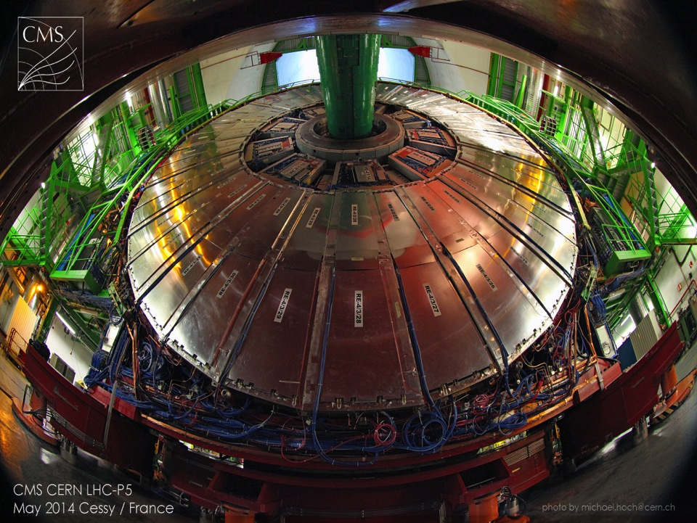
New Bakelite production or Phase 2
Salvatore Buontempo
(INFN, Naples & CERN)
on behalf of CMS Central TC Group
Atlas & CMS meeting RPC Phase 2 , November 26th 2014

Slide 2
Index
Bakelite production facilities in Puricelli
Quality control in Puricelli and INFN PV
New Production constrains
Tentative schedule
Preliminary cost estimation
Conclusions

Slide 3
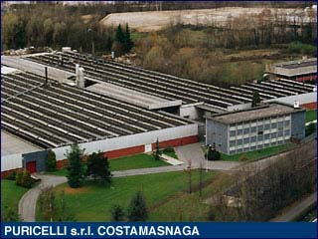
Bakelite production facilities in Puricelli
Puricelli production site in Costamasnaga (Milan- Italy).

Slide 4
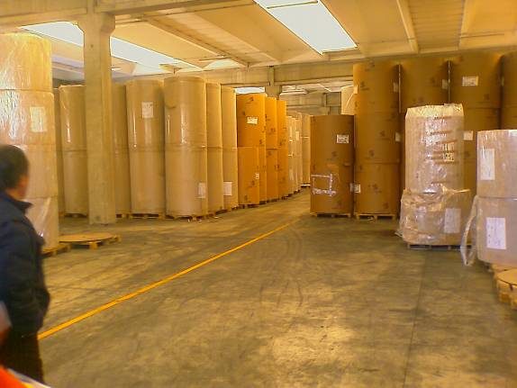
Bakelite production facilities in Puricelli
Large Craft Paper deposit, meaning possibility to store similar quality batches in
safe environment and negotiate the costs

Slide 5
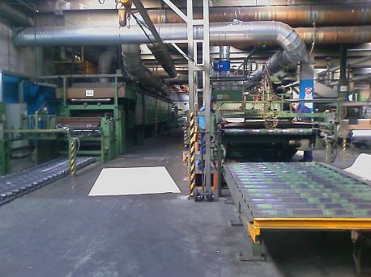
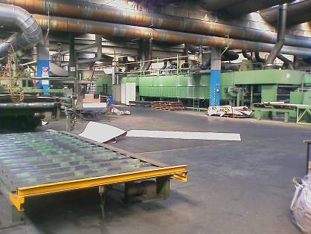
Bakelite production facilities in Puricelli
On the back: Industrial production line for Craft paper treatment with melaminic resin
Used for RE4 production
Industrial production line for Craft paper
treatment with phenolic resin.
Not suitable for our application in RE4

Slide 6
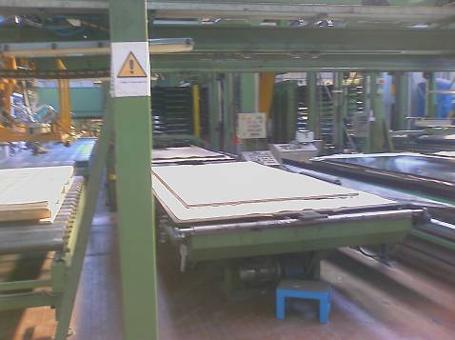
Bakelite production facilities in Puricelli
Large size pressing unit, dedicated for CMS RE4 production (one of the 5 available in this site)
10 pressing slots for production of 5 panel each: total production in single pressing action
= 50 panels

Slide 7
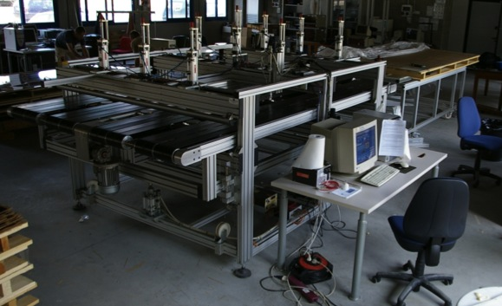
Quality control in Puricelli and INFN PV
Automatic Resistivity System located at INFN Pavia
Manual Bakelite panel edge resistivity measurement in Puricelli
Automatic Bakelite panel full size resistivity measurement in Pavia
Study of bakelite resistivity uniformity
Being discussed if moving at CERN or in Puricelli site
7

Slide 8
New Production constrains
Kraft paper
Minimum quantity to buy : 2-3 pallets of Kraft paper
1 pallet = 2250 kg, about 1600 foils
2 mm panel = 11 foils, 1 pallet = about 145 panels
Agreed with firm that THEY buy and store it
Panel production
For CMS resistivity range (1-6 x 10¹⁰ Ohm cm) we have to produce 50 panels
For new resistivity ranges (0,5-1 x 10¹⁰ Ohm cm) , still under discussion the minimum amount of panels to be produced (rest of press slots used with other phenolic material for different application)
Agreed with firm to provide a price list for each panel vs panel quantity and resistivity range

Slide 9
Tentative schedule
Kraft paper
2-3 pallets being delivered 2 months after the order reception
Bakelite panels
Driving element is the shine plates to be installed in the pressing unit. They do not install plates for just one production (even for a full press of 50 panels !). We have to wait for them to receive and group at least 10 pressing actions
Once we have this condition we can have the panels in 1-2 days

Slide 10
Preliminary cost estimation
Kraft paper
1 pallet = 4.5 keuro
2-3 pallets (being negotiated with krafr paper supplier) = 9-12.5 keuro
Bakelite panels
Standard resistivity Panel thickness Panel thickness 1,5-1,8 mm thickness = 27 euro/m²
1 panel = about 5 m2, meaning 135 euro
Minimum amount = 50 panels, meaning 6,75 keuro
New resistivity (0,5-1 x 10¹⁰ Ohm cm)
Panel thickness 1,5-1,8 mm thickness) = 30-35 euro/m2 (to be confirmed)
1 panel = about 5 m2, meaning 150-175 euro
Minimum amount of panels being defined according to their plan for other material with phenolic paper (10-50, meaning 1.5-8.75 keuro)
Costs to be added :
Cutting , Brushing in GT, + trasports
Deleted
To be updated vs new price list

Slide 11
Conclusions
Controlled resistivity bakelite industrial partner is a solid team
Riva & Puricelli showed their solid cooperation in RE4 mass production
To secure some new panels in february 2015 we need to:
Buy immediately craft paper (firm costs)
Order 50 panels in standard resistivity (1-6 x 10¹⁰ Ohm cm), thickness 1,5-1,8 mm, 7 keuro
Order 10-50 (being discussed) Panels in lower resistivity (0,5-1 x 10¹⁰ Ohm cm) , ?? keuro
thickness 1,5-1,8 mm ( 3-10 keuro, depending from the # trials and panel amount for each trial)
+ cutting, brushing, transport
Total budget about Depending from firm price list expected in these days
Delivery time february 2015 ( to be confirmed )

