Slide 1
PORFIDO
Physical Oceanography by RFID Outreach
INFN-LNF
Orlando Ciaffoni, Marco Cordelli, Roberto Habel, Agnese Martini, Luciano Trasatti
Use neutrino telescopes infrastructure
(power, communication)
for oceanographic measurements

Slide 2
RFID communication through OM glass without connectors
Very little interference with detector
Very little bandwidth to-from shore
Very little power
continuous data taking
data rate controlled from shore

Slide 3
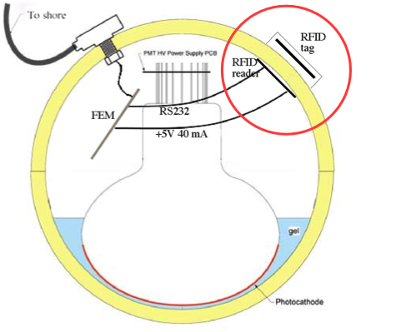
KM3 Optical Module with PORFIDO probe schematic
FCM
FCM

Slide 4
Tag - WISP
Passive (no batteries)‏
Includes temperature
can add new sensors

Slide 5
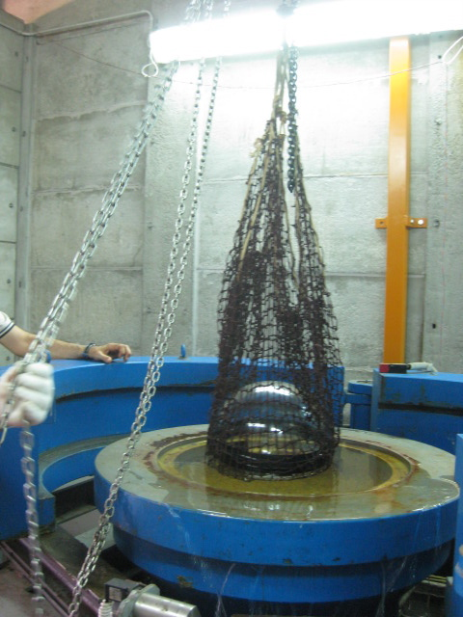
LNS pressure test

Slide 6
PORFIDO for NEMO Phase II

Slide 7
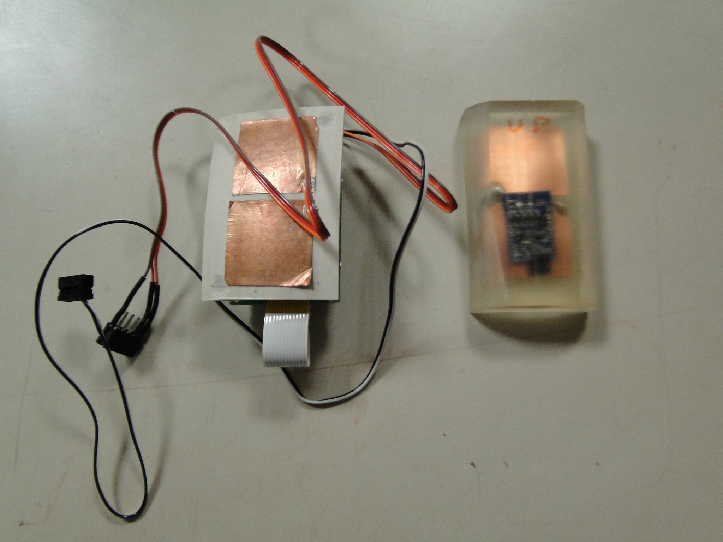
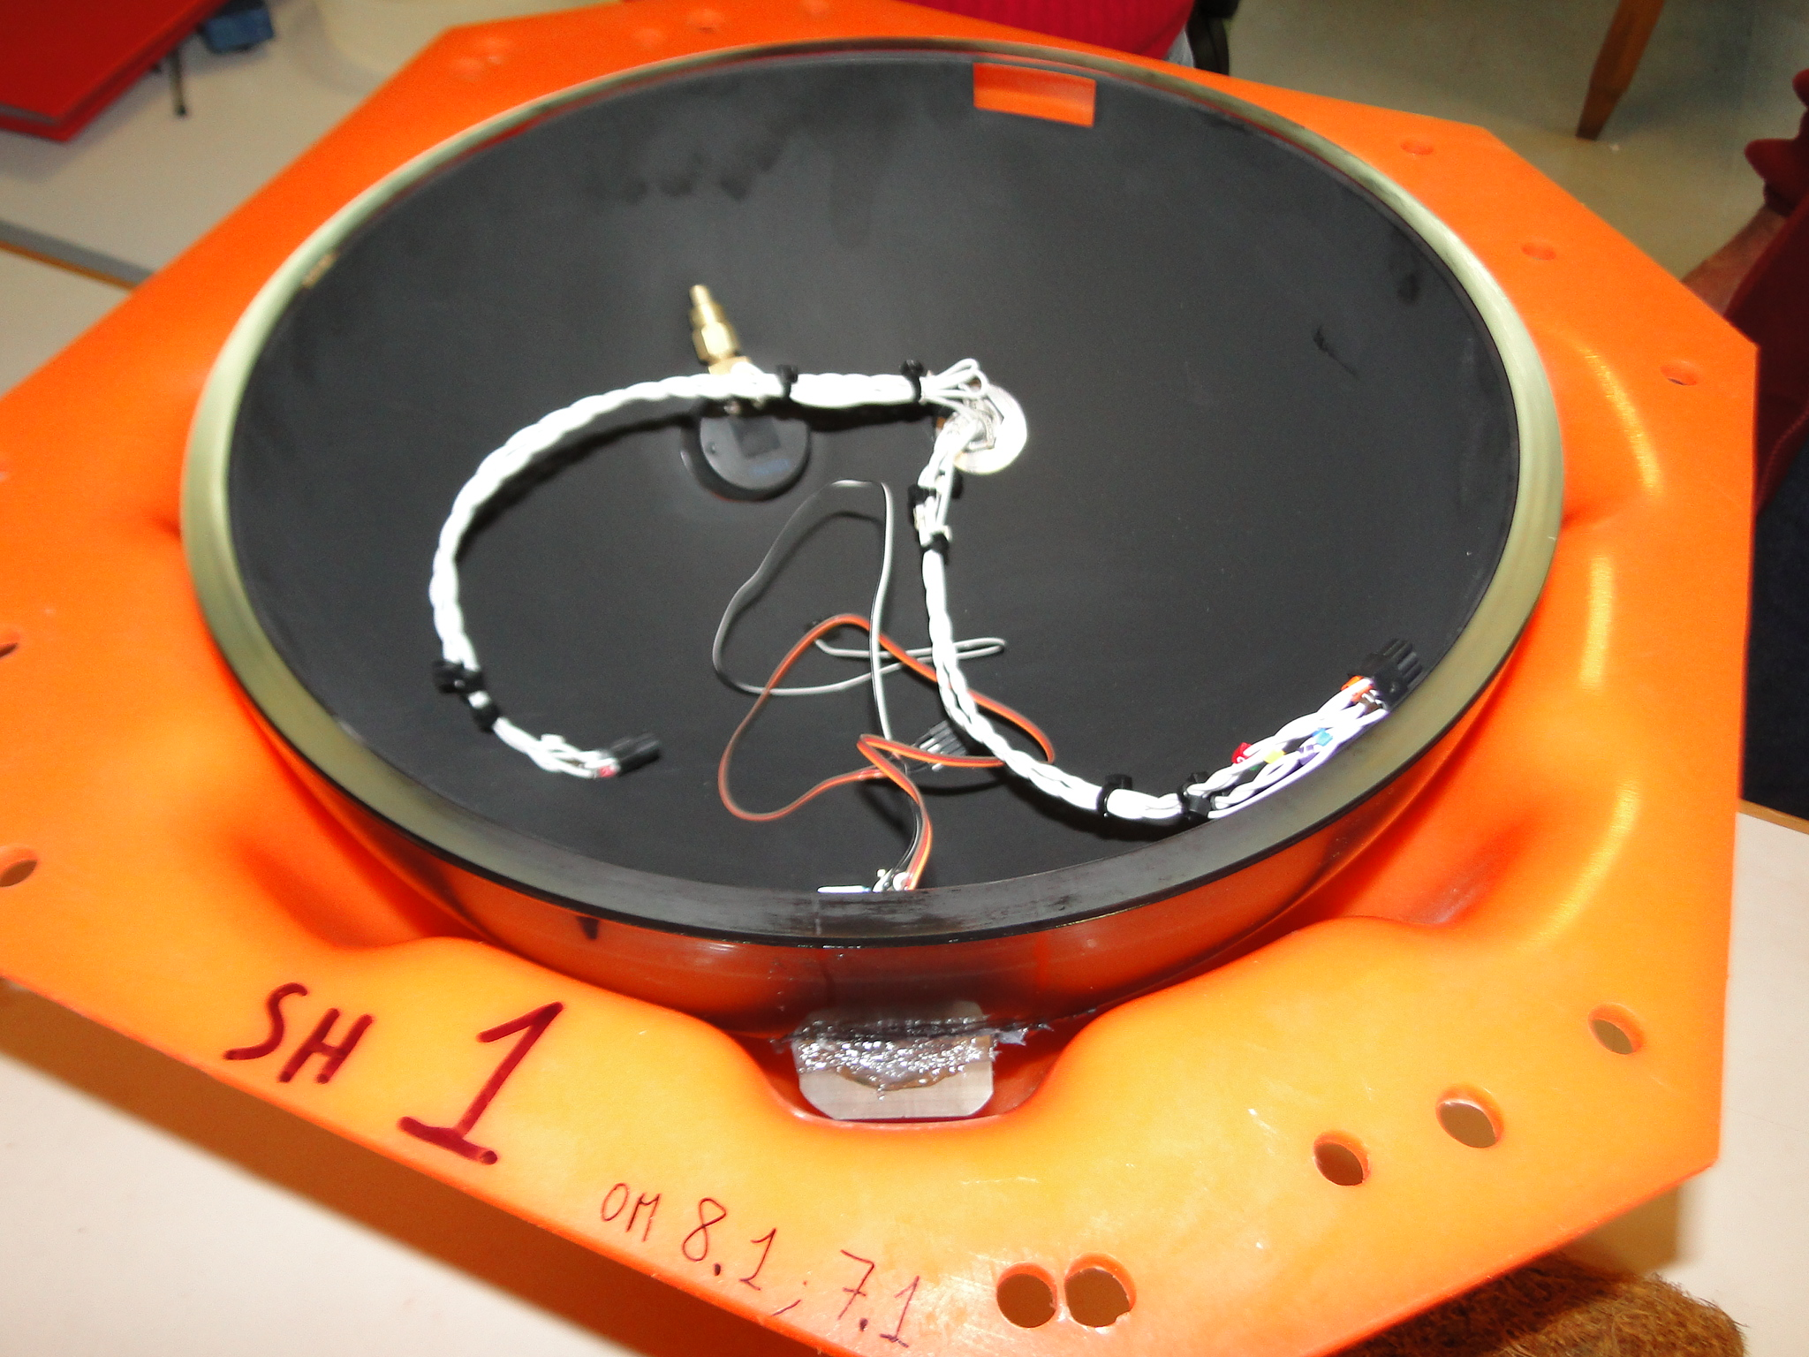
PHASE II
- 4 PORFIDO probes have been installed on 4 OMs

Slide 8
PHASE II – System test
built-in thermometer with ±1 ˚C accuracy
communications and power (50 mA @ 5V)
all 4 working after one year
Km3Net –Italy
Good Temperature
water masses movements
thermometer - accuracy better than 10E-3 ˚C
salinity meter with a resolution of ~1ppm

Slide 9
Km3Net –Italy Good Temperature
2 x 24 bit ADC
Thermistor thermometers - accuracy of 10E-4 ˚C
2 mA@3.3V
4 ready to install
Inductive salinity meter: need ~1 ppm
under test

Slide 10
PORFIDO 2

Slide 11
PORFIDO 2

Slide 12
Km3Net - Italy
4 PORFIDO 2 with thermometers
ready
12 on all towers
calibration?
DOM

