Slide 1

Carla Distefano
Measurement of the atmospheric muon flux at 3500 m depth with the NEMO Phase-2 detector

Slide 2
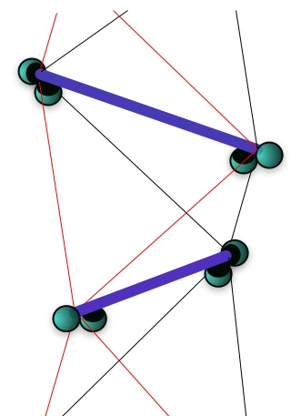
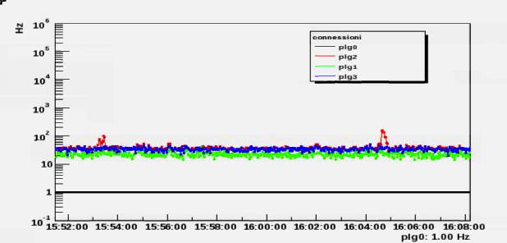
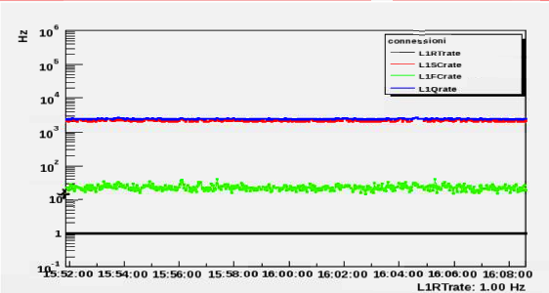
Muon Triggers
L1 triggers
SC (20 ns)
1:100 or all if #≥2
FC (100 ns)
(SC in 20 ns + PMT)
Qthreshold && SC
(Q first10 samples > 500 adc)
Minimum bias
(1 ms @ 1 Hz)
Event trigger rate: ~100 Hz
Expected (simulation): ~0.1 Hz
Signal dominated by noise, rejected during the off-line analysis.
Trigger rates

Slide 3
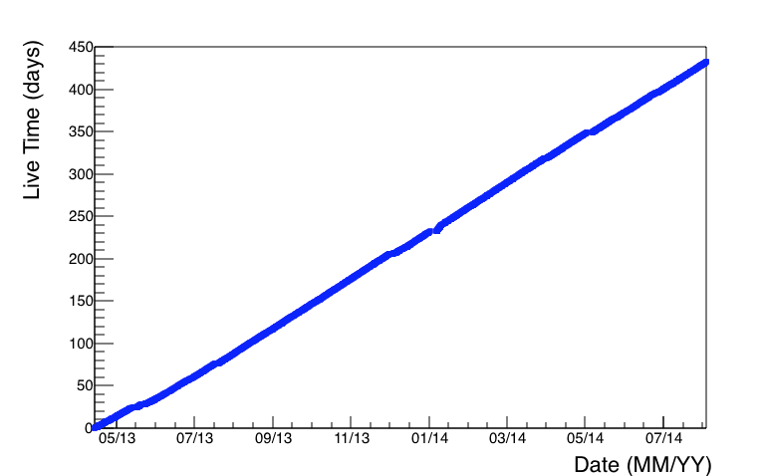
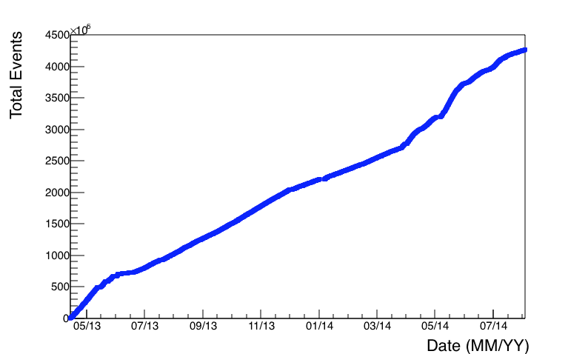
Live time and accumulated events
Deployment and operation: 23 March 2013
Detector turning off: 4 August 2014
Detector operation time: 500 days
Total live time: 432.3 days
Total accumulated events: 4.3E9
(since 16 April 2014, commissioning phase ending)
≈100% live time
Slope changing due to DAQ reconfiguration

Slide 4
Post-Trigger Data
Data Set | Runs | Period | HV | Trigger L1 | Trigger L2
Set1 | 412-498 | 2013-04-27 - 2013-05-08 | SetUp0 (on-shore values) | SC: 5 ns FC: 5 ns (old definition + bug) Q: 1E6 | -
Set2 | 499-675 | 2013-05-08 - 2013-05-30 | SetUp1 (2013-05-08) | SC: 5 ns FC: 5 ns (old definition + bug) Q: 1E6 | -
Set2to3 | 676-703 | 2013-05-30 - 2013-05-31 | SetUp1 -> SetUp2 | SC: 5 ns FC: 5 ns (old definition + bug) Q: 1E5 (1E6 for 676, 677) | -
Set3 | 704-846 | 2013-05-31 - 2013-06-22 | SetUp2 (2013-05-30) | SC: 20 ns FC: 100 ns (old definition + bug) Q: 1E5 | FC 1:10, SC 1:100
Set4 | 847-873 | 2013-06-22 - 2013-06-28 | SetUp2 (2013-05-30) | SC: 20 ns FC: 100 ns (old definition + bug) Q: 500 (first 10 samples) | FC 1:1 && no Q, SC 1:100 or 1:1 if SC≥2 and no Q, Q && SC (differ. PMTs)
Set5 | 874-1325 | 2013-06-28 - 2013-07-16 | SetUp3 (2013-06-28) | SC: 20 ns FC: 100 ns (old definition + bug) Q: 500 (first 10 samples) | FC 1:1 && no Q, SC 1:100 or 1:1 if SC≥2 and no Q, Q && SC (differ. PMTs)
Set6 | 1326-1718 | 2013-09-16 – 2013-12-05 | SetUp3 (2013-06-28) | SC: 20 ns FC: 100 ns (new definition) Q: 500 (first 10 samples) | FC 1:1 && no Q, SC 1:100 or 1:1 if SC≥2 and no Q, Q && SC (differ. PMTs) At this level, FC condition is equivalent to the old L1 FC condition
Runs before 412 were not analyzed

Slide 5
Post-Trigger Data
Data Set | Runs | Period | HV | Trigger L1 | Trigger L2
Set7 | 1719-2500 | 2013-12-05 – 2014-03-14 | SetUp3 (2013-06-28) | SC: 20 ns FC: 100 ns (new definition) Q: 500 (first 10 samples) L1 Seq Hits Trigger | FC 1:1 && no Q, SC 1:100 or 1:1 if SC≥2 and no Q, Q && SC (differ. PMTs) At this level, FC condition is equivalent to the old L1 FC condition
Set8 | 2501-2865 | 2014-03-14 - 2014-06-04 | SetUp3 (2013-06-28) | SC: 20 ns FC: 100 ns (new definition) Q: 500 (first 10 samples) L1 Seq Hits Trigger | FC 1:1 && no Q, SC 1:100 or 1:1 if SC≥2 and no Q, Q && SC (differ. PMTs) At this level, FC condition is equivalent to the old L1 FC condition
Set9 | 2869-3206 | 2014-06-06 – 2014-08-04 | SetUp3 (2013-06-28) | SC: 20 ns FC: 100 ns (new definition) Q: 500 (first 10 samples) L1 Seq Hits Trigger | -FC 1:1, SC≥2, Q && SC (differ. PMTs) At this level, FC condition is equivalent to the old L1 FC condition
FileSize>100 MB
Files without errors (see column “Comments” in the PT DB)
Physics runs (e.g. no beacons)
Selected data sample:
Files: 2634
Live Time: 411.1 days

Slide 6
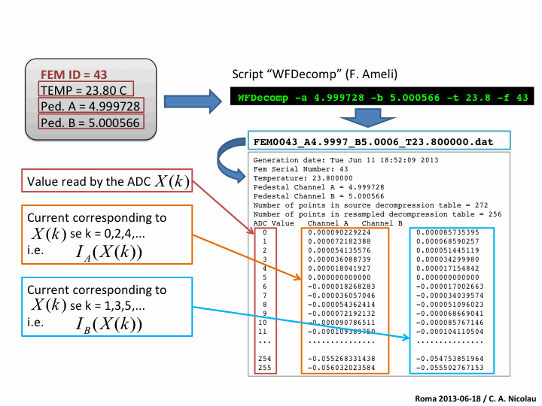
Hit decompression and calibration
Hit Waveform
Decompressed Hit Waveform
After the decompression procedure:
Total hit charge in pC (integrating the decompressed waveform)
The hit time (fitting the waveform leading edge with a sigmoid function + time offsets)
Time accuracy better than 1 ns (instead of 5 ns)

Slide 7
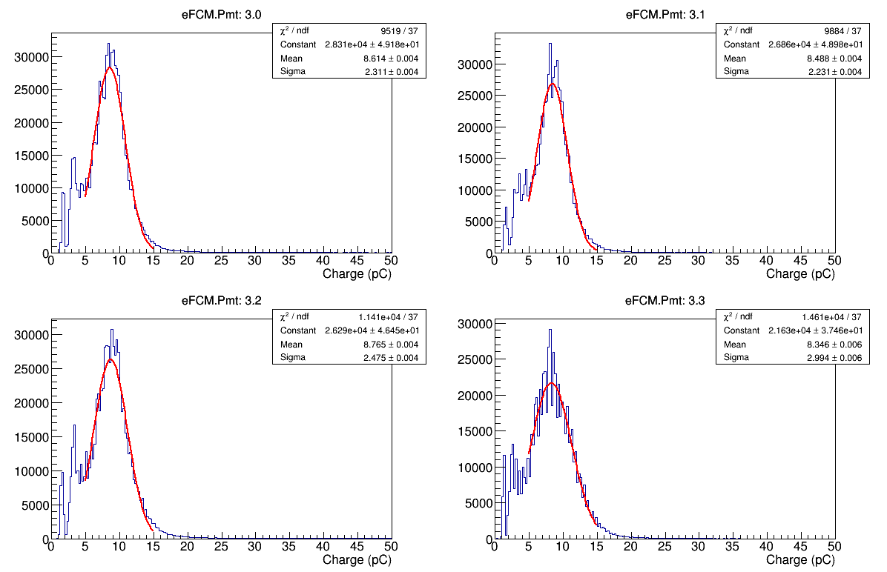
Hit decompression and calibration
The total hit charge (in pC) is converted in units of p.e., using conversion factors determined from the fit of s.p.e. charge spectra.
nemo_f2_pt_R00000874_F00000000.dat

Slide 8
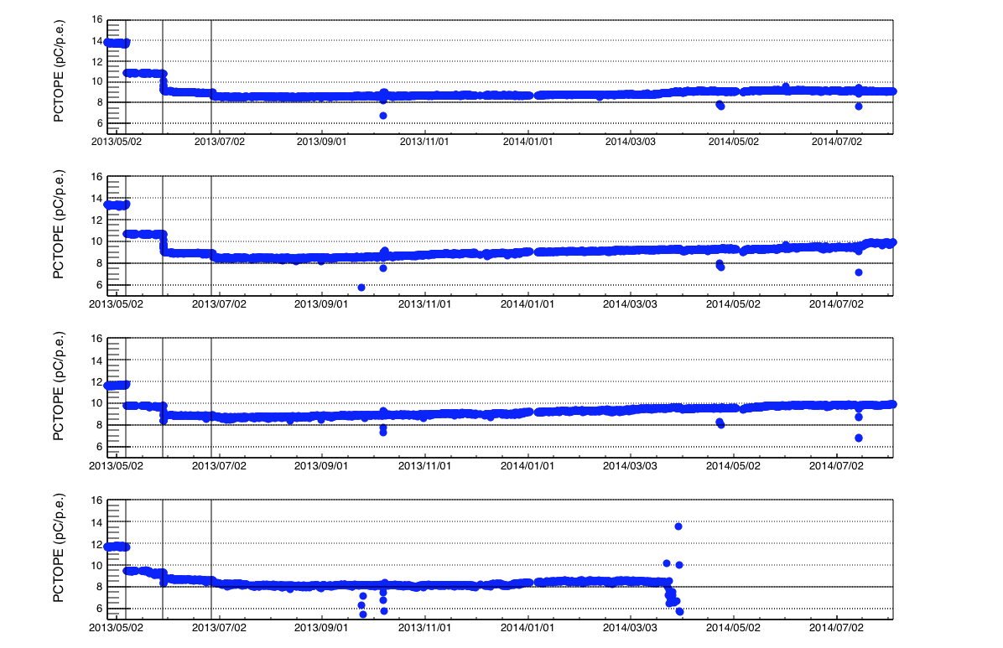
Hit decompression and calibration
The conversion factors are computed on a run-by-run basis during the whole period:
PMT gain variation due to new HV set-up, PMT ageing…
eFCM3
PMT0
PMT1
PMT2
PMT3

Slide 9
Off-Line Muon Filter and Reconstruction
After hit calibration, we re-checked the “trigger seeds”:
1- Simple Coincidence (SC): Coincidence between 2 close hits in the same floor ∆T_{CS} ≤ 20 ns
2- Floor Coincidence (FC): Coincidence between 2 hits at the opposite ends of a same floor ∆T_{FC} ≤ 200 ns
3- Charge Shooting (CS): A hit exceeding a charge threshold of 2.5 p.e.
Off-Line Filter Condition:
Ensemble of all hits participating to the Off-Line Trigger seeds
For each hit, we calculate the number of the other hits in the ensemble causality correlated according to
|dt|<dr/v_{light} + 20 ns
We calculate the maximun number of causality relations N_{caus}
We selects all the events having N_{Caus}≥6: improves the purity by three order of magnitude and optimized to have a muon purity ≈ 1 at the track reconstruction level (from simulations)
Track reconstruction:
A Causality Filter is applied to reject background hits in the muon events (|dt|<dr/v_{light} +20 ns)
Muon events are reconstructed with an algorithm based on the maximization likelihood method (taking into account the Cherenkov features and the possible presence of background hits).

Slide 10
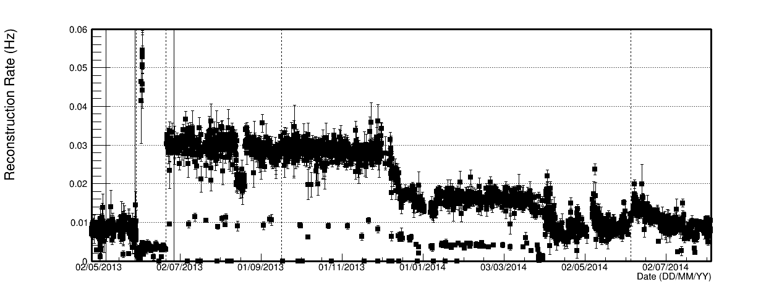
Reconstruction rate
HV
Trigger
Mean Rate= 17.1 mHz
List of PMT off (2014-08-05):
2.2 2.3 3.3 4.0 4.1 6.2 7.0 7.2 8.3

Slide 11
Monte Carlo simulations
Rbr simulation
To take into account the different trigger conditions.
To take into account PMTs don’t take data.
Possibility to use the whole data set to compute the transfer function and then the DIR.
For each analysed PT file:
- We generate a corresponding MuPage file with the same live time
- After FemSim, we switch off the PMTs which didn’t take data in
that PT file (list from PT DB)

Slide 12
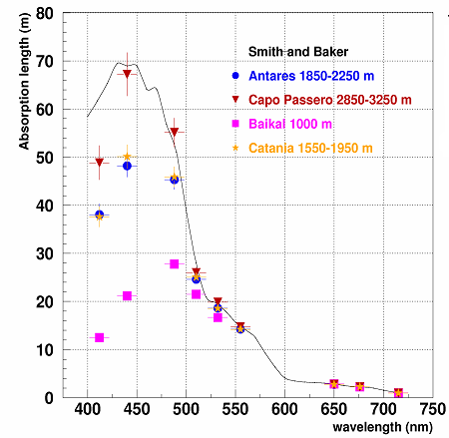
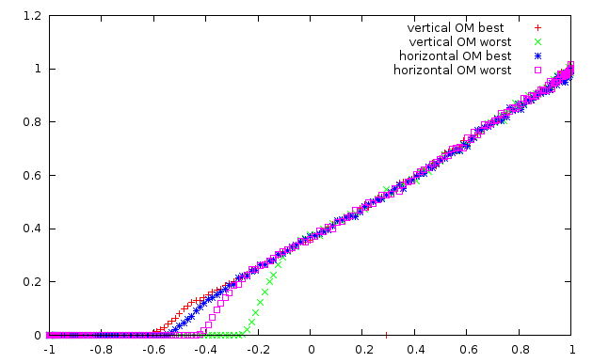
Muon tracking and light generation (km3 code)
The gen and hit codes (version v4r4) have been used to generate photon tables simulating the CP optical parameters and the Phase2 OM. Muon tracking simulated with km3 code (version v4r4) .
Absorption length profile measured at the Capo Passero (AC9 + ANTARES)
Scattering: partic model
Gel:
Thickness: 1.0 cm
Absorption length measured by Catania group
Glass:
Thickness: 1.2 cm
Absorption length quoted by Vitrovex
(D. Lattuada)
Angular acceptance:
(C. Hugon)

Slide 13
Monte Carlo simulations and DATA analysis
Simulations
Atmoph. Muon Generator
MuPage
* using tables from gen+hit codes
** + SwitchPmtOff: no PMTs off (from PT DB)
*** + SelOnLine: on line trigger conditions
Propagator and Light Simulator
km3*
Background Simulator
GenBkg
Electronics Simulator
FemSim**
PT Data
OnLine Trigger Simulator
TriggerSim
On-Line***
HitDeco2
TriggerSim
Off-Line
OffLine Trigger Seeds
Evt Selector (OffLine Trigger Condition)
SelectionPois
Antares
Track reconstructor
reco
Our codes

Slide 14
Atmospheric muon analysis: reconstruction results
Total live time= 411.1 days
(∧>-10)
(∧>-10)
(∧>-10)

Slide 15
Atmospheric muon flux measurement
Monte Carlo simulations were used to evaluate the detector transfer function.
The transfer function was then used to evaluate the muon flux angular dependence through a deconvolution procedure.
Systematic uncertainties on environmental and detector parameters were included.
Flux Angular Dependence:
I (θ_{μ}) = N_{μ}(θ_{μ}) m(θ_{μ}) /T ΔΩ A^{eff}(θ_{μ})
N_{μ}(θ_{μ}): number of detected muons (deconvolution)
T: livetime
ΔΩ: solid angle
A^{eff}(θ_{μ}): effective area*
m(θ_{μ}): mean multiplicity*
* From Monte Carlo simulations

Slide 16
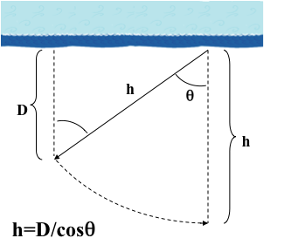
Depth Intensity Relation: DIR
Live time= 411.1 days
Vertical Muon Intensity as a function of Depth
DIR in water extended up to 13 km

Slide 17
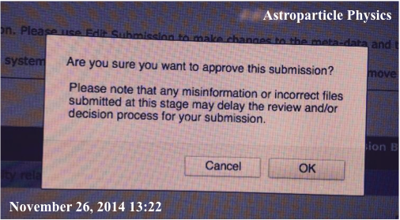
Conclusions

