Slide 1


KM3NeT-Italy Collaboration meeting
28/11/2014
Sistema di trasmissione dati su fibra ottica: Junction Box
Sara Pulvirenti

Slide 2
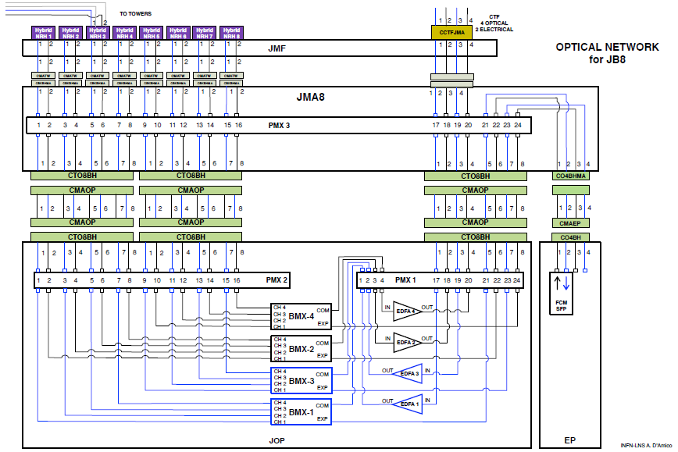
Junction Box Optical Data Transmission Scheme
BASE TOWER
SHORE STATION
Blue and Black colors of the fibres correspond to downstream or upstream signals respectively

Slide 3
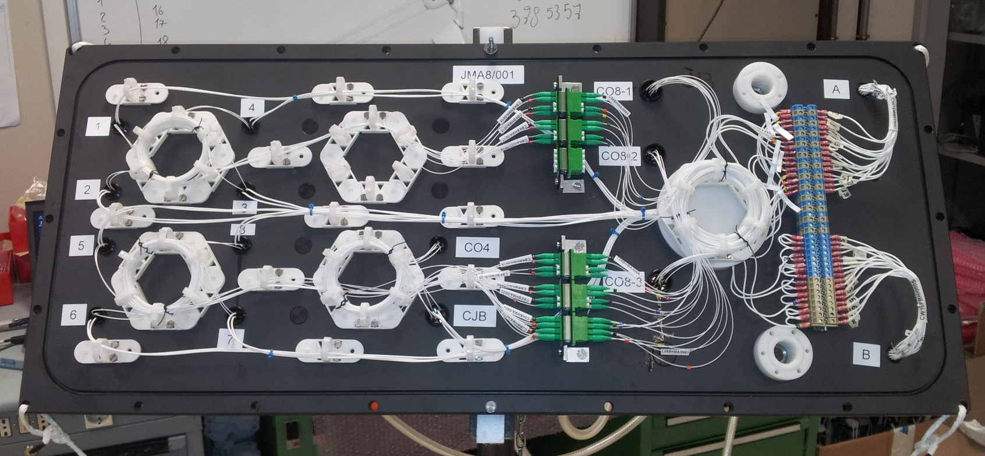
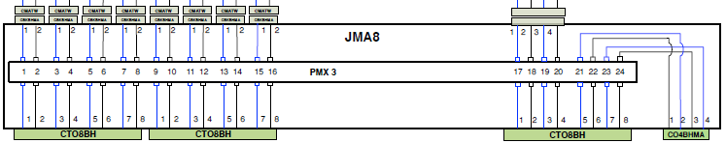
Junction Box Manifold (JMA8)
The 4 optic fibres from the CTF enter to the photonics pod (JOP) in the Junction Box through the panel JMF and the manifold (JMA8). The optical pigtails in the JMA are terminated with LC/APC (grade A) connectors to have a better suppression of back scattered light.
This manifold is just a passive optical routing to distribute the 4 fibres of the interlink cable from the CTF to the optical and electric pods and finally to the towers connected to the JB.

Slide 4
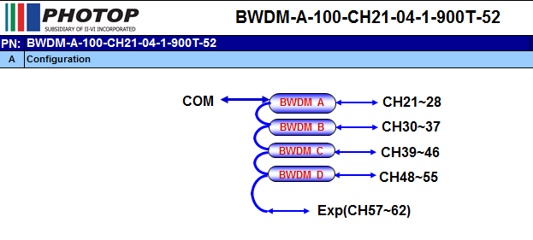
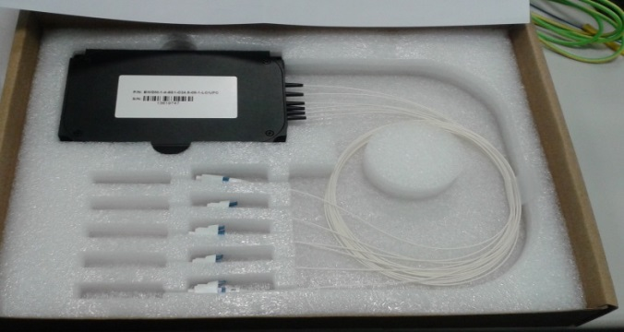
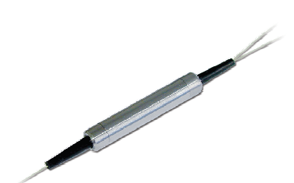
Junction Box Mux/Demux
The photonics pod hosts some passive DWDM optical filters. Their function is to mix (multiplex/demultiplex) different groups of DWDM channels into one optical fibre. The passive optics in the “photonics POD” is made by 4 optical band filters modules BMX (Band Multiplexer) .
Each tower receives 15 DWDM channels and transmits back to shore 15 DWDM channels. Received and transmitted channels have the same frequencies.
Each filter handles up to 15 DWDM channels equally spaced at 50 GHz (on the ITU standard frequency grid).
Two set of band filters are used for the downstream transmission (shore-station to tower) while the remaining two are used for the upstream data. The passive optics in the Junction Box is thus capable to handle up to 60 DWDM channels per fibre.
Notes:
Each group of 4 band filters will be assembled together in a single bandpass module with aluminium package and mounted on the mechanical support of the “photonics POD” . Each module will have 6 fibre pigtails of 0.5/1 m (TBC) length and fibre type will be 900 m tight buffer terminated with LC/UPC connectors.

Slide 5
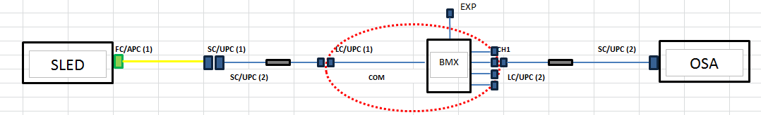
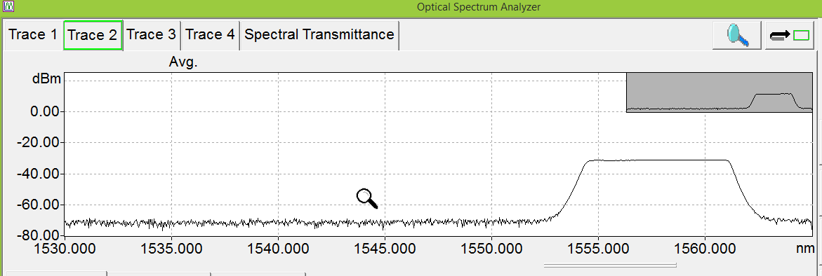
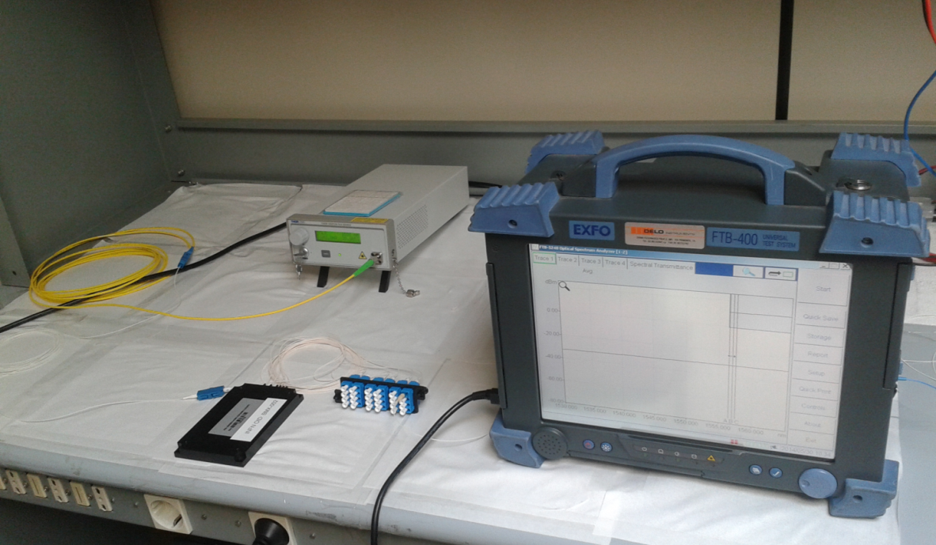
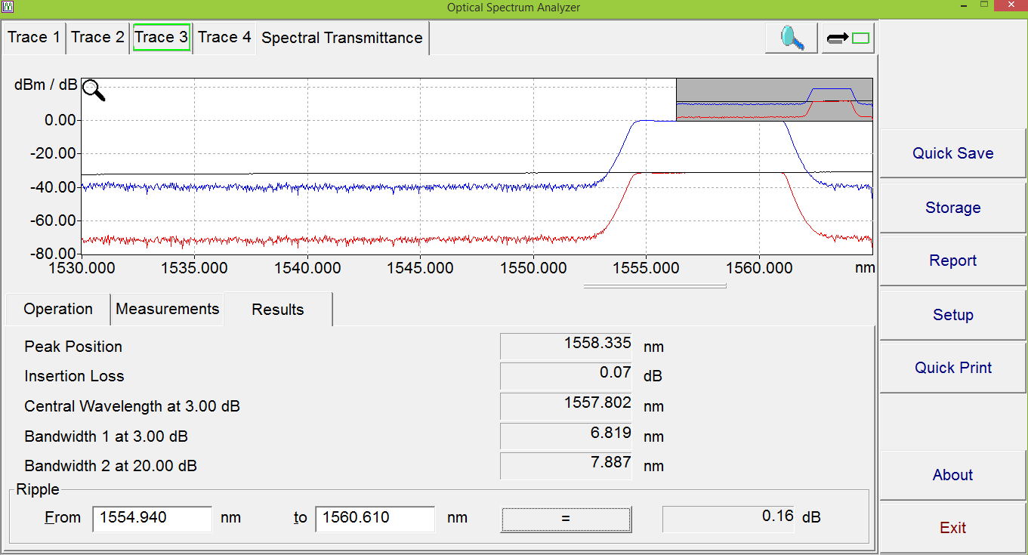
Junction Box Mux/Demux: TEST
The BMX performance was tested using one of its port as input (SuperLuminescent Diode output was send to it) and evaluating the spectrum response of the remaining ports
SLD

Slide 6
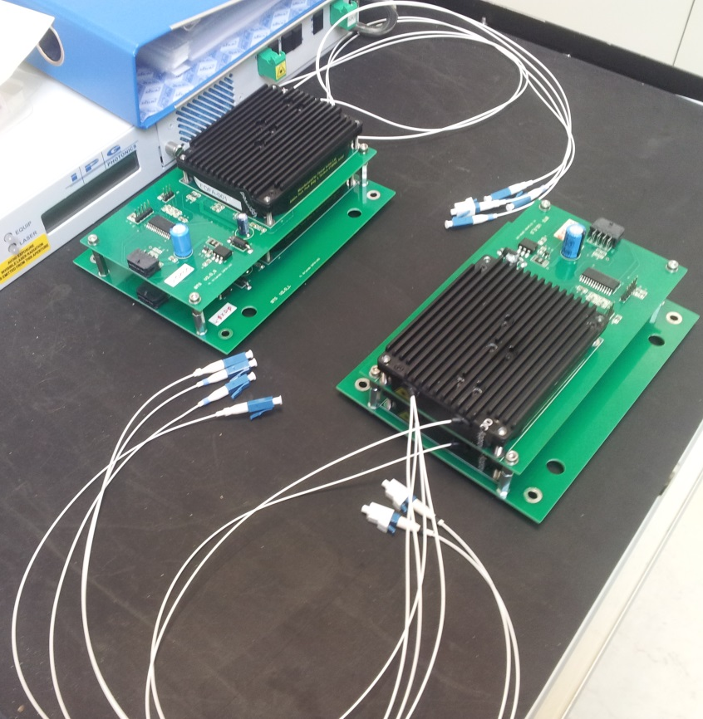
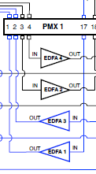
Junction Box Optical Amplifier
The optical Gain introduced by the EDFA stages is typically:
• For the Boosters: (APC = 15 dBm)
• For the Preamplifiers: (APC = 5 dBm)
The EDFA stages offshore operate together with the EDFA stages at the shore station, which will introduce further gain into the system budget:
• Shore station Boosters: (APC = 10 dBm)
• Preamplifiers: (APC = 5 dBm)

Slide 7
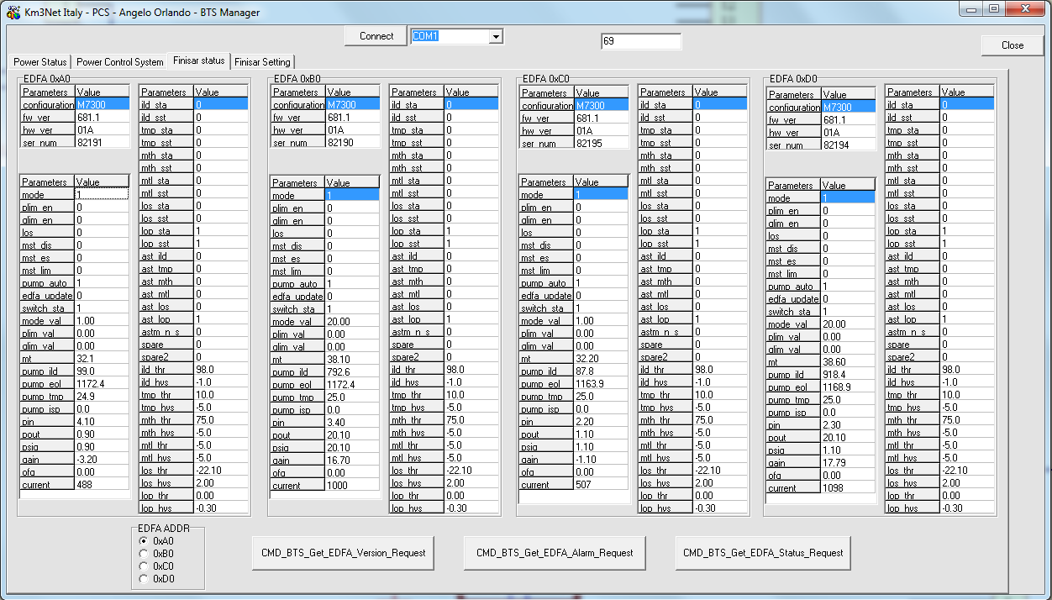
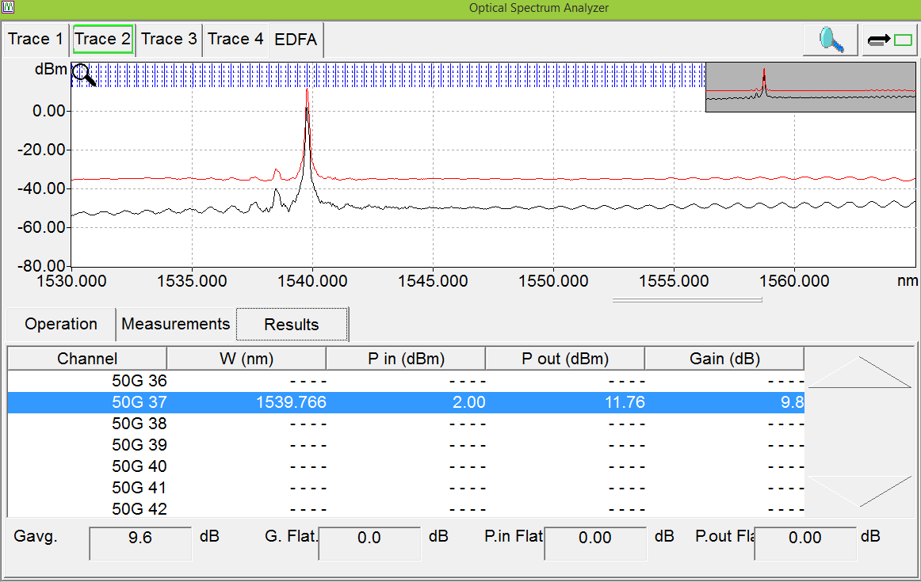
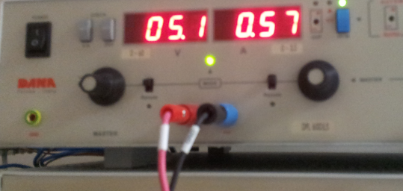
Junction Box Optical Amplifier
Optical Amplifier:
Test on current absorption and temperature status
Alarm settings
APC and AGC testing

Slide 8
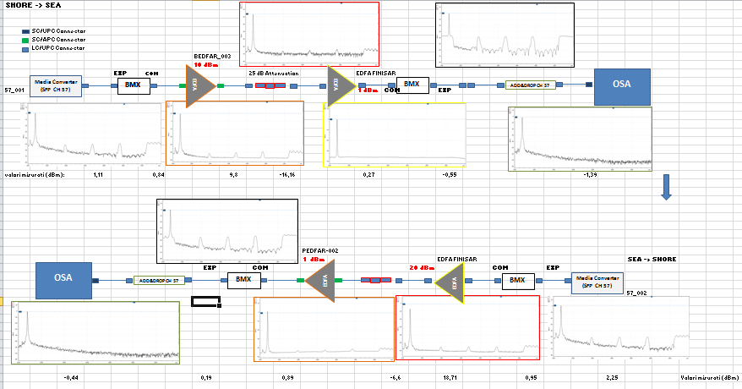
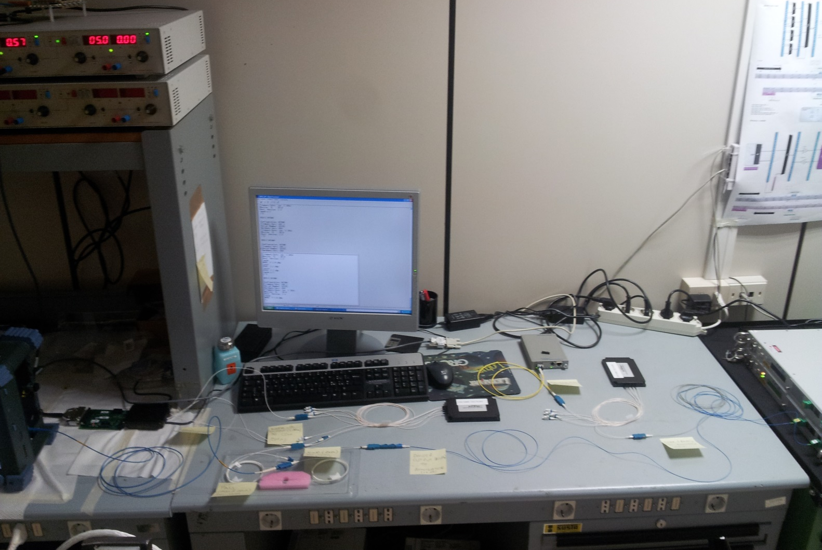
Junction Box Optical Chain transmission test
The electro-optical system for the infrastructure slow control is based on the FCM (floor control module) board and hosts SFP transceivers with frequency spacing of 50 GHz. The DWDM frequency of the slow control channels is assigned out of the bandpass module pass band and share the same fibres used for readout data transmission. Frequencies of the slow control can be in the range ch.57 to ch.62 (ITU channel numbering). Ch. 57 will be used for the Junction Box slow control channel.

Slide 9
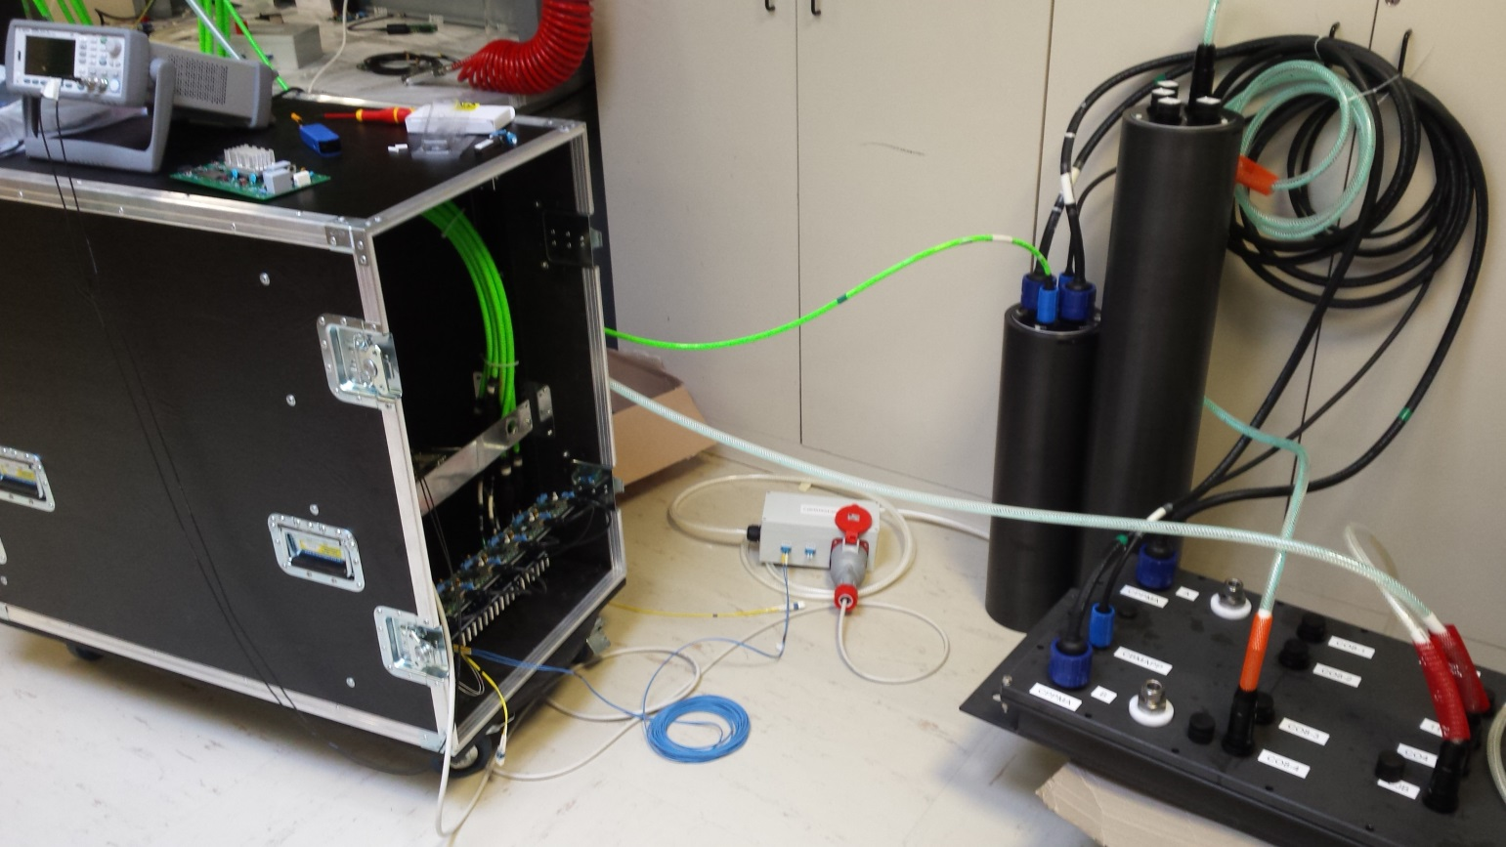
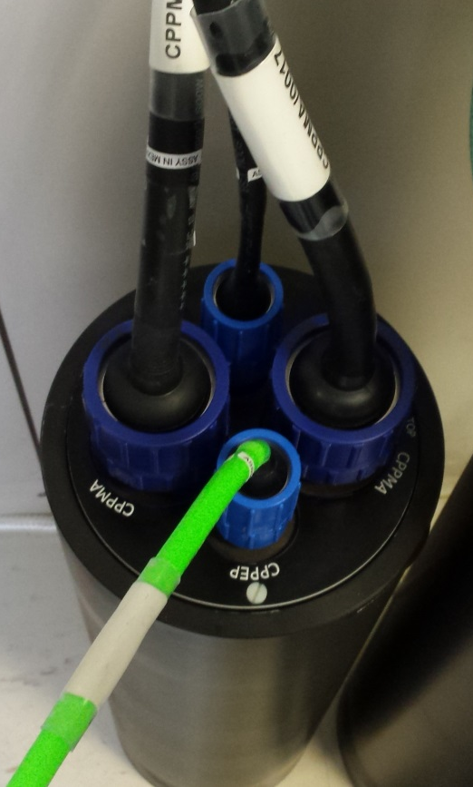
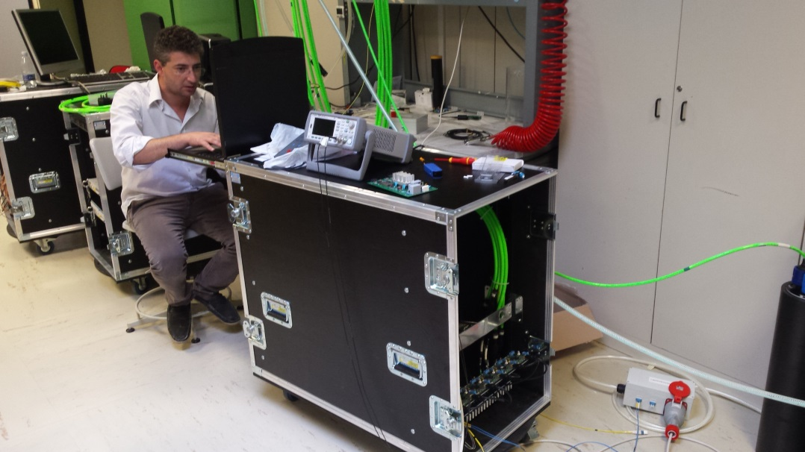
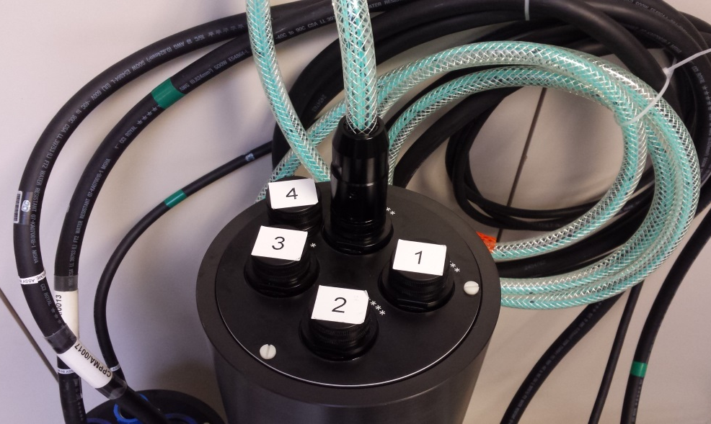
Junction Box Optical Chain transmission test
JOP
JEP
JMA8
Optical Amplifier control

Slide 10
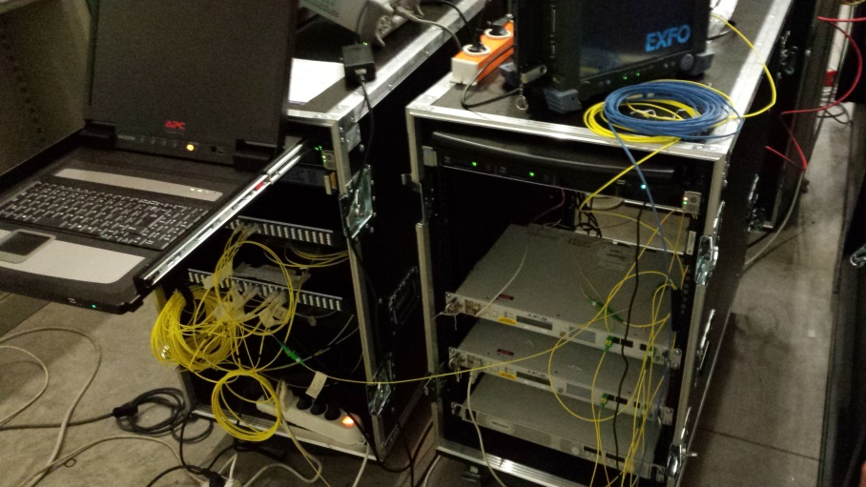
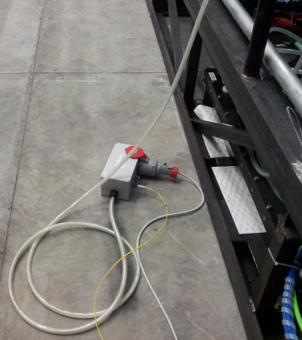
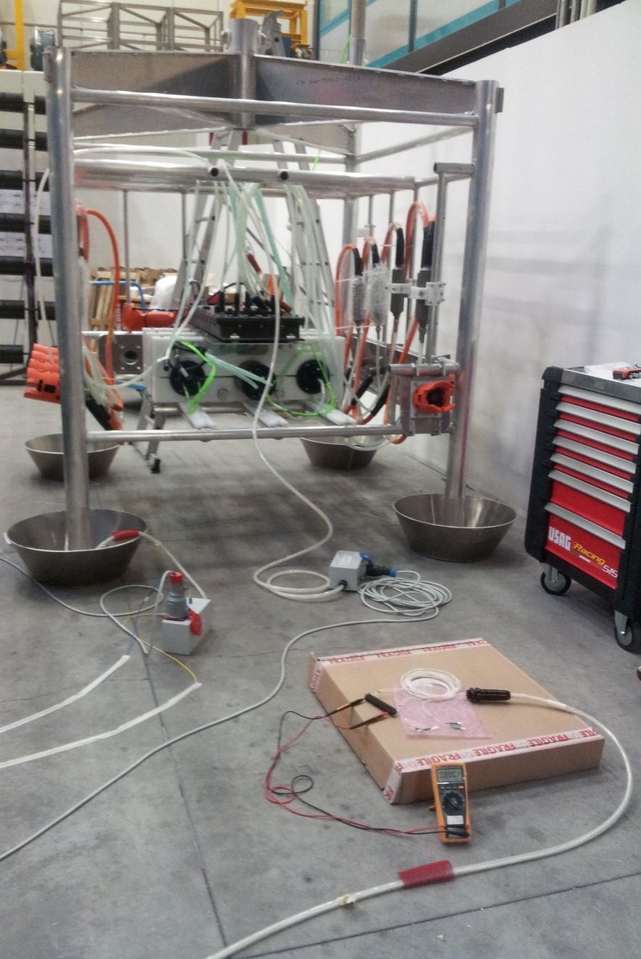
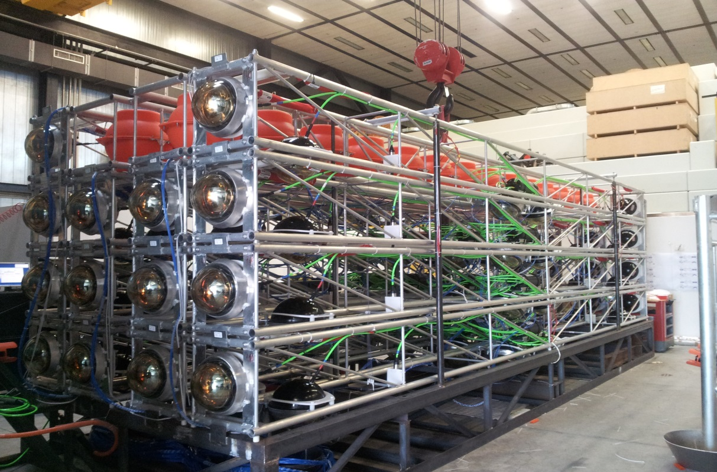
Junction Box Optical Chain transmission test
Validation test before the deployment of JB Power Loss considering also the tower and the shore station (25 dB of attenuation in order to simulate the MEOC)\
25 dB OF Attenuation

Slide 11
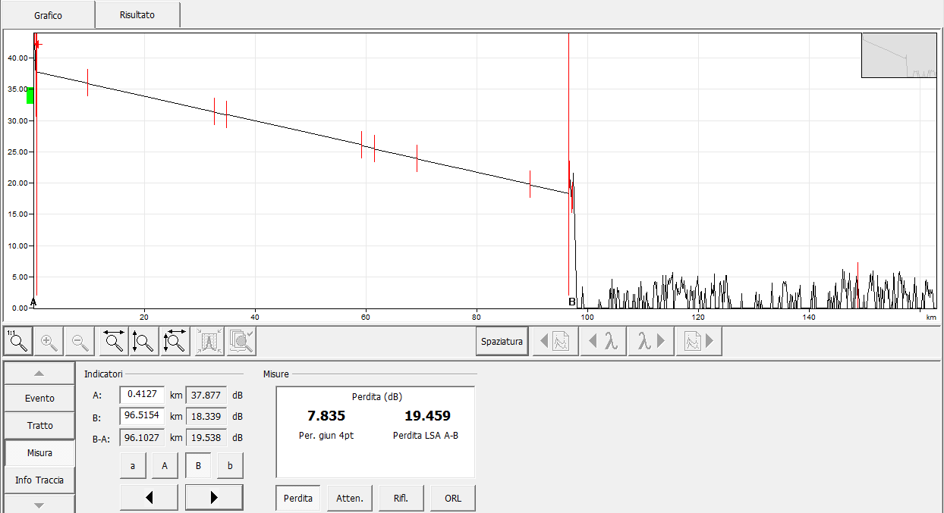
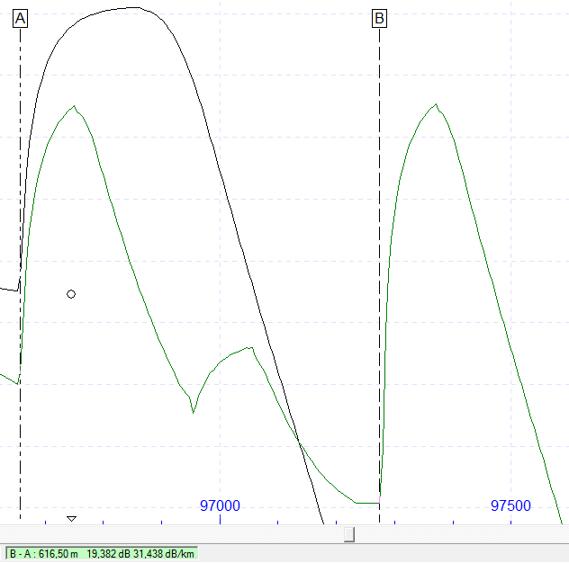
Deployment: Interlink Cable
OTDR Measures during the interlink cable connection.
Black -> MEOC measure reference before the interlink connection (until CTF)
Green -> MEOC measure after interlink cable connection (CTF and interlink cable)

Slide 12
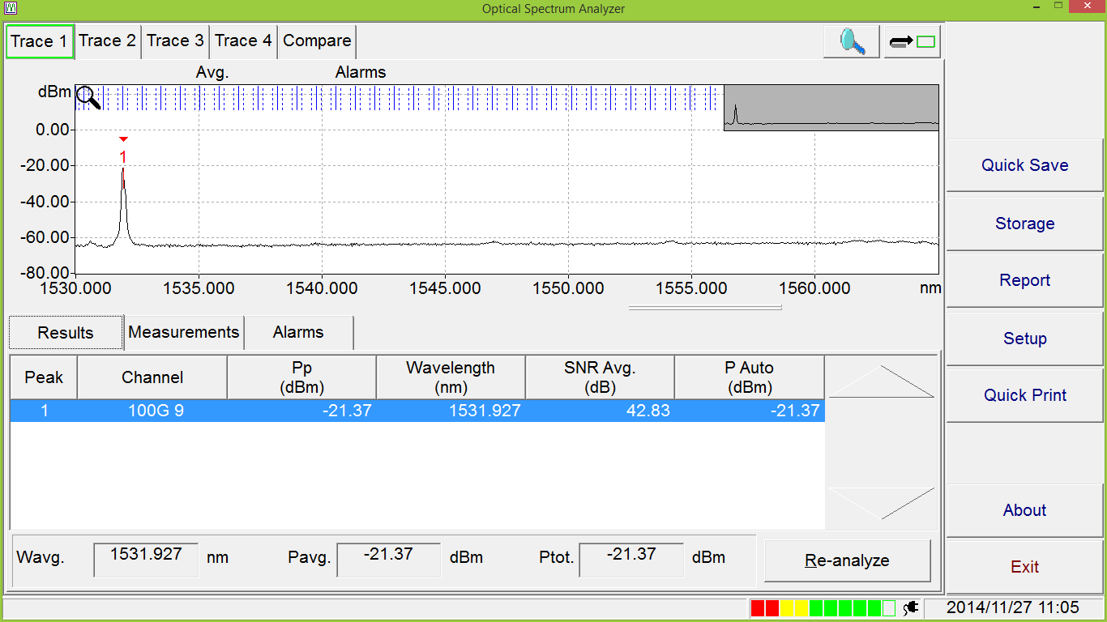
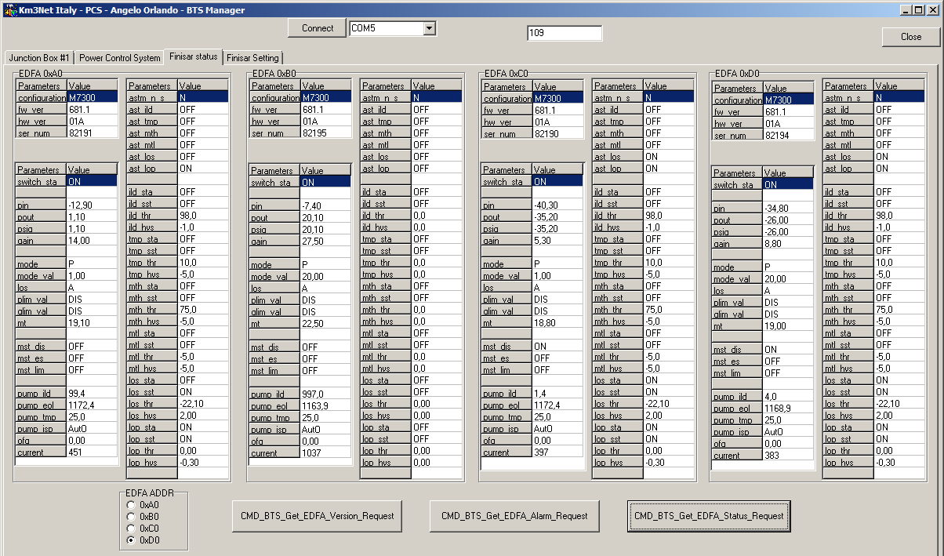
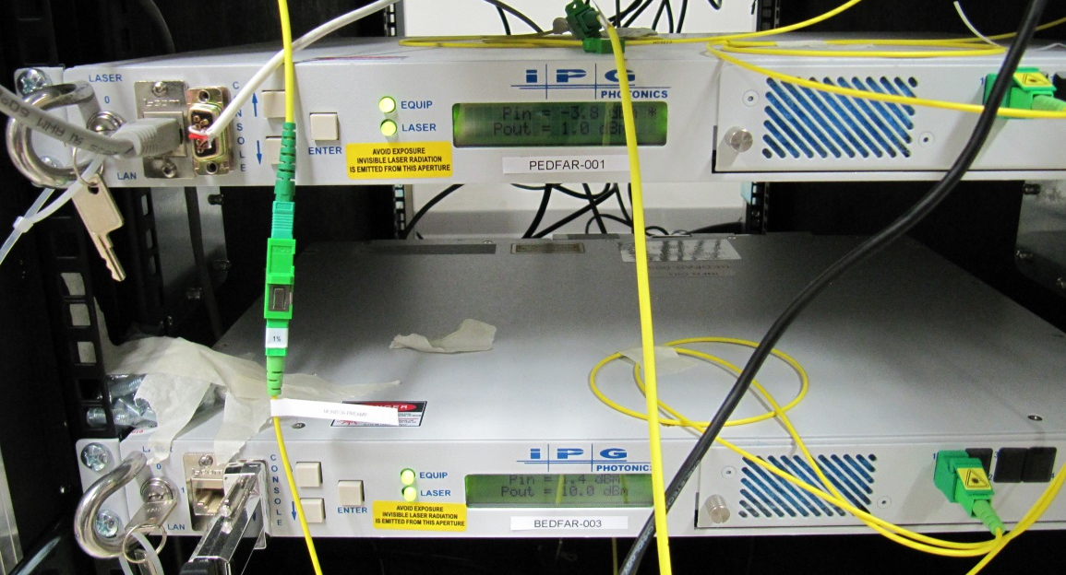
Deployment: Junction Box Connection
Check on:
Shore Optical Amplifier
Signal power from JB transceiver to shore
JB Optical Amplifier status

