Slide 1
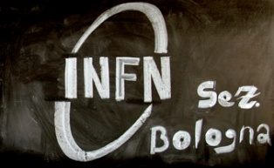
KM3NeT-Italy Collaboration Meeting |
Catania, November 26-27 2014 |
Introduction to the
String
DAQ/Read-out
part 2
Tommaso Chiarusi
Carmelo Pellegrino
INFN - Sezione di Bologna
Notes:
Before to start talking about the Trigger and data acquisition system, I’ll introduce the physics case, the neutrino telescopes and in particular km3net. The aim of a neutrino telescope is to study high energy cosmic events by revealing neutrinos.

Slide 2
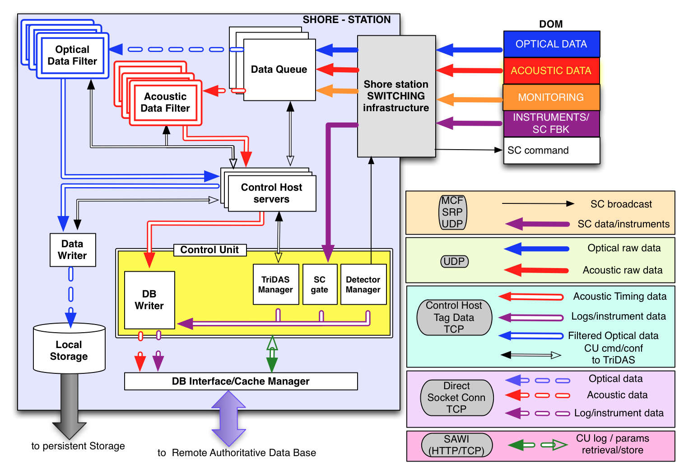
Trigger and Data Acquisition System (TriDAS)
Notes:
That’s the solution we adopted: here is sketched the data acquisition system

Slide 3
DataQueue
The DataQueue (DQ) is the software component of the KM3NeT-EU TriDAS which provides the data aggregation and distribution layer for both acoustic and optical data.
Read-out of the KM3NeT-EU data frames (UDP) from a predefined number of CLBs
Reassembling of the Time Slice (TS, which is compiled by the off-shore electronics)
Distribution of the TSs to the proper DataFilter

Slide 4
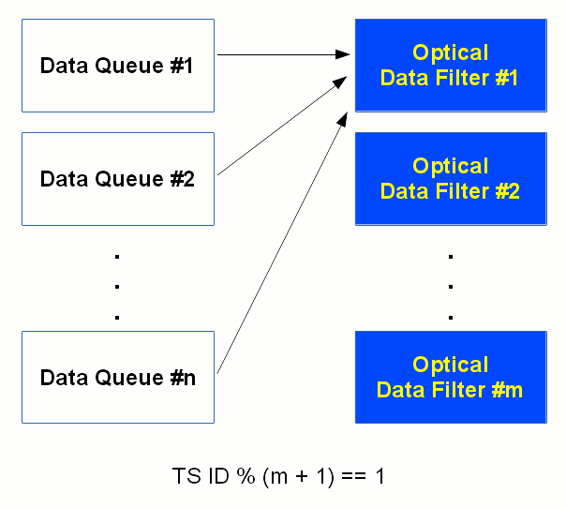
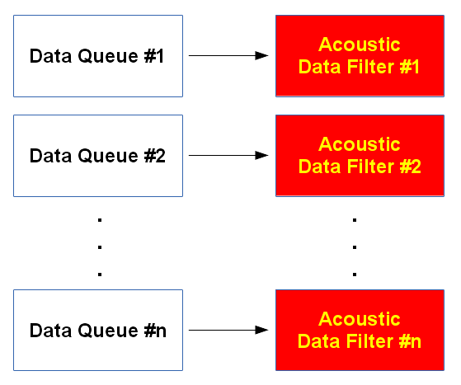
Two flavours
Optical World
Acoustic World
Route the data collected from all DQs referring to a precise Time Slice to the very same oDF.
Acoustic data must be sent in a continuous stream, addressing all data from one DQ to a single aDF.

Slide 5
Optical DataFilter
The main task of the optical DataFilter (oDF) is to reduce the data-stream coming from the DOMs' PMTs by selecting events that are interesting for physics analyses.
Apply algorithms that find space-time correlations between hits.
Keep a buffer of raw data for dumping in case of an external alert (i.e. GRB alert)
Send data to the Data Writer

Slide 6
Algorithms serving Physics
Motivation | T-Trigger | Simple Causality Trigger | Sky Scan Trigger | Tracking | Stack-Analysis | Vertex / Inertia
muon | ✔ | ✔ | ✔ | ✔ | ✔ | ✔
showers | ✔ | ✔ | ✔ | ✔ |  | ✔
slowly moving particles | ✔ | ✔ | ✔ | ✔ |  | ✔
sources | ✔ |  |  | ✔ | ✔ | ✔
But other algorithms are under development...

Slide 7
DataWriter
The DataWriter collects the filtered data coming from the various oDFs and performs write operation on permanent storage media in a ROOT compatible data format.

Slide 8
Acoustic DataFilter
The acoustic DataFilter (aDF) performs online calculation of the Time-Of-Arrival (TOA) of the acoustic signals emitted by the ground-based acoustic beacon array.
Calculate the TOA using the data from all the sensors (piezo + hydrophone) collected on-shore by a DQ
Send data directly to the DB Writer

Slide 9
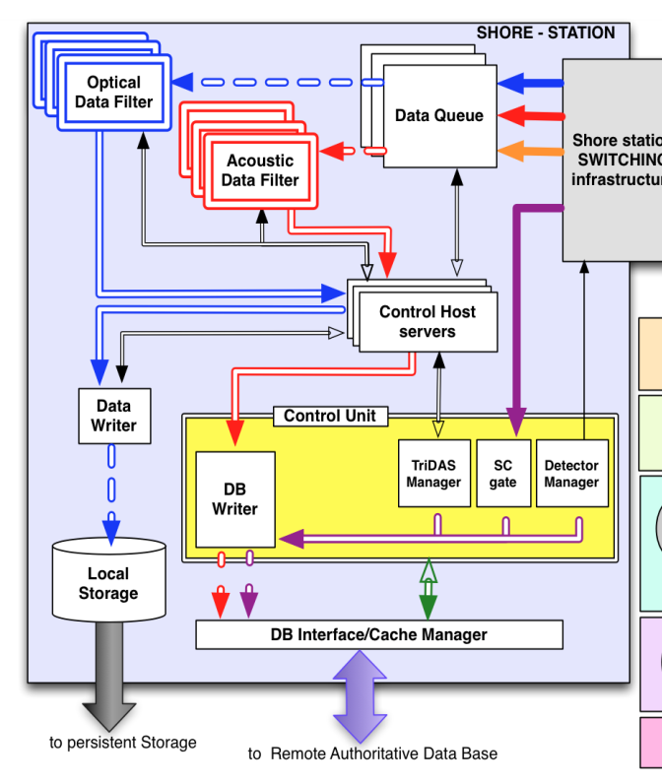
Control Unit
Slides from C. Bozza
The Control Unit (CU) is composed of several elements:
Detector Manager (DM):
Perform complete configuration of the CLBs (PMT HV, instruments, etc…)
Record all parameters and the occurring events
Provide online monitoring of sensible parameters/measurements
Tridas Manager (TM):
Operate the TriDAS computing farm
SC Gate:
Read-out of the SlowControl data
DB Writer
Perform write operation to the remote Data Base

Slide 10
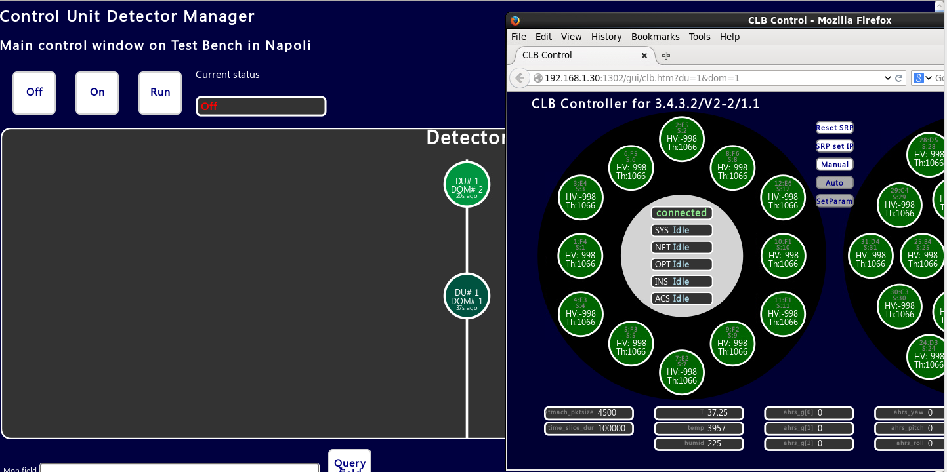
DM GUI
Slides from C. Bozza

Slide 11
Control Unit features
Slides from C. Bozza
High flexibility
Customizable GUI via HTML files
Easy read-out of the parameters via HTTP/JSON
http://<mysrv>:1302/mon/clb/outparams/pmt_threshold@/1/1/2
Manual mode (authorization required)
http://<mysrv>:1302/override?inp=pmt_highvolt&inv=-1500&du=1&dom=2&pos=3&scope=0
Security
Authentication required
Local Authentication Provider + DBInterface
«Jolly token» to be used in test benches
To be configured at Detector Manager start-up

Slide 12
DAQ Kit
CLBSwissKnife, which allows to have fast debugging, monitoring and raw data dump on file (still developing, but already usable and very helpful);
DAQ chain, i.e. DataQueue + DataFilter + DataWriter;
ROyWeb, which is the powerful, web-based, monitoring server;
Detector Manager (still developing, see C. Bozza’s talk) and JavaGUI, which allow the operation of the CLB.
Please, find the documentation about how to install and use here:
http://wiki.km3net.de/index.php/CLB_Swiss_Knife
http://wiki.km3net.de/index.php/Jpp
https://github.com/tamasgal/royweb
http://wiki.km3net.de/index.php/DAQ_kit_for_integration_tests

Slide 13
Thank you for your attention!

