Slide 1
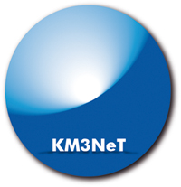
Naples
KM3NeT
DOM Integration site
D. Vivolo
INFN Section of Naples

Slide 2
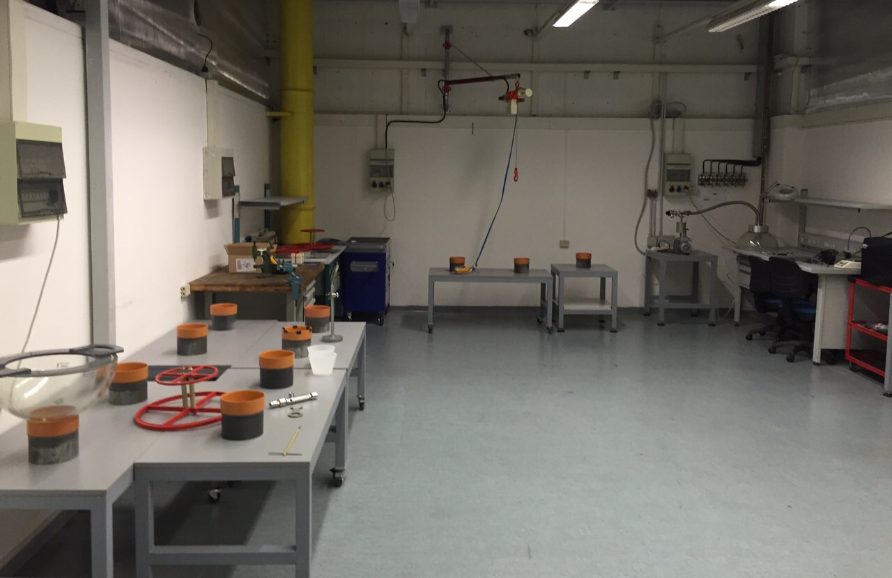
The DOM integration site

Slide 3
The DOM integration site
5 mobile tables for hemispheres

Slide 4
The DOM integration site
Integration stand
5 mobile tables for hemispheres

Slide 5
The DOM integration site
Integration stand
5 mobile tables for hemispheres
5 fixed workspaces:
He test;
PMT structure painting and PMT integration;
Gel degassing;
Vacuum for DOM closure;
Worktable

Slide 6
The DOM integration site
All integration phases are ready to be performed
All integration tools are currently available

Slide 7
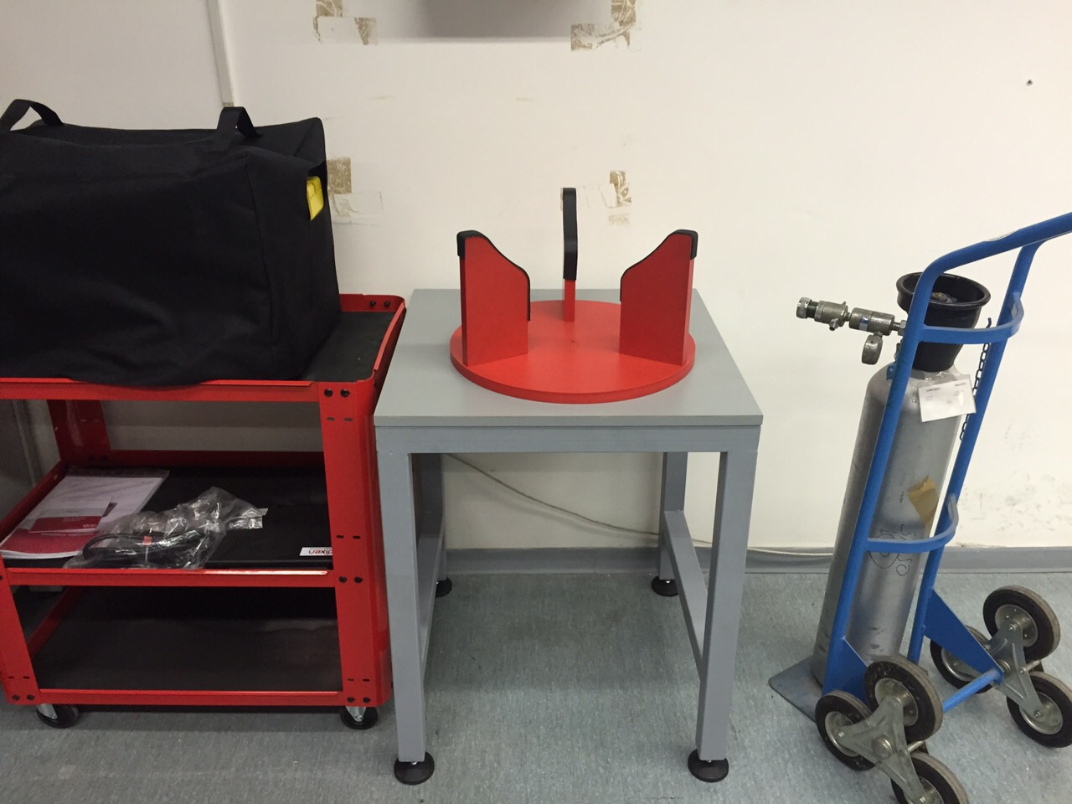
Leak test
ADIXEN ASM 340 leak tester is available

Slide 8
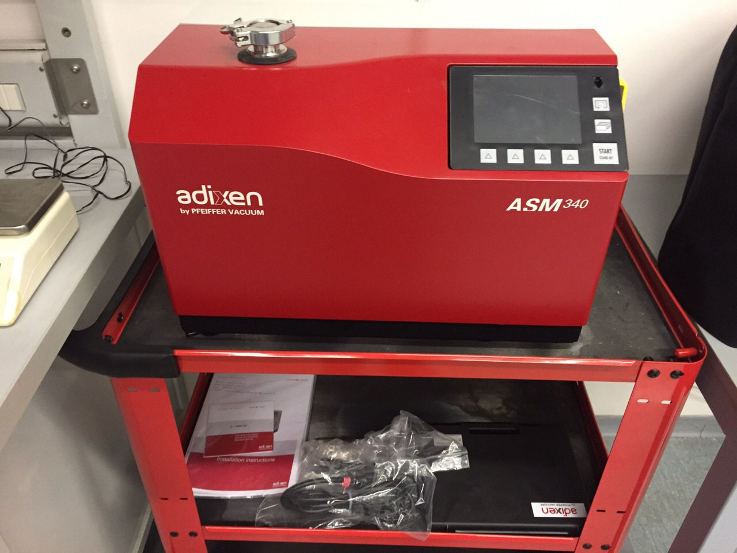
Leak test
ADIXEN ASM 340 leak tester is available
Minimum detectable leak rate for He 5 x 10⁻¹³ Pa m³/s

Slide 9
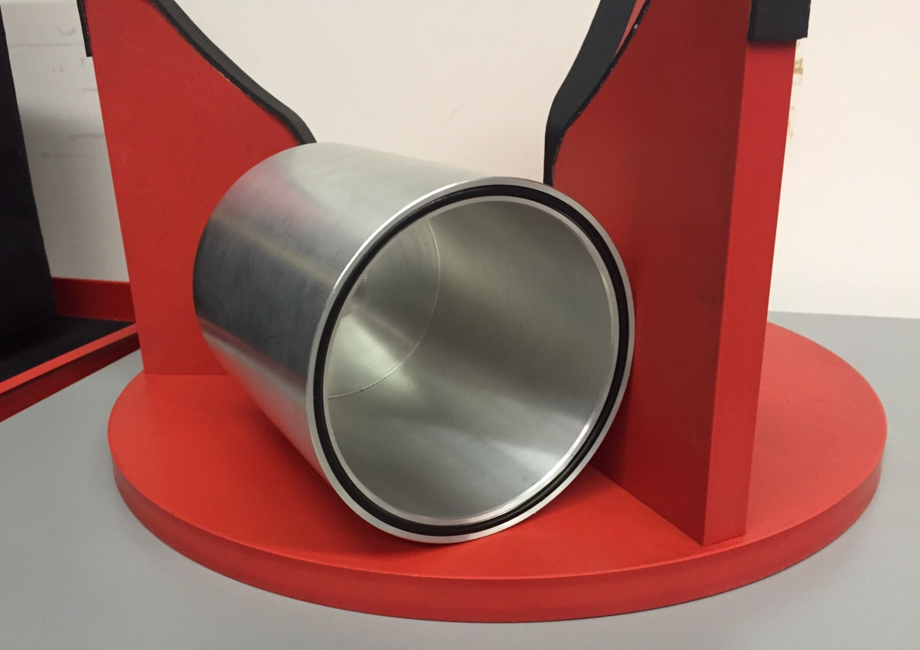
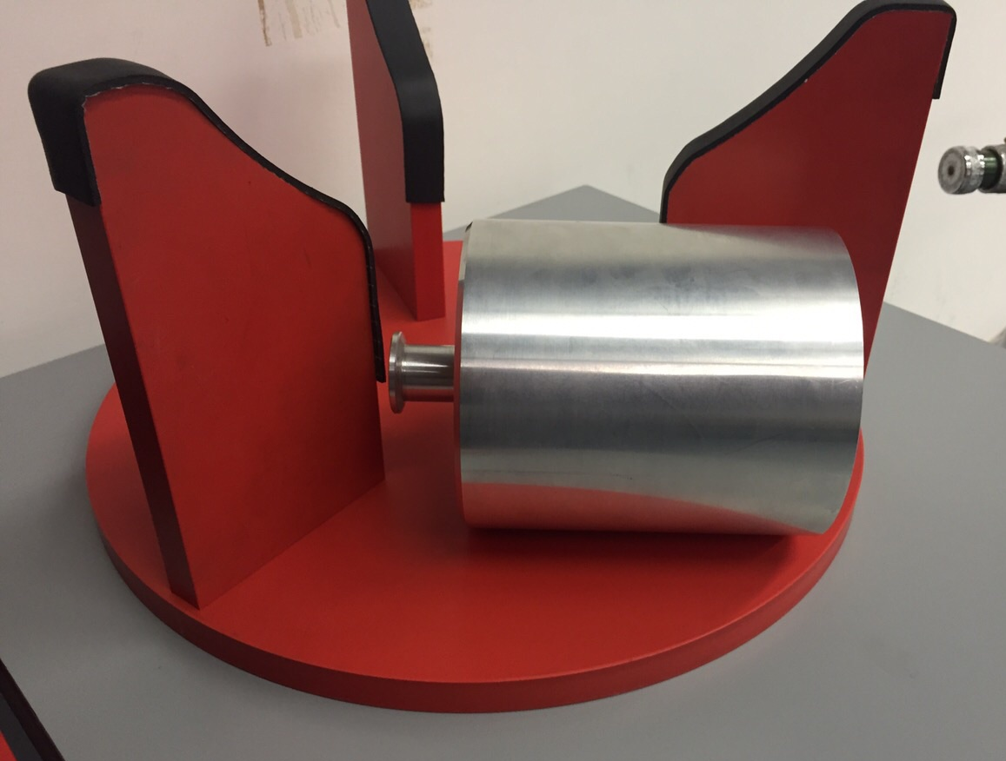
Leak test
ADIXEN ASM 340 leak tester is available
Cylinder for He test on penetrator

Slide 10
Splicing
Fitel S178Av2 handheld arc fusion splicer with core alignment
Purchased. Official delivery time: December 1st 2014
Fiber meter for attenuation measure:
Fluke SimpliFiber PRO

Slide 11
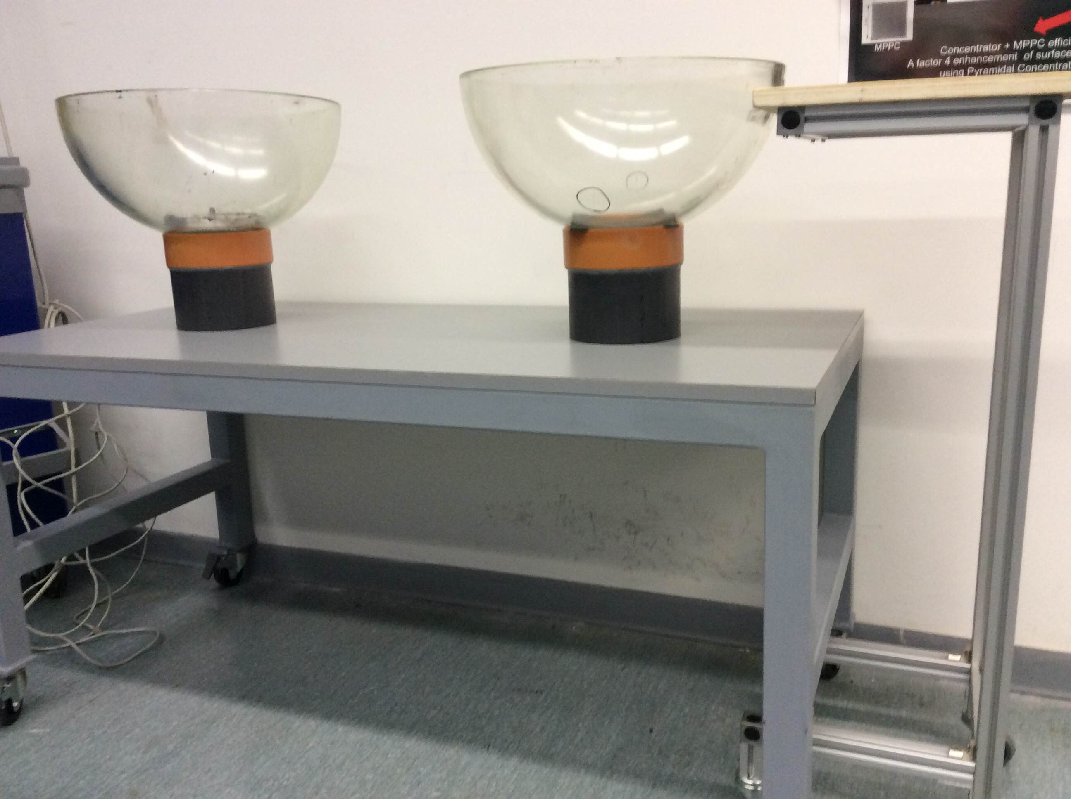
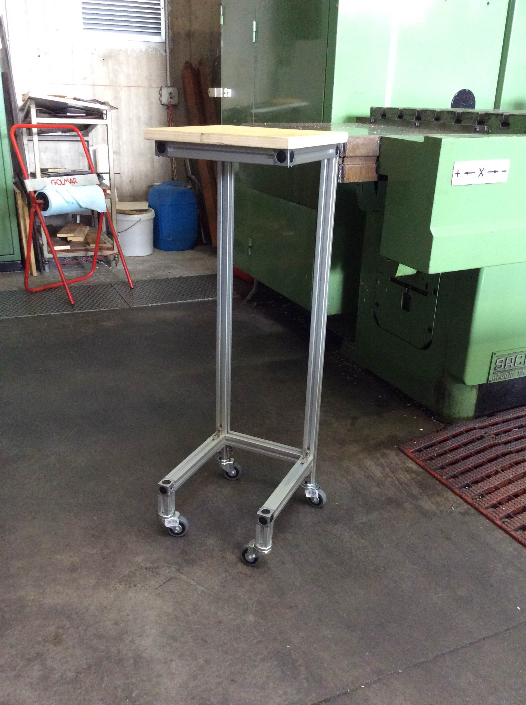
Splicing
Fitel S178Av2 handheld arc fusion splicer with core alignment
Purchased. Official delivery time: December 1st 2014

Slide 12
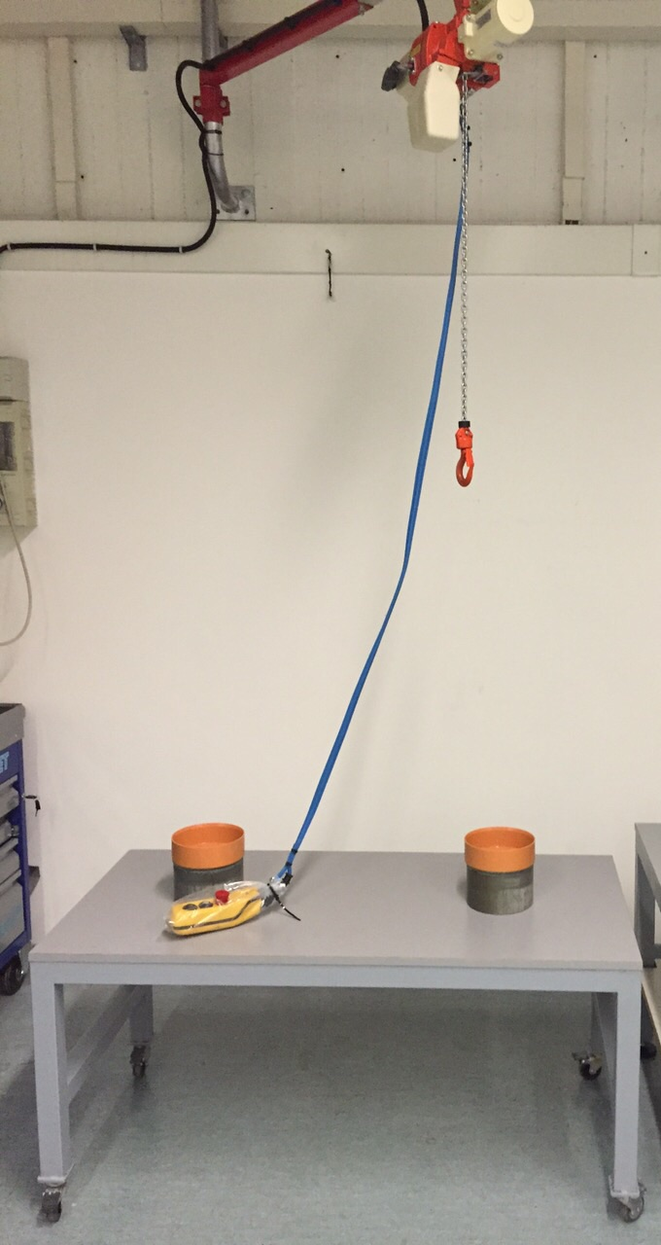
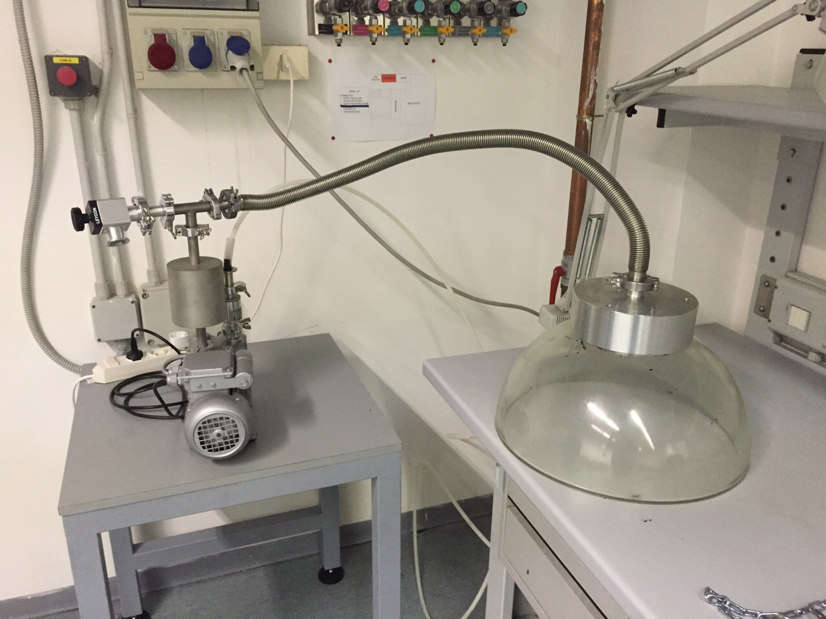
Integration stand and lift
Maximum load: 480 kg
Lift test successful

Slide 13
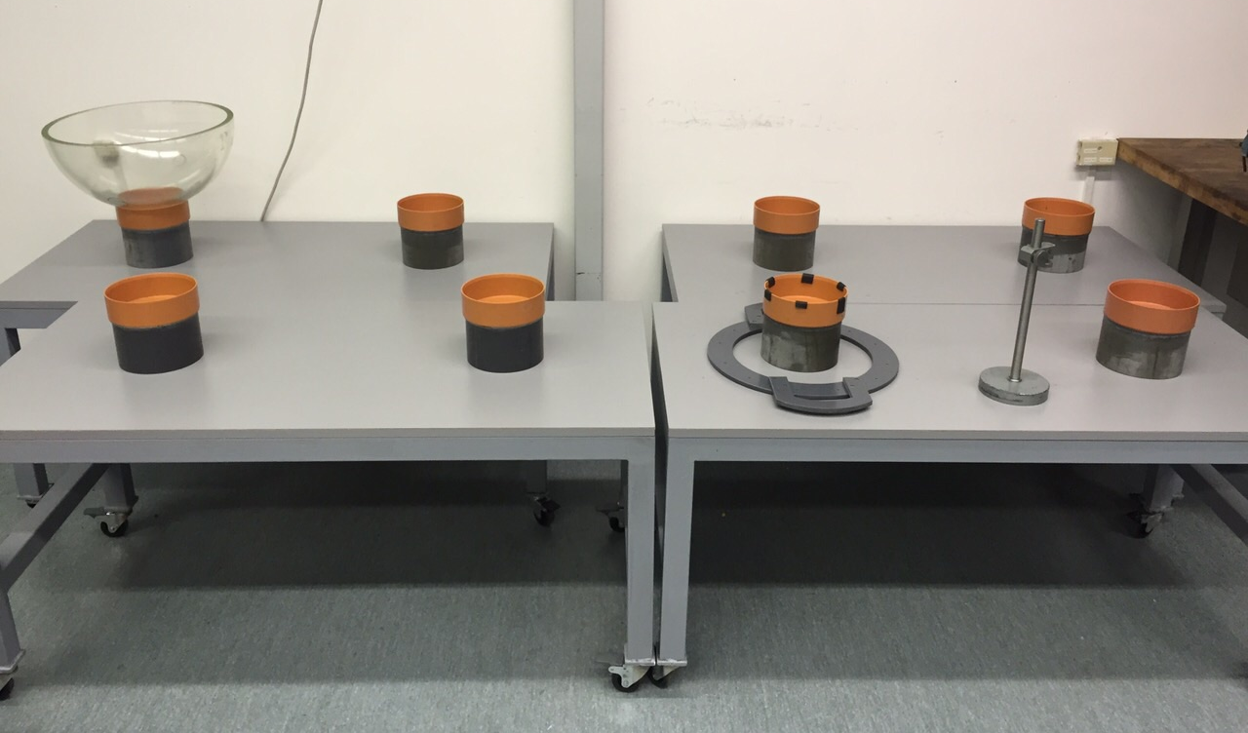
Integration tables
5 tables;
wheels for easy handling;
supports to hold the hemispheres

Slide 14
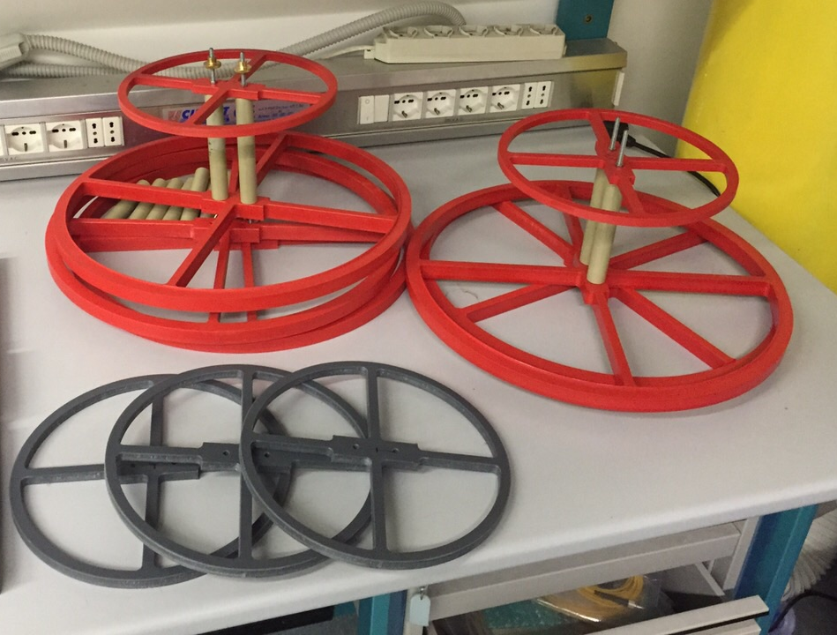
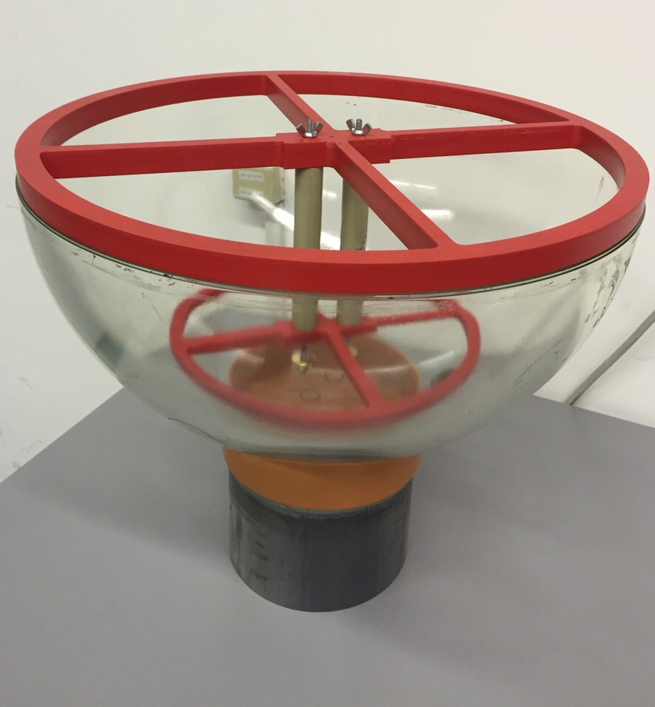
Integration tools
Mushroom alignment tool
based on a custom design, 5 samples available

Slide 15
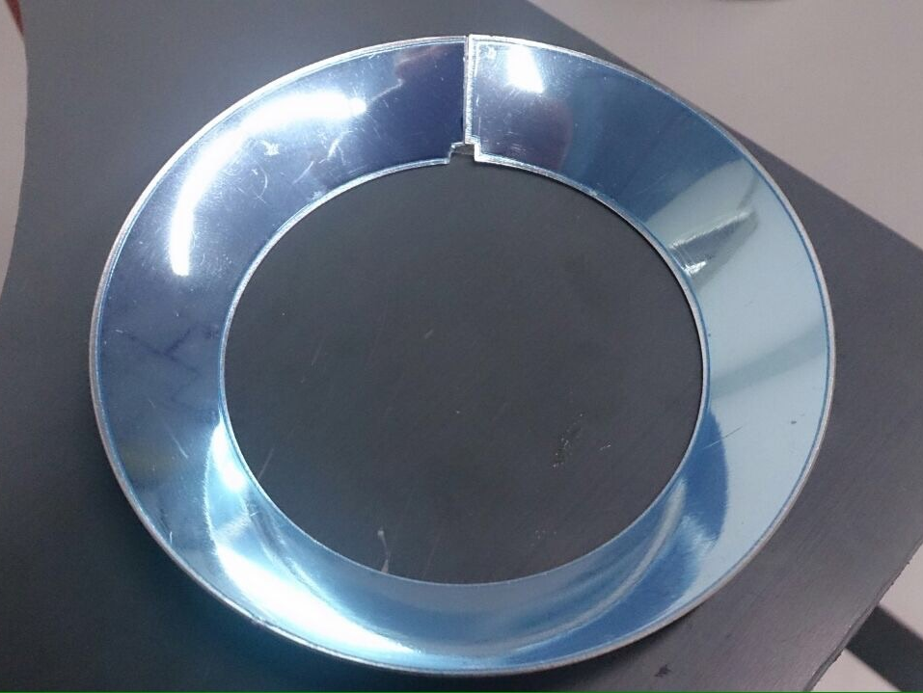
Integration tools
Reflector ring press
Nikhef-based layout, slightly different design for optimized fine tuning

Slide 16
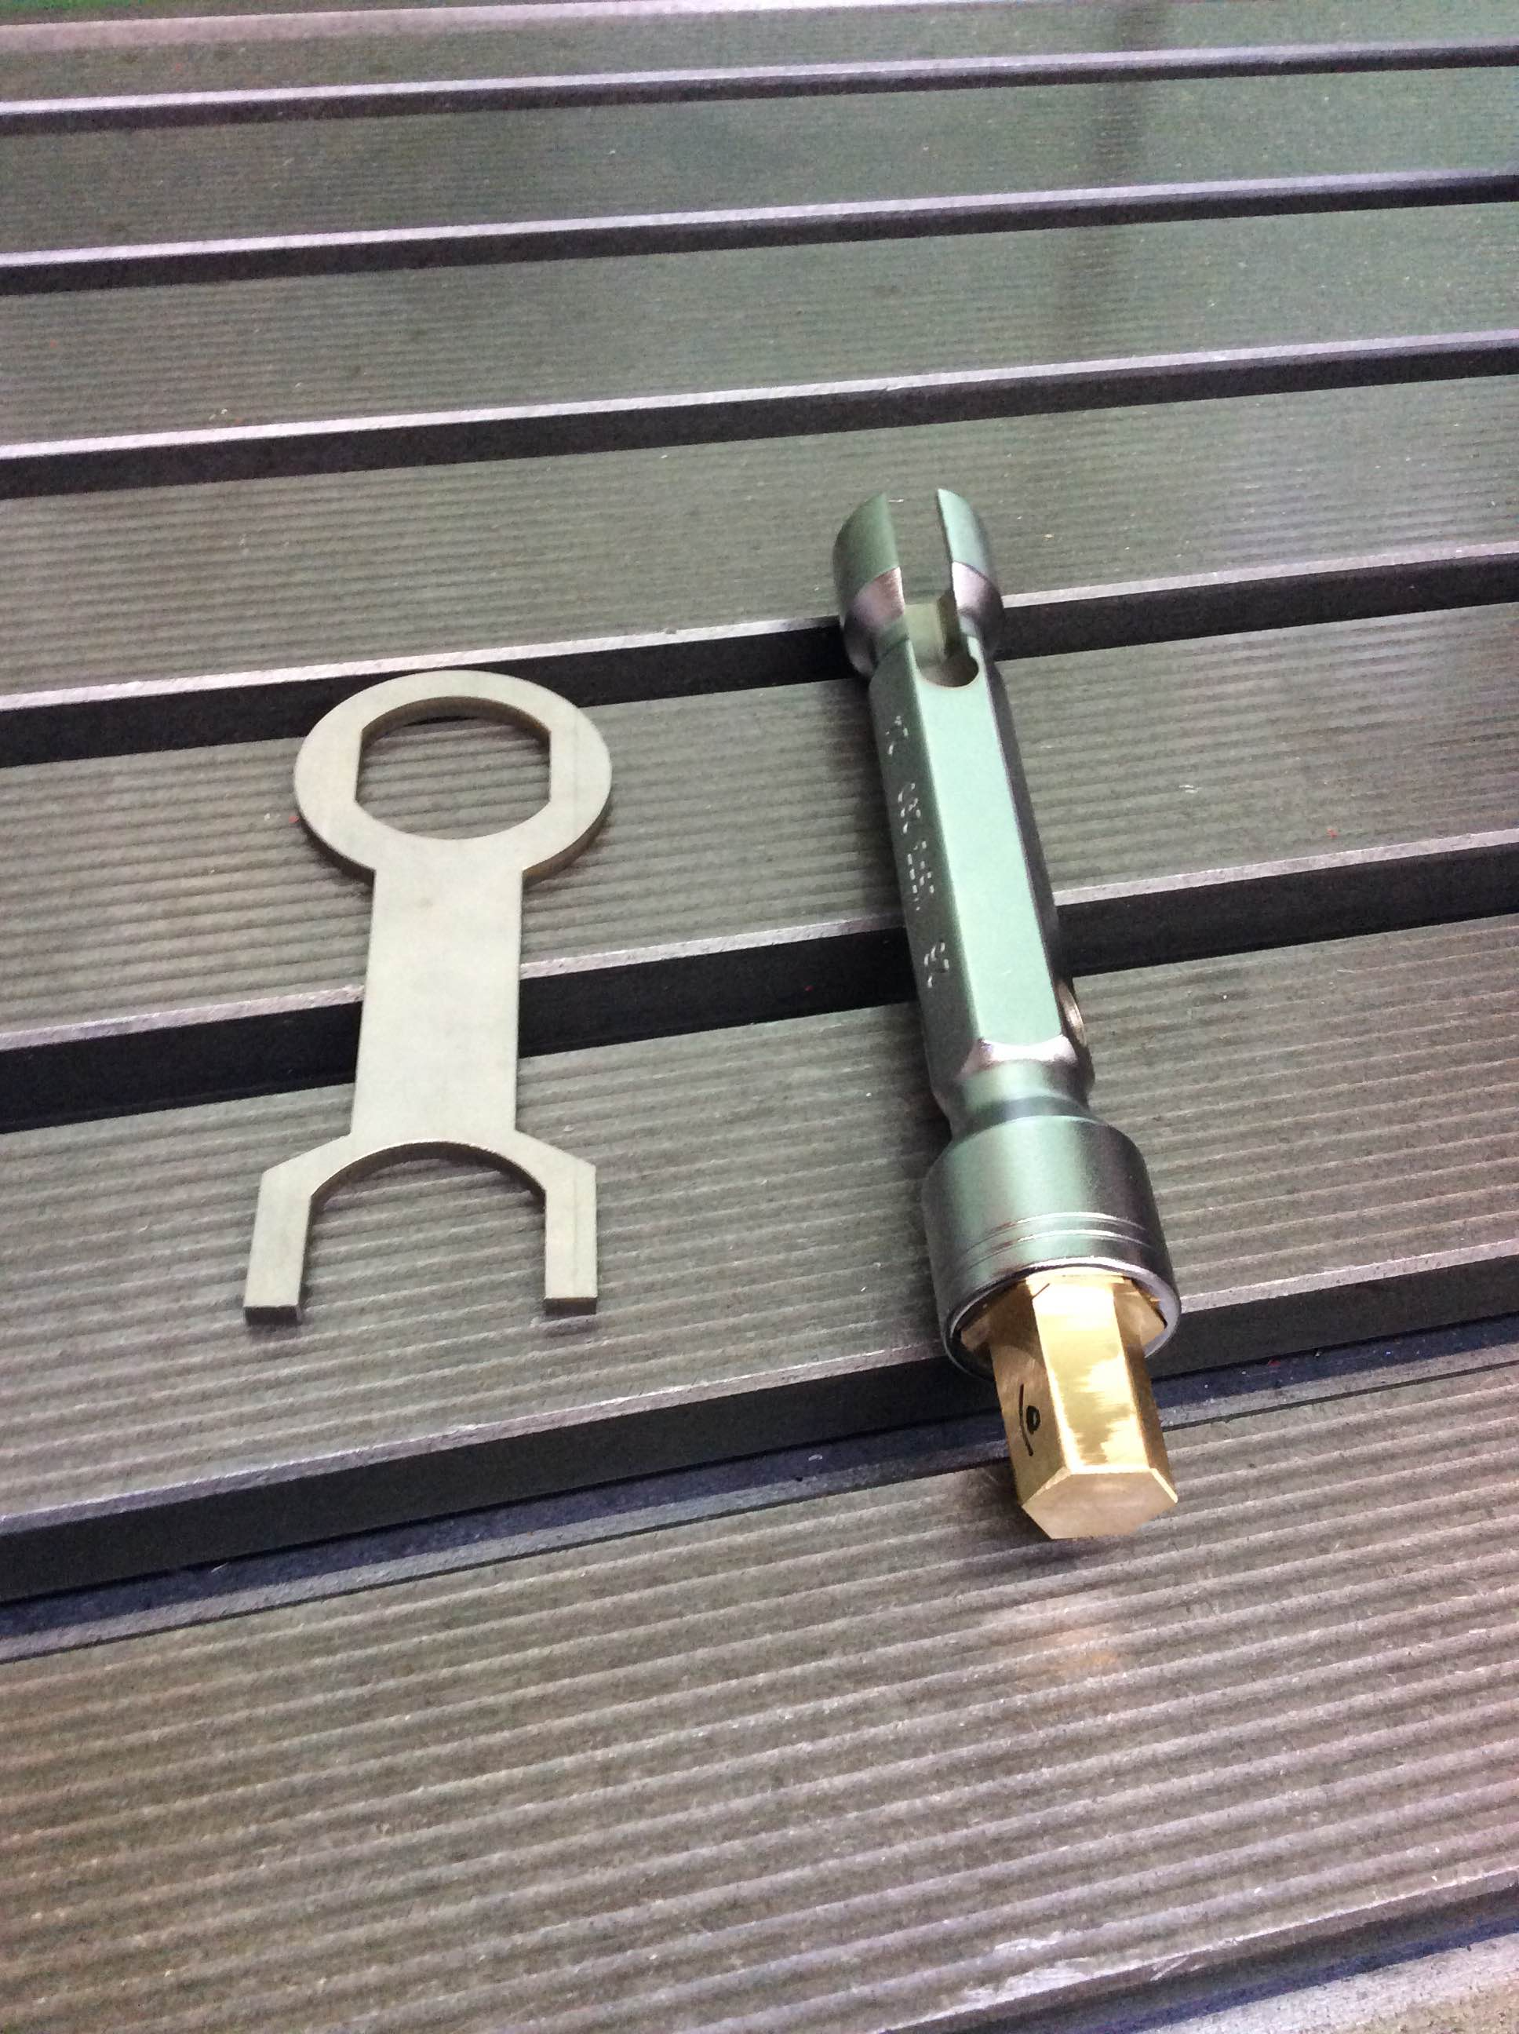
Integration tools
Penetrator wrench and adapter

Slide 17
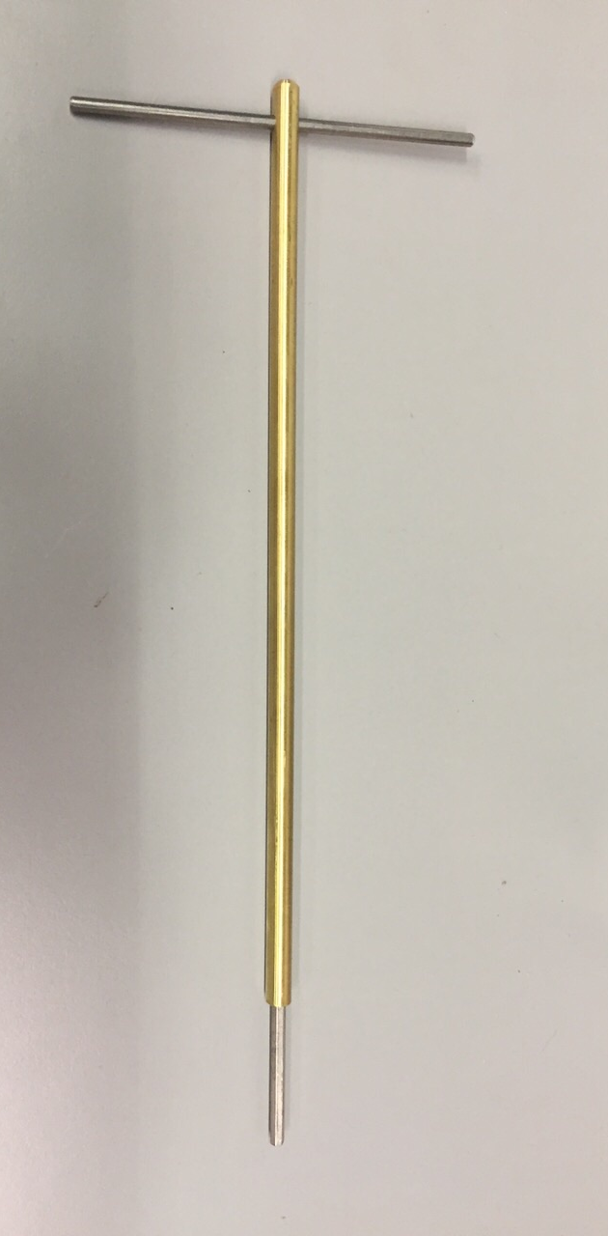
Integration tools
Octopus board holder and nut tool

Slide 18
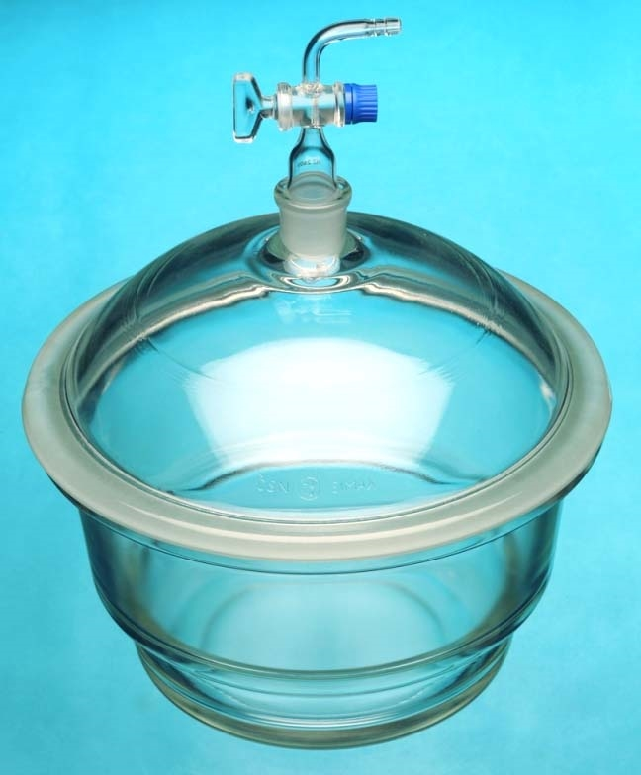
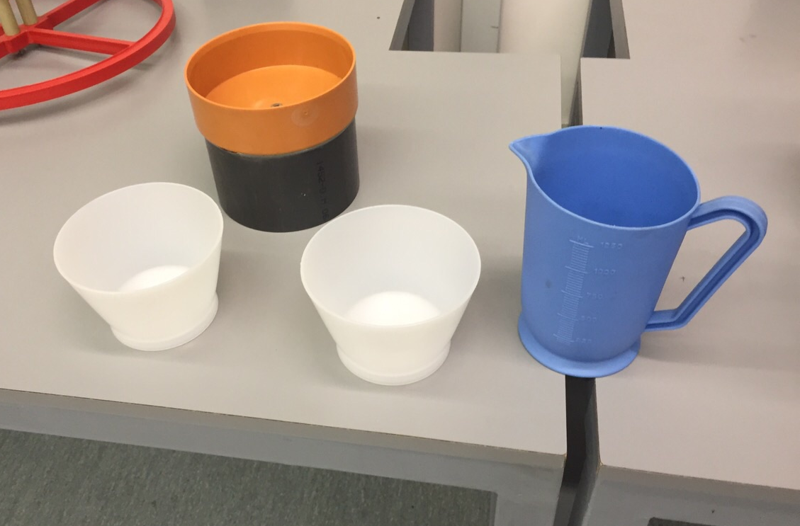
Integration tools
Gel pouring and degassing
Vacuum bell purchased;
Glueing buckets;
Syringes;
10mm PVC glueing tube

Slide 19
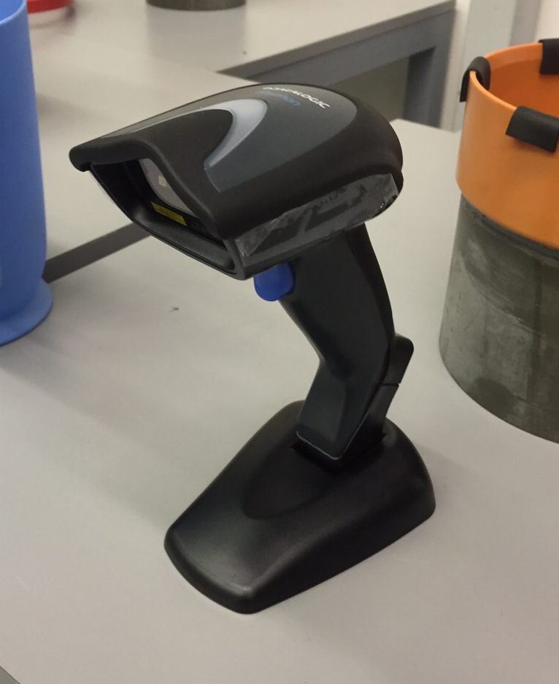
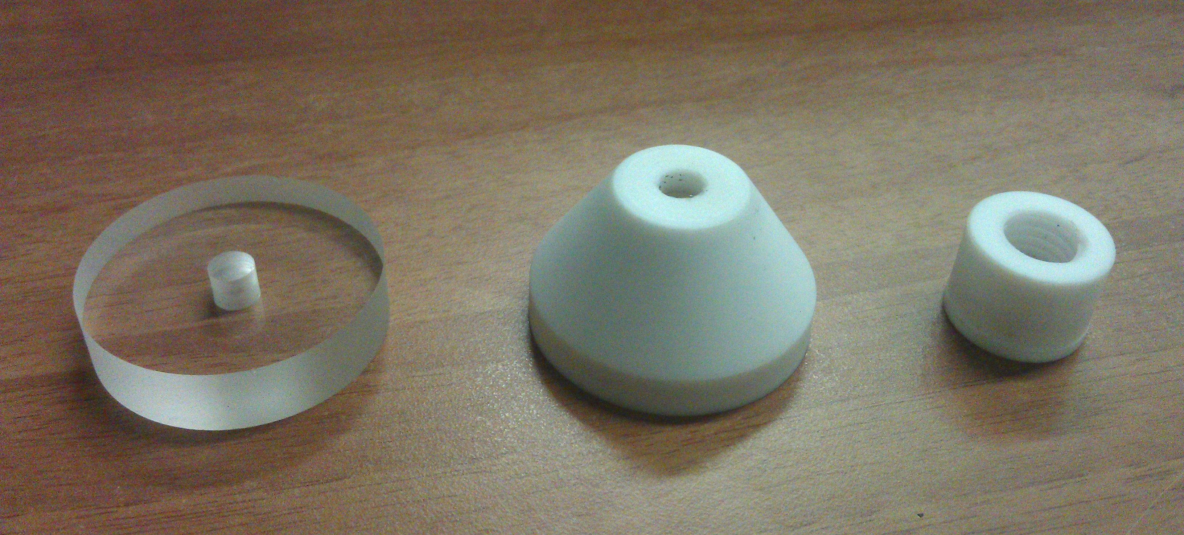
Integration tools
Support structure attachment;
penetrator and valve plugs;
thermal pad mask (picture N/A);
QR reader.

Slide 20
Conclusions
The DOM Integration site is ready
Tools are available;
Workspaces and tools are ready for the required DOM production rate (5/week);
Even a more massive production is addressable.

