Slide 1


Integrazione PMT e BaseBoards: procedure, test e calibrazione
Carlos Maximiliano Mollo
KM3NeT – IT Meeting – Catania 28 Novembre 2014

Slide 2
Introduzione
Integrazione PMT e BaseBoard e prime misure
Studio sull’andamento anomalo dei dark counts
Procedura di coating
Progettazione della stazione di test per i PMT di KM3NeT
Lavorazioni meccaniche
Elettronica e test
Carlos Maximiliano Mollo
INFN (Naples)
KM3NeT – IT Meeting – Catania 28 Novembre 2014

Slide 3
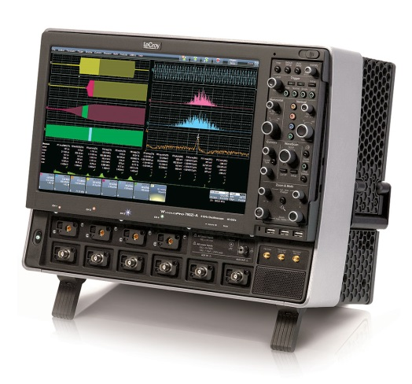
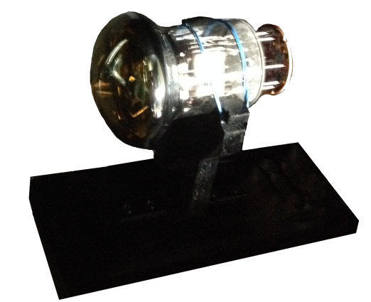
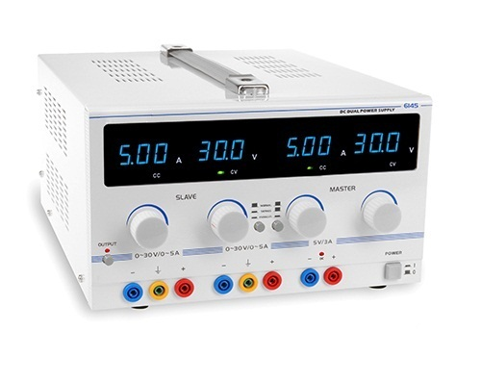
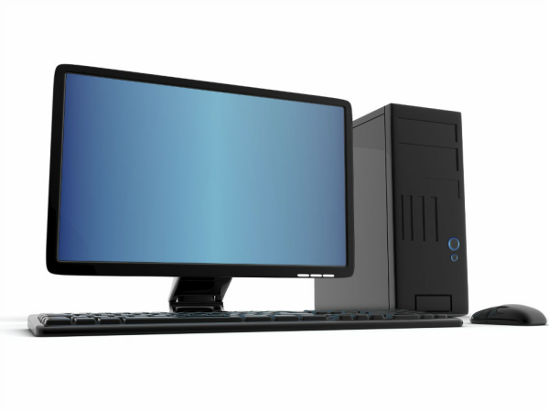
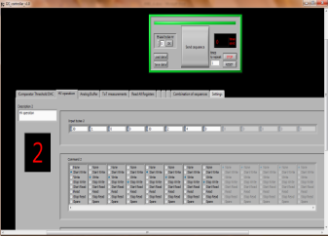
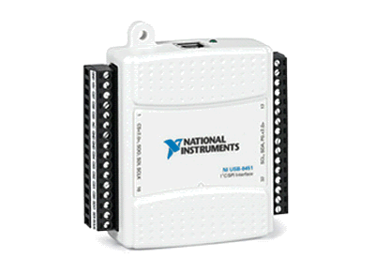
Test setup
Dark Box
Lecroy Wavepro SDA 760Zi 40 GS/s
LVDS ToT signal
15 cm
MiniOctopus
PMT+Base Board
Power Supply @3.3V
PC
I²C
LabVIEW
Software
USB
NI-USB to I²C
Carlos Maximiliano Mollo
INFN (Naples)
KM3NeT – IT Meeting – Catania 28 Novembre 2014

Slide 4
Dark Counts
First Measurement
Base Board without conformal coating
PMT ZB7845
From Hamamatsu Datasheet:
HV=-1270V (Hex code 0xB9)
DC= 370 cps
TTS= 3.578 ns
Carlos Maximiliano Mollo
INFN (Naples)
KM3NeT – IT Meeting – Catania 28 Novembre 2014

Slide 5
Dark Counts
ZB7845
Carlos Maximiliano Mollo
INFN (Naples)
KM3NeT – IT Meeting – Catania 28 Novembre 2014

Slide 6
Dark Counts
ZB7845
PROBLEMA
Carlos Maximiliano Mollo
INFN (Naples)
KM3NeT – IT Meeting – Catania 28 Novembre 2014

Slide 7
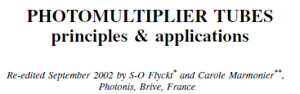
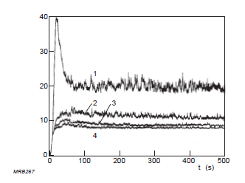
Dark Counts: solution
Carlos Maximiliano Mollo
INFN (Naples)
KM3NeT – IT Meeting – Catania 28 Novembre 2014

Slide 8
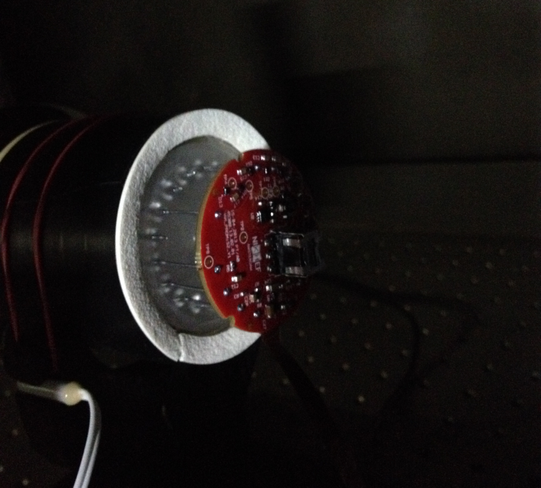
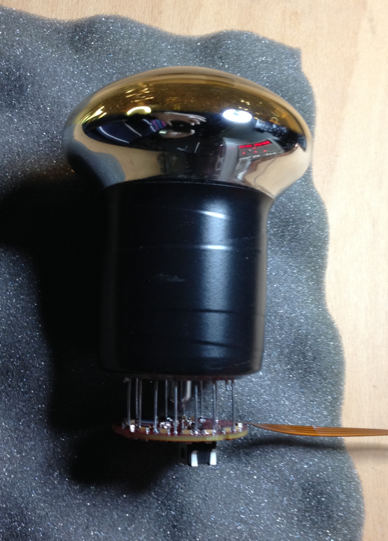
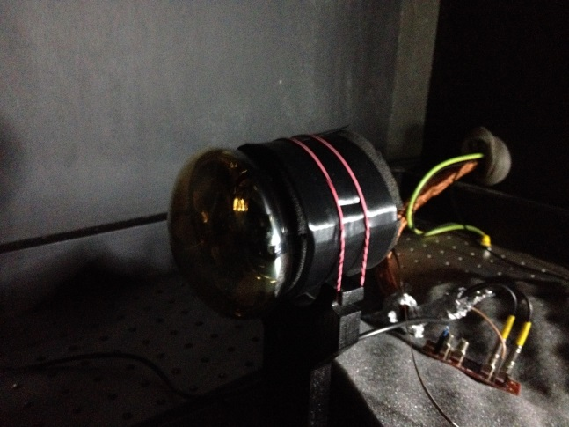
Dark Counts: solution
Dark count measurements with different holder materials
1) 2 layers of insulating tape on the PMT and neoprene
2) Silastene on the PMT and 2 layers of insulating tape
3) 4 Layers of insulating tape
1
2
3
Carlos Maximiliano Mollo
INFN (Naples)
KM3NeT – IT Meeting – Catania 28 Novembre 2014

Slide 9
Dark Counts
And the winner is…
T= 17.8 °C
3 hours
8 hours
24 hours
Carlos Maximiliano Mollo
INFN (Naples)
KM3NeT – IT Meeting – Catania 28 Novembre 2014

Slide 10
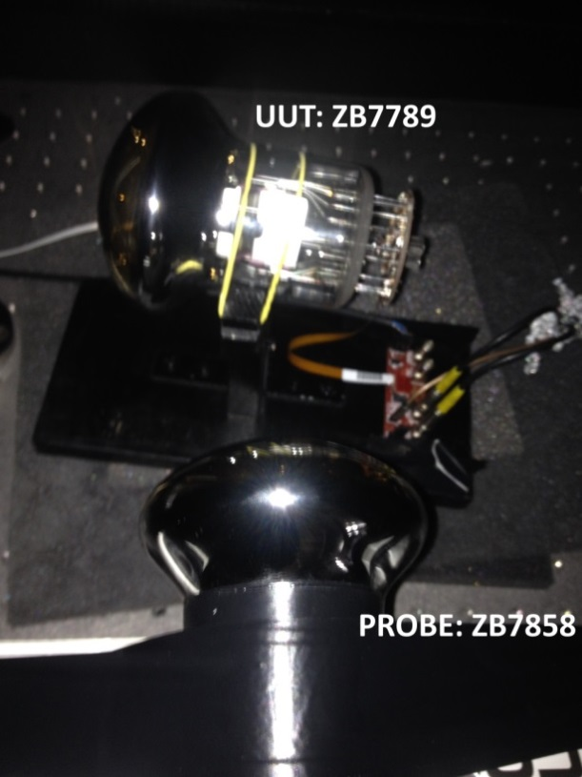
Understanding of the DC anomaly
One of the possible explanations for the DC anomaly is the creation of discharges in air due to gaps between the glass surface of the PMT and the holder.
First Setup
UUT: PMT ZB7789 No insulating tape,
no coating (HV:-1100 V DC_{Hamamatsu}: 592 cps)
PROBE: PMT ZB7858 with insulating tape
(HV:-1250 V DC_{Hamamatsu}: 1180 cps)
If the UUT is noisy and the effect is due to light emission we will see in the PROBE high dark counts when UUT is ON.
Carlos Maximiliano Mollo
INFN (Naples)
KM3NeT – IT Meeting – Catania 28 Novembre 2014

Slide 11
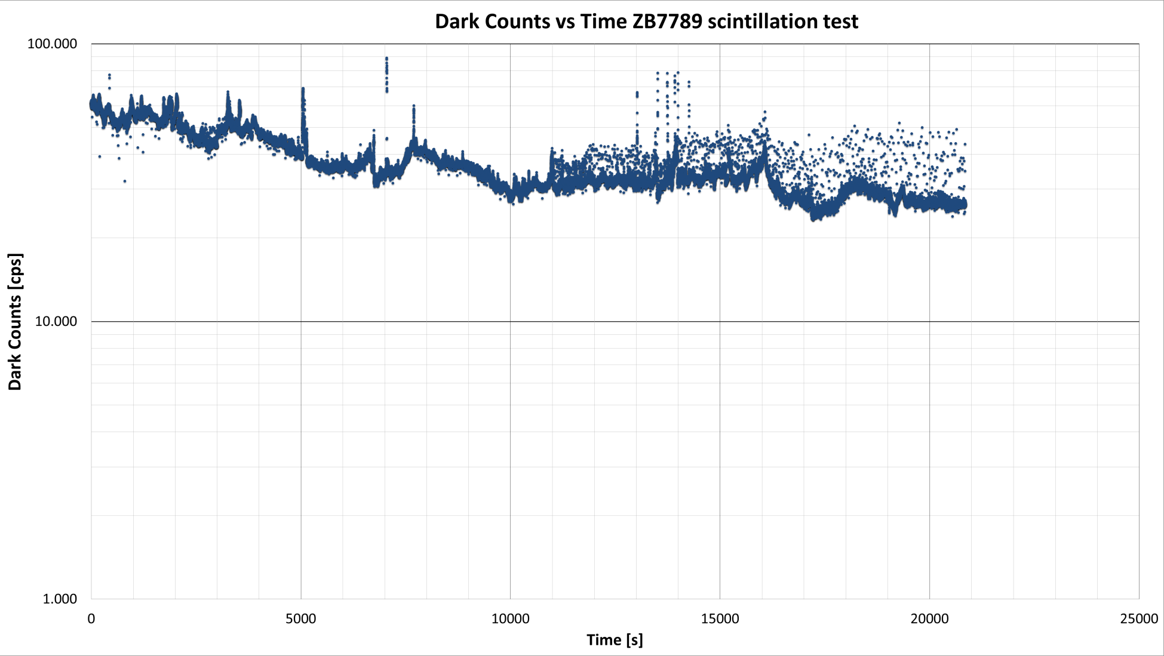
Understanding of the DC anomaly
As expected the UUT is noisy: NO INSULATING MATERIAL BETWEEN THE PMT AND THE HOLDER
Carlos Maximiliano Mollo
INFN (Naples)
KM3NeT – IT Meeting – Catania 28 Novembre 2014

Slide 12
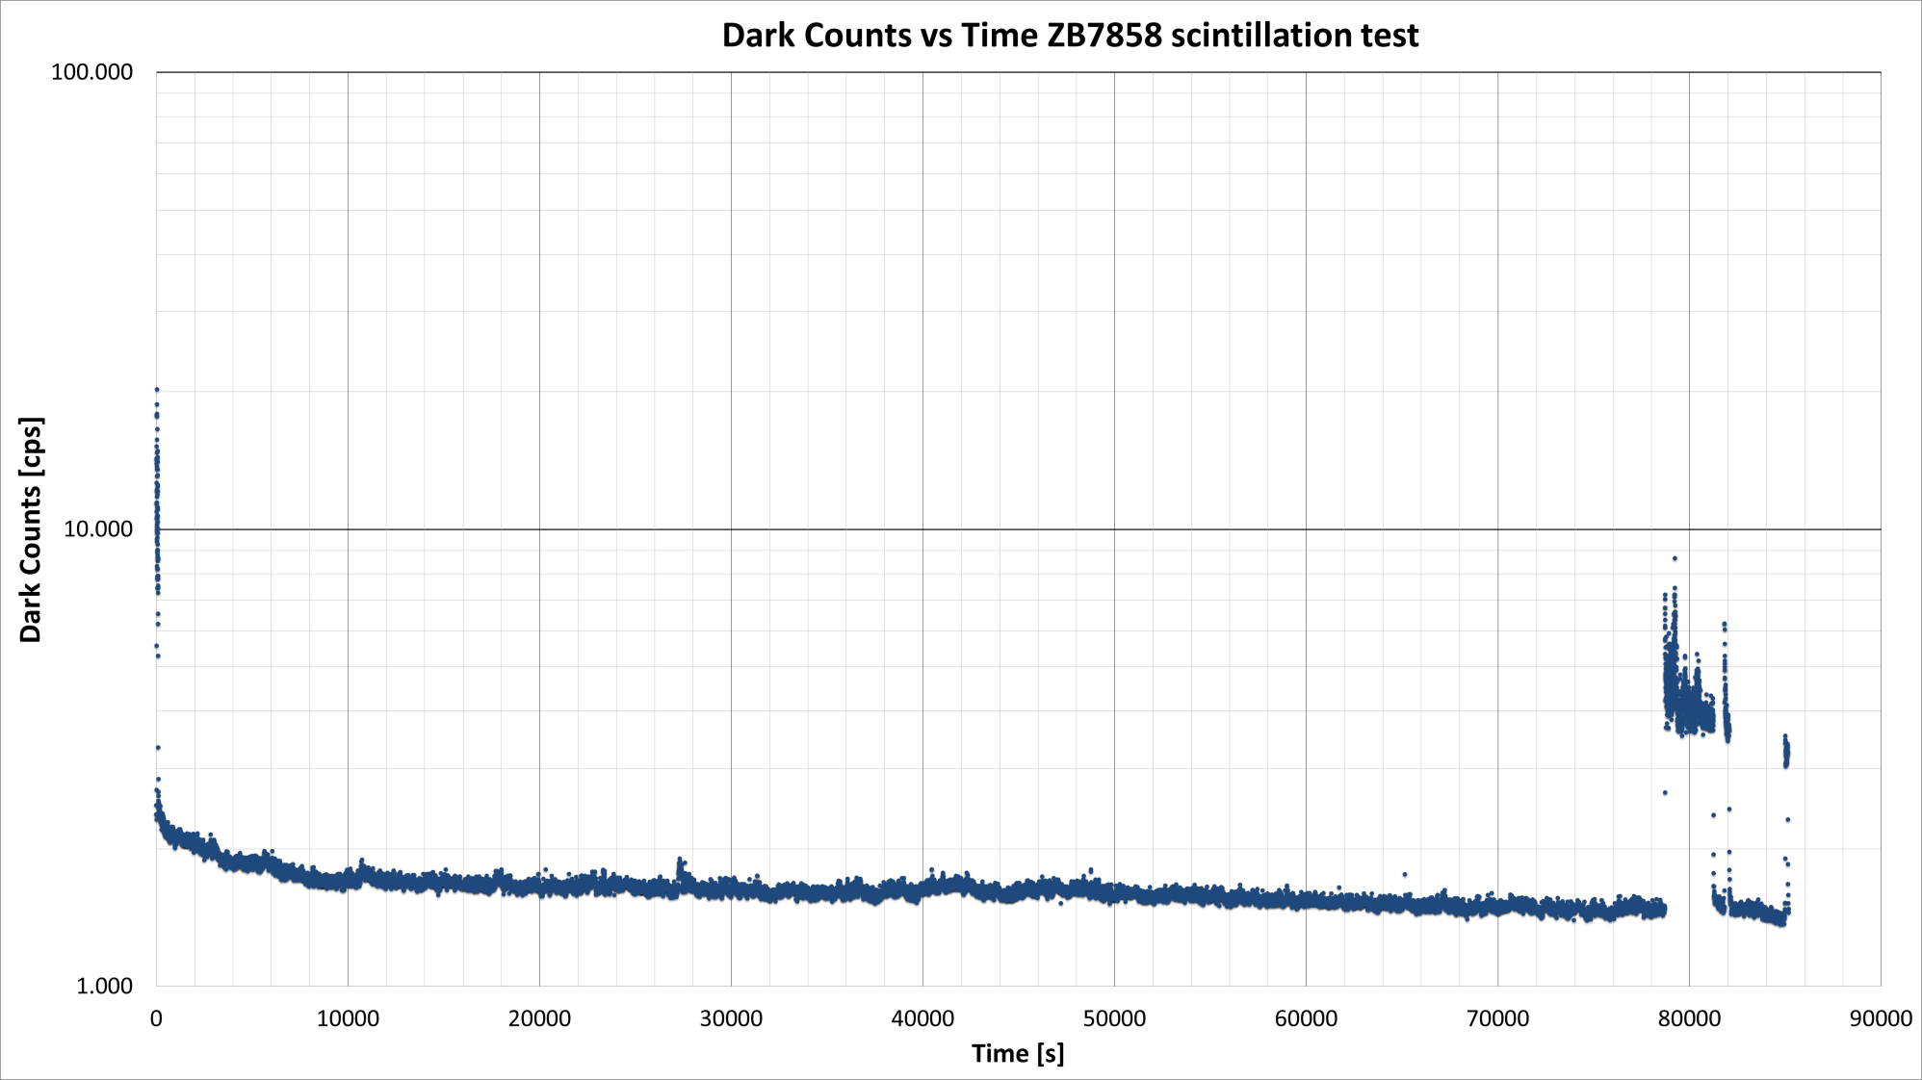
Understanding of the DC anomaly
Instead, the PROBE PMT reaches fast the nominal DC (1180 cps) using insulating tape
Adaption
test
After the adaption we powered up the UUT …
Carlos Maximiliano Mollo
INFN (Naples)
KM3NeT – IT Meeting – Catania 28 Novembre 2014

Slide 13
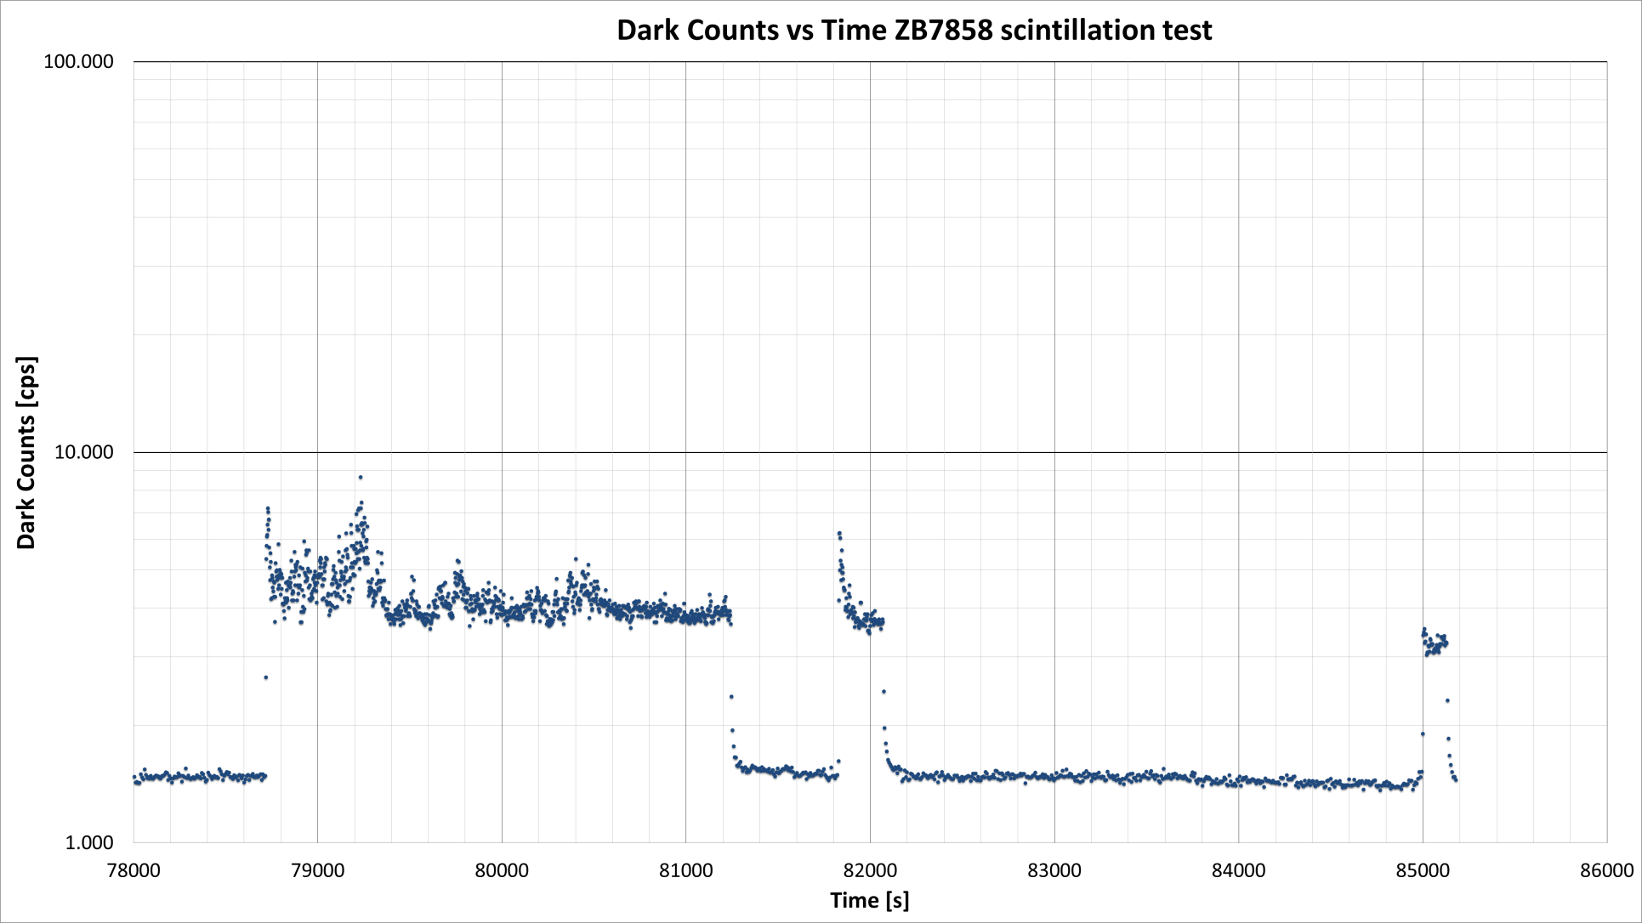
Understanding of the DC anomaly
We powered up and down the UUT and we observed changes in the PROBE DC rate.
UUT:ON
UUT:ON
UUT:OFF
UUT:ON
UUT:OFF
UUT:OFF
UUT:OFF
Carlos Maximiliano Mollo
INFN (Naples)
KM3NeT – IT Meeting – Catania 28 Novembre 2014

Slide 14
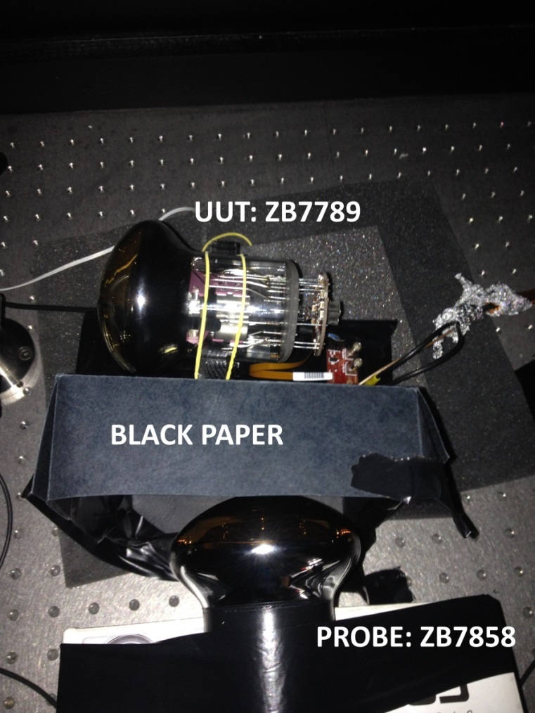
Understanding of the DC anomaly
Is really the correlation between the PROBE and the UUT due to photons?
Second Setup
UUT: PMT ZB7789 No insulating tape,
no coating (HV:-1100 V DC_{Hamamatsu}: 592 cps)
PROBE: PMT ZB7858 with insulating tape
(HV:-1220 V DC_{Hamamatsu}: 1180 cps)
Black paper between the PMTs
Carlos Maximiliano Mollo
INFN (Naples)
KM3NeT – IT Meeting – Catania 28 Novembre 2014

Slide 15
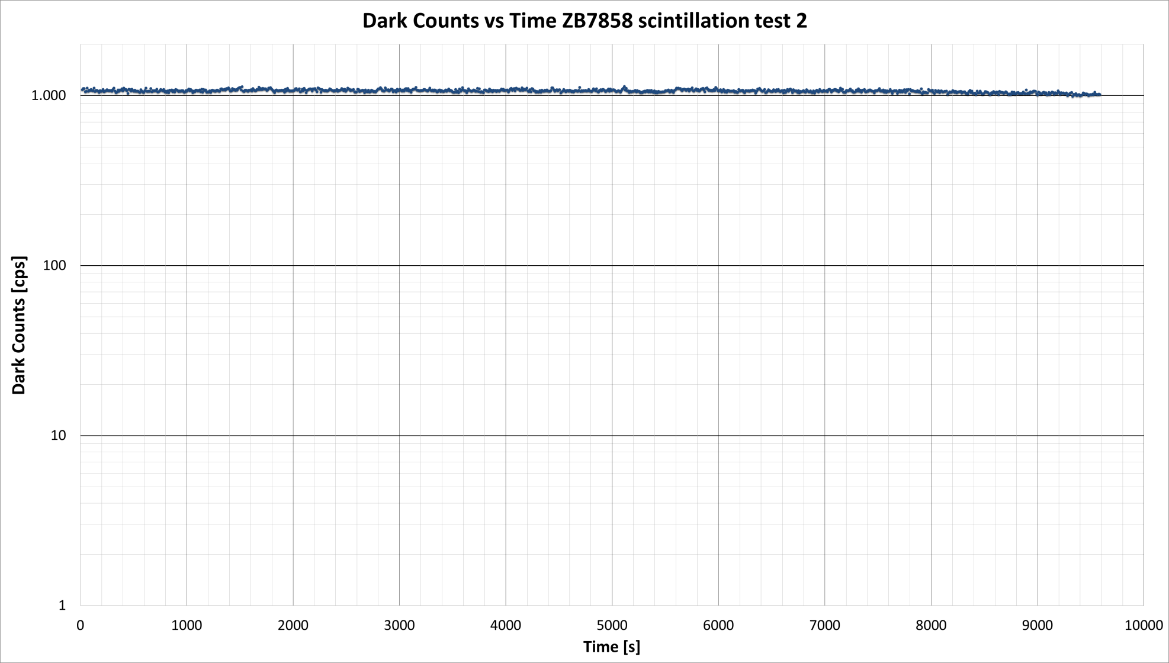
Understanding of the DC anomaly
UUT:OFF
UUT:ON
UUT:OFF
UUT:ON
UUT:OFF
UUT:OFF
UUT:ON
The correlation disappeared. A noisy PMT generates photons!
Carlos Maximiliano Mollo
INFN (Naples)
KM3NeT – IT Meeting – Catania 28 Novembre 2014

Slide 16
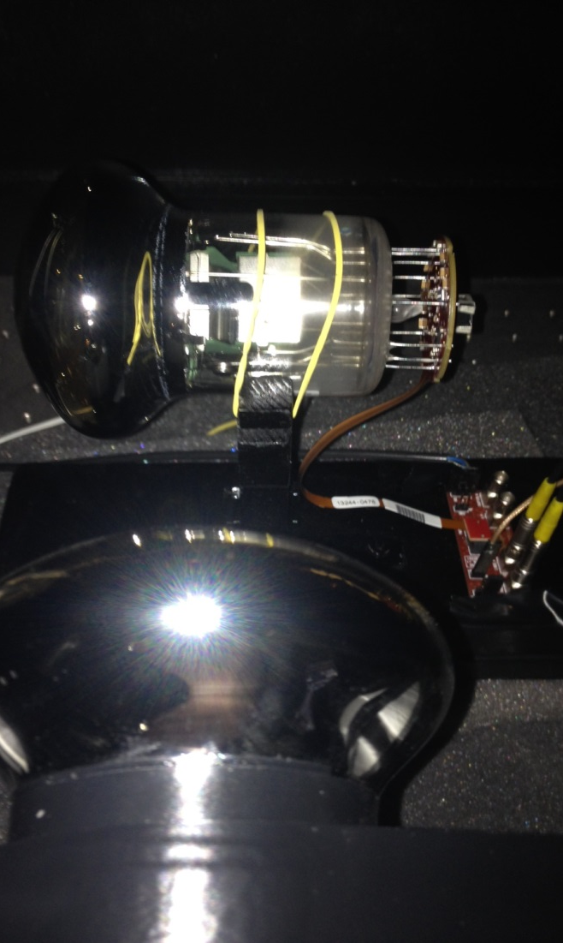
Understanding of the DC anomaly
But are really the photons due to the scintillation between the PMT and the holder or are they produced by the normal functioning of the dynodes?
(Light Emission from Light Detectors, Max L. Knötig et al , Max Planck Institute fur Physik)
There is a transparent material with a high
electric impedance?
YES!!! The same coating used for the bases!!!!!!!
UUT: AA0347
Third Setup
UUT: PMT AA0347 coating on the tube
(HV:-990 V)
PROBE: PMT ZB7858 with insulating tape
(HV:-1250 V DC_{Hamamatsu}: 1180 cps)
PROBE: ZB7858
Carlos Maximiliano Mollo
INFN (Naples)
KM3NeT – IT Meeting – Catania 28 Novembre 2014

Slide 17
Understanding of the DC anomaly
The UUT (PMT AA0347) with insulating coating on the tube reaches quickly a good DC rate.
No anomalies on the DC behavior
Carlos Maximiliano Mollo
INFN (Naples)
KM3NeT – IT Meeting – Catania 28 Novembre 2014

Slide 18
Understanding of the DC anomaly
As shown in the plot the DC of the PROBE does not change when the UUT is powered up/down
UUT:OFF
UUT:ON
UUT:OFF
UUT:ON
UUT:OFF
UUT:ON
UUT:OFF
Carlos Maximiliano Mollo
INFN (Naples)
KM3NeT – IT Meeting – Catania 28 Novembre 2014

Slide 19
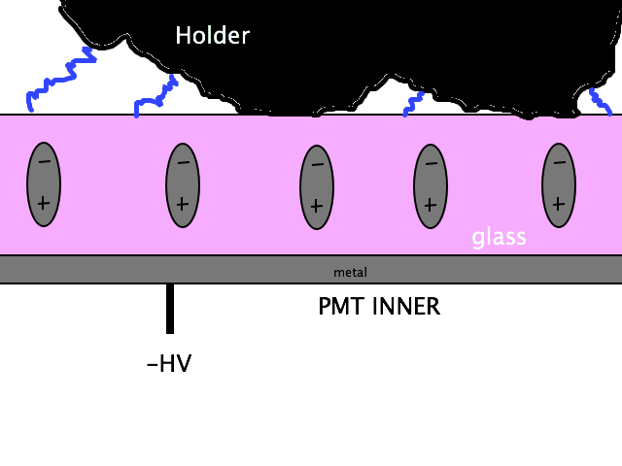
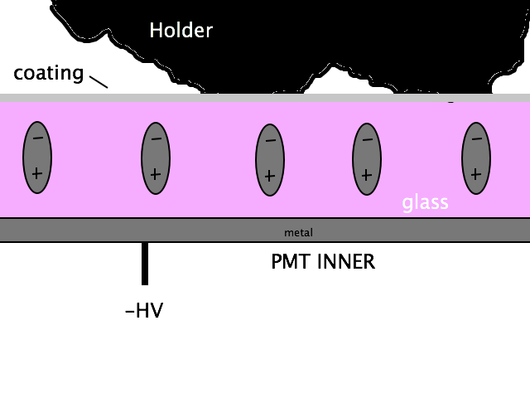
Understanding of the DC anomaly
Since the holder could not perfectly stick to the PMT glass surface, there could be air gaps with distances below 0.2 mm where electrical discharges occur.
In the case of good insulating material covering the glass tube the external surface of the coating is at 0V. Therefore, electrical discharges cannot occur.
The higher the negative HV the most evident the effect! As shown in the last meeting
at Leiden.
A good insulation material in perfect contact with the PMT surface avoid the effect.
Carlos Maximiliano Mollo
INFN (Naples)
KM3NeT – IT Meeting – Catania 28 Novembre 2014

Slide 20
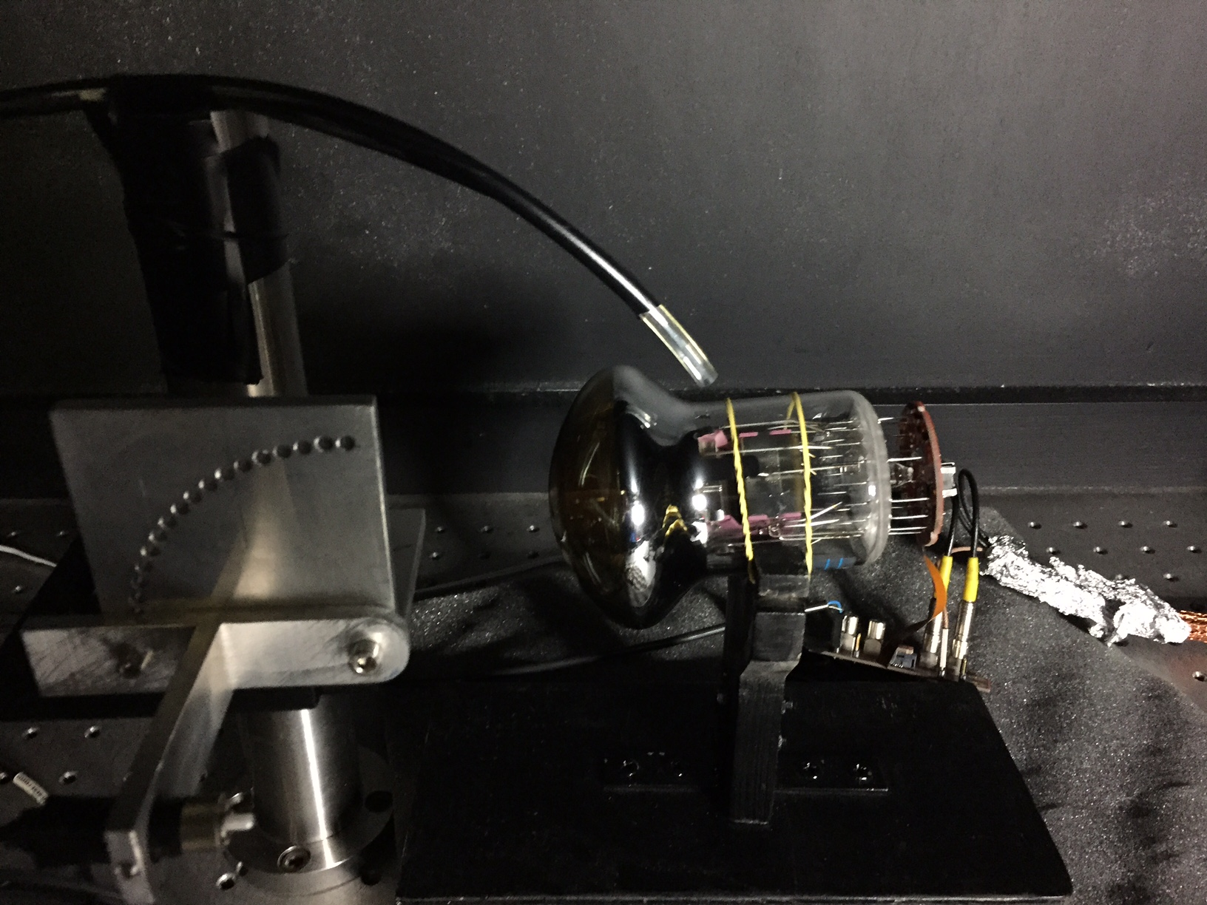
Prova definitiva sull’origine dell’andamento anomalo dei dark counts
PMT ZB7789
Nessun isolamento elettrico fra supporto e
Fotomoltiplicatore
Flusso di SF6 (pressure 2 bar) in corrispondenza
Del punto di contatto fra fotomoltiplicatore
e supporto
Se l’origine dell’andamento anomalo dei DC è data da micro scariche fra il vetro
Del PMT ed il supporto, la presenza di un gas fortemente elettronegativo come
L’SF6 dovrebbe abbattare i DC
Carlos Maximiliano Mollo
INFN (Naples)
KM3NeT – IT Meeting – Catania 28 Novembre 2014

Slide 21
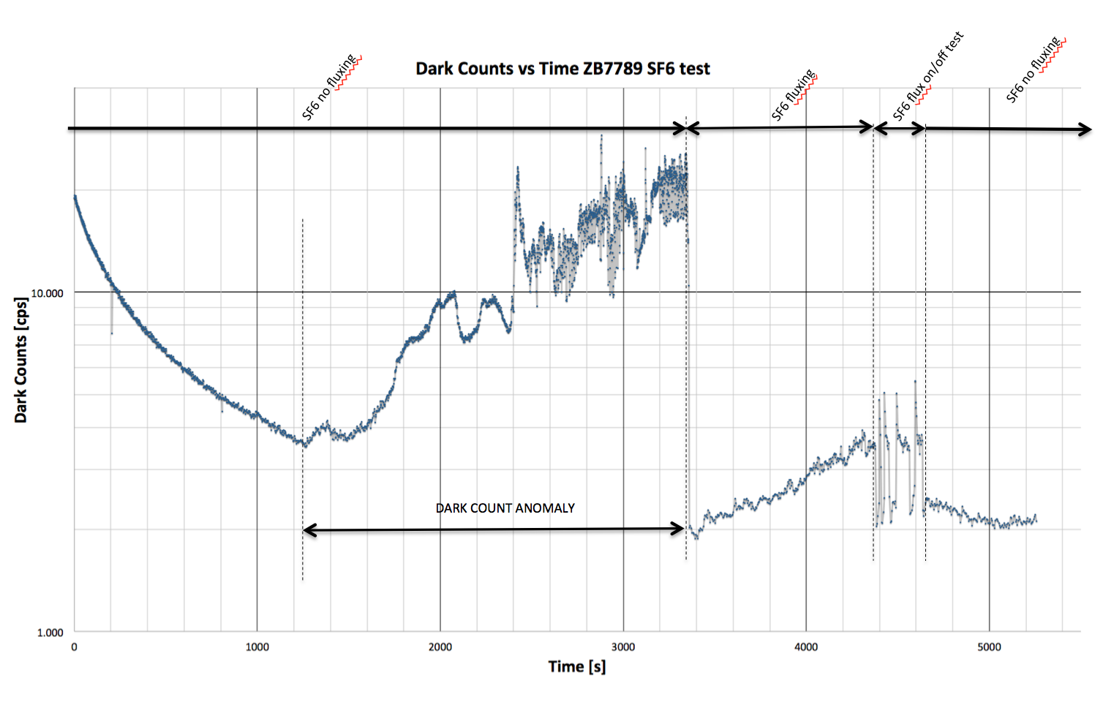
Prova definitiva sull’origine dell’andamento anomalo dei dark counts
La presenza di SF6 altera i DC. L’unica spiegazione: Riduzione di scariche esterne
al PMT.
Carlos Maximiliano Mollo
INFN (Naples)
KM3NeT – IT Meeting – Catania 28 Novembre 2014

Slide 22
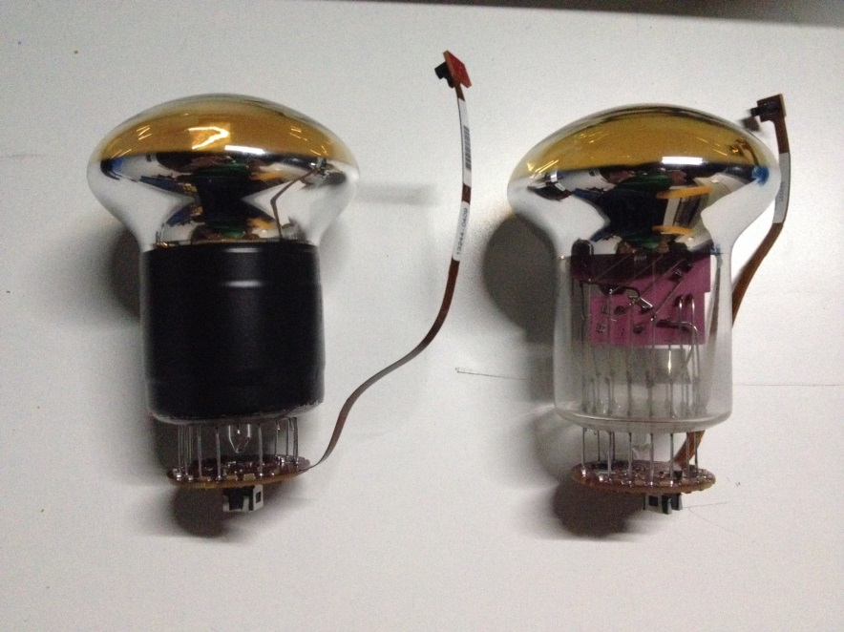
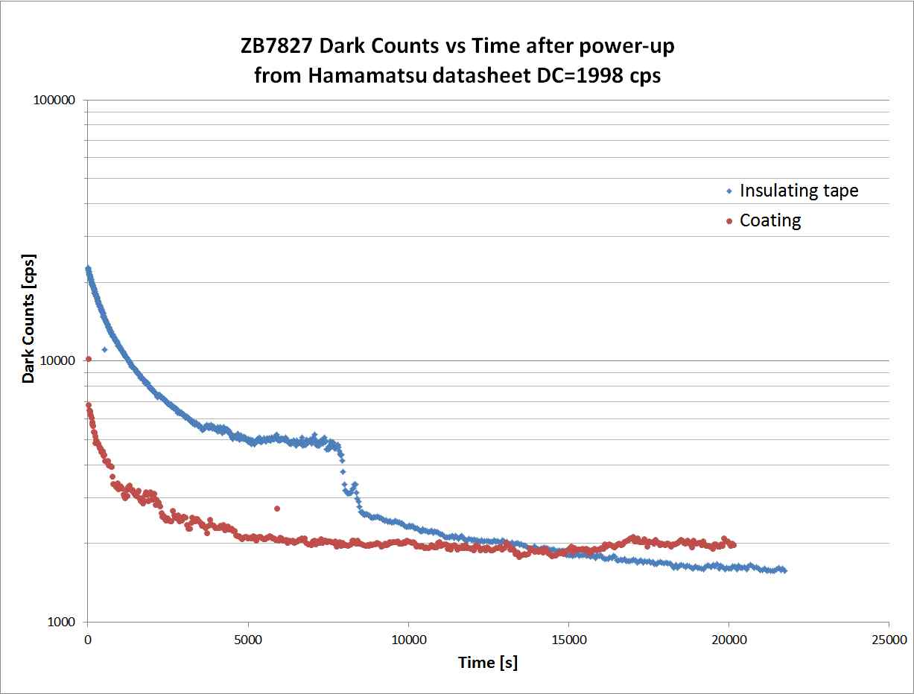
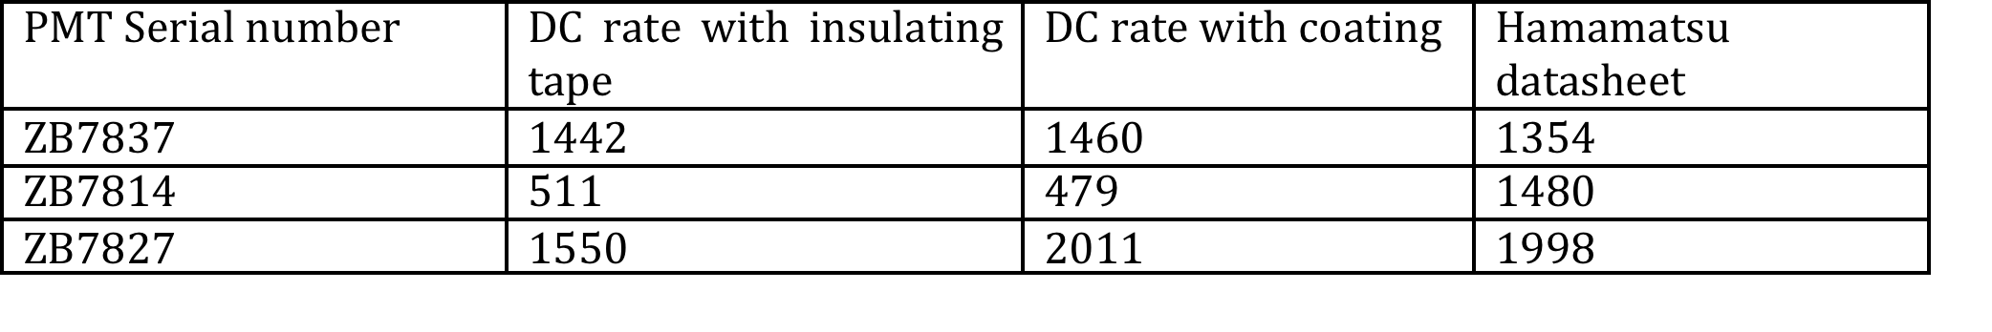
An innovative method to control the dark counts
THE LIQUID COATING CAN BE USED TO IMPROVE THE DC RATES
INSULATING
TAPE
COATING
Carlos Maximiliano Mollo
INFN (Naples)
KM3NeT – IT Meeting – Catania 28 Novembre 2014

Slide 23
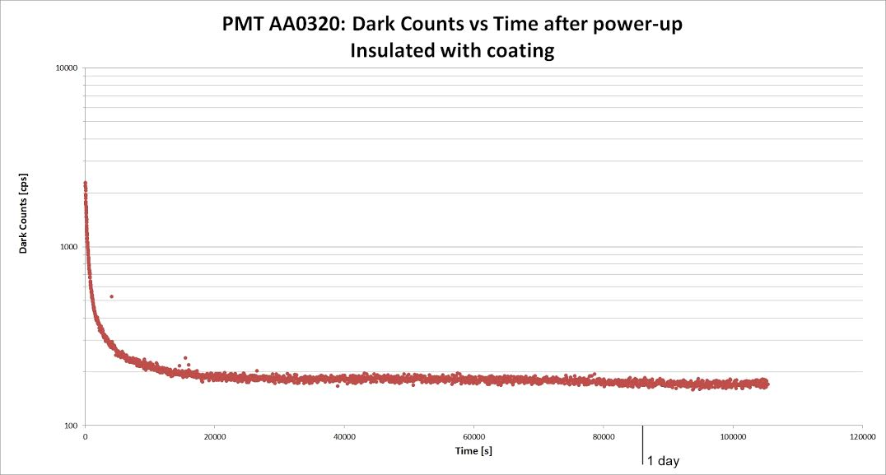
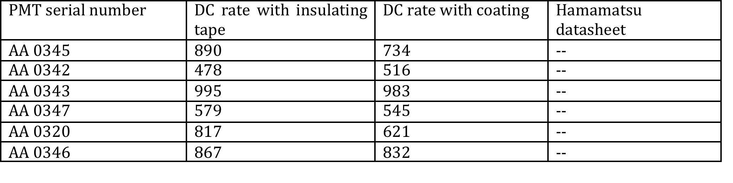
An innovative method to control the dark counts
CHINESE PRODUCTION
DC RATE TREND OVER A PERIOD LONGER THAN 1 DAY
GOOD STABILITY!
Carlos Maximiliano Mollo
INFN (Naples)
KM3NeT – IT Meeting – Catania 28 Novembre 2014

Slide 24
An innovative method to control the dark counts
THIS SOLUTION IS:
FAST: the coating on the PMT will be done simultaneously with the base board coating
CHEAP: no additional costs or man power is required
EASY: the PMT coating procedure is very simple and is not different with the respect to the base board coating procedure.
0 IMPACT: the coating is transparent, the coating layer is very thin and do not interfere with the holder mechanic design.
Ok but: may the coating interfere with the optic gel?
Carlos Maximiliano Mollo
INFN (Naples)
KM3NeT – IT Meeting – Catania 28 Novembre 2014

Slide 25
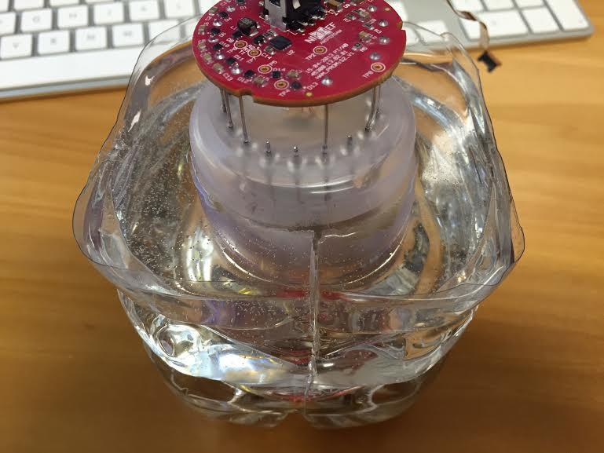
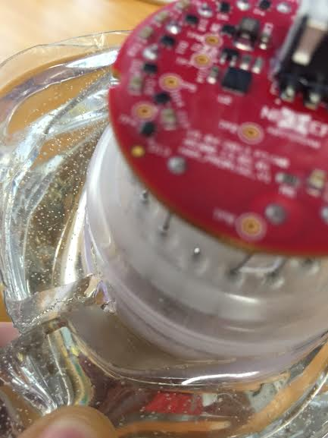
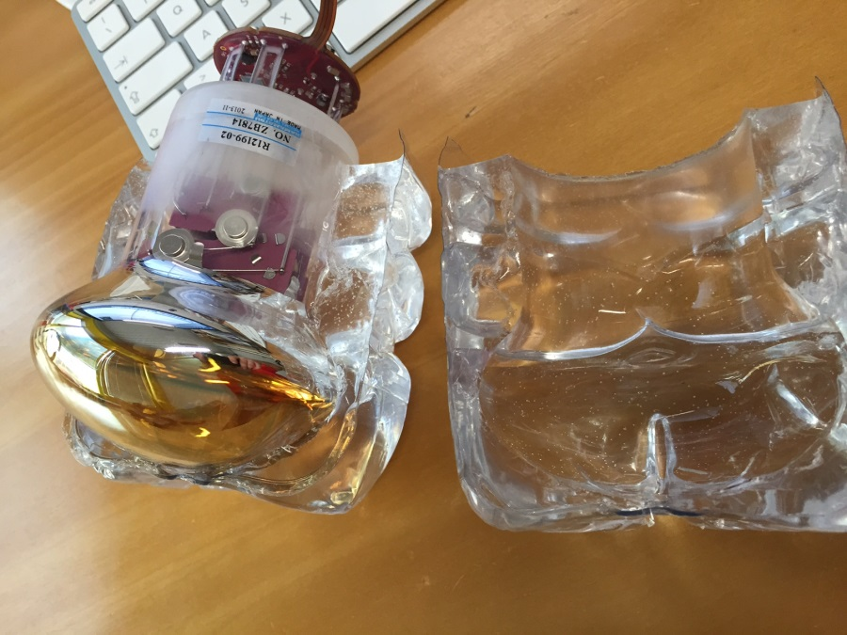
Compatibility tests, measurements and procedure
Liquid coating and GEL compatibility
In order to check the gel-coating compatibility we poured the gel around a PMT whose glass tube was covered with coating. Note that, given the goal of this test, we did not follow the procedure to eliminate the bubbles from the gel.
The situation after about 72 hours
it was not sticky in any place close or far the glass where the coating was applied.
The gel was well polymerized
Carlos Maximiliano Mollo
INFN (Naples)
KM3NeT – IT Meeting – Catania 28 Novembre 2014

Slide 26
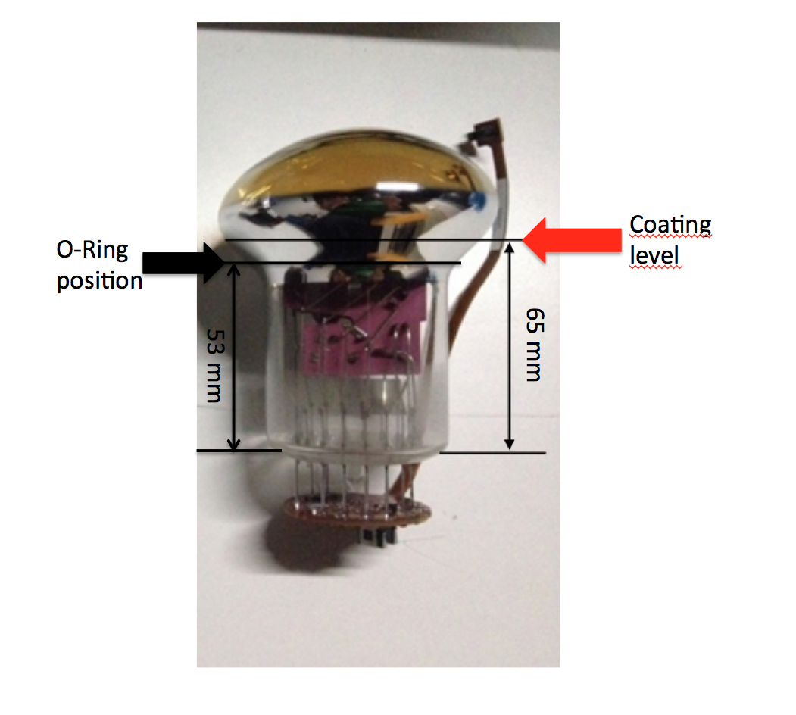
Compatibility tests, measurements and procedure
In order to be effective the coating must be placed between the PMT and the O-Ring in the DOM holder.
Carlos Maximiliano Mollo
INFN (Naples)
KM3NeT – IT Meeting – Catania 28 Novembre 2014

Slide 27
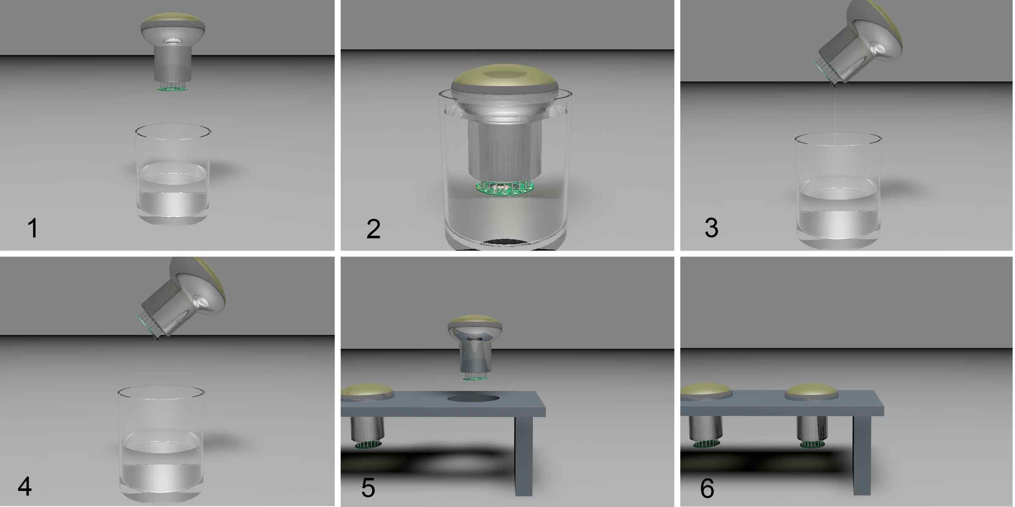
Compatibility tests, measurements and procedure
THE LIQUID COATING APPLICATION PROCEDURE
Pour the liquid in a container large enough to immerse the PMT up to the position indicated by the red arrow in the previous slide.
Immerse the PMT in the coating with the fingers on the longer diameter. Move the PMT slowly to let the liquid coating enter between the various components of the base board and wait 2-3 seconds. DO NOT immerse the connector in the coating! Make sure that the connector of the base board remains clean. Of course, part of the flat cable between the base board and the connector will be immersed in the coating
Remove the PMT from the container and tilt it of 45° so that the coating excess drips. During this operation is recommended to rotate the PMT to uniform the layer of coating ;
Wait until it stops to drip;
Place the PMT in a holder with a diameter slightly less than the maximum diameter of the PMT;
Wait at least 48 hours (depending on the room temperature) so that the coating is dry.
Carlos Maximiliano Mollo
INFN (Naples)
KM3NeT – IT Meeting – Catania 28 Novembre 2014

Slide 28
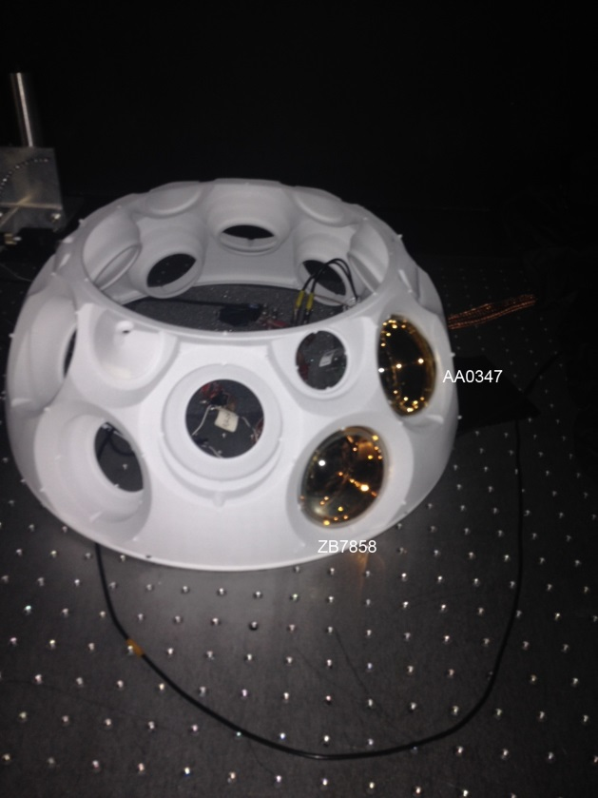
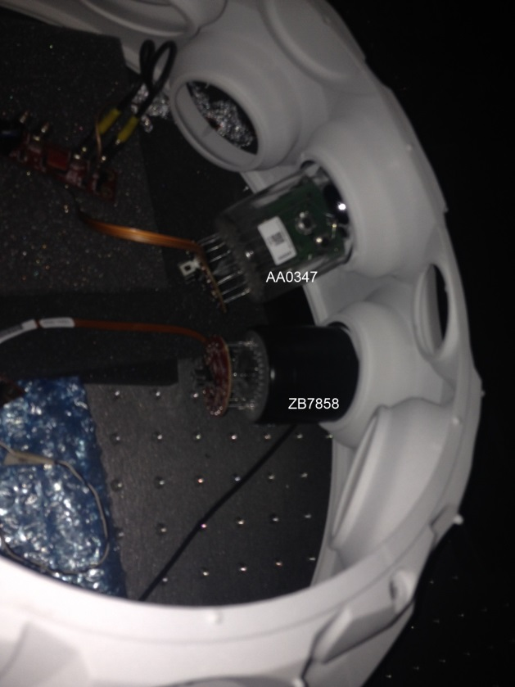
Compatibility tests, measurements and procedure
Testing PMTs hosted in the PMT support structure
PMT ZB7858: NHV=1250 V, DC= 1180, insulating tape used as insulator for the tube.
PMT AA0347: NHV= 990 V, DC= 250 conformal coating used as insulator for the tube.
Carlos Maximiliano Mollo
INFN (Naples)
KM3NeT – IT Meeting – Catania 28 Novembre 2014

Slide 29
Compatibility tests, measurements and procedure
Testing PMTs hosted in the PMT support structure
cps
Setup A: PMT AA0347 placed in our “homemade” holder with liquid coating
Setup B: PMT AA0347 placed in the DOM holder with
Insulating tape in the region near the O-Ring and the
O-ring.
Setup C: PMT AA0347 placed in the DOM holder with
O-Ring and no insulating tape or coating between the PMT and the O-ring.
Setup D: PMT AA0347 placed in the DOM holder without O-Ring and no insulating tape or coating.
setup
Carlos Maximiliano Mollo
INFN (Naples)
KM3NeT – IT Meeting – Catania 28 Novembre 2014

Slide 30
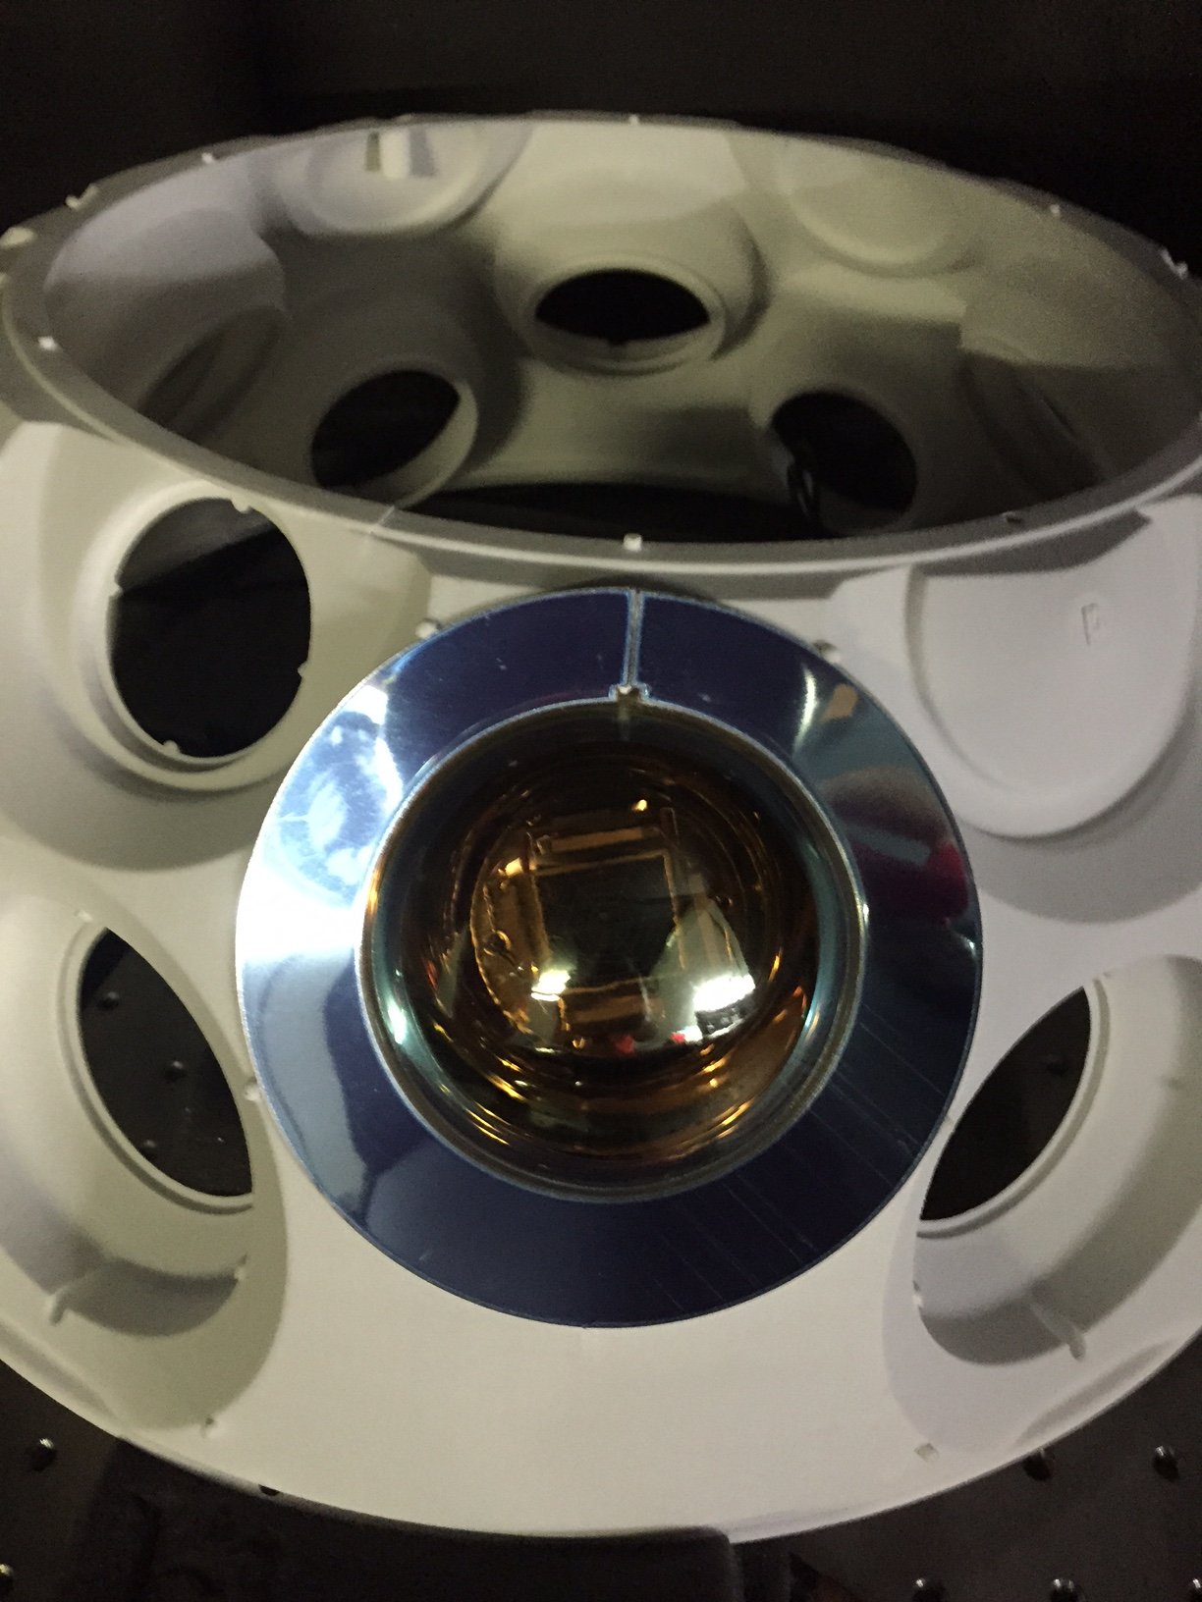
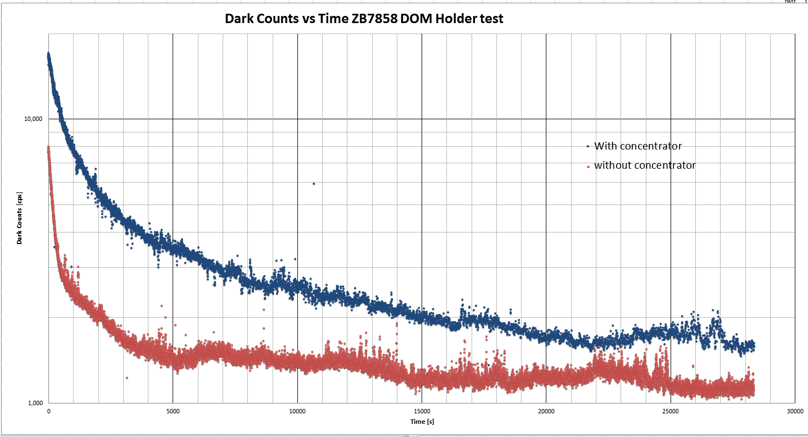
Compatibility tests, measurements and procedure
Testing PMTs hosted in the PMT support structure with and without light concentrator
PMT ZB7858: NHV=1250 V, DC= 1180 cps
Setup 1: With concentrator ring
Setup 2: Without concentrator ring
Setup 1: final DC rate about 1300 cps (concentrator ring not in contact with the PMT)
Setup 2: final DC rate about 1150 cps
Carlos Maximiliano Mollo
INFN (Naples)
KM3NeT – IT Meeting – Catania 28 Novembre 2014

Slide 31
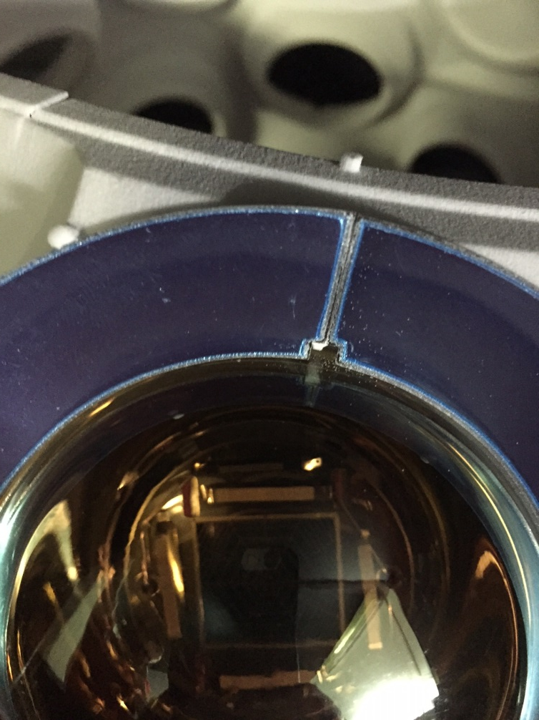
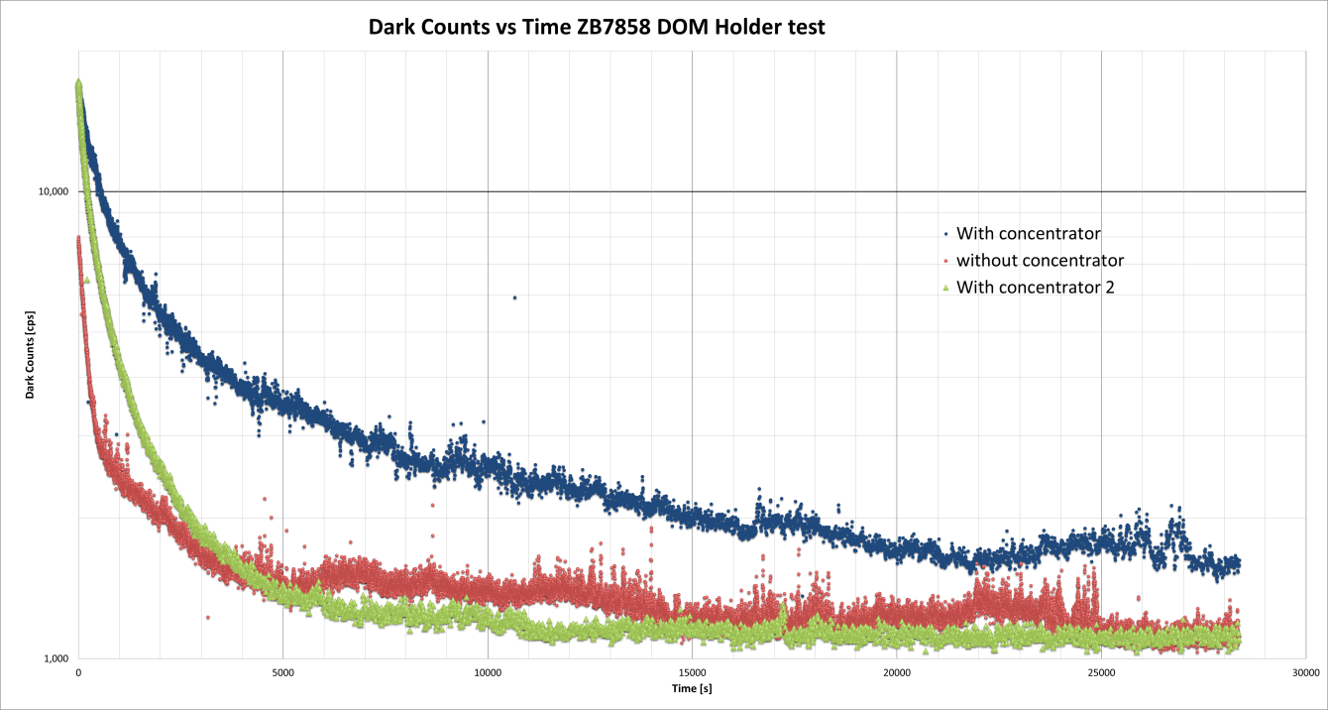
Compatibility tests, measurements and procedure
Concentrator ring in contact with the PMT
PMT ZB7858: NHV=1250 V, DC= 1180 cps
Setup 1: With concentrator ring
Setup 2: Without concentrator ring (not in contact)
Setup 3: Without concentrator ring (in contact)
Setup 1: final DC rate about 1300 cps
Setup 2: final DC rate about 1150 cps
Setup 3: final DC rate about 1150 cps
Carlos Maximiliano Mollo
INFN (Naples)
KM3NeT – IT Meeting – Catania 28 Novembre 2014

Slide 32
Compatibility tests, measurements and procedure
Concentrator ring in contact with the PMT
It seems that if the concentrator ring is in contact with the PMT the DC trend is better.
WHY?
The concentrator ring is a conductor, if it is directly in contact with the PMT its potential is the same as the PMT surface.
No micro-discharges will occur.
The measurements was done using the ZB7858 that works at
-1250V. Ones of the highest nominal HV.
All effects will be most evident for those PMTs with high negative voltage.
Conclusion: the contact between the PMT and the concentrator ring is not critical
Carlos Maximiliano Mollo
INFN (Naples)
KM3NeT – IT Meeting – Catania 28 Novembre 2014

Slide 33
Dark box for PMTs assembly in view of the mass production
Carlos Maximiliano Mollo
INFN (Naples)
KM3NeT – IT Meeting – Catania 28 Novembre 2014

Slide 34

PMTs + bases TEST – Dark Box
  Dark Box components
LASER source
PiLas Mod. EIG2000DX
Repetition rate (internal trigger) | 50 Hz – 1 MHz
Repetition rate (external trigger) | Single shot – 1 MHz
External trigger input | TTL & VAR upt 120 MHz
External trigger pulse width | Typ. ≥ 4 ns
Synchronization output pulse width | typ. ≥ 4 ns for external triggering 50% duty cycle for internal oscillator
Typical jitter between synchronization trigger output and optical signal | typ. ≤ 4 ps
Warm-up time | < 5 minutes
LASER head | Wavelength 470 +/- 10 nm, spectral width < 7 nm, pulse width (FWHM) typ < 45 ps
Carlos Maximiliano Mollo
INFN (Naples)
KM3NeT – IT Meeting – Catania 28 Novembre 2014

Slide 35
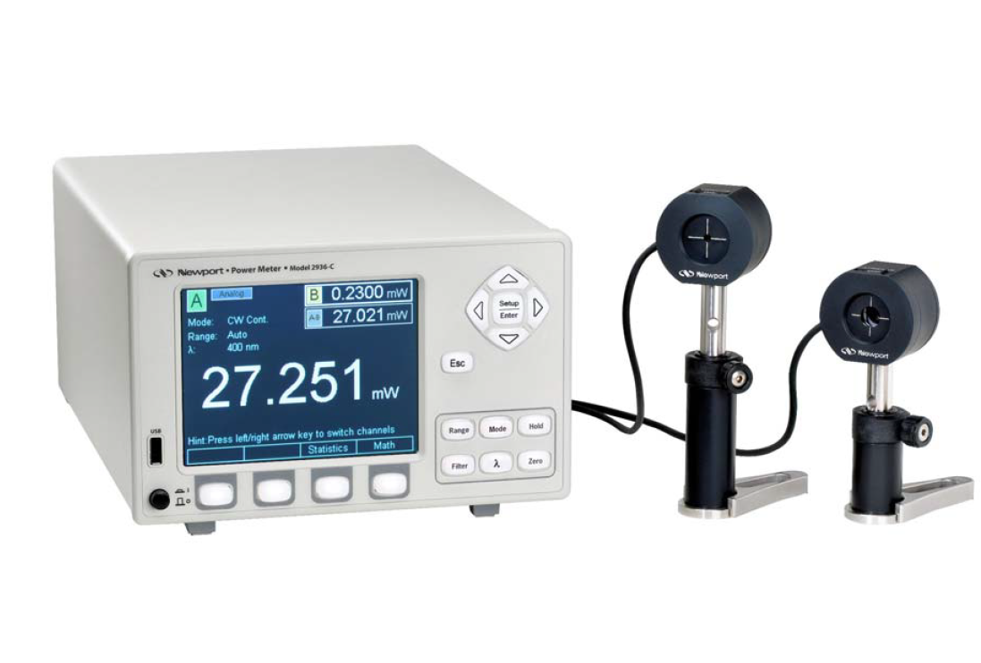
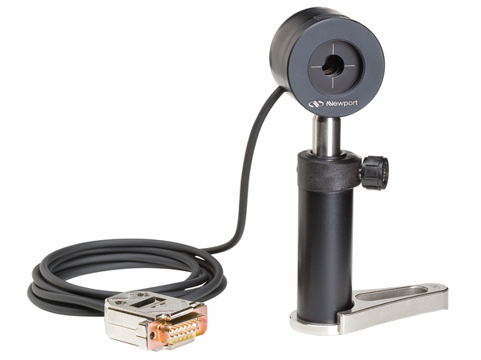
PMTs + bases TEST – Dark Box
  Dark Box components
Dual Channel Power Meter
Newport Mod. 2936-C
Full-Scale Current | 2.5 nA – 25 mA
Resolution | 10 fA
Accuracy | 0.2%
SNR | 100 dB
Bandwidth | 1.2 Hz – 400 kHz
Minimum Power Resolution | 11 fW
Power Meter Probes
Newport Mod. 918D-SL-OD3
Material | Silicon
Spectral Range | 400 to 1100 nm
NEP (detector noise equivalent power) | 0.55 pW/√Hz
Minimum Detectable Power $=\left(NEP\right)\sqrt{B}=$ 0.60 pW
Carlos Maximiliano Mollo
INFN (Naples)
KM3NeT – IT Meeting – Catania 28 Novembre 2014

Slide 36
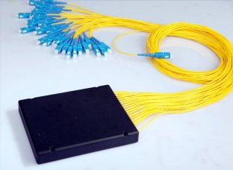

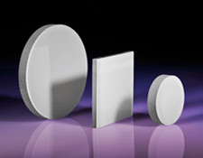
PMTs + bases TEST – Dark Box
  Dark Box components
1 to 32 and 1 to 2 Optical splitters
Fiber-to-fiber U-bench for filters
Opal Diffusing Glass
Carlos Maximiliano Mollo
INFN (Naples)
KM3NeT – IT Meeting – Catania 28 Novembre 2014

Slide 37
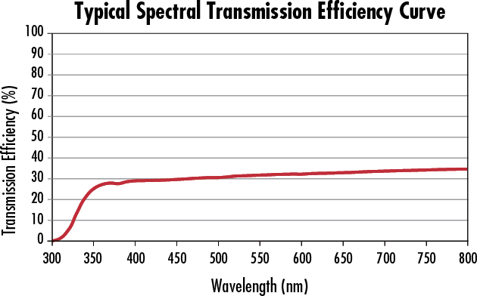
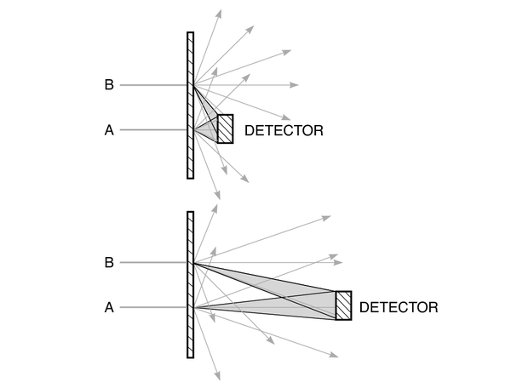
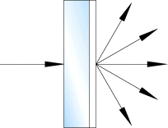
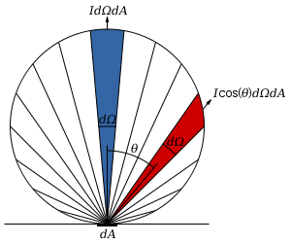
PMTs + bases TEST – Dark Box
Opal diffusing Glass
  Dark Box components
Near Lambertian Distribution
Carlos Maximiliano Mollo
INFN (Naples)
KM3NeT – IT Meeting – Catania 28 Novembre 2014

Slide 38
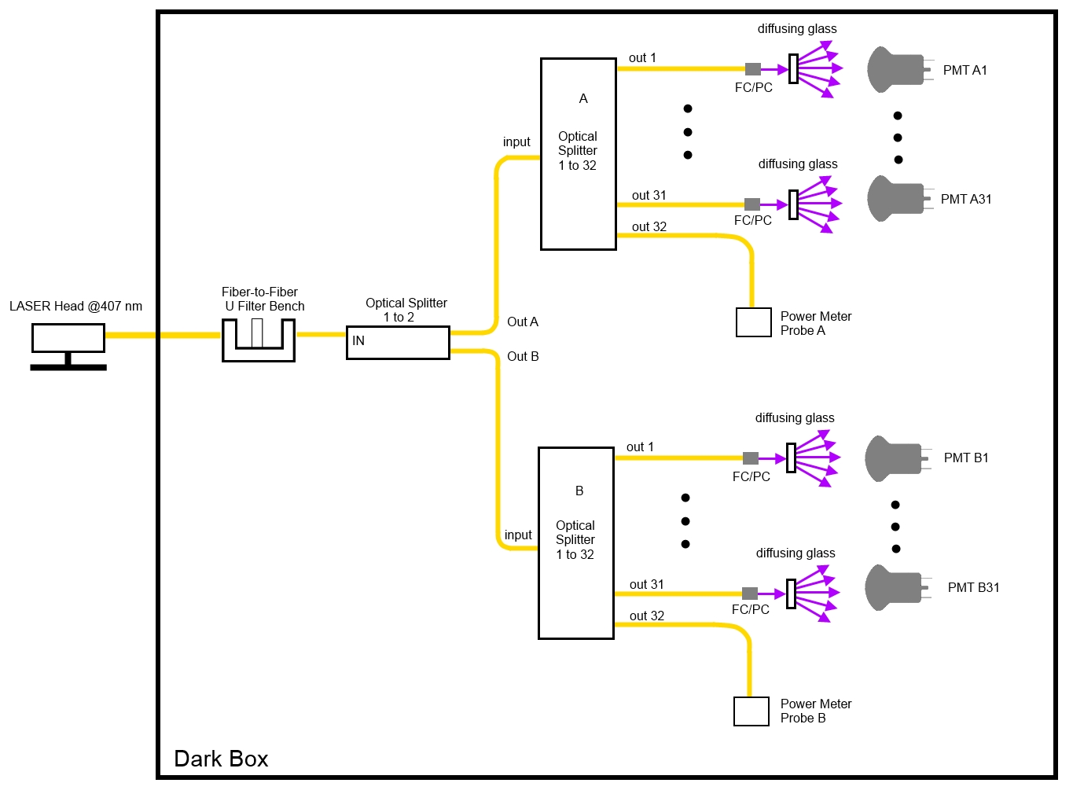
PMTs + bases TEST – Dark Box
  Dark Box design
Optical scheme
62 PMTs under test In parallel
Single LASER source
Dual channel Power Meter for LASER monitoring
2 high resolution, low power probes
1 splitter 1 to 2
2 splitters 1 to 32
62 opal diffusing glass disks
Carlos Maximiliano Mollo
INFN (Naples)
KM3NeT – IT Meeting – Catania 28 Novembre 2014

Slide 39
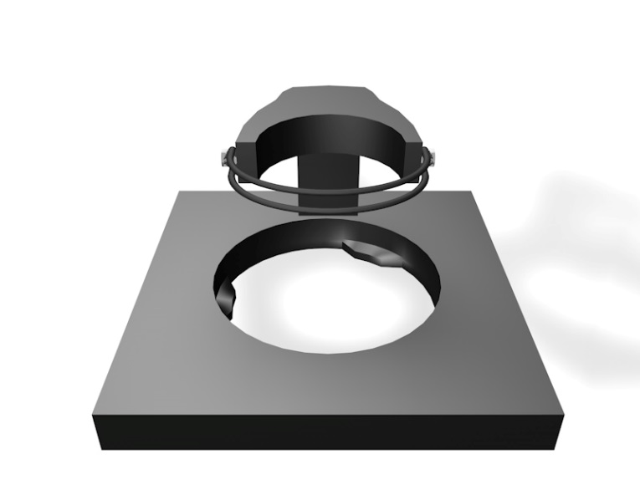
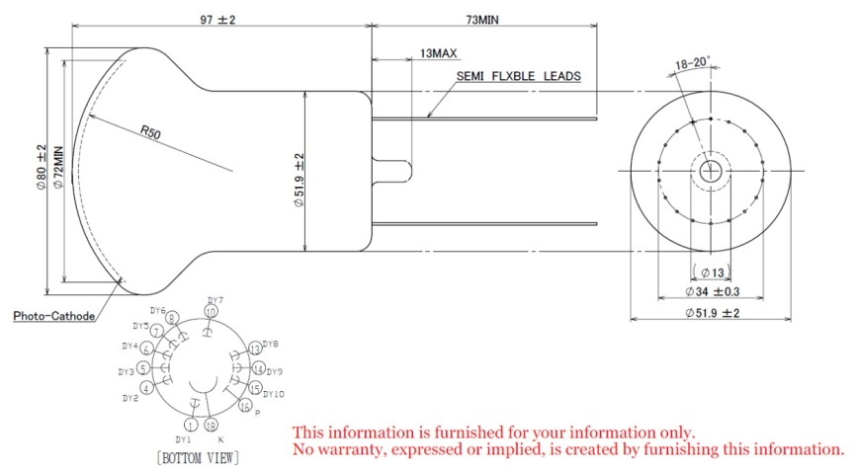
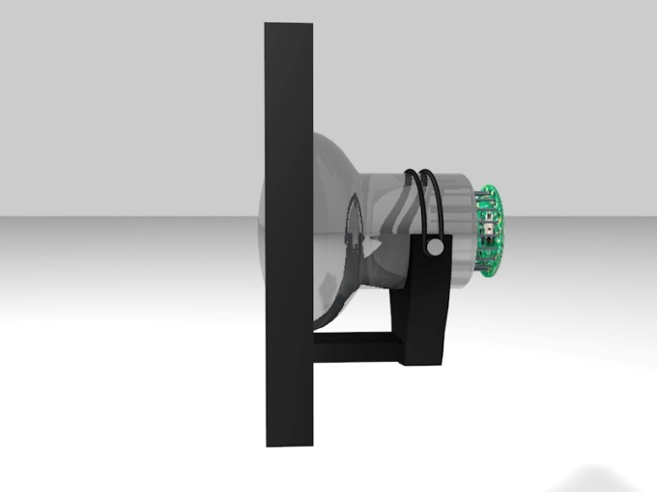


PMTs + bases TEST – Dark Box
  Dark Box concept design
PMT Hamamatsu
PMT holder unit
D: 54 mm
O-Ring
D: 83 mm
D: 73 mm
lateral
back
front
Carlos Maximiliano Mollo
INFN (Naples)
KM3NeT – IT Meeting – Catania 28 Novembre 2014

Slide 40


PMTs + bases TEST – Dark Box
  Dark Box concept design
Two trays of 31 PMTs each
66 cm
57 cm
top
bottom
Carlos Maximiliano Mollo
INFN (Naples)
KM3NeT – IT Meeting – Catania 28 Novembre 2014

Slide 41



PMTs + bases TEST – Dark Box
  Dark Box concept design
Two trays of 31 PMTs each
lateral
Carlos Maximiliano Mollo
INFN (Naples)
KM3NeT – IT Meeting – Catania 28 Novembre 2014

Slide 42

PMTs + bases TEST – Dark Box
  Dark Box concept design
The Dark Box
58 cm
88 cm
120 cm
Carlos Maximiliano Mollo
INFN (Naples)
KM3NeT – IT Meeting – Catania 28 Novembre 2014

Slide 43

PMTs + bases TEST – Dark Box
  Dark Box concept design
The Dark Box
62 dark cylinders:
each PMT is optical insulated
with the respect of the others
Carlos Maximiliano Mollo
INFN (Naples)
KM3NeT – IT Meeting – Catania 28 Novembre 2014

Slide 44


PMTs + bases TEST – Dark Box
  Dark Box concept design
The Dark Box
15 cm
Opal diffusing
disk
FC/PC Pannel
Connector
Optical fiber
Carlos Maximiliano Mollo
INFN (Naples)
KM3NeT – IT Meeting – Catania 28 Novembre 2014

Slide 45

PMTs + bases TEST – Dark Box
  Dark Box concept design
Trays positioning
Carlos Maximiliano Mollo
INFN (Naples)
KM3NeT – IT Meeting – Catania 28 Novembre 2014

Slide 46

PMTs + bases TEST – Dark Box
  Dark Box concept design
Trays positioning
Carlos Maximiliano Mollo
INFN (Naples)
KM3NeT – IT Meeting – Catania 28 Novembre 2014

Slide 47

PMTs + bases TEST – Dark Box
  Dark Box concept design
Trays positioning
Carlos Maximiliano Mollo
INFN (Naples)
KM3NeT – IT Meeting – Catania 28 Novembre 2014

Slide 48

PMTs + bases TEST – Dark Box
  Dark Box concept design
Trays positioning
Tray pin
Guide hole
Carlos Maximiliano Mollo
INFN (Naples)
KM3NeT – IT Meeting – Catania 28 Novembre 2014

Slide 49

PMTs + bases TEST – Dark Box
  Dark Box concept design
The Dark Box Electronics
2 DOM electronics:
4 Octopus boards
2 CLBs
2 Power Boards
1.5 meters extension
Cable Between
Octopus Boards
and PMT bases
(Marco Circella)
Carlos Maximiliano Mollo
INFN (Naples)
KM3NeT – IT Meeting – Catania 28 Novembre 2014

Slide 50



lavorazione del vassoio
Disegni tecnici esecutivi di Michele Costa
Lavorazione Meccanica: INFN Napoli – INFN Catania - LNS
Carlos Maximiliano Mollo
INFN (Naples)
KM3NeT – IT Meeting – Catania 28 Novembre 2014

Slide 51


Lavorazione della struttura interna
Carlos Maximiliano Mollo
INFN (Naples)
KM3NeT – IT Meeting – Catania 28 Novembre 2014

Slide 52



Dark box
Carlos Maximiliano Mollo
INFN (Naples)
KM3NeT – IT Meeting – Catania 28 Novembre 2014

Slide 53


Lavorazione della struttura interna
4 vassoi: durante il test è possibile inserire nei vassoi i PMT che verranno testati alla fine del
Test.
In questo modo prevediamo almeno 2 test al giorno per un totale di 124 PMT testati al giorno
60 giorni necessari per testare i 7500 PMT
Carlos Maximiliano Mollo
INFN (Naples)
KM3NeT – IT Meeting – Catania 28 Novembre 2014

Slide 54
Elettronica
white rabbit switch
CLBs, octopus boards (Long e short) e power board
Laser Controller
WR
PC
CLB0
CLB1
DB
DAQ e DB
V. Kulikovskiy
G. Riccobene
C. Bozza
OBL
OBS
OBL
OBS
LASER
Controller
Alle Base Boards
Carlos Maximiliano Mollo
INFN (Naples)
KM3NeT – IT Meeting – Catania 28 Novembre 2014

Slide 55




Elettronica
Sistema di raffreddamento per le CLB e Power Boards
DAQ Test
Presentazione di V. Kulikovskiy
Carlos Maximiliano Mollo
INFN (Naples)
KM3NeT – IT Meeting – Catania 28 Novembre 2014

Slide 56
Grazie!
Carlos Maximiliano Mollo
INFN (Naples)
KM3NeT – IT Meeting – Catania 28 Novembre 2014

