Slide 1



EIC
A Prototype Combination TPC Cherenkov Detector with GEM Readout for Tracking and Particle Identification and its Potential Use at an Electron Ion Collider
Craig Woody
Physics Dept.
Brookhaven National Lab
Upton, NY USA
2015 Micropattern Gas Detector Conference
Trieste, Italy
October 12, 2015

Slide 2
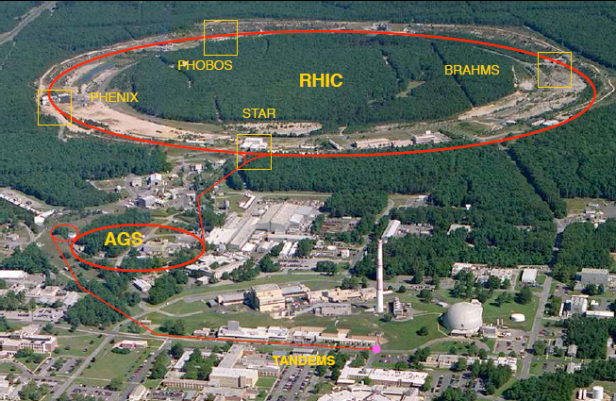
15 Years at RHIC
Two independent rings: AA (√s=7.7-200 GeV/A), p(d)A and polarized protons (√s=500)
First collisions in June 2000
Four initial experiments
Experiments originally designed to discover the Quark Gluon Plasma and study its properties
We have now spent more than 15 years measuring and studying the properties of the QGP
and we would now like to go beyond what was envisioned in these original experiments

Slide 3
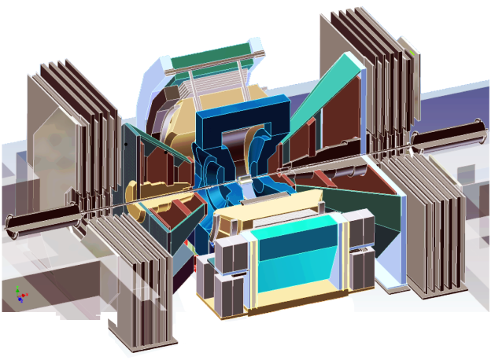
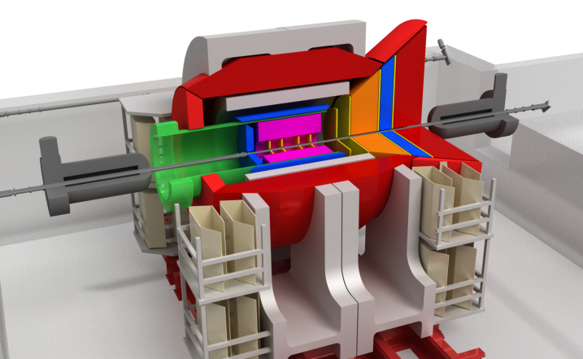
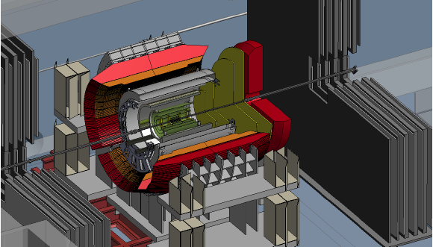
Upgrade Plans for the PHENIX Experiment
Documents: http://www.phenix.bnl.gov/plans.html
Current PHENIX
sPHENIX (+fsPHENIX)
An EIC detector
15 years of operation
Produced broad spectrum of studies of QGP and Hadron Physics
140+ published papers to date
Last run in 2016
Comprehensive upgrade based on the BaBar magnet
Goal is to do a systematic study the QGP near T_{c} by measuring jets and heavy quarkonia
Possible addition of a forward spectrometer (fsPHENIX) to continue study of Spin and CNM
Further upgrades of sPHENIX leads to a capable Day 1 detector for eRHIC
Study polarized ep and eA physics
Large coverage of tracking, calorimetry and PID
~2000
2017→2020
~2025
Time
RHIC: A+A, spin-polarized p+p, spin-polarized p+A
EIC: e+p, e+A

Slide 4
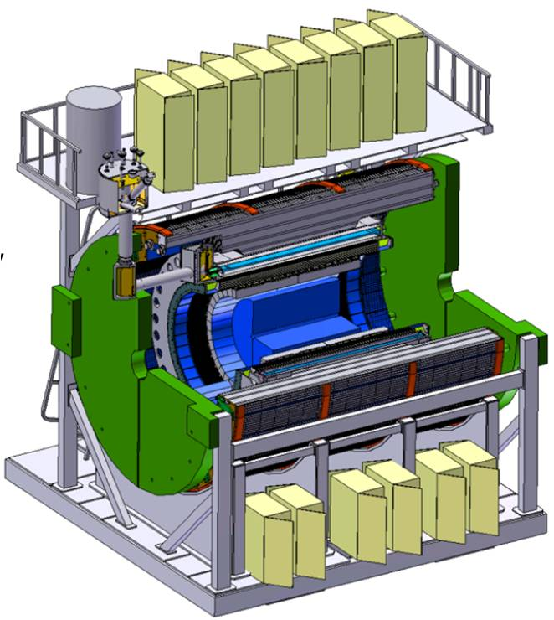
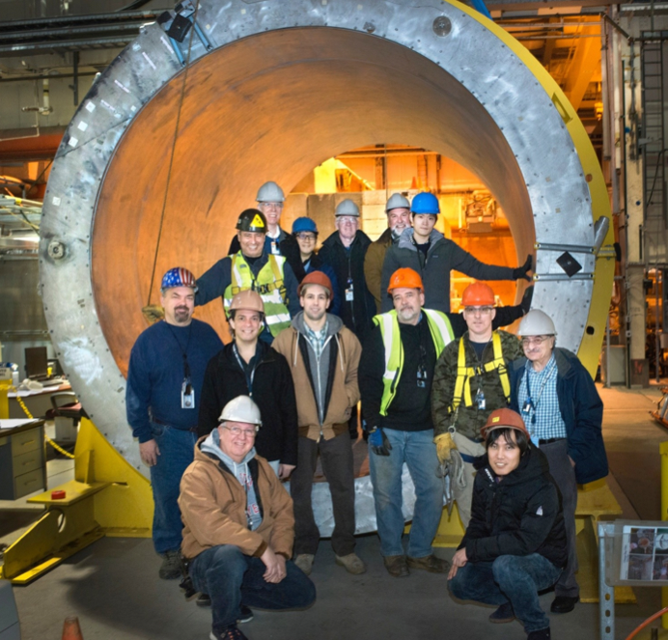
The Experiment
The BaBar magnet at BNL
Solenoid spectrometer based around the BaBar magnet

Slide 5
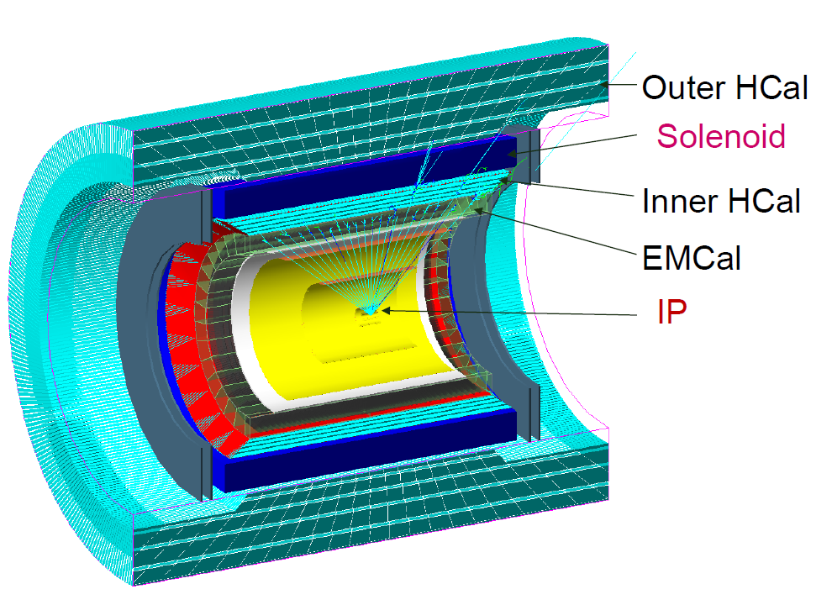
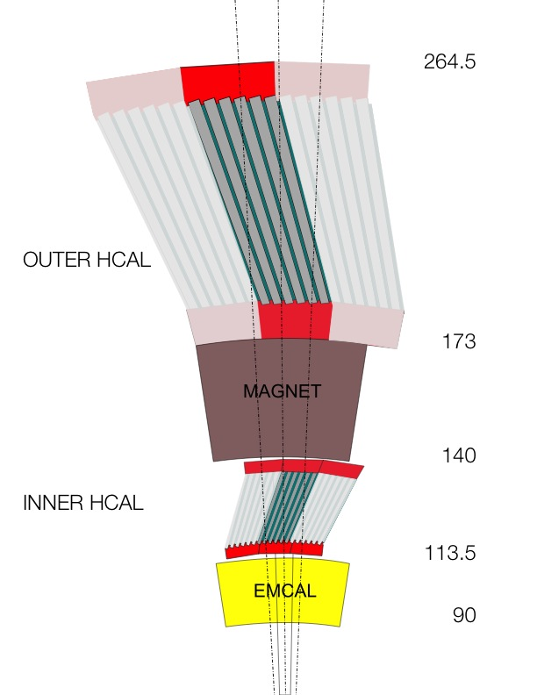
(BaBar)
TPC or Si
Si Vertex
Two new calorimeter systems: Electromagnetic and Hadronic
Coverage: ± 1.1 in η, 2π in φ
Central Tracker: Si + TPC

Slide 6
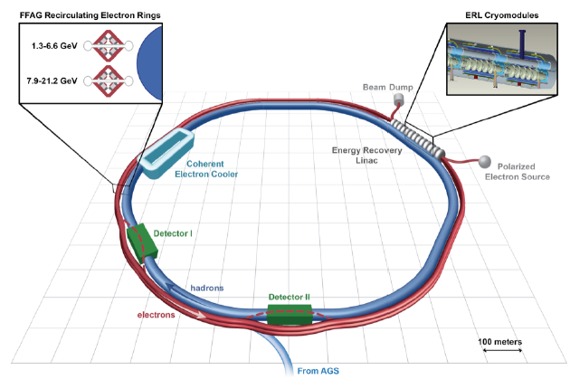
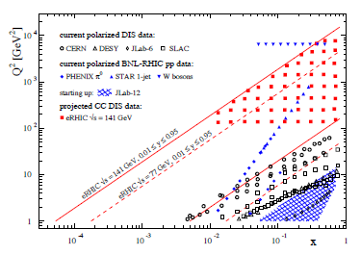
eRHIC: An Electron Ion Collider at Brookhaven
Electron beam is accelerated with a 1.3 GeV Energy Recovery Linac (ERL) and circulated in two
transport rings inside the RHIC tunnel and then collide with the hadron beam
Energy: Electrons: 6.6–21.2 GeV
  Protons: 25–250 GeV
  Ions: 10–100 GeV/A
  √s: up to 145 GeV
eRHIC will enable the study of nucleon structure and QCD in nuclei over a broad range of x and Q² using deep inelastic polarized ep and eA collisions
Polarization: Electrons: 80%
  Protons and ³He: 70%
Luminosity: >10³³ cm⁻² s⁻¹

Slide 7

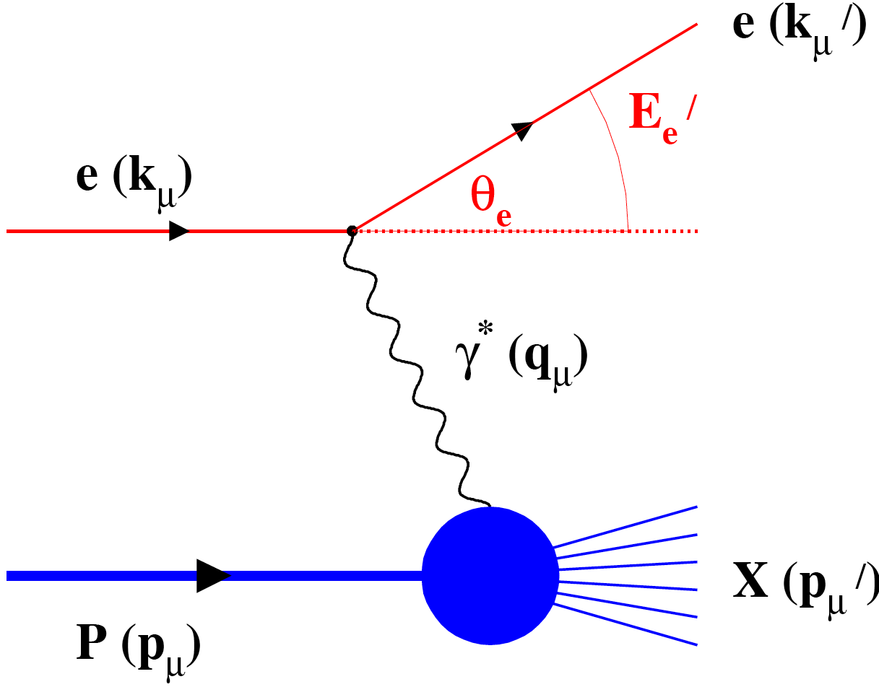
DIS at EIC
Scattered electron determines kinematics of the event (x,Q²)
Must measure energy/momentum and angle of the scattered electron
Scattered electron kinematics
Electrons and hadrons are scattered over a large range in η
⇒ Need good electron id over a large η range
Produced hadron kinematics

Slide 8
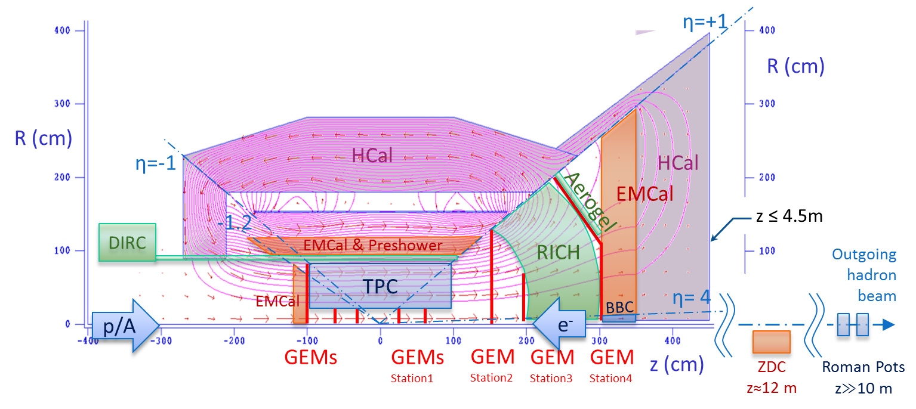
sPHENIX → eRHIC Detector
-1<η<+1 (barrel) : sPHENIX + Compact-TPC + DIRC
-4<η<-1 (e-going) :
High resolution EM calorimeter + GEM trackers
+1<η<+4 (h-going) :
  1<η<4 : GEM tracker + Gas RICH
  1<η<2 : Aerogel RICH
  1<η<5 : EM Calorimeter + Hadron Calorimeter
Along outgoing hadron beam: ZDC and roman pots
LOI: arXiv:1402.1209

Slide 9
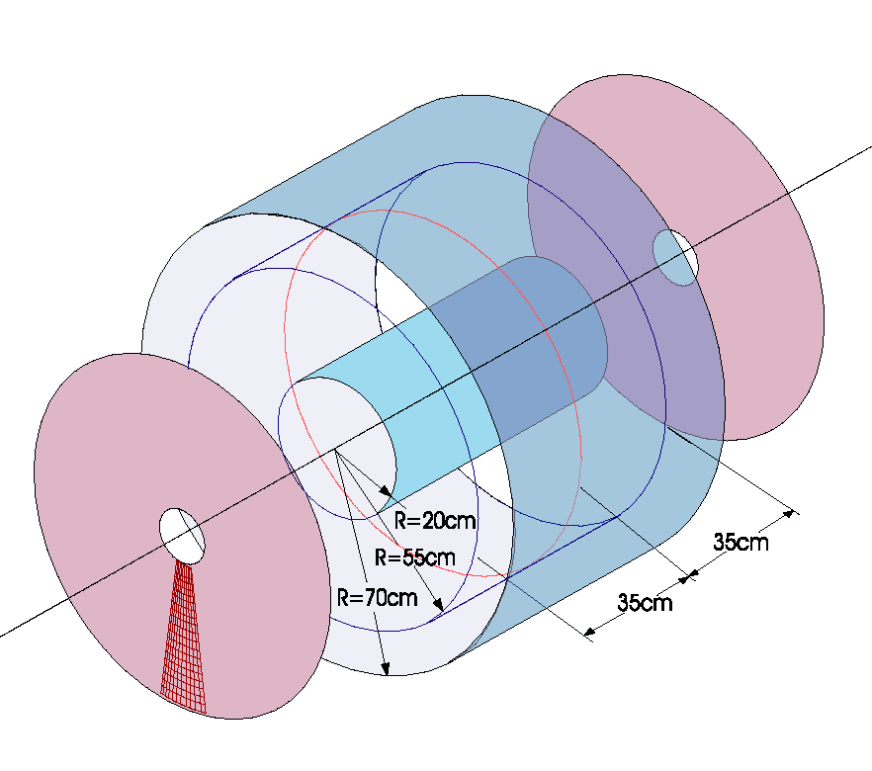
Particle ID Using the Central TPC
GEMs with CsI Readout Plane
TPC provides momentum measurement and particle id through dE/dx. Use ionization in gas volume to measure track trajectory.
Use Cherenkov light produced in the same gas volume to identify electrons
⇒ HBD concept
Acts as a threshold counter
(no other particle id)
TPC with GEM Readout
Drift regions
Detector proposed for PHENIX ~ 2004
Readout Pads
Gas must be transparent to UV light → CF₄ (like HBD)
Want fast drift velocity (→ CF₄ or mixtures containing CF₄)
Photosensitive GEM must operate near the HV plane of the field cage. Field cage must be optically transparent on its outer radius and take up minimal radial space.

Slide 10
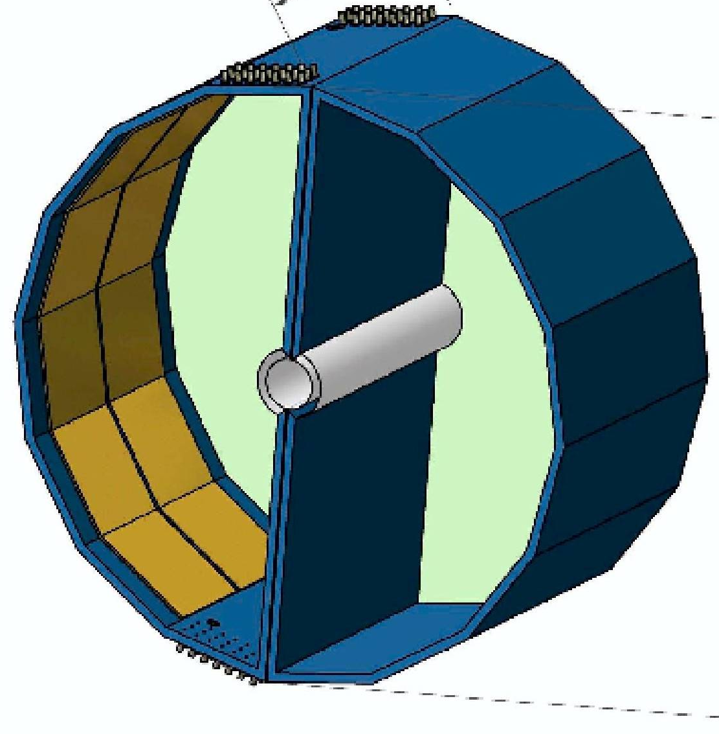
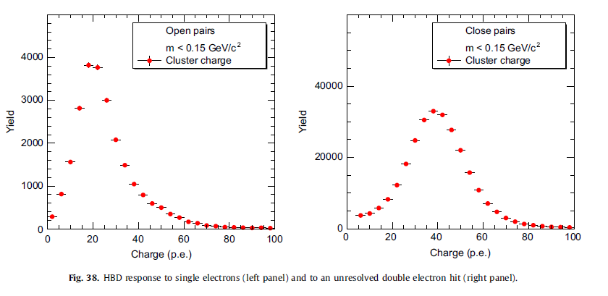
The PHENIX HBD
Proximity Focused Windowless Cherenkov Detector
Radiator gas = Working gas
Gas volume filled with pure CF₄ radiator
HV
g
Primary ionization
Mesh
e⁻
CsI layer
Triple
GEM
Cherenkov
blobs
e⁻
Readout Pads
e⁺
θ_{pair}
opening angle
~ 1 m
Discriminated between single and double electrons using pulse height from Cherenkov light
W.Anderson et.al., NIM A646 (2011) 35-58
N₀ = 322 cm⁻¹

Slide 11
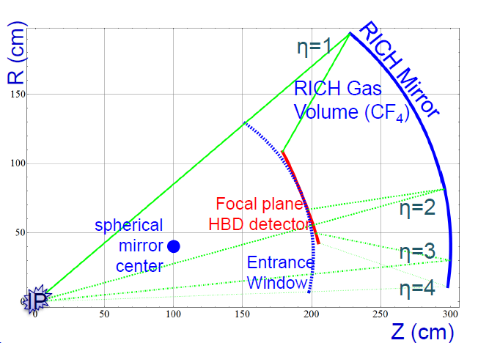
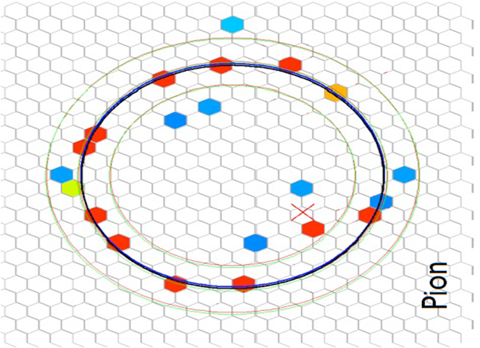
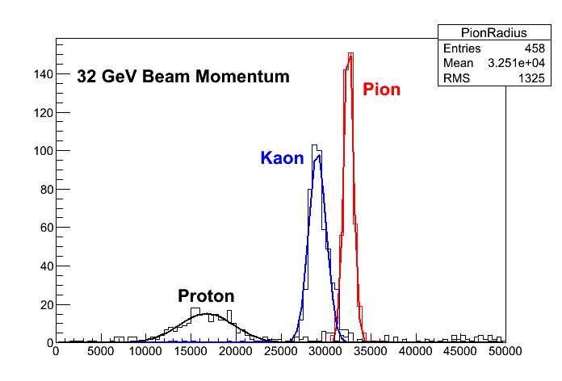
Focusing RICH for EIC
Beam test data
StonyBrook group
Courtesy : EIC RD6 TRACKING & PID CONSORTIUM
Fermilab T-1037 data
M.Blatnik et.al., “Performance of a Quintuple GEM Based RICH Detector Prototype”, arXiv:1501.03530 (submitted to IEEE Trans. Nucl. Sci
Ring size (A.U.)

Slide 12
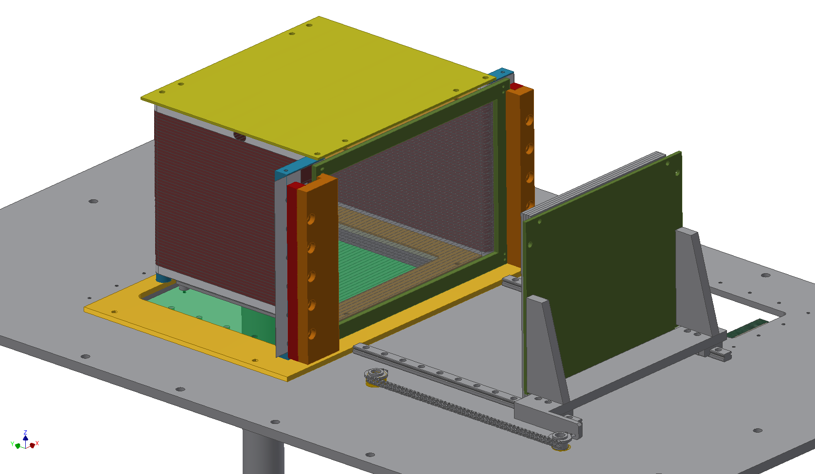
3D Detector Model
Top HV Plate
Field Cage
Wire Plane
3 Sided
Field Cage Foil
Movable CsI GEM
Č
Drift
TPC GEM

Slide 13
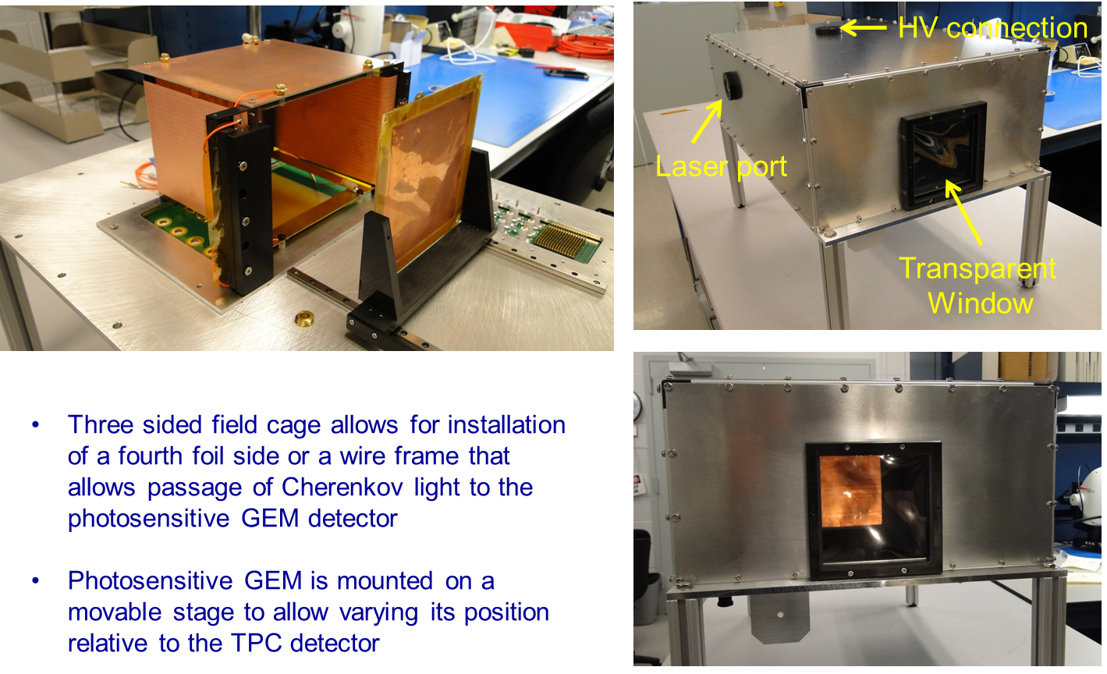
The Actual Prototype

Slide 14
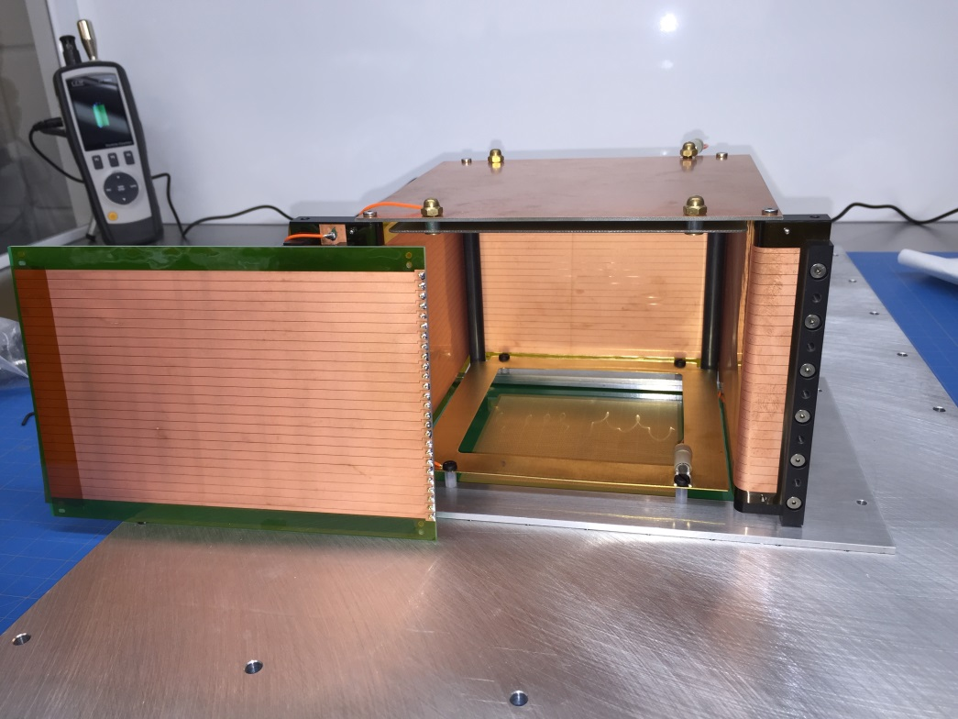
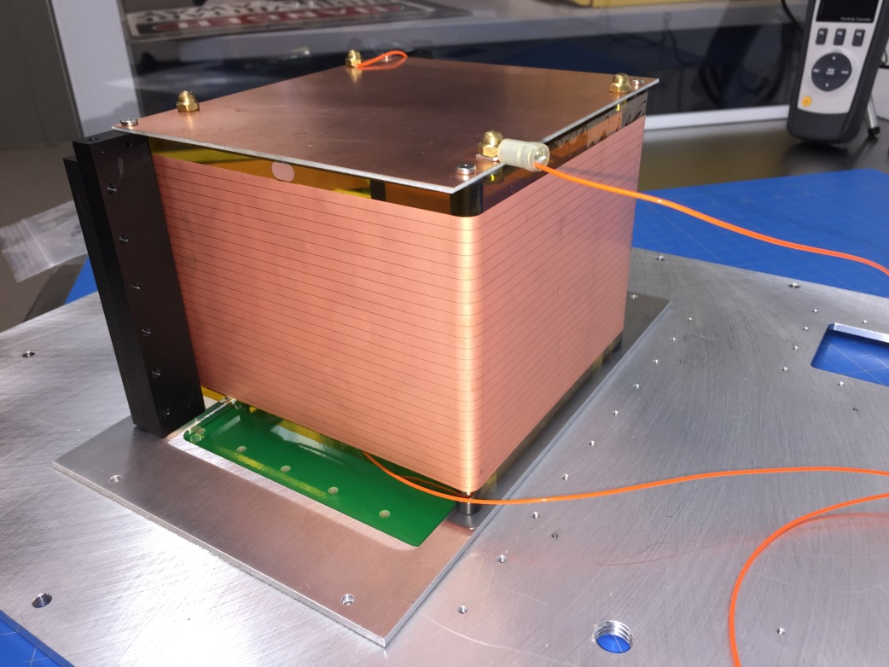
3 Sided Field Cage + 1 Sided Foil
Kapton foil with 3.9 mm copper strips with 0.1 mm gaps
Tested to full operating voltage of 1 kV/cm

Slide 15
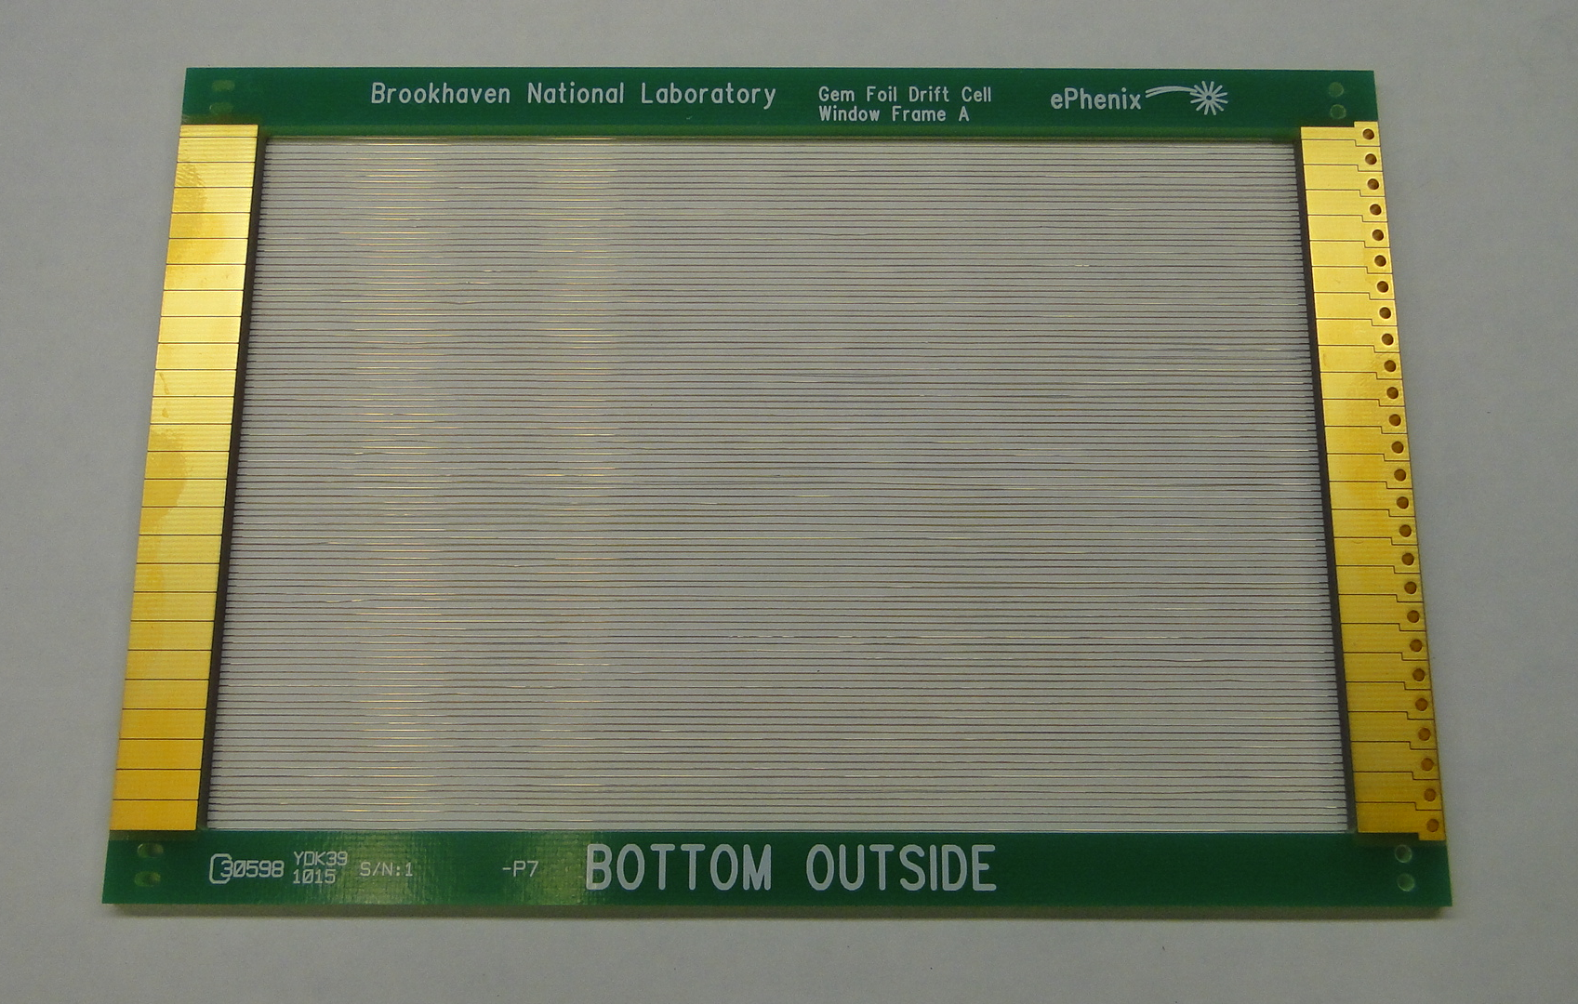
Field Cage Wire Plane
1 mm wire spacing forming 4 mm wide strips

Slide 16
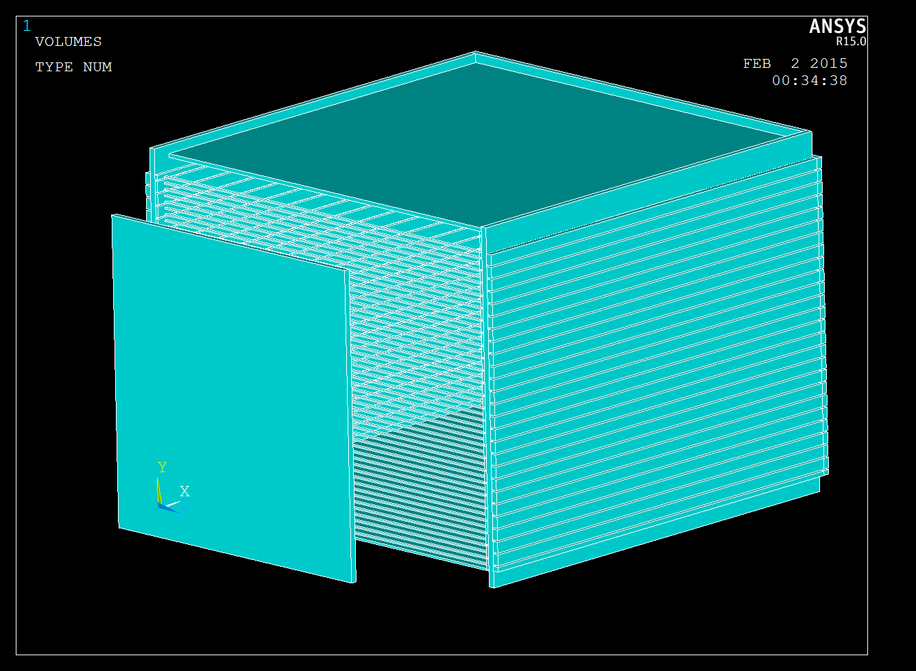
Electrostatic Simulation
ANSYS
Top Plate
Y
Mirrored Strip Plane
X
Z
Cherenkov Mesh
Wire Plane

Slide 17
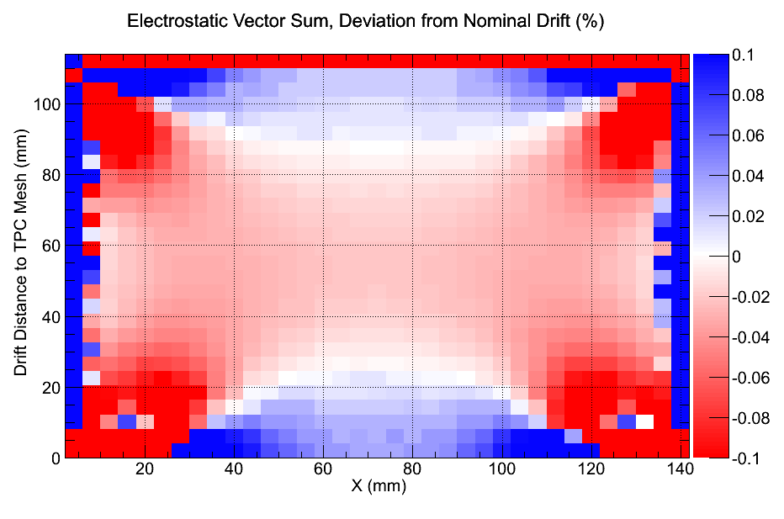
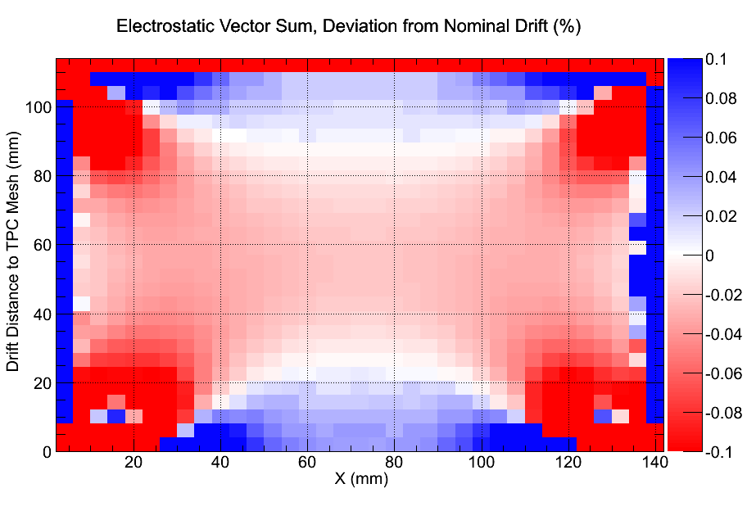
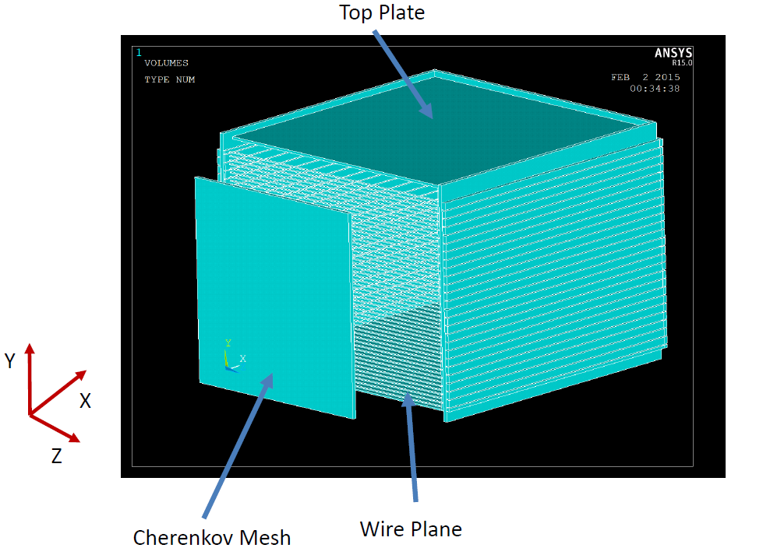
Field Distortions with One Plane of Wires for Field Cage
4 sides of strips
3 sides of strips + 1 side of wires
Drift
Beam
Slice in XY plane at mid Z
Wire plane is at X=0

Slide 18
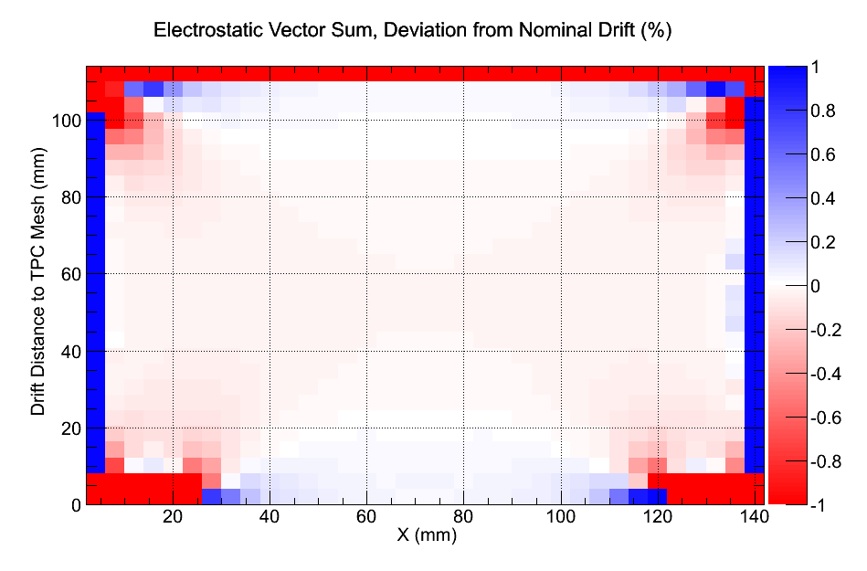
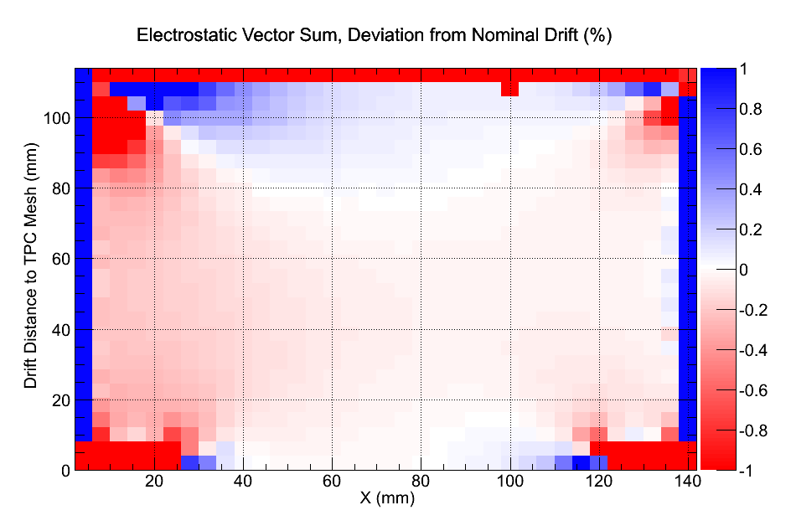
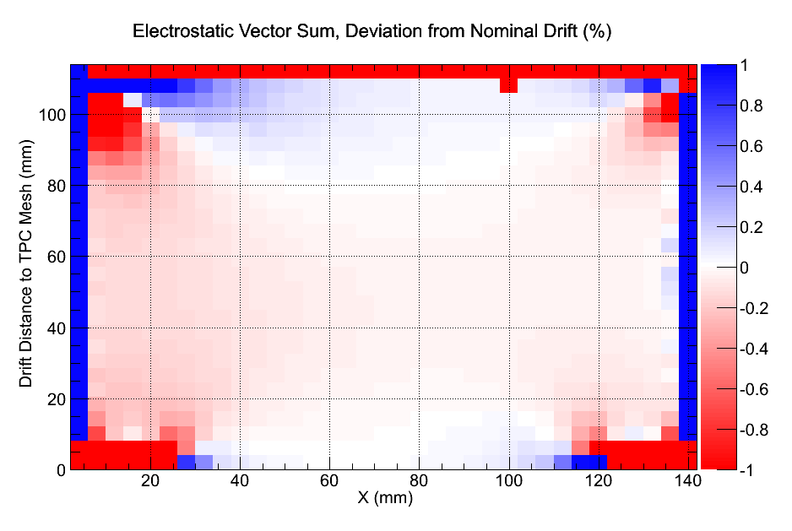
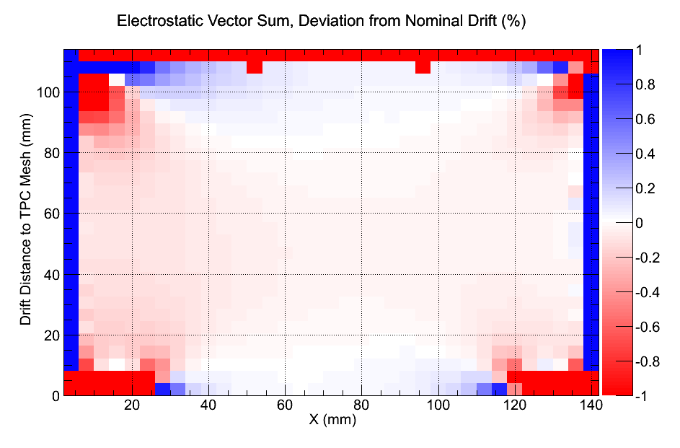
Field Distortions with Addition of Cherenkov Mesh
No Cherenkov mesh
Cherenkov mesh at -15 mm
Cherenkov mesh at -25 mm
Cherenkov mesh at -40 mm

Slide 19
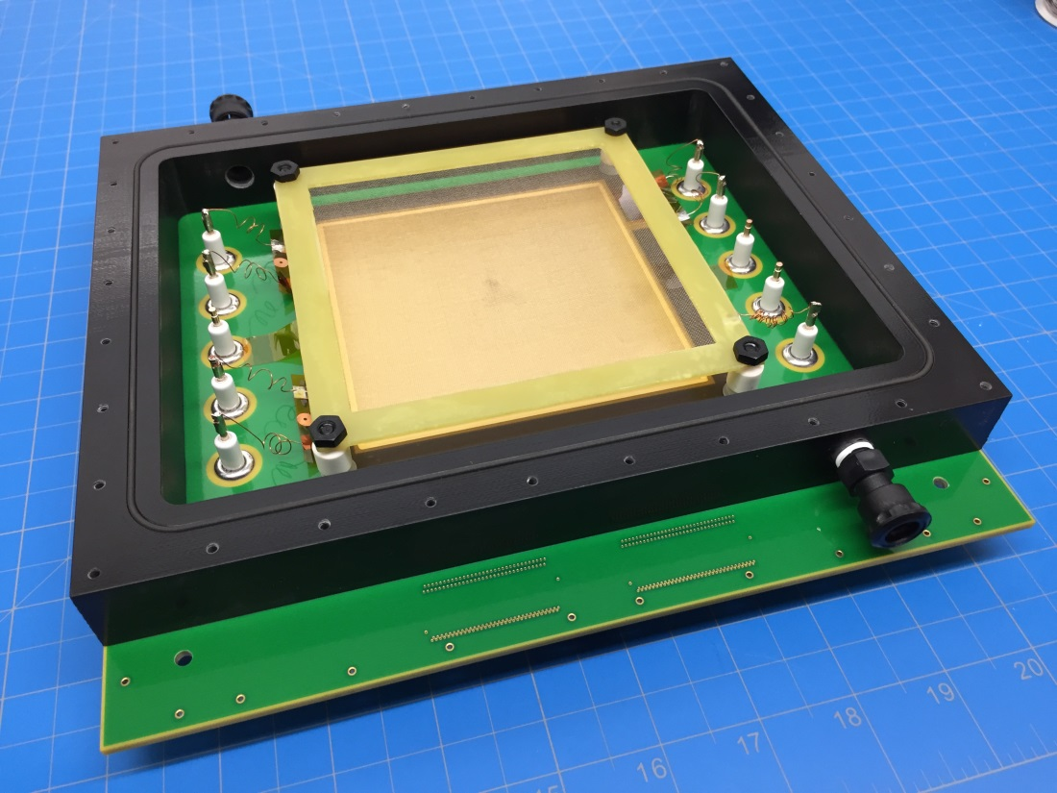
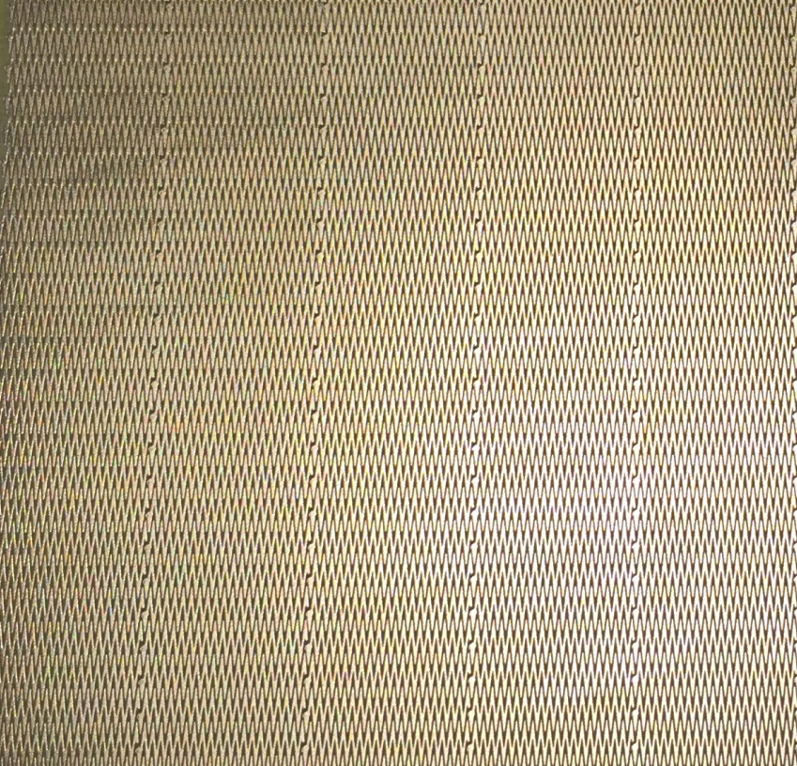
TPC GEM Detector with Chevron readout board
10x10 cm² Triple GEM
2 x10 mm Chevron Pads
0.5 mmm pitch

Slide 20
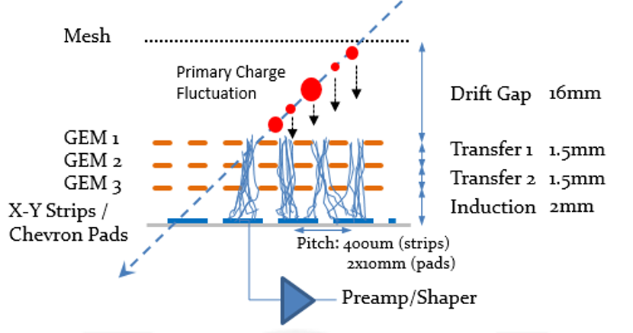
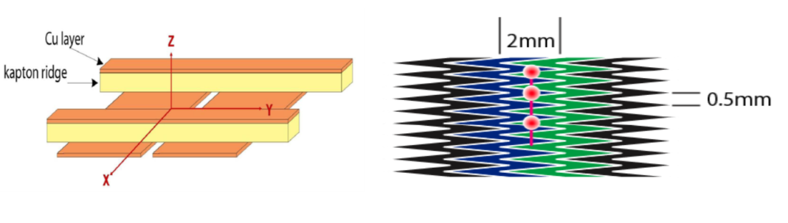
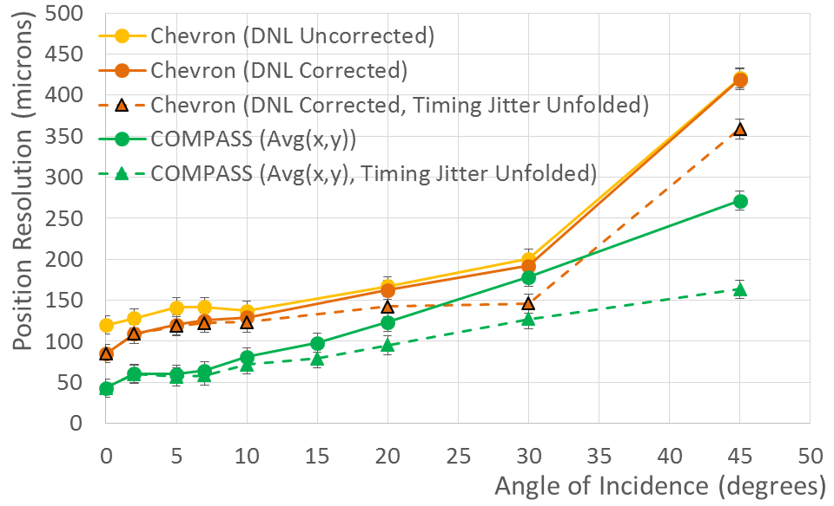
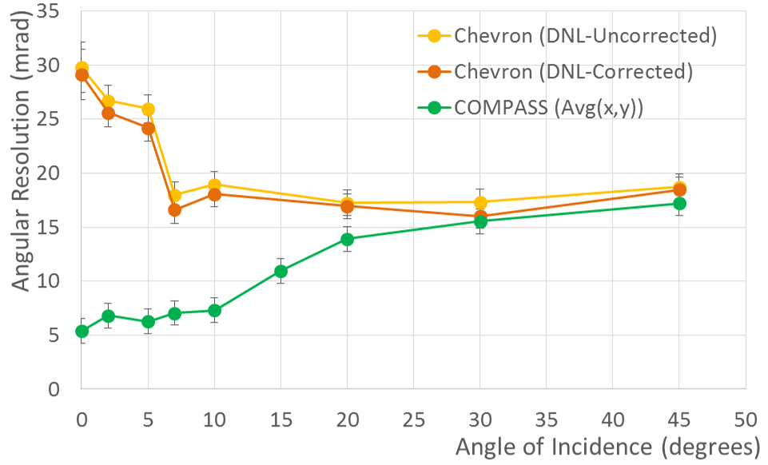
Minidrift GEM Detector
See Poster # 11
arXiv:1510.01747
Short drift Mini TPC
Studied with COMPASS style readout plane and chevron pads
Improves position resolution at large angles
Provides moderate angular resolution

Slide 21
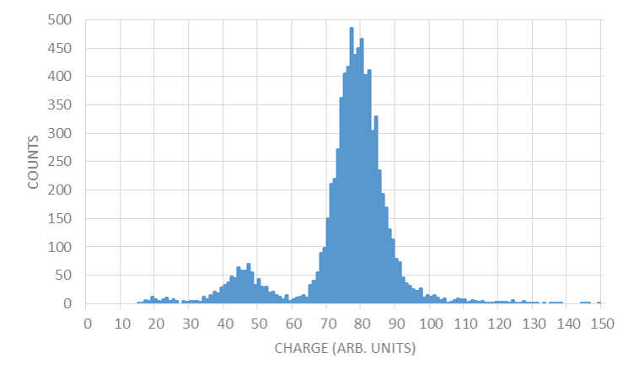
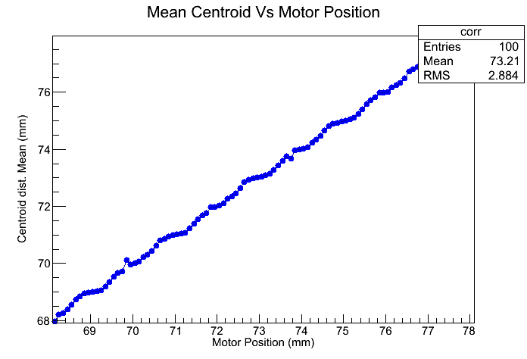
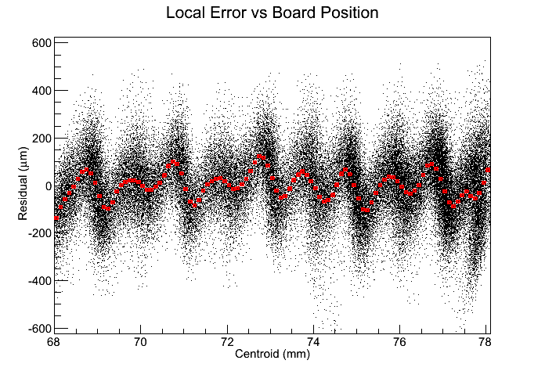
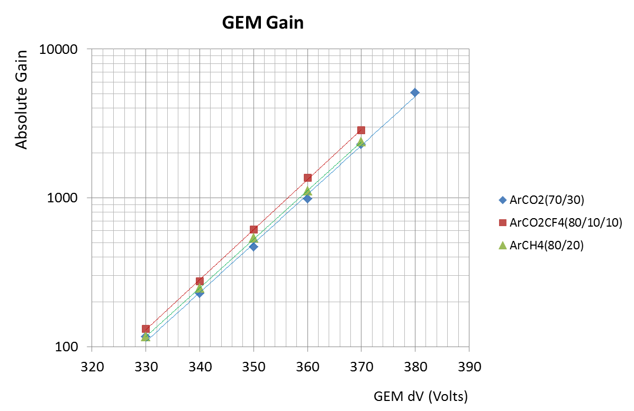
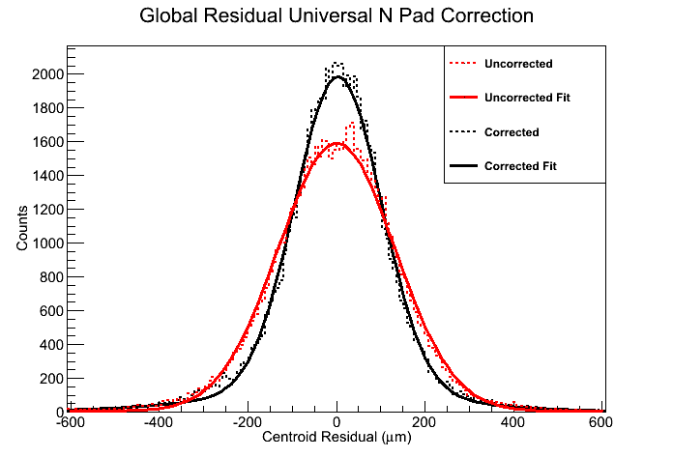
First Tests of the GEM TPC
Scan across chevron pads with collimated X-ray source
Fe-55
Differential Non-Linearity
GEM Gain
Position Resolution of Chevron Pads
Uncorrected: 132 μm
Corrected: 98 μm
Note: SRS electronics limits measurable drift distance due to limited range of time sampling

Slide 22
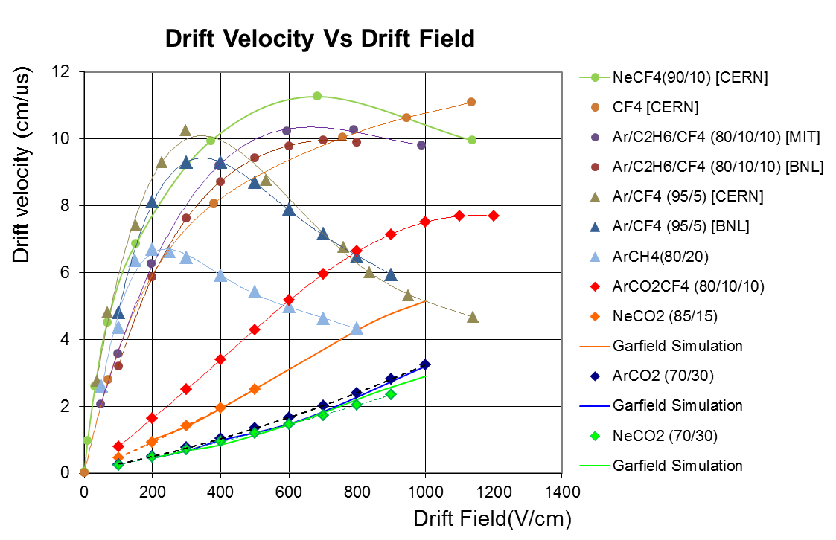
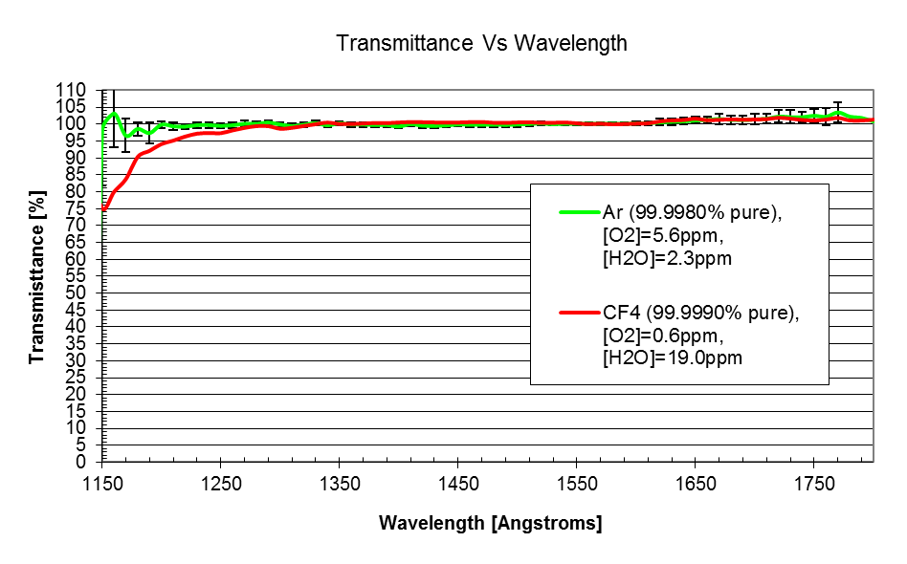
Possible Operating Gases
Desired properties
Good optical transparency into deep UV
Fast drift velocity
Stable GEM operation
Possible choices: CF₄, Ar/CF₄ mixtures

Slide 23
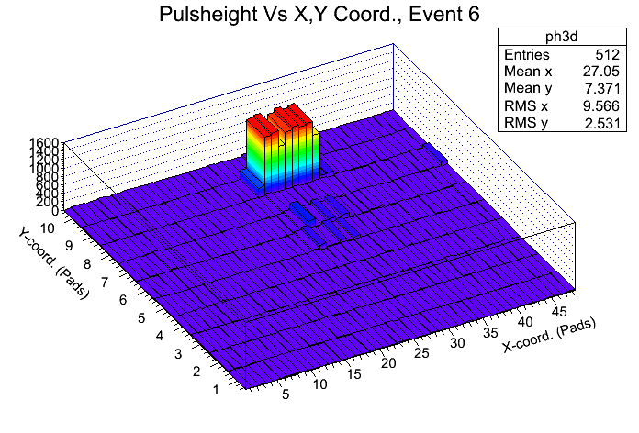
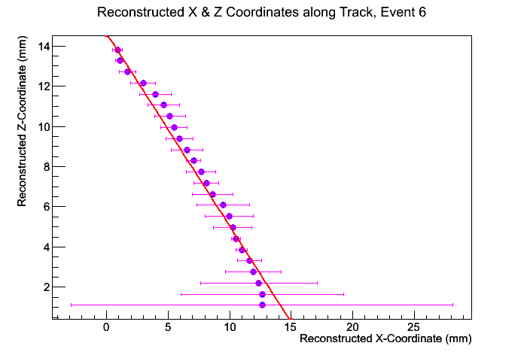
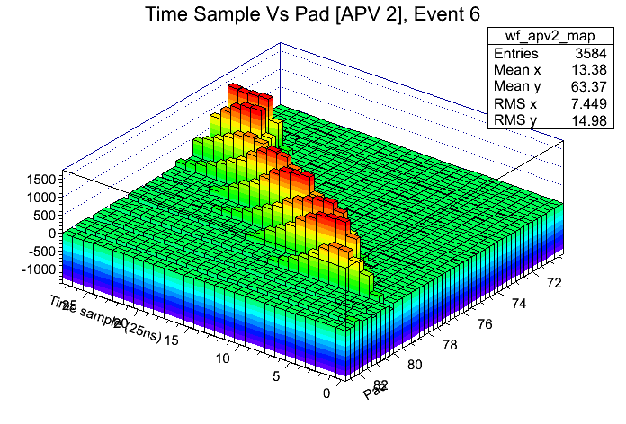
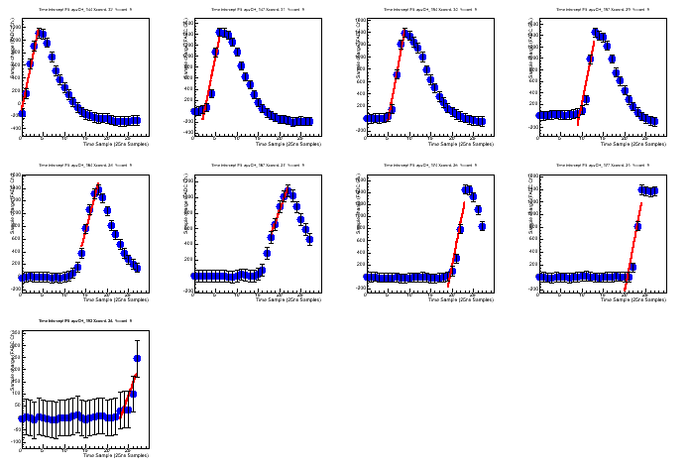
Cosmic Ray Tracks in the TPC
Ar/CO₂ (70/30), 0.8 kV/cm, Drift Velocity: 2.2 cm/μsec, Drift Distance ~ 14 mm

Slide 24
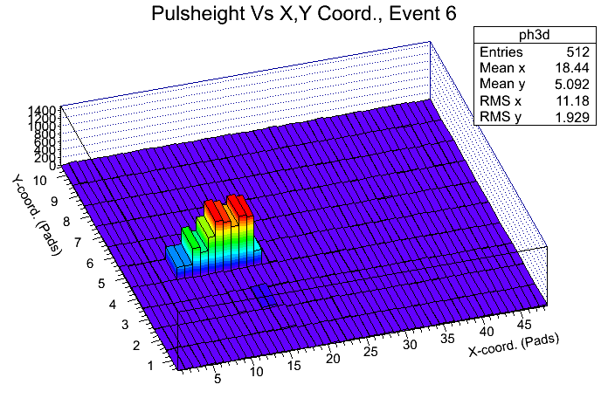
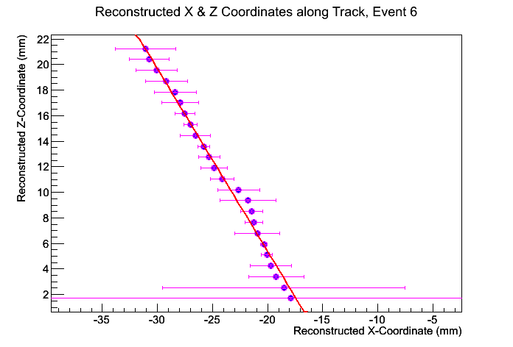


Cosmic Ray Tracks in the TPC
Ar/CO₂/CF₄ (80/10/10), 0.4 kV/cm, Drift Velocity: 3.4 cm/μsec, Drift Distance ~ 22 mm

Slide 25
Summary & Conclusions
We are developing a novel new detector that combines the features of a TPC and a proximity focused Cherenkov detector that can provide both tracking information as well as particle id.
Assembly of the prototype TPC/Cherenkov is nearly complete
Preliminary testing of the field cage and TPC GEMs look good. Cosmic ray tracks have been reconstructed in several different gases
Next step will be to test the Cherenkov section. HV simulations indicate there should be minimal field distortions.
How close can we bring the Č-GEM in proximity to the wire plane ?
Add CsI GEM and study the Cherenkov detector
Test entire detector in a test beam at Fermilab or SLAC
A detector such as this would add considerable capability for a central tracking detector at a future Electron Ion Collider.

Slide 26
Backup Slides

Slide 27





Physics of sPHENIX
Jet evolution dominated by in-medium effects at RHIC for T ~ T_{c}

Slide 28

A New Dedicated Detector at eRHIC
BEAST

Slide 29

MEIC Detector for JLAB

Slide 30


LEGS TPC (circa ~ 2005)
Designed for low rate (~kHz), low multiplicity (single sample per channel per trigger)
Inner diameter ~9cm; Outer diameter ~35cm; Drift Length: 50cm
Chevron pad readout
(~ 200 µm resolution)
~ 7K Readout channels
Custom ASIC
32 channels per chip
40mW per chip
ENC < 250 e’s
500ns peaking time
Single peak time and amplitude measurement
Timing resolution ~ 20ns
Double GEM (G <1000)
Drift field ~ 600V/cm (30kV HV)
Drift time ~ 5µs

Slide 31
Electronics
Current readout options
SRS : 1024 chs, 25 ns sampling
28 samples → 700 ns drift time
DRS4 : 128 chs, 1048 samples with selectable time resolution
0.2 ns → 200 ns drift time
1 ns → 1 μsec drift time
Struck SIS3300 : 24 chs, 10 ns sampling, 10 μsec drift time
VMM2 (derived from LEGS TPC chip)
Single peak amplitude recorded, 1 μsec time buffer
GET: General Electronics for TPCs
General purpose TPC readout system developed at Saclay
Used in many small to medium sized TPC systems in nuclear physics
SAMPA
Being developed for ALICE GEM TPC
Time scale: needs to be ready by 2018
→ This is probably our best ultimate solution

