Slide 1
The Micromegas Vertex Tracker for the CLAS12 Experiment
MPGD Meeting – TRIESTRE
OCT 2015
Maxence Vandenbroucke – CEA saclay – IRFU
(on behalf of david attié)
david.attie@cea.fr
maxence.vandenbroucke@cea.fr

Slide 2
Overview
The CLAS12 Micromegas Vertex Tracker
Forward detectors
Barrel detectors
Production status
Spatial Resolution and Clustering Algorithms

Slide 3
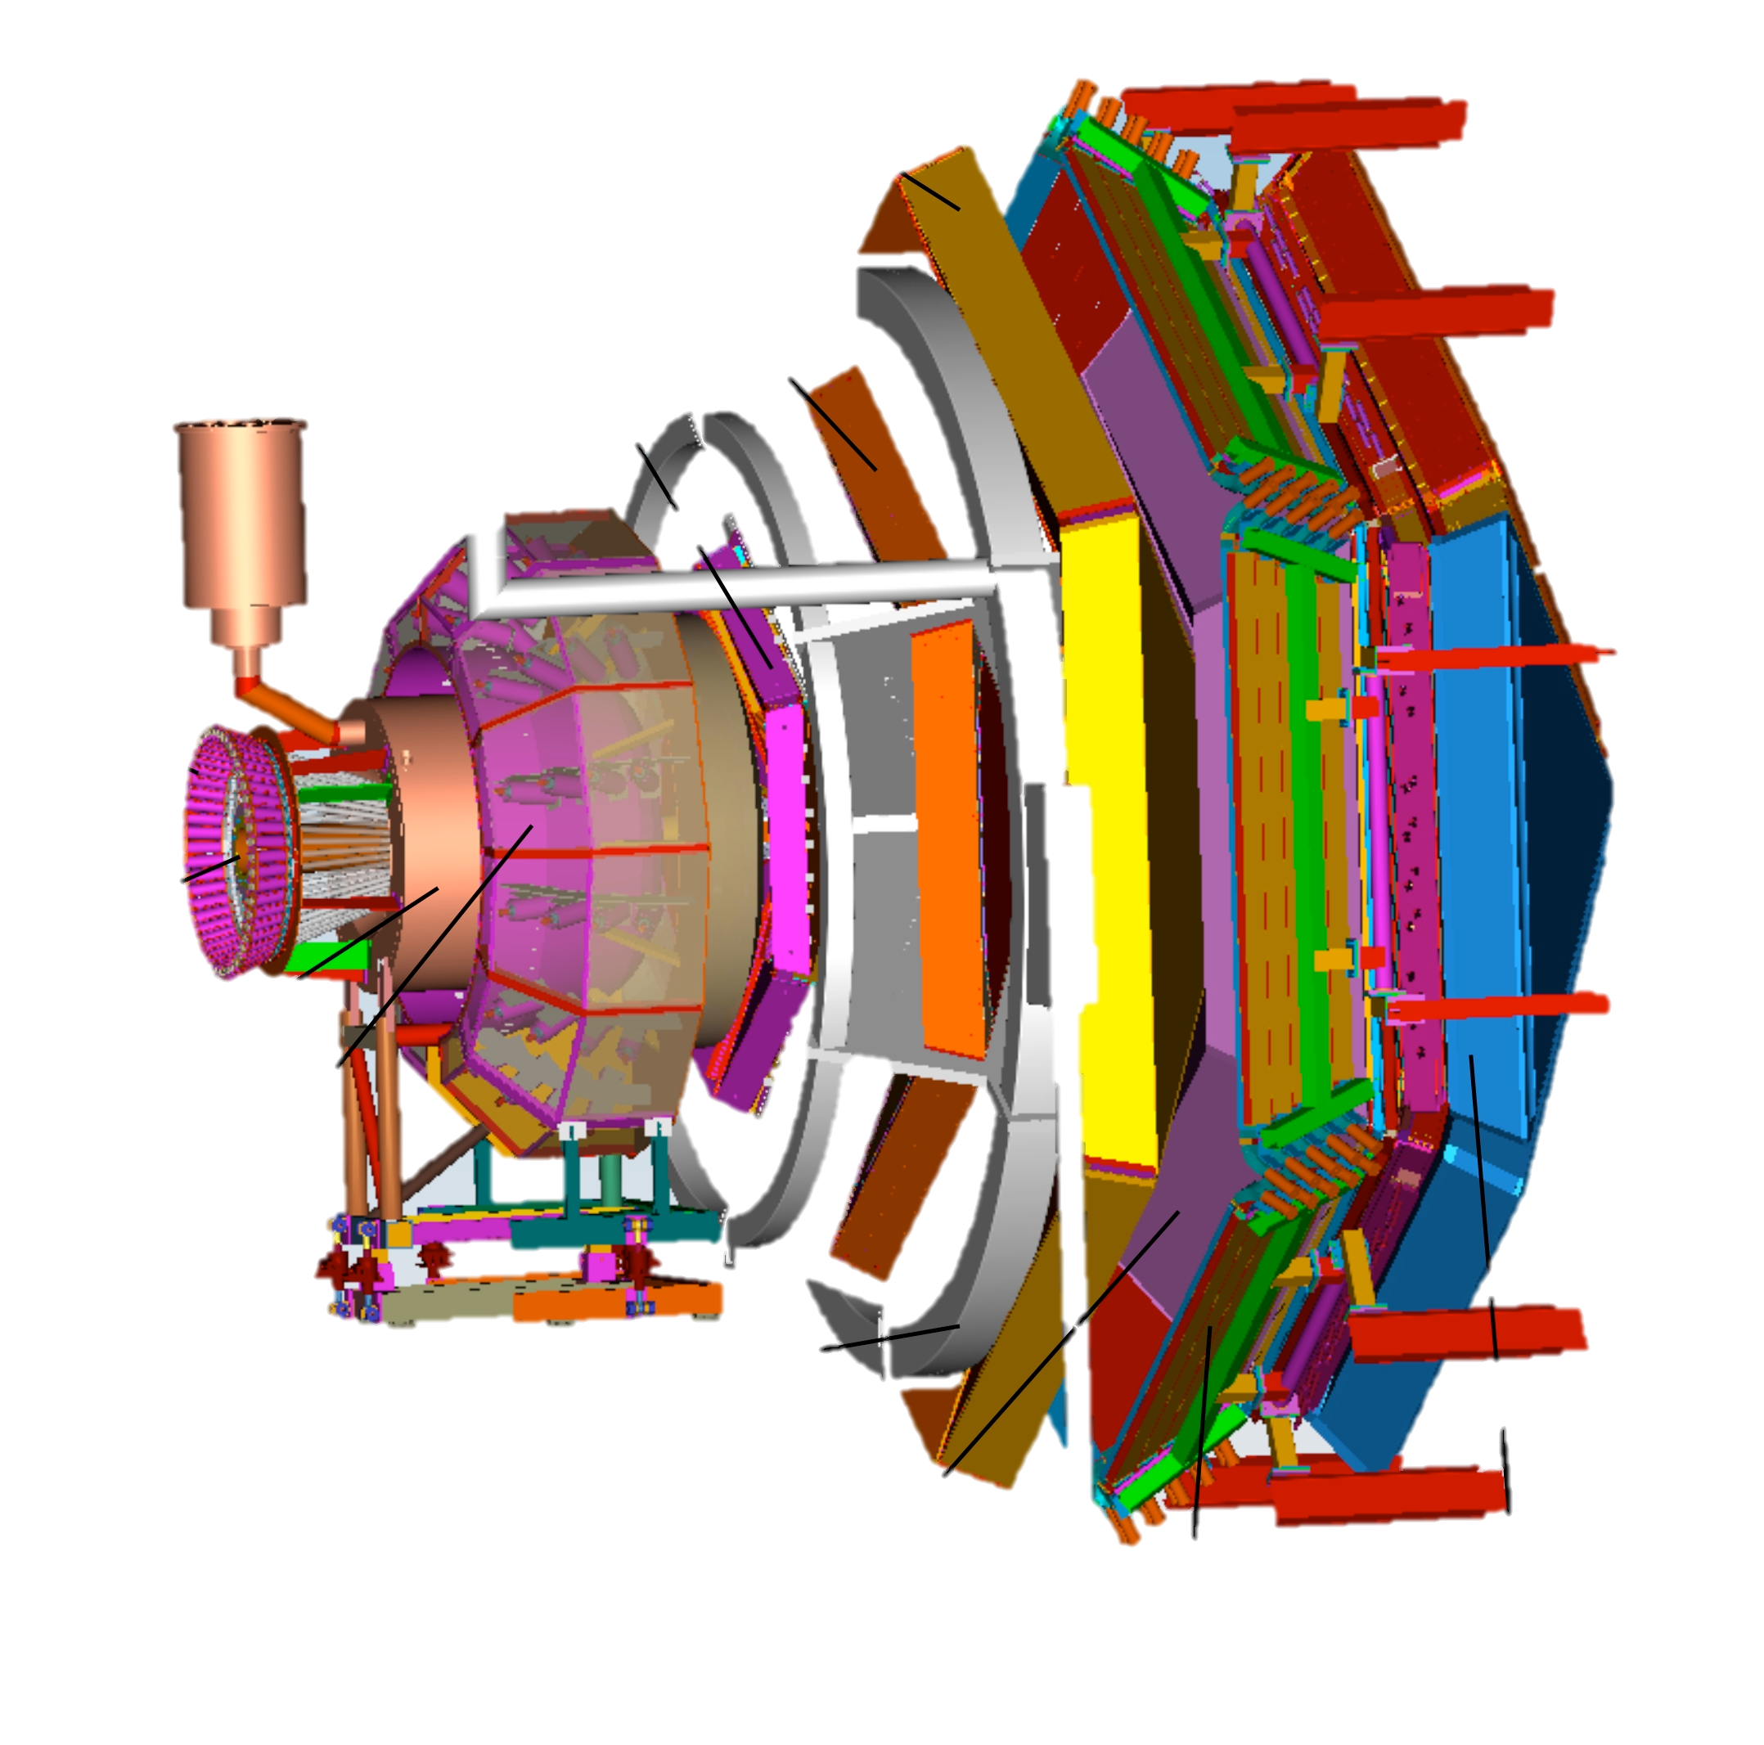
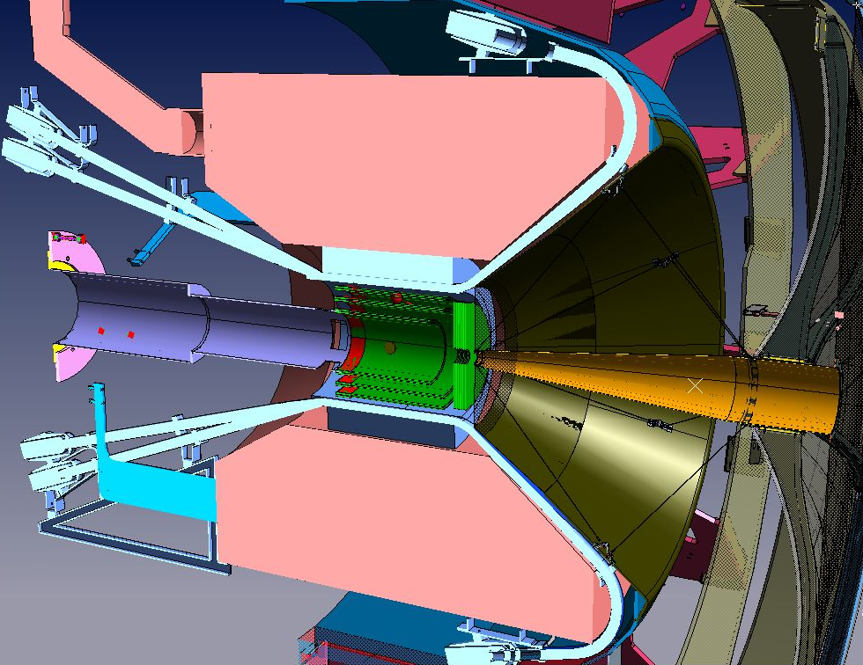
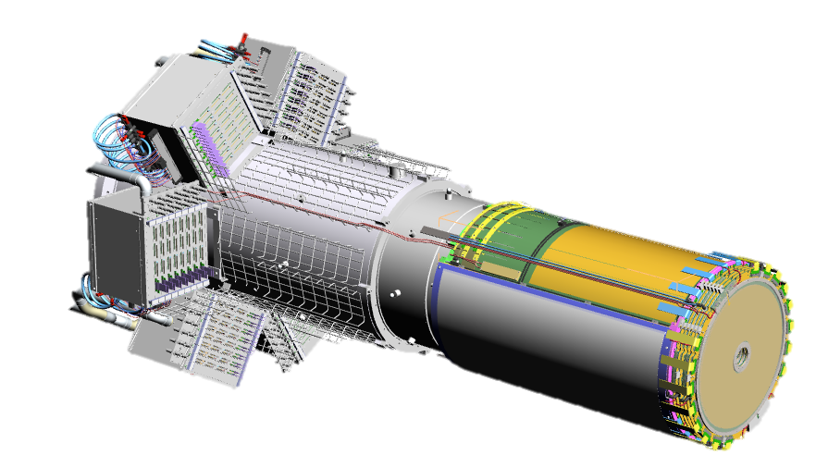
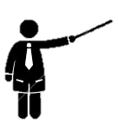
The CLAS12 Experiment
Upgrade of the CLAS Experiment at Jefferson lab
Study of the nucleon structure with high 11 GeV electron beam at high luminosity (10³⁵ cm⁻².sec⁻¹)
Micromegas Vertex Tracker :
Improve the track reconstruction in the vicinity of the target
Reduced volume bet. the magnet and the Silicon Vertex Tracker (SVT)
Large curved Micromegas
5T field
Remote electronics
Resistive technology
Small dead space
High particle rate (30 MHz)
e⁻

Slide 4
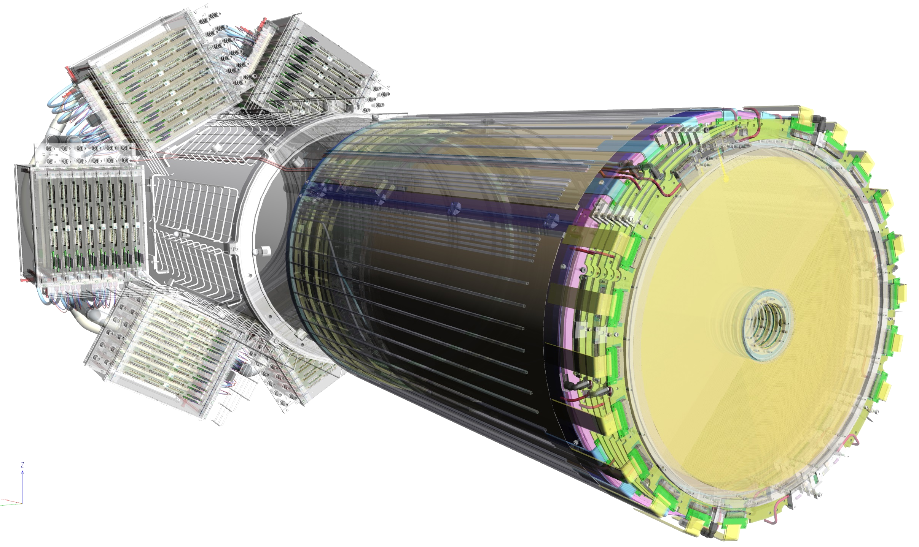
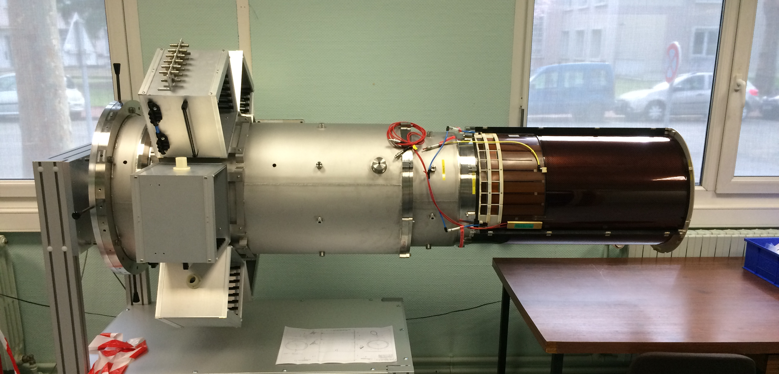
The Micromegas Vertex Tracker
4 m² of Micromegas detectors to be installed in 2015/2016
DREAM Front-End Electronics
Remote electronics connected with 2m micro-coaxial cables
Forward Detectors
  High particle rate => Fast detectors
  Resistive strips divided in 2 zones inner/outer
  Dimensions: 430 mm diameter disk with a 50 mm diameter hole at the center
Cylindrical Barrel
  Low momentum particles => Light Detectors
  High magnetic field
  Phase 1 : 2 Layers (6 Det. Of 120º)
  Phase 2 : 6 Layers (18 Det.)
Notes:
ToDo Barrel intro + CLAS12 logo + dream

Slide 5
The Micromegas Vertex Tracker
4 m² of Micromegas detectors to be installed in 2015/2016
DREAM Front-End Electronics
Remote electronics connected with 2m micro-coaxial cables
Forward Detectors
  High particle rate => Fast detectors
  Resistive strips divided in 2 zones inner/outer
  Dimensions: 430 mm diameter disk with a 50 mm diameter hole at the center
Cylindrical Barrel
  Low momentum particles => Light Detectors
  High magnetic field
  Phase 1 : 2 Layers (6 Det. Of 120º)
  Phase 2 : 6 Layers (18 Det.)
Notes:
ToDo Barrel intro + CLAS12 logo + dream

Slide 6
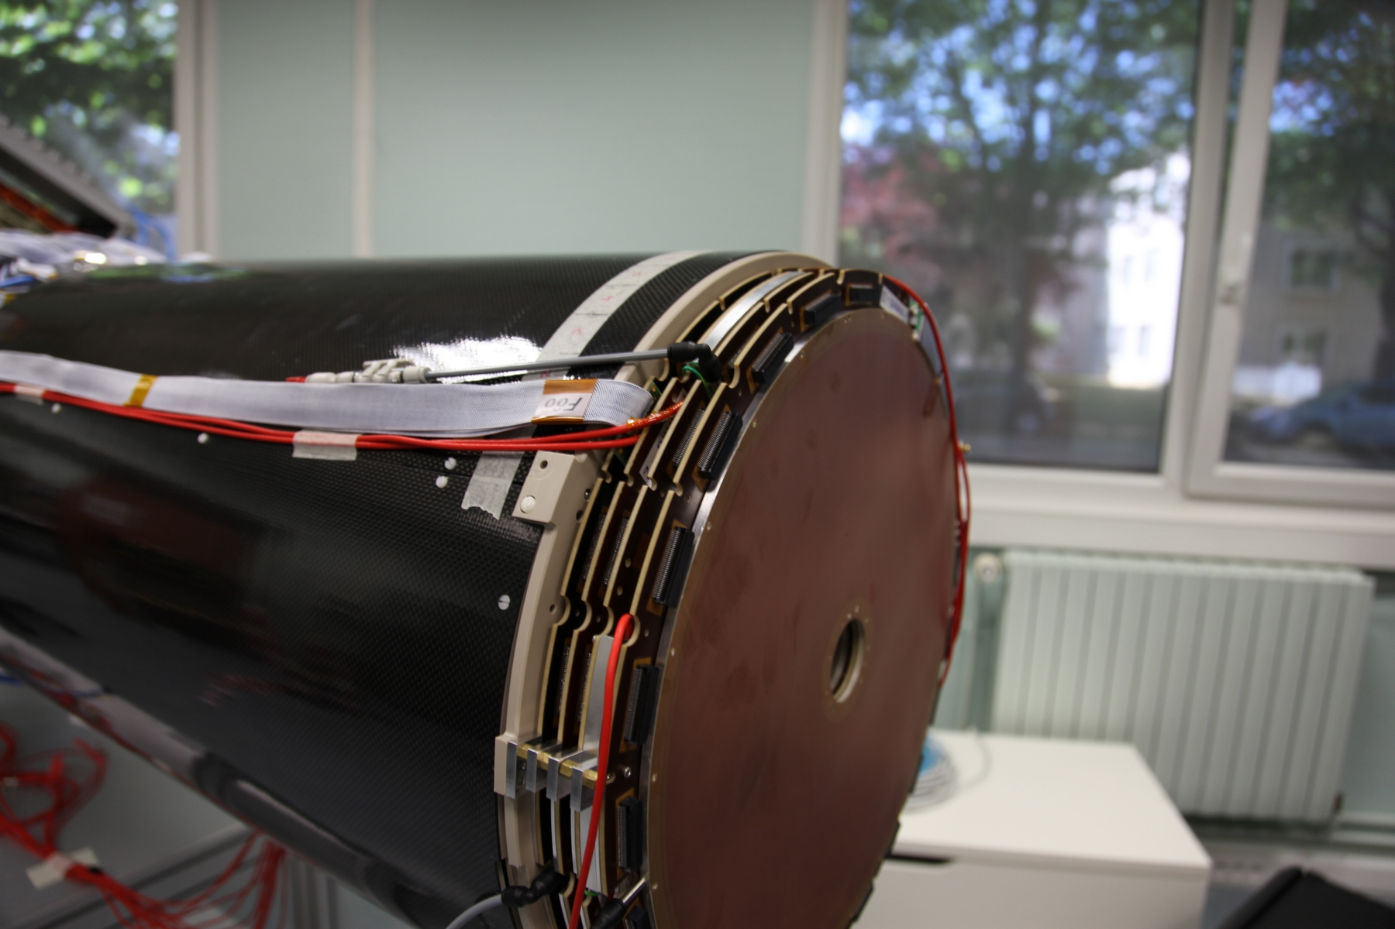
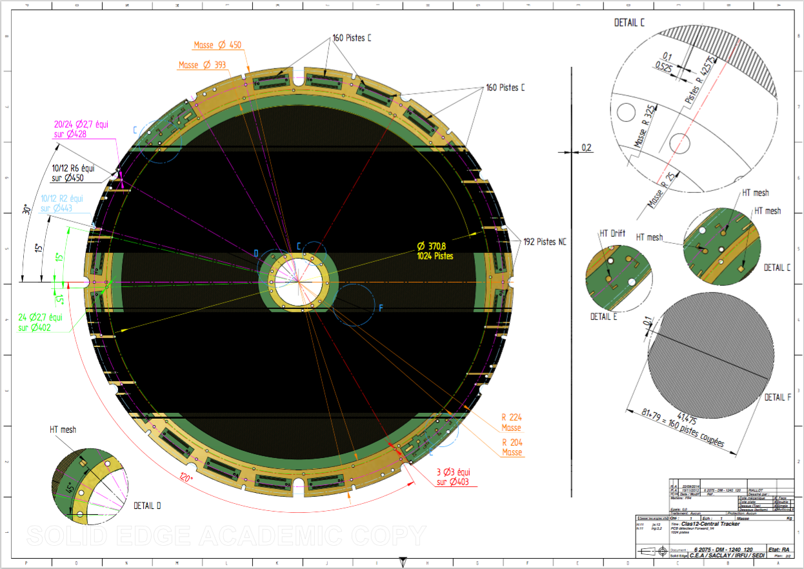
The Forward Detectors
6 layers of Micromegas with strips alternatively at 0° and 60°
Same detector design for the 6 detectors
Specifications:
  Dimensions: 430 mm diameter disk with a 50 mm diameter hole at the center; 5mm drift gap
  Fast gas : Ne + 10% C₂H₆ + 10% CF₄
  100 µm PCB glued on ROHACELL
  525 µm pitch, with 120 µm between two strips
  2 separated resistive strips zones
Notes:
Why two zones ?

Slide 7
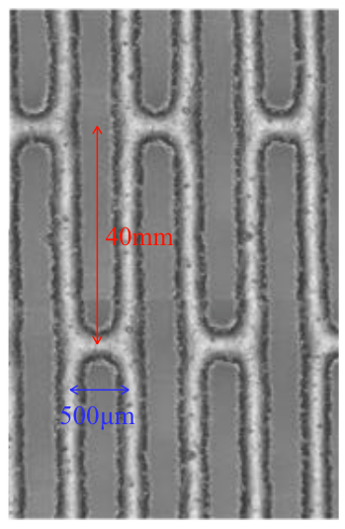
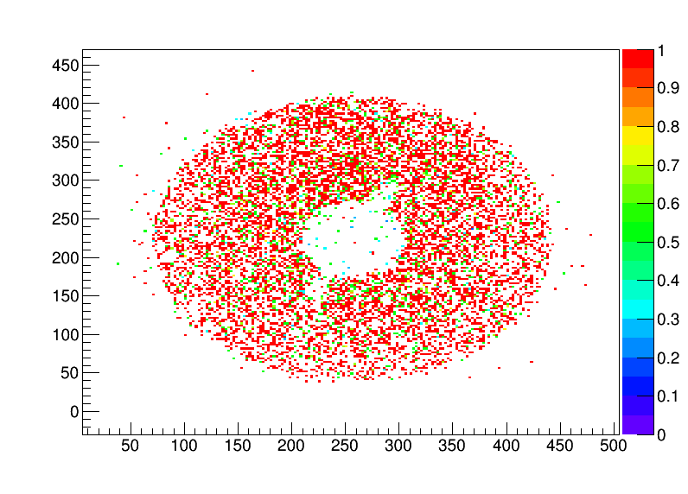
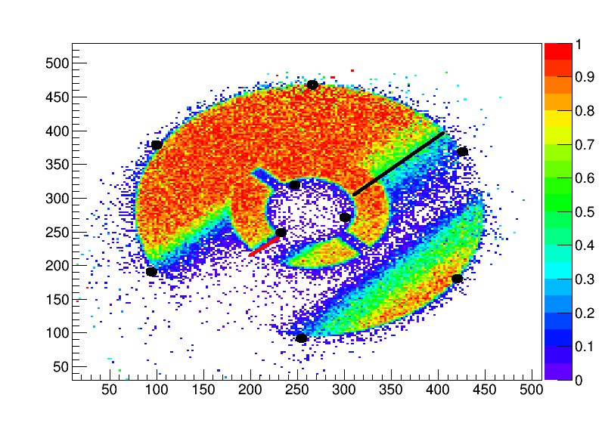
Pre-Prod. Forward Disk for CLAS12: issue with resistive ladders
2 pre-production detector tested, One was not ok :
  High current due to a contact in the active area (can’t burn it with sparks)
  Current flows from the contact to ground (black dots)
  Large impacted zone due to ladders
  Drift electrode glued (intervention impossible)
  Carbon frame for gas distribution
40mm
Before the current appeared
With current
0.5mm
Resistive Strips
S. Procureur
S. Procureur

Slide 8
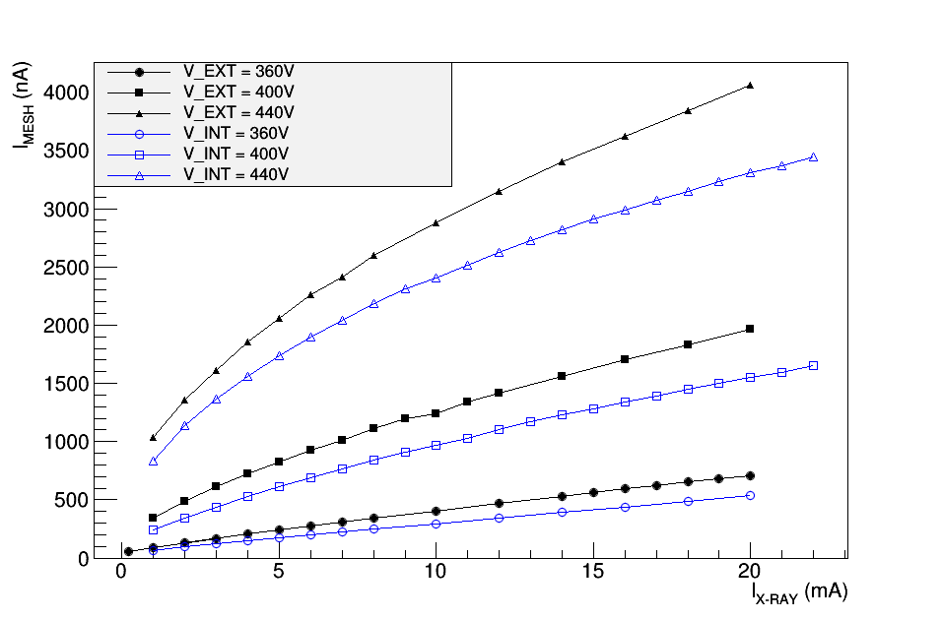
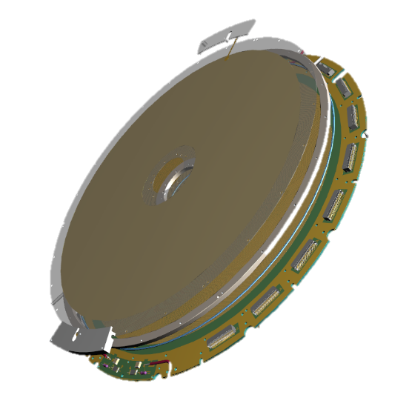
Forward Detector – Final Design
Re-openeable design
Aluminum frame for gas distribution
No ladder between resistive strips
More ground connections
  Test with X-Ray generator for charging effect without ladders
Charging-up effect meas. with X-Rays
Black : no ladders
Blue : ladders

Slide 9
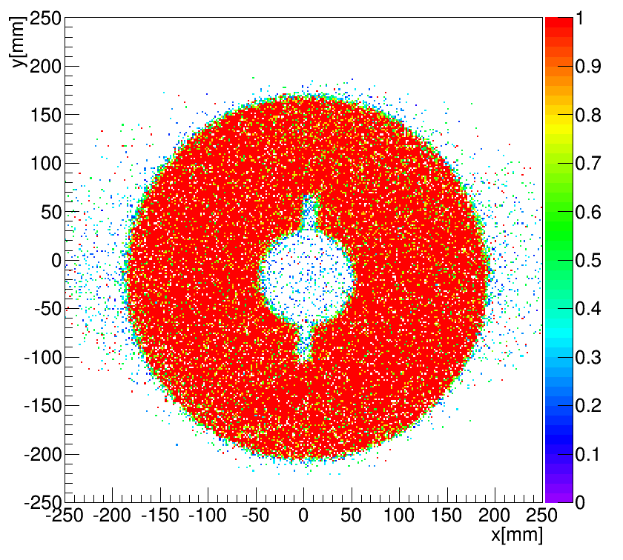
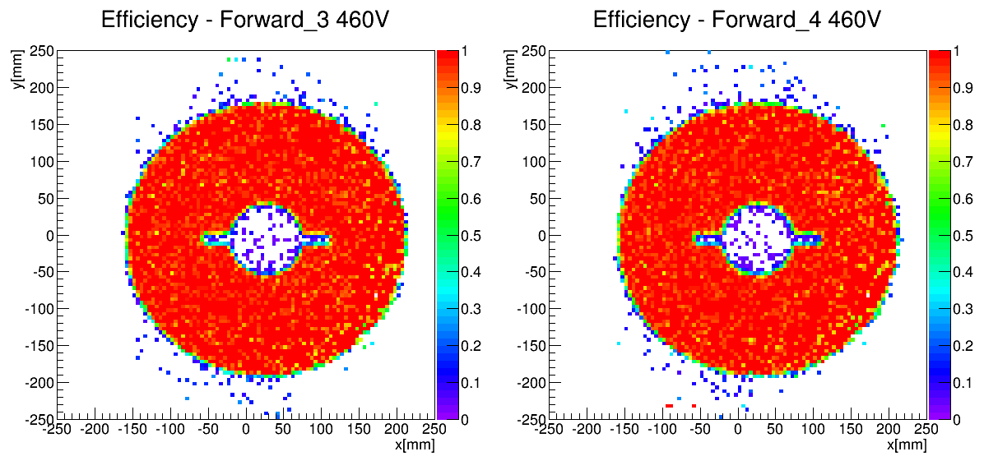
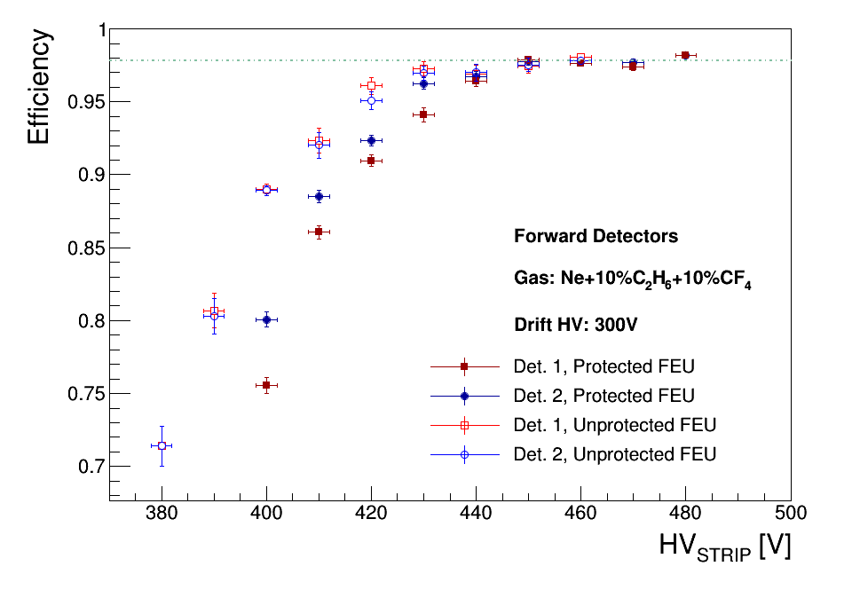
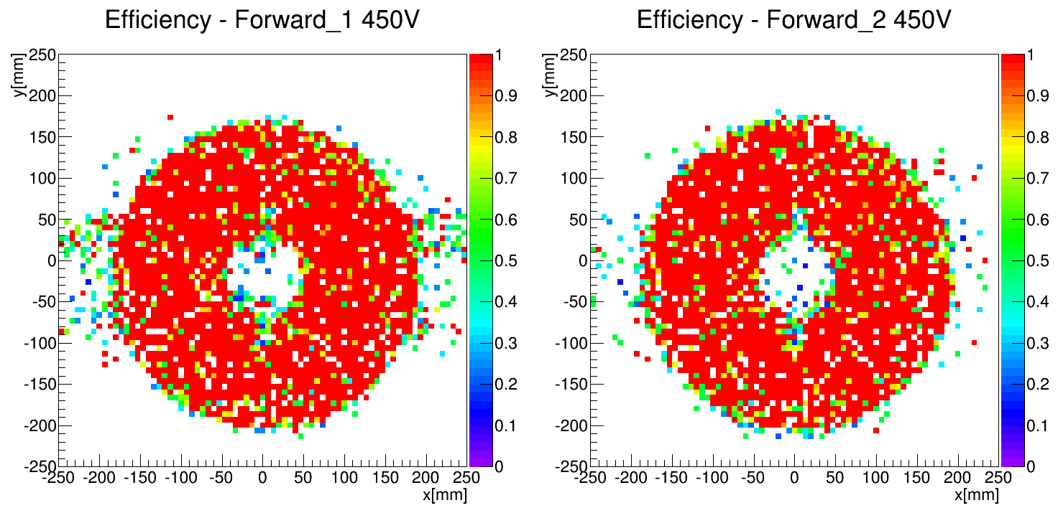
Forward Detector Results
4 Detectors fully operational
No further issue with resistive layer
Efficiency map
Cut for eff. calc

Slide 10
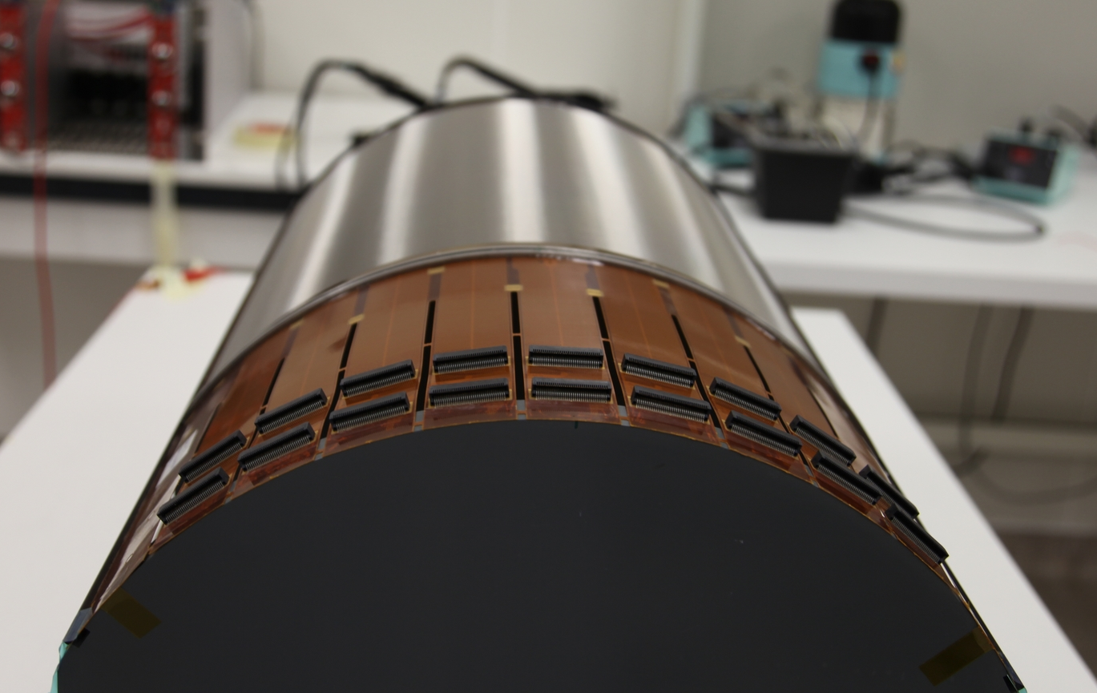
The CLAS12 Central Tracker
Forward detectors
Barrel detectors

Slide 11
The Micromegas Vertex Tracker
4 m² of Micromegas detectors to be installed in 2015/2016
DREAM Front-End Electronics
Remote electronics connected with 2m micro-coaxial cables
Forward Detectors
  High particle rate => Fast detectors
  Resistive strips divided in 2 zones inner/outer
  Dimensions: 430 mm diameter disk with a 50 mm diameter hole at the center
Cylindrical Barrel
  Low momentum particles => Light Detectors
  High magnetic field
  Phase 1 : 2 Layers (6 Det. Of 120º)
  Phase 2 : 6 Layers (18 Det.)
Notes:
ToDo Barrel intro + CLAS12 logo + dream

Slide 12
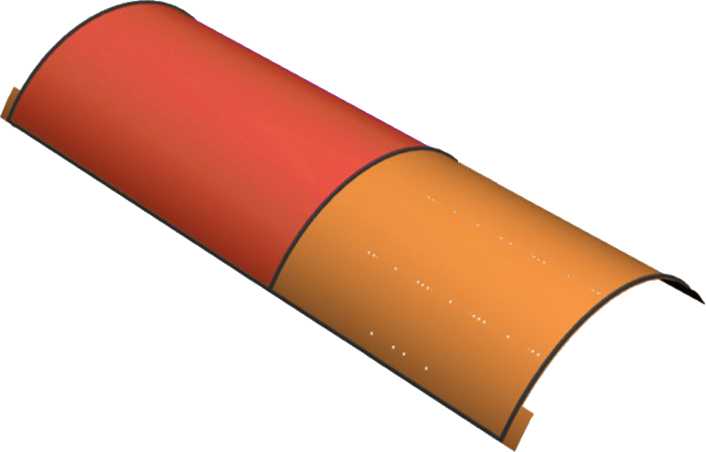
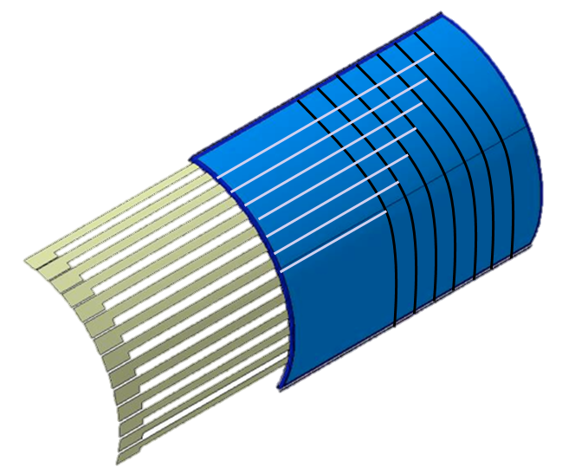
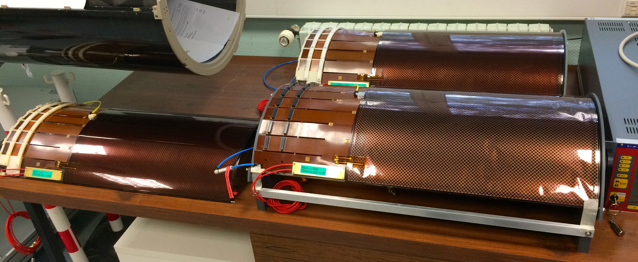
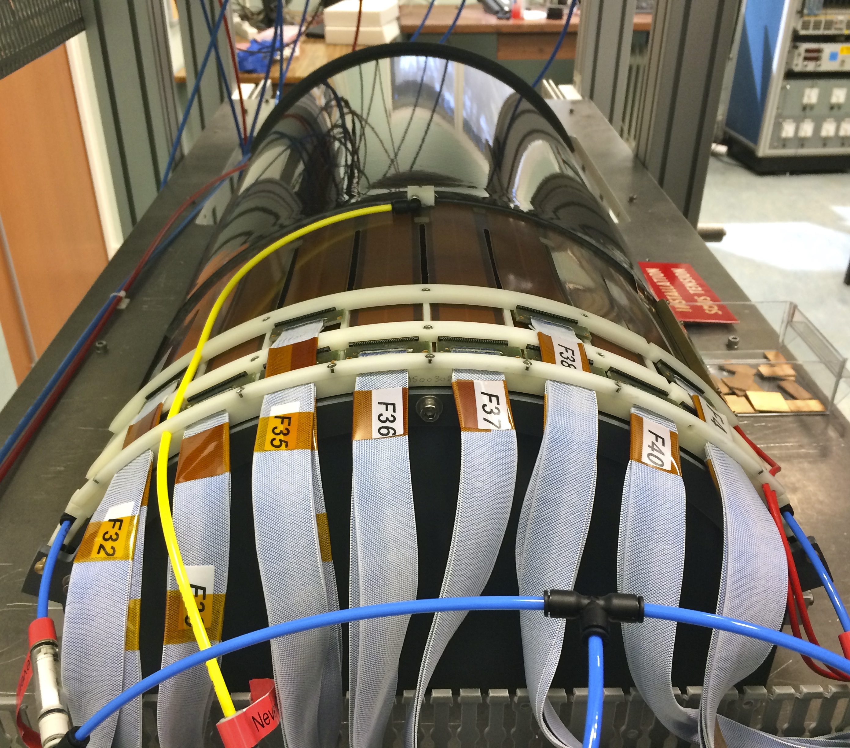
CLAS12 Barrel Detectors
1152 “C” strips
221 mm radius
Pitch from 0.67 to 0.33 mm
PCB thickness 100 µm, Drift thickness 250 µm
0.35% of X0
Drift Field 5 kV/cm : 1.5kV on 3 mm gap
Slow Gas: Ar + 10% iC₄H₁₀
768 “Z” strips
225 mm radius
0.529 mm pitch
PCB thickness 200 µm, Drift thickness 250 µm
0.41% of X0
Drift Field 8 kV/cm : 2.4kV on 3 mm gap
Resistive strips technology
“Z” Barrel
“C” Barrel
“Z” Barrel
“C” Barrel
Notes:
To do reoder bullets to have symetry

Slide 13
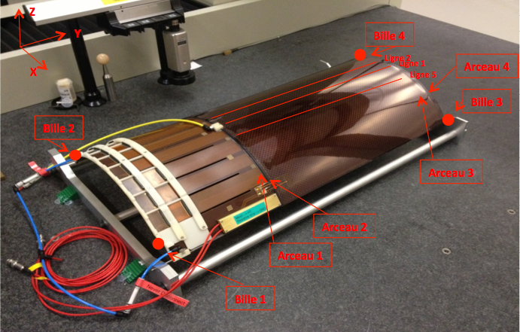
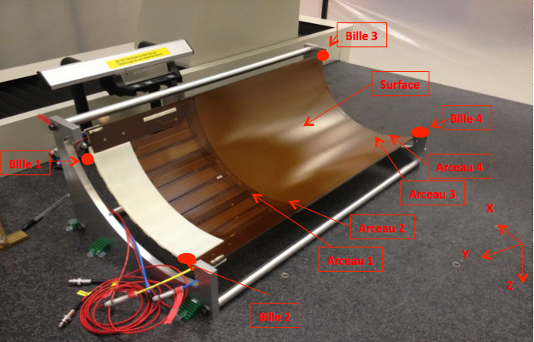
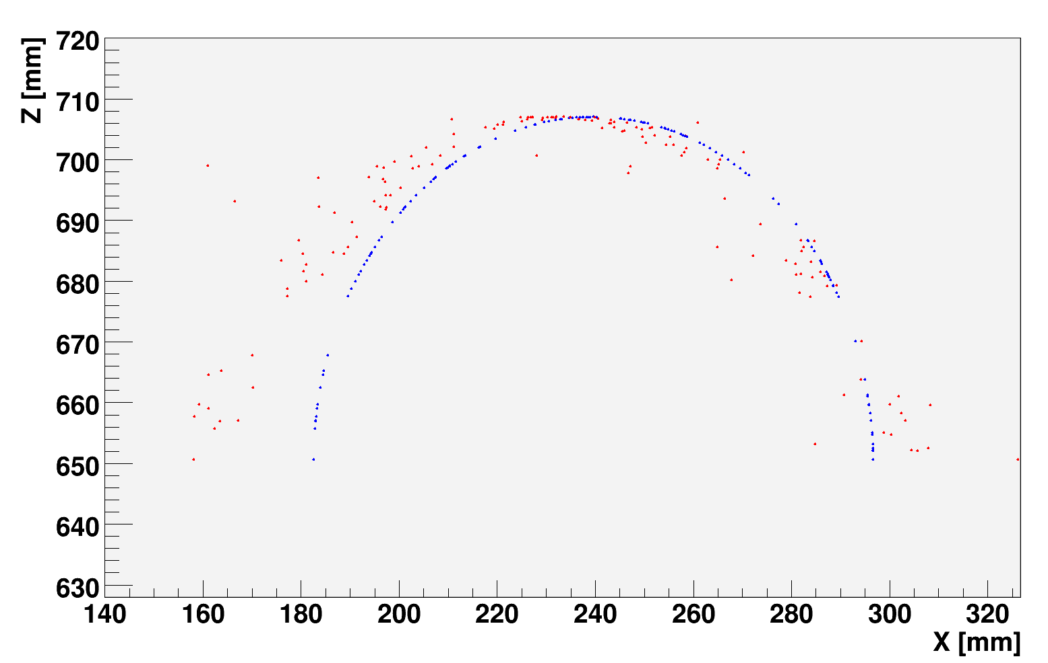
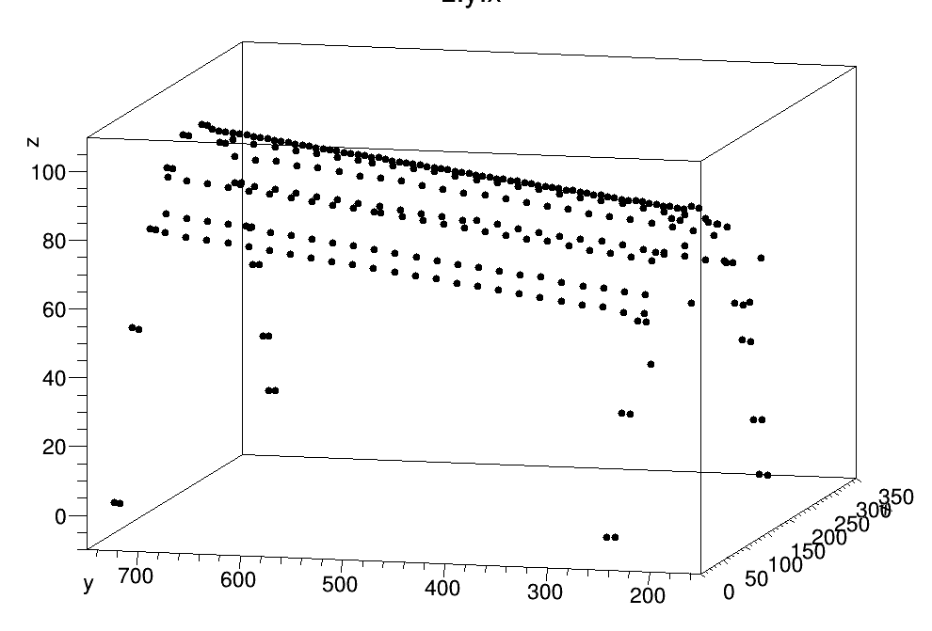
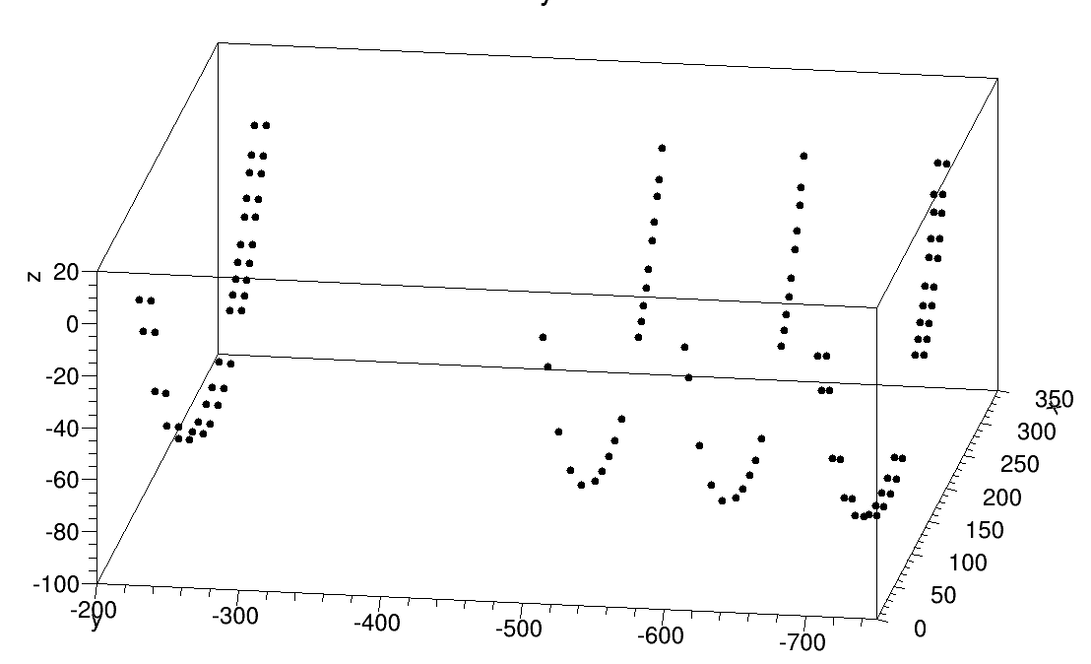
CLAS12 Barrel : Geometry
How well a self support cylindrical MM hold its shape ?
Minimal mechanical support
3D probing machine measuring points :
  270 points on top (drift side)
  120 points under (readout side)
List of measured points
 | X | Y | Z
PT-Arceau1_1 | -3.588 | 231.995 | -0.005
PT-Arceau1_2 | 28.993 | 231.995 | 33.071
PT-Arceau1_3 | 64.992 | 231.994 | 57.126
…
Crosscheck using cosmic ray data reconstruction
Mechanical precision up to ~2mm in radius (only one measurement)
Notes:
Motivation + self supporting + 0.40 % of x0 + “Frist time mm, don’t know

Slide 14
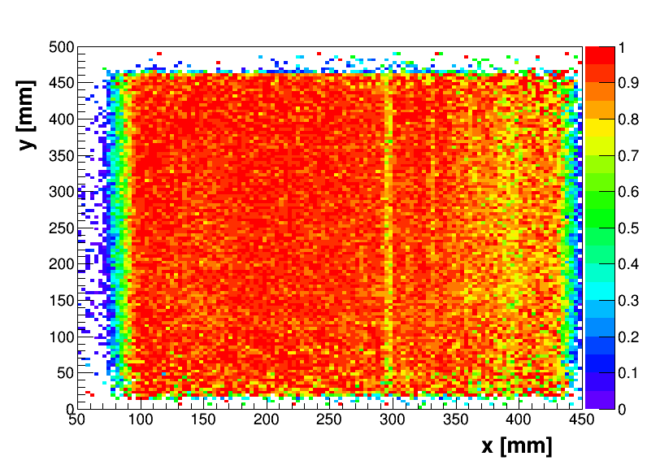
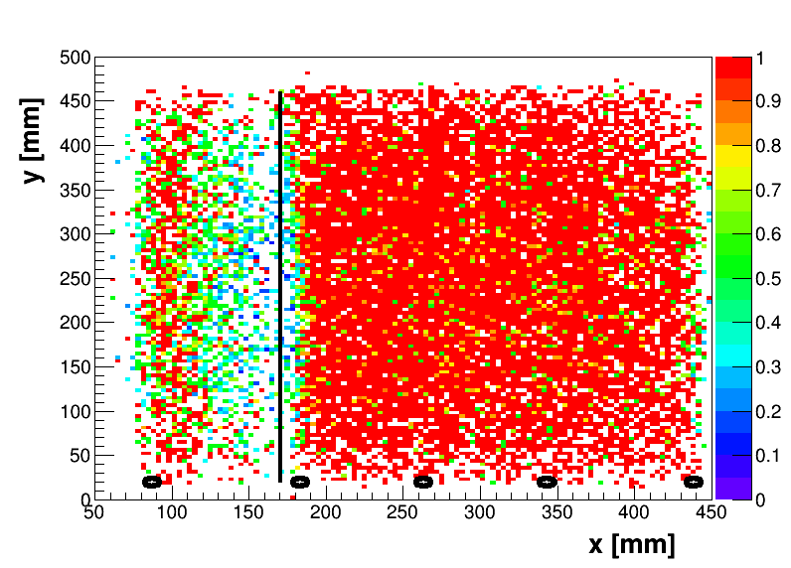
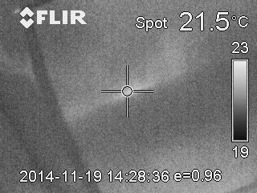
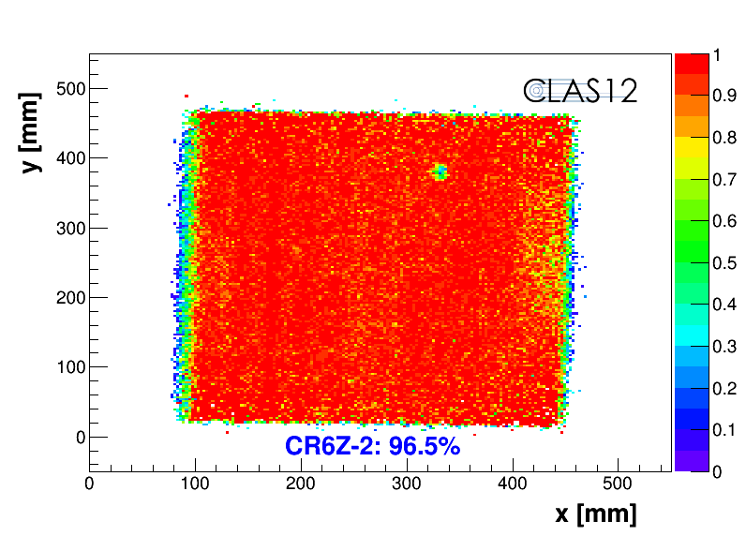
High current on Barrel detectors
Happens when an impurity enters in the amplification gap
Not possible to burn using sparks
Not a barrel related issue, also observed in the forward detectors
Large problem when the current flows over the detector surface to the nearest ground
without current
with current
position of the noisy strip
position of resistive contacts
S. Procureur
S. Procureur
Efficiency Map
Solutions :
  No resistive interconnection (ladders)
  Aluminum frame at the gas inlet
  More ground connections
    “C” Barrel detectors had no problem !
  Fixing is possible by filing the area with a drop of polymer
Zoom on a part of the CLAS12 Barrel with thermal cam, with HV on and current of about 300 μA

Slide 15
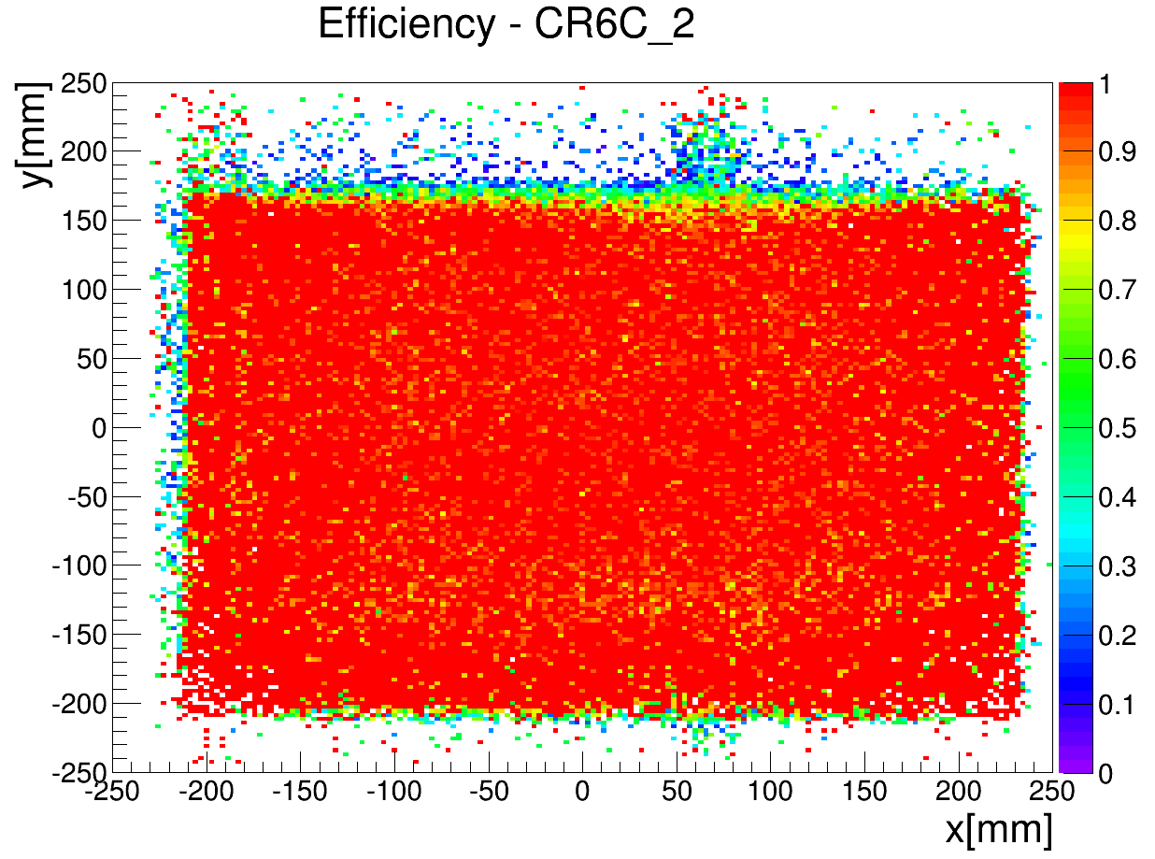
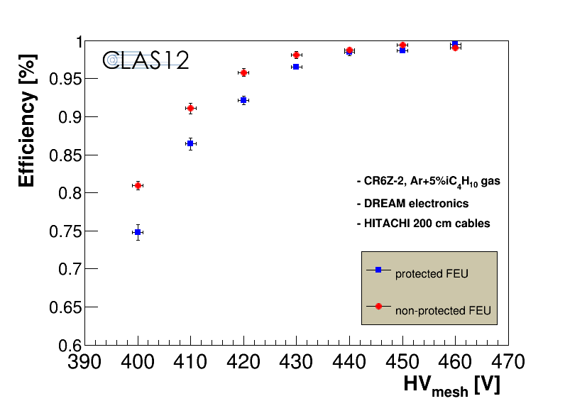
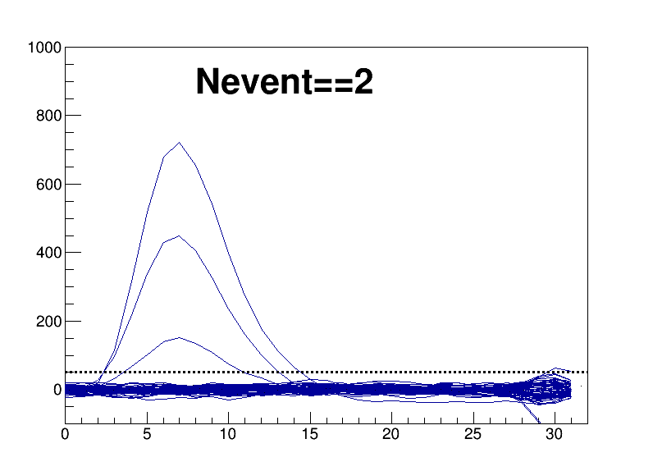
CLAS12 Barrel : Performances
Cosmic rays characterization at Saclay
Barrel efficiency >98% :
S. Procureur
Z Barrel Efficiency Map
C Barrel Efficiency Map
(with 6.5µA on res. strips)
Resistive Barrel Nominal performances :
  Long plateau at full efficiency
  Fully efficient
  1500V on drift electrode
  ~200µm spatial resolution
  (limited by track resolution)
  ~25ns time resolution
Efficiency Plateau
Typical event

Slide 16
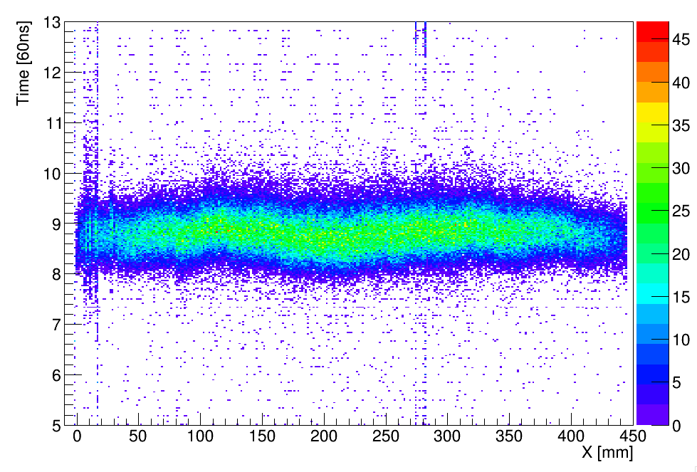
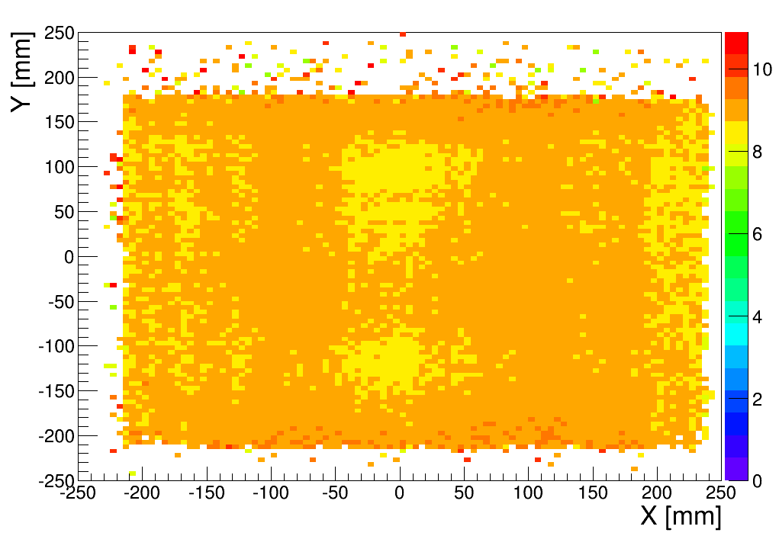
Time resolution
Time Resolution with resistive detectors is ~25ns instead of ~15ns (depending on the conditions)
Time resolution not critical for the CLAS12 barrel
Inhomogeneities over the detector surface observed
Time Vs Det. X
2D Time distribution
Solutions :
  Electronic parameters optimization (~3ns)
  1D (2D?) corrections (~5ns) but difficult with cosmic rays

Slide 17
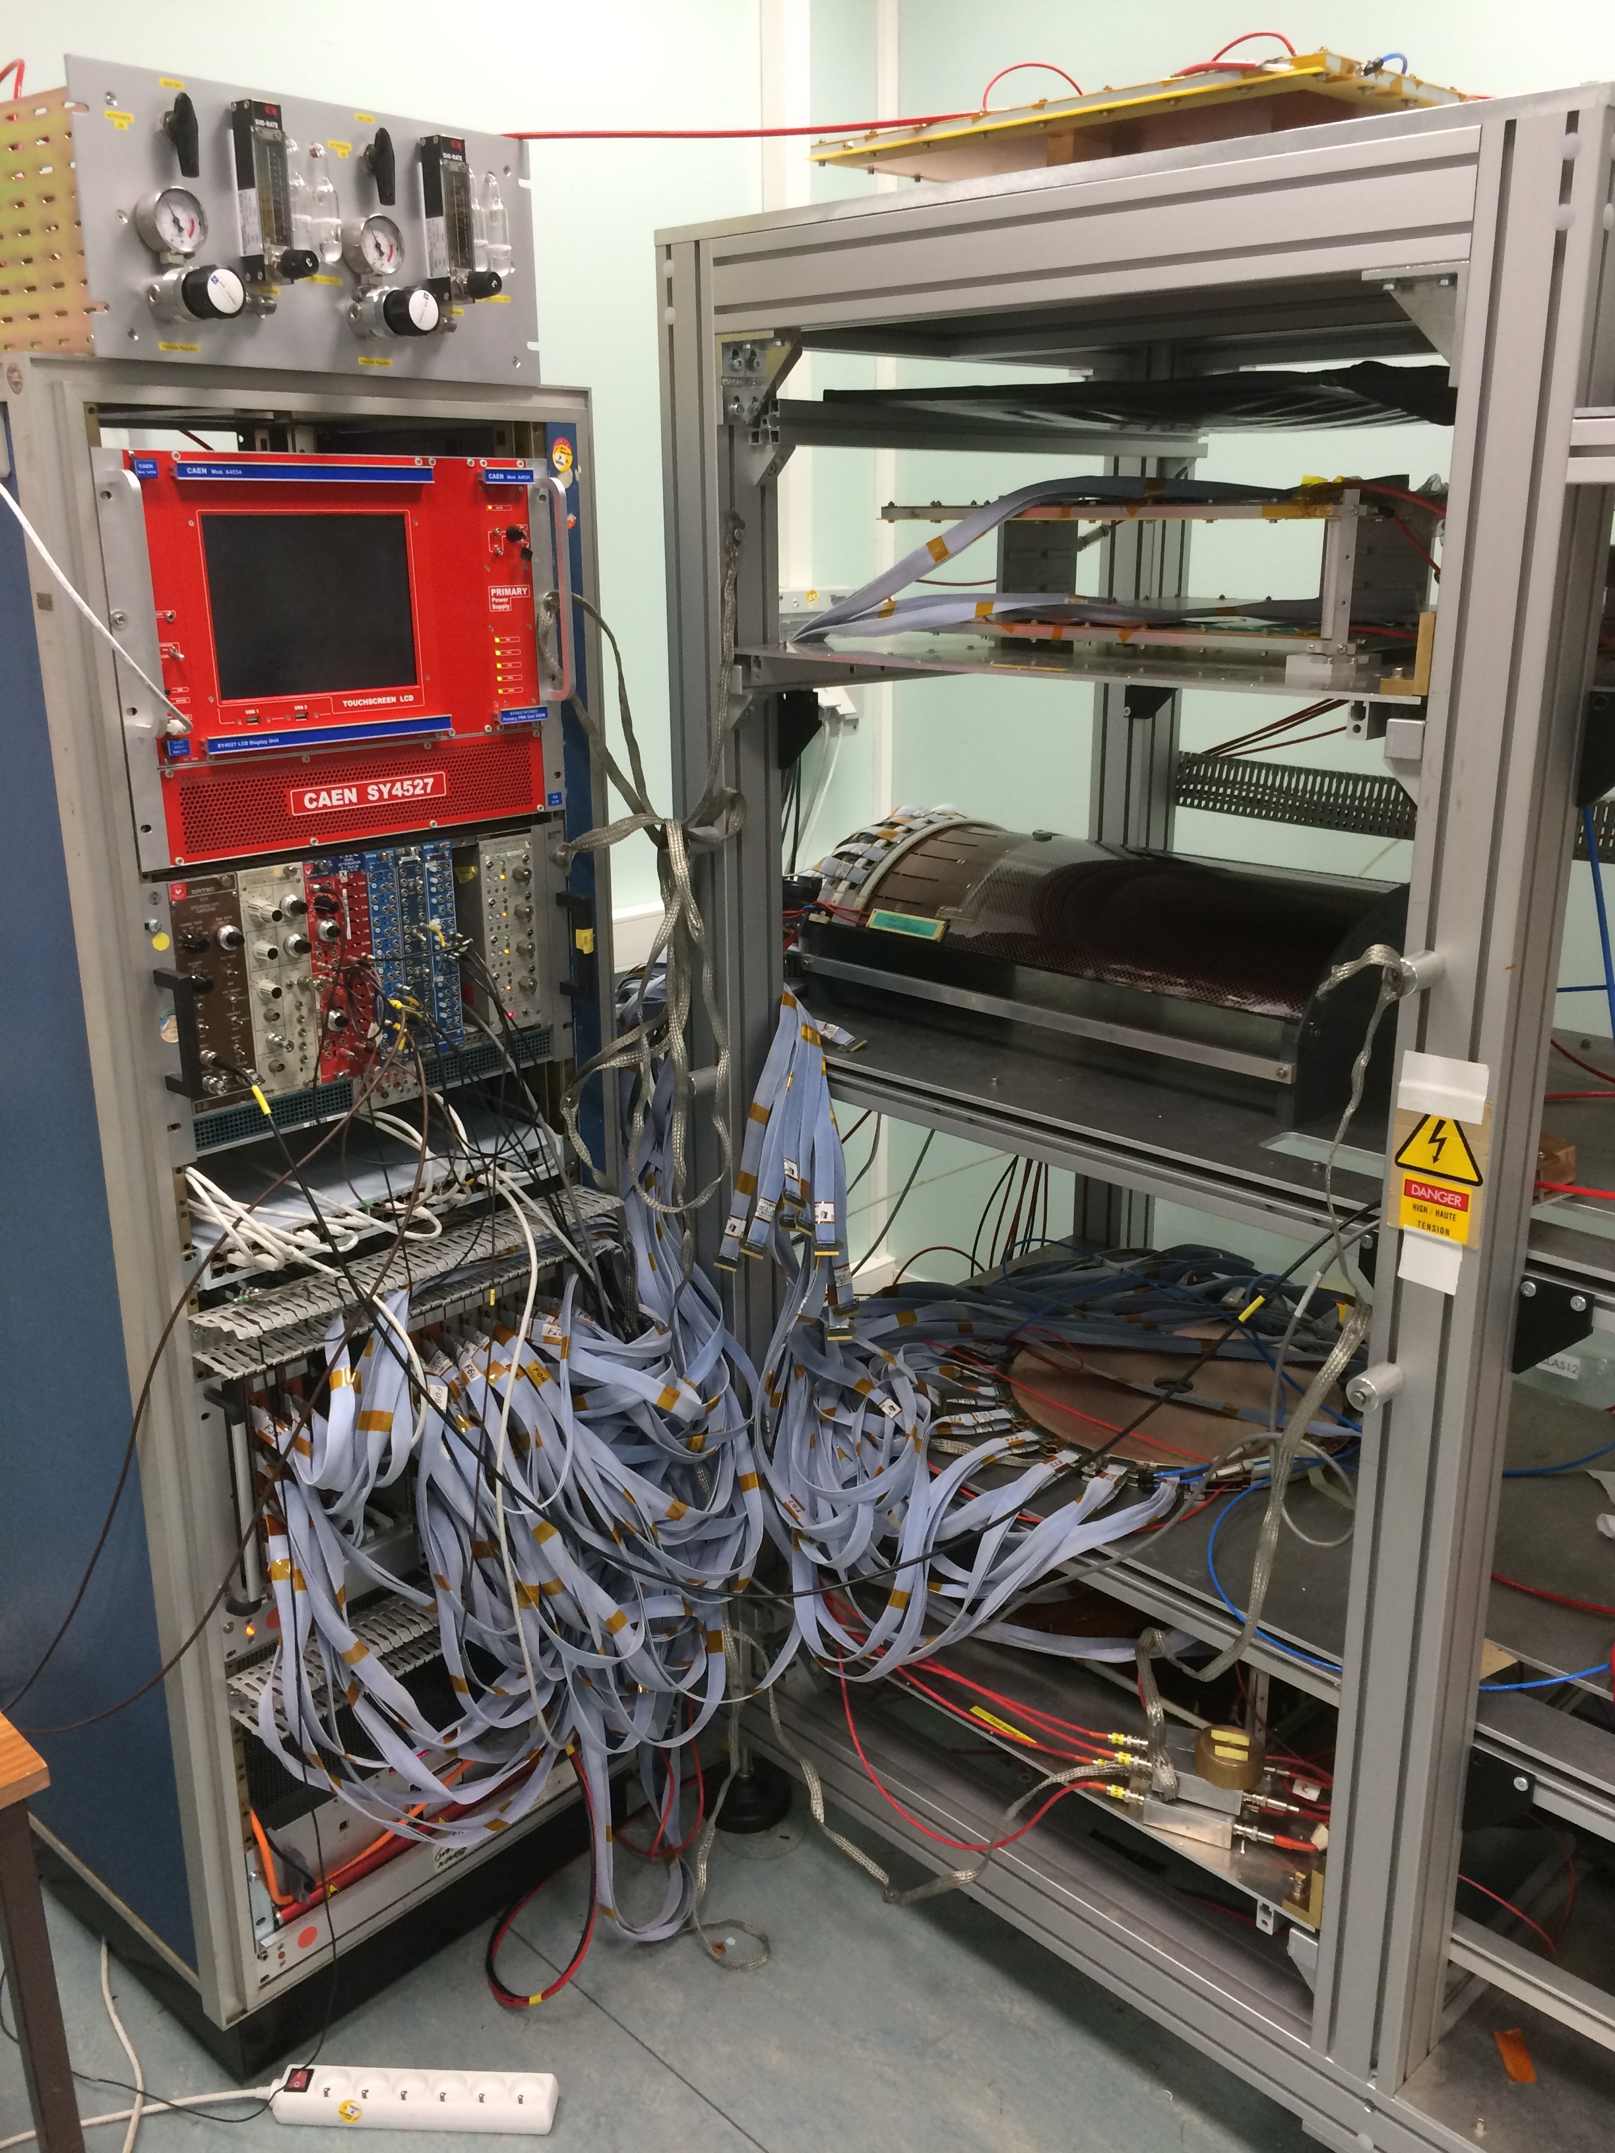
CLAS12 Micromegas Production status
Forward Detectors :
  4 Nominal det. Ok
  1 spare
  2 will be delivered and assembled before spring
Barrel Detectors
  “C” barrel :
    2 detectors ok
    1 Spare Detector with 60 unconnected strips
  “Z” Barrel :
    2 are being assembled, test with cosmic rays next week
    1 Spare with max drift voltage at 2050V
Cosmic rays test bench at Saclay
Notes:
OK OK

Slide 18
The CLAS12 Micromegas Vertex Tracker
Forward detectors
Barrel detectors
Production status
Spatial Resolution and Clustering Algorithms

Slide 19
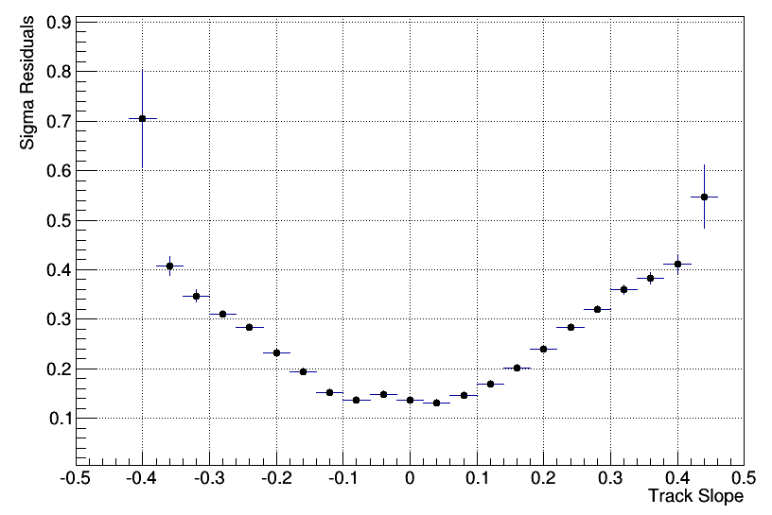
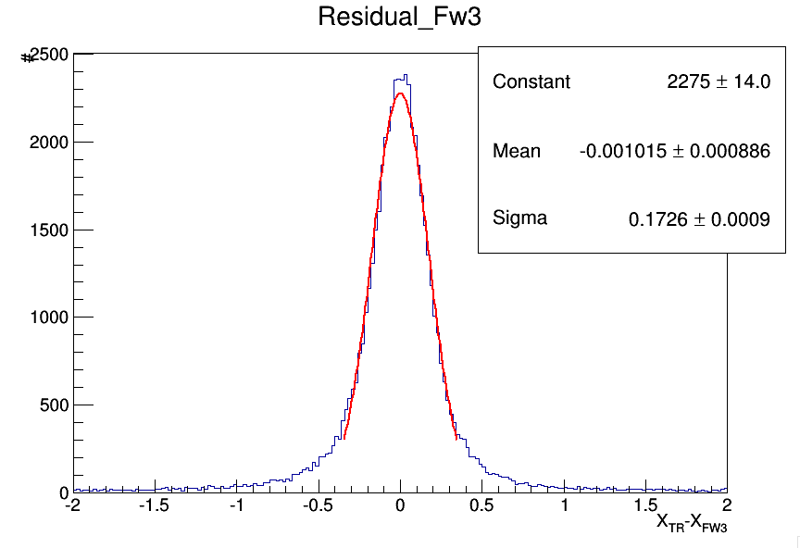
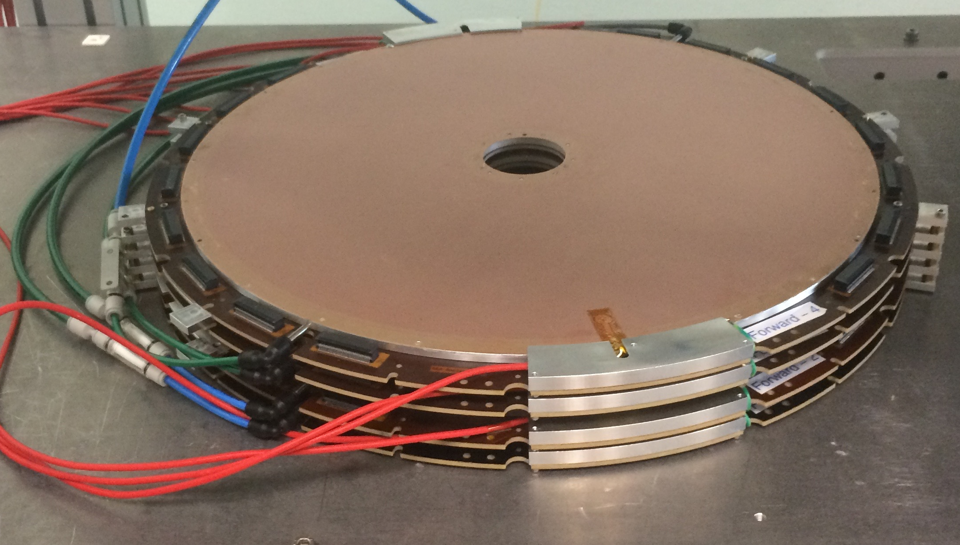
Spatial Resolution Study
Goal: Reduction of the impact of tracks with large angle on spatial resolution
Muon telescope for track selection
4 Forward Detectors (Pitch = 525µm) with precise mechanical support structure
  Measurement of the Forward spatial resolution with cosmic rays
  Study of different methods using amplitude and time for position reconstruction
  Study of different clustering micro-TPC algorithms
Detector Resolution:
  Fw1 Sigma = 251.7µm
  Fw2 Sigma = 172.6µm
  Fw3 Sigma = 174.3µm
  Fw4 Sigma = 256.1µm
Residulas Vs. Track Slope

Slide 20
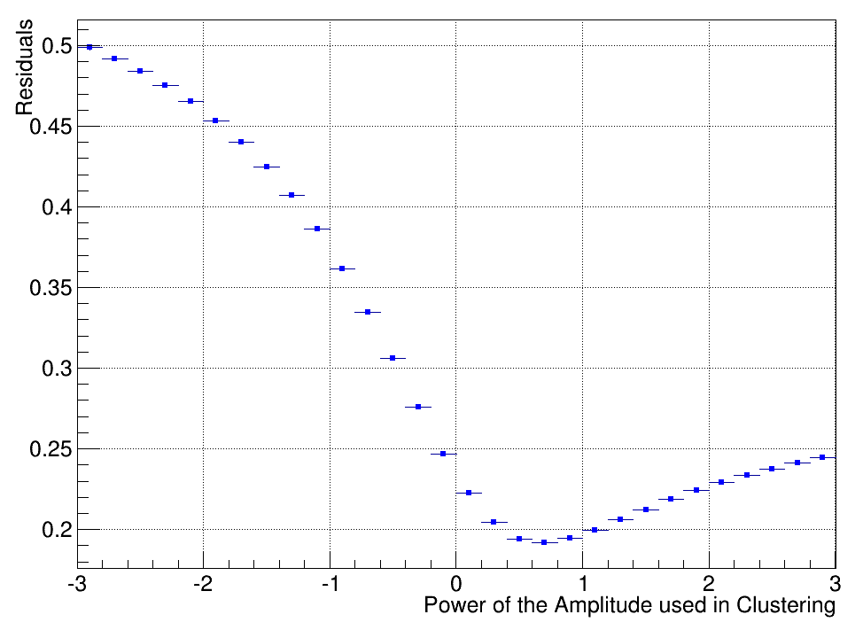
Weighting methods for the clustering algorithm
Amp
s₁
s₂
s₃
s₄
s₅
Cluster Position = sum{f(amp).x_{STR}}/sum{f(amp)}
f(amp) | Residuals
amp | 172.6µm
Sqrt(amp) | 169.8µm
Erf(amp) | 172.5µm
Sin(amp) | 172.5µm
Cos(amp) | 205.9µm
amp² | 196.1µm
1/amp | 358.0µm
Log(amp) | 261.5µm
Log₁₀(amp) | 261.3µm
√amp
Notes:
Diffusion in sqrt ?

Slide 21
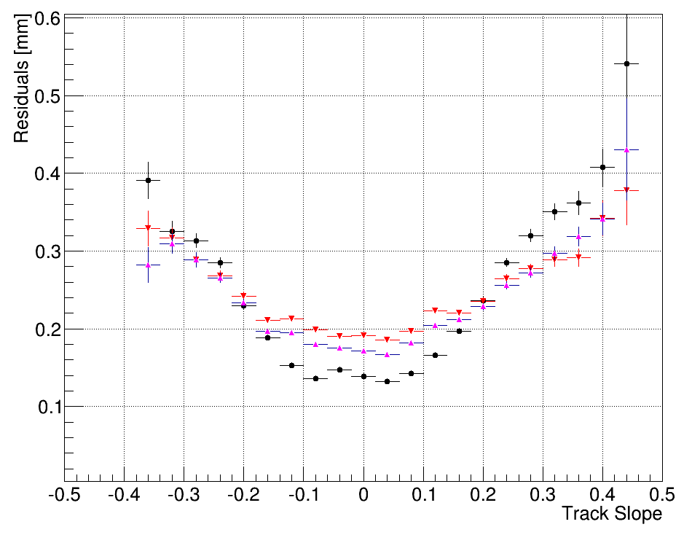
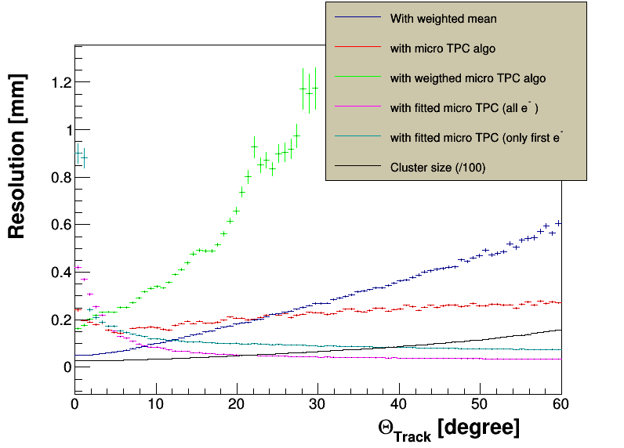
Weighting with strip time
  Strip Time is extracted from the shape of signal (3rd degree polynomial fit)
  If time is used as the weight instead of amplitude => sigma = 206.6µm
Linear mix of time and amplitude :
            weight = (alpha*amp+(1-alpha)*time)
            (Alpha=1 only amplitude, Alpha=0 only Time)
            ]
Time
Residuals vs Track Slope
s₁
s₂
s₃
s₄
s₅
Red : alpha = 0
Cyan : alpha = 0.5
black : alpha = 1
Crossing at ~10º same as in MC (tan⁻¹(0.2))

Slide 22
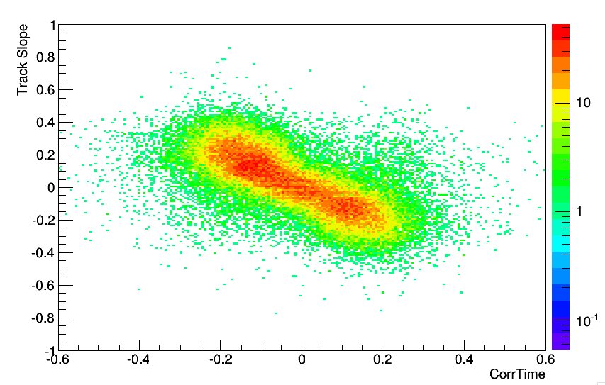
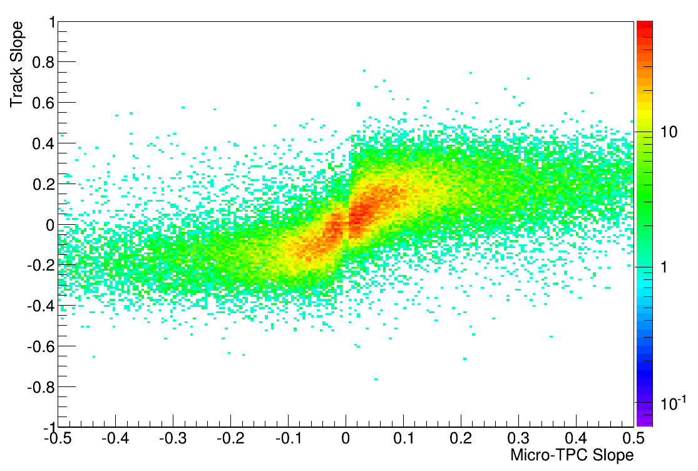
Micro-TPC
Mean of Amp.
Readout
Effect of track angle
Correct the cluster position using an estimation of track slope at the detector level
Difficult in our case: fast gas mixture, 5mm drift gap, DREAM not optimized for time measurements
Correlation between track slope and estimator from detector :
  CorrTime = Sign *(Max. Time – Min Time)
    The sign is given by which strip as the max/min time
  TimeBinFit= slope of the w. mean in time bin
  Slope in time bin is estimated using the Theil–Sen estimator
CorrtTime vs Track Slope
TimeBinFit vs Track Slope
T3 amp.
Time
T1 amp.
T0 amp.
s₁
s₂
s₃
s₄
s₅
s₁
s₂
s₃
s₄
s₅

Slide 23
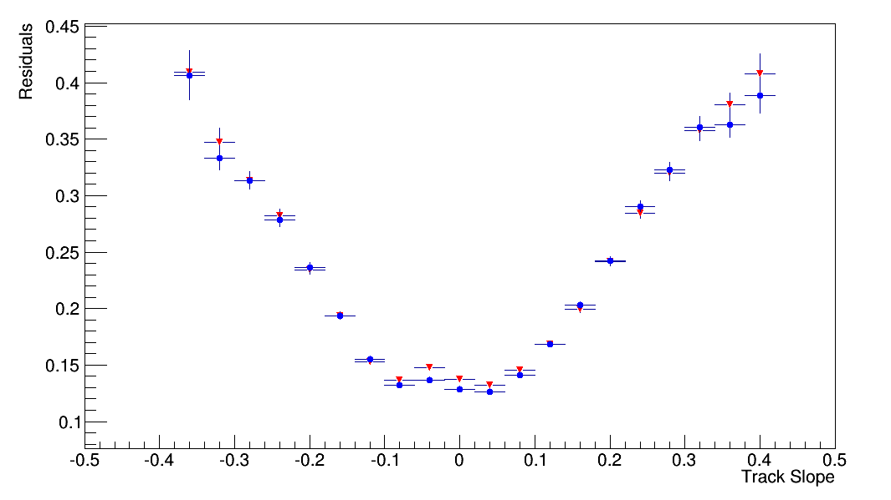
Micro-TPC
Test with CorrTime
Better but not significant
More studies are needed here
  Blue : Corrected
  Red : Uncorrected
Time
s₁
s₂
s₃
s₄
s₅

Slide 24
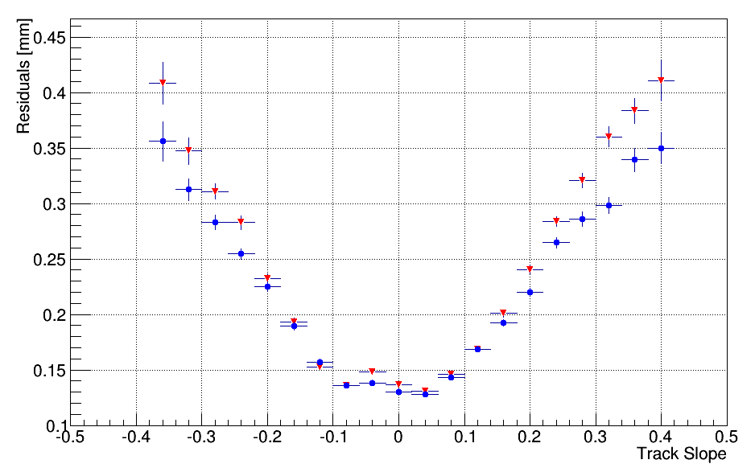
Sqrt + Micro-TPC
Best correction: MicroTPC + Sqrt(Amp)
  Blue : Corrected
  Red : Uncorrected
√amp
+
Time
Bottom line with fit on narrow peak of residuals :
sigma = 167.1µm (ref= 172.6µm)
s₁
s₂
s₃
s₄
s₅

Slide 25
Outlook
The CLAS12 experiment MPGD MM Vertex Tracker is under construction and a first delivery is planned for the end of 2015
2 Micromegas Disks “Forward Pre-Production” have been built and characterized
Resistive interconnections have been found to create large inefficiency issues
The “Forward” design has been modified and 4 disks have been successfully produced and tested
Large Cylindrical Resistive Micromegas have been build and characterized
2 “Z” pre-production cylindrical detectors have been build
Design has been modified to lower the risk and the impact of leakage current
3 ”C” full scale CLAS12 Barrels have been produced and tested
2 “Z“ are in production
The MVT is being assembled for system level tests before shipping
Offline study on corrections for large angle tracks is ongoing
First results combining new weighting scheme and µTPC algorithm show a visible improvement of the resolution

Slide 26
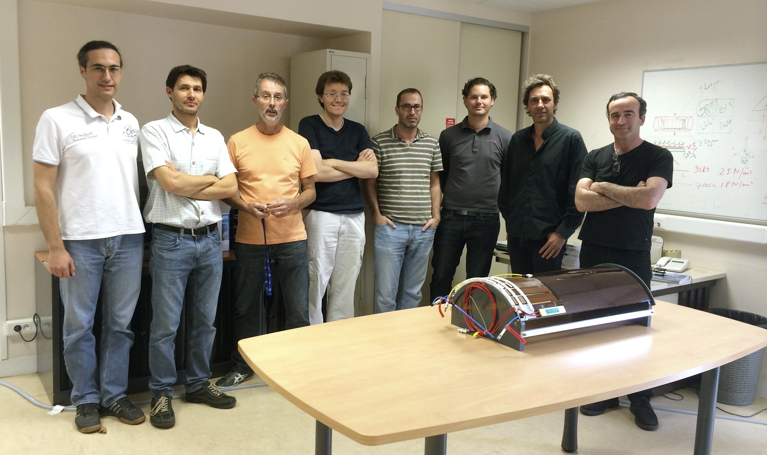
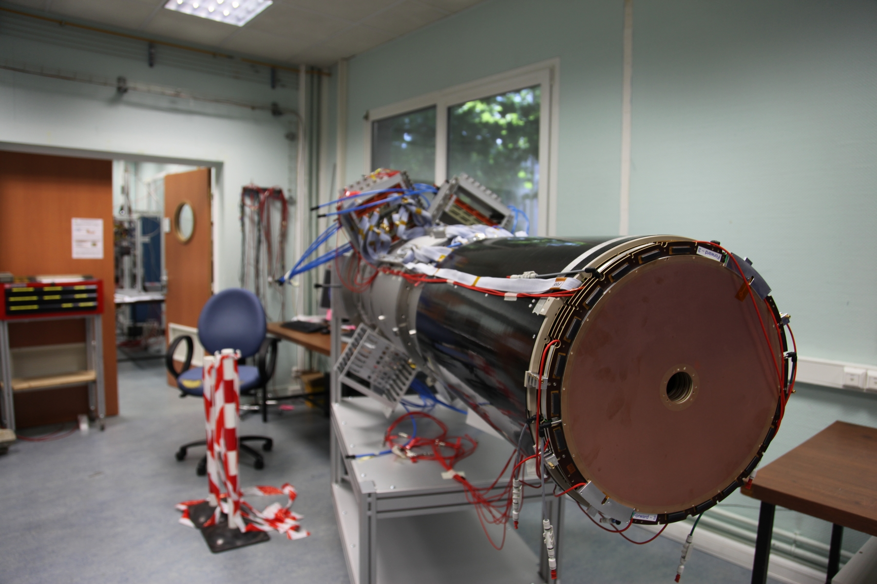
CLAS12 TEAM AT SACLAY
D. Attie, S. Aune, J. Giraud, R. Granelli, C. Lahonde-Hamdoun, I. Mandjavidze, O. Meunier, Y. Moudden, S. Procureur, M. Riallot, J-Y Rousse, F. Sabatie, M. Vandenbroucke

Slide 27
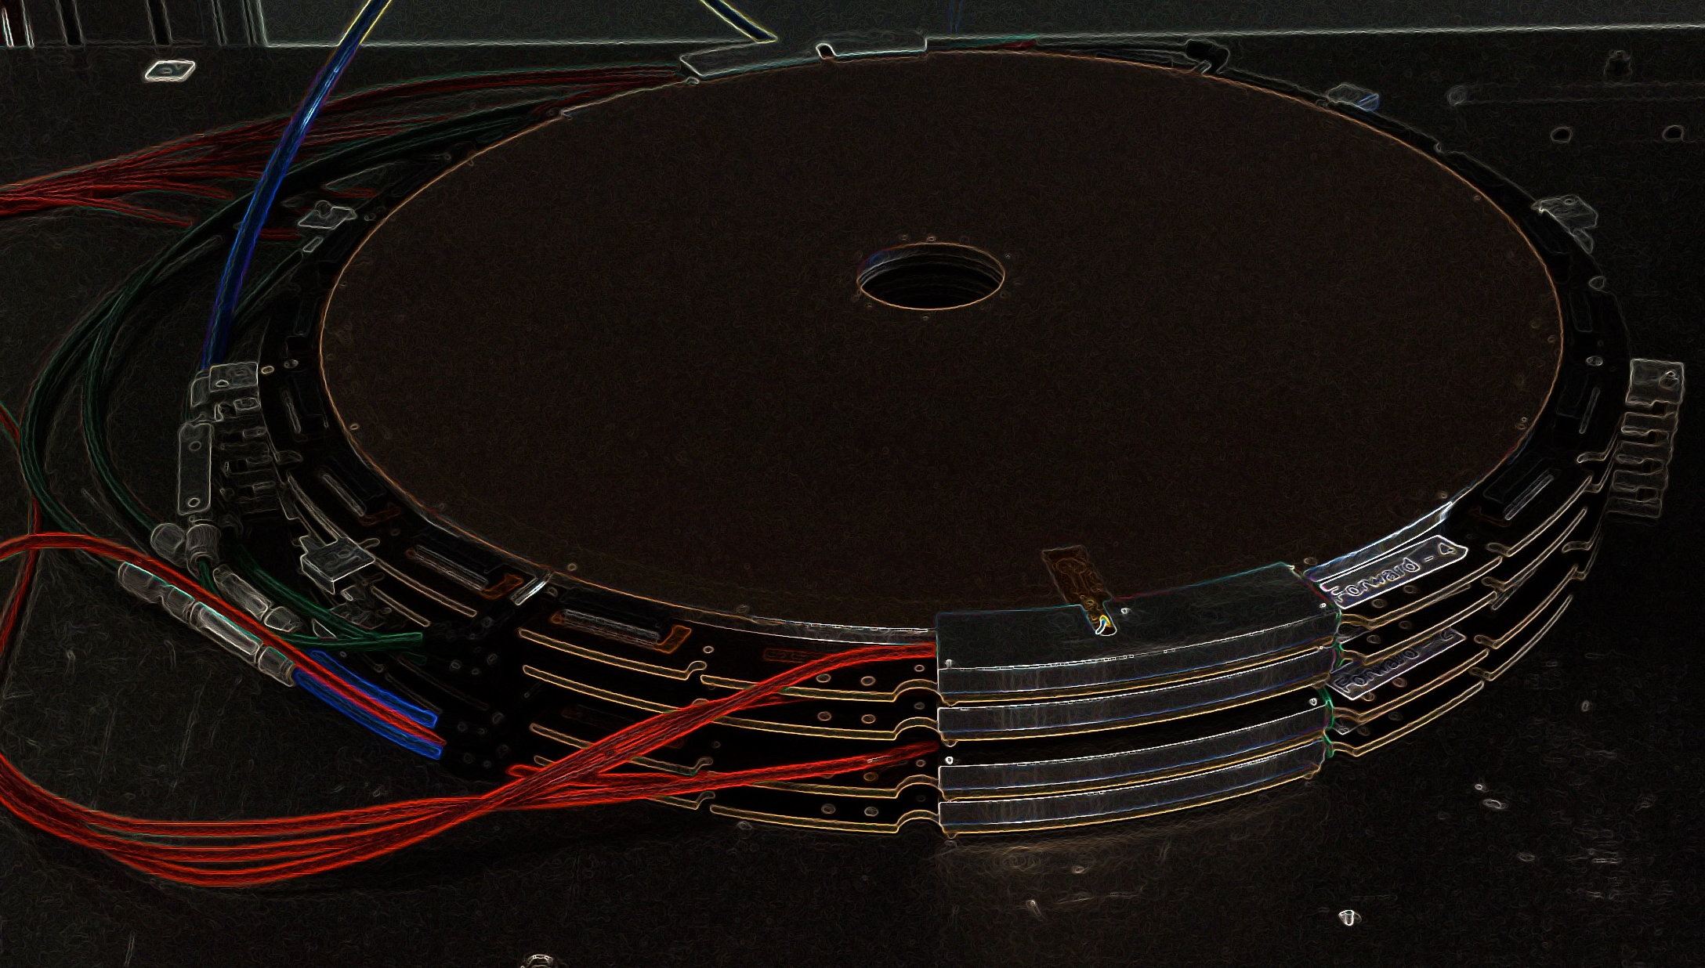
Spares

Slide 28




Bulk Technology (2006)
Embedded of the MicroMesh on the readout electrode
Goal : Make the Production of Micromegas an Industrial process
Robust, Cheap
Simplified and light mechanical structure
Ability to use thin PCBs and produce different shapes (cylindrical detectors !)
Notes:
ToDo add transition toward Barrel

Slide 29






Cylindrical Micromegas
Segmentation and preparation
Gluing of the side carbon ribs on circular shape
Electric leak test
Gluing of additional ribs
Setting drift plane
Gluing of the drift plane

Slide 30

CLAS12 Barrel : Geometry
Using cosmic ray data reconstruction
OUTER (4 ribs)
R= 211.3 +/- 1.8
INNER(4 ribs)
R= 207.3+/- 2.1
=> Mechanical precision up to ~2mm in radius (only one measurements)
Notes:
Maybe suppress X0 to avoid Q?

Slide 31



Detector characterization at Saclay : The Cosmic Test Bench
Scintillator
Top reference
detectors
Coincidence
module
Prototype
to the
trigger
Down reference
detectors
Setup to characterize in 2D the prototypes
Tracking detectors : MultiGen 2D x4 (8 Connectors)
Fully equipped with DREAM FEE
24 Positive + 24 Negative HV
Gas mixing system + pre-mixed bottles
Trigger control module, trigger time resolution below 3 ns, Projected track resolution of ~100 µm
6 Hz trigger rate, >90% track reconstruction efficiency
1h to get one efficiency point

Slide 32
CLAS12 Operating Conditions

Slide 33


Forward

Slide 34

From Residuals to Resolution
Within the same geometry, assuming same resolution for all detectors (MC)

Slide 35

Material Budget

Slide 36

Clustering – Definitions
Hit: One signal associated with a single strip
Hit Time: std. time extrapolation from signal shape
Amplitude: Maximum amplitude of one signal
Cluster : group of consecutive hits
Cluster Position : combination of the hits positions
Tracking detectors
Tested detector

Slide 37



Barrel Micromegas for an
Electron-Ion Collider (EIC)
A solution based on a TPC + Barrel detectors is considered for an EIC detector
Internal (~20cm) and external (~2m radius) 2D cylindrical layers
Establish <100 µm spatial resolution in a 3T field
Deliver reliable “vector” measurement
Fast measurement layer between MAPS and the TPC
Minimized material budget
Internal layers
EIC GEMs : See B. Surrow Poster
External layers
Notes:
Bernd –posrter’s

