Slide 1
Wrap up

Slide 2
Upcoming events
Physics Vidyo conferences (last Monday of the month)
23 February 15:00
Summary of workshop
Software progress
27 April
also accelerator VIDYO conferences (next is on Monday 9 February)
General FCC meeting in Washington 23-27 March
https://indico.cern.ch/event/340703/
COME AND REGISTER!
3 x90’ sessions for FCC--ee physics and detectors on Tuesday 24 March
agenda in preparation taking into account results from this meeting
-- MDI and detectors
-- physics and phenomenology specific of FCC-ee
4 x 90’ sessions for FCC-ee accelerator on wednesday
-- also MDI
4 x 90’ sessions for FCC phenomenology on Thursday
-- experimental reports on
EW precisions (FCCee+hh+eh) (Roberto Tenchini)
Higgs measurements (FCCee+hh+eh) (Makus Klute)
BSM searches at high energy (Maurizio Pierini)
Dark matter searches (FCCee+hh+eh) (Nicola Serra TBC)

Slide 3
Upcoming events
Next FCC-ee physics workshop in September 2014 place and time TBD
HF2015 (the yearly accelerator workshop) Frascati 16-19 November 2015
Sequel of HF2012 (Fermilab), HF2014 (Beijing)

Slide 4
General remarks
Selected Highlights
-- first simulations of FCC-ee signals and environment (P. Azzi, E. Perez)
a first step towards event display!
-- engagement of theoretical community in
-- translating precisions to BSM physics
-- considering how to improve calculation precisions by factor 20
-- inventing new things to measure
-- quality of work and people !
but quantity (of people) is an issue.
-- involvement of LC colleagues is small but very positive.
Need to grow in that direction
Largely shared opinion that next step should be e+e- collider
-- involvement of Italian community and presence of INFN officials

Slide 6
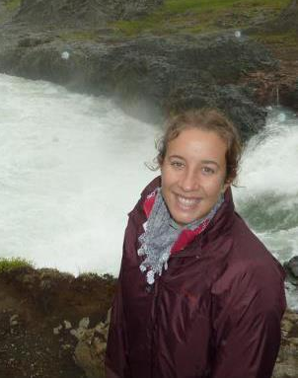
Cristina is doing a fantastic job for the communication of the FCC-ee
FCC-ee web site (are you all registered?)
FCC-ee posters
FCC video and Youtube !
FCC-ee news!
prepared FCC, FCC-ee hh etc..
wikipedia pages
THANK YOU!

Slide 7
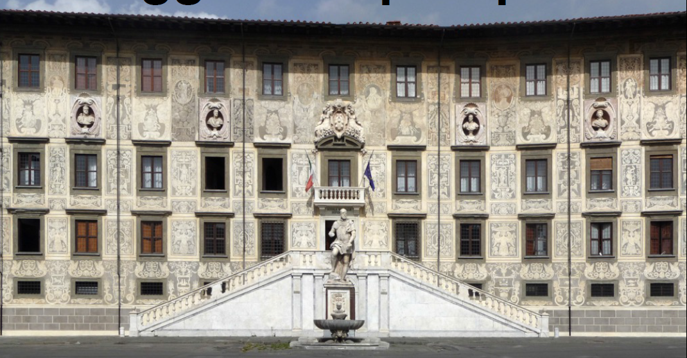
Thank you
Gigi and Roberto!

