Slide 1
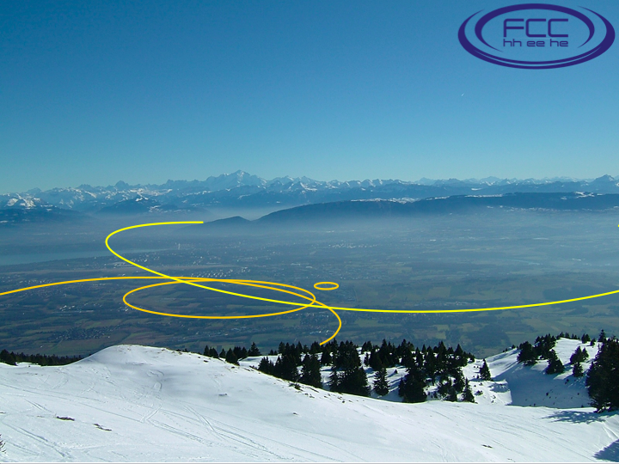
The Future Circular Collider Vision
Exploration of the 10 TeV scale
Direct (100 TeV pp) + Indirect (e⁺e⁻)

Slide 2
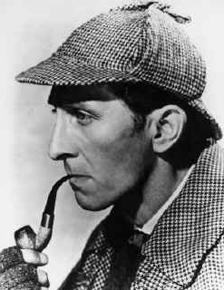
The Dog(s) that did not Bark
To Sherlock Holmes:
“Is there any other point to which you
would wish to draw my attention?”
Holmes:
"To the curious incident of the dog in the night-time."
To Holmes:
"The dog did nothing in the night-time."
Holmes:
"That was the curious incident.”
We have a/the Higgs:
Is there anything else?

Slide 3
No BSM? Beware Historical Hubris
"So many centuries after the Creation, it is unlikely that anyone could find hitherto unknown lands of any value” - Spanish Royal Commission, rejecting Christopher Columbus proposal to sail west, < 1492
“The more important fundamental laws and facts of physical science have all been discovered” – Albert Michelson, 1894
"There is nothing new to be discovered in physics now. All that remains is more and more precise measurement" - Lord Kelvin, 1900
“Is the End in Sight for Theoretical Physics?” – Stephen Hawking, 1980

Slide 4

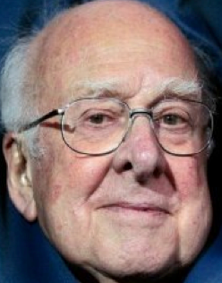
SUSY
« Empty » space is unstable
Dark matter
Origin of matter
Masses of neutrinos
Hierarchy problem
Inflation
Quantum gravity
…
SUSY
SUSY
SUSY
SUSY
SUSY
^{The} Standard Model
Notes:
4

Slide 5
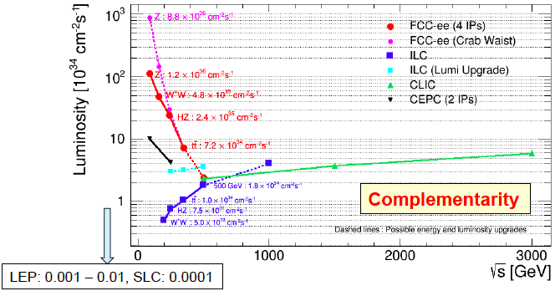
Projected e⁺e⁻ Colliders:
Luminosity vs Energy
Updated from TLEP physics study group: arXiv:1308.6176

Slide 6
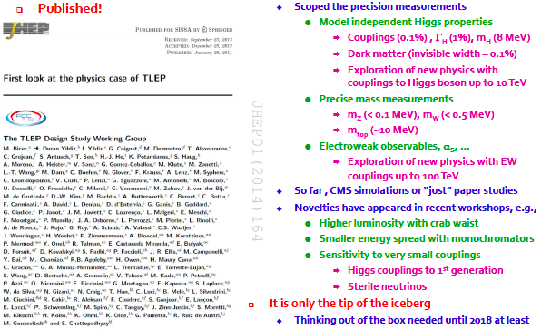
First FCC-ee Physics Study

Slide 7
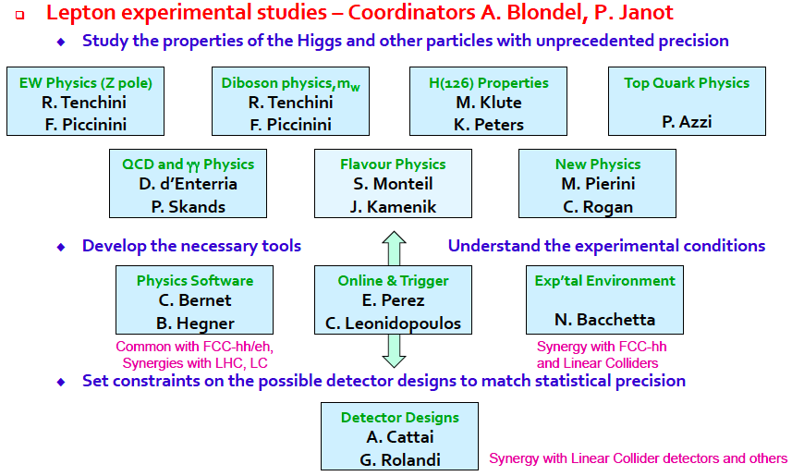
FCC-ee Experimental Studies

Slide 8
Phenomenology Working Groups
QCD and γγ physics (with exp)
    Peter Skands
Precision electroweak calculations
    Sven Heinemeyer
Flavour physics (with exp)
    Jernej Kamenik
Model-building and new physics
    Andi Weiler
Global analysis, combination, complementarity
    John Ellis

Slide 9
The Twin Frontiers of FCC-ee Physics
Precision Measurements
Rare Decays
Springboard for sensitivity to new physics
Experimental issues:
  Systematics
Theoretical issues:
  Higher-order QCD
  Higher-order EW
  Mixed QCD + EW
Direct searches for new physics
Many opportunities
Z: 10¹³
b, c, τ: 10¹²
W: 10⁸
H: 10⁶
t: 10⁶

Slide 10
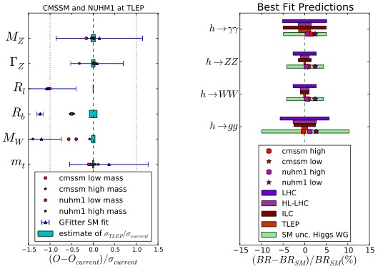
Precision FCC-ee Measurements
Precision Electroweak
Precision Higgs

Slide 11
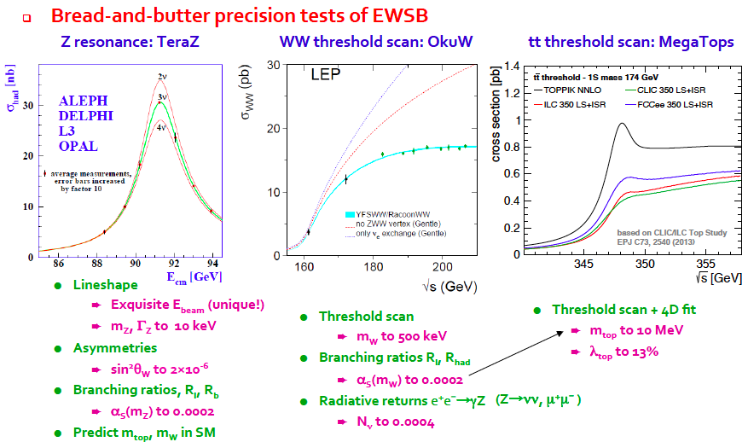
Possible FCC-ee Precision Measurements

Slide 12
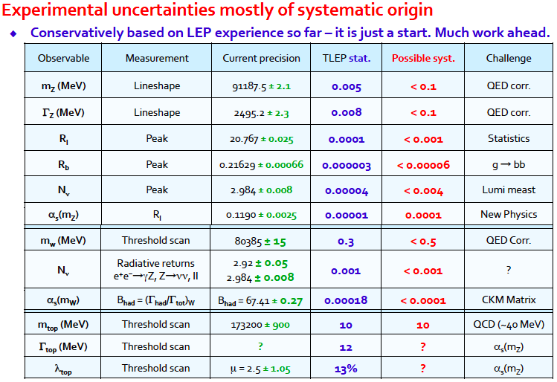
Possible FCC-ee Precision Measurements

Slide 13

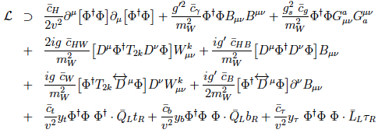
Why is there Nothing rather than Something?
Effective field-theory (EFT) operators as relics of higher-energy physics:
EFT operators with SU(2) × U(1) symmetry:
Constrain with precision EW, Higgs data, TGCs ...

Slide 14


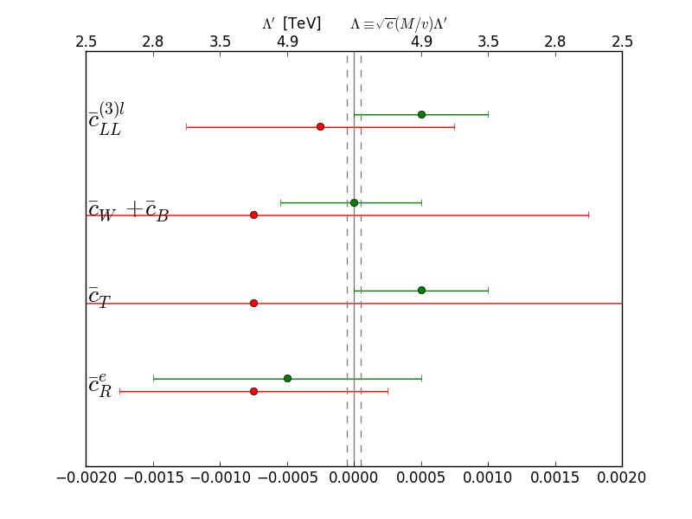
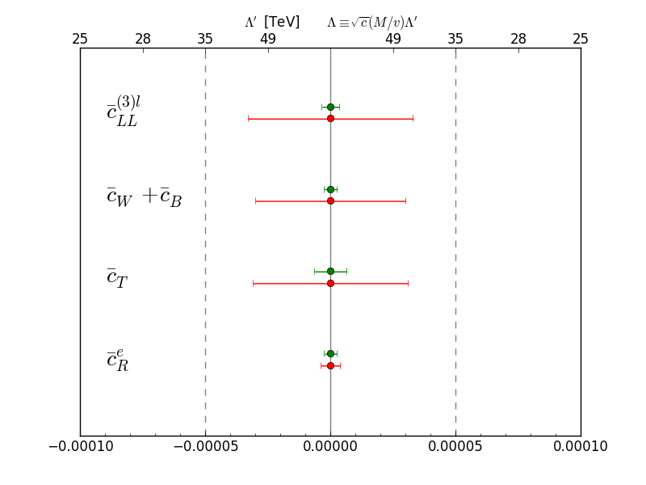




FCC-ee Sensitivity to EFT Operators
Possible new physics corrections to EWPOs:
LEP constraints
FCC-ee constraints
See Λ ~ 100 TeV?
JE, Sanz & You

Slide 15
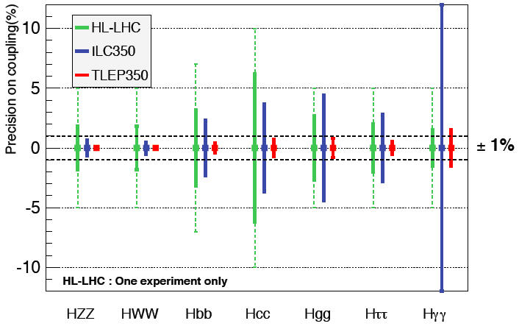
Possible Future Higgs Measurements

Slide 16
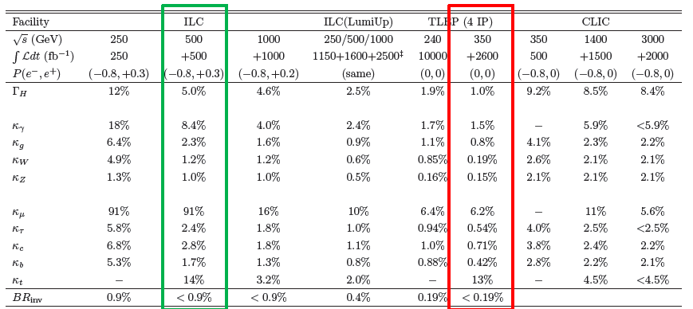
Possible Future Higgs Measurements
Need to reduce theoretical uncertainties to match
Essential for new physics interpretations

Slide 17
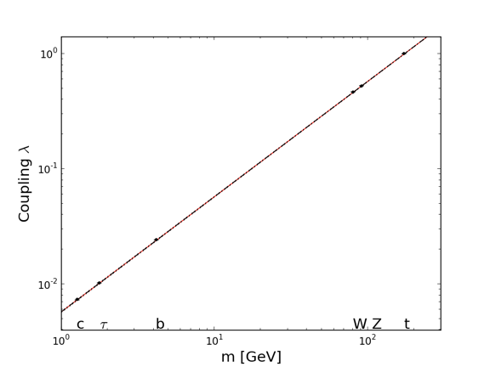
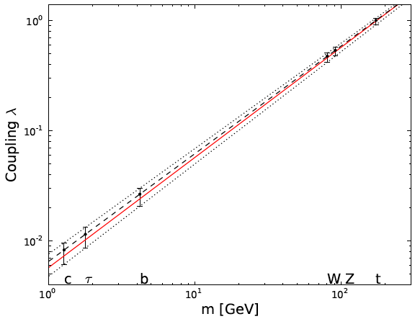

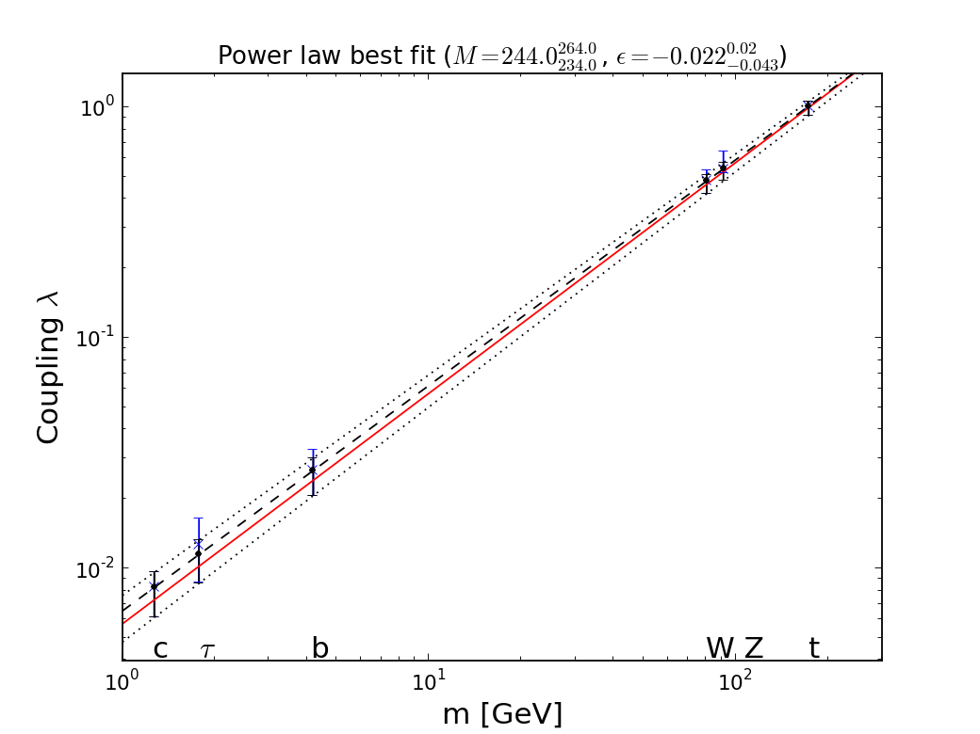

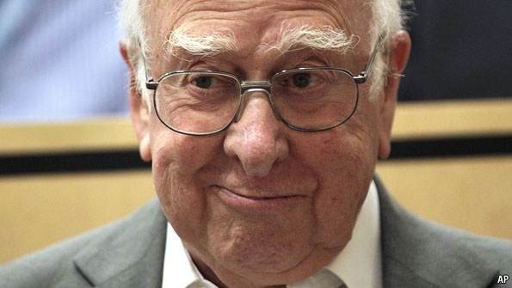

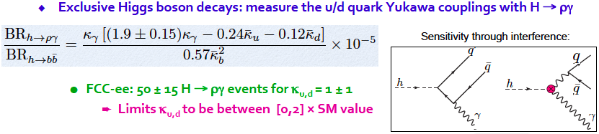
H Coupling Measurements Now
@FCC-ee
M = 246.0 ± 0.8 GeV, ε = 0.0000^{+0.0015}_{-0.0010}
e⁺e⁻ coupling?
JE & Tevong You

Slide 18
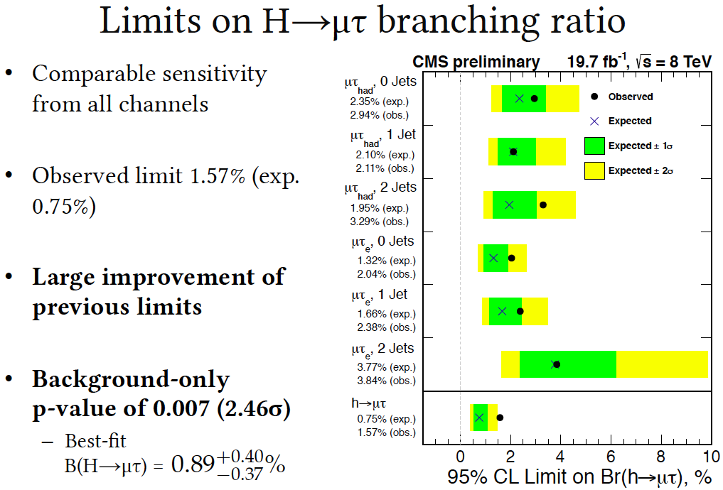
Flavour-Changing Higgs Couplings?
BUT?

Slide 19
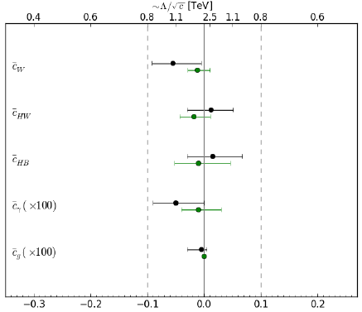
LHC Fits including Associated Production
Using H signal strengths & VH kinematics in global fit
Single-parameter fits
JE, Sanz & Tevong You, arXiv:1404.3667

Slide 20
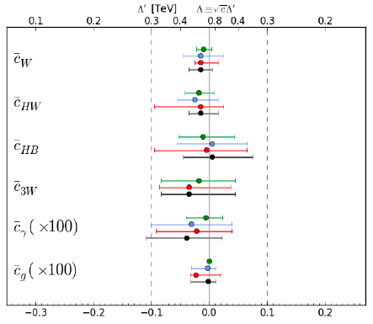
Including LHC Triple-Gauge Couplings
Higgs production
LHC Triple-gauge couplings
Global combination
Individual operators
JE, Sanz & Tevong You, arXiv:1410.7703

Slide 21
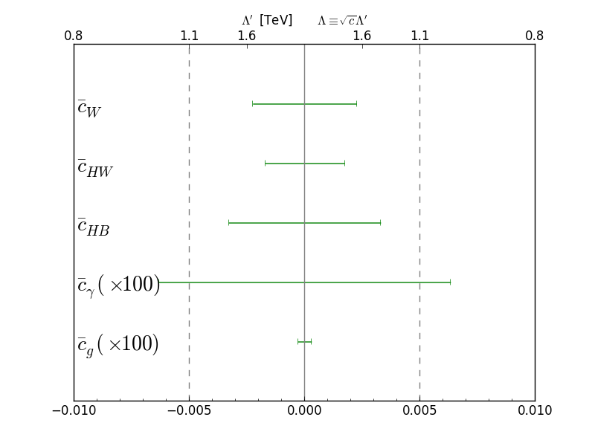
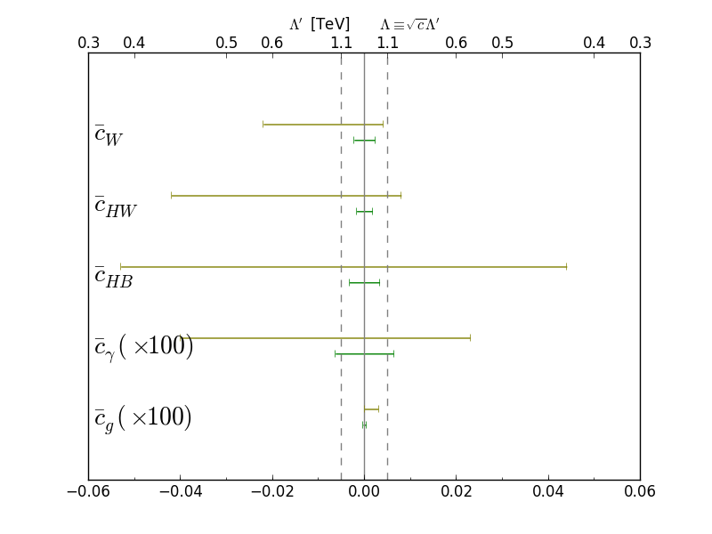
FCC-ee Higgs Measurements vs EFTs
LHC constraints
FCC-ee constraints
JE, Sanz & You

Slide 22
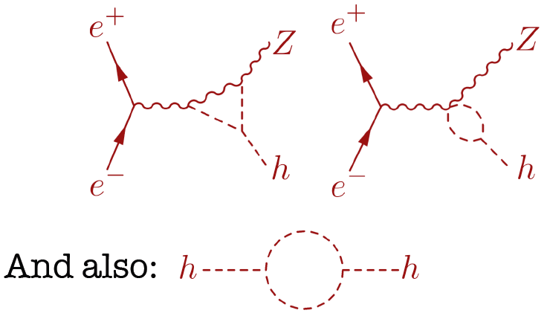
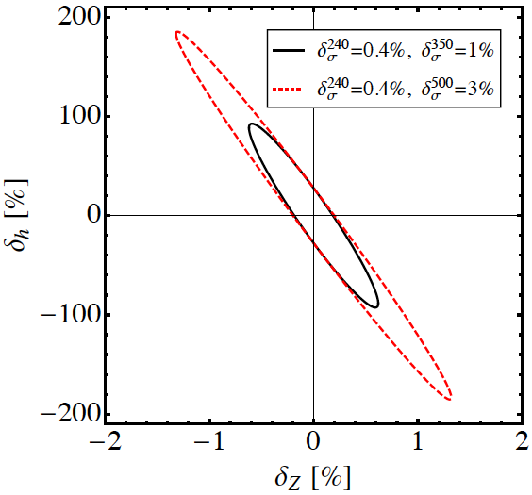

FCC-ee Sensitivity to 3h Coupling
Loop corrections to σ(H+Z):
3h correction δ_{h} energy-dependent
δ_{Z} energy-independent: can distinguish
McCullough

Slide 23
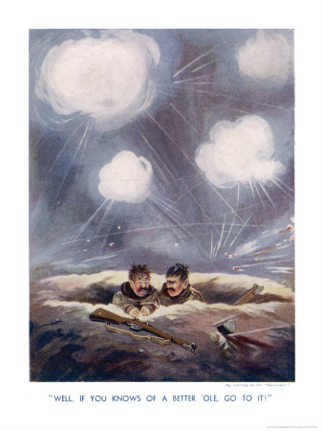
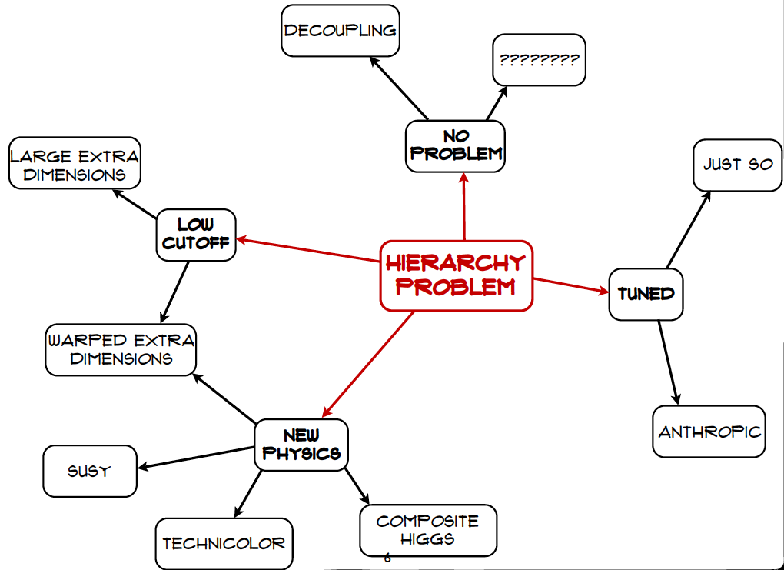
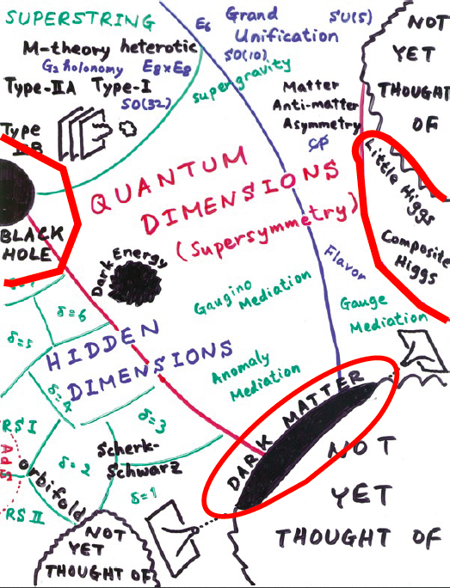
Craig@LHCP

Slide 24
What else is there?
Supersymmetry
New motivations
From LHC Run 1
Stabilize electroweak vacuum
Successful prediction for Higgs mass
  Should be < 130 GeV in simple models
Successful predictions for couplings
  Should be within few % of SM values
Naturalness, GUTs, string, …, dark matter

Slide 25


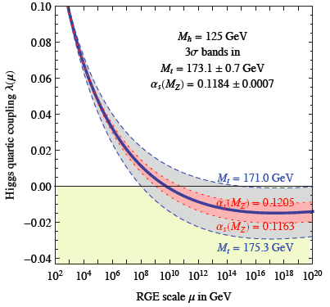
Instability of Electroweak Vacuum
Large M_{h} → large self-coupling → blow up at low-energy scale Λ due to
renormalization
Small: renormalization
due to t quark drives
quartic coupling < 0
at some scale Λ
→ vacuum unstable
Vacuum could be stabilized by Supersymmetry
Instability @
10^{11.1±1.3} GeV
Degrassi, Di Vita, Elias-Miro, Giudice, Isodori & Strumia, arXiv:1205.6497

Slide 26
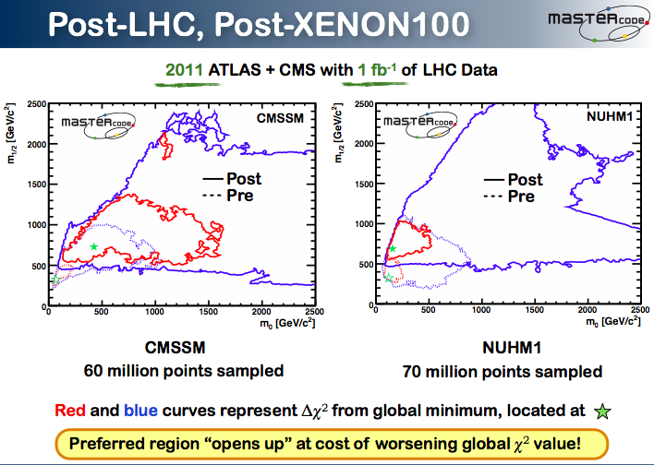
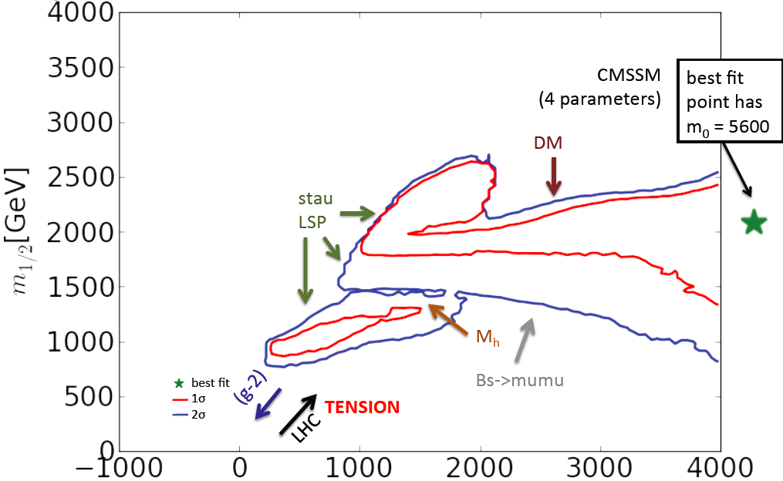
Constrained MSSM
2012
20/fb
Buchmueller, JE et al: arXiv:1312.5250
p-value of simple models ~ 5% (also SM)

Slide 27
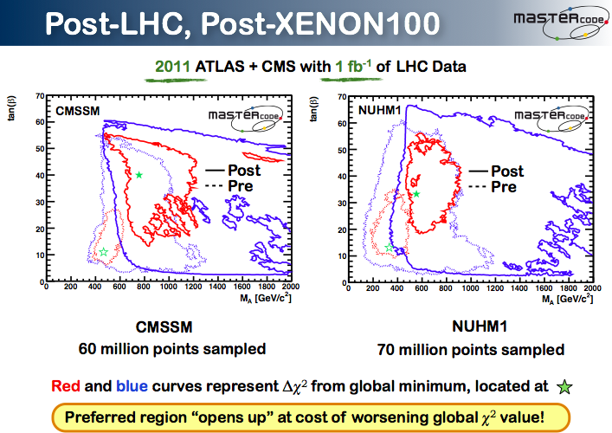

Constrained MSSM
2012
20/fb
1
5
Reach of LHC at
High luminosity
Squark mass
CMSSM
Buchmueller, JE et al: arXiv:1312.5250
Favoured values of squark mass also significantly
above pre-LHC, > 1.6 TeV

Slide 28
Impact of LEP Precision Z on CMSSM
Γ_{Z}
O. Buchmueller, JE, K. de Vries et al.
Γ_{Z} constraint on (m₀, m_{1/2}) plane in CMSSM:
All points within one current σ of low-mass best-fit value

Slide 29
Impact of FCC-ee Precision Z on CMSSM
Γ_{Z}
O. Buchmueller, JE, K. de Vries et al.
Γ_{Z} constraint on (m₀, m_{1/2}) plane in CMSSM:
Points within one, two, three FCC-ee σ of low-mass best-fit value

Slide 30
Impact of FCC-ee Precision on Susy
M_{W}
K. De Vries
(MasterCode)
M_{W} constraint on (m₀, m_{1/2}) plane in CMSSM:
All points within one current σ of low-mass best-fit value

Slide 31
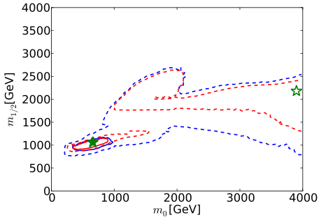
Impact of FCC-ee Precision Z on CMSSM
O. Buchmueller, JE, K. de Vries et al.
Estimate of (m₀, m_{1/2}) in CMSSM on basis of
EW precision measurements with low-mass best-fit central values

Slide 32
Impact of LHC Precision H on CMSSM
H to WW
O. Buchmueller, JE, K. de Vries et al.
H to WW constraint on (m₀, m_{1/2}) plane in CMSSM:
All points within one current σ of low-mass best-fit value

Slide 33
Impact of LHC Precision H on CMSSM
H to gg
O. Buchmueller, JE, K. de Vries et al.
H to gg constraint on (m₀, m_{1/2}) plane in CMSSM:
All points within one current σ of low-mass best-fit value

Slide 34
Impact of FCC-ee Precision H on CMSSM
H to ZZ
O. Buchmueller, JE, K. de Vries et al.
H to ZZ constraint on (m₀, m_{1/2}) plane in CMSSM:
Points within one, two, three FCC-ee σ of low-mass best-fit value

Slide 35
Impact of FCC-ee Precision H on CMSSM
H to gg
O. Buchmueller, JE, K. de Vries et al.
H to gg constraint on (m₀, m_{1/2}) plane in CMSSM:
Points within one, two, three FCC-ee σ of low-mass best-fit value

Slide 36
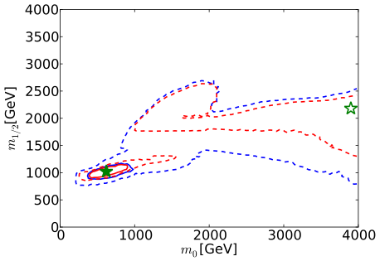
Impact of FCC-ee Precision H on CMSSM
O. Buchmueller, JE, K. de Vries et al.
Estimate of (m₀, m_{1/2}) in CMSSM on basis of
H measurements with low-mass best-fit central values

Slide 37
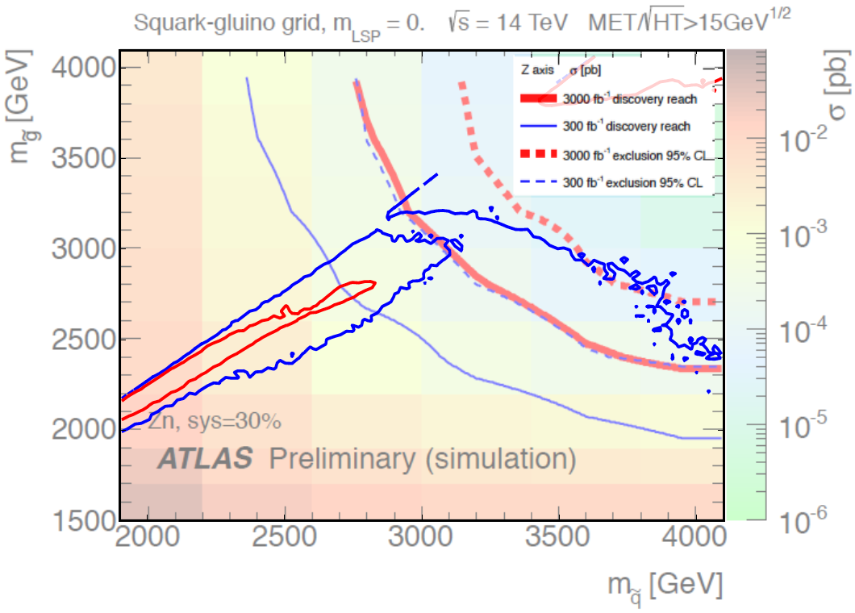
LHC Reach for Supersymmetry
CMSSM, etc.
O. Buchmueller, JE, K. de Vries et al.

Slide 38
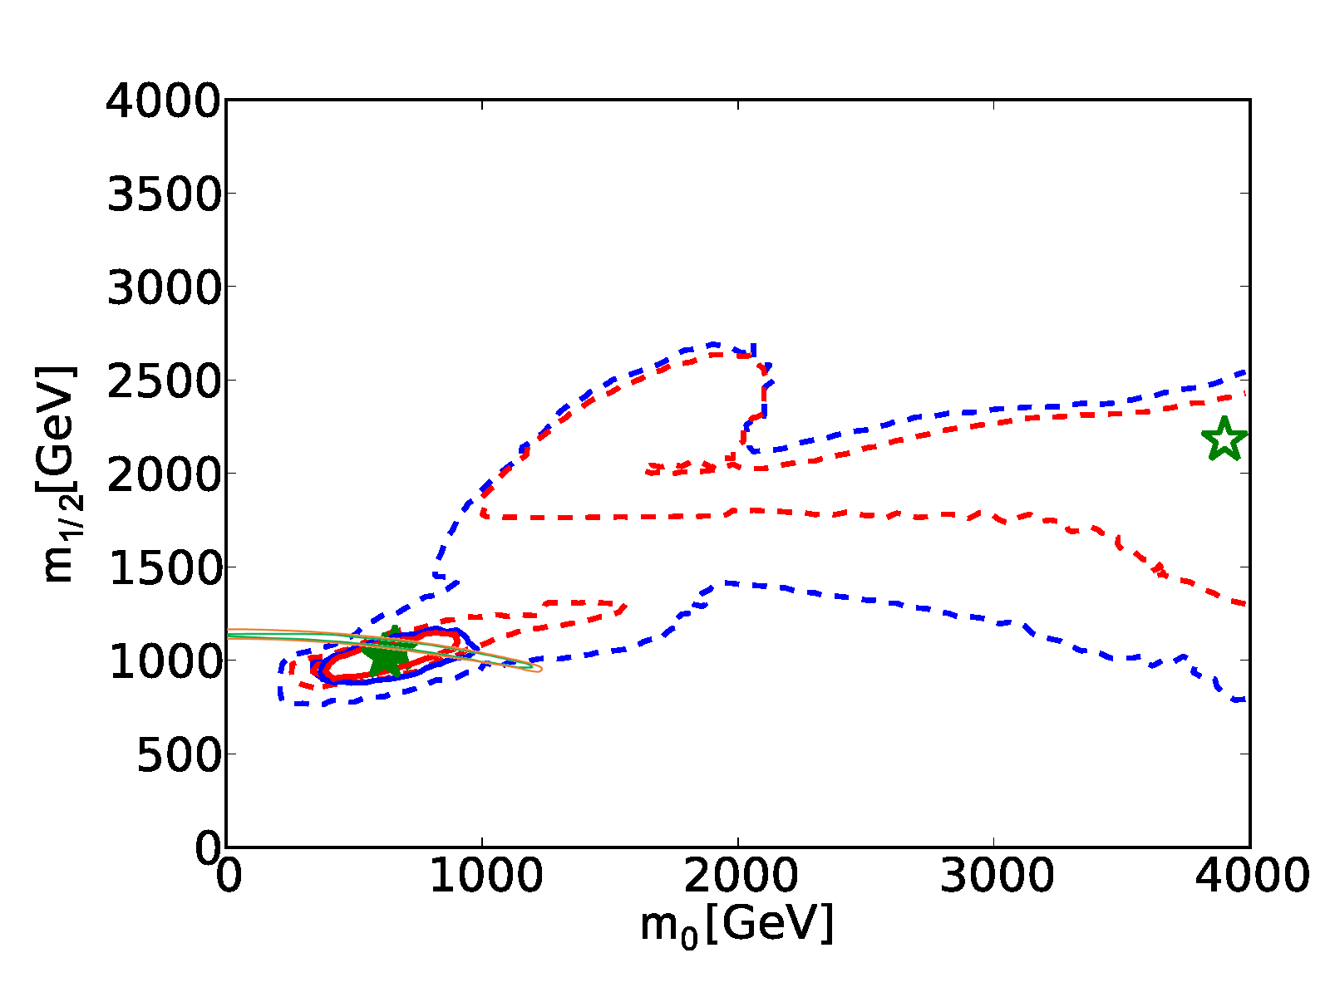
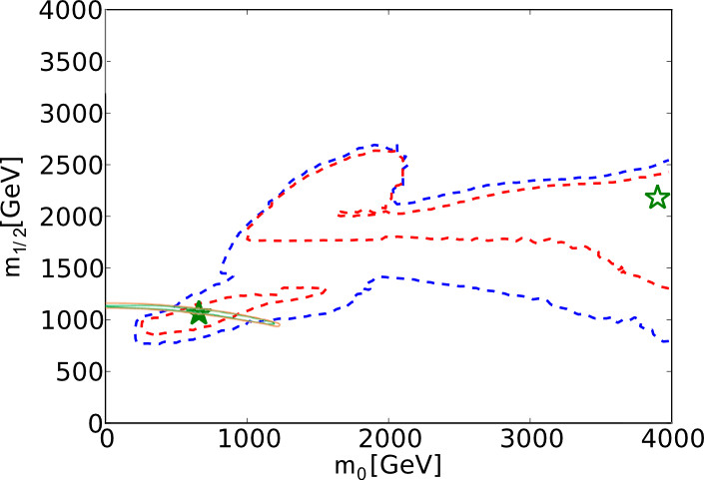
LHC - FCC-ee Comparison in CMSSM
Compare LHC masses with FCC-ee measurements,
Test SUSY at the loop level
O. Buchmueller, JE, K. de Vries et al.

Slide 39
cf, LEP and LHC
“Those who don't know history are doomed to repeat it…”
  Edmund Burke
“… and maybe also those who do.”
LEP: Precision Z studies, W+W-,
search for Higgs, anything else
LHC: search for Higgs, anything else
FCC-ee, -hh together: 50 years of physics
✔ ✔
✖ ✖
✔ ?

