Slide 1


Future Circular Collider (FCC)
Study Scope & Collaboration
M. Benedikt, F. Zimmermann
gratefully acknowledging input from FCC global design study team
Pisa, 3 February 2015

Slide 2

Outline
Motivation & scope
Parameters & a few challenges
Study organization
Summary

Slide 3
Summary: European Strategy Update 2013
Design studies and R&D at the energy frontier
….“to propose an ambitious post-LHC accelerator project at CERN by the time of the next Strategy update”:
d) CERN should undertake design studies for accelerator projects in a global context,
with emphasis on proton-proton and electron-positron high-energy frontier machines.
These design studies should be coupled to a vigorous accelerator R&D programme, including high-field magnets and high-gradient accelerating structures,
in collaboration with national institutes, laboratories and universities worldwide.
http://cds.cern.ch/record/1567258/files/esc-e-106.pdf
strategy adopted at Brussels in May 2013, during exceptional session of the CERN Council in presence of the European Commission

Slide 4

Future Circular Collider Study - SCOPE
CDR and cost review for the next ESU (2018)
Forming an international collaboration to study:
pp-collider (FCC-hh) → main emphasis, defining infrastructure requirements
80-100 km infrastructure in Geneva area
e⁺e⁻ collider (FCC-ee) as potential intermediate step
p-e (FCC-he) option
~16 T ⇒ 100 TeV pp in 100 km
~20 T ⇒ 100 TeV pp in 80 km

Slide 5


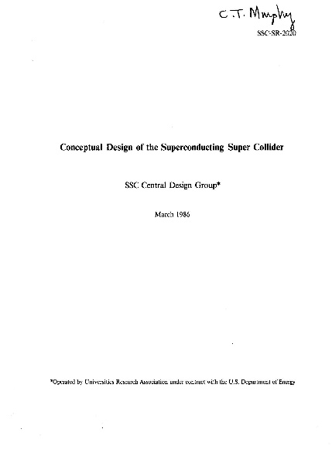
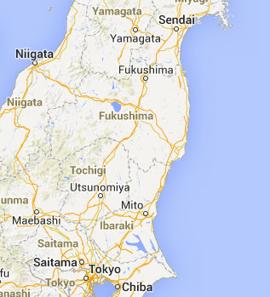
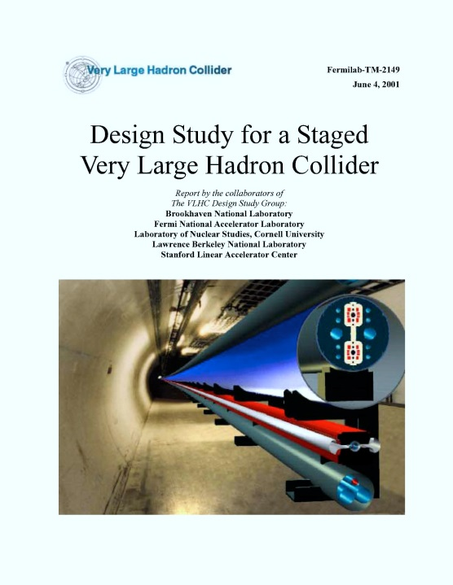
Previous studies in Italy (ELOISATRON 300km), USA (SSC 87km, VLHC 233km), Japan (TRISTAN-II 94km)
ex. ELOISATRON
ex. SSC
Supercolliders Superdetectors: Proceedings of the 19th and 25th Workshops of the INFN Eloisatron Project
SSC CDR 1986
ex. TRISTAN
Many aspects of machine design and R&D non-site specific.
Exploit synergies with other projects and prev. studies
Tristan-II
option 2
ex. VLHC
F. Takasaki
H. Ulrich Wienands, The SSC Low Energy Booster: Design and Component Prototypes for the First Injector Synchrotron, IEEE Press, 1997
VLHC Design Study Group Collaboration
June 2001. 271 pp.
SLAC-R-591, SLAC-R-0591, SLAC-591,
SLAC-0591, FERMILAB-TM-2149
Tristan-II
option 1
http://www.vlhc.org/

Slide 6
meanwhile on the other side of the globe

Slide 7
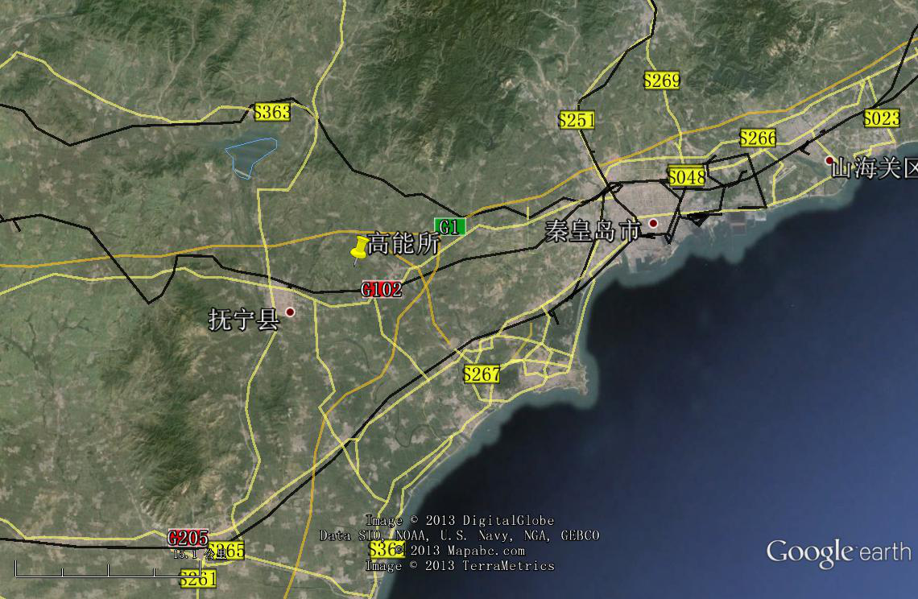
CepC/SppC study (CAS-IHEP), CepC CDR Feb. 2015, e⁺e⁻ collisions ~2028; pp collisions ~2042
Qinhuangdao (秦皇岛）
CepC, SppC
50 km
easy access
300 km from Beijing
3 h by car
1 h by train
70 km
“Chinese Toscana”
Yifang Wang

Slide 8
W. Chou

Slide 9
US P5 Recommendations (2014)
“The motivation for future-generation accelerators must be the Science Drivers”
“A very high-energy proton-proton collider is the most powerful future tool for direct discovery of new particles and interactions under any scenario of physics results that can be acquired in the P5 time window.”

Slide 10

FCC hadron collider motivation:
pushing the energy frontier
hadron collider: presently and for coming decades the
only option for exploring energy scale at 10’s of TeV
energy reach
Cf. LHC: → factor 3.5-4 in radius, → factor 2 in field
→ factor 7-8 in energy
$$E∝B_{dipole}{×ρ}_{bending}$$

Slide 11
FCC-hh baseline parameters
parameter | FCC-hh | LHC
energy | 100 TeV c.m. | 14 TeV c.m.
dipole field | 16 T | 8.33 T
# IP | 2 main, +2 | 4
normalized emittance | 2.2 μm | 3.75 μm
luminosity/IP_{main} | 5 x 10³⁴ cm⁻²s⁻¹ | 1 x 10³⁴ cm⁻²s⁻¹
energy/beam | 8.4 GJ | 0.39 GJ
synchr. rad. | 28.4 W/m/apert. | 0.17 W/m/apert.
bunch spacing | 25 ns (5 ns) | 25 ns
Preliminary, subject to evolution (several luminosity scenarios)

Slide 12
FCC-hh: high-field magnet R&D
FHC baseline is 16T Nb₃Sn technology for ~100 TeV c.m. in ~100 km
Develop Nb₃Sn-based 16 T dipole technology (at 4.2 K?),
conductor developments
short models with sufficient aperture (40 – 50 mm) and
accelerator features (margin, field quality, protect-ability, cycled operation).
Goal: 16T short dipole models by 2018/19 (America, Asia, Europe)
In parallel HTS development targeting 20 T (option and longer term)
Goal: Demonstrate HTS/LTS 20 T dipole technology:
5 T insert (EuCARD2), ~40 mm aperture and accelerator features
Outsert of large aperture ~100 mm, (FRESCA2 or other)

Slide 13
US High Field Magnet R&D Proposal
White paper submitted to HEPAP ARD subpanel: G. Apollinari et al., “National Program on High Field Accelerator Magnet R&D” Fermilab-FN-0993-TD
Calls for creation of a US Lab Program (BNL, FNAL, NHMFL, LBNL) coordinated with international efforts to support P5 priorities
Main objectives:
Develop accelerator magnets at the limit of Nb₃Sn capabilities.
Explore LTS accelerator magnets with HTS inserts for fields beyond Nb₃Sn capabilities.
Drive high-field conductor development, both Nb₃Sn and HTS materials, for accelerator magnets.
Address fundamental aspects of magnet design, technology and performance that could lead to substantial reduction of magnet cost.
These common goals are implemented focusing on different coil geometries
linking a large-scale science project (FCC) to ambitious technological developments
G.L. Sabbi

Slide 14

Superconductor Price Comparison
Steve Gourlay – superconductor prices paid by LBNL to US companies:
present superconductor prices quoted by Chinese companies:
Bi-2223: RMB 15,000/kg ⇔ USD 2,400/kg
YBCO: RMB 20,000/kg ⇔ USD 3,300/kg
another factor 10 cost reduction promised by Chinese industry over the coming ten years!
W. Chou

Slide 15
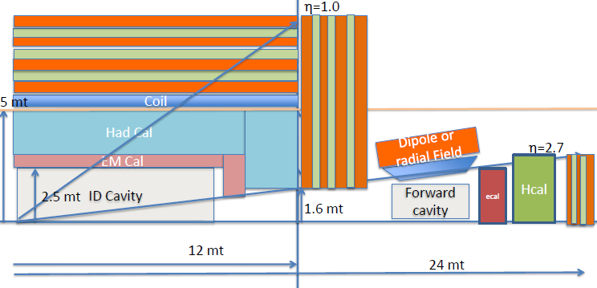
SC magnets for detectors
Dipole Field
Need BL² ~10 x ATLAS/CMS for 10% muon momentum resolution at 10-20 TeV.
Solenoid: B=5T, R_{in}=5-6m, L=24m → size is x2 CMS. Stored energy: ~ 50 GJ
> 5000 m³ of Fe in return joke → alternative: thin (twin) lower-B solenoid at
larger R to capture return flux of main solenoid
Forward dipole à la LHCb: B~10 Tm
F. Gianotti, H. Ten Kate

Slide 16

FCC-hh machine protection
  Stored beam energy: 8 GJ/beam (0.4 GJ LHC) = 16 GJ total
  ➔ equivalent to an Airbus A380 (560 t) at full speed (850 km/h)
  Collimation, beam loss control, radiation effects: important
  Injection / dumping / beam transfer: critical operations
  Magnet / machine protection: to be considered early on

Slide 17
FCC-ee collider motivation:
pushing precision & lumi frontier
lepton collider: best option to search for extremely rare
decays of H, Z, etc. and for precision coupling
Measurements
luminosity & energy reach
Cf. LEP2: → factor 3.5-4 in radius
→ factor 4-4.5 in P_{SR}
→ factor 50 in 1/β_{y}*
→ factor >2 in ξ_{y,0}

Slide 18
FCC-ee baseline parameters
parameter | FCC-ee | LEP2
energy/beam | 45 – 175 GeV | 105 GeV
bunches/beam | 98 – 16700 | 4
beam current | 6.6 – 1450 mA | 3 mA
hor. emittance | ~2 nm | ~22 nm
emittance ratio ε_{y}/ε_{y} | 0.1% | 1%
vert. IP beta function β_{y}* | 1 mm | 50 mm
luminosity/IP | 1.8-28 x 10³⁴ cm⁻²s⁻¹ | 0.0012 x 10³⁴ cm⁻²s⁻¹
energy loss/turn | 0.03-7.55 GeV | 3.34 GeV
synchrotron radiation power | 100 MW | 23 MW
RF voltage | 2.5 – 11 GV | 3.5 GV
  Large number of bunches at Z and WW and H requires 2 rings.
  High luminosity means short beam lifetime (few mins) and requires continues injection.

Slide 19
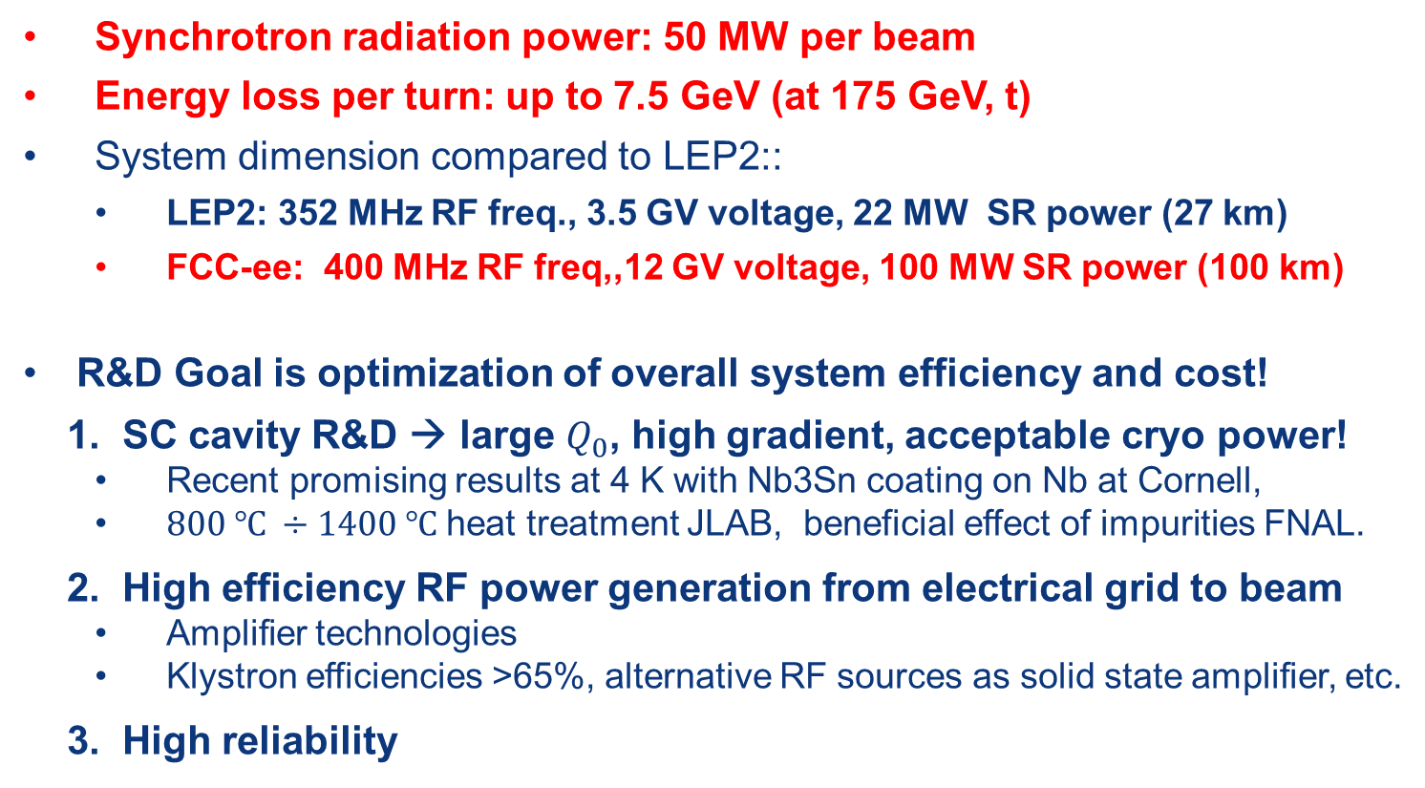
FCC-ee: RF parameters and R&D
Synchrotron radiation power: 50 MW per beam
Energy loss per turn: up to 7.5 GeV (at 175 GeV, t)
System dimension compared to LEP2::
  LEP2: 352 MHz RF freq., 3.5 GV voltage, 22 MW SR power (27 km)
  FCC-ee: 400 MHz RF freq,,12 GV voltage, 100 MW SR power (100 km)
R&D Goal is optimization of overall system efficiency and cost!
  1. SC cavity R&D → large $Q_{0}$, high gradient, acceptable cryo power!
  Recent promising results at 4 K with Nb3Sn coating on Nb at Cornell,
  $800 ℃ ÷1400 ℃$ heat treatment JLAB, beneficial effect of impurities FNAL.
2. High efficiency RF power generation from electrical grid to beam
  Amplifier technologies
  Klystron efficiencies >65%, alternative RF sources as solid state amplifier, etc.
3. High reliability

Slide 20
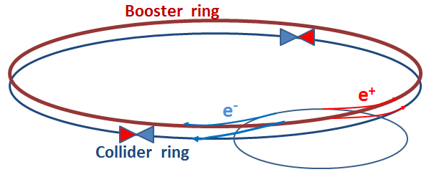
FCC-ee top-up injector
Beside the collider ring(s), a booster of the same size (same tunnel) must provide beams for top-up injection
  same RF voltage, but low power (~ MW)
  top up frequency ~0.1 Hz
  booster injection energy ~5-20 GeV
  bypass around the experiments
A. Blondel
injector complex for e⁺ and e⁻ beams of 10-20 GeV
  Super-KEKB injector ~ almost suitable

Slide 21

SuperKEKB = FCC-ee demonstrator
beam commissioning will start in 2015
K. Oide et al.
top up injection at high current
β_{y}* =300 μm (FCC-ee: 1 mm)
lifetime 5 min (FCC-ee: ≥20 min)
ε_{y}/ε_{x} =0.25% (similar to FCC-ee)
off momentum acceptance (±1.5%, similar to FCC-ee)
e⁺ production rate (2.5x10¹²/s, FCC-ee: <1.5x10¹²/s (Z cr.waist)
SuperKEKB goes beyond FCC-ee, testing all concepts

Slide 22
tentative FCC-he parameters
parameter | e⁻ | p
energy/beam | 60 GeV (ERL) | 50 TeV
bunches/beam | - | 10600
bunch intensity | 5x10⁹ | 10¹¹
hor. & vert. emittance | 0.17 nm | 0.04 nm
emittance ratio ε_{y}/ε_{y} | 1 | 1
IP beta function β_{x,y}* | 100 mm | 400 mm
IP beta function σ_{x,y}* | 4 μm
luminosity/IP | 1.0 x 10³⁴ cm⁻²s⁻¹
synchrotron power | ~50 MW | 2.5 MW
Preliminary, subject to evolution (staging scenarios)

Slide 23
FCC Work Breakdown Structure
Physics and Experiments
Accelerators
Infrastructures
and Operation
Implementation
and Planning
Study and Quality
Management
Hadron Collider Physics
Hadron Injectors
Civil Engineering
Project Risk Assessment
Study Administration
Hadron Collider Experiments
Hadron Collider
Technical Infrastructures
Implementation Scenarios
Communications
Lepton Collider Physics
Lepton Injectors
Operation and Energy Efficiency
Cost Models
Conceptual
Design Report
Lepton Collider Experiments
Lepton Collider
Integration
Lepton-Hadron Collider Physics
Lepton-Hadron Collider
Computing and
Data Services
top level
Lepton-Hadron Collider Experiment
Technology R&D
Safety, RP and Environment

Slide 24
FCC study status
Study launched at FCC kick-off meeting in Feb. 2014
Presently forming a global collaboration based on general MoU between CERN and individual partners. Specific addenda for each participant.
First international collaboration board meeting on 9. and 10. September 2014 at CERN. Chair Prof. L. Rivkin (PSI/EPFL).
DS proposal for EC support within Horizon 2020
First FCC Week 23-27 March in Washington DC.

Slide 25

FCC work plan study phase
2014 |  |  |  | 2015 |  |  |  | 2016 |  |  |  | 2017 |  |  |  | 2018
Q1 | Q2 | Q3 | Q4 | Q1 | Q2 | Q3 | Q4 | Q1 | Q2 | Q3 | Q4 | Q1 | Q2 | Q3 | Q4 | Q1 | Q2 | Q3 | Q4
Prepare
Kick-off, collaboration forming,
→study plan and organisation
Ph 1: Explore options
“weak interaction”
Workshop & Review →identification of baseline
Ph 2: Conceptual study of baseline “strong interact.”
Workshop & Review, cost model, LHC results → study re-scoping?
4 large FCC Workshops
1st FCC workshop 23 – 27 March 2015
Ph 3: Study
consolidation
Workshop & Review
→ contents of CDR
Report
Release CDR & Workshop on next steps

Slide 26
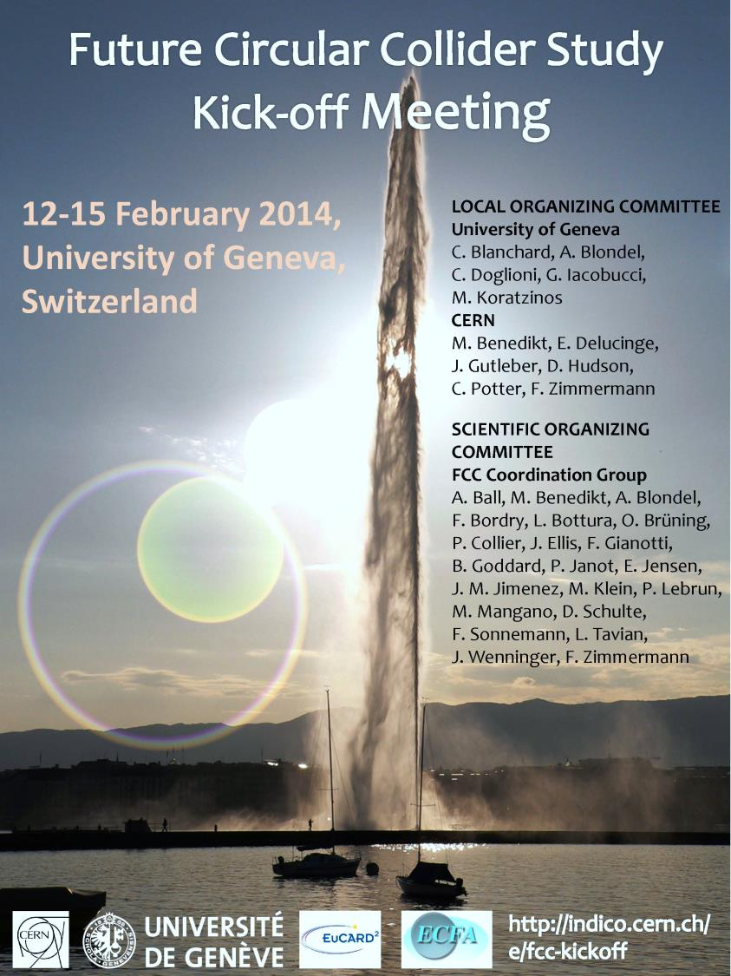
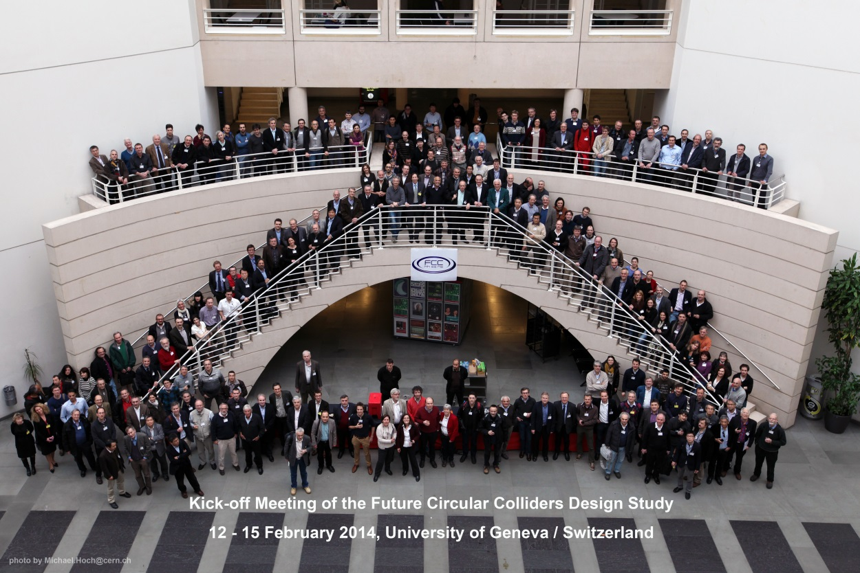
FCC Kick-off Meeting
University of Geneva
12-15 February 2014
>340 participants
http://indico.cern.ch/e/fcc-kickoff
http://cern.ch/fcc

Slide 27
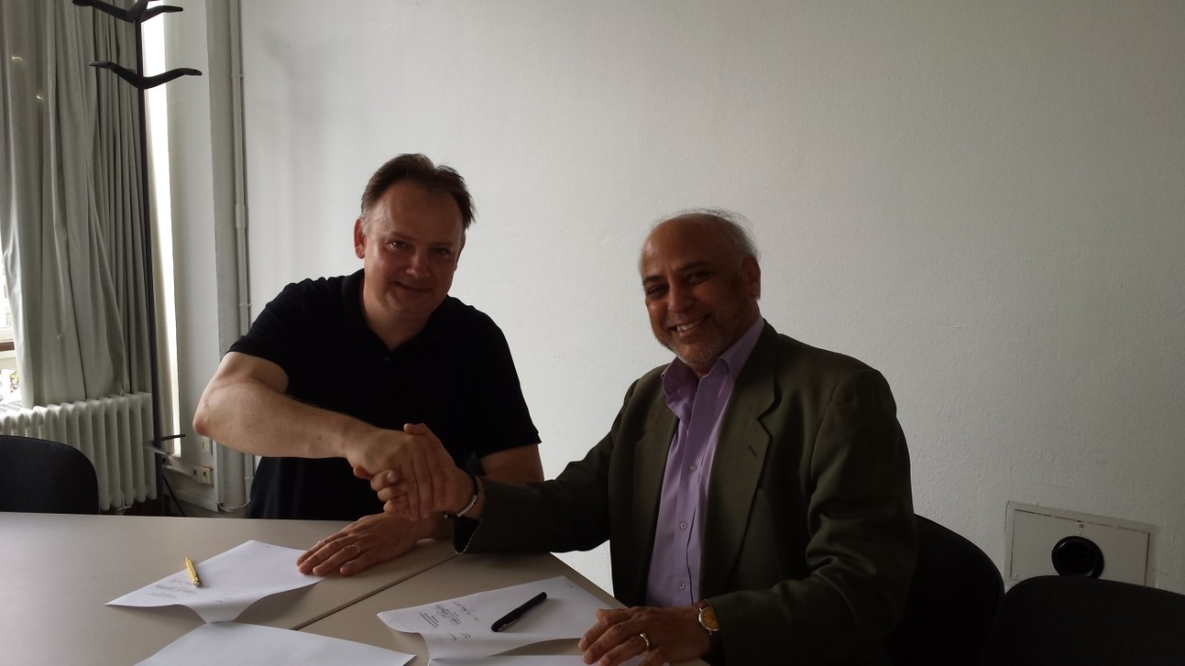
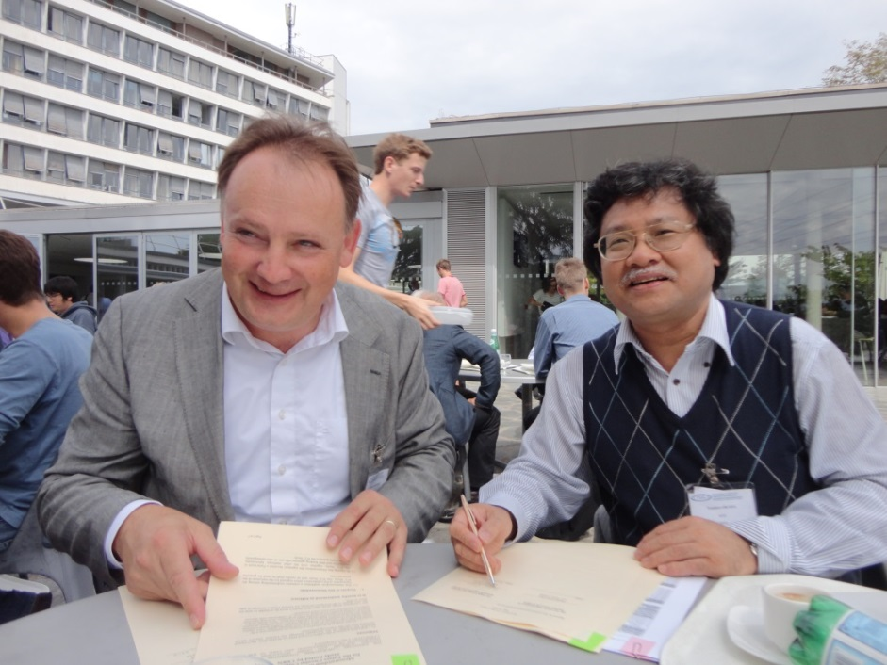
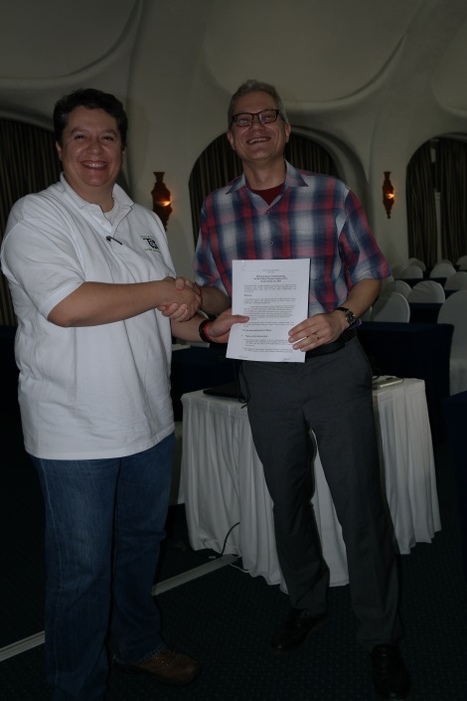
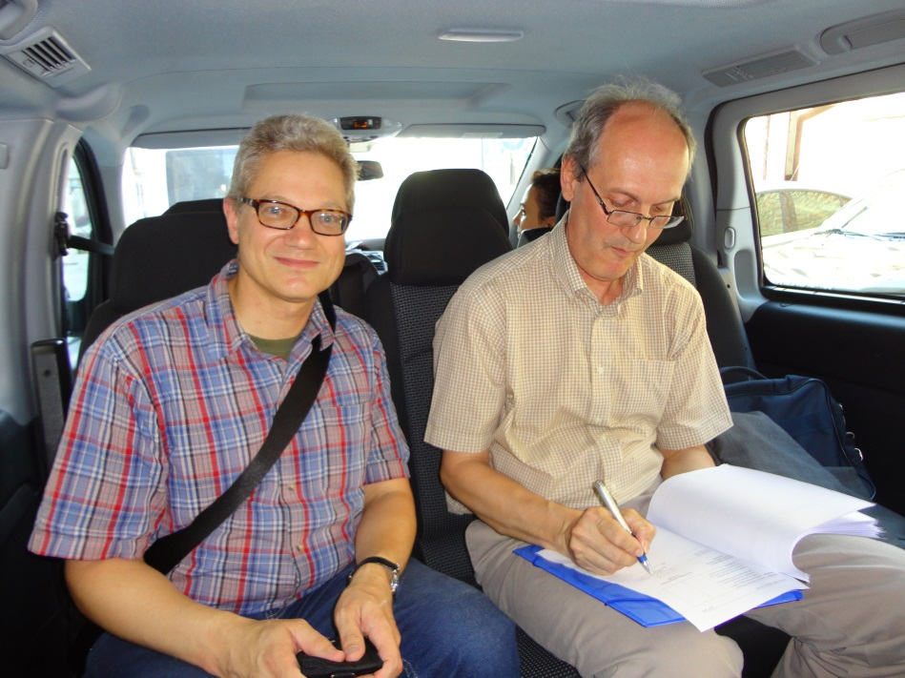
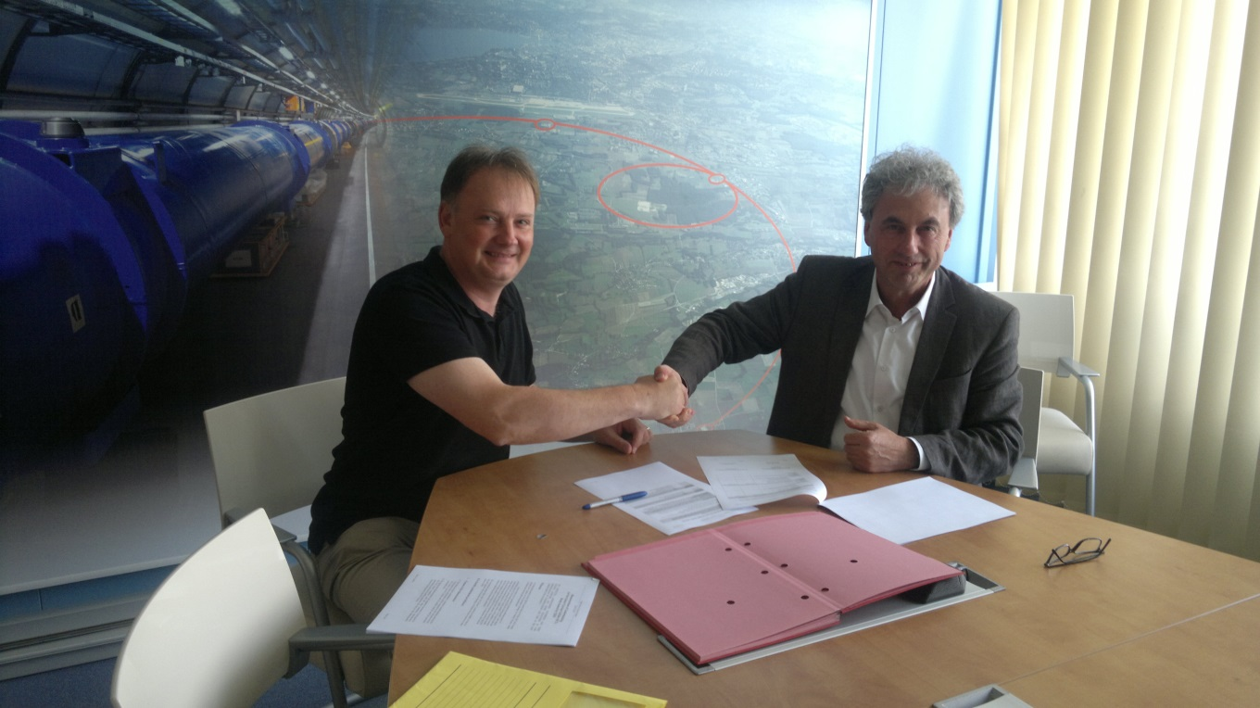
presently signing FCC MoUs with partners

Slide 28
FCC MoU Status
43 collaboration members & CERN as host institute , 21 Jan. 2015
ALBA/CELLS, Spain
U Bern, Switzerland
BINP, Russia
CASE (SUNY/BNL), USA
CBPF, Brazil
CEA Grenoble, France
CIEMAT, Spain
CNRS, France
Cockcroft Institute, UK
U Colima, Mexico
CSIC/IFIC, Spain
TU Darmstadt, Germany
DESY, Germany
TU Dresden, Germany
Duke U, USA
EPFL, Switzerland
Gangneung-Wonju Nat. U., Korea
U Geneva, Switzerland
Goethe U Frankfurt, Germany
GSI, Germany
Hellenic Open U, Greece
HEPHY, Austria
IFJ PAN Krakow, Poland
INFN, Italy
INP Minsk, Belarus
U Iowa, USA
IPM, Iran
UC Irvine, USA
Istanbul Aydin U., Turkey
JAI/Oxford, UK
JINR Dubna, Russia
KEK, Japan
KIAS, Korea
King’s College London, UK
Korea U Sejong, Korea
MEPhI, Russia
Northern Illinois U., USA
NC PHEP Minsk, Belarus
PSI, Switzerland
Sapienza/Roma, Italy
UC Santa Barbara, USA
U Silesia, Poland
TU Tampere, Finland

Slide 29
FCC Study Coordination Group
preliminary
Study Coordination
M. Benedikt, F. Zimmermann
Hadron Collider Physics and Experiments
F. Gianotti, A. Ball, M. Mangano
Lepton Collider Physics and Experiments
A. Blondel, J. Ellis, C. Grojean, P. Janot
e-p Physics, Experiments, IP Integration
M. Klein, O. Bruning
Hadron Injectors
B. Goddard
Hadron Collider
D. Schulte, M. Syphers, J.M. Jimenez
Lepton Injectors
Y. Papaphilippou
Lepton Collider
J. Wenninger, U. Wienands, J.M. Jimenez
Accelerator R & D Technologies
M. Benedikt, F. Zimmermann
Infrastructures and Operation
P. Lebrun, P. Collier
Costing Planning
F. Sonnemann, P. Lebrun

Slide 30
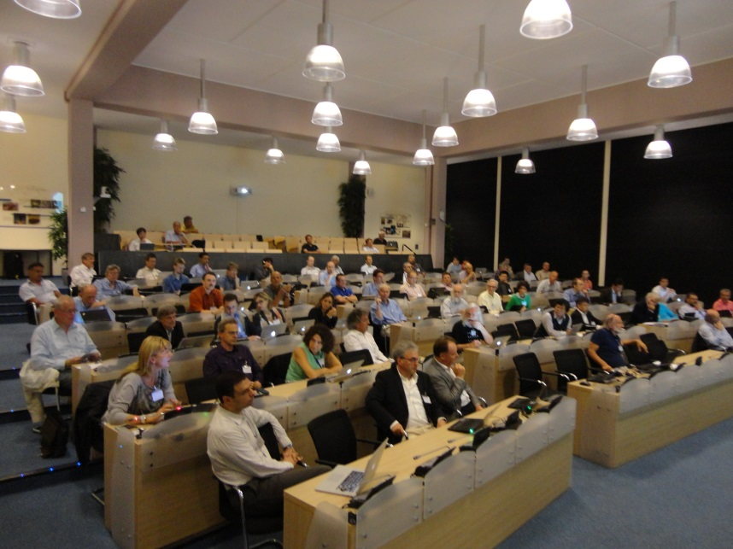
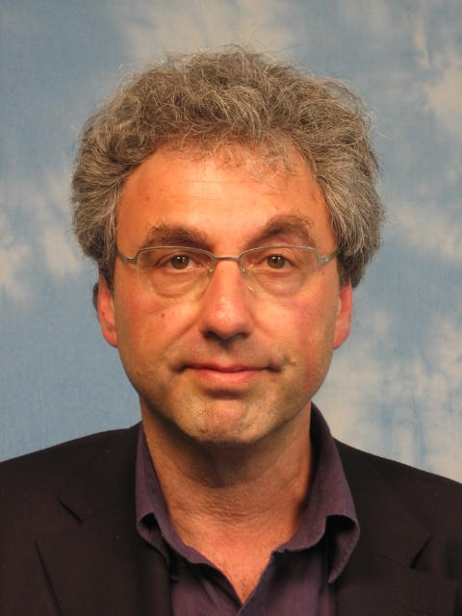
FCC Collaboration Board
preparatory meeting 9-10 September 2014 at CERN (~80 participants, 1 / inst.)
Leonid “Lenny” Rivkin (EPFL & PSI) unanimously elected as interim Collaboration Board Chair

Slide 31

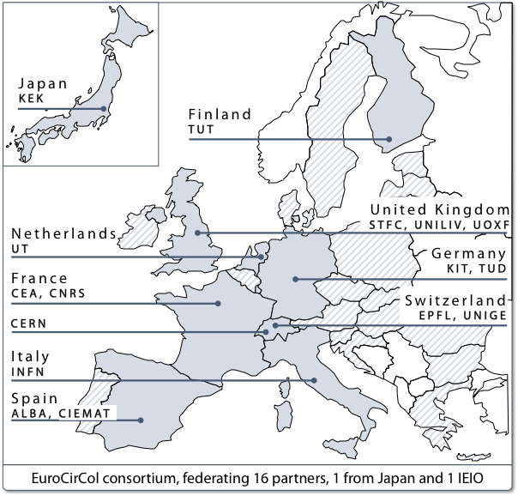
FCC Horizon 2020 Design Study Proposal
approved by European Commission on 28 January 2015, at maximum rating (15/15)
key aspects of 100 TeV energy frontier hadron collider:
conceptual design, feasibility, implementation scenario

Slide 32
Resource Status
CERN
  Medium-Term Plan 2015-2019 (June ‘14)
  ~ 30 FTEs: ~ 1800 person months
  ~ 30 fellows and doct. Students ~ 1800 person months
  Material budget for fellows, PhD and technology R&D (focus on 16 T dipole program and SRF): 50 MCHF
Collaboration
  Commitment of 1085 person months for EuroCirCol H2020 DS l
  Other commitments (Addenda) presently: ~ 200 PM
  Further commitments TBD
another ~2500 person-months being looked for…

Slide 33
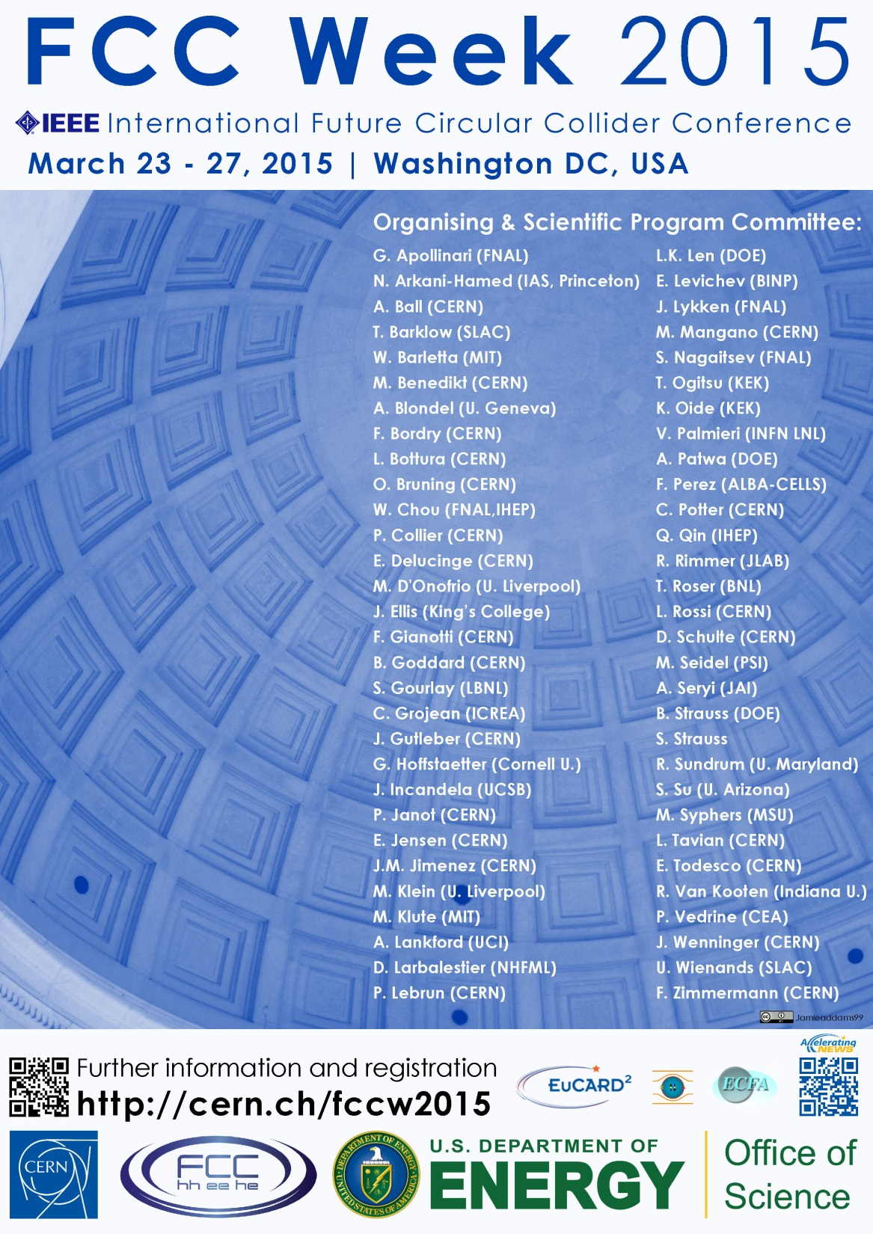
First FCC Week
Conference
Washington DC
23-27 March 2015
http://cern.ch/fccw2015
++...

Slide 34
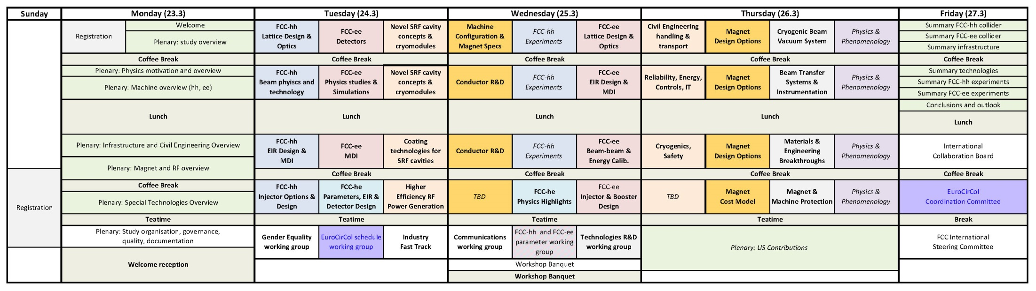
First FCC Week, Washington DC
23-27 March 2015 – DRAFT SCHEDULE
hoping to see you there!

Slide 35
Conclusions
Fast growing activities in circular energy-frontier circular colliders worldwide
Under ESU mandate, FCC collaboration, formed with CERN as host laboratory, performs international design study for Future Circular Colliders (FCC).
FCC presents many R&D & innovation opportunities, e.g. in SC magnets, SRF and other technical areas.
Global collaboration on physics, experiments and accelerators and using all synergies essential to move forward and be successful.

Slide 36
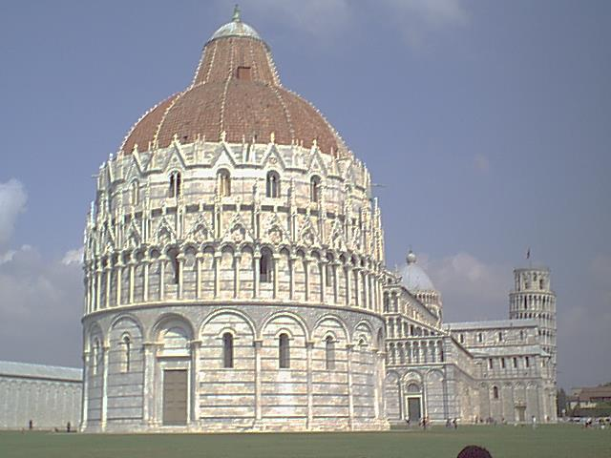
the future starts now
– with FCC-ee !

Slide 37
spare slides

Slide 38
FCC as heavy-ion collider
preliminary parameters
 | Unit | LHC Design | FCC-hh | FCC-hh
operation mode | - | Pb-Pb | Pb-Pb | p-Pb
number of bunches |  | 592 | 432 | 432
part. / bunch | [10⁸] | 0.7 | 1.4 | 115(1.4)/1.4
β-functionat IP | [m] | 0.5 | 1.1 | 1.1
RMS beam size at IP | [um] | 15.9 | 8.8 | 8.8
initial luminosity | [10²⁷cm⁻²s⁻¹] | 1 | 3.2 | 267(3.2)
peak luminosity | [10²⁷cm⁻²s⁻¹] | 1 | 12.7 | 5477(3356)
integr. lumi. per fill | [μb⁻¹] | <15 | 83 | 30240
total cross-section | [b] | 515 | 597 | 2
initial luminosity lifetime | [h] | <5.6 | 3.7 | 3.2 (10.6)
M. Schaumann, J. Jowett

Slide 39
collider parameters | FCC ERL | FCC-ee ring |  | protons
species | e⁻ (e⁺?) | e± | e± | p
beam energy [GeV] | 60 | 60 | 120 | 50000
bunches / beam | - | 10600 | 1360 | 10600
bunch intensity [10¹¹] | 0.05 | 0.94 | 0.46 | 1.0
beam current [mA] | 25.6 | 480 | 30 | 500
rms bunch length [cm] | 0.02 | 0.15 | 0.12 | 8
rms emittance [nm] | 0.17 | 1.9 (x) | 0.94 (x) | 0.04 [0.02 y]
β_{x,y}*[mm] | 94 | 8, 4 | 17, 8.5 | 400 [200 y]
σ_{x,y}* [μm] | 4.0 | 4.0, 2.0 |  | equal
beam-b. parameter ξ | (D=2) | 0.13 | 0.13 | 0.022 (0.0002)
hourglass reduction | 0.92 (H_{D}=1.35) | ~0.21 | ~0.39
CM energy [TeV] | 3.5 | 3.5 | 4.9
luminosity[10³⁴cm⁻²s⁻¹] | 1.0 | 6.2 | 0.7
preliminary FCC-he parameters shown at ICHEP’14

Slide 40
FCC Work and Organisation (i)
Work/meeting structures established based on INDICO, see:
FCC Study: https://indico.cern.ch/category/5153/
In particular:
FCC-hh Hadron Collider Physics and Experiments VIDYO meetings
  https://indico.cern.ch/category/5258/
  Contacts: michelangelo.mangano@cern.ch, fabiola.gianotti@cern.ch, austin.ball@cern.ch
FCC-ee Lepton Collider (TLEP) Physics and Experiments VIDYO meetings
  https://indico.cern.ch/category/5259/
  Contacts: alain.blondel@cern.ch, patrick.janot@cern.ch

Slide 41
FCC Work and Organisation (ii)
FCC-hh Hadron Collider VIDYO meetings
  https://indico.cern.ch/category/5263/
  Contacts: daniel.schulte@cern.ch
FCC-hadron injector meetings
  https://indico.cern.ch/category/5262/
  Contacts: brennan.goddard@cern.ch
FCC-ee (TLEP) Lepton Collider VIDYO meetings
  https://indico.cern.ch/category/5264/
  Contacts: jorg.wenninger@cern.ch,
FCC infrastructure meetings
  https://indico.cern.ch/category/5253/
  Contacts: philippe.lebrun@cern.ch, peter.sollander@cern.ch

