Slide 1
Seven years of gamma-ray astrophysics with the Fermi LAT
Francesco Loparco
(Bari University & INFN)
on behalf of the Fermi LAT Collaboration

Slide 2
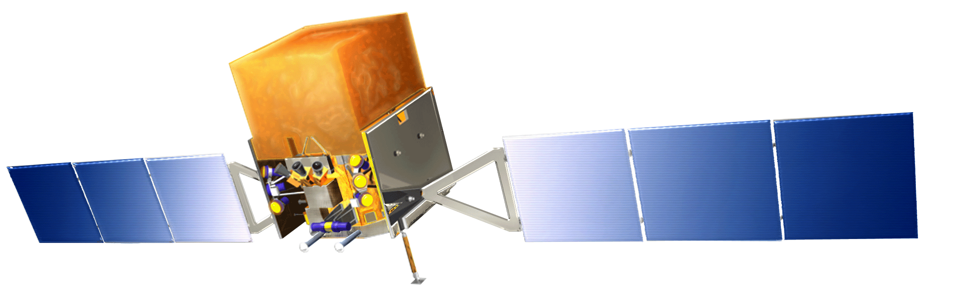


The Fermi satellite
The Fermi Gamma-Ray Space Telescope is an International Science Mission exploring the gamma-ray sky by means of its two main instruments:
  GLAST Burst Monitor (GBM): 8 keV → 40 MeV
  Large Area Telescope (LAT): 20 MeV → > 300 GeV
Huge energy range: including largely unexplored band for a total of >7 energy decades!
Large Area Telescope (LAT)
GLAST Burst Monitor (GBM)

Slide 3
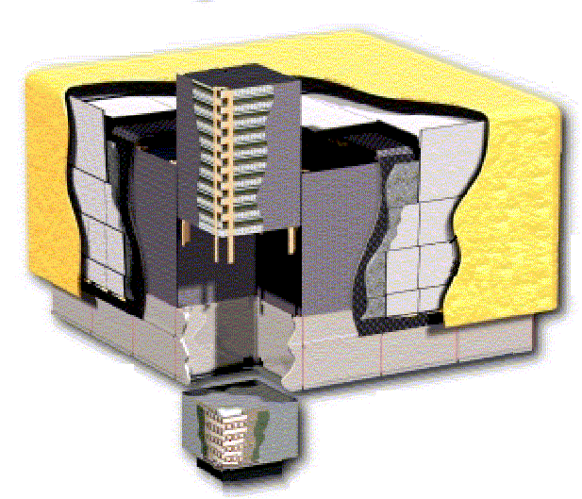
The Fermi LAT
Anticoincidence Detector (ACD)
89 scintillator tiles
First step in the reduction of large charged cosmic ray background
Segmentation reduces self-veto at high energy
Precision Si-strip Tracker (TKR)
Measures incident γ-ray direction
18 XY tracking planes: 228 μm strip pitch
High efficiency. Good position resolution
12x 0.03 X₀ front end → reduce multiple scattering
4x0.18X₀ back-end → increase sensitivity >1 GeV
γ
The LAT is also an excellent electron detector! See the presentation by Carmelo Sgrò
Hodoscopic CsI Calorimeter
Segmented array of 1536 CsI(Tl) crystals
8.6 X₀: shower max contained
  200 GeV normal (1.5X₀ from TKR included)
  1TeV @ 40° (CAL-only)
Measures the incident γ-ray energy
Rejects cosmic-ray background
e⁺
e⁻
Electronics system
Includes flexible, highly efficient, multi-level trigger

Slide 4
Fermi observation strategy
Mostly ~uniform sky survey
  Dec 2013 – Dec 2014, transitioned to galactic center biased survey for 1 year
Target of opportunity observations generally between 1 day – few weeks in duration:
  flaring AGN, Novae, Sun, Crab, Binary systems, etc
2.5 hour autonomously commanded pointed observations following detection of bright hard-spectrum GRB
The wide field of view and survey mode operation allows Fermi to explore the high energy gamma-ray sky on timescales from milliseconds to years

Slide 5
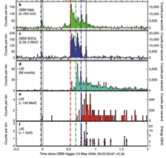
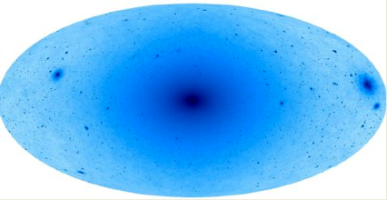
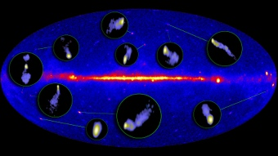
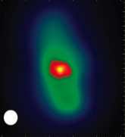
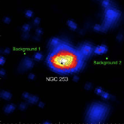
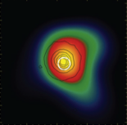
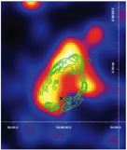
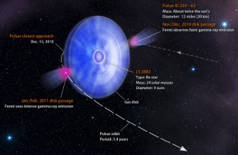
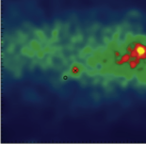
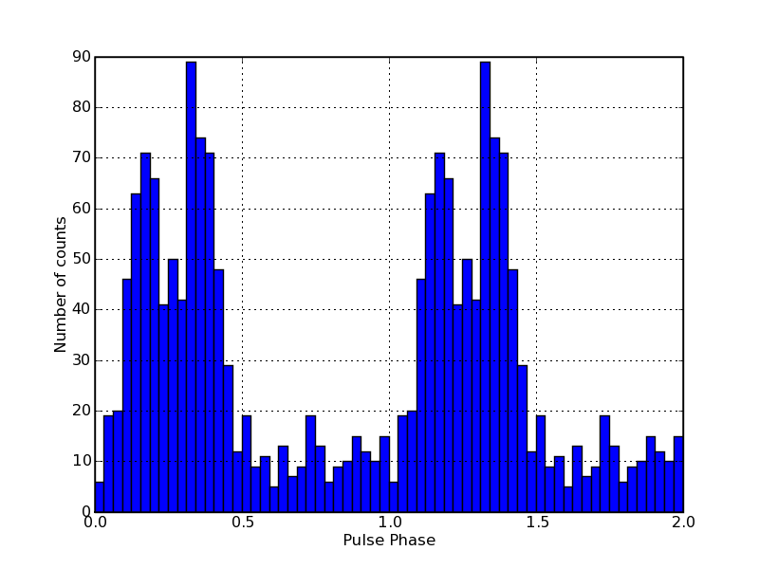
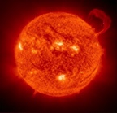
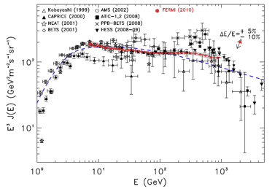
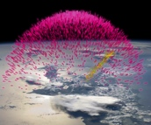
An overview of the Fermi LAT Science
Dark Matter searches
GRBs
Blazars
Radio Galaxies
Extragalactic
Starburst Galaxies
Globular Clusters
SNRs & PWN
γ-ray Binaries
Novae
Galactic
Pulsars: isolated, binaries, & MSPs
Moon
Earth Limb
Sun: flares & CR interactions
Local
Terrestrial γ-ray Flashes
Unidentified Sources
e⁺e⁻ spectrum

Slide 6
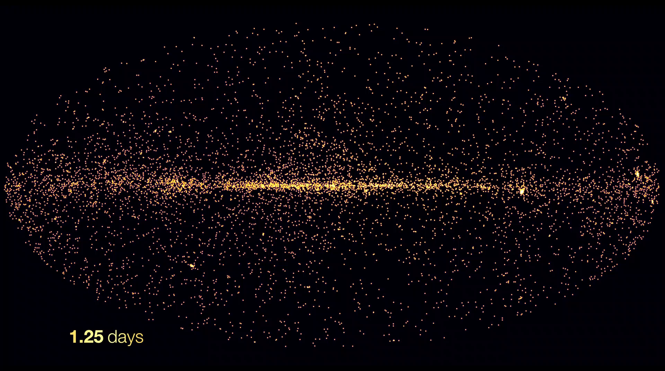
The gamma-ray sky above 1 GeV

Slide 7
The LAT Catalogs
Catalog | Energy Range (GeV) | Data Interval (months) | Sources | Event Selection | Release Date
0FGL | 0.2-100 | 3 | 205 | P6V1 DIFFUSE | Feb. 2009
1FGL | 0.1-100 | 11 | 1451 | P6V3 DIFFUSE | Feb. 2010
2FGL | 0.1-100 | 24 | 1873 | P7V6 SOURCE | Aug. 2011
1FHL | 10-500 | 36 | 511 | P7V6 CLEAN | Jun. 2013
3FGL | 0.1-300 | 48 | 3033 | P7V15 SOURCE | Jan. 2015
2FHL | 50-2000 | 80 | 360 | P8_SOURCE | In press
There are also class-specific LAT source catalogs
  AGN, Pulsars, GRBs, SNRs, transients…

Slide 8
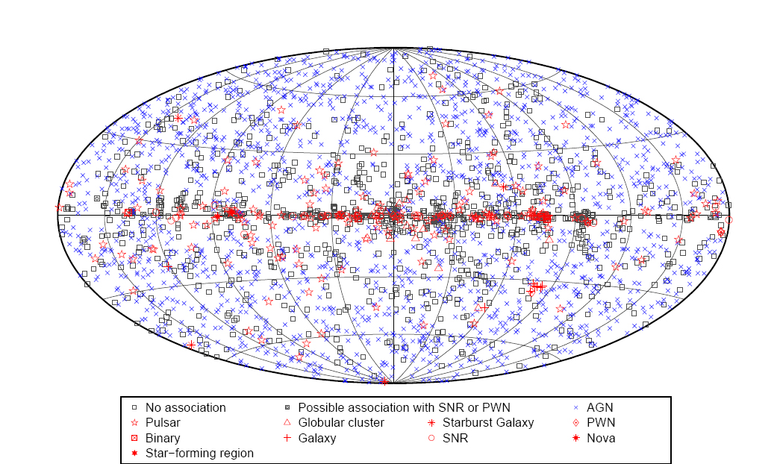
The Fermi LAT 3rd Source Catalog (3FGL)
4-years data sample with P7 reprocessed data
3033 sources detected with >4σ significance
See Astrophys. J. Suppl. 218 (2015), 23 [arXiv 1501.02003]

Slide 9
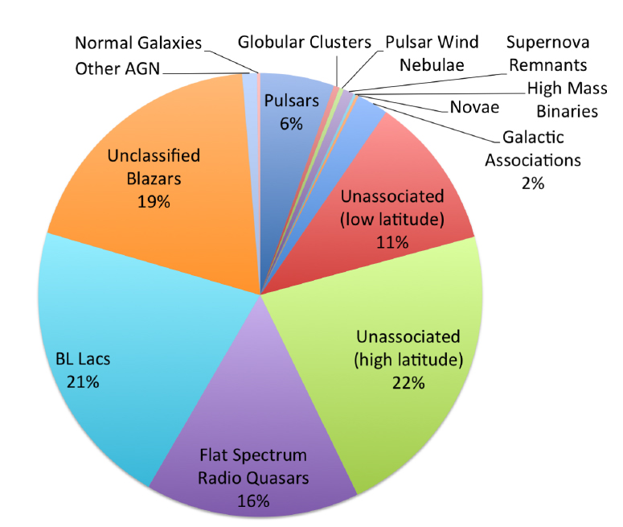
The 3FGL gamma-ray sources

Slide 10
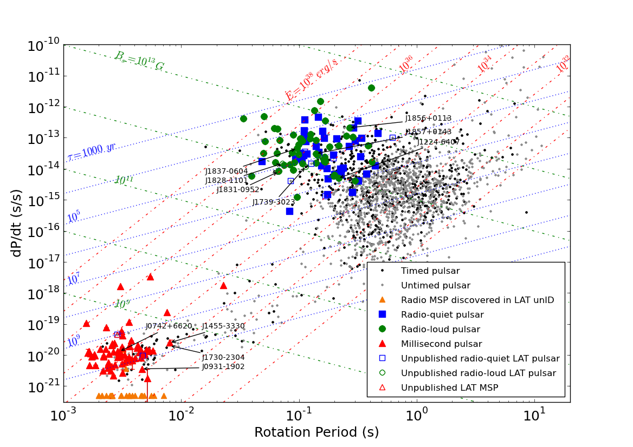
The Fermi LAT pulsars
At present the LAT has detected 161 gamma-ray pulsars
  Half of the gamma-ray pulsars were not known before Fermi

Slide 11
The Fermi LAT pulsars: main discoveries
Before Fermi only 7 gamma-ray pulsars were detected → now 161!
  Discover of gamma-ray MSPs
Emission region: outer gap model preferred wrt polar cap model
Pulsars considered to be stable gamma-ray sources were discovered to be variable!
PSR J2021+4026 in the Cygnus region, ApJ Letters 777 (2013), L2
Gamma-ray flares from the Crab Nebula, Science 331(2011), 739
Average spectrum
Feb 2009 flare
Sep 2010 flare
2011 Oct 16

Slide 12
1st Fermi LAT SNR Catalog
3 years Pass7 data, 279 ROIs studied, 102 detections
  population studies, spectral and morphology studies
Paper submitted to ApJ

Slide 13
Correlations between radio and GeV spectra
If radio and GeV emissions originate from the same particle population the spectral indices should be correlated
Data challenge model assumptions
  Underlying particle populations may have different indices
  Emitting particle populations may not follow power law: breaks?
  Multiple emission zones?
π⁰ decay or e^{+/-} bremsstrahlung
Inverse Compton with cooling
Inverse Compton without cooling

Slide 14
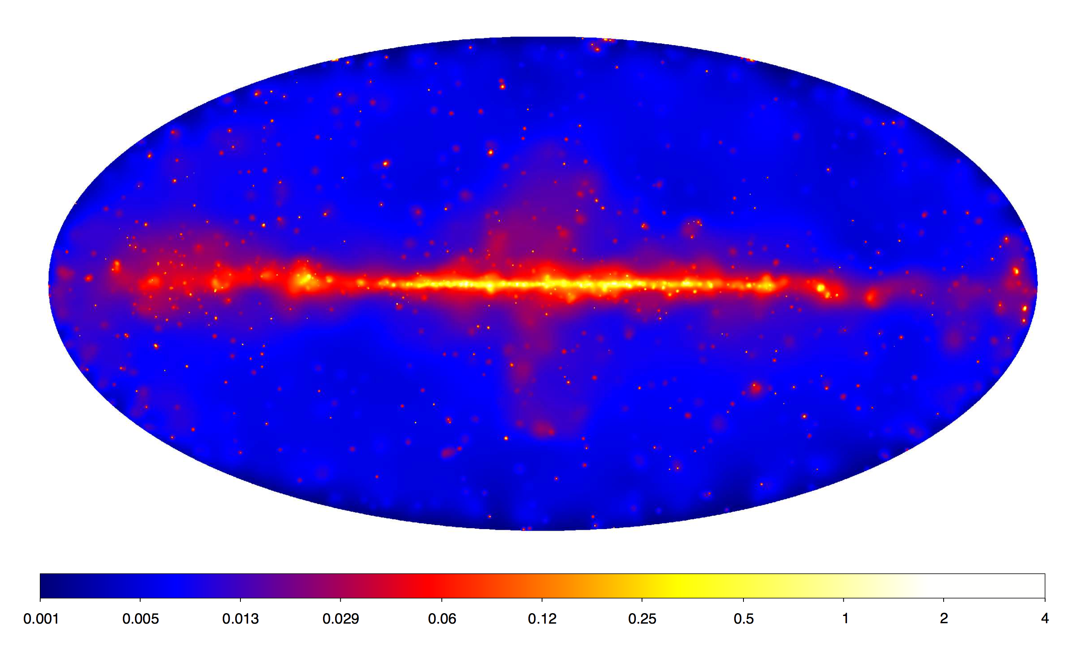
The gamma-ray sky above 50 GeV: 2FHL catalog
Paper submitted to ApJ, see arXiv 1508.04449
Energy range from 50 GeV to 2 TeV
80 months of data
360 sources detected:
  78 detected by IACTs (TeVCat)
  230 detected in 1FHL
  303 detected in 3FGL
  57 brand new sources (not 1FHL/3FGL)

Slide 15
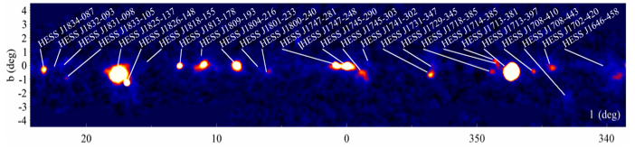
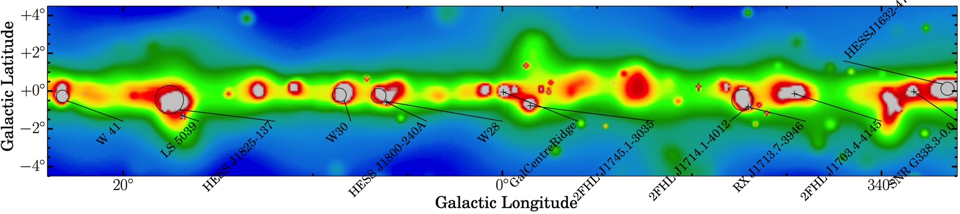
Comparison with HESS GP survey
HESS Significance Map (Aharonian et al. 2006, Carrigan et al. 2013)
Fermi LAT >50 GeV Count Map (adaptively smoothed)
H.E.S.S. detected 69 sources reaching a sensitivity of ~2% of the >1 TeV Crab Nebula flux
The LAT detects 36 sources with an average sensitivity of 3-4% of the Crab Nebula flux
The LAT detects an equal number of PWNe/SNRs while for H.E.S.S they are in a 1.5:1 ratio

Slide 16
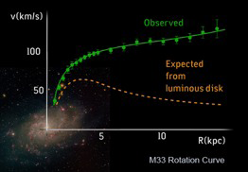
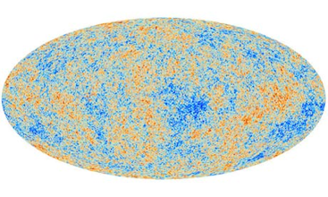
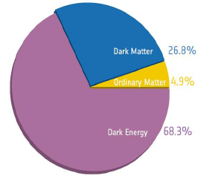
Dark Matter
Astrophysical evidence for missing mass
  Galaxy rotation curves
  Colliding clusters
  Cosmological probes (Ω_{dm} h² ≈ 0.1)
Observational evidence indicates:
  Non-baryonic
  (Almost totally) neutral
  (Almost totally) collisionless
Theoretical candidates:
  Axions, sterile neutrinos, etc.
  Modifications to gravity
  Weakly Interacting Massive Particles (WIMPS)

Slide 17
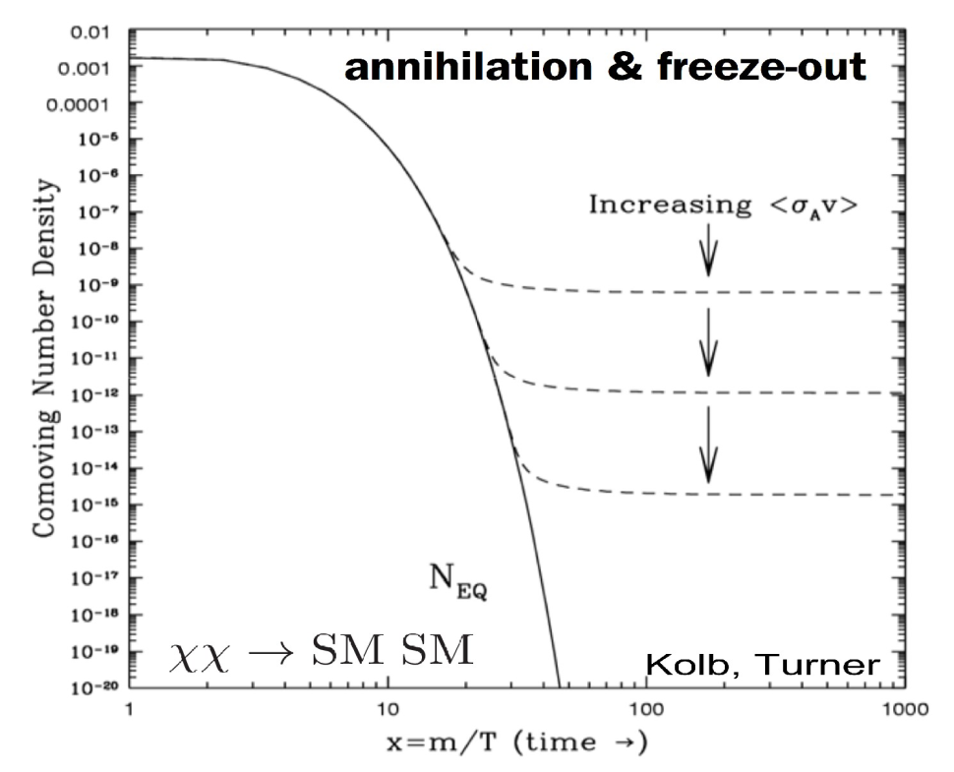
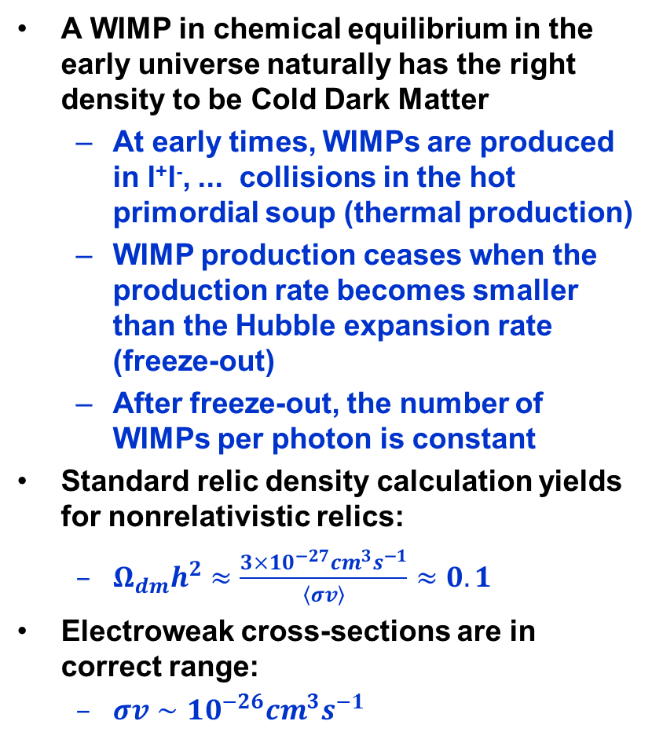
WIMPs as DM candidates
A WIMP in chemical equilibrium in the early universe naturally has the right density to be Cold Dark Matter
  At early times, WIMPs are produced in l⁺l⁻, ... collisions in the hot primordial soup (thermal production)
  WIMP production ceases when the production rate becomes smaller than the Hubble expansion rate (freeze-out)
  After freeze-out, the number of WIMPs per photon is constant
Standard relic density calculation yields for nonrelativistic relics:
  $Ω_{dm}h^{2}≈\frac{3×{10}^{−27}{cm}^{3}s^{−1}}{\left\langle σv\right\rangle }≈0.1$
Electroweak cross-sections are in correct range:
  $σv∼{10}^{−26}{cm}^{3}s^{−1}$
Freeze-out:
Γ_{ann} = n <σ v> ∼ H
annihilation rate ∼ expansion rate
<σv>_{ann} ∼3 ×10⁻²⁶ cm³/s for thermal relic

Slide 18
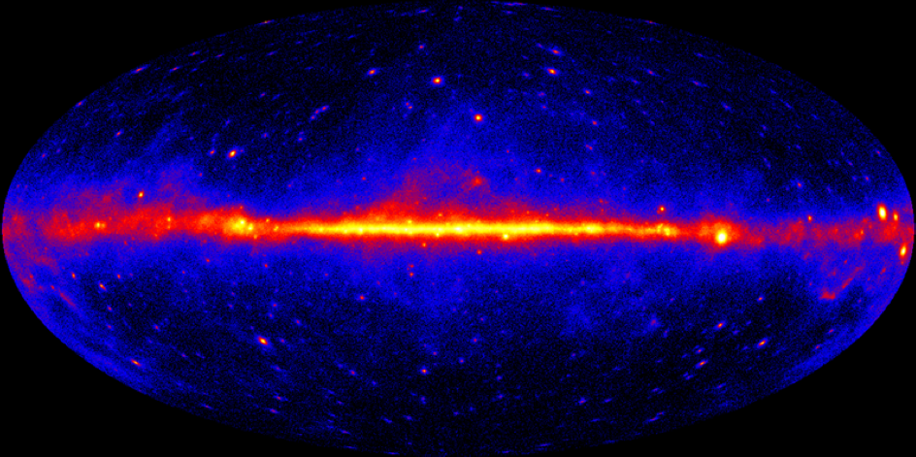
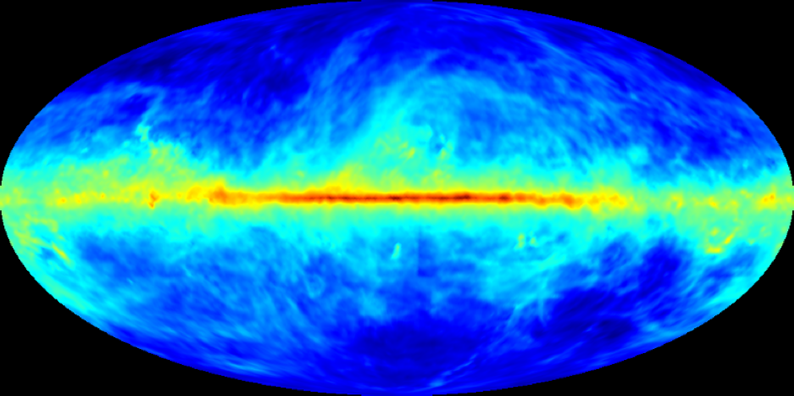
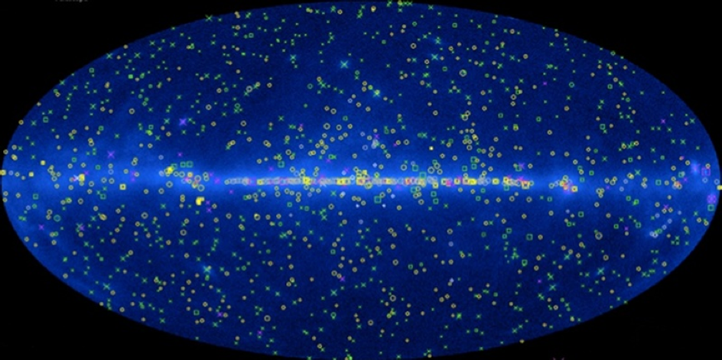

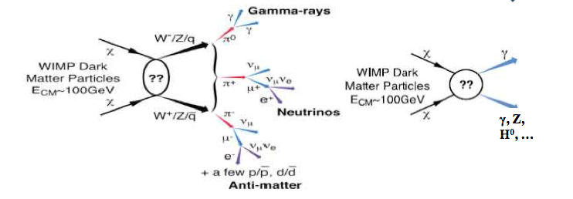
Indirect searches for dark matter in the GeV gamma-ray sky
???
GeV Sky
Galactic
Point Sources
Isotropic

Slide 19
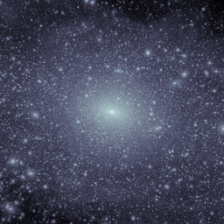
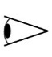
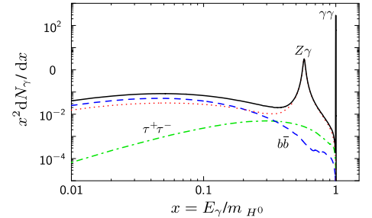
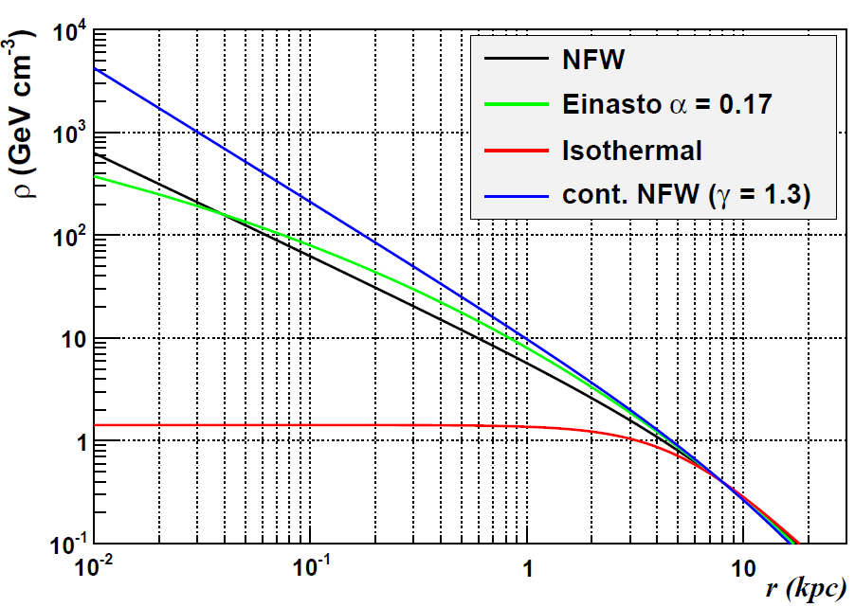
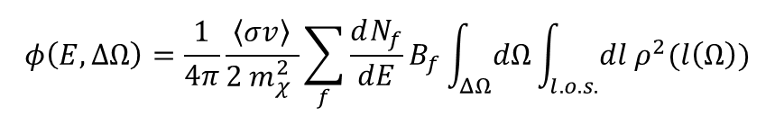

Dark matter signatures in gamma-rays
Observed flux
Intrinsic Particle Properties
Astrophysics
$$φ\left(E,∆Ω\right)=\frac{1}{4π}\frac{〈σv〉}{2 m_{χ}^{2} }\sum_{f}{\frac{dN_{f}}{dE}B_{f}\int_{ΔΩ}{dΩ}\int_{l.o.s.}{dl ρ^{2}(l\left(Ω\right))}}$$
Annihilation
Decay
Γ_{D}/m_{χ}
$ρ(l$)
<σv>_{ann} ~ 3 ×10⁻²⁶cm³/s for thermal relic
J-factor – DM distribution
(line-of-sight integral)
Monochromatic Signal
Continuum Signal
Gustafsson et al. PRL 99.041301

Slide 20
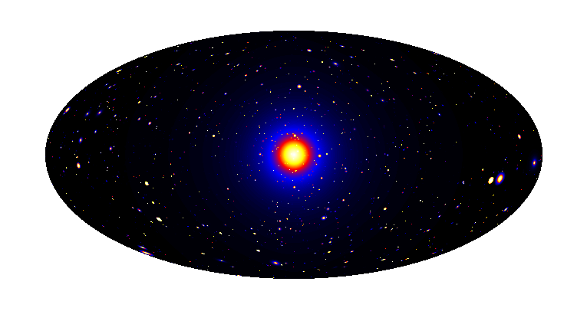
Dark matter search targets
Satellites
Low background and good source id, but low statistics
Galactic Center
Good Statistics, but source
confusion/diffuse background
Milky Way Halo
Large statistics, but diffuse
background
Dwarf Galaxies
Known location and DM content
Low statistics
Spectral Lines
Little or no astrophysical uncertainties, good source id, but low sensitivity because of expected small branching ratio
Isotropic contributions Large statistics, but astrophysics, galactic diffuse background
Galaxy Clusters
Low background, but low statistics

Slide 21
Dark Matter searches in dSph Galaxies
/
Included/Excluded in
Composite LAT Analysis
Dwarf spheroidal galaxies (dSphs) are dark and highly DM-dominated systems
Most are found at high latitude where astrophysical foregrounds are low
Low backgrounds make these a very clean target for indirect DM searches

Slide 22
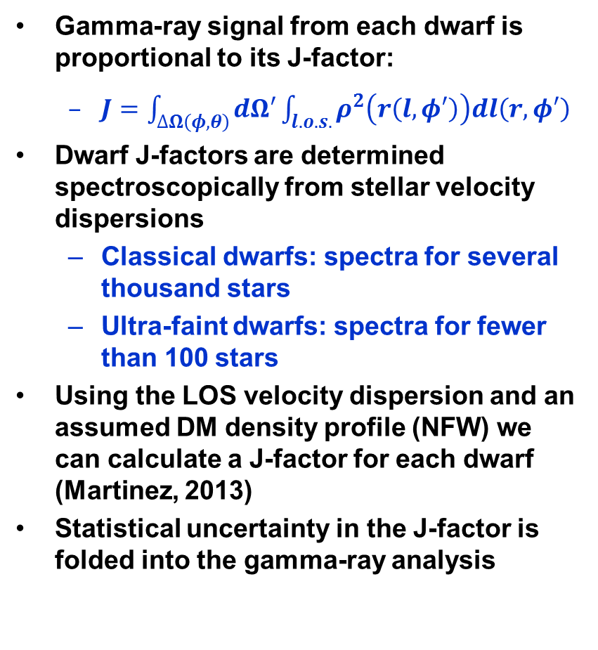
Dark Matter content of dSph Galaxies
Gamma-ray signal from each dwarf is proportional to its J-factor:
  $J=\int_{∆Ω\left(φ,θ\right)}{dΩ′\int_{l.o.s.}{ρ^{2}\left(r\left(l,φ′\right)\right)dl\left(r,φ′\right)}}$
Dwarf J-factors are determined spectroscopically from stellar velocity dispersions
  Classical dwarfs: spectra for several thousand stars
  Ultra-faint dwarfs: spectra for fewer than 100 stars
Using the LOS velocity dispersion and an assumed DM density profile (NFW) we can calculate a J-factor for each dwarf (Martinez, 2013)
Statistical uncertainty in the J-factor is folded into the gamma-ray analysis

Slide 23
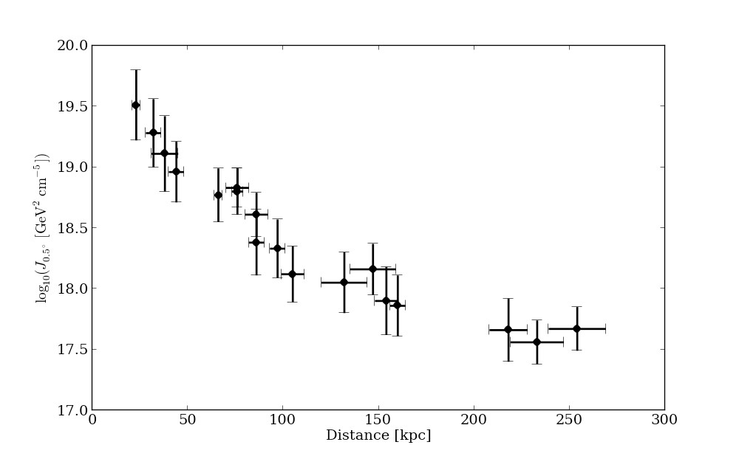
J-factors for 18 dSph Galaxies
Seg1
NFW profile integrated over 0.5 degree cone
UMaII
Wil1
Com
18 dwarf galaxies have well-determined J-factors.
BooI
Dra
Scl
x
UMaI
UMi
Car
Her
For
Sex
LeoIV
CVnII
CVnI
LeoI
x
LeoII
x
15 dwarfs used for composite analysis (UMaI,CVn1, and Leo1 excluded due to ROI overlap).

Slide 24
Upper limits on DM annihilation cross section from dSph analysis
6 years of Fermi-LAT Pass8 data from 15 dwarf spheroidal galaxies constrain the thermal relic cross section for low mass dark matter
DM Limits from the LAT Dwarf stacking analysis are highly competitive with those provided by ground-based gamma-ray observatories (HESS, MAGIC)
LAT Dwarf limits are more constraining for WIMP models with mass below 1 TeV
Currently, statistically limited (especially at high masses)
Paper accepted by PRL (arXiv 1503.02641)

Slide 25
Search for gamma-ray lines
WIMP annihilations in the Universe may produce gamma rays detectable by the LAT
  χχ→γγ, γZ⁰, γH⁰ would produce a narrow feature
  Sharp, distinct spectral feature (“smoking gun”)
    Likely a small branching fraction
    Signal predicted to be small (b.f. typically ~10⁻² to 10⁻⁴)
Most recent line search from the LAT Collaboration:
  5.8 years Pass 8 data sample
    Improved energy reconstruction
    Increased effective area
  Energy interval from 200 MeV to 500 GeV
  Improved understanding of systematics
  See Phys. Rev. D91, 122002 (2015)

Slide 26
ROI optimization
Control regions
Control regions
ROIs for line search:
  R3 (circle with 3° radius centered on the GC), R16 (Einasto Optimized), R41 (NFW Optimized), R90 (Isothermal Optimized), R180 (Decay Optimized)
Control regions:
  31 boxes 10°× 10°along the GP
  Same line search algorithms as in signal ROIs
  Allow to evaluate systematics

Slide 27
Upper limits on the WIMP mass from line searches
No evidence of spectral lines found!

Slide 28
The line feature at 133 GeV
A potential signal was reported in the 3.7yrs data sample for a small ROI containing the GC
  Bringmann+, JCAP 07 (2012), 054
  Weniger+, JCAP 08 (2012), 007
The LAT detected the feature, although with low global significance
Newest LAT data analysis:
  Increased data set (5.8 yrs)
  Use of Pass 8 event classification
    Improved energy reconstruction
  Greater exposure towards the GC
    Modified observing strategy from Dec 2013 to Dec 2014
The excess in the 3.7 yrs data is of 2σ (3.3σ with Pass 7 data) and decreases using the full 5.8 yrs data set

Slide 29
Dark Matter in the inner Galaxy?
Likely the brightest dark matter source in the gamma-ray sky, but it is embedded in large and complicated backgrounds:
  resolved sources
  unresolved sources
  diffuse emission
Several independent studies find GeV excesses above the expected diffuse background
The excess at the Galactic center could be due to:
  dark matter
  unresolved sources (e.g. MSPs)
  …
Paper submitted to ApJ

Slide 30
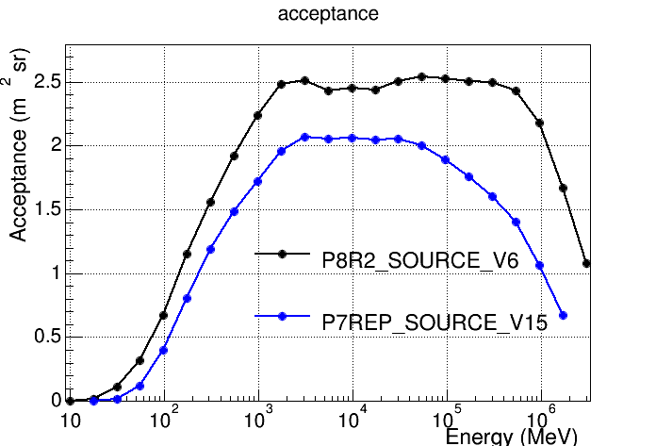
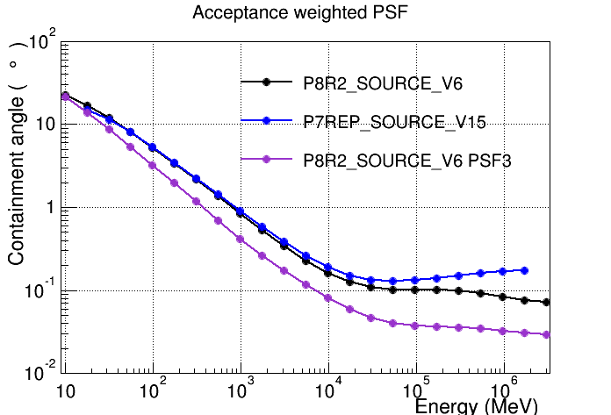
LAT analysis upgrade: Pass 8
A major upgrade of the LAT (aka Pass 8) was released in 2015
  Complete revamp of LAT event reconstruction algorithms
  More than double acceptance below 100 MeV
  Retroactively updated entire Fermi-LAT data archive

Slide 31
Conclusions and perspectives
Fermi has opened a window on the extreme high-energy Universe
Exciting results in all fields of gamma-ray astrophysics
  Many discoveries, many new source classes, many surprises
    Many results not shown here!
  The LAT gamma-ray data improved our understanding of CR accelerations processes and allowed to set more constrained limits on new physics than previously done
The LAT has been monitoring the gamma-ray sky for 7 years and is still in good health
Significant improvements of the LAT performance
  Updated event reconstruction with Pass 8
  Updated diffuse model coming soon
Extended long term operations will provide a unique opportunity for time domain astrophysics and multi-wavelength observations

