Slide 1
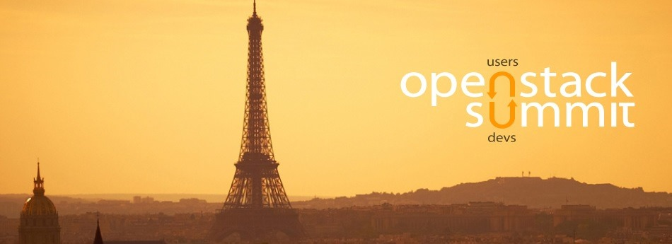
Federico Zani
INFN Roma Tor Vergata

Slide 2
The numbers...
4800 attendees
59 countries
More than 200 talks
Dozens of stands (...and gadgets...)
RedHat, IBM, CERN, HP..you name it!

Slide 3
The quote… (pt.1)
“The old model of, ‘buy what they sell us, upgrade when they tell us and use the gear they tell us to use’ is gone. It’s been replaced with an expectation you can get the resources you want, when you want them, configured the way you want.”
Jonathan Bryce, OpenStack Foundation executive director

Slide 4
The quote... (pt.2)
“[in OpenStack] there’s too much software to be written for any one company to write it”
Jim Zemlin, Linux Foundation

Slide 5
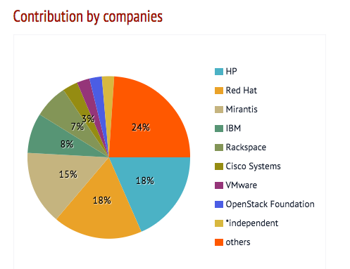
Contributors...

Slide 6
The awful truth...
“The majority of companies around here are not really using this in production but don’t tell anybody”
Nigel Kersten, Puppetlabs CIO - during informal coffee break -

Slide 7
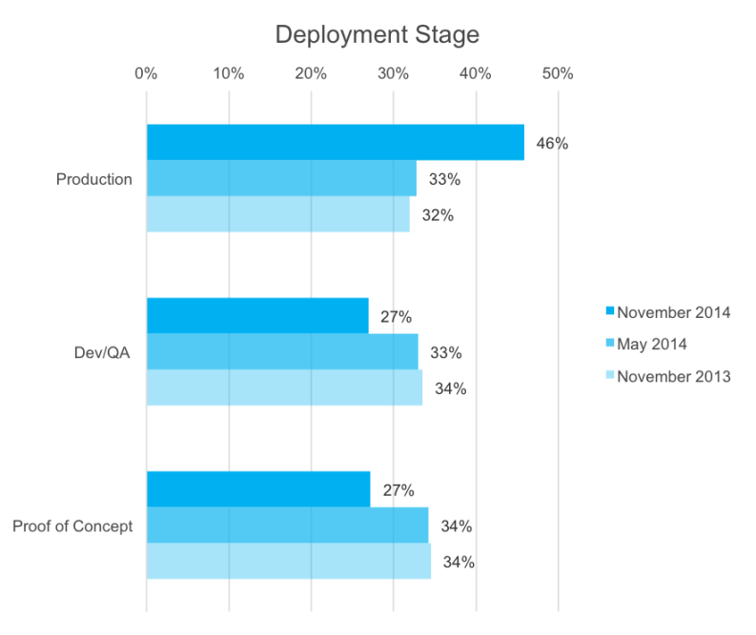
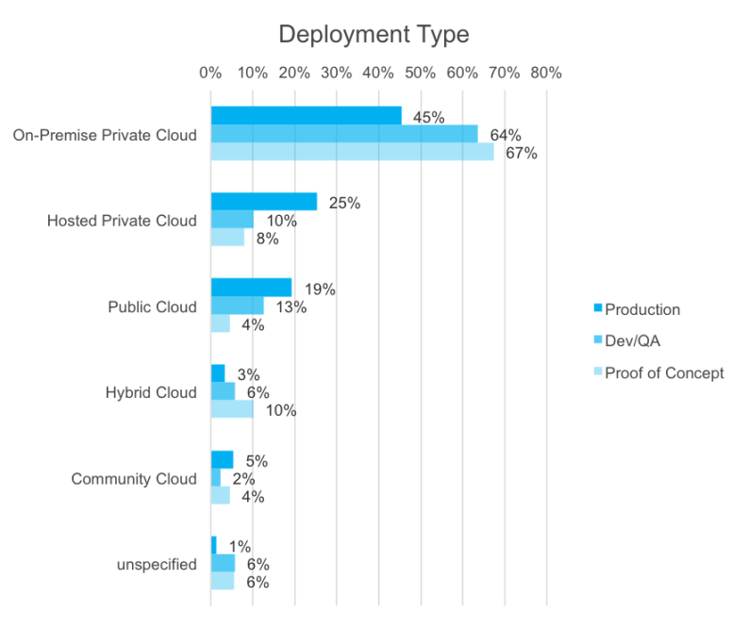
The slides… (pt.1)

Slide 8
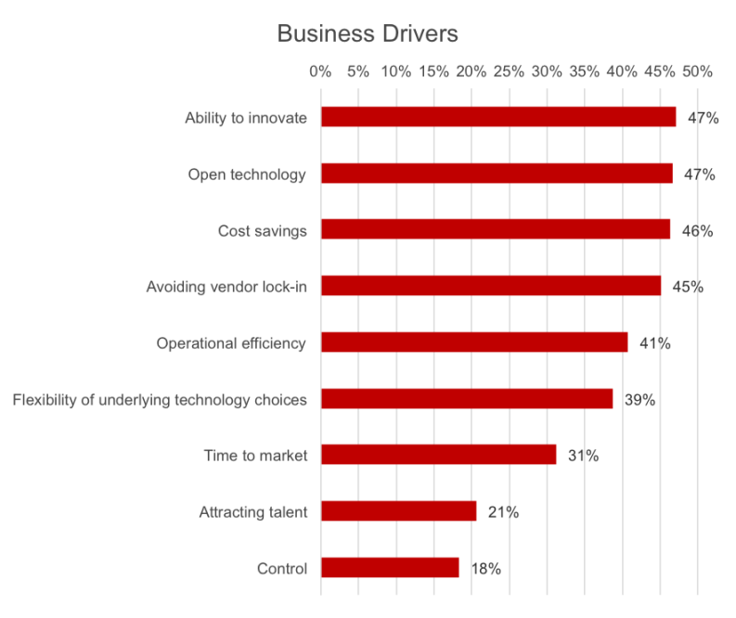
The slides… (pt.2)

Slide 9
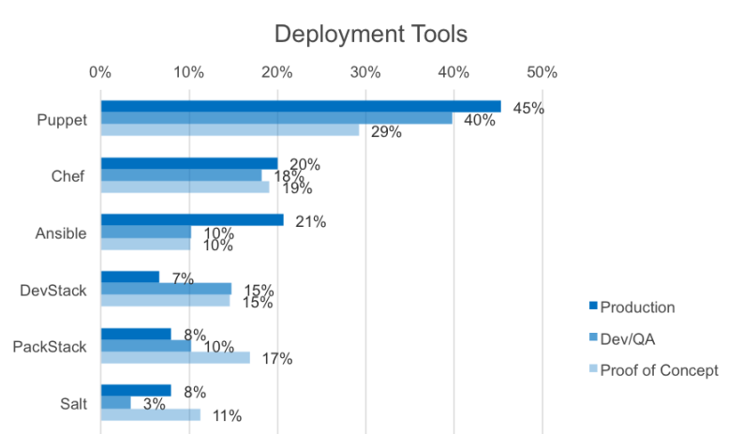
The slides... (last one!)

Slide 10
Facts…
You need (a lot of) manpower to
maintain
support
contribute - possibly -
Expect
minor architectural changes
brand new features
brand new bugs
Every upgrade is a pain (guaranteed)

Slide 11
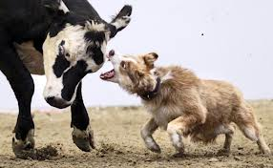
The eternal dilemma: cattle vs pets
Cloud is all about cattles, but..
...do we also need to support pets ?
Rethink your apps!!

Slide 12
Some cool buzzwords...
Docker/Kubernetes (chroot on steroids)
Core service deploy/management
Virtualization layer
PaaS platforms
Foreman
VM / bare metal nodes provisioning
Puppet
Infrastructure management

Slide 13
Community main efforts...
Stability
Automation
Networking
Core services HA

Slide 14
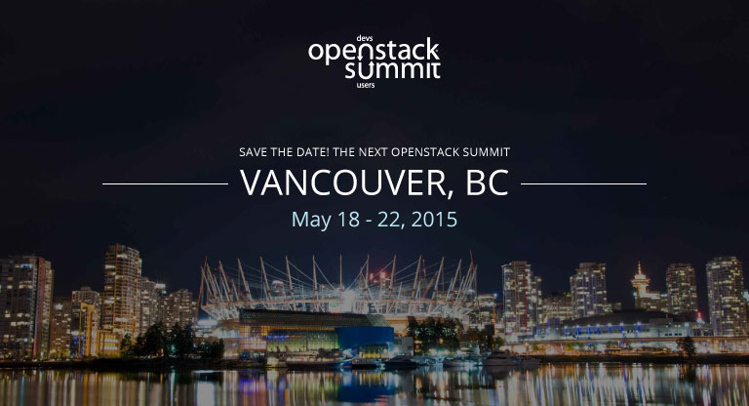
Next year...

