Slide 1
INAF (National Institute for Astrophysics) and its major international projects
Monica Tosi
INAF – Osservatorio Astronomico di Bologna
Bologna, November 4th 2014

Slide 2
Astrophysics in Italy
Research performed within Universities and mostly (~80%) INAF
Education within Universities (with INAF contribution – this year 21 INAF PhD grants):
3 PhD courses in Astrophysics (Bologna, Padova, Roma) +
PhDs in Physics with astrophysics thesis (Catania, Ferrara, Firenze, Milano, Napoli, Palermo, Pisa, Torino, Trieste)

Slide 3
INAF in a nutshell
About 1000 employees (researchers + technicians + clerks) plus (360 !) postdocs
17 research institutes in 12 Italian cities
Bologna hosts 3:
-IASF (mostly space-based astrophysics),
-IRA (mostly radioastronomy),
-Observatory (stellar pops, galaxy evolution, large scale structure, high-energy)
Excellent international collaborations
(special relations with NL !)

Slide 4
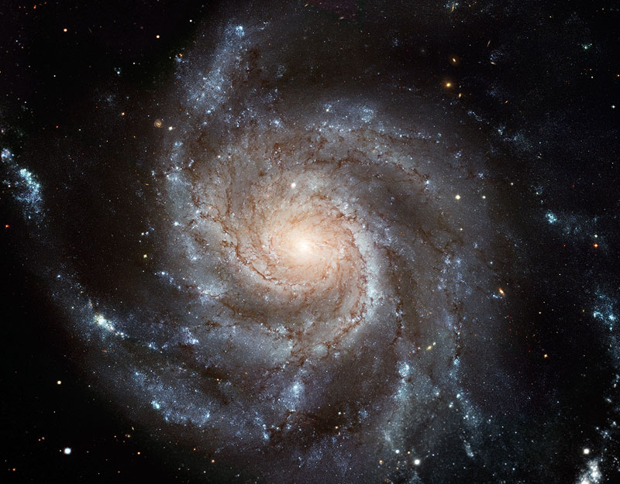
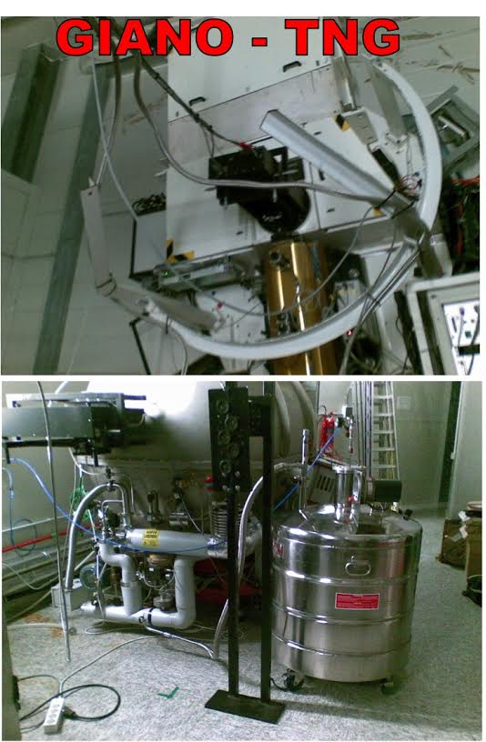
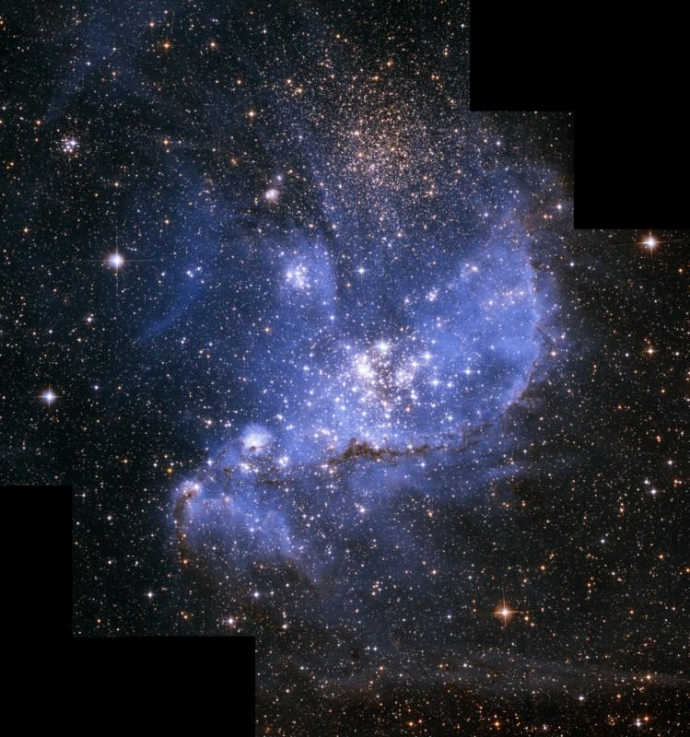
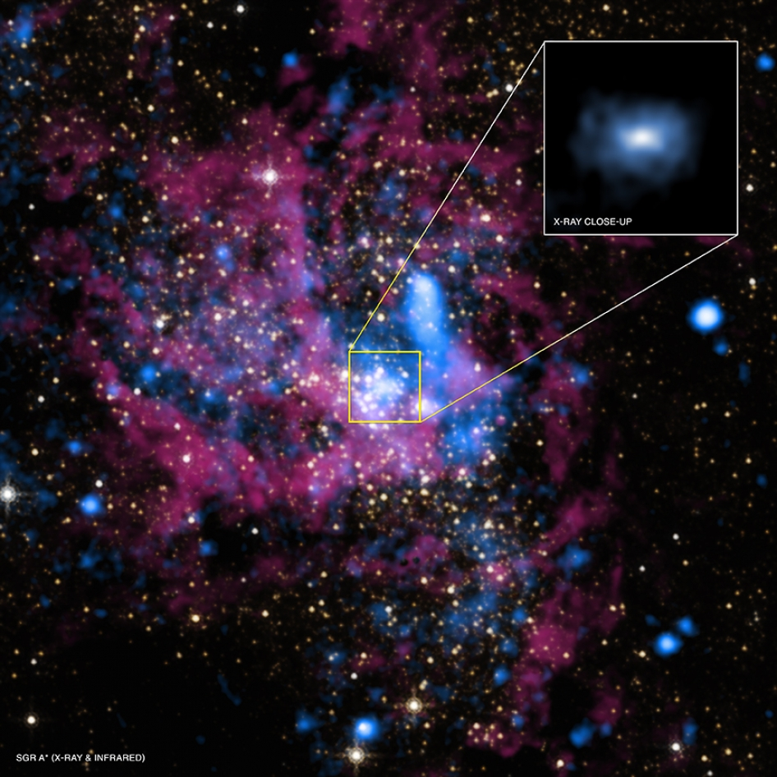
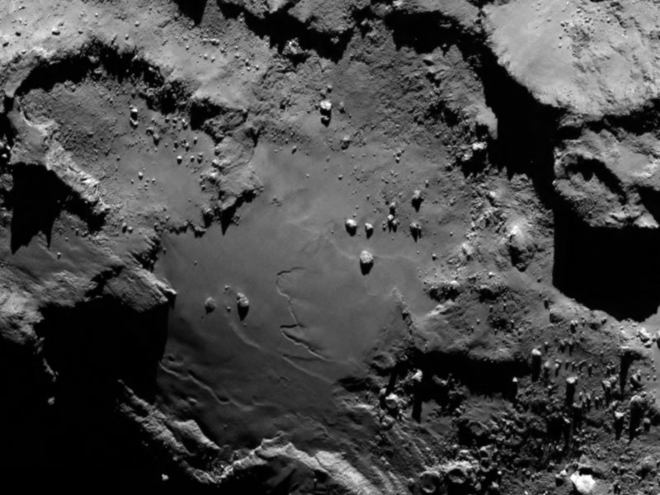
INAF in a nutshell
Science activities cover all astrophysical topics, from Solar System to Cosmology, and are organized in 5 Macro Areas:
Galaxies and cosmology
Stars, stellar populations, ISM
Sun and solar system (not in Bo)
Particle and relativistic astrophysics
Technology and instrumentation

Slide 5
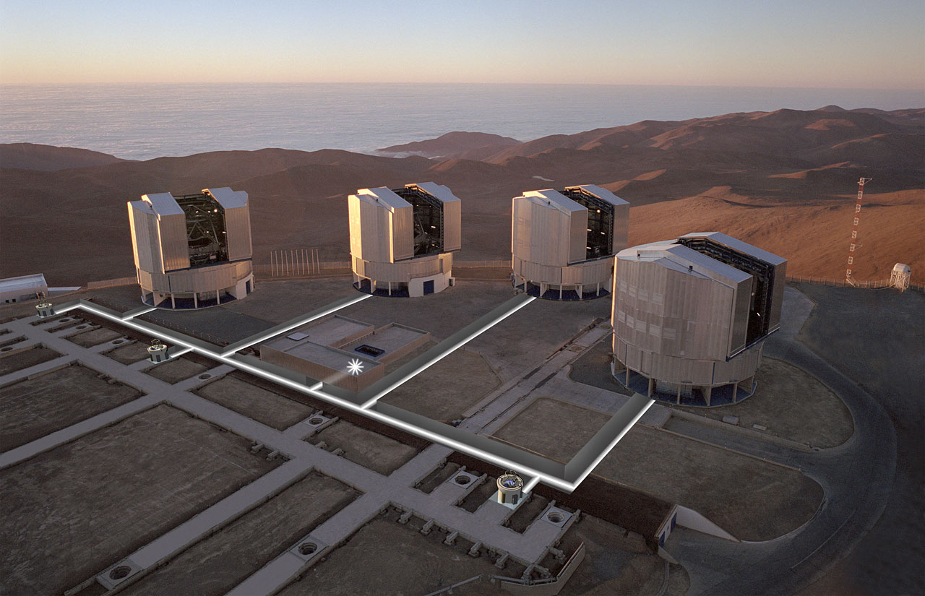
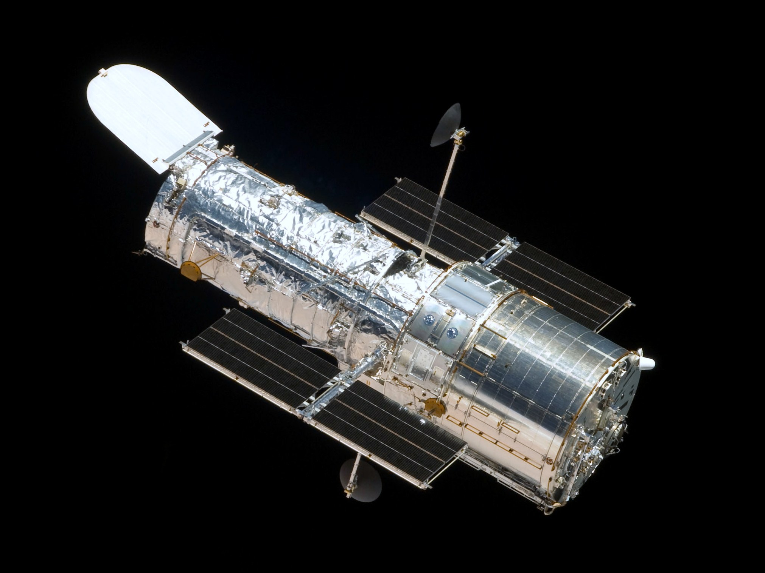
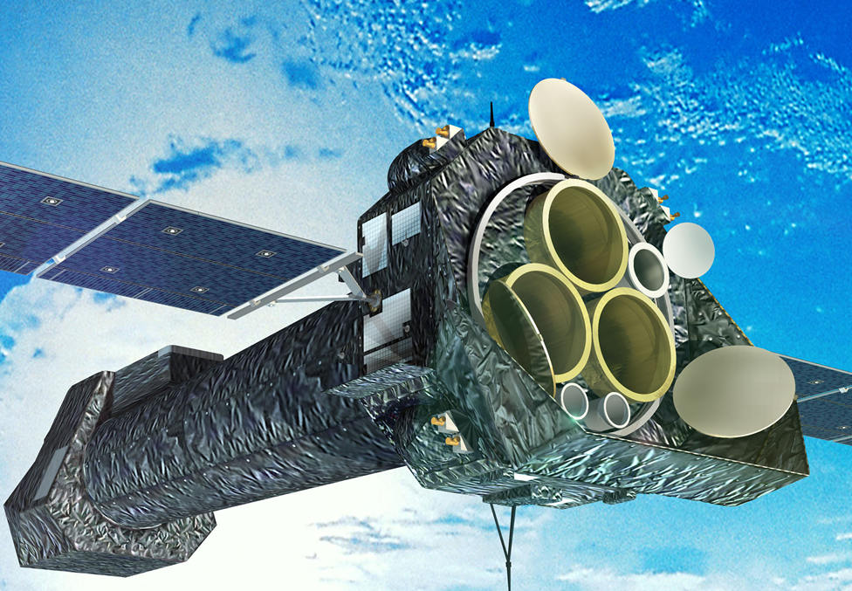
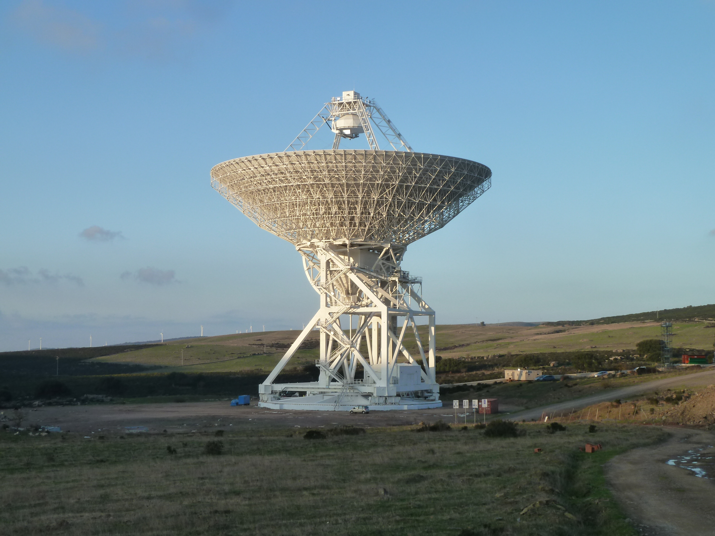
INAF in a nutshell
For observations:
as members of ESO, we have access to all the Chilean telescopes (VLT, Vista, VST, Alma, NTT, etc)
as members of ESA, we have access to all major space missions (e.g. HST, XMM, Planck, Herschel, Gaia, Rosetta ... JWST, Euclid, Plato, Athena+, etc)
plus the 4m National Telescope Galileo (TNG, Canary Islands) and ¼ of the 2x8m Large Binocular Telescope (LBT, Arizona)
plus our radiotelescopes (SRT, Bologna, Noto), VLBI and related international radio network

Slide 6
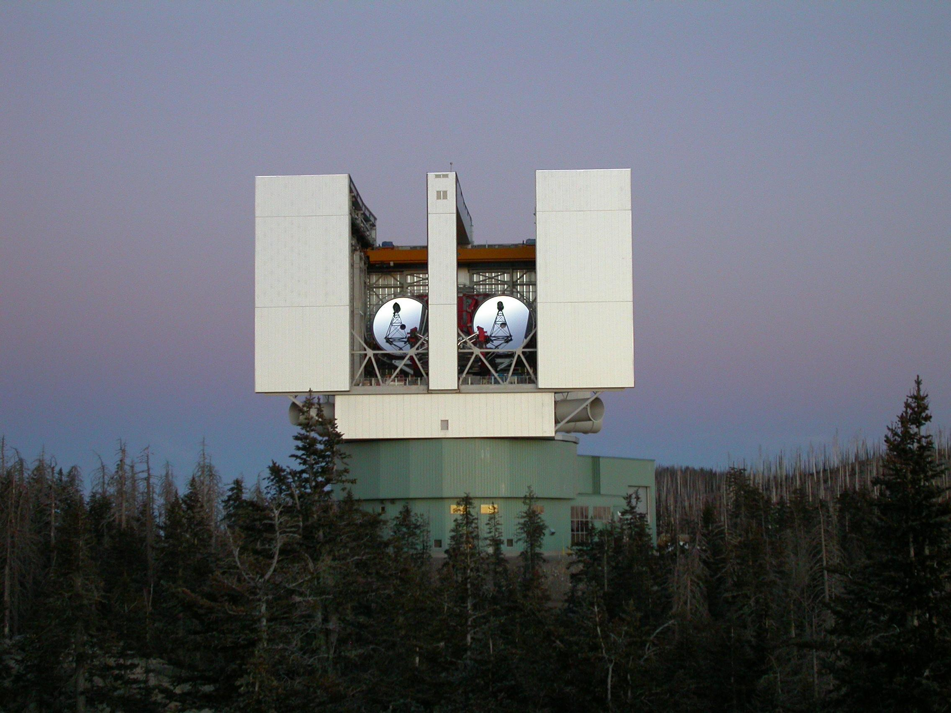
LBT (USA, INAF, Germany)
2 × 8.4m primary mirrors => collecting area equivalent to 11.4m diameter => largest worldwide;
Capable of interferometric imaging and to achieve diffraction-limited image sharpness of a 22.8m aperture
Mt Graham (AZ)

Slide 7
LBT (USA, INAF, Germany)
2 × 8.4m primary mirrors => collecting area equivalent to 11.4m diameter => largest worldwide;
Capable of interferometric imaging and to achieve diffraction-limited image sharpness of a 22.8m aperture
Mt Graham (AZ)
The INAF - Bologna Observatory has participated to its construction, and is an active LBT user (open and globular clusters, MW and M31 satellites, UFDs, nearby galaxies, high-z galaxies, QSOs)

Slide 8
SRT (Sardinia Radio Telescope)
Radiotelescope with 64 m diameter (1st in Europe, 2nd worldwide)
Frequency 0.3 - 100 GHz
Will be exploited both to study radio sources in the Universe and as ground communication receiver for interplanetary missions
Opened September 30 2013

Slide 9
SRT (Sardinia Radio Telescope)
Radiotelescope with 64 m diameter (1st in Europe, 2nd worldwide)
Frequency 0.3 - 100 GHz
Will be exploited both to study radio sources in the Universe and as ground communication receiver for interplanetary missions
Opened September 30 2013
The INAF – IRA in Bologna conceived and managed its construction, and hosts the SRT’s Project Scientist, who coordinates the current Astronomical Validation phase.

Slide 10
Main technology challenges (international)
INAF participates to all the international astrophysical enterprises of highest European priority, and is a major player in several of them.
Its 3 Bologna institutes particularly active in
Space: Gaia, Planck, Euclid, Athena+,
Ground: LBT, E-ELT, VLBI, Alma, SKA, CTA

Slide 11
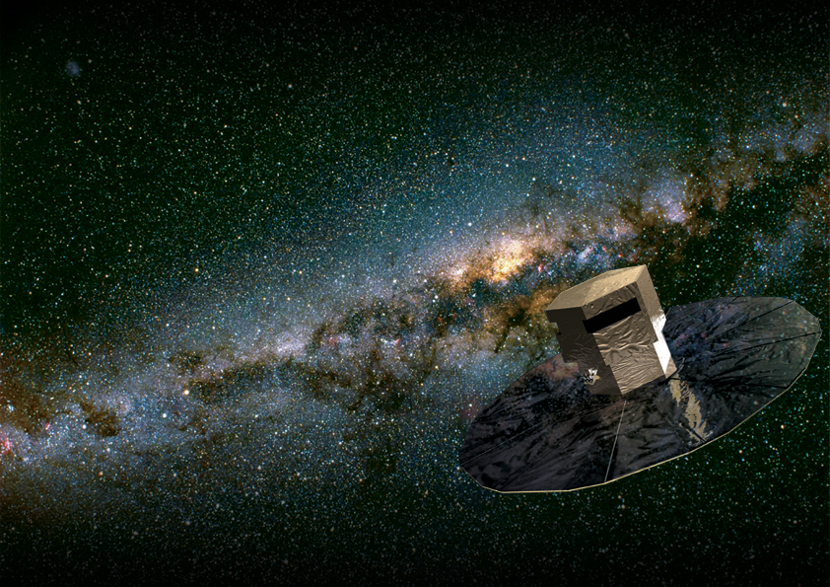
GAIA (Global Astrometric Interferometer for Astrophysics)
satellite in L2 orbit at 1.5 million Km from Earth, mirrors 1.45 x 0.5 m
Launched December 19th 2013
see Cacciari’s talk
Will perform high precision astrometry of 1 billion stars down to V=20,
Will provide 3-D map of our Galaxy, revealing its composition, formation and evolution,
Will detect extra-solar planets

Slide 12
GAIA (Global Astrometric Interferometer for Astrophysics)
INAF is one of the major players in Gaia, and the Bologna Observatory leads its photometry calibration unit and strongly contributes to the variable stars unit
satellite in L2 orbit at 1.5 million Km from Earth, mirrors 1.45 x 0.5 m
Launched December 19th 2013
see Cacciari’s talk
Will perform high precision astrometry of 1 billion stars down to V=20,
Will provide 3-D map of our Galaxy, revealing its composition, formation and evolution,
Will detect extra-solar planets

Slide 13
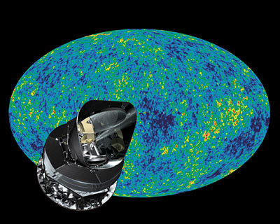
PLANCK (ESA) to study the Cosmic Microwave Background see Burigana’s talk
Launched May 14th 2009

Slide 14
PLANCK (ESA) to study the Cosmic Microwave Background see Burigana’s talk
The INAF – IASF in Bologna has been a leader in Planck’s design and construction, hosting the PI of one of the 2 instruments (LFI), and being at the forefront of its scientific exploitation
Launched May 14th 2009

Slide 15
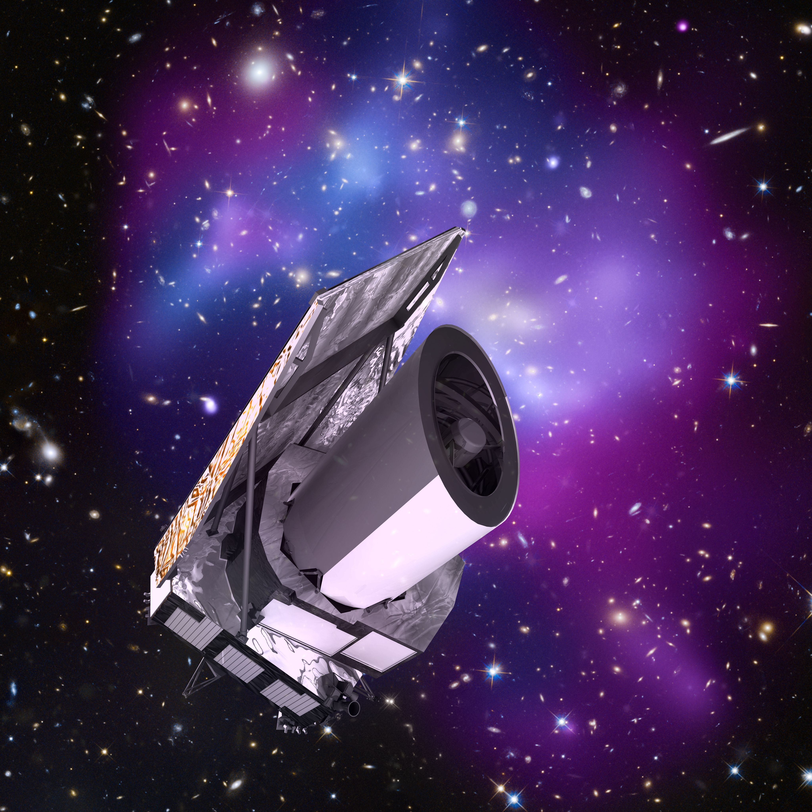
Euclid (ESA+Euclid Consortium) to map the geometry of the dark universe
M class mission
Orbit in L2
1.2m mirror
VIS (visible imager)
NISP (NIR spectrometer and photometer)
Launch planned in 2020
Billions of sources over 15000 sq.deg; redshifts for 50 million galaxies; weak lensing, galaxy clustering, baryonic acoustic oscillations, redshift space distortions, to study dark energy and dark matter

Slide 16
Euclid (ESA+Euclid Consortium) to map the geometry of the dark universe
M class mission
Orbit in L2
1.2m mirror
VIS (visible imager)
NISP (NIR spectrometer and photometer)
Launch planned in 2020
At the Bologna University - DIFA we have the national contact point of the Euclid Consortium. Several INAF researchers (IASF and OABo) prepare the Euclid data exploitation.
Billions of sources over 15000 sq.deg; redshifts for 50,000 galaxies; weak lensing, galaxy clustering, baryonic acoustic oscillations, redshift space distortions, to study dark energy and dark matter

Slide 17
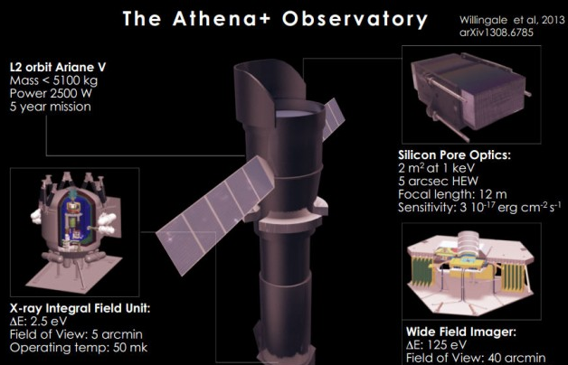
Athena+ (ESA) Advanced Telescope for High ENergy Astrophysics
L2 class mission
Orbit in L2
0.1 – 10 Kev
Instruments: X-IFU, WFI
Launch planned in 2028
General purpose X-ray telescope; in particular: GRBs, BHs, IGM, magnetic interplay between exoplanets and their parent stars, Jupiter’s auroras, etc.

Slide 18
Athena+ (ESA) Advanced Telescope for High ENergy Astrophysics
L2 class mission
Orbit in L2
0.1 – 10 Kev
Instruments: X-IFU, WFI, ?
Launch planned in 2028
We have a large X-ray INAF community in Bologna (mainly at IASF and OABo), who participates to the Athena+ preparation.
General purpose X-ray telescope; in particular: GRBs, BHs, IGM, magnetic interplay between exoplanets and their parent stars, Jupiter’s auroras, etc.

Slide 19
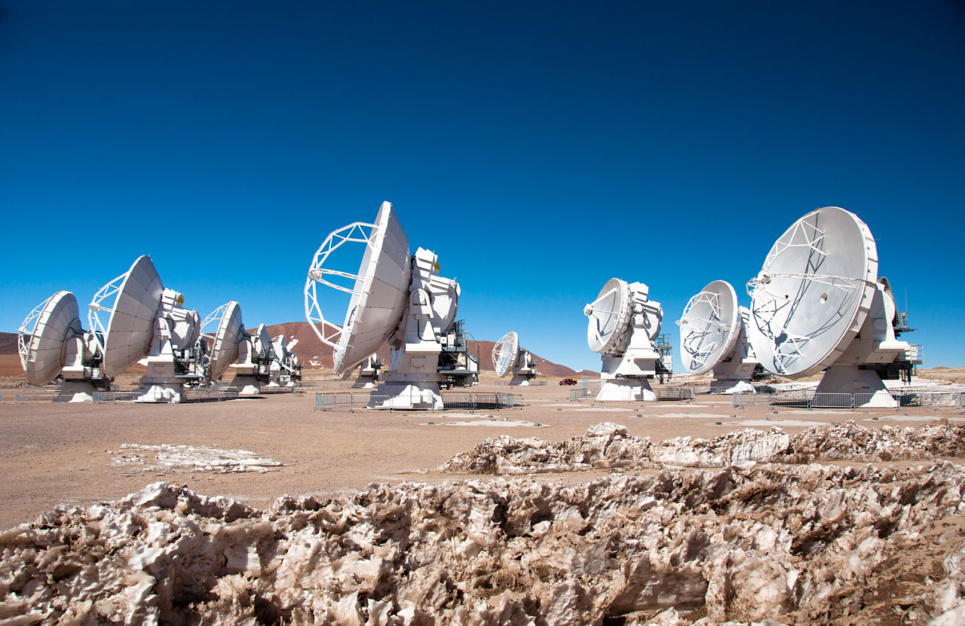
ALMA (ESO, USA, Japan) Atacama Large Millimeter/submillimeter Array
50 12m antennas over 16 Km in the Atacama desert (Chile) to study the physics of the cold Universe: first stars and galaxies, star and planet formation

Slide 20
ALMA (ESO, USA, Japan) Atacama Large Millimeter/submillimeter Array
The INAF – IRA in Bologna hosts the Italian Alma Regional Center (ARC) which helps to prepare proposals, observations, data reduction, and data analysis
50 12m antennas over 16 Km in the Atacama desert (Chile) to study the physics of the cold Universe: first stars and galaxies, star and planet formation

Slide 21
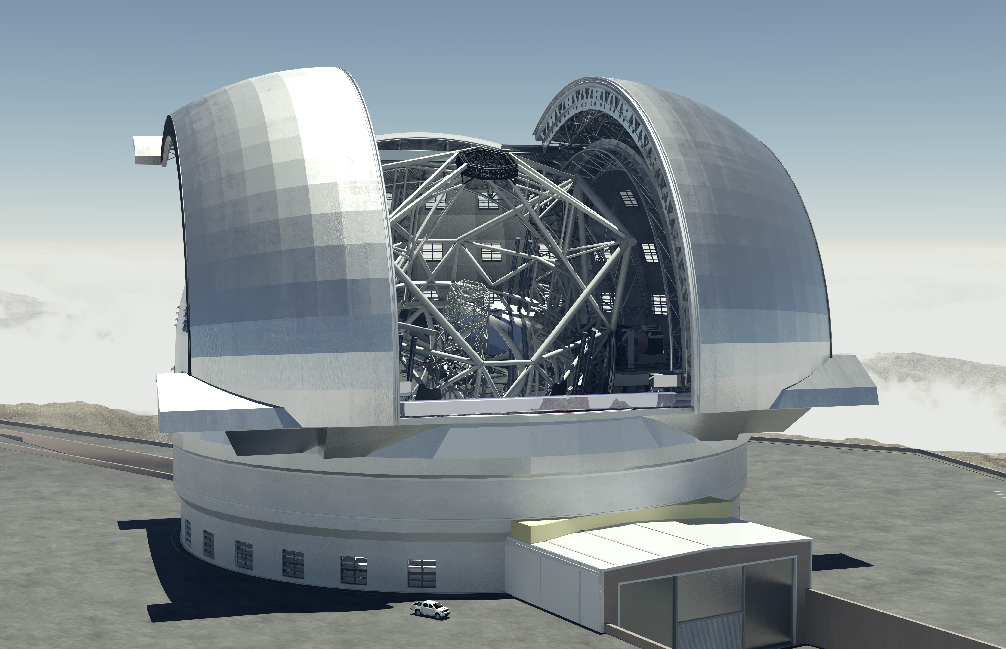
E-ELT (European Extremely Large Telescope)
Optical-infrared telescope, in Chile,
Primary mirror of 39 m diameter, adaptive optics,
Funded by ESO (intergovernmental european institution) + Member States
To study extrasolar planets, back holes, first stars in the Universe, remote galaxies, dark matter and energy
First light in 2024

Slide 22
E-ELT (European Extremely Large Telescope)
Optical-infrared telescope, in Chile,
Primary mirror of 39 m diameter, adaptive optics,
Funded by ESO (intergovernmental european institution) + Member States
To study extrasolar planets, back holes, first stars in the Universe, remote galaxies, dark matter and energy
First light in 2024
INAF is one of the major players in E-ELT (AO, instruments, mirrors), and the Bologna Observatory hosts the PI of the consortium building the First Light MCAO module Maory.

Slide 23
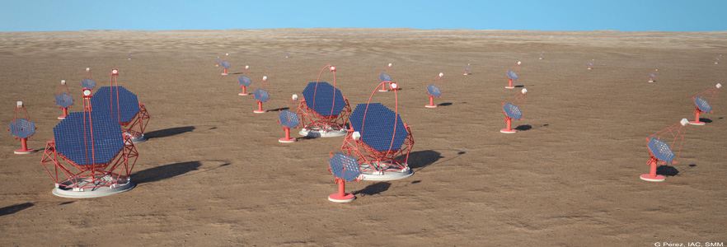
CTA (Cherenkov Telescope Array)
Array of tens of telescopes of 4 to 24m diameter
to detect very high energy photons (from tens of GeV to 10 TeV)
Funded by an international Consortium of 27 countries
(INAF among leading countries)
To study gamma-ray sources, origin of cosmic rays and particle accelerators
Construction starting 2015 ?

Slide 24
CTA (Cherenkov Telescope Array)
INAF is one of the major players in CTA; other INAF institutes have leading roles in it; in Bologna we have several participants (both at IASF and OA-Bo)
Array of tens of telescopes of 4 to 24m diameter
to detect very high energy photons (from tens of GeV to 10 TeV)
Funded by an international Consortium of 27 countries
(INAF among leading countries)
To study gamma-ray sources, origin of cosmic rays and particle accelerators
Construction starting 2015 ?

Slide 25
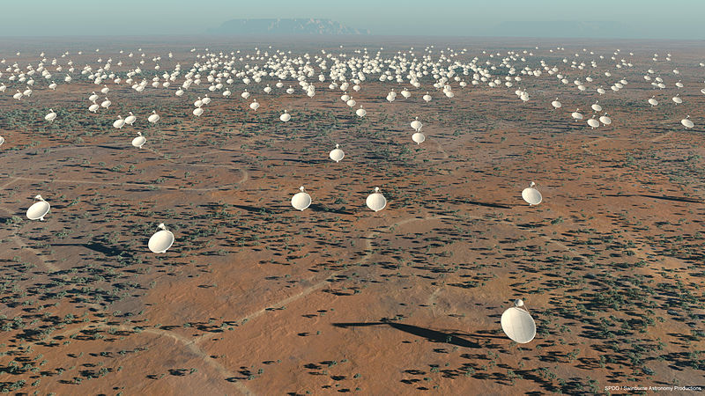
SKA (Square Kilometer Array)
Array of thousands of radiotelescopes equivalent to one with 1 Km diameter
in Australia (low frequency) e South Africa (high frequency)
Funded by international consortium of >10 countries (INAF among leading ones)
To study first stars and galaxies in the Universe, magnetic field role, gravity law, search for extra-terrestrial life
Costruction starting in 2016 ?

Slide 26
SKA (Square Kilometer Array)
Array of thousands of radiotelescopes equivalent to one with 1 Km diameter
in Australia (low frequency) e South Africa (high frequency)
Funded by international consortium of >10 countries (INAF among leading ones)
To study first stars and galaxies in the Universe, magnetic field role, gravity law, search for extra-terrestrial life
Costruction starting in 2016 ?
INAF is one of the major players in SKA; in Bologna several IRA’s scientists are involved in the organization, also in prominent roles

Slide 27
THANK YOU

