Slide 1
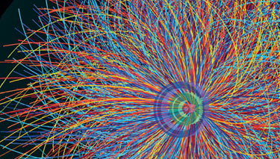
QCD at LHC
Eugenio Scapparone
Nov. 3, 2014

Slide 2
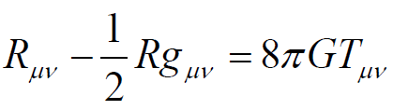
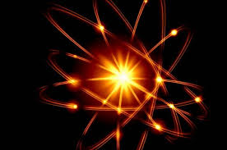
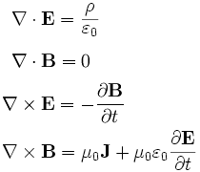
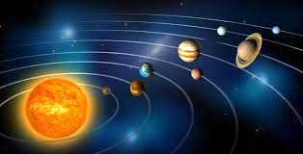
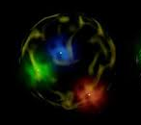
Who binds the atoms ?
→ Electromagnetic interaction
Who binds the solar system ?
→ Gravity
Who binds the proton ?
We call it «the strong nuclear force»
That’s all ? No.
We can observe free electrons, but we cannot observe
free quarks. NEVER. They are prisoners in the particles made of them.
We call these particle «hadrons».

Slide 3
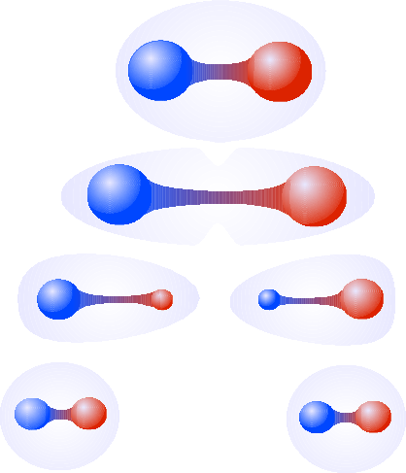
Quantum chromodynamics (QCD) is the underlying theory of the strong force
We have 1 electromagnetic charge ( positive or negative). QCD charges are three ( positive and negative).
We call them blue, red , green ( anti- blue, anti- red , anti- green ).
The messenger of the electromagnetism is the photon → yes, we can observe free-photons.
The messanger of strong nuclear force are the gluons→ no, we cannot observe free-gluons.
Why ?
The most striking difference is that photon has no charge, while gluons carry a charge and one anti-charge (i.e. Red-antigreen).
I don’t believe it: can we have a particle made by just 2 quarks or 1 quark + 1 anti-quark ? YES
Ok, let’s stratch them, increase the energy and sooner or later we will separate them.
q
q
q
q
q
q
q
q
q
q
q
q
There are compelling arguments (but no rigorous proof) that the non-abelian nature of QCD is responsible for the confinement of colour. Gottfried-Weisskopf
..and another quark-jail is formed

Slide 4
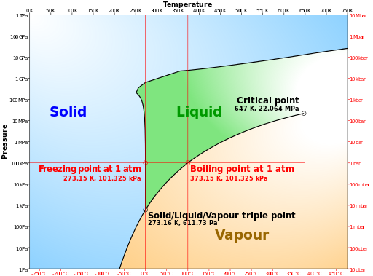
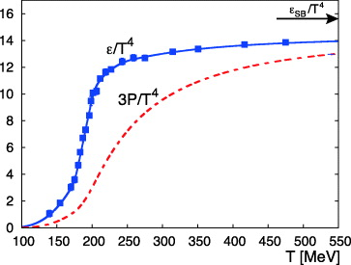
What about the big bang ? How could the quarks be confined into hadrons if the hadrons did not exist yet ?
Indeed at t < ~ 1 μs we expect quarks were free....
Can we have nowadays free quarks ? A special branch of theoretical physics says YES
QCD can give quantitative predictions when quarks are close, but it’s difficult to compute when quarks stay far away. An approach that can be followed is to use field equations numerically on a discrete space–time grid (Lattice QCD).
Energy density ε/Τ⁴

Slide 5
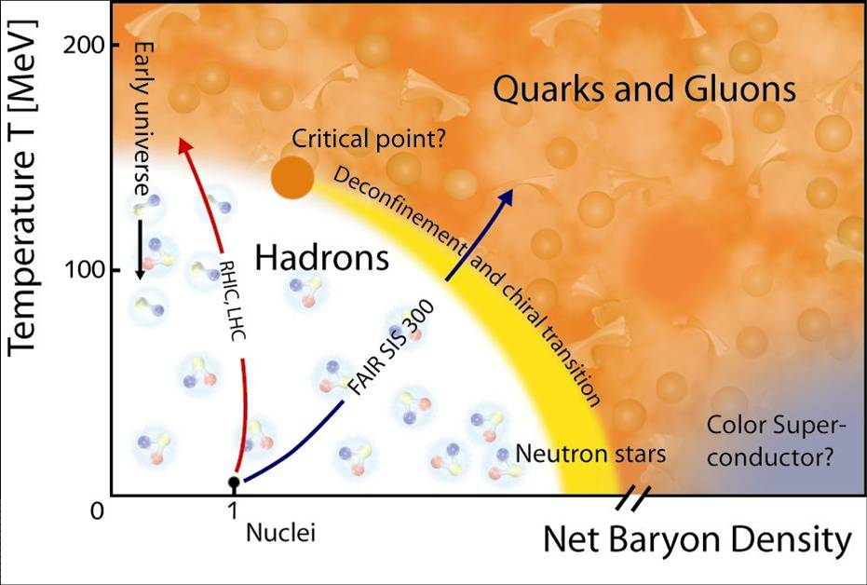
QCD Phase Diagram
LHC

Slide 6

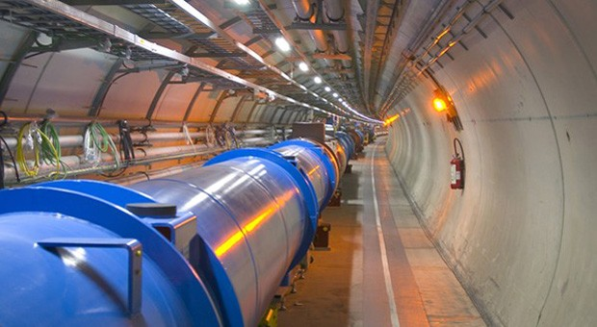
LHC accelerates not only protons, but heavy ions too !
Temperatures as high as 300 MeV can be reached ( T ~ 3•10¹² K). The center of the sun is quite
cold in comparison, just T ~ 2•10⁷ K

Slide 7
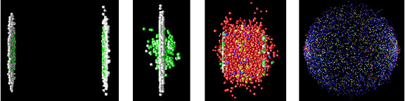
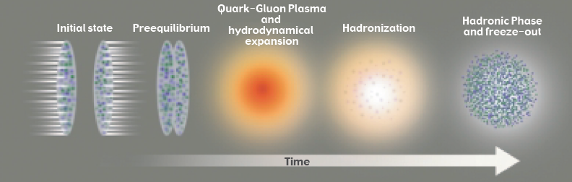
Heavy Ion Collisions at LHC energies

Slide 8
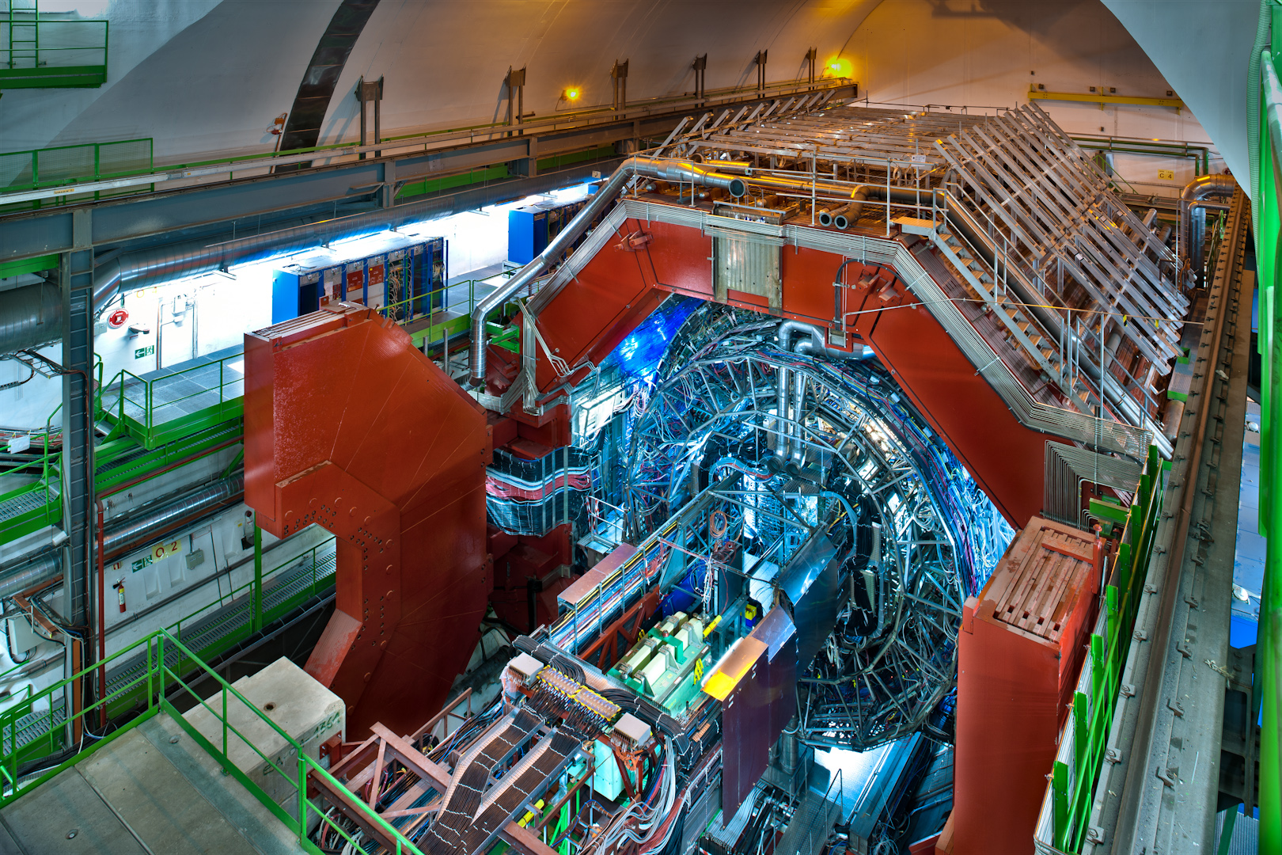
ALICE: an experiment focused on Quark gluon plasma study

Slide 9
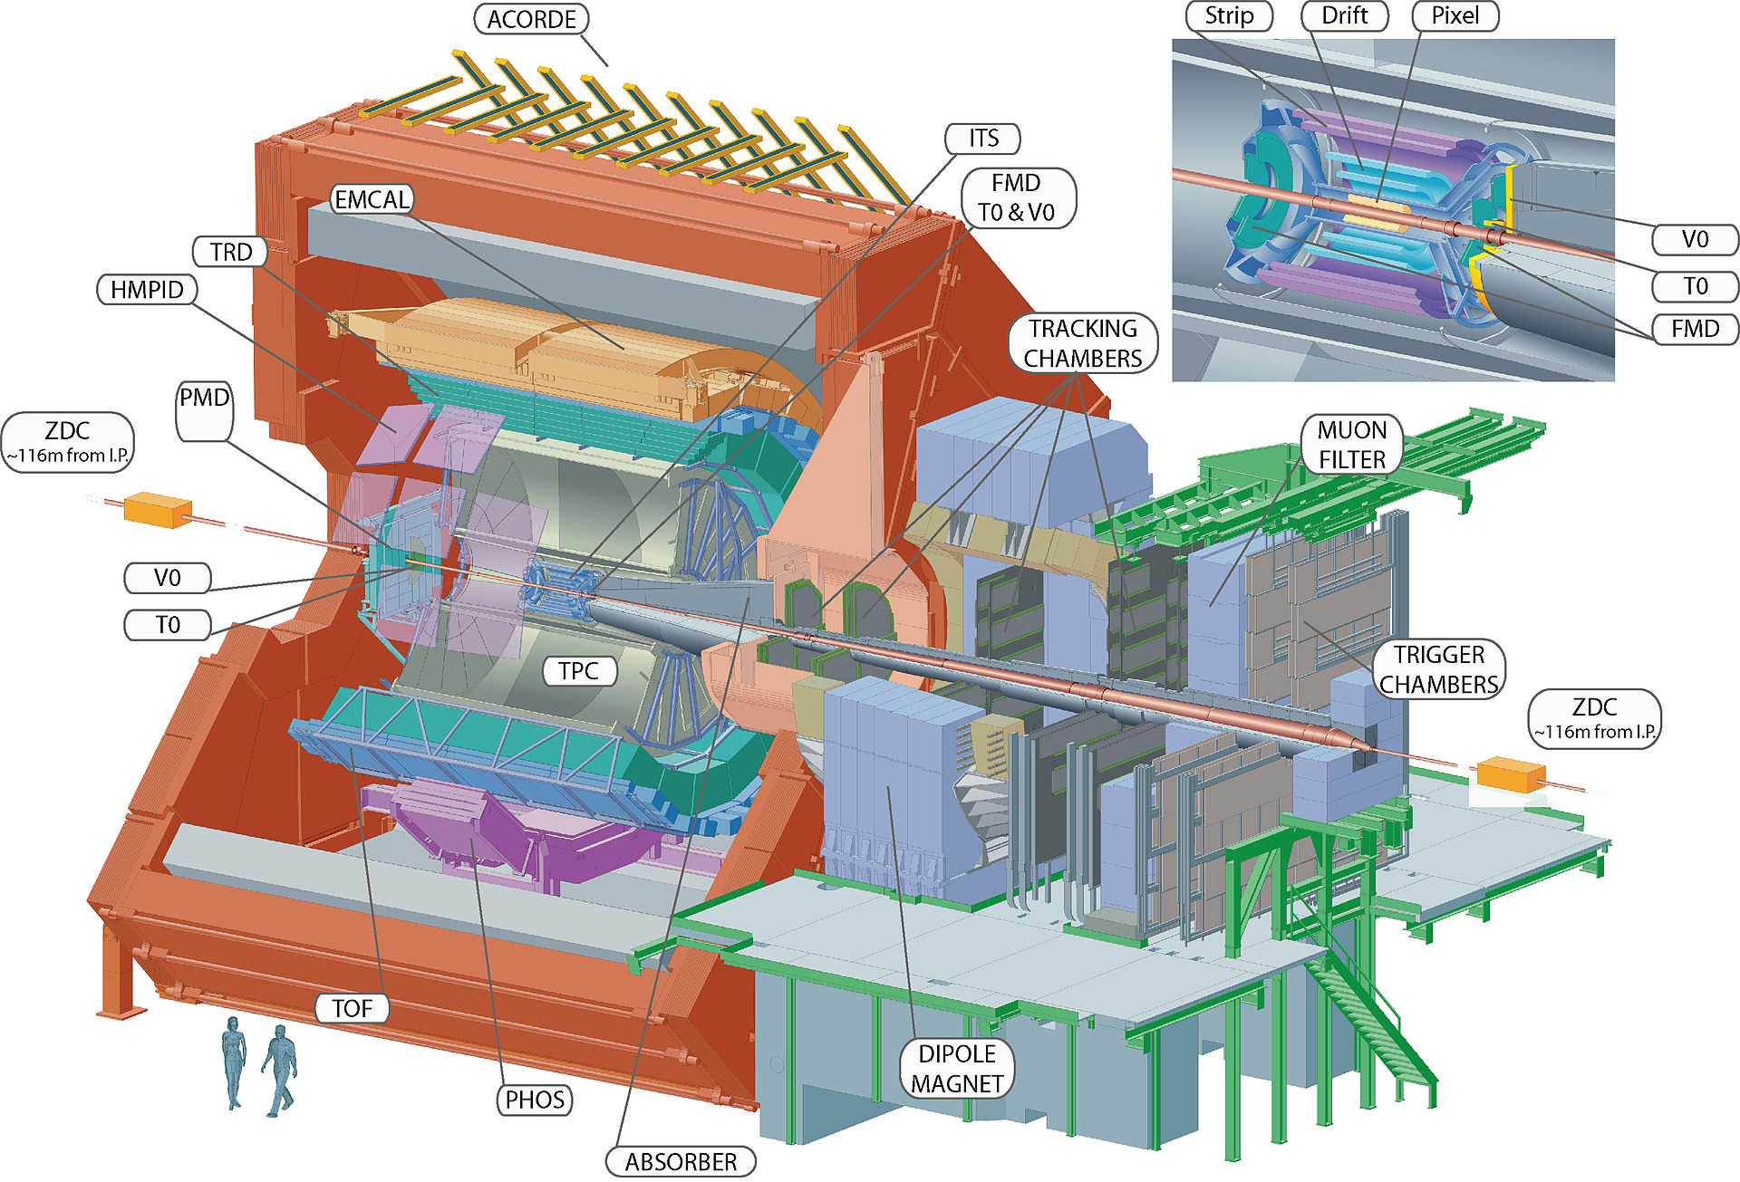
ALICE: an experiment focused on Quark gluon plasma study
Made in bo

Slide 10
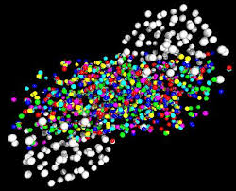
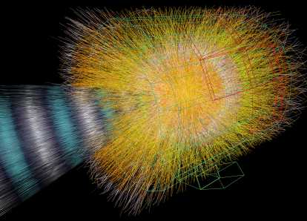
QGP physics is not hunting for a new particle, whose discovery can validate a theory.
It’s the exploration of a new state of matter, formed shortly after the Pb-Pb collisions.
The hot fireball formed by the Pb-Pb interaction expanded and cooled.
Particle chemestry freezes out and later kinetic scattering between partcles freezes too.
At the end of the process we detect a huge number of produced particles.
Extracting the characteristics of the QGP is not trivial
Hadrons identification (p, K, π …) is essential in QGP physics

Slide 11

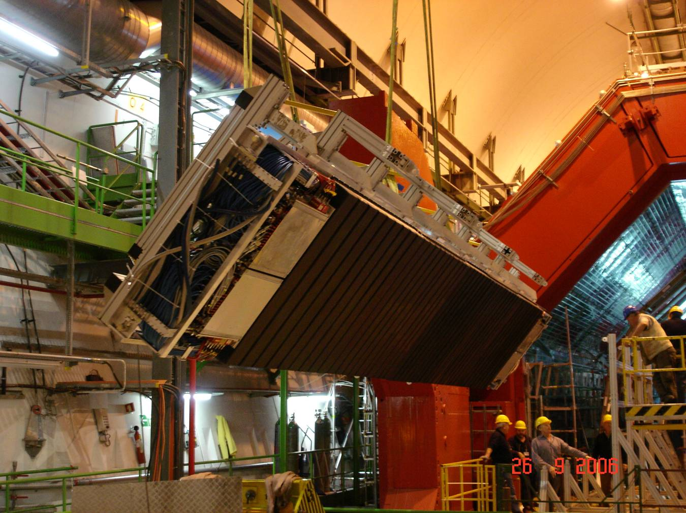
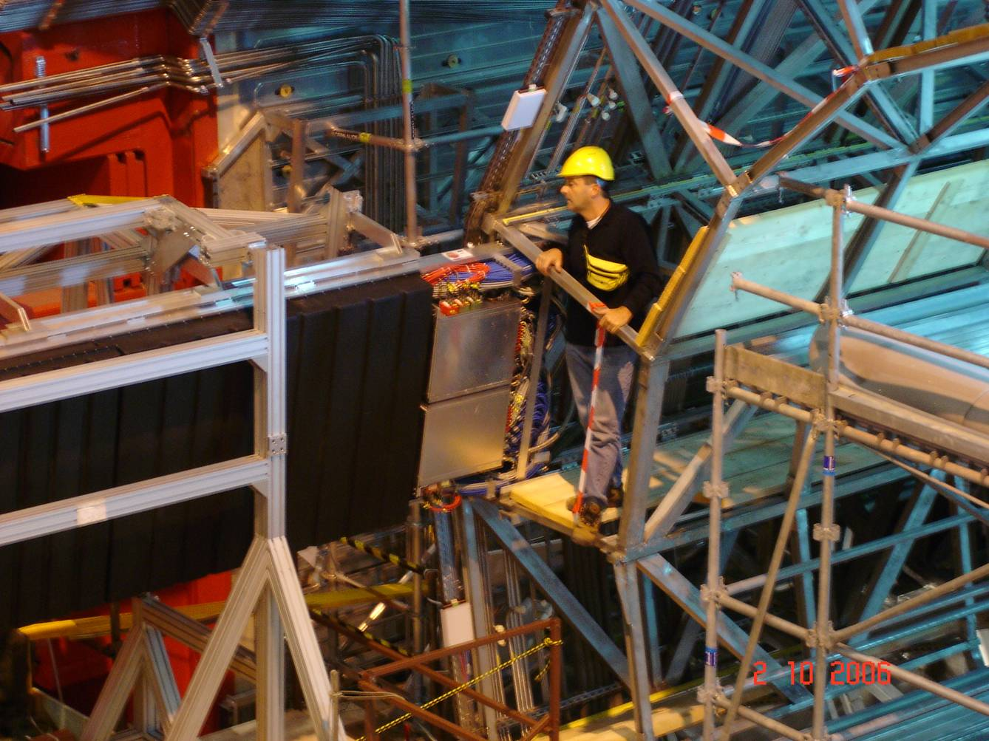
TOF construction & mounting (INFN – BOLOGNA had the full responsability)
INFN-Bologna engineers not exactly similar to those of Prometheus, but highly skilled anyway

Slide 12
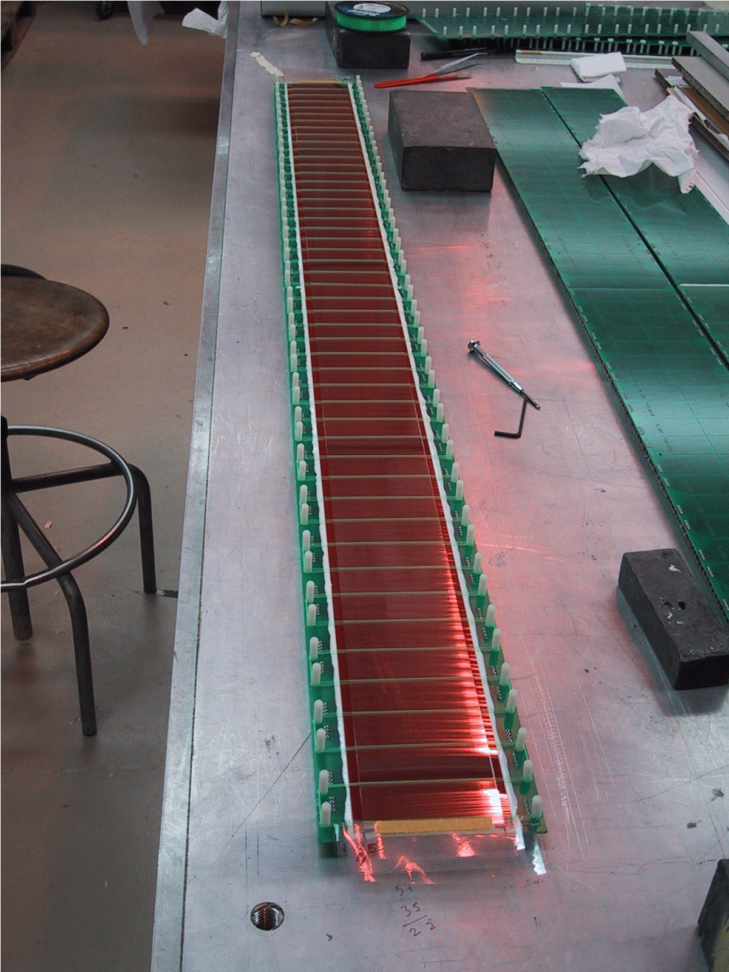
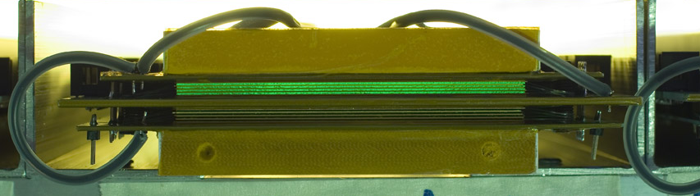
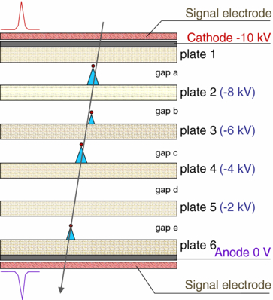
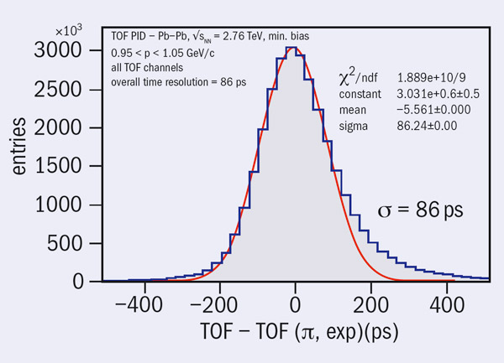
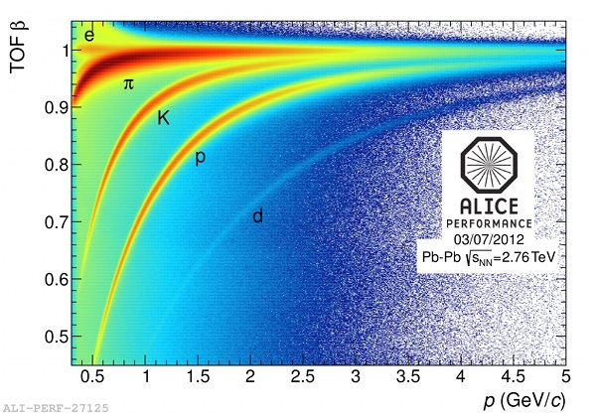
glass layers form 10 gaps (220 μm)

Slide 13
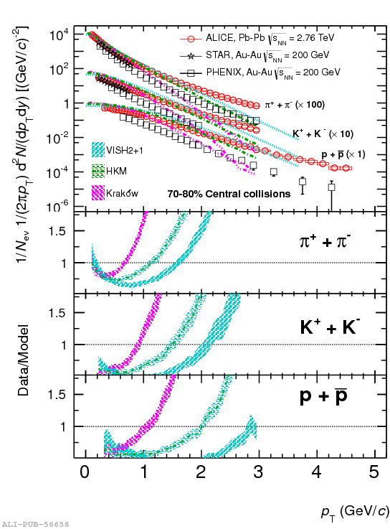
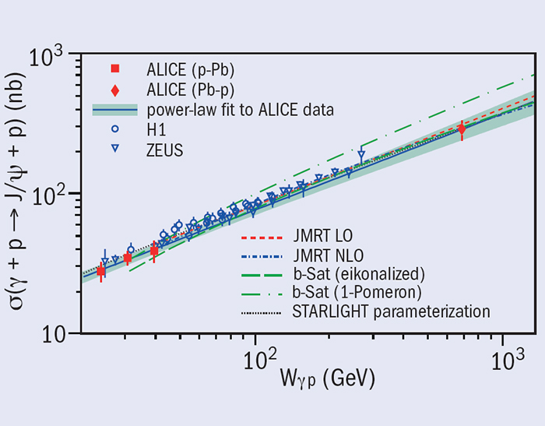
ALICE Bologna group focuses on:
Study of the transverse momentum of identified particles;
Study of the hot created matter characteristics.
(Do you believe it’s a gas-like medium ? )
Study of antimatter (d, ³He);
Study of resonances, whose shape could be modified by the QGP (K*, Φ);
Study of heavy quarks produced by a photon interacting with a Pb nucleus.

Slide 14
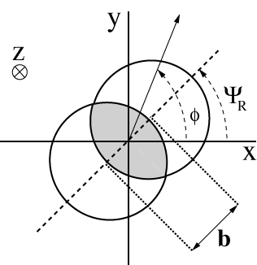
(ELLIPTIC FLOW)
Reaction plane provides natural coordinate
system in non central collisions
Reaction
plane
y
z
x
The system has an asymmetric shape → pressure gradient
Can the asymmetry in space be transformed into asymmetry in momentum ? It depends on the medium characteristics.

Slide 15


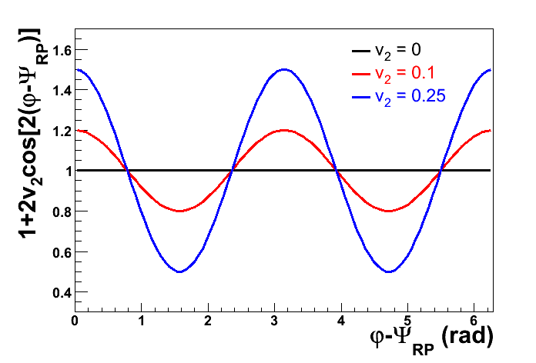
The angular distribution can be written as:
σ_{y}
ϕ
σ_{x}
If v₂≠0 → difference between the number of particles parallel(0°, 180°) and orthogonal (90°,270°) to the impact parameter.
Th effects comes from the difference between // and ⊥ pressure gradients.
Elliptic flow
//
//
⊥
⊥
15

Slide 16



What is Elliptic Flow?
Ollitrault (’92)
How does the system respond to spatial anisotropy?
y
No secondary interaction
Hydro behavior
φ
x
INPUT
Spatial Anisotropy
Interaction among
produced particles
2v₂
dN/dφ
OUTPUT
dN/dφ
Momentum Anisotropy
0
φ
2π
0
φ
2π

Slide 17
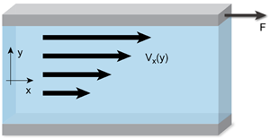
How do we describe a fluid ?
Examples: good fluid ( water) and… a bad fluid (honey).
Energy to the water: waves damp down slowly. The waves formed when a ball falls into a small pool water ,
goes forward and backward for a long time
A spoon falls into a honey dispenser: no waves seen, honey shape restored in a short time.
In a good fluid a small force gives a large velocity gradient
η ~ F /∇v
The viscosity of a fluid is a measure of its resistance to shearing flows
(fluid capability to bring momentum to another point)
To predict the elliptic flow we need the superposition of QCD + hydro-dynamic models.

Slide 18
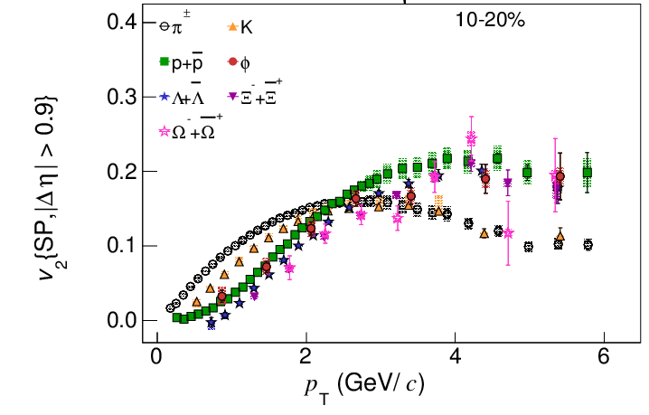
Elliptic flow
Eccentricity
A non trivial result: mass splitting of elliptic
flow is at least qualitatively explained within
the fluid dynamic framework radial flow boosts
heavier particles to higher p_{T}: Δp_{T} ~ m βT
Mass ordering (p_{T} < 2.5 GeV/c): smaller
v₂ for heavier particles
arXiv: 1405.4632
Integrated v2: 30% increase from 0.2 TeV (STAR) to 2.76 TeV (ALICE), due to the increase of <pT>
9

Slide 19
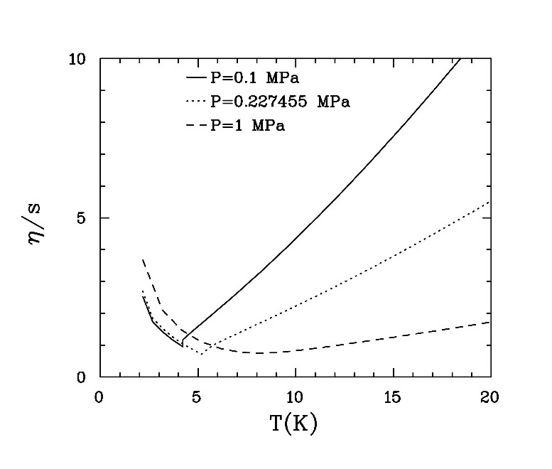
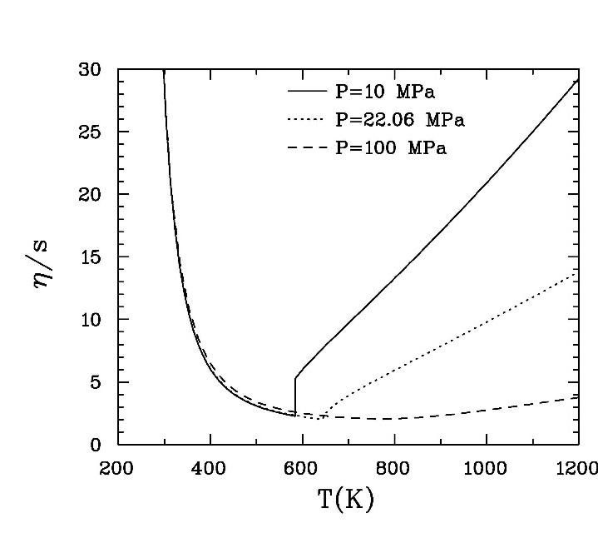
Question: how perfect is this fluid ?
String theory conjecture:
η/s ≥ 1/4π (ħ/k) = 0.08 (ħ/k)
He
H₂0
N

Slide 20
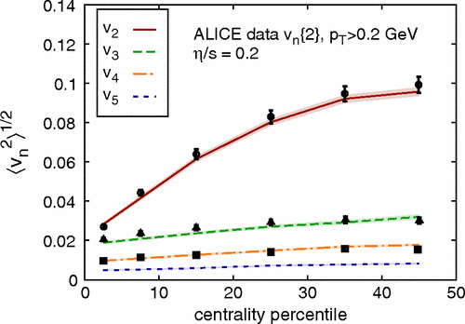
the most "perfect" fluid ever discovered
0.08 < η/s < 0.2-0.3
...QCD physics needs high luminosity accelerators, cutting edge technology particle detectors and last
but not least → young people bringing their enthusiasm and new ideas.

