Slide 1
Some ideas for New 3D Layout
Gian-Franco Dalla Betta
University of Trento and TIFPA INFN, Trento, Italy
Available ROC’s
FEI4, FEI3, PSI46, MEDIPIX2
Layout options for testability

Slide 2
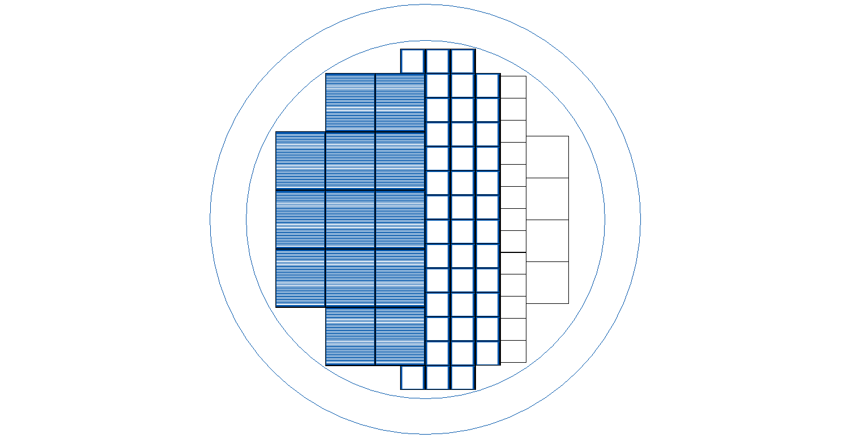
WAFER FLOORPLAN
PSI46
FEI3
FEI4
MEDIPIX2

Slide 3
FEI4 bump pad array layout
50 μm
450 μm
50 μm
450 μm
Bump
Pads (x 336)

Slide 4
FEI4 compatible test pixels 50 x 50
4x250
2x50 + 2x450L
4x50 + grid
450 μm
250 fF
250 fF
50 μm
450 μm

Slide 5
FEI4-compatible test pixels 25 x 100
4x25x100(2E) + grid
4x25x100(1E) + grid
25x500(1E)
450 μm
50 μm
450 μm

Slide 6
FEI3 bump pad array layout
50 μm
750 μm
50 μm
750 μm
Bump
Pads (160x )

Slide 7
FEI3 compatible test pixels
4x50 + grid
4x25x100(2E) + grid
750 μm
50 μm
750 μm

Slide 8
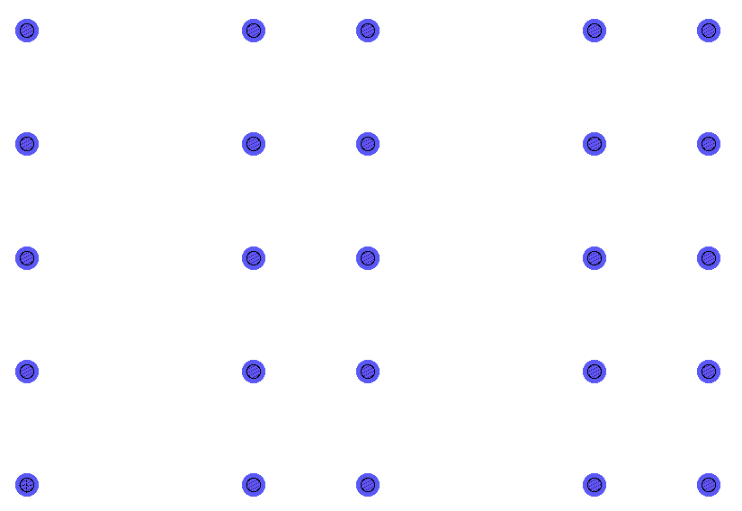
PSI46 bump pad array layout
200 μm
100 μm
Bump Pads (52 x )
100 μm

Slide 9
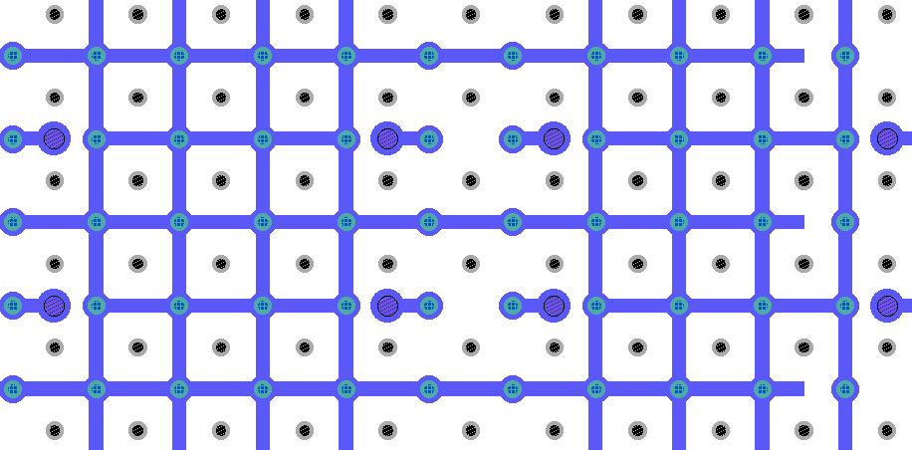
PSI46 compatible test pixels 50 x 50
Single cells 50x50 + grid

Slide 10
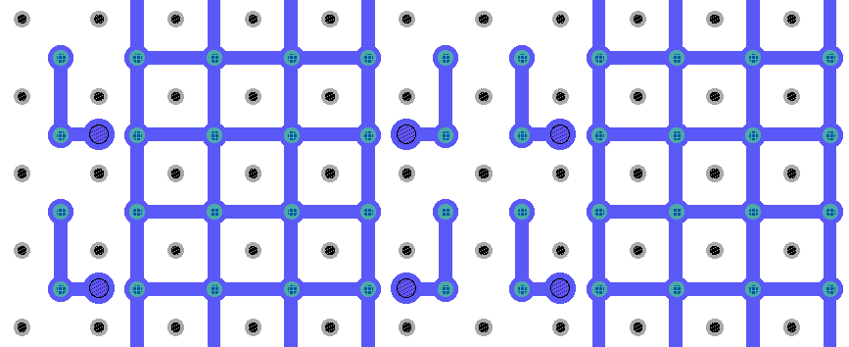
PSI146 compatible test pixels 50 x 50
Double cells 50x100 + grid

Slide 11
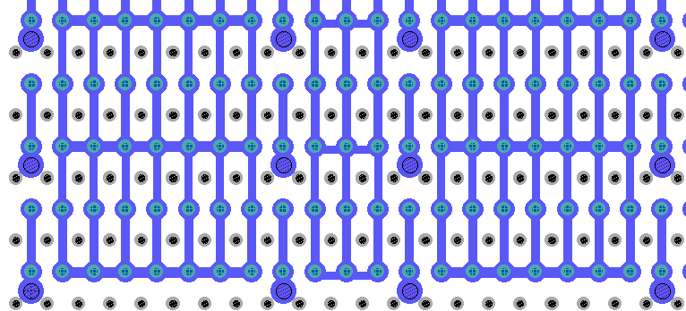
PSI146 compatible test pixels 25 x 100
Single cells 25x100 + grid

Slide 12
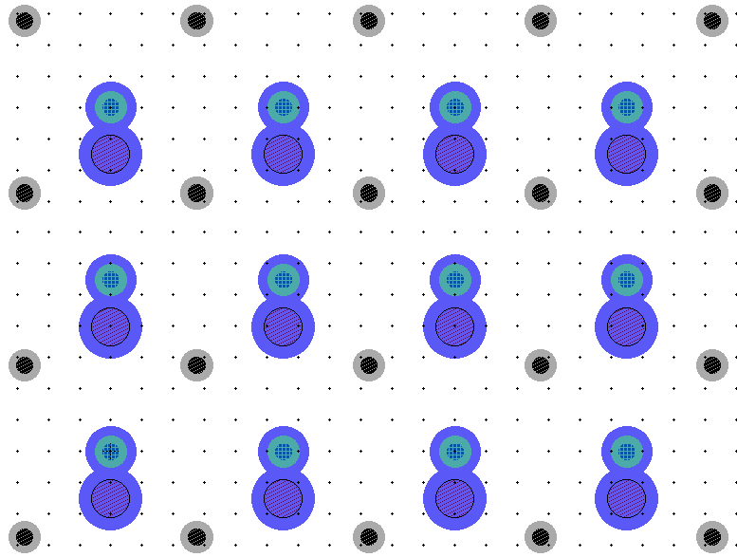
MEDIPIX2 pixels 55 x 55
55 μm
55 μm

Slide 13
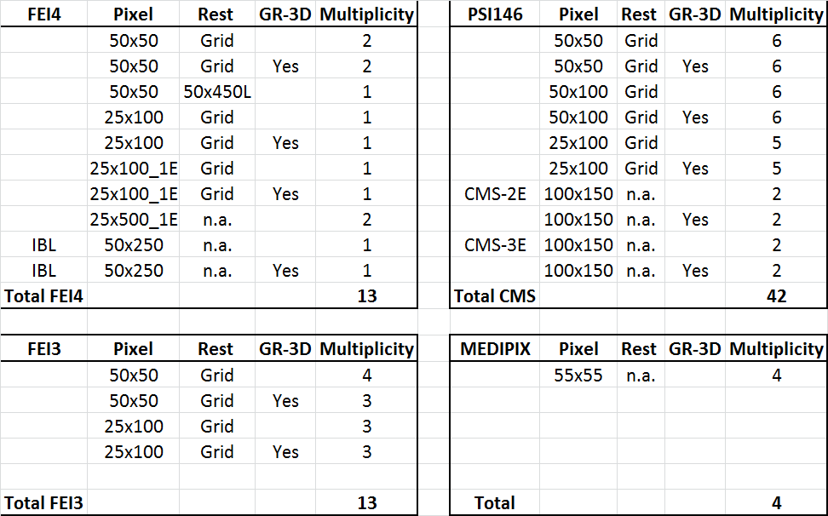
Summary Table

