Slide 1
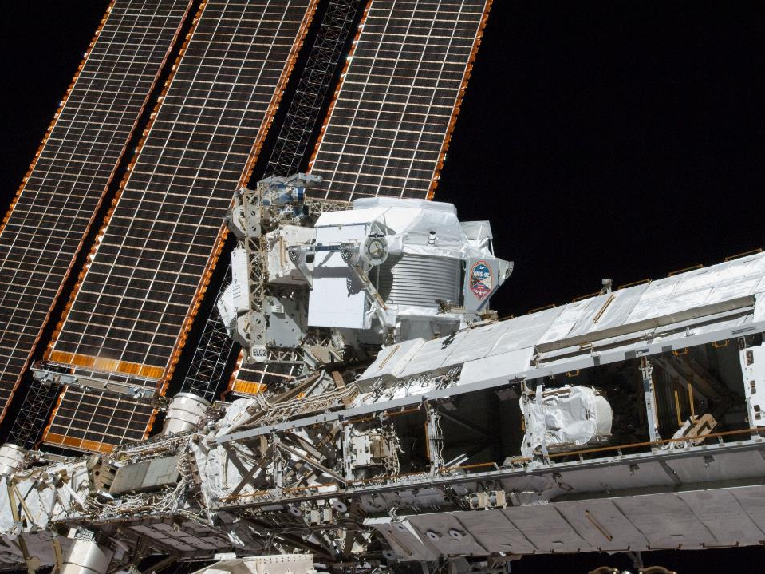
Le misure di elettroni e positroni in AMS e la loro interpretazione
Bruno Borgia
Paolo Lipari

Slide 3
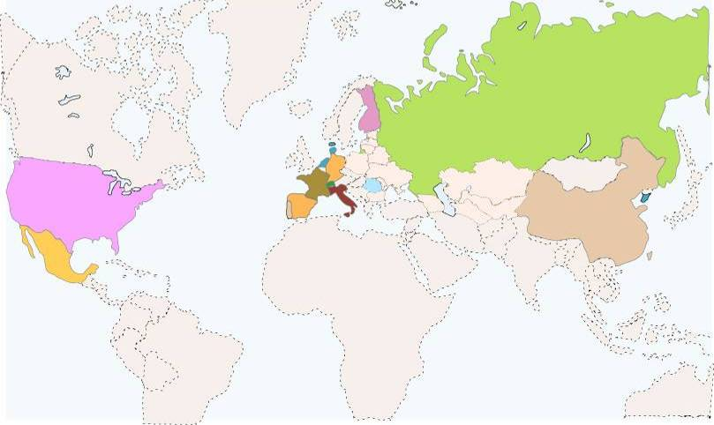
16 Paesi 60 Istituti 500 ingegneri ricercatori e tecnici
FINLAND
RUSSIA
HELSINKI UNIV.
UNIV. OF TURKU
I.K.I.
ITEP
KURCHATOV INST.
MOSCOW STATE UNIV.
DENMARK
NETHERLANDS
UNIV. OF AARHUS
ESA-ESTEC
NIKHEF
NLR
GERMANY
RWTH-I
RWTH-III
MAX-PLANK INST.
UNIV. OF KARLSRUHE
KOREA
USA
EWHA
KYUNGPOOK NAT.UNIV.
A&M FLORIDA UNIV.
JOHNS HOPKINS UNIV.
MIT - CAMBRIDGE
NASA GODDARD SPACE FLIGHT CENTER
NASA JOHNSON SPACE CENTER
UNIV. OF MARYLAND-DEPRT OF PHYSICS
UNIV. OF MARYLAND-E.W.S. S.CENTER
YALE UNIV. - NEW HAVEN
FRANCE
ROMANIA
CHINA
BISEE (Beijing)
IEE (Beijing)
IHEP (Beijing)
SJTU (Shanghai)
SEU (Nanjing)
SYSU (Guangzhou)
SDU (Jinan)
GAM MONTPELLIER
LAPP ANNECY
LPSC GRENOBLE
ISS
UNIV. OF BUCHAREST
SWITZERLAND
ETH-ZURICH
UNIV. OF GENEVA
TAIWAN
SPAIN
CIEMAT - MADRID
I.A.C. CANARIAS.
ITALY
ACAD. SINICA (Taiwan)
CSIST (Taiwan)
NCU (Chung Li)
NCKU (Tainan)
NCTU (Hsinchu)
NSPO (Hsinchu)
ASI
CARSO TRIESTE
IROE FLORENCE
INFN & UNIV. OF BOLOGNA
INFN & UNIV. OF MILANO
INFN & UNIV. OF PERUGIA
INFN & UNIV. OF PISA
INFN & UNIV. OF ROMA
INFN & UNIV. OF SIENA
MEXICO
UNAM
PORTUGAL
LAB. OF INSTRUM. LISBON
Y96673-05_1Commitment

Slide 4
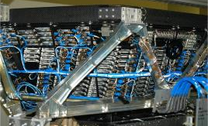
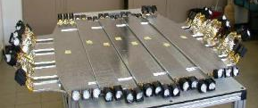
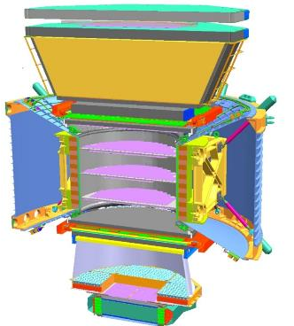
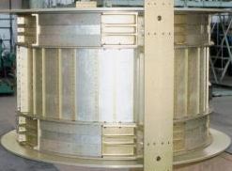
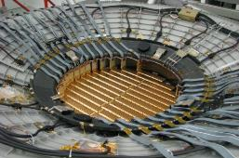
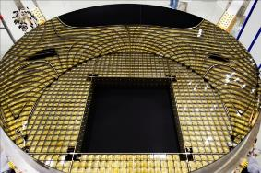
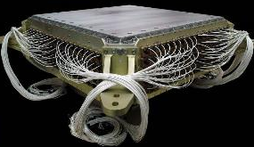
AMS: A TeV precision, multipurpose spectrometer
TRD
Identify e⁺, e⁻ , Z
Particles and nuclei are defined by their charge (Z) and energy (E ~ P)
TOF
Z, E
1
Magnet
±Z
Silicon Tracker
Z, P
TRD
TOF
2
3-4
5-6
Tracker
7-8
TOF
RICH
Z, E
ECAL
E of e⁺, e⁻, γ
RICH
9
ECAL
Z, P are measured independently by the Tracker, RICH, TOF and ECAL
Notes:
4
4
4

Slide 5
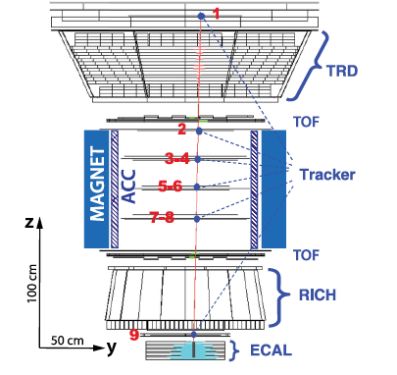
Dimensioni: 5 x 4 x 3 m³
Massa: 7 500 kg
Potenza: 2 500 W
Canali di elettronica: 300 000
Microprocessori: 650
Data rate a terra: 10 Mbit/s
Durata della missione: 10 - 18 anni
Campo magnetico: 0.15 T
Magnete permanente 1200 kg Nd₂ Fe₁₄ B

Slide 6
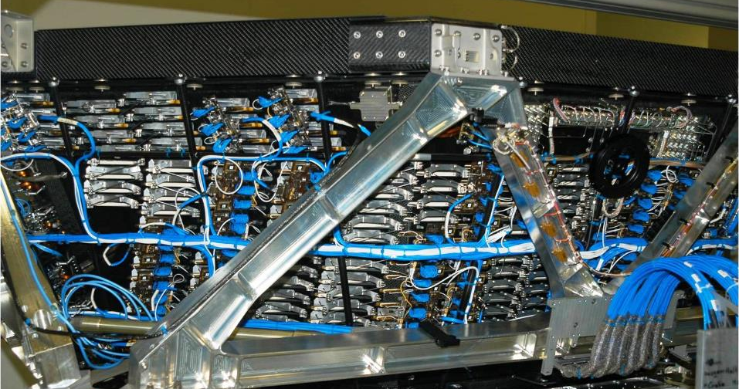
Transition Radiation Detector (TRD):
identifies Positrons, Electrons by transition radiation
and Nuclei by dE/dX

Slide 7
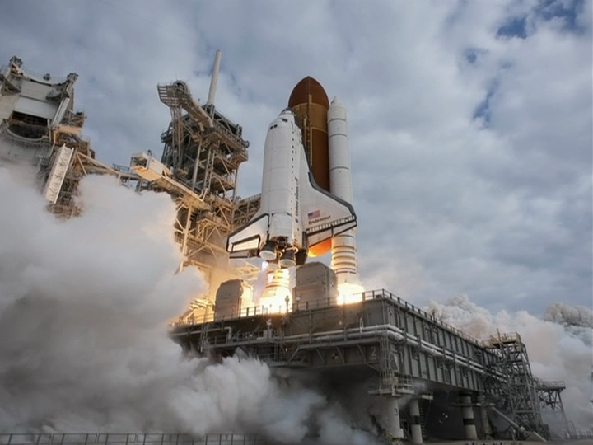
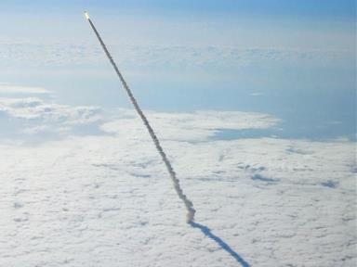
May 16, 2011, 08:56 AM
Total weight: 2008 t
AMS weight: 7.5 t

Slide 8
2,5 ore dopo il lancio, i primi a funzionare
sono i controlli del TRD

Slide 9
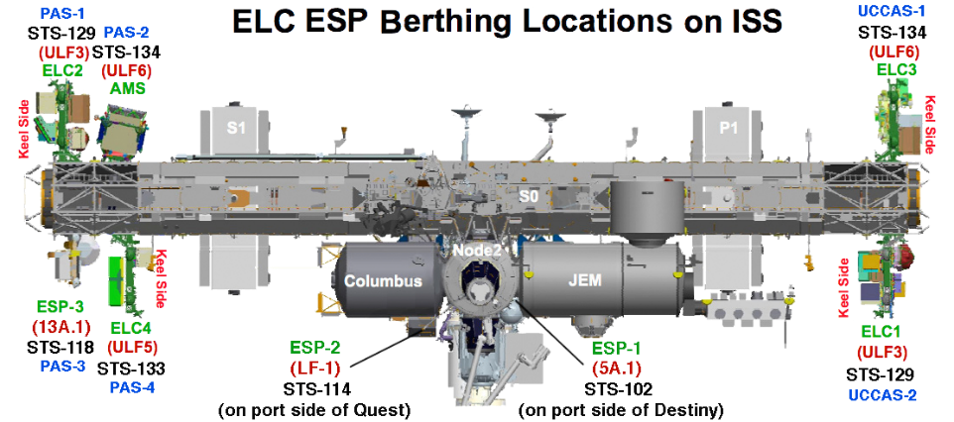

Slide 10
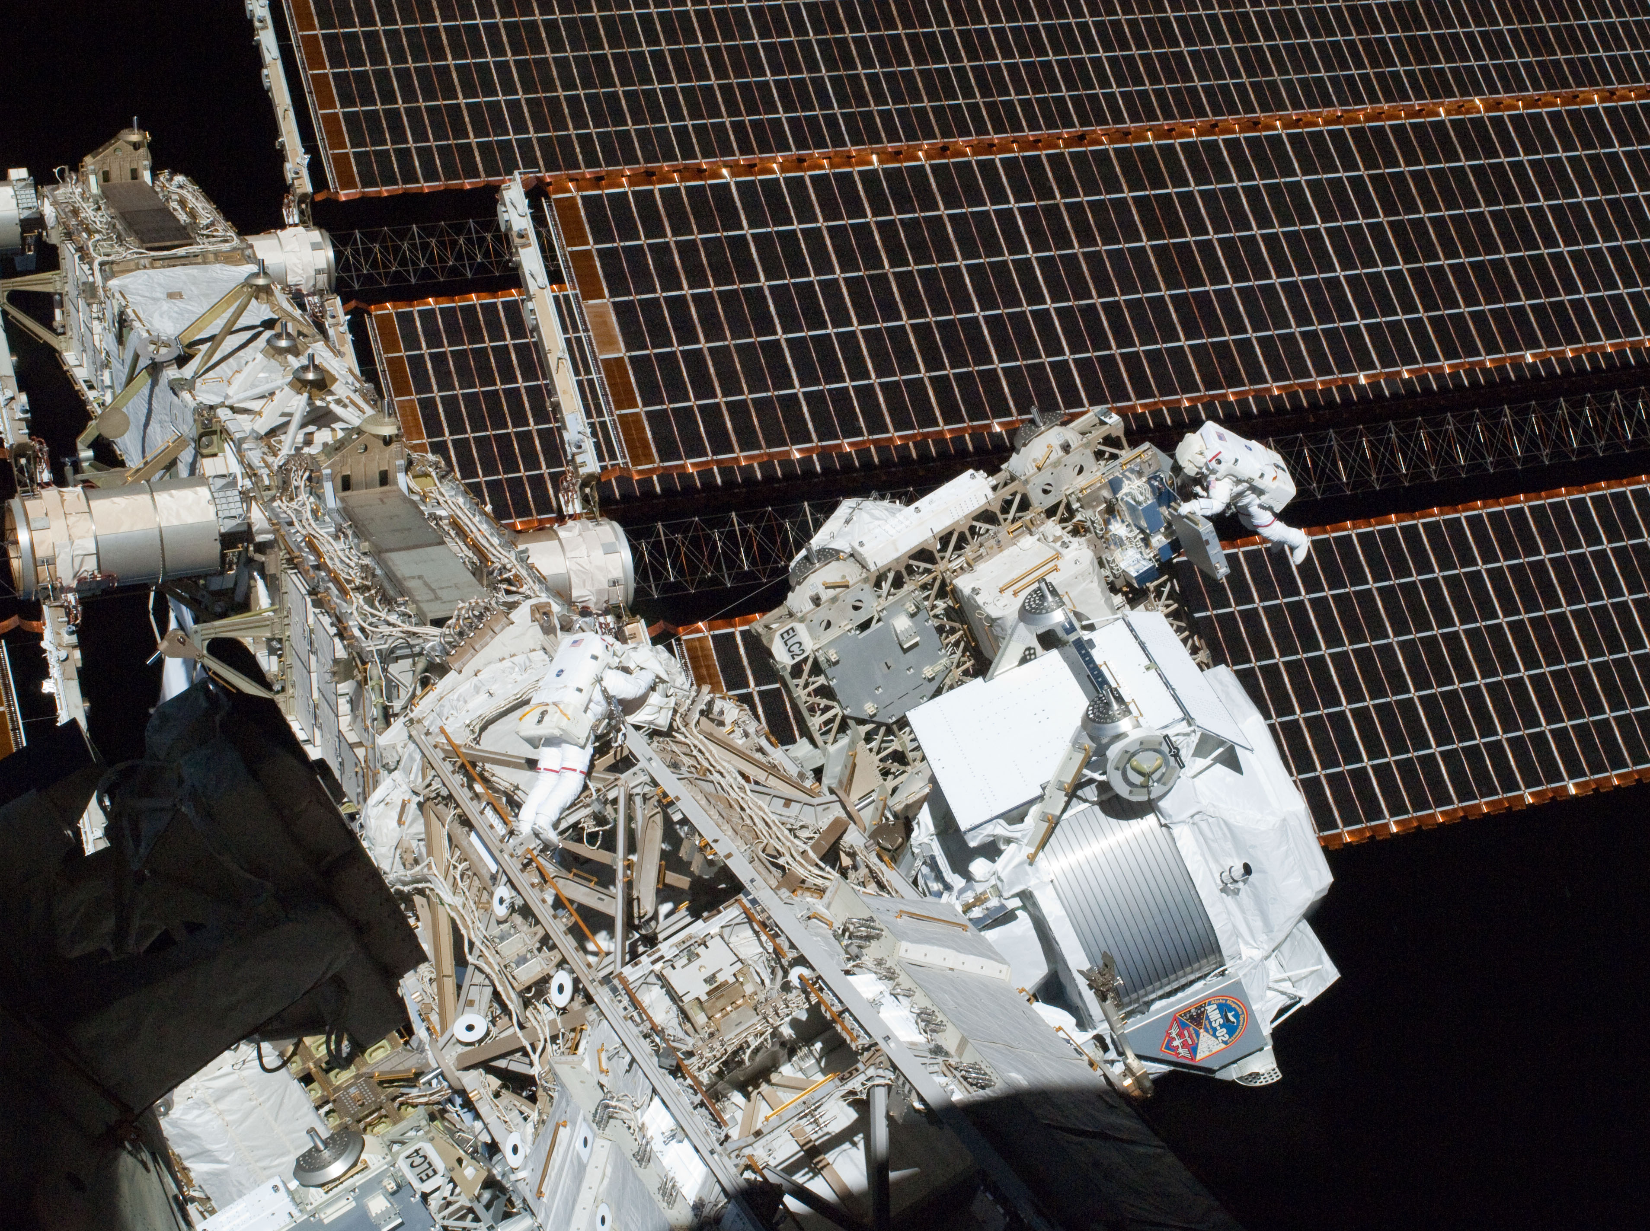
Installazione completata 5.15 AM
del 19/5/2011
dalle 9.35 AMS è in misura

Slide 11
AMS Payload Operation Control Center POCC
al CERN
Foto POCC e storia controllo
24h/24 365 d/y ≈ 1200 days data taking ≈ 50x10⁹ events

Slide 12
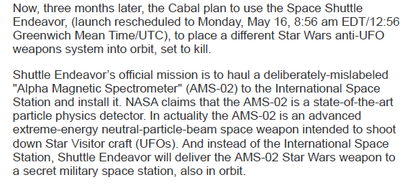

Slide 13
Obiettivi
Ricerca di antimateria primordiale:
Anti-nuclei: He, C, …
Ricerca di materia oscura:
annichilazione dei neutralini e+ , e± , p , …
Ricerca di nuovi tipi di materia:
strangelets, …
Misura degli spettri dei RC
Sorgenti locali di fotoni di alta energia (~TeV):
SNR, Pulsars, PBH, …
Effetti della modulazione solare (ciclo 11a)
Fenomeni inaspettati

Slide 15
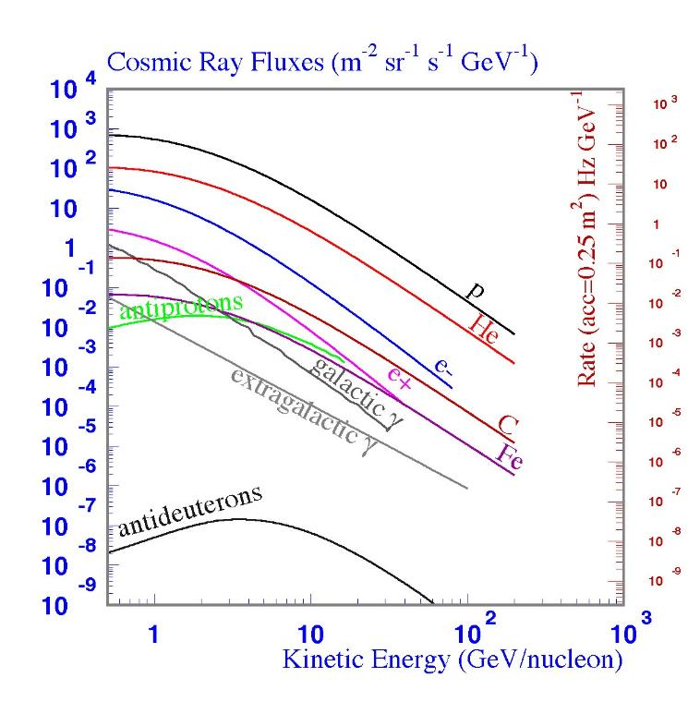
AMS

Slide 16
χ+χ
e⁺........
e⁺/(e⁺ + e⁻)

Slide 17
Positron identification + flux with p/e⁺ >10⁶
p
Tracker Entry
TRD:
P
rejection >10²
e⁺
TRD
TOF
0.33 X₀
p
e⁺
Tracker Total
e⁺
Tracker
0.50 X₀
TOF
RICH
Tracker Exit
ECAL
P
ECAL:
e⁺
rejection >10⁴
a) Minimal material in the TRD and TOF So that the detector does not become a source of e^{+.}
b) A magnet separates TRD and ECAL so that e⁺ produced in TRD will be swept away and not enter ECAL In this way the rejection power of TRD and ECAL are independent
c) Matching momentum of 9 tracker planes with ECAL energy measurements

Slide 20
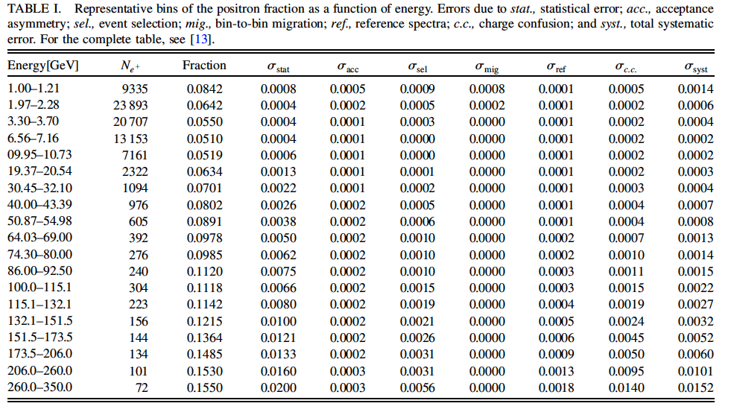
PRL 110, 141102 (2013)
6.8 M e⁺ + e⁻

Slide 21
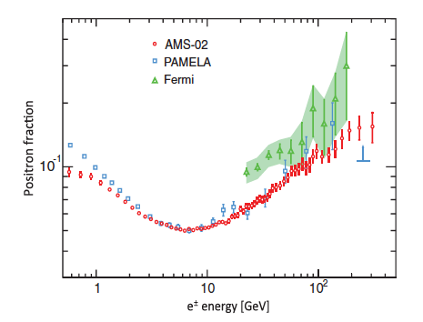
e⁺/(e⁺ + e⁻)
2013
6.8 M e⁺ + e⁻

Slide 22
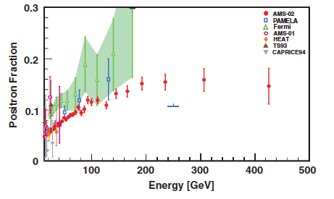
e⁺/(e⁺ + e⁻)
10.9 M e⁺ + e⁻

Slide 23
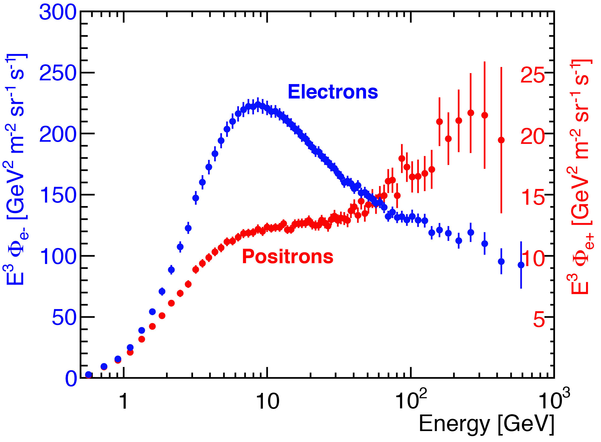

Slide 24
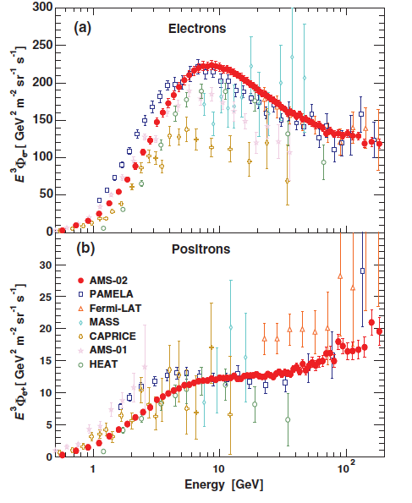

Slide 25
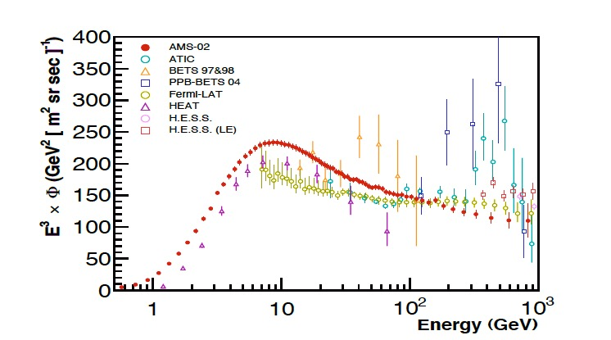
Spettro e⁺ + e⁻

Slide 26
(accepted, in press November 8th)

