Slide 1
Progress of CGEM software
Yue GUO, Jingran HU,
Liangliang WANG, Linghui WU

Slide 2
Outline
Garfield Simulation
Reconstruction
  CGEM cluster reconstruction
  Track fit
Summary

Slide 3
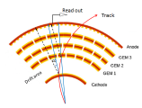
Garfield simulation
  Motivation
    To understand the drift property in magnetic field and implement more realistic digitization model
Use Garfield++
Construct the detector
and calculate the field
map using Ansys

Slide 4
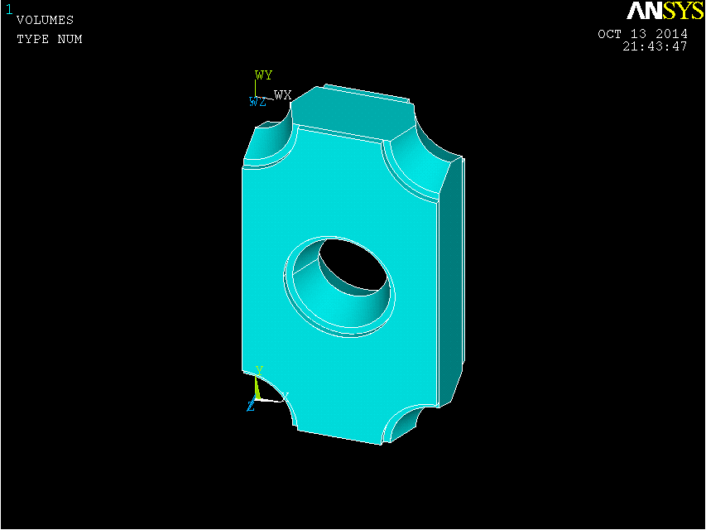
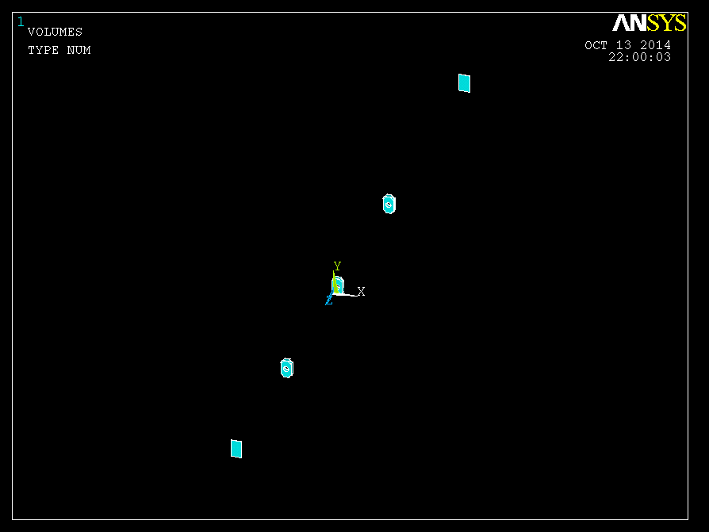
CGEM of a hexagonal geometry
The basic cell,which is used to construct the whole detector by periodic arrangement in X and Y

Slide 5
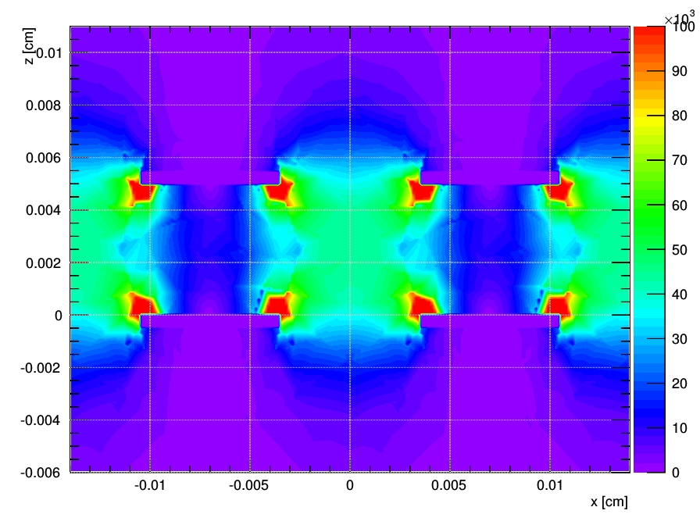
Electric field from Garfield
Cathode
-3190V
Drift
3mm
-2740V
-2350V
GEM3
Transfer1
2mm
-2050V
-1670V
GEM2
Transfer2
2mm
GEM1
-1370V
-1000V
Induction
2mm
Anode
0
A typical voltage from 300 to 500V is applied between the two sides of the foil.
The field reaches 100kV/cm in the hole.
The expected gain should be around 10^4.
-0.5
cathode
-0.2
gem-1
0
gem-2
0.2
gem-3
0.4
anode

Slide 6
Simulation of the avalanche
AvalancheMicroscopic
  Accurate simulations of electron trajectories in small-scale structures
  Detailed calculations of ionization and excitation processes
  Transporting electrons on a microscopic level
  Time consuming
AvalancheMC
  Calculate Δs=v_{d}Δt in the direction of V_{d} at the local field
  A random diffusion step is sampled from Gaussian distributions
  Time consuming but Faster than AvalancheMicroscopic

Slide 7
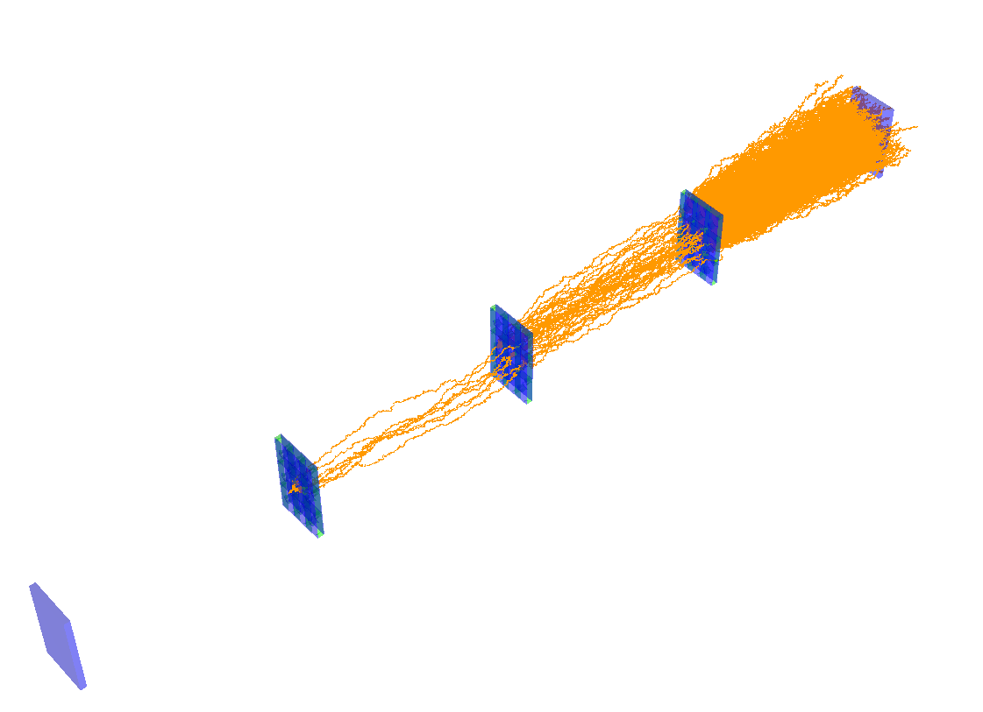
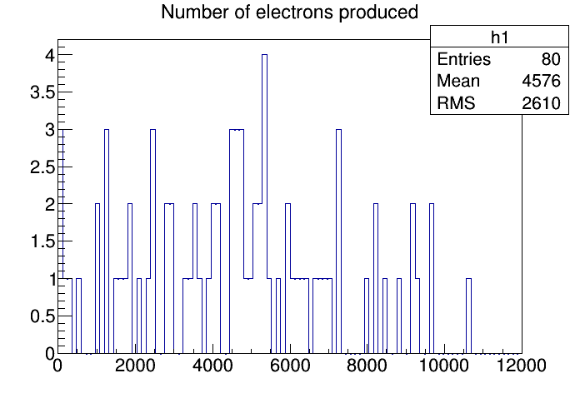
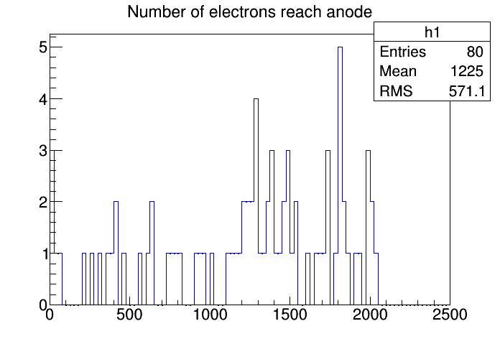
AvalancheMicroscopic
Get gain about 10³
Set the limit of size of an electron avalanche to 1000
Time consuming
Need more study

Slide 8
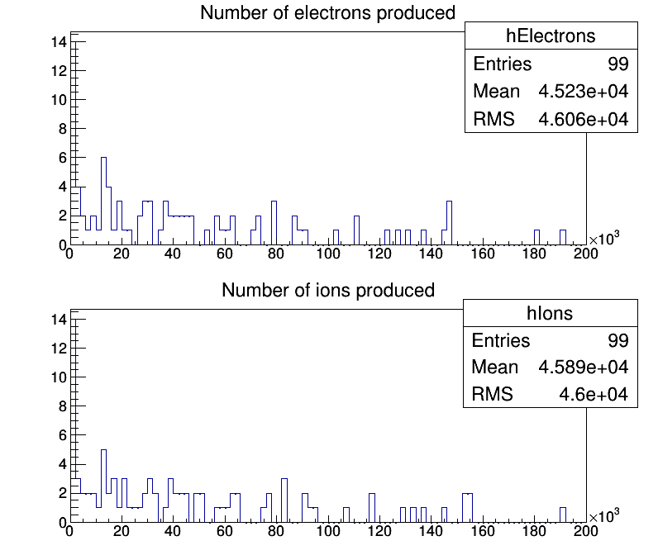
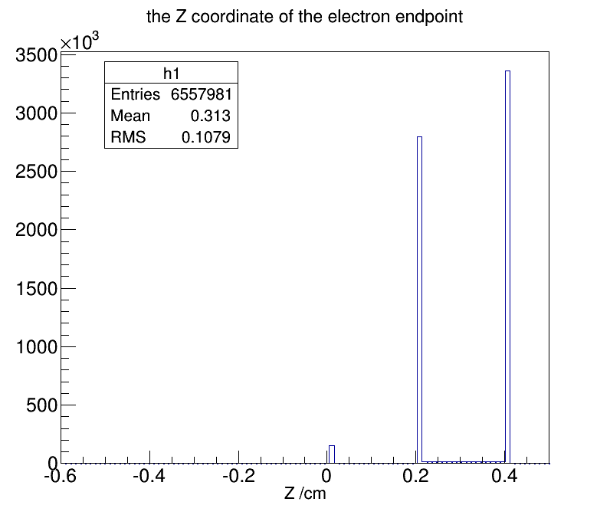
AvalancheMC
Without magnetic field
Get the gain about 10⁴
Half of generated electrons are absorbed by the 3rd GEM

Slide 9
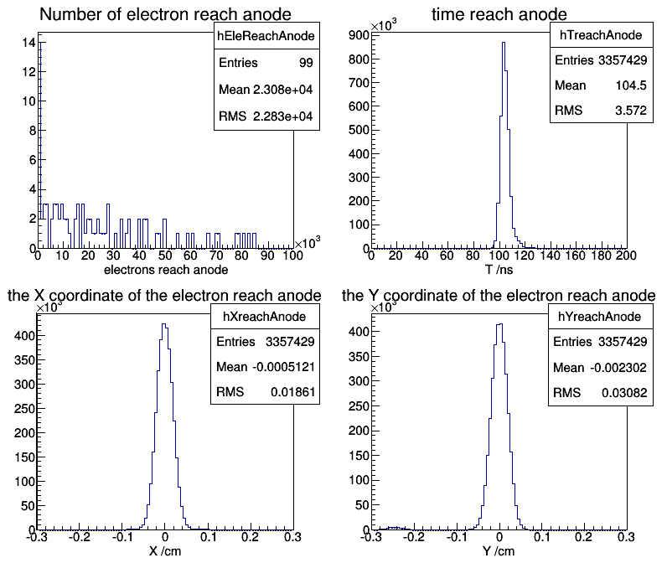

Slide 10
Reconstruction flow for CGEM + DC
Cluster reconstruction for CGEM:
fired strips → cluster (preliminary algorithm finished)
Track segment finding in CGEM (not started)
Track segment finding in DC (exist)
Combination of track segments
(need modification)
Global fit (need modification)
Kalman filter (in progress)

Slide 11
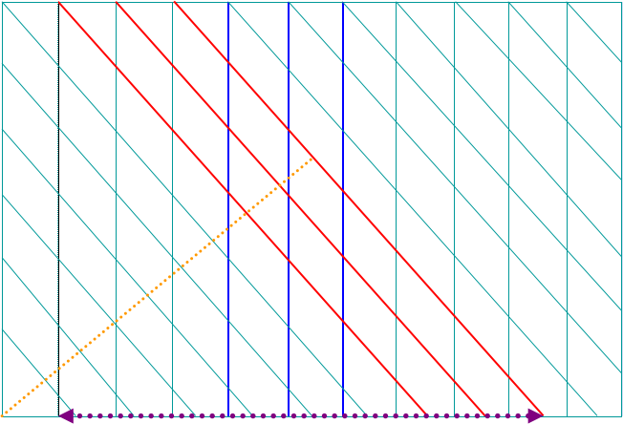
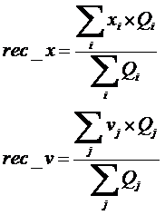
Cluster reconstruction for CGEM
Search for continuous fired X strips
Package: CgemClusterCreate
Charge weighted geometrical center
Correction to the position on track
Intersections
as clusters
Search for continuous fired V strips
rec_v
rec_x

Slide 12
Variables in RecCgemCluster
RecCgemCluster
type | item | Description
int | m_layered | ID of CGEM Layer
int | m_sheeted | ID of CGEM sheet
int | m_flag | Type of cluster: 0-X, 1-V, 2-XV
double | m_energydeposit | Total energy deposit
double | m_recphi | X position (phi)
doulbe | m_recv | V position

Slide 13
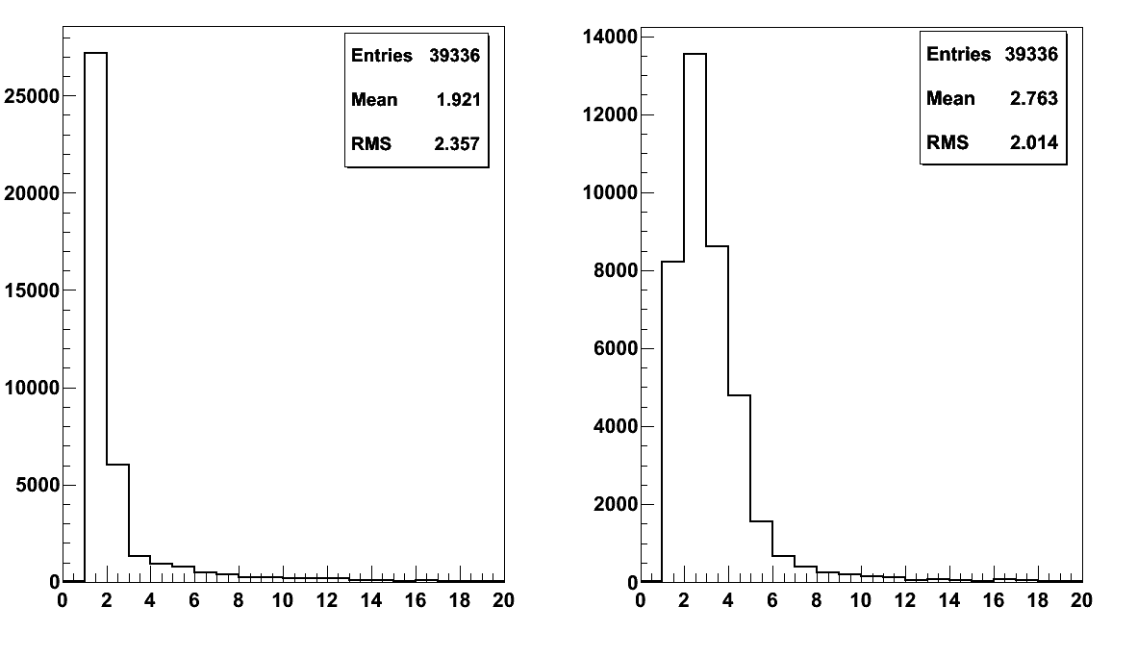
Distribution of number of fired strips in each cluster
single muon MC sample 1.0 GeV |cosθ|<0.93
Number of fired X strips
Number of fired V strips
Average number of strips that each cluster contains is 2~3 in either direction

Slide 14
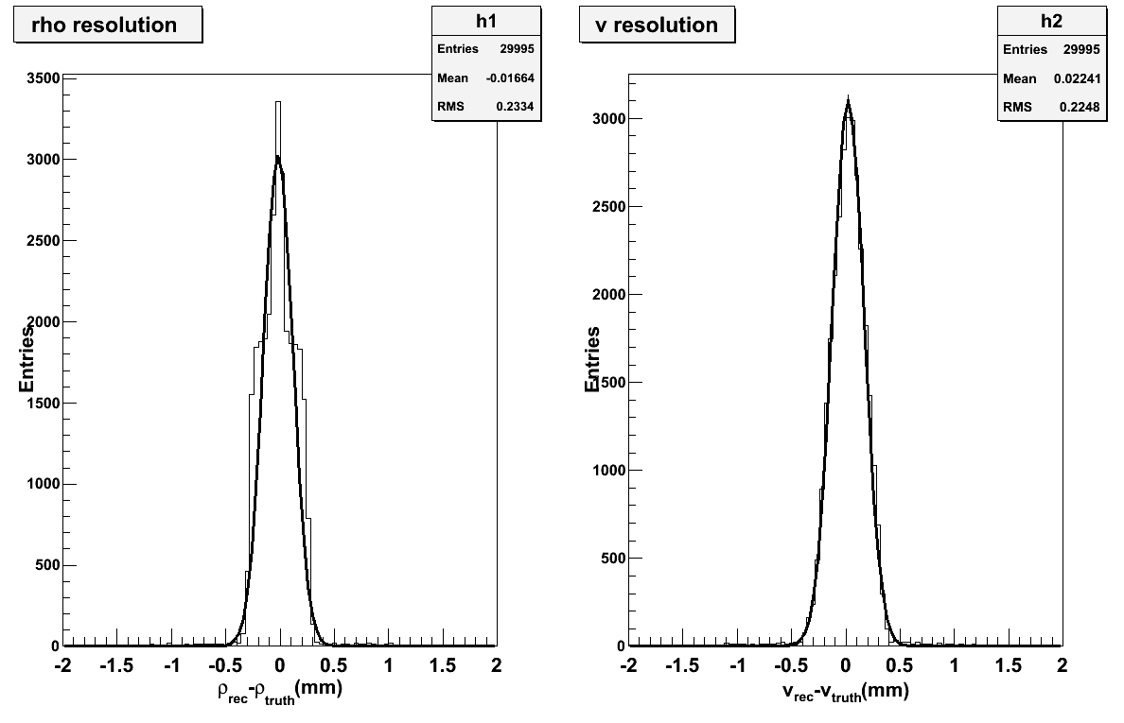
Resolution for 2D readout in drift layer
σ_{ρ}= 134.9μm
σ_{v}= 146.7μm
X_{rec} – X_{truth} (mm)
V_{rec} – V_{truth} (mm)

Slide 15
Track fit using Kalman filter
Reconstructed tracks (with MDC outer chamber hits ) as input
Use MDC hits and CGEM clusters to update the track parameters from the outermost point to the origin
Take into Account the multiple scattering, energy loss and NUMF
Obtain track parameters and covariance matrix under different hypothesis (e,μ,π,K, p)

Slide 16
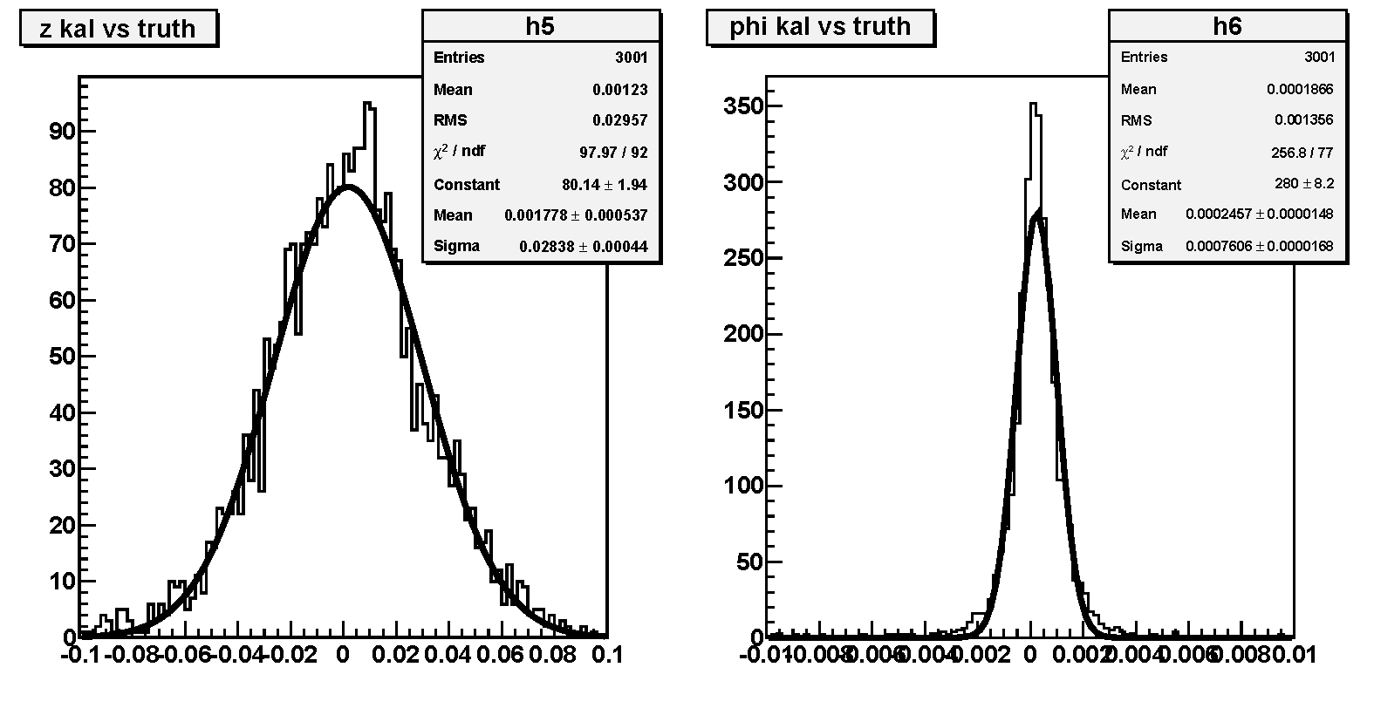
Difference between the fit and truth
z
phi
z_{fit} – z_{truth} (cm)
phi_{fit} – phi_{truth} (rad)

Slide 17
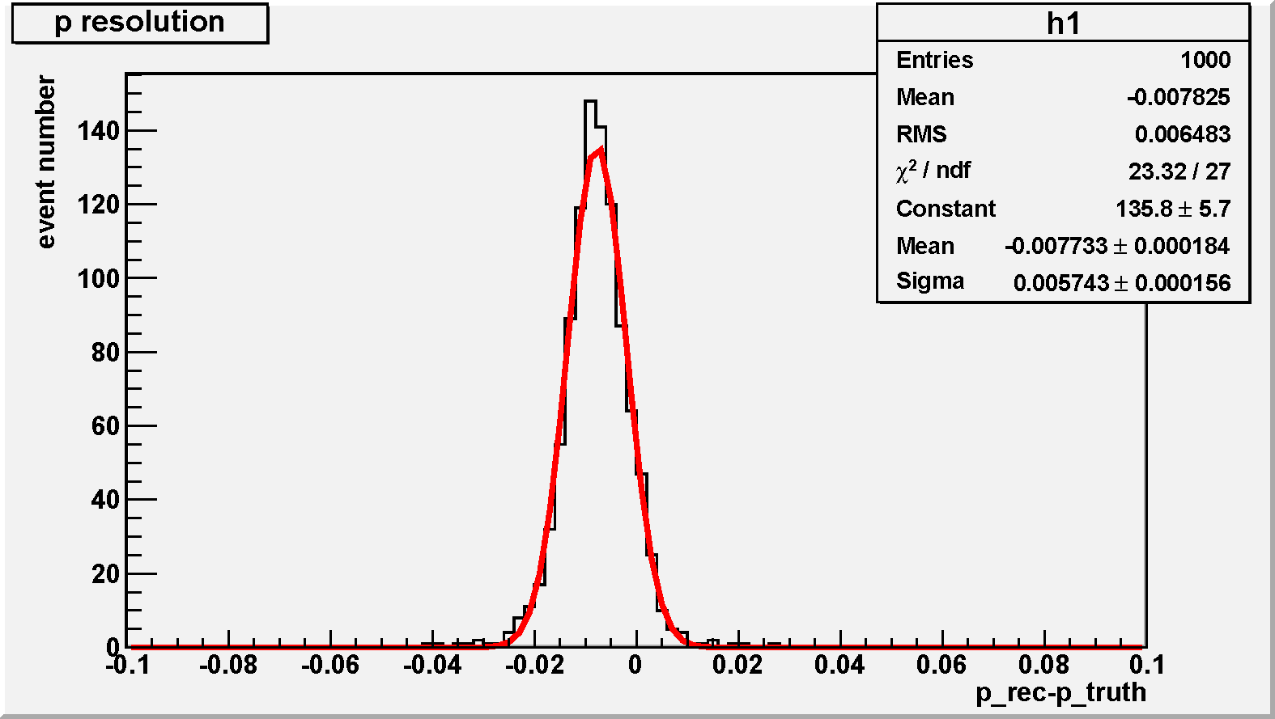
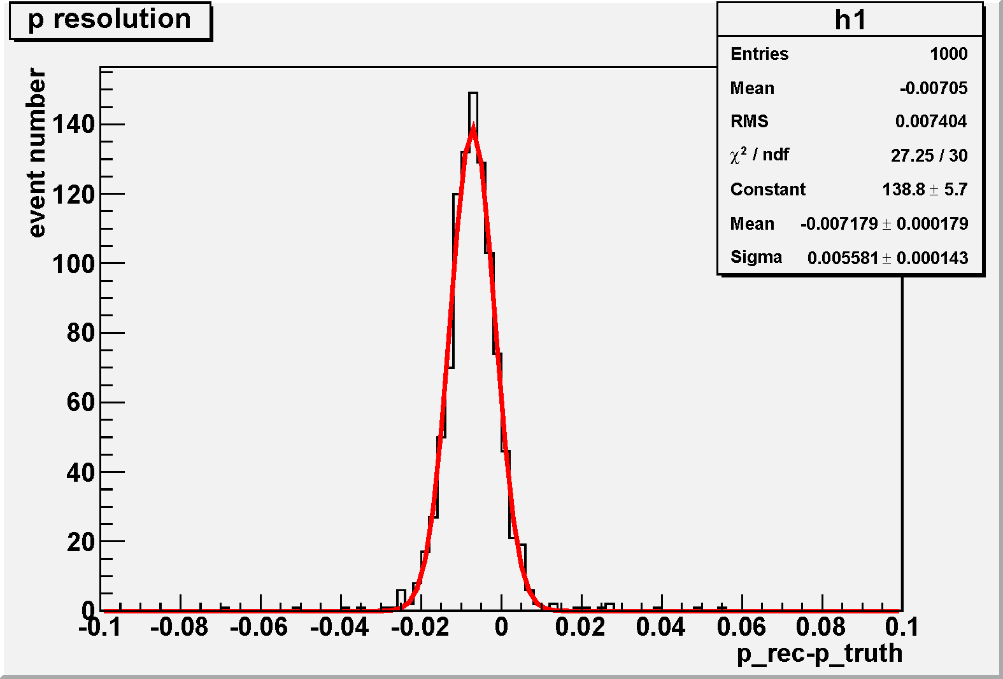
Momentum resolution
1GeV/c μ-
1GeV/c μ+
p_{fit} – p_{truth} (GeV/c)
p_{fit} – p_{truth} (GeV/c)

Slide 18
Summary
Garfield simulation
  Get some preliminary results
  CPU consuming is a big problem
Reconstruction
  A preliminary cluster reconstruction package is developed
  The Kalman filter based track fitting with full simulation of CGEM + outer DC is in progress

Slide 19
Backup

Slide 20
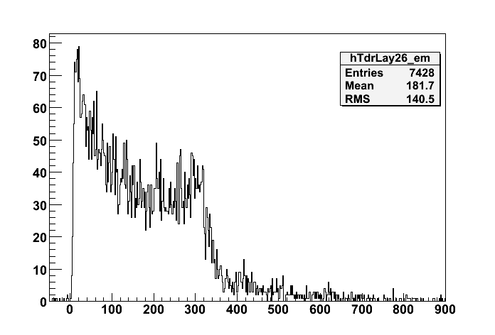
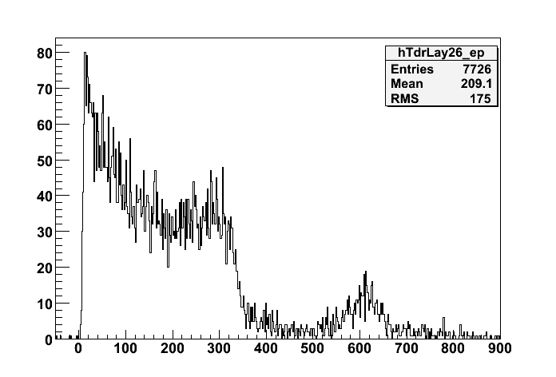
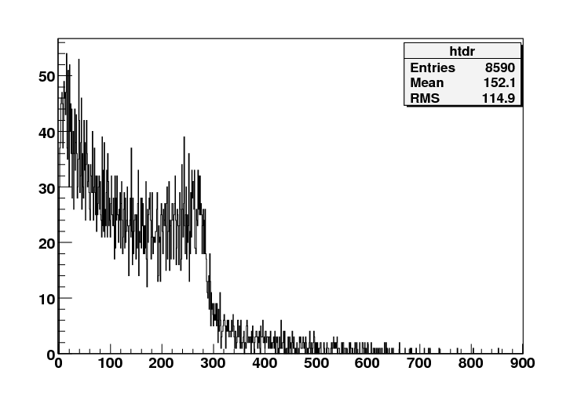
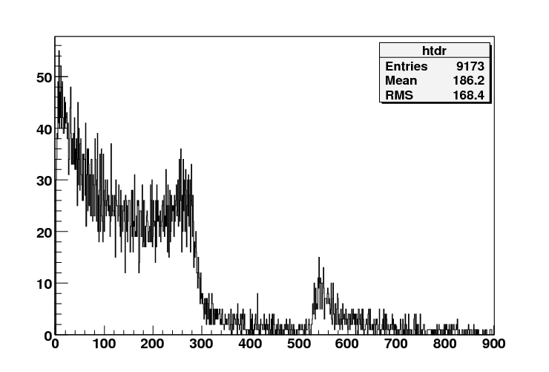
Drift time distribution
Data
e-
Data
e+
Drift distance (mm)
Garfield
e-
Garfield
e+
Drift time (ns)

Slide 21
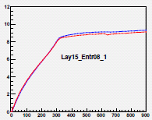
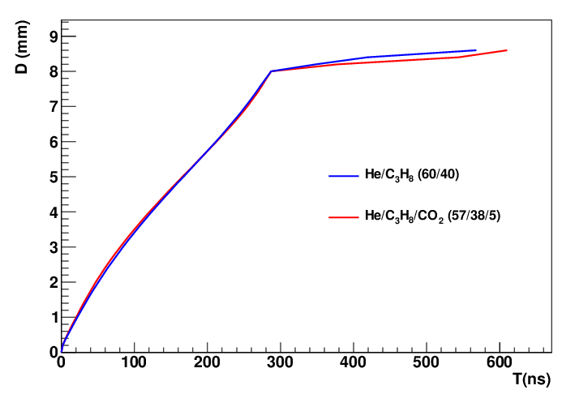
X-T relations of MDC
Data
Garfield sim
Drift behavior from Garfield simulation are comparable with data

