Slide 1
Tracking software of the BESIII drift chamber
Linghui WU
For the BESIII MDC software group

Slide 2
Outline
Introduction
Tracking algorithms
  PAT algorithm
  TSF algorithm
  CurlFinder algorithm
  Track fitting with Kalman filter
Tracking efficiency
Alignment
Summary

Slide 3
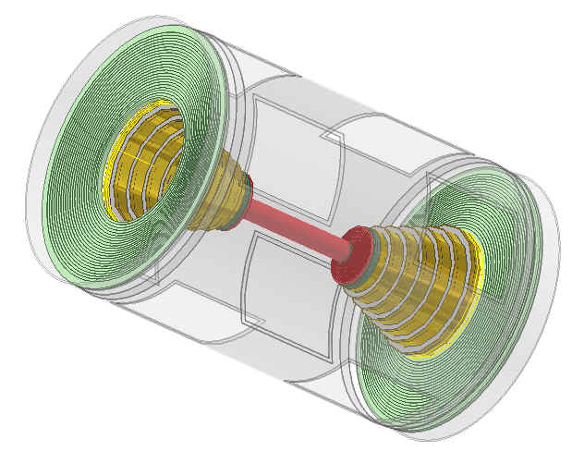
Introduction
2.6m long cylindrical chamber
It consists of an inner chamber and an outer chamber
With an inner radius of 59mm and an outer radius of 810mm
Filled with He/C₃H₈(60/40)

Slide 4
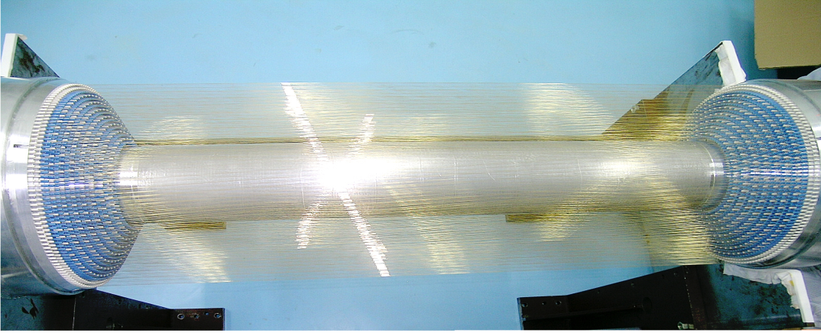
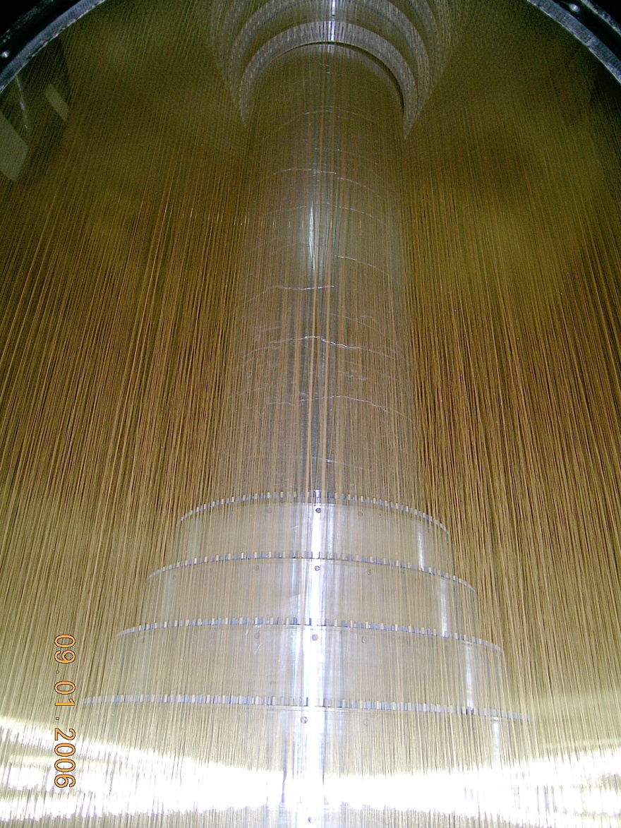
Inner chamber
Outer chamber
Sense wires:
  φ25μm gold-plated tungsten
  at a potential of 2100V for the inner chamber and 2200V for the outer chamber
Field wires:
  φ110μm gold-plated aluminum
  at ground

Slide 5
Cell geometry
Square cell
6796 sense wires and 21884 field wires.
The average half-cell size is 6mm for the inner chamber and 8.1mm for the outer chamber
Half cell staggering to resolve the left-right ambiguity
12 or 16.2 mm

Slide 6
Layer Configuration
43 sense layers
  The inner most 8 layers are located in the inner chamber and the other 35 layer are in the outer chamber.
Layer | Number of cells per layer | type | Stereo angle（degree）
1 － 4 | 40/44/48/56 | stereo (-) | 2.9 ~ 3.3
5 － 8 | 64/72/80/80 | stereo (+) | 3.4 ~ 3.9
9 － 20 | 76/88/100/112/128/140 | axial | —
21 － 24 | 160 | stereo(-) | 2.4 ~ 2.7
25 － 28 | 176 | stereo(+) | 2.7 ~ 3.1
29 － 32 | 208 | stereo(-) | 3.0 ~ 3.3
33 － 36 | 240 | stereo(+) | 3.3 ~ 3.6
37 － 40 | 256 | axial | —
41 － 43 | 288 | axial | —

Slide 7
Flow diagram of reconstruction
MdcFastTrkAlg
EsTimeAlg
Track finding
(PAT/TSF/CurlFinder)
MdcDedxAlg
Track fit
(KalFitAlg)
TofRec
Track
extrapolation
&
matching
EmcRec
MucRecAlg

Slide 8
Track parameters
dr
  Signed distance in x-y plane from the pivot to the helix
φ₀
  Azimuth angle of the Poca (point of closest approach in the x-y plane)
κ
  q/Pt
dz
  z position of the Poca
tanλ
  Tangent of the dip angle

Slide 9
Tracking algorithms
PAT algorithm
  Based on template matching
TSF algorithm
  Conformal transformation
CurlFinder algorithm
  For low momentum tracks
Track fitting with Kalman filter

Slide 10
PAT algorithm
Read MDC raw hits
Find segments in super layers based on template matching
Combine axial segments to circle
Track fit in x-y plane
Combine stereo segments
Helix track fit

Slide 11
Segment Finding Method
Tracking in the MDC is based on segments
Search for patterns in the super layer
An example of the pattern
Cells for pattern
One segment pattern
(3,5)
(3,4)
(3,3)
(3,2)
(3,1)
(3,0)
7
6
5
(2,5)
(2,4)
(2,3)
(2,2)
(2,1)
(2,0)
4
3
(1,5)
(1,4)
(1,3)
(1,2)
(1,1)
(1,0)
2
(0,5)
(0,4)
(0,3)
(0,2)
(0,1)
(0,0)
1
0
clockwise
1
0
0
1
0
1
0
1
7
6
5
4
3
2
1
0
We have 8 4-hit patterns
and 20 3-hit patterns
Pattern No.0

Slide 12
4-hit patterns
X
X
X
X
X
X
X
X
X
X
X
X
X
X
X
X
10010101=0225
01010101
01001101
00101101
X
X
X
X
X
X
X
X
X
X
X
X
X
X
X
X
10010110
01010110
01001110
00101110

Slide 13
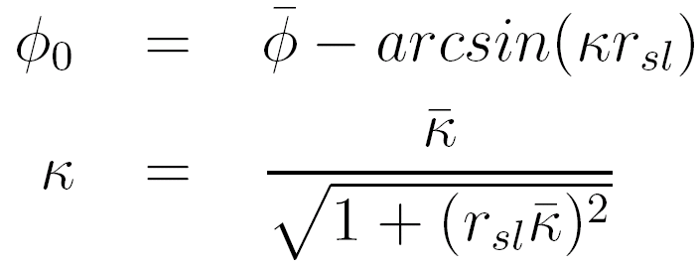
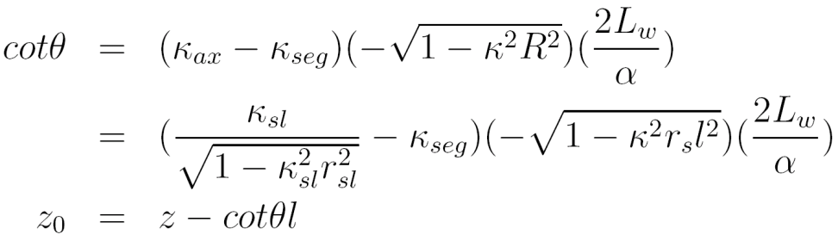
Combination of segments
Link axial segments
Link stereo segments

Slide 14
Track fit
Least squares fitting without consideration of NUMF, multiple scattering, energy loss
d_{meas} is the measured drift distance
d_{track} i.e. doca, distance of closest approach

Slide 15
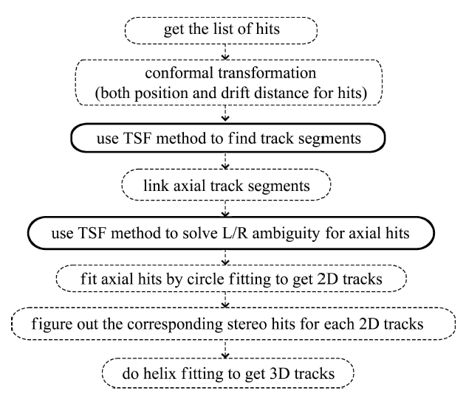
TSF algorithm

Slide 16
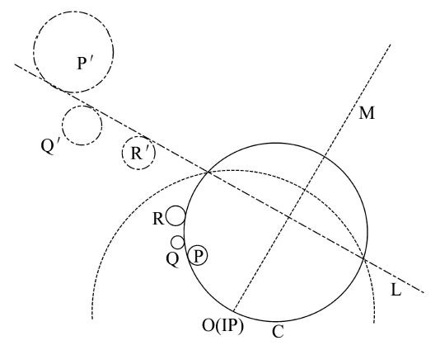
Conformal transformation
A hit position (x, y) in x-y plane is transformed into a position (X, Y) in the conformal plane.
  X = 2x/(x²+y²), Y = 2y/(x²+y²)
A circle which passes through the origin (0, 0) is transformed into a line.
  x_{c}X + y_{c}Y = 1
  (x_{c}, y_{c}) is the center of the circle
A circle which does not pass through the origin in x-y plane is transformed into a new circle which still does not pass through the origin in the conformal plane.

Slide 17
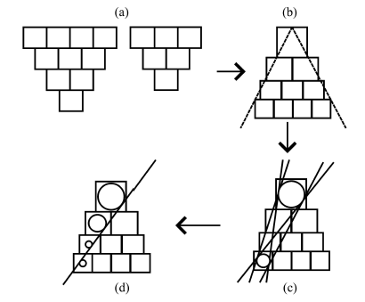
Track segment finding
If the hit belongs to the track, its drift circle in the conformal plane is tangent to the line of the track
Left-right ambiguity is kept after conformal transformation
Require that at least 3 layer are fired in each super layer
Patterns
Four-layer pattern in the conformal plane
Four candidates of track segment
The best candidate after matching the middle layers

Slide 18
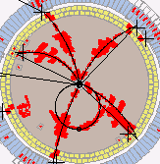
CurlFinder algorithm
Super layer | Stereo/ axial | Radius (cm) | p_{T} (MeV/c)
1 | stereo | 11.5 | 17
2 | stereo | 16.2 | 24
3 | axial | 24.6 | 37
4 | axial | 31.0 | 47
5 | axial | 37.5 | 56
6 | stereo | 44.8 | 67
7 | stereo | 51.4 | 77
8 | stereo | 57.9 | 87
9 | stereo | 64.2 | 96
10 | axial | 71.6 | 107
11 | axial | 77.1 | 116
Outer tube | -- | 81.0 | 122
An algorithm for low momentum track finding

Slide 19
Flow diagram

Slide 20
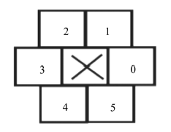
Axial segment finding
More than one hit in the same layer
Find consecutive hits in each axial super layer
  Fired cell → find neighbor → find neighbor’s neighbor …
Definition of neighbor

Slide 21
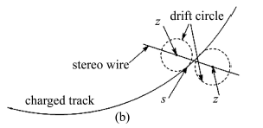
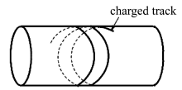
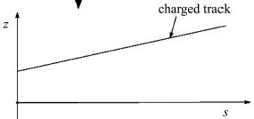
3-D track finding
Find stereo hits near the circle
Line fit in s-z plane
Helix fitting

Slide 22
Track fitting with Kalman Filter
A standard track fitting with Kalman Filter method
Initial track parameters and hits from track finding
Track parameters obtained by in iterations:
…→prediction→filter with a hit→update→…
Considered effects: nonuniform magnetic field, energy loss and multiple scattering
5 hypothesis: e, μ, π, K, p
Inwards filter: provide track parameters at IP
Outwards filter: provide track parameters seed for extrapolation (expected TOF, reconstruction with TOF/EMC/MUC)

Slide 23
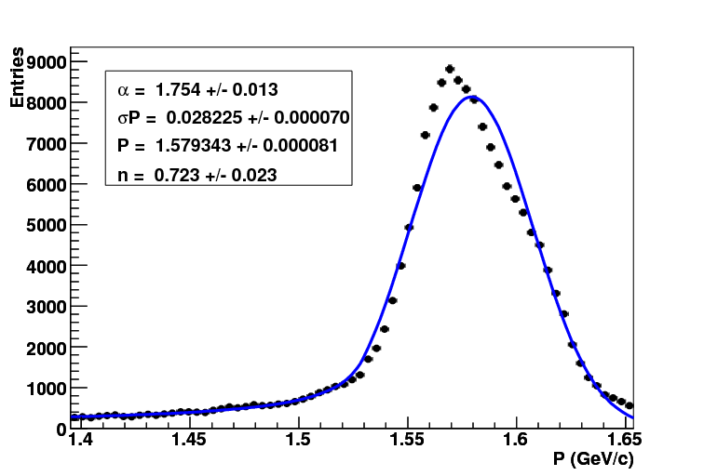
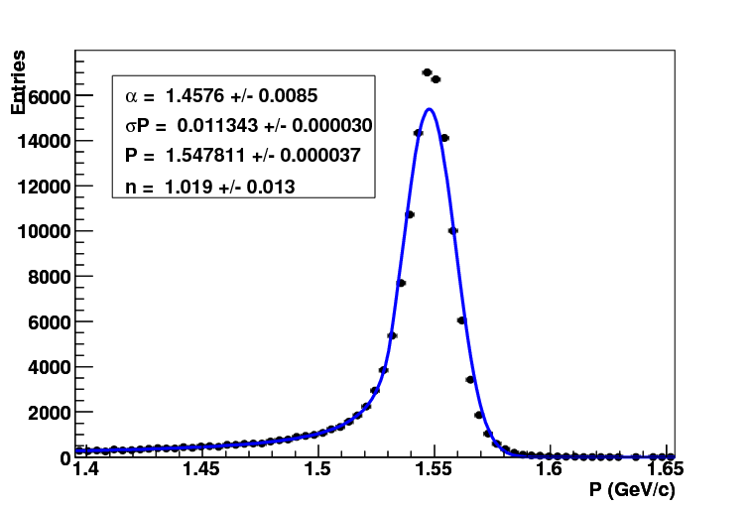
Momentum distribution
Track finding
Kalman fitting
σP=28MeV/c
σP=11.3MeV/c

Slide 24
BESIII Drift Chamber Tracking
MdcPatRec
  limited by segment pattern coverage, rec. for high pt tracks (P_{T} > 250MeV/c)
MdcTsfRec
  P_{T} : 120~250MeV/c
CurlFinder
  P_{T} <120MeV
PAT
TSF
Kalman fitting
Runge-Kutta fitting
Curlfinder

Slide 25
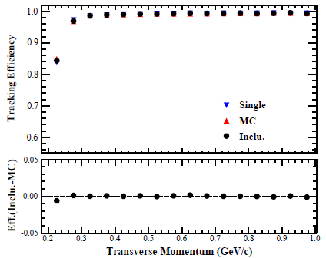
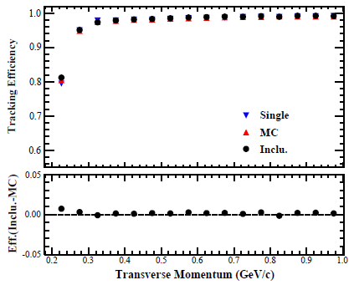
Tracking efficiency with P_{T}
J/psi → ppππ
proton
anti-proton

Slide 26
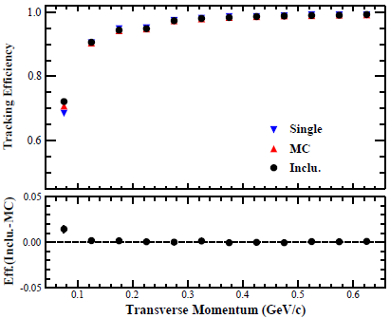
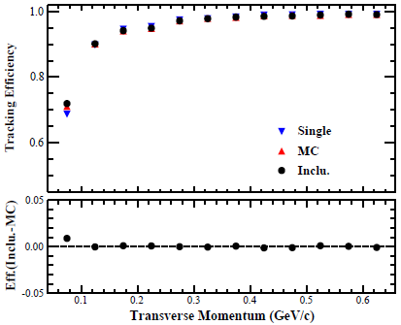
Tracking efficiency with P_{T}
J/psi → ppππ
π+
π-

Slide 27
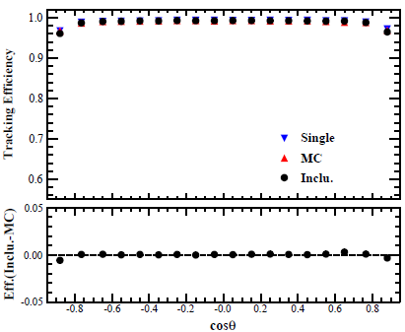
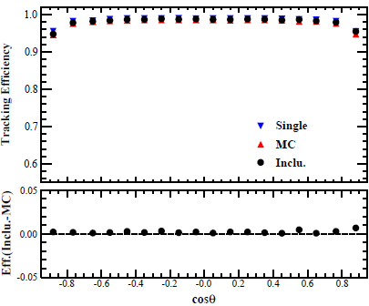
Tracking efficiency with cosθ
J/psi → ppππ
proton
anti-proton

Slide 28
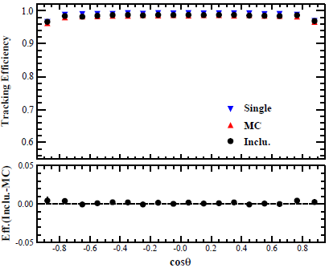
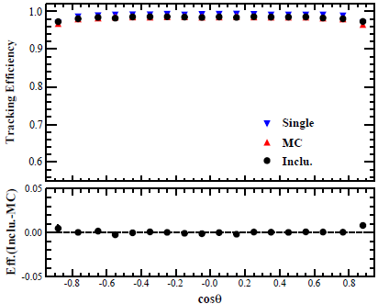
Tracking efficiency with cosθ
J/psi → ppππ
π+
π-

Slide 29
Alignment
Alignment with tracks is the only possible strategy to estimate positions and orientations of components of a track detector with sufficiently high precision
16 independent components in total.
  Inner chamber (×2)
  Ring ×6 (×2)
  big endplate (×2)
For each component, 3 alignment
parameters (δx, δy, θz) are considered
Methods:
  Residual fit
  Millepede Matrix method
δy
δx
θz

Slide 30
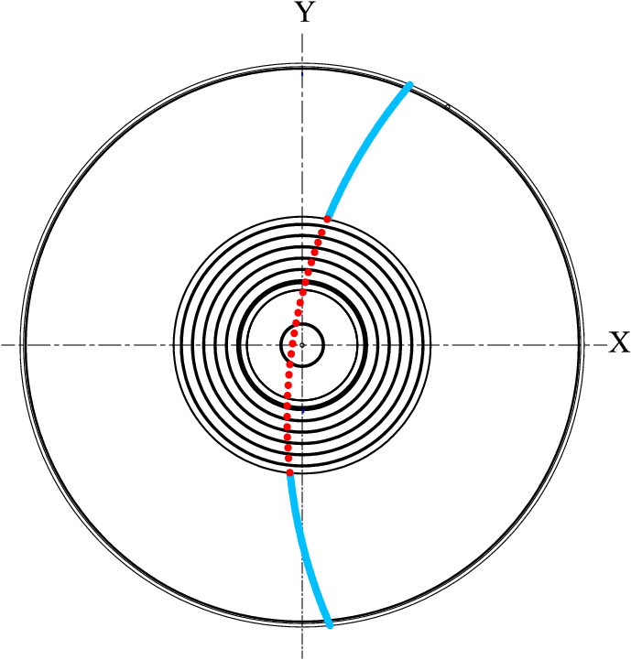
Pre-alignment
Alignment method: Residual fit
Tracking algorithm: PAT algorithm
Big endplates are fixed to BESIII mechanical measurements
Use cosmic tracks fitted by hits in the outer sections to align the inner and stepped sections

Slide 31
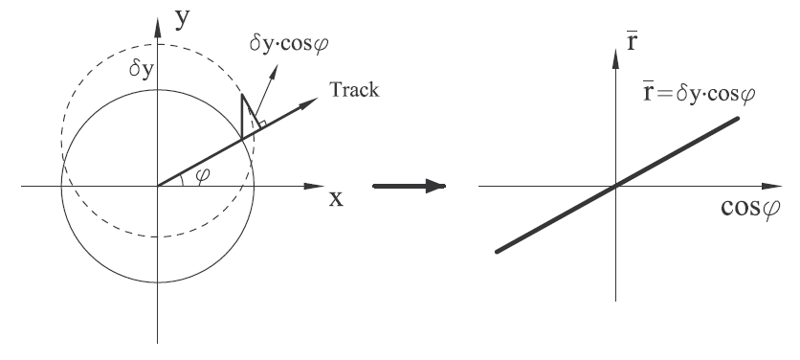
Translation in x causes dependence of residual on sinφ
Translation in y causes dependence of residual on cosφ

Slide 32
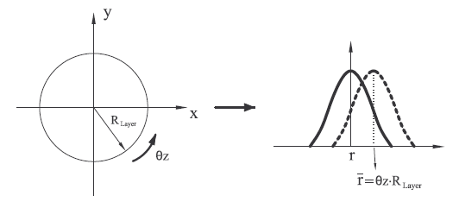
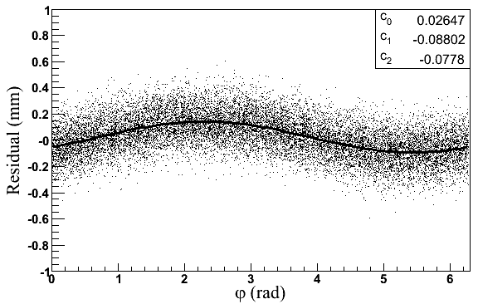
Rotation in z causes shift of residuals which are independent of φ
So r_{mean} = c0 -c1∙sinφ + c2∙cosφ
where
  r_{mean} is the mean value of residuals
  c1 and c2 are estimated values of δx and δy, respectively
  θz = c0 / R_{layer}
    ( R_{layer} is the radius of the layer )
Misalignment effects (MC)

Slide 33
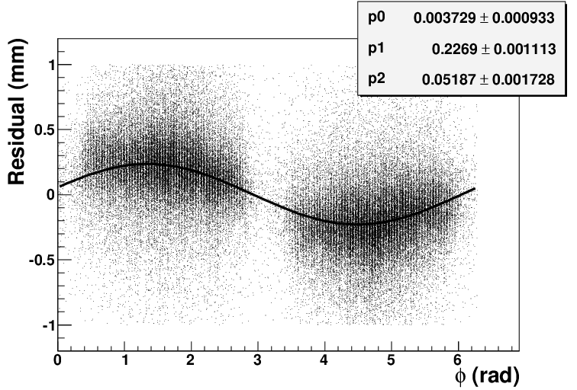
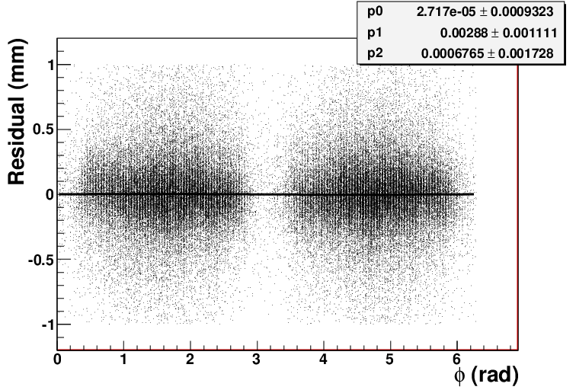
Results of the cosmic-ray
Residual vs φ
(The first stepped section in the east)
Before alignment
After alignment

Slide 34
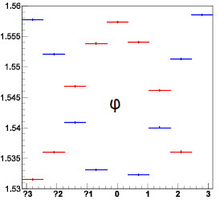
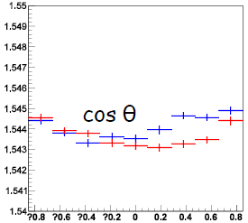

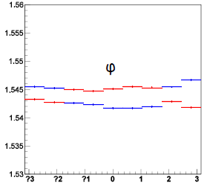
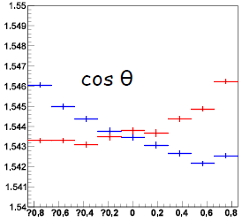
Results (dimu in May 2012)
P vs ϕ
P vs cosθ
Before alignment
After pre-alignment

Slide 35
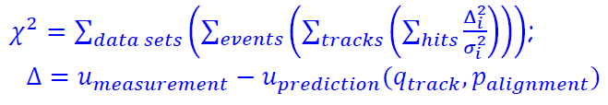
Precise alignment
In order to improve the alignment of MDC sub-endplates, Millepede matrix method is introduced.
  Global fit: simultaneous fit of all alignment and track parameters
Big endplates are free
Data sets: dimu + cosmic rays

Slide 36
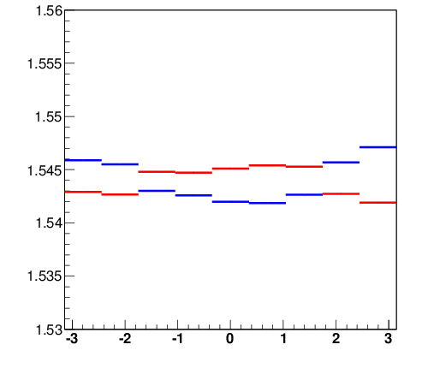
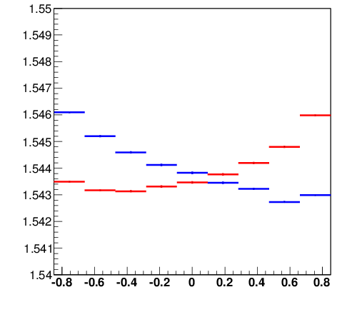
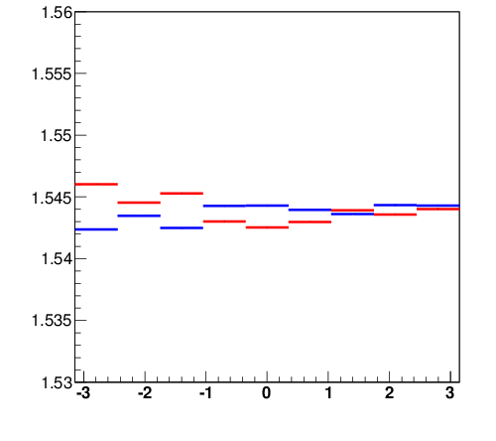
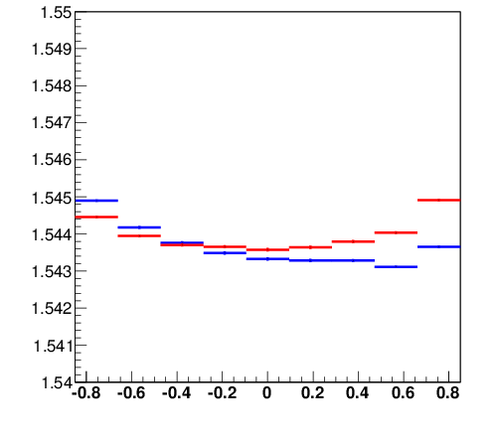
Results (dimu in May 2012)
P vs ϕ
P vs cosθ
Pre-alignment
Precise alignment

Slide 37
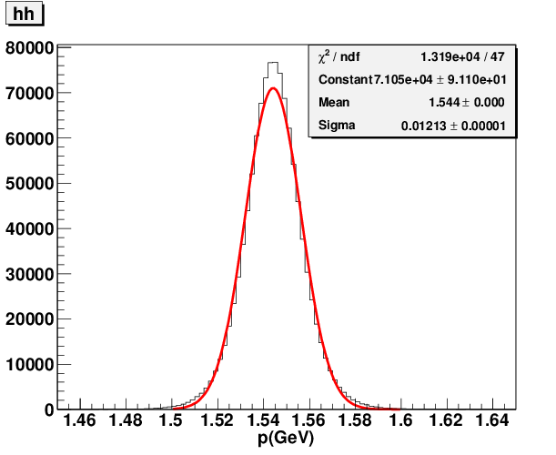
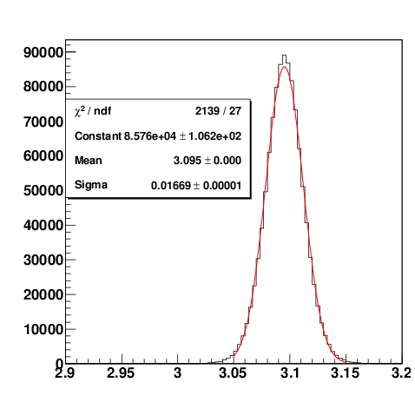
Resolutions
Dimu from J/psi in 2012
Momentum distribution
μ+μ- invariant mass
M(μ⁺μ⁻)(GeV/c²)
σP= 12.13 ±0.01 MeV/c
σ_{J/psi} = 16.74 ±0.01 MeV

Slide 38
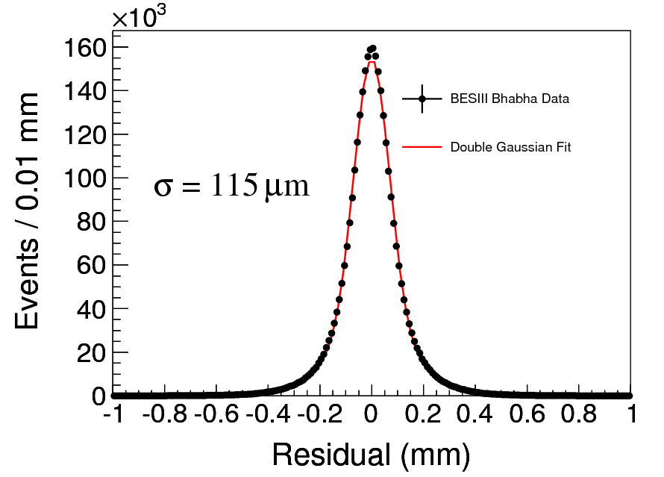
Spatial resolution (Bhabha)
Residual distribution
(from XYZ in 2014)
Data | Spatial resolution (μm)
Before HV optimization (J/psi in 2009) | 123
After HV optimization (XYZ in 2014) | 115

Slide 39
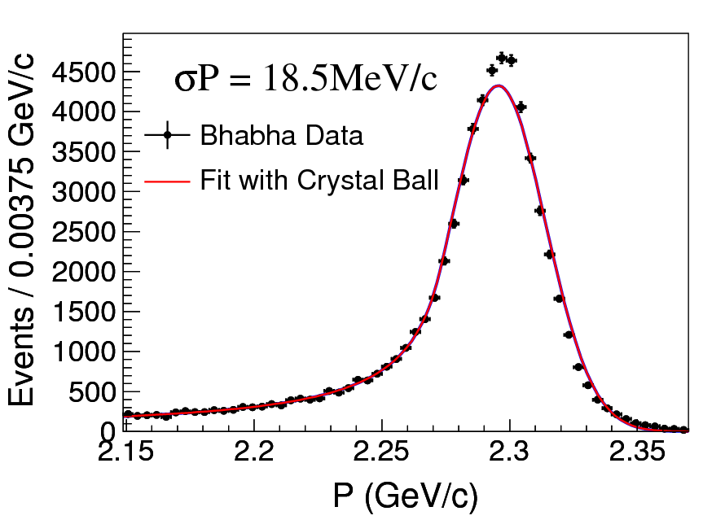
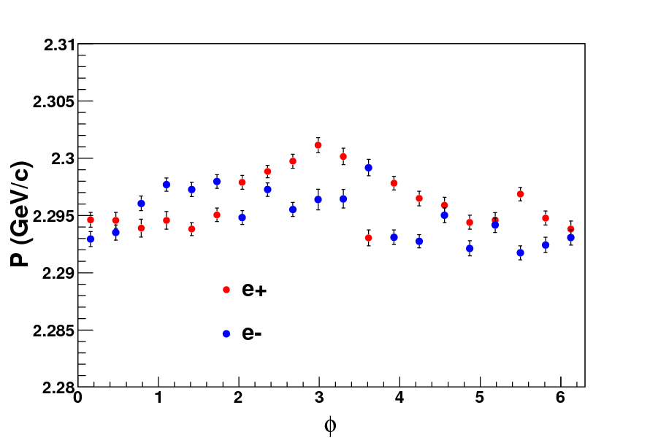
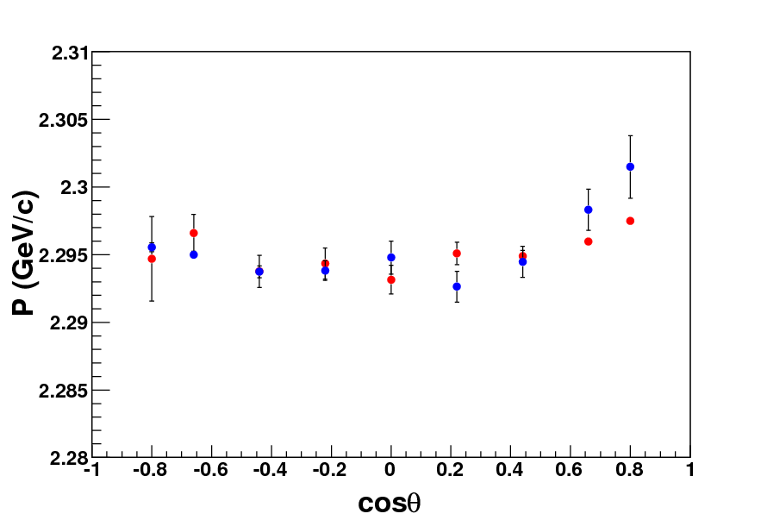
Momentum resolution (Bhabha)
From XYZ data in 2014
no serious misalignment
σP = 18.5MeV/c @ 2.3GeV/c
Run35320
P vs φ
P vs θ

Slide 40
Summary
MDC tracking Algorithms
  Track finding
    High momentum: PAT, TSF (tracking efficiency 98~99%)
    Low momentum: CurlFinder
  Track fitting
    Kalman filter
Alignment
  Pre-alignment: residual fit using cosmic tracks
  Precise alignment: Millepede matrix method using cosmic and dimu tracks
Performance of Bhabha events (from XYZ in 2014)
  Spatial resolution: 115μm
  Momentum resolution: σP = 18.5MeV/c @ 2.3GeV/c

