Slide 1
Study of MDC Noise and Aging
Linghui WU
For MDC software group

Slide 2
Outline
Study of MDC noise
Anode aging effect of MDC
Impact of aging on hit efficiency and spatial resolution
Impact of aging on tracking
Summary

Slide 3
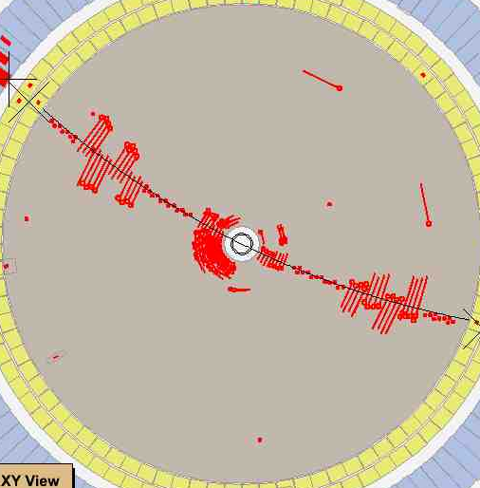
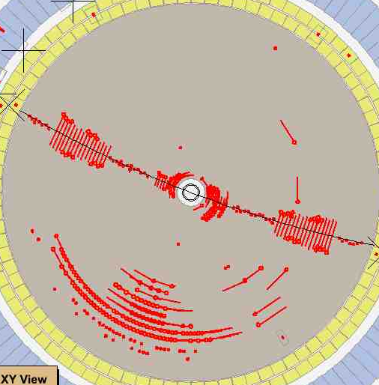
Study of MDC noise
MDC Noise contains:
  Beam related background (focus in inner layers)
  Electronic noise (contribute to all)

Slide 4
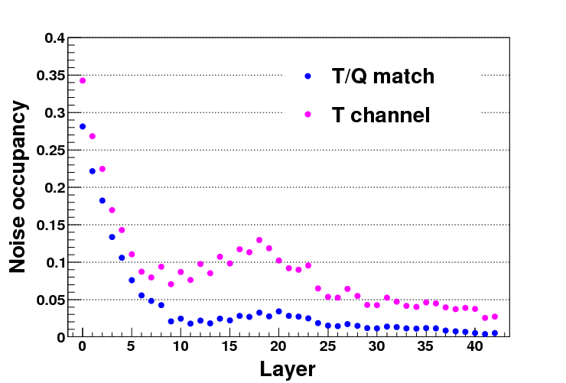
Noise in each layer
(layer 0-7: inner chamber)
Run 27978 (May 2012)
Noise occupancy is calculated from Bhabha events with subtracting hits on the track.

Slide 5
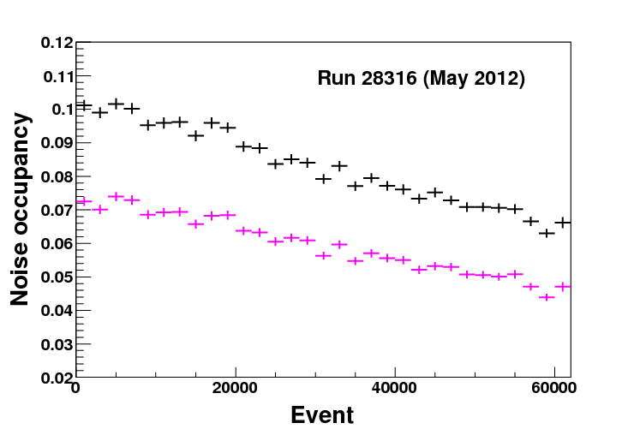
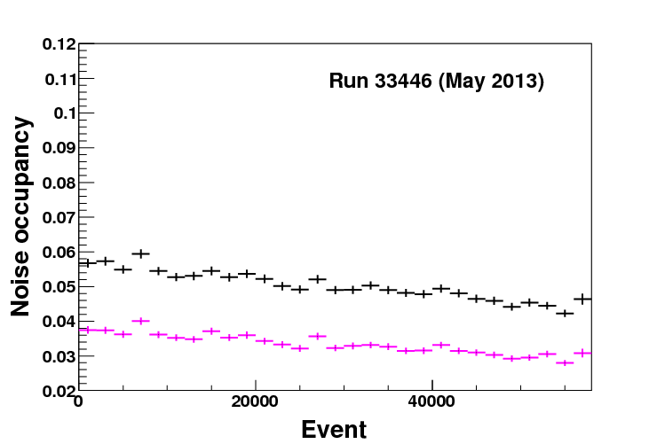
Variation of noise occupancy with event ID
(typical distribution of inner chamber)
— T channel
— T/Q match

Slide 6
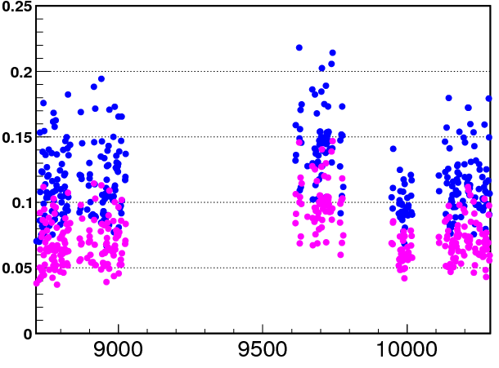
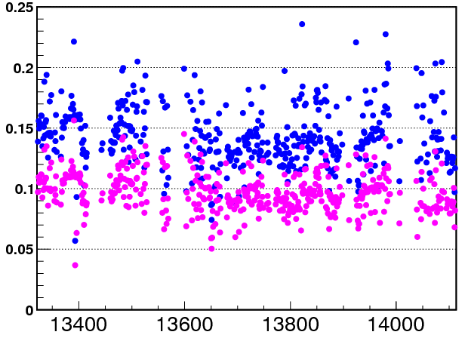
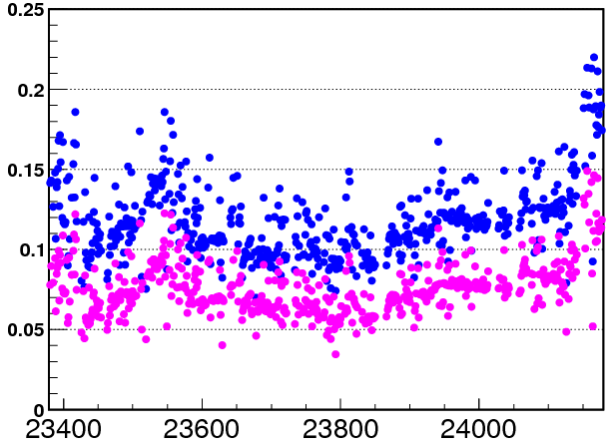
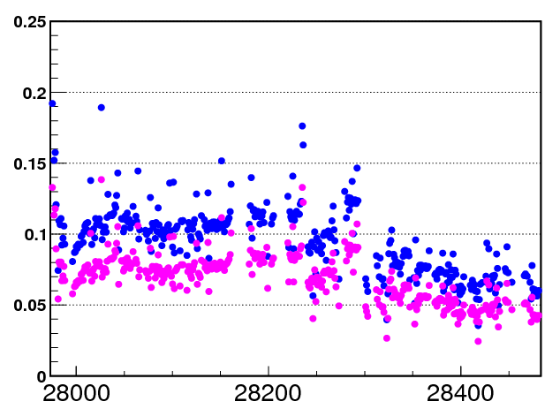
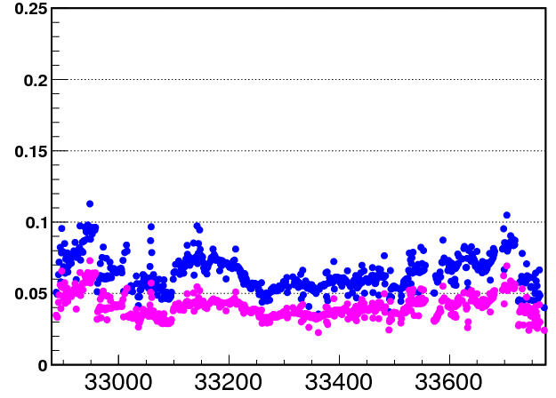
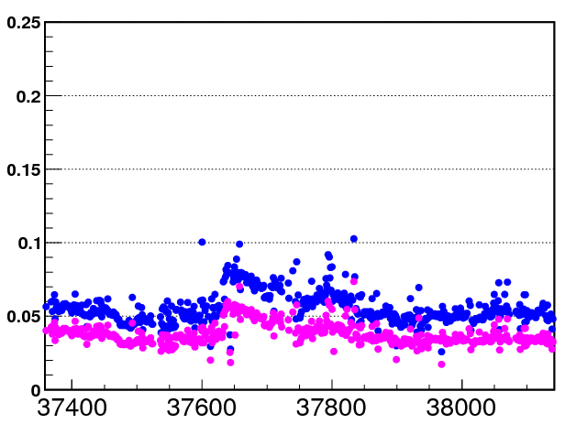
Noise level in each year
(data from May to June)
2009
2010
2011
Noise occupancy
2012
2013
2014
— T channel
— T/Q match
Run

Slide 7
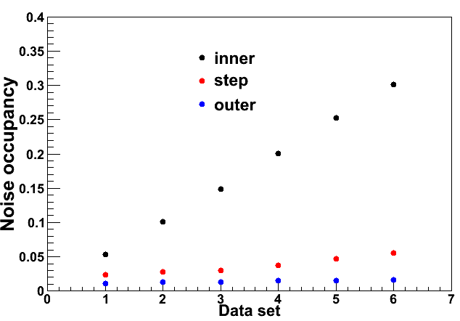
Data sample (for noise study)
Select data sets with different noise occupancy from data in Dec 2013
T channel
Inner: Layer 0-7
Step: Layer 8-19
Outer: Layer 20-42

Slide 8
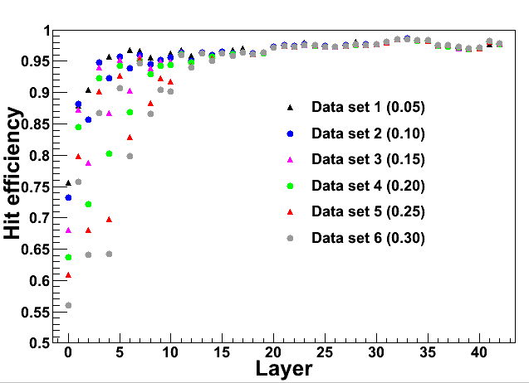
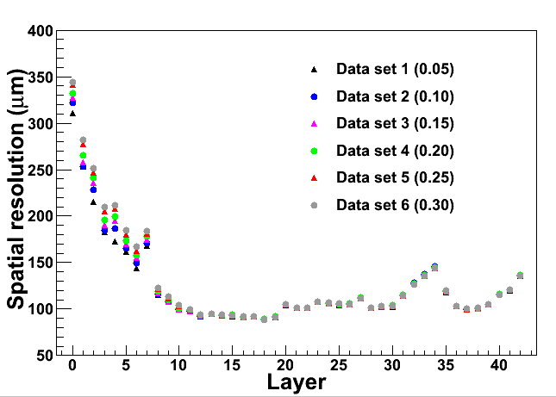
Rec Hit efficiency and spatial resolution of each layer in different noise level
Rec Hit efficiency vs layer
Spatial resolution vs layer
Rec hit efficiency = number of times used in track fit / number of times with tracks pass

Slide 9
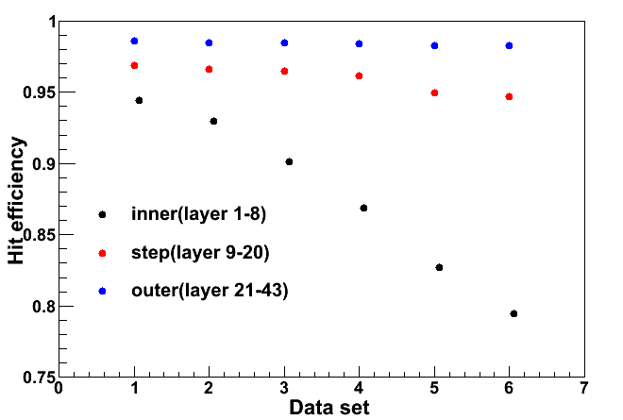
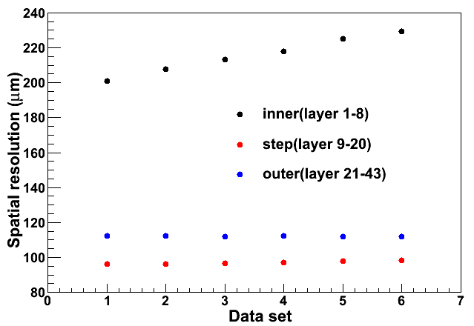
Rec Hit efficiency and spatial resolution as a function of noise occupancy
Rec Hit efficiency vs Noise occupancy
Spatial resolution vs Noise occupancy
● Inner (0-7)
● Step (8-19)
● Outer (20-42)
Noise has significant impact on Rec hit efficiency and spatial resolution

Slide 10
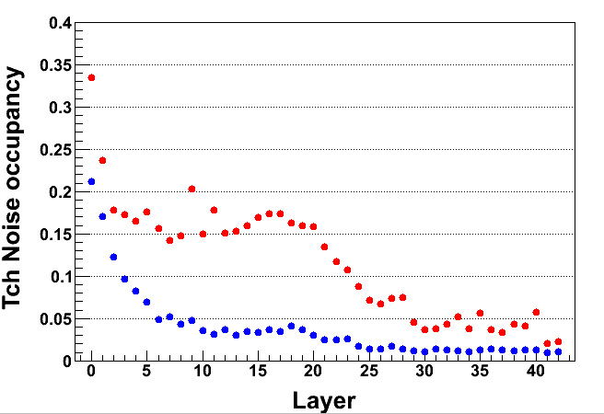
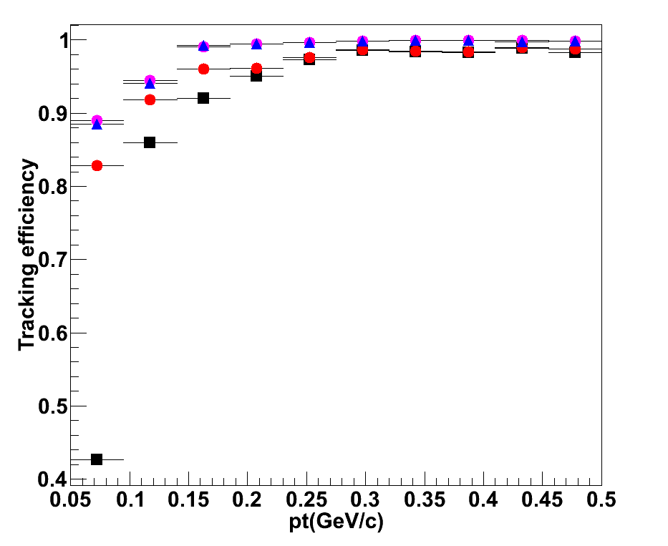
Impact of noise on tracking efficiency (MC)
T channel
Normal noise
Big noise
Ideal
Normal noise
Big noise
Big noise & Without inner DC
Average noise occupancy of inner DC
 | Normal | Big
T channel | 0.094 | 0.184
T/Q match | 0.059 | 0.103
Ideal: layer 0-7 has the same spatial resolution and raw hit efficiency with layer 8
Little difference between the ideal and normal
High noise occupancy has significant impact on tracking efficiency

Slide 11

Anode aging effect of MDC
Deposits on the anode wire cause loss of gain
Depend upon accumulated charges of the wires
R is the aging ratio

Slide 12
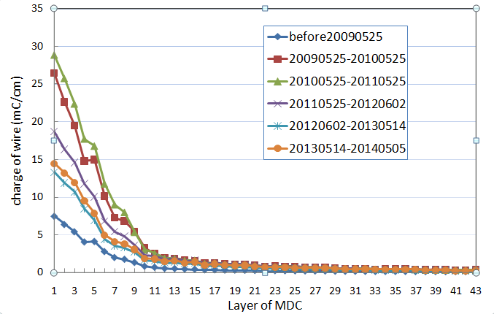
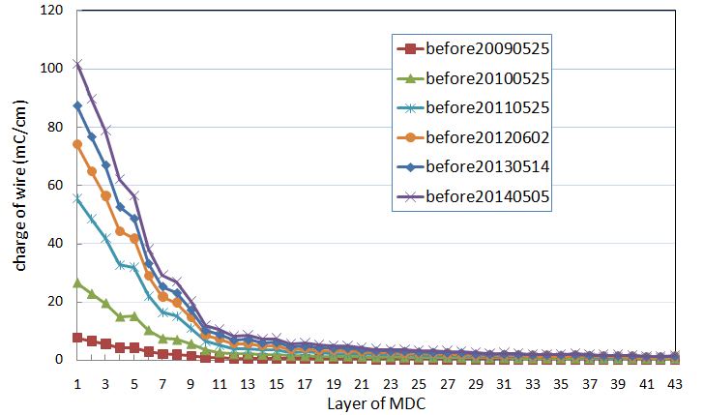
Accumulated charges of MDC sense wires
Total accumulated charges
Accumulated charges in each year
The accumulated charges of each layer are obtained by integrating the dark currents of the sense wires
In the last two years the accumulated charges are smaller than before, about 14mC/cm for the first layer
The total charges are about 100mC/cm for the first layer . For the layers far away from the IP, the charges reduce rapidly

Slide 13
Loss of gain in each layer
Gain in 2009 is the reference
Effects of temperature and pressure are corrected
R is about 0.3% cm/mC
Gains of the first 10 layers drop year by year
Gain of the 1st layer fall 21% from 2009 to 2014
More details can be found in Mingyi’s report (BESIII Collaboration Meeting in Jun 4 - 7, 2014)

Slide 14
Impact of aging on hit efficiency and spatial resolution
Select samples with the same operating parameters and noise occupancy
Operating parameters
  Same electronics thresholds in all data
  Gas mixture
    Same from 2009 to Jan 2012 (He+C₃H₈)
    Same from Apr 2012 to now (with water vapor)
    Data in Mar 2012 (with CO₂)
  High voltage
    Same in 2009 and 2010
    2011: HV of inner 4 layers is increased 1%
    Same in 2012, 2013 and 2014: optimized HV
  Magnetic field
    0.9 T from Apr to June, 2012
    1.0 T for the others

Slide 15
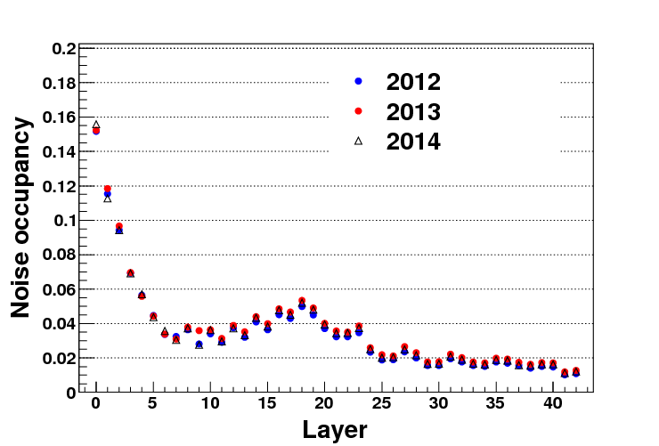
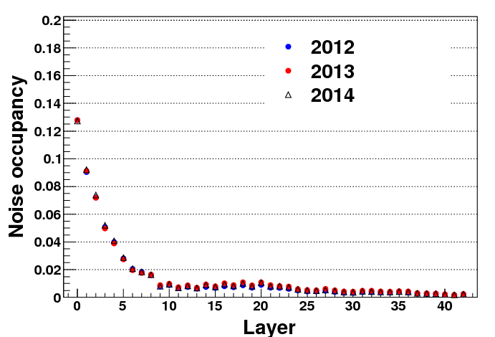
Select samples with the same noise occupancy
Noise occupancy of inner DC
Data samples | Sample I 2012 | Sample II 2013 | Sample III 2014
T channel | 0.065 | 0.066 | 0.065
T/Q match | 0.047 | 0.046 | 0.046
Noise occupancy vs layer
T channel
T/Q match

Slide 16
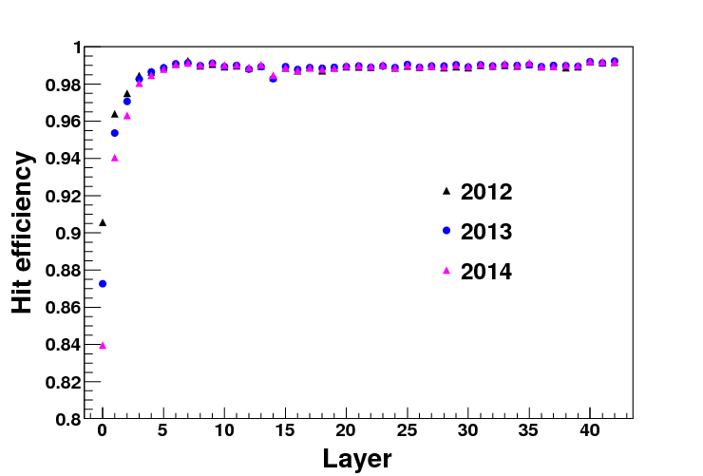
Raw hit efficiency vs layer
(degraded only for first 3 layers)
Raw hit efficiency = number of times with the cell fired/ number of times with tracks pass
Raw hit efficiency of the first few layers falls every year (~3% for 1st layer, almost same for layers with layer NO>2)

Slide 17
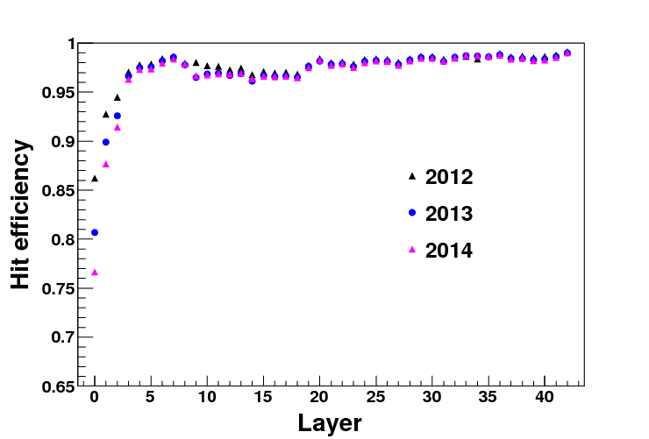
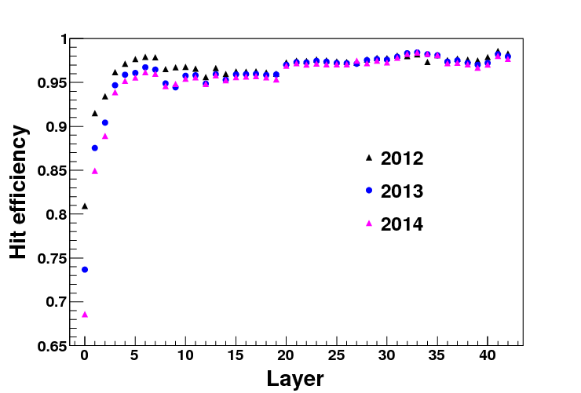
Rec hit efficiency in last 3 years
After tracking
After Kalman track fit
(0.9T)
Rec hit efficiency with Kalman fit of the 1st layer falls about 5% every year

Slide 18
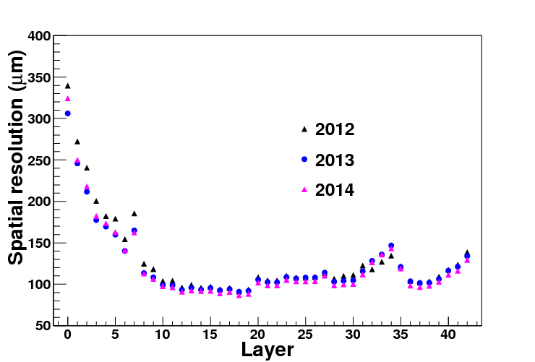
Spatial resolution in last 3 years
(0.9T)
No big difference for most layers.

Slide 19
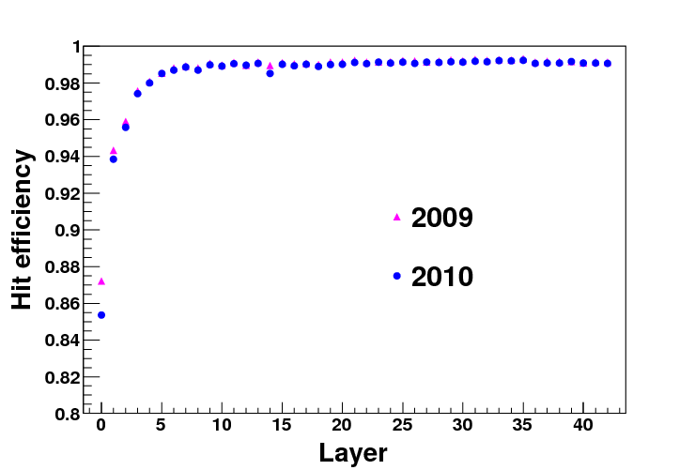
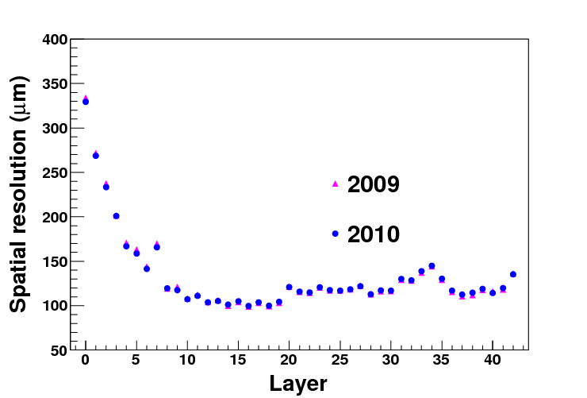
Validation with data in 2009 and 2010
Raw hit efficiency vs layer
Spatial resolution vs layer
Noise occupancy of inner DC
Data samples | Sample I 2009 | Sample II 2010
T channel | 0.105 | 0.103
T/Q match | 0.071 | 0.070
Raw hit efficiency has 2% fall in 1st layer
Difference of spatial resolution is small

Slide 20
Estimated raw hit efficiency for inner DC in the future (for MC study)
Layer | 2014 | 2015 | 2016 | 2017 | 2018 | 2019 | 2020
1 | 0.8396 | 0.8066 | 0.7737 | 0.7408 | 0.7078 | 0.6749 | 0.6420
2 | 0.9405 | 0.9275 | 0.9145 | 0.9014 | 0.8884 | 0.8754 | 0.8623
3 | 0.9631 | 0.9555 | 0.9479 | 0.9403 | 0.9326 | 0.9250 | 0.9174
4 | 0.9804 | 0.9782 | 0.9760 | 0.9738 | 0.9716 | 0.9694 | 0.9672
5 | 0.9846 | 0.9827 | 0.9808 | 0.9789 | 0.9770 | 0.9751 | 0.9732
6 | 0.9880 | 0.9874 | 0.9868 | 0.9863 | 0.9857 | 0.9851 | 0.9845
7 | 0.9906 | 0.9903 | 0.9900 | 0.9897 | 0.9895 | 0.9892 | 0.9889
8 | 0.9913 | 0.9913 | 0.9913 | 0.9913 | 0.9912 | 0.9912 | 0.9912
Assume noise level is the same as that of 2014
Assume the drop rate is equal in every year (see slide 16)

Slide 21
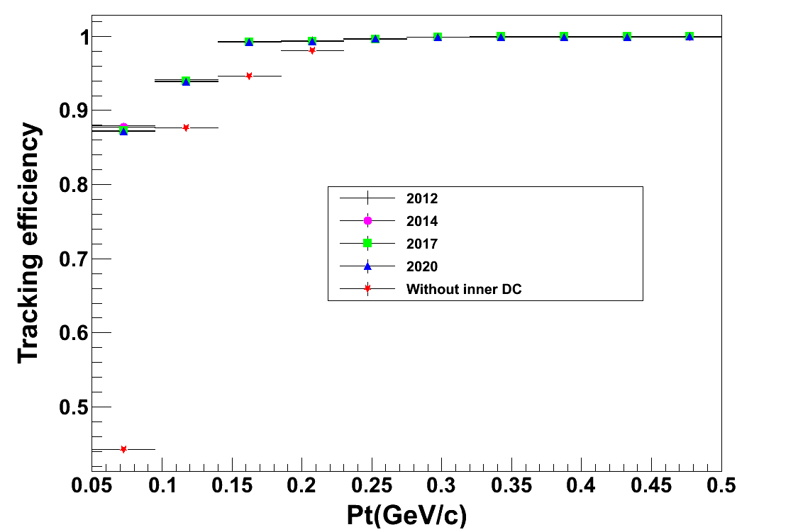
Aging effect on tracking
(MC: single muon track)
Tracking efficiency vs Pt
Variation of tracking efficiency from 2012 to 2020 is small!
Obvious drop at low momentum if inner DC does not work!

Slide 22
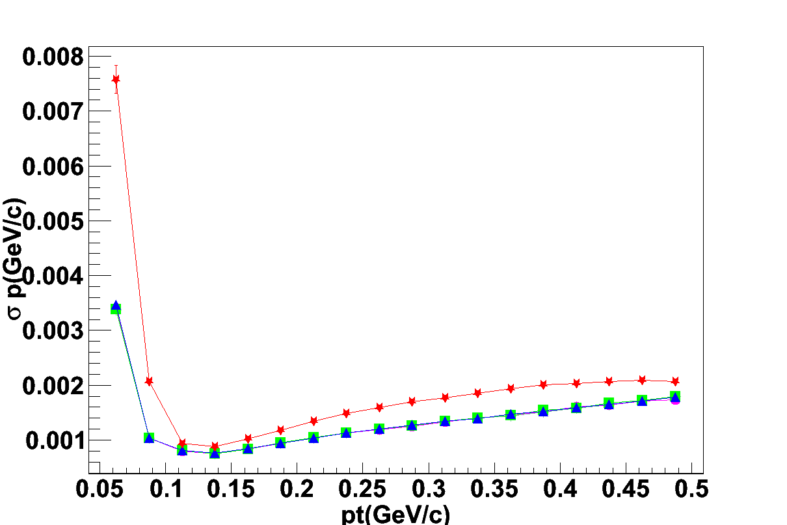
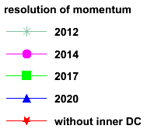
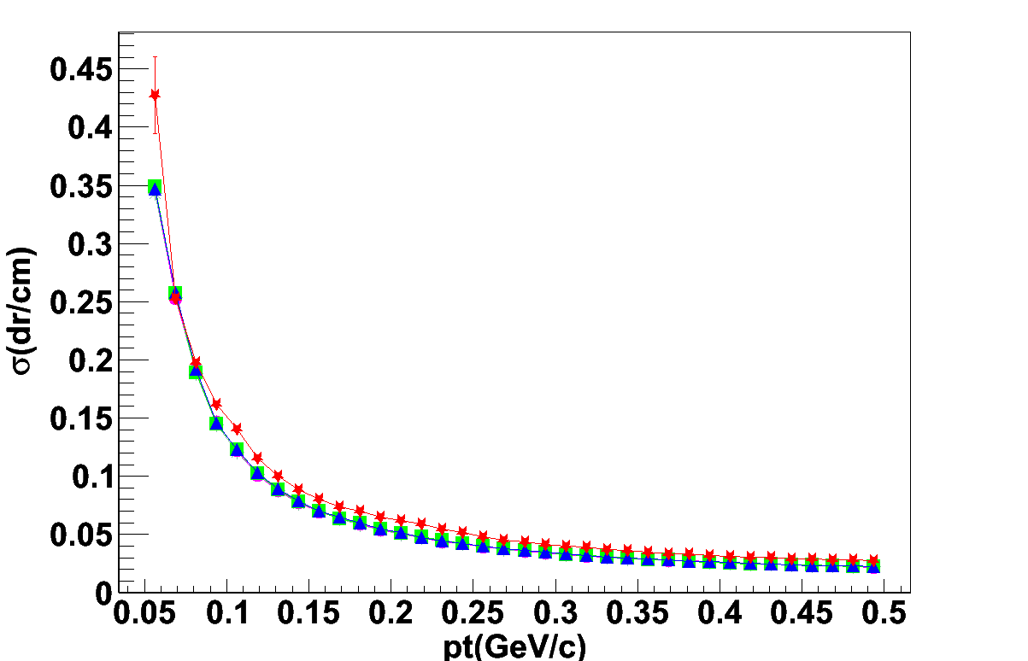
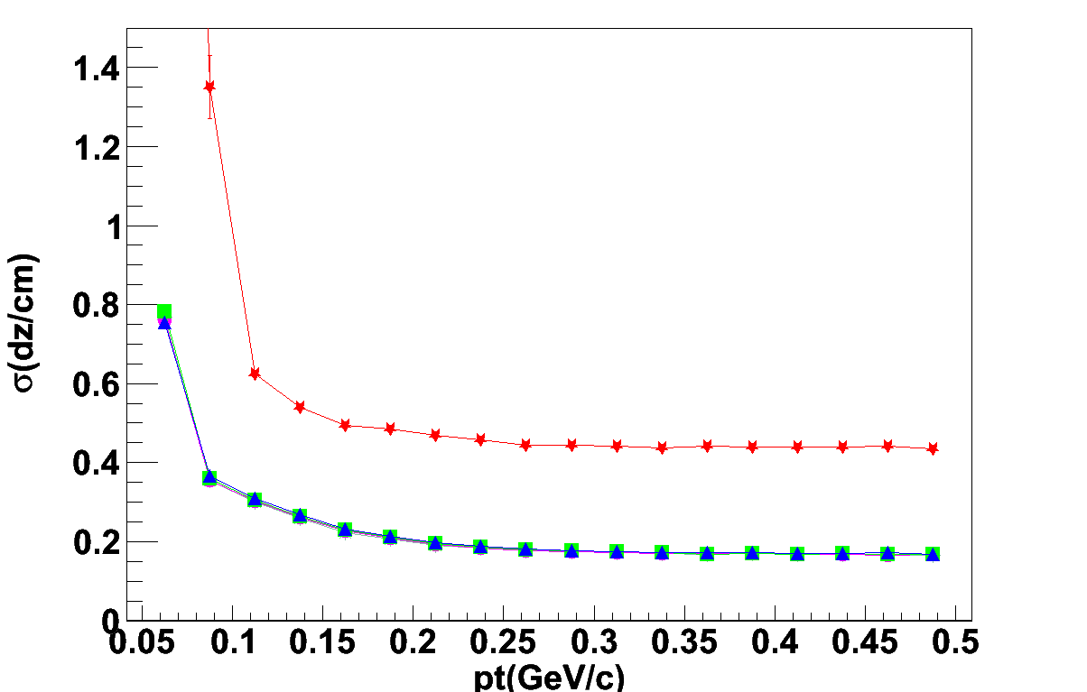
Aging effect on resolutions
(MC: single muon track)
Momentum resolution
dr resolution
dz resolution

Slide 23
Summary
Noise (beam related background and electronic noise)
  has obvious impact on hit efficiency and spatial resolution
  Big noise has impact on tracking efficiency
Anode aging effect of MDC
  Gain of inner DC decreases year by year, which results in the drop of the hit efficiency (1-3% for first 3 layers)
  Performances of outer layers are almost stable
  If BEPCII/BESIII keep operating performance of 2013/2014
  Very little impact on tracking efficiency, momentum and position resolutions in future 5 years
  Significant degradation in tracking efficiency and dz resolution if inner DC does not work

Slide 24
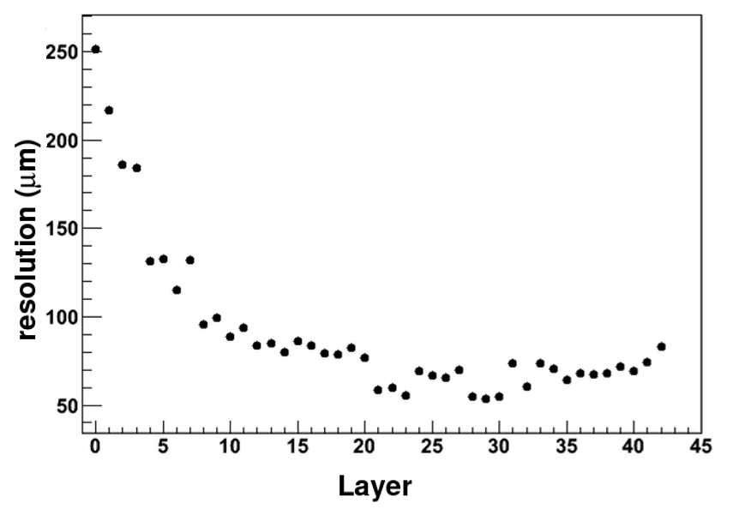
Backup
Input resolution for MC
Spatial resolution (μm)

Slide 25
Variation of HV
layer | 2009-2010 | 2011 | 2012-2014
0 | 2150*95% | 2150*96% | No change
1 | 2150*96% | 2150*97% | No change
2 | 2150*97% | 2150*98% | No change
3 | 2150*98% | 2150*99% | No change
4 - 7 | 2150 | No change | 2200*97.7%
8 | 2150 | No change | 2200*98%
9 | 2150 | No change | 2200*98.5%
10 | 2150 | No change | 2200*99%
11 | 2150 | No change | 2200*99.5%
12 – 39 | 2150 | No change | 2200
40 - 42 | 2150 | No change | No change

Slide 26
Definition of noise occupancy
  Number of noise hits / number of cells per event

