Slide 1



RD_FASE2: Tracking
1 October 2014
G. Darbo – INFN / Genova
On behalf of Tracker RD_FASE2
ATLAS: BO, CS, GE, MI, TN, UD
CMS: BA, FI, MIB, PG, PI, TO
Indico agenda:
https://agenda.infn.it/conferenceDisplay.py?confId=8515

Slide 2
ITk (Inner Tracker) Timeline – V1.0
Dates:
    Nov 2014: ITk collaboration kick-off meeting
    Sep 2017: Pixel TDR @ LHCC – Jan 2018: interim-MoU
2014
2015
2016
2017
2018
2019
2020
2021
2022
2023
CB
Endorse
Pixel TDR
~ 2019
Preproduction
2-3 Years Pixel Production
ITk-IDR
APR-OCT
ITk Ready for Installation
PIXEL
UCG, LHCC,
Pixel-MOU, RRB
Begin
Integration
UCG, LHCC,
Strip-MOU, RRB
STRIP
ITk Commission
on Surface
ITk-Kick off
EB Approval
Strips TDR
~ 2018
Preproduction
3-4 Year Strip Production
YR=1
2
3
4
5
6
7
8
9
10
CB= collaboration board, EB=executive board, IMOU=interim memorandum of understanding, UCG=upgrade cost group, RRB= Resources review board, IDR=initial design review (internal), TDR=technical design report (external)
Ref.: S. McMahon ITK Week. Sept. 2014

Slide 3
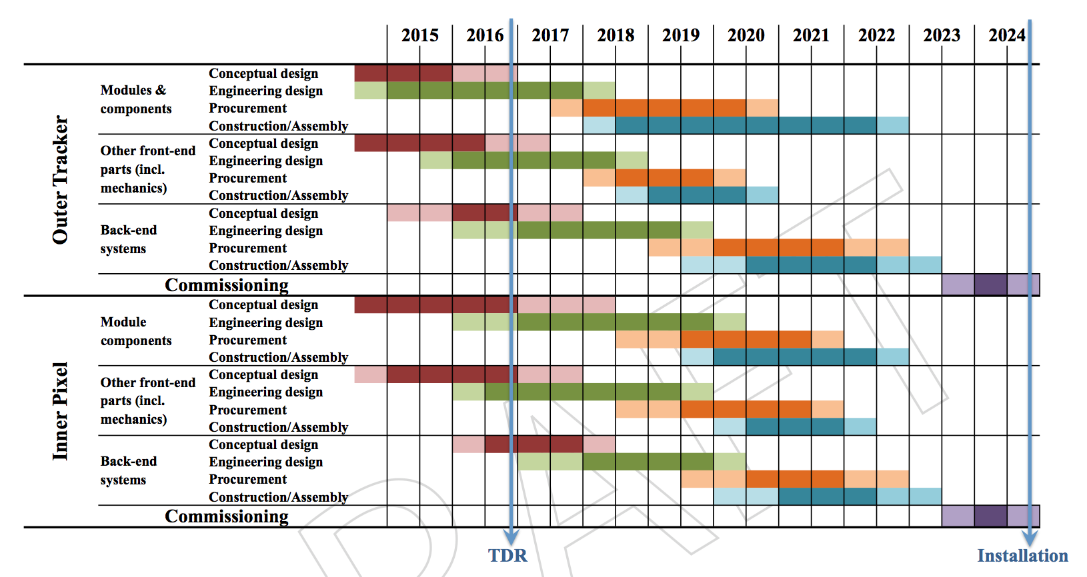
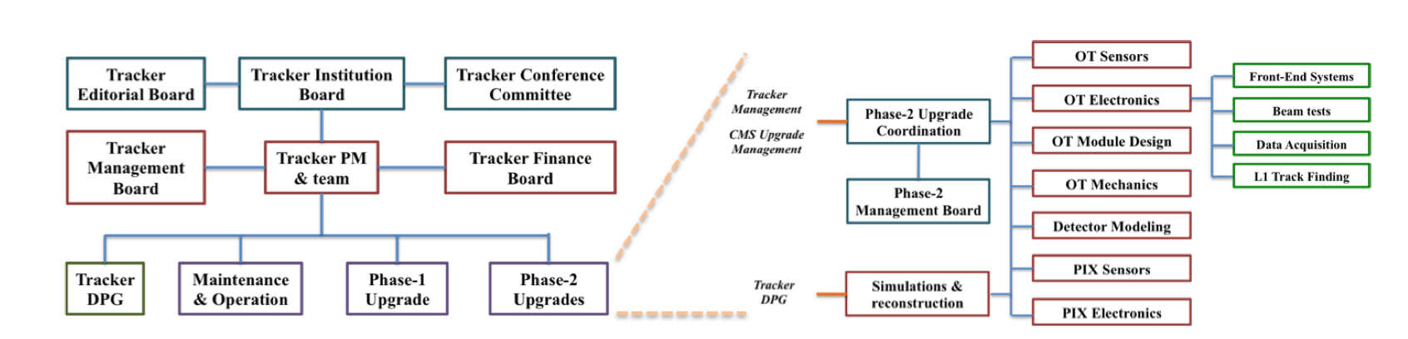
CMS: Phase-2 Tracker Timeline
Draft of Outer Tracker and Inner Pixel Phase-2 schedule
Management chart of CMS Tracker with detail of the Phase-2 Upgrade coordination structure

Slide 4
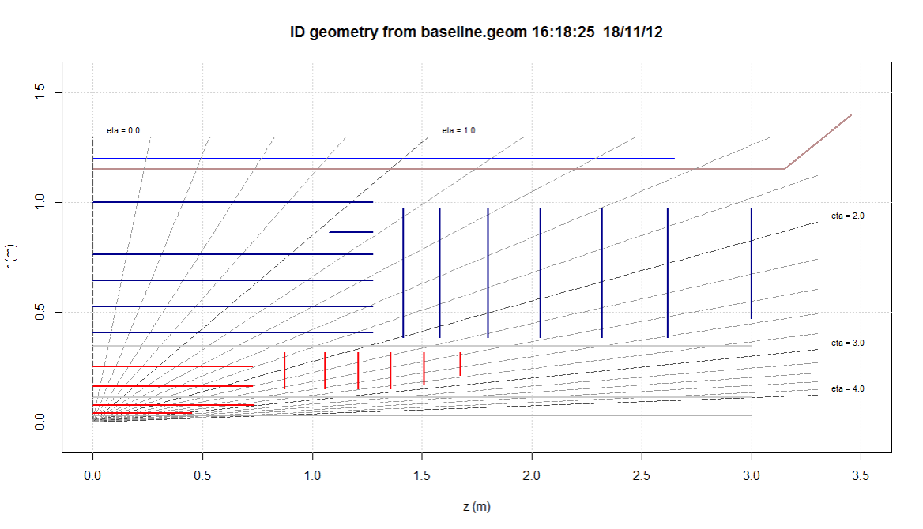
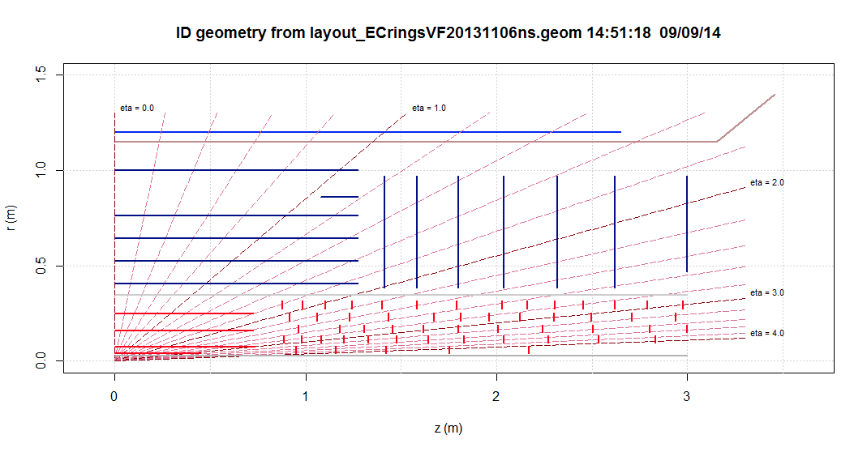
ATLAS Layout – Extend at High-η
LoI layout in refinement:
Study extensions at η ≥ 4.
Ex.: rings and/or long-IBL
Pixel area: 8.2 m²
  Barrel: 5.1 m²
  Disk: 3.1 m²
Total pixel area: 5.1 + 3.1 m² – today Pixels + IBL = 1.9 m²
Letter of Intent Layout
CERN-2012-022
LHCC-I-23
Possible High-η extension

Slide 5
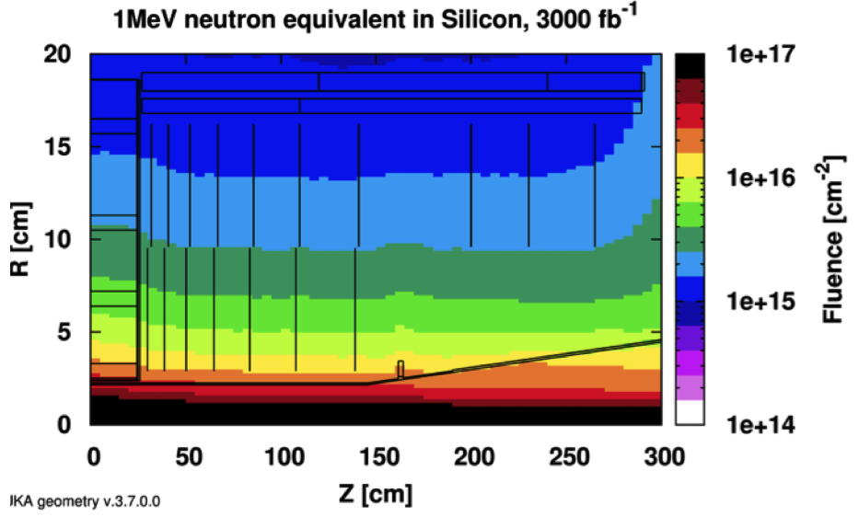
CMS High η Layout
Refined TP Layout
  Pixel area: 3.6 m²
    Barrel: 1.6 m²
    Disk: 2.0 m²
  Smaller CMS area, but stronger magnetic field.
CMS Technical Proposal (TP)
  CERN-LHCC-2011-006; LHCC-P-004
Simulated Fluka fluence for 3000 fb⁻¹ in the CMS Pixel region:
  2x10¹⁶ 1 MeV n_{eq}/cm² – inner layer
Event pileup a HL-LHC design luminosity: 160÷200 ev/BC
Similar picture is held for ATLAS

Slide 6
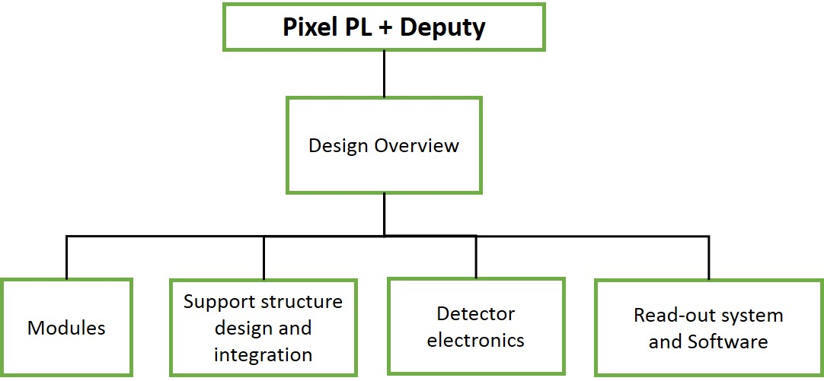
ATLAS ITk: Organization & Institutions
Countries and Institutions Expressing Interest in ITk
Country | Number of institutions
Australia | 3
Canada | 4
CERN | 1
China | 1 (cluster)
Czech Republic | 3
France | 5
Germany | 10
Italy | 6: BO, CS, GE, MI, TN, UD
Japan | 7
Netherland | 1
Norway | 2
Poland | 2
Switzerland | 2
Spain | 2
Slovenia | 1
Sweden | 2
South Africa | 2
Taiwan | 1
United Kingdom | 12
United States | 16
Total | 83
ITk Organization Chart
ITk Pixel Organization Chart
P. Morettini +
M. Garcia Sciveres
R. Bates, C. Gemme, D. Giuni,
P. Grenier
https://twiki.cern.ch/twiki/bin/viewauth/Atlas/ITkPixelOrganization

Slide 7
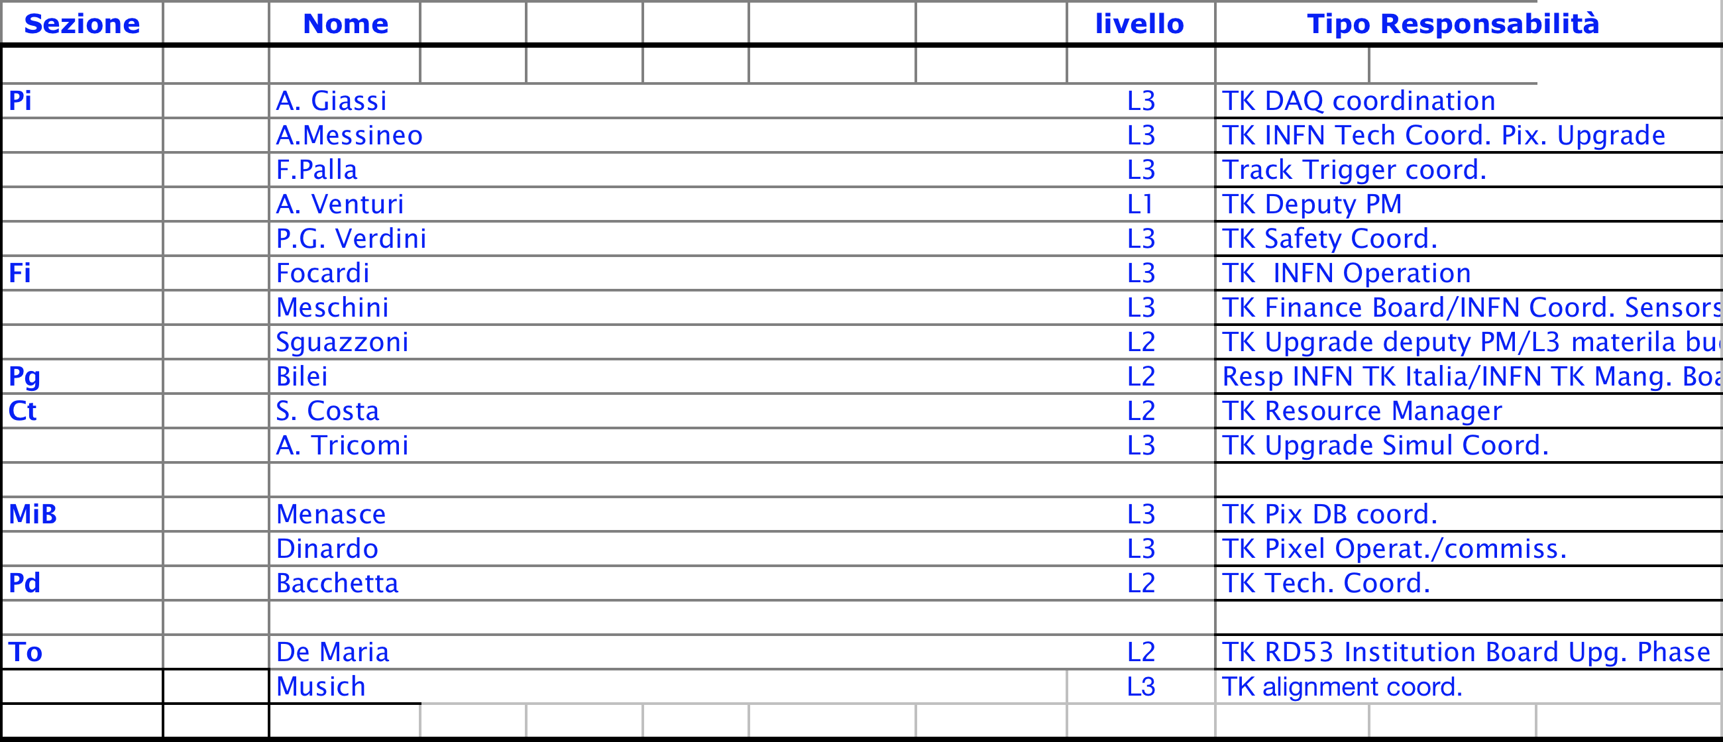
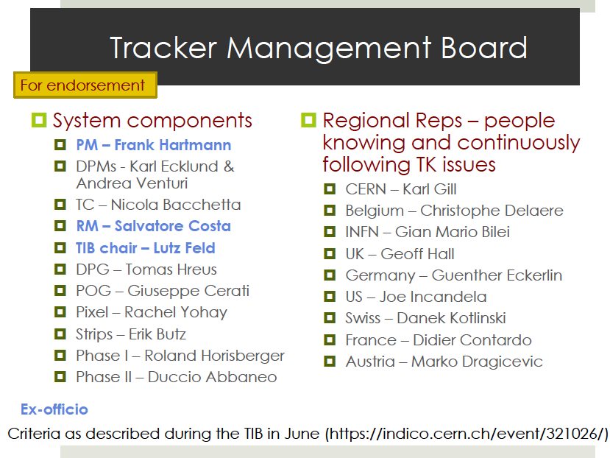
CMS Tracker: Organization & Institutions

Slide 8
2015 Activities
2015: Activities and line of funding
  Continue with 3D Sensor plan: produce modules, test in lab and TB, irradiate, procure sensors for next FBK run.
  Continue with Active Edge Sensor plan: produce modules, test in lab and TB, irradiate, procure sensors for next FBK run.
  Bump-bonding: for testing FBK sensors and to develop for future RD53 requirements (high-density bump-bonding with indium)
  Module Assembly and Test, Irradiation, Test-beam: modules with FBK sensor designs (planar, 3D, active edge) and FE-I3/FE-I4 ATLAS + PSI46dig CMS R/O chips.
  CO₂ cooling: contribute to ATLAS stave R&D, thermal simulation and test with CO₂ plant, µ-channel cooling demonstrator and CO₂ system setup in CMS
  Multi-module R/O: use leading experience of ROD designer (BO) to develop a 16 module table-top road for architecture study and for test-beam application.
  CSN5: HV/HR-CMOS (new project in CSN5 by BO, GE, MI) CHIPIX65 INFN interface to RD53 collaboration – Approved as CSN5 Call (2013)
COLLABORATION:
COMMON
SYNERGY
SPECIFIC
CSN5

Slide 9
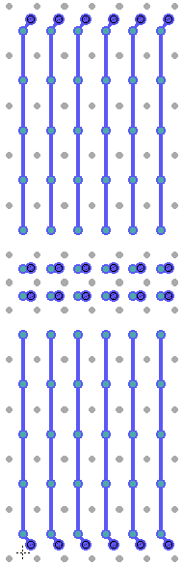
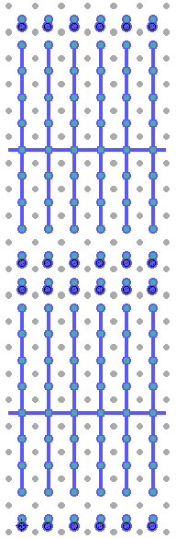
3D Sensors
3D Sensor development with FBK
  p-bulk sensor on 6” wafers
  Active volume: FZ on SiSi or Epi
  Active thickness: 100/130µm
  Single-side process, bias on back
Test with:
  Batch 1: FE-I4, PSI46
  Batch 2: (2016) RD53 chip
INFN Collaboration
  INFN-FBK under MEMS3
  ATLAS: CS, GE, MI, UD, TN
  CMS: BA, FI, MIB, PG, PI, TO
International Collaboration
  Common chip floorplan with producers: CNM, SINTEF/SNC
  Testing: ATLAS 3D Sensor WG
  Agreement CMS-FNAL for TB Telescope DAQ
  Collaboration for Irradiations @ Los Alamos
Single side 3D process
n⁺⁺ col
Charge Amp.
Bump-bond
P⁻ Epi layer /
P⁻ High Ω•cm wafer
100÷150µm
Epi – SiSi DWB
P⁺⁺ Low Ω•cm wafer
Thin-down
-V_{b}
p⁺⁺ col
metal
Test with FE-I4
(50x250 µm²)
50x50 µm²
Pixels + Large Pixels
with lower column
density
2 x 50x50 µm²
Pixels + other
grounded
2x50 + 2x450 L
250 fF
2x50 + GRID

Slide 10
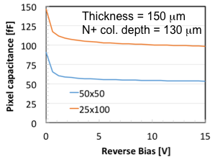
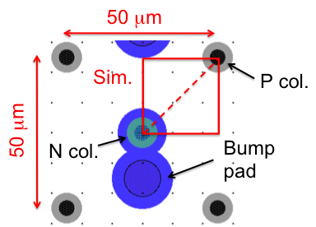
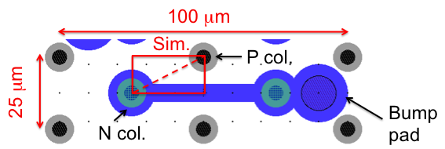
RD53 Chip – Requirements on 3D Sensor
Next front-end chip generation (RD53 chip)
  50x50 µm² pixels (also 25x100 µm²)
  C_{DET} ≤ 100 fF
  I_{leak} ≤ 5 nA/pixel (if no amp. compensation)
  Threshold: 1000 e (possible?)
3D Sensors
  50x50 µm² pixels best option (25x100 µm² difficult layout – too little clearances)
  Simulated capacitance (150 µm thick): 50 fF
  Expected charge 3200 – 3700 e (in 100 µm thickness) after 2x10¹⁶ n_{eq}/cm² – simulated
  and “extrapolated” values.
Ref. G.F. Dalla Betta, IFD 2014,
Mar 2014, Trento, IT.
Ref. G. Darbo, Pixel2014, Niagara Falls, Sept. 2014.

Slide 11
3D Sensor Program – 2014/15
Planned 3 run at FBK in 2014 – Funded by CSN1 in Feb 2014
Batch.1: DRIE process setting up for thin columns. Process in completion. Found that 5-6 µm are the best suitable column diameter.
Batch.2: test planar process with SiSi DWB and Epi substrates. Layout completed, mask submission, wafer expected in 6 weeks.
Batch.3: 3D single side process with SiSi DWB and Epi substrates. Layout in discussion. Compatible layout with other foundries (CNM) to simplify common test of devices.
Note:
A second 3D run is foreseen at the
end of 2015 / early 2016 – layout matching
RD-53 layout.
Schedule presented in Feb’14.
Still up to date.
Need approval from MEMS3 committee of 3rd batch!

Slide 12
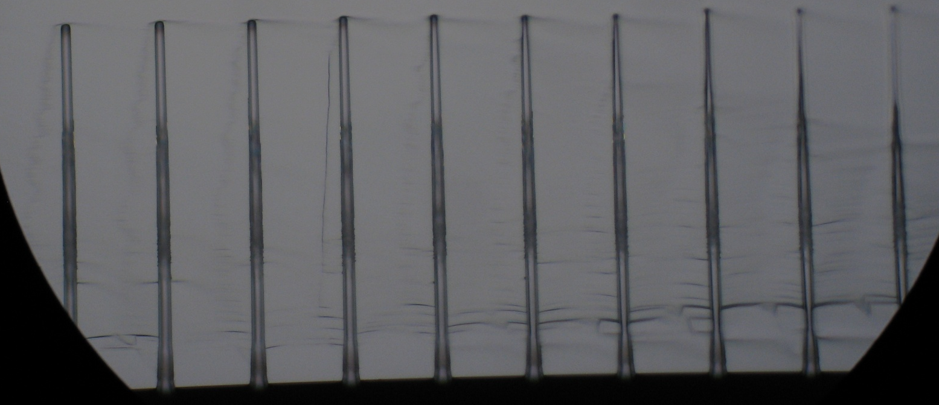
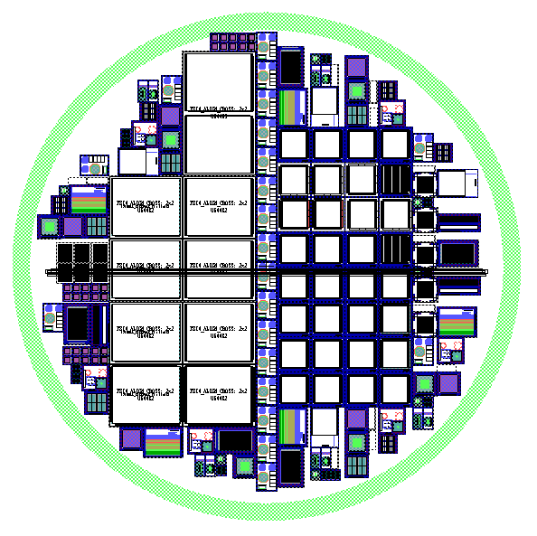
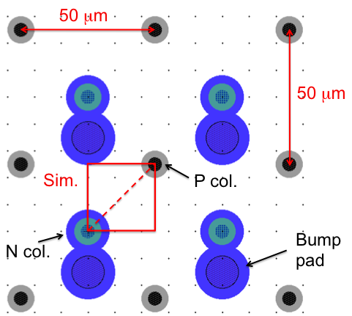
FBK: Status of Batches
Batch 1: study of columns
  In measurement
Batch 2: study SiSi subtrates
  Mask submitted
3.8 um
158 um
5.6 um
ATLAS
CMS
Ref.: M. Boscardin and S. Ronchin, FBK
Batch 3: 3D sensors
  Layout under study
  and Simulation of a
  3D pixel cell
  55 SiSi substrates
  from Icemos already
  available
  Epi wafers from
  Shinetsu on order
Test structures for Si-Si qualification

Slide 13
Active Edge
QUI DEVO CONTROLLARE COSA METTE DARBO, HA IL PPT DELLE MIE SLIDE PISA
AGGIUNGERE RICHIESTA PER AUTORIZZARE ACTIVE EDGE MEMS3
To extract material from
Marco’s Presentation

Slide 14
Active Edge
PER ME VA BENE COSI’
s
To extract material from
Marco’s Presentation

Slide 15
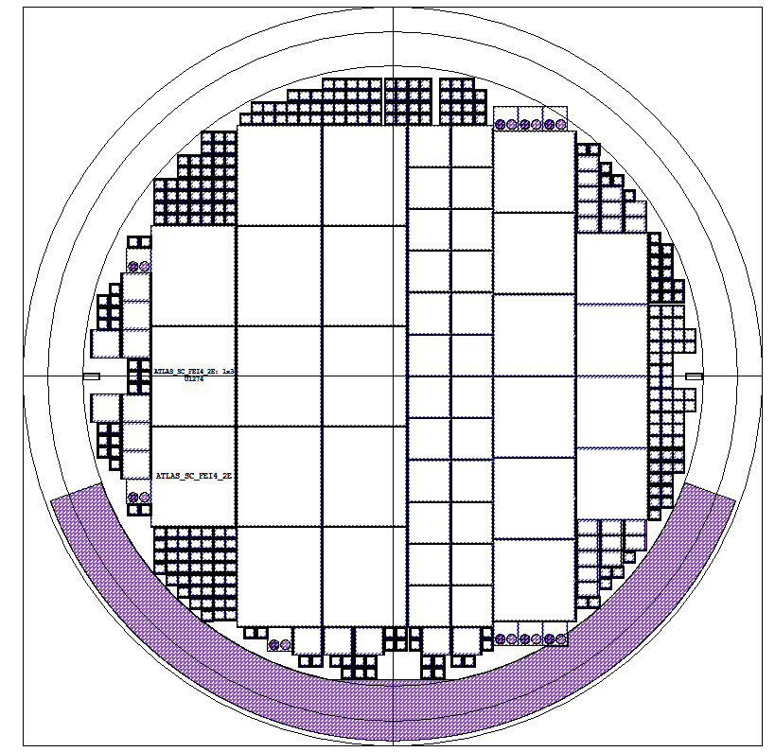
Bump-bonding Program
3D Double Side Batch
Planar ATLAS/CMS “Batch 2”
ATLAS FE-I4 (13x)
CMS Single chip (24x)
(1E, 2E, 3E, 4E)
ATLAS
CMS
CMS Quads (6x)
(2E, 3E)
MEDIPIX2 (4x)
NA62 test chip (20x)
Test structures for Si-Si qualification
In program 4 sensor batches that would need BB in 2014/15:
  3D double side – October - Funds (MI) assigned for 2014
  Planar ATLAS/CMS Batch 2 – November – Funds (TO) assigned 2014
  3D and Active edge batches coming 2015 – no funds yet, fund request: GE+FI
  Bumping at IZM and Selex: some money saving with available FE-I4/PSI with bumps from older productions
R&D on high density indium bumps
  Test on dummy wafers: high density (130k bumps/chip) – smaller bump <18µm diameter – fund request: MI (20k) and FI (10k)

Slide 16
3D – Module Assembly/Test & Irradiation
Assembly 3D modules:
  To irradiate with p- and n-irradiation at 2x10¹⁶ n_{eq}/cm²
    FE-I4 (ATLAS): heavily activate with low energy neutron (from reactor) – Tantalum is present in technologies below 250 nm
    FE-I3 (ATLAS): has shown to resist neutron irradiation, no activation, better ToT measurement (7-bits instead of 4-bits)
    PSI46-dig (CMS): has better noise performance than the analog chip (PSI46), 8-bit charge resolution, low threshold (<2000 e, 1500 e achieved)
  Assembly using PCB (better for laser test) and flex hybrids
Irradiation plans with CMS and ATLAS 3D/Sensor community
  Ljubljana (reactor): can reach 2x10¹⁶, usable with FE-I3 – may need some gamma for p-spray activation (to increase breakdown)
  KIT (Karlsruhe) 25 MeV protons (too high TID for reaching target NIEL dose – FE-I4 “suffers”),
  PS (CERN) 24 GeV protons, long time for 2x10¹⁶, but best equilibrium between TID/NIEL
  LANL (LOS ALAMOS) high intensity 800 MeV protons from linear accelerator, also good TID/NIEL ratio.

Slide 17
Test Beam & Tracking
Tracking community mostly interested in high energy beam…
  ATLAS and CMS 3D communities have used in the passed years several test beam facilities (see table)
… and high resolution tracking telescope – Experience in 3D communities:
  EUDET telescope family (mostly at DESY and CERN) – used by ATLAS/CMS – best for resolution
  CAPTAN pixel telescope (PSI46 R/O) at FERMILAB – used by CMS
  TimePix (MediPix R/O) – Available at SPS – used by ATLAS
  New FE-I4 based telescope (Geneva) and old strip telescopes (Bonn)
  Test beam facilities used in the past for 3D Pixel Sensor testing
Laboratory | No. of beam lines | Particle | Energy Range | Availability
CERN PS (CH) | 4 | p (prim.) e, h, µ (sec.) | 24 GeV/c 0.6 – 12 GeV/c | 9 months / year Duty cycle depends on PS/SPS/LHC operating mode and is typical PS ~ 1 – 3 % SPS 20 – 40 %
CERN SPS (CH) | 4 | p (prim.) e, h, µ (sec.) | 400 GeV/c 10 – < 400 GeV/c
DESY (D) | 3 | e+, e- (sec.) e- (prim. planned for 201X) | 1 – 6 GeV/c 6.3 GeV/c | 10 months per year duty cycle ~ 50 %
FERMILAB / FTBS (US) | 2 | p (prim.) e, h, µ (sec.) | 120 GeV/c 1 – 66 GeV/c | 24 hrs / day 10 % duty cycle
SLAC (US) | 1 | e (prim.) e (sec.) | 2.5 – 15 GeV/c - 14 GeV/c | 9 months per year 50 % duty cycle
From data compiled by C. Rembser, June 2013

Slide 18
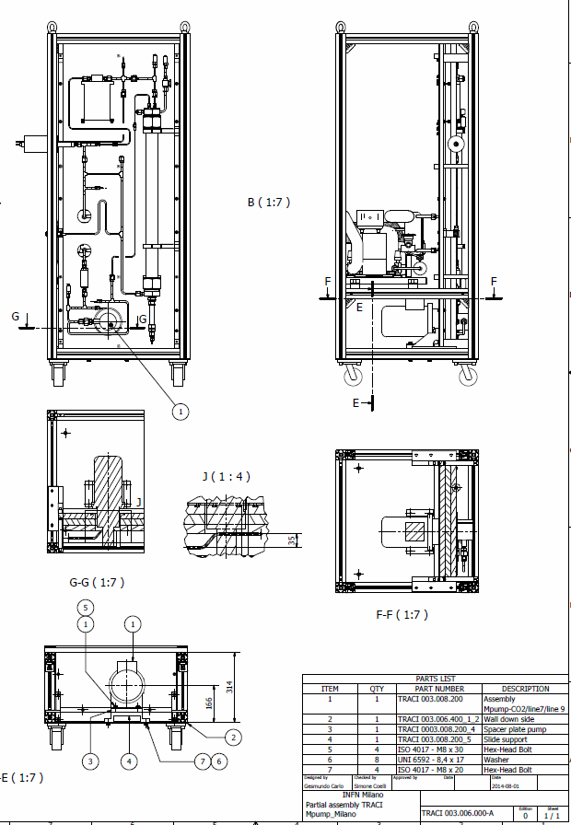
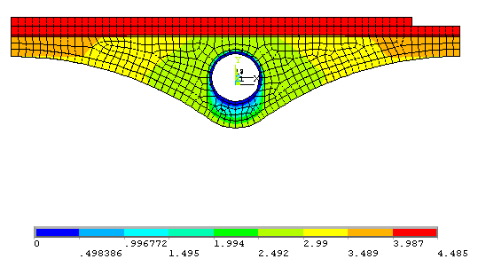
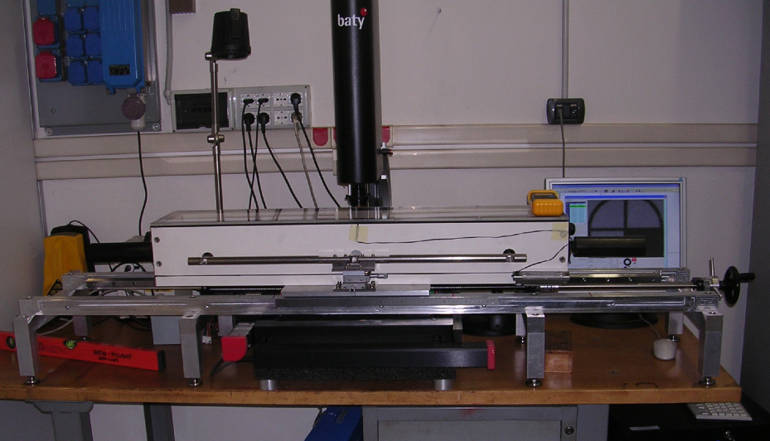
Evaporative CO₂ cooling Milano
TRACI
2014 Activities
  Completed design of TRACI v.3
    100 W transportable CO2 recirculating system
    Collaboration: CERN, NIKHEF, MILANO, SHEFFIELD,
    OXFORD, LIVERPOOL
    Test on M PUMPS, Corbola (RO)
  Purchasing of components on-going:
    Being part of collaboration allows purchase sharing
    In Milano co-funded by LHCb and Dotazioni
  Installation before end 2014
2015 Plans
  L’ufficio tecnico is involved in the design of the ITk cooling
    Strengthen the know-how acquired from IBL construction
  Finite Element Analysis of stave designs based on
  mini-piping
    Ti pipe, 𝜙 2 mm
  Test of prototypes with TRACI
    Need to build a setup based on TRACI, similar to what done
    for IBL
Thermal simulation (IBL)
Test setup (IBL)

Slide 19
CO2 CMS
PER ME VA BENE COSI’
To extract material from
Marco’s Presentation

Slide 20
CO2 CMS
PER ME VA BENE COSI’
To extract material from
Marco’s Presentation

Slide 21
Stand-alone prototype board including IBL BOC and ROD features
Standalone test board to R/O up to 16 FE-I4 with BOC+ROD functionality
Compatible with IBL ROD/BOC firmware today present on separated cards
16 FE-I4 chips
8 modules
IBL ROD and BOC features in one card
Table-TOP
Gb/s Ethernet
Control
Calibration
Trigger
Busy
2 S-Links
Card foresees commercial standard
fast protocols (infiniband, rapid-IO,…).
Such protocols are oriented to ATLAS
Phase II upgrade
- PC Iexpress 3
- InfiniBand
- RapidIO
- 10 Gb/s Ethernet

Slide 22
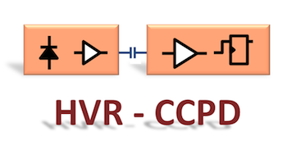
HVR_CCPD – Cost & Organization
3 year project submitted to CSN5: HVR_CCPD
Develop HV/HR-CMOS chip (HVR)
Study Capacitively Coupled Pixel Detector (CCPD)
~300 k€ project cost
National Coordinator:
Attilio Andreazza (MI)
Collaborative tools:
SharePoint: cern.ch/HVR_CCPD
Proposal on SharePoint

Slide 23
Conclusions
From CMS

Slide 24
FTE & FUNDS

Slide 25
FTE 2015 on ATLAS Related R&D
Total 13.8 FTE for the 3 R&D of interest of ITk.

Slide 26
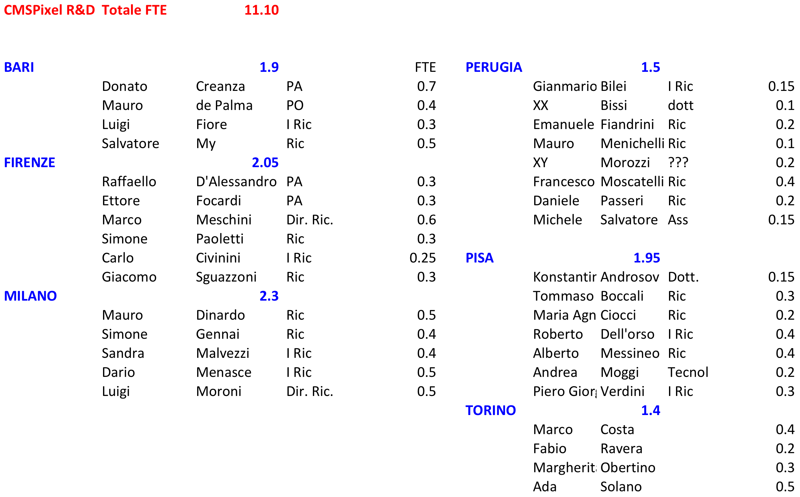
FTE 2015 on CMS Related R&D

Slide 27
RD_FASE2 – “Richieste 2015” (1/2)
Attività | Descrizione | BO | CS | GE | MI | TN | UD
3D | 6" Wafer procurement (SOI, wafer bonding, epi) | - | - | - | - | 10.0 | -
 | PicoScope 6407 Digitizer with 1.5 GHz probes and accessories. | - | - | - | - | 8.5 | -
BB | 6" dummy wafers - test deposition on 6" and high-density bumps (150 k-bumps/chip) | - | - | - | 20.0 | - | -
 | BB for 3D sensor test | - | - | 24.0 | - | - | -
MOD | Upgarde R/O Systems | - | 2.0 | 2.0 | 2.0 | - | 2.0
 | Module assembly and irradiation, RD on flex | - | - | 10.0 | - | - | -
MM-R/O | Multi module R/O | 15.0 | - | - | - | - | -
CO2/µCH | Develop µ-channel cooling | - | - | - | 10.0 | - | -
Total requested by ATLAS Groups |  | 15.0 | 2.0 | 36.0 | 32.0 | 18.5 | 2.0
 |  | 105.5
Legend:
  ATLAS/CMS
  Common ATLAS / CMS
Trento:
  Request of 4 k€ of Travel Money for test-beam participation and support.

Slide 28
RD_FASE2 – “Richieste 2015” 2/2
Attività | Descrizione | BA | FI | MIB | PG | PI | TO
3D | 6" Wafer procurement (SOI, wafer bonding, epi) |  | 10
Sensor / AE | Contribution to common CMS sensor batch |  | 20
 | Parylene or BCB isolation of sensors |  |  |  |  | 5
BB | High density bump-bonding test: industrial partner to be defined |  | 10
 | Bump-bonding for FBK sensor testing: 3D + Active Edge (AE) |  | 24
 |  |  | 24
Module | Mechanical Assembly: jigs for WB, support structures for lab test | 8
 | Adapter interface boards: 100 pc (one for each ROC) |  |  |  |  | 10
 | Test beam mechanics and DAQ: precision mechanics, cooling contacts and piping, interface electronics (FNAL + DESY) for PSI46dig only |  |  | 12
 | Irradiation: sample preparation, mechanical supports and facilities costs. Min 2 fluences |  |  |  |  |  | 12
 | USBpix 3.0: FE-I4 lab R/O system |  | 4.5
 | High Density pitch sensor probing: probe cards for qualification |  | 6
 | Module qualification, laser & X-ray in cool box: mechanics and cooling for X-ray station and jig for cooling box |  |  |  | 7
CO2/µCH | CO2 system completion |  |  |  |  | 3
 | Single micro-channel cooling demonstrator |  |  |  |  | 7
 | Cooling technical equipment |  |  |  |  | 10
 | Cooling consumables |  |  |  |  | 5
Total requested by CMS Groups |  | 8 | 98.5 | 12 | 7 | 40 | 12
 |  | 177.5

Slide 29
2014 Activities & Funds (ATLAS)
2014: CSN1 funded (Feb and May) R&D Phase 2 activities for ATLAS & CMS inner trackers.
  Development of 3D and Active Edge sensors with FBK – 3 Batches (ATLAS/CMS)
  Bump-bonding: development of Indium bumps (6” sensors) and produce modules
  Develop a technology for pixel detector hybridization using C (dielectric) instead of R (bump-bonding) coupling
  Completion of CO₂ test plant (combined ATLAS / LHCb)
Assigned on | Sezione | Category | ATLAS/CMS/COMMON | Assigned | Description
Feb 2014 | GE | 3D | COMMON | 21 000 | Wafer for 3D sensors (common with CMS)
Apr 2014 | GE | 3D | COMMON | 44 000 | 3 processes at FBK: 2 committed with MEMS3
May 2014 | GE | HV | ATLAS | 13 000 | HV-CMOS Hybridization + 3 FE-I4B wafers
May 2014 | MI | BB | ATLAS | 27 000 | BB of 3D (IBL design on 6") + 3 FE-I4B wafers
May 2014 | MI | CO2/µ-CH | ATLAS | 20 000 | TRACI: co-funded with LHCb
 |  |  |  | 125 000

Slide 30
2014 Activities & Funds (CMS)
2014: Funds for CMS-ATLAS common activities are in the previous slide.
  Development of 3D and Active Edge sensors with FBK – 3 Batches (ATLAS/CMS)
  Bump-bonding: ROC wafers, hybridization, single-ROC module production
  First step towards “Blowing” CO₂ test plant (initial equipment, to be completed in 2015)
Assigned on | Sezione | Category | ATLAS/CMS/COMMON | Assigned | Description
May 2014 | TO | Active Edge | CMS | 32 000 | 10 MEMS3 Litho Steps + wafers for sensors
May 2014 | TO | BB | CMS | 27 000 | BB of Planar + PSI_dig “Express Line”wafers
May 2014 | PI | CO2 | CMS | 10 000 | CO2 Blowing System components
 |  |  |  | 69 000

Slide 31
Spare slides

Slide 32
Substrates Specifications
SiSI DWB – 100 and 130 µm nominal thickness
Producer: Icemos
  Overall Thickness: 600 / 630 ± 12 µm
  Wafer diameter: 150 mm
  Bow and wrap: < 60 µm
  TTV: <5 µm
  Handle wafer growth: CZ
  Handle wafer resistivity: 0.001 ÷ 1 Ω•cm
  Handle doping type: p (Boron)
  Device wafer growth: FZ
  Device resistivity: >3000 Ω•cm
  Device nominal thickness: 100 / 130 ± 2 µm
  Device doping type: p (Boron)
Epi-wafers – 130 µm nominal thickness
Producer: Shinetsu
  Overall Thickness: 625 ± 25 µm
  Wafer diameter: 150 mm
  Bow and wrap:
  TTV:
  Handle wafer growth: CZ
  Handle wafer resistivity: 10 ÷ 20 Ω•cm
  Handle doping type: p (Boron)
  Device wafer growth: Epitaxial
  Device resistivity: 700 ÷ 2500 Ω•cm
  Device nominal thickness (*): 115 ÷ 145 µm
  Device doping type: p (Boron)
  Note: (*)
  Epi layer thickness uniformity in a wafer: average value ± 5%
  Epi layer thickness uniformity wafer-to-wafer: average value ±5%
  Shinetsu is the only producer of thick 6” Epitaxial wafers we have found

Slide 33
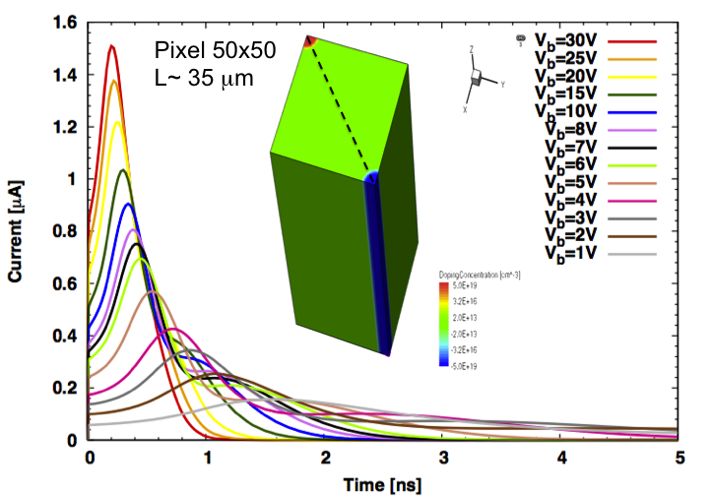
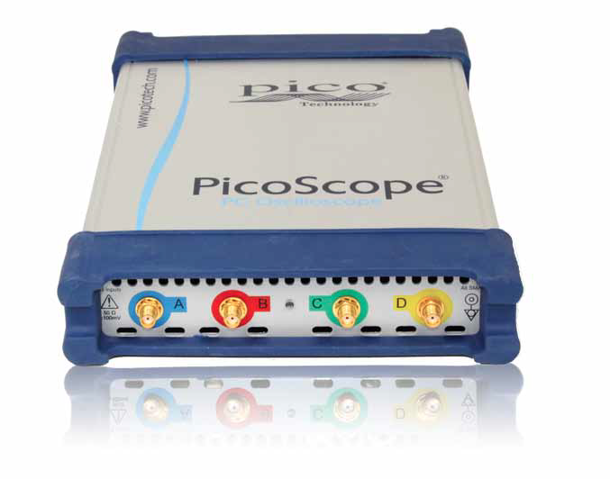
3D – TN: PicoScope
TN Involved in design, TCAD simulation and 3D diode structure measurements
New 3D design:
  electrode distance reduced
  High speed signals (<1ns)
Need direct comparison
between measurements
and simulation to optimize design
Test on ad-hoc structures (OK)
High speed laser (OK)
High-bandwidth amplifier (OK)
High sampling oscilloscope (not available)
PicoScope modules (High speed A/D Converters
with USB computer interface) are a valid
sustainable cost alternative.
Fund Request:
8.5 k€ (TN)
TCAD simulation of mip on 50x50 pixel
www.picotech.com

Slide 34
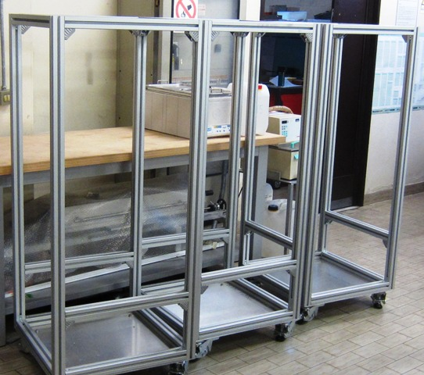


Prototypes cooling test system status
TRACI=Transportable Refrigeration Apparatus for Co2 Investigation
Collaboration group: CERN, NIKHEF, MILANO, SHEFFIELD, OXFORD, LIVERPOOL
Re-Design and production of the working drawings
finished (Milano technical office)
TRACI structures assembled
(Milano mech. Workshop)
Design of the test set-up in progress
Ordering sensor for the test set-up

Slide 35
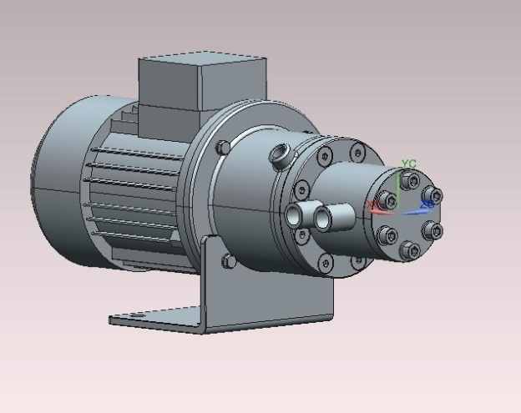
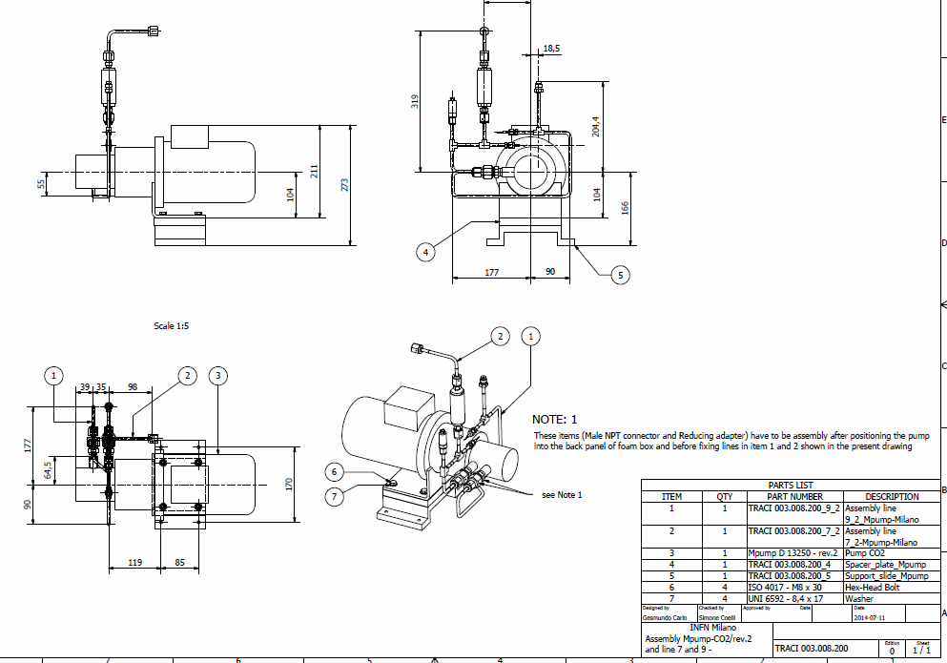
TRACI CO₂ CIRCULATING PUMP
Milano TRACI will use a M-PUMPS for CO₂ circulation
Ordered and arriving at the end of September
Re-designed in collaboration with the manufacturer company
according to CERN experience
(smaller and better thermal insulated)
Note:
Actual internal cartridge is in METCAR
We foreseen a future R&D using composite CERACOMP cartridge but after the prototype test
Design of the relavant TRACI connection lines
Finished (Milano technical office)

Slide 36
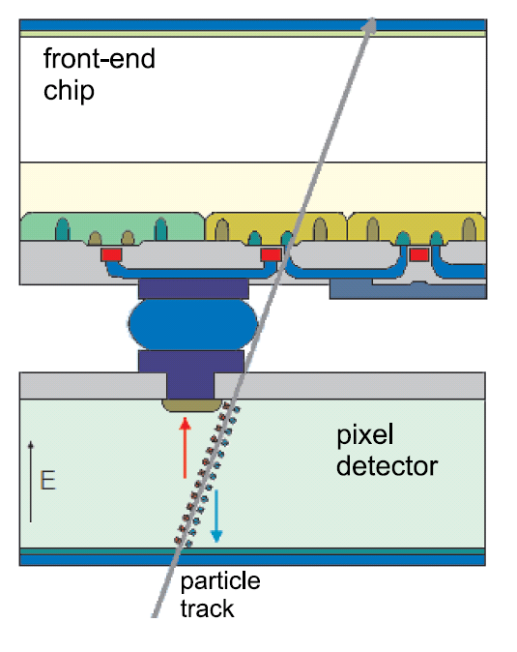
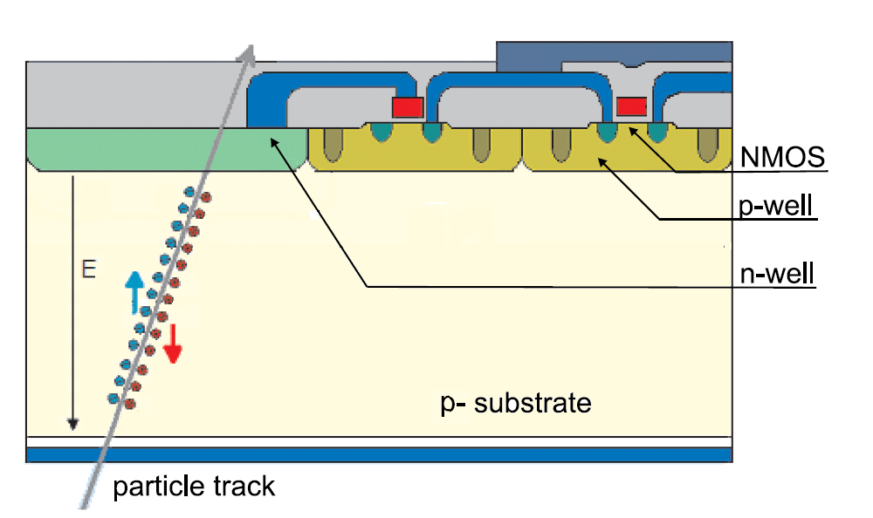
HV/HR-CMOS – Detector Principle
Standard Hybrid Pixel Detector
(as ATLAS Pixel and IBL).
Signal collected in a silicon sensor coupled to amplifier by bump-bonding
High Voltage (HV) CMOS pixel detector.
Amplifier (at least) on same substrate as detection layer – Use p-substrate with High Resistivity: depletion layer (30 µm) to collect signal by drift under application of HV.
R/O done through “digital chip” – i.e. FE-I4 / RD53
HVR_CCPD – High Voltage/High Resistivity CMOS Capacitively Coupled Pixel Detector
  Use high voltage CMOS technology and modify to high resistivity silicon the substrate to deplete the layer underneath the active chip layer and collect the charge by drift.
  Work in collaboration with STMicroelectronics (Agrate) using BCD8sP 70 V/160 nm technology – design by Milano with contribution from Genova
  NDA (non disclosure agreement) signed between STM and BO, GE, MI and Karlsruhe
  Assembly of module will happen in Genova, irradiation and test beam coordinated by Milano with contribution from Bologna.

Slide 37
CCPD Hybridization
HV/HR-CMOS chip coupled capacitively to R/O chip (CCPD – Capacitively Coupled Pixel Detector) instead of “classic” bump-bonding
  Develop a technique to insert uniform, well defined thickness of dielectric between R/O and HV/HR-CMOS chips
  Should be a cost effective, rad-hard process to transfer to industry
Test program in progress:
    See preliminary results next slide
Activities will continue in the HVR_CCPD project in CSN5 (new experiment)
  Involving BO, GE & MI
  Also scientists outside ATLAS will participate.
Process Recipe
Spin SU-8 photoresist
Pattern pillars by mask
Spacer define the
distance between chips
Target to D = 5 µm,
C ~ 4 fF for 18 µm
pad diameter.
Proper qualified glue
R/O CHIP
Glue deposition
R/O CHIP
Align & pressure
DETECTOR CHIP
R/O CHIP

Slide 38
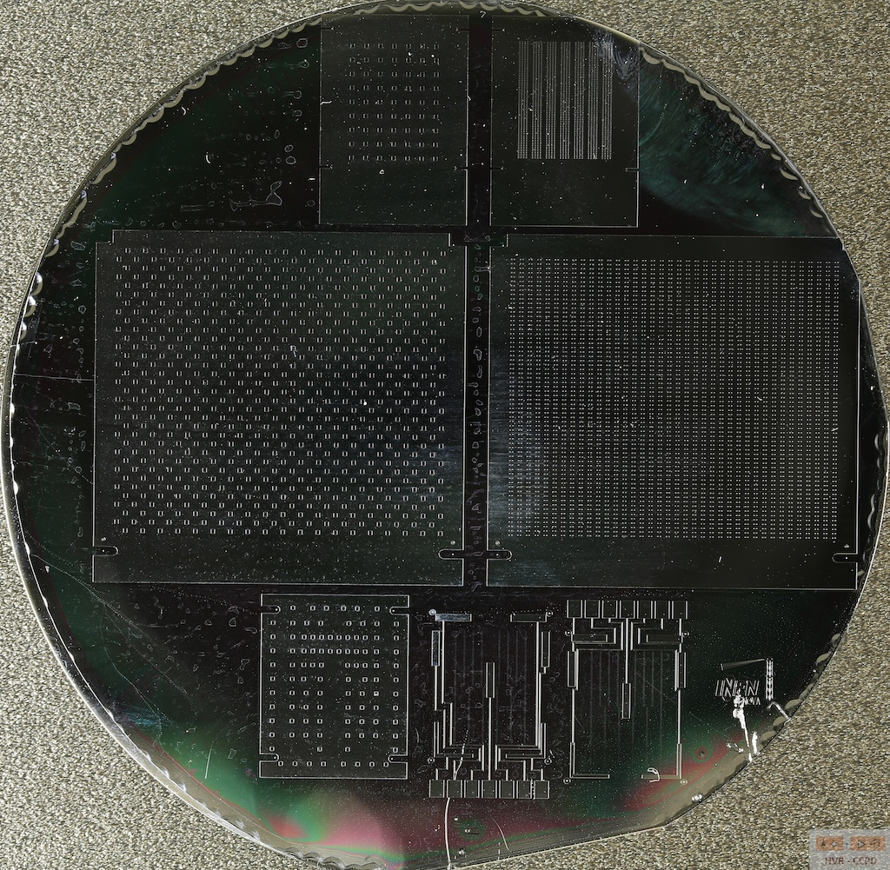
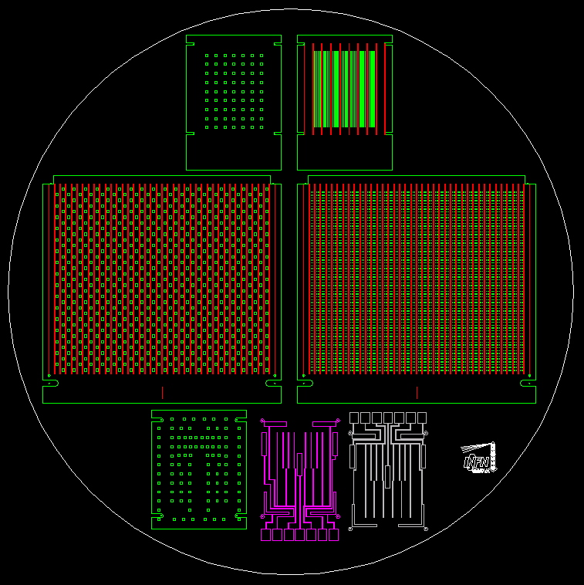
Deposition of Pillars (spacers)
2-inch mask below with different
Densities of spacers – FE-I4/FE-I3
Structures.
SU8-2005 deposited on 2-inch wafer
from Siegert
Credits: V. Ceriale
FE-I4 with matrix of SU8 spacers:
200 µm x 200 µm columns 4.7 µm high
FE-I4 with matrix of SU8 spacers:
40 µm x 40 µm columns 4.7 µm high
Profilometer measurements: 4.7 µm high pillars

Slide 39
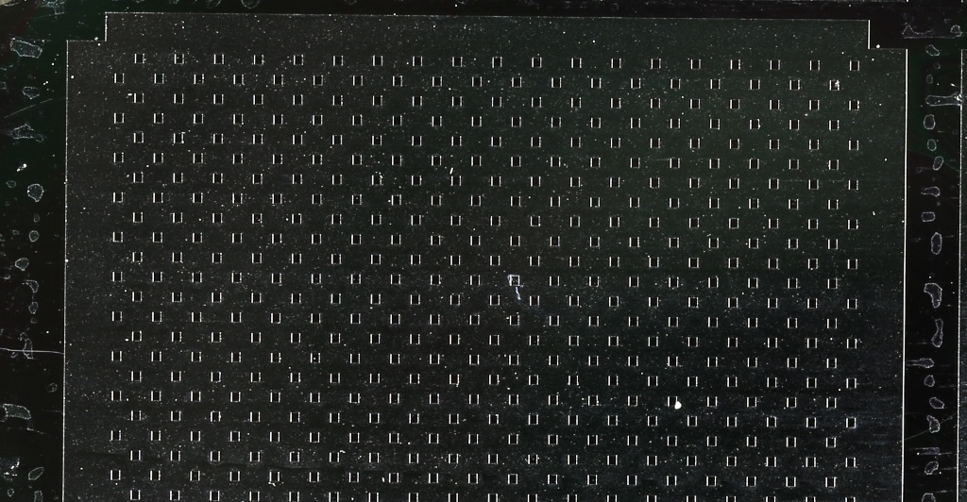
SU8-2005 Results
Profile scan direction
1.26 µm of bow. Column highs are very uniform: 4.7 µm over 2 cm
Results obtained with a spinning rotation of 2500 rpm and SU8-2005

