Slide 1
R&D Pixel Phase-2
CMS INFN Activities
Update
Marco Meschini
on behalf of
Bari, Firenze, Milano B., Perugia, Pisa, Torino
CMS Tracker Week, Phase-2 pixel, Nov 2014

Slide 2
Pixel Sensors R&D in Italy
Pixel R&D with FBK Trento under INFN agreement
    N in P sensors on 6” wafer production line
    6”diam. ~600μm total thickness wafers
  Three batches funded:
    The first planar batch is a test to qualify 6” substrates, production line, process quality. Cost shared with ATLAS-Italy, 6 Lithographic steps. Now in production
    The 3D batch will be launched early 2015. Cost shared with ATLAS-Italy, 11 Lithographic steps
    Active Edge batch will follow closely, layouts should be prepared and discussed with FBK by end of 2014. Cost relies on CMS-Italy, 10 Lithographic steps funded
  Thinning after processing and isolation treatment have to be planned as needed
  Bump Bonding of single chip; explore different technologies and BB thermal budget
  Irradiation campaign
  Test beams

Slide 3
6” Wafers
55 wafers Float Zone Si-Si DWB from Icemos Tec. (UK):
  P type
  CZ Handle wafer, very low resistivity, 500μm thick
  FZ Sensor wafer resistivity > 3kOhm cm
  2 thicknesses: 100μm (25 wafers) and 130 μm (30 wafers), to be used for planar, 3D, AE batches
Epitaxial Wafers:
  Extremely difficult to find 6” Epi wafers producers
  At present only one found: Shin-Etsu (Japan). They do not sell directly to CERN, a proxy is needed
  Resistivity range 700-2500 Ohm cm. Possibility to get Res. >1000 Ohm cm
  According to specs Epi layer has large thickness variations from wafer to wafer (130 ± 15 μm). To be checked
  Price is in the high range
  Japan wafer Outer Flat Length standards are different from those of EU foundries, to be followed. Order not yet placed. Epi to be used for 3D and AE if possible

Slide 4
Planar Batch in Production at FBK
DWB 100 and 130 μm wafers and Float Zone 275 μm wafers
DWB is a new material, hence Float Zone is used as a “Reference”
  → verify performance of DWB vs FZ on standard, known pixels before going to 3D pixel production on DWB
Three P_Spray isolation doses (Hi, Medium, Low) will be used on different wafers as shown in table below
We have designed standard PSIdig sensors with and without P_stop implant to study the performance and isolation
Production status is advanced, delivery expected by end of November
Dose p-spray | Fz | Si-Si 100 | SI-Si 130
Low |  |  | 2 (w80,w81)
Medium | 2 (w1-w2) | 3 (w30,w33,w49) | 2 (w74,w75)
High |  |  | 2 (w63,w69)

Slide 5
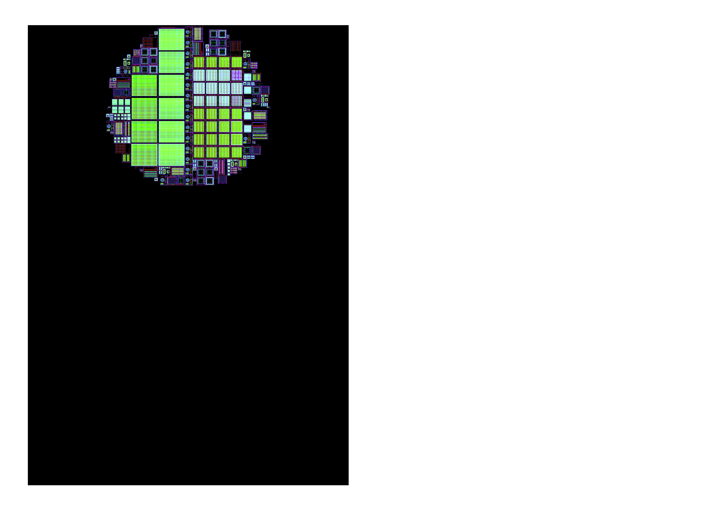

Planar Batch in Production at FBK Trento, Italy
Wafer periphery filled with common TS from CMS, FBK, ATLAS
TS will be used to qualify the process, to compare with previous productions made elsewhere, to study “simple diode” case, etc.
FBK QA test structures
ATLAS
CMS
ATLAS sensors
(FE-I4)
P_Spray process
P_Stop only where required
CMS sensors (PSI_dig)
Layout finalization at FBK: G. Giacomini, M. Boscardin, N. Zorzi

Slide 6
The CMS Side of the Moon
4 replicas MAPSL, KIT
Layout in production at FBK
Pixels with P_stop
G. Bolla pixels
55x55um2
30x100um2
50x100um2
translated at FBK from N_in_N to N_in_P
(by G. Giacomini)
Each sensor is replicated from 1 to 5 times in each wafer
Pixels without P_stop
Increasing number of Guard Rings
Large number of sensors and TS to be measured!

Slide 7
What Can you Find in This Layout?
32 single chip sensors suitable to be bonded to PSI46dig
4 MAPSL sensors for PS modules
5 small pitch sensors
7 different Guard Ring protection designs
  4 from ATLAS from slim edge geometry studies
  1 CMS PSI-like, not present in currently installed detector
  1 FBK according to their technology
  1 HPK large protection ring
  GR’s interleaved with P_Stop rings
Structures to study inter-pixel capacitance down to 50x50um2
A large number of other Test Structures (~50) to study material properties and to make comparisons with known pixels from other vendors/productions
8 single + 1 double chip sensors for ATLAS FE-I4, just in case…

Slide 8
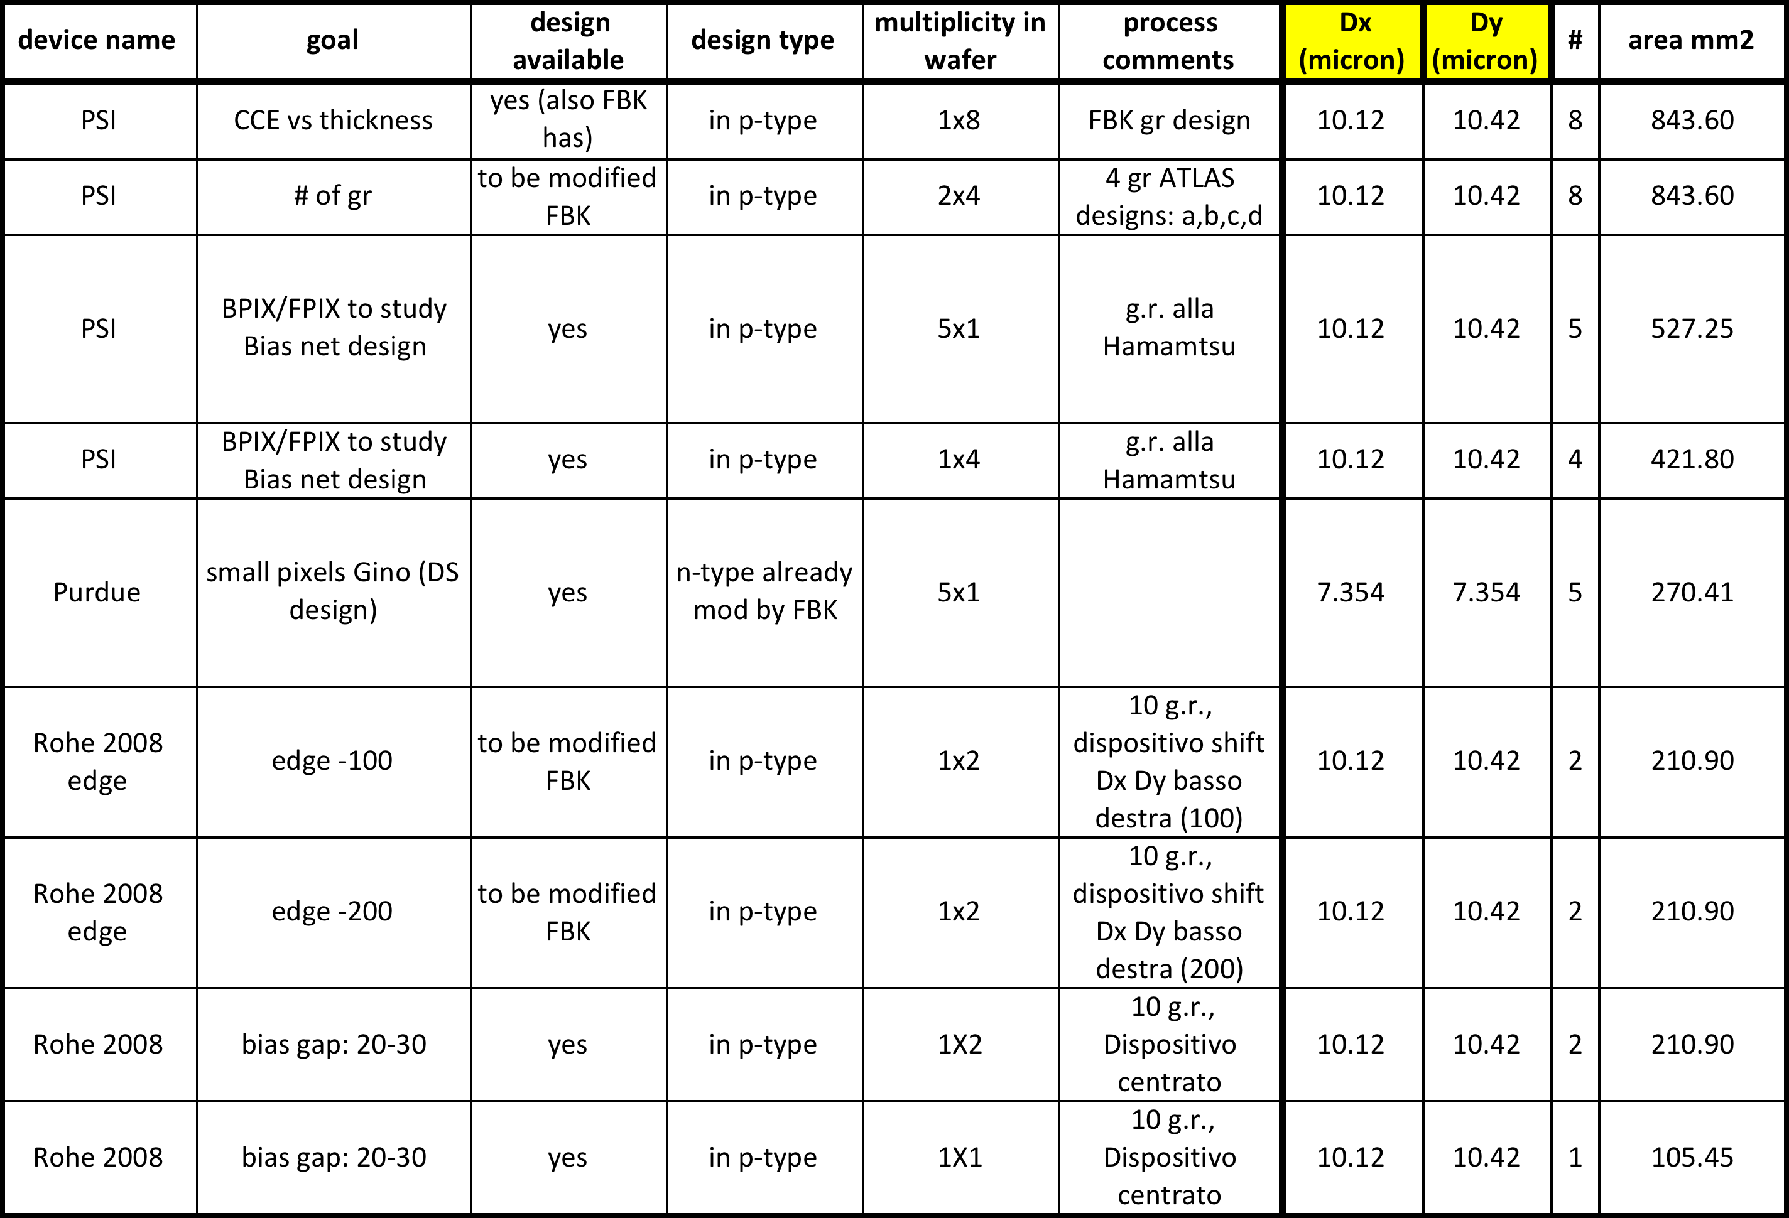
Planar Batch: 32 CMS_PSI + 5 Small Pitch test Sensors

Slide 9
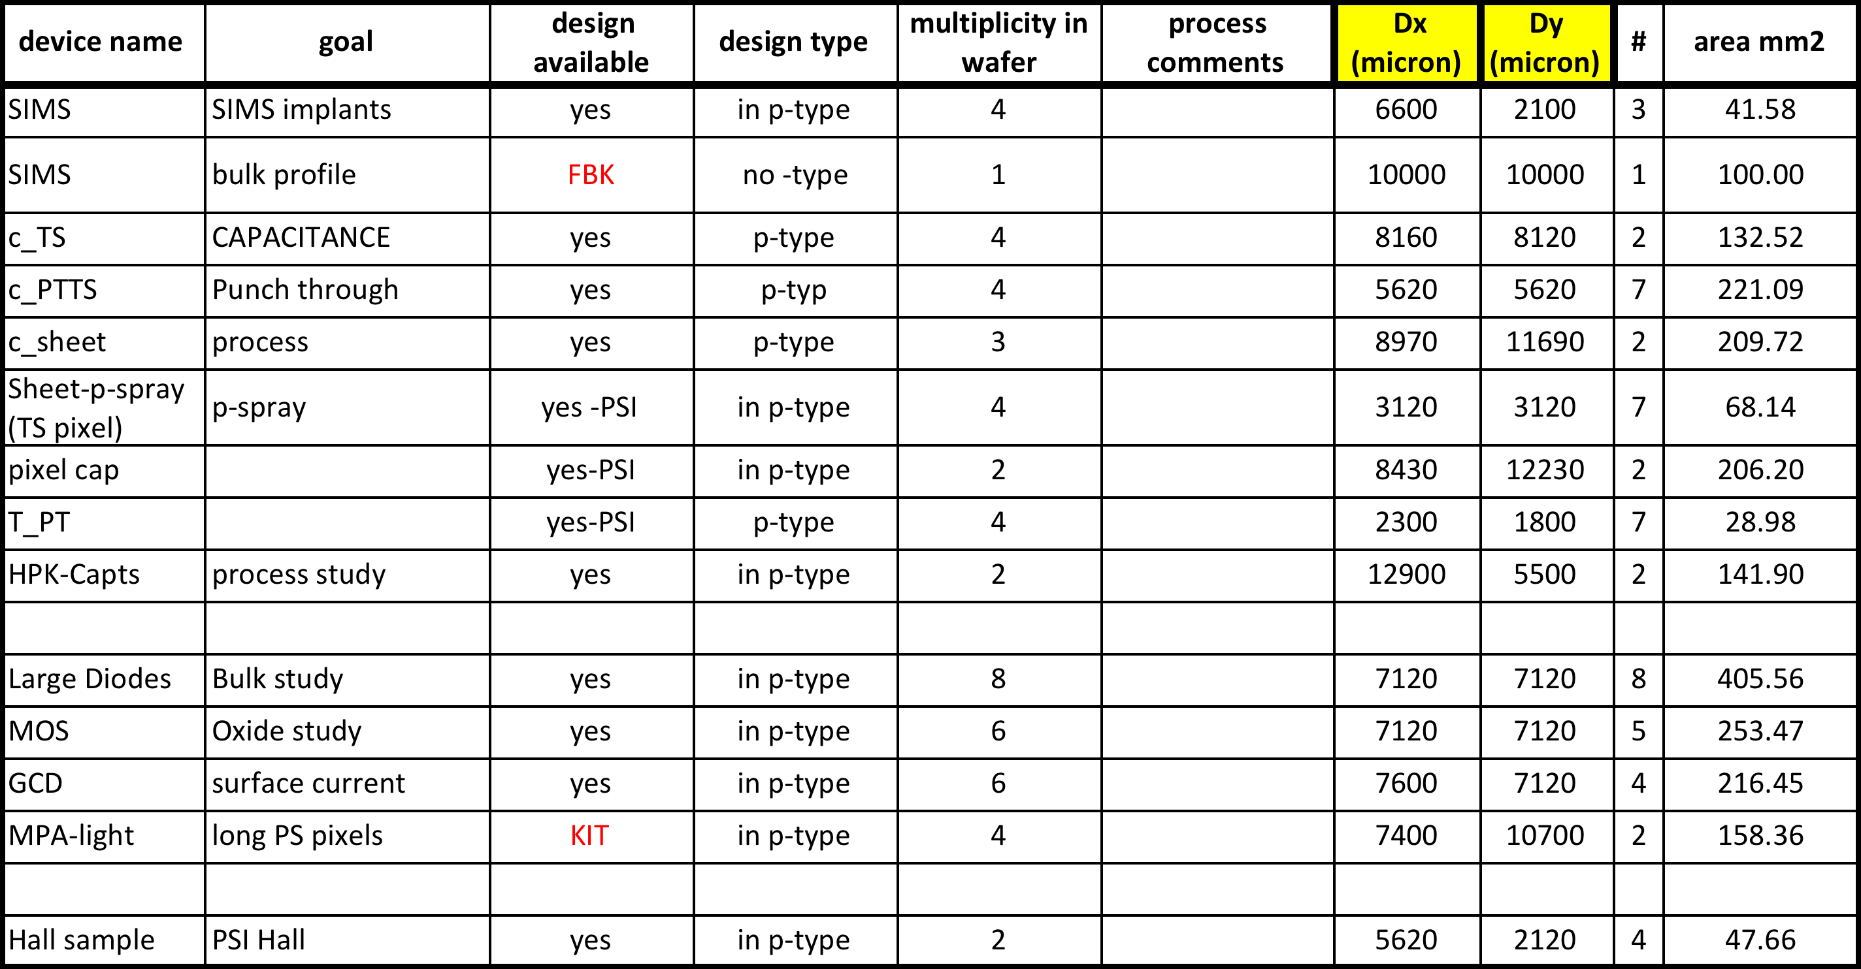
Planar Batch: ~50 Test Structures

Slide 10
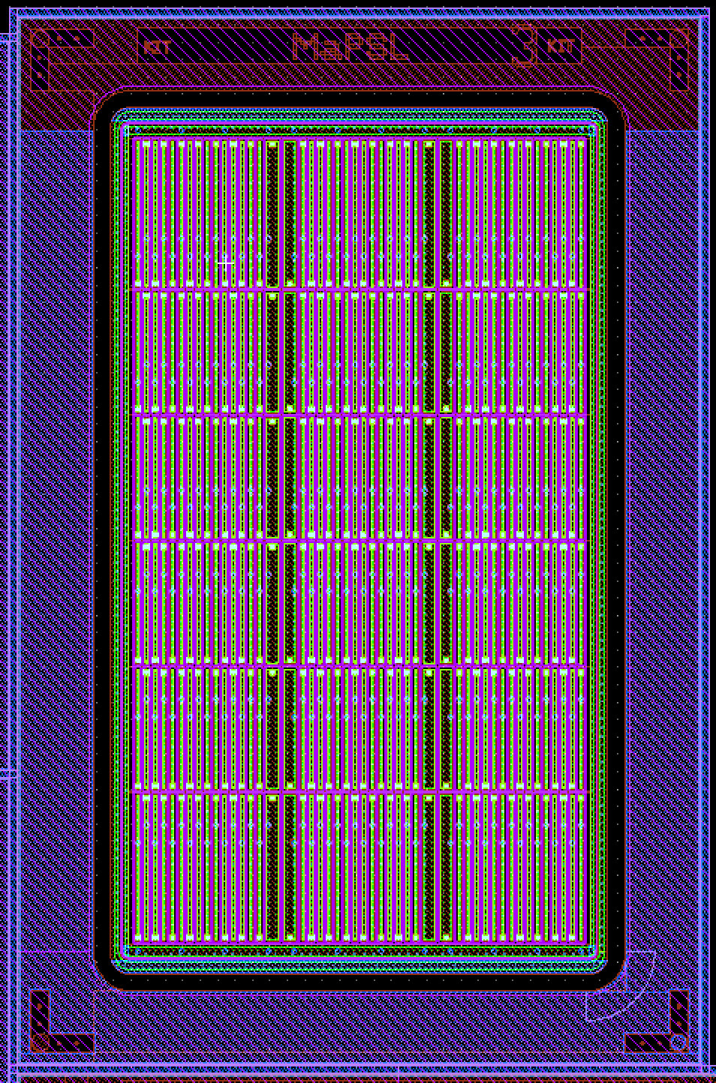
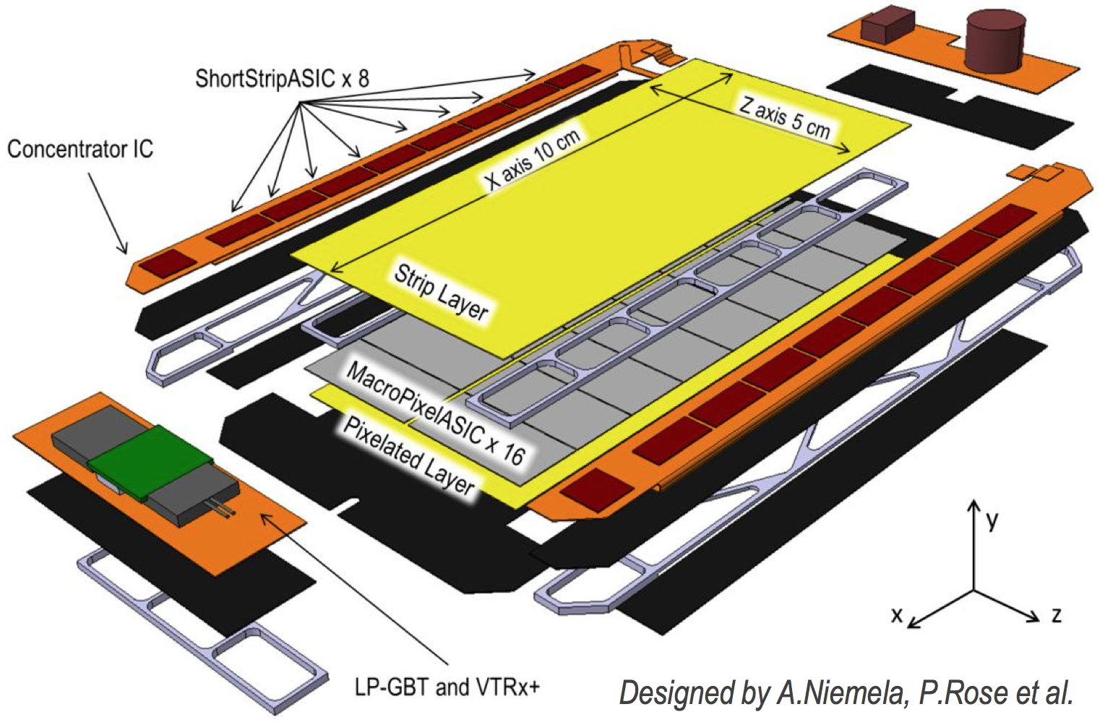
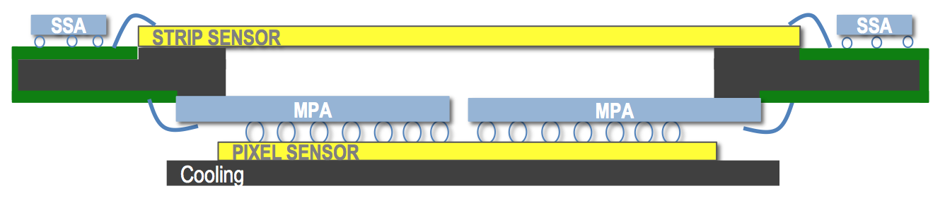
MaPSL Sensor
8 x 12.2 mm²
Macro Pixel (M. Dragicevic and M. Printz) version of June 3rd 2014
MaPSA Light project see this week talk by D. Ceresa in
https://indico.cern.ch/event/341319/session/11/contribution/9/material/slides/0.pdf
PS Module Outer Tracker

Slide 11
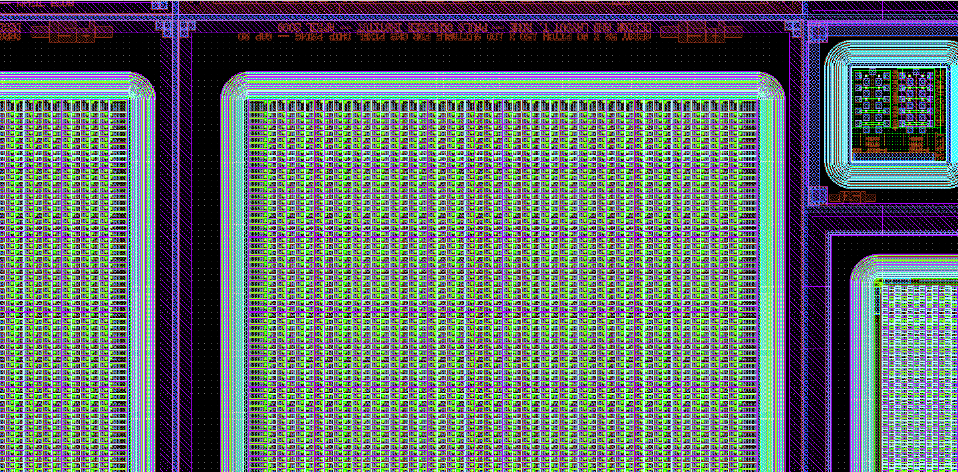
“A Displaced Sensor”
Full sensor shifted towards the cut line at right and bottom.
Two versions: 300um and 400um distance between outer GR and cut line
300um
680um

Slide 12
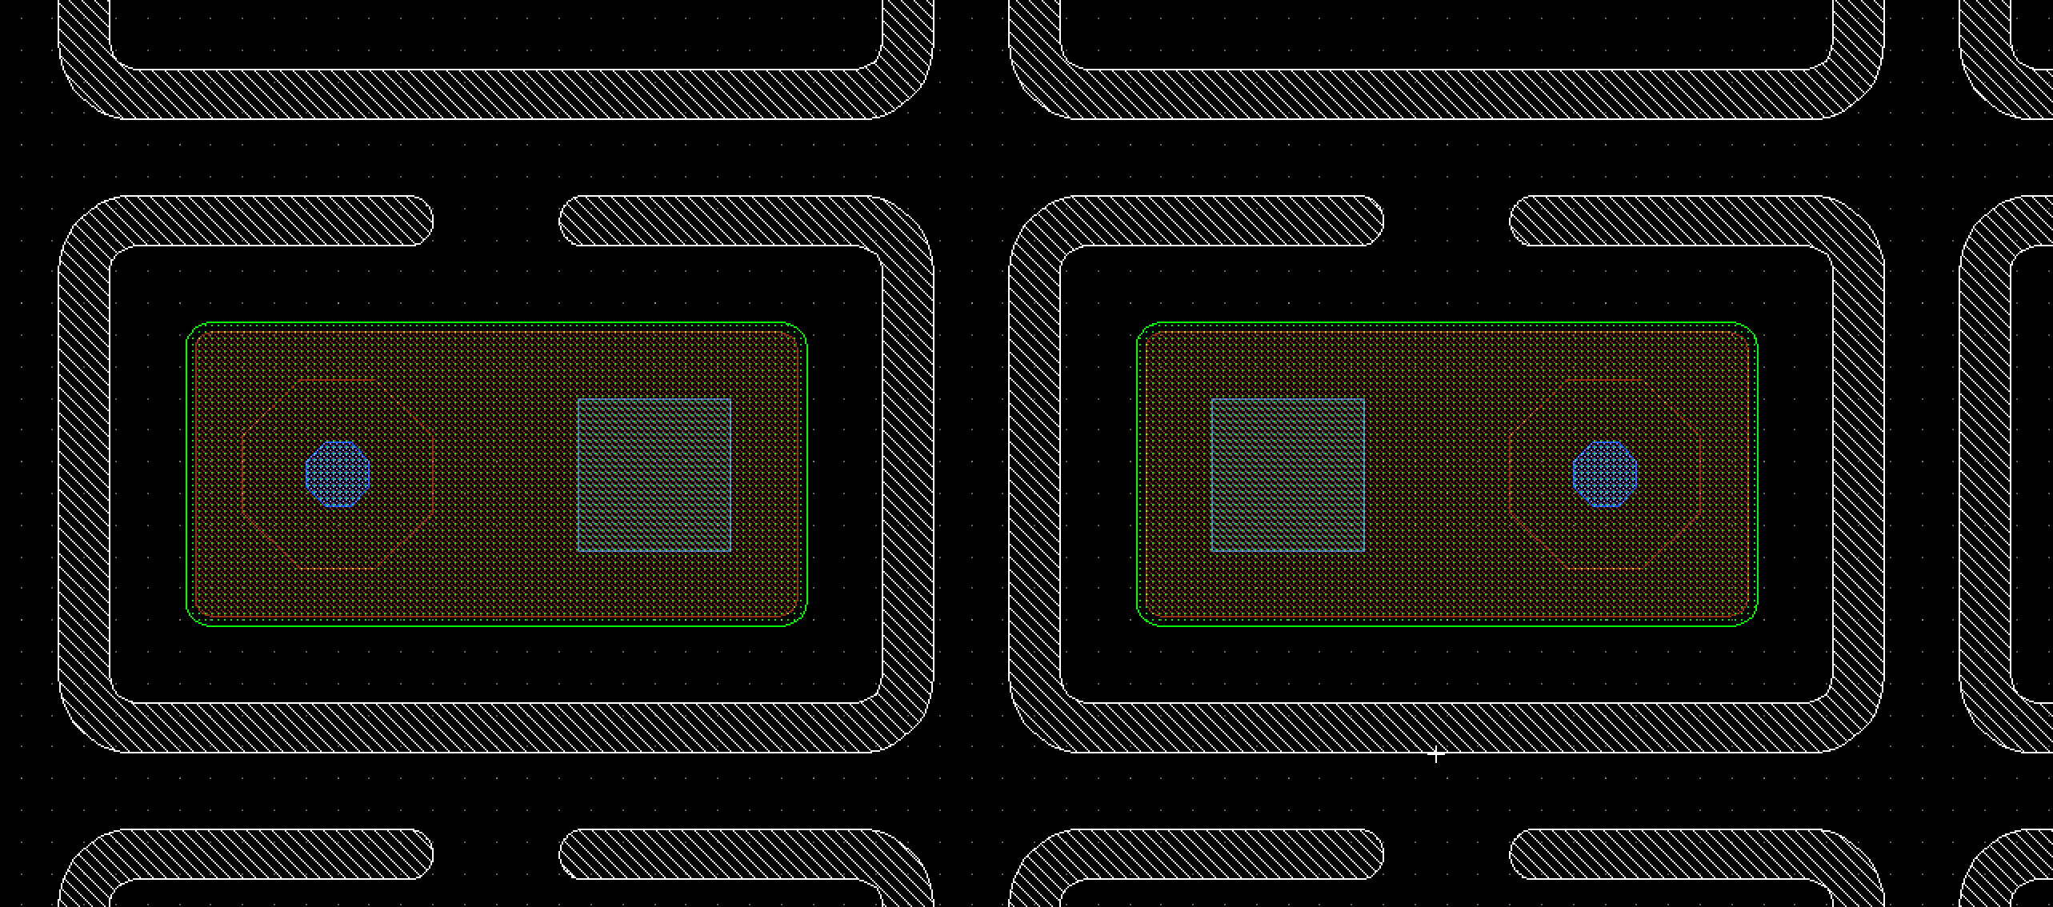
Open P_Stop Sensor
Pixel with opening in the P_Stop enclosure
No Punch Through implant structure

Slide 13
Bump Bonding and Related Matters
Bump Bonding: start a.s.a.p., provided quality checks on planar batch are satisfactory
  Contacts with IZM (CMS) and Selex (ATLAS)
  BB process: exploit opportunities for low temperature during bonding and short process time
Spark Isolation on planar pixels
  BCB? Parylene? To be discussed with BB companies
Sensor Thinning still to be decided

Slide 14
Towards 3D Pixel Single Side Batch at FBK
The base idea:
Single side process on Si_Si DWB
Ohmic columns reaching the low resistivity substrate
Junction columns slightly shorter than the active bulk
Reduction of hole diameter down to 5 um
Partial filling with poly
Compatible with edgeless
Single side 3D process
n⁺⁺ col
Bump-bond
Charge Amp.
P⁻ Epi layer /
P⁻ High Ω•cm wafer
100÷150µm
Epi – SiSi DWB
P⁺⁺ Low Ω•cm wafer
Thin-down
-V_{b}
p⁺⁺ col
metal
Layout studies (ATLAS+CMS) already started, trying to include:
  New pitches: 100x30, 50x50, 25x100 μm² if possible
  Standard PSI and FE-I4 pixels
  New metal design to read only a few small pitch pixel with PSI (or FE-I4)

Slide 15
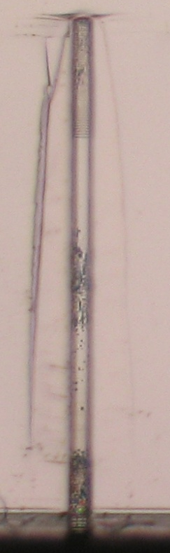

Work in Progress at FBK
Thin Si-3D : DRIE Tests on Columns
Test on DRIE: recipe optimization
  Nominal Hole diameter 5micron
  On wafer hole diameter = 5.3 micron on top and on botton of hole
Depth 117 micron
Good uniformity of depth on wafer diameter
Tests ongoing
Results needed before starting 3D single side production
117 μm
(S. Ronchin, FBK)
M. Boscardin

Slide 16
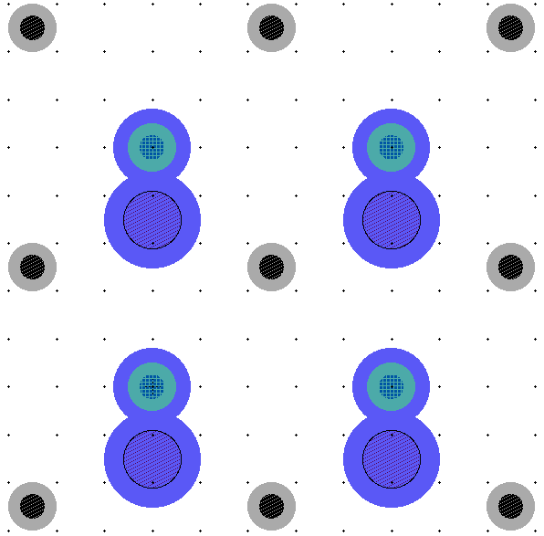
3D cell layout 1: 50 x 50
50 μm
50x50um2 cell design looks feasible
50 μm
15 μm
P col.
Bump
pad
N col.

Slide 17
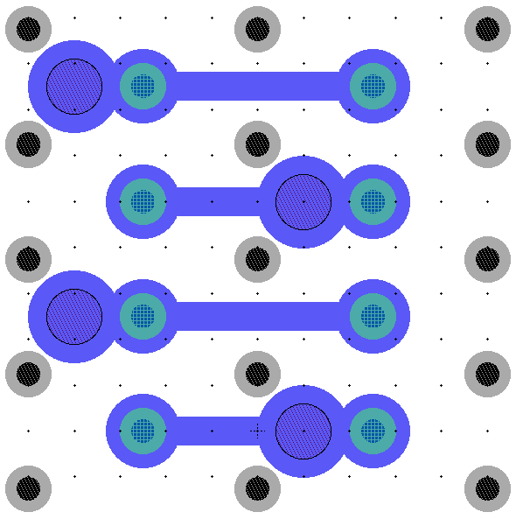
3D cell layout 2: 25 x 100
100 μm
100x25um2 cell design looks more risky
~56 μm
50 μm
25 μm
P col.
N col.
Bump
pad

Slide 18
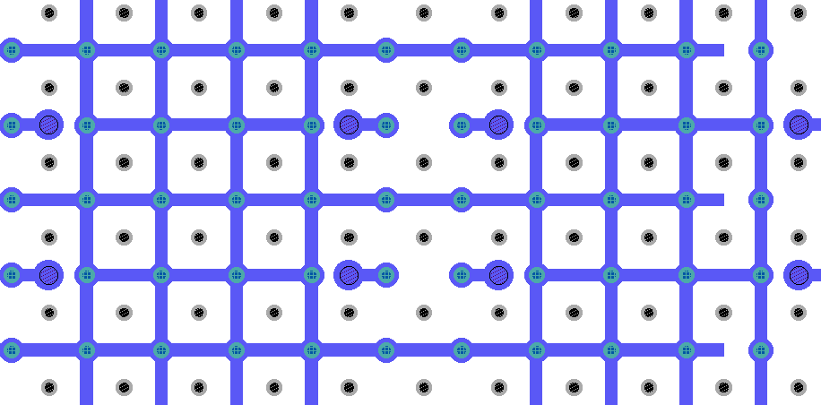
PSI46 compatible test pixels 50 x 50
Small Pitch sensors: as of today no ROC suitable for readout, we have to imagine alternative solutions for testing
Single cells 50x50 + grid
100um
100um

Slide 19
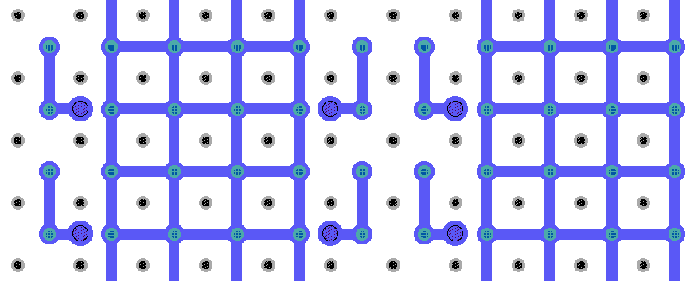
PSI46 compatible test pixels 50 x 50
Double cells 50x100 + grid

Slide 20
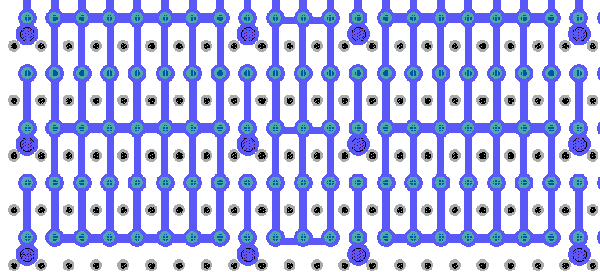
PSI46 compatible test pixels 25 x 100
Single cells 25x100 + grid

Slide 21
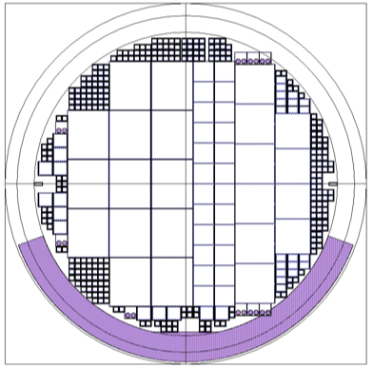
“Old Style” FBK Run: 3D Double Side Pixels on 6” wafer
Ready by Dec 2014
CMS sensors will be mainly used for pre-production tests for the PPS project (Torino)
BB planned together with planar batch, share same ROC wafers
CMS Single chip (24x)
(1E, 2E, 3E, 4E)
ATLAS
FE-I4
(13x)
CMS Quads (6x)
(2E, 3E)
MEDIPIX2 (4x)
NA62 test chip (20x)
Double-sided process
Passing through ohmic columns
Partially-through junction columns
Columns diameters about 10μm
Temporary metal for electrical characterization before bump-bonding
275 μm wafer thickness
From G.F. Dalla Betta, M. Boscardin

Slide 22
ROC Wafers and Chips
We joined the first Phase-1 PSIdig common order:
  Two wafers from the first delivery of 48 ROCs (arrived at PSI)
  Three next year
  These 5 wafers will be used for both pixel R&D and PPS project
We have also ordered 2 FE-I4 wafers, no time estimates yet
FNAL 100x30 chip
  Clarify how many we can get
  Bump Bonding:
    probably not feasible to make deposition on a full wafer
    find a facility for single chip-single ROC BB
    join efforts within CMS to reduce cost
PSI ROC4sens chip 50x50 um
  any news?
  BB as above
RD53 small prototype: if the bump pad floor-plan is defined by end of year (or early 2015) we can include it in 3D and AE batches

Slide 23
Planar Active Edge Batch
The AE batch will follow the same philosophy of 3D for pitch and layout
Slim edge: try to go down to 100um
Most of the wafer area will be available for CMS (at present ATLAS-Italy is not interested in planar AE, maybe some interest from foreign Institutes)
It is a good opportunity to submit common CMS designs
New ideas and innovative solution can be tried with this batch and can be tested already in 2015
We are open to
new collaborators

Slide 24
Conclusions
Planar batch is close to completion at FBK, wafer test should be available by beginning of December
3D Double Side batch is expected to be complete before end of year (or even sooner)
We are establishing plans for test and Bump Bonding
3D Single Side and Active Edge Batches are in the layout design stage
There is a lot of wafer area in 3D and especially in AE batch: why not start a collaboration?
INFN is participating in the transnational proposal AIDA-2020
  WP7: Advanced hybrid pixel detectors
    Detector validation for tracking devices

Slide 25
BACKUP
colonne, in generale
piani 3d ae tempi lunghi
disegni con e senza pstop
GR con e senza pstop
we’re planning BB and BCB

Slide 26
Altre Attività Specifiche 2015
Nel 2015 si prevede:
  BB del batch 3D parzialmente in comune con ATLAS
  BB Batch Active Edge solo CMS
  Partner industriale BB secondo convenienza (IZM, Selex)
  Assemblaggi moduli planari, 3D, Active Edge
  Test Beam
  Primi irraggiamenti planari
  DAQ laboratorio con Digital Test Board CMS e con USBpix3 ATLAS

Slide 27
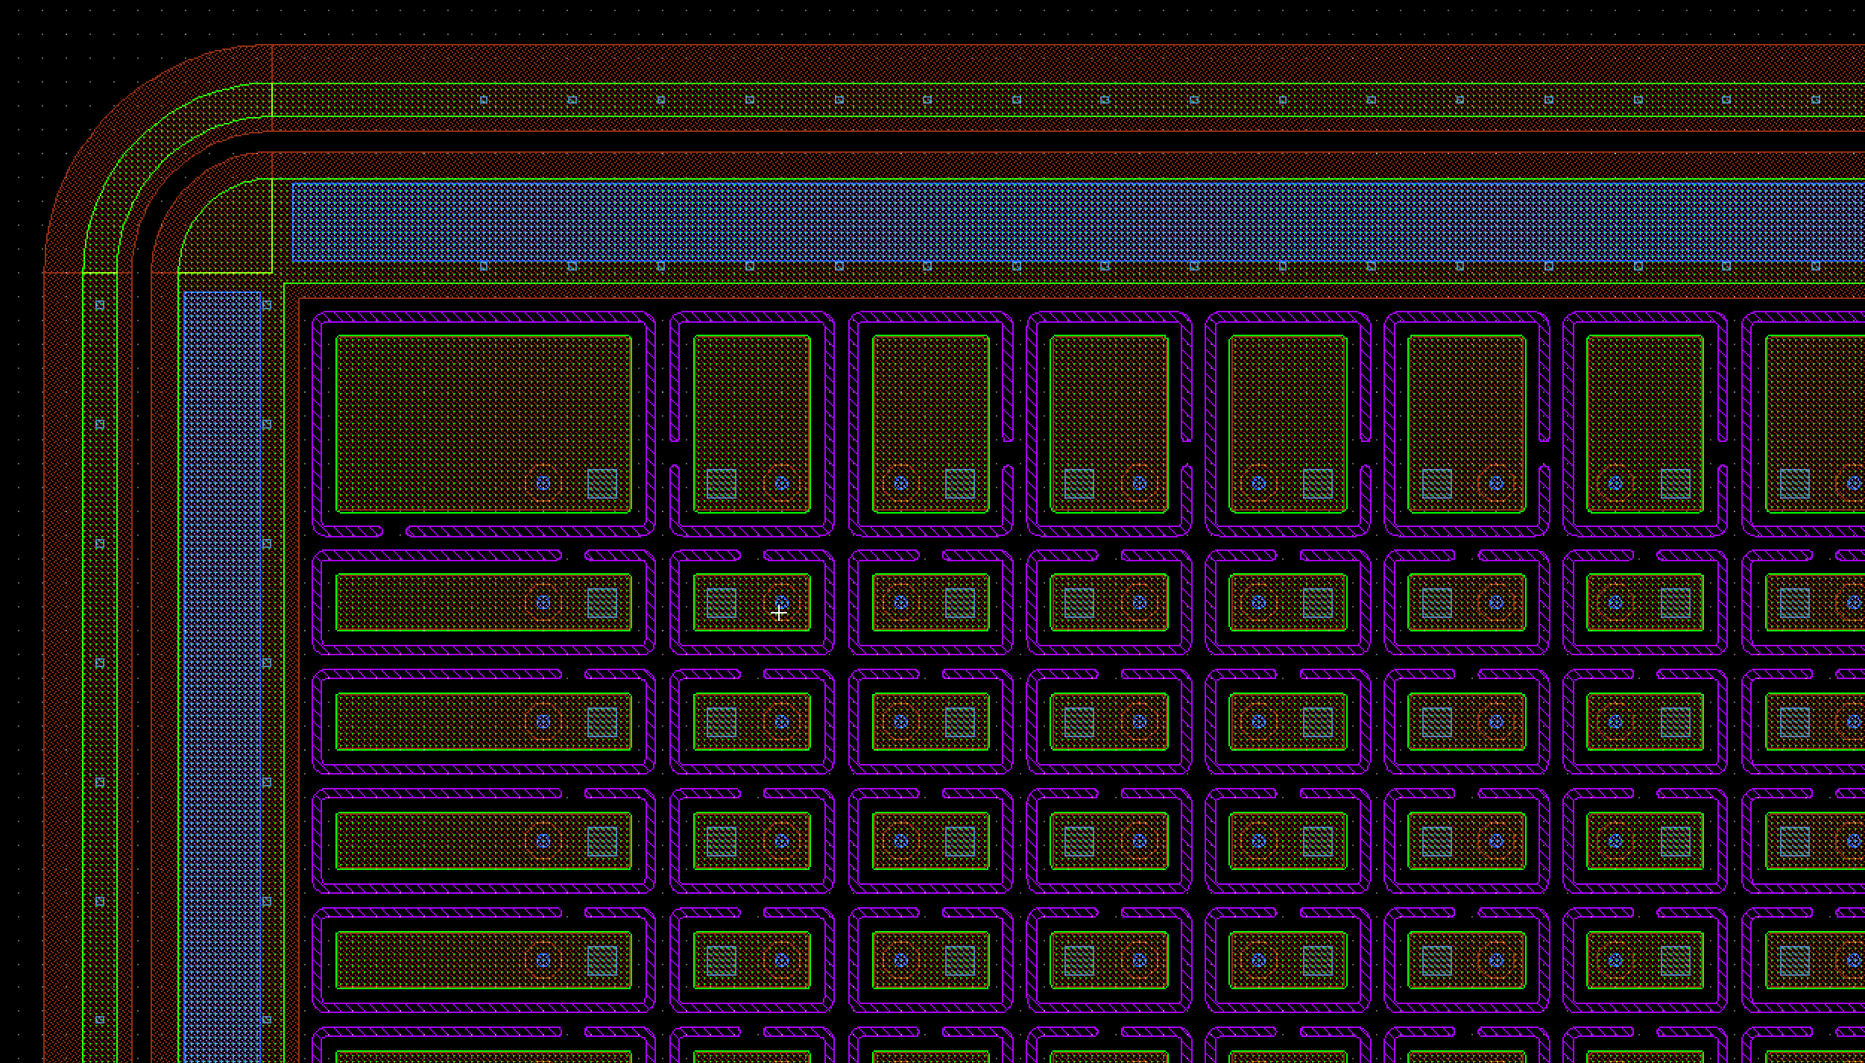
Open P_Stop Sensor

Slide 28
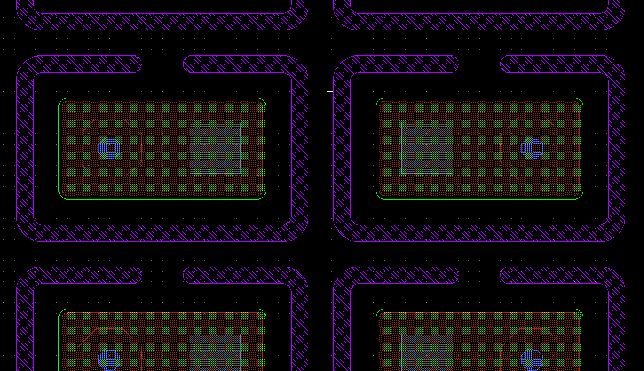
Open P_Stop Sensor
Pixel with opening in the P_Stop enclosure
No Punch Through implant structure

