Slide 1
RD_FASE2 Pixel
Common ATLAS/CMS
23 September 2014
G. Darbo – INFN / Genova
On behalf of ATLAS Tracker RD_FASE2
Slides to pick-up material for the presentation of common ATLAS / CMS Tracker R&D.
Indico agenda:
https://agenda.infn.it/conferenceDisplay.py?confId=8544

Slide 2
2014 Activities
2014: CSN1 funded (Feb and May) R&D Phase 2 activities for ATLAS & CMS inner trackers.
  Development of 3D and Active Edge sensors with FBK – 3 Batches (ATLAS/CMS)
  Bump-bonding: development of Indium bumps (6” sensors) and produce modules
  Develop a technology for pixel detector hybridization using C (dielectric) instead of R (bump-bonding) coupling
  Completion of CO₂ test plant (combined ATLAS / LHCb)
Assigned on | Sezione | Category | ATLAS/CMS/COMMON | Assigned | Description
Feb 2014 | GE | 3D | COMMON | 21 000 | Wafer for 3D sensors (common with CMS)
Apr 2014 | GE | 3D | COMMON | 44 000 | 3 processes at FBK: 2 committed with MEMS3
May 2014 | GE | HV | ATLAS | 13 000 | HV-CMOS Hybridization + 3 FE-I4B wafers
May 2014 | MI | BB | ATLAS | 27 000 | BB of 3D (IBL design on 6") + 3 FE-I4B wafers
May 2014 | MI | CO2/µ-CH | ATLAS | 20 000 | TRACI: co-funded with LHCb
 |  |  |  | 125 000

Slide 3
2015 Activities
2015: Activities and line of funding
  Continue with 3D Sensor plan: produce modules, test in lab and TB, irradiate, procure sensors for next FBK run.
  Bump-bonding: for testing FBK sensors and to develop for future RD53 requirements (high-density bump-bonding with indium)
  CO₂ cooling: contribute to ATLAS stave R&D, thermal simulation and test with CO₂ plant
  Multi-module R/O: use leading experience of ROD designer (BO) to develop a 16 module table-top road for architecture study and for test-beam application.
  Upgrade to USBPix3: most diffused single module system based on USB. Upgrade also for use if HV/HR-CMOS
  HV/HR-CMOS: presented a new project in CSN5 (BO, GE, MI)
  CHIPIX65: INFN interface to RD53 collaboration – Approved as CSN5 Call (Sept.2013)

Slide 4
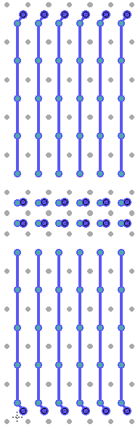
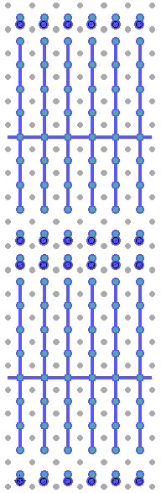
3D Sensors
3D Sensor development with FBK
  p-bulk sensor on 6” wafers
  Active volume: FZ on SiSi or Epi
  Active thickness: 100/130µm
  Single-side process, bias on back
Test with:
  Batch 1: FE-I4, PSI46
  Batch 2: (2016) RD53 chip
INFN Collaboration
  INFN-FBK under MEMS3
  ATLAS: CS, GE, MI, UD, TN
  CMS: BA, FI, MIB, PG, PI, TO
ATLAS Collaboration
  Common chip floorplan with producers: CNM, SINTEF/SNC
  Testing: ATLAS 3D Sensor WG
Single side 3D process
n⁺⁺ col
Charge Amp.
Bump-bond
P⁺ Epi layer /
P⁺ High Ω•cm wafer
100÷150µm
Epi – SiSi DWB
P⁺⁺ Low Ω•cm wafer
Thin-down
-V_{b}
p⁺⁺ col
metal
Test with FE-I4
(50x250 µm²)
50x50 µm²
Pixels + Large Pixels
with lower column
density
2 x 50x50 µm²
Pixels + other
grounded
2x50 + 2x450 L
250 fF
2x50 + GRID

Slide 5
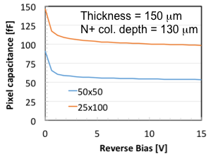
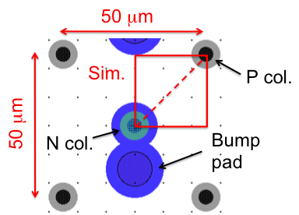
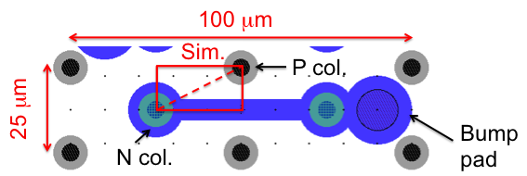
RD53 Chip – Requirements on 3D Sensor
Next front-end chip generation (RD53 chip)
  50x50 µm² pixels (also 25x100 µm²)
  C_{DET} ≤ 100 fF
  I_{leak} ≤ 5 nA/pixel (if no amp. compensation)
  Threshold: 1000 e (possible?)
3D Sensors
  50x50 µm² pixels best option (25x100 µm² difficult layout – too little clearances)
  Simulated capacitance (150 µm thick): 50 fF
  Expected charge 3200 – 3700 e (in 100 µm thickness) after 2x10¹⁶ n_{eq}/cm² – simulated
  and “extrapolated” values.
Ref. G.F. Dalla Betta, IFD 2014,
Mar 2014, Trento, IT.
Ref. G. Darbo, Pixel2014, Niagara Falls, Sept. 2014.

Slide 6
3D Sensor Program – 2014/15
Planned 3 run at FBK in 2014 – Funded by CSN1 in Feb 2014
Batch.1: DRIE process setting up for thin columns. Process in completion. Found that 5-6 µm are the best suitable column diameter.
Batch.2: test planar process with SiSi DWB and Epi substrates. Layout completed, mask submission, wafer expected in 6 weeks.
Batch.3: 3D single side process with SiSi DWB and Epi substrates. Layout in discussion. Compatible layout with other foundries (CNM) to simplify common test of devices.
Note:
A second 3D run is foreseen at the
end of 2015 / early 2016 – layout matching
RD-53 layout.
Schedule presented in Feb’14.
Still up to date.
Need approval from MEMS3 committee of 3rd batch!

Slide 7
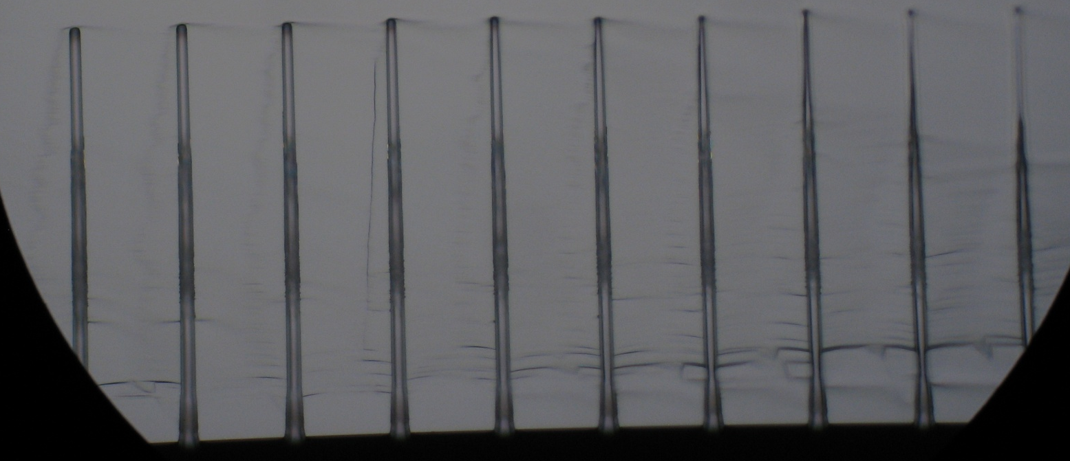
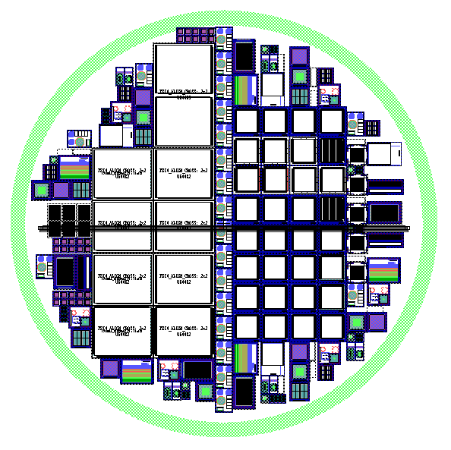
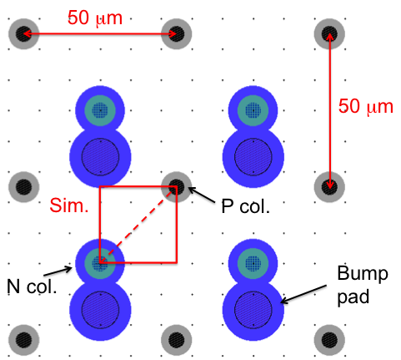
FBK: Status of Batches
Batch 1: study of columns
  In measurement
Batch 2: study SiSi subtrates
  Mask submitted
3.8 um
158 um
5.6 um
ATLAS
CMS
Ref.: M. Boscardin and S. Ronchin, FBK
Batch 3: 3D sensors
  Layout under study
  and Simulation of a
  3D pixel cell
  55 SiSi substrates
  from Icemos already
  available
  Epi wafers from
  Shinetsu on order
Test structures for Si-Si qualification

Slide 8
3D – GE: Module Assembly, Irradiation, TB
Assembly 3D modules:
  To irradiate with p- and n-irradiation at 2x10¹⁶ n_{eq}/cm²
    FE-I4 heavily activate wit low energy neutron (from reactor) – Tantalum is present in technologies below 250 nm
    FE-I3 has shown to resist neutron irradiation, no activation, better ToT measurement (7-bits instead of 4-bits)
  Assembly using PCB (better for laser test) and flex hybrids
Irradiation plans with CMS and ATLAS 3D/Sensor community
  Ljubljana (reactor): can reach 2x10¹⁶, usable with FE-I3 – may need some gamma for p-spray activation (to increase breakdown)
  KIT (Karlsruhe) 24 MeV protons (too high TID for reaching target NIEL dose – FE-I4 “suffers”),
  PS (CERN) 24 GeV protons takes long time, but best equilibrium between TID/NIEL
Test beam: experience with EUDet telescope both in Desy and CERN
Fund request:
  10 k€ for module assembly, PCB, Irradiation, test-beam mechanics
  consider ~ 30-40 modules assembled.

Slide 9
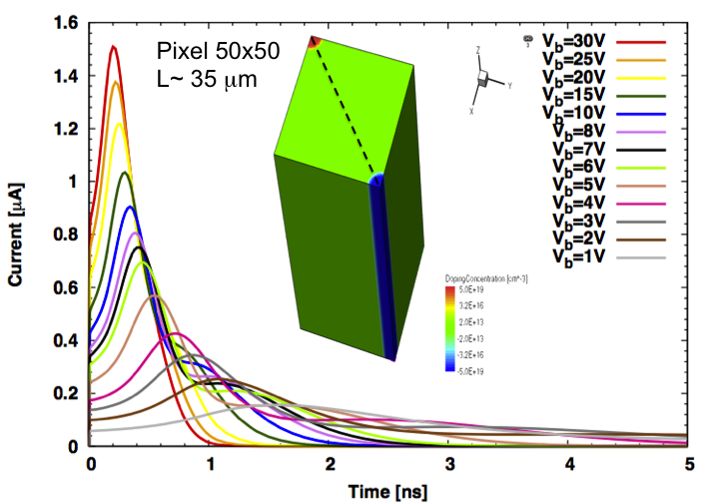
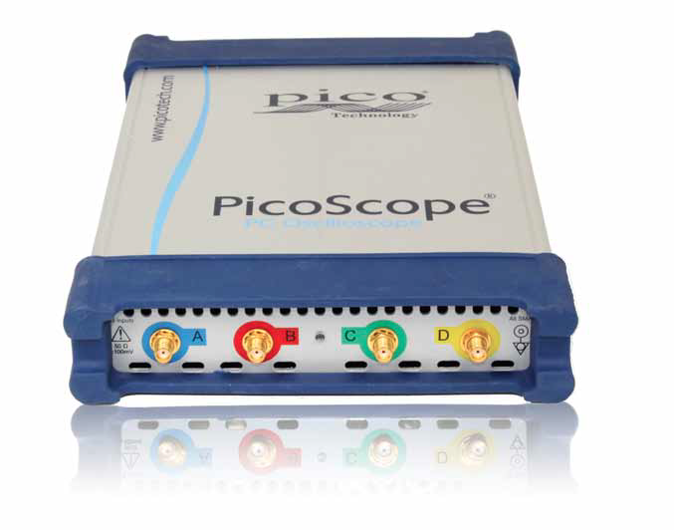
3D – TN: PicoScope
TN Involved in design, TCAD simulation and 3D diode structure measurements
New 3D design:
  electrode distance reduced
  High speed signals (<1ns)
Need direct comparison
between measurements
and simulation to optimize design
Test on ad-hoc structures (OK)
High speed laser (OK)
High-bandwidth amplifier (OK)
High sampling oscilloscope (not available)
PicoScope modules (High speed A/D Converters
with USB computer interface) are a valid
sustainable cost alternative.
TCAD simulation of mip on 50x50 pixel
www.picotech.com

Slide 10
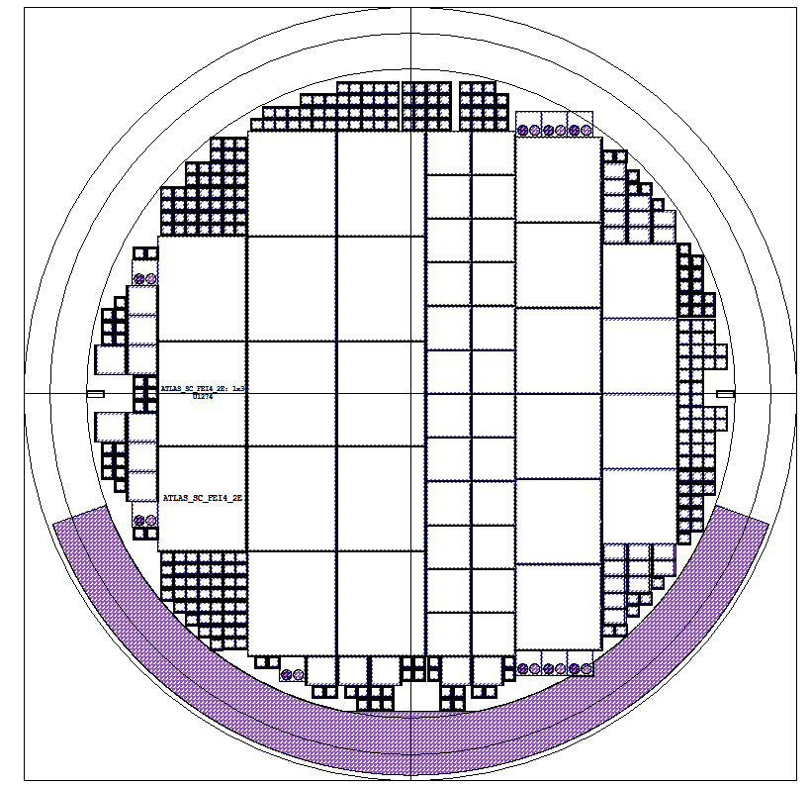
Bump-bonding Program
3D Double Side Batch
Planar ATLAS/CMS “Batch 2”
ATLAS FE-I4 (13x)
CMS Single chip (24x)
(1E, 2E, 3E, 4E)
ATLAS
CMS
CMS Quads (6x)
(2E, 3E)
MEDIPIX2 (4x)
NA62 test chip (20x)
Test structures for Si-Si qualification
In program 4 sensor batches that would need BB in 2014/15:
  3D double side – October - Funds (MI) assigned for 2014
  Planar ATLAS/CMS Batch 2 – November – Funds (TO) assigned 2014
  3D and Active edge batches coming 2015 – no funds yet, fund request: GE+FI
  Bumping at IZM and Selex: some money saving with available FE-I4/PSI with bumps from older productions
R&D on high density indium bumps
  Test on dummy wafers: high density (130k bumps/chip) – smaller bump <18µm diameter – fund request: MI

Slide 11
RD_FASE2 – “Richieste 2015”
Attività | Descrizione | BO | CS | GE | MI | TN | UD
3D | 6" Wafer procurement (SOI, wafer bonding, epi) | - | - | - | - | 10.0 | -
 | PicoScope 6407 Digitizer with 1.5 GHz probes and accessories. | - | - | - | - | 8.5 | -
BB | 6" dummy wafers - test deposition on 6" and high-density bumps (150 k-bumps/chip) | - | - | - | 20.0 | - | -
 | BB for 3D sensor test | - | - | 24.0 | - | - | -
MOD | Upgarde R/O Systems | - | 2.0 | 2.0 | 2.0 | - | 2.0
 | Module assembly and irradiation, RD on flex | - | - | 10.0 | - | - | -
MM-R/O | Multi module R/O | 15.0 | - | - | - | - | -
CO2/µCH | Develop µ-channel cooling | - | - | - | 10.0 | - | -
Total requested by ATLAS |  | 15.0 | 2.0 | 36.0 | 32.0 | 18.5 | 2.0
 |  | 105.5
Legend:
  ATLAS
  Common ATLAS / CMS
Trento:
  Request of 4 k€ of Travel Money for test-beam participation and support.

Slide 12
Milestones RD_FASE – Prev.2015
Descrizione | Data completamento
SENSORI PIXEL: verifica batch FBK n. 2 pixel planari su wafer DWB 6". Se positiva seguono test di moduli single ROC con pixel planari | 31-07-2015
SENSORI PIXEL: qualifica della prima produzione di pixel 3D single side FBK | 30-11-2015
MICROCOOLING-CMS: verifica uso CO2 evaporativo con micro-channel | 31-10-2015
TRACKTRIGGER: set-up funzionante con 2 schede mezzanine con chip AM05 montate su scheda PULSAR in crate ATCA | 01-10-2015
RPC: elettrodo HPL a bassa resistivita' e prototipo camera piccola dimensione | 30-09-2015
RPC: prototipo camera piccola dimensione testato alla GIF++ | 31-12-2015
ECAL-CMS: prova di concetto di un calorimetro a readout ottico basato su fibre rad-hard per HL-LHC | 31-12-2015
ECAL-CMS: studio dellaresistenza alle radiazioni di SiPM raffreddati come rivelatore candidato per readout ottico | 31-12-2015
LAr-ATLAS: Moduli di potenza commerciali acquisiti e caratterizzati elettricamente | 30-09-2015
LAr-ATLAS: Design della scheda ATCA terminato | 31-10-2015
Tile-ATLAS: preparazione apparato sperimentale a Pisa | 30-09-2015
Tile-ATLAS: definizione del protocollo di test delle schede di FE | 31-12-2015
TRACKTRIGGER : inizio disegno del primo prototipo per AMchip2020, stima dimensione prima cella AM | 31-12-2015

Slide 13
AIDA-2020
AIDA-2020proposal
  Submitted on 2 Sept. 2014
  Approval status before end of the year

Slide 14
Silicon in AIDA2: Beneficiaries
WP4:
Electronics & Interconnections
WP6:
Advanced Hybrid Pixel Detectors
WP7:
HV/HR-CMOS
ATLAS – Beneficiary
CMS – Beneficiary

Slide 15
Spare slides

Slide 16
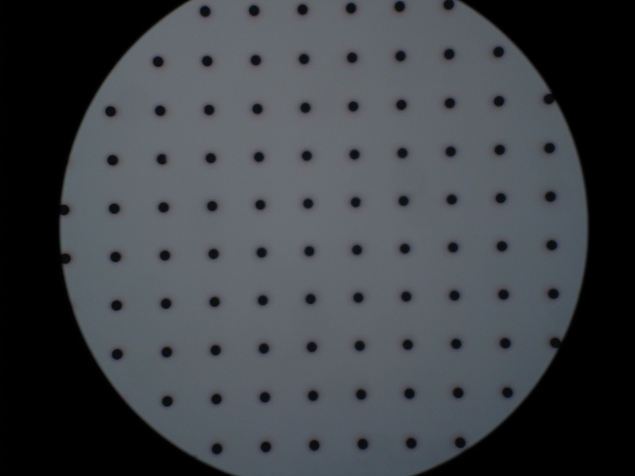
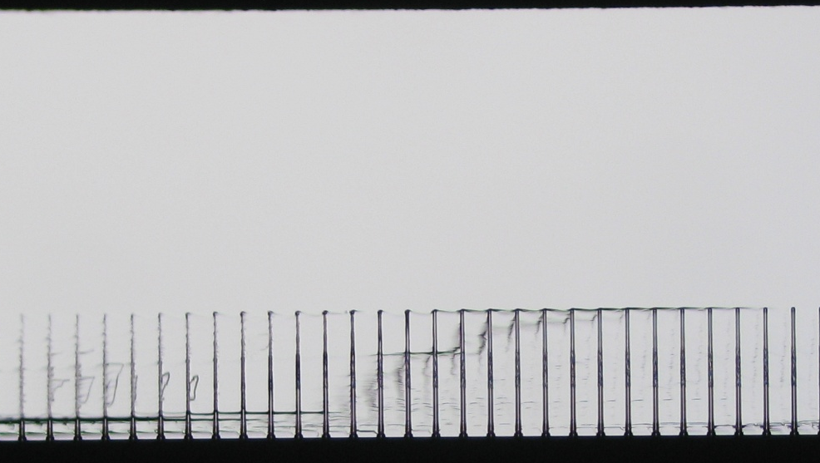

DRIE for Ohmic Columns
Ref.: M. Boscardin and S. Ronchin, FBK
3.8 µm
158 µm
5.6 µm
7.6^{(*)} µm
(*) – the 2.6 µm larger than nominal (5 µm) can be corrected by the DRIE recipe

Slide 17
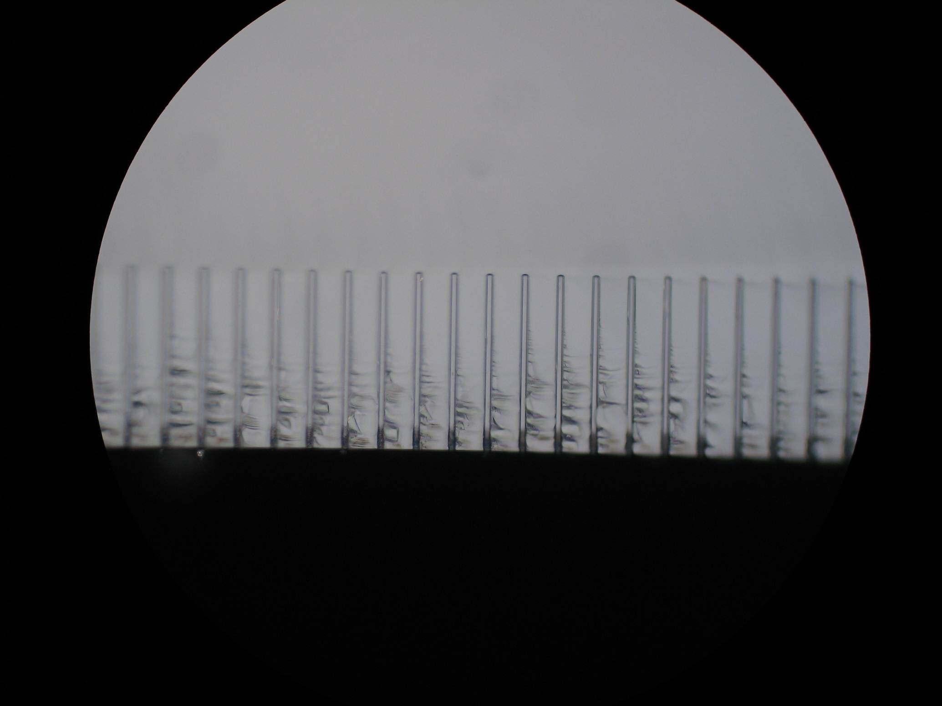
DRIE for Junction Columns
ID# | Nominal diameter (um) | Depth (um) | Surface diameter (um) | Diameter at tip (um)
5.1 | 5 | 99 | 3.5 | 3.2
5.5 | 5 | 99.5 | 5.5 | 2.9
5.5 | 5 | 100 | 5.5 | 3.5
5.6 | 5 | 98 | 4.3 | 2.6
5.8 | 5 | 98 | 5.5 | 2.6
5.9 | 5 | 98 | 3.9 | 2.9
5.10 | 5 | 95 | 3.3 | 2.7
5.11 | 5 | 95 | 3.3 | 2.7
LEFT
CENTER
RIGHT
Ref.: M. Boscardin and S. Ronchin, FBK

Slide 18
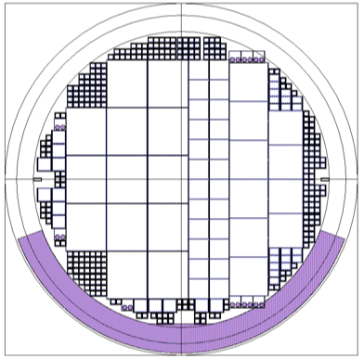
First batch on 6” wafers at FBK
CMS Single chip (24x)
(1E, 2E, 3E, 4E)
ATLAS FE-I4
(13x)
CMS Quads (6x)
(2E, 3E)
MEDIPIX2 (4x)
NA62 test chip (20x)
IBL-Like process – 275 µm thick wafers – optimized slim edge – increased V_{bd}.
4” wafers (IBL): 8 FE-I4 tiles
6” wafers (future): ~ 30 FE-I4 tiles
Wafers available after summer, BB with Indium at Selex – 20 k€ assigned to MI in May ’14 by CSN1
Ref.: G.F. Dalla Betta – IFD2014, Trento, February 2014

Slide 19
Planar test batch
ATLAS
CMS
p-type SiSi DWB wafers
from ICEMOS
100-mm and 130-mm HR active
sensor thickness
p-spray & p-stop isolation
Layout ready, masks ordered
To start now, to be completed
in 6-7 weeks
Test structures for Si-Si qualification

