Slide 1
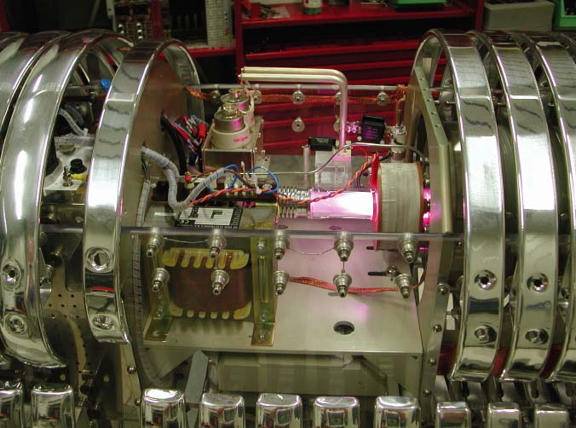
Nuclear Astrophysics at LUNA
and the Big Bang Nucleosynthesis
C. Gustavino
INFN-Roma
Nuclear Astrophysics
LUNA experiment
Big Bang Nucleosynthesis
BBN reactions at LUNA:
³He(α,γ)⁷Be → ⁷Li abundance
D(α,γ)⁶Li → ⁶Li abndance
D(p, γ)³He → D abundance
Notes:
Needs to be colored

Slide 2
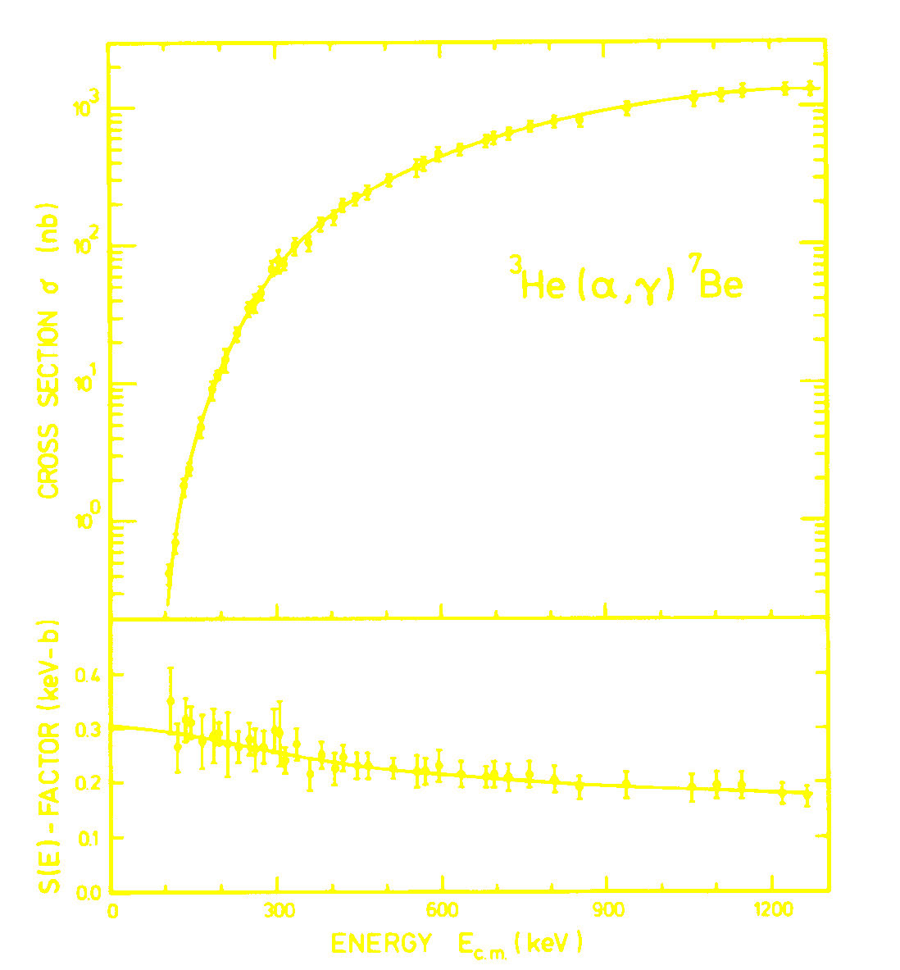
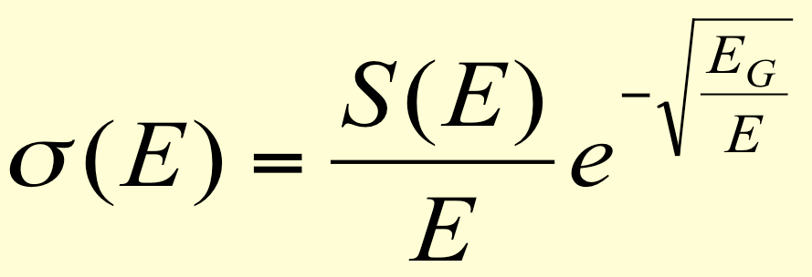
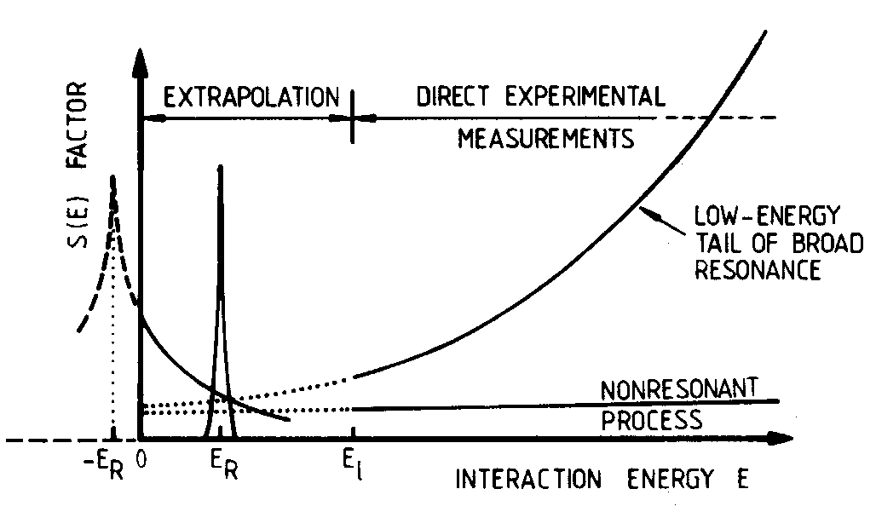
Reaction rate for charged particles
At energies of Astrophysical interest the cross section are very low due to the Coulomb barrier. The cross section is often factorized as follow:
Typical rates are 10⁻¹-10² events/day or even below
Extrapolation from higher energies are often wrong because of unforeseen nuclear effects
→ Nuclear Astrophysics measurements require low background environments
Simplest solution: Underground facilities
2

Slide 3
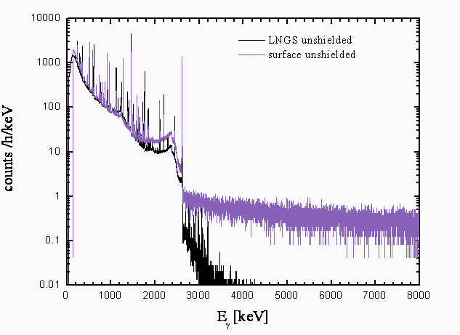
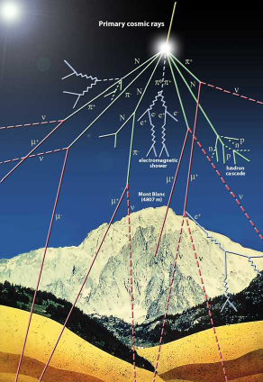
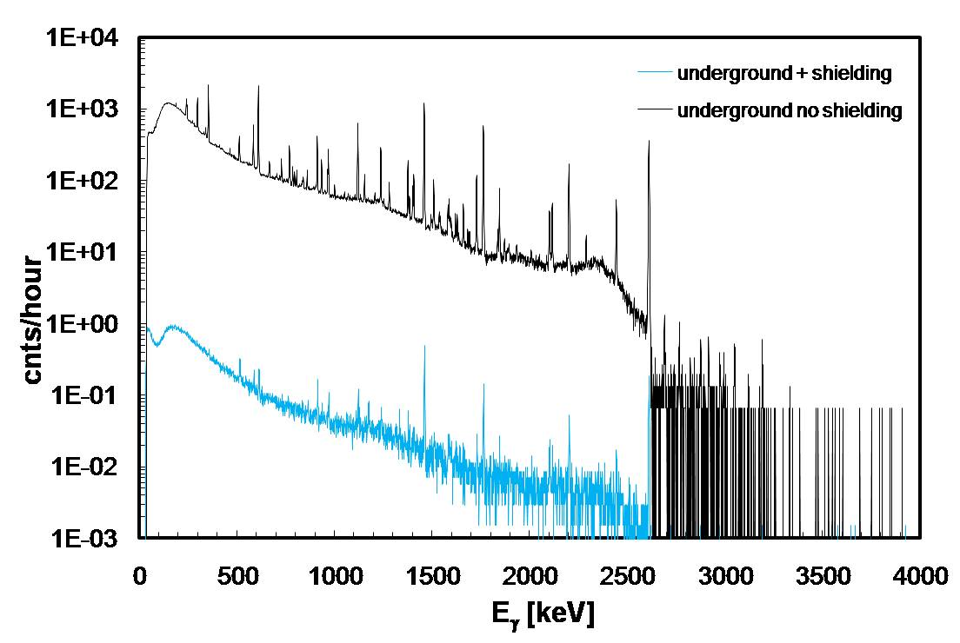
Background @ Gran Sasso
Surface Vs LNGS
LNGS Vs LNGS + shielding
Passive shielding is more effective underground since the μ flux, that create secondary γs, is suppressed.

Slide 4
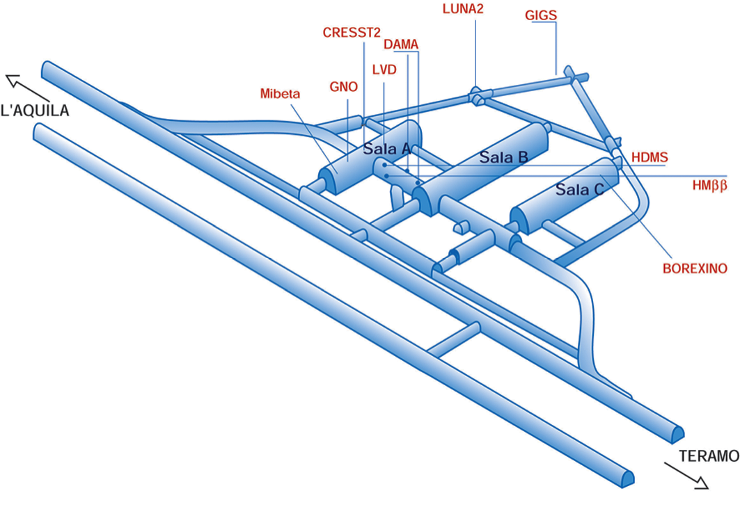
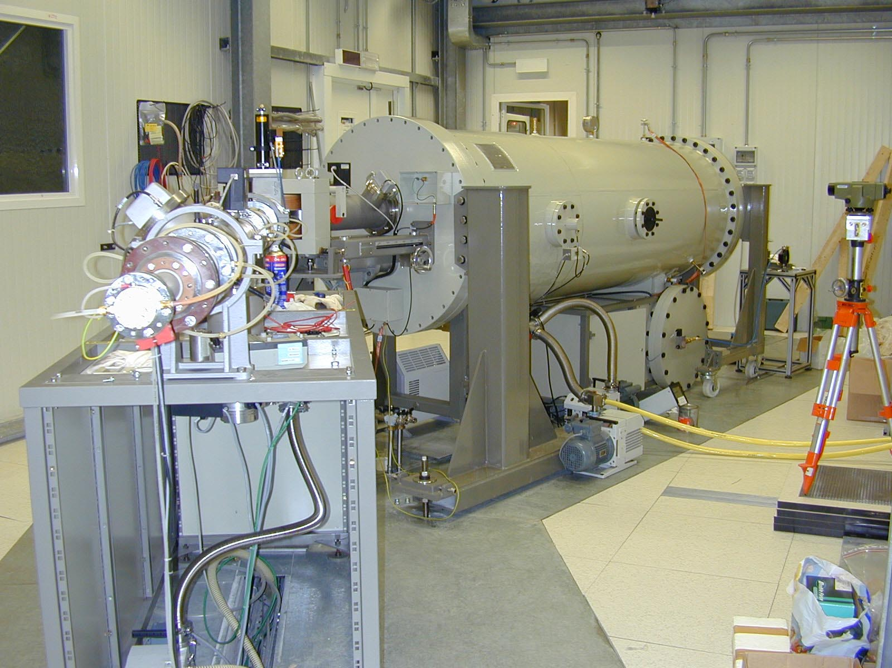
The LUNA accelerator
LUNA
Background reduction
Muons: 10⁻⁶
Neutrons: 10⁻³
γ’s:10⁻²-10⁻⁵
³He(³He,2p)⁴He
¹⁴N(p,γ)¹⁵O
²⁵Mg(p,γ)²⁶Al
¹⁵N(p,γ)¹⁶O
¹⁷O(p,γ)¹⁸F
²²Ne(p,γ)²³Na
³He(α,γ)⁷Be
D(α,γ)⁶Li
D(p, γ)³He
Voltage Range: 50-400 kV
Output Current: 1 mA @ 400 kV Absolute Energy error: ±300 eV
A. Formicola et al., NIMA 527 (2004) 471.

Slide 5
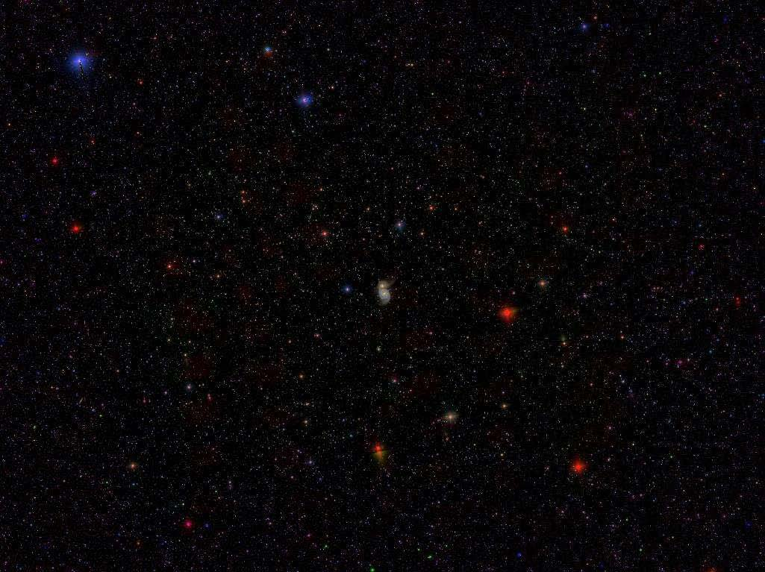
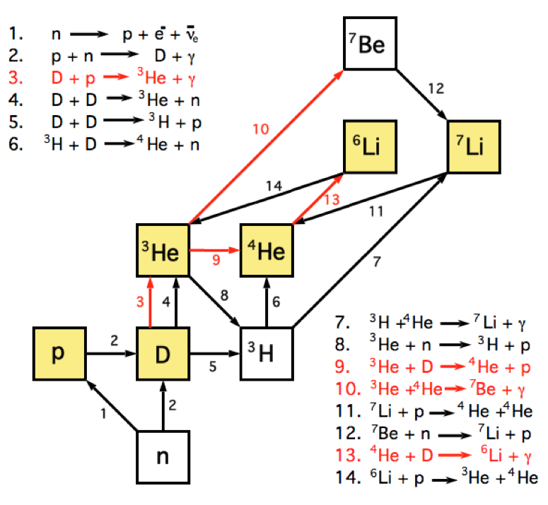
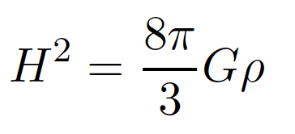
Big Bang Nucleosynthesis
BBN is the result of the competition between the relevant nuclear processes and the expansion rate of the early universe, governed by the Freidmann Equation:
the primordial abundances of light isotopes ONLY depends on:
-Baryon density Ω_{b}
-Particle Physics (N_{eff}, α..)
-Nuclear Astrohysics, i.e. Cross sections of relevant processes at BBN energies
Close interplay with CMB experiments (PLANCK, BICEP2…).
BBN: the Universe after 10 minutes
CMB: the Universe after 380.000 years.
A coherent theory (Cosmology, Astrophysics, Particle physics…) must provide the matching between BBN prediction and the observed abundances of ALL stable isotopes.

Slide 6
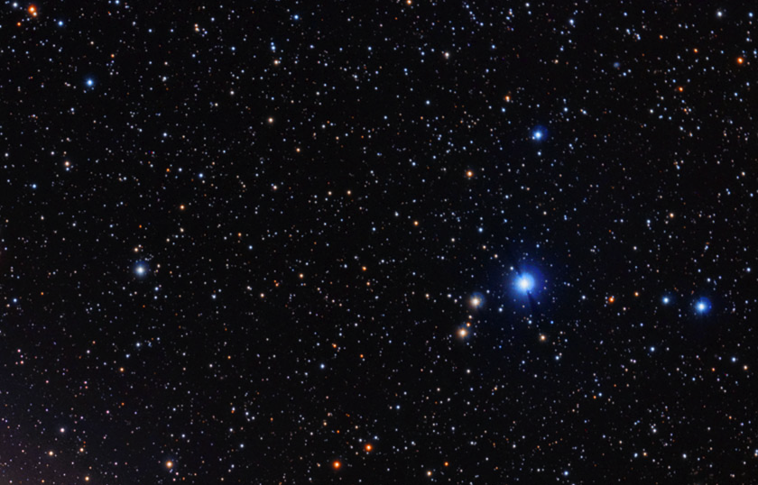
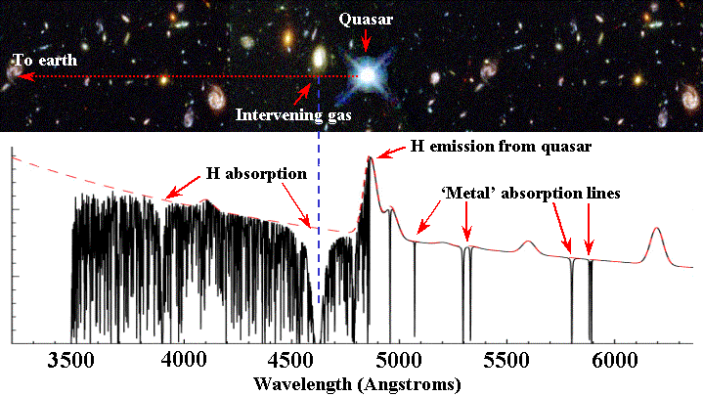
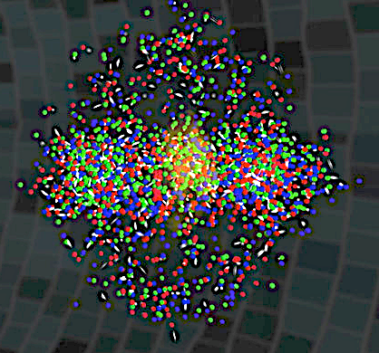
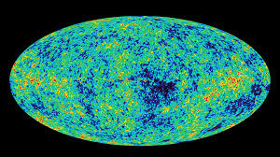
BBN “Flowchart”
Direct observations
of light isotopes
Cosmology
BBN
AstroPhysics
Nuclear Astrophysics
New Physics?
PDG “stuff”
τ_{n}, G, N_{eff}, α...
CMB

Slide 7
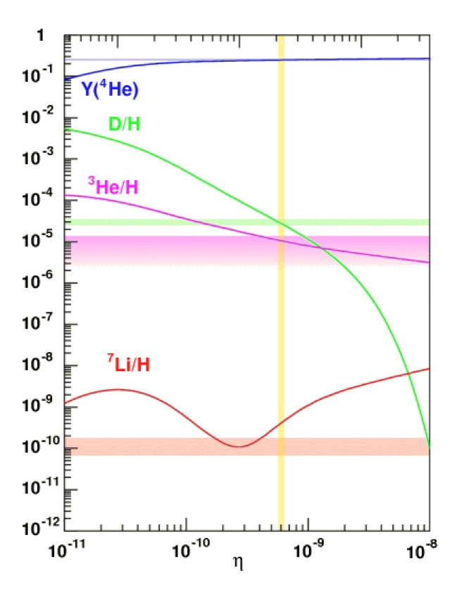
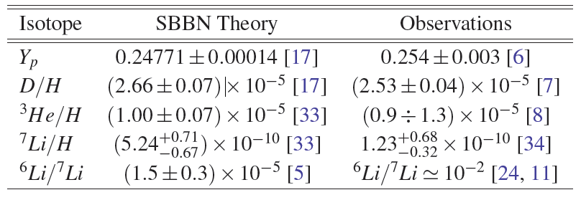
Observations Vs Theory
Direct measuremets:
Observation of the absorption lines in primitive objects (born when the universe was young). The primordial abundance is obtained extrapolating to zero metallicity (Fe/H, O/H, Si/H,…. → 0)
⁴He: Observation in H_{II} regions. Quite large systematics.
D: Observation of absorption lines in DLA systems. Good accuracy (percent Level)
³He: Solar System, H_{II} regions in milky way. Very large systematics, not a powerful probe fo BBN
⁷Li: observation of metal poor stars absorption lines (Spite plateau)
⁶Li: observation of metal poor stars absorption lines (controversial)
BBN error budgets:
⁴He: Almost entirely due to Δτ_{n}
D: Mainly due to the D(p,γ)³He reaction
³He: Mainly due to the ³He(d,p)⁴He reaction
⁶Li: Mainly due D(α,γ)⁶Li reaction
⁷Li: ³He(α,γ)⁷Be and other reactions of the BBN network
⁴He, D, ³He abundances are (broadly) consistent with BBN expectations.
⁷Li: Long standing “Lithium problem”
⁶Li: “Second Lithium problem”?

Slide 8
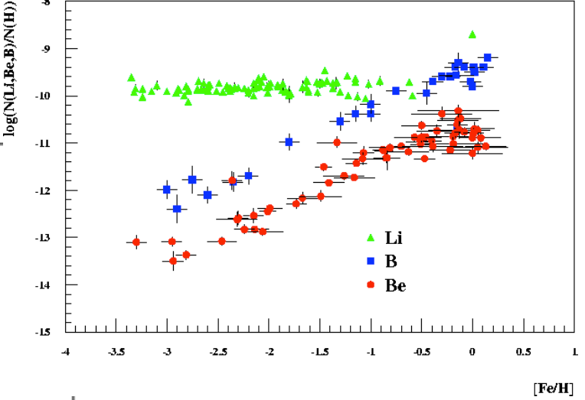
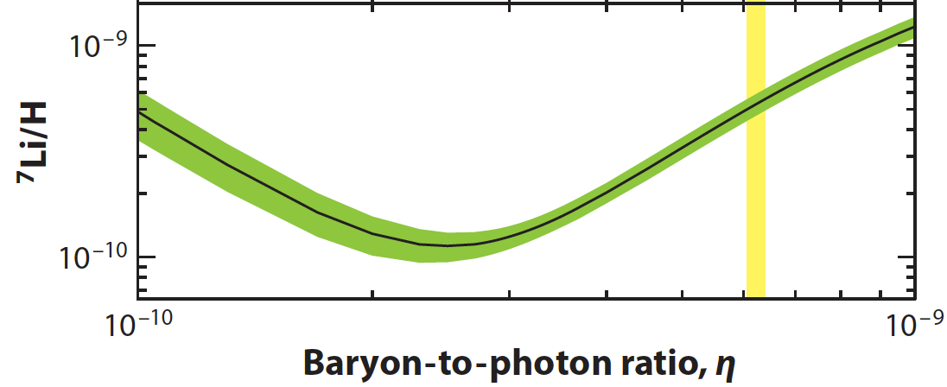
The Lithium problem
Spite plateau
Observed ⁷Li abundance is about 2-4 times lower than foreseen: Well established ”Lithium problem”.
Systematics in the measured ⁷Li and abundances in the metal-poor stars of our Galaxy.
Unknown processes before the birth of the galaxy, able to burn ⁷Li
New physics, e.g. sparticle annihilation/decay (Jedamzik2008), long lived negatively charged particles (Kusakabe2010)
…Nuclear physics, i.e. the lack of knowledge of the relevant nuclear reactions.
1-σ uncertainty
95% CL

Slide 9
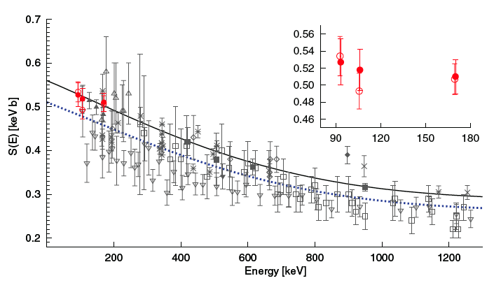
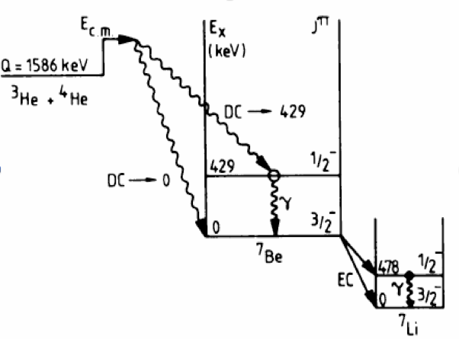
³He(α,γ)⁷Be reaction: The “lithium problem”
Confortola et al. (LUNA collaboration)
PRC 75, 065803 (2007)
Prompt γs
BBN
Delayed γs
(τ=53 days )
Best accuracy (4%)
Lowest energy (E_{cm}=93 keV)
Prompt and delayed gammas detected.
→The “lithium problem” is still there!
N.B. ³He(α,γ)⁷Be reaction is also very important for Solar neutrino flux (Boron and Berillium neutrinos).

Slide 10
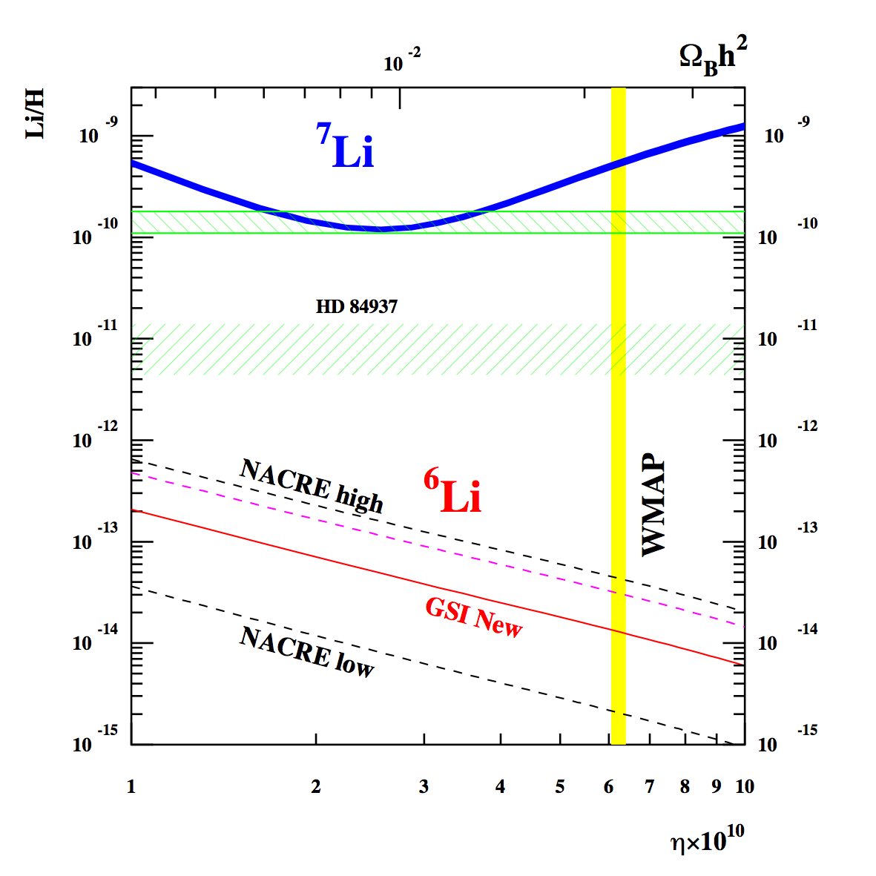
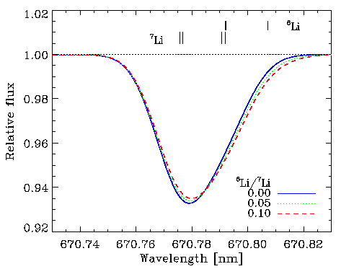
D(α,γ)⁶Li reaction: The “second lithium problem”
Observed ⁶Li abundance orders of magnitude higher than expected (Asplund2006). However:
-The “Second Lithium problem” is debated, because convective motions on the stellar surface can give an asymmetry of the absorption line, mimicking the presence of ⁶Li (see “Lithium in the Cosmos”, 27-29 february 2012, Paris)
-Lack of the knowledge of the D(α,)⁶Li reaction. In Fact:
NO DIRECT MEASUREMENTS in the BBN energy region in literature (large uncertainty due to extrapolation)
INDIRECT coulomb dissociation measurements (Kiener91, Hammache2010) are not reliable because the nuclear part is dominant.
FOR FIRST TIME, LUNA has studied the D(α,)⁶Li reaction well inside the BBN energy region.
Line strength: ⁷Li abundance
Line Profile: ⁶Li/⁷Li ratio

Slide 11
D(α,γ)⁶Li experimental approach
“Impossible” measurement because of the low cross section (σ~10⁻¹¹ barn) and the existence of a beam induced background
SIGNAL
α-beam (I~300 μA) on a D₂ gas target: D(⁴He,γ)⁶Li
High Purity Germanium detector to detect the 1,6 MeV gamma’s from D(⁴He,γ)⁶Li
NATURAL BACKGROUND REDUCTION
4π shield of lead to minimize the natural background
N₂ flushing to reduce the Radioactivity induced by Radon (Radon Box)
BEAM-INDUCED BACKGROUND
Reduced volume for the gas target (see later)
Measurement method (see later)

Slide 12
Beam Induced Background in the D(⁴He,γ)⁶Li measurement
α
α
α beam
d
D(α,α)d Rutherford scattering
Deuterium gas target
d
³He
E_{cm}(³He)= 0,820 MeV
D(d,n)³He reaction
Q=3.269 MeV
d
d
n
E_{cm}(n)=2.450 MeV
(n,n’γ) reaction on the surrounding materials (lead, steel, copper and germanium)
γ-ray background in the RoI for the D(α,γ)⁶Li DC transition (∼1.6 MeV)
Notes:
alpha particles elastically scattered by deuterons produce “hot deuterons” that in turn may collide with the cold deuteronss of the gas target producing neutrons through the d(d,n)3He reaction. These neutrons in turn may produce gammas in the energy region of interest through (n, n′γ) reactions with the “environment” (mainly made of steel, copper, lead and germanium).

Slide 13
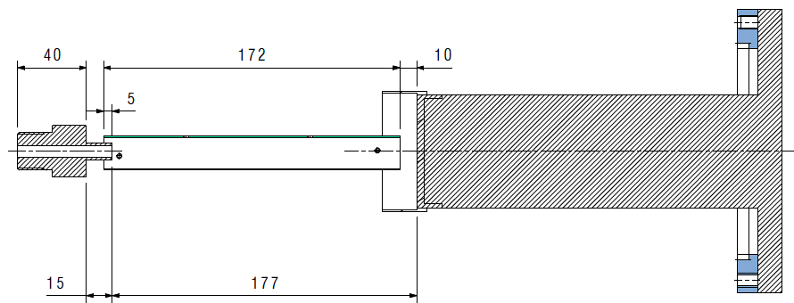
D(α,γ)⁶Li setup
Germanium detector close to the beam line to increase the detection efficiency
Pipe to reduce the path of scattered deuterium, to minimize the d(d,n)³He reaction yield
Target length optimized
Copper removal
Silicon detector to monitor the neutron production through the d(d,p)³H protons
Lead, Radon Box to reduce and stabilize Natural Background
Silicon
Detector
Radon Box (N₂ flushing)
Deuterium
inlet
Alpha beam
Calorimeter
Pipe
Ge
Detector
Crown
HPGe Detector
Deuterium
exhaust
Lead shield
13

Slide 14
Measurement method
The measurement is performed into 2 steps:
Measurement with E_{α}=400 keV on D₂ target. The Ge spectrum is mainly due to background induced by neutrons interacting with the surrounding materials (Pb, Ge, Cu). The D(α,γ)⁶Li signal is expected in a well defined RoI (1587-1625 keV).
Same as 1., but with E_{α} =280 keV. The Ge spectrum is essentially the same as before, while the gammas from the D(α,γ)⁶Li reaction are expected at 1550-1580 keV.
D(α,γ)⁶Li Signal is obtained by subtracting the two spectra

Slide 15
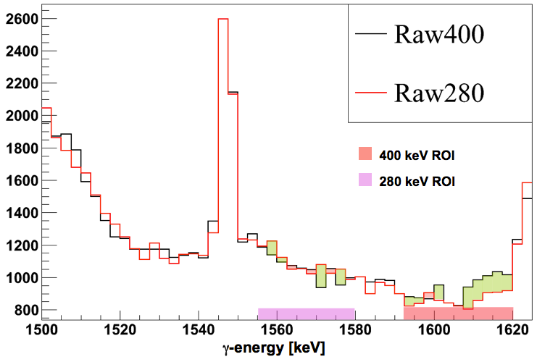
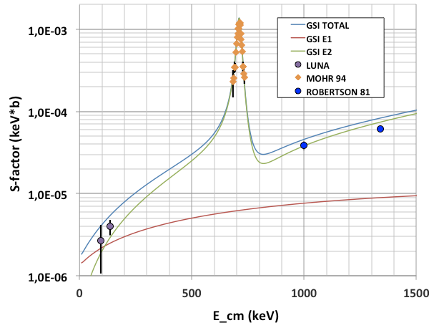
D(α,γ)⁶Li reaction: Result
BBN
LUNA-MV
First direct measurement at BBN energies. della sezione d’urto D(α,γ)⁶Li. The theoretical ⁶Li abundance can be now computed on a solid experimental footing.
S₂₄(134 keV ) = (4.0±0.8^{(stat)} ± 0.5^{(syst)}) x 10⁻⁶ keV b
S₂₄(94 keV ) = (2.7±1.5^{(stat)} ± 0.3^{(syst)}) x 10⁻⁶ keV b
(⁶Li/H)_{BBN}=7.4±1.6 x 10⁻¹⁵
→ A nuclear solution for the “Second lithium problem” is now excluded on a solid experimental footing.
New measurements at higher energies are highly desirable!

Slide 16
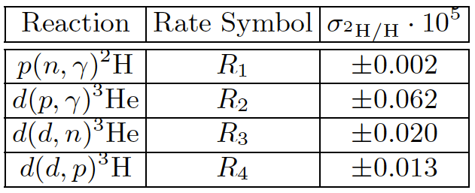
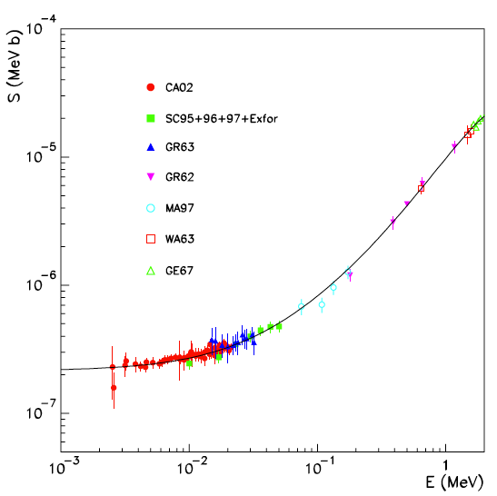
D(p,γ)³He reaction: The Deuterium abundance
BBN chain
Primordial deuterium error budget
(Di Valentino et al. 2014)
The error of computed deuterium abundance (D/H)_{BBN} is mainly due to the D(p,γ)³He reaction, because of the paucity of data in the BBN energy region
Physics:
1) Cosmology: measurement of Ω_{b}h².
2) Neutrino physics: measurement of N_{eff}.
3) Nuclear physics: comparison of data with theoretical “ab initio” predictions.
LUNA400

Slide 17
D(p,γ)³He reaction: Baryon density
1) Cosmology: Ω_{b} is provided by the CMB experiments. Assuming Standard Model (N_{eff}=3):
100Ω_{b,0}h²(CMB)=2.20±0.03 (PLANCK2013)
The comparison between the observed and calculated Deuterium abundance provides a indipendent measurement of Ω_{b} . Assuming Standard Model (N_{eff}=3):
100Ω_{b,0}h²(BBN)=2.20±0.02±0.04 (Cooke&Pettini 2013)
D/H observations
Nuclear Astrophysics (Dpγ reaction uncertainty)
Note that:
BBN and CMB measurements have a comparable accuracy.
The BBN error can be reduced with the study of the D(p,γ)³He reaction at BBN energies.

Slide 18
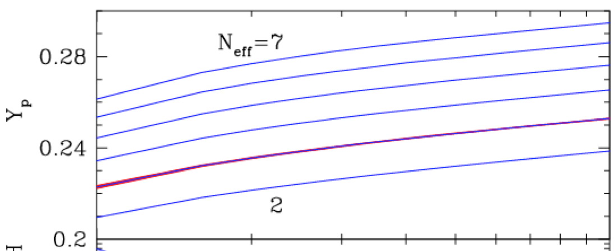
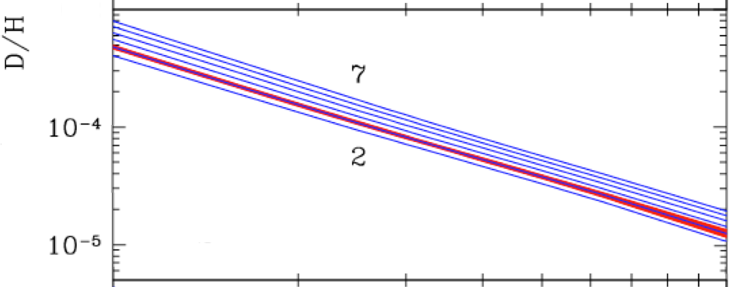
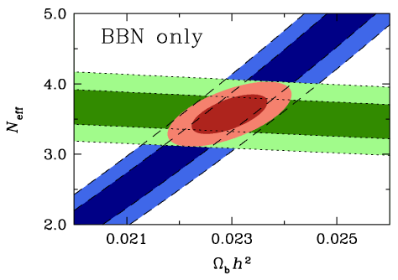
D(p,γ)³He reaction: N_{eff}
2) Neutrino physics: The deuterium abundance is also sensitive to the number of relativistic species. With the present D(p,γ)³He data at BBN energies we have:
N_{eff} (CMB) = 3.36±0.34 (PLANCK 2013)
N_{eff} (BBN) = 3.57±0.18 (Cooke&Pettini 2013)
N_{eff} (SM) = 3.046
Good agreement between CMB and BBN results, suggesting the presence of “dark radiation”.
The poorly known cross-section of the ²H(p,γ)³He reaction at BBN energies represent the most important obstacle to improve the constraints on the existence of “dark radiation”.
Cooke&Pettini 2013

Slide 19
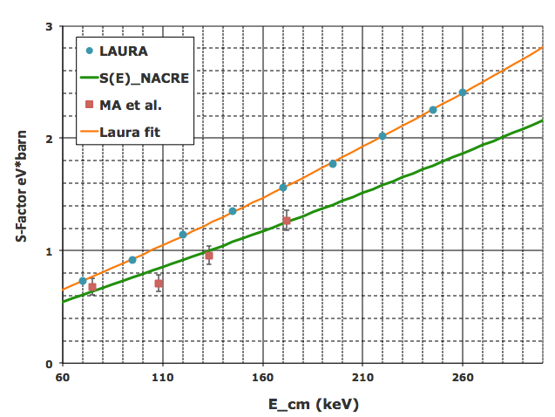
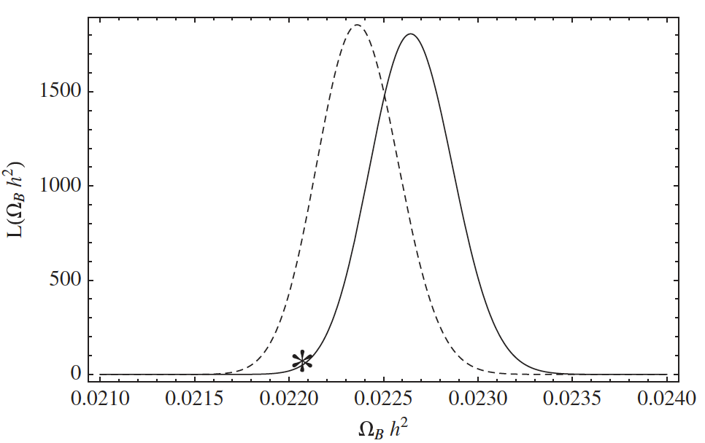
D(p,γ)³He reaction: Nuclear Physics
3) Nuclear Physics: Present S₁₂ data differ from “ab initio” predictions of about 30%.
A cross section close to theoretical predictions provides a better agreement between CMB and BBN data, towards a baryon density close to CMB value (PLANCK)
Di Valentino et al. 2014

Slide 20
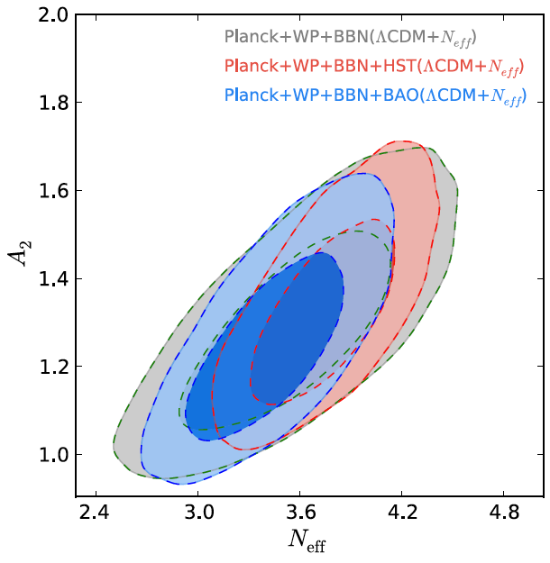
D(p,γ)³He reaction: Nuclear Physics
3) Nuclear Physics: Present S₁₂ data differ from “ab initio” predictions of about 30%.
A cross section close to theoretical predictions provides a better agreement between CMB and BBN data, towards a number of relativistic species N_{eff}>3
Di Valentino et al. 2014
D(p,γ)³He reaction rate A.U.

Slide 21
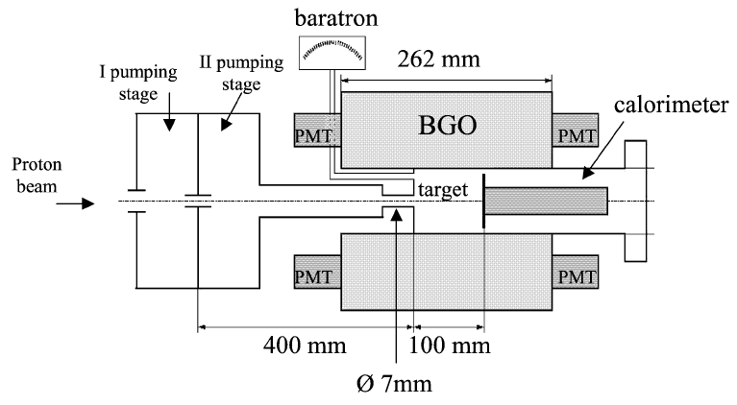
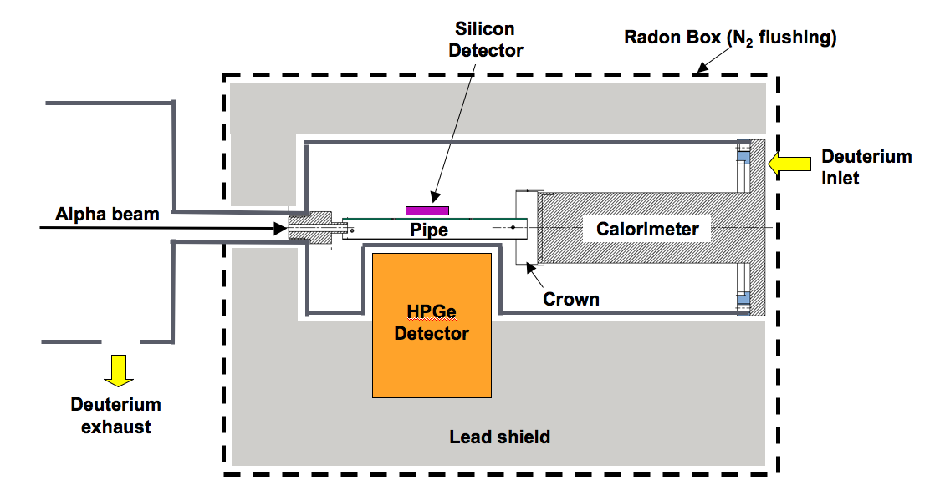
D(p,γ)³He reaction: Possible setup @ LUNA
Experimental goals:
-Measurement of the Total cross section in wide energy range: 45<E_{lab}(keV)<400
-Good accuracy, with overall systematics error at the 3% level.
-Measurement of the differential cross section at several energies.
Proton beam
BGO detector
Total cross section Vs Energy 25<E_{cm(}keV)<266
Ge(Li) detector
Study of angular emission of photons 100<E_{cm}(keV)<266

Slide 22
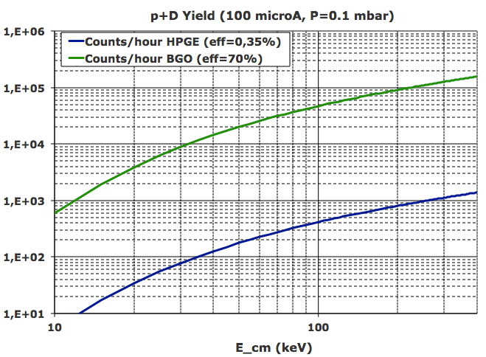
D(p,γ)³He reaction: Reaction Yields
BGO:
10⁴-10⁵ events/hour (30<E_{cm}(keV)<266)
HPGe:
10³-10⁴ events/day (100<E_{cm}(keV)<266)
LUNA400 (BGO)
LUNA 50
LUNA400 (HPGe)
BBN
2014: Preliminary Test (study of systematics and calibration measurements)
2015-2016: Differential and total cross section measurement in a wide BBN energy region.

Slide 23
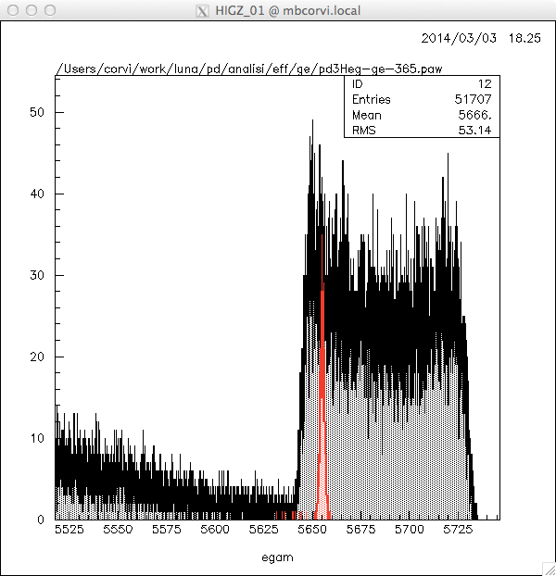
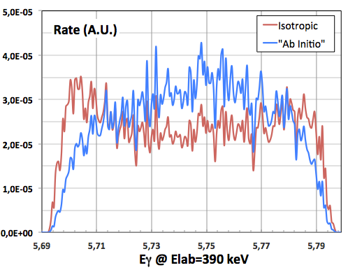
D(p,γ)³He reaction: Angular distribution
Proton beam
D₂ gas target
Beam stopper
γ
HPGe
Doppler effect and high resolution Germanium detector to extract the angular distribution.

Slide 24
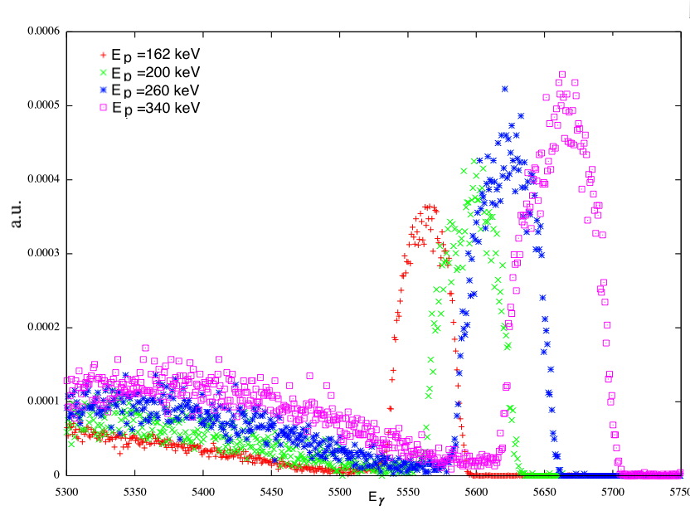
D(p,γ)³He reaction: Preliminary test
PRELIMINARY!!
Notes:
Perchè è importante dal 9 al 3
Spiegare meglio le conclusioni

Slide 25
Conclusions
We are entered in the “Precision Era of Cosmology”
Examples:
Ω_{b} error: 4.3% (WMAP2003)→ 1.4% (PLANCK2013)
(D/H)_{obs} error: 8% (Cyburt 2006)→1.6% (Cooke&Pettini 2013)
FUTURE:
CMB
Misure di polarizzazione (BICEP2→LSPE)
BBN:
Osservazioni dirette → Y_{p}, D/H, ³He/H, ⁷Li/H, ⁶Li/H
A renewed study of several BBN reaction is necessary, to improve the constraints on cosmology and particle physics. It can be done with Underground accelerators, like LUNA or future facilities (e.g. the approved LUNA-MV, DIANA, Fersenkeller).
-The ³He(α,γ)⁷Be LUNA measurement at BBN energies makes very unlikely a nuclear solution for the “Lithium problem”.
-Likewise, the recent measurement of the D(α,γ)⁶Li rules out the possibility of a standard explication for the claimed excess of ⁶Li in metal-poor stars.
-The forthcoming measurement of the D(p,γ)³He cross section is of crucial importance to precisely calculate the D abundance and therefore to increase the BBN and CMB sensitivity to N_{eff}.

