Slide 1
Electronics & DAQ: status and perspective
Electronics for the profiler (Michela e Adalberto)
Profiler: development of an evaluation board for the test (Matteo)
Design of the FE-ASIC (Cristoforo)
Tofpet ASIC: overview and characterization (Manuel)
PET DAQ (Giancarlo)
Tofpet TX board firmware and test board (Richard)
Meeting INSIDE, September 15-16, 2014, Torino
Notes:
This is the outline of the presentation.
Fist of all, we needed an accurat model of the detector in order to perform reliable simulations at circuit level. So, the classical model of the SiPM has been modified by adding some relevant features which gives remarkable contributions to the electrical behaviour of the detector itself and, moreover we set up a suitable extraction procedure to evaluate the paramenters involved in the model.
After that, different front-end circuit solutions have been compared to find out the most suitable one, considering the SiPM characteristics. Some prototypes of the very first front-end have been realized and some results fromt their characterization will be shown.
The very first version of the f.e. has been equipped with more building blocks and a first version of the complete analog channel has been designed, realized and characterized. Also in this case some measurements results wil be provided.
Next, the design of an 8 channel test chip has been carried out, togheter with the architecture of the digital read-out section. The chip has been submitted to a MPW for fabrication at the end of July and we expect the delivery of the prototypes by the first part of October.
Eventually some possible future work will be described

Slide 2
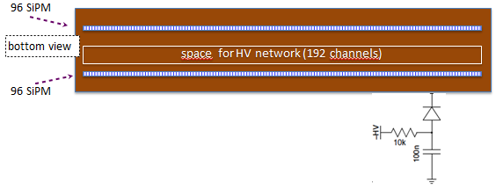
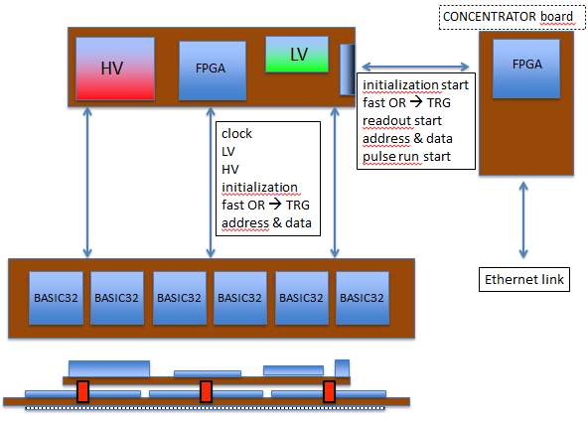
Electronics for the profiler
16 front-end boards, each equipped with BASIC32_ADC (32 channels) for the tracker and the absorber
Calorimeter read-out: LFS matrices from Hamamatsu (the same used for the PET) read-out by 16 MAPMT H8500 already purchased and partially tested
Anger logic readout performed by BASIC32_ADC (if there will be enough...)
BASIC32_ADC test board to be delivered soon
To be investigated: effective cooling system needed, due to the underestimated power consumption of BASIC32_ADC
Preliminary temperature tests to be done with the test board
top view
Meeting INSIDE, September 15-16, 2014, Torino

Slide 3
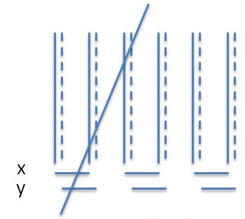
Profiler: trigger definition and DAQ
TRG definition: signals from at least 3 contiguous double layers
Expected TRG rate < 100 Hz
if neutron induced event rate is higher, more layers, absorber and calorimeter could be required: configurable TRG logic (within concentrator)
DAQ layout:
front end board: 6 BASIC will be sequentially read (< 96 x 2 word in < 6 x 7 μs) → < 25 kHz
data from 16 FE board trasferred in parallel (time division?) to the concentrator
less than 400 bytes/TRG → 0,4 MB/s data acquisition rate in total (@1 kHz TRG rate)
➔ not an issue ... start of project: next weeks
Meeting INSIDE, September 15-16, 2014, Torino

Slide 4
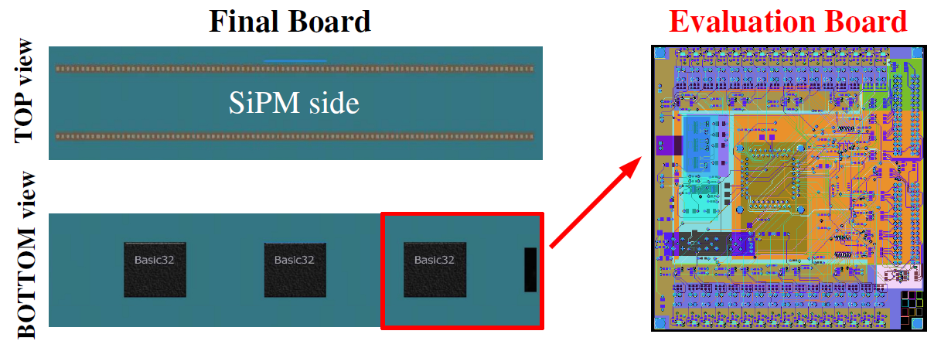
Test board for the profiler electronics
The evaluation board has been fully designed as a subset of the final FE board
The production of 5 boards is ongoing
The board testing will begin during next weeks
Main features of the layout:
10 layers
separated Analog and Digital GND
the SiPMs are mounted on TOP layer and the other components on BOTTOM layer
Meeting INSIDE, September 15-16, 2014, Torino
Notes:
4

Slide 5
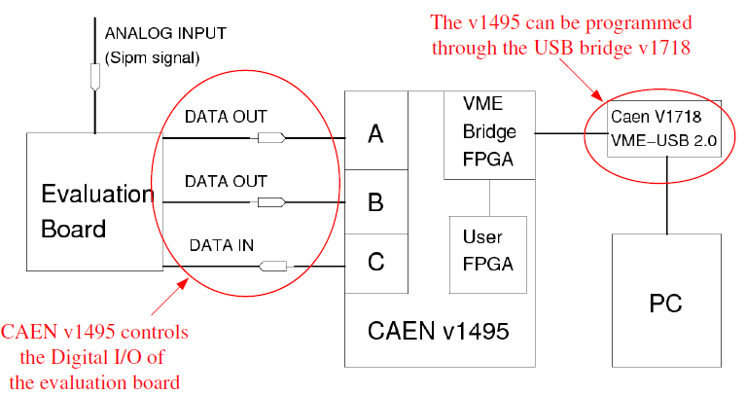
Main features of the test board
Channels can be pulsed by an external pulser or by the CAEN v1495 (via a charge injection circuit)
DC levels at the input of the channel monitored via on-board ADCs (for fine tuning of the SiPM bias)
SiPMs can be connected to the channels by means of zero-Ohm resistors.
Meeting INSIDE, September 15-16, 2014, Torino
Notes:
5

Slide 6
FE ASIC design
Structure of the analog channel almost fully defined and designed
Fine tuning of the SiPM bias (8 bit DAC, LSB less than 10mV)
SiPM “p-on-n” and “n-on-p” can be used (1 configuration bit)
Input impedance: 50Ω, obtained with total bias current 1.5mA
RC integration with τ_{int}=170ns
Current ratio of “slow” to “fast” path equal to 1/20 (fixed)
Signal validation: threshold on the integrated signal
Dynamic range: about 2500 p.e. (with SiPM gain 10⁶)
“Slow” path overall gain: about 1.2mV/p.e.
Total current consumption of the analog channel 2.4 mA
Estimated timing jitter (MC simulations of the scintillation pulse with 1000 p.e.) ≅ 300ps FWHM, taking into account a 0.9ns rise time of the scintillator
More blocks defined and designed: peak detector, programmable interface amplifier for the ADC input, delay line and bias circuits
Digital part not fully defined (the final level of programmability of some features have to be decided), but the entire digital design flow has been completed for the current version of the internal logic
Open issue: the solution proposed to enhance the resolution of the available 8-bit ADC seems to be too slow.
More ADC modules must be added to increase the sustainable rate of events
Notes:
6

Slide 7
FE ASIC: status and planning
Block | Circuit level | Layout level
Current buffer | x | x
Integration circuit | x | x
‘Fast’ comparator | x | x
‘Slow’ comparator | x | x
Peak detector | x | x
Bandgap and bias circuits | x | x
DACs (8 bit and 10 bit) | x | x
8 bit ADC | x | x
ADC interface amplifier | x | o
LVDS interfaces | x | x
Digital part* | x | x
To be defined:
- Final solution for A/D conversion
- Delay line (programmability)
- Final version of the digital part (digital design flow OK)
To be done:
- Placement and routing of the blocks
- Power supply distribution
- Complete layout, with periphery cells and padring
Next available MPW run deadline: November 17, unlikely to be met
Submission expected for the first MPW available in 2015 (January or February)
* provisional version
Meeting INSIDE, September 15-16, 2014, Torino
Notes:
This is the outline of the presentation.
Fist of all, we needed an accurat model of the detector in order to perform reliable simulations at circuit level. So, the classical model of the SiPM has been modified by adding some relevant features which gives remarkable contributions to the electrical behaviour of the detector itself and, moreover we set up a suitable extraction procedure to evaluate the paramenters involved in the model.
After that, different front-end circuit solutions have been compared to find out the most suitable one, considering the SiPM characteristics. Some prototypes of the very first front-end have been realized and some results fromt their characterization will be shown.
The very first version of the f.e. has been equipped with more building blocks and a first version of the complete analog channel has been designed, realized and characterized. Also in this case some measurements results wil be provided.
Next, the design of an 8 channel test chip has been carried out, togheter with the architecture of the digital read-out section. The chip has been submitted to a MPW for fabrication at the end of July and we expect the delivery of the prototypes by the first part of October.
Eventually some possible future work will be described

Slide 8
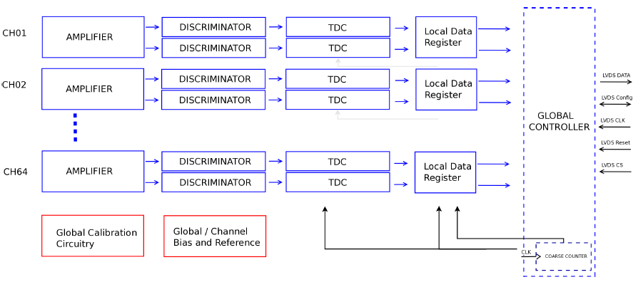
Tofpet ASIC: overview
64-channel analogue block, calibration circuitry, global controller
LVDS 10 MHz SPI configuration link for bias/channel setting
LVDS 160-640 Mbps data output interface (max. event rate sustainable per channel: 100kHz)
On-chip DACs and reference generators
Time and charge measurements with independent TDCs (time binning 50ps)
Charge measured with Time-over-threshold
Typ. power consumption is 7mW p/channel (trigger 0.5 p.e. with SNR > 23dB )
Meeting INSIDE, September 15-16, 2014, Torino
Notes:
This is the outline of the presentation.
Fist of all, we needed an accurat model of the detector in order to perform reliable simulations at circuit level. So, the classical model of the SiPM has been modified by adding some relevant features which gives remarkable contributions to the electrical behaviour of the detector itself and, moreover we set up a suitable extraction procedure to evaluate the paramenters involved in the model.
After that, different front-end circuit solutions have been compared to find out the most suitable one, considering the SiPM characteristics. Some prototypes of the very first front-end have been realized and some results fromt their characterization will be shown.
The very first version of the f.e. has been equipped with more building blocks and a first version of the complete analog channel has been designed, realized and characterized. Also in this case some measurements results wil be provided.
Next, the design of an 8 channel test chip has been carried out, togheter with the architecture of the digital read-out section. The chip has been submitted to a MPW for fabrication at the end of July and we expect the delivery of the prototypes by the first part of October.
Eventually some possible future work will be described

Slide 9
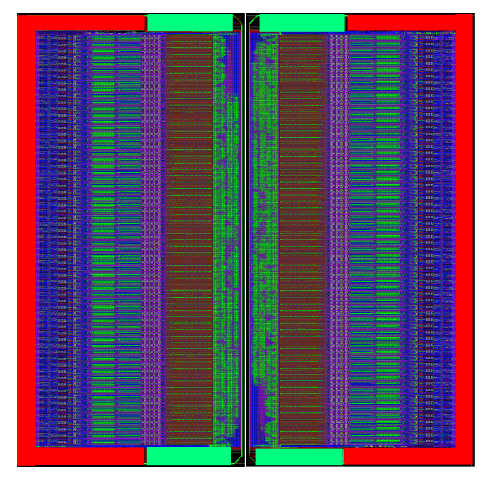
Tofpet ASIC: last characterization results
New optimized test board available
Coincidence Time Resolution obtained with 3x3x15mm³ crystal and 4x4 Hamamatsu SiPM TSV array: 270ps FWHM (single channels considered)
Using two abutted ASICs (128 total channels) all coupled to the SiPM and a LYSO scintillator not perfectly matched to the detectors: 309ps FWHM
Two abutted Tofpet ASICs packaged into a BGA
(128 channels)
Meeting INSIDE, September 15-16, 2014, Torino
Notes:
This is the outline of the presentation.
Fist of all, we needed an accurat model of the detector in order to perform reliable simulations at circuit level. So, the classical model of the SiPM has been modified by adding some relevant features which gives remarkable contributions to the electrical behaviour of the detector itself and, moreover we set up a suitable extraction procedure to evaluate the paramenters involved in the model.
After that, different front-end circuit solutions have been compared to find out the most suitable one, considering the SiPM characteristics. Some prototypes of the very first front-end have been realized and some results fromt their characterization will be shown.
The very first version of the f.e. has been equipped with more building blocks and a first version of the complete analog channel has been designed, realized and characterized. Also in this case some measurements results wil be provided.
Next, the design of an 8 channel test chip has been carried out, togheter with the architecture of the digital read-out section. The chip has been submitted to a MPW for fabrication at the end of July and we expect the delivery of the prototypes by the first part of October.
Eventually some possible future work will be described

Slide 10
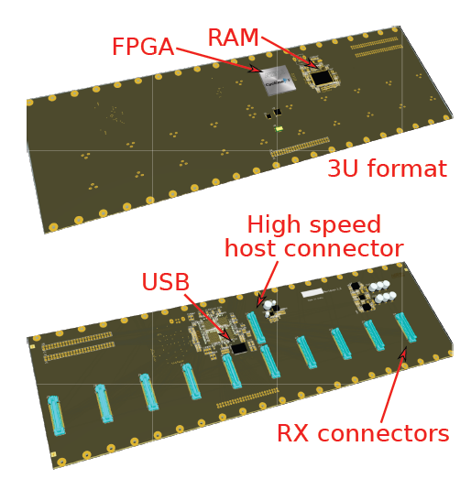
PET DAQ
From last meeting
Each SiPM/ASIC pair can handle single rates at 180 kHZ
The 5cm x 5cm module will acquire at 720 kHZ
Data collected by two FPGAs
TX, coupled to the ASIC
RX, plugged on the mainboard
TX–RX ethernet connection (RX uses Altera FPGA)
Data packet is 10B
The expected module output bandwidth is 7.2 MB/s
Motherboard HW development
Functional design ✔
Schematic design ✔
Mechanical design ✔
PCB design (in progress)
Construction and assembly ✖!!
Delivery initially scheduled 12/2013,
expected 4/2014 10/2014
Meeting INSIDE, September 15-16, 2014, Torino
Notes:
10

Slide 11
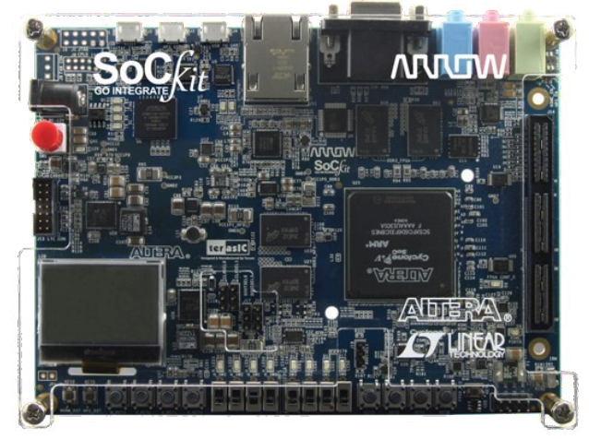
PET DAQ
Motherboard FW development
Functional architecture design ✔
USB interface (imported from DoPET) ✔
RX interface (SPI and LVDS) ✔
Coincidence sorter and processor ✖
Expected first version delivery 12/2014 (depending on HW status)
Motherboard SW development
Largely imported from DoPET
No specific developments are being made at the moment
RX board prototype
Development based on the SoCKit board
Same technology, all the redundant HW eliminated
ARM processor available
Can be used to emulate the motherboard
Meeting INSIDE, September 15-16, 2014, Torino
Notes:
11

Slide 12
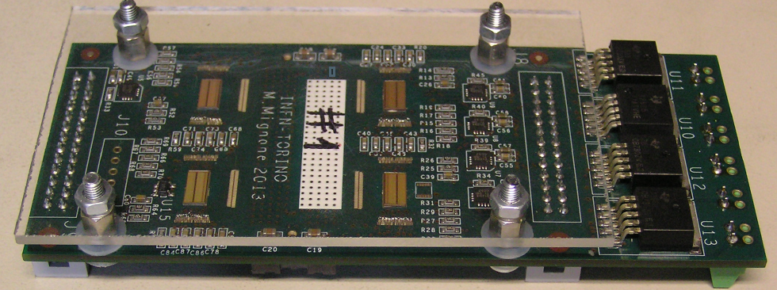
Status Tofpet Tx and FE boards
FE Tofpet Tx board firmware
Evolution of the original Torino Tofpet firmware, now using a custom UDP interface (no soft CPU)
Development on ML605 board (Virtex 6) for now for easy debugging
Same software interface, added fine time calculation in hardware and FE board temperature sensor reading
Only one FE Tofpet board per ML605 board, but firmware and software designed to allow running up to four ML605 boards together on Gigabit Ethernet switch
Everything ready for a stand-alone test at CNAO (or CNR)
Next step: port to SP605 board (Spartan 6)
Interaction with Rx boards TBD
FE Tofpet board
Submitted for production in May (design ready in January but delayed by Hamamatsu due to flex circuit definition issues)
Delivered first week of July, total of 6 boards
Two boards bonded and tested
Two chips have unusually low TOT gain but are otherwise apparently Ok
Meeting INSIDE, September 15-16, 2014, Torino

Slide 13
More issues
Long cables
Tx boards do not fit in the detector boxes
Tests Ok at 160MHz with 2 metres of twisted-flat cables including interruptions with connectors to simulate patch-panels (but timing needs careful study)
Timing jitter with test pulse increases to 140ps sigma, assuming equal contributions from clock transmission and teat pulse transmission implies clock jitter ~ 100ps sigma
2 metres seems to be enough
Possible test at CNR by the end of the year ?
Definition of the communication protocol between Tx and Rx boards (first quarter of 2015), including calibration
Use of Ethernet switches to manage more Tx boards (4x2 or 5x2 modules configuration) ?
Meeting INSIDE, September 15-16, 2014, Torino

