Slide 1
INSIDE Software
Status Report
Simulation:
FLUKA speed up
Activity generator
Reconstruction:
DoPET beam test
INSIDE beam test

Slide 2

Development of techniques to speed up the simulation of PET and SPECT for hadrontherapy monitoring
Detectors for monitoring have a limited solid angle in general. Most of simulated physics is wasted outside the detector

Slide 3
How to accelerate FLUKA calculations for PET and prompt photon calculations
Optimization of production and transport thresholds
Inelastic interaction biasing
Further “tuning” as a function of particle energy
Multiple “replicas” of radioactive decays
Direction biasing of annihilation photons
Multiple “replicas” of final (gamma) de-excitation
Direction biasing of de-excitation photons (work in progress)

Slide 4
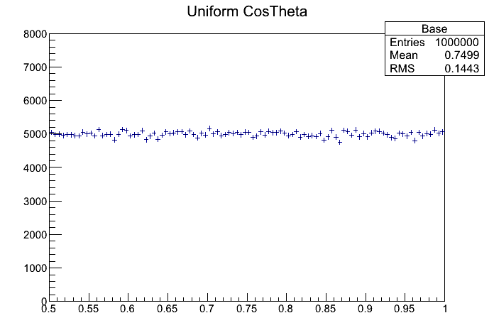
Example: a photon is sampled from a uniform Cosθ distribution (as expected)
Detector region of interest

Slide 5
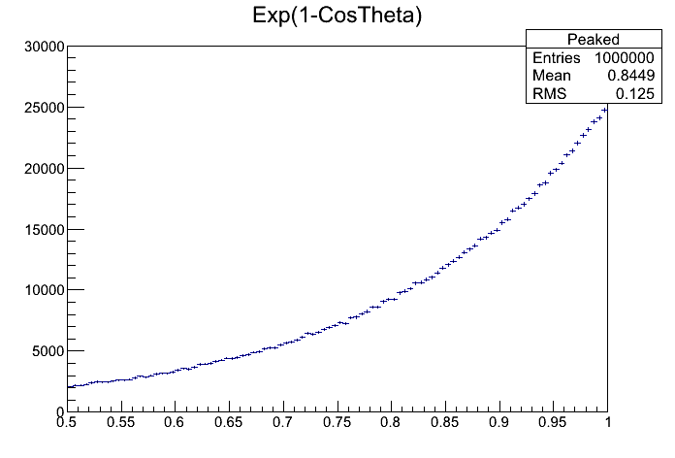
Probability of pointing to the detector region is artificially enhanced (biased) towards the detector region
Angular distr. altered
Parameter to be optimized on the basis of detector size and physical considerations

Slide 6
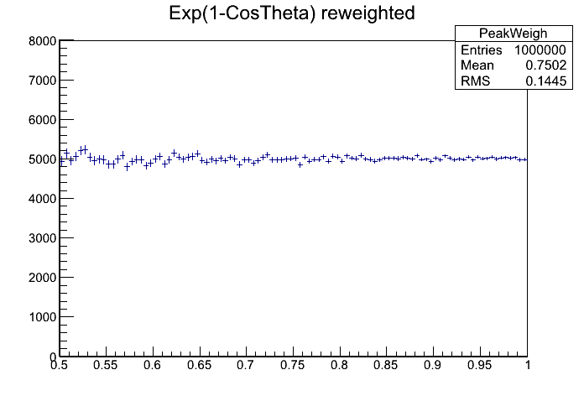
h->Fill(cost,weight)
Stat. uncertainty reduced in the region of interest
for the same no. of primaries

Slide 7
Test case: 200 MeV p on PMMA
“Detector”: 2 10x20 cm² surfaces at R=50 cm
Observables:
Prompt photons (> 1 MeV) in the detector area
Annihilation photons (from β⁺ decays) in the detector area
Figure Of Merit (FOM):
1/[σ²T_{CPU}] for both observables (a factor x larger FOM → a factor x less CPU required for the same statistics)
…evaluated with runs with equal T_{CPU} for an easy estimation

Slide 8
Bias
Natural isotropic distribution altered so that the first photon preferentially points to the detector(s) (note please preferentially and not always, in order not to bias the results, particularly Compton related backgrounds)
“Physical” interaction length reduced by a user chosen factor (weights adjusted accordingly)
Last stage of interaction (γ de-excitation), replicated several times for the same excited fragments

Slide 9
Protons

Slide 10
Carbon ions

Slide 11
Interazione Nucleo-Nucleo
E > 5 GeV/n
Dual Parton Model (DPM)
DPMJET-III (original code by
R.Engel, J.Ranft and S.Roesler,
FLUKA-implemenation by T.Empl et al.)
Ottimizzato per energie intermedie. Possibili problemi
vicino alla soglia inferiore
0.1 GeV/n < E < 5 GeV/n
Relativistic Quantum Molecular Dynamics Model (RQMD)
RQMD-2.4 (original code by H.Sorge et al.,
FLUKA-implementation by A.Ferrari et al.)
E < 0.1 GeV/n
Boltzmann Master Equation (BME) theory
BME (original code by E.Gadioli et al.,
FLUKA-implementation by F.Cerutti et al.)
Non si osservano anomalie evidenti se ci si limita a distribuzione di dose

Slide 12
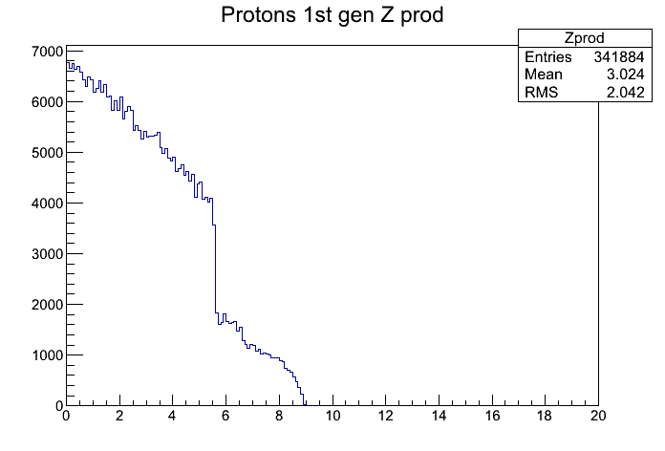
Selezione generazione
soglia di transizione fra modelli e’ sharp
Ricostruzione della distribuzione del punto di origine dei protoni che escono dal target
Z (cm)

Slide 13
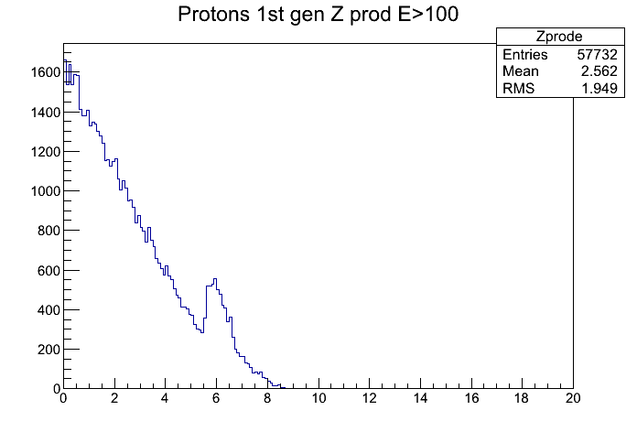
Selezione in energia

Slide 14
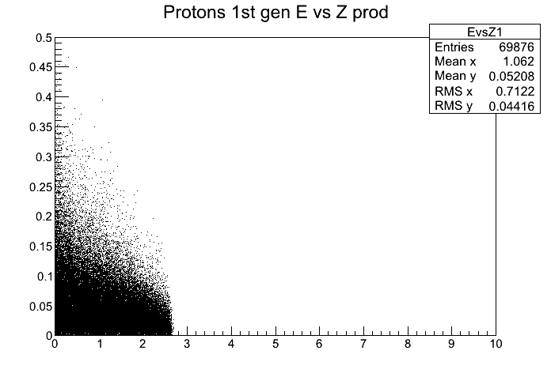
Per energie contenute nel range BME (es. C a 100 MeV/u) non ci sono anomalie evidenti
Il problema non esiste comunque per le interazioni p-N dove non c’e’ transizione di modelli di interazione

Slide 15
FLUKA in-beam PET simulations
Speed up the simulation
  Bias
  Activity based-generator
  Faster workstation
  Cloud-computing

Slide 16
Hadrontherapy activity-based generator
Needed components
  Hadrons treatment simulation
  Activity scoring with time tagging
    Spatial sampling
    Time sampling (spills?)
    Activity distribution vs annihilation points distribution per nucleon
      Pairs generation vs positrons generation

Slide 17
Hadrontherapy activity-based generator
SOURCE.F file for photons pair generation
  Spatial and time sampling of activity, “simple” pairs generation
    Input file contains 4D spatial sampling
    With REAL*4 for 100x100x100x300 voxel the memory used is 1.2 GB
  Alternative: activity sampled per nucleon
    Input file contains different data per emitter
    Positron generation instead of pairs
    -> More complete physics
Results: full proton treatment simulated in about 1h10’

Slide 18
Treatment Plan Simulation
starting from full treatment plan (4*10^10 p)
  FLUKA, which will provide another gain for the direction bias: ~ 10^2
  4D Activity distribution: gain of about a factor 1000 (163 because all p generate beta+, another 10 because activity map is sampled with a 1mm and 1s step)
Total gain about: 10^4
4D Activity distribution

Slide 19
RHD-DoPET CNAO test beam result (may 2014)
Pisa group, INSIDE meeting 15-16 September 2014,Torino

Slide 20
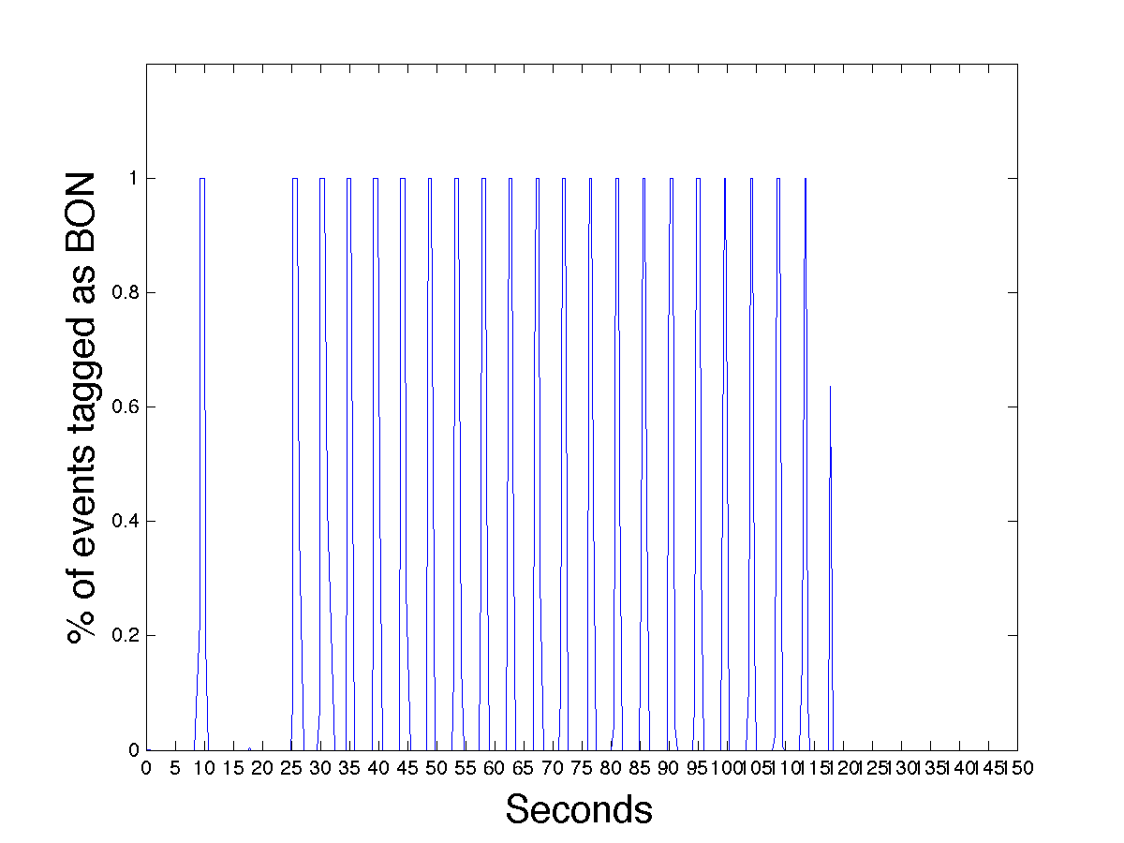
DoPET hardware updates
New: acquisition of the gating signal provided by CNAO
Allowed us to divide accurately data between “in spill”, “intra spill” and “Beam OFF” (BOFF) data

Slide 21
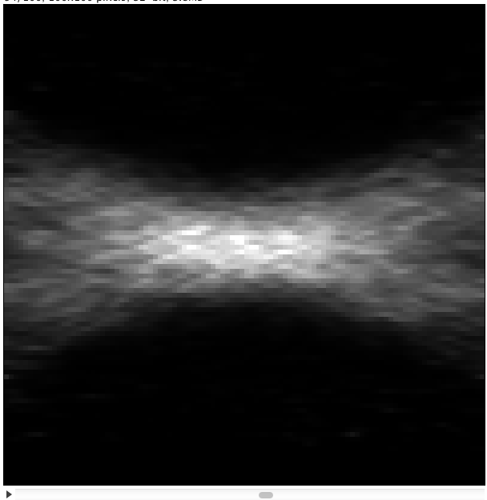
Data 15476: 95.3 MeV protons on homogeneous PMMA
95 MeV protons on uniform PMMA
Nr events:
In-spill =12234
Inter-spill=196624
2 min beam-off=326913;
BON+2min beam-off=534837;
1-D z-profile for DATA and MC

Slide 22
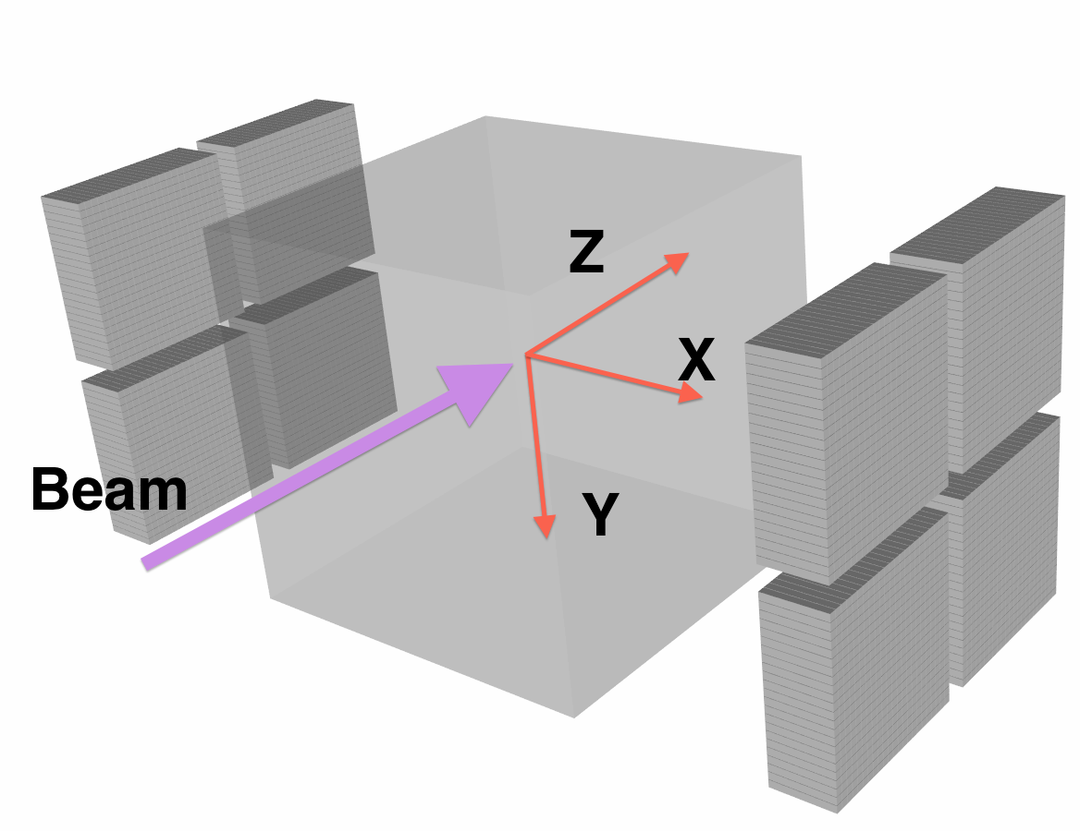
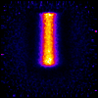
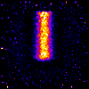
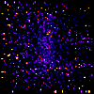
95.3 MeV Proton on PMMA images
BON time 118.2 sec
Intra spill time ~20 sec
Inter spill time ~100 sec
BOFF time 548.5 sec
BEAM
Y
Z
BOFF
Inter spill
In-spill

Slide 23
Data 172120: 95.3 MeV protons on PMMA+ “small” hole
95 MeV protons on PMMA with
a cavity at z=2 (d=1cm, h=1 cm)
x-y view of ROI
(“ellipse-cylinder”)
(so “zoomed” on
cavity)
1-D z-profile for DATA and MC
Nr events:
In-spill =9134
Inter-spill=179049
2 min beam-off =347090;
BON+2min beam-off =535273

Slide 24
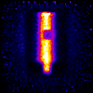
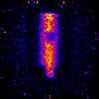
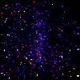
95.3 MeV Proton on a PMMA with a “small” air cavity
BON time 90.6 sec
Intra spill time ~20 sec
Inter spill time ~100 sec
BOFF time 583.4 sec
BEAM
Y
Z
BOFF
Inter spill
In-spill

Slide 25
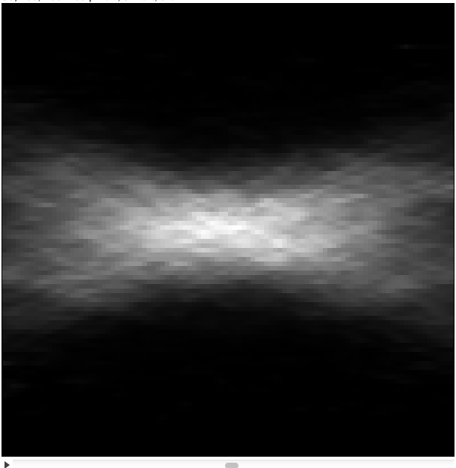
Data 1601: 2 Gy plan on homogeneous PMMA
2 Gy plan on uniform PMMA 3x3x3 cm³
located at z=2.5->5.5 cm
Nr events:
In-spill =9349
Inter-spill=181422
2 min beam-off =278171
BON+2min beam-off =468942
1-D z-profile for DATA and MC

Slide 26
2 Gy plan: “big” (~4cm diameter) cavity vs no cavity
Just with intra-spill data can already detect anomalies
2-D Inter-spill
Inter-spill
x-y view of ROI“ellipse-cylinder”(so “zoomed” on the cavity)
2 min beam-off
Beam-on+2 min beam-off

Slide 27
DoPET: Conclusions
DoPET is capable of detecting ``small’’ abnormalities when delivering mono-energetic beam
DoPET is capable of detecting ``big’’ abnormalities when delivering treatment plans
Analysis with ``small’’ abnormalities detection in treatment plans still ongoing
Distal fall off position of a treatment plan is visible after ~150 sec from the last layer delivery

Slide 28
INSIDE CNAO II test beam results

Slide 29
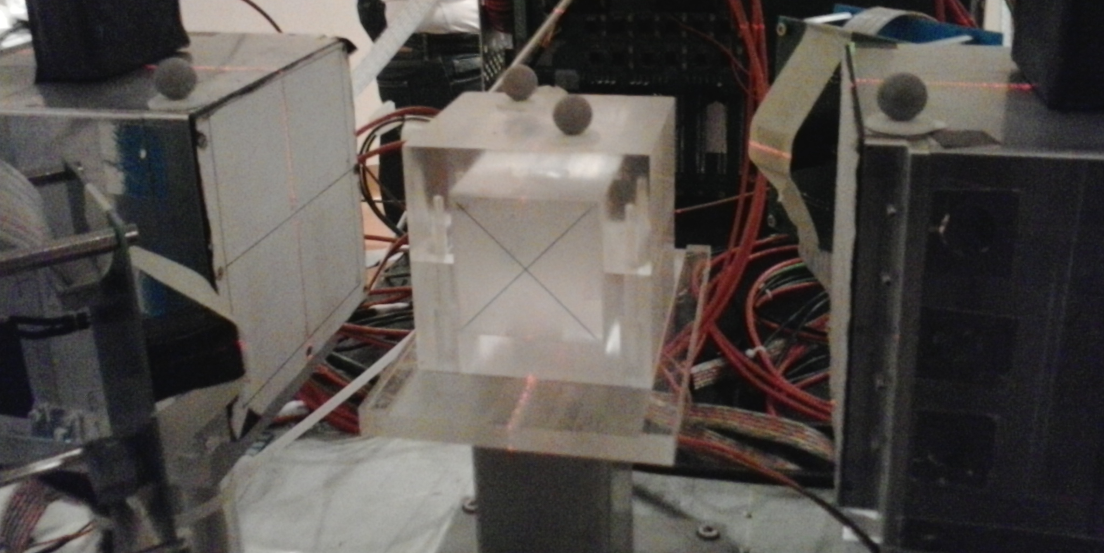
Experimental set up
Schematic top view (not to scale)
Dopet
Dopet
SiPM + LYSO
Dopet
PMMA phantom
Dopet
SiPM + LSF
Proton beam
95 MeV proton beam
SiPM + LSF
SiPM + LYSO
SiPM matrices: 4x4 matrix,
16 x 16 mm2 total cross section area
Each pixel has a 3 mm x 3 mm cross section area
Matrix coupled to LSF/LYSO pixellated crystal

Slide 30
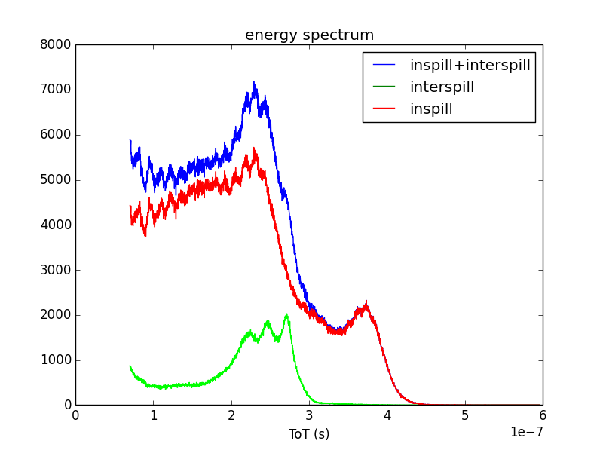
Energy spectrum
single matrix
LSO peaks
511 keV peak

Slide 31
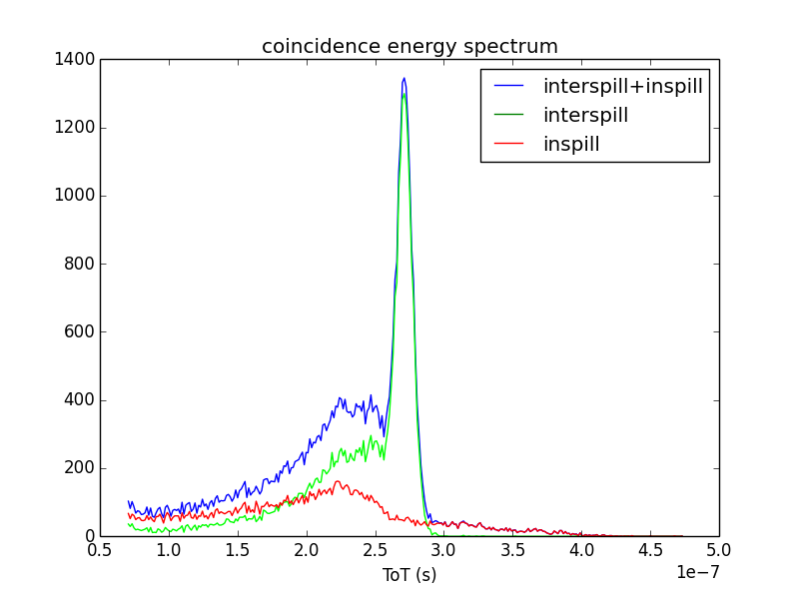
Energy spectra of the coincidence events
511 keV
A lot of multiple coincidences are calculated for the inspill data. The 511 keV events could be discarded because they are marked as multiple coincidence.

Slide 32
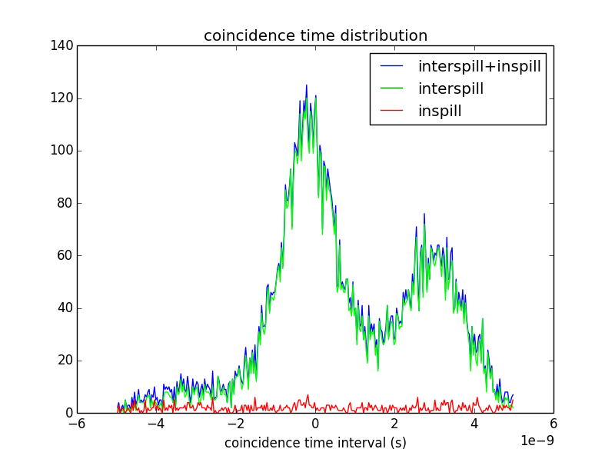
Distribution of the coincidence time interval
( 511 keV data only)
-300 ps
Why do we find two peaks?
3 ns
1.5 ns
2.4 ns

Slide 33
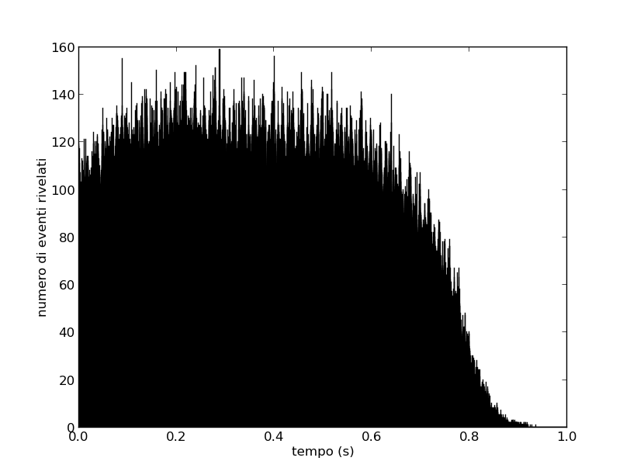
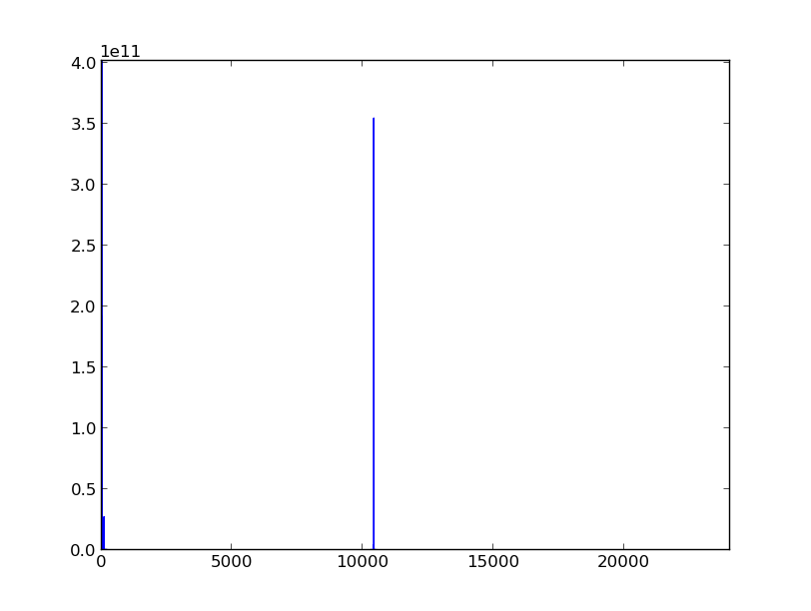
Time distribution of the inspill events
FFT
Frequency (1/s)
100 Hz
100 kHz

Slide 34
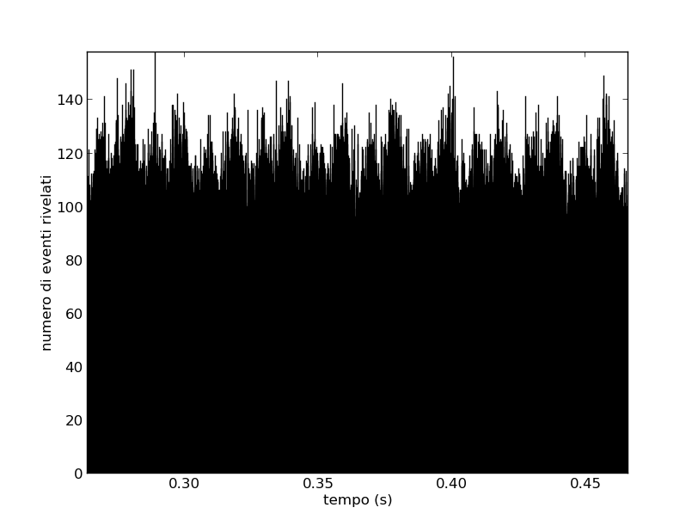
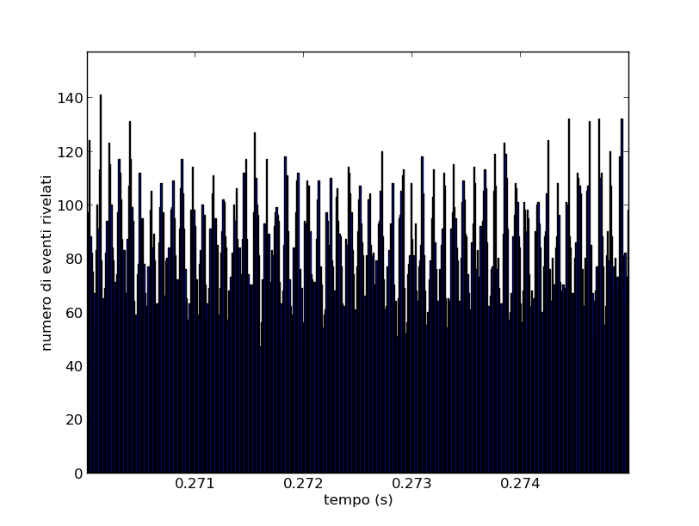
100 Hz frequency
Frequency (1/s)
100 Hz
100 kHz
10 kHz is the frequency of the protons extraction within the bunch (spill).
10 kHz frequency

Slide 35
INSIDE Software
Status Report
Objectives:
Integrate activity generator in FLUKA
Software repository (CNAF?)
Software integration
Analysis:
Time deconvolution in TP?
Calibration + monitoring

