Slide 1
INSIDE UPDATEs
M. Giuseppina Bisogni
PISA, 16/09/2014

Slide 2
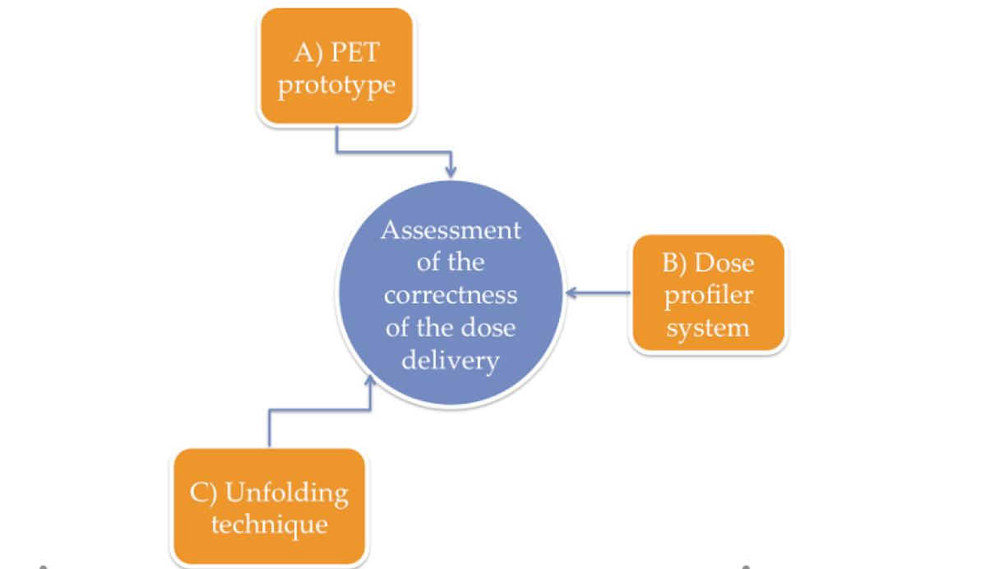

Slide 3
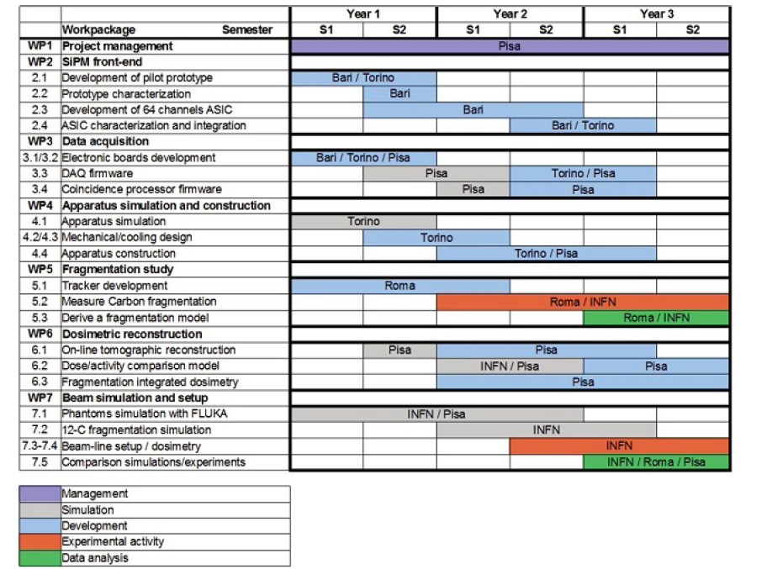
1/2/2013
31/1/2016

Slide 4
NEWS
Collaborazione INSIDE-CNAO
In preparazione documenti tecnici (schema elettrico e progetto meccanico) per fissare i requisiti minimi di sicurezza per il personale che opera nelle sale trattamento dove verranno eseguite le prove con i fantocci→ da sottoporre per approvazione al CNAO entro fine anno
Workshop CNAO 19-20/9/2014
Invited talk per presentare progetto INSIDE
Contatti con industria
Abbiamo ricevuto alcune richieste di informazioni per stabilire una possibile collaborazione con IBA. Meeting a Pisa il 7/10 con Damien Bertrand.

Slide 5
Questions for the evaluation of a PET detection system for range verification in particle therapy
The INSIDE projects aims at range verification in both proton and carbon ion therapy. Apart from the proton tracker for vertex imaging which is meant for carbon ion therapy, are the specifications of the PET system the optimal ones from proton therapy ? Or did it appear necessary to compromise certain specifications in view of carbon ion therapy? Which ones?
Are you looking forward to a system comparable to the one reported by Shao from MD Anderson (PMB 2014) who is investigating a dedicated, small radius, brain PET approach to favor high geometric efficiency for sufficient statistic at the treatment time scale at the cost of limited versatility? Or are you considering a larger system for all treatment sites? Will your dual-head design allow variable distances between the two heads?
For in-beam PET imaging in proton therapy, the plan is to start the acquisition at the same time as the treatment, isn’t it? When do you estimate sufficient statistics can be reached with the envisioned dual-head design (2 times 10x20x2 cm³)? Already at the end of the treatment? Or a few minutes afterwards? How long?
What balance between signal from fast-decaying isotopes with large positron ranges (N-12, O-13 and B-8) and signal from slow-decaying isotopes with short positron ranges (O-15, C-11, etc.) are you expecting in regard of the acquisition time considered?
For what treatment sites do you think biological washout can be fully neglected in regard of the acquisition time considered?

Slide 6
Cont.
For in-beam PET imaging, in situations where a coincidence event is detected in the course of a pencil beam scanning irradiation and its LOR intersects with several already delivered spot trajectories, how do you correct the statistical weight of this event before reconstruction (considering that isotopes created by the first spots have more time to decay than the ones created by the last spots)?
In case of multiple fields, will you only record the first field? Or all fields? In case of all fields, did you develop an approach to correct acquisitions of later fields for the contamination by the previous ones?
Will you implement TOF? If yes, are considering the approach suggested by Crespo (PMB 2007) where the TOF information is used identify data belonging to a region of interest and discard the other data in order to reduce data volume and allow quicker reconstruction so that images might start to be available even during irradiation?
What specific advantages do you expect from your dedicated, PET module design with LYSO and SiPM in comparison, for example, to the dSiPM modules for LYSO with TOF capability marketed by Philips?

Slide 7
Sviluppo sistema PET
5/2014 aggiudicata gara d’appalto per la fornitura di 22 moduli di rivelazione
5/2014 acquisiti 200 ASICs TOFPET non testati
7/2014 ordinati 22 circuiti flex
7/2014 acquisizione prime Schede front end e inizio test
7/2014 ordine probe card test massa ASIC TOFPET
9/2014 inizio Test 200 asic TOFPET su probe station
Torino 15-16/9/2014 collaboration meeting
17/10/2014 consegna primi due moduli completi di circuito flex per collegamento alle schede di front-end

