Slide 1
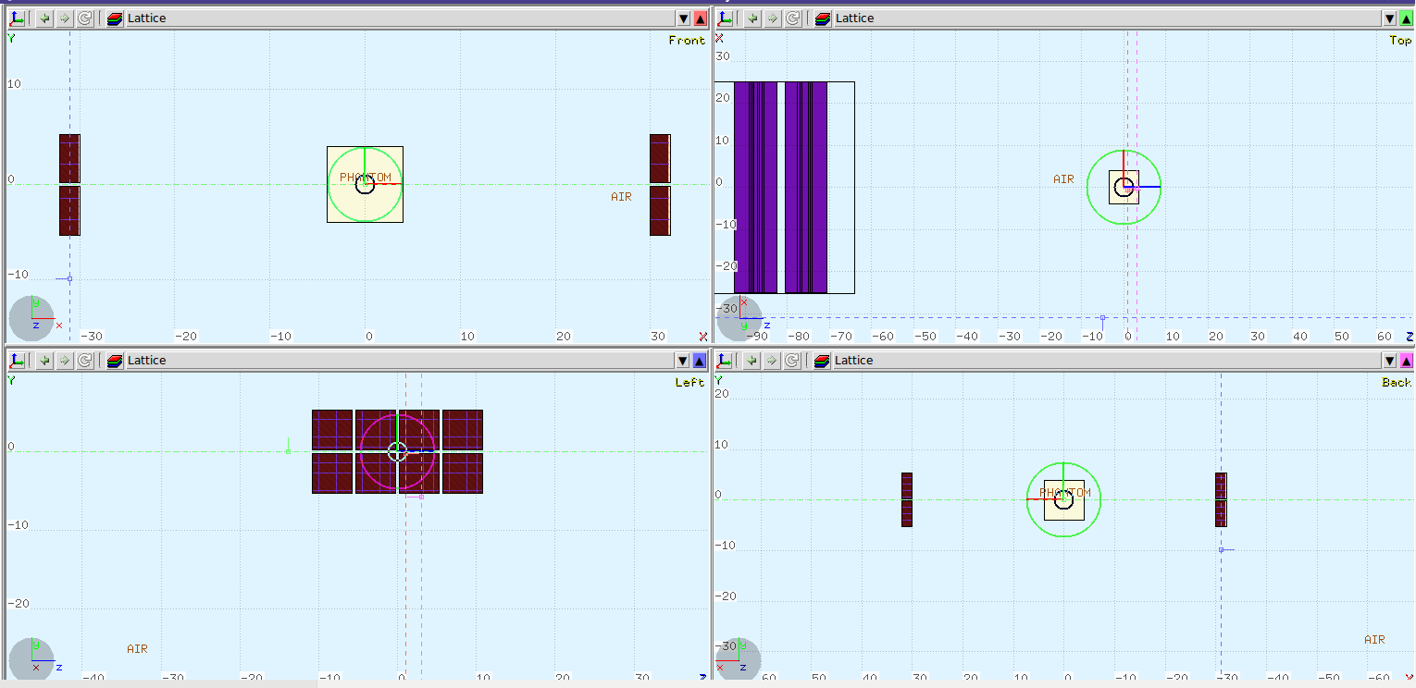
FLUKA in-beam PET simulations

Slide 2
FLUKA in-beam PET simulations
Speed up the simulation
Bias
Activity based-generator
Faster workstation
Cloud-computing

Slide 3
FLUKA in-beam PET simulations
Speed up the simulation
Bias
Activity based-generator
Faster workstation
Cloud-computing

Slide 4
Hadrontherapy activity-based generator
Needed components
Hadrons treatment simulation
Activity scoring with time tagging
SOURCE.F file for photons pair generation
Post-processing
Image reconstruction

Slide 5
Hadrontherapy activity-based generator
Needed components
Hadrons treatment simulation
Activity scoring with time tagging
SOURCE.F file for photons pair generation
Post-processing
Image reconstruction

Slide 6
Hadrontherapy activity-based generator
Needed components
Hadrons treatment simulation
Activity scoring with time tagging
Spatial sampling
Time sampling (spills?)
Activity distribution vs annihilation points distribution per nucleon
Pairs generation vs positrons generation

Slide 7
Hadrontherapy activity-based generator
Needed components
Hadrons treatment simulation
Activity scoring with time tagging
SOURCE.F file for photons pair generation
Post-processing
Image reconstruction

Slide 8
Hadrontherapy activity-based generator
SOURCE.F file for photons pair generation
Spatial and time sampling of activity, “simple” pairs generation
Input file contains 4D spatial sampling
With REAL*4 for 100x100x100x300 voxel the memory used is 1.2 GB
Alternative: activity sampled per nucleon
Input file contains different data per emitter
Positron generation instead of pairs
-> More complete physics

Slide 9
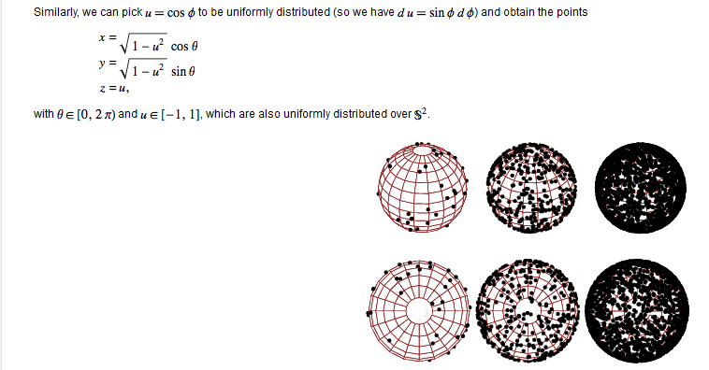
Hadrontherapy activity-based generator
SOURCE.F file for photons pair generation
Random direction generation

Slide 10
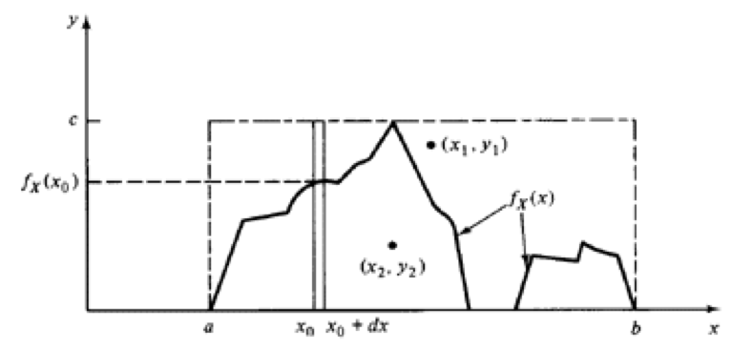
Hadrontherapy activity-based generator
SOURCE.F file for photons pair generation
Sample-based activity distribution
Rejection method implemented: picked 4 coordinates random within the input sampling
Rejection method with the fifth number picked
no
Activity distribution
ok

Slide 11
Hadrontherapy activity-based generator
Results: full proton treatment simulated in about 1h10’
Deadline per fare la prima ricostruzione: 15 Ottobre 2014

