Slide 1
INSIDE CNAO II test beam results

Slide 2
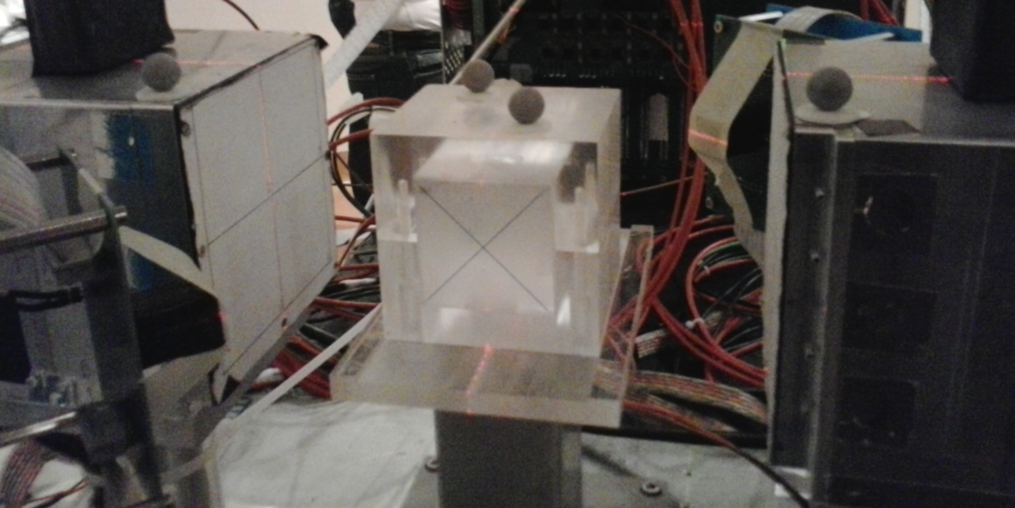
Experimental set up
Schematic top view (not to scale)
Dopet
Dopet
SiPM + LYSO
Dopet
PMMA phantom
Dopet
SiPM + LSF
Proton beam
95 MeV proton beam
SiPM + LSF
SiPM + LYSO
SiPM matrices: 4x4 matrix,
16 x 16 mm2 total cross section area
Each pixel has a 3 mm x 3 mm cross section area
Matrix coupled to LSF/LYSO pixellated crystal

Slide 3
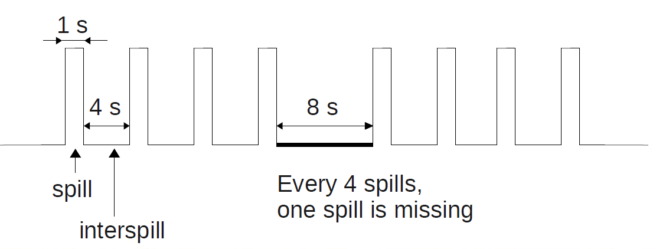
Radiation beam characteristics
Proton beam: 95 MeV
Pulsed beam: 109 protons per spill
Continuous irradiation, ~28 min, about 330 spills
Time structure of the beam:

Slide 4
Data acquisition set up
TOFPET ASIC read out, 32 channels used:
- SiPM matrix + LSF scintillator connected to the TOFPET channels from 21 to 28 and from 31 to 38 by twisted cables
- SiPM matrix + LSO scintillator connected to the TOFPET channels from 41 to 48 and from 51 to 58 by twisted cables
4DMPET acquisition board
Acquisition software developed in LabView code at INFN, sez. Torino

Slide 5
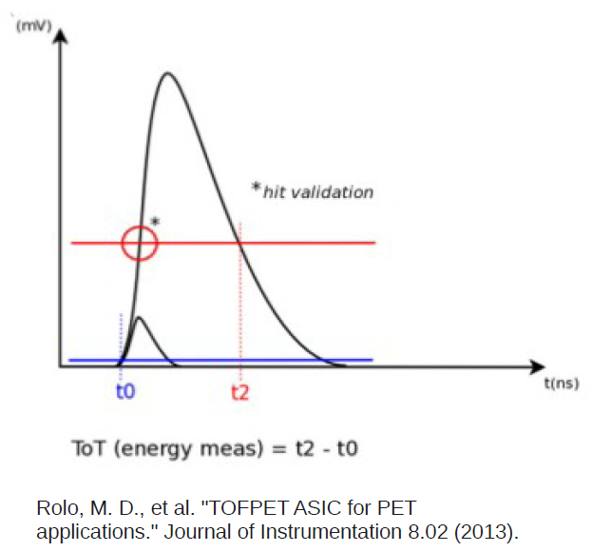
TOFPET working principle

Slide 6
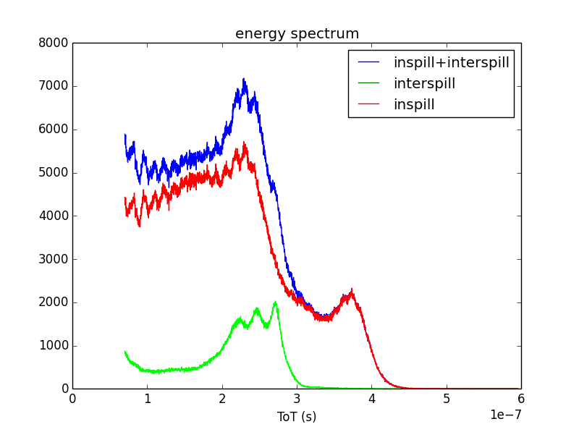
Energy spectrum single matrix
LSO peaks
511 keV peak

Slide 7
Selection of the coincidence events
Selection of the interspill or inspill data of each matrix
Sorting of the data from both matrices by the time stamp (T_time variable)
Starting from the first event detected, count of the number of events falling within 5 ns:
- 1 event from the opposite matrix event marked as a coincidence event
- more than 1 event events discarded
4. The next 5 ns time window starts from the first event out of the previous coincidence time window

Slide 8
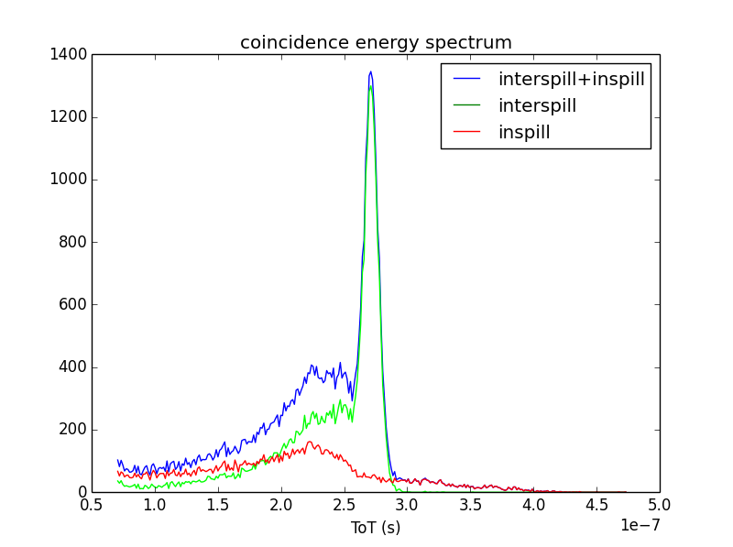
Energy spectra of the coincidence events
511 keV
A lot of multiple coincidences are calculated for the inspill data. The 511 keV events could be discarded because they are marked as multiple coincidence.

Slide 9
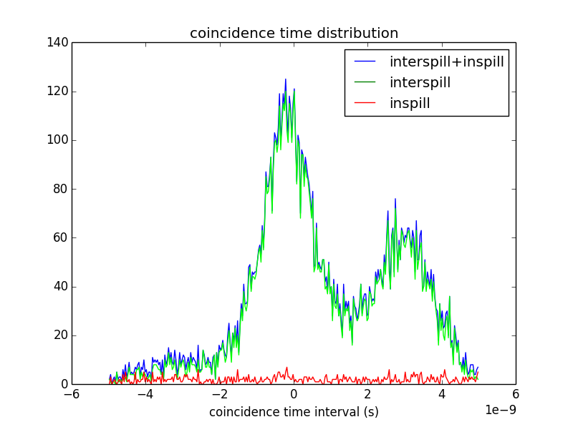
Distribution of the coincidence time interval ( 511 keV data only)
-300 ps
Why do we find two peaks?
3 ns
1.5 ns
2.4 ns

Slide 10
Coincidence time resolution with 22Na radioactive source
511 keV events only
Coincidence time window: 10 ns
Disc iDAC dc start 55: Threshold on the experimental set up noise
Disc iDAC dc start 50: Threshold above the experimental set up noise
-1.33 ns
-645 ps
-4.7 ns
1.3 ns FWHM
1.4 ns FWHM

Slide 11
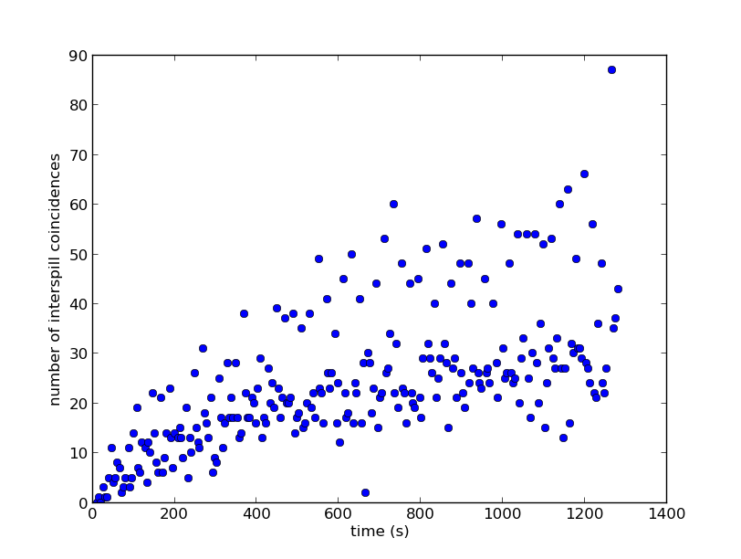
Number of coincidences with time (coincidence window: 5 ns)
The time interval between two consecutive spills doubles every 4 spills, therefore the counts double

Slide 12
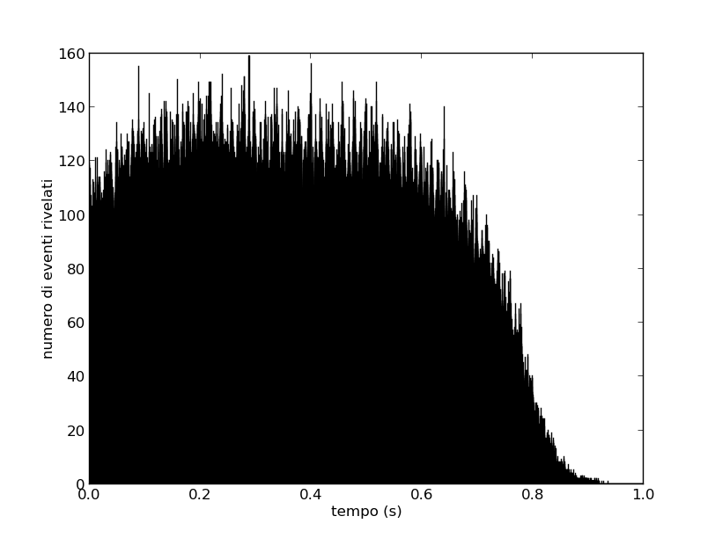
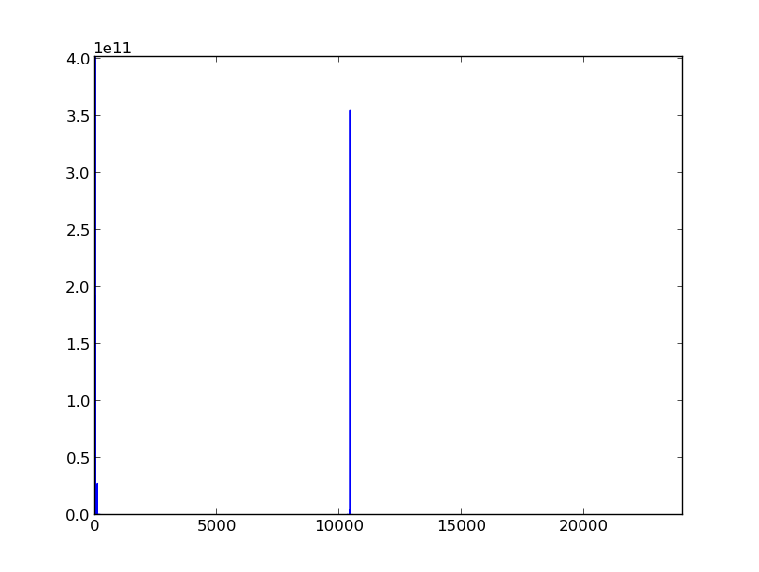
Time distribution of the inspill events
FFT
Frequency (1/s)
100 Hz
100 kHz

Slide 13
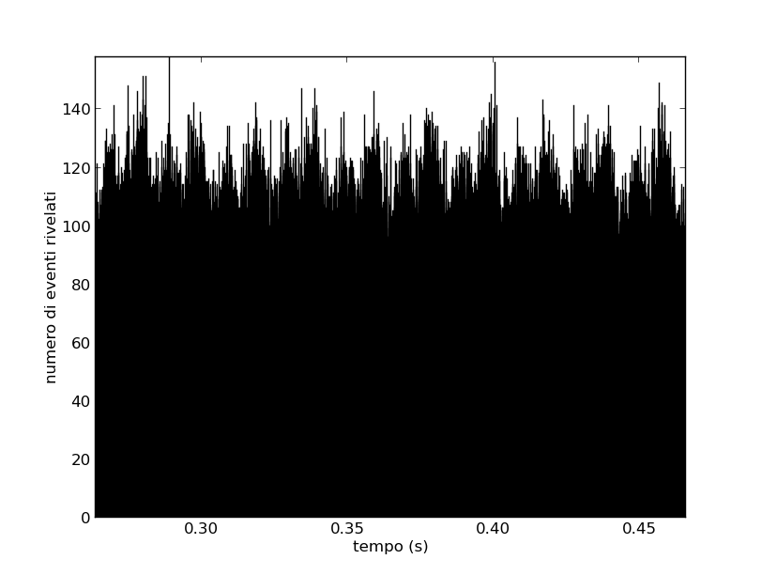
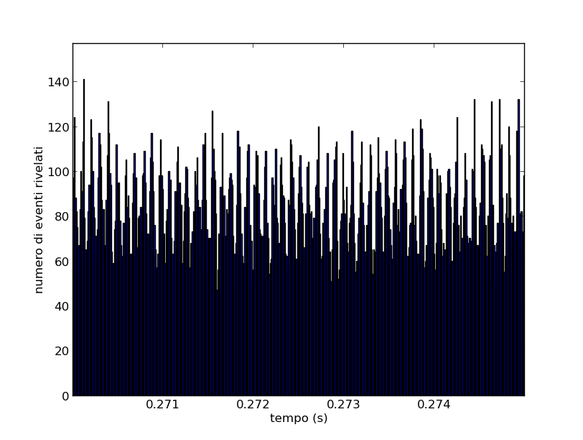
100 Hz frequency
Frequency (1/s)
100 Hz
100 kHz
10 kHz is the frequency of the protons extraction within the bunch (spill).
10 kHz frequency

