Slide 1
RHD-DoPET CNAO test beam result (may 2014)
Pisa group, INSIDE meeting 15-16 September 2014,Torino

Slide 2
Outline
DoPET hardware and software updates
  Gating signal acquisition
  Improvements in simulation and analysis framework
Data taking at CNAO beam line: data vs MC simulations
Treatment plans time analysis
Conclusions

Slide 3
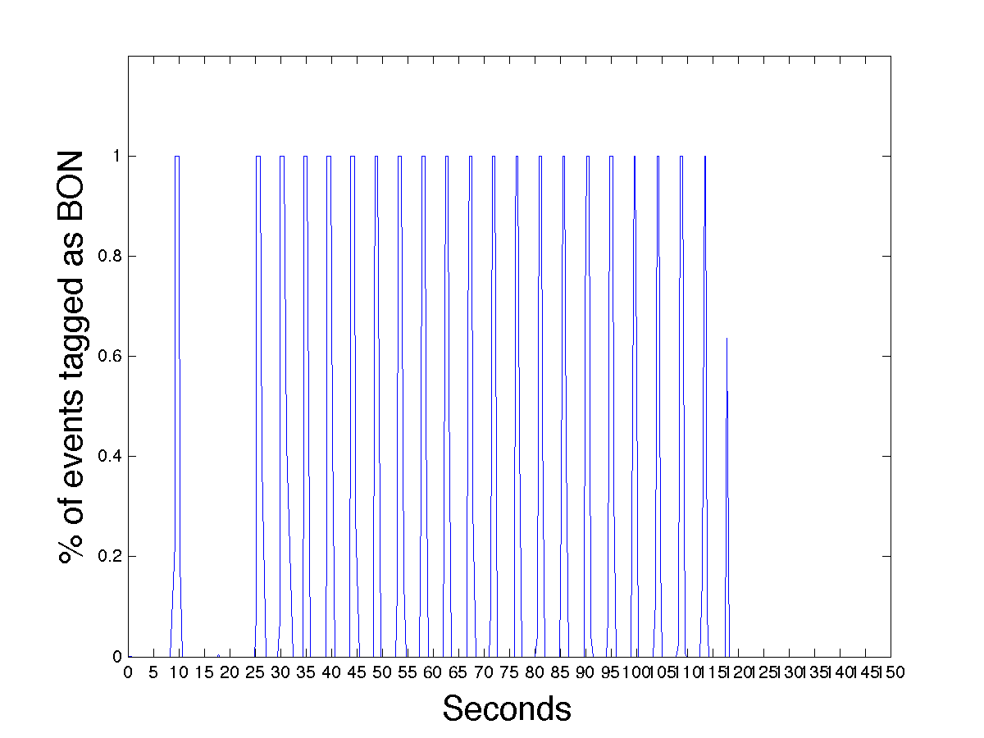
DoPET hardware updates
New: acquisition of the gating signal provided by CNAO
Allowed us to divide accurately data between “in spill”, “intra spill” and “Beam OFF” (BOFF) data

Slide 4

Improvements
Goal: “automatic” MC-data comparison framework
Code to compare
  DATA
  MC truth (“MC”): FLUKA
  MC including geometrical description of detector (“MC_RECO”):
      Annihilations from fluka
      Photon-pair (or more pairs!)
      Calculate hit position
      Save information just like data
      Reconstruct it
Includes statistical errors
  Relate Grey values to nr of events
Procedure to determine 1-D activity profile width:
    Fitting : 50%, 20%, 10%, …
    Smoothing: 50%, 20%, 10%,…
Dose can be included from FLUKA
→ Everything done in ROOT
MC truth (FLUKA)
Real PET data
Geometrical detector simulation (root)
MLEM reconstrution
MLEM reconstrution
“MC truth”
.root files
“MC-RECO”
.raw binary files
“DATA”
.raw binary files
ROOT analysis

Slide 5
Activity and dose
FLUKA Monte Carlo simulations: dose versus activity
Mono-energetic 95 MeV protons on uniform PMMA
2Gy treatment plan uniform dose cube 3x3x3 cm³:17 energy layers

Slide 6
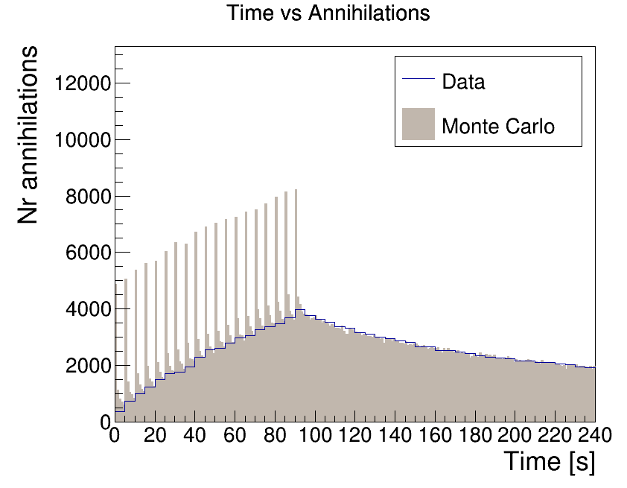
Time profile: data vs MC (172120)
Data in histogram:
Average rate of acquired coincidences in energy window

Slide 7
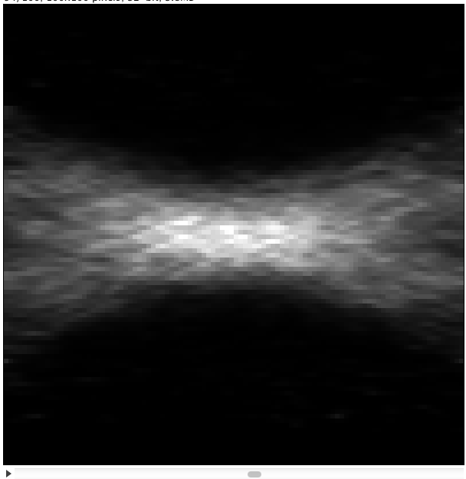
Data 15476: 95.3 MeV protons on homogeneous PMMA
Nr events:
In-spill =12234
Inter-spill=196624
2 min beam-off=326913;
BON+2min beam-off=534837;
1-D z-profile for DATA and MC

Slide 8
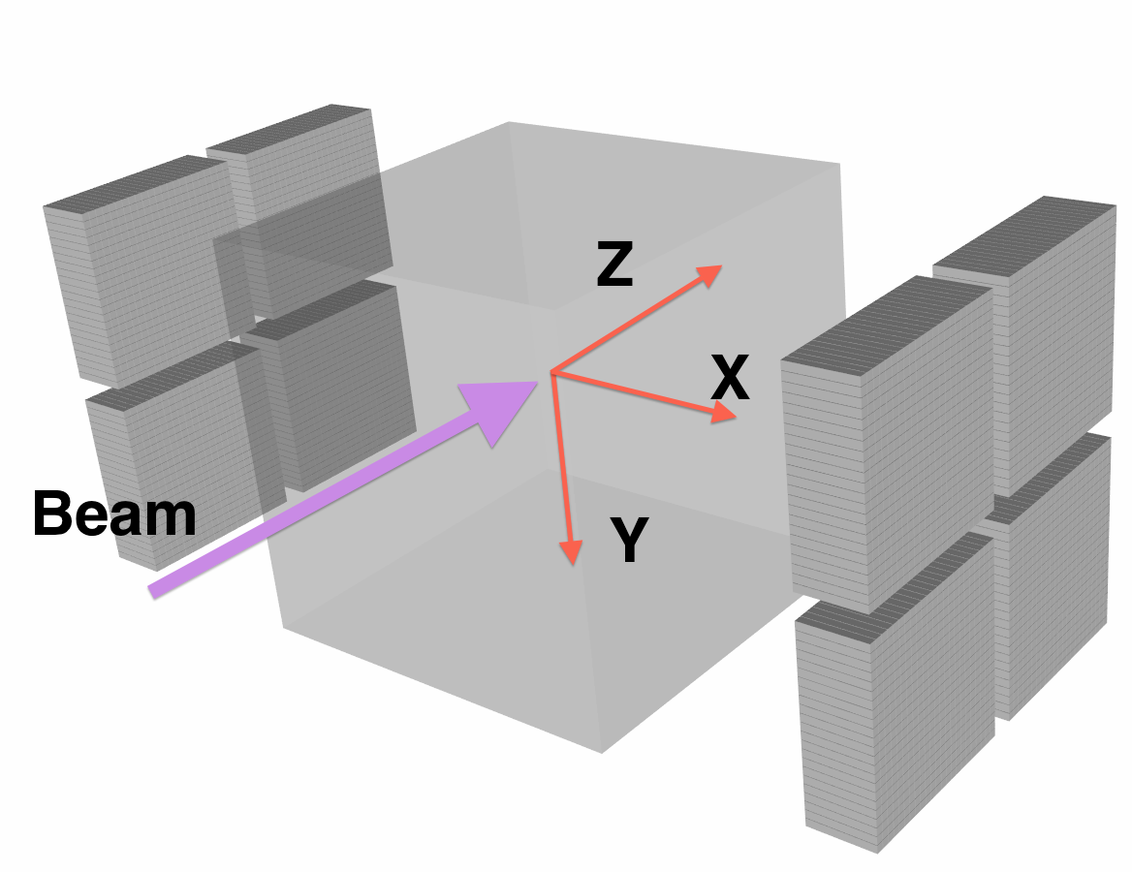
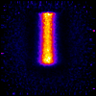
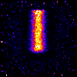
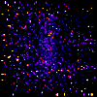
95.3 MeV Proton on PMMA images
BON time 118.2 sec
Intra spill time ~20 sec
Inter spill time ~100 sec
BOFF time 548.5 sec
BEAM
Y
Z
BOFF
Inter spill
In-spill

Slide 9
Data 172120: 95.3 MeV protons on PMMA+ “small” hole
95 MeV protons on PMMA with
a cavity at z=2 (d=1cm, h=1 cm)
x-y view of ROI
(“ellipse-cylinder”)
(so “zoomed” on
cavity)
1-D z-profile for DATA and MC
Nr events:
In-spill =9134
Inter-spill=179049
2 min beam-off =347090;
BON+2min beam-off =535273

Slide 10
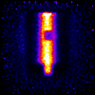
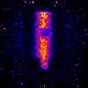
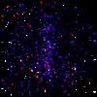
95.3 MeV Proton on a PMMA with a “small” air cavity
BON time 90.6 sec
Intra spill time ~20 sec
Inter spill time ~100 sec
BOFF time 583.4 sec
BEAM
Y
Z
BOFF
Inter spill
In-spill

Slide 11
95.3 MeV protons: cavity vs no cavity
Inter-spill
x-y view of ROI
(“ellipse-cylinder”)
(so “zoomed” on
cavity)
Beam-on+2 min beam-off
2 min beam-off

Slide 12
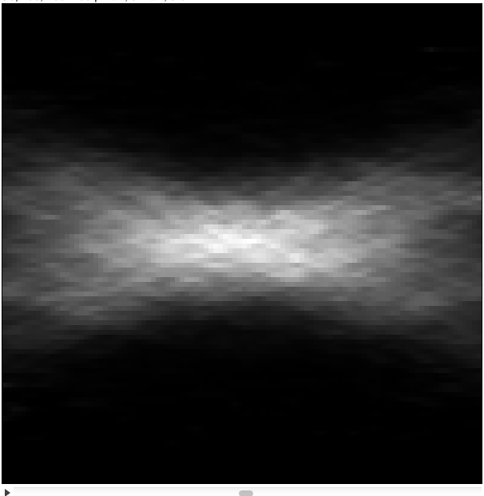
Data 1601: 2 Gy plan on homogeneous PMMA
2 Gy plan on uniform PMMA 3x3x3 cm³
located at z=2.5->5.5 cm
Nr events:
In-spill =9349
Inter-spill=181422
2 min beam-off =278171
BON+2min beam-off =468942
1-D z-profile for DATA and MC

Slide 13
2 Gy plan: “big” (~4cm diameter) cavity vs no cavity
Just with intra-spill data can already detect anomalies
2-D Inter-spill
Inter-spill
x-y view of ROI“ellipse-cylinder”(so “zoomed” on the cavity)
2 min beam-off
Beam-on+2 min beam-off

Slide 14
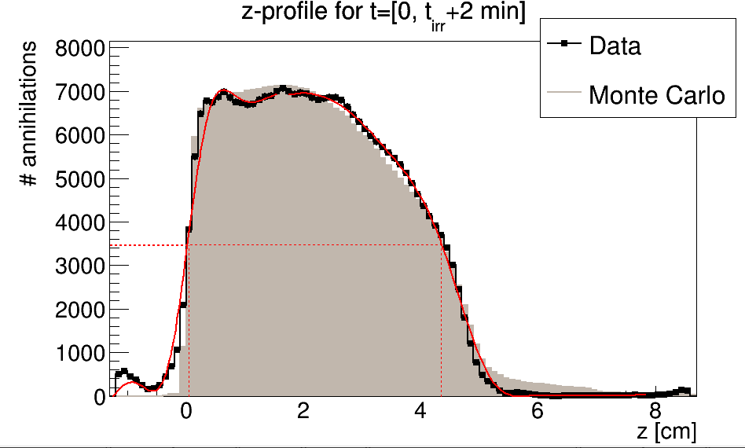
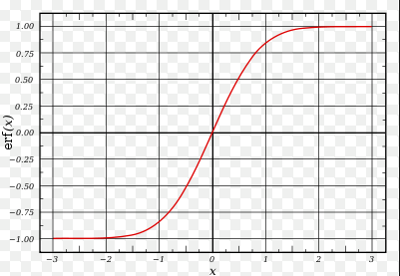
Determination of profile-width
Width of the 1-D activity profile generally determined with fitting.
But error function is not always representing the shape
So implemented also way to determine the value at half of the max (no fitting, only some smoothing of the curve and interpolation to best value)
Mono-energetic beam: fitting error function is ok!
2-Gy plan on PTV of 3x3x3 cm3, located from z=2 to 5 cm.
Error function does not have right shape, just determine 50%-value!
Can be applied to any profile shape

Slide 15
Treatment plans time analysis

Slide 16
Uniform dose treatment plan 3x3x3 cm³
Acquisition | Irradiation time | Acquisition time | Dose | Target
I | 145.5 sec | 708.4 | 2 Gy | Uniform PMMA
II | 135.5 sec | 690.4 | 1 Gy | PMMA with an air hole of 1 cm diameter at the depth 2 a 3cm

Slide 17
Signal time dependence study method
Acquisition were divided into frames according to time, so that each frame is 10 seconds longer than the previous, e.g. [0,10]sec , [0,20]sec,[0,30]sec..
Each frame is reconstructed with standard settings: 5 iteration, energy window 350-850keV, Normalization etc.
Frame rate 1 Frame per second

Slide 18
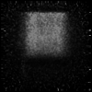
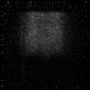
X-Y slice of reconstructed images
BEAM
BEAM
TP on uniform PMMA
TP on PMMA with hole
Beam Overshoot?

Slide 19


Qualitative comparison
2 Gy TP on uniform PMMA
1 Gy TP on PMMA with hole

Slide 20
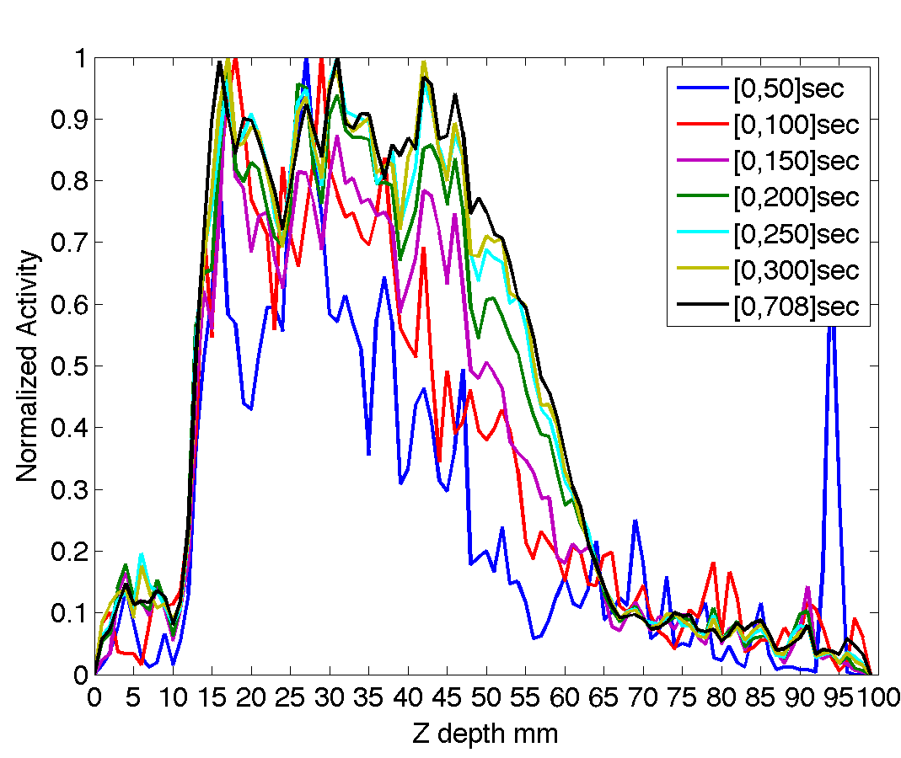
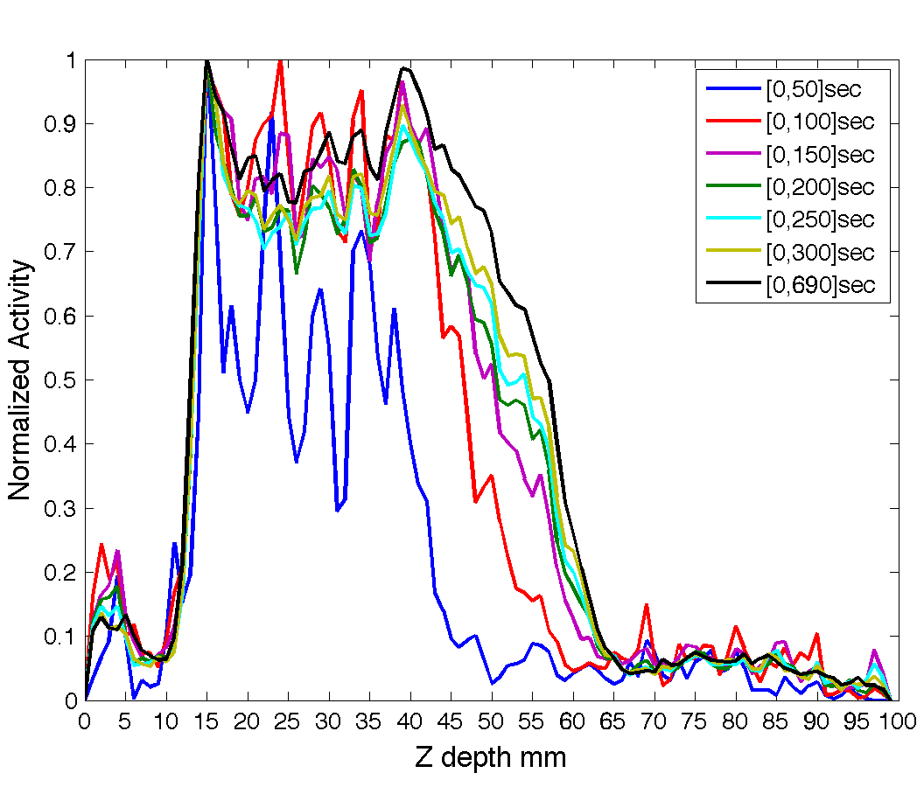
Z-Profiles at different times
Uniform PMMA phantom
Uniform PMMA phantom + hole

Slide 21
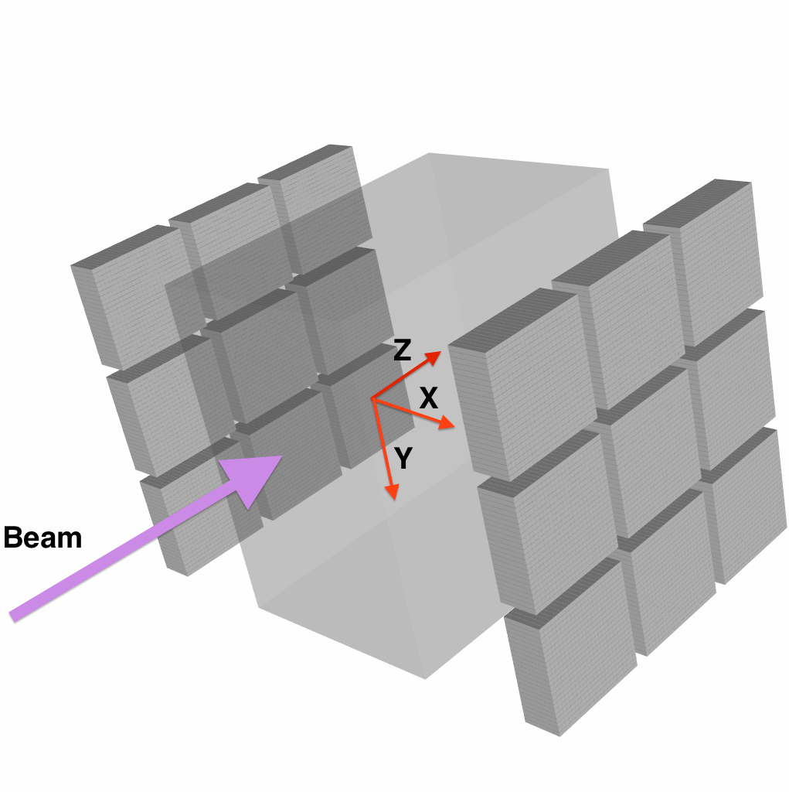
Next…

Slide 22
Conclusions
DoPET is capable of detecting ``small’’ abnormalities when delivering mono-energetic beam
DoPET is capable of detecting ``big’’ abnormalities when delivering treatment plans
Analysis with ``small’’ abnormalities detection in treatment plans still ongoing
Distal fall off position of a treatment plan is visible after ~150 sec from the last layer delivery

Slide 23
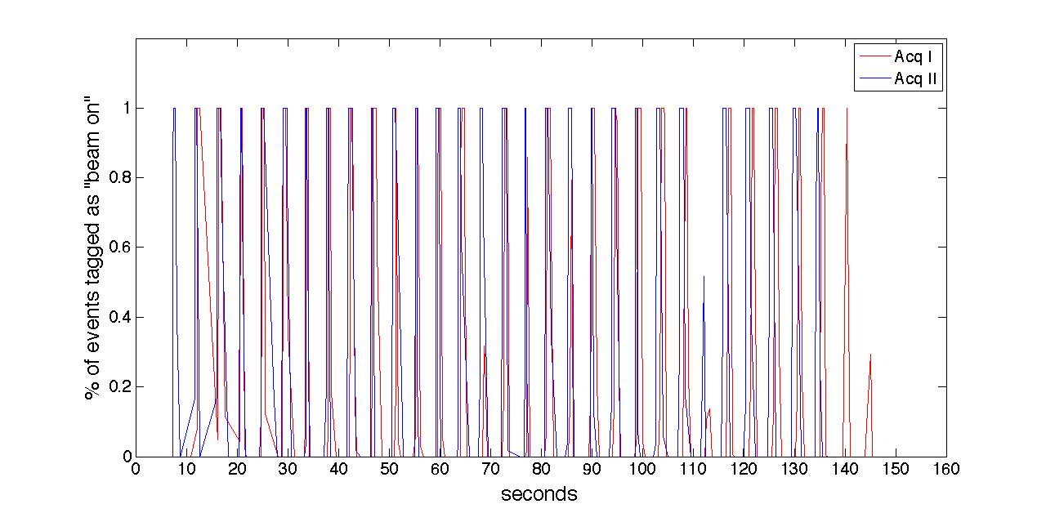
Gating signals of the acquisitions

