Slide 1
Laser excitation of Positronium to Rydberg levels in high magnetic fields to produce a cold beam of antihydrogen in the AEgIS experiment
Ruggero Caravita on behalf of the AEgIS collaboration

Slide 2
Summary
Introduction to the AEgIS experiment
  Experiment motivation: first WEP and CPT tests on a full antimatter system
  Overview on the experimental technique
The role of lasers in AEgIS: exciting Positronium atoms to Rydberg states in external fields
  Theoretical modeling
  Laser design for spectroscopy and excitation in AEGIS
  Performances of the lasers
Future prospects of atomic physics techniques in AEGIS.

Slide 3
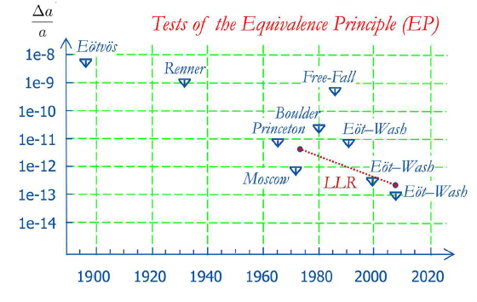
Motivation
Test the Weak Equivalence Principle on antimatter
All bodies at the same spacetime point in a given gravitational field will undergo the same acceleration (a form of WEP)
Any violation of WEP implies either that theory (GR) is in error or that there is a new force acting
Tests of the WEP were performed with high precision, but only for matter.
No direct experimental tests – main reason for making an experiment!
Attempt with e+ e-: dominated by systematics (Witteborn FC, PRL 19 (1967))
PS200@LEAR with pbars: never completed – dominated by stray electric fields

Slide 4
Brief (human) antimatter history
1928: relativistic equation of the ½ spin e- (Dirac)
1929: electron sea theory (Dirac)
1931: prediction of antimatter (Dirac, Oppenheimer, Weyl)
1932: discovery of positron in cosmic rays (Anderson)
1933: discovery of e+/e- pair production (Blackett, Occhialini)
1937: symmetric theory of electrons and positrons
1954: construction of Bevatron (Berkeley)
1955: antiproton discovery (Segrè, Chamberlain, Wiegand)
1956: antineutron discovery (Cork, Lambertson, Piccioni, Wenzel)
1965: antinuclei discovery (Zichichi, Lederman)
1978: first storage of antiprotons (CERN)
1982: construction of LEAR (CERN)
1995: synthesis of high-energy antihydrogen (CERN, Fermilab)
2000: construction of Antiproton Decelerator (CERN)
2002: synthesis of 10 K antihydrogen (Athena, Atrap)
2011: antihydrogen confinement (Alpha)
2013: preliminary antihydrogen gravity measurement (Alpha)
2013: first antihydrogen “beam “ (Asacusa)
2015-20: pulsed, intense beams of antihydrogen (ELENA)
positron
era
antiproton
era
antihydrogen
era

Slide 5
































A E g I S collaboration
CERN
Czech Technical
University
ETH Zurich
Stefan Meyer Institute
University of
Genova
University of
Milano
University of
Padova
University of
Pavia
Institute of Nuclear
Research of the
Russian Academy
of Science
Max-Planck Institute
Heidelbert
Politecnico di
Milano
University College
London
University of
Bergen
University of
Bern
University of
Brescia
Heidelberg
University
University of
Oslo
University of
Paris Sud
University of
Trento
University of
Lyon 1
INFN sections of:
Genova, Milano,
Padova, Pavia,
Trento

Slide 6
AEgIS goals
Produce an intense, pulsed beam of antihydrogen
Measure Earth gravitational acceleration g of antihydrogen
Spectroscopy of the hyperfine spectrum of antihydrogen

Slide 7
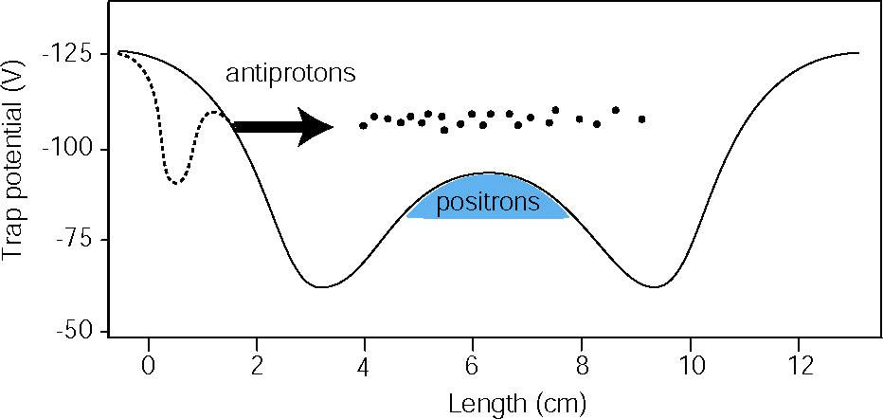
Antihydrogen production channels
Method I: Antiproton + Positron (ATHENA)
Method II: Antiproton + Rydberg Ps (ATRAP)
M. Amoretti et al., Production and detection o cold antihydrogen atoms,Nature 419, 456-459 (2002)
C. H. Storry et al., First Laser-Controlled Antihydrogen Production, Physical Review Letters 93, 263401 (2004)
10⁴ antiprotons
10⁸ e⁺
Two-stage Rydberg
charge exchange
14 ± 4 antihydrogen atoms
Three body recombination (dominant)
Spontaneous radiative recombination (subdominant)
Charge exchange between Rydberg Cs and positrons
Charge exchange between Rydberg Ps and antiprotons

Slide 8

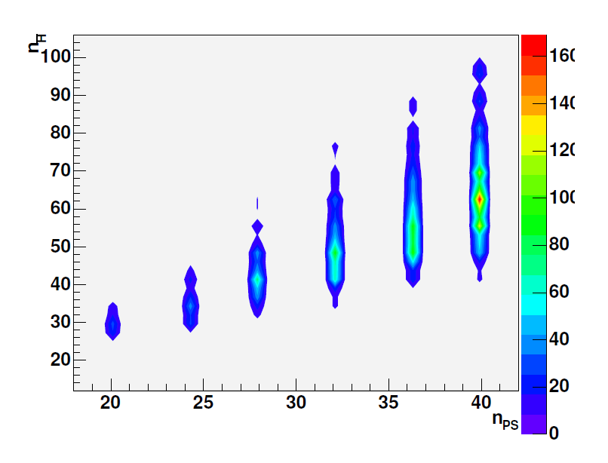
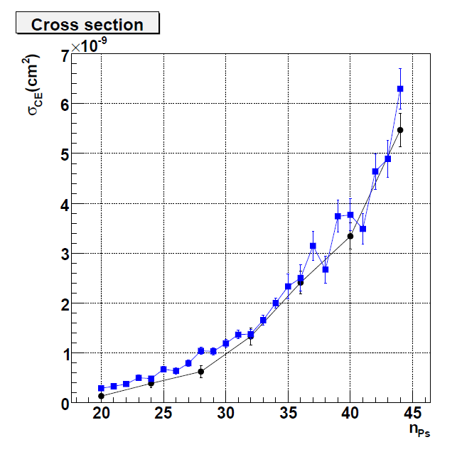
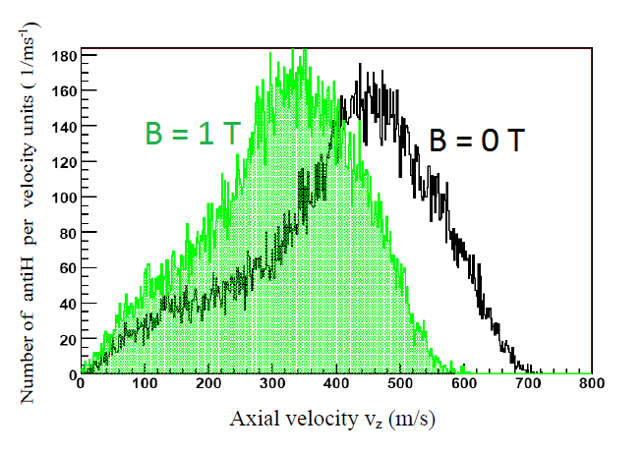
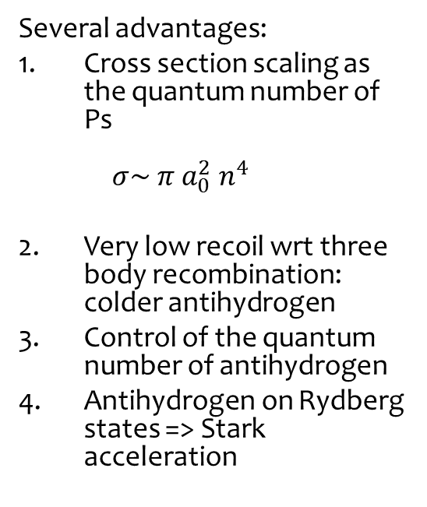
Antihydrogen production in AEgIS
Antiproton + Rydberg Ps => Rydberg antihydrogen
Several advantages:
Cross section scaling as the quantum number of Ps
$σ\sim π a_{0}^{2} n^{4}$
Very low recoil wrt three body recombination: colder antihydrogen
Control of the quantum number of antihydrogen
Antihydrogen on Rydberg states => Stark acceleration
+
-

Slide 9
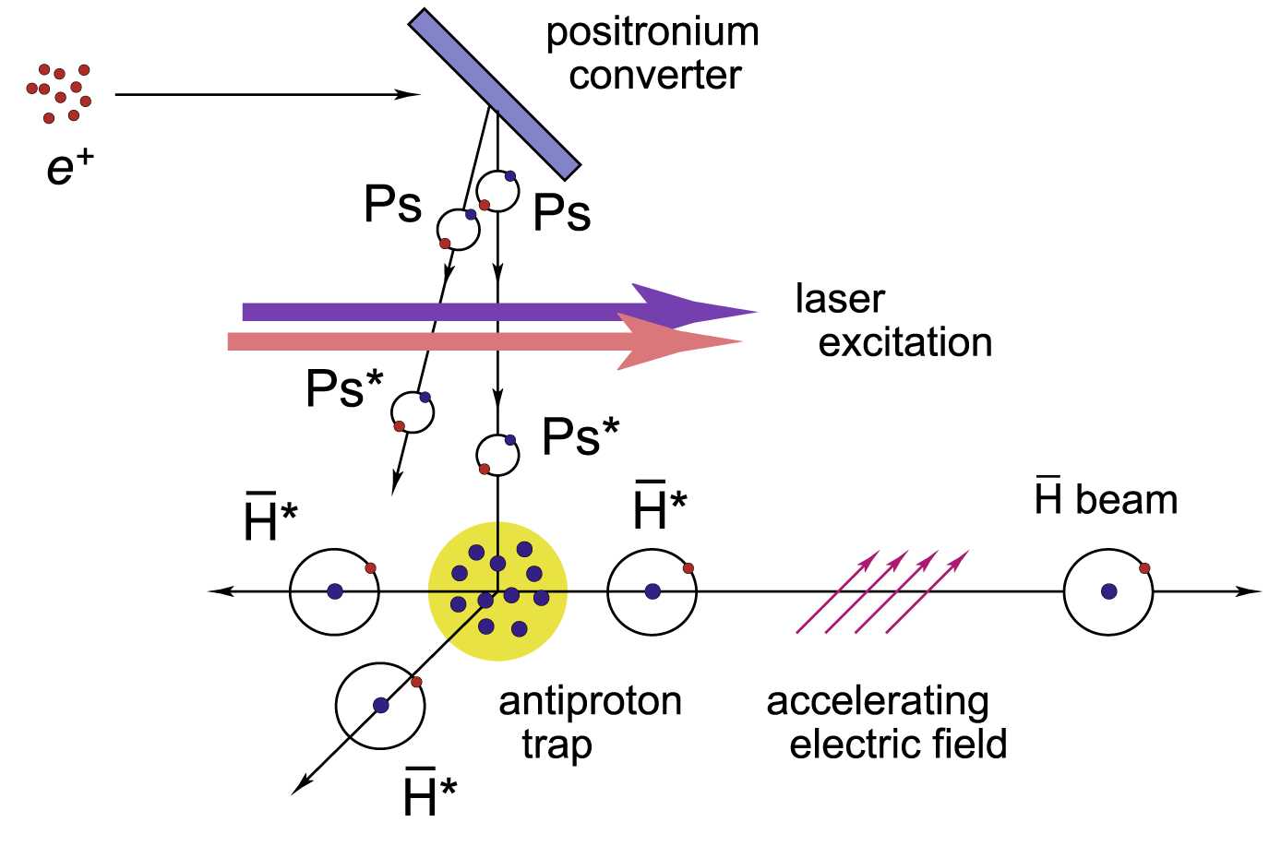
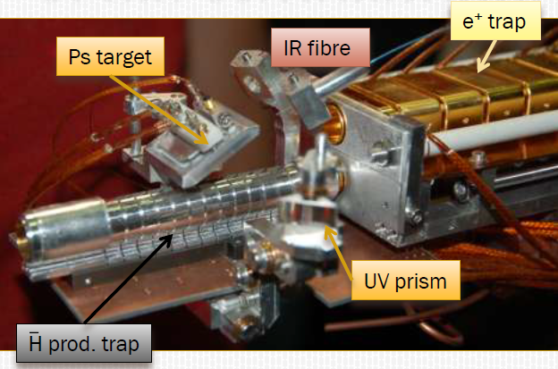
AEgIS in a nutshell
Catch and cool antiprotons to 0.1K
Form thermal Ps by implanting e+ in nanoporous silica
Laser excite Ps to Rydberg levels
Form Rydberg, cold antihydrogen through charge exchange reaction
Accelerate Hbar using an inhomogeneous electric field
Send it towards a deflectometer (gravity) or a microwave resonant cavity (hyperfine).

Slide 10
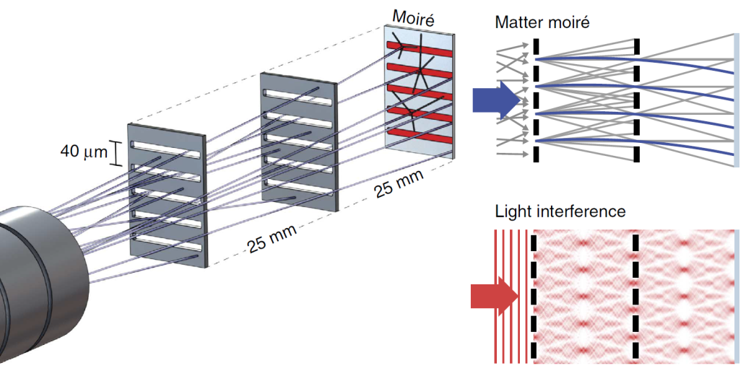
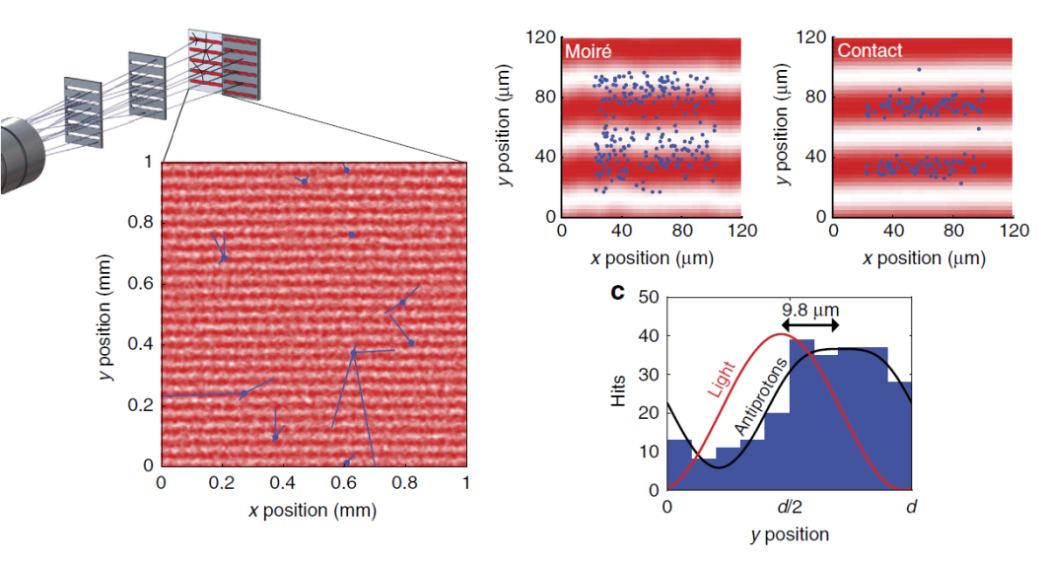
Measuring gravity on antihydrogen
The moirè deflectometer
Purely classical device – reconstruct the vertical displacement due to free fall
Pattern of antihydrogen annihilations compared with light pattern of near-field interfecente (Talbot-Lau interferometer)
Annihilation vertices detected by an high-sensitive nuclear emulsion and a silicon strip detector and a sci-fi tracker.
Antiproton/antihydrogen detection efficiency close to 100%
Aghion S. et al (AEGIS collaboration), Nature communications (2013) DOI: 10.1038/ncomms5538

Slide 11
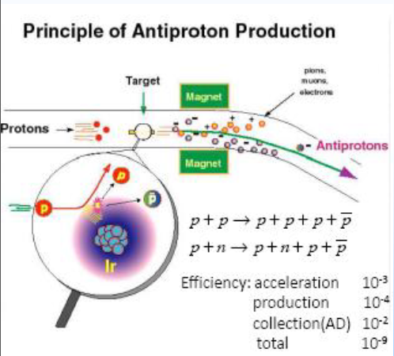
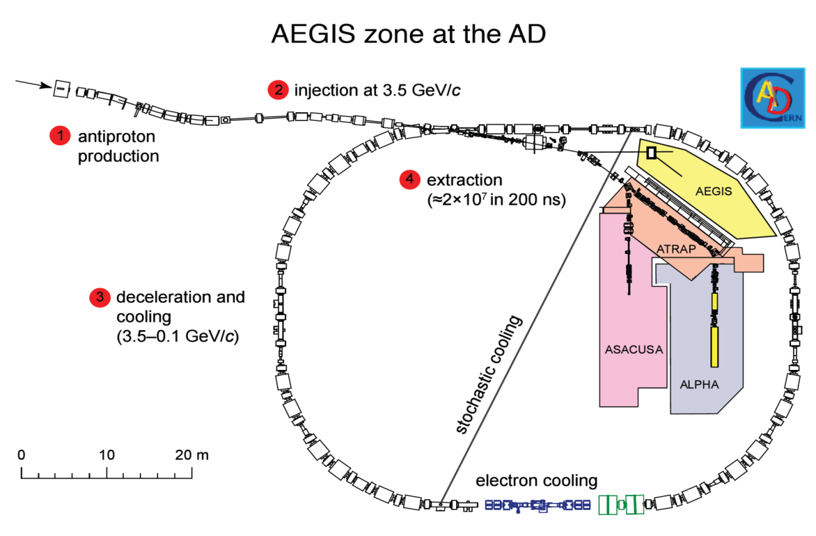

Ingredient 1: cold antiprotons
A 26 GeV proton beam from CERN Proton Synchrotron (PS) hits a beryllium target.
Antiprotons are selected among all the garbage produced with a magnetic field acting as a mass spectrometer
Stored in CERN Antiproton Decelerator (AD)
Cooled down in AD using
  Stochastic cooling
  Electron cooling
5 MeV antiproton bunches given to the experiments every 100 s
Degrading Al foils required to lower the energy to few keV

Slide 12
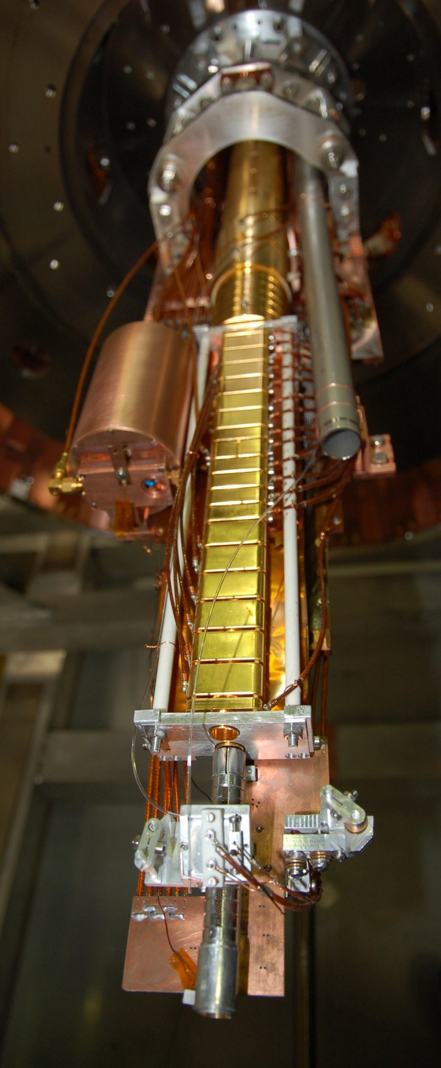
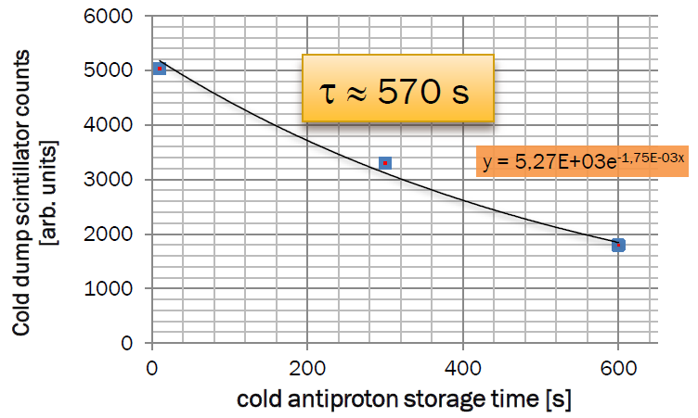
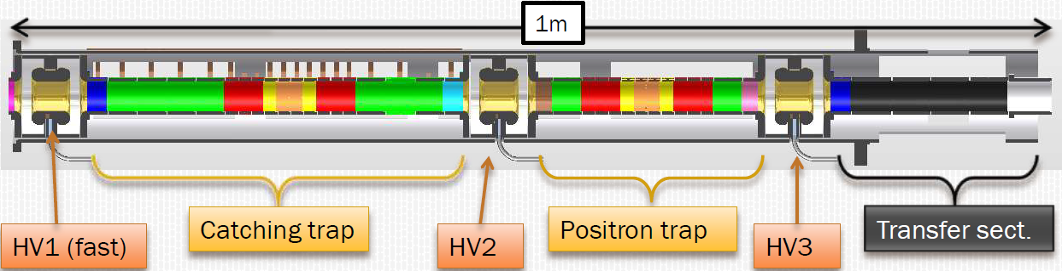
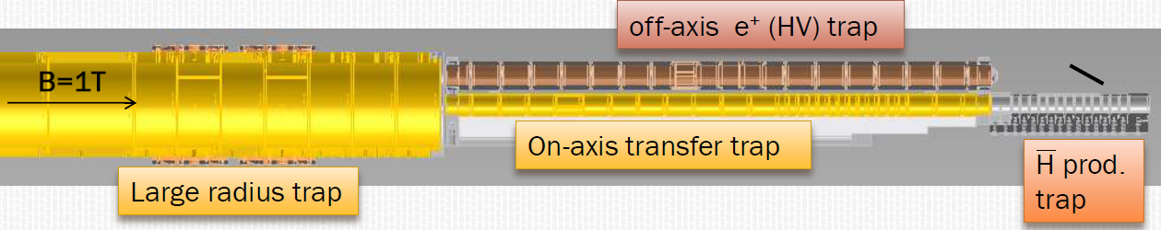
Ingredient 1: cold antiprotons
Two Penning-Malmberg trap systems
5T field
Catching pbars with high voltage
Sympathetic cooling with electrons
Rotating wall
Catching positrons and cooling
1T field
Rotating wall
Positron off-axis movement (diocotron)
Resistive cooling of antiprotons
Antihydrogen making

Slide 13
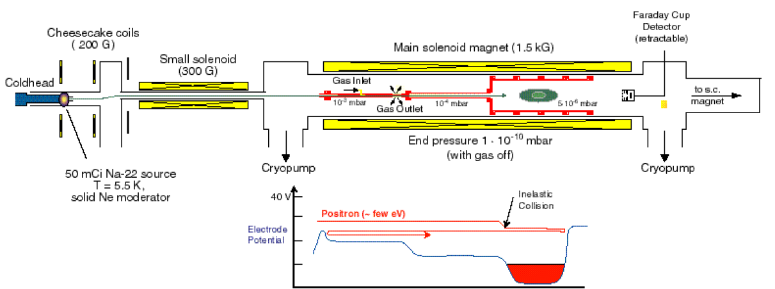
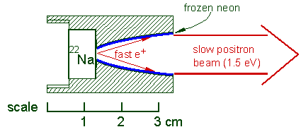
Ingredient 2: Rydberg positronium
Surko-type positron accumulators:
Positrons are emitted by a strong β⁺, Na²² source
Cooled down and focused by a Ne moderator grown in parabolic shape
Enter in a potential well loaded with inert gas
Collisions make the positrons fall in the hole
Hole pulsed cyclically to transfer cooled positrons to an accumulator magnet
A rotating wall in the accumulator reduces the size of the plasma
Dump towards the transfer line to the experiment

Slide 14
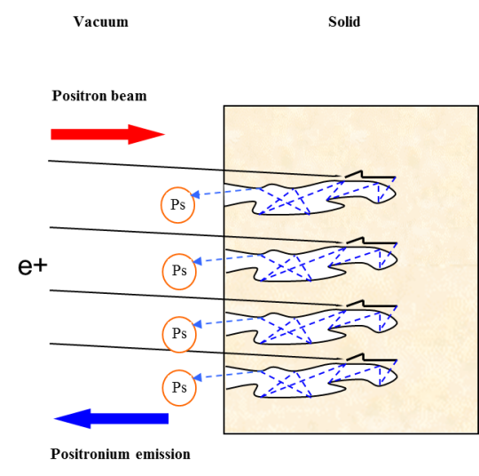
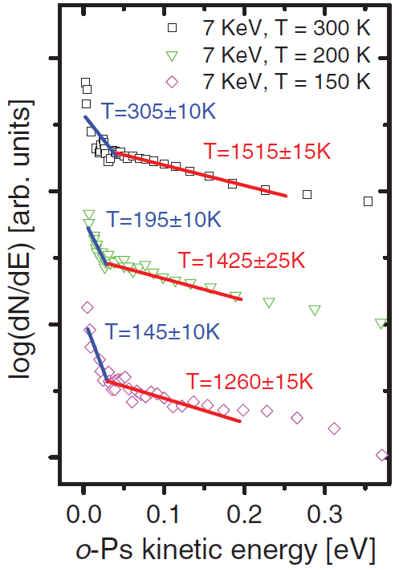
Ingredient 2: Rydberg positronium
Once the positrons are obtained from the accumulator:
Transferred to the production region
Positronium is produced by implantation at 7 kV of positrons in nanoporous, oxidized silicon
Positronium spontaneously thermalizes by collisions in the pores
Pore diameter sets the minimum temperature
The lifetime is not significantly reduced
High yield of thermal positronium emitted in vacuum (~15%)
Mariazzi S. et al., Phys. Rev. B 81 (2010) 235418
Mariazzi S. et al., Phys. Rev. Lett. 104 (2010) 243401
Danielson J.R., Weber T.R., Surko C.M., Phys. Plasmas 13 (2006) 123502
Canali C. et al., Eur. Phys. J. D 65 (2011) 499-504

Slide 15
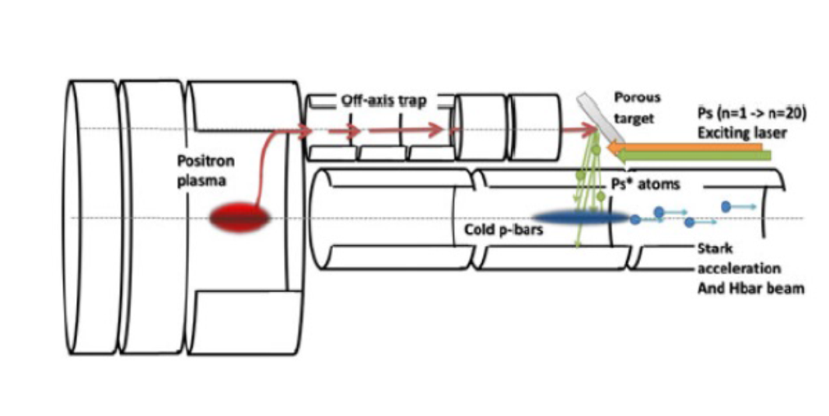
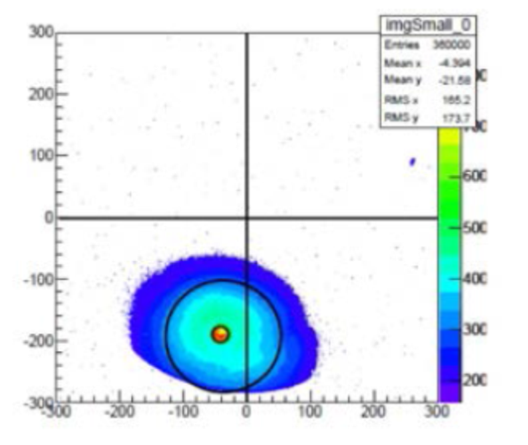
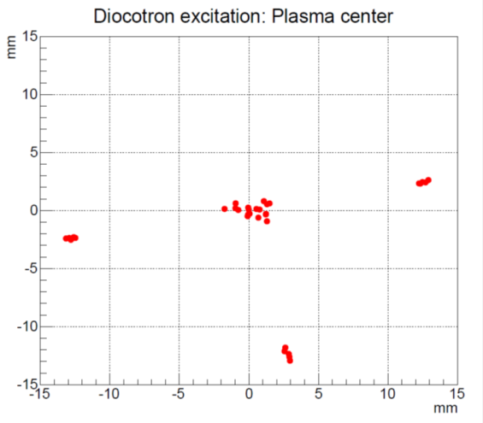
Ingredient 2: Rydberg positronium
Implantation energy of 7kV
=> high voltage off-axis Penning trap.
Need to be moved off-axis to give room to the antiprotons!
=> diocotron collective motion of the plasma
Diocotron motion never performed with positrons!

Slide 16
Ingredient 2: Rydberg positronium
Problem:
Efficient laser excitation to Rydberg levels of positronium in the antihydrogen production region
Constraints:
1 T magnetic field in the whole region (external high magnetic field)
~100 V potentials few mm away of the production Penning trap (external electric field)
20 ns time spread of the emerging positronium cloud
120 GHz doppler broadening due to Ps speed (10⁴-10⁵ m/s)

Slide 17
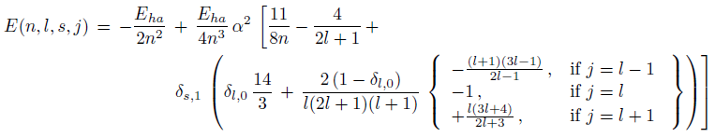
Rydberg Ps in external fields
Positronium unperturbed energy states are calculated with high precision on the usual basis |n, l, s, j, m> that diagonalizes the free Hamiltonian:
When you insert external fields in the Hamiltonian via minimal coupling, and perform center of mass and relative motion separation, you obtain the following perturbed Hamiltonian expression:
CM motion
MS term
Relative motion
Quadratic
Zeeman
Coulomb
Electric field

Slide 18
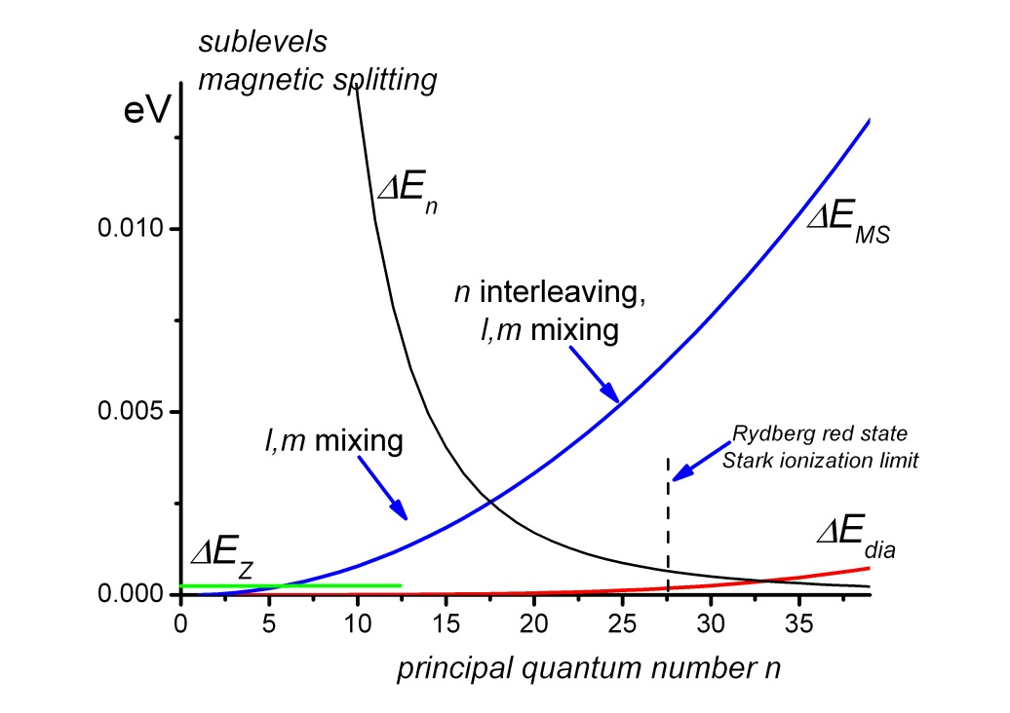
Ps in high magnetic field
In presence of external magnetic field only, in the frame of reference of Ps in motion both E and B are present.
This is the origin of the Motional Stark effect: Stark splitting due to an electric field induced by the motion.
The Motional Stark term:
It’s negligible in traditional atoms, like hydrogen, because it’s orders of magnitudes smaller than second order magnetic effects.
It’s specific of Ps on high excited states, where it dominates both (in AEGIS conditions, 1T and 100K Ps velocity):
  Fine structure correction term (for n > 3)
  Zeeman splitting term (n > 5)
Axial symmetry is broken
Couples the center of mass and relative motions

Slide 19
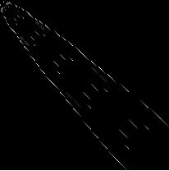
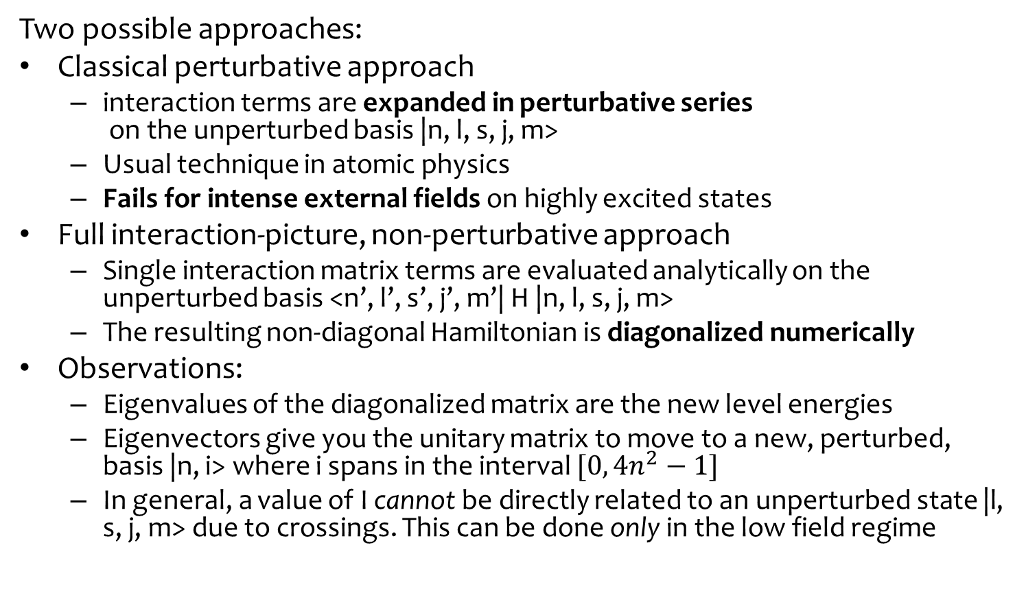
Simulation of Ps in high magnetic field
Two possible approaches:
Classical perturbative approach
  interaction terms are expanded in perturbative series
  on the unperturbed basis |n, l, s, j, m>
  Usual technique in atomic physics
  Fails for intense external fields on highly excited states
Full interaction-picture, non-perturbative approach
  Single interaction matrix terms are evaluated analytically on the unperturbed basis <n’, l’, s’, j’, m’| H |n, l, s, j, m>
  The resulting non-diagonal Hamiltonian is diagonalized numerically
Observations:
  Eigenvalues of the diagonalized matrix are the new level energies
  Eigenvectors give you the unitary matrix to move to a new, perturbed, basis |n, i> where i spans in the interval $[0, 4n^{2}−1]$
  In general, a value of I cannot be directly related to an unperturbed state |l, s, j, m> due to crossings. This can be done only in the low field regime

Slide 20
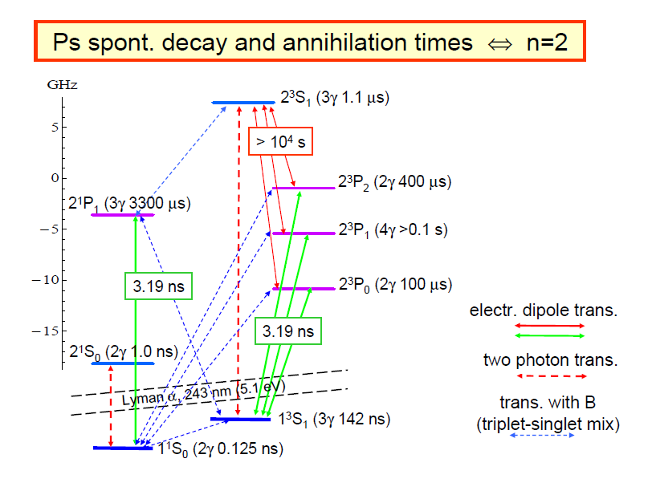
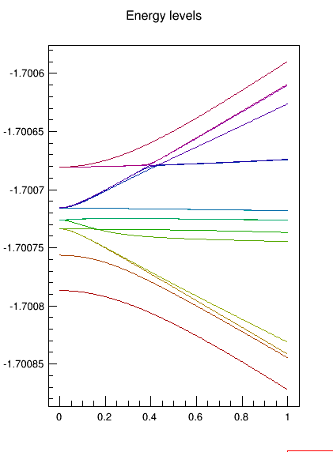
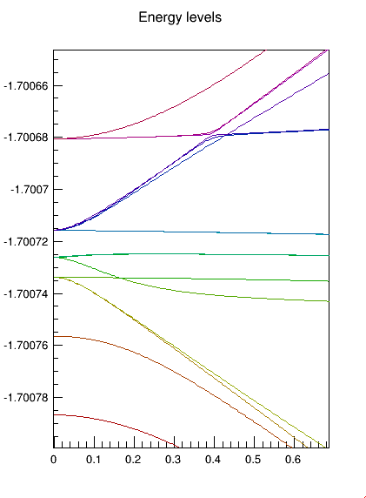
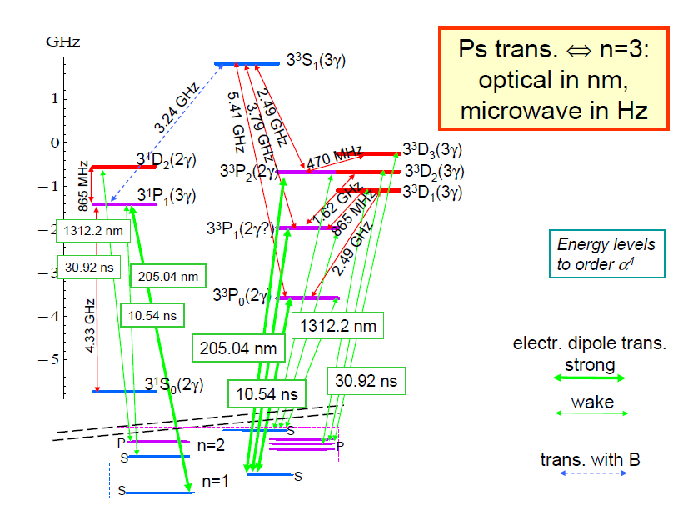
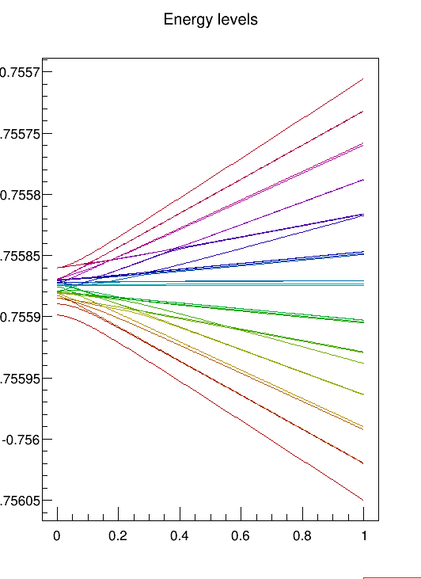
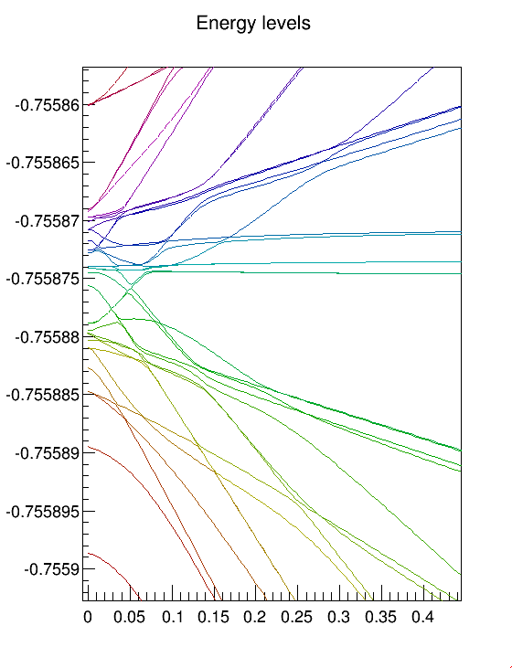
Ps in high magnetic fields: energy levels
Preliminary

Slide 21
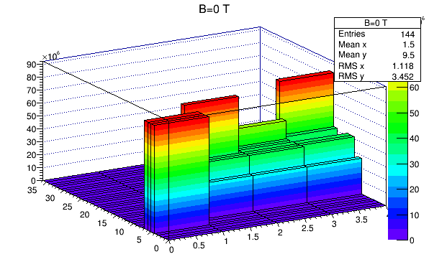

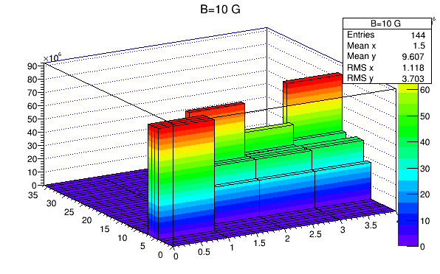
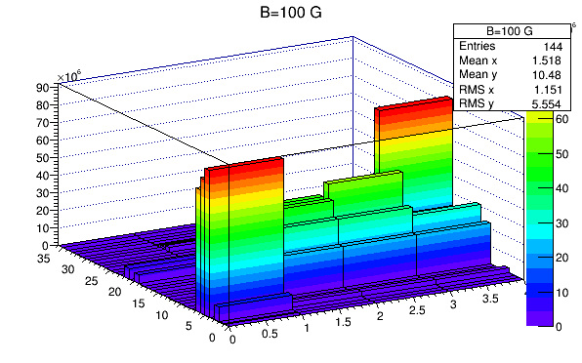
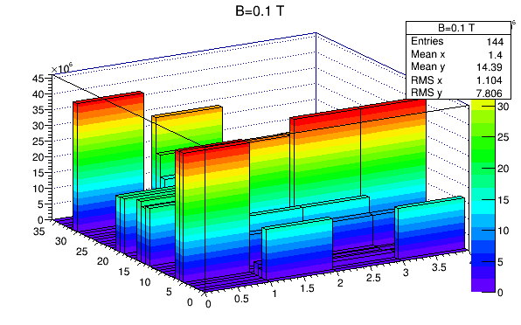
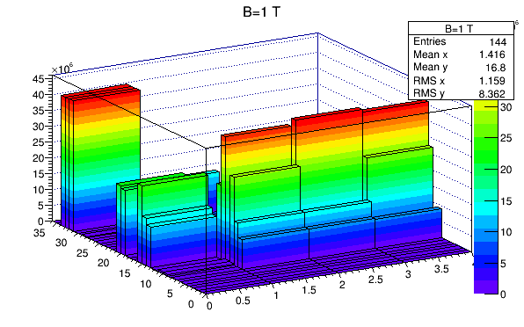
Ps in high magnetic fields: transition amplitudes
Spontaneous emission rate (Hz) from n=3 to n=1
on x axis, n=1 sublevels (4); on y-axis, n=3 sublevels (36)
Preliminary

Slide 22
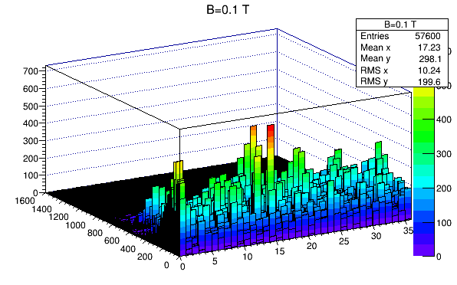
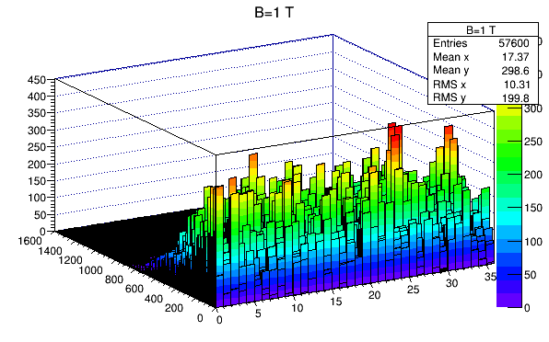
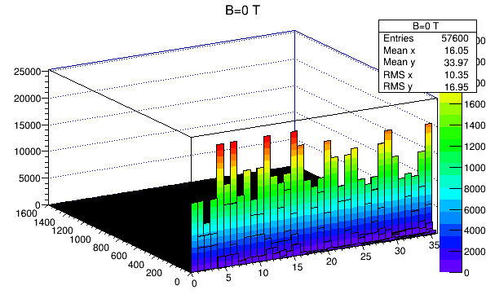
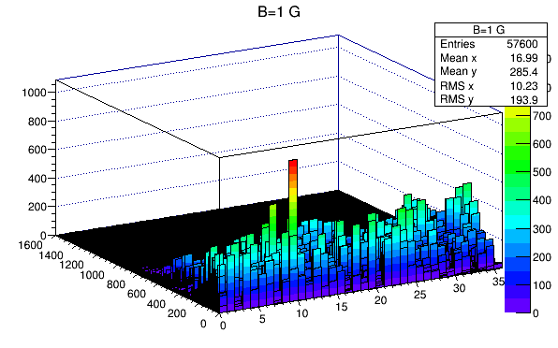
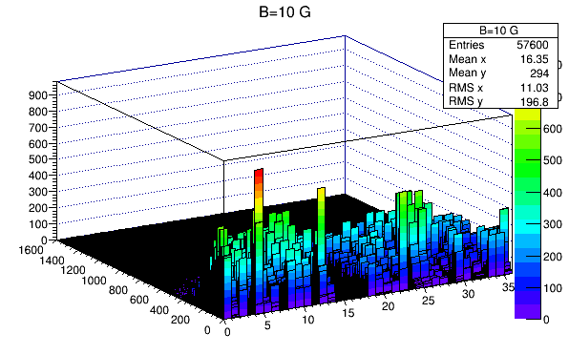
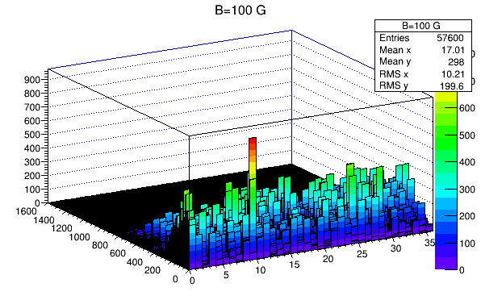
Ps in high magnetic fields: transition amplitudes
Spontaneous emission rate (Hz) from n=20 to n=3
on x axis, n=3 sublevels (36); on y-axis, n=20 sublevels (1600)
Preliminary

Slide 23
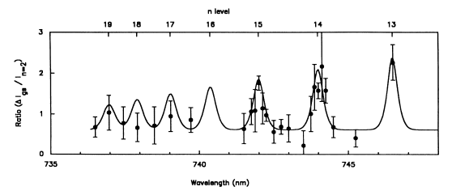
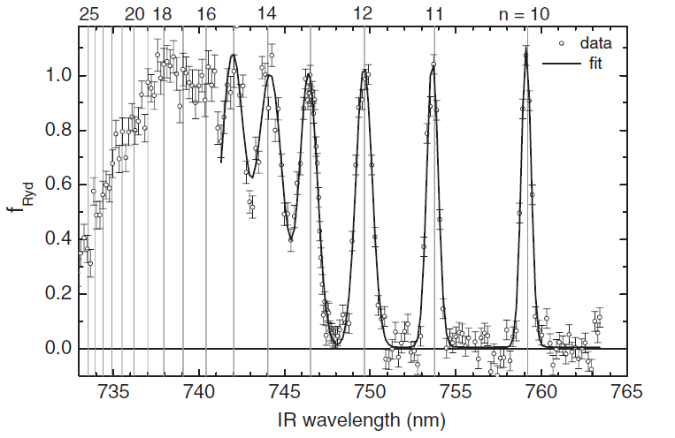
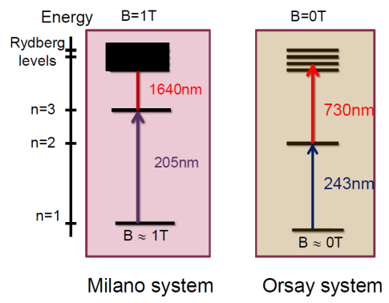
Excitation and spectroscopy lasers
Simulations show that a laser linewidth of 300Ghz covers completely the whole range of sublevels on n=3 for both E and B.
Efficient antihydrogen production requires full sublevel coverage + Doppler broadening compensation
=> broadband laser
Cold source of positronium leads to a new generation of spectroscopic studies
=> narrowband laser
Ziock et al. First obs. of resonant excitation of high-n states in Ps, PRL 64 (1990)
Excitation laser for antihydrogen production
crystal, broadband (300 GHz), 1 => 3 => 14-23
Spectroscopy laser for dedicated Ps studies
dye, narrowband (300 GHz), 1 => 2 => 14-23
Dedicated test chamber for spectroscopic studies in arbitrary field conditions
Cassidy D.B. et al, Efficient production of Rydberg Ps, PRL 108 (2012) 043401

Slide 24
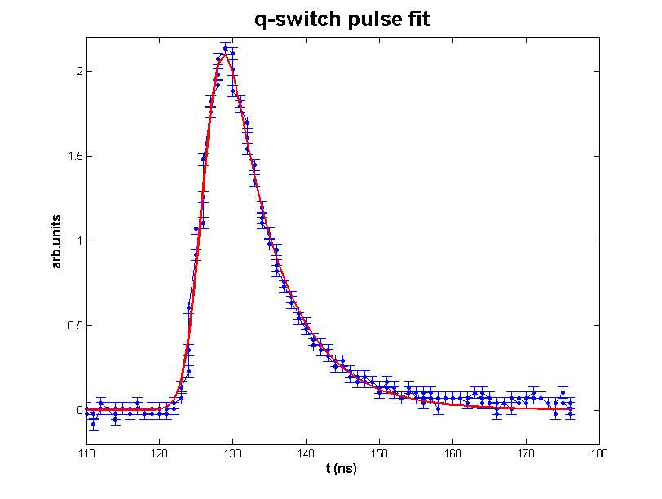
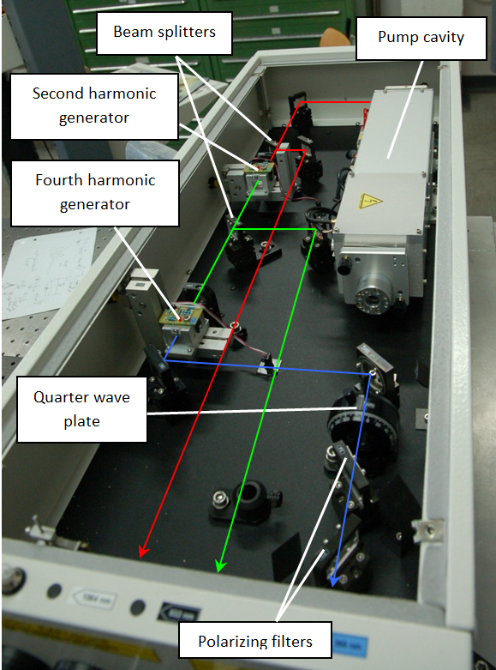
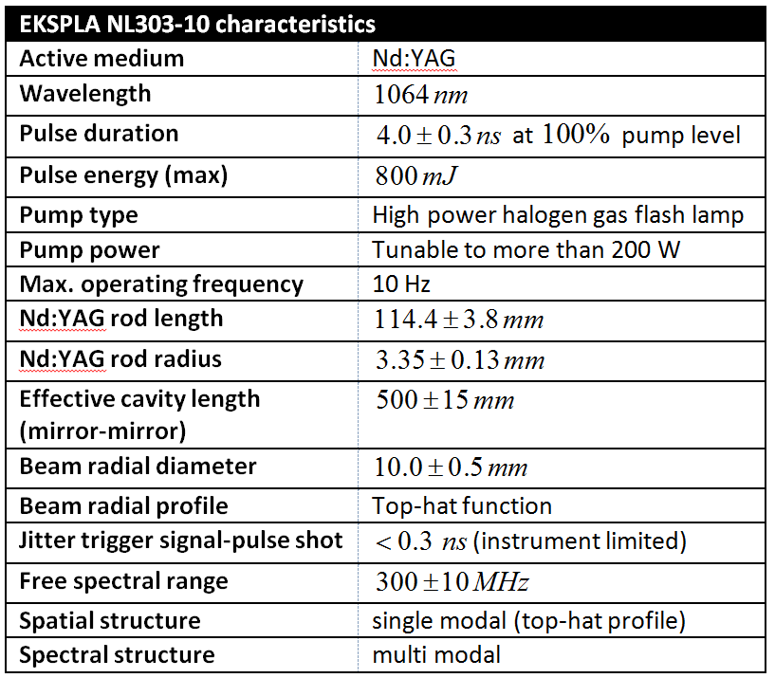

Common source: Q-Switched pump
1064 nm pulse
532 nm
1064 nm
266 nm
Commercial high-energy, broadband Q-Switched Nd:YAG pump at 1064 nm.
1 J peak power at 1064 nm, 4ns FWHM, 10 Hz rept. rate
Second harmonic (532 nm) and fourth harmonic (266 nm) generator
Very low trigger-to-pulse jitter (<300 ps, fast photodiode limited)

Slide 25



Excitation laser
Based on non-linear crystal optics
205 nm (1 -> 3)
  OPG: synthesize 894 nm
  OPA: amplify 894 nm to 15 mJ
  SUM: frequency sum 266 nm and 894 nm to obtain 205 nm
  300 uJ of 205 nm obtained (32 uJ needed)
1650-1720 nm (3 -> Ry)
  OPG: synthesize 1650-1720 nm
  OPA: amplify to 4 mJ
  => 4 mJ obtained (350 uJ needed)
... commissioned, tested and ready!

Slide 26


Spectroscopy laser
Based on tunable dye cavities
Doubled 360-550 nm (1 -> 2)
  Third YAG harmonic
  Tunable dye cavity
  Amplifier dye cell
550-800 nm (2 -> Ry)
  Second YAG harmonic
  Tunable dye cavity
  Amplifier dye cell
Potentially all the useful wavelengths, but for 205 nm!
Under construction @CERN

Slide 27

Dedicated spectroscopy chamber
Preliminary
Preliminary
Dedicated test enviroment, independent from main apparatus cryogenics
Buncher
  7 kV acceleration of positrons
  No electric field in the target region
  Parabolic profile: time squeezing
First tests under way, stay tuned!

Slide 28

Future prospects: sub-K cooling of pbars
1) Sympathetic laser cooling of antiprotons using ions
  Capture of anions in the Penning trap
  Pre-cooling of anions with electrons
  Laser cooling of anions
  Simultaneous confinement of antiprotons
  in the trap
  Sympathetic cooling of antiprotons by
  anions
Method can be used to cool any negative ion species
[A. K. & J. Walz, New J. Phys. 8 (2006) 45]

Slide 29


Future prospects: laser cooling of La⁻
Promising laser cooling transition in negative lanthanum (theo. calculation)
First La⁻ resonance recorded at MPIK:
Transition rate Γ ≈ 4.5 kHz
99.98% closed transition
Preliminary
Wavelength λ ≈ 3104 nm
Parallel/newborn proposal: laser cooling of molecular C2- to sympatetically cool antiprotons
[S. M. O’Malley & D. R. Beck, Phys. Rev. A 81 (2010) 032503]
[C. W. Walter et al., Phys. Rev. Lett. 113 (2014) 063001]
33

Slide 30

Future prospects
  2) Laser cooling of Ps (using a enlonged 1s-2p pulse or a brand-new alexandrite laser)

Slide 31

Future prospects
3) Ps focalization using dipolar force in B=0

Slide 32
Future prospects
4) AEgIS phase 2 – atomic interferometry on a neutral antimatter system
Split and recombine the atomic wave function
in presence of gravity
Interference pattern with phase shift sensitive to g
g
?
?
Quantum interference if
A. Peters et al, Nature 400 (1999) 849
Under study!

Slide 33
Conclusions
The 2014 antiproton run is in progress now: AEgIS is taking data – very exciting moment, quick progresses in short time!
First goal: show pulsed antihydrogen formation by charge exchange at 4K
  Inner goal: cooling the antiproton plasma to K temperature in the production region
  Inner goal: diocotron motion of a positron plasma
  Inner goal: Ps excitation to Rydberg levels using 1 -> 3 -> n with and without external field
Second goal: Ps spectroscopy in the dedicated setup, using both broadband and narrowband laser systems

Slide 34
Thanks for the attention - please ask questions!

